Slide 1
Spanish phonics collection
SSC [ge], [gi] ('soft G')
Nick Avery / Rachel Hawkes / Amanda Izquierdo / Emma Fletcher / Blatchington Mill School Hub Teachers / Victoria Hobson
Artwork: Mark Davies
Date updated: 08 / 08 / 22
Notes:
Artwork by Mark Davies. All additional pictures selected are available under a Creative Commons license, no attribution required.

Slide 2
SSC [ge], [gi] ('soft G')
fonética
Introduction

Slide 3
ge
gente
Nick Avery
Notes:
Introduce and elicit the pronunciation of the individual SSC ‘ge’ and then present and practise the pronunciation of the source word ‘gente’.
A possible gesture for this source word would be to point to all the people surrounding you in a single, semi-circular motion, palm upwards.

Slide 4
ge
gente
Nick Avery
Notes:
Repeat the sound and elicit the source word.

Slide 5
ge
gente
Nick Avery
Notes:
Repeat the sound and elicit the source word.

Slide 6
ge
imagen
recoger
gesto
gente
argentino
generalmente
[generally]
Nick Avery
Notes:
Timing: 2 minutes
Aim: To introduce/consolidate SSC [ge]
Procedure:
Introduce and elicit the pronunciation of the individual SSC [ge] and then the source word again ‘gente’ (with gesture, if using).
Then present and elicit the pronunciation of the five cluster words.
The cluster words have been chosen for their high-frequency, from a range of word classes, with the SSC (where possible) positioned within a variety of syllables within the words (e.g. initial, 2nd, final etc.). Additionally, we have tried to use words that build cumulatively on previously taught SSCs (see the Phonics Teaching Sequence document) and do not include new SSCs. Where new SSCs are used, they are often consonants which have a similar symbol-sound correspondence in English.
Word frequency (1 is the most frequent word in Spanish): gente [137]; imagen [384]; gesto [928]; generalmente [1387]; recoger [828]; argentino [1032]
Source: Davies, M. & Davies, K. (2018). A frequency dictionary of Spanish: Core vocabulary for learners (2nd ed.). Routledge: London

Slide 7
ge
imagen
recoger
gesto
gente
argentino
generalmente
Nick Avery
Notes:
Without the images, students focus this time again closely on the SSC and the cluster words.

Slide 8
ge
imagen
recoger
gesto
gente
argentino
generalmente
Nick Avery
Notes:
Without the images or sound, students have to pronounce the words themselves.

Slide 9
gi
imaginar
Nick Avery
Notes:
Introduce and elicit the pronunciation of the individual SSC ‘gi’ and then present and practise the pronunciation of the source word ‘imaginar’.
A possible gesture for this source word would be to start with your palm closed and touching your head. Then, gradually remove the palm away from your head and open it (as if the thought were about to disappear into the air)

Slide 10
gi
imaginar
Nick Avery
Notes:
Repeat the sound and elicit the source word.

Slide 11
gi
imaginar
Nick Avery
Notes:
Repeat the sound and elicit the source word.

Slide 12
gi
elegir
original
Versión original
P57
religión
imaginar
colegio
página
48
47
Nick Avery
Notes:
Timing: 2 minutes
Aim: To introduce/consolidate SSC [gi]
Procedure:
Introduce and elicit the pronunciation of the individual SSC [gi] and then the source word again ‘imaginar’ (with gesture, if using).
Then present and elicit the pronunciation of the five cluster words.
The cluster words have been chosen for their high-frequency, from a range of word classes, with the SSC (where possible) positioned within a variety of syllables within the words (e.g. initial, 2nd, final etc.). Additionally, we have tried to use words that build cumulatively on previously taught SSCs (see the Phonics Teaching Sequence document) and do not include new SSCs. Where new SSCs are used, they are often consonants which have a similar symbol-sound correspondence in English.
Word frequency (1 is the most frequent word in Spanish): imaginar [500]; elegir [561]; religión [1338]; página [598]; original [1122]; colegio [628]
Source: Davies, M. & Davies, K. (2018). A frequency dictionary of Spanish: Core vocabulary for learners (2nd ed.). Routledge: London

Slide 13
gi
elegir
original
P57
religión
imaginar
colegio
página
Nick Avery
Notes:
Without the images, students focus this time again closely on the SSC and the cluster words.

Slide 14
gi
elegir
original
religión
imaginar
colegio
página
Nick Avery
Notes:
Without the images or sound, students have to pronounce the words themselves.

Slide 15
Fonética
leer / hablar
gente
60
elegir
imagen
página
Segundos
gesto
religión
imaginar
0
recoger
INICIO
Notes:
Alphabetical read aloud
Timing: 1 minute
Aim: to practise using SSCs [ge] and [gi] in oral production
Procedure:
1. Individually (but all at once) pupils read out the words but in alphabetical order. They keep going for one minute.
Transcript:
Word frequency (1 is the most frequent word in Spanish): gente [137]; imagen [384]; gesto [982]; recoger [828]; imaginar [500]; elegir [561]; religión [1338]; página [598]
Source: Davies, M. & Davies, K. (2018). A frequency dictionary of Spanish: Core vocabulary for learners (2nd ed.). Routledge: London

Slide 16
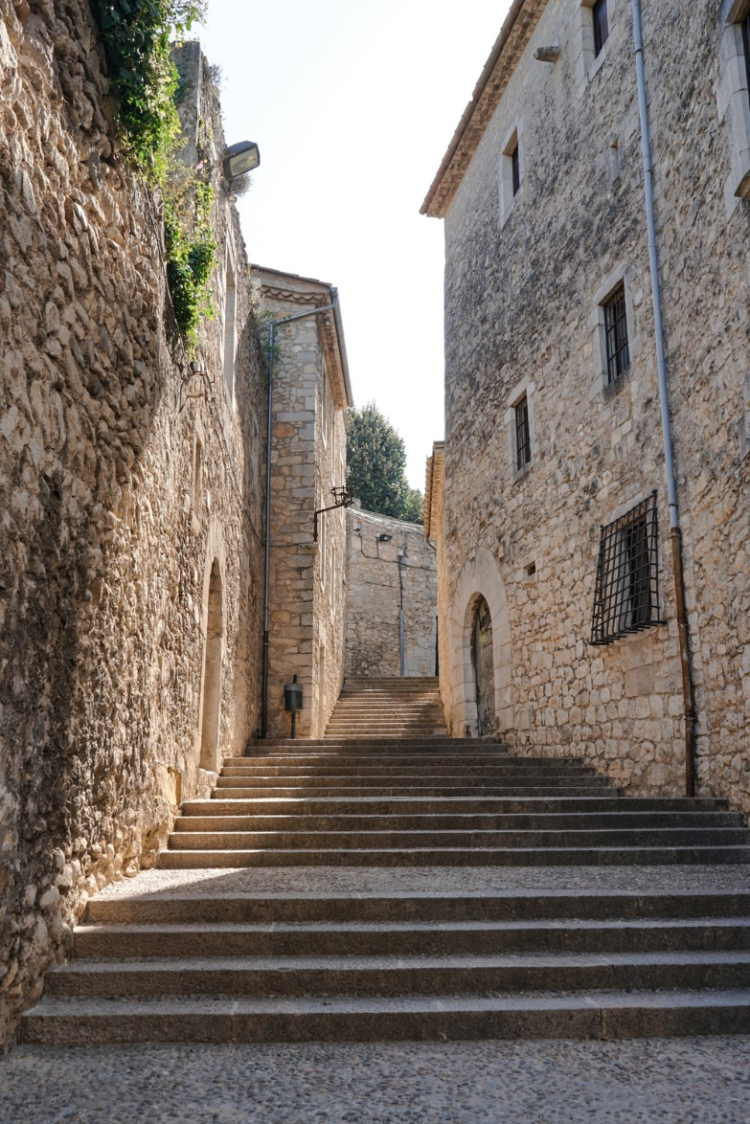
escuchar / escribir
Una conversación entre amigos
¿Dónde está Tomás?
Está en ___rona. Estudia allí.
¿___rona?
Sí, es una ciudad en España. Tengo una ima___n – ¡aquí!
Ah, ¡es una ciudad antigua!
Muy antigua. Tiene tres iglesias y una plaza en el centro.
Y la ___nte, ¿cómo es?
Es inteli____nte. Lee libros y estudia mucho.
¿Qué estudia?
Estudia de todo - ciencias, inglés, español, arte, y reli___ón.
Girona
Notes:
Phonics activity
Timing: 6 minutes
Aim: to practise mapping sound to spelling in a longer text; to revisit previously taught vocabulary
Procedure:
Students listen and complete the dialogue with the target SSCs ‘GI’ and ‘GE’
See next slide for completed version (with all the missing SSCs)
Notes:
This dialogue can also be used for a dictation or for a read aloud in pairs.
The fully readable text (i.e., a text that includes 100% or near to 100% previously taught language) could be used for a dictation. All words except ‘de todo’ have previously been encountered as vocabulary items or phonics practice words.
To help students understand ‘de’ todo’, use slightly exaggerated intonation here and when listing the subjects that follow. This should be sufficient to elicit the meaning from students.
Photo by Fikri Rasyid on Unsplash
Transcript:
¿Dónde está Tomás? Está en Girona. Estudia allí. ¿Girona? Sí, es una ciudad en España. Tengo una imagen – ¡aquí! Ah, ¡es una ciudad antigua! Muy antigua. Tiene tres iglesias y una plaza en el centro. Y la gente, ¿cómo es? Es inteligente. Lee libros y estudia mucho. ¿Qué estudia? Estudia de todo - ciencias, inglés, español, arte, y religión.
Word frequency (1 is the most frequent word in Spanish): centro [316]; plaza [806]; iglesia [437]; ciudad [178]; gente [137]; imagen [384]; estudiar [281]; español¹ [262]; inglés¹ [583]; arte [208]; ciencia(s) [738]; religión [1338]
Source: Davies, M. & Davies, K. (2018). A frequency dictionary of Spanish: Core vocabulary for learners (2nd ed.). Routledge: London

Slide 17
Una conversación entre amigos
¿Dónde está Tomás?
Está en Girona. Estudia allí.
¿Girona?
Sí, es una ciudad en España. Tengo una imagen – ¡aquí!
Ah, ¡es una ciudad antigua!
Muy antigua. Tiene tres iglesias y una plaza en el centro.
Y la gente, ¿cómo es?
Es inteligente. Lee libros y estudia mucho.
¿Qué estudia?
Estudia de todo - ciencias, inglés, español, arte, y religión.
Girona
Notes:
Full text of the conversation on the previous slide.
Photo by Fikri Rasyid on Unsplash

Slide 18
escuchar
A. Y la gente, ¿cómo es?
B. Estudia de todo – ciencias, inglés, español, arte, y religión.
1
D
2
J
C. Muy antigua. Tiene tres iglesias y una plaza en el centro.
3
F
D. ¿Dónde está Tomás?
E. Es inteligente. Lee libros y estudia mucho.
4
H
5
G
F. ¿Girona?
G. Ah, ¡es una ciudad antigua!
6
C
7
A
H. Sí, es una ciudad en España. Tengo una imagen – ¡aquí!
8
E
I. ¿Qué estudia?
9
I
10
B
J. Está en Girona. Estudia allí.
Notes:
OPTIONAL
Procedure:
Students listen again and put the sentences in order
Teacher brings up answers
Note: This could also be used as a reading-only task to challenge higher achieving students.
Word frequency (1 is the most frequent word in Spanish): centro [316]; plaza [806]; iglesia [437]; ciudad [178]; gente [137]; imagen [384]; estudiar [281]; español¹ [262]; inglés¹ [583]; arte [208]; ciencia(s) [738]; religión [1338]
Source: Davies, M. & Davies, K. (2018). A frequency dictionary of Spanish: Core vocabulary for learners (2nd ed.). Routledge: London

Slide 19
SSC [ge], [gi] ('soft G')
fonética
Consolidation [1]

Slide 20
Fonética
escuchar / escribir
Escucha y escribe la palabra. ¿Es [ge], [gi] o [j]? Luego, escribe la frase en inglés.
La ______ está _____ de la ______.
The woman is far from the people.
1
mujer
lejos
gente
El chico es _____ .
The boy is short.
2
bajo
3
Es un ______ muy _______ .
The drawing is very original.
dibujo
original
4
El _______ en _______ es ______.
(The) work in pairs is better.
trabajo
parejas
mejor
¿Puedes _________ un _______ ____?
5
imaginar
pájaro
rojo
Can you imagine a red bird?
6
argentino
El chico __________ está en el _______.
colegio
The Argentinian boy is in the school.
Notes:
Timing: 10 min.
Aim: for students to consolidate their spelling of words that begin with soft ‘g’ and ‘j’.
Procedure:
1. Teachers play the audio once by clicking the number button and students write the missing words.
2. Teachers show the answers by clicking for each sentence, one by one.
3. Teachers play the audio again each time so students can listen and read at the same time.
Transcript:
La mujer está lejos de la gente.
El chico es bajo.
Es un dibujo muy orginal.
El trabajo en parejas es mejor.
¿Puedes imaginar un pájaro rojo?
El chico argentino está en el colegio.
Notes:
As these sound the same, the activity tests individual word knowledge, rather than SSC knowledge. Audio is provided to reinforce the sound of the SSC, rather than to give a cue for correct spelling.

Slide 21
ge
imagen
recoger
gesto
gente
argentino
generalmente
[generally]
Notes:
Timing: 2 minutes
Aim: To consolidate SSC [ge]
Procedure:
Recap and elicit the pronunciation of the individual SSC [ge] and then the source word again ‘gente’ (with gesture, if using).
Then present and elicit the pronunciation of the five cluster words.
The cluster words have been chosen for their high-frequency, from a range of word classes, with the SSC (where possible) positioned within a variety of syllables within the words (e.g. initial, 2nd, final etc.). Additionally, we have tried to use words that build cumulatively on previously taught SSCs (see the Phonics Teaching Sequence document) and do not include new SSCs. Where new SSCs are used, they are often consonants which have a similar symbol-sound correspondence in English.
Word frequency (1 is the most frequent word in Spanish): gente [137]; imagen [384]; gesto [928]; generalmente [1387]; recoger [828]; argentino [1032]
Source: Davies, M. & Davies, K. (2018). A frequency dictionary of Spanish: Core vocabulary for learners (2nd ed.). Routledge: London

Slide 22
ge
imagen
recoger
gesto
gente
argentino
generalmente
Notes:
Without the images, students focus this time again closely on the SSC and the cluster words.

Slide 23
ge
imagen
recoger
gesto
gente
argentino
generalmente
Notes:
Without the images or sound, students have to pronounce the words themselves.

Slide 24
gi
elegir
original
Versión original
P57
religión
imaginar
colegio
página
48
47
Notes:
Timing: 2 minutes
Aim: To consolidate SSC [gi]
Procedure:
Recap and elicit the pronunciation of the individual SSC [gi] and then the source word again ‘imaginar’ (with gesture, if using).
Then present and elicit the pronunciation of the five cluster words.
The cluster words have been chosen for their high-frequency, from a range of word classes, with the SSC (where possible) positioned within a variety of syllables within the words (e.g. initial, 2nd, final etc.). Additionally, we have tried to use words that build cumulatively on previously taught SSCs (see the Phonics Teaching Sequence document) and do not include new SSCs. Where new SSCs are used, they are often consonants which have a similar symbol-sound correspondence in English.
Word frequency (1 is the most frequent word in Spanish): imaginar [500]; elegir [561]; religión [1338]; página [598]; original [1122]; colegio [628]
Source: Davies, M. & Davies, K. (2018). A frequency dictionary of Spanish: Core vocabulary for learners (2nd ed.). Routledge: London

Slide 25
gi
elegir
original
P57
religión
imaginar
colegio
página
Notes:
Without the images, students focus this time again closely on the SSC and the cluster words.

Slide 26
gi
elegir
original
religión
imaginar
colegio
página
Notes:
Without the images or sound, students have to pronounce the words themselves.

Slide 27
Fonética
escuchar / escribir
Remember that [soft g] and [j] sound the same, so the spelling will depend on the word!
Escucha y marca. ¿Escuchas [ge], [gi] o [j]?
 | ge | gi | j
1. |  |  |  | generalmente | Generally dogs are good.
2. |  |  |  | hijo | S/he speaks with the son.
3. |  |  |  | julio | Where are you in July?
4. |  |  |  | páginas | The homework is many pages long.
5. |  |  |  | elegir | It’s normal to choose a cheap product.
6. |  |  |  | imágenes | The books have quite beautiful images.
7. |  |  |  | religion | It’s an old religion.
8. |  |  |  | jugar | It’s good to play with the grandmother.
la palabra
la frase en inglés
1
2
(literally, ‘has a lot of pages’).
3
4
5
6
7
8
Notes:
Timing: 8 min.
Aim: As the ‘soft’ G and J sound the same, students will need to learn that spelling here is word knowledge and not SSC knowledge. In this case, the audio is provided to reinforce the sound of the SSC, rather than to give a cue for correct spelling.
Procedure:
Students should copy down the grid.
Teachers play the audio once by clicking on the number button. Students need to tick the SSC and write the missing word in Spanish.
Teachers play it again and students write the sentence in English.
Answers are shown for each sentence, one by one, by clicking. The answers for the SSC are shown first for 1-8, then the words, and finally the English translations.
Teachers can pllay the audio again each time so students can listen and read at the same time.
Transcript:
Generalmente los perros son buenos.
Habla con el hijo.
¿Dónde estás en julio?
Los deberes tienen muchas páginas.
Es normal elegir un producto barato.
Los libros tienen imágenes bastante bonitas.
Es una religión antigua.
Es bueno jugar con la abuela.

Slide 28
SSC [ge], [gi] ('soft G')
fonética
Consolidation [2]

Slide 29
ge
gente
Notes:
Introduce and elicit the pronunciation of the individual SSC ‘ge’ and then present and practise the pronunciation of the source word ‘gente’.
A possible gesture for this source word would be to point to all the people surrounding you in a single, semi-circular motion, palm upwards.

Slide 30
ge
gente
Notes:
Repeat the sound and elicit the source word.

Slide 31
ge
gente
Notes:
Elicit the sound and the source word.

Slide 32
ge
imagen
recoger
gesto
gente
argentino
generalmente
[generally]
[Argentinian]
Notes:
Timing: 2 minutes
Aim: To consolidate SSC [ge]
Procedure:
Recap and elicit the pronunciation of the individual SSC [ge] and then the source word again ‘gente’ (with gesture, if using).
Then present and elicit the pronunciation of the five cluster words.
The cluster words have been chosen for their high-frequency, from a range of word classes, with the SSC (where possible) positioned within a variety of syllables within the words (e.g. initial, 2nd, final etc.). Additionally, we have tried to use words that build cumulatively on previously taught SSCs (see the Phonics Teaching Sequence document) and do not include new SSCs. Where new SSCs are used, they are often consonants which have a similar symbol-sound correspondence in English.
Word frequency (1 is the most frequent word in Spanish): gente [137]; imagen [384]; gesto [928]; generalmente [1387]; recoger [828]; argentino [1032]
Source: Davies, M. & Davies, K. (2018). A frequency dictionary of Spanish: Core vocabulary for learners (2nd ed.). Routledge: London

Slide 33
ge
imagen
recoger
gesto
gente
argentino
generalmente
Notes:
Without the images, students focus this time again closely on the SSC and the cluster words.

Slide 34
ge
imagen
recoger
gesto
gente
argentino
generalmente
Notes:
Without the images or sound, students have to pronounce the words themselves.

Slide 35
gi
imaginar
Notes:
Introduce and elicit the pronunciation of the individual SSC ‘gi’ and then present and practise the pronunciation of the source word ‘imaginar’.
A possible gesture for this source word would be to start with your palm closed and touching your head. Then, gradually remove the palm away from your head and open it (as if the thought were about to disappear into the air)

Slide 36
gi
imaginar
Notes:
Repeat the sound and elicit the source word.

Slide 37
gi
imaginar
Notes:
Elicit the sound and the source word.

Slide 38
gi
elegir
original
Versión original
religión
imaginar
colegio
página
48
47
Notes:
Timing: 2 minutes
Aim: To consolidate SSC [gi]
Procedure:
Recap and elicit the pronunciation of the individual SSC [gi] and then the source word again ‘imaginar’ (with gesture, if using).
Then present and elicit the pronunciation of the five cluster words.
The cluster words have been chosen for their high-frequency, from a range of word classes, with the SSC (where possible) positioned within a variety of syllables within the words (e.g. initial, 2nd, final etc.). Additionally, we have tried to use words that build cumulatively on previously taught SSCs (see the Phonics Teaching Sequence document) and do not include new SSCs. Where new SSCs are used, they are often consonants which have a similar symbol-sound correspondence in English.
Word frequency (1 is the most frequent word in Spanish): imaginar [500]; elegir [561]; religión [1338]; página [598]; original [1122]; colegio [628]
Source: Davies, M. & Davies, K. (2018). A frequency dictionary of Spanish: Core vocabulary for learners (2nd ed.). Routledge: London

Slide 39
gi
elegir
original
religión
imaginar
colegio
página
Notes:
Without the images, students focus this time again closely on the SSC and the cluster words.

Slide 40
gi
elegir
original
religión
imaginar
colegio
página
Notes:
Without the images or sound, students have to pronounce the words themselves.

Slide 41
¿ GE o GI ?
escuchar
Escucha y escribe ge o gi.
_ _neralmente
ele_ _r
generalmente
elegir
1
7
_ _sto
gesto
original
ori_ _nal
2
8
imaginar
página
ima_ _nar
pá_ _na
3
9
recoger
cole_ _o
reco_ _r
colegio
4
10
religión
imagen
reli_ _ón
5
ima_ _n
11
argentino
6
_ _nte
ar_ _ntino
gente
12
Notes:
Timing: 4 minutes
Aim: listening exercise to practise distinguishing between the SSCs [ge] and [gi].
Procedure:
Click the number button to play the word.
Students listen and complete the word with the correct SSC.
Click to reveal the answers.
Before moving on, students should write the English for as many of the words as they can to reinforce their meanings. Students could have a minute individually then team up with a partner to see if they can achieve translations for all 12 words. See slide 10 to check answers to the translations.

Slide 42
¿ GE o GI ?
escuchar
Escucha y escribe ge o gi.
elegir
generalmente
1
7
gesto
original
2
8
imaginar
página
3
9
colegio
recoger
4
10
5
imagen
11
religión
6
gente
12
argentino
Notes:
Alternative exercise to previous slide
Procedure:
In this differentiated version, students are asked to write the whole word, rather than just the target SSC.
Click to show the answers.
Before moving on, students should write the English for as many of the words as they can to reinforce their meanings. Students could have a minute individually then team up with a partner to see if they can achieve translations for all 12 words. Use the next slide to check answers to the translations.

Slide 43
¿Qué significan las palabras?
generalmente
?
elegir
?
generally
to choose, choosing
gesto
?
original
?
gesture
original
imaginar
página
?
?
page
to imagine, imagining
colegio
?
recoger
?
school
to pick up, picking up
imagen
religión
?
?
religion
image
gente
?
argentino
?
people
Argentinian
Notes:
Timing: 2 minutes
Aim: learning vocabulary practice for words with SSCs [ge] or [gi].
Procedure:
1. Click on the box with ‘?’ to reveal the answer for each word. In this way, answers can be volunteered in any order.

Slide 44
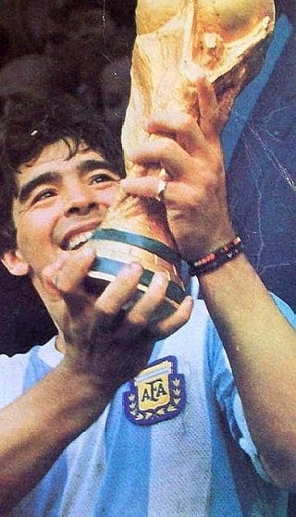
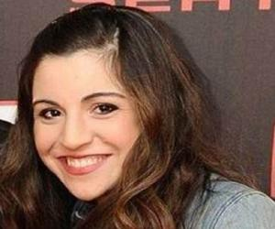
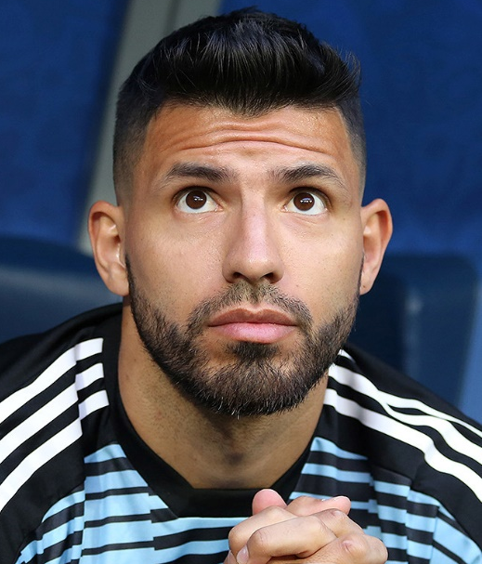
Una familia argentina famosa
ge
gi
leer
Diego Armando Maradona es un exfutbolista argentino.
Ahora, dirige* a Gimnasia de la Plata, un equipo de la Superliga Argentina.
Tiene una hija, Giannina.
Names can be exceptions! The ‘gi’ in Giannina is pronounced a bit like ‘hee’ or ‘yee’, depending on the Spanish-speaking country.
Giannina tiene un hijo con Sergio Agüero, otro futbolista argentino.
Maradona con la Copa del Mundo de 1986.
* manages
Notes:
Timing: 3 minutes
Aim: speaking and reading practice for words including the SSCs [ge] and [gi]
Procedure:
There is an alternative option on the next slide. Non-audio version of the texts are on this slide – see next slide for audio version. This could be used as a read aloud task by students. Click to show each section of the text.
A call out is revealed showing a detail of the pronunciation of Giannina Agüero.
Encourage students to think about the translations into English to see if they can arrive at a full comprehension. Words are either from previous vocab sets or source/cluster words, plus some cognates and names, however, dirige is given in a gloss as this is unknown to students.
Notes: Giannina is an exception to the ‘gi’ SSC, explained in the speech bubble. The name has Italian origins (62.5% of Argentinians have Italian heritage), but the pronunciation is not 100% Italian either. Click on Giannina’s picture to hear the name pronounced by an Argentinian.
Facts from Wikipedia, true to best of our knowledge at the time of writing. Source: https://es.wikipedia.org/wiki/Diego_Armando_Maradona
Update: Maradona died in November 2020.

Slide 45
Una familia argentina famosa
ge
gi
escuchar
eer
Diego Armando Maradona es un exfutbolista argentino.
Ahora, dirige* a Gimnasia de la Plata, un equipo de la Superliga Argentina.
Tiene una hija, Giannina.
1
Names can be exceptions! The ‘gi’ in Giannina is pronounced a bit like ‘hee’ or ‘yee’, depending on the Spanish-speaking country.
2
Giannina tiene un hijo con Sergio Agüero, otro futbolista argentino.
3
Maradona con la Copa del Mundo de 1986.
‘Argentino’ is an adjective. The ending can change, depending on the gender and number of the noun.
* manages
Notes:
Timing: 4 minutes
Aim: listening activity to practise distinguishing between SSCs [ge] and [gi]
Procedure:
This is an alternative listening activity to the previous slide. Students listen and complete the texts with the target SSCs [ge] and [gi].
Click the number button to play the recording for each box. Click to go through the answers before moving on to the next box.
Two call outs with additional information are revealed after showing the last answer.
These texts can also be used for a dictation or for a read aloud in pairs. Students will have to recall the [ge] and [gi] SSCs, which are missing.
Notes
Giannina is an exception to the ‘gi’ SSC, explained in the speech bubble. It is a popular name in Latin America. The name has Italian origins (62.5% of Argentinians have Italian heritage), but the pronunciation is not 100% Italian either. Click on Giannina’s picture to hear the name pronounced by an Argentinian (pronounced like ‘hee’). The audio embedded in the three action buttons was recorded by a Spanish native speaker from the Canary Islands who naturally pronounces this as a ‘yee’.
Facts from Wikipedia, true to best of our knowledge as at April 2020. Source: https://es.wikipedia.org/wiki/Diego_Armando_Maradona

Slide 46
SSC [ge], [gi] ('soft G')
fonética
Consolidation [3]

Slide 47
Fonética
escuchar / escribir
Escucha las palabras. ¿Escuchas [ge] o [gi]?
Completa cada palabra.
g e
[leader]
prote _ _ r
[to protect]
diri _ _ nte
1
g e
6
g é
g i
_ _ nero
[sort, gender]
2
re _ _ istro
[register, record]
7
g i
[to demand]
g i
exi _ _ r
3
estrate _ _ a
[strategy]
8
g i
[regime, diet]
_ _ stión
9
ré _ _ men
4
g e
[management]
su _ _ rir
_ _ rar
g e
[to suggest]
5
g i
[to turn]
10
Notes:
Phonics Timing: 5 minutes
Aim: To revisit SSCs [ge], [gi]
Procedure: 1. Students listen to the recording and complete the words with ‘ge’ or ‘gi’ depending on what they hear. There is the option to transcribe the whole word. To do so, students turn away from the board.
2. Teacher clicks to bring up the Spanish gapped words, and English meanings. 3. Teacher plays either the full recording (inserted with mp3 player with playback control) or individual words by clicking the action buttons. With the full recording, students hear each word twice.. 4. Teacher clicks to reveal answers
Transcription:
proteger
registro
estrategia
gestión
girar
dirigente
género
exigir
régimen
sugerir
Note: these words have not been previously taught. The aim is not to rely on word knowledge and focus on SSC knowledge instead.
Frequency of unknown/glossed words (1 is the most common word in Spanish):
proteger [1107]; registro [1963]; estrategia [1460]; gestión [1454]; girar [1416]; dirigente [1360]; género [1238]; exigir [854]; régimen [1167]; sugerir [1680].
Source: Davies, M. & Davies, K. (2018). A frequency dictionary of Spanish: Core vocabulary for learners (2nd ed.). Routledge: London

Slide 48
hablar / escuchar
Fonética
Trabajamos en parejas.
El estudiante A lee las palabras en cada serie. You can try to read the words fast!
El estudiante B escribe el orden que escucha.
Ejemplo:
genial, julio, argentino
Estudiante A habla:
Estudiante B escribe el orden:
1 | genial - julio - argentino
1 | a) Argentinian b) great c) july
b c a
Notes:
Timing: 5 mins
Aim: to gain confidence in practising the SSCs with soft [g] and to revisit previously taught vocabulary in the oral modality.
Procedure:
Student A reads out the words in the given order.
Student B listens and writes down the order.
Students swap roles.

Slide 49
hablar / escuchar
Fonética / Vocabulario
Estudiante A
 | Lee las palabras en cada serie
1 | gesto – trabajar - página
2 | coger – pareja - Argentina
3 | paisaje – juntos - viaje
4 | elegir – recoger - mejor
 |  | ¿Cuál es el orden que escuchas?
1 | a) image b) people c) player
2 | a) mirror b) religion c) red
3 | a) july b) game c) to leave
4 | a) generally b) I choose c) great

Slide 50
hablar / escuchar
Fonética / Vocabulario
Estudiante B
 | Lee las palabras en cada serie
1 | jugador – imagen - gente
2 | espejo – rojo - religión
3 | dejar – juego - julio
4 | elijo – genial - generalmente
 |  | ¿Cuál es el orden que escuchas?
1 | a) to work b) gesture c) page
2 | a) to catch b) Argentina c) partner
3 | a) trip b) together c) landscape
4 | a) better b) to choose c) to collect

Slide 51
hablar / escuchar
Fonética / Vocabulario
Estudiante A - Solución
 | Lee las palabras en cada serie
1 | gesto – trabajar - página
2 | coger – pareja - Argentina
3 | paisaje – juntos - viaje
4 | elegir – recoger - mejor
 |  | ¿Cuál es el orden que escuchas?
1 | a) image b) people c) player
2 | a) mirror b) religion c) red
3 | a) july b) game c) to leave
4 | a) generally b) I choose c) great
c a b
a c b
c b a
b c a
Notes:
Solución

Slide 52
hablar / escuchar
Fonética / Vocabulario
Estudiante B - Solución
 | Lee las palabras en cada serie
1 | jugador – imagen - gente
2 | espejo – rojo - religión
3 | dejar – juego - julio
4 | elijo – genial - generalmente
 |  | ¿Cuál es el orden que escuchas?
1 | a) to work b) gesture c) page
2 | a) to catch b) Argentina c) partner
3 | a) trip b) together c) landscape
4 | a) better b) to choose c) to collect
b a c
a c b
c b a
b c a
Notes:
Solución

Slide 53
SSC [ge], [gi] ('soft G')
fonética
Consolidation [4]

Slide 54
Fonética
leer / escuchar
Lee y escucha este mensaje de Daniel sobre las tradiciones durante la Navidad. Escribe las palabras que faltan: ¿escuchas gue, ge, gui o gi?
El último día de 1) ________ en diciembre 2) ______________ hacemos una 3) __________ en clase. Normalmente también
4) ____________ 5) _________ para repartir a los niños porque es bueno ser 6) ___________ y así es un día 7) _________ para todos.
Luego aprendemos cómo la 8) _______ celebra la Navidad en otros países. Mi compañero 9) ________ es 10) ___________ y dice que allí 11) _______ figuras con forma de personas y las tiran a unas 12) __________.
*guirnalda = wreath
*hoguera = bonfire
*mágico = magic
*argentino = Argentinian
*juguete = toy
*generoso = generous
colegio
generalmente
guirnalda
recogemos
juguetes
generosos
mágico
gente
Miguel
argentino
cogen
hogueras.
Notes:
Timing: 7 minutes.
Aim: to practise written recall (either receptive or productive) of 12 words which contain the SSCs [gue], [ge], [gui] and [gi]
Procedure: 1. Students read and listen to the message and try to fill in the gaps.
2. Teacher reveals the answers with further clicks.
3. Students are encouraged to discuss the meaning of the text orally.
Transcript:
El último día de colegio en diciembre generalmente hacemos una guirnalda en clase. Luego aprendemos cómo la gente celebra la Navidad en otros países. Mi compañero Miguel es argentino y dice que allí cogen figuras con forma de personas y las tiran a unas hogueras. Normalmente también recogemos juguetes para repartir a los niños porque es bueno ser generosos y así es un día mágico para todos.
Notes:
More information about the Argentinian tradition of burning figures can be found here: https://es.wikipedia.org/wiki/Quema_de_mu%C3%B1ecos_de_fin_de_a%C3%B1o
Word frequency (1 is the most frequent word in Spanish):
guirnalda [>5000]; hoguera [>5000]; mágico [2518]; argentino [1032]; juguete [3162]; generoso [3193]

Slide 55
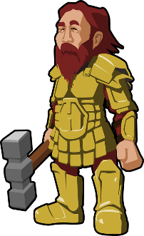
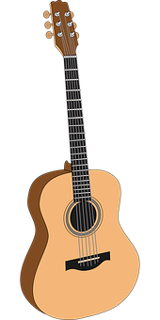
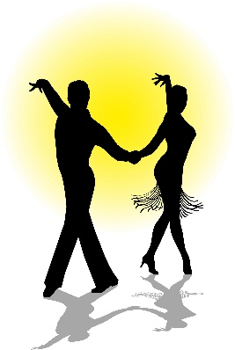
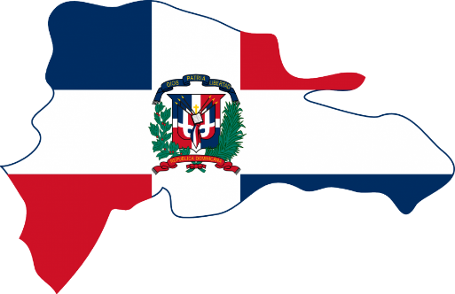
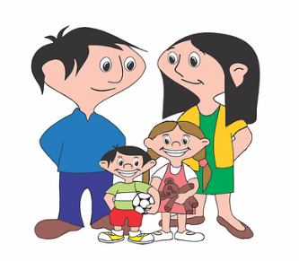
Miguel, el *guerrero portugués, toca la guitarra y baila merengue. Ángel de Gerona usa *poderes mágicos en el colegio para pasar las páginas. Generalmente, la gente de Argentina es genial, inteligente y generosa.
*guerrero = warrior
*poder = power
hablar
Tongue twisters
1
2
3
El merengue es un tipo de música para bailar de la República Dominicana.
1
2
3
1
2
3
Notes:
A tonguetwister
Timing: 5 mins
Aim: to gain confidence in practising the SSCs [gue] / [ge] vs [gui] / [gi] in sentences
Procedure:
The teacher first asks students to read the short text and think about what it means.
The teacher reads the text aloud in fragments, eliciting the meanings from students. A number of new words are included.
Students then practise saying the sentence in pairs, at increasing speed.
The teacher can challenge students to listen to a native speaker read the text at three different speeds (1=slow; 3=very fast). Each time, students can be challenged to say it at the same speed.
Notes:
The teacher can show a brief definition of ‘merengue’ with one click, and it will disappear with a further click.
Frequency rankings of unknown words and cognates (1 is the most common word in Spanish):
guerrero [2648]; merengue [>5000]; poder [352]; generoso [3193]
Source: Davies, M. & Davies, K. (2018). A frequency dictionary of Spanish: Core vocabulary for learners (2nd ed.). Routledge: London

Slide 56
SSC [ge], [gi] ('soft G')
fonética
Consolidation [5]

Slide 57
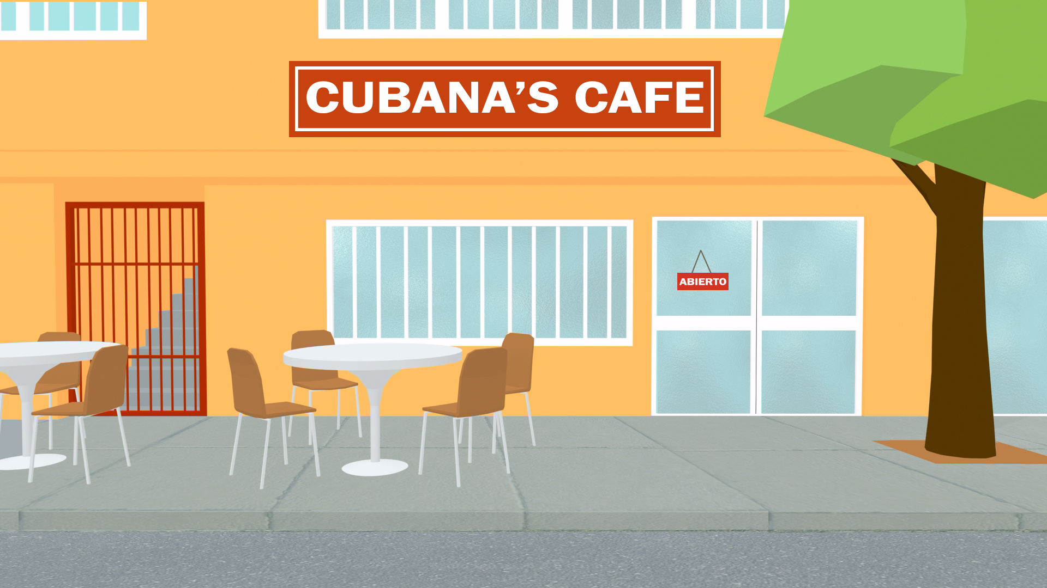
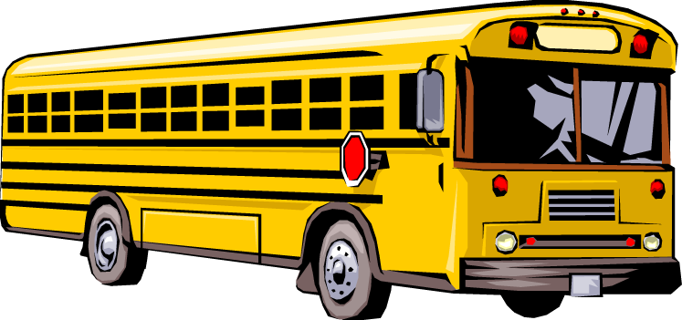
leer / hablar
Fonética
Remember: ‘ge’ and ‘je’ are pronounced the same.
Lee la primera parte del texto con tu pareja. ¡Debes pronunciar las palabras con ‘ge’ y ‘je’ correctamente!
“Mi hermano Jorge Jesús y yo somos cubanos, pero vivimos en los Estados Unidos. Nuestra casa está en Miami, Florida, en una zona generalmente de población cubana. Hay mucha gente extranjera aquí. Asistimos a un colegio genial donde aprendemos muchas cosas y hacemos ejercicio. Por ejemplo, leemos y escribimos textos sobre personajes* actuales y corremos en el parque. Cuando salimos de clase cogemos el autobús y volvemos a casa”.
*personaje = character (e.g. in a film), celebrity
Notes:
Timing: 3 minutes
Aim: to gain confidence in producing the SSCs [ge] and [je] in context.
Procedure:
Students read the text out loud in pairs, paying attention to the pronunciation of [ge] and [je].
The teacher can walk around the classroom listening to students’ pronunciation and giving support.
Frequency of unknown words:
personaje [595] (not known with the meaning ‘celebrity’); típico [1934]

Slide 58
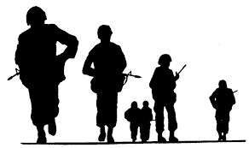
Pronuncia cada palabra correctamente.
hablar
garaje
gesto
[garage]
jefe
paisaje
[boss]
agente
tarjeta
[agent]
generación
mensaje
salvaje
generoso
inteligente
[wild]
ejército
[generous]
[intelligent]
[army]
Notes:
Timing: 3 minutes
Aim: to practise pronunciation of SSCs ‘ge’ and ‘je’.
Procedure:
Students say the word aloud in chorus when it pulsates, making sure they pronounce ‘ge’ and ‘je’ correctly.
Teacher shows all of the animations one by one, correcting students’ pronunciation if necessary.
Word frequency (1 is the most frequent word in Spanish) of unknown words:
garaje [>5000]; jefe [726]; salvaje [3458]; agente [1493]; ejército [905]; generoso [3193].

Slide 59
Ahora lee el texto con tu pareja para practicar la pronunciación. ¡Atención a las palabras con ‘ge’ y ‘je’!
leer / hablar
boda* = wedding
a) Ambos nacimos en La Habana, crecimos en el mismo barrio y asistimos a la misma escuela. ¡Pasamos mucho tiempo juntos! Durante varios años disfrutamos una vida simple.
b) Sí, compartimos muchas experiencias y vivimos momentos muy felices. Un día empezamos una relación y poco después consideramos ser marido y mujer. Pensamos en crear una familia y comprar una casa en nuestro barrio. Entonces celebramos una boda* muy bonita, ¡invitamos a mucha gente!
a) Y un año después decidimos tener un hijo, vuestro padre Gerardo y, más tarde, vuestra tía Jezabel. Pero entonces empezamos a ver muchos cambios políticos en el país y perdimos el derecho a dar nuestra opinión.
b) Pues sí, no soportamos la situación. Estudiamos las opciones y elegimos huir del país. Organizamos un equipaje* ligero y escapamos urgentemente.
a) Durante el viaje a Estados Unidos reconocimos a unos amigos cubanos y los ayudamos a cruzar la frontera. Llegamos todos juntos con muchas dudas, pero también con esperanza. Finalmente, cumplimos nuestro sueño.
equipaje* = luggage
Notes:
Timing: 3 minutes
Aim: to improve pronunciation of words with [ge] and [je].
Procedure:
Students read the text aloud, taking turns to read each part of the conversation. One student reads the sections with ‘a)’ and the other student reads the sections with ‘b)’.
Students could then swap roles for additional practice, if there is time.
Note: urgente is a near-cognate and is likely to be understood with the affix –mente, given that this has previously been taught.
Word frequency (1 is the most frequent word in Spanish) of unknown words:
boda [2473]; equipaje [>5000]; urgentemente [>5000]

