Slide 1
Spanish phonics collection
SSC [a]
Date updated: 29 / 06 / 22
Notes:
Artwork by Mark Davies. All additional pictures selected are available under a Creative Commons license, no attribution required.

Slide 2
SSC [a]
fonética
Introduction

Slide 3
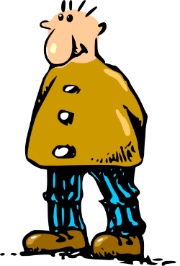
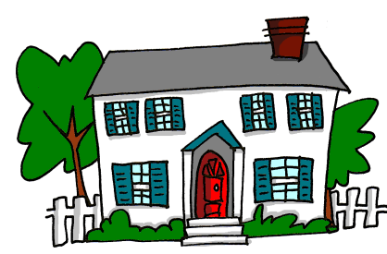
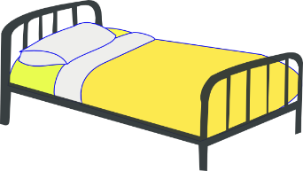
a
nada
amar
∅
casa
alto
agosto
cama
Nick Avery
Notes:
Timing: 2 minutes for slides 3-5
Aim: To introduce SSC [a]
Procedure:
Introduce and elicit the pronunciation of the individual SSC [a] and then the source word again ‘alto’ (with gesture, if using).
Then present and elicit the pronunciation of the five cluster words.
The cluster words have been chosen for their high-frequency, from a range of word classes, with the SSC (where possible) positioned within a variety of syllables within the words (e.g. initial, 2nd, final etc.). Additionally, we have tried to use words that build cumulatively on previously taught SSCs (see the Phonics Teaching Sequence document) and do not include new SSCs. Where new SSCs are used, they are often consonants which have a similar symbol-sound correspondence in English.
Word frequency (1 is the most frequent word in Spanish): alto [231]; nada [87]; casa [106] cama [609]; amar [700]; agosto [931] Source: Davies, M. & Davies, K. (2018). A frequency dictionary of Spanish: Core vocabulary for learners (2nd ed.). Routledge: London

Slide 4
a
nada
amar
casa
alto
agosto
cama
Nick Avery
Notes:
Without the images, students focus this time again closely on the SSC and the cluster words.

Slide 5
a
nada
amar
casa
alto
agosto
cama
Nick Avery
Notes:
Without the images or sound, students have to pronounce the words themselves.

Slide 6
Fonética
leer / hablar
alto
agosto
60
nada
amar
Segundos
casa
cama
estar
0
INICIO
Notes:
Phonics practice activity: alphabetical read aloud
Timing: 1 min
Aim: To elicit the production of the SSC [a].
Procedure:
1. Click on ‘inicio’ to start the timer
2. Individually (but all at once) pupils read out the words but in alphabetical order.
3. Students keep going for one minute.
3. Teacher can circulate to listen into their SSC knowledge.
Note: the new vocabulary item ‘estar’ [21] is also included.
Word frequency (1 is the most frequent word in Spanish): alto [231]; nada [87]; casa [106] cama [609]; amar [700]; agosto [931]
Source: Davies, M. & Davies, K. (2018). A frequency dictionary of Spanish: Core vocabulary for learners (2nd ed.). Routledge: London

Slide 7
SSC [a]
fonética
Consolidation [1]

Slide 8
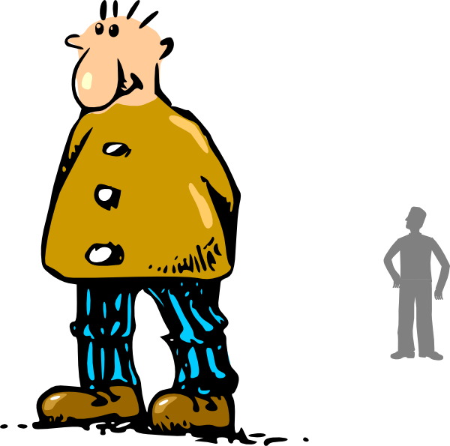
a
alto
Notes:
Timing: 1 minute (for slides 8 and 9)
Aim: A refresh of the SSCs [a] and [o] ahead of the phonics consolidation activity
Procedure:
The teacher clicks to play the SSC [a], first individually, then in a word, then with an accompanying picture.
The process is repeated on the next slide with the SSC [o]

Slide 9
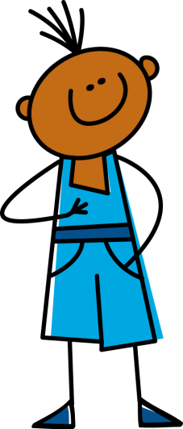
o
yo
Notes:
A refresh of the SSC ‘o’ ahead of the phonics consolidation activity

Slide 10
Escucha. Escribe la letra correcta y la palabra en inglés.
escuchar / escribir
escuchar / escribir
 | Palabra | Traducción
 | flor | flower
 | saber | to know
 | torre | tower
 | balcón | balcony
 | pasar | to pass
 | Palabra | Traducción
 | dama | lady
 | blanco | white
 | plaza | square
 | caballero | gentleman/knight
 | llevar | to carry/wear
1
_
6
_
_
2
_
7
_
_
3
_
8
_
_
4
_
9
_
_
_
5
_
_
10
_
Notes:
Timing: 5 minutes
Aim: listening activity pairing the [a] and [o] SSCs, practising sound recognition, then vocabulary recognition
Procedure:
Students copy the grid into their exercise books. They will need to complete the word with either ‘a’ or ‘o’, and then write the translation.
The teacher clicks the number button to play the word.
Answers are revealed individually for each question by clicking to enable teachers to elicit answers for the missing letter and the translation.
Transcript
flor
saber
torre
balcón
pasar
dama
blanco
plaza
caballero
llevar

