Slide 1
KS2 - KS3 Transition
What we can usefully do ☺
Date updated: 02/03/20

Slide 2

Does starting at primary help?
But what about the extent to which other issues cause the lack of observed benefits?
“The younger the better!” …. “They just absorb it!”
BUT… evidence of long-term benefits of early start is mixed/negative
(Huang, 2016; Lambelet & Berthele, 2015; Muñoz & Singleton, 2011; Pfenninger & Singleton, 2017, 2019).
Those who start at secondary very often catch up with those who started earlier.
Learning happens faster when you are older.
VERY large scale studies. E.g.,
in Germany: Jaekel et al. (2017) OASIS Summary
in Spain & beyond: Muñoz (2008) OASIS Summary
in England: Burstall (1975) report (mis)interpreted as showing ‘no benefit’
“There is no real dispute about the scientific facts, which are that primary school instruction in L2 fails to equip learners with a level of L2 proficiency which by the end of secondary schooling is superior to that of those whose instruction begins later …”
(Singleton & Pfenninger, 2019, p. 30).
Notes:
The purpose of these first few slides is to show you what the research has told us so far in answer to this question. The aim is that if others (your school leaders, the media, parents) make claims about primary foreign languages you will be better equipped to respond.
We hear claims like …. Younger the better! They just pick it up! They learn implicitly!
In fact, sobering evidence of little to no benefits in the longer term. You might be reassured to know that the problems that we are encountering are happening across Europe, even when pupils are being taught the ‘magic English’
But our knowledge about the benefits is limited
Let’s look at some of the factors that influence the usefulness of primary FLs..

Slide 3
What influences the usefulness of early FLs?
“In Belgium, even after eight years of [French] instruction, many learners were not familiar with the 2,000 most frequent words in French, which meant that they could do little with the language in terms of reading, listening, speaking, or writing.” Learners of English knew much more, after less time in the classroom
(Peters et al. 2019)
Things we have no control over...
Pupils’ individual differences (Courtney et al., 2017).
Pupils’ socio-economic status (Jaekkel et al, 2017, OASIS Summary)
Exposure outside class (Puimège & Peters, 2019, OASIS Summary; Peters et al. 2019, OASIS Summary)
Things we have little to no control over…
Quality of teaching: Primary teachers’ training and language proficiency
Amount of teaching: 60 mins better than less time
(Graham, et al. 2017, OASIS Summary)
Notes:
Things we have no control over...
Pupils’ individual differences (Courtney et al., 2017).
Pupils’ socio-economic status (Jaekkel et al, 2017, OASIS Summary)
Exposure outside class (Puimège & Peters, 2019, OASIS Summary; Peters et al. 2019, OASIS Summary)
Peters et al: The point being that even in a country where they introduce languages early, and where some of the country use that language to operate in, an slightly earlier start in French (10) versus 13 in English did not make French any better. English always better because of the out of school exposure.
We also have little to no control over…
Quality of teaching: Primary teachers’ training and language proficiency
Amount of teaching: 60 mins better than less time
So, what kinds of amounts and quality of teaching is going on generally?

Slide 4
Things we don’t have much control over (cont’d…):
Amount & quality of provision in England?
Almost 100% primary schools teach a language in curriculum time across KS2 (as % of schools responding to survey)
French (75%), Spanish (29%), German (5%), Chinese (3%), Latin (2%), other languages (1%)
81% allocate a set time each week, but very few knew the number of teaching hours per year
In schools without a set time, teaching often ad hoc & minimal
46% language specialists, 62% class teachers
Source: Language Trends Survey 2019
Notes:
So, it is happening, but it is piecemeal.
It is mainly French
And it is not being done by specialists

Slide 5
But we do have some control over … quality of transition
A recent, very large study in Germany (Baumert et al., 2020) showed…
Compared to many other factors, a ‘lack of adaptivity in secondaries’ was the most likely cause of little / no long-term benefit of early start
Poor transition may even have negative effects for some pupils
Notes:
All a bit bleak – sobering evidence about the benefits of primary FLs..
[slide…]
But, this evidence from Baumert et al’s study suggests it is important to get transition right.
So, how is transition going, broadly speaking?

Slide 6
So, how well is the gap bridged between primary & secondary?
Continuity of instruction a hot topic:
reports (e.g., Ofsted, 2011)
studies/reviews (e.g., Bolster, Balandier-Brown, & Rea-Dickens, 2004; Courtney, 2014; Galton & McLellan, 2018; Muñoz, Tragant, & Camuñas, 2015; Richardson, 2014)
Main challenges identified:
  secondary teachers systematically underestimating knowledge of new students;
  mutual lack of acceptance of differences in teaching methods;
  infrastructure (timetabling, grouping, exchange of performance data);
  learning content not being aligned between primary and secondary schools.
Notes:
Transition is a problem even in countries where English is the FL… where there is just one language to work on!
[slide]
There are of course different ways in which content might align to help transition …
Here is one example of different approaches

Slide 7
Addressing the problem from grass-roots …
Long-term benefits for primary MFL might be felt if …
there were clear goal posts for the end of primary, e.g.,
  an agreed list of 300 or 400 words?
  an agreed programme of basic phonics?
transition arrangements built on that knowledge?
primary FL involved some explicit language analysis to help learning other languages at secondary?

Slide 8
Considering alignment of content at transition:
An example
Can we reduce the drop in motivation during year 7?
  (Courtney 2017, OASIS summary; Graham et al., 2016 OASIS summary)
Option 1: Build on knowledge systematically?
Increased focus on reading & writing in year 7 causes de-motivation (??)
  phonics is key to reading and writing,
  if phonics were part of primary, an increased focus on reading & writing might be fine.
Or option 2: … Make it different?!
As things stand, Year 7 NCELP materials may help transition, as they reduce repetition of topic vocabulary from primary?!
Notes:
A drop in motivation during the course of year 7 has been observed
One reason for this might be the increased focus on literacy (reading and writing) when pupils arrive in year 7 compared to primary
But reading and writing might be a problem if pupils don’t have good SSCs! Good SSCs help reading and writing and, as we know from Erlam & Macaro’s study, being able to sound out is motivating – so teaching a phonics programme at primary might be one approach to take.
Another approach might be to say, let’s keep the primary and secondary content different, in planned ways – we can’t control what goes on at primary, and so… so long as year 7 isn’t too similar, then motivation might not suffer and any learning that has gone on in primary might be extended (not repeated)….
The Pedagogy Review and RIPL recommend one approach which is to try to build on knowledge at primary

Slide 9
RIPL White Paper Primary Languages Policy in England
Recommendation 4: Transition arrangements
In the short term, at the very least, primary schools should provide receiving secondary schools with a clear statement of what pupils in the class have been taught and what pupils should know and be able to do at the point of transfer from KS2 to KS3.
Link to RIPL White Paper
Notes:
The recent publication by a group of primary languages stakeholders makes several recommendations about primary languages policy. This is what it says about transition, as a baseline minimum point of departure:
Recommendation 4: Transition arrangements
In the short term, at the very least, primary schools should provide receiving secondary schools with a clear statement of what pupils in the class have been taught and what pupils should know and be able to do at the point of transfer from KS2 to KS3.
http://www.ripl.uk/wp-content/uploads/2019/02/RIPL-White-Paper-Primary-Languages-Policy-in-England.pdf
There are further recommendations made, too:
Where primary and secondary schools can collaborate, head teachers should encourage smooth transition by supporting teachers to develop continuity of approach from Year 6 to Year 7, by sharing common expectations of outcomes and/or developing a cross-phase scheme of work;
In the mid-term, each child should receive a clear statement of learning outcomes against agreed benchmarks at the end of key stage 2;
In the mid to longer-term, the DfE, the Teaching Schools Council and Regional Commissioners, and Ofsted should incentivise schools to work in local and regional consortia, involving primary and secondary schools, networks and multi-academy trusts in order to develop and agree clear and structured programmes of language learning which provide continuity and progression across key stages 2 and 3. This aligns with recommendations put forward in the Modern Foreign Languages Pedagogy Review (2016)xii.

Slide 10
Survey findings (transition)
45% (54% in 2014) primary schools, 53% (77% in 2014) secondary schools have contact with at least one receiving or feeder school
21% schools exchange information on point of transfer
69% secondary schools receive no data on prior attainment
After four years’ statutory KS2 language learning, 74% secondary school judge standards as the same as previous cohorts (13% better,13% worse)
Very mixed picture of national provision
Notes:
These are the most recent findings about current transition practice in England, based on the Language Trends Survey 2019.
We can see that, nationally, we are some way from the minimum recommendation of the RiPL report.

Slide 11
Survey findings (transition)
We have repeatedly tried to engage the languages department at the local secondary school to take an interest in our language learners and the skills they have achieved, but with no success, This is a source of huge frustration as these language learners are confident and competent in French but are then expected to go right back to the beginning again.
The experience students have at Key Stage 2 is too mixed and we need to start from scratch when they start Year 7.
p.8, Language Trends Survey, 2019.
p.11, Language Trends Survey, 2019.
Notes:
These two quotes from the Language Trends Survey aptly describe the current problem. Some primary teaching is strong, provision across a whole secondary intake is very uneven and secondary schools can’t see how to cater for the range of knowledge, so they start from the beginning. A most extreme example is where a school deliberately chooses a completely different language from that taught in its feeder primaries!
Go back four years to 2015, and the messages were uncannily similar:
‘We have taught French for years – teaching has improved. We hope this will ensure that pupils move on in high school; previous experience has shown that they “mark time” for the first year.’
(primary teacher)
‘The reliability of good teaching at Key Stage 2 is poor – students come here with huge variations in knowledge. Even those who have studied French for three years cannot spell the initial words of je m’appelle, j’ai .... ans. We assume zero knowledge and differentiate in class.’ (secondary teacher)
Go back even further, to 2008, and this was being said:
‘The kids who have had German in their primary schools are streets ahead of the others. This can be a problem.’
(secondary teacher)
We’re seeing things happening in the primary that are going to affect our teaching, our future in the secondary. Yes, it’s an exciting period, but it’s going to be an upheaval, and we are going to have to re-write our [secondary] schemes again.’
(outreach teacher)
http://dx.doi.org/10.1016/j.tate.2007.08.005
Hunt, M. J., Barnes, A., Powell, B., Martin, C., (2008) Moving on : the challenges for foreign language learning on transition from primary to secondary school. Teaching and Teacher Education, Vol.24 (No.4). pp. 915-926. ISSN 0742-051X

Slide 12

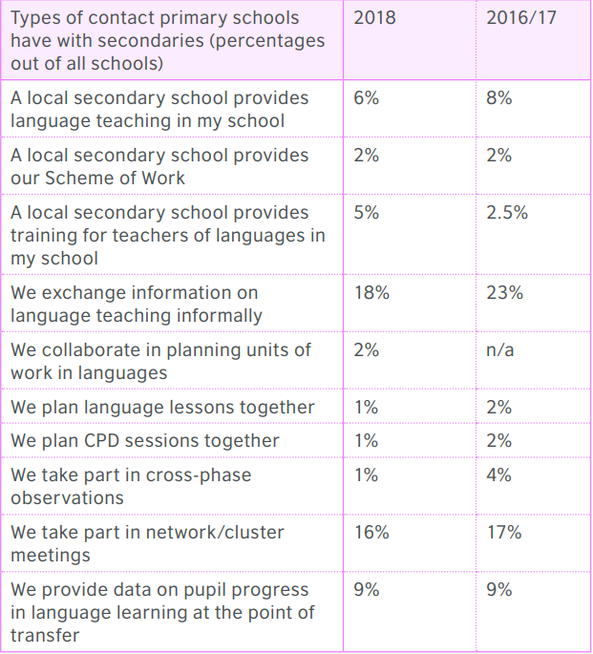
Group discussion
Which (if any) of these take place with your feeders and/or those of your hub schools?
Which of these have/would have the greatest impact, in your view?
Which of these are/would be the easiest to set up and maintain?
Are there any other things you already do with your feeder schools?
p.13, Language Trends Survey, 2018.
Notes:
These are the sorts of things that the Language Trends Survey asked about in 2016-17 and 2018 about the transition activities and interaction between primary and secondary school language teachers.
Take a few minutes to discuss the interaction you have with your primary feeders and anything you know about that of your hub schools.
Which of these are the easiest to set up/maintain?
Which of these have/would have the biggest impact in your view?

Slide 13
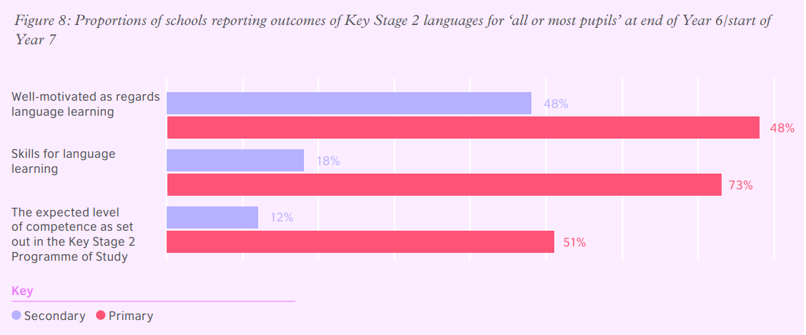
Survey findings (transition)
78%
p.13, Language Trends Survey, 2018.
Notes:
This table highlights a gulf in perceptions between primary and secondary.
We can attribute this in part to the variety of primary feeders into each secondary school, and also to the summer holiday forgetting. Perhaps, though, there is a case for suggesting that we in secondary may underestimate student knowledge because it’s not immediately apparent when we first meet the students in their first lesson. We have to remember the impact that being in a brand new school, in a class with largely unknown peers is likely to have on them.
It is worth thinking about the sort of things we might do to get a better overall picture of what students know already…
What could be the easy wins for us in secondary schools?

Slide 14
Quick wins [1]
Teach the NCELP SOW in Y7
  Essential language (PVG) revisited (or introduced)
  No repetition of familiar topics
  Gap between pupils ‘with’ and ‘without’ prior language is far less apparent to them
  Even without inter-school liaison, chance of de-motivation through boredom or excessive challenge much reduced
Notes:
The caveat here is that obviously, over time, we would hope that there might be a more detailed national curriculum for KS2.
There would be some similarity/overlap with the current NCELP Y7 SOW, of course, which would then itself need to change. But that is some way off.

Slide 15
Quick wins [2]
Capture data from different sources
  Basic knowledge about provision from primary feeders (language taught, average minutes per week, list of topics)
  Y6 induction evening from parents (language taught at KS2, home language)
  Y6 pupil induction day or Y7 first lesson (short survey)
  Agreed piece of written work produced without reference resources (e.g., letter of introduction to new language teacher), which is then stuck inside front cover of Y7 exercise book

Slide 16
Quick wins [3]
Baseline testing
  Language Magician?
  Language Aptitude Test?
  School-created test in one language?
    E.g., pupils write (or select) the English for some high frequency words they hear and/or read
  Primary Bee?

Slide 17
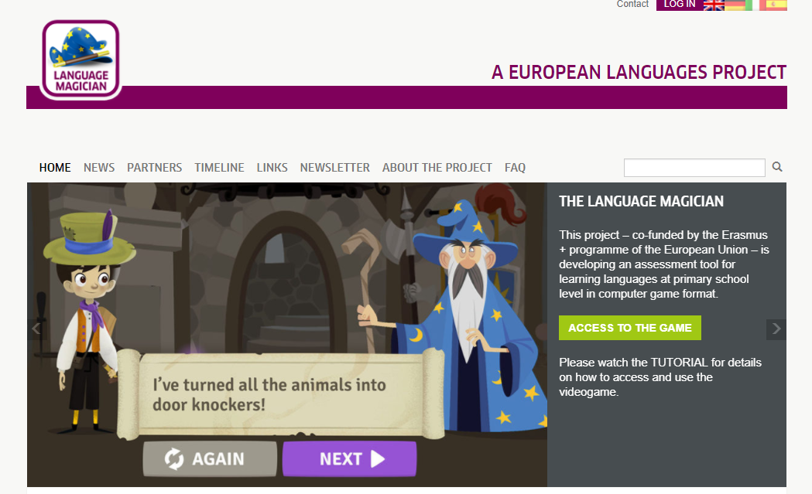
The Language Magician

Slide 18
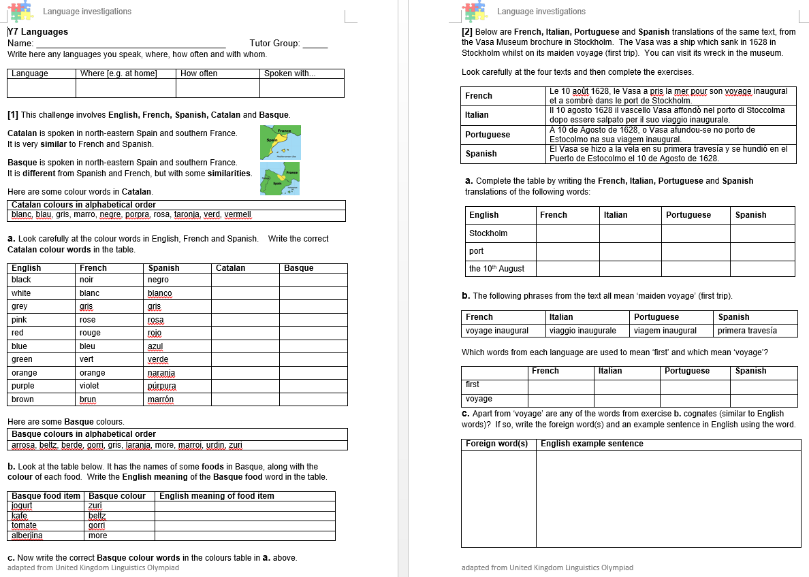
LAT
Notes:
This LAT is based on tasks from the UK Linguistics Olympiad.
It is one example of a school-made language aptitude test. It is NOT perfect, and is only used in conjunction with primary transition data and a language-based entry test. The three sources of data are triangulated and combined also with SATs and CATs data to inform rough, provisional setting.
As you can see, all of this is rather tentative, as it needs to be!

Slide 19
Example of Language Analytic Ability test (Kasprowicz & Marsden, 2019)
Created for year 5 & 6:
English meaning | Somali verb (“I”) | Somali verb (“he”) | English meaning
I went | tagay | tagtay | He went
I brought | keenay | keentay | He brought
I rose | kacay | kactay | He rose
I taught | baray | bartay | He taught
Somali is a language from Africa.
Look how you say “I” did something and “he” did something in the past.
Can you spot any patterns?
Fill in the missing words in the table below. Use the examples above to help you.
English meaning | Somali verb (“I”) | Somali verb (“He”) | English meaning
I saw | aragay |  | He saw
I built |  | dhistay | He built
I entered |  | galtay | He entered
I ran away | cararay |  | He ran away

Slide 20



Example of Language Analytic Ability test (Kasprowicz & Marsden, 2019, question adapted from Tellier, 2013)
Created for year 5 & 6:
These words are from a language called Esperanto.
Look how you say one animal and more than one animal.
one elephant → elefanto
more than one elephant → elefantoj

Slide 21











Fill in the missing words. Use the examples above to help.
Example of Language Analytic Ability test (Kasprowicz & Marsden, 2019, question adapted from Tellier, 2013)
Created for year 5 & 6
One… |  | More than one…
 | hundo | ___________
 | ___________ | leonoj
 | ___________ | delfenoj
 | porko | ___________

Slide 22


Owl exercise
Example of Language Analytic Ability test (Kasprowicz & Marsden, 2019, question adapted from Tellier, 2013)
Created for year 5 & 6:
ogrtsi means owl
Look at these examples.
Can you spot any patterns?
When pupils scored well on this test, they scored well on tests of French verb endings.
Reliable test
Language neutral
Could this test be used (with other data) to inform a year 7 teacher about students’ awareness of grammar?
ogrtsi krit
ogrtsin krite
Notes:
And so it continues… owls this time…
This was found to be a good reliable test that was positively correlated with learning of French grammar.

Slide 23


The Primary Bee
Response to pilot in 2 schools
highly motivating
embeds knowledge much more securely
involves parents / prompts language learning beyond the classroom
improves speed of productive recall
improves pronunciation and physical production
improves behaviour
Email Sarah Schechter:
ss2431@cam.ac.uk
Notes:
The Primary Bee
It’s relevant at this point to mention the Primary Bee.
Two schools in Peterborough have piloted the competition this term, Orton Meadows for French and Gladstone for Spanish.
Jane Driver ran a school final for French just before half term and it was awesome. Fiona (KS2 French teacher) said that it had really helped the students’ vocabulary learning and it made her realise that they had been relying on her word walls and not really embedding the knowledge. She felt PB had really improved their spontaneity as they had really embedded it. She also felt that it had involved the parents and they had supported by practising at home.
The Spanish final is on Friday 15 November. Both piloting teachers spoke at the Peterborough ALL meeting about how motivating it had been for the students and how that had improved behaviour, too.
22 items correctly translated was the winning score in the first school final.
Possible transition tool?
Extracts from the Teacher Pack:
The aim of the Primary Bee is for students in Years 5 & 6 who have started learning a foreign language ab initio in primary school to practise and improve their vocabulary, pronunciation and memory skills in the target language (French, Spanish and German).
Words and phrases have been selected according to the work of NCELP (National Centre for Excellence in Language Pedagogy) which highlights the importance of word frequency in informing vocabulary learning, particularly during the early stages of language development. The list includes many high-frequency words (e.g., some numbers, some colours, some verbs, days of the week, question words and a number of common verbs to help early learners to acquire a robust knowledge of verb vocabulary. These most common verbs are included in the infinitive and 3rd person singular forms; these two verb forms have been shown to provide a very useful linguistic core that can subsequently be further developed. For information we publish the word lists, indicating the word frequency.
Students will be given 40 words or phrases to learn at the first stage (school) of the competition and a further 40 words or phrases will be added at Stage 2 (regional), followed by an additional 40 words or phrases in Stage 3 (national). Vocabulary will be relevant to the curriculum and aim to support classroom talk.
Students will be given the word or phrase in English and they will have to translate it correctly into the Target Language ensuring accurate pronunciation and intonation.
When participating, students will be given one minute to correctly translate as many words/phrases as possible.
Pronunciation must be accurate clearly enunciated. If the word/phrase is not clearly and accurately pronounced, a point cannot be awarded.

Slide 24

Ormiston Meadows Academy
Primary Bee winners
(school stage) 2019

Slide 25
Quick wins [4]
In Y7
  Strategic seating plans (based on transition data)
  Open-ended tasks to elicit prior knowledge

Slide 26
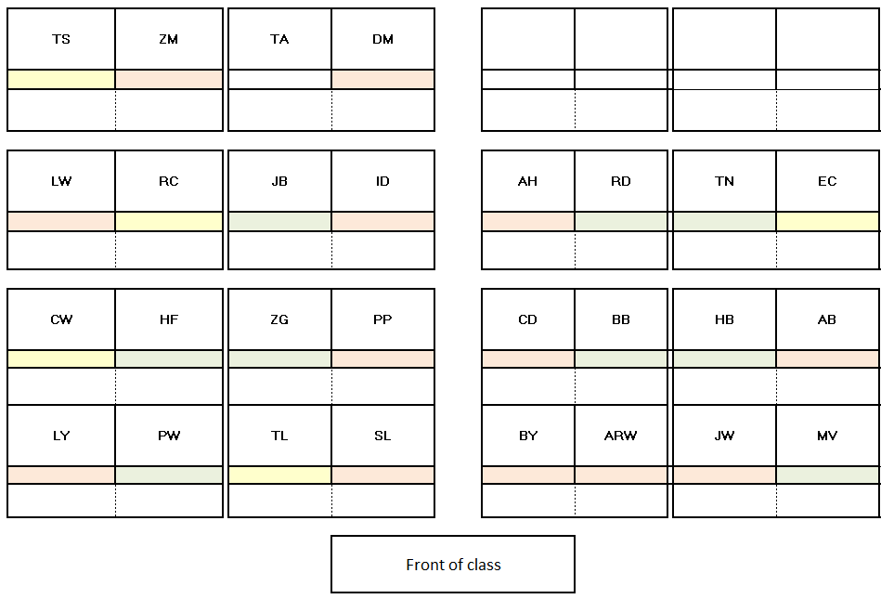
Y7 data
In September Y7 seat according to transition data
Lower proficiency/ prior experience students to outer edges
(for easier support by the teacher)
Pair work first done with Higher / Lower proficiency pairs (i.e., Left/Right)
Pair work task then repeated with more equal pairs (i.e. Front/Back)

Slide 27

Ma famille
Je suis une fille
J’ai une famille
Je suis un garçon
J’ai deux poissons
J’ai cinq instruments
Je suis un papa
J’ai deux chocolats
Je suis une mamie
J’ai huit amies
Je suis un papy
J’ai trois copies
J’ai un copain
Il est Alain!
Je suis une maman
Read aloud to ascertain phonics knowledge
Translate to ascertain knowledge of ‘je suis’ and ‘j’ai’
Categorise the nouns (e.g., into masculine and feminine to check awareness of gender)
Elicit additional nouns (e.g., people, animals, food, objects)
Extend to descriptions (e.g. il/elle est + adjective) to check vocabulary and knowledge of adjectival agreement
Adapted from Multicolore transition resources
Notes:
Obviously, these sorts of tasks can be best designed by teachers when there is some knowledge of what has been taught at KS2…!
However, even where such knowledge is limited, it makes sense to start with an activity that allows students to show what they know.

Slide 28
Quick wins [5]
In primary schools
  Y6 induction lessons
  Language Leaders (e.g., Y9 students teach lessons in primary)
  Primary Bee?
  Send the primary school a list of 100 high frequency words you’d like pupils to know on arrival in year 7 at secondary.
    Thirty high frequency nouns
    Fifteen high frequency and engaging verbs
      Choose one short (je?) and infinitive (mange, manger)
    Key personal pronouns
    Ten (regular) high frequency adjectives
    A few adverbs
    A few question words
    A few interaction words (oui, non, merci, bonjour)
Notes:
Suggest 100 as a start – this wouldn’t be daunting and could be compatible with what is going on already in the primary school
Don’t worry about the grammar too much – need a critical mass of vocabulary before grammar kicks in
If you think this is a good idea, next academic year NCELP could create a quizlet / oral set for this with a link you can send to your primary schools. This is essentially the Primary Bee list of 120 words!

Slide 29
Quick wins [6]
Use the new Ofsted framework to start a conversation
  Progress means knowing more, remembering more
  The curriculum should be ambitious
  Pupils study the full curriculum; it is not narrowed. In primary schools, a broad range of subjects (exemplified by the national curriculum) is taught in key stage 2 throughout each and all of Years 3 to 6.
  CEFR A1 = 500-word vocabulary
  Over the course of study, teaching is designed to help pupils to remember long-term the content they have been taught
  The language that Y6 learners remember at the end should match the curriculum intent (i.e., what is planned to be taught)
Notes:
Allocation time
60 mins per week - models? 30 mins + 5+5+5+5+10
Content
PVG
Number of words
3.2 words per week

Slide 30
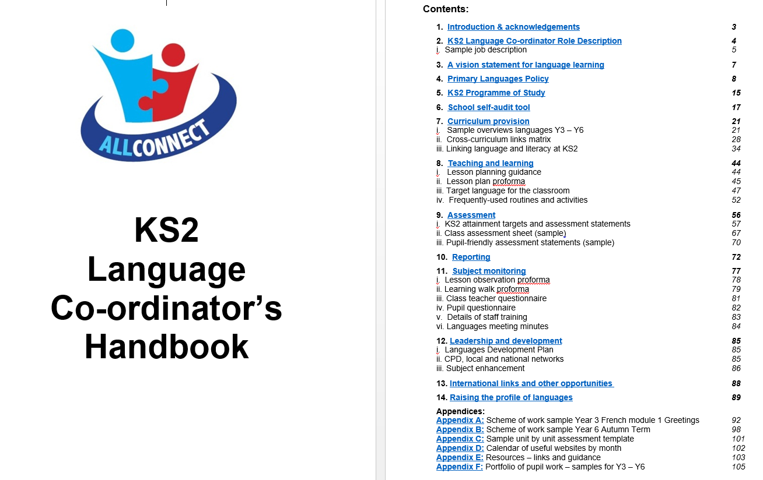
KS2 Language Co-Ordinator’s Handbook
Link to the Handbook
Notes:
Primary language co-ordinators are often not linguists. They also have very little time to dedicate to the role, so any help with essential documentation, access to the NC documents, is often a lifeline.
Signposting primary teachers to this document is a first step and give them something practical to work with.
The documents in the handbook are editable and can therefore be easily customised to suit each primary school’s circumstances.

Slide 31
KS2 curriculum
Listening
1) Listen and show understanding by joining in and responding
2) Link the sound, spelling and meaning of words
Speaking
1) Ask and answer questions
2) Express opinions
3) Ask for clarification and help
4) Speak in sentences
5) Describe people, places, things
Grammar
1) Gender of nouns
2) Singular and plural forms
3) Adjectives (place and agreement)
4) Conjugation of key verbs
Reading
1) Read and show understanding of phrases and simple texts
2) Read aloud with accurate pronunciation
3) Use a dictionary
Writing
1) Write phrases from memory
2) Adapt phrases to create new sentences.
3) Describe people, places, things
Notes:
KS2 curriculum on a slide
Many primary colleagues may be at very early stages in terms of their KS2 provision.
It can help to share key documentation, such as this concise version of the KS2 languages curriculum.
This can kick start a conversation about what can realistically be taught over the 4 years.

Slide 32
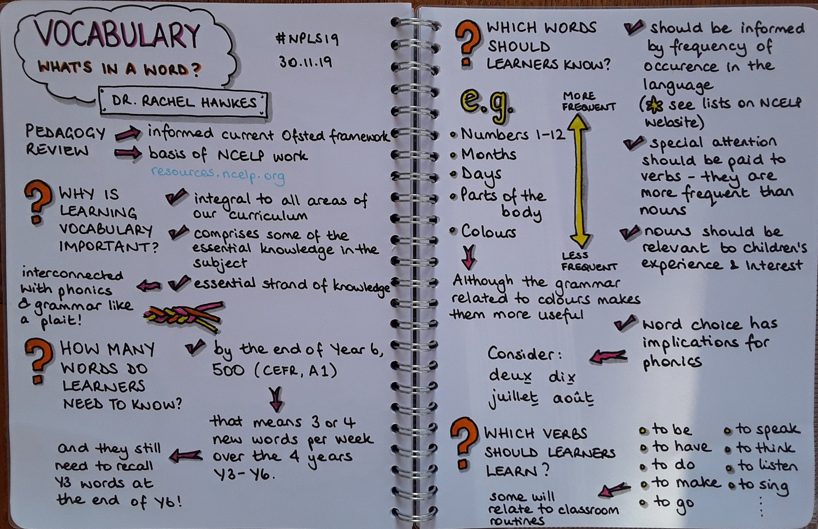
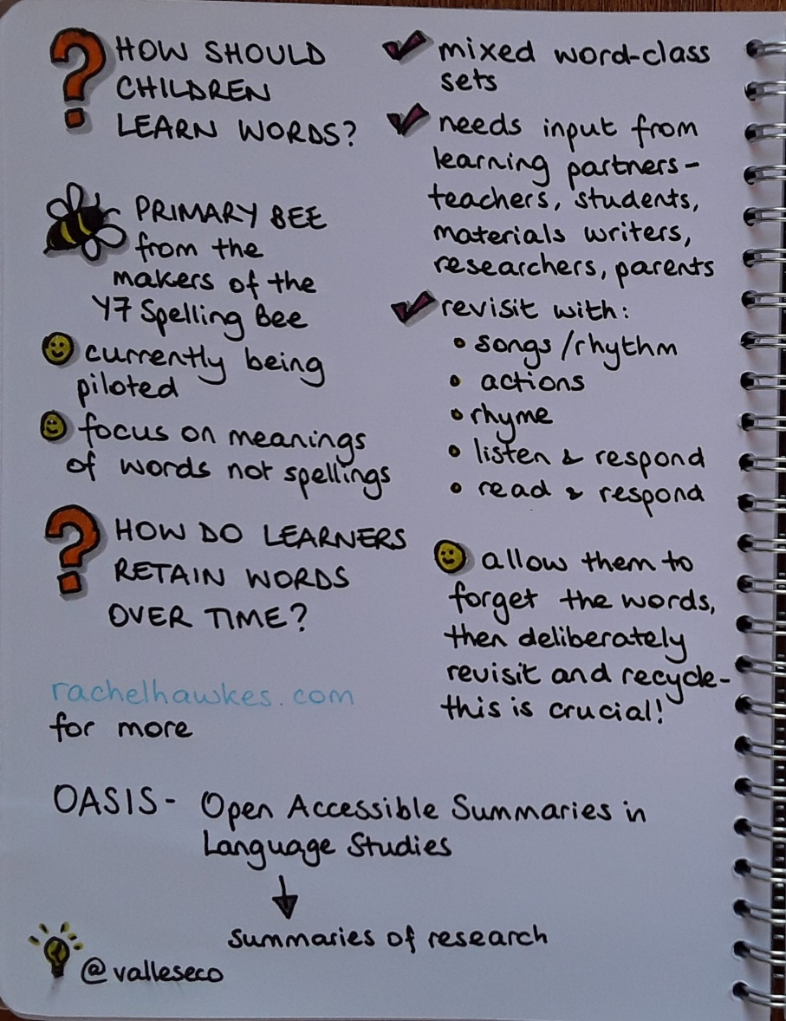
Vocabulary-what’s in a word?
Link to What's in a word? Presentation at the 30th Northern Primary Languages Show
Notes:
If primary colleagues want more input, there is a presentation about choice of vocabulary at KS2.

Slide 33
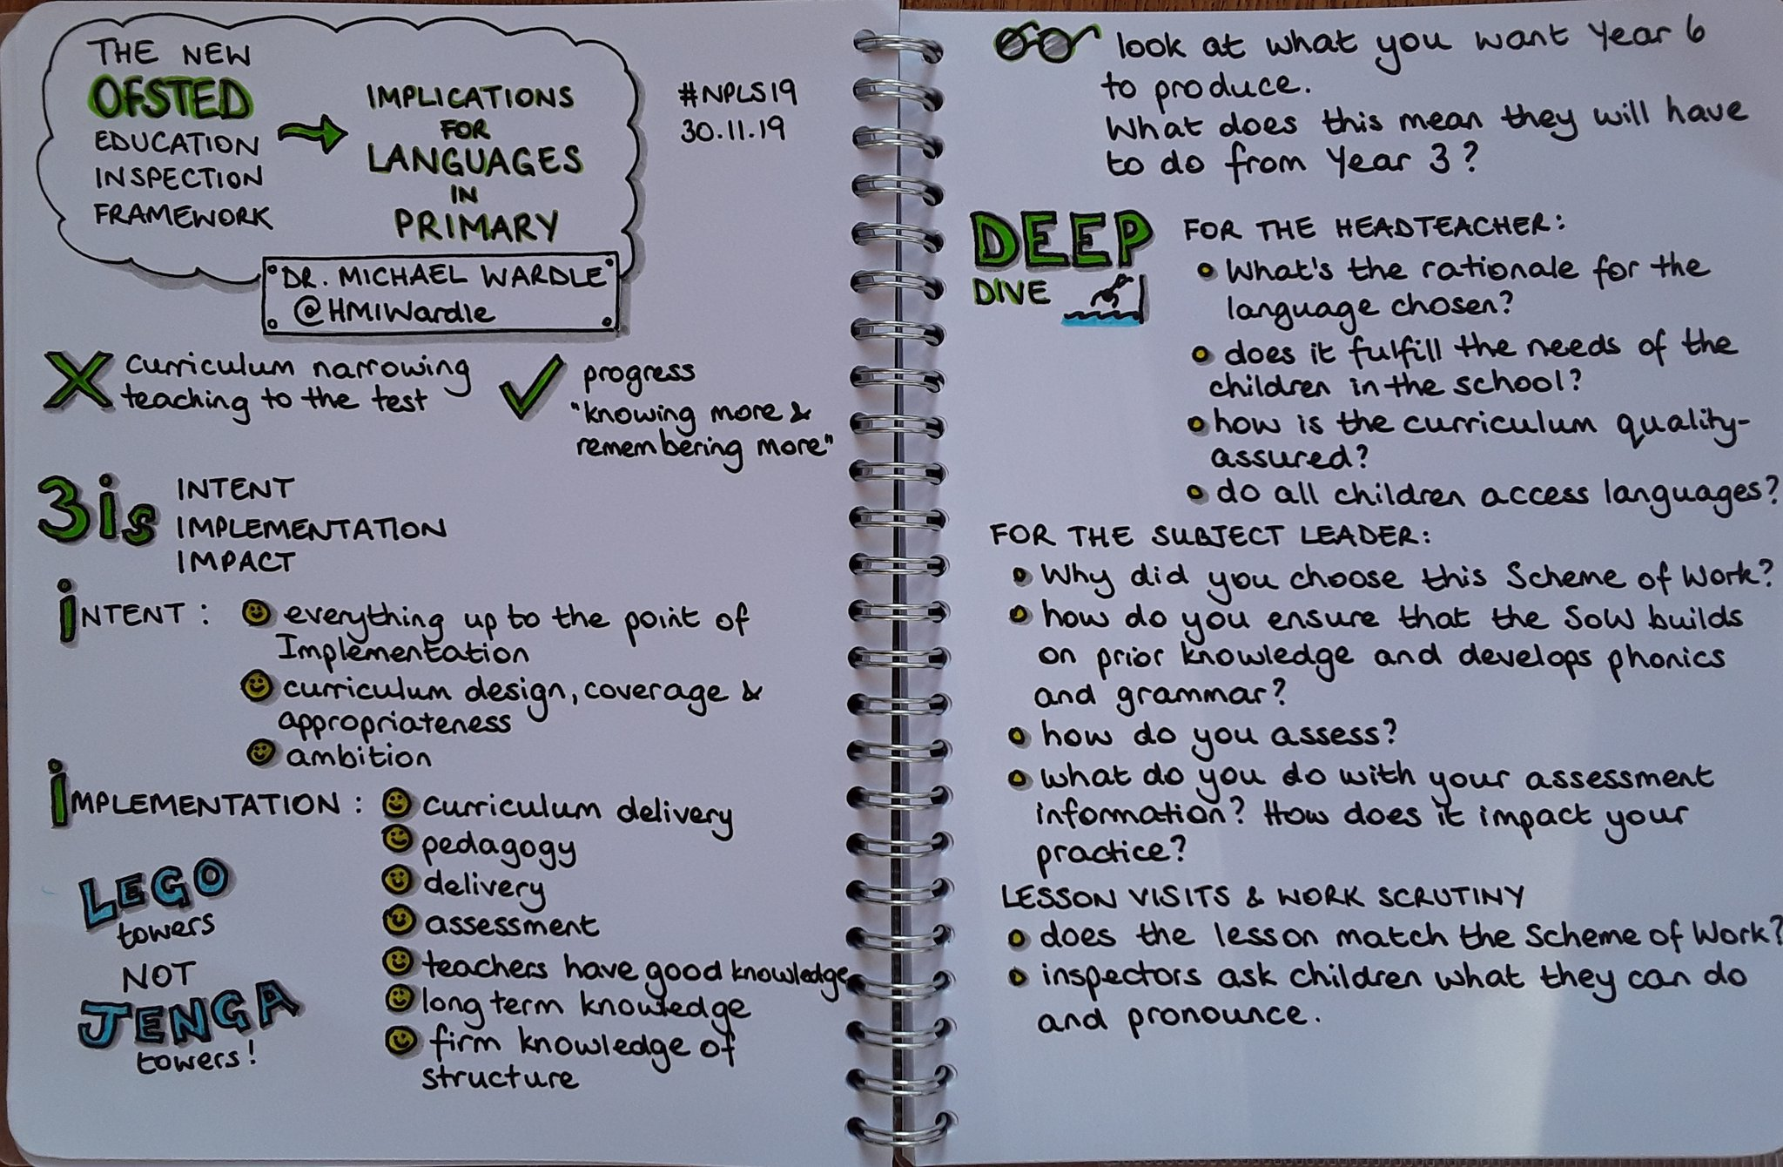
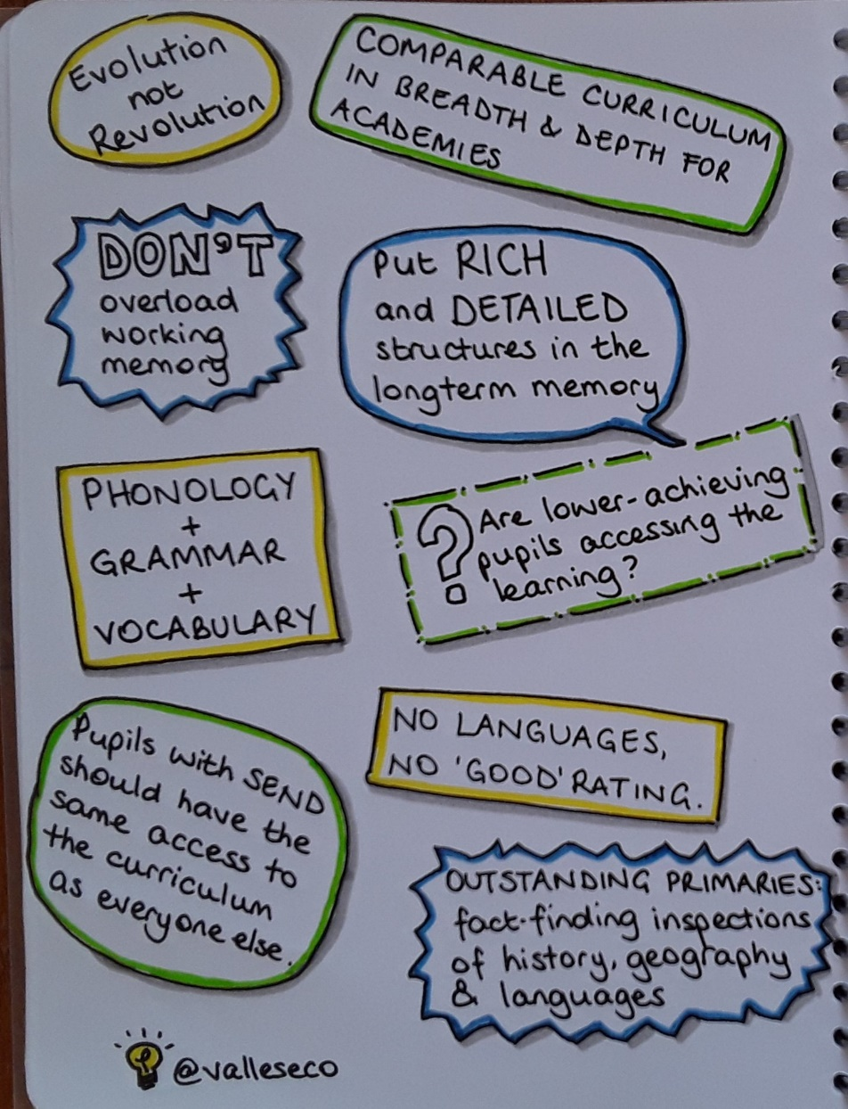
Summary of recent keynote
Summary of Lead HMI for Languages Michael Wardle’s recent keynote on the new Ofsted Framework’s implications for KS2 languages

Slide 34
Group discussion
What are your thoughts on these six ideas?
Any additional ‘quick win’ ideas to add?
Notes:
Group discussion
What is your experience of what primary learners know / don’t know? How they are on arrival to secondary school?

Slide 35
SMART targets for transition
Consider:
one thing you could do within your school as a department
one thing you could do jointly with primaries
Note: Slides from this session to be included in TRG 3 in May 2020:
KS2 Grammar & KS2 transition arrangements, plus preparation for Hub Day 2.
Notes:
5-10 minutes to discuss with others from your department and agree/record these.

Slide 36
References
Baumert, J., Fleckenstein, J., Leucht, J., Köller, O., Moeller, J. (accepted). Starting Foreign Language learning early at school: Long-term prfocieny of earlty, mideel and late beginners. Language Learning. 70, 4
Burstall, C. (1975). Primary French in the balance. Educational Research, 17(3), 193–198. doi:10.1080/0013188750170304
Courtney, L. (2017). Transition in modern foreign languages: a longitudinal study of motivation for language learning and second language proficiency. Oxford Review of Education43(4), 462-481. doi: https://doi.org/10.1080/03054985.2017.1329721
Courtney, L., Graham, S., Tonkyn, A., & Marinis, T. (2017). Individual differences in early language learning: A study of English learners of French. Applied Linguistics, 38(6), 824–847. doi:10.1093/applin/amv071
Cummins, J. (1979). Linguistic interdependence and the educational development of bilingual children. Review of Educational Research, 49(2), 222–251. doi:10.3102/00346543049002222
De Bot, K. (2014). The effectiveness of early foreign language learning in the Netherlands. Studies in Second Language Learning and Teaching, 4(3), 409–418. doi:10.14746/ssllt.2014.4.3.2
Galton, M., & McLellan, R. (2018). A transition Odyssey: Pupils’ experiences of transfer to secondary school across five decades. Research Papers in Education, 33(2), 255–277. doi:10.1080/02671522.2017.1302496
Graham, S., Courtney, L., Marinis, T., & Tonkyn, A. (2017). Early language learning: The impact of teaching and teacher factors. Language Learning, 67(4), 922–958. doi:10.1111/lang.12251
Graham, S., Courtney, L, Tonkyn, A., & Marinis, T. (2016). Motivational trajectories for early language learning across the primary-secondary school transition. British Educational Research Journal, 42 (4), 682-702. https://doi.org/10.1002/berj.3230
Huang, B. H. (2016). A synthesis of empirical research on the linguistic outcomes of early foreign language instruction. International Journal of Multilingualism, 13(3), 257–273. doi:10.1515/9783110197372.0.1
Jaekel, N., Schurig, M., Florian, M., & Ritter, M. (2017). From early starters to late finishers? A longitudinal study of early foreign language learning in school. Language Learning, 67(3), 631–664. doi:10.1111/lang.12242
Kasprowicz, R. E., Marsden, E. J., & Sephton, N. (2019). Investigating distribution of practice effects for the learning of foreign language verb morphology in the young learner classroom. The Modern Language Journal, 103(3), 580-606. https://doi.org/10.1111/modl.12586

Slide 37
Further reading
Bennett, S. N. (1975). Weighing the evidence: A review of ‘Primary French in the Balance’. British Journal of Educational Psychology, 45(3), 337–340. doi :10.1111/j.2044-8279.1975.tb02976.x
Bolster, A., Balandier-Brown, C., & Rea-Dickens, P. (2004) Young learners of modern foreign languages and their transition to the secondary phase: A lost opportunity? Language Learning Journal 30, 35–41. doi:10.1080/09571730485200211
Boyson, B. A., Semmer, M., Thompson, L. E., & Rosenbusch, M. H. (2013). Does beginning foreign language in kindergarten make a difference? Results of one district’s study. Foreign Language Annals, 46(2), 246–263. doi:10.1111/flan.12023
Lambelet, A., & Berthele, R. (2015). Age and foreign language learning in school. New York, NY: Palgrave Macmillan
Larson-Hall, J. (2008). Weighing the benefits of studying a foreign language at a younger starting age in a minimal input situation. Second Language Research, 24(1), 35–63. doi:10.1177/0267658307082981

