Slide 1
Phonics
Year 7 French
Term 1.2 - Week 7
Stephen Owen / Rachel Hawkes
Date updated: 23/02/20
Notes:
Phonics learning aims for Term 1.2, Week 7:
revisiting ‘i’
All pictures selected are available under a Creative Commons license; no attribution required.

Slide 2
i
midi
Stephen Owen / Rachel Hawkes
Notes:
Introduce and elicit the pronunciation of the individual SSC ‘i’ and then present and practise the pronunciation of the source word ‘midi’.
A possible gesture for this source word would be to draw a circle representing a clock face with one hand, with the other arm and hand pointing straight up (representing the hands on 12) within the circle

Slide 3
i
midi
Stephen Owen / Rachel Hawkes
Notes:
Introduce and elicit the pronunciation of the individual SSC ‘i’ and then present and practise the pronunciation of the source word ‘midi’.
A possible gesture for this source word would be to draw a circle representing a clock face with one hand, with the other arm and hand pointing straight up (representing the hands on 12) within the circle

Slide 4
i
midi
Stephen Owen / Rachel Hawkes
Notes:
Elicit the pronunciation of the individual SSC ‘i’ and practise the pronunciation of the source word ‘midi’ again, this time without the embedded audio.
A possible gesture for this source word would be to draw a circle representing a clock face with one hand, with the other arm and hand pointing straight up (representing the hands on 12) within the circle

Slide 5
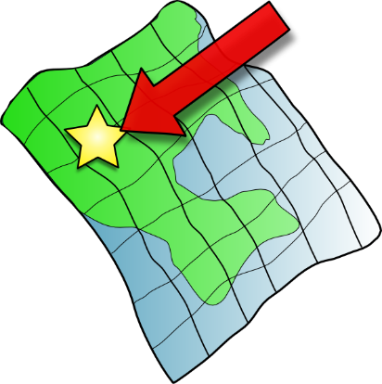
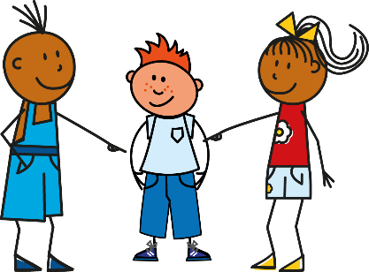
i
petit
lit
midi
ici
qui ?
il
?
Stephen Owen / Rachel Hawkes
Notes:
Introduce and elicit the pronunciation of the individual SSC ‘i’ and then the source word ‘midi’ again (with gesture, if using).
Then present and elicit the pronunciation of the five cluster words. The cluster words have been chosen for their high-frequency, from a range of word classes, with the SSC (where possible) positioned within a variety of syllables within the words (i.e. initial, 2nd/final) and additionally, we have tried to use words that build cumulatively on previously taught SSCs (see the Phonics Teaching Sequence document) and do not include new SSCs. Where new SSCs are used, they are often consonants which have a similar symbol-sound correspondence in English.
Word frequency rankings (1 is the most common word in French): petit [138]; lit [1837] ici [167]; il[13]; qui [14]; midi [2483]. Source: Londsale, D., & Le Bras, Y. (2009). A Frequency Dictionary of French: Core vocabulary for learners London: Routledge.

Slide 6
i
petit
lit
midi
ici
qui ?
il
Stephen Owen / Rachel Hawkes
Notes:
Introduce and elicit the pronunciation of the individual SSC ‘i’ and then the source word ‘midi’ again (with gesture, if using). Then present and elicit the pronunciation of the five cluster words. The cluster words have been chosen for their high-frequency, from a range of word classes, with the SSC (where possible) positioned within a variety of syllables within the words (i.e. initial, 2nd/ final) and additionally, we have tried to use words that build cumulatively on previously taught SSCs (see the Phonics Teaching Sequence document) and do not include new SSCs. Where new SSCs are used, they are often consonants which have a similar symbol-sound correspondence in English.
Word frequency rankings (1 is the most common word in French): petit [138]; lit [1837] ici [167]; il[13]; qui [14]; midi [2483]. Source: Londsale, D., & Le Bras, Y. (2009). A Frequency Dictionary of French: Core vocabulary for learners London: Routledge.

Slide 7
i
petit
lit
midi
ici
qui ?
il
Stephen Owen / Rachel Hawkes
Notes:
Elicit the pronunciation of the individual SSC ‘i’ and then the source word ‘midi’ again (with gesture, if using), followed by the five cluster words – this time without the embedded audio.
The cluster words have been chosen for their high-frequency, from a range of word classes, with the SSC (where possible) positioned within a variety of syllables within the words (i.e.initial, 2nd/final) and additionally, we have tried to use words that build cumulatively on previously taught SSCs (see the Phonics Teaching Sequence document) and do not include new SSCs. Where new SSCs are used, they are often consonants which have a similar symbol-sound correspondence in English.
Word frequency rankings (1 is the most common word in French): petit [138]; lit [1837] ici [167]; il[13]; qui [14]; midi [2483]. Source: Londsale, D., & Le Bras, Y. (2009). A Frequency Dictionary of French: Core vocabulary for learners London: Routledge.

Slide 8
parler
ancien
action
60
livre
fille
il
oui
animal
Secondes
idée
petit
machine
rapide
0
DÉBUT
ami
Notes:
Learners take it in turns to try to pronounce correctly as many words as they can to a partner in one minute. The person who has pronounced the greatest number of words correctly by the time limit wins, or the one with the greatest amount of time remaining, if both have said all the words correctly. The two words at the top of the slide recall the SSCs of the previous week (‘-tion’ and ‘-ien’), though focusing on the ‘i’ sound within these this time.
The words have been selected from vocabulary presented early on in the course (therefore forming useful vocabulary revision), from a range of word classes, with the SSC positioned within a variety of syllables within the words (initial, 2nd, final). The teacher can circulate during this activity to listen into learners’ SSC knowledge.

