Slide 1
Dreams and Goals
Authentic non-fiction texts
Conjunction wenn + WO3
Revisit several SSCs
Y8 German
Term 3.2 - Week 6 - Lesson 69
Natalie Finlayson / Catherine Morris / Rachel Hawkes
Artwork: Steve Clarke
Date updated: 21/07/21
Notes:
Artwork by Steve Clarke. All additional pictures selected are available under a Creative Commons license, no attribution required.
Native speaker teacher feedback provided by Stephanie Cross.
Learning outcomes (lesson 1):
Revisit several SSCs
Authentic non-fiction texts: ich lebe für den Fußball, Traumberuf, Strassenbauerin
Introduction of wenn + WO3, preposition ‘aus’
Word frequency (1 is the most frequent word in German):
8.3.2.6 (introduce) bauen [667] studieren [600] Ausbildung [1174] Freizeit [2594] Karriere [1813] Traum [992] relativ [571] wenn [42] aus² [37] pro [412] tausend [1177]
8.3.2.1 (revisit) bringen [153] gebracht [153] verlieren [313] verloren [313] Insel [1029] Meer [852] Reise [734]
Wind [1124] halb [443] stark [178] nach² [34] vor³ [50]
8.2.2.5 (revisit) kennen [216] Anwalt [1887] Deutschland [140] Firma [686] Firmen [686] Weile [1631] gleich [141] einmal [124] bei [29] seit [130] vor¹ [50]
Source: Jones, R.L & Tschirner, E. (2019). A frequency dictionary of German: Core vocabulary for learners. London: Routledge.
The frequency rankings for words that occur in this PowerPoint which have been previously introduced in NCELP resources are given in the NCELP SOW and in the resources that first introduced and formally re-visited those words.
For any other words that occur incidentally in this PowerPoint, frequency rankings will be provided in the notes field wherever possible.

Slide 2
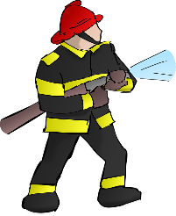
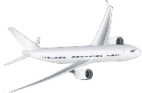
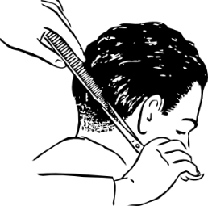
Phonetik: Was passt nicht?
lesen / sprechen
1.
Fußballspielerin
2.
Feuerwehrmann
3.
Software-Entwickler
4.
Steward
Friseur
Maurerin
Grafikerin
Dozent
Kassierer
Verkäuferin
Verlegerin
Apothekerin
Notes:
Timing: 8 minutes. This is slide 1/3. Aim: Written recognition and oral production of a range of SSCs; to revise the addition of –in to masculine people nouns to refer to a woman; strengthening the connection between SSCs that are written differently but sound the same. Procedure: 1. Students write 1-12 and choose which job title (A-C) is the odd one out in each set, based on the pronunciation of the letters in bold.
2. Students say the words to each other in pairs to check their answers.
3. Click to reveal the answers, eliciting the correct pronunciations.
4. Where the feminine form is given, elicit the masculine form, and vice versa. Draw attention to exceptions Feuerwehrmann/Feuerwehrfrau, Psychologe/Psychologin and Steward/Stewardess.
5. Ensure the English meanings of the words are understood as the words will be used in the discussion exercise which follows. Draw attention to:
compound nouns (Fußballspieler/in, Stadtführer/in, Yogalehrer/in, Konditionstrainer/in, Grundschullehrer/in, Krankenpfleger/in, Flugbegleiter/in, Briefträger/in)
near-cognates (Kassierer/in, Steward/ess, Gärtner/in, Polizist/in, Sekretär/in, Soldat/in, Psychologe/Psychologin, Pilot/in, Mechaniker/in, Juwelier/in, Physiker/in, Grafiker/in)
words containing known roots (Krankenpfleger/in, Fußballspieler/in (spielen), Flugbegleiter, Briefträger/in (tragen), Zahnarzt/Zahnärztin, Stadtführer/in (führen), Verkäufer/in (kaufen), Zimmerer/in, Grundschullehrer/in, Yogalehrer/in)
Word frequency of unknown words used (1 is the most frequent word in German):
Fußballspieler [Fußball 1277; Spieler 822] Friseur [>5000] Kassierer [>5000]; Feuerwehrmann [Feuerwehr 3778; Mann 121] Maurer [>5000] Verkäufer [2374] Software-Entwickler [Software 3151; Entwickler [>5000] Grafiker [>5000] Verleger [>5000] Steward [>5000] Dozent [>5000] Apotheker [>5000] Source: Jones, R.L. & Tschirner, E. (2019). A frequency dictionary of German: core vocabulary for learners. Routledge

Slide 3
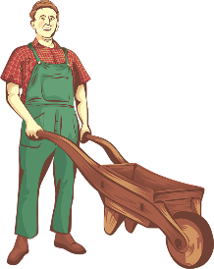
Phonetik: Was passt nicht?
lesen / sprechen
5.
Mechanikerin
6.
Physikerin
7.
Flugbegleiter
8.
Dolmetscherin
König
Yogalehrer
Briefträger
Polizistin
Gärtner
Juwelier
Kaiserin
Stadtführerin
Notes:
This is slide 2/3. Word frequency of unknown words used (1 is the most frequent word in German): Mechaniker [>5000] König [1087] Gärtner [>5000] Physiker [>5000] Yogalehrer [Yoga >5000; Lehrer [695] Juwelier [>5000] Flugbeglaeiter [Flug 2220; Begleiter 4802]; Briefräger [Brief 838; Träger 3786]; Kaiser [2563] Dolmetscher [>5000] Polizist [1433] Stadt [204] Führer [2684]
Source: Jones, R.L. & Tschirner, E. (2019). A frequency dictionary of German: core vocabulary for learners. Routledge

Slide 4
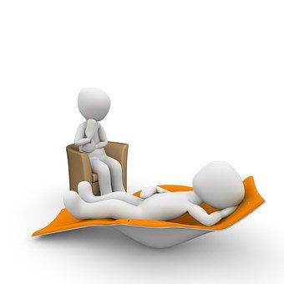
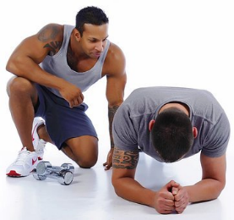
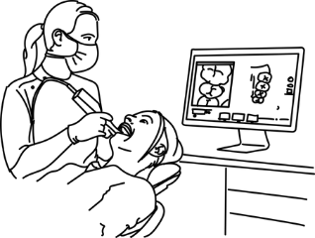
Phonetik: Was passt nicht?
lesen / sprechen
9.
Soldat
10.
Psychologe
11.
Schneider
12.
Krankenpfleger
Zimmerer
Grundschullehrerin
Erzieherin
Sekretärin
Konditionstrainer
Übersetzer
Pilot
Zahnarzt
Notes:
This is slide 3/3. Word frequency of unknown words used (1 is the most frequent word in German): Soldat [1267] Zimmerer [>5000] Konditionstrainer [Kondition 5000; Trainer 1003] Psychologe [4241] Grundschullehrer [>5000] Übersetzer [2902] Schneider [>5000] Erzieher [>5000] Pilot [2956] Krankenpfleger [>5000] Sekretär [4533] Zahnarzt [Zahn 1871; Arzt 622]
Source: Jones, R.L. & Tschirner, E. (2019). A frequency dictionary of German: core vocabulary for learners. Routledge

Slide 5
Der Girls’ Day
lesen / sprechen
Du findest einen interessanten Artikel in der Zeitung:
Traumberuf Straßenbauerin
Der Girls' Day will Mädchen Männerberufe näher bringen.
Denkst du, dass manche Berufe „typische Männerberufe“ oder „typische Frauenberufe“ sind? Wenn ja, welche? Diskutiere mit einem Partner/einer Partnerin.
Ich denke, dass Straßenbauer leider noch ein Männerberuf ist.
Notes:
Timing: 4 minutes Aim: To build anticipation by asking students to think about the content of the text in a broader sense; raising cultural awareness (jobs considered to be male- or female-dominated in Germany). Procedure: 1. Ensure students understand the headline. Draw attention to the compound Traumberuf, built from one new and one known noun. Encourage them to piece together the compound Straßenbauerin using their knowledge of known noun Straße, new verb bauen and –in suffix.
2. Ensure students understand the subheading. They will need some help with this as the structure is tricky. Break down the compound Männerberufe (they may need reminding of plural rule 4). Explain that näher is a comparative form, and ask them to identify the base form. Remind students of sentence structure with modal verbs, and explain that nah does not take preposition ‘to’ in German.
3. Display the three previous slides again. Ask students to read through the job titles again, and discuss whether they consider any of them to be male- or female-dominated in the UK. Encourage students to use Ich denke, dass + WO3 as modelled in the speech bubble in their discussions.
4. Students may find it interesting to know which careers are considered male- and female-dominated in Germany, and to compare their own responses with these. Some links to statistics and further learning materials on this topic are provided below.
https://www.vigozone.de/typische-maennerberufe-frauenberufe/
https://learngerman.dw.com/de/m%C3%A4nnerberufe-und-frauenberufe/l-40488293/e-40489532
https://www.dw.com/de/m%C3%A4nnerberufe-frauenberufe/a-15807670 Word frequency of cognates used (1 is the most frequent word in German):
Artikel [1378], typisch [1109], diskutieren [997], partner [1172] Source: Jones, R.L. & Tschirner, E. (2019). A frequency dictionary of German: core vocabulary for learners. Routledge

Slide 6
Vokabeln
hören
 | wenn | if, when
 | der Traum | dream
 | pro | per
 | bauen | to build, building
 | relativ | relatively
 | studieren | to study
1
2
eine Ausbildung zur/zum (+ job title) machen
– to do training to be a …
3
4
5
 | die Ausbildung | training
 | tausend | thousand
 | die Karriere | career
 | aus | out/out of, from
 | die Freizeit | free time
6
7
8
in meiner Freizeit (R3) – in my free time
Studieren specifically means ‘to study at university.’ To talk about studying a subject at school use ‘lernen’.
9
10
11
Notes:
Timing: 3 minutes Aim: Aural recognition of this week’s new vocabulary. Procedure: 1. Click on the numbers to hear the new words said aloud.
2. Students write down the German and the English translation.
3. Click to reveal the German followed by the English – elicit answers as you go.
4. Click to reveal additional information about the use of words studieren, die Ausbildung and die Freizeit.
Transcript:
1. wenn
2. der Traum
3. pro
4. bauen
5. relativ
6. studieren
7. die Ausbildung
8. tausend
9. die Karriere
10. aus
11. die Freizeit

Slide 7
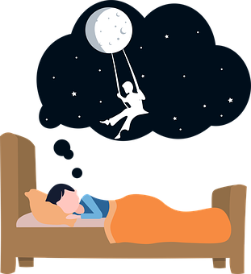
Neue Wörter verstehen
lesen
What kind of word ends in –en?
Was heißt ‘der Traum’?
This is an example of a noun-verb pair where verb stem = noun.
träumen
to dream, dreaming
Notes:
Timing: 4 minutes. This is slide 1/8. Aim: Increasing students’ vocabulary coverage for comprehension of texts; encouraging students to think more broadly about vocabulary; inference of meanings of word family members of known words and cognates; priming students for recognising these words in short texts. Procedure: 1. Students read the target word aloud and try to guess the English meaning.
2. If students are unsure, click to reveal a clue. If students are still unsure, keep clicking until all three clues are revealed.
3. Click to reveal the English translation.
4. Repeat steps 1-3 for 8 slides.

Slide 8
Neue Wörter verstehen
lesen
What kind of word ends in –en?
Which letter often replaces German ‘z’ in English words?
-ieren is a common ending for verbs that look like English.
faszinieren
Wow!
to intrigue, fascinate
Notes:
This is slide 2/8.

Slide 9
Neue Wörter verstehen
lesen
What does ‘interessant’ mean?
What kind of word starts with a capital letter?
What English word does this look like?
das Interesse
interest
Notes:
This is slide 3/8.

Slide 10
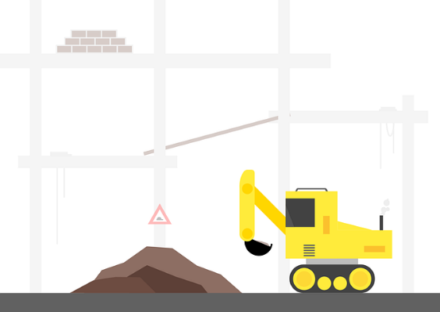
Neue Wörter verstehen
lesen
What kind of word starts with a capital letter?
Was heißt ‘bauen’?
Was heißt ‘stellen’?
die Baustelle
building ‘place’ (site)
Notes:
This is slide 4/8.

Slide 11
Neue Wörter verstehen
lesen
What kind of word starts with a capital letter?
Was heißt ‘anfangen’?
This is an example of a noun-verb pair where verb stem = noun.
der Anfang
beginning
Notes:
This is slide 5/8.

Slide 12
Neue Wörter verstehen
lesen
What kind of word ends in –isch?
Was heißt ‘Frauen’?
What English word does ‘typisch’ look like?
frauentypisch
typically female
Notes:
This is slide 6/8.

Slide 13
Neue Wörter verstehen
lesen
Was heißt ‘Kaffee’?
Was heißt ‘kochen’?
What happens to a verb when you add ‘das’ and a capital letter?
das Kaffeekochen
making coffee
Notes:
This is slide 7/8.

Slide 14
Neue Wörter verstehen
lesen
Was heißt ‘bauen’?
What English word does ‘ingenieur’ look like?
What other German words do you know that end in –wissenschaften?
Bauingenieurwissenschaften
construction engineering science
(civil engineering)
Notes:
This is slide 8/8.

Slide 15
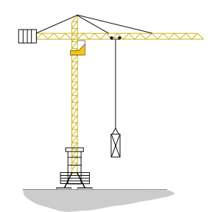
Traumberuf Straßenbauerin
1
2
3
4
5
6
7
8
9
hören / lesen
Der Girls' Day will Mädchen Männerberufe näher bringen. Janet Schulz (22) aus Dresden macht eine Ausbildung zur Straßenbauerin.
Verbs ending in -ieren do not add ge- to their past participles.
?
?
Manche Mädchen träumen von Puppen* und schöne Kleidung, nicht so Janet Schultz. «Straßen haben mich immer fasziniert», sagt sie. Das Interesse liegt in der Familie: Ihr Opa hat Brücken* gebaut. Janet ist als Kind in ihrer Freizeit mit ihm auf die Baustelle
gegangen. Seit damals ist es klar: eine Karriere als Straßenbauerin ist ihr Traum. «Am Anfang war es relativ schwierig», erzählt Janet. Früher hat sie frauentypische Arbeiten wie putzen oder Kaffeekochen bekommen.
Aber jetzt nicht mehr. «Heute wissen alle, dass ich so gut wie die Männer arbeite», sagt sie. «Das macht richtig Spaß.» Janet wird vielleicht Bauingenieurwissenschaftenstudieren, wenn sie später an die Universität geht.
?
?
?
?
?
?
?
Ausbildung
wenn
studieren
Karriere
relativ
Freizeit
Traum
gebaut
aus
*die Puppe – doll *die Brücke – bridge
Notes:
Timing: 8 minutes Aim: Bimodal input; written recognition of this week’s new vocabulary in context; reading comprehension. Procedure: 1. Click on a number to hear a section of the text read aloud. The audio stops just before each question mark.
2. Students read along. When the audio stops, ensure comprehension of the text that has been heard up to that point. Pay particular attention to the words which precede and follow the question mark (see below for suggested hints).
3. Students choose, from the distractors in the blue box, the word that they think is hidden.
4. Click to reveal the answer.
5. Click on the next number to restart the audio.
6. Repeat steps 1-5 until the whole text has played.
7. Click to reveal the note about the past tense of faszinieren.
Transcript:
1. Traumberuf Straßenbauerin. Der Girls' Day will Mädchen Männerberufe näher bringen. Janet Schulz (22)… Ask students: what is Dresden? They may not have heard of it. Explain that it is the name of the city and perhaps give some brief information about it. Ask which word is likely to come before the name of a city.
2. aus Dresden macht eine… Ask students look at the words which surround the gap. Remind them of the usage note about Ausbildung on the vocabulary slide. What must you do to become a road builder?
3. Ausbildung zur Straßenbauerin. Manche Mädchen träumen von Puppen und schöne Kleidung, nicht so Janet Schultz. «Straßen haben mich immer fasziniert», sagt sie. Das Interesse liegt in der Familie: Ihr Opa hat Brücken… Ask students to look at the words before the gap. Which tense is indicate by the presence of hat? What type of word is needed to complete the tense ?
What can you do to bridges?
4. gebaut. Janet ist als Kind in ihrer… Ask students to consider the phrases in ihrer. They may need some help with this as they have not seen ihre in the dative before. Explain that the structure means 'in her‘. They may guess Karriere or Traum, both of which are semantically possible answers and should be commended (it is not expected at this stage that students will connect ihrer with a feminine noun).
5. Freizeit mit ihm auf die Baustelle gegangen. Seit damals ist es klar: eine… Ask students what kind of word eine introduces (a feminine noun).
6. Karriere als Straßenbauerin ist ihr… Ask student what kind of word ihr introduces (a masculine or neuter noun).
7. Traum. «Am Anfang war es… Ask students what kind of word could describe an adjective.
8. relativ schwierig», erzählt Janet. Früher hat sie frauentypischen Arbeiten wie putzen oder Kaffeekochen bekommen. Aber jetzt nicht mehr. «Heute wissen alle, dass ich so gut wie die Männer arbeite», sagt sie. «Das macht richtig Spaß.» Janet wird vielleicht Bauingenieurwissenschaften… Ask students to identify the tense indicated by wird, and what kind of word they expect to complete the clause (verb in infinitive). Ask them to check whether the remaining word wenn fits the context. They are only likely to work this out by process of elimination, but it provides a convenient lead-in to the further information given about it on slide 18.
9. studieren, wenn sie später an die Universität geht.
Word frequency of cognates used (1 is the most frequent word in German):
fasziniert [faszinieren 2655] Interesse [606] Source: Jones, R.L. & Tschirner, E. (2019). A frequency dictionary of German: core vocabulary for learners. Routledge
Word frequency of unknown words used (1 is the most frequent word in German):
Traumberuf [Traum 992; Beruf 1036] Männerberuf [Mann 121; Beruf 1036] Straßenbauer [Straße 391; Bauer 1548] träumen [1793] Puppe [4674] Opa [2776] Brücke [1938] Baustelle [4016] klar [239] Anfang [427] frauentypisch [Frau 99; typisch 1109] Kaffeekochen [Kaffee 1299; kochen 1481] Bauingenieurwissenschaften [Bau 1598; Ingenieur 4005; Wissenschaft 1462] Source: Jones, R.L. & Tschirner, E. (2019). A frequency dictionary of German: core vocabulary for learners. Routledge
Adapted from the original: https://www.fr.de/ratgeber/karriere/traumberuf-strassenbauerin-11433660.html [accessed 2 March 2021]

Slide 16
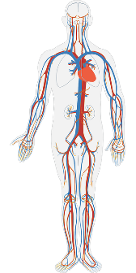
Einen Text verstehen (2)
lesen / schreiben
Knowledge about word families can also help you understand more words in a text. Complete the tables with the noun, verb, adjective or person forms of these words.
der Körper | body
körperlich | bodily, physical
1
studieren | to study
der Student | student
4
bauen | to build
der Bau | construction
2
das Jahr | year
16-jährig | 16-year-old
5
die Ausbildung | training
ausbilden | to train someone
3
Notes:
Timing: 3 minutes Aim: increasing students’ vocabulary coverage for comprehension of texts; to encourage students to think more broadly about vocabulary; inference of meanings of word family members of known words; priming students for recognising these words in short texts. Procedure: 1. Complete question 1 as a class. Students know the meaning of der Körper. Remind students of the meaning of the –lich suffix they encountered in 8.3.2.1, and ask them what kind of word, therefore, this is likely to be (an adjective).
2. Students consider a likely English translation. Reveal on a click.
3. Complete question 2 as a class. Students know the German translation of the verb to build. Ask them to consider their knowledge of noun and verb pairs to predict what the nominal form might be (Bau and Baue both acceptable answers). Click to reveal.
4. Students then complete 3-6 individually or as a class, drawing on their knowledge of word patterns and word families each time.
Word frequency of cognates used (1 is the most frequent word in German): Student [1017] Source: Jones, R.L. & Tschirner, E. (2019). A frequency dictionary of German: core vocabulary for learners. Routledge
Word frequency of unknown words used (1 is the most frequent word in German): körperlich [1791] Bau [1598] ausbilden [1893] jährig [1839] Source: Jones, R.L. & Tschirner, E. (2019). A frequency dictionary of German: core vocabulary for learners. Routledge

Slide 17
Saying ‘when’ and ‘if’
Grammatik
Unlike in English, there is always a comma before wenn in German.
To ask ‘when?’ in a question, use wann:
Wann schwimmst du im Meer?
When do you swim in the sea?
To say ‘when’ in a statement in the present, use wenn.
Ich schwimme im Meer, wenn ich auf die Insel fahre.
I swim in the sea when I go to the island.
Depending on the context, wenn can also mean ‘if’:
Ich schwimme im Meer, wenn kein starker Wind ist.
I swim in the sea if there is no strong wind.
The word ‘wenn’ kicks the verb to the end of the clause – just like ‘weil’ and ‘dass’!
Used like this, wenn is a conjunction like ‘weil’.
It connects a main clause with a condition on which it depends.
Notes:
Timing: 2 minutes Aim: To introduce usage rules associated with wenn; to explain that the English word when has two possible translations in German depending on whether it is being used as a question word or a conjunction; to explain that the German word wenn has two possible translations in English, depending on context.

Slide 18
Wenn oder denn?
* abschreckend – off-putting *die Pflege – care *die Erziehung – education
lesen
Girls' Day
Janet ist im Ausbildungszentrum bekannt, denn es gibt hier kaum Mädchen. Frau Köhler organisiert die Ausbildungen. Sie sagt: „Ich wünsche mir viel mehr Frauen als Studentinnen. Die Gruppendynamik ist besser, denn die Jungen arbeiten härter, wenn Mädchen in der Klasse sind.“
Der Girls' Day will den Mädchen männerdominierte Berufe näher bringen. Wenige Mädchen suchen nach der Schule einen Bauberuf, denn die schwere körperliche Arbeit, die Arbeitszeiten und das viele Reisen sind abschreckend*.
Firmen haben Probleme, wenn es wenige junge Leute in der Baubranche gibt. 5200 Mädchen können also am 14. April typische Männerberufe testen, wenn sie zum Girls' Day kommen. Später im Jahr testen auch 2300 Jungen Berufe in Pflege* und Erziehung*.
5.
1.
4.
6.
2.
3.
Notes:
Timing: 8 minutes. This is slide 1/2. Aim: Written recognition of sentences containing conjunctions wenn and denn and connecting these with meaning (cause and condition). Procedure: 1. Tell students that each of the numbers 1-6 covers either wenn or denn. Remind students that denn is followed by WO1, and wenn by WO3.
2. Ask students to write down the first verb that follows each number.
3. Reveal answers on clicks.
4. Bring up slide 19 on another screen or provide a printed copy. Students use the position of the verb (at the end of the sentence or not) to determine whether the missing conjunction must be wenn or denn. At lower levels, the missing conjunctions can be revealed first by clicking on this slide. Higher level students may proceed directly to slide 19.
5. Answers to the questions on slide 19 are revealed on clicks.
6. Oral translation or summary of full text.
Word frequency of cognates used (1 is the most frequent word in German): organisiert [organisieren 1295] Gruppendynamik [Gruppe 369; Dynamik 3805], härter [hart 728], männerdominierte [Mann 121; dominiert >5000] testen [2312] Source: Jones, R.L. & Tschirner, E. (2019). A frequency dictionary of German: core vocabulary for learners. Routledge Word frequency of unknown words used (1 is the most frequent word in German): Ausbildungszentrum [Ausbildung 1174; Zentrum 1145] Bauberuf [Bau >5000; Beruf 1036] körperlich [1791] abschreckend [<5000], Baubranche [Bau >5000; Branche 1703], Männerberufe [Mann 121; Beruf 1036] testen Pflege [4625], Erziehung [3413]
Source: Jones, R.L. & Tschirner, E. (2019). A frequency dictionary of German: core vocabulary for learners. Routledge
Adapted from the original: https://www.fr.de/ratgeber/karriere/traumberuf-strassenbauerin-11433660.html [accessed 2 March 2021]

Slide 19
Was steht im Text?
Would you be more likely to say ‘when’ or ‘if’ in each case?
lesen
1. | Janet is well-known in the training centre... | when/if there are hardly any girls there.
 |  | because there are hardly any girls there.
2. | The group dynamic is better ... | when/if the boys work harder.
 |  | because the boys are working harder.
3. | The boys work harder... | when/if there are girls in the class.
 |  | because there are girls in the class.
4. | Few girls look for building work after school ... | when/if the conditions are off-putting.
 |  | because the conditions are off-putting.
5. | Companies have problems ... | when/if there are few young people in the building industry.
 |  | because there are few young people in the building industry.
6. | 5200 girls will be able to try out typically male jobs ... | when/if they go to ‘Girls’ Day’.
 |  | because they are going to ‘Girls’ Day’.
Notes:
This is slide 2/2.
NB: the discussion prompt in the bubble is merely to draw attention to the dual meaning of wenn. Both ‘when’ and ‘if’ are correct in each case – the choice will depend on personal preference.

Slide 20
Wann machst du was?
schreiben /sprechen
When are you getting a new mobile phone?
Wann bekommst du ein neues Handy?
When I lose this one.
Wenn ich dieses verliere.
Wann? + WO2
Wenn + WO3
Notes:
Timing: 10 minutes. This is slide 1/4. Aim: Written and/or oral production of sentences containing wenn and wann to translate ‘when’; revision of WO2 with questions; revision of WO3 with subordinating conjunctions. Procedure: 1. Use this slide to model the task. Explain to students they will have to translate the questions and answers on their role cards, and use these translations to engage in a dialogue with a partner.
2. Click to reveal an English question. Students translate into German. Click to reveal suggested translation.
3. Repeat step 2 for an English statement.
4. Split into pairs, and display slide 21 or distribute printed role cards.
5. Students individually translate their sentences into German (in writing).
6. Partner A asks questions and Partner B answers with the relevant sentence from their card. At higher levels, you may wish to skip the writing stage, and/or encourage students to provide their own answers with wenn + WO3.
7. Students swap roles.
8. Answers on slides 3/4 and 4/4.

Slide 21
Wann machst du was?
schreiben /sprechen
Partner A:
When are you going on holiday?
When do you do do your homework?
When do you watch TV?
When are you finding a job?
When I am hungry.
When I earn enough money.
When it is warm.
When I find my new dress.
Partner B:
When I am older.
When it is summer.
When I have more time.
When I get home.
When are you buying a house?
When are you coming to the party?
When are you eating your sandwich?
When are you going hiking?
Notes:
Role cards for printing or display. This is slide 2/4.

Slide 22
Wann machst du was?
schreiben /sprechen
Partner A:
When are you going on holiday?
When do you do your homework?
When do you watch TV?
When are you looking for a job?
Partner B:
When it is Summer.
d) When I get home.
c) When I have more time.
a) When I am older.
Wann fährst du in Urlaub?
Wenn es Sommer ist.
Wann machst du deine Hausaufgaben?
Wenn ich nach Hause komme.
Wann siehst du fern?
Wenn ich mehr Zeit habe.
Wann suchst du einen Beruf?
Wenn ich älter bin.
Notes:
Example Answers to Partner A questions – this is slide 3/4.
Procedure:
1. Click to reveal German translation of question.
2. Click to reveal matching English answer.
3. Click to reveal German translation of answer.

Slide 23
Wann machst du was?
schreiben /sprechen
Partner B:
When are you buying a house?
When are you coming to the party?
When are you eating your sandwich?
When are you going hiking?
Partner A:
b) When I earn enough money.
d) When I find my new dress.
When I am hungry.
c) When it is warm.
Wann kaufst du ein Haus?
Wenn ich genug Geld verdiene.
Wann kommst du zur Party?
Wenn ich mein neues Kleid finde.
Wann isst du dein Butterbrot?
Wenn ich Hunger habe.
Wann gehst du wandern?
Wenn es warm ist.
Notes:
Example Answers to Partner B questions – this is slide 4/4.

Slide 24
Dreams and Goals
Authentic non-fiction texts
Preposition aus + R3 (dative) (vs von to mean from)
Y8 German
Term 3.2 - Week 6 - Lesson 69
Natalie Finlayson / Catherine Morris / Rachel Hawkes
Artwork: Steve Clarke
Date updated: 21/07/21
Notes:
Artwork by Steve Clarke. All additional pictures selected are available under a Creative Commons license, no attribution required.
Native speaker teacher feedback provided by Stephanie Cross.
Learning outcomes (lesson 1):
Revisit several SSCs
Authentic non-fiction texts: ich lebe für den Fußball, Traumberuf, Strassenbauerin
Introduction of preposition ‘aus’ +R3 (dative) (vs von to mean from)
Word frequency (1 is the most frequent word in German):
8.3.2.6 (introduce) bauen [667] studieren [600] Ausbildung [1174] Freizeit [2594] Karriere [1813] Traum [992] relativ [571] wenn [42] aus² [37] pro [412] tausend [1177]
8.3.2.1 (revisit) bringen [153] gebracht [153] verlieren [313] verloren [313] Insel [1029] Meer [852] Reise [734]
Wind [1124] halb [443] stark [178] nach² [34] vor³ [50]
8.2.2.5 (revisit) kennen [216] Anwalt [1887] Deutschland [140] Firma [686] Firmen [686] Weile [1631] gleich [141] einmal [124] bei [29] seit [130] vor¹ [50]
Source: Jones, R.L & Tschirner, E. (2019). A frequency dictionary of German: Core vocabulary for learners. London: Routledge.
The frequency rankings for words that occur in this PowerPoint which have been previously introduced in NCELP resources are given in the NCELP SOW and in the resources that first introduced and formally re-visited those words.
For any other words that occur incidentally in this PowerPoint, frequency rankings will be provided in the notes field wherever possible.

Slide 25
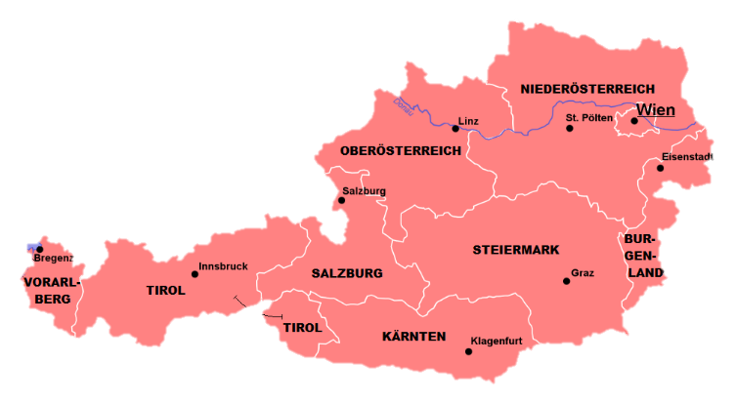
Ich lebe für den Fußball 1/3
Sturm Graz is an Austrian football club based in Graz
lesen
Michael aus Kumberg will Profifußballer werden.
Daher* besucht er die Fußballakademie
Steiermark von SK Sturm Graz.
Die Fußballakademie Steiermark von SK Sturm Graz
bildet junge Talente zu Profis aus.
Einer ihrer Spieler ist der 16-jährige Michael Kuwal aus Kumberg.
Michael trainiert sechs Mal pro Woche.
Am Wochenende hat er Spiele, und er hält sich* auch im
Fitnesszentrum und beim Laufen fit.
„Schule und Sport zusammen sind nicht einfach”, sagt Michael.
„Aber ich bin ein relativ guter Schüler.”
*daher – therefore *sich fit halten – to keep fit
Notes:
Timing: 8 minutes. This is slide 1/3. Aim: Fluency development; production of a range of SSCs at sentence level; reading an unknown text aloud. Procedure: 1. Tell students they are going to play the role of newsreaders. They will work in pairs to read a short German news article aloud from a ‘teleprompter’, taking it in turns to read alternate lines of text.
2. Click to bring up Student A’s first sentence on the teleprompter. Focus SSCs are highlighted in bold. The student reads along as the words appear on the screen (the speed is set to ‘slow’ on this slide).
3. Click to bring up Student B’s first sentence. A different set of SSCs are highlighted in bold.
4. Students continue to take turns until they have read three sentences each and the text is complete.
5. Move to the second teleprompter slide and repeat steps 1-4. This time, a different set of SSCs is highlighted, and the speed of the teleprompter increases. Students take turns to read the same sentences again, building their fluency, confidence and speed as they focus on different SSCs but continue to practise the set they focused on previously.
6. Move to the third teleprompter slide (in which no particular focus SSCs are highlighted) and repeat steps 1-5. The speed of the teleprompter increases again.
7. Oral translation/summary of content.
Word frequency of cognates used (1 is the most frequent word in German):
Profifußballer [Profi 3528; Fußballer >5000] Fußballakademie [Fußball 1277; Akademie 3589] Fitnesszentrum [>5000; Zentrum 1145] Talent [2924] Spieler [822] Source: Jones, R.L. & Tschirner, E. (2019). A frequency dictionary of German: core vocabulary for learners. Routledge Word frequency of unknown words used (1 is the most frequent word in German):
daher [354], ausbilden [1893] sich [14] beim [bei 29] Source: Jones, R.L. & Tschirner, E. (2019). A frequency dictionary of German: core vocabulary for learners. Routledge
(adapted from the original in Österreichischer Spiegel)

Slide 26
Ich lebe für den Fußball 2/3
lesen
Michael aus Kumberg will Profifußballer werden.
Daher* besucht er die Fußballakademie
Steiermark von SK Sturm Graz.
Die Fußballakademie Steiermark von SK Sturm Graz
bildet junge Talente zu Profis aus.
Einer ihrer Spieler ist der 16-jährige Michael Kuwal aus Kumberg.
German speech marks open below the line
Michael trainiert sechs Mal pro Woche.
Am Wochenende hat er Spiele, und er hält sich* auch im
Fitnesszentrum und beim Laufen fit.
„Schule und Sport zusammen sind nicht einfach”, sagt Michael.
„Aber ich bin ein relativ guter Schüler.”
*daher – therefore *sich fit halten – to keep fit
Notes:
This is slide 2/3.

Slide 27
Ich lebe für den Fußball 3/3
lesen
Michael aus Kumberg will Profifußballer werden.
Daher* besucht er die Fußballakademie
Steiermark von SK Sturm Graz.
Die Fußballakademie Steiermark von SK Sturm Graz
bildet junge Talente zu Profis aus.
Einer ihrer Spieler ist der 16-jährige Michael Kuwal aus Kumberg.
Michael trainiert sechs Mal pro Woche.
Am Wochenende hat er Spiele, und er hält sich* auch im
Fitnesszentrum und beim Laufen fit.
„Schule und Sport zusammen sind nicht einfach”, sagt Michael.
„Aber ich bin ein relativ guter Schüler.”
*daher – therefore *sich fit halten – to keep fit
Notes:
This is slide 3/3.

Slide 28
Ein Interview (1/2)
schreiben
Eine englische Journalistin will einen Artikel über Michael für ihre Zeitung schreiben. Übersetze* ihre Fragen und schreib Antworten auf Deutsch.
Questions | Fragen | Antworten
What is Michael’s dream career? | Was ist Michaels Traumkarriere? | Michaels Traumkarriere ist Profifußballer.
Where is he doing his training? | Wo macht er seine Ausbildung? | Er macht seine Ausbildung an der Fußballakademie Steiermark von SK Sturm Graz.
How old is he? | Wie alt ist er? | Er is 16 Jahre alt.
Notes:
Timing: 8 minutes. This is slide 1/2. Aim: Written production of new and known vocabulary and grammar knowledge in short questions and statements; reading comprehension. Procedure: 1. Students translate questions from English to German.
2. Click to reveal question in German and then answer in German.
3. Students write answers in German using information from the text. Remind students that they will sometimes need to re-write information given in the 1st person in the 3rd person.
4. Click to reveal suggested answers.
5. Repeat steps 1-4 for the items on slide 29.
Word frequency of cognates used (1 is the most frequent word in German):
interview [931], Journalist [1480], englisch [662], Artikel [1378] Source: Jones, R.L. & Tschirner, E. (2019). A frequency dictionary of German: core vocabulary for learners. Routledge
Word frequency of unknown words used (1 is the most frequent word in German):
übersetzen [1765] Source: Jones, R.L. & Tschirner, E. (2019). A frequency dictionary of German: core vocabulary for learners. Routledge

Slide 29
Ein Interview (2/2)
schreiben
Questions | Fragen | Antworten
How often does he train? | Wie oft trainiert er? | Er trainiert sechs Mal pro Woche.
What does he do in his free time? | Was macht er in seiner Freizeit? | Er hält sich im Fitnesszentrum und beim Laufen fit.
Is Michael a good pupil? | Ist Michael ein guter Schüler? | Michael ist ein relativ guter Schüler.
Notes:
This is slide 2/2.

Slide 30
die Nummern 1000+
In English, we say ‘one thousand’. In German, we just say ‘thousand’.
hören
As you know, numbers are written as one word. Numbers 1000+ are very long!
e.g. = tausendsiebenhundertdreiundneunzig
Say the number of thousands followed by the numbers you already know.
1793
tausend|sieben|hundert|dreiundneunzig
= sechstausendsiebenhundertvierundachtzig
6784
sechs|tausend|sieben|hundert|vierundachtzig
= fünfundzwanzigtausendzweihunderteinundneunzig
25.291
fünfundzwanzig|tausend|zwei|hundert|einundneunzig
?
?
?
1259
?
3618
9403
14.872
?
62.937
Schreib die Nummern!
Notes:
Timing: 5 minutes Aim: To build on key knowledge about German numbers from 8.1.2.1. by introducing construction rules for numbers 1000+. Procedure: 1. Click to reveal the first number. Use this opportunity to recap construction rules for numbers up to 999.
2. Click to reveal the second and third numbers, followed by the info bubbles.
3. Click to reveal a set of audio buttons. On clicking the question marks, a number is read aloud.
4. Students write down the number they hear (in digits).
5. Click to reveal answers.
Transcript: 1. tausendzweihundertneunundfünfzig
2. dreitausendsechshundertachzehn
3. neuntausendvierhundertdrei
4. vierzehntausendachthundertzweiundsiebzig 5. zweiundsechzigtausendneunhundertsiebenunddreißig

Slide 31
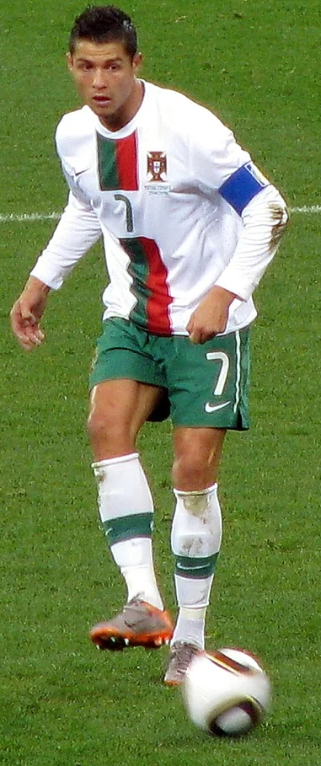
Quiz (1/5)
lesen / sprechen
576
1021
4589
12.986
39.143
52.689
Wieviel Geld verdient Cristiano Ronaldo in einem Tag? (£)
Notes:
Timing: 5 minutes. This is slide 1/5. Aim: Oral production of large numbers; reading comprehension.
Procedure: 1. Students read the question and decide, individually or in pairs, which number they think represents the answer.
2. Students take thirty seconds to work out the structure of their chosen number, then volunteer their answers orally (elicit answers from several students).
3. Click to reveal the answer.
Source: http://www.whatfootballersearn.com/compare/lionel-messi/vs/cristiano-ronaldo/

Slide 32
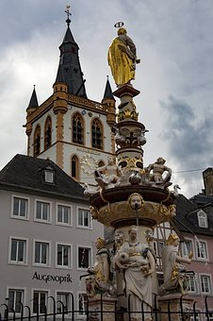
Quiz (2/5)
lesen / sprechen
209
760
1500
2036
7129
11.698
Trier ist die älteste Stadt Deutschlands – sie gibt es schon eine Weile! Wie alt ist sie? (Jahre)
Notes:
This is slide 2/5.
Teachers might wish to compare this with Amesbury, the oldest town in the UK (10,840 years old!)

Slide 33
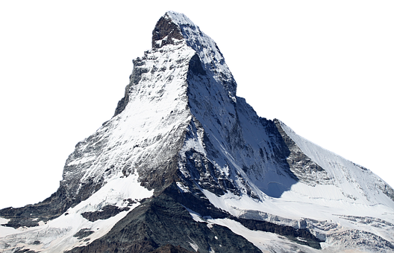
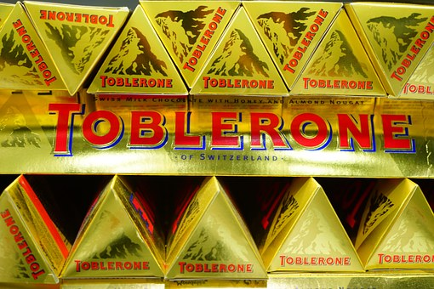
Quiz (3/5)
lesen / sprechen
815
1007
1762
2897
3129
4478
Kennst du Toblerone aus der Schweiz? Der Berg auf der Verpackung heißt das Matterhorn. Wie hoch* ist er? (m)
* hoch = high *die Verpackung = packaging
Notes:
This is slide 3/5.
Teachers might wish to compare this with Ben Nevis, the highest mountain in the UK (1345m).
Word frequency of unknown words used (1 is the most frequent word in German):
hoch [118] Verpackung [>5000] Source: Jones, R.L. & Tschirner, E. (2019). A frequency dictionary of German: core vocabulary for learners. Routledge

Slide 34
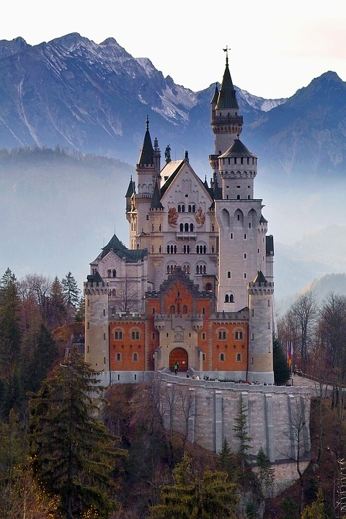
Quiz (4/5)
lesen / sprechen
1017
2300
4650
9800
15.700
25.000
Wie viele Schlösser gibt es in Deutschland? (Mehr als ...)
Notes:
This is slide 4/5.
Teachers might wish to compare this with the estimated number of castles in the UK (around 4000).
Source: https://www.dw.com/en/does-germany-really-have-25000-castles/a-42350502

Slide 35
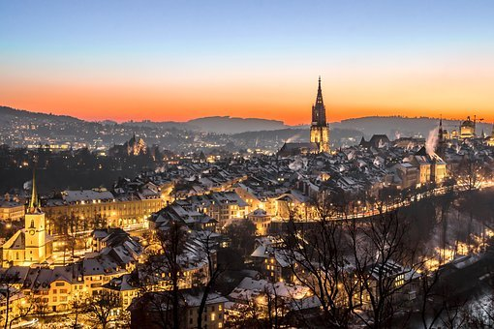
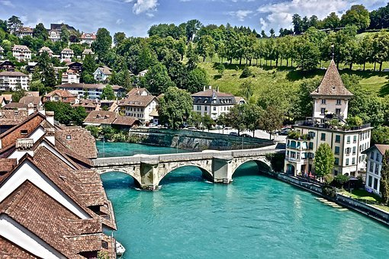
Quiz (5/5)
lesen / sprechen
2786
29.673
44.987
133.115
567.890
920.372
Wie viele Leute wohnen in Bern, der Haupstadt von der Schweiz?
Notes:
This is slide 5/5.
Teachers might wish to compare this with the population of London (8.98 million).
Word frequency of unknown words used (1 is the most frequent word in German):
Hauptstadt [1694] Source: Jones, R.L. & Tschirner, E. (2019). A frequency dictionary of German: core vocabulary for learners. Routledge

Slide 36
Aus (out/of of, from)
Grammatik
You already know that ‘aus’ means ‘out of’ when talking about movement.
It is always followed by the dative case (R3 endings):
R3:
Sie kommt aus …
dem Apfel
der Tür
dem Fenster
‘Aus’ can also mean ‘from’ when used with a country or city name to talk about someone’s origins:
R3:
Sie kommt aus …
der Schweiz
Berlin
Notes:
Timing: 2 minutes Aim: Revise use of aus + R3 (dative); highlight the two uses of aus to mean ‘out of’ and ‘from somewhere’.

Slide 37
Woher kommen sie?
lesen
Wie heißt ‘aus’ auf Englisch?
 |  | out of | from
1. | Die Journalistin kommt aus dem Büro.
2. | Der Koch kommt aus der Türkei.
3. | Der Lehrer kommt aus der Schule.
4. | Der Schauspieler kommt aus Dresden.
5. | Der Anwalt kommt aus dem Zimmer.
6. | Der Arzt kommt aus der Schweiz.
7. | Der Soldat kommt aus Deutschland.
8. | Die Maurerin* kommt aus dem Gebäude.
*der Maurer – bricklayer
Notes:
Timing: 5 minutes Aim: Meaning recognition; translating aus as ‘out of’ or ‘from’ based on context. Procedure: 1. Students read sentences and tick whether they think ‘aus’ means from or out of, based on whether it is followed by a placename or a noun.
2. Answers revealed on clicks.
3. Oral translation of sentences.
Word frequency of cognates (1 is the most frequent word in German): Journalist [1480] Sekretär [4533] Source: Jones, R.L. & Tschirner, E. (2019). A frequency dictionary of German: core vocabulary for learners. Routledge
Word frequency of unknown words (1 is the most frequent word in German): Koch [3784] Soldat [1267] Maurer [>5000] Source: Jones, R.L. & Tschirner, E. (2019). A frequency dictionary of German: core vocabulary for learners. Routledge

Slide 38
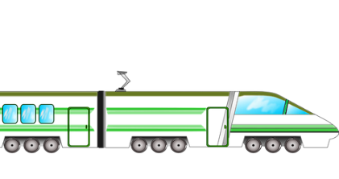
Aus vs von (from)
Grammatik
You know another word meaning ‘from’ which is followed by the dative case:
R3:
Sie kommt von …
dem Ort
der Insel
dem Haus
place of departure
‘Von’ means ‘from’ when talking about a starting point in a journey:
Er kommt von Berlin (und fährt nach München).
He’s coming from Berlin (and going to Munich).
place of origin
Er kommt aus Berlin.
He comes from Berlin (it is his hometown).
Notes:
Timing: 2 minutes Aim: To differentiate between the uses of von and aus to mean departing from and originating from a place.

Slide 39
Woher kommen sie? (aus vs von)
hören
 |  | Option 1 | Option 2
1
Die Mechanikerin kommt von
Deutschland
der Garage
1
2
Der Lehrer kommt aus
Peru
der Schule
2
3
Die Sekretärin kommt von
dem Büro
der Schweiz
3
4
Der Fußballspieler kommt von
Polen
der Arena
4
5
Die Autorin kommt aus
der Bibliothek
England
5
6
Der Gärtner kommt aus
Österreich
dem Garten
6
7
Das Essen kommt aus
der Firma
der Schweiz
7
8
Die Ärztin kommt von
dem Krankenhaus
Schottland
8
Notes:
Timing: 5 minutes Aim: Aural recognition of sentences containing prepositions aus and von and connecting these with meaning (place of departure vs place of origin).
Procedure:
1. Click on numbers on the left hand side to hear statements with kommen aus and kommen von with the noun obscured.
2. Students listen to sentences and decide how the sentence ends.
3. Click to reveal answers.
4. Click on the numbers on the right to hear the full audio.
Transcript: 1. Die Mechanikerin kommt von [der Garage].
2. Der Lehrer kommt aus [Peru].
3. Die Sekretärin kommt von [dem Büro].
4. Der Fußballspieler kommt von [der Arena].
5. Die Autorin kommt aus [England].
6. Der Gärtner kommt aus [Österreich].
7. Das Essen kommt aus [der Schweiz].
8. Die Ärztin kommt von [dem Krankenhaus]. Word frequency of cognates (1 is the most frequent word in German): Mechaniker [>5000] Garage [>5000] Peru [>5000] Sekretär [4533] Büro [1663] Arena [>5000], Autor [723], England [1762], Gärtner [>5000] Source: Jones, R.L. & Tschirner, E. (2019). A frequency dictionary of German: core vocabulary for learners. Routledge
Word frequency of unknown words (1 is the most frequent word in German): Fußballspieler [Fußball 1277; Spieler 822] Source: Jones, R.L. & Tschirner, E. (2019). A frequency dictionary of German: core vocabulary for learners. Routledge

Slide 40
Ich lebe für den Fußball 1/4
Du liest mehr über Michael in einem Sportmagazin. Beantworte die Fragen und übersetze den Text.
lesen
Der größte Traum „Ich habe nicht so viel Freizeit”, erklärt Michael, „aber manchmal bleibt ein bisschen Zeit für meine Freunde übrig*.” Das ist für Michael aber kein Problem: „Ich lebe für den Fußball”. Profifußballer zu werden, „das ist mein größter Traum, seit ich klein bin.”
Sportwissenschlaftler und Coach Wenn es mit der Fußballkarriere nichts wird, möchte Michael Sportwissenschaftler oder Fitness-Coach werden, denn er will sowieso* weiterstudieren.
Übersetze den Text!
Welches Wort heißt ‘sports scientist’?
Welche zwei Wörter heißen ‘biggest’ ?
Wo steht im Text ‘if nothing (be)comes of it’?
Wo steht im Text ‘since I was little’?
Welches Wort heißt ‘to study more’ ?
‘when’ or ‘if’?
*übrig – remaining, leftover *sowieso – anyway
Notes:
Timing: 10 minutes. This is slide 1/4. Aim: Reading comprehension; German to English translation. Procedure: 1. Click to reveal questions drawing attention to more challenging vocabulary and grammar structures.
2. Elicit responses from students. If they are unsure, encourage them to draw on their word pattern and word family knowledge to look for parts of words that they already know.
3. Click again to reveal answer in the text.
4. Repeat steps 1-3 until the ‘Übersetze den Text!‘ bubble appears.
5. Click to highlight the different uses of wenn, and discuss the translations.
6. Students translate or summarise the text (if time is tight, the full translation may be completed for homework).
7. Suggested translation appears on the following slide, one sentence at a time.
8. Repeat steps 1-6 for slides 42 and 43. Word frequency of cognates used (1 is the most frequent word in German):
trainieren [2255] Magazin [4247] Profifußballer [Profi 3528; Fußballer >5000] Coach [>5000] Source: Jones, R.L. & Tschirner, E. (2019). A frequency dictionary of German: core vocabulary for learners. Routledge
Word frequency of unknown words used (1 is the most frequent word in German):
trainieren [2255] übrig [921] sowieso [1547] übersetzen [1765] Text [473] Sportwissenschlaftler [Sport 945; Wissenschaftler 1522] möchte [mögen 168] weiterstudieren [weiter 182; studieren 600] Source: Jones, R.L. & Tschirner, E. (2019). A frequency dictionary of German: core vocabulary for learners. Routledge

Slide 41
Ich lebe für den Fußball 2/4
Du liest mehr über Michael in einem Sportmagazin. Beantworte die Fragen und übersetze den Text.
lesen
The biggest dream
“I don’t have so much free time,” explains Michael, “but sometimes there’s a bit of time left over for my friends.
But this isn’t a problem for Michael: “I live
for football”.
Becoming a professional footballer,“that’s been my biggest dream since I was small.”
Sports scientist and coach
If nothing comes of his football career, Michael would like to become a sports scientest or fitness coach, as he wants to study more anyway.
Der größte Traum „Ich habe nicht so viel Freizeit”, erklärt Michael, „aber manchmal bleibt ein bisschen Zeit für meine Freunde übrig*.” Das ist für Michael aber kein Problem: „Ich lebe für den Fußball”. Profifußballer zu werden, „das ist mein größter Traum, seit ich klein bin.”
Sportwissenschlaftler und Coach Wenn es mit der Fußballkarriere nichts wird, möchte Michael Sportwissenschaftler oder Fitness-Coach werden, denn er will sowieso* weiterstudieren.
*übrig – remaining, left over *sowieso – anyway
Notes:
This is slide 2/4.

Slide 42
Ich lebe für den Fußball 3/4
Du liest mehr über Michael in einem Sportmagazin. Beantworte die Fragen und übersetze den Text.
lesen
‘when’ or ‘if’?
Er ist aber sicher, dass es klappt*: „Für mich ist es das beste Gefühl, wenn man einen Ball am Fuß und Spaß am Kicken hat. Solange der Spaß da ist und man einen Traum im Kopf hat, wird er in Erfüllung gehen. Man muss nur alles dafür* machen.”
Update: November, 2019. Michael Kuwal ist jetzt Fußballprofi. Er spielt seit 2018 für FC Gleisdorf 09 in der Regionalliga Mitte. Mehr Informationen zu SK Sturm Graz: https://www.sksturm.at/
Welches Wort heißt ‘has been playing’?
Übersetze den Text!
Welches Wort heißt ‘kicking’ (a ball around)?
Wo steht im Text ‘to fulfil / come true’ ?
Welches Wort heißt ‘regional league’?
Wo steht im Text ‘he is sure?’
*klappen – to work out *dafür – for it
Notes:
This is slide 3/4.
Word frequency of cognates used (1 is the most frequent word in German):
Ball [1782] Kicken [>5000] Information [465] Source: Jones, R.L. & Tschirner, E. (2019). A frequency dictionary of German: core vocabulary for learners. Routledge Word frequency of unknown words used (1 is the most frequent word in German):
dafür [175] klappen [2022] Erfüllung [3939] Wissenschlafter [1522] Fuß [573], Regionalliga [regional 2011 ; Liga 2343] Source: Jones, R.L. & Tschirner, E. (2019). A frequency dictionary of German: core vocabulary for learners. Routledge

Slide 43
Ich lebe für den Fußball 4/4
Du liest mehr über Michael in einem Sportmagazin. Beantworte die Fragen und übersetze den Text.
lesen
But he’s sure that it will work out.
“For me, the best feeling is when you have a ball at your feet and you’re enjoying kicking it around.
As long as the fun is there and you have a dream in your head, it will come true.
You just have to do everything for it.”
Update: Novermber 2019
Michael Kuwal is a pro footballer now.
He has been playing for Gleisdrof 09 FC since 2018 in the middle regional league.
More information about SK Sturm Graz […]
Er ist aber sicher, dass es klappt*: „Für mich ist es das beste Gefühl, wenn man einen Ball am Fuß und Spaß am Kicken hat. Solange der Spaß da ist und man einen Traum im Kopf hat, wird er in Erfüllung gehen. Man muss nur alles dafür* machen.”
Update: November, 2019. Michael Kuwal ist jetzt Fußballprofi. Er spielt seit 2018 für FC Gleisdorf 09 in der Regionalliga Mitte. Mehr Informationen zu SK Sturm Graz: https://www.sksturm.at/
*klappen = to work out *dafür = for it
Notes:
This is slide 4/4.

Slide 44
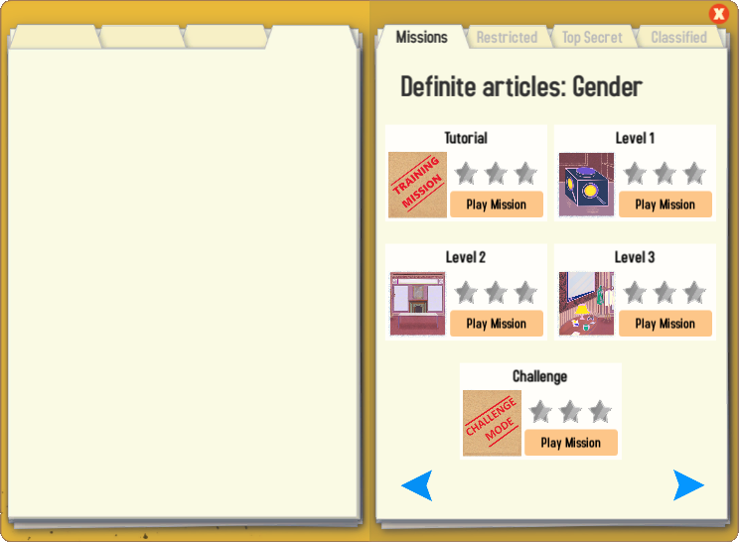
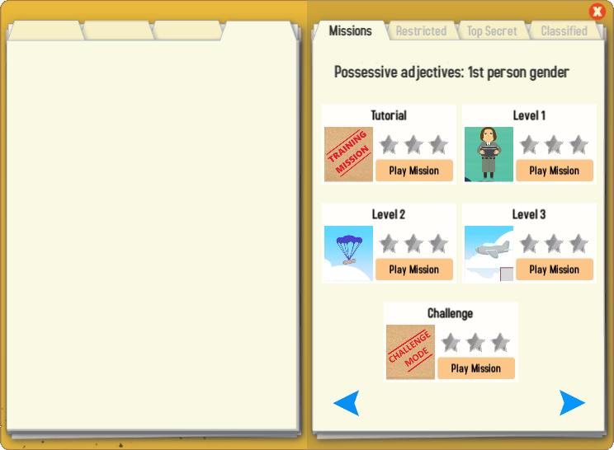
Gaming Grammar
Try the following Gaming Grammar missions to practise:

Slide 45
Hausaufgaben
Pre-learning for lesson: Year 8 German Term 3.2 Week 7
Y8 Mashup C:
Y8 Mashup A:
Y8 Mashup D:
Y8 Mashup B:
Notes:
This is the HW slide for the Oak Academy videoed lesson. Don’t upload to the portal with this slide, but do save a separate version on the Google drive and send link to RH, when complete.

Slide 46
Hausaufgaben
Vocabulary Learning Homework (Y8, Term 3.2, Week 7)
Y8 Mashup C:
Y8 Mashup A:
Y8 Mashup D:
Y8 Mashup B:
Notes:
Note to resource creators: links needs to be properly formatted as hyperlinks (copy url, select target text, right click, and add hyperlink), do not paste the website url directly on the slide. The Student worksheet link to the resource portal needs to be formatted like the other links on the slide; if this is done correctly there is no need to shorten the url.

