Slide 1
Comparing things (shopping)
Demonstrative adjectives ‘este’ and ‘esta’
Comparatives [revisited]
Y8 Spanish
Term 3.1 – Week 4 – Lesson 55
Pete Watson / Nick Avery / Mollie Bentley-Smith Artwork: Mark Davies
Date updated: 28/04/21
Notes:
Artwork by Mark Davies. All additional pictures selected are available under a Creative Commons license, no attribution required.
Native teacher feedback provided by Blanca Román.
Learning outcomes (lesson 1):
Introduction of demonstrative adjectives ‘este’ and ‘esta’
Consolidation of comparatives
Consolidation of weak vowel [u] SSC
New vocabulary: parecer [89]; guardar [687]; marca [1276]; falda [2743]; mitad [834]; precio [557]; tipo [168]; euro [2435]; pagar [377]; ligero [1930]; práctico [2141]; este [24]
8.2.2.5 (revisit): llorar [630]; esperar [157]; volver [112]; encontrar [102]; gritar [691]; querer² [58]; historia [186]; mes [288]; papá [865]; mamá [675]; frío [1020]
8.2.2.1 (revisit)]: parar [706]; acompañar [606]; dejar² [86]; saludar [1575]; besar [1591]; seguir [99]; sigo [seguir-99]; policía [629]; cocina [1214]; lo [10]; la [61]
Source: Davies, M. & Davies, K. (2018). A frequency dictionary of Spanish: Core vocabulary for learners (2nd ed.). Routledge: London
The frequency rankings for words that occur in this PowerPoint which have been previously introduced in NCELP resources are given in the NCELP SOW and in the resources that first introduced and formally re-visited those words.
For any other words that occur incidentally in this PowerPoint, frequency rankings will be provided in the notes field wherever possible.

Slide 2
Fonética
escuchar / escribir
Escucha cada palabra y escribe las dos letras que no están.
Ahora pronuncia las palabras con un compañero.
u
o
leng__ __
individ__ __
1
u
a
5
[tongue, language]
[individual, person]
u
e
c__ __rpo
e
de ac__ __rdo
2
6
u
Remember, [u] is a ‘weak’ vowel. It merges with [a], [e] and [o] to make a single syllable.
[body]
[ok, in agreement]
a, e, o
rec__ __rdo
u
e
u
e
3
j__ __z
7
[memory, souvenir]
[judge]
g__ __rdar
u
a
a
contin__ __r
8
u
4
[to keep, keeping]
[to continue, continuing]
Notes:
Timing: 6 minutes
Aim: to recognise the ‘weak’ vowel [u], in combination with a ‘strong’ vowel, and to spell the two letters
Procedure:
1. The teacher plays the audio for each word and students write the missing letters. These will be [u] + [a], [e] or [o].
2. The teacher shows the answer for each word, one letter at a time, followed by the English for each word, so students connect Spanish word and English meanings. Some students will learn additional words incidentally.
4. Students practise pronunciation by reading each word out loud. They should try to mimic the weak vowel sounds that they heard in the recordings, and ensure that they produce the two letters as a single syllable.
5. Students could be asked if they can think of another word for ‘ok’ (anticipate ‘vale’).
Notes: The Spanish words in the activity are all unknown apart from 'cuerpo’, which has previously been encountered as a Y7 phonics cluster word. Frequency rankings are below.
Transcript:
lengua
cuerpo
recuerdo
guardar
individuo
de acuerdo
juez
continuar
Frequency of unknown/glossed words (1 is the most frequent word in Spanish):
lengua [586]; cuerpo [232]; recuerdo [771]; guardar [687]; individuo [1133]; acuerdo [348]; juez [1168]; continuar [396]

Slide 3
Fonética
escuchar / escribir
Escucha y escribe la palabra.
i, u
Ahora pronuncia las palabras con un compañero.
1
lengua
5
individuo
[language, tongue]
[individual, person]
a, e, o
cuerpo
de acuerdo
2
6
Remember, [u] is a ‘weak’ vowel. It merges with [a], [e] and [o] to make a single syllable.
[body]
[ok, in agreement]
a, e, o
recuerdo
juez
3
7
[memory, souvenir]
[judge]
guardar
continuar
4
8
[to keep, keeping]
[to continue, continuing]
Notes:
VARIATION
The activity is the same as that described on the previous slide, except that students write the full word.

Slide 4
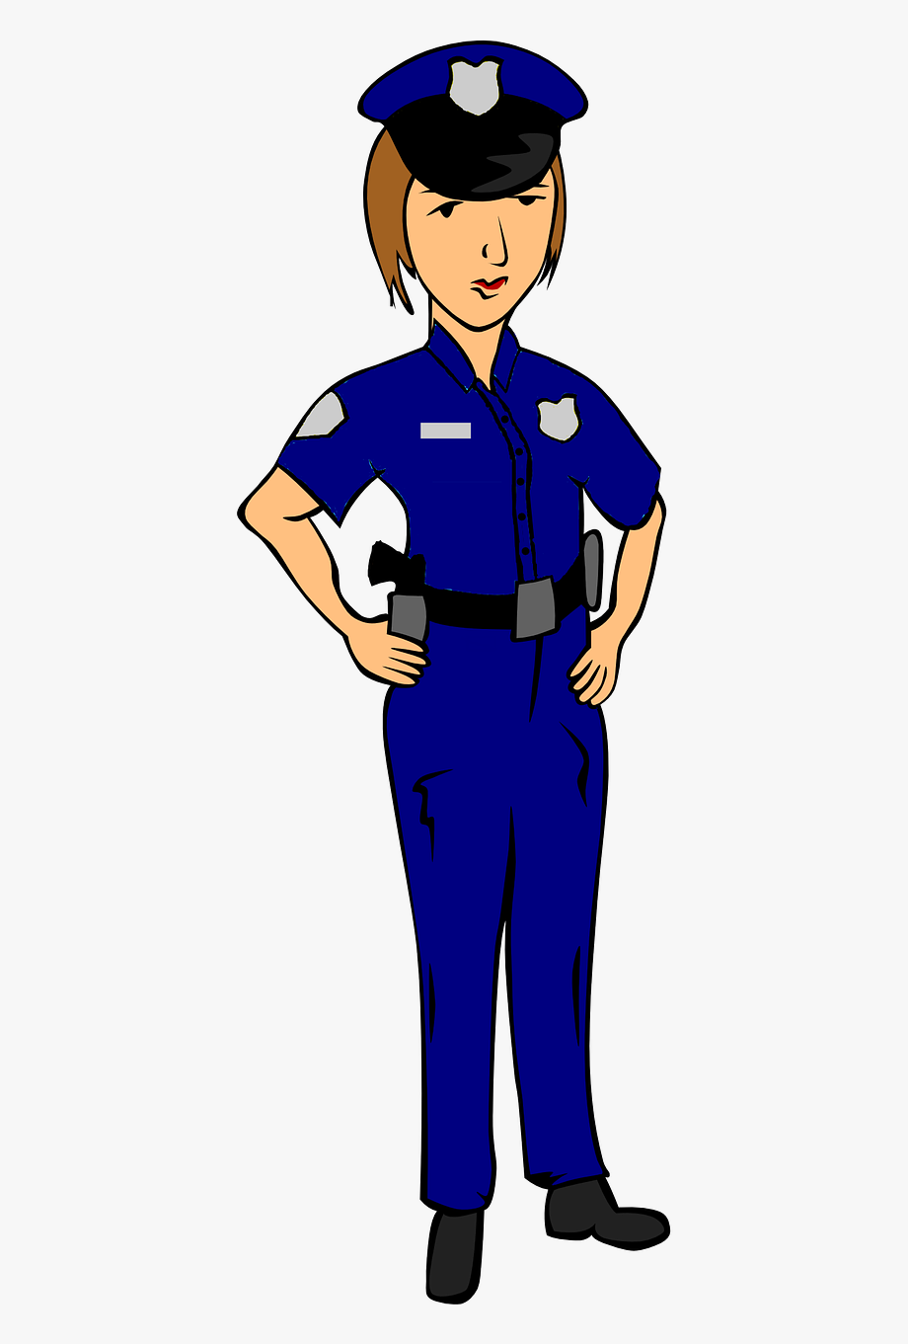
vocabulary
s_ _ _ _ _ _
hablar
la c_ _ _ _ _
b_ _ _ _
p_ _ _ _
d_ _ _ _
el p _ _ _ _ _ _
a_ _ _ _ _ _ _ _
police, police officer (f)
l_
l_
s_ _ _
s_ _ _ _ _
la p_ _ _ _ _ _
la policía
Notes:
Vocabulary revision
Timing: 5 minutes (12 slides)
Aim: oral productive recall of vocabulary introduced in lesson 8.2.2.1 (revisited in the scheme of work this week)
Procedure:
Students look at prompt (the word or image in the centre).
They say the Spanish word aloud.
The teacher clicks anywhere on the screen to reveal the answer.

Slide 5
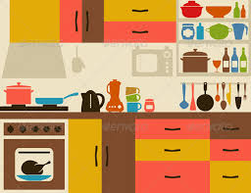
vocabulary
s_ _ _ _ _ _
hablar
la c_ _ _ _ _
la cocina
b_ _ _ _
p_ _ _ _
d_ _ _ _
el p_ _ _ _ _ _
a_ _ _ _ _ _ _ _
l_
l_
kitchen
s_ _ _
s_ _ _ _ _
la p_ _ _ _ _ _
Notes:
Vocabulary revision
Click on the picture to reveal the answer

Slide 6
vocabulary
s_ _ _ _ _ _
hablar
la c_ _ _ _ _
b_ _ _ _
p_ _ _ _
d_ _ _ _
acompañar
el p_ _ _ _ _ _
a_ _ _ _ _ _ _ _
l_
to accompany, to go with
l_
s_ _ _
s_ _ _ _ _
la p_ _ _ _ _ _
Notes:
Vocabulary revision
Click on the picture to reveal the answer

Slide 7
vocabulary
s_ _ _ _ _ _
hablar
la c_ _ _ _ _
b_ _ _ _
p_ _ _ _
parar
d_ _ _ _
el p_ _ _ _ _ _
a_ _ _ _ _ _ _ _
to stop, stopping
l_
l_
s_ _ _
s_ _ _ _ _
la p_ _ _ _ _ _
Notes:
Vocabulary revision
Click on the picture to reveal the answer

Slide 8
vocabulary
s_ _ _ _ _ _
hablar
la c_ _ _ _ _
b_ _ _ _
p_ _ _ _
d_ _ _ _
el p_ _ _ _ _ _
him, it (object)
a_ _ _ _ _ _ _ _
l_
l_
lo
s_ _ _
s_ _ _ _ _
la p_ _ _ _ _ _
Notes:
Vocabulary revision
Click on the picture to reveal the answer

Slide 9
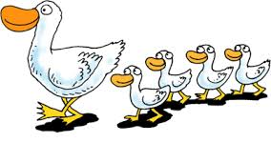
vocabulary
s_ _ _ _ _ _
hablar
c_ _ _
b_ _ _ _
p_ _ _ _
d_ _ _ _
el p_ _ _ _ _ _
a_ _ _ _ _ _ _ _
l_
to follow, following
l_
s_ _ _
s_ _ _ _ _
seguir
la p_ _ _ _ _ _
Notes:
Vocabulary revision
Click on the picture to reveal the answer

Slide 10
vocabulary
s_ _ _ _ _ _
hablar
besar
b_ _ _ _
la c_ _ _ _ _
p_ _ _ _
d_ _ _ _
el p_ _ _ _ _ _
to kiss, kissing
a_ _ _ _ _ _ _ _
l_
l_
s_ _ _
s_ _ _ _ _
la p_ _ _ _ _ _
Notes:
Vocabulary revision
Click on the picture to reveal the answer

Slide 11
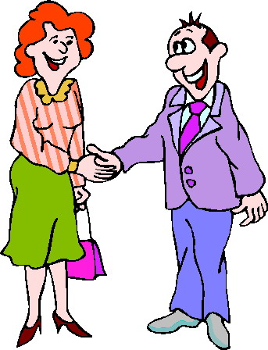
vocabulary
s_ _ _ _ _ _
hablar
saludar
la c_ _ _ _ _
b_ _ _ _
p_ _ _ _
d_ _ _ _
el p_ _ _ _ _ _
a_ _ _ _ _ _ _ _
l_
to greet, greeting
l_
s_ _ _
s_ _ _ _ _
la p_ _ _ _ _ _
Notes:
Vocabulary revision
Click on the picture to reveal the answer

Slide 12
vocabulary
s_ _ _ _ _ _
hablar
la c_ _ _ _ _
b_ _ _ _
p_ _ _ _
d_ _ _ _
el policía
el p_ _ _ _ _ _
a_ _ _ _ _ _ _ _
police officer (m)
l_
l_
s_ _ _
s_ _ _ _ _
la p_ _ _ _ _ _
Notes:
Vocabulary revision
Click on the picture to reveal the answer

Slide 13
vocabulary
s_ _ _ _ _ _
hablar
la c_ _ _ _ _
b_ _ _ _
p_ _ _ _
d_ _ _ _
el p_ _ _ _ _ _
her, it (object)
a_ _ _ _ _ _ _ _
l_
la
l_
s_ _ _
s_ _ _ _ _
la p_ _ _ _ _ _
Notes:
Vocabulary revision
Click on the picture to reveal the answer

Slide 14
vocabulary
s_ _ _ _ _ _
hablar
la c_ _ _ _ _
b_ _ _ _
p_ _ _ _
d_ _ _ _
el p_ _ _ _ _ _
a_ _ _ _ _ _ _ _
I follow, I am following
l_
l_
sigo
s_ _ _
s_ _ _ _ _
la p_ _ _ _ _ _
Notes:
Vocabulary revision
Click on the picture to reveal the answer

Slide 15
vocabulary
s_ _ _ _ _ _
hablar
la c_ _ _ _ _
b_ _ _ _
p_ _ _ _
dejar
d_ _ _ _
el p_ _ _ _ _ _
to leave, to let
a_ _ _ _ _ _ _ _
l_
l_
s_ _ _
s_ _ _ _ _
la p_ _ _ _ _ _
Notes:
Vocabulary revision
Click on the picture to reveal the answer

Slide 16
vocabulary
Vocabulario
vocabulario
 | Español | Inglés
1 | guardar | to keep, keeping
2 | pagar | to pay, paying
3 | parecer | to seem, seeming
4 | la marca | brand
5 | la falda | skirt
6 | la mitad | half
7 | el precio | price
8 | el tipo | type
9 | el euro | euro
10 | ligero, ligera | light
11 | práctico, práctica | practical, useful
Segundos
60
To say that something is half price, use estar + ‘a mitad de precio’.
Ejemplo:
La falda está a mitad de precio.
The skirt is half price.
0
INICIO
Notes:
Timing: 4 minutes
Aim: Vocabulary practice slide for this week’s vocabulary set.
Procedure:
Pupils either work by themselves or in pairs, reading out the words and studying their English meaning (1 minute). Teachers click on the ‘inicio’ button to start the 1 minute timer or can use their own timing device.
Then the English meanings are removed by clicking and students try to recall them, looking at the Spanish (1 minute).
Then the Spanish meanings are removed by clicking and students try to recall them, looking at the English (1 minute)
Further rounds of learning can be facilitated by one pupil turning away from the board, and his/her partner asking him/her the meanings. This activity can work from L2 → L1 or L1 → L2.
Notes:
Attention should be given to the pronunciation of ‘euro’. Spanish pronounces the ‘e’ and ‘u’ as two separate syllables, whereas in English these are pronounced as a single syllable.
The next slide offers further practice of ‘parecer’ (including short form ‘parece’), so time need not be spent here explaining how the verb conjugates.

Slide 17
parecer
[to seem | seeming]
parece
[s/he seems, it seems]
Notes:
Timing: 3 minutes for sequence of six verbs (slides 17-22)
Aim: to introduce the verb ‘parecer’ more explicitly. ‘Parecer’ is one of the 25 most frequently used verbs in Spanish. All 25 most frequent verbs will be introduced early on using the same format. Both long form (infinitive) and short form (3rd person singular) are introduced in order to familiarise students with various forms of the same verb.
Procedure
Teachers bring up the word ‘parecer’ on its own, say it, students repeat it, and remind them of the phonics.
Teachers try to elicit the meaning from the students.
Teachers then bring up the English translations. Emphasise the two meanings for the infinitive.
Teachers bring up the short form ‘parece’, say it, students repeat it.
Teachers try to elicit the meaning from the students. Emphasise the meanings for the short form.

Slide 18
parecer
[to seem | seeming]
parece
[s/he seems | it seems]
Notes:
Cycle through the long and short form again.

Slide 19
parecer
[to seem | seeming]
La ropa puede parecer barata.
[The clothing can seem cheap.]
Notes:
Teachers introduce the long form in a sentence.

Slide 20
parece
[s/he seems | it seems]
La falda parece barata.
[The skirt seems cheap.]
Notes:
Teachers introduce the short form in a sentence.

Slide 21
parecer
[to seem | seeming]
La ropa puede ________ barata.
parecer
[The clothing can seem cheap.]
Notes:
Teachers cycle through the long form again.
Note: students only have to provide the verb in the gap, but the animation sequence also allows for the full sentence to be elicited when the English prompt is shown. This may suit a higher-ability group.

Slide 22
parece
[s/he seems | it seems]
La falda ________ barata.
parece
[The skirt seems cheap.]
Notes:
Teachers cycle through the short form again.
Note: students only have to provide the verb in the gap, but the animation sequence also allows for the full sentence to be elicited when the English prompt is shown. This may suit a higher-ability group.

Slide 23
Comparing things Regular comparatives [revisited]
gramática
In English we often use ‘more … than’ or ‘less ... than’ with an adjective to make comparisons.
más
adjective
que
To say ‘more … than’ in Spanish, use _____ + __________ + _____.
My watch is more practical / useful than the other watch.
mas práctico que
Mi reloj es ___________________ el otro reloj.
In English we sometimes add –er to mean ‘more’ (e.g. smaller).
menos
adjective
que
To say ‘less … than’ in Spanish, use the words use _______ + __________ + _____.
The bike is less expensive than the car.
menos cara que
La bici es __________________ el coche.
Notes:
Timing: 2 minutes
Aim: to recap regular Spanish comparatives with ‘más que’ and ‘menos que’
Procedure:
Teachers click to go through the slide. Gaps are left for students to provide answers which will be revealed with a click.
Notes:
1. The slide could easily be adapted for a higher-ability group so that students have to provide the full sentence when prompted.
2. Teachers could optionally ask students here how to say ‘better than’ and ‘worse than’ (these were also introduced last week). These irregular comparatives will also be recapped in this lesson’s activities.

Slide 24
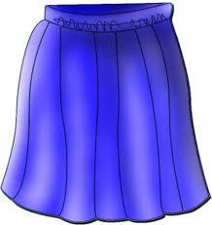
Distinguishing one thing from another Demonstratives ‘este’ and ‘esta’
gramática
Demonstrative adjectives (e.g. ‘this’) are used to distinguish one thing from another.
In Spanish, to say ‘this’ for a singular masculine noun, use este.
¡Atención! Accents matter!
To say ‘this’ for singular feminine noun, use esta.
esta
this (f)
Ejemplos:
s/he is, it is (for state)
está
This price is very high.
This skirt is expensive.
Este precio es muy alto.
Esta falda es cara.
Notes:
Timing: 2 minutes
Aim: to introduce the demonstrative adjectives ‘este’ and ‘esta’
Procedure:
Teachers click to go through the explanations and examples.
Teachers could highlight in the examples that there is gender agreement between the adjective and noun. This will be a focus of the next activity.

Slide 25
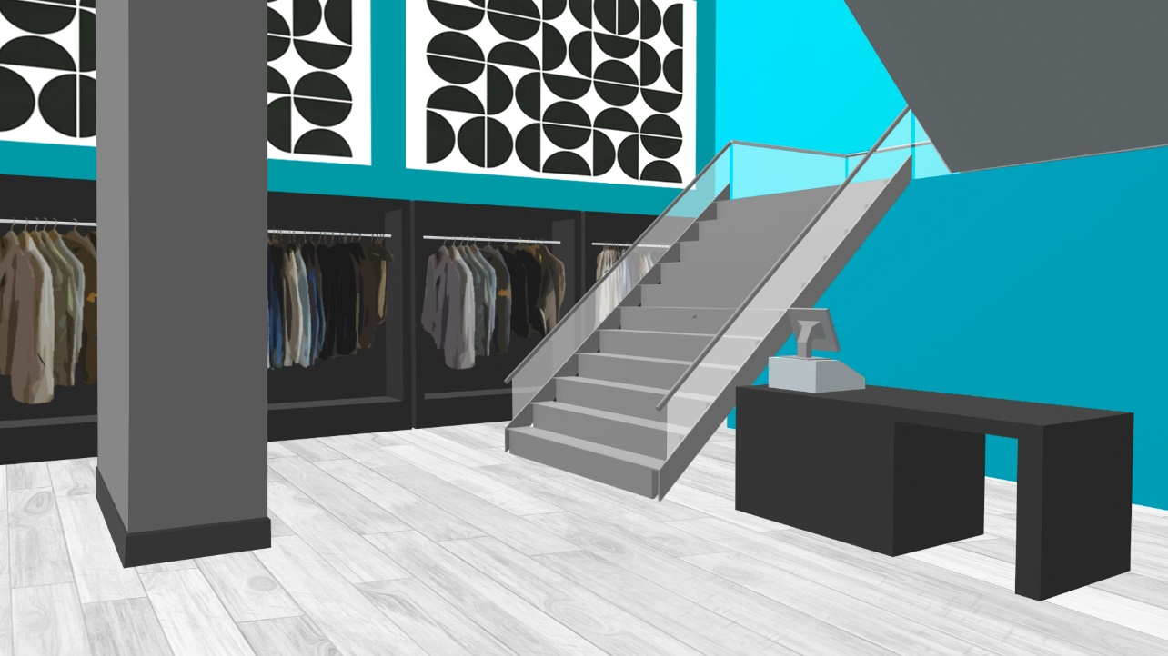
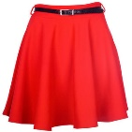
¡Lucía y Nadia van de compras! Están en una tienda de ropa. Lee la conversación. Escribe 1-9 y ‘este’ o ‘esta’.
leer
Lucía: (1) Este / Esta tienda es muy buena. Creo que es mejor que la tienda en el centro.
Nadia: Sí, es verdad. ¿Te gusta (2) este / esta vestido azul?
Lucía: ¿Cuánto es?
Nadia: 30 euros. Es más bonito que el vestido rojo y menos caro que el vestido al lado de la puerta.
Lucía: Me gusta mucho. Y (3) este / esta marca es muy conocida también.
Nadia: Claro. Además, según una amiga,
el color azul es más popular que el amarillo o el rojo (4) este / esta año.
Lucía: ¡Mira! (5) Este / Esta falda es preciosa también, y ¡está a mitad de precio!
Nadia: ¡Qué bien!* El precio de la falda en (6) este / esta tienda es más bajo que en otros lugares.
¡Qué bien! That’s great!
Notes:
Timing: 7 minutes
Aim: to practise deciding between ‘este’ and ‘esta’ by identifying the gender of the noun; to consolidate understanding of comparatives and new vocabulary
Procedure:
Click to show the instructions and then the reading passage and the table which the students can copy out.
Students write either ‘este’ or ‘esta’ for each number.
Students can listen to the conversation to check answers. Click on the audio player (top right of the slide).
Answers are also shown in the text by clicking.
The next slide continues to exploit the text with an activity where students translate five comparative sentences into English.
Note: ‘Qué bien’ has been encountered in other lessons, but hasn’t been taught yet as new vocabulary, so is glossed again here.

Slide 26
Ahora traduce las frases comparativas del texto al inglés.
leer
1. Esta tienda es mejor que la tienda en el centro.
2. Este vestido es más bonito que el vestido rojo.
3. Este vestido es menos caro que el vestido al lado de la puerta.
4. El color azul es más popular que el amarillo o el rojo.
5. El precio de este vestido es menos caro que el precio de esta falda.
This shop is better than the shop in the centre.
¿Cómo se dice ‘worse than’ en español?
?
peor que
This dress is prettier than the red dress.
?
This dress is less expensive than the dress next to the door.
?
The colour blue is more popular than yellow or red.
?
The price of this dress is less expensive than the price of this skirt.
?
Notes:
Timing: 4 minutes
Aim: to consolidate understanding of comparatives by translating sentences from the previous text into English.
Procedure:
Students translate these sentences that come from the previous text. Some phrases have been slightly adapted to allow for full sentence translation.
Teachers click to reveal the answers. In checking answer number 1, teachers can use the callout to ask also students how they would say ‘worse than’ rather than ‘better than’. This will aid comprehension in the next activity, where ‘peor’ is revisited in listening.
Note: in item 4, it will be worth reminding students about article use (‘el amarillo’ and ‘el rojo’ are simply ‘yellow’ and ‘red’ here). This was explained when colours were first presented in Year 7, but is easy to forget (particularly when translating into Spanish).

Slide 27
Daniel y Hugo van de compras también. ¿Qué dicen? Escucha y escribe ‘este’ o esta’. Completa la frase en inglés con el comparativo correcto.
escuchar
 | este | esta | Completa la frase en inglés.
brand
This _________ is _____________________________ in England.
1
less well-known in Spain than
book
worse than
2
This _________ seems _____________ the other (one).
3
fruit
tastier than
This _________ is _____________ the food at home.
4
price
much higher than
This _________ seems ___________________ in other towns.
shirt
less practical / useful than
5
This _________ is ___________________________ other types of clothing.
shop
better than
6
This _________ is ______________ the market.
man
less silly than
7
This _________ is ______________ my boyfriend.
8
skirt
lighter than
This _________ is ______________ the trousers.
Notes:
Timing: 7 minutes
Aim: to identify the correct demonstrative adjective based on the gender of the noun heard; to practise understanding regular comparatives in listening.
Procedure:
Students write 1-8 in their books.
Teachers click the number button to play the recording.
Students listen and write either ‘este’ or ‘esta’ (this is represented on the screen by ticks). They will not hear these words in the audio, so they must pay attention to the gender of the noun that follows the bleep to work out the answer. They may find it useful to write the noun that they hear, then to consider its gender.
Students listen again and complete the missing parts of the translation (the noun and then the comparative).
The answers are revealed by clicking.
Note: the activity could easily be adapted for a higher ability group by requiring students to translate the whole sentence into English. This is more challenging in listening than reading, so students may need to transcribe or take notes before writing a translation in English.
Transcript:
[beep] marca es menos conocida en España que en Inglaterra.
[beep] libro parece peor que el otro.
[beep] fruta es más rica que la comida en casa.
[beep] precio parece mucho más alto que en otros pueblos.
[beep] camisa es menos práctica que otros tipos de ropa.
[beep] tienda es mejor que el mercado.
[beep] hombre es menos tonto que mi novio.
[beep] falda es más ligera que el pantalón.

Slide 28
¡Vamos de tiendas!
escribir / hablar
Usa las palabras para hacer una frase en español.
This brand | is | cheaper than | the shops
This dress | isn’t | more expensive than | the blue dress
This market | seems | less beautiful than | the red skirt
This skirt | doesn’t seem | prettier than | the red shirt
This price |  | lighter than | the price in the shop
This shop |  | less well-known than | the price in my town
This shirt |  | better than | the other brands
 |  | worse than | the other one
Este precio no es más caro que el precio en mi pueblo.
Este vestido es más bonito que el vestido azul.
Esta marca es menos conocida que las otras marcas.
Esta falda parece más ligera que la falda roja.
Este mercado no parece peor que las tiendas.
Esta camisa parece mejor que la camisa roja.
Notes:
Timing: 10 minutes
Aim: to write sentences using demonstratives and comparatives, using the prompts; to practise producing new and revisited vocabulary in writing
Procedure:
The teacher brings up each combination of sentence parts
Students can be asked to write the Spanish on mini-whiteboards or in their books, then volunteer the answer orally.
Students could then create a number of their own sentences, using new combinations of words in the grid. Students can be encouraged to use the rectangles that haven’t yet been used (‘this shop’, ‘cheaper than’, ‘less beautiful than’, ‘the price in the shop’ and ‘the other one’).
After writing the six sentences, the teacher could encourage an oral simultaneous translation task, where students say a sentence and their partner translates it. Some may find this challenging to do on the spot, so this oral component could be done by some students, while other students continue to practise writing.
A final question could involve the teacher writing a sentence down from the elements provided, but not showing it. Every student also writes down one sentence, trying to use their sixth sense to make it as similar as possible to the teacher’s sentence. Great minds think alike!
Sentences:
This skirt seems lighter than the red skirt. (Esta falda parece más ligera que la falda roja.)
This brand is less well-known than other brands. (Esta marca es menos conocida que las otras marcas.)
This price isn’t more expensive than the price in my town. (Este precio no es más caro que el precio en mi pueblo.)
This market doesn’t seem worse than the shops. (Este mercado no parece peor que las tiendas.)
This dress is prettier than the blue dress. (Este vestido es más bonito que el vestido azul.)
This shirt seems better than the red shirt. (Esta camisa parece mejor que la camisa roja.)

Slide 29
Asking about things (shopping)
Demonstrative adjectives ‘estos’ and ‘estas’
Question words [revisited]
Y8 Spanish
Term 3.1 – Week 4 – Lesson 56
Pete Watson / Nick Avery / Mollie Bentley-Smith Artwork: Mark Davies
Date updated: 28/04/21
Notes:
Artwork by Mark Davies. All additional pictures selected are available under a Creative Commons license, no attribution required.
Native teacher feedback provided by Blanca Román.
Learning outcomes (lesson 2):
Introduction of demonstrative adjectives ‘estos’ and ‘estas’
Consolidation of demonstrative adjectives ‘este’ and ‘esta’
Consolidation of question words and vocabulary
Consolidation of weak vowel [i] SSC
Word frequency (1 is the most frequent word in Spanish):
New vocabulary: parecer [89]; guardar [687]; marca [1276]; falda [2743]; mitad [834]; precio [557]; tipo [168]; euro [2435]; pagar [377]; ligero [1930]; práctico [2141]; este [24]
8.2.2.5 (revisit): llorar [630]; esperar [157]; volver [112]; encontrar [102]; gritar [691]; querer² [58]; historia [186]; mes [288]; papá [865]; mamá [675]; frío [1020]
8.2.2.1 (revisit)]: parar [706]; acompañar [606]; dejar² [86]; saludar [1575]; besar [1591]; seguir [99]; sigo [seguir-99]; policía [629]; cocina [1214]; lo [10]; la [61]
Source: Davies, M. & Davies, K. (2018). A frequency dictionary of Spanish: Core vocabulary for learners (2nd ed.). Routledge: London

Slide 30
hablar
A
B
C
D
[to cry, crying]
[to wait for, waiting for]
[to return, returning]
[to find, finding]
E
F
G
H
[to shout, shouting]
[to want, to love]
[story]
[month]
I
J
K
L
[Dad (informal)]
[Mum (informal)]
[to seem, seeming]
[cold]
Notes:
Vocabulario
Timing: 4 minutes
Aim: to revise in productive mode/oral modality 12 items of vocabulary, within a limited time frame.
Procedure:
1. Teacher clicks / presses enter to flash an English prompt. It will disappear after 3 seconds. Note that the prompts do not appear in alphabetical order to increase the challenge.
2. Students say the Spanish word before the English prompt has faded away. 3. Teacher should ensure that gender/definite articles are known for any words that are nouns.
Note: the word is shown for 3 seconds, but the animation settings can be adjusted to increase the amount of time given.
ANSWERS:
A = llorar
B = esperar
C = volver
D = encontrar
E = gritar
F = querer
G = la historia
H = el mes
I = el papá
J = la mamá
K = el frío
L = parecer
Notes:
Parecer is one of this week’s vocabulary set, but as an important verb it is included here alongside the vocabulary from 8.2.2.5

Slide 31
escuchar / escribir
Remember, the vowel [i] merges with [a], [e] or [o] to make one syllable.
Escucha las frases. ¿Es IA, IE o IO? Escribe las palabras. Si ya conoces la palabra, escribe la traducción en inglés.
 | IA | IE | IO
palabra(s) con IA, IE, IO
1
1. biblioteca
(library)
2. palacio
(palace)
3. preciosa
(beautiful)
2
1. nadie
(nobody)
2. tiene
miedo
(is scared)
3. ingenieros
(engineers)
3
1. colegio
(school)
2. premio
(prize)
3. literario
(literary)
4
1. anunciar
(to announce)
2. victoria
(victory)
3. inmediatamente
(immediately)
5
1. historia
(story, history)
2. especialmente
(especially)
6
1. descubrimiento
(discovery)
2. piedra
(stone, rock)
3. vieja
(old)
Notes:
Phonics and vocabulary
Timing: 7 minutes
Aim: to identify instances of weak vowel [i] + strong vowel in the input (these letters combine to form a diphthong); to accurately transcribe the relevant words.
Procedure:
The teacher plays the audio for each sentence and students tick the correct column in the first table depending on what they hear.
Students listen to each sentence again and write down any words they hear containing IA, IE and IO in the main table. Note that some students may be able to do this at the same time as step 1.
The teacher clicks to show the answers for each sentence, which appear one word at a time. A mix of known and unknown words are used. The meanings of any known words are given on a separate click, so the translations can be elicited from students. The meaning of unknown words appear when each answer is given. The meaning of these unknown words may be learnt incidentally – they are frequent words that students are likely to reencounter over time.
Transcript:
La biblioteca del palacio es preciosa.
Nadie tiene miedo de los ingenieros.
Mi colegio nunca ganó el premio literario.
Debe anunciar la victoria inmediatamente.
La historia de Ayaymamá es especialmente interesante.
El descubrimiento de una piedra vieja es aburrido.
Frequency rankings of unknown words (1 is the most frequent word in Spanish):
biblioteca [1612]; palacio [1705]; nadie [206]; ingeniero [1936]; colegio [628]; premio [1090]; anunciar [785], victoria [1266], inmediatamente [1469]; historia [186], especialmente [757]; descubrimiento [1928], piedra [774], vieja [225]

Slide 32
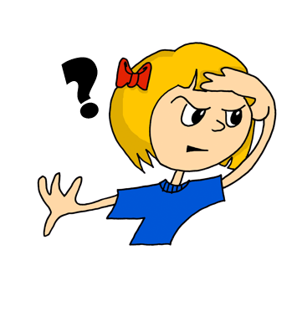
dónde
hablar
¿dónde?
where?
¿ _______ guardas los euros?
Dónde
[Where do you keep the euros?]
Notes:
Timing: 5 minutes (slides 33-42)
Aim: to revise question words
Procedure:
Teachers bring up the English prompt in the centre of the screen.
Teachers elicit the Spanish from students.
Teachers bring up the sentence in English at the bottom of the screen.
Teachers then either elicit the full sentence OR click again and elicit the missing question word only, depending on the ability of the students.
Follow the same procedure for all slides.

Slide 33
cuándo
hablar
¿cuándo?
when?
¿ ________ llegas a la tienda?
Cuándo
[When do you arrive at the shop?]
Notes:
Students could be reminded here of how Spanish uses ‘llegar a’ for ‘arrive at’.

Slide 34
qué
hablar
¿qué?
what?
Qué
¿ ____ tipo de falda necesitas?
[What type of skirt do you need?]

Slide 35
quién
hablar
¿quién?
Remember, use the ‘s/he’ form of the verb (e.g., ‘-a’) with ‘quién’.
who?
Quién
¿ ______ grita en la calle?
[Who shouts / is shouting in the street?]

Slide 36
Por qué
hablar
¿por qué?
why?
¿ ___ ____ pagas en euros?
Por qué
[Why do you pay / are you paying in euros?]

Slide 37
cuál
Remember to use cuáles if you are referring to more than one thing.
Ejemplo: ¿Cuáles son más ligeros?
Which ones are lighter?
hablar
¿cuál?
which?
¿ _____ es la marca conocida?
Cuál
[Which is the well-known brand?]

Slide 38
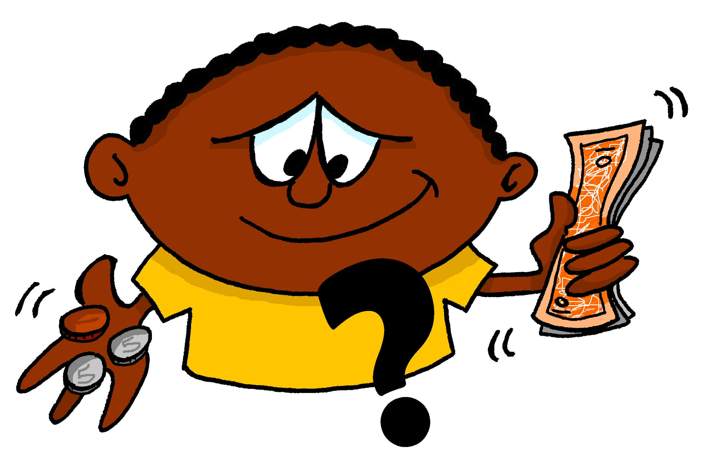
cuánto
hablar
¿cuánto?
how much?
¿ _______ es el reloj?
Cuánto
[How much is the watch?]
Notes:
On the next slide, students will also be given a reminder about gender agreement. Because ‘cuánto’ is used as a pronoun here, gender agreement rules do not apply.

Slide 39
cuántos
Remember that ‘cuánto’ also needs to agree with the gender of the noun.
Use ‘cuántos’ for nouns that are plural and ____________.
Use ‘cuántas’ for nouns that are plural and ____________.
hablar
¿cuántos/as?
masculine
feminine
how many?
¿ ________ marcas hay?
Cuántas
[How many brands are there?]
Notes:
Teachers may wish to remind students here that this also applies to the singular form (cuánto, cuánta) when it refers directly to a noun (e.g., ¿Cuánta ropa hay?, ¿Cuánto dinero tienes?)

Slide 40
cómo
hablar
¿cómo?
how?
Cómo
¿ ______ lavas el vestido?
[How do you wash the dress?]

Slide 41
cómo
¿cómo es/son?
hablar
What is it like?
Cómo es?
¿ ______ ____ ¿Muy ligero ?
[What is it like? Very light?]

Slide 42
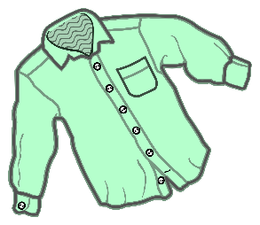
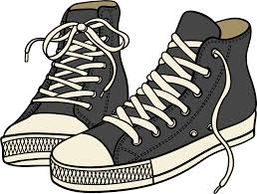
Distinguishing between different things Demonstratives: ‘estos and ‘estas’
gramática
este
To say ‘this’ with a single masculine noun in Spanish, use ______.
esta
To say ‘this’ with a single feminine noun in Spanish, use ______ .
Ejemplos:
this price
este precio
this shirt
esta camisa
To say ‘these’ with a plural masculine noun in Spanish, use estos.
To say ‘these’ with a plural feminine noun in Spanish, use estas.
Ejemplos:
¡Atención!
estos zapatos
these shoes
estas camisas
these shirts
estas
these (f)
estás
you are (for state)
Notes:
Timing: 2 minutes
Aim: to recap the demonstrative adjectives ‘este’ and ‘esta’ and introduce the plural forms ‘estos’ and ‘estas’
Procedure:
Teachers click to go through the explanations and examples on the slide.
Gaps are left for teachers to elicit the previously taught features from the students.
Note: a callout also highlights the difference between ‘estas’ and ‘estás’. The teacher could model the stress here, juxtaposing its position in the two words (i.e. penultimate vs final syllable position).

Slide 43
leer / escuchar
Hugo y Daniel van de compras. Lee las preguntas. Completa la pregunta con la palabra correcta. Luego escucha las respuestas. Identifica la pregunta correcta (e.g. pregunta 3).
La pregunta | Objetos
1. ¿Por qué no compras estas ______? | zapatos bicicletas
2. ¿Cuánto son estos ______? | bolsas espejos
3. ¿Quién necesita estas ______? | relojes cosas
4. ¿Cómo son estos ______? | pantalones cajas
5. ¿Dónde guardas estas _______? | vestidos camisas
6. ¿Cuáles son estas ________? | marcas libros
Respuestas
A
Pregunta 6
Notice how the –a (‘s/he’) ending is used after ‘quién’.
B
Pregunta 2
C
Pregunta 4
D
Pregunta 1
E
Pregunta 3
F
Pregunta 5
Notes:
Reading and listening activity
Timing: 8 min
Aim: to recognise whether to use ‘estos’ or ‘estas’ by looking at the gender of the noun (reading); to practise pairing up question words with their answers (listening and reading).
Procedure:
Students read each sentence and decide if the demonstrative goes with a masculine plural or feminine plural word. The answers are shown by clicking in order.
Then, students listen to the responses (A, B, C...) and decide which question it must refer to. Teachers play the recording by clicking the letter button. The answers are then revealed by clicking.
Transcript:
Adidas y Nike. Son muy conocidas.
Veinticinco euros cada uno.
Muy prácticos, pero no son ligeros.
Porque son demasiado caras.
Diego, para ir al trabajo.
En casa, debajo de la cama.

Slide 44
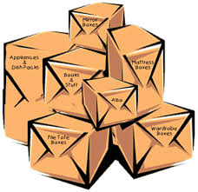
Preguntas en las tiendas. Escucha y completa la frase con la palabra correcta. Completa la pregunta en inglés.
escuchar
¡Atención! Vas a escuchar ‘cómo’ y ‘cómo son’. Cuidado con la traducción.
 | ¿Cuál es la palabra? |  | La pregunta completa (en inglés).
 | camisas | pantalones
 | cajas | regalos
 | bebidas | productos
 | monedas | juegos
 | libros | marcas
 | periódicos | tarjetas
 | vestidos | faldas
 | bolsas | tipos
1
How
these trousers
1
_____ do you wash ______________?
2
2
Who
these boxes
_____ buys / is buying _____________?
3
3
Where
these products
_______ do you keep _______________?
4
4
Why
these coins
‘Tarjeta’ can be a written card or a debit/credit card!
______ don’t you use ____________?
5
5
Which
these books
_______ are _____________?
6
6
When
these cards
_______ do you pay with ____________?
7
7
What
these dresses like
______ are _________________?
8
8
How much
these bags
___________ do you use ____________?
Notes:
Timing: 8 minutes
Aim: to correctly identify the noun that matches the gender of the demonstrative adjective heard (‘estos’ or ‘estas’). To also consolidate understanding of question words and other vocabulary.
Procedure:
1. Click to bring up the ‘¡Atención!... and prompt students to say how they would translate cómo (how) and cómo son (what… like). 2. Students write 1-8 in their exercise books. They need to listen to the recording (click on the blue action buttons) and choose which word completes the question. This will depend on whether ‘estos’ or ‘estas’ is heard.
3. Teachers click the number button to play the recording.
4. Then students listen to the recording again and translate the missing words into English to complete the sentence (they don’t need to write the full sentence). Note that in the instructions, students are warned that they will hear ‘cómo’ and ‘cómo son’, which may be tricky to distinguish! It may be useful to briefly recap their meanings once more before starting.
5. Answers are then revealed by clicking. Full sentence audio is also provided for feedback and reinforcement (click on the beige action buttons).
Notes:
There is an alternative to this exercise on the next slide which may be more suitable for a higher ability group. It requires full sentence translation, rather than the sentence completion here.
Transcript:
¿Cómo lavas estos…?
¿Quién compra estas…?
¿Dónde guardas estos…?
¿Por qué no usas estas…?
¿Cuáles son estos…?
¿Cuándo pagas con estas…?
¿Cómo son estos…?
¿Cuánto usas estas…?
Transcript (complete sentences):
1. ¿Cómo lavas estos pantalones?
2. ¿Quién compra estas cajas?
3. ¿Dónde guardas estos productos?
4. ¿Por qué no usas estas monedas?
5. ¿Cuáles son estos libros?
6. ¿Cuándo pagas con estas tarjetas?
7. ¿Cómo son estos vestidos?
8. ¿Cuánto usas estas bolsas?

Slide 45
Preguntas en las tiendas. Escucha y completa la frase con la palabra correcta. Escribe la pregunta completa en inglés. ¡Atención! Vas a escuchar ‘cómo’ y ‘cómo son’. Cuidado con la traducción.
escuchar
 | ¿Cuál es la palabra? |  | La pregunta completa (en inglés).
 | camisas | pantalones
 | cajas | regalos
 | bebidas | productos
 | monedas | juegos
 | libros | marcas
 | periódicos | tarjetas
 | vestidos | faldas
 | bolsas | tipos
1
1
How do you wash these trousers?
2
2
Who buys these boxes?
3
3
Where do you keep these products?
4
4
Why don’t you use these coins?
‘Tarjeta’ can be a written card or a debit/credit card!
5
5
Which are these books?
6
6
When do you pay with these cards?
7
7
What are these dresses like?
8
8
How much do you use these bags?
Notes:
ALTERNATIVE VERSION
This is the same as the previous exercise, but in the second part, students have to translate the full sentence. This may be more suitable for higher-ability groups.
Transcript (incomplete sentences):
¿Cómo lavas estos…?
¿Quién compra estas…?
¿Dónde guardas estos…?
¿Por qué no usas estas…?
¿Cuáles son estos…?
¿Cuándo pagas con estas…?
¿Cómo son estos…?
¿Cuánto usas estas…?
Transcript (complete sentences):
1. ¿Cómo lavas estos pantalones?
2. ¿Quién compra estas cajas?
3. ¿Dónde guardas estos productos?
4. ¿Por qué no usas estas monedas?
5. ¿Cuáles son estos libros?
6. ¿Cuándo pagas con estas tarjetas?
7. ¿Cómo son estos vestidos?
8. ¿Cuánto usas estas bolsas?

Slide 46
How to ask questions in Spanish Using verbs in questions
gramática
When asking questions in English, we often use ‘do’ before the subject and main verb.
Example:
The main verb describes the event or action (e.g. keep, use).
Where do you keep these shoes?
Spanish doesn’t have a word for ‘do’ in questions. Only the main verb is used.
Ejemplos:
¿Dónde guardas estos zapatos?
¿Cuándo usas estas tarjetas?
(do you keep)
(do you use)
Above, the –as (‘you’) verb ending is used.
You can ask questions with other verb forms!
e.g. ¿Quién compra…?
(‘Who buys…?’)
e.g. ¿Cuánto son…?
(‘How much are…?’)
Notes:
Timing: 2 minutes
Aim: recap slide to help students prepare for the productive elements of the next task, in particular Spanish question formation. (Some students may find it difficult to construct questions by translating from English prompts, as translation is often not literal.)
Procedure:
1. Teachers click to go through this slide’s explanation and examples.
2. Teachers should draw attention to the use of the second person singular ‘-as’ form of the verb, but highlight how other verbs (like ‘son’) may also be used. ‘¿Cuánto son?’ will appear in the next activity.
Note: the teacher could also highlight the fact that Spanish questions have raised intonation at the end. This distinguishes them from statements.

Slide 47
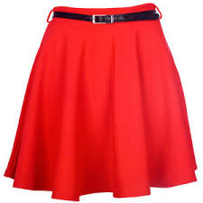
Persona A: read the question in Spanish but don’t say the crossed out word!
hablar / escuchar / escribir
Preguntas en las tiendas
Persona B: look at the cards. Is it ‘A’ or ‘B’? Say the words below the picture in Spanish.
¿Cuándo necesitas estas…?
Esta semana.
Un ejemplo
Persona A (pregunta):
Persona B (escucha y mira las tarjetas):
When do you need these (skirts)? (f)
A
(m)
B
(f)
(faldas)
Esta semana.
_______________
Say:
This Monday.
This week.
Notes:
Timing: 12-14 minutes
Aim: speaking, listening and writing activity to practise ‘estos’ and ‘estas’, question words and vocabulary.
Procedure:
This is the example slide to explain the activity. Teachers click to go through the example stage by stage. It may be useful to give the pairs out their cards to help understand the task. The prompt cards for both Person A and Person B are on slide 48, and the picture cards are on slides 49 and 50 respectively. These slides should not be shown during the activity.
Teachers need to stress that students do not say the word that has been crossed out. It is there to indicate which gender of ‘these’ is needed.
Person B listens to Person A’s question and works out which image the ‘estos’ or ‘estas’ is referring to, and then orally translates the answer below the correct picture into Spanish. Person A writes this down in their book.
Students swap roles after doing all 6.
The answers to the activity are shown on slide 51.

Slide 48
Persona A
hablar
How much are these (books)? (m)
Why do you buy these (shirts)? (f)
What are these (m) (shoes) like? (m)
Where do you keep these (boxes)? (f)
When do you need these (games)? (m)
Who uses these (watches)? (f)
Persona B
Where do you buy these (trousers)? (m)
When do you need these (bicycles)? (f)
Who pays for these (cards)? (f)
Why do you keep these (newspapers)? (m)
How much are these (shirts)? (f)
What are these (dresses) like? (m)
Notes:
Prompt cards
DO NOT DISPLAY IN CLASS

Slide 49
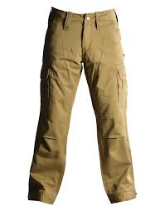
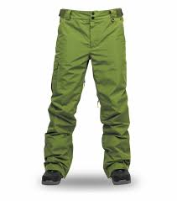
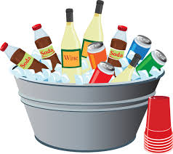
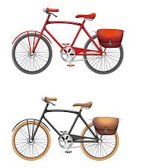
1.
A
(m)
B
(f)
4.
A
(f)
B
(m)
Because I want to drink something.
Because I want to read the news.
in the market
in the shop
2.
A
(f)
B
(m)
5.
A
(f)
B
(m)
this week
this Saturday
They are 30 euros.
They are 27 euros.
3.
A
(m)
B
(f)
6.
A
(m)
B
(f)
my Dad
my Mum
They are pretty.
They are short.
Notes:
Person A
DO NOT SHOW THIS SLIDE DURING THE ACTIVITY

Slide 50
1.
A
(f)
B
(m)
4.
A
(f)
B
(m)
They are 24 euros.
in the kitchen
in the shop
They are 29 euros.
2.
A
(m)
B
(f)
5.
A
(f)
B
(m)
They are not expensive.
I like the colour.
at the weekend
this Sunday
3.
A
(m)
B
(f)
6.
A
(m)
B
(f)
They are very practical/ useful.
They are tasty.
my aunt
my grandfather
Notes:
Person B
DO NOT SHOW THIS SLIDE DURING THE ACTIVITY

Slide 51
Respuestas
hablar / escuchar / escribir
Persona A:
1. Son veinticuatro euros.
2. Me gusta el color.
3. Son muy prácticos.
4. En la cocina.
5. Este domingo.
6. Mi tía.
Persona B:
1. En el mercado.
2. Esta semana.
3. Mi madre / mi mamá.
4. Porque quiero leer las noticias.
5. Son treinta euros.
6. Son bonitos.
Notes:
Answers for the speaking, listening and writing

Slide 52
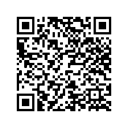
Deberes
Vocabulary Learning Homework (Y8, Term 3.1, Week 5)
Audio file
Audio file QR code:
Student worksheet
Quizlet link
In addition, revisit: Term 3.1 Week 2
Term 2.2 Week 2

Slide 53
¡Escribe tu propia conversación!
escribir
Escribe un diálogo corto en una tienda.
Usa por lo menos* 4 preguntas.
Por ejemplo, puedes usar:
¿dónde?; ¿cuándo?; ¿qué?; ¿por qué?; ¿cuál/es)?;
¿cuánto/a/os/as?; ¿quién?; ¿cómo?; ¿cómo es/son?
Usa también los adjetivos ‘estos’ y ‘estas’ con diferentes productos.
E.g: estos zapatos, estas camisas
Intenta usar un precio, e.g, ‘treinta euros’.
*por lo menos – at least
Notes:
OPTIONAL ALTERNATIVE HOMEWORK
Aim: writing practice using question words, demonstrative adjectives and vocabulary, providing an opportunity for student creativity.
Procedure:
This is a potential writing exercise for extra practice if needed and if there is time. Questions and answers can be modelled on the previous exercises.
Students could also record themselves performing this with a partner on Vocaroo as part of an oral homework.
Note: There are no animations on this slide. Students may wish to refer back to slide 25 of this lesson for an example of a dialogue.

