Slide 1
Phonics
Revisiting SSCs [cue], [cua], [cui]
Y7 Spanish
Term 2.2 - Week 4
Author name(s): Nick Avery / Rachel Hawkes
Date updated: 29/03/2020

Slide 2
¡A pronunciar!
CUE
CU + vowel
(CUE/CUA/CUI)
cuerpo
escuela

Slide 3
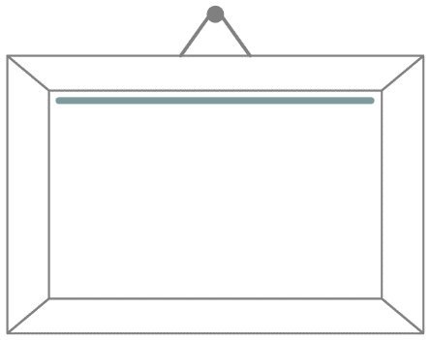
¡A pronunciar!
CUA
CU + vowel
(CUE/CUA/CUI)
cuatro
cuadro

Slide 4
¡A pronunciar!
CUI
CU + vowel
(CUE/CUA/CUI)
to look after;
take care of
cuidar
¡cuidado!

Slide 5
¿CE, CI, CUE o CUI?
escuchar / escribir
Escucha y escribe las letras.
de__r
cue
ci
___rpo
1
5
ci
__en__as
cue
ci
es____la
2
6
¡___dado!
ce
cui
ne___sario
3
7
ce
cui
___ntro
___dar
8
4
Notes:
Students listen and write the missing letters. We also revisit two related SSCs here: [ce] and [ci].

Slide 6
¿CE, CI, CUE o CUI?
escuchar / escribir
Escucha y escribe la palabra.
decir
cuerpo
1
5
escuela
ciencias
2
6
necesario
¡cuidado!
3
7
cuidar
centro
4
8
Notes:
Differentiation More challenging version of previous activity: students listen and write the whole word.

Slide 7
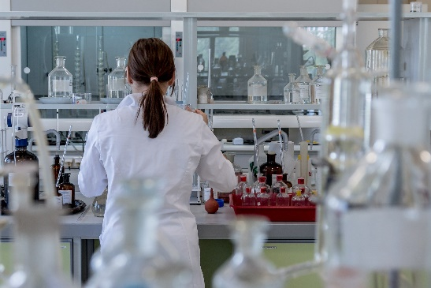
Identifica la imagen/la palabra y escribe la letra correcta.
A
B
C
cuidar
decir
ciencias
cuerpo
escuela
centro
necesario
¡cuidado!
D
I
A
D
E
F
C
F
centre
to look after
E
H
H
I
B
necessary
to say; tell
Notes:
OPTIONAL
Having focused on the sound-spelling correspondence(s), students now focus on the meaning of the words used for practice.
They can write them in their books, and write the letter next to the word, as above.
Elicit the letter in Spanish to practise letters of the alphabet.
Alternatively, the teacher can read out each word and students will say the corresponding letter in Spanish. For additional productive practice of the SSC, the teacher could then say the letters fairly swiftly in jumbled order, and the students pronounce the Spanish word.
A) Image by Michal Jarmoluk from Pixabay
B) Image by Clker-Free-Vector-Images from Pixabay

Slide 8
Escucha y completa las palabras con ‘cua’, ‘cue’, ‘que’, ‘cui’ o ‘qui’.
escuchar / escribir
Luego escribe la frase en inglés.
cui
cue
1. Si no ___das el ____rpo, los efectos son malos.
1
If you don’t look after the body, the effects are bad.
2. En la imagen hay ___nce ____dros pe____ños.
2
qui
cua
que
In the image there are fifteen small squares.
qui
3. ¿___én sabe qué ___ere?
3
Qui
Who knows what s/he wants?
4. ¡____dado con el material de la es____la!
4
Cui
cue
Careful with the school material!
que
5. Hay ____tro personas en el par____.
5
cua
There are four people in the park.
Notes:
In this activity we revisit [cue], [cua] and [cui] with two related SSCs: [que] and [qui].

