Slide 1
Grammar
ER verbs: je & nous
(I and we)
Lesson 1
Y7 French - Term 1.2 - Week 5
Victoria Hobson / Emma Marsden
Date updated: 23/02/20
Notes:
Learning aims for term 1.2 Week 5:
SSC revisiting: ‘SFC’
-ER verbs in first person singular and plural
vocab set: regarder [425], marcher [1532], travailler [290], préparer [368], nous [31], maison [325], télé [2746], film [848], déjeuner [2724], dehors [1217]

Slide 2
Regular –er verbs
To say ‘I’ + verb in French, the verb is in the short form, often ending in -e.
Je regarde.
I watch (or I am watching).
Je travaille.
I work (or I am working).
To say ‘we’ + verb, the verb ends with -ons.
Nous regardons.
We watch (or we are watching).
Nous travaillons.
We work (or we are working).
Stephen Owen

Slide 3
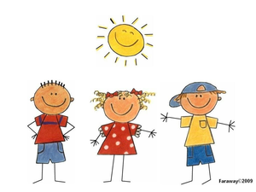
lire
lire
nous
je
C’est qui? Pierre has written a short article about himself. Is he doing these activities by himself (‘I’) or with his friends (‘we’)?
1 | regardons la télé
2 | prépare le déjeuner
3 | restons à la maison
4 | travaillons à l’école
5 | marche dehors
6 | parle à un ami
7 | demandons la raison
8 | montre un exemple
Notes:
This vocabulary should be known to students and so teachers could also choose to ask students the meanings of the sentence as vocabulary practice after the initial task.
There is no need to print the table, students can write the answers in their exercise books.

Slide 4
Listening activity
écouter
Nous ou je? Is the speaker talking about just themselves (‘I’) or themselves with other people (‘we’). You will not hear ‘je’ (I) or ‘nous’ (we). Écris l’ anglais.
 | I (je) | We (nous) | Activité – écris en anglais
1
find a present
2
like the dog
3
give the solution
4
wear a uniform
5
speak French
6
stay outside
7
work in the house
8
watch a film
Notes:
Now that students are becoming familiar with the verb endings, students are also asked to work out the activity to not only reinforce the grammar but work on the vocabulary as well. The sequencing of the answers is such that the verb is addressed first (as this is the element all students should be able to access) allowing teachers to take feedback on scores out of 8, then comes the comprehension of the vocabulary. Teachers could re-order the custom animation if they wish the activity to follow immediately after the tick.
Teachers need not print this slide. Simply ask students to write the answers in their exercise books.
TRANSCRIPT
[beep] trouvons un cadeau
[beep] aimons le chien
[beep] donne la solution
[beep] porte un uniforme
[beep] parlons français
[beep] reste dehors
[beep] travaillons dans la maison
[beep] regarde un film
To note: the vocabulary chosen for this activity has all been previously seen by students (either as identified vocab for a particular week or as source/cluster words).
Teachers need not print this slide. Simply ask students to write the answers in their exercise books.

Slide 5
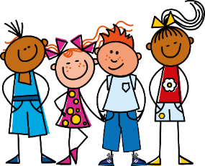
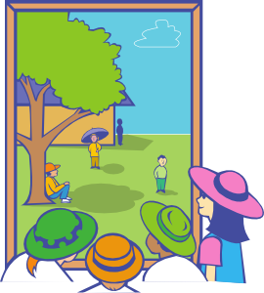
écrire et parler
Chut!
Partner A
Partner B
(walk outside)
_____________________
Chut
Nous marchons dehors.
Je
Nous
Notes:
Introduce the game – (partners’ cards are on the following slides.) This slide could be used to model what the students need to do.
This is a game of ‘chut’ (=shhhhh!) – don’t give away the pronoun.
Partners must listen carefully to the verb and tick under the correct picture whether ‘Je’ or ‘Nous’ is needed to complete their partner’s sentence.
Full instructions for reference which also appear on the next slide:
Partner A writes these sentences in French following the English prompts. At the same time Partner B also writes their sentences (see next slide).
When both students have completed their sentences, they take it in turns to say one sentence at a time to their partner without using the subject pronoun.
Make this the game element: this is a game of ‘chut’ (=shhhhh!) – don’t give away the pronoun.
Partners must listen carefully to the verb and tick under the correct picture whether ‘Je’ or ‘Nous’ is needed to complete their partner’s sentence.
EG
Partner A writes: Je regarde un film
Partner A says to B: chut regarde un film
Partner B finds the correct pair of images and ticks ‘Je’ underneath.
STEP 2
Once they have said all 6 sentences to their partner, students then recreate, in speaking, the sentences that their partners must have written. They use their pictures on their sheet, and the box they have ticked (je or nous) to re-create their partner’s sentence and read out this sentence. The partner who wrote the sentences confirms if they are correct – the sentence read out loud should be exactly the same as the sentence they themselves had written earlier.

Slide 6
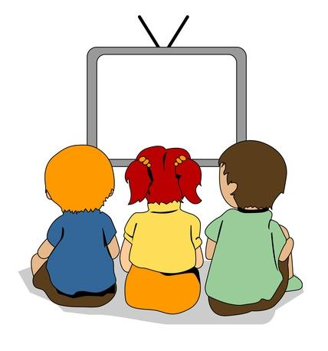
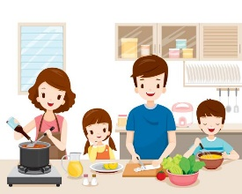
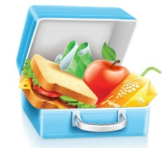
écrire et parler
Partner A
Partner B
1) (watch a film)
___________________________
2) (speak French)
___________________________
3) (work in the house)
___________________________
4) (prepare lunch)
___________________________
5) (walk outside)
___________________________
6) (like the dog)
___________________________
Je Je
Nous Nous
Je Je
Nous Nous
Je Je
Nous Nous
Notes:
Partner A writes these sentences in French following the English prompts. At the same time Partner B also writes their sentences (see next slide).
When both students have completed their sentences, they take it in turns to say one sentence at a time to their partner without using the subject pronoun.
Make this the game element: this is a game of ‘chut’ (=shhhhh!) – don’t give away the pronoun.
Partners must listen carefully to the verb and tick under the correct picture whether ‘Je’ or ‘Nous’ is needed to complete their partner’s sentence.
EG
Partner A writes: Je regarde un film
Partner A says to B: chut regarde un film
Partner B find the correct pair of images and ticks ‘Je’ underneath.
STEP 2
Once they have said all 6 sentences to their partner, students then recreate, in speaking, the sentences that their partners must have written. They use their pictures on their sheet, and the box they have ticked (je or nous) to re-create their partner’s sentence and read out this sentence. The partner who wrote the sentences confirms if they are correct – the sentence read out loud should be exactly the same as the sentence they themselves had written earlier.

Slide 7
écrire et parler
Partner B
Partner A
1) (work outside)
___________________________
2) (watch tv)
___________________________
3) (prepare lunch)
___________________________
4) (like the film )
___________________________
5) (speak English )
___________________________
6) (walk in the house )
___________________________
Je Je
Nous Nous
Je Je
Nous Nous
Je Je
Nous Nous

Slide 8
Grammar
ER verbs: je & nous
(I and we)
Lesson 2
Y7 French - Term 1.2 - Week 5
Victoria Hobson / Emma Marsden
Date updated: 23/02/20
Notes:
In this second lesson, the tasks are more challenging and finish with incorporating third person singular (learnt in the previous week) into students’ production practice.

Slide 9
Regular –er verbs
To say ‘I’ + verb in French, the verb is in the short form, often ending in -e.
Je regarde.
I watch (or I am watching).
Je travaille.
I work (or I am working).
To say ‘we’ + verb, the verb ends with -ons.
Nous regardons.
We watch (or we are watching).
Nous travaillons.
We work (or we are working).
Stephen Owen
Notes:
Teachers may find it useful to recap the verb endings that the students will hear in the following Dictogloss task.

Slide 10
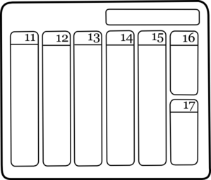
Dictogloss activity
dimanche
semaine
[week]
un peu
génial
[a little]
aussi
[also]
Notes:
These are the selection of source/cluster words that feature in the dictogloss activity. Teachers could take this opportunity to revisit these words in advance, should it be appropriate for their group.
Give students a minute to read the slide, then remove the images/English. Students then have to give the meaning of the five words – either orally or written in ex. books/whiteboards.
(This step may not be necessary with higher ability groups).
Teachers could also use this as an opportunity to practise the pronunciation of the words and focussing on the SSCs.

Slide 11
Dictogloss
écouter/écrire
You are going to hear Louis talking about what he does during his holidays. Make notes in French (or English if you need to). It will be too fast for you to write every word!
Then, work with a partner to write it up in good French, as if you were Louis.
Keep the meaning the same as what you heard.
Stephen Owen
Notes:
Transcript:
Je passe une semaine à Paris. Je reste avec un ami, Pierre. À la maison nous parlons français. C’est génial! Nous regardons aussi la télé, nous aimons les films. À l’école, je parle anglais un peu. Nous portons un uniforme. C’est drôle! Chaque dimanche, je prépare le déjeuner. Je donne un cadeau à Pierre aussi.

Slide 12
Dictogloss
Je passe une semaine à Paris. Je reste avec un ami, Pierre. À la maison nous parlons français. C’est génial! Nous regardons aussi la télé, nous aimons les films. À l’école, je parle anglais un peu. Nous portons un uniforme. C’est drôle! Chaque dimanche, je prépare le déjeuner. Je donne un cadeau à Pierre aussi.
Stephen Owen
Notes:
Here is the transcript. This can either be read by the teacher, or teachers can use the audio recording.
Here, students’ focus is regular verbs in 1st person singular and plural. All verbs and associated items of vocab are taken from the SoW (either from vocab sets/source and cluster words) and as such, should be known by the students. This activity does, however, represent a greater level of challenge and teachers may wish to scaffold this with a vocab list of infinitives (provided on subsequent slide) so that students have them as reference. There is also a help tool for use during the listening, should teachers wish to give students support. This then doubles as a scaffold for the write-up.
Word frequency rankings of those words not in vocab sets:
semaine[245]; avec [23] génial [3827]; aussi [44]; un peu [138/91]; dimanche [1235]. Source: Londsale, D., & Le Bras, Y. (2009). A Frequency Dictionary of French: Core vocabulary for learners London: Routledge.
NB
All additional words used are source/cluster words already known to students with the exception of avec (taught in term 3).

Slide 13
Pour t’aider
 |  | I | We | Additional info (in French or English)
to spend a week | passer une semaine
to stay with a friend | rester avec un ami
to speak French | parler français
to watch tv | regarder la télé
to like films | aimer les films
to speak English | parler anglais
to wear a uniform | porter un uniforme
to prepare lunch | préparer le déjeuner
to give a present | donner un cadeau
Stephen Owen
Notes:
Teachers could use this as a scaffold.
During the listening, students tick whether it is je or nous they hear associated with the activity, plus write any additional information that they hear such as ‘in the house’ or ‘at school’. This then helps students with the write up, as a record of which person to put the infinitive into.
Or it could be used as a stand alone vocab list if the teachers remove the final three columns.

Slide 14
translations
Je passe une semaine à Paris.
Je reste avec un ami, Pierre.
À la maison nous parlons français. C’est génial!
Nous regardons aussi la télé, nous aimons les films.
À l’école, je parle anglais un peu.
Nous portons un uniforme. C’est drôle!
Chaque dimanche, je prépare le déjeuner.
Je donne un cadeau à Pierre aussi.
I spend a week in Paris.
I stay with a friend, Pierre.
In the house we speak French. It’s great!
We also watch tv, we like films.
At school I speak English a little.
We wear a uniform. It’s funny!
Each Sunday, I prepare lunch.
I give a present to Pierre also.
Notes:
This is a back translation activity that allows teachers to check students’ understanding of the whole text and as such an opportunity to revisit the selection of source/cluster words that may (potentially) not be as familiar to students.
Students could attempt this is pairs or groups of four.

Slide 15
Regular –er verbs
To say ‘I’ + verb in French, the verb is in the short form, often ending in -e.
Je regarde.
I watch (or I am watching).
To say ‘s/he’ + verb in French, the verb is in the short form, often ending in -e.
Il regarde.
He watches (or he is watching).
Elle regarde.
She watches (or he is watching).
To say ‘we’ + verb, the verb ends with -ons.
Nous regardons.
We watch (or we are watching).
Stephen Owen
Notes:
Here, first person singular and plural plus third person singular are recapped ahead of the production activities to follow. Now that students are familiar with the pair ‘je’ and ‘nous’ we add third person plural which was learnt in the previous week to offer a greater level of challenge and extend students’ competency with these regular –er verbs.

Slide 16
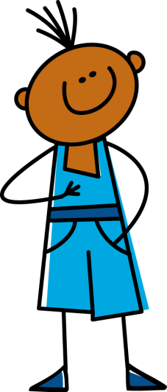
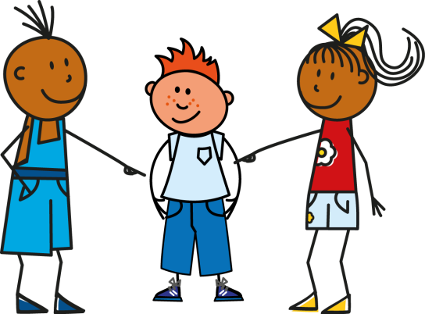
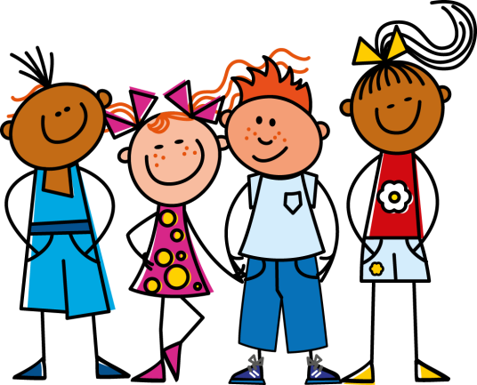
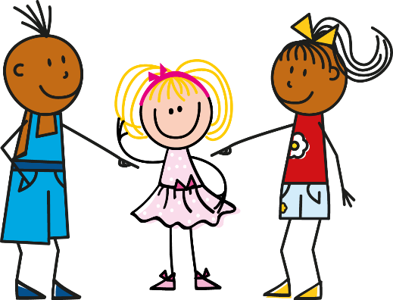
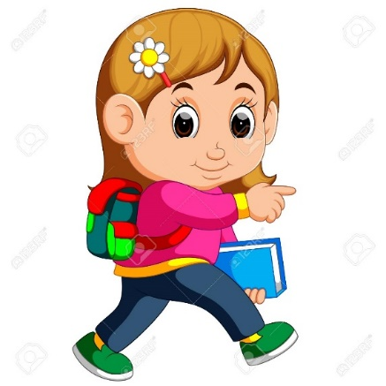
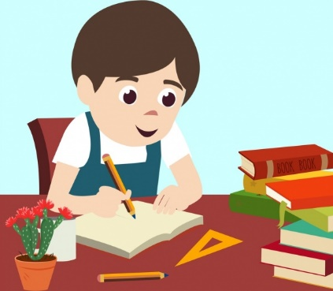
parler/écrire
Notes:
Now that students have thoroughly practised the new ‘nous’ form with the ‘je’ form, it is timely to combine this with 3rd person singular to recap this also.
This activity could be done:
written - as a mini-whiteboard / exercise book activity
speaking – class choral response according to picture prompt or pairs turn to each other.
Sequence:
il travaille
nous marchons
je prépare
elle regarde
nous regardons
il prépare
je marche
nous travaillons
elle marche
il regarde
je prépare
nous préparons

Slide 17
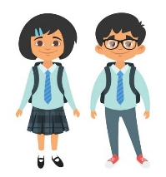
écrire
 | Louis (I) | Pierre (He)
Louis parle de l’experience.
Écris le français.
1)
2)
3)
4)
5)
6)
Nous aimons le français.
Il marche à l’école.
Nous portons un uniforme.
Nous parlons anglais.
Il aime le cadeau.
J’aime Paris.
Notes:
Now that students have thoroughly practised the new ‘nous’ form with the ‘je’ form, it is timely to combine this with 3rd person singular to recap this also, this time with verbs from previous weeks added in.
Explain to students that for Louis this will be a ‘je’ sentence, for Pierre an ‘il’ sentence and when they both do the activity a ‘nous’ sentence.
There may be some errors related to the parts of the sentence other than the verb e.g Nous aimons français –students may miss for example the definite article. Correct this but do not penalise.
NB. J’aime may not have been addressed up until now. If students have written je aime – use this as an opportunity to explain this rule as a discreet teaching point (whilst reinforcing that the ending is correct). Further exemplify with other verbs such as adorer, étudier, admirer etc. These verbs will not be known to students but teachers can write these up on the board and ask students how they would say ‘I…’ Plus ask where they have seen this before (students should say j’ai!)

