Slide 1
Vocabulary
Y7 French
Term 1.2 - Week 7
Stephen Owen / Emma Marsden
Date updated: 27/04/20

Slide 2
Vocabulaire
le tableau
board
determiner
+ noun
la classe
class
la chemise
shirt
le silence
silence
mettre
to put (on), putting (on)
verb
écrire
to write, writing
ouvrir
to open, opening
pronoun
vous
you (plural)
Notes:
This slide provides practice with the new vocabulary for this week - French to English.
This vocabulary should have been pre-learned, either in class or for homework, using a vocabulary learning app.
Here are some ideas for introducing and practising it in class, in three steps:
1/ First, class repetition of the French modelled by the teacher, each French word followed by the teacher showing the written English equivalent.
2/ Once all the words are displayed on the screen, with French and English, check the students know what type (part of speech) these words are (this will be useful later and is revision). This is illustrated by the animations.
3/ French to English practice.
(See next slide for animations for English to French practice).
Vocabulary
mettre [27], ouvrir [257], écrire [382], vous [50], chemise [3892], silence [1281], tableau [1456], classe [778]
Source: Londsale, D., & Le Bras, Y. (2009). A Frequency Dictionary of French: Core vocabulary for learners London: Routledge.

Slide 3
Vocabulaire
le tableau
board
la classe
class
la chemise
shirt
le silence
silence
mettre
to put (on), putting (on)
écrire
to write, writing
ouvrir
to open, opening
vous
you (plural)
Notes:
This slide provides practice with the new vocabulary for this week - English to French. It works in a similar way to the previous one (but without the part of speech animation).
Production practice should be in both the oral and written modalities. Learners can say the French as a whole class, to their partner or individually to the teacher.
They can then write the French words, after each English word appears on the slides.
We now move on to some grammar activities where these words will be used.

Slide 4
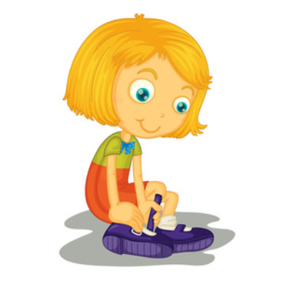
mettre
[to put (on) | putting (on)]
met
[puts (on) | is putting (on)]
Notes:
Note: Students should know the meanings of the infinitives of these verbs already, as it was homework to learn them (audio and Quizlet) but they are re-presented here in the infinitive and short form to deepen students’ knowledge and model the use of both forms in sentences.
Introducing the verb mettre more explicitly. Mettre is one of the 25 most frequently used verbs in French. All 25 most frequent verbs will be introduced early on using the same format. Both long form (infinitive) and short form (3rd person singular) are introduced in order to familiarise students with the various forms of the same verb.
Bring up the word mettre on its own, say it, students repeat it, and remind them of the phonics.
2. Try to elicit the meaning from the students.
3. Bring up the picture.
4. Bring up the word, and establish the meaning of the word in English, clearly, i.e., ‘to put (on)’. Emphasise the two meanings of the infinitive. 5. Bring up the short form met, say it, students repeat it. Draw attention to the silent /t/ which they have studied. Emphasise the two meanings for the short form.
6. Try to elicit the meanings from the students. Emphasise the two meanings for the short form, reminding students that French only has one form and does not have a direct equivalent of the grammar for ‘is + ing’, the continuous form (as covered in previous weeks).
Note: Students have had explicit teaching that the present tense in French communicates two different present tense meanings in English. It is useful to reinforce that learning here.

Slide 5
mettre
[to put (on) | putting (on)]
met
[puts (on) | is putting (on)]
Notes:
Cycle through the long and short form again.
Get the students to produce both English forms.

Slide 6
met
[puts (on) | is putting (on)]
Nicolas met l’uniforme.
[Nicolas puts on | is putting on the uniform.]
Notes:
Introduce the short form in a sentence.
Point out the Silent Final Consonant. Or ask the students to explain why ‘met’ is pronounced as it is.

Slide 7
mettre
[to put (on) | putting (on)]
Nicolas aime mettre l’uniforme.
[Nicolas likes putting on the uniform.]
Notes:
Introduce the long form in a sentence.

Slide 8
met
[puts (on) / is putting (on)]
met
Nicolas ____ l’uniforme.
[Nicolas puts on | is putting on the uniform.]
Notes:
Cycle through the short form in context again.

Slide 9
mettre
[to put (on) | putting (on)]
Nicolas aime ______ l’uniforme.
mettre
[Nicolas likes putting on the uniform.]
Notes:
Cycle through the long form in context again.

Slide 10
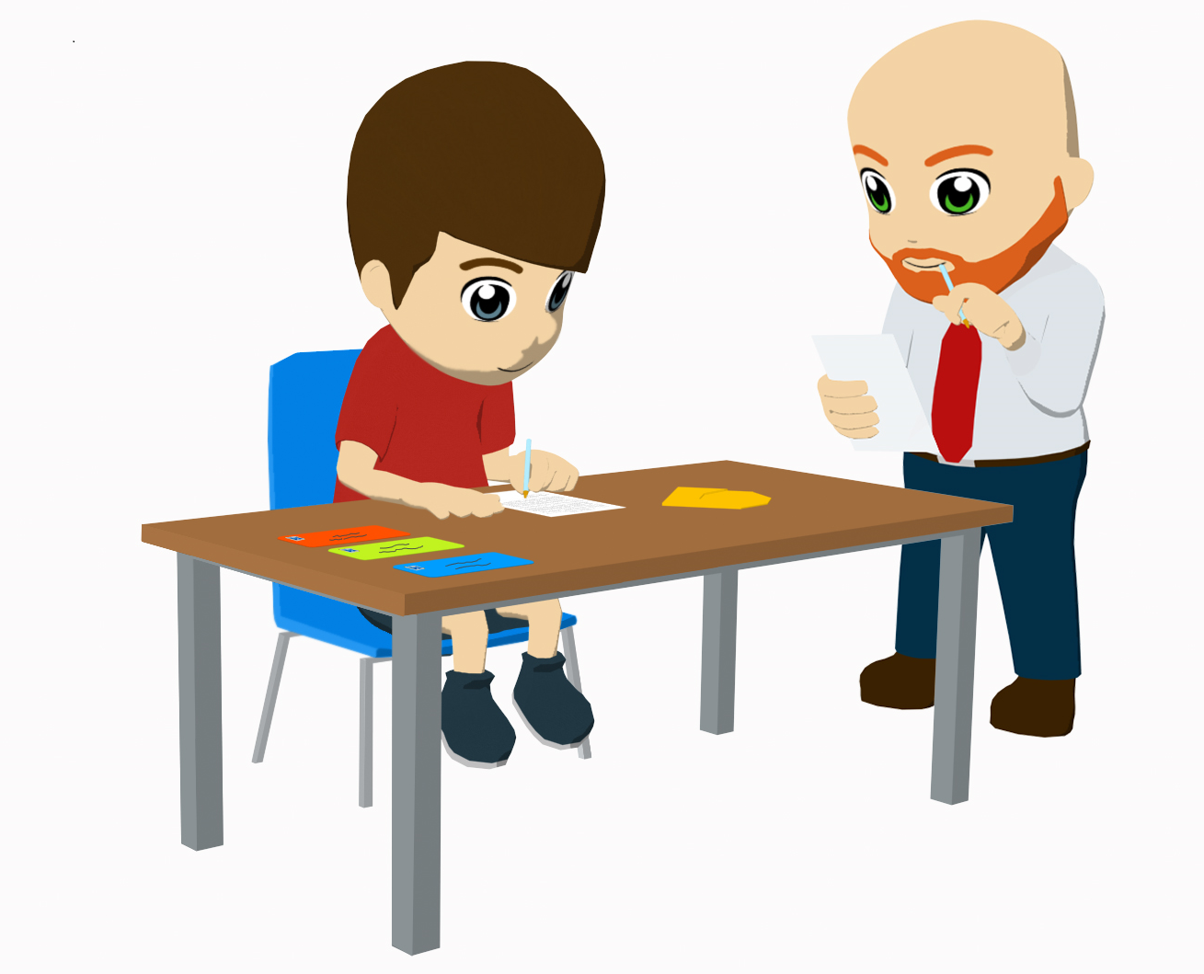
écrire
[to write | writing]
écrit
[writes | is writing]
Notes:
Introducing the verb écrire more explicitly. Écrire is one of the 25 most frequently used verbs in French. All 25 most frequent verbs will be introduced early on using the same format. Both long form (infinitive) and short form (3rd person singular) are introduced in order to familiarise students with the various forms of the same verb.
1. Bring up the word écrire on its own, say it, students repeat it, and remind them of the phonics. Draw attention to /é/ and /i/ which they have met.
2. Try to elicit the meaning from the students.
3. Bring up the picture.
4. Bring up the word, and establish the meaning of the word in English, clearly, i.e., ‘to write’. Emphasise the two meanings for the infinitive. 5. Bring up the short form écrit, say it, students repeat it. Draw attention to the silent /t/ which they have studied.
6. Try to elicit the meanings from the students. Emphasise the two meanings for the short form.
Note: Students have had explicit teaching that the present tense in French communicates two different present tense meanings in English. It is useful to reinforce that learning here.

Slide 11
écrire
[to write | writing]
écrit
[writes | is writing]
Notes:
Cycle through the long and short form again.

Slide 12
écrit
[writes | is writing]
Elle écrit bien.
[She writes well.]
Notes:
Introduce the short form in a sentence.
Point out the Slient Final Consonant on ‘écrit’. Or ask students to explain why ‘écrit’ is pronounced as it is.

Slide 13
écrire
[to write | writing]
Elle aime écrire en français.
[She likes writing in French.]
Notes:
Introduce the long form in a sentence.

Slide 14
écrit
[writes | is writing]
Elle ____ bien.
écrit
[She writes well.]
Notes:
Cycle through the short form in context again.

Slide 15
écrire
[to write | writing]
Elle aime ______ en français.
écrire
[She likes writing in French.]
Notes:
Cycle through the long form in context again.
You could point out that the long form – the infinitive – expresses the ‘general meaning’ of the verb. Point out that in English, this ‘general meaning of the verb’ can be expressed using ‘to...’ or ‘-ing’.

Slide 16
ouvrir
[to open | opening]
ouvre
[opens | is opening]
Notes:
Introducing the verb ouvrir more explicitly. Ouvrir is a common verb in French [frequency ranking = 257].. Both long form (infinitive) and short form (3rd person singular) are introduced in order to familiarise students with the various forms of the same verb.
1. Bring up the word ouvrir on its own, say it, students repeat it, and remind them of the phonics. Draw attention to /ou/ and /i/ which they have studied.
2. Try to elicit the meaning from the students.
3. Bring up the picture.
4. Bring up the word, and establish the meaning of the word in English, clearly, i.e., ‘to open’. Emphasise the two meanings for the infinitive. 5. Bring up the short form ouvre, say it, students repeat it.
6. Try to elicit the meaning from the students. Emphasise the two meanings for the short form.
Note: Students have had explicit teaching that the present tense in French communicates two different present tense meanings in English. This reinforces that learning.

Slide 17
ouvrir
[to open | opening]
ouvre
[opens | is opening]
Notes:
Cycle through the long and short form again.

Slide 18
ouvre
[opens | is opening]
Elle ouvre le livre.
[She opens the book.]
Notes:
Introduce the short form in a sentence.

Slide 19
ouvrir
[to open | opening]
Elle aime ouvrir le livre.
[She likes opening the book.]
Notes:
Introduce the long form in a sentence.

Slide 20
ouvre
[opens | is opening]
Elle _____ le livre.
ouvre
[She opens the book.]
Notes:
Cycle through the short form in context again.

Slide 21
ouvrir
[to open| opening]
ouvrir
Elle aime _____ le livre.
[She likes opening the book.]
Notes:
Cycle through the long form in context again.

