Slide 1
Describing a thing or a person [2]
être (je, tu, il/elle)
SSC [i]
Y7 French
Term 1.1 - Week 2 - Lesson 3
Stephen Owen / Rachel Hawkes / Catherine Morris
Artwork by: Chloé Motard
Date updated: 24/09/21
Notes:
Learning outcomes (lesson 1):
Introduction of SSC [i]
Introduction of third person singular form of être
Word frequency (1 is the most frequent word in French):
1.1.2 (introduce) est [5], il [13], elle [38], amusant [4695], calme [1731], content [1841], intelligent [2509], malade [1066], méchant [3184], triste [1843], mais [30], ou [33], merci [1070]
Source: Londsale, D., & Le Bras, Y. (2009). A Frequency Dictionary of French: Core vocabulary for learners London: Routledge.

Slide 2
i
midi
Notes:
Timing: 1 minute
Aim: To introduce SSC [i]
Procedure: 1. Present the letter(s) and say the [i] sound first, on its own. Students repeat it with you. 2. Bring up the word ”midi” on its own, say it, students repeat it, so that they have the opportunity to focus all of their attention on the connection between the written word and its sound.
3. A possible gesture for this would be to draw a circle representing a clock face with one hand, with the other arm and hand pointing straight up (representing the hands on 12) within the circle. 4. Roll back the animations and work through 1-3 again, but this time, dropping your voice completely to listen carefully to the students saying the [i] sound, pronouncing ”midi” and, if using, doing the gesture.
Word frequency (1 is the most frequent word in French):
midi [2483].
Source: Londsale, D., & Le Bras, Y. (2009). A Frequency Dictionary of French: Core vocabulary for learners London: Routledge.

Slide 3
i
midi
Notes:
With sound and no pictures to focus all attention on the sound-symbol correspondence.

Slide 4
i
midi
Notes:
Without sound to elicit pronunciation (without first hearing the teacher).
Teacher to elicit pronunciation by asking “Comment dit-on …"

Slide 5
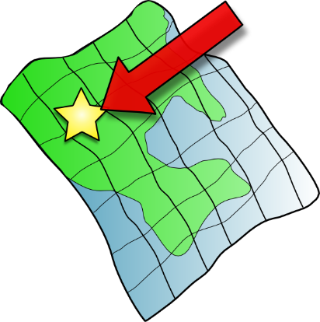
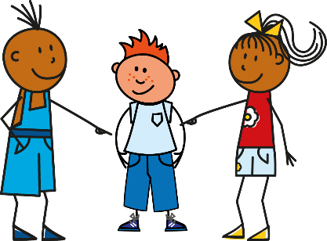
i
petit
lit
midi
ici
qui ?
il
?
Notes:
Timing: 2 minutes
Aim: To introduce SSC [i]
Procedure:
1. Introduce and elicit the pronunciation of the individual SSC [i] and then the source word again ‘midi’ (with gesture, if using). 2. Then present and elicit the pronunciation of the five cluster words.
The cluster words have been chosen for their high-frequency, from a range of word classes, with the SSC (where possible) positioned within a variety of syllables within the words (e.g. initial, 2nd, final etc.). Additionally, we have tried to use words that build cumulatively on previously taught SSCs (see the Phonics Teaching Sequence document) and do not include new SSCs. Where new SSCs are used, they are often consonants which have a similar symbol-sound correspondence in English.
Word frequency (1 is the most frequent word in French): midi [2483]; petit [138]; lit [1837] ici [167]; il[13]; qui [14]. Source: Londsale, D., & Le Bras, Y. (2009). A Frequency Dictionary of French: Core vocabulary for learners London: Routledge.

Slide 6
i
petit
lit
midi
ici
qui ?
il
Notes:
With sound and no pictures to focus all attention on the sound-symbol correspondence.

Slide 7
i
petit
lit
midi
ici
qui ?
il
Notes:
Without sound to elicit pronunciation (without first hearing the teacher).
Teacher to elicit pronunciation by asking “Comment dit-on …"

Slide 8
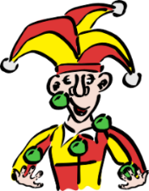
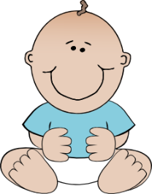
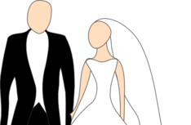
Phonétique
écouter
1
a) b) c)
innocent
3
a) b) c)
idée
2
a) b) c)
mari
4
a) b) c)
ville (town)
Notes:
Timing: 5 minutes
Aim: practicing aural recognition of SSC [i]
Procedure:
1. Click the numbers to play the audio. Tell students they are going to hear the letters ‘a’, ‘b’ and ‘c’ said in French.
2. Write 1-4 and choose if ‘a’, ‘b’ or ‘c’ is a word containing the SSC [i].
3. Click to reveal the answers.
Transcript:
a) innocent, b) méchant, c) amusant
a) jeune, b) mari, c) médecin
a) idée, b) étape, c) carré
a) égal, b) treize, c) ville
Word frequency (1 is the most frequent word in French): innocent [2059], méchant [3184], amusant [4695], jeune [152], mari [1589], médecin [827], idée [239], étape [1145], carré [3162], égal [1183], treize [3245], ville [260]
Source: Londsale, D., & Le Bras, Y. (2009). A Frequency Dictionary of French: Core vocabulary for learners London: Routledge.

Slide 9
Phonétique
parler
SFC
guide
20
climat
Paris
animal
minimal
secondes
guitare
discipline
rapide
machine
0
DÉBUT
Notes:
Timing: 3 minutes
Aim: practising production of SSC [i]
Procedure:
Start the timer.
Students tried to say as many words as they can correctly in twenty seconds. Student B takes note of any words pronounced the English way!
Students swap roles and the timer is restarted.
The person who has pronounced the greatest number of words correctly wins. If there is a tie, the student with the greatest amount of time remaining wins.
Click on the words to hear them said by a native speaker. Students repeat.
Go over the meaning of the words. These are all cognates or near-cognates, purposefully chosen for unlearning the connection between the SSC and the English sound. In some cases, the words may have an English translation which is a related but not direct equivalent (e.g. rapide - fast) so these should be clarified. Students will find it rewarding in the second lesson to be able to recognise nine new words! Explain that lots of words are shared between the languages and they will encounter more of these across the year.
Word frequency (1 is the most frequent word in French): guide [2392], climat [2006], minimal [3652], animal [1002], prime [2094], guitare [>5000], discipline [2120], rapide [672], Paris [n/a], machine [1294]
Source: Londsale, D., & Le Bras, Y. (2009). A Frequency Dictionary of French: Core vocabulary for learners London: Routledge.

Slide 10
Odd one out
lire
‘grand’ is not a nationality
‘intelligent’ has a silent final consonant (SFC)
français | anglais | grand | française
triste | intelligent | malade | calme
contente | amusant | méchant | intelligente
mais | parler | lire | écouter
‘méchant’ is a negative description
the other words are verbs
Notes:
Timing: 3 minutes
Aim: identifying connections between vocabulary items
Procedure:
Students identify which of the three words is the odd one out from each row.
Answers and justifications appear on clicks.

Slide 11
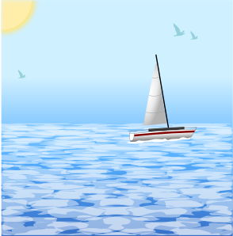
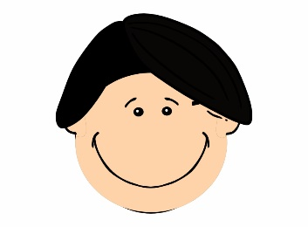
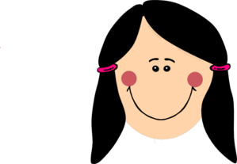
Vocabulaire
écouter
 | thank you | but
1
méchant
5
calme
anglais
il
2
6
il
merci
grand
3
merci
7
intelligent
intelligent
triste
4
8
triste
Notes:
Timing: 5 minutes
Aim: practising aural recognition of this week’s vocabulary
Procedure:
Click on a number to hear a word said out loud.
Students match what they hear with the image that best represents it.
On a click, a transcription is revealed. Students use this to check their answers.
Answer appears on a click.
At more advanced levels, ask students if they can recall the word that represents the other picture.
Ask students to identify which words contain the SSC [i].
Answers on clicks.
Transcript:
méchant
anglais
merci
intelligent
calme
il
grand
triste
Word frequency (1 is the most frequent word in French): méchant [3184], anglais [784], merci [1070], intelligent [2509], calme [1731], il [13], grand [59], triste [1843]
Source: Londsale, D., & Le Bras, Y. (2009). A Frequency Dictionary of French: Core vocabulary for learners London: Routledge.

Slide 12
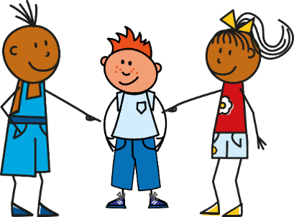
‘He is’ and ‘she is’
grammaire
As you know, je suis (I am) and tu es (you are) are parts of the verb être (to be).
To say ‘he is’, use il est. To say ‘she is’, use elle est.
Je suis
Il est
Elle est
Je suis malade.
Il est malade.
Elle est malade.
I am unwell.
He is unwell.
She is unwell.
Il est and elle est are the third person singular form of the verb être (to be).
Notes:
Timing: 3 minutes
Aim: To teach students the written and spoken forms of the verb être in the third person singular.
Procedure:
1. Read out the slide to the pupils, so that they are sure how to pronounce ‘suis’ and ‘est’.
2. Remind students about the ‘silent final consonant’ rule – we don’t pronounce the ‘s’ or the ‘t’ on the end of the verbs.
3. Remind students that ‘am’ and ‘is’ are part of the English verb ‘be’ – this is a very irregular verb in English! And it is irregular in French too!
4. Tell students, in this series of activities we will only use ‘il’ which means ‘he’.
5. We will practise the word for ‘she’ (elle) in later activities.

Slide 13
Écouter – je ou il?
écouter
You hear a man arguing with his partner about their dog! Bits of the conversation are not clear. Is the man talking about himself (‘I am …’) or about the dog (‘he is …’)?
1
5
2
6
3
7
4
8
Notes:
Timing: 6 minutes
Aim: practising aural recognition of the third person singular form of être
Procedure:
1. Click the numbers to play the audio with pronoun beeped out.
2. Write 1-8 and choose ‘I’ or ‘he’.
3. Click to reveal the answers.
4. Full audio (including pronoun) can be found on the next slide so that students can hear complete French sentences.
Transcript
[beep] est méchant.
[beep] est amusant.
[beep] suis amusant.
[beep] suis intelligent.
[beep] est stupide.
[beep] suis calme.
[beep] suis triste.
8) [beep] est content.
Note that all the adjectives are compatible with a male noun (the dog). This is so that we steer clear of adjectival agreement for now.
Word frequency of unknown cognates used (1 is the most frequent word in French): stupide [3407]
Source: Londsale, D., & Le Bras, Y. (2009). A Frequency Dictionary of French: Core vocabulary for learners London: Routledge.

Slide 14
Écouter – je ou il?
écouter
You hear a man arguing with his partner about their dog! Bits of the conversation are not clear. Is the man talking about himself (‘I am …’) or about the dog (‘he is …’)?
1
5
2
6
3
7
4
8
Notes:
Answers to the previous exercise with full audio played on clicks.
Transcript
Il est méchant.
Il est amusant.
Je suis amusant.
Je suis intelligent.
Il est stupide.
Je suis calme.
Je suis triste.
Il est content.

Slide 15
Lire
lire
You are reading a blog. Some of the text has not downloaded properly. Is the person talking about himself or his ideal penfriend? Look carefully at the verb.
1 | đĦĦċđø est cool |  |  | 5 | đĦĦċđø suis grand
2 | đĦĦċđø est français |  |  | 6 | đĦĦċđø est petit
3 | đĦĦċđø suis anglais |  |  | 7 | đĦĦċđø suis triste
4 | đĦĦċđø est intelligent |  |  | 8 | đĦĦċđø suis amusant
I
he
I
he
Notes:
Timing: 6 minutes
Aim: practising written recognition of the third person singular form of être
Procedure:
1. Write 1-8 and choose ‘I’ or ‘he’.
2. Click to reveal answers.
Word frequency of unknown cognates used (1 is the most frequent word in French): cool [>5000], français [251], sportif [2670], grand [59], amusant [4695]
Source: Londsale, D., & Le Bras, Y. (2009). A Frequency Dictionary of French: Core vocabulary for learners London: Routledge.

Slide 16
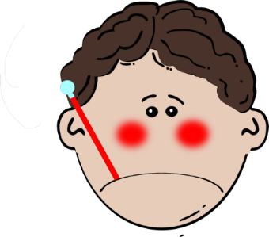
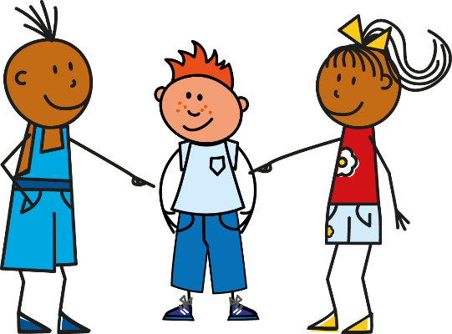
Écrire
écrire
Notes:
Timing: 8 minutes
Aim: practising written production of the third person singular form of être
Procedure:
1. Each click produces a new combination of a pronoun (I or he) plus adjective.
2. Using mini whiteboards/paper as the teacher sees fit, students write each sentence that is generated after each click.
3. Feedback could be given after the first two or three to check that all learners are producing ‘je suis’ or ‘il est’ correctly.
4. NB Only ‘il est’ is practised here, to eliminate the need for adjective agreement to reduce cognitive load. Adjective agreement is practised as a separate teaching points in two sets of activities for Year7 Week 1 and Year 7 Week 2.

Slide 17
Parler
parler
Picks a verb + adjective
Partner A
“Il est
malade."
Partner B
Translates
“He is unwell.”
Notes:
Timing: 8 minutes
See separate set of cards (word doc)
Aim: practising aural production of the third person singular forms of être
Procedure:
1. Download and cut out the prompt cards (found on the portal alongside this resource). Encourage students to thank you for their set of cards by saying ‘merci!’
2. Separate the cards into two piles: one pile of pronouns (“I” and ”he”) and one pile of adjectives. (Take care to not include any of the ‘tu’ cards, which look a bit similar!)
3. Partner A picks a verb and then an adjective, partner B gives the translation.
4. Players can then swap roles.
5. Pairs of students can time themselves, and then repeat the activity to see how quickly they can complete all the sentences and translations. With each new game, different sentences will be generated.
NB Only ‘il est’ is practised here, to eliminate the need for adjective agreement to reduce cognitive load. Adjective agreement is practised as a separate teaching points in two sets of activities for Year 7 Week 1 and Year 7 Week 2.
Note: The cards do not have to be printed, but they provide a model for the speaking activity. Pupils can easily be given one sheet of A4 white paper, fold it in half (lengthways), then again in half (widthways), then again into three, so that 12 equal-sized rectangular shapes are created. In 3 of them, they write ‘I’, in 3 others, they write ‘he’, then they write: ill, cool, big, small, English, French once on each of the other six. They tear (with or without use of a ruler, and certainly no scissors – it doesn’t need to be neat!). The first time students create their own flashcards takes about 5 mins, but they get quicker and quicker. It saves copying, cutting…

Slide 18
Describing a thing or a person [2]
regular adjective gender agreement intonation questions
SSC [eu]
Y7 French
Term 1.1 - Week 2 - Lesson 4
Stephen Owen / Rachel Hawkes / Catherine Morris
Artwork by: Chloé Motard
Date updated: 18/09/2021
Notes:
Learning outcomes (lesson 2):
Introduction of SSC [eu]
Consolidation of regular adjective gender agreement – as complement to verb only
Introduction of intonation questions
Word frequency (1 is the most frequent word in French):
1.1.2 (consolidate) est [5], il [13], elle [38], amusant [4695], calme [1731], content [1841], intelligent [2509], malade [1066], méchant [3184], triste [1843], mais [30], ou [33], merci [1070]
Source: Londsale, D., & Le Bras, Y. (2009). A Frequency Dictionary of French: Core vocabulary for learners London: Routledge.

Slide 19
eu
deux
Notes:
Timing: 1 minute
Aim: To introduce SSC [eu]
Procedure: 1. Present the letter(s) and say the [eu] sound first, on its own. Students repeat it with you. 2. Bring up the word ”deux” on its own, say it, students repeat it, so that they have the opportunity to focus all of their attention on the connection between the written word and its sound.
3. A possible gesture for this would be to hold up two fingers (N.B. palm of the hand facing the class!). 4. Roll back the animations and work through 1-3 again, but this time, dropping your voice completely to listen carefully to the students saying the [eu] sound, pronouncing ”deux” and, if using, doing the gesture.
Word frequency (1 is the most frequent word in French):
deux [41].
Source: Londsale, D., & Le Bras, Y. (2009). A Frequency Dictionary of French: Core vocabulary for learners London: Routledge.

Slide 20
eu
deux
Notes:
With sound and no pictures to focus all attention on the sound-symbol correspondence.

Slide 21
eu
deux
Notes:
Without sound to elicit pronunciation (without first hearing the teacher).
Teacher to elicit pronunciation by asking “Comment dit-on …"

Slide 22
eu
jeudi
lieu
[place]
deux
feu
jeu
un peu
[a little]
Notes:
Timing: 2 minutes
Aim: To introduce SSC [eu]
Procedure:
1. Introduce and elicit the pronunciation of the individual SSC [eu] and then the source word again ‘deux’ (with gesture, if using). 2. Then present and elicit the pronunciation of the five cluster words.
The cluster words have been chosen for their high-frequency, from a range of word classes, with the SSC (where possible) positioned within a variety of syllables within the words (e.g. initial, 2nd, final etc.). Additionally, we have tried to use words that build cumulatively on previously taught SSCs (see the Phonics Teaching Sequence document) and do not include new SSCs. Where new SSCs are used, they are often consonants which have a similar symbol-sound correspondence in English.
Word frequency (1 is the most frequent word in French): deux {41]; jeudi[1112]; lieu [117] feu [786]; un peu [138/91]; jeu [291]. Source: Londsale, D., & Le Bras, Y. (2009). A Frequency Dictionary of French: Core vocabulary for learners London: Routledge.

Slide 23
eu
jeudi
lieu
deux
feu
jeu
un peu
Notes:
With sound and no pictures to focus all attention on the sound-symbol correspondence.

Slide 24
eu
jeudi
lieu
deux
feu
jeu
un peu
Notes:
Without sound to elicit pronunciation (without first hearing the teacher).
Teacher to elicit pronunciation by asking “Comment dit-on …"

Slide 25
Phonétique
écouter
Tally how many times you hear [eu] |  | Phrases
1
De nombreux animaux vivent à la ferme.
I
A lot of animals live at the farm.
2
IIII
Ceux qui font la queue sont heureux.
Those who queue are happy.
3
Il veut être courageux, mais c’est douteux.
III
He wants to be brave, but it’s doubtful.
Notes:
Timing: 2 minutes
Aim: practising recognition of SSC [eu]
Procedure:
1. Click the numbers to play the audio.
2. Students write 1-3 and tally how many times they hear the SSC [eu].
Transcript:
De nombreux animaux vivent à la ferme.
Ceux qui font la queue sont heureux.
Il veut être courageux, mais c’est douteux.
Word frequency (1 is the most frequent word in French): nombreux [366], animal [1002], celui [45], queue [3255], heureux [764], vouloir [57], courageux [2198], douteux [>5000]
Source: Londsale, D., & Le Bras, Y. (2009). A Frequency Dictionary of French: Core vocabulary for learners London: Routledge.

Slide 26
Phonétique
SFC
parler
bleu
creux
30
[blue]
[hollow]
eux
neutre
vieux
[them]
[neutral]
[old]
secondes
peut-être
nerveux
[maybe]
[nervous]
mieux
milieu
dieu
0
[better]
[middle]
DÉBUT
[god]
Notes:
Timing: 3 minutes for 3 slides
Aim: To correctly pronounce unknown words containing [eu] in decreasing amounts of time, helping automisation of SSC production. The words chosen otherwise contain sounds that are equivalent (or very similar) to English SSCs, as well as known SSCs, so that students can focus fully on the [eu] (allowances are made for English pronunciation of [r], which is covered in year 8).
Procedure:
Students pair up, and take turns trying to say all the words in 30 seconds (run the timer twice).
Ask students which words also contain the other SSC introduced this week [i].
Click on the words to hear them pronounced by a native speaker. Students repeat.
Move on to the next slide.
Word frequency (1 is the most frequent word in French): bleu [1216], creux [3508], eux [161], neutre [2785], vieux [671], peut-être [190], nerveux [3735], mieux [217], milieu [479], dieu [2262]
Source: Londsale, D., & Le Bras, Y. (2009). A Frequency Dictionary of French:], Core vocabulary for learners London: Routledge.

Slide 27
Phonétique
SFC
parler
bleu
creux
20
[blue]
[hollow]
eux
neutre
vieux
[them]
[neutral]
[old]
secondes
peut-être
nerveux
[maybe]
[nervous]
mieux
milieu
dieu
0
[better]
[middle]
DÉBUT
[god]
Notes:
As per previous slide, but with ten fewer seconds on the timer.

Slide 28
Phonétique
SFC
parler
bleu
creux
10
[blue]
[hollow]
eux
neutre
vieux
[them]
[neutral]
[old]
secondes
peut-être
nerveux
[maybe]
[nervous]
mieux
milieu
dieu
0
[better]
[middle]
DÉBUT
[god]
Notes:
As per previous slide, but with ten fewer seconds on the timer again.

Slide 29
Vocabulaire
parler
Word |  | English Meaning
1 |  | calm, quiet (m/f)
2 |  | but
3 |  | thank you
4 |  | or
5 |  | funny (m)
6 |  | she
Word |  | English Meaning
7 |  | glad/pleased (f)
8 |  | Ill
9 |  | sad
10 |  | mean (f)
11 |  | he
12 |  | Intelligent (m)
calme
contente
mais
malade
merci
triste
ou
méchante
amusant
il
elle
intelligent
Notes:
Timing: 2 minutes
Aim: recalling this week’s vocabulary
Procedure:
1. Elicit the French for 1-12.
2. Click to reveal the French.

Slide 30
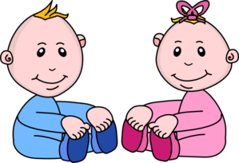
Vocabulaire
écrire
1
2
3
4
triste
malade
elle
amusant
Notes:
Timing: 2 minutes
Aim: recalling this week’s vocabulary
Procedure:
1. Students write 1-4 and the adjective they think best describes the picture
2. Click to reveal the answers.

Slide 31
Using adjectives
grammaire
The spelling and sound of adjectives sometimes change in the feminine form.
The most common change is adding an ‘e’ to the end of the adjective. This does not happen if the masculine adjective already ends in –e.
Masculine
Il est triste.
He is sad.
Je suis petit.
I (a boy) am small.
Tu es anglais.
You (a boy) are English.
Feminine
Elle est triste.
She is sad.
Je suis petite.
I (a girl) am small.
Tu es anglaise.
You (a girl) are English.
Notes:
Timing: 1 minute
Aim: To revise regular adjective gender agreement and introduce the idea that adjectives ending in –e don’t change.
Teachers may wish to ask students if they can remember the rule before showing the text.
Teachers may wish to ask students which adjectives (of those they have learnt so far) will fall into this category and which won’t. By week 2 these are: grand, petit, français, anglais, content, méchant, amusant, intelligent. The three already ending in –e are: triste / calme / malade. You then may wish to flag up that we don’t need to practise these ones as they stay the same for feminine.

Slide 32
Using adjectives
grammaire
Pronunciation can change when adding an ‘e’ to an adjective in feminine form.
Remember the rule: Silent Final Consonant
Masculine
Il est intelligent.
Silent final consonant.
An ‘e’ at the end, means you do pronounce the consonant.
The ‘t’ is not pronounced.
Feminine
Elle est intelligente.
The ‘t’ is pronounced.
The ‘e’ is not pronounced.
Notes:
Timing: 1 minute
Aim: recapping pronunciation changes with regular adjective gender agreement
Teachers may wish to ask students how the adjectives will be pronounced, before the text appears.

Slide 33
Lire
lire
Léa is reading a book about Chloé (a girl) and Isaac (a boy). The book has been read so often that some of the text has worn away. Who is being described - Chloé (C) ou Isaac (I)?
1 | grand |  |  | 5 | intelligente
2 | content |  |  | 6 | petite
3 | méchante |  |  | 7 | anglaise
4 | français |  |  | 8 | triste
I
C
I
C
Notes:
Timing: 5 minutes
Aim: practising written recognition of regular adjective gender agreement
Procedure:
1. Write 1-8 and choose ‘C’ for Chloé or ‘I’ for Isaac.
2. Click to reveal the answers.

Slide 34
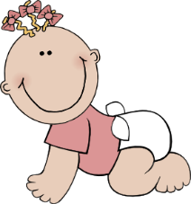
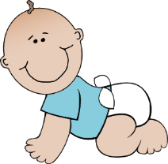
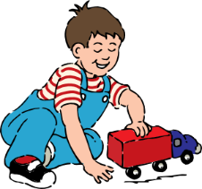
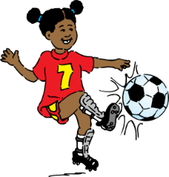
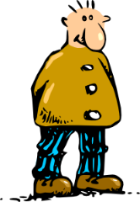
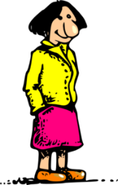
Écouter
écouter
There is also an audio book. This chapter describes Chloé’s family. Some of the sound hasn’t downloaded properly. Who is being described – the male or the female?
‘JeIl ou elle ?
1
5
2
6
3
7
4
8
Notes:
Timing: 5 minutes
Aim: practising aural recognition of regular adjective gender agreement
Procedure:
1. Click the numbers to play the audio.
2. Write 1-8 and choose ‘male’ or ‘female’.
3. Click to reveal the answers.
4. Full audio (including pronouns) can be found on the next slide so that students can hear complete French sentences.
Transcript
1) [beep] est petit
2) [beep] est intelligente
3) [beep] est grande
4) [beep] est amusant
5) [beep] est française
6) [beep] est contente
7) [beep] est méchant
8) [beep] est anglais

Slide 35
Écouter
écouter
There is also an audio book. This chapter describes Chloé’s family. Some of the sound hasn’t downloaded properly. Who is being described – the male or the female?
‘JeIl ou elle ?
1
5
2
6
3
7
4
8
Notes:
Answers to the previous exercise with full audio played on clicks.
Transcript
1) Il est petit
2) Elle est intelligente
3) Elle est grande
4) Il est amusant
5) Elle est française
6) Elle est contente
7) Il est méchant
8) Elle est anglais

Slide 36
Using adjectives
grammaire
Masculine | Feminine | Meaning
intéressant | intéressante | interesting
grand | grande | tall
petit | petite | short
amusant | amusante | funny
anglais | anglaise | English
français | française | French
content | contente | happy
méchant | méchante | naughty
Notes:
Timing: 2 minutes
Aim: reinforcing/practising pronunciation changes, checking understanding of vocabulary
Procedure:
This slide can be used in a number of ways:
1. To reinforce pronunciation changes ahead of the speaking, in a listen and repeat whole class style
2. To practise pronunciation changes. Whole class – the teacher asks individuals to give the correct answer.
3. To practise pronunciation changes. Pairwork – when the adjective disappears, ask students to turn to their partner and say the adjective out loud. This could be then be practised a few times, with a competition element added by shortening the time sequence on the animation. Challenge pairs to complete within the new speeded up time.
4. As a help-sheet which can be printed out for reference at any point during the speaking and writing activities for those students who need it. (Duplicate the slide and select print “2 to a page” for A5 size help sheets)
A note about the verbs needed for the production activities that follow:
Following on from students’ learning of être in week 1, the following pairs are practised in this sequence:
The speaking activity practises Je suis / Tu es
The writing activity practises Il / Elle est

Slide 37
Asking questions
grammaire
To change a statement into a question, raise your voice at the end:
Elle est malade.
Statement
In French, we add a space before a question mark!
She is ill.
Elle est malade ?
Question
Is she ill?
Notes:
Timing: 1 minute
Aim: introducing intonation questions
Teachers will need to model raised intonation when introducing the question.

Slide 38
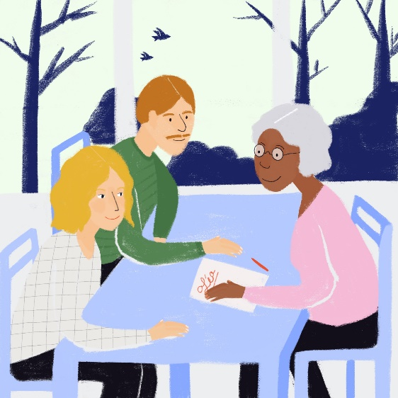
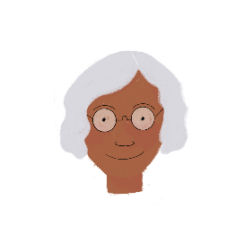
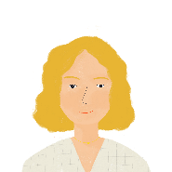
Réunion parents-professeurs !
écouter
It is parents’ evening! Léa’s mum is asking questions. Léa’s teacher answers. Who is talking? Write 1-8 and teacher OR mum ?.
?
?
1
5
2
6
3
7
4
8
Notes:
Note: This slide has no audio, yet.
Timing: 5 minutes
Aim: practising recognition of intonation questions
Procedure:
1. Students should try to work out the meaning of the title. They do not know these near cognates, but they should be encouraged to draw on their knowledge of English.
2. Write 1-8 and choose ‘teacher’ for a statement or ‘mum’ for a question.
3. Click to reveal the answers.
Transcript
Elle est intelligente
Elle est contente?
Elle est calme?
Elle est méchante
Elle est triste?
Elle est malade ?
Elle est amusante
Elle est contente
Word frequency of unknown near-cognates used (1 is the most frequent word in French): réunion [971], parent [546], professeur [1150]
Source: Londsale, D., & Le Bras, Y. (2009). A Frequency Dictionary of French: Core vocabulary for learners London: Routledge

Slide 39
Who am I?
parler
Partner A
Partner B
Je suis (+ adjective)
Tu es (+ name) ?
Oui / Non
(Yes / No)
Notes:
Timing: 10 minutes
Aim: practising oral production of regular adjective agreement and yes/no intonation questions
Procedure:
1. Teachers may wish to use this slide to model/aid the instructions for the pair work before displaying the master, or print this out as a prompt for those pairs who need support.
2. Partner A picks out a card (for these cards, see later slides) and gives a sentence to describe the card as though they were the person on the card (“I am … adjective”). They must not give the name of the person. e.g. ‘Je suis grand’. Explain to the pupils that they have to pronounce the adjective correctly, with the correct ending, otherwise their partner cannot guess who they are.
3. Partner B looks at the master on the board and says ‘Tu es Marc ?’ with raised intonation.
4. Partner A would reply ‘Oui’ if correct or ‘Non’ if incorrect. Teachers may need to explain ‘oui’ and ‘non’ if some learners aren’t familiar with these words.
5. For each correct identification players could tally their scores.

Slide 40
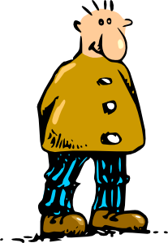
Who am I?
parler
Marc
Hélène
Clara
Philippe
(tall)
(tall)
(intelligent)
(intelligent)
Lucie
Pierre
Isaac
Emilie
(naughty)
(naughty)
(French)
(French)
Chloé
Luc
Oscar
Ella
(pleased)
(pleased)
(English)
(English)
Anna
Manon
Félix
Paul
Anna
(funny)
(funny)
(short)
(short)
Notes:
Procedure:
1. Master – display this on the IWB whilst the speaking activity is taking place.
2. Players take it in turns to select a picture from their set of 8. They imagine they are the person they have picked.
3. They give a sentence to describe themselves (I am …). The other player has to identify who is being described.
4. Explain to the pupils that they have to pronounce the adjective correctly, with the correct ending, otherwise their partner cannot guess who they are.
5. The English adjective is given underneath so that students know which to use in case it is not obvious from the picture.

Slide 41
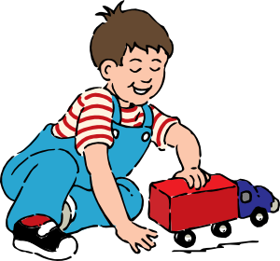
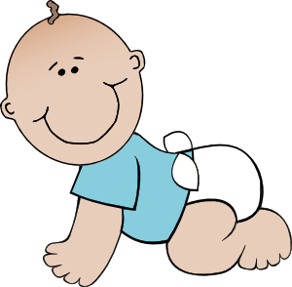
Partner A
parler
Marc
Clara
Lucie
Emilie
Luc
Ella
Paul
Félix
Notes:
Note: The creation of cards is optional.
Alternatives:
Show the master slide and give students 10 seconds to write down 8 names of their choice.
2. Use the final slide – print one sheet and cut into 32 pieces 16 x Partner A, 16 x Partner B.
Procedure:
1. Partner A cards – cut up these cards into 8 separate cards and put them into a small envelope/bag.
2. Partner A picks out a card and gives a sentence to describe the card, as though they were the person on the card (“I am … adjective”). They must not give the name of the person. e.g. ‘Je suis grand’
3. Partner B would then look at the master and say ‘Tu es Marc ?’
4. Partner A would reply ‘Oui’ if correct or ‘Non’ if incorrect.
5. For each correct identification players could tally their scores.

Slide 42
Partner B
parler
Hélène
Philippe
Pierre
Isaac
Chloé
Oscar
Anna
Manon
Notes:
Procedure:
1. Partner B cards – cut up these cards into 8 separate cards and put them into a small envelope/plastic bag.
2. Partner B picks out a card and gives a sentence to describe the card (WITHOUT using the name!) e.g. ‘Je suis grande’.
3. Partner A looks at the master and says ‘Tu es Hélène ?’
4. Partner B replies ‘Oui’ if correct or ‘Non’ if incorrect.
5. For each correct identification players could tally their scores.

Slide 43
Marc Clara Lucie Emilie Luc Paul Ella Félix
Marc Clara Lucie Emilie Luc Paul Ella Félix
Marc Clara Lucie Emilie Luc Paul Ella Félix
Marc Clara Lucie Emilie Luc Paul Ella Félix
Marc Clara Lucie Emilie Luc Paul Ella Félix
Marc Clara Lucie Emilie Luc Paul Ella Félix
Marc Clara Lucie Emilie Luc Paul Ella Félix
Marc Clara Lucie Emilie Luc Paul Ella Félix
Marc Clara Lucie Emilie Luc Paul Ella Félix
Marc Clara Lucie Emilie Luc Paul Ella Félix
Marc Clara Lucie Emilie Luc Paul Ella Félix
Marc Clara Lucie Emilie Luc Paul Ella Félix
Marc Clara Lucie Emilie Luc Paul Ella Félix
Marc Clara Lucie Emilie Luc Paul Ella Félix
Marc Clara Lucie Emilie Luc Paul Ella Félix
Marc Clara Lucie Emilie Luc Paul Ella Félix
Hélène Philippe Pierre Isaac Chloé Anna Oscar Manon
Hélène Philippe Pierre Isaac Chloé Anna Oscar Manon
Hélène Philippe Pierre Isaac Chloé Anna Oscar Manon
Hélène Philippe Pierre Isaac Chloé Anna Oscar Manon
Hélène Philippe Pierre Isaac Chloé Anna Oscar Manon
Hélène Philippe Pierre Isaac Chloé Anna Oscar Manon
Hélène Philippe Pierre Isaac Chloé Anna Oscar Manon
Hélène Philippe Pierre Isaac Chloé Anna Oscar Manon
Hélène Philippe Pierre Isaac Chloé Anna Oscar Manon
Hélène Philippe Pierre Isaac Chloé Anna Oscar Manon
Hélène Philippe Pierre Isaac Chloé Anna Oscar Manon
Hélène Philippe Pierre Isaac Chloé Anna Oscar Manon
Hélène Philippe Pierre Isaac Chloé Anna Oscar Manon
Hélène Philippe Pierre Isaac Chloé Anna Oscar Manon
Hélène Philippe Pierre Isaac Chloé Anna Oscar Manon
Hélène Philippe Pierre Isaac Chloé Anna Oscar Manon

Slide 44
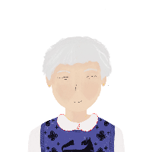
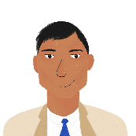
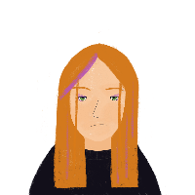
Il / elle est...
écrire
The following people are members of Léa and Amir’s families. Write six sentences describing these family members.
1 | Noura
2 | Romain
3 | Renée
4 | Bilal
5 | Elodie
6 | Abdel
e.g. 1) Elle est intelligente
Remember:
Il = ‘he’
Elle = ‘she’
Notes:
Timing: 8 minutes
Aim: practising written production of regular adjective gender agreement
Procedure:
1. Write 1-6 and write a sentence to describe each character using il or elle + adjective.

Slide 45
Devoirs
Vocabulary Learning Homework (Term 1.1, Week 3)
Audio file
Audio file QR code:
Student worksheet
Quizlet link

