Slide 1
Saying who receives the action: ‘lo’ and ‘la’ in object-first sentences
Nick Avery and Emma Marsden

Slide 2
Saying who receives the action: ‘lo’ and ‘la’ in object-first sentences
In English, the person (or thing) that ‘receives’ the action (the object) goes after the verb.
In the example, ‘the man calls the woman’, the object ‘woman’ comes after the verb.
In Spanish, there are two ways to say this:
(1) El hombre llama a la mujer.
(2) A la mujer la llama el hombre.
So, in sentences like (2) which start with the object:
‘lo’ or ‘la’ (object pronouns) are used between the object and verb.
‘lo’ is for a masculine object; ‘la’ is for a feminine object.
¡Ojo! The words ‘el’ and ‘la’ (‘the’) are different to these.
Note: when the object is a person (or pet) ‘a’ is usually used before the object, too.
Nick Avery / Emma Marsden
Notes:
This sequence is divided into four parts. Variations in pronoun use are gradually phased in.
Part 1 (slides 2–15): OVS order with an overt subject and object (e.g. al hombre lo llama la mujer)
Part 2 (slides 16–43): OVS order with an overt subject but object pronoun only (e.g. lo llama la mujer)
*Includes special narration activity for speaking/listening practice*
Part 3 (slides 45–87): The absence of subject pronouns in SVO order (e.g. llama al hombre)
Part 4 (slides 88–103): The presence of subject pronouns in SVO order (e.g. ella llama al hombre)

Slide 3
Your Spanish agent has just spotted a criminal!
She is following him and reporting back to you in HQ.
Read her messages and decide if the statements are true or false.
 | Messages
1 | El hombre mira a la mujer.
2 | Al hombre lo lleva la mujer en su coche.
3 | El hombre ve la cámara de seguridad.
4 | La policía sigue al hombre.
5 | El coche lo para el tráfico.
6 | Al hombre lo besa la mujer.
7 | El hombre llama a alguien.
8 | La mujer ve a la policía.
9 | Al hombre lo deja salir la mujer.
10 | ¡El coche lo destruye la policia!
 | True | False
The man looks at the woman.
The man takes the woman in his car.
The man sees the security camera.
The police follow the man.
The car stops the traffic.
The woman kisses the man.
Someone calls the man.
The woman sees the police.
The man lets the woman leave.
The police destroy the car!
leer
Nick Avery / Emma Marsden
Notes:
Note: Animations are set up so that the teacher offers whole class feedback after each answer. (Teachers just need to re-order the animations by clicking on ‘Animation Pane’ and moving all the ‘pictures’ to the end so that the English sentences appear first, students complete all of the task, and then the teacher corrects all answers with the class).
Word frequency rankings (1 is the most common word in Spanish):
Verbs: mirar [125]; llevar [101]; ver [38]; seguir [99]; parar [706]; besar [1591]; llamar [122]; dejar [86]; salir [114]; destruir [1283].
Nouns: hombre [97]; coche [1190]; cámara [903]; seguridad [538]; policía [629]; tráfico [2226].
Source: Davies, M. & Davies, K. (2018). A frequency dictionary of Spanish: Core vocabulary for learners (2nd ed.). London: Routledge.

Slide 4
The criminal’s accomplice escaped. Spanish police are now spying on her.
She has just been spotted with a different person.
What do they say about their actions?
 | The woman does it | The man does it
call the other person
see the other person
follow the other person
take the other person in their car
observe the other person
greet the other person
hide the other person
contact the other person
help the other person
look for the other person
1
2
3
4
5
6
7
8
9
10
escuchar
Nick Avery / Emma Marsden
Notes:
Note: Here the audio is activated for each sentence by clicking on the number. The audio is heard twice, but can be clicked again to repeat. Answers appear on each click. The task sentences are not animated. Teachers can choose whether to listen and correct each one or complete the whole task, and then correct (without making any changes to the slide animations)
Transcript: 1. La mujer llama al hombre. / 2. A la mujer la ve el hombre. / 3. La mujer sigue al hombre. / 4. A la mujer la lleva el hombre en su coche. / 5. La mujer observa al hombre. / 6. La mujer saluda al hombre. / 7. la mujer esconde al hombre. / 8. A la mujer la contacta el hombre. / 9. La mujer ayuda al hombre. / 10. A la mujer la busca el hombre.
Verb frequency: llamar [122]; ver [38]; seguir [99]; llevar [101]; mirar [125]; saludar [1575]; esconder [1130]; contactar [3866]; ayudar [328]; buscar [179].
Noun frequency: coche [1190]; hombre [97]; mujer [120]

Slide 5
Listen again and decide if the statements are true or false.
 | True | False
1
The man calls the woman.
2
The man sees the woman.
3
The man follows the woman.
4
The man takes the woman in his car.
5
The woman watches the man.
6
The man greets the woman.
7
The woman hides the man.
8
The man contacts the woman.
9
The woman helps the man to hide.
10
The man looks for the woman.
escuchar
Nick Avery / Emma Marsden
Notes:
This second part of the activity is optional. The true-false decision adds a challenge for more able students.
Transcript: 1. La mujer llama al hombre. / 2. A la mujer la ve el hombre. / 3. La mujer sigue al hombre. / 4. A la mujer la lleva el hombre en su coche. / 5. La mujer observa al hombre. / 6. La mujer saluda al hombre. / 7. A la mujer la esconde el hombre. / 8. A la mujer la contacta el hombre. / 9. La mujer ayuda al hombre. / 10. A la mujer la busca el hombre.
Verb frequency: llamar [122]; ver [38]; seguir [99]; llevar [101]; mirar [125]; saludar [1575]; esconder [1130]; contactar [3866]; ayudar [328]; buscar [179].
Noun frequency: coche [1190]; hombre [97]; mujer [120]

Slide 6
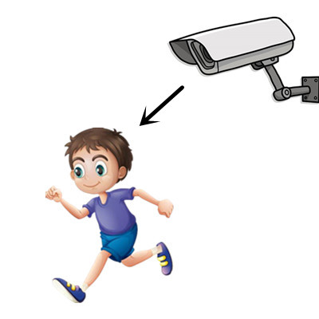
Al criminal lo ve
1) _____________________ la cámara de seguridad.
escribir
Nick Avery / Emma Marsden
Notes:
In this activity, there are 5 pairs of pictures which have been intentionally juxtaposed. This is slightly less challenging than using a different lexical item for each sentence.
NB: NCELP will soon be creating a full set of pictures to suit the police/criminal context.

Slide 7
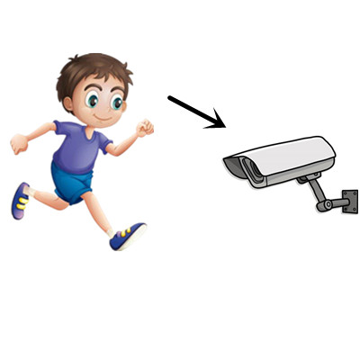
El criminal ve
2) ___________________ la cámara de seguridad.
escribir
Nick Avery / Emma Marsden

Slide 8
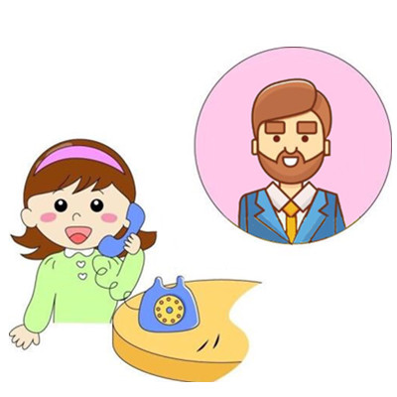
Al hombre lo llama
3) ______________________ la chica.
escribir
Nick Avery / Emma Marsden

Slide 9
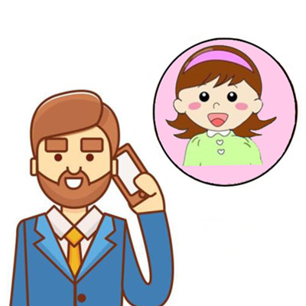
El hombre llama
4) ___________________ a la chica.
escribir
Nick Avery / Emma Marsden

Slide 10
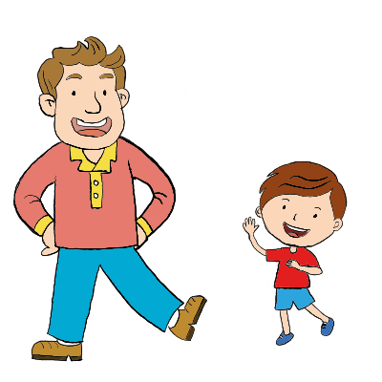
El chico saluda
5) ___________________ al hombre.
escribir
Nick Avery / Emma Marsden

Slide 11
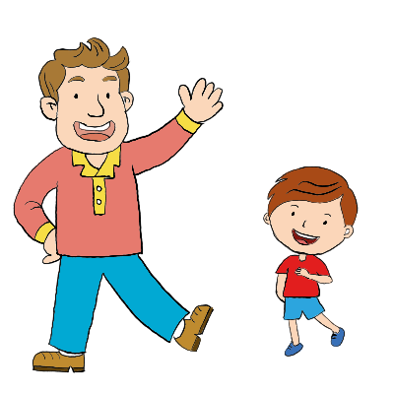
Al chico lo saluda
6) ___________________ el hombre.
escribir
Nick Avery / Emma Marsden

Slide 12
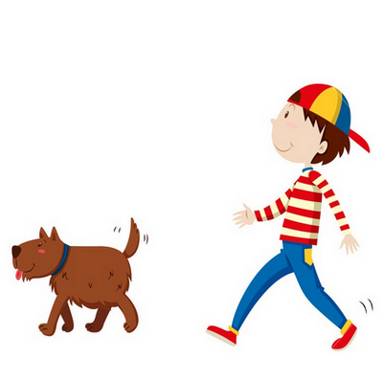
El chico sigue
7) ___________________ al perro.
escribir
Nick Avery / Emma Marsden

Slide 13
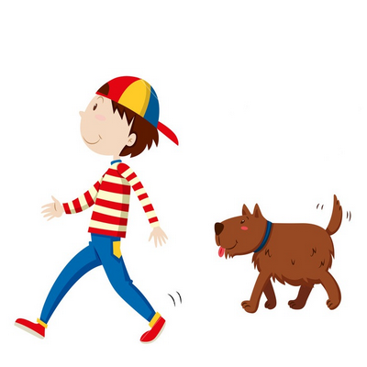
Al chico lo sigue
8) ___________________ el perro.
escribir
Nick Avery / Emma Marsden

Slide 14
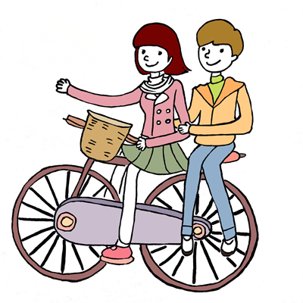
Al chico lo lleva
9) ___________________ la chica.
escribir
Nick Avery / Emma Marsden

Slide 15
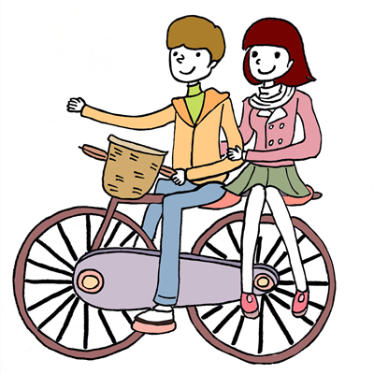
El chico lleva
10) ___________________ a la chica.
escribir
Nick Avery / Emma Marsden

Slide 16
Saying who receives the action (part 2): ‘lo’ and ‘la’ in object-first sentences
In English, we can use words like ‘him’, ‘her, and ‘it’(pronouns) to avoid repeating nouns.
Which sentence sounds more normal?
Lucy called Mark, then Lucy met Mark. Lucy then invited Mark for coffee and Lucy bought Mark a sandwich.
Lucy called Mark, then met him. She invited him for coffee and bought him a sandwich.
Spanish also has such words!
Nick Avery / Emma Marsden

Slide 17
Saying who receives the action (part 2): ‘lo’ and ‘la’ in object-first sentences
This can be confusing because ‘la’ means ‘the’ when it comes before a noun.
If the object is masculine, use ‘lo’:
La mujer llama al hombre.
Lo llama la mujer.
If the object is feminine, use ‘la’:
El hombre llama a la mujer.
La llama el hombre.
Notice that, unlike in English, the pronoun normally goes before the verb.
You have already seen that, in Spanish, the object can come first. E.g., Al hombre lo llama la mujer.
→ The woman calls the man.
→ The woman calls him.
(literally, ‘Him calls the woman.’)
→ The man calls the woman.
→ The man calls her.
(literally, ‘Her calls the man.’)
→ The woman calls the man.
→ The woman calls him.
Nick Avery / Emma Marsden

Slide 18
Saying who receives the action (part 2): ‘lo’ and ‘la’ in object-first sentences
Remember that all nouns have gender in Spanish:
Use ‘lo’ to mean ‘it’ if the object is masculine:
La mujer hace el examen.
Lo hace la mujer.
Use ‘la’ to mean ‘it’ if the object is feminine:
El hombre hace la carta.
La hace el hombre.
→ The woman does the exam.
→ The woman does it.
→ The man makes the card.
→ The man makes it.
Nick Avery / Emma Marsden
Notes:
An optional additional slide to reinforce that ‘lo’ and ‘la’ do not just mean ‘him’ and ‘her’ but also ‘it’.

Slide 19
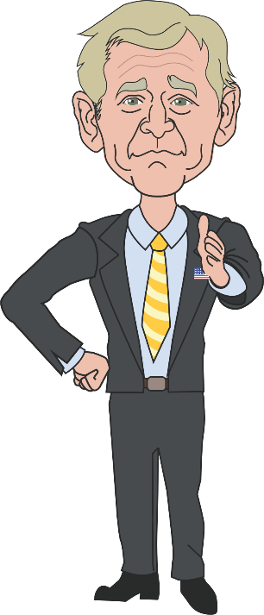
El presidente y el asistente
The president has a personal assistant at the White House.
Read the following sentences to find out about their Mondays.
https://www.goodfreephotos.com
Nick Avery / Emma Marsden

Slide 20
leer
Los lunes
1 | El presidente observa al asistente.
2 | Lo escucha el asistente.
3 | El presidente saluda al asistente.
4 | Lo ayuda el presidente.
5 | Lo llama el asistente.
6 | El asistente sigue al presidente.
7 | Lo saca de la oficina el asistente.
8 | El presidente despierta al asistente.
9 | Lo lleva a una reunion el presidente.
10 | El asistente contacta al presidente.
 | True | False
The president observes the assistant.
The assistant listens to the president.
The assistant greets the president.
The assistant helps the president.
The assistant calls the president.
The president follows the assistant.
The assistant takes the president out of the office.
The president wakes the assistant up.
The president takes the assistant to a meeting.
The president contacts the assistant.
Nick Avery / Emma Marsden
Notes:
Word frequency:
Verbs: observar [556]; escuchar [281]; saludar [1575]; ayudar [328]; llamar [122]; seguir [99]; sacar [273]; despertar [894]; llevar [101]; contactar [3866].

Slide 21
Now listen to what they do on Fridays. Who does what?
Nick Avery / Emma Marsden

Slide 22
escuchar
Los viernes
 | The president does it | The assistant does it
1. watch the other person
2. listen to the other person
3. greet the other person
4. help the other person
5. call the other person
6. follow the other person
7. take the other out of office
8. wake up the other person
9. contact the other person
10. take the other to a meeting
1
2
3
4
5
6
7
8
9
10
Nick Avery / Emma Marsden
Notes:
Transcript: 1. Lo observa el asistente. / 2. El asistente escucha al presidente. / 3. Lo saluda el presidente. / 4. Lo ayuda el asistente. / 5. El asistente llama al presidente. / 6. El presidente sigue al asistente / 7. Lo saca de la oficina el presidente / 8. Lo despierta el asistente. / 9. Lo contacta el presidente. / 10. El asistente lleva al president a la reunión.
Word frequency: observar [556]; escuchar [281]; saludar [1575]; ayudar [328]; llamar [122]; seguir [99]; sacar [273]; despertar [894]; contactar [3866]; llevar [101].

Slide 23
Monty and María
Monty is no ordinary dog!
He is María’s best four-legged friend.
Read the sentences about things they do on Mondays.
Then decide if each statement is true or false.
leer
Nick Avery / Emma Marsden

Slide 24
leer
 | True | False | Is this normal?
1
2
3
4
5
6
7
8
9
10
La lleva al parque.
He takes her to the park.
La lava.
She washes him.
Lo saluda.
She greets him.
Lo observa cuando duerme.
He watches her as she sleeps.
Lo saca de la casa.
She takes him out of the house.
La lleva al colegio.
He takes her to school.
La despierta.
He wakes her up.
Lo sigue a la cocina.
He follows her to the kitchen.
La besa.
He kisses her.
La observa atentamente.
She watches him closely.
Nick Avery / Emma Marsden
Notes:
Word frequency:
Verbs: llevar [101]; saludar [1575]; observar [556]; sacar [273]; llevar [101]; despertar [894]; seguir [99]; besar [1591]; dormir [403].
Nouns: parque [1354]; casa [106]; cocina [1214]
Adverbs: atentamente [>5000]; cuando [57].

Slide 25
Now listen to what they do on Thursdays.
Decide which picture matches the sentence.
escuchar
Nick Avery / Emma Marsden

Slide 26
A las seis de la mañana…
escuchar
Nick Avery / Emma Marsden

Slide 27
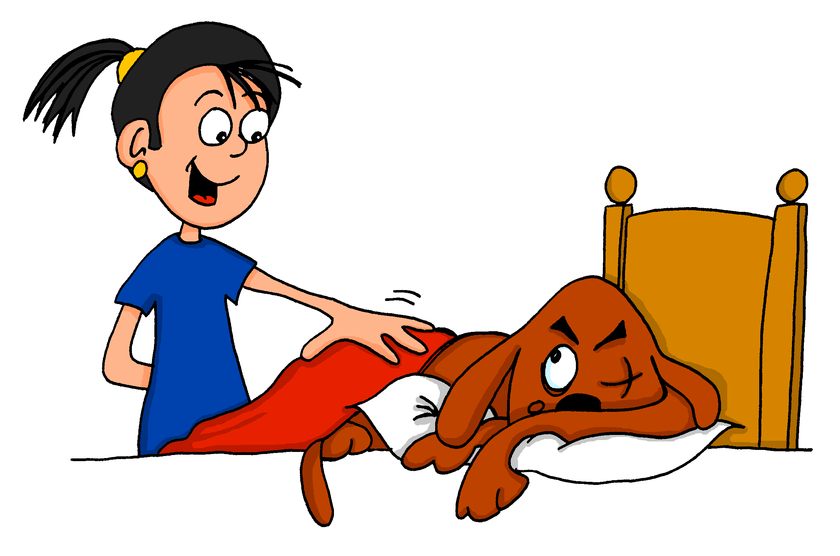
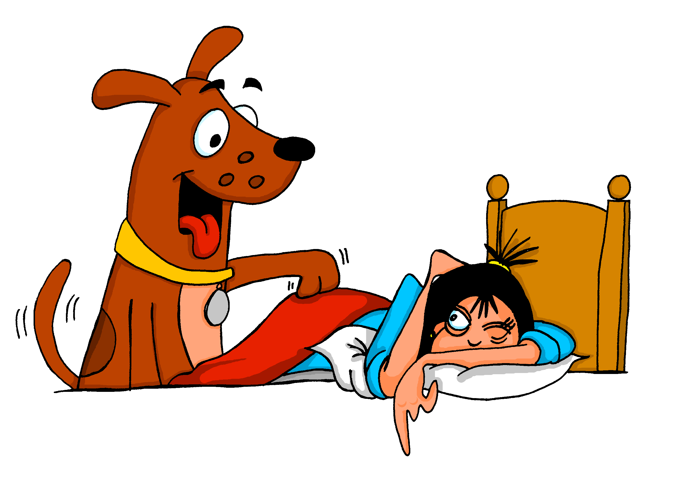
1
A
B
¿Esto es normal?
escuchar
Nick Avery / Emma Marsden
Notes:
Transcript: 1. Lo despierta con mucha emoción.
Word frequency: despertar [894]; much@ [41]; emoción [1448].

Slide 28
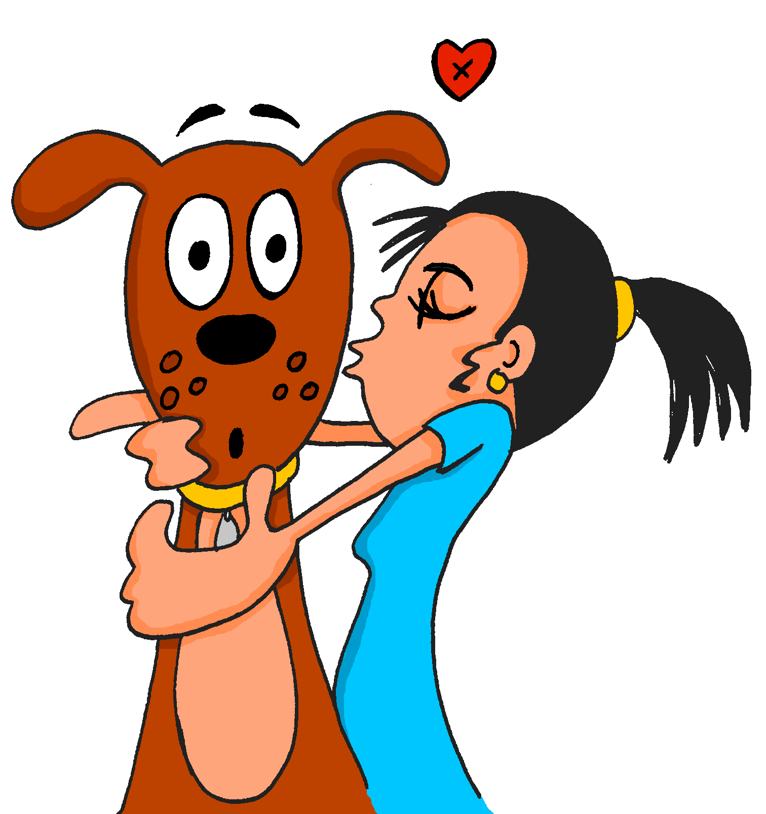
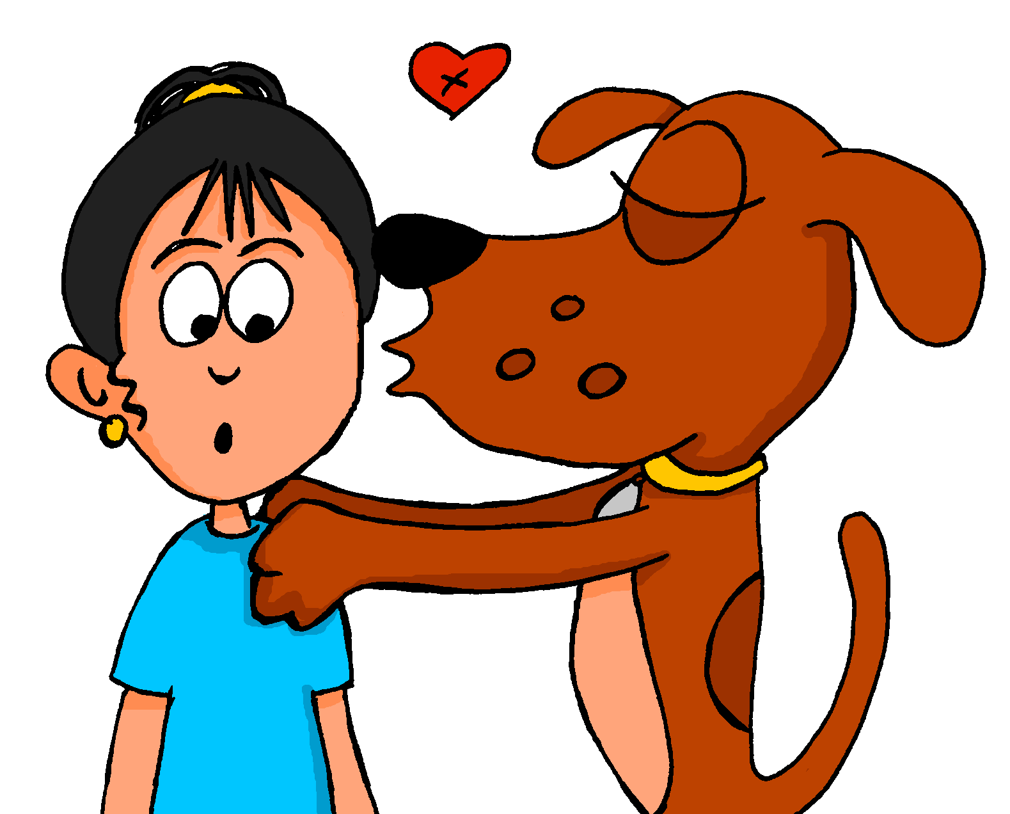
2
A
B
¿Esto es normal?
escuchar
Nick Avery / Emma Marsden
Notes:
Transcript: 2. Lo besa.
Word frequency: besar [1591]

Slide 29
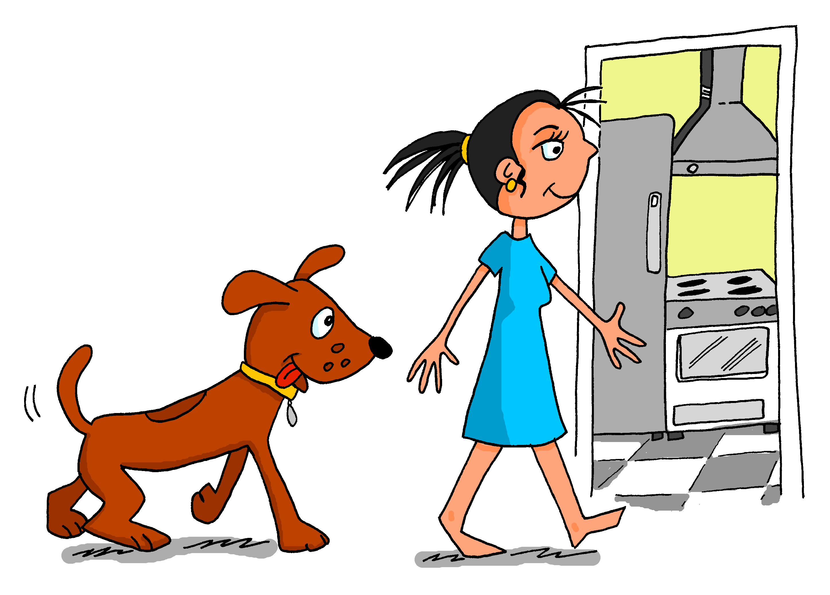
3
A
B
¿Esto es normal?
escuchar
Nick Avery / Emma Marsden
Notes:
Transcript: 3. La sigue a la cocina.
Word frequency: seguir [99]; cocina [1214]

Slide 30
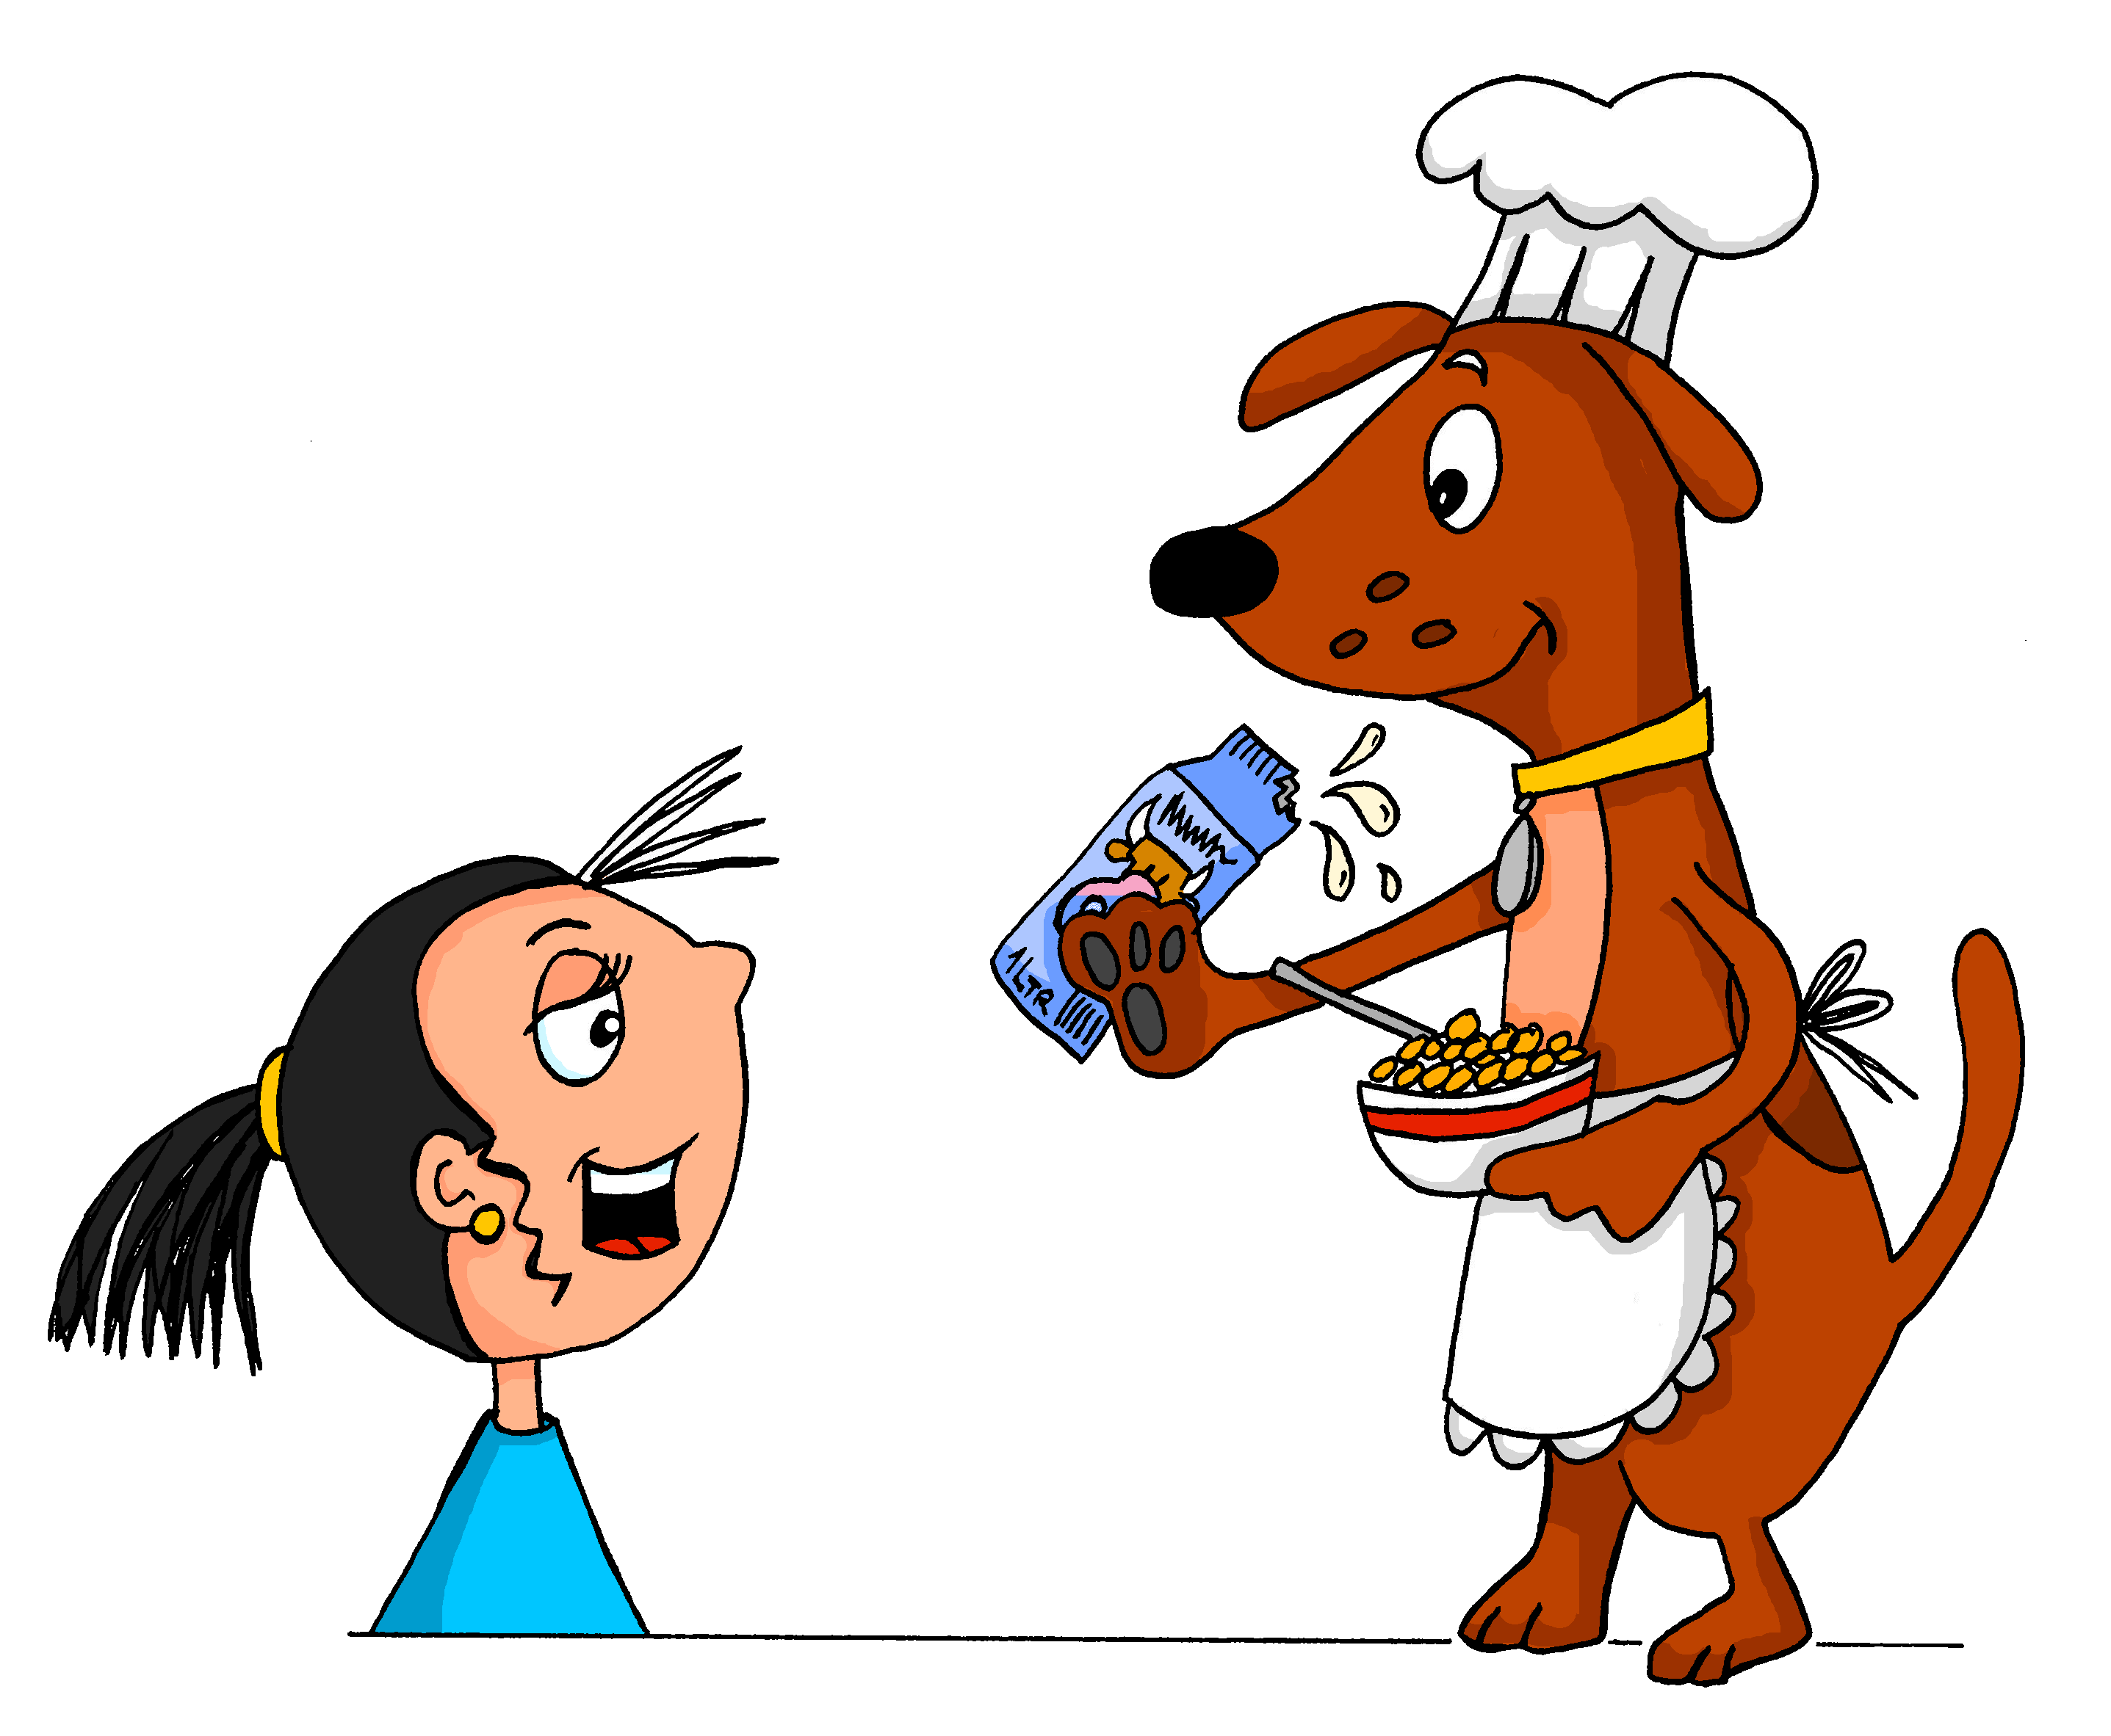
4
A
B
¿Esto es normal?
escuchar
Nick Avery / Emma Marsden
Notes:
Transcript: 4. Lo observa atentamente.
Word frequency: observer [556]; atentamente [>5000]

Slide 31
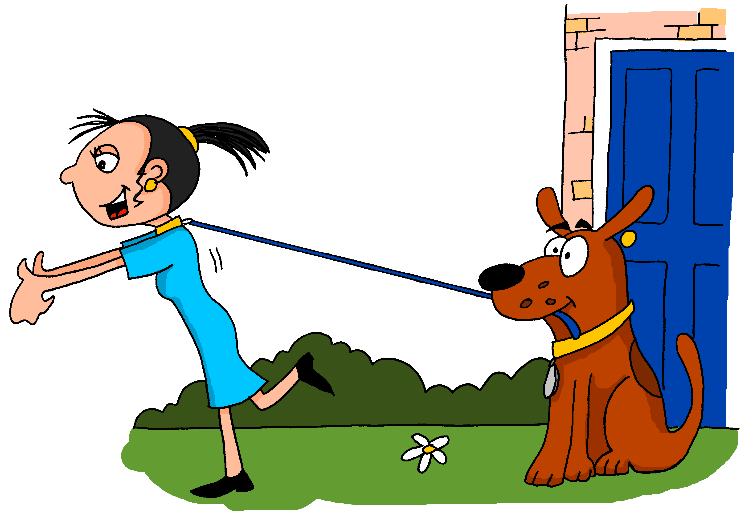
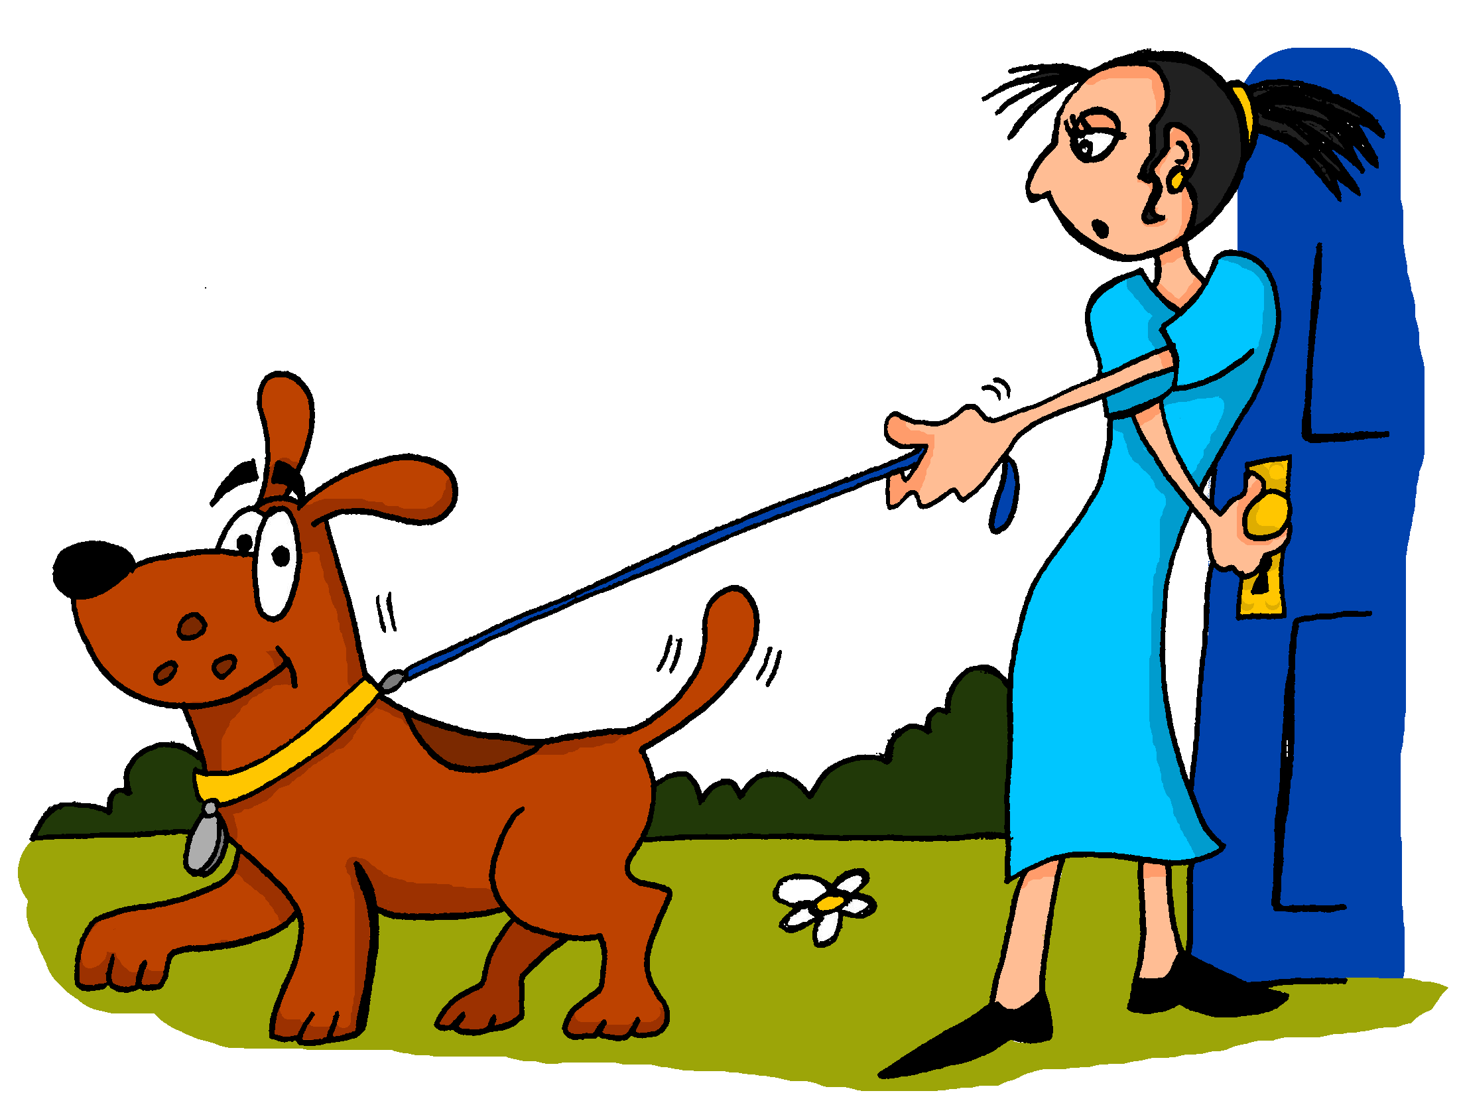
5
A
B
¿Esto es normal?
escuchar
Nick Avery / Emma Marsden
Notes:
5. La saca de la casa.
Word frequency: sacar [273]; casa [106]

Slide 32
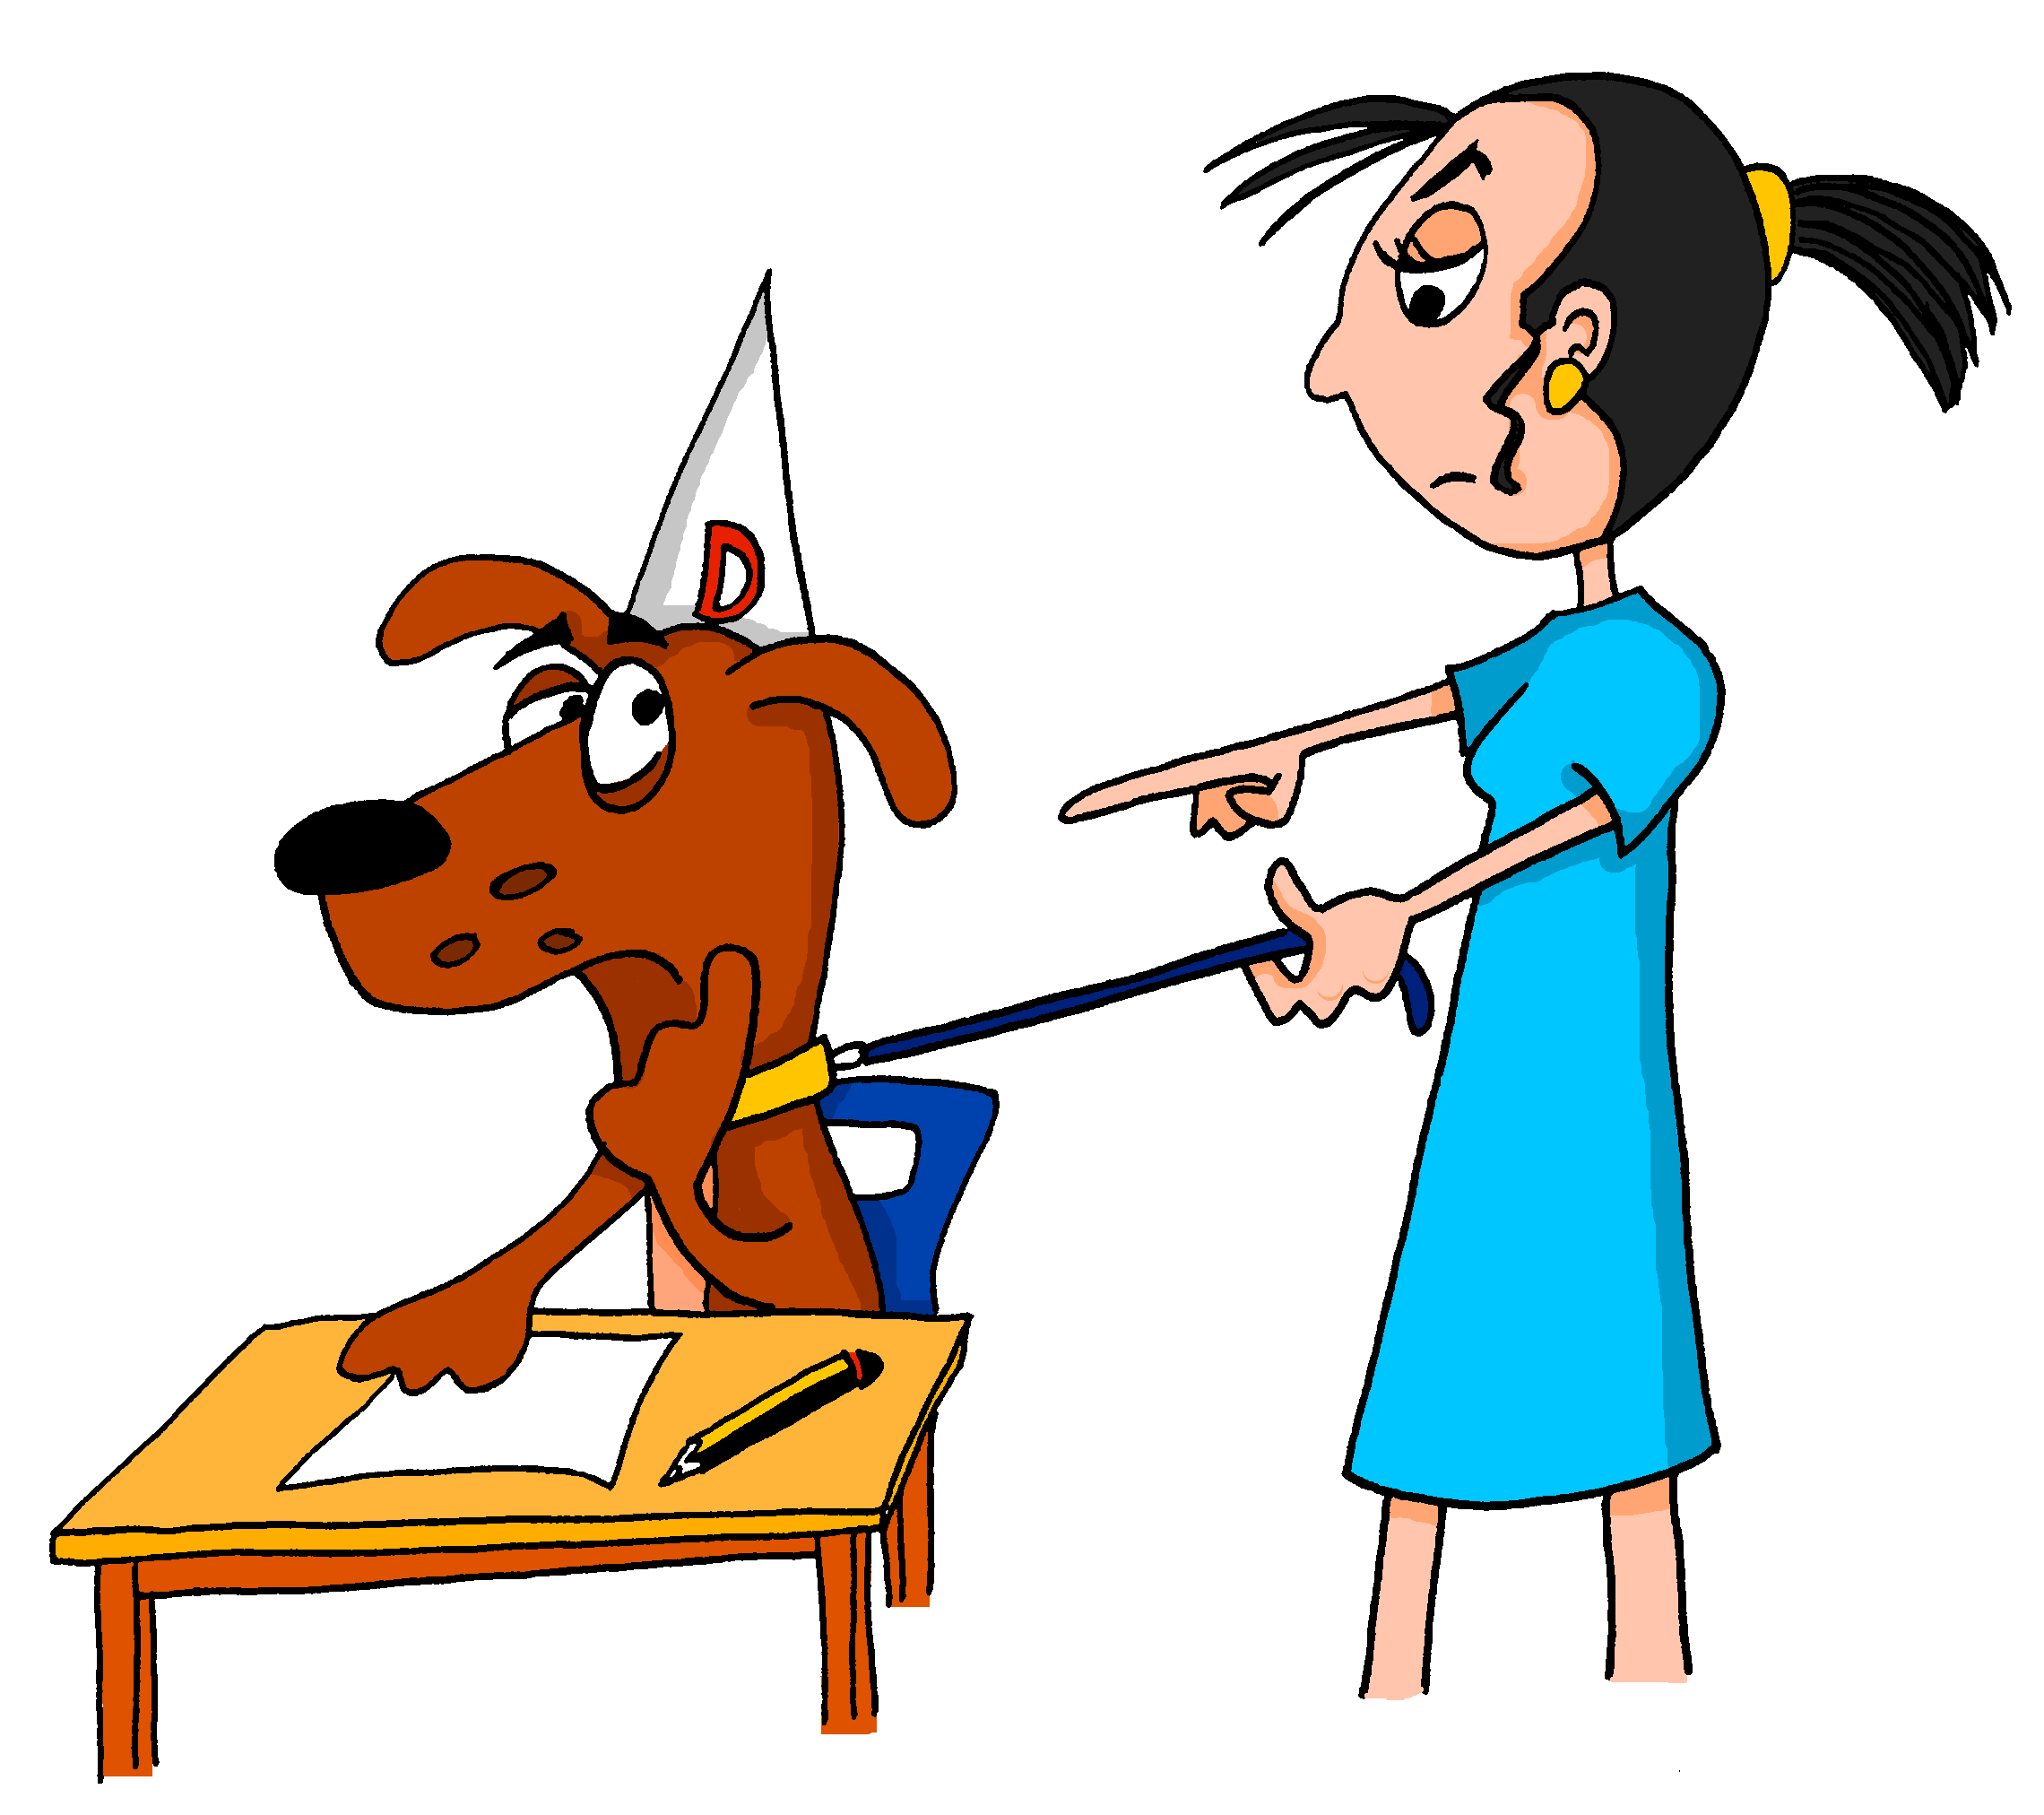
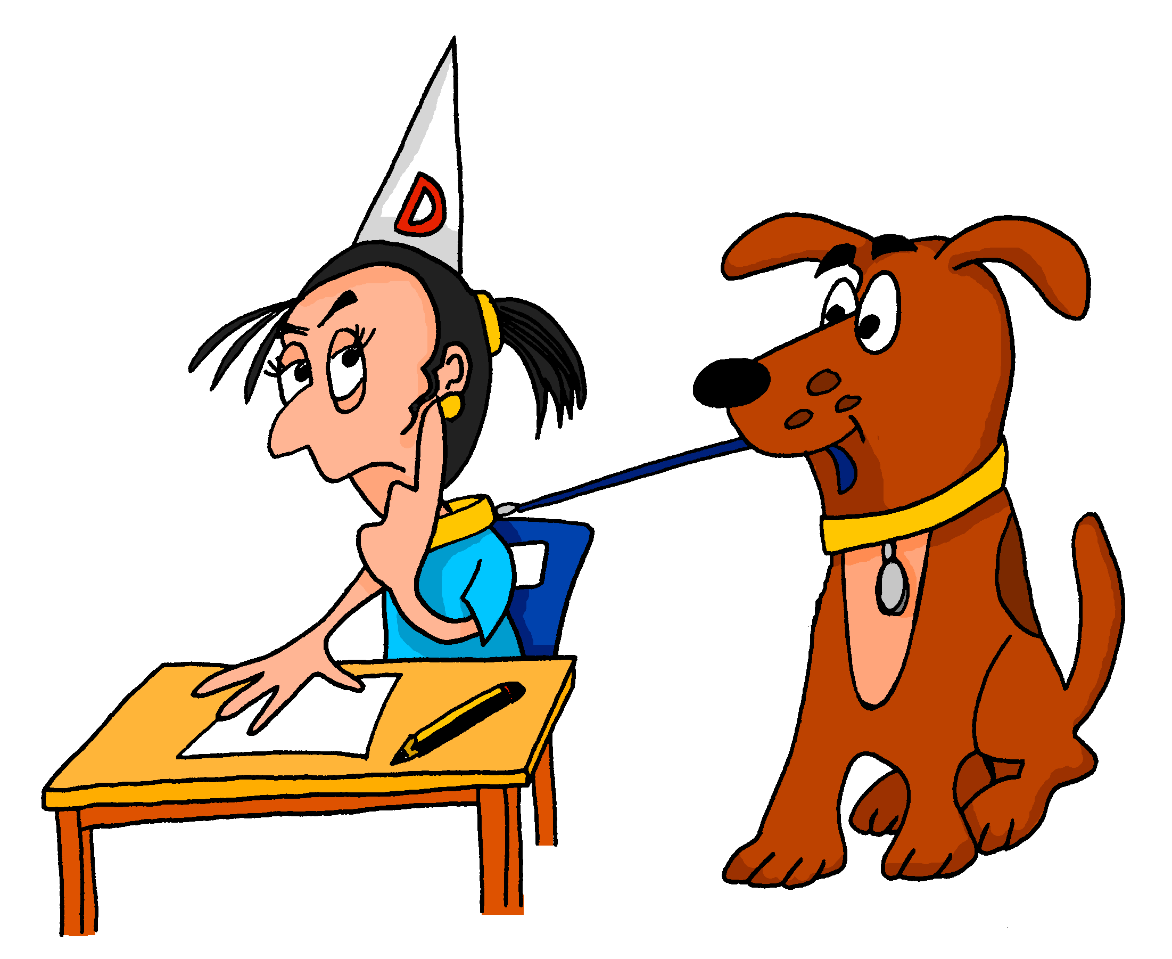
6
A
B
¿Esto es normal?
escuchar
Nick Avery / Emma Marsden
Notes:
6. Lo lleva al colegio.
Word frequency: llevar [101] colegio [628]

Slide 33
Más tarde, María llega a casa…
Nick Avery / Emma Marsden

Slide 34
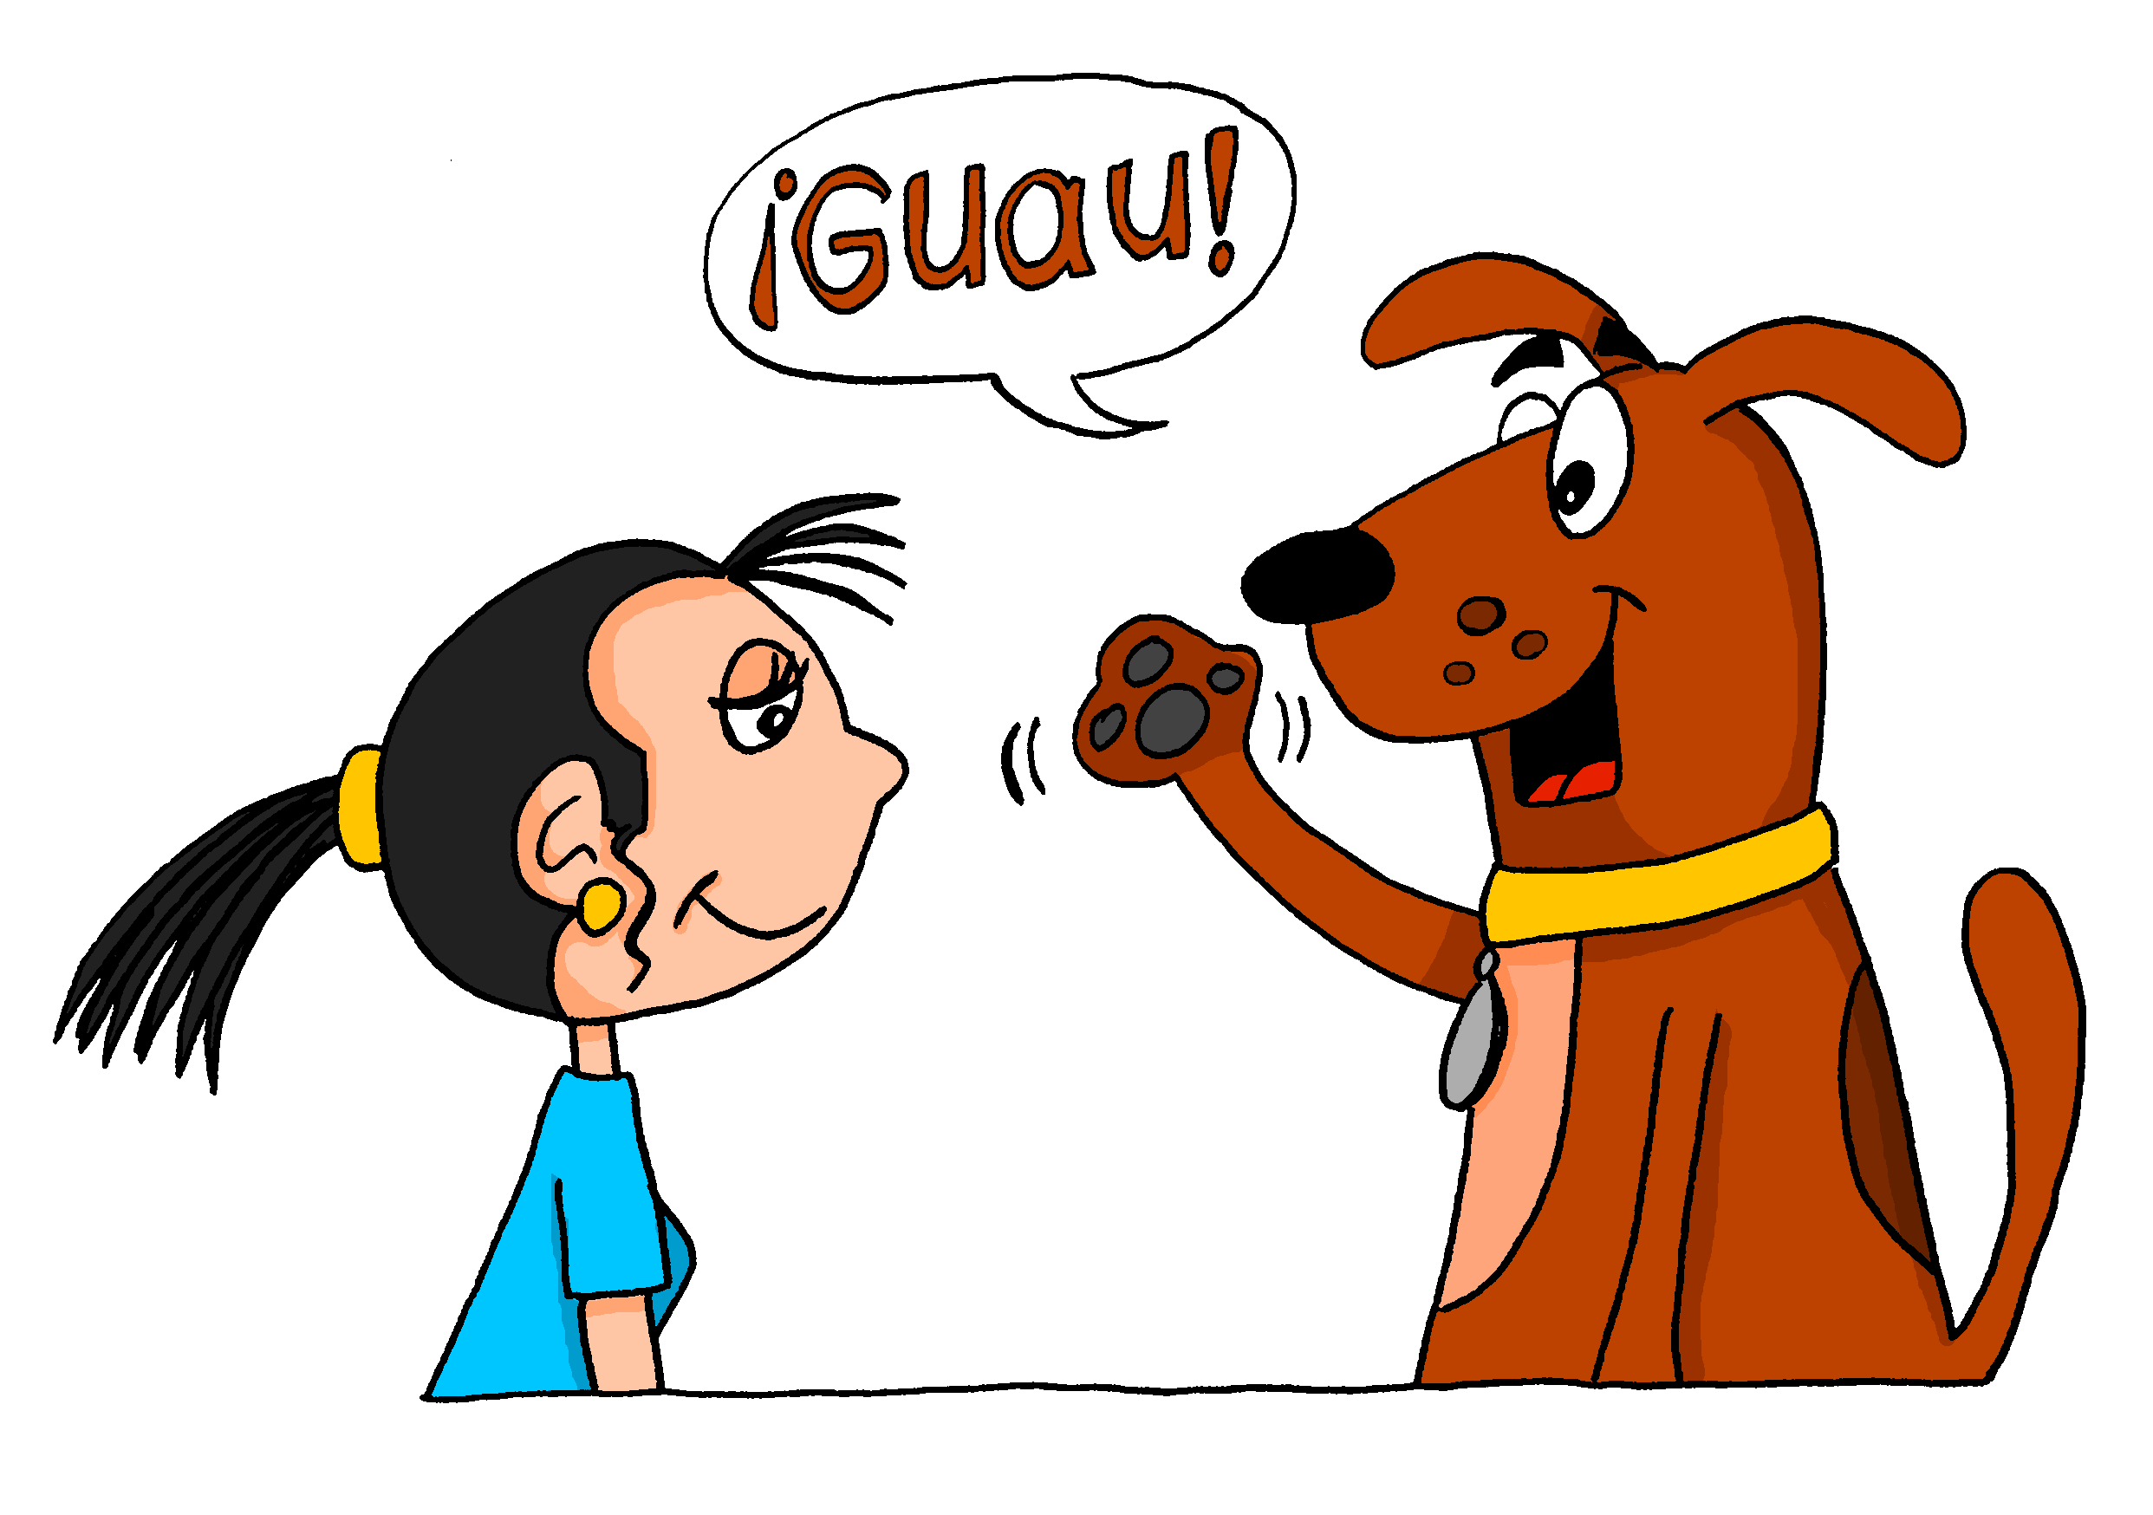
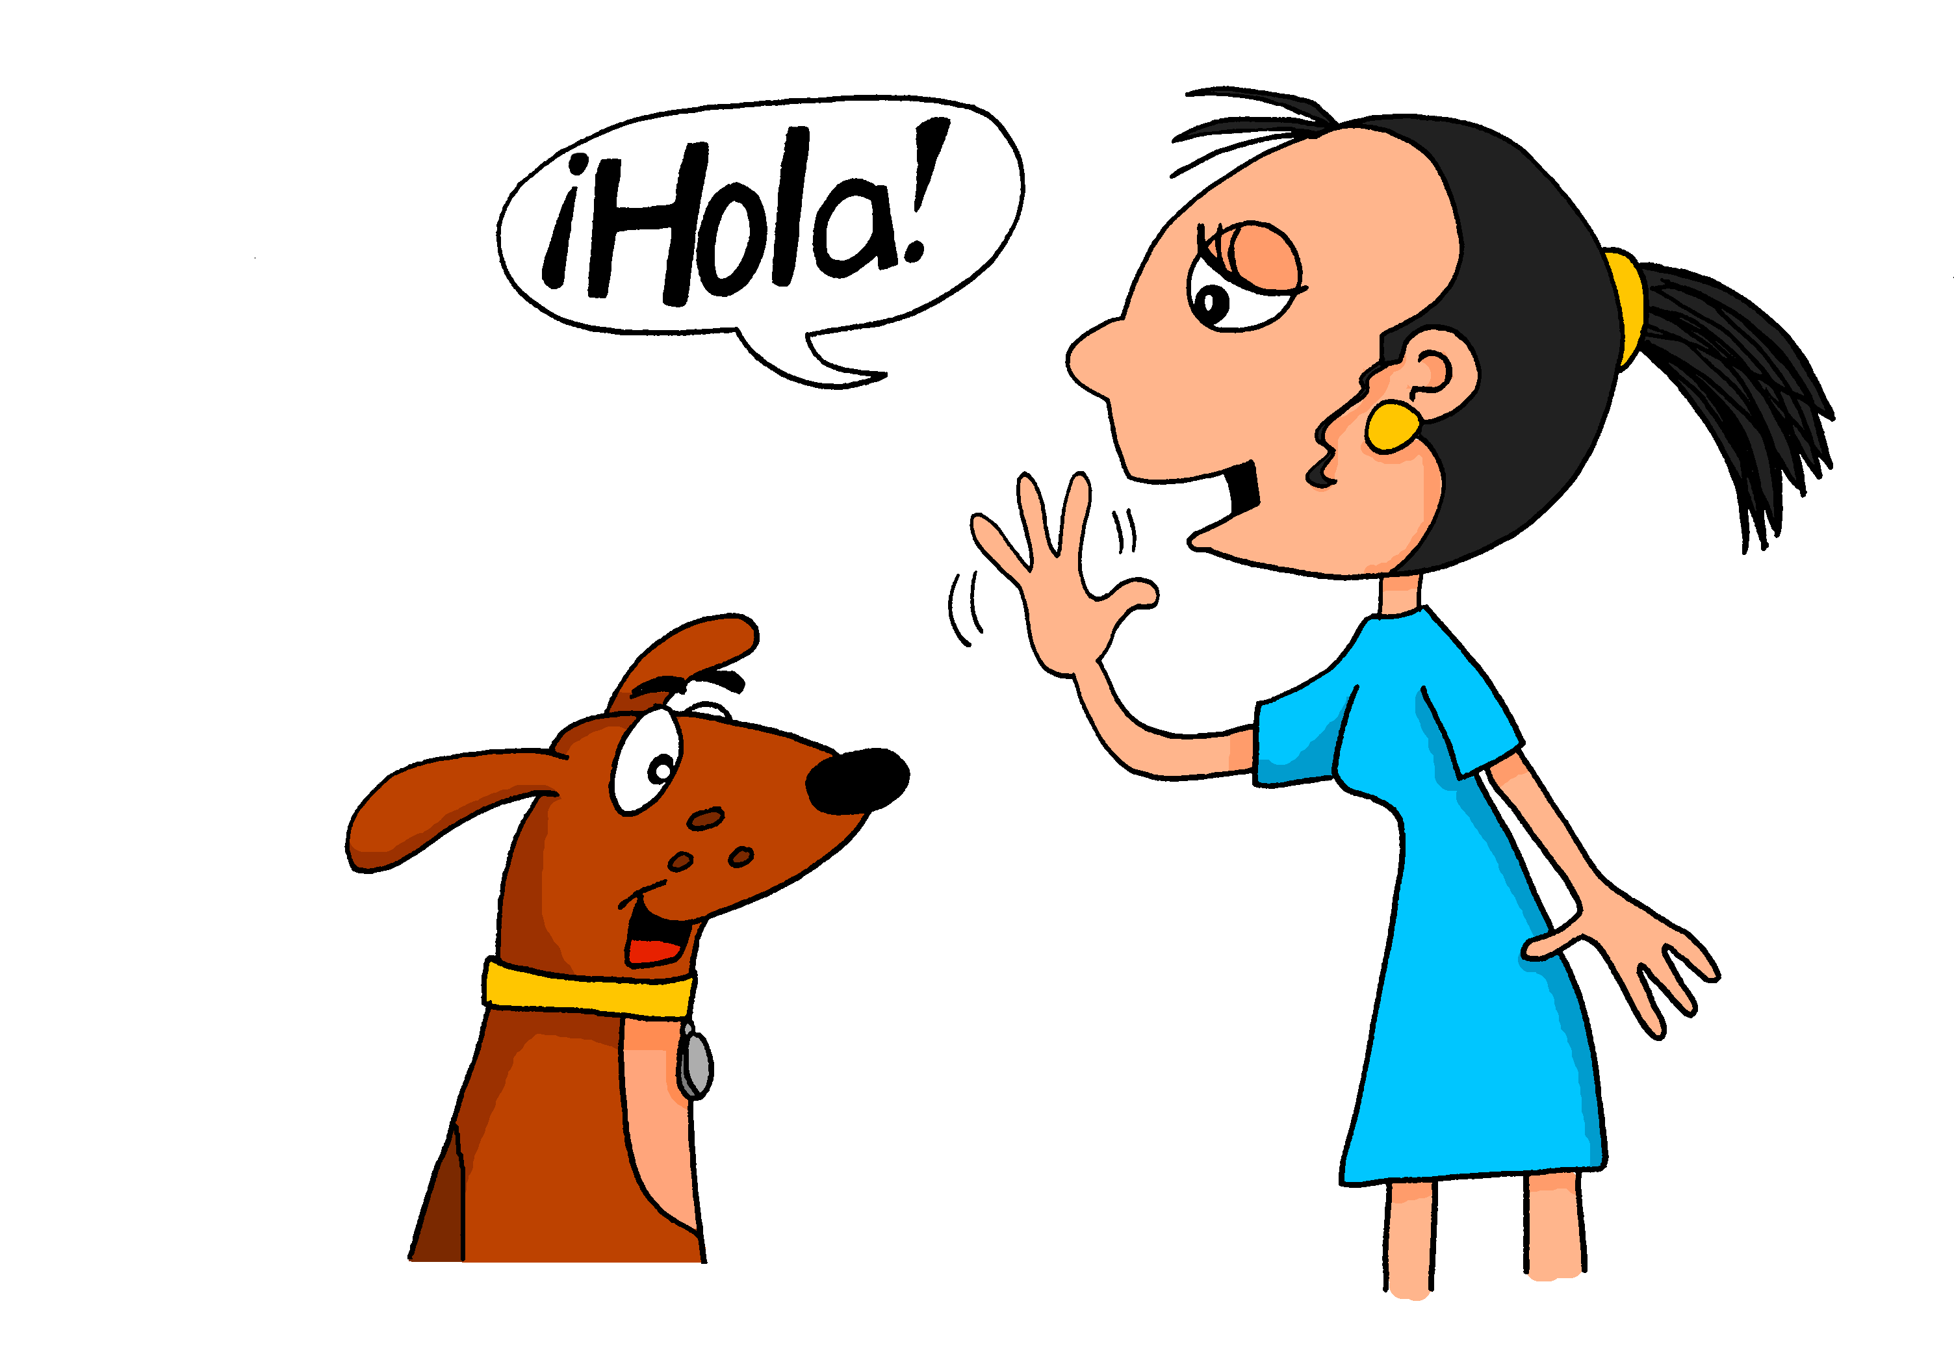
7
A
B
¿Esto es normal?
escuchar
Nick Avery / Emma Marsden
Notes:
Transcript: 7. La saluda.
Word frequency: saludar [1575].

Slide 35
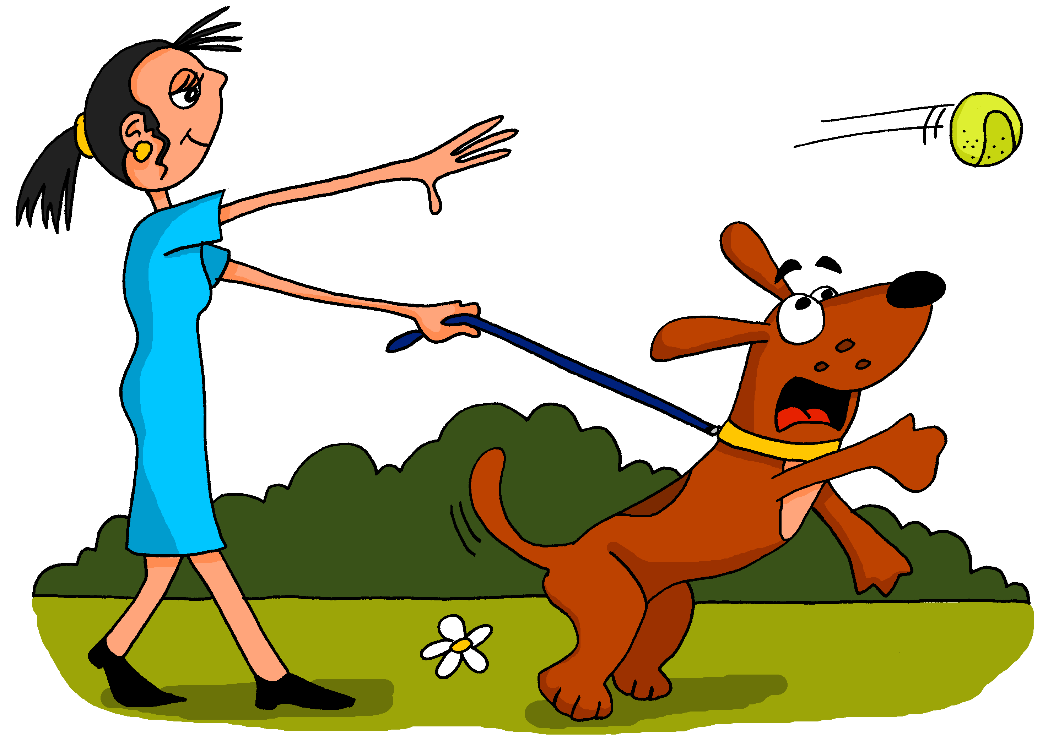
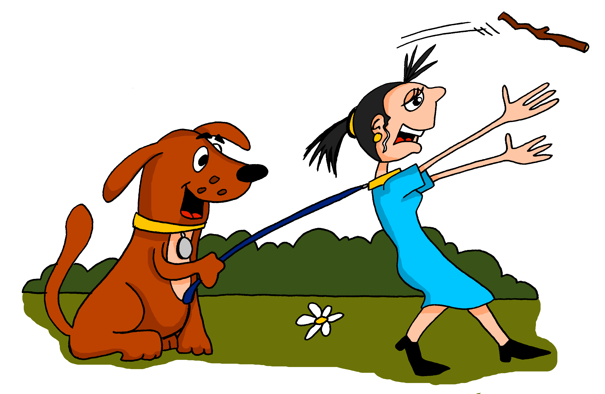
8
A
B
¿Esto es normal?
escuchar
Nick Avery / Emma Marsden
Notes:
Transcript: 8. Lo lleva al parque para jugar.
Word frequency: Llevar [101]; parque [1354]; para [16]; jugar [356].

Slide 36
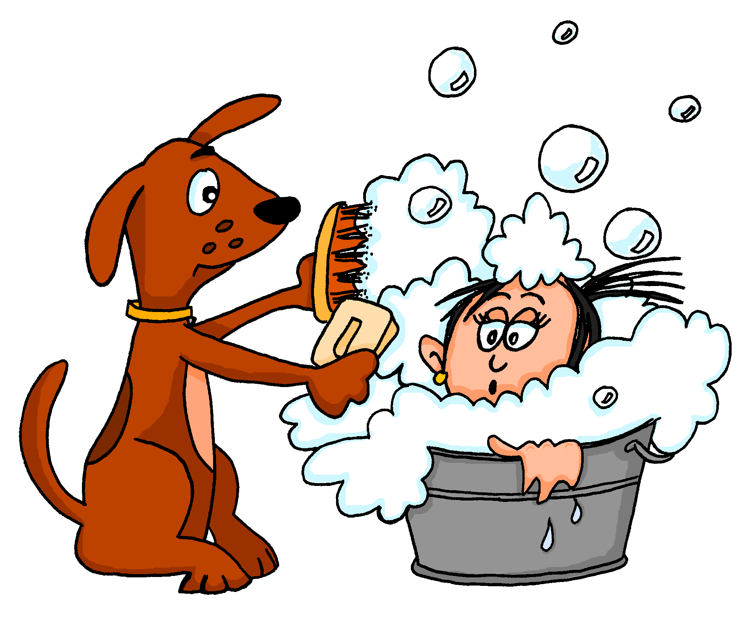
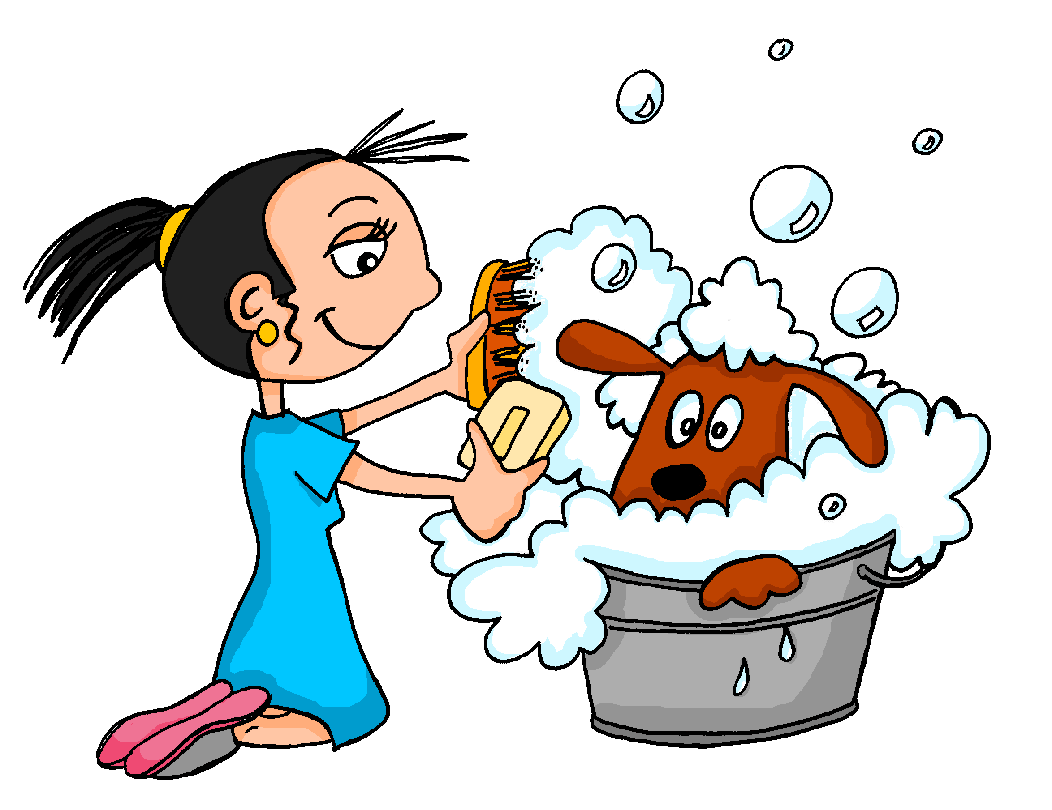
9
A
B
¿Esto es normal?
escuchar
Nick Avery / Emma Marsden
Notes:
Transcript: 9. Lo lava con mucho jabón.
Word frequency: lavar [1676]; con [14]; mucho [41]; jabón [4783].

Slide 37
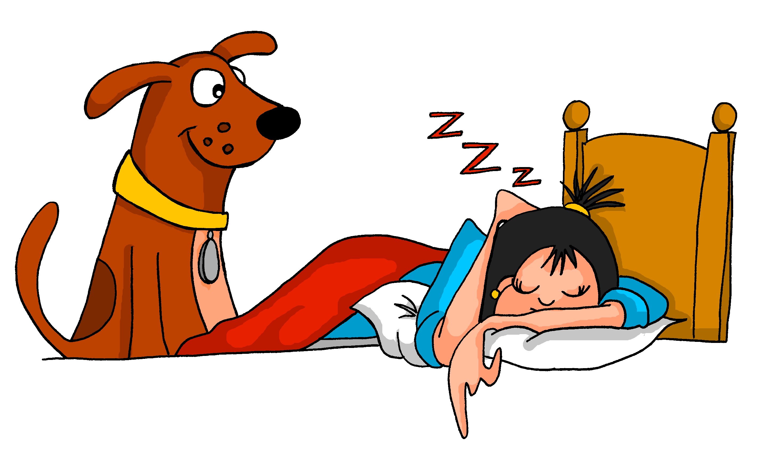
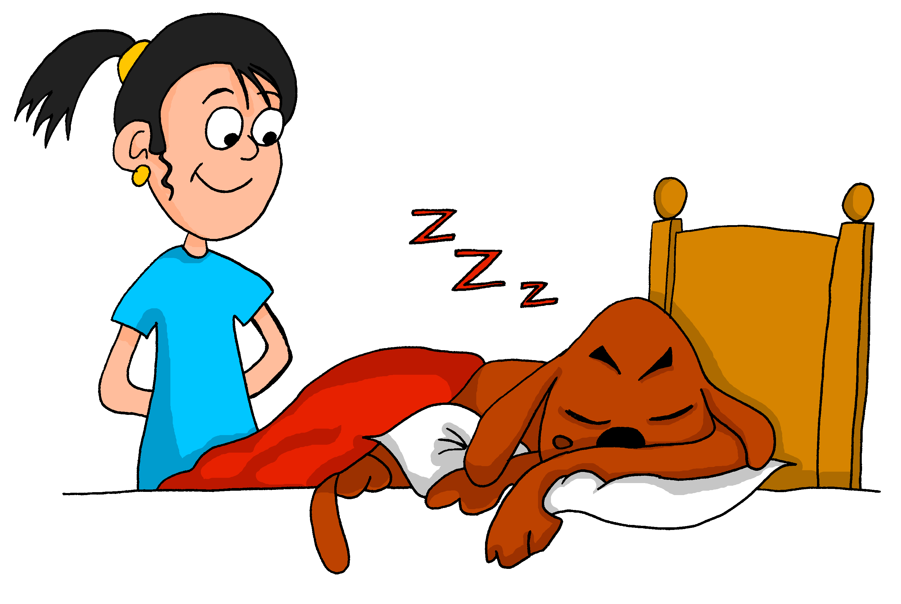
10
A
B
¿Esto es normal?
escuchar
Nick Avery / Emma Marsden
Notes:
Transcript: 10. La observa en su cama.
Word frequency: observar [556]; cama [609].

Slide 38
What about non-school days?
Listen to each sentence.
Write down what is happening in English.
escuchar
Nick Avery / Emma Marsden

Slide 39
1
2
2
1
3
4
4
3
5
5
escuchar
Nick Avery / Emma Marsden
Notes:
Items 1-5 Transcript: 1. La despierta con mucha emoción. / 2. Lo lava con mucho jabón. / 3. Lo sigue a la cocina. / 4. La lleva al parque para jugar. / 5. La lava con mucho jabón.
Answers appear as numbers on pictures

Slide 40
9
10
6
7
7
8
9
10
8
6
escuchar
Nick Avery / Emma Marsden
Notes:
Items 6-10 6. Lo saluda. / 7. La saca de la casa. / 8. Lo observa en su cama. / 9. Lo despierta. / 10. La besa.
Answers appear on the pictures

Slide 41
Now tell the story yourself!
Be careful! It isn’t in the same order as before.
Student A: Use the prompt cards to tell the story (in order, from 1-10).
Student B: Listen and take notes – what is the sequence of events?
Then compare the notes and pictures
hablar / escuchar
Nick Avery / Emma Marsden
Notes:
Refer to accompanying Word resource for printer-friendly pictures.
Student A uses the numbered pictures as prompts to tell the story. Student B listens and takes notes, either in English or Spanish. To check that meaning was correctly expressed and understood, they can then compare Student B’s notes with the pictures used by Student A.

Slide 42
1
2
3
4
5
6
7
8
9
10
Nick Avery / Emma Marsden
Notes:
These slides shouldn’t be displayed during the activity (while student B is listening), but can be used for whole class feedback afterwards.

Slide 43
Need help?
Verbs
s/he wakes [someone] up – despierta
s/he kisses – besa
s/he follows – sigue
s/he watches – mira, observa
s/he takes [someone] out – saca
s/he greets – saluda
s/he takes [someone somewhere] – lleva
s/he washes – lava
Nouns
kitchen – cocina
park – parque
bed – cama
hablar / escuchar
Nick Avery / Emma Marsden
Notes:
These could be shown briefly for a couple of minutes in a quick "revision and knowledge check" opportunity before the speaking activity. They would then be removed.

Slide 44
Now create your own story!
Choose ten pictures. Each must have a different action.
Write a sentence for each one.
Choose your sequence of events!
escribir
Nick Avery / Emma Marsden
Notes:
Refer to the accompanying Word resource for printer-friendly set of pictures.
Students could be given time markers like primero, luego, después, and finalmente to use for this activity.

Slide 45
Saying who receives the action (part 3): ‘lo’ and ‘la’ in object-first sentences
In English, to say who does something, we need a subject.
We can’t just say ‘calls her’; we need to say, e.g., ‘the man calls her’.
Spanish is different. Usually, you don’t need to say the subject.
Compare:
1. EL hombre llama a la mujer.
2. Llama a la mujer.
→ The man calls the woman.
→ S/he calls the woman.
Nick Avery / Emma Marsden

Slide 46
Your teacher has paid a Spanish artist to make some pictures for her class.
The artist has made them, but has mixed up the labels.
Can you help to put the label on the correct picture?
Nick Avery / Emma Marsden

Slide 47
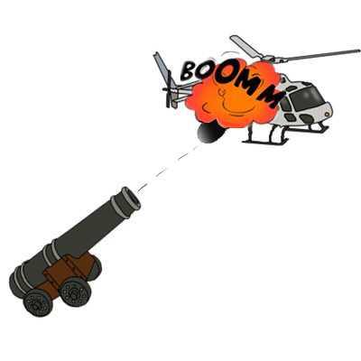
1.
Destruye el helicóptero.
Lo destruye el helicóptero.
leer
Nick Avery / Emma Marsden
Notes:
Word frequency: destruir [1283]; helicóptero [4824].

Slide 48
2.
Ve a la cámara de seguridad.
Lo ve la cámara de seguridad.
leer
Nick Avery / Emma Marsden
Notes:
Word frequency: ver [38]; cámara [903]; seguridad [538].

Slide 49
3.
Lo llena la botella.
Llena la botella.
leer
Nick Avery / Emma Marsden
Notes:
Word frequency: llenar [600]; botella [1878]

Slide 50
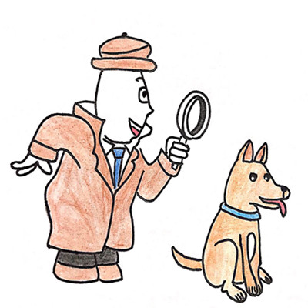
4.
Lo mira el hombre.
Mira al hombre.
leer
Nick Avery / Emma Marsden
Notes:
Word frequency: mirar [125]; hombre [97].

Slide 51
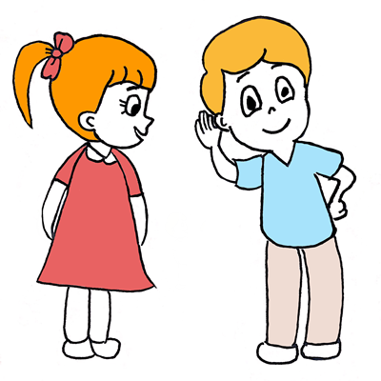
5.
Lo escucha la chica.
Escucha a la chica.
leer
Nick Avery / Emma Marsden
Notes:
Word frequency: escuchar [281]; chica [1129].

Slide 52
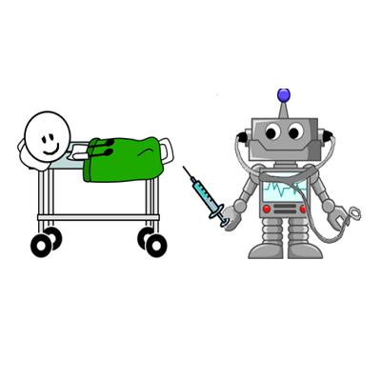
6.
Arregla al robot.
Lo arregla el robot.
leer
Nick Avery / Emma Marsden
Notes:
Word frequency: arreglar [1314]; robot [>5000]

Slide 53
7.
Lleva al chico.
La lleva el chico.
leer
Nick Avery / Emma Marsden
Notes:
Word frequency: llevar [101]; chico [727].

Slide 54
8.
La llama el hombre.
Llama al hombre.
leer
Nick Avery / Emma Marsden
Notes:
Word frequency: llamar [122] hombre [97]

Slide 55
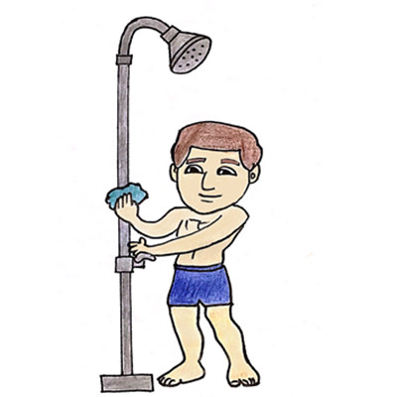
9.
Lava la ducha.
Lo lava la ducha.
leer
Nick Avery / Emma Marsden
Notes:
Word frequency: lavar [1676]; ducha [<5000].

Slide 56
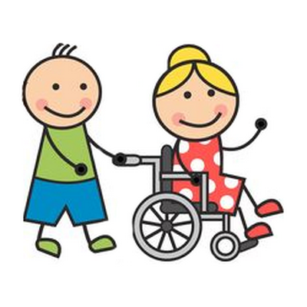
10.
Cuida a la mujer.
Lo cuida la mujer.
leer
Nick Avery / Emma Marsden
Notes:
word frequency: cuidar [751]; mujer [120].

Slide 57
Here are some more pictures.
The artist gave these to you in pairs, but only one label came with each pair.
Put the label on the right picture.
Nick Avery / Emma Marsden
Notes:
This is further reading practice, if needed. There are an additional ten items in a slightly different format: match the sentence to the right picture.

Slide 58
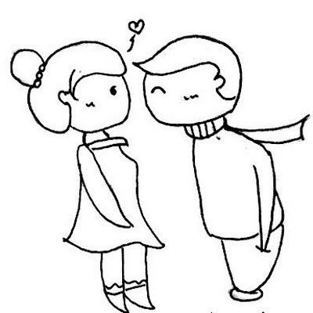
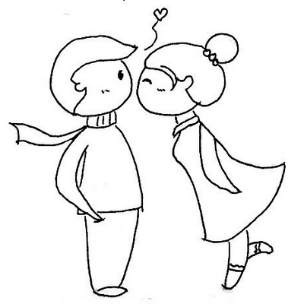
1.
A
B
Lo besa la chica.
leer
Nick Avery / Emma Marsden
Notes:
Word frequency: besar [1591]; chica [1129].

Slide 59
2.
A
B
Sigue al perro.
leer
Nick Avery / Emma Marsden
Notes:
Word frequency: seguir [99]; perro [888].

Slide 60
3.
A
B
Lo saluda el chico.
leer
Nick Avery / Emma Marsden
Notes:
Word frequency: saludar [1575]; chico [727].

Slide 61
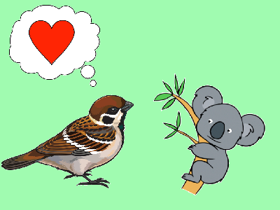
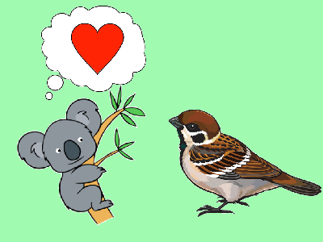
4.
A
B
Ama al koala.
leer
Nick Avery / Emma Marsden
Notes:
Word frequency: amar [700]; koala [>5000].

Slide 62
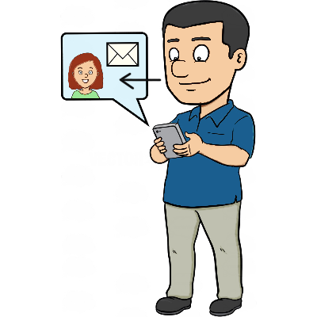
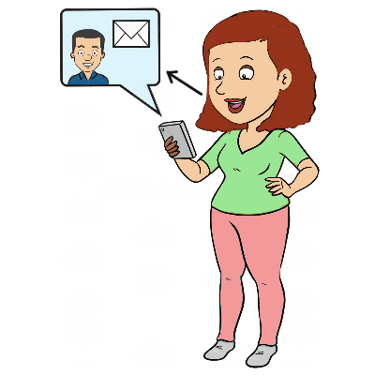
5.
A
B
La contacta el hombre.
leer
Nick Avery / Emma Marsden
Notes:
Word frequency: contactar [3866]; hombre [97].

Slide 63
6.
A
B
Lo come el pez.
leer
Nick Avery / Emma Marsden
Notes:
Word frequency: comer [347]; pez [3579].

Slide 64
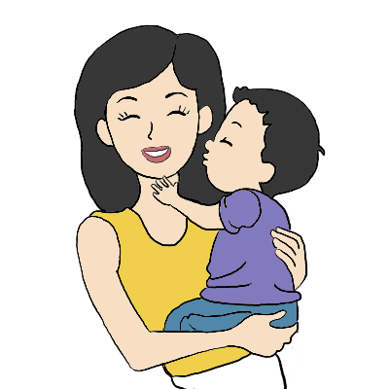
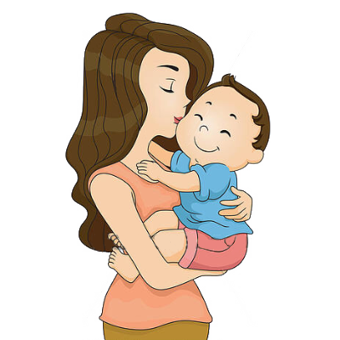
7.
A
B
La besa el niño.
leer
Nick Avery / Emma Marsden
Notes:
Word frequency: besar [1591]; niño [173].

Slide 65
8.
A
B
Llena el vaso.
leer
Nick Avery / Emma Marsden
Notes:
Word frequency: llenar [600]; vaso [1609].

Slide 66
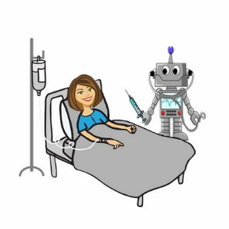
9.
A
B
Arregla al robot.
leer
Nick Avery / Emma Marsden
Notes:
Word frequency: arreglar [1314]; robot [>5000]

Slide 67
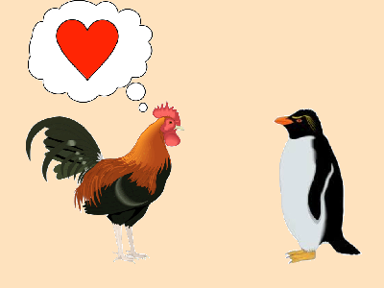
10.
A
B
Ama al pingüino.
leer
Nick Avery / Emma Marsden
Notes:
Word frequency: amar [700]; pingüino [>5000].

Slide 68
The artist is now suggesting some pictures that your teacher could use in her next class.
Listen and decide which pictures she says should be used.
escuchar
Nick Avery / Emma Marsden

Slide 69
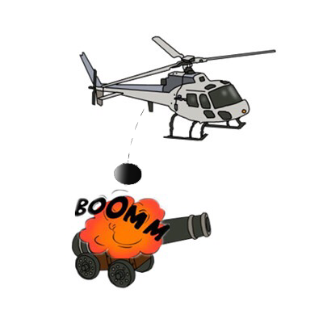
1
A
B
escuchar
Nick Avery / Emma Marsden
Notes:
Transcript: Destruye el cañón.
Word frequency: destruir [1283]; cañón [4015]

Slide 70
Listen again and write the sentence.
Destruye el cañón
1
______________________.
escuchar / escribir
Nick Avery / Emma Marsden
Notes:
This is an optional – teachers can either choose to do this or just the sentence-picture matching activity.

Slide 71
2
A
B
escuchar
Nick Avery / Emma Marsden
Notes:
Transcript: La ve el chico.
Word frequency: ver [38]; chico [727].

Slide 72
Listen again and write the sentence.
La ve el chico
2
______________________.
escuchar / escribir
Nick Avery / Emma Marsden

Slide 73
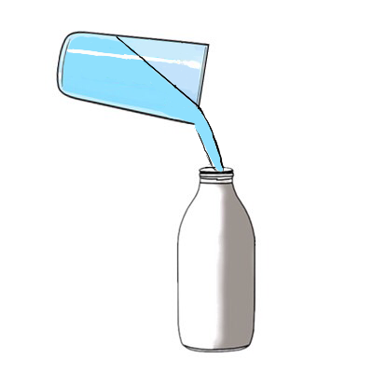
3
A
B
escuchar
Nick Avery / Emma Marsden
Notes:
Transcript: La llena el vaso.
Word frequency: llenar [600]; vaso [1609].

Slide 74
Listen again and write the sentence.
La llena el vaso
3
______________________.
escuchar / escribir
Nick Avery / Emma Marsden

Slide 75
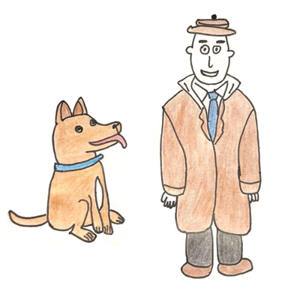
4
A
B
escuchar
Nick Avery / Emma Marsden
Notes:
Transcript: Mira al hombre.
Word frequency: mirar [125]; hombre [97].

Slide 76
Listen again and write the sentence.
Mira al hombre
4
______________________.
escuchar / escribir
Nick Avery / Emma Marsden

Slide 77
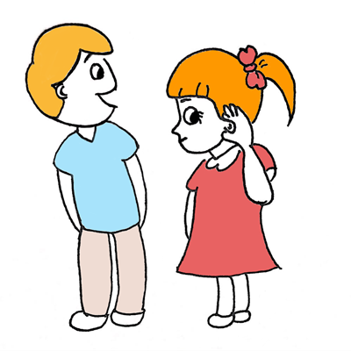
5
A
B
escuchar
Nick Avery / Emma Marsden
Notes:
Transcript: Escucha a la chica.
Word frequency: escuchar [281]; chica [1129].

Slide 78
Listen again and write the sentence.
5
Escucha a la chica
______________________.
escuchar / escribir
Nick Avery / Emma Marsden

Slide 79
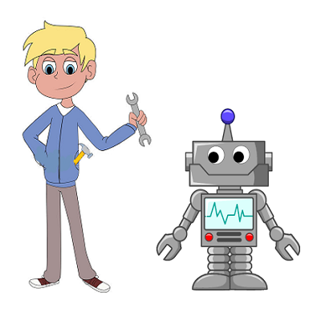
6
A
B
escuchar
Nick Avery / Emma Marsden
Notes:
Transcript: Lo arregla el chico.
Word frequency: arreglar [1314]; chico [727]

Slide 80
Listen again and write the sentence.
6
Lo arregla el chico
______________________.
escuchar / escribir
Nick Avery / Emma Marsden

Slide 81
7
A
B
escuchar
Nick Avery / Emma Marsden
Notes:
Transcript: lo lleva la chica.
Word frequency: llevar [101]; chica [1129].

Slide 82
Listen again and write the sentence.
Lo lleva la chica
7
______________________.
escuchar / escribir
Nick Avery / Emma Marsden

Slide 83
8
A
B
escuchar
Nick Avery / Emma Marsden
Notes:
Transcript: Llama a la chica.
Word frequency: llamar [122]; chica [1129].

Slide 84
Listen again and write the sentence.
8
Llama a la chica
______________________.
escuchar / escribir
Nick Avery / Emma Marsden

Slide 85
9
A
B
escuchar
Nick Avery / Emma Marsden
Notes:
Transcript: lo lava la ducha.
Word frequency: lavar [1676]; ducha [>5000]

Slide 86
Listen again and write the sentence.
Lo lava la ducha
9
______________________.
escuchar / escribir
Nick Avery / Emma Marsden

Slide 87
10
A
B
escuchar
Nick Avery / Emma Marsden
Notes:
Transcript: Cuida al hombre.
Word frequency: cuidar [751]; hombre [97].

Slide 88
Listen again and write the sentence.
10
Cuida al hombre
______________________.
escuchar / escribir
Nick Avery / Emma Marsden

Slide 89
Saying who does / receives the action: using ‘lo’ and ‘la’ (part 4)
Sometimes, to avoid confusion about who is the ‘doer’, the subject pronoun (e.g. he, she) is used before the verb.
Compare:
1. La llama el hombre.
2. Ella llama al hombre.
→ The man calls her.
→ She calls the man.
Nick Avery / Emma Marsden
Notes:
This final part is the most challenging. Students will have to pay attention to whether the pronoun before the verb refers to the subject (e.g. ella) or the object (e.g. la).

Slide 90
Remember this pair? Look at the picture and decide which sentence is correct.
 |  | True
1.
Ella despierta a Monty.
La despierta Monty.
leer
Nick Avery / Emma Marsden

Slide 91
 |  | True
2.
La besa Monty.
Ella besa a Monty.
leer
Nick Avery / Emma Marsden

Slide 92
 |  | True
3.
Ella sigue a Monty.
La sigue Monty.
leer
Nick Avery / Emma Marsden

Slide 93
 |  | True
4.
Ella observa atentamente a Monty.
La observa atentamente Monty.
leer
Nick Avery / Emma Marsden

Slide 94
 |  | True
5.
La saca de la casa Monty.
Ella saca a Monty de la casa.
leer
Nick Avery / Emma Marsden
Notes:
Note: She i

Slide 95
 |  | True
6.
Ella lleva a Monty al colegio.
La lleva al colegio Monty.
leer
Nick Avery / Emma Marsden

Slide 96
 |  | True
7.
Ella saluda a Monty.
La saluda Monty.
leer
Nick Avery / Emma Marsden

Slide 97
 |  | True
8.
Ella lleva a Monty al parque.
La lleva al parque Monty.
leer
Nick Avery / Emma Marsden

Slide 98
 |  | True
9.
La lava Monty con mucho jabón.
Ella lava a Monty con mucho jabón.
leer
Nick Avery / Emma Marsden

Slide 99
 |  | True
10.
La observa Monty cuando duerme.
Ella observa a Monty cuando duerme.
leer
Nick Avery / Emma Marsden

Slide 100
Brotherly love
leer
Esteban and his twin brother are always helping each other out!
Read the sentences about what they do.
Tick which statement is true.
 |  | True
1.
2.
3.
4.
5.
He calls his brother.
His brother calls him.
He takes his brother to school.
His brother takes him to school.
1 | Él llama al hermano.
2 | Lo lleva al colegio el hermano.
3 | Lo ayuda el hermano con los deberes.
4 | Él ayuda al hermano en el jardín.
5 | Lo cuida el hermano.
His brother helps him with homework.
He helps his brother with homework.
He helps his brother in the garden.
His brother helps him in the garden.
He looks after his brother.
His brother looks after him.
Nick Avery / Emma Marsden
Notes:
Note: Animations are set up so that the teacher offers whole class feedback after each answer. (If desired, teachers just need to re-order the animations by clicking on ‘Animation Pane’ and moving all the ‘pictures’ to the end so that the English sentences appear first, students complete all of the task, and then the teacher corrects all answers with the class).
Word frequency rankings (1 is the most common word in Spanish):
Verbs: llamar [122]; llevar [101; ayudar [328]; cuidar [751]
Nouns: hermano [333]; deber [2187]; jardín [1195].

Slide 101
Brotherly love?
 |  | True
6.
7.
8.
9.
10.
His brother wakes him up.
He wakes his brother up.
He gets his brother up.
His brother gets him up.
6 | Él despierta a su hermano.
7 | Lo levanta su hermano.
8 | Lo observa su hermano cuando juega al tenis.
9 | Él saluda a su hermano todos los días.
10 | Lo respeta mucho su hermano.
He watches his brother play tennis.
His brother watches him play tennis.
He greets his brother every day.
His brother greets him every day.
His brother really respects him.
He really respects his brother.
leer
Nick Avery / Emma Marsden
Notes:
Note: The animations here are set up so that students complete questions 6-10 independently, and then check them in whole class feedback with the teacher.
Word frequency rankings (1 is the most common word in Spanish):
Verbs: despertar [894]; levantar [354]; observar [556]; saludar [1575]; respetar [1191; jugar [356].
Nouns: tenis [4856]; día [65].

Slide 102
Now complete the translations about Esteban and his older brother.
His brother calls him
1) _____________su hermano.
Lo llama
He takes his brother to school.
2) _____________a su hermano al colegio.
(Él) lleva
He helps his brother with the homework.
3) _____________a su hermano con los deberes.
(Él) ayuda
Nick Avery / Emma Marsden
escribir
Nick Avery / Emma Marsden

Slide 103
Now complete the translations about Esteban and his older brother.
His brother helps him in the garden.
4) _____________su hermano en el jardín.
Lo ayuda
He looks after his brother.
5) _____________a su hermano.
(Él) cuida
His brother wakes him up.
6) _______________su hermano.
Lo despierta
escribir
Nick Avery / Emma Marsden

Slide 104
Now complete the translations about Esteban and his older brother.
He gets his brother up.
7) ______________ a su hermano.
(Él) levanta
He watches his brother play tennis.
8) ________________a su hermano cuando juega al tenis.
(Él) observa
His brother greets him.
9) _______________su hermano.
Lo saluda
He respects his brother
10) _______________a su hermano.
(Él) respeta
escribir
Nick Avery / Emma Marsden

