Slide 1
Describing what people do (visiting a Spanish-speaking city)
Subject pronouns [revisited]
Present tense –er/–ir verbs [revisited]
Y8 Spanish
Term 3.1 - Week 1 – Lesson 49
Amanda Izquierdo / Nick Avery / Rachel Hawkes Artwork: Mark Davies
Date updated: 04/08/21
Notes:
Artwork by Mark Davies. All additional pictures selected are available under a Creative Commons license, no attribution required.
Native-speaker teacher feedback provided by Blanca Román.
Learning outcomes (lesson 1):
Consolidation of subject pronouns for singular persons (yo, tú, él, ella)
Consolidation of present tense –er/–ir verbs in singular persons (for habitual meaning)
Consolidation of a range of SSCs
Consolidation of Y7 vocabulary
Word frequency (1 is the most frequent word in Spanish):
Revisit subset of Y7 vocabulary:
interesante [616]; hermoso [980]; grande [66]; blanco [372]; bailar [1323]; hay [haber-13]; pasar [68]; llevar [101]; descansar [1749]; cambiar [255]; preguntar [219]; participar [593]; pensar [105]; correr [343]; ir [33]; visitar [792]; disfrutar [939]; hago; haces; hace [hacer-26]; tienes; tiene; tener; tengo [tener-19]; puedo; puedes; puede [poder-32]; moneda [1577]; revista [920]; zapato [1477]; camisa [1873]; plan [625]; ciudad [178]; centro [316]; iglesia [437]; mercado [487]; plaza [806]; museo [1114]; tienda [1515]; edificio [857]; dinero [364]; torre [2138]; lugar [144]; viernes [1259]; sábado [1179]; domingo [693]; ejercicio [1162]; vacaciones [2641]; gracias [275]; de nada [nada-87]; pero [30]; mucho [41]; ¿cómo es? [cómo-151]; entre [63]; fuera [299]; delante [1742]; por [15]; al [a-8]; después [115]; cuánto [580].
Source: Davies, M. & Davies, K. (2018). A frequency dictionary of Spanish: Core vocabulary for learners (2nd ed.). Routledge: London
The frequency rankings for words that occur in this PowerPoint which have been previously introduced in NCELP resources are given in the NCELP SOW and in the resources that first introduced and formally re-visited those words.
For any other words that occur incidentally in this PowerPoint, frequency rankings will be provided in the notes field wherever possible.

Slide 2
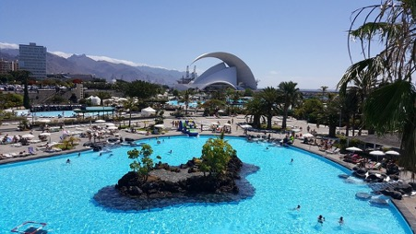
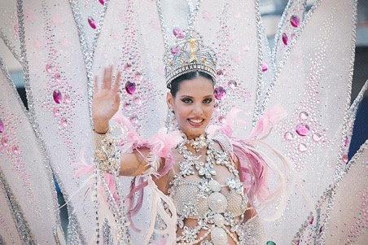
Fonética
hablar / escuchar / escribir
Leemos un texto sobre una ciudad en España: Santa Cruz de Tenerife.
Trabajamos en parejas.
Piscinas y auditorio
El estudiante A lee la primera parte del texto.
El estudiante B escucha y escribe las letras que faltan.
Santa Cruz de Tenerife es la capital...
Ejemplo:
Carnaval
Estudiante A
Estudiante B
Texto: Santa Cruz de Tenerife es la c_p_t_l...
Gloss
Texto: Santa Cruz de Tenerife es la capital...
* el castillo = castle
* la piscina = swimming pool
* celebrar = to celebrate
a
i
a
Notes:
Timing: 7 minutes
Aim: to revisit a range of previously taught SSCs; to learn about a new city in the Spanish-speaking world.
SCCs revisited: [a], [e], [i], [o], [u]; [r], [rr]; [co]; [ci]; [ll]; [que], [qui]; silent h; [gu], [go], [gui]; [ge]; [z]; [b], [v].
Procedure:
Students work in pairs, taking it in turns to read out the text to their partner.
The partner listens for the missing SSCs and writes the missing letters.
Students swap roles.
The teacher clicks on the ‘gloss’ box to reveal the meanings of several new words. (‘Celebrar’ has been used as a phonics word and will be taught in 8.3.1.6.)
Notes:
Some highly skilled students might be able to complete some of the words on their own, but most will need the input from their partner reading the full text aloud to be able to complete all the words.
In the second paragraph, there are several written accents. Students can be encouraged to write these where needed.
It may be necessary to explain the meaning of ‘faltar’ in these instructions as this verb hasn’t yet been taught.
The 'Auditorio de Tenerife ' is a concert hall in Santa Cruz de Tenerife. The building was completed in 2003 and it was designed by the renowned architect Santiago Calatrava. It is home to the Orquesta Sinfónica de Tenerife (Tenerife Symphony Orchestra).
Word frequency of glossed words (1 is the most frequent word in Spanish): castillo [2545]; piscina [4605]; celebrar [887]

Slide 3
Fonética
hablar / escuchar / escribir
Persona A
Persona B
✄
Santa Cruz de Tenerife es la capital de la isla de Tenerife, en Canarias. Es una ciudad con edificios antiguos y modernos: hay *castillos, iglesias, parques, torres, mercados y muchas tiendas. Santiago Calatrava, un arquitecto famoso, creó el auditorio allí. _d_m_s _st_ el T_ _tr_ _ _ _merá y t_mb__n _ay b_st_nt_s pla_as donde p_ _d_s tomar un c_f_ y d_sfr_t_r el c_l_r. P_ _d_s ir a la pl_y_ o a la *p_sc_n_. C_s_r Manri_ _ _, otro ar_ _ _tecto, cr_ _ unas p_sc_nas hermosas a_ _ í. En feb_e_o y mar_o la _ _nte *cele_ra el Carna_al, una f_ _st_ muy di_ertida.
Santa Cruz de Tenerife es la capital de la _sl_ de Tenerife, en C_n_r_ _s. Es una _ _ udad con edifi_ _os anti_ _os y mode_nos: hay casti_ _os, igl_s_ _s, par_ _es, to_ _es, m_rc_d_s y muchas t_ _nd_s. Santia_ _ C_l_tr_v_, un ar_ _ _tecto f_m_s_, cr_ _ el _ _d_t_r_ _ a_ _í. Además está el Teatro Guimerá y también hay bastantes plazas donde puedes tomar un café y disfrutar el calor. Puedes ir a la playa o a la *piscina. César Manrique, otro arquitecto, creó unas piscinas hermosas allí. En febrero y marzo la gente *celebra el Carnaval, una fiesta muy divertida.
- - - - - - - - - - - - - - - - - - - - - - - - - - - - - - -
Notes:
Do not display during the activity – Display only during feedback.

Slide 4
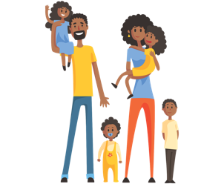
Escribe la letra correcta para cada palabra en español.
leer / hablar
 |  | Letra
1 | hago
2 | el dinero
3 | la familia
4 | puedo
5 | fuera
6 | cambiar
7 | correr
8 | la moneda
9 | entre
10 | tengo
11 | el domingo
12 | el viernes
J
B
A
B
C
I
[coin]
[money]
F
H
to change, changing
I can
D
E
F
D
L
A
outside
G
H
I
[family]
G
[between]
K
E
to run, running
I do, I make
I have
J
K
L
C
Notes:
Vocabulary practice slide
Timing: 6 minutes
Aim: to practise receptive recall of vocabulary in the written modality, then productive recall in the oral modality
Procedure 1. Students write the correct letter for each word.
2. The teacher can call out letters, so students say the corresponding word in Spanish.
3. The Spanish words are then obscured so that students have to recall the word themselves for oral production. This could be done in pairs or as a whole-group activity.

Slide 5
Talking about what people do -er/-ir verbs in singular persons
gramática
As you know, some Spanish infinitives end in –er and –ir .
The verb ending changes depending on who the verb refers to.
–o
To mean ‘I’ with an –er / –ir verb, remove –er/ –ir and add ____.
I run in the square.
Corro en la plaza.
–es
To mean ‘you’ with an –er / –ir verb, remove –er/ –ir and add ____.
You make plans.
Haces planes.
Remember - this verb ending also means ‘it…’.
–e
To mean ‘s/he’ with an –er / –ir verb, remove –er/ –ir and add ____.
S/he reads in the museum.
Lee en el museo.
Notes:
Timing: 2 minutes
Aim: to revise the first, second and third person singular endings for –er and –ir verbs in present tense.
Procedure:
Go through the grammar explanation with students, revealing each new sentence on a mouse click.

Slide 6
Using subject pronouns: yo (‘I’), tú (‘you’), él (‘he’), ella (‘she’)
gramática
To compare different people, use a subject pronoun (e.g., I, you, s/he) before the verb. This makes it clear who the verb refers to and it emphasises the contrast.
yo
To say ‘I’ use____.
tú
To say ‘you’ use____.
él
To say ‘he’ use ____.
ella
To say ‘she’ use ____.
English always uses subject pronouns when the subject changes, not just for contrast.
You have holidays, but she can’t go.
Tú tienes vacaciones, pero ella no puede ir.
Notes:
Timing: 2 minutes
Aim:
to recap the singular subject pronouns.
to revise one function of subject pronouns: to add clarity about who the verb refers to when verbs are used to refer to different people (‘He does X, but I do Y’).
Procedure:
1. Click to bring up each part of the explanation.

Slide 7
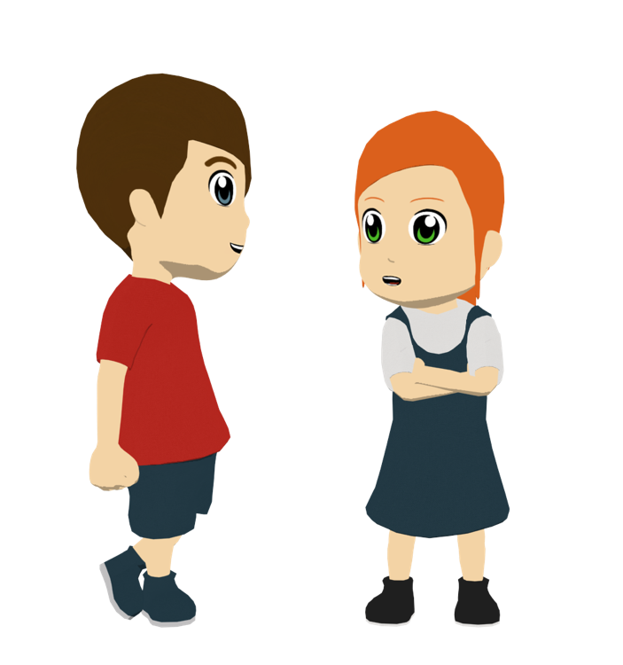
leer / escuchar
Lucía, Daniel, Ana y Diego preparan un viaje a Tenerife cada año para
participar en el Carnaval. ¿Cuál es la opción correcta? Después escribe las frases en inglés.
1 | hace muchos planes. hago muchos planes. haces muchos planes.
2 | imprimes los billetes. imprimo los billetes. imprime los billetes.
3 | pone todas las cosas encima de la cama. pongo todas las cosas encima de la cama. pones todas las cosas encima de la cama.
4 | reparte la comida. repartes la comida. reparto la comida.
5 | decido qué ropa va a llevar a la fiesta. decide qué ropa va a llevar a la fiesta. decides qué ropa va a llevar a la fiesta.
1
A month before the holidays he makes a lot of plans.
2
Several days before travelling I print the tickets.
3
Then, you put the things on the bed.
4
During the trip/journey you usually hand out the food.
5
Before going to the carnival she decides what clothes she is going to wear the party.
Notes:
[1/2]
Timing: 6 minutes
Aim: to practise the use of subject pronouns and –er and –ir verb endings in present tense; to revise vocabulary.
Procedure: 1. Students listen to each sentence and decide which is the correct option depending on the subject pronoun that they hear.
2. Students listen again and write the whole sentence in English. This will involve translating the first few words from the audio, then translating the rest of the sentence, which is already displayed.
Notes:
Some students may find it best to transcribe what they hear, then translate it. This will allow more time for thought.
As it’s a consolidation week, and as –er/-ir verbs have been practised extensively already in the SoW, this activity includes all 3 verb endings.
It is envisaged that while checking the answers for pronoun-verb agreement, teachers will also check that students have understood the meaning of each sentence. The animation sequence therefore brings up the answers in both columns before continuing to the next item. If teachers wish to solely focus on the grammar first, then the animation order can easily be changed.
Transcript:
Un mes antes de las vacaciones él...
Unos días antes de viajar, yo...
Luego, tú...
Durante el viaje normalmente tú...
Antes de ir al carnaval ella...

Slide 8
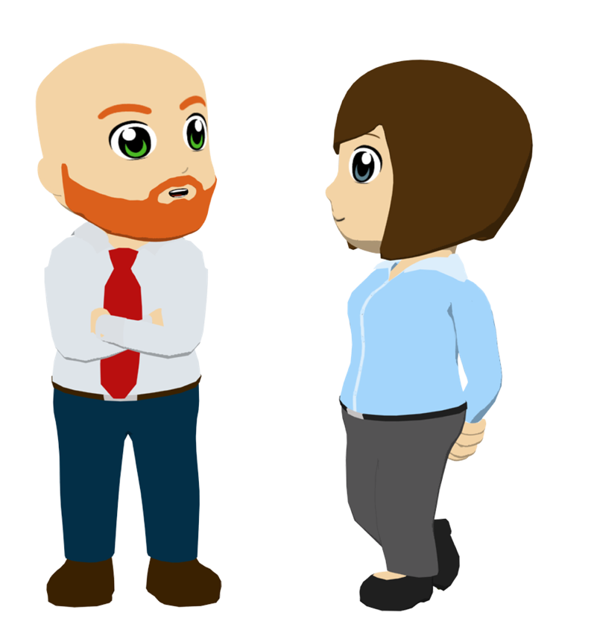
leer / escuchar
Lucía, Daniel, Ana y Diego preparan un viaje a Tenerife cada año para
participar en el Carnaval. ¿Cuál es la opción correcta? Después escribe las frases en inglés.
1 | escribo una lista de actividades. escribes una lista de actividades. escribe una lista de actividades.
2 | recibo información sobre los conciertos. recibes información sobre los conciertos. recibe información sobre los conciertos.
3 | compartes ideas para hacer cosas diferentes. comparte ideas para hacer cosas diferentes. comparto ideas para hacer cosas diferentes.
4 | divido las tareas. divides las tareas. divide las tareas.
5 | cubre el coste de las vacaciones. cubro el coste de las vacaciones. cubres el coste de las vacaciones.
6
I generally write a list of activities.
She normally receives information about the concerts.
7
8
At the weekends he shares ideas to do different things.
9
Before organising things I divide up the tasks.
10
You sometimes cover the cost of the holidays.
Notes:
[2/2]
Transcript
6. Generalmente yo...
7. Normalmente ella...
8. Los fines de semana él...
9. Antes de organizar las cosas yo...
10. A veces tú...

Slide 9
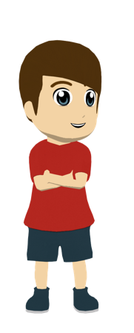
La familia de Daniel prepara las vacaciones en Tenerife como cada año. Decide si las frases en inglés están en el texto. Luego, escribe el pronombre (yo, tú o ella), según el verbo.
leer
 | ¿Está en el texto?
1. I bring some bags. | Sí / No
2. You offer help. | Sí / No
3. She goes out to buy food and water. | Sí / No
4. I read information about the place. | Sí / No
5. You ask questions. | Sí / No
6. I know the island very well. | Sí / No
7. She collects the boat tickets. | Sí / No
8. I want to visit other islands. | Sí / No
ella
Antes de las vacaciones 1) ______ trae unas bolsas para organizar las camisas y los zapatos y 2) ______ ofreces ayuda, mientras que 3) ______ salgo para comprar comida y agua para el viaje.
Después, 4) ______ leo información sobre el lugar y las fiestas y 5) ______ haces preguntas sobre la cultura y la historia. 6) ______ conoce la isla muy bien, así que también responde.
Más tarde 7) ______ recoge los billetes para el barco porque 8) ______ siempre quieres visitar otras islas.
tú
yo
Note that ‘salir’ has a spelling change when used in the 1st person singular > ’salgo’
yo
tú
Ella
ella
tú
Notes:
Timing: 8 minutes
Aim: to consolidate understanding of the 1st, 2nd and 3rd person singular endings for –er and –ir verbs and the use of subject pronouns in Spanish.
Procedure: 1. Students first read the text and write down any examples of things that one can do before a trip. At this stage, the focus is on understanding the meaning of vocabulary, rather than grammar.
2. Students then decide which of the English sentences on the right are present in the text or not. It may help them to know that the true/false element here is the subject of the verb, rather than the vocabulary.
3. Students write in the missing subject pronouns from 1 to 8. The verb in the text gives them the cue for each one. Ask students why we need to add these subject pronouns (anticipate: because the verbs in the text refer to different people within the same sentence and subject pronouns emphasise who is being referred to).
4. When checking answers, students should be encouraged to explain why some of the sentences are not in the text (e.g. ¿Por qué no puede ser ‘I’? Sí, exacto, porque el verbo termina en –es).
Notes:
This text is written using 100% previously taught language.
Some students may be able to do steps 2 and 3 together. Because these steps are closely connected, and both features are revisited, the answers are presented for these steps together in the animations. Teachers can adapt as necessary (e.g. presenting all step 2 answers first, then all step 3 answers).
If working with a higher-achieving group, the 8 sentences on the left could be presented in a jumbled order. This would require students to locate the vocabulary related to each English statement within the text.
To automatise this knowledge in oral production, the teacher could remove the subject pronouns and verbs from the text and replace them with English prompts. Students then read the text aloud to a partner, translating the English prompts into Spanish as they go. A slide with this option follows.

Slide 10
Escucha y lee el texto al mismo tiempo para pensar en opciones diferentes:
leer / escuchar
1
5
Antes de las vacaciones ella trae unas bolsas para organizar las camisas y los zapatos y tú ofreces ayuda, mientras que yo salgo para comprar comida y agua para el viaje.
Después, yo leo información sobre el lugar y las fiestas y tú haces preguntas sobre la cultura y la historia. Ella conoce la isla muy bien, así que también responde.
Más tarde ella recoge los billetes para el barco porque tú siempre quieres visitar otras islas.
2
6
3
7
4
Notes:
Timing: 6 minutes
Aim: to help students to connect the spoken and written forms of the language more securely; to consolidate vocabulary and grammar knowledge by eliciting suggested changes to the text.
Procedure: Click on the audio button to play the text. Read and listen.
Note: There is a full version of the audio top right with a player. Alternatively the audio is in 6 sections with a pause just after the words 1-6 below, to facilitate easy stop/start.
To support segmentation, stop the audio and ask students to say: a) the next word b) the previous word
In addition, to develop understanding, vocabulary and grammar knowledge, pause at key points and ask students to suggest an alternative word that could replace the next word. This is a chance to draw on previously taught grammar and vocabulary knowledge. All of the set gaps are after the subject pronouns, so students will need to think about the verbs they can use in that context, and be aware of the verb ending that corresponds to each subject pronoun. As the lesson practises –er and –ir verbs, some ideas using such verbs are suggested below, but students may also come up with –ar verbs. If so, they just need to make sure that the correct endings are used.
Antes de sus vacaciones ella….. (some possible words could be: tiene, hace, recibe, recoge, ofrece, comparte...)
para organizar las camisas y los zapatos y tú….. (recibes, tienes, quieres...)
mientras que yo ….. (voy, corro, subo...)
sobre el lugar y las fiestas y tú….. (descubres, conoces, tienes...)
Más tarde, ella ….. (comparte, ofrece, reparte...)
para el barco porque tú siempre... (puedes, debes, ofreces...)

Slide 11
Lee el texto con tu compañero/a de clase. Traduce* los verbos y los pronombres al español.
hablar
Antes de las vacaciones 1) [she brings] unas bolsas para organizar las camisas y los zapatos y 2) [you offer] ayuda, mientras que 3) [I go out] para comprar comida y agua para el viaje.
Después, 4) [I read] información sobre el lugar y las fiestas y 5) [you make] preguntas sobre la cultura y la historia. 6) [she knows] la isla muy bien, así que también responde.
Más tarde 7) [she collects] los billetes para el barco porque 8) [you always want] visitar otras islas.
*traducir – to translate
Notes:
OPTIONAL Timing: 1-2 minutes
Aim: to automatise knowledge in oral production.
Procedure: 1. Students read the text aloud to a partner, translating the English prompts into Spanish as they go. They swap after each sentence, taking it in turns.
2. The teacher may wish to do the first one together with the class to ensure understanding that two words (pronoun and verb) are needed for each prompt.

Slide 12
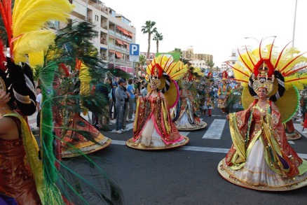
¡Ahora tú escribes!
escribir / hablar / escuchar
Escribe el texto otra vez, pero debes cambiar cosas.
¿Cómo organizas tú las vacaciones?
Puedes usar una persona diferente (yo, tú, él, mi hermano...). También puedes cambiar los verbos y usar otros verbos en –er o –ir:
aprender
recoger
perder
entender
recibir
permitir
decidir
cubrir
repartir
dividir
leer
comer
correr
vender
subir
beber
abrir
Después vas a leer tu texto. Tu pareja va a escuchar para completar una tabla con información; primero el/la estudiante A, y luego el/la estudiante B.
Notes:
Timing: 12 minutes
Aim: to allow students to write more freely and creatively using 1st, 2nd and 3rd person singular forms of –er and –ir verbs; to further consolidate use of subject pronouns
Procedure:
After going through the instructions on this slide, the full text can be displayed (see next slide).
Students write a new version of the text. The bold, italicised parts of the text are given as examples of phrases that students can include, while the non-bold parts are those that could be modified. Their new version could include changes to some or all of the following in the original: 1) subject pronoun/person; 2) verb, including its ending; 3) vocabulary.
Students read out their texts to their partners, who will make note of the information on a grid by ticking ‘I’, ‘you’ or ‘s/he’ and then writing what that person does.
Students swap and compare answers in pairs (e.g. comparing Person A’s new text with the information that Person B noted while listening).
The teacher circulates around the classroom to give feedback, monitoring and responding to any questions.
Notes:
Depending on the ability of the group / how they have coped with producing verbs in the last activity, teachers may wish to ask students to conjugate these verbs before beginning the next activity (i.e. as a warm-up).
There is plenty of scope for differentiation in the number of changes students make to the text. Higher-achieving students could also be asked to add alternative time markers in the text (e.g. durante el viaje, el fin de semana, en verano etc.) An even freer variation of the activity would be for students to write a dialogue between two people saying what ‘I’, ‘you’ and ‘s/he’ do when planning a trip (using the –er and –ir verbs on this slide if desired).

Slide 13
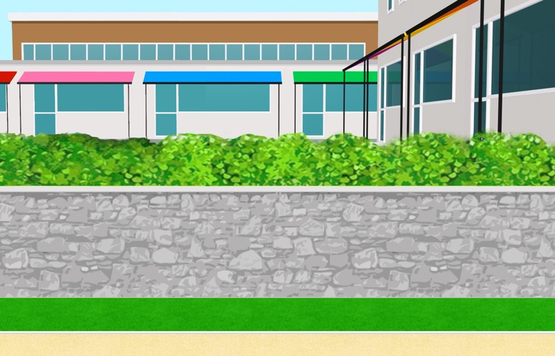
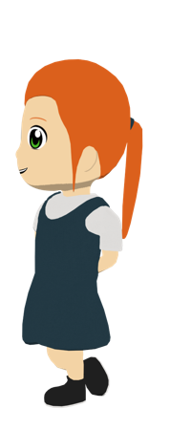
Escribe otra versión del texto. Puedes usar frases como ‘antes’ y ‘después’.
escribir / hablar / escuchar
Antes de las vacaciones ella trae unas bolsas para organizar las camisas y los zapatos y tú ofreces ayuda, mientras que yo salgo para comprar comida y agua para el viaje.
Después, yo leo información sobre el lugar y las fiestas y tú haces preguntas sobre la cultura y la historia. Ella conoce la isla muy bien, así que también responde.
Más tarde ella recoge los billetes para el barco porque tú siempre quieres visitar otras islas.
Notes:
DISPLAY DURING ACTIVITY
Underlined parts are those that students can change.

Slide 14
escribir
Estudiante A
Estudiante B
yo | tú | él/ella | ¿Qué actividad en inglés?
yo | tú | él/ella | ¿Qué actividad en inglés?
Notes:
ANSWER GRIDS (no printing needed)
These grids can copied into students’ books for note-taking.

Slide 15
Describing what people do (visiting a Spanish-speaking city) [2]
Present tense –ar verbs [revisited]
Use of ‘para’ + infinitive [revisited]
Y8 Spanish
Term 3.1 - Week 1 – Lesson 50
Amanda Izquierdo / Nick Avery / Rachel Hawkes Artwork: Mark Davies
Date updated: 04/08/21
Notes:
Learning outcomes (lesson 2):
Consolidation of use of present tense –ar verbs in singular persons (including ongoing meaning)
Consolidation of use of ‘para’ + infinitive
Consolidation of a range of SSCs
Consolidation of Y7 vocabulary

Slide 16
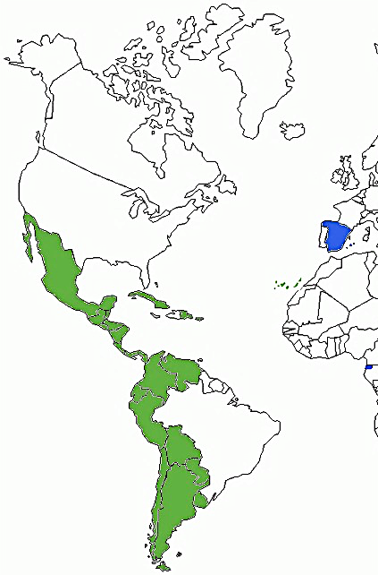
SSCs [CE], [CI] y [Z]
escuchar
Remember, there are different ways to pronounce CE, CI and Z.
In the Canary Islands and Latin America, this ‘c’ and the ‘z’ is often pronounced like an ____.
‘s’
In most of mainland Spain, the ‘c’ before ‘e’ or ‘i’ and the ‘z’ is pronounced like _____ in English.
‘th’
Escucha. Es ¿España (Península o Baleares) o Canarias / Latinoamérica?
edificio
Canarias / Latinoamérica
1
________________________________
edificio
España (Península o Baleares)
2
________________________________
plaza
Canarias / Latinoamérica
3
________________________________
‘s’
‘th’
plaza
España (Península o Baleares)
4
________________________________
Notes:
Phonics recap slide
Timing: 3 minutes
Aim: to consolidate understanding of the different ways in which [ce], [ci] and [z] are pronounced in the Spanish-speaking world.
Procedure:
Read the explanation, eliciting the answers from students where prompted by gaps.
Play the audio and ask where the person is from (‘¿La persona es de…?’)
Ask students which other words they can recall from Y7 which have [ce], [ci] and [z]. This will help to prepare them for the next activity.
Anticipate, for [CI], edificio, participar, decir, cierto, ciudad
Anticipate, for [CE], centro, necesitar, necesario, cerca, doce, parecer.
Anticipate, for [Z], azul, zapato, naturaleza
Notes:
Teachers might want to tell students that the reason why [CE], [CI] and [Z] are pronounced as ‘s’ in the Canary Islands and Latin America is because most of the sailors in the first expeditions to America (stopping in the Canary Islands) were from areas in the South of Spain where the pronunciation follows this pattern. This is why a picture of a ship is included.
It may be necessary to explain to students that the Balearic Islands are located in the Mediterranean, just off the East coast of Spanish. They include Mallorca, Menorca and Ibiza.
Teachers may also find it useful to consider the information from exam board specifications below:
AQA : “The [listening] test will be studio recorded using native speakers speaking Castilian in clearly articulated, standard speech at near normal speed. Different types of spoken language will be used, using familiar language across a range of contemporary and cultural themes. (p. 82)
EdExcel : “For listening and reading assessments, the majority of contexts are based on the culture and countries where the assessed language is spoken. […] It is, therefore, important that students are exposed to materials relating to Spanish-speaking countries throughout the course.” (p. 7)
WJEC : “This GCSE specification in Spanish for use in Wales is based on a conviction that learners studying a modern foreign language will develop their desire and ability to communicate with and understand speakers of Spanish in a variety of contexts and for a variety of purposes.” (p. 3)

Slide 17
¡Lucía y su familia ya están en el Carnaval de Tenerife! Lucía escucha a diferentes personas. ¿De dónde es cada persona, de Canarias / Latinoamérica o de España (Península y Baleares)?
escuchar
Canarias / Latinoamérica | España (Península y Baleares)
1
participas
Escribre la palabra con [ce], [ci] o [z] en la columna correcta. ¡Atención! En ocasiones hay dos palabras en una frase.
2
centro, ciudad
3
haces, ejercicio
4
zapatos
5
plaza
6
edificio
7
necesitas
Carnaval de Santa Cruz de Tenerife
8
azul
Notes:
Video by permission given by VisitTenerife.es https://www.youtube.com/watch?v=_XeezoDJk1A
Phonics practice activity
Timing: 5 minutes + 30 secs video
Aim: to raise awareness of the different ways in which the SSCs [ce], [ci] and [z] are pronounced in the Spanish-speaking world.
Procedure:
Go through instructions with students.
Check understanding of instructions by asking students an example. E.g., plaza (pronounced with seseo): ¿Es Canarias / Latinoamérica? Sí, muy bien. ¿Y en España (Península y Baleares) cómo es la pronunciación?
Play the audio and ask students to tick the correct column and write the words with the target SSCs in the correct column.
Check answers, including spelling, in the feedback.
The video could be used in one of several ways. It could be played before the activity to help set the context of being at the carnaval. It could alternatively be played after the activity and students could be asked questions (e.g., ¿Cómo es?, ¿Qué hace la gente?)
Note:
Some students may be able to write the entire sentence.
It may be necessary to explain ‘en ocasiones’ using ‘a veces’ if this is not immediately clear.
Transcript:
¿Participas en el carnaval cada año?
¡El centro de la ciudad está lleno de gente!
Durante el carnaval caminas durante horas, ¡haces mucho ejercicio!
¡Oh, no! Los zapatos me molestan.
Hay música fuerte en la plaza.
Bailo delante del edificio grande.
¿Necesitas descansar un poco?
Lleva una camisa azul.

Slide 18
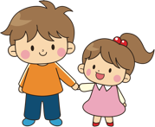
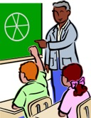
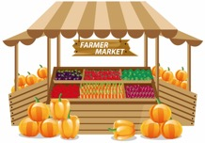
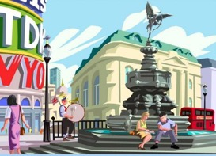
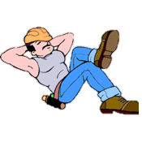
escuchar
Escucha. Identifica la imagen correcta y escribe su letra.
1
2
3
4
5
6
7
8
9
10
11
12
J
A
C
K
H
G
D
E
I
B
F
L
A
B
C
D
E
F
There is an interesting museum.
You take your sister to the shop.
I ask the teacher (m).
You pass by the market.
I enjoy the holidays.
You do exercise.
G
H
I
J
K
L
She dances with some new shoes.
He wants to have a white t-shirt.
He runs in the city center.
You think about a plan.
I rest in the square.
I visit the tower.
Notes:
Timing: 6 minutes
Aim: to recap vocabulary from Year 7 in listening and speaking
Procedure:
The teacher gives students 1-2 minutes in pairs to try to anticipate the vocabulary items they will hear, based on the English prompts.
The teacher plays the audio by clicking on the the number triggers.
Feedback is given to students on their answers.
As a final step, the Spanish sentences can be elicited from students in oral production using the prompts. Encourage retrieval from memory where possible (e.g. by asking students to close their books, where they may have written sentences down).
Transcript:
Piensas sobre un plan.
Hay un museo interesante.
Llevas a tu hermana a la tienda.
Descanso en la plaza.
Corre en el centro de la ciudad.
Visito la torre.
Pregunto al profesor.
Pasas por el mercado.
Baila con unos zapatos nuevos.
Haces ejercicio.
Disfruto las vacaciones.
Quiere tener una camisa blanca.

Slide 19
Saying what people do -ar verbs in singular persons
gramática
As you know, some Spanish infinitives end in –ar.
The verb ending changes depending on who the verb refers to.
–o
To mean ‘I’ with an –ar verb, remove –ar and add ____.
I rest in the park.
Descanso en el parque.
–as
To mean ‘you’ with an –ar verb, remove –ar and add ____.
Remember - this verb ending also means ‘it…’.
You pass by the market.
Pasas por el mercado.
–a
To mean ‘s/he’ with an –ar verb, remove –ar and add ____.
S/he visits the city.
Visita la ciudad.
Notes:
Timing: 2 minutes
Aim: to revise the first, second and third person singular endings for –ar verbs in present tense.
Procedure:
Go through the grammar explanation with students, revealing each new sentence on a mouse click.

Slide 20
Talking about intentions Using ‘para’ + infinitive
gramática
Remember that ‘para’ can mean ‘in order to’.
When used in this way, ‘para’ is always followed by an infinitive.
Llevo una revista para leer en el coche.
I take a magazine (in order) to read in the car.
Remember that we often leave out the words ‘in order’ in spoken English.
Preguntas cosas sobre las islas para conocer la cultura.
You ask things about the islands (in order) to get to know the culture.
Notes:
Timing: 2 minutes
Aim: to consolidate the meaning of ‘para + infinitive’ as ‘in order to’.
Procedure:
1. Read through the slide, eliciting the translations of the example sentences.

Slide 21
Routine vs ongoing/current actions
gramática
Remember that in Spanish you can use the same verb in present for routine actions and current/ongoing actions.
Sometimes adverbs of time can tell us which English tense to choose. Other times the context will let you know which is the most natural translation.
Siempre descansa en la playa
S/he always rests on the beach
Present simple - normally; a routine action
Ahora descansa en la playa
She is resting on the beach now.
Present continuous (BE + -ing) – current; unfinished action
Notes:
Timing: 2 minutes
Aim: to remind students about the two possible translations for verbs in present tense in Spanish, as routine or ongoing actions.
Procedure:
1. Teacher to remind students about the distinction in English between present simple for routine actions and present continuous for current/ongoing actions.
2. Teacher to stress that the ‘routine’ or ‘current/ongoing’ nature of the action is the way to decide which English tense to use and that it is the adverbs of time that give the pointer on this.
3. Teacher to explain that the same tense in Spanish can be used for both routine and current/ongoing actions.

Slide 22
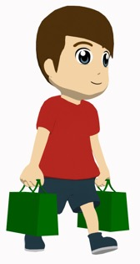
Daniel necesita comprar unas cosas para ir al Carnaval con Lucía. Lee el diálogo en la tienda. Después, escribe los ejemplos de verbos en –ar.
leer
Daniel: Hola, busco unas camisas blancas.
Dependiente*: ¿Pequeñas o grandes?
Daniel: Pues ella busca una camisa pequeña y yo busco una camisa grande.
Dependiente: ¿Necesitas otra cosa?
Daniel: Sí, yo necesito unos zapatos negros y ella unos zapatos blancos.
Dependiente: ¿Buscas unos zapatos para ir al Carnaval?
Daniel: Sí, para bailar en la plaza.
Dependiente: Vale, debes participar en la fiesta del Carnaval el sábado, es el mejor día para todo.
Daniel: ¿Cómo es la fiesta el sábado?
Dependiente: ¡Genial! Cada año hay un concierto interesante en la plaza con música muy fuerte y mucha gente canta y baila en la calle.
Daniel: *¡Qué bien! Gracias por la información. ¿Cuánto es?
Dep: Las camisas quince euros cada una y los zapatos veinte euros.
Daniel: Vale, gracias.
Dependiente: De nada.
 | verbos en -ar
‘I’
‘you’
‘s/he’
busco
necesito
necesitas
buscas
busca
baila
canta
*el/la dependiente/a = shop assistant
*¡Qué bien! = That’s great!
Notes:
Timing: 8 minutes
Aim: to consolidate –ar verbs in singular persons; to recap the use of ‘para’ + infinitive.
Procedure:
Students read the dialogue.
2. The teacher can check understanding of the information via one of the following or another preferred task: i. Whole class oral English translation, phrase by phrase ii. Ask direct questions to elicit the key information. 1. What is Daniel looking for? 2. Is he looking for something just for himself? 3. When does the shop assistant recommend going to the Carnaval? Why? 4. How much are the different items?
3. Students group all the examples of –ar verbs according to the different persons (‘I’, ‘you’, ‘s/he’).
4. The teacher then prompts students to look at these verbs in context and decide on the most natural way to translate – would it be English present continuous or present simple? This will help to reinforce understanding of how the Spanish present simple can be translated in two ways in English.
5. The teacher prompts students to explain why some of the verbs appear in the text with a pronoun and other examples don’t. For example, in line 1 there is no pronoun, but in line 3 pronouns ‘yo’ and ‘ella’ are used. Answer: the personal pronoun is used to emphasise the contrast between different people (e.g. when the same verb refers to two different people in the same sentence, as in line 3, ‘She’s looking for….and I’m looking for…’).
Frequency values of unknown words:
Dependiente/a [>5000]

Slide 23
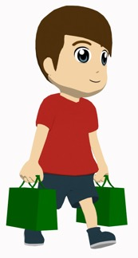
Lee las frases con ‘para’ otra vez y completa la traducción.
leer
¿La traducción es ‘for’ o ‘in order to’?
¿Buscas unos zapatos para ir al Carnaval?
Sí, para bailar en la plaza.
1
Are you looking for some shoes _______________ to the Carnival?
Yes, ___________________ in the square.
(in order) to go
(in order) to dance
- Vale, debes participar en la fiesta del Carnaval el sábado, es el mejor día para todo.
2
- OK, you have to take part in the Carnaval on Saturday, it’s the best day _______________.
for everything
Notes:
Timing: 2 minutes
Aim: to consolidate the use of ‘para’ + infinitive.
Procedure:
Students read the excerpts from the previous dialogue and decide whether the correct translation is ‘for’ or ‘in order to’.

Slide 24
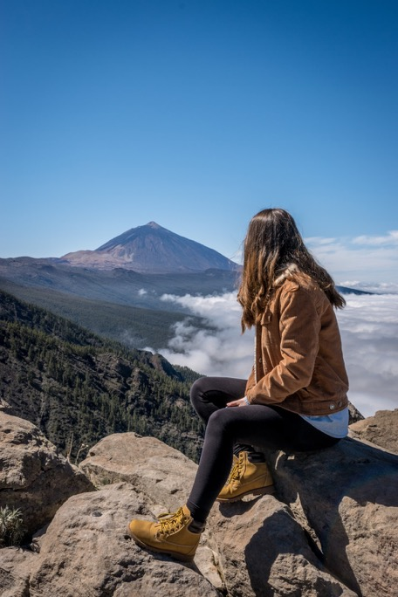
Lucía habla con su amiga Nadia sobre las vacaciones en Tenerife. Lee y elige el verbo correcto. Después escucha el audio y escribe las palabras que no están.
leer / escuchar
Hola, Nadia. ¿Cómo estás?
Muy bien, ¿y tú, 1) disfruto / disfruta / disfrutas las vacaciones?
¡Sí, mucho! Yo 2) viajas / viajo / viaja a lugares diferentes cada día mientras Daniel 3) monto / montas / monta en bicicleta ____________ ejercicio.
¡Qué bien! ¿Y tú qué lugares 4) visitas / visito / visita?
Pues yo 5) visito / visita / visitas el museo y las tiendas en el centro con mi madre y mi padre 6) descanso / descansas / descansa en la playa, aunque él también 7) pasas/ pasa / paso tiempo en el campo y en la montaña.
¿Y tú 8) piensa / pienso / piensas subir a la montaña?
¿Al Teide? Claro*, siempre intento ir con mi padre ____________ el paisaje porque es hermoso. Normalmente yo 9) aprovechas / aprovecho / aprovecha el día ____________ fotos y él 10) camina / caminas / camino por la montaña con Daniel.
para hacer
¡El Teide es la montaña más alta de España!
para ver
para sacar
*claro – of course
El Teide
Notes:
Timing: 8 minutes
Aim: to consolidate understanding of –ar verbs in singular persons; to recap the use of ‘para’ + infinitive.
Procedure:
Students first read and the choose the verb in the correct form, depending on the subject pronoun or name preceding it.
Answers are checked by the teacher, without yet playing the audio. At this stage the teacher can prompt students to look at these verbs in context and decide whether the English translation would be present continuous or present simple. In some cases, both might be possible, as in ii and iii below.
In particular it could be interesting to ask students for translations of…
i. ‘Y tú, disfrutas las vacaciones?’ (And you, are you enjoying the holidays?)
ii. ‘Yo viajo a lugares diferentes cada día’ (I visit different places every day / I’m visiting different places every day).
iii. ‘Y tú qué lugares visitas?’(And you, which places do you visit / are you visiting?)
iv. ‘Claro*, siempre intento ir con mi padre’ (Of course, I always try to go with my dad).
v. ‘Normalmente yo aprovecho el día’ (Normally, I make the most of / take advantage of the day…)
3. Students then listen to the dialogue and write ‘para’ together with the verb after it.
4. The teacher checks these answers, asking for translations of the full sentence in which ‘para + infinitive occurs to check understanding of how it is used to convey intention.
Notes:
1. Some higher-achieving groups may be comfortable with completing both parts of the activity (verb endings and use of ‘para’) before receiving feedback on these different features. If so, it would be advisable to change the animation order, which currently supports doing the steps separately.
2. Superlatives have not yet been covered in the scheme of work. The meaning of ‘la montaña más alta’ in the callout may therefore need to be given to students. Students might be interested to know that the mountain is 3715 metres, making it more than twice as a high as any mountain in the UK!

Slide 25
hablar
Leemos el diálogo en parejas.
Ahora, lee el diálogo por turnos y completa con las palabras que no están.
El/la estudiante A empieza.
El/la estudiante B escucha y dice si es correcto o no.
Ejemplo:
Pues ella busca una camisa pequeña y yo busco una camisa grande.
Estudiante A
Pues ella [she is looking for] una camisa pequeña y [I look for] una camisa grande.
¡Sí, correcto!
Estudiante B
Notes:
Timing: 12 min.
Aim: to orally produce the grammar points revisited in this week’s lessons (pronouns, present tense regular verbs, para + infinitive); to gain confidence in reading texts aloud
Procedure:
The teacher goes through the instructions and prompts with students, ensuring that each part is understood.
Students work in pairs, one person with text 1 and one person with text 2. They should not show each other their respective texts.
Students take turns to read out the dialogue to a partner, translating the English words/phrases into Spanish as they go.
As Student A and B have different sets of prompts, the student listening can offer feedback to their partner. This might take different forms (e.g. helping if the partner struggles to remember a word during the activity, or listening and taking notes, then offering feedback after the text has been read).
The reading text used earlier in the same lesson (slide 22) is also provided on slide 27 with English prompts for additional read aloud and retrieval practice.
Note: the prompts could be easily modified by the teacher, if desired, to increase the level of difficulty for a higher-achieving group. For example, more English prompts could be given.

Slide 26
hablar
Texto 1 – Estudiante A
Texto 1 – Estudiante B
Hola, Nadia. ¿Cómo [are you]?
Muy bien, ¿y tú, disfrutas las vacaciones?
¡Sí, mucho! [I] viajo a lugares diferentes cada día mientras Daniel [rides] en bicicleta [in order to do] ejercicio.
¡Qué bien! ¿Y tú qué lugares visitas?
Pues [I visit] el museo y las tiendas en el centro con mi madre y mi padre [rests] en la playa, aunque él también pasa tiempo en el campo y en la montaña.
¿Y tú piensas subir a la montaña?
¿Al Teide? Claro, siempre intento ir con mi padre [in order to see] el paisaje porque es hermoso. Normalmente yo [I make the most of] el día para sacar fotos y él [he walks] por la montaña con Daniel.
Hola, Nadia. ¿Cómo estás?
Muy bien, ¿[and you], [are you enjoying] las vacaciones?
¡Sí, mucho! Yo viajo a lugares diferentes cada día mientras Daniel monta en bicicleta para ejercicio.
¡Qué bien! ¿Y [you] qué lugares [are you visiting]?
Pues visito el museo y las tiendas en el centro con mi madre y mi padre descansa en la playa, aunque [he] también [is spending time] en el campo y en la montaña.
¿Y tú [are you thinking] subir a la montaña?
¿Al Teide? Claro, siempre intento ir con mi padre para ver el paisaje porque es hermoso. Normalmente yo aprovecho el día [in order to take photos] y él camina por la montaña con Daniel.
Notes:
DO NOT DISPLAY DURING ACTIVITY

Slide 27
hablar
Texto 2 – Estudiante A
Texto 2 – Estudiante B
Hola, [I am looking for] unas camisas blancas.
¿Pequeñas o grandes?
Pues ella [she is looking for] una camisa pequeña y yo [I am looking for] una camisa grande.
¿Necesitas otra cosa?
Sí, yo [I need] unos zapatos negros mientras que ella [she needs] unos zapatos blancos.
¿Buscas unos zapatos para ir al Carnaval?
Sí, [in order to dance] en la plaza.
Vale, debes participar en la fiesta del Carnaval el sábado, es el mejor día [for everything].
¿Cómo es la fiesta el sábado?
¡Genial! Cada año hay un concierto interesante en la plaza con música muy fuerte y mucha gente canta y baila en la calle.
¡Qué bien! Gracias por la información.
Hola, busco unas camisas blancas.
¿Pequeñas o grandes?
Pues ella busca una camisa pequeña y yo busco una camisa grande.
¿[Do you need] otra cosa?
Sí, yo necesito unos zapatos negros mientras que ella necesita unos zapatos blancos.
¿[Are you looking for] unos zapatos [in order to go] al Carnaval?
Sí, para bailar en la plaza.
Vale, [you must] participar en la fiesta del Carnaval el sábado, es el mejor día para todo.
¿Cómo es?
Cada año hay un concierto interesante en la plaza con música muy fuerte y mucha gente [sings] y [dances] en la calle.
¡Qué bien! Gracias por la información.
Notes:
DO NOT DISPLAY DURING ACTIVITY

Slide 28
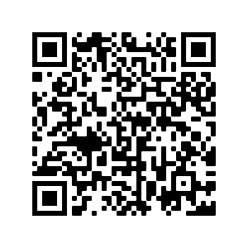
Deberes
Vocabulary Learning Homework (Term 3.1, Week 2)
Audio file
Audio file QR code:
Student worksheet
Quizlet link
In addition, revisit: Term 2.2 Week 2
Term 2.1 Week 5
Notes:
Audio file links to be added.

