Slide 1
Talking about what groups of people did
-ER verbs (taking avoir) in the perfect tense
(nous, vous, ils/elles)
SSC soft [c]/[ç] revisited
Y8 French
Term 3.2 - Week 4 - Lesson 65
Amber Dudley / Catherine Morris / Natalie Finlayson
Artwork by: Chloé Motard
Date updated: 09/07/21
Notes:
Artwork by Chloé Motard. All additional pictures selected are available under a Creative Commons license, no attribution required.
Native teacher feedback provided by Sarah Brichory.
With thanks to Rachel Hawkes and Emma Marsden for their input on the lesson material.
Learning outcomes (lesson 1):
Consolidation of SSC soft [c]/[ç]
Introduction of –ER verbs taking avoir in the perfect tense (nous, vous, ils/elles)
Word frequency (1 is the most frequent word in French):
8.3.2.4 (introduce) commencer [139], bibliothèque [2511], expliquer [252], emprunter [1268], quitter [507], cours [169], fois [49], tâche [887], déjà¹ [58], enfin [349], toujours [103]
8.3.1.5 (revisit) décrire [1176], traduire [1125], communauté [558], culture [913], expérience [679], information [317], produit [373], programme [340], tout¹, tous¹ [24]
8.2.2.2 (revisit) finir [583], nourrir [1261], chat [3138], dimanche [1235], heure [99], jeudi [1112], lundi [1091], mardi [1044], mercredi [1168], minute [375], vendredi [1086]
Source: Londsale, D., & Le Bras, Y. (2009). A Frequency Dictionary of French: Core vocabulary for learners London: Routledge.
The frequency rankings for words that occur in this PowerPoint which have been previously introduced in NCELP resources are given in the NCELP SOW and in the resources that first introduced and formally re-visited those words.
For any other words that occur incidentally in this PowerPoint, frequency rankings will be provided in the notes field wherever possible.

Slide 2
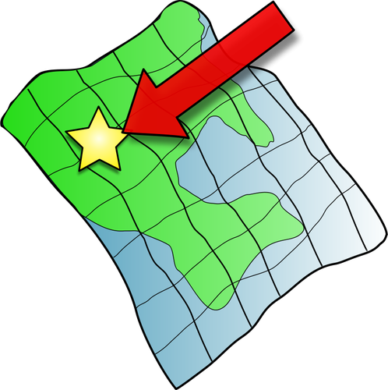
ç/c
ici
Notes:
Timing: 1 minute (2 SSC slides).
Aim: To consolidate SSC [ç/c]
Procedure: 1. Present the letter(s) and say the [ç/c] sound first, on its own. Students repeat it with you. 2. Bring up the word ”ici” on its own, say it, students repeat it, so that they have the opportunity to focus all of their attention on the connection between the written word and its sound.
3. A possible gesture for this would be to point to the spot on which one is standing / indicate the room in which the lesson is taking place with a sweeping motion of one’s index finger. 4. Roll back the animations and work through 1-3 again, but this time, dropping your voice completely to listen carefully to the students saying the [ç/c] sound, pronouncing ”ici” and, if using, doing the gesture.
Word frequency (1 is the most frequent word in French):
ici [167]. Source: Londsale, D., & Le Bras, Y. (2009). A Frequency Dictionary of French: Core vocabulary for learners London: Routledge.

Slide 3
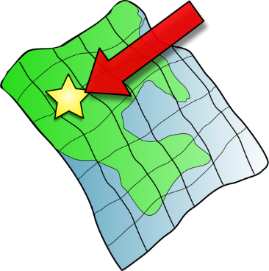
ç/c
français
garçon
ici
cinéma
cinq
décider
[to decide]
Notes:
Aim: To consolidate SSC [ç/c]
Procedure:
1. Introduce and elicit the pronunciation of the individual SSC [ç/c] and then the source word again ‘ici’ (with gesture, if using). 2. Then present and elicit the pronunciation of the five cluster words.
The cluster words have been chosen for their high-frequency, from a range of word classes, with the SSC (where possible) positioned within a variety of syllables within the words (e.g. initial, 2nd, final etc.). Additionally, we have tried to use words that build cumulatively on previously taught SSCs (see the Phonics Teaching Sequence document) and do not include new SSCs. Where new SSCs are used, they are often consonants which have a similar symbol-sound correspondence in English.
Word frequency (1 is the most frequent word in French): français [251]; garçon [1599]; cinéma [1623]; décider [165]; cinq [288]; ici [167]. Source: Londsale, D., & Le Bras, Y. (2009). A Frequency Dictionary of French: Core vocabulary for learners London: Routledge.

Slide 4
Hard and soft [c]
Hard and soft [c]
phonétique
Remember!
In French, the letter c is naturally soft (sounds like s) before e or i:
le cinéma c’est
However, the letter c is hard (sounds like k) before a, o or u:
calme content cuisine
We sometimes soften the c before a, o or u with a cedilla (ç):
le français le garçon le reçu (receipt)
Notes:
Timing: 2 minutes
Aim: To revise spelling rules governing the pronunciation of the letter ‘c’ before vowels and use of a cedilla..
Procedure:
1. Bring up the rules governing each category on clicks.
2. Teacher reads the words in each category out loud. Students repeat.

Slide 5
Hard and soft [c]
Some verbs must add a cedilla (ç) before the –ons ending in the nous form so that the sound is soft, like in the infinitive.
parler / écrire
Doit-on utiliser une cédille ? Lis, écoute et écris les mots.
1
commencer | nous commençons
5
prononcer | vous prononcez
a
b
a
b
to start, starting | we start, we are starting
to pronounce| you _{[pl/forma]} pronounce
2
reculer | vous reculez
6
décaler | ils décalent
a
b
a
b
to move back| you_{[pl/formall]} move back
to postpone| they postpone
3
avancer | nous avançons
7
remplacer | nous remplaçons
a
b
a
b
to move forward| we move forward
to replace| we replace
4
raconter | elles racontent
8
renoncer | vous renoncez
a
b
a
b
to tell| they tell
to give up| you _{[pl/formal]} give up
Notes:
Timing: 4minutes
Aim: Oral recognition and transcription of hard [c] and soft [c]/[ç]. This slide also primes students for the spelling change in the 1st person plural form of commencer, which is introduced in this week’s vocabulary set.
Procedure:
1. Tell students that the letters a) and b) hide a cedilla in some cases, and nothing in others.
2. Click on the number buttons to play the audio.
3. Students listen to the pairs of verbs and decide whether the SSCs above a) and b) are hard or soft. With lower levels, you may wish to check that students have this part correct before moving on to 4).
4. Remind students of the spelling rules governing the spelling of soft [c]/[ç]. Students complete the spelling of each word accordingly (either by adding a cedilla, or not).
5. Click to reveal the answers.
6. Click again to reveal translations of the words.
7. Click to reveal the explanation about the spelling change before a 1st person plural ending. NB: This is not a grammar point that students are expected to produce at this stage and will not feature in any NCELP tests. It is showcased here for awareness and passive understanding only.
Transcript:
commencer nous commençons
reculer vous reculez
avancer nous avançons
raconter elles racontent
prononcer vous prononcez
décaler ils décalent
remplacer nous remplaçons
renoncer vous renoncez
Word frequency of unknown words used(1 is the most frequent word in French): commencer [139], reculer [1922], avancer [449], raconter [890], prononcer [706], décaler [>5000], remplacer [448], renoncer [1363]
Source: Londsale, D., & Le Bras, Y. (2009). A Frequency Dictionary of French: Core vocabulary for learners London: Routledge.

Slide 6
Vocabulaire
lire
to borrow, borrowing
library
lesson, class
finally, at last
emprunter
quitter
déjà
la fois
toujours
le cours
la bibliothèque
la tâche
enfin
commencer
expliquer
to leave, leaving (somewhere)
task, chore
to start, to begin
always
time
already
to explain, explaining
Notes:
Timing: 3 minutes
Aim: Written recognition of this week’s new vocabulary.
Procedure:
1. Click to reveal the French words.
2. Elicit the English for each.
3. Click to reveal the answers.

Slide 7
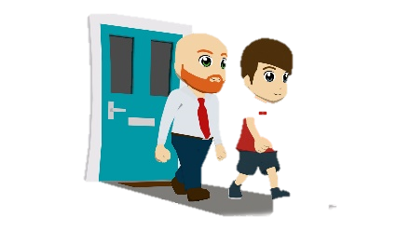
Saying ‘leave’: partir and quitter
vocabulaire
The verbs partir and quitter both mean ‘to leave’ in English.
Quitter is followed by a direct object describing somewhere:
Nous quittons la maison. We are leaving the house.
Partir is used when there is no direct object or when it is separated from the direct object by a preposition:
Nous partons. We are leaving.
Nous partons dans deux minutes. We are leaving in two minutes.
Nous partons pour Paris. We are leaving for Paris.
Notes:
Timing: 3 minutes
Aim: To highlight the syntactic differences between partir and quitter.
Procedure:
1. Click to animate the explanation.
2. Teacher to stress that quitter tells us where the person has come from. Partir does not give us this information.

Slide 8
En vacances !
lire
Bilal et Amandine prennent des vacances ! Lis les phrases et choisis le bon verbe.
Je quitte / pars à huit heures.
Abdel quitte / part l’aéroport.
Nous quittons / partons Paris.
Léa quitte / part demain.
Je quitte / pars la maison.
Nous quittons / partons pour Paris.
Ammar et Aïcha quittent / partent en vacances.
Léa et Aurélie quittent / partent la France.
Notes:
Timing: 5 minutes
Aim: Written recognition of direct objects and connecting the presence or absence of these with use of partir or quitter.
Procedure:
1. Students read the sentences and choose partir or quitter based on the syntactic context.
2. Click to reveal answers.
3. Oral translations of sentences.
Word frequency of cognates used (1 is the most frequent word in French): verbe [>5000]
Source: Londsale, D., & Le Bras, Y. (2009). A Frequency Dictionary of French: Core vocabulary for learners London: Routledge.

Slide 9
commencer
[to start | starting]
commence
The c in the stem changes to ç in the nous form.
[starts | is starting]
commençons
[start | are starting]
Notes:
Timing: 4 minutes for sequence of eight slides
Aim: to introduce the verb commencer more explicitly. Both long form (infinitive) and short form (3rd person singular) are introduced in order to familiarise students with various forms of the same verb.
Procedure:
Bring up the word commencer on its own, say it, students repeat it, and remind them of the phonics.
Try to elicit the meaning from the students. Students have had explicit teaching that the present tense in French communicates two different present tense meanings in English. This reinforces that learning. Emphasise the two meanings for the short form, reminding students that French only has one form and does not have a direct equivalent of the grammar for ‘is + ing’, the continuous form (as covered in previous weeks).
Bring up the picture, and, if using gestures, a possible gesture would be to start doing an action.
Then bring up the English translations. Emphasise the two meanings for the infinitive.
Bring up the first short form commence, say it, students repeat it.
Bring up the second short form commençons, say it, students repeat it. Draw attention to SSC [c]/[ç], open [o], [en], [on] and SFC.
Try to elicit the meaning from the students. Emphasise the two meanings for the short forms.
Bring up the info bubble to introduce the stem-change. NB: This is not a grammar point that students are expected to produce at this stage and will not feature in any NCELP tests. It is showcased here for awareness and passive understanding only.
Transcript:
commencer
commence
commençons

Slide 10
commencer
[to start | starting]
commence
[starts | is starting]
commençons
[start | are starting]
Notes:
Cycle through the long and short forms again.
Transcript:
commencer
commence
commençons

Slide 11
commence
[starts | is starting]
Elle commence la tâche.
[She starts | is starting the task.]
Notes:
Introduce the first short form in a sentence.
Transcript:
commence
Elle commence la tâche.

Slide 12
commençons
[start | are starting]
Nous commençons le cours.
[We start | are starting the lesson.]
Notes:
Introduce the second short form in a sentence.
Transcript:
commençons
Nous commençons le cours.

Slide 13
commencer
[to start | starting]
Il doit commencer demain.
[He has to start tomorrow.]
Notes:
Introduce the long form in a sentence.
Transcript:
commencer
Il doit commencer demain.

Slide 14
commence
[starts | is starting]
Elle commence la tâche.
[She starts | is starting the task.]
Notes:
Cycle through the first short form in context again.
Transcript:
commence
Elle commence la tâche.

Slide 15
commençons
[start | are starting]
Nous commençons le cours.
[We start | are starting the lesson.]
Notes:
Cycle through the second short form in context again.
Transcript:
commençons
Nous commençons le cours.

Slide 16
commencer
[to start | starting]
Il doit commencer demain.
[He has to start tomorrow.]
Notes:
Cycle through the long form in context again.
Transcript:
commencer
Il doit commencer demain.

Slide 17
Le passé composé
grammaire
Remember: the singular forms of -ER verbs in the perfect tense are as follows:
Present
je commence
(I start, am starting)
tu commences
(you start, are starting)
il/elle commence
(he/she starts, is starting)
Perfect (past)
→ j’ai commencé
(I started)
→ tu as commencé
(you started)
→ il/elle a commencé
(he/she started)
present tense of avoir + past participle
__
__
__
__
__
__
Notes:
Timing: 2 minutes
Aim: To recap the singular forms of –ER verbs in the perfect tense .
Procedure:
1. Click to animate the explanation.

Slide 18
Le passé composé
grammaire
present tense of avoir + past participle
What do you think the nous/vous/ils/elles forms look like?
Present
nous commençons
(we start, are starting)
vous commencez
(you start, are starting)
ils/elles commencent
(they start, are starting)
Attention! Commencez and commencé sound the same. The presence of ‘avoir’ tells us if the vous form is in the present or the past.
Perfect (past)
→ nous avons commencé
(we started)
→ vous avez commencé
(you started)
→ ils/elles ont commencé
(they started)
______
__
_____
__
___
__
Notes:
Timing: 2 minutes
Aim: To introduce the plural forms of –ER verbs in the perfect tense .
Procedure:
1. Click to animate the explanation.
2. Ask students to predict the plural forms of the perfect tense look like before revealing the answer.
3. Highlight that commencez and commencé sound the same, and that the auxiliary verb gives information about tense in the spoken vous form.

Slide 19
Le nouveau livre
écouter
Le professeur d’Amir parle à sa classe. Que dit-il ?
 |  | adverbe | phrase entière en anglais
 |  | en ce moment/hier | You started a new book yesterday.
 |  | maintenant/mercredi dernier | You are studying this book now.
 |  | en ce moment/lundi dernier | You talked about the text last Monday.
 |  | maintenant/mardi dernier | You explained the story to a partner last Tuesday.
 |  | en ce moment/jeudi dernier | Are you borrowing the school’s books at the moment?
 |  | normalement/vendredi dernier | Normally, you share the books with another class.
 |  | en ce moment/samedi dernier | You watched the film last Saturday.
 |  | maintenant/dimanche dernier | You are helping Océane’s friends now.
1
R
2
R
3
R
4
R
5
R
6
R
7
R
8
R
Notes:
Timing: 8 minutes
Aim: Aural recognition of second-person plural forms of regular –ER verbs in the present and perfect tenses. NB: The vous form is used because the present tense form and past participle sound the same, forcing students to notice the presence or absence of the auxiliary verb.
Procedure
1. Click on the number to listen to the audio with the time phrase obscured.
2. Students listen to each sentence and choose the correct adverb based on the verb form.
3. Click the R button to listen to the audio of the full sentence.
4. Click to reveal the answers.
5. Optional extension: ask students to translate the sentences that they have just heard.
6. Click to reveal suggested translations.
Transcript:
1. Vous avez commencé un nouveau livre [hier].
2. Vous étudiez ce livre [maintenant].
3. Vous avez parlé du texte [lundi dernier] ?
4. Vous avez expliqué l’histoire à un partenaire [mardi dernier].
5. Vous empruntez les livres du collège [en ce moment]?
6. [Normalement], vous partagez les livres avec une autre classe.
7. Vous avez regardé le film [samedi dernier].
8. Vous aidez les amis d’Océane [maintenant].
Word frequency of cognates used (1 is the most frequent word in French): entier [455]
Source: Londsale, D., & Le Bras, Y. (2009). A Frequency Dictionary of French: Core vocabulary for learners London: Routledge.

Slide 20
Astérix et Obélix (1/3)
la bande dessinée (BD) = comic
le francophone = a French speaker
lire
Amir parle de la bande dessinée, Astérix. Choisis le bon sujet.
Nous avons trouvé une copie de la bande dessinée* franco-belge « Astérix » hier. Une bande dessinée, c’est une histoire avec beaucoup des images et peu de texte. Plusieurs francophones ont partagé les aventures d’Astérix et Obélix. Il y a un parc d’attraction, le Parc Astérix, à Paris.
Nous avons visité le Parc l’année dernière.
Nous / mes parents
Nous / plusieurs francophones
Nous / mes amis
Notes:
Timing: 8 minutes. This is slide 1/3.
Aim: Written recognition of the plural forms of –ER verbs in the perfect tense; written comprehension of a longer text.
Procedure:
1. Students read the text and choose the appropriate subject based on the short form of avoir they see. The text is continued on slide 2/3.
2. Click to reveal the answers.
3. On slide 3/3, students re-read the text and choose whether the sentences in English are true or false.
4. Click to reveal the answers.
Word frequency of unknown words used (1 is the most frequent word in French): bande [977], dessiné [2624], francophone [3118]
Source: Londsale, D., & Le Bras, Y. (2009). A Frequency Dictionary of French: Core vocabulary for learners London: Routledge.
Word frequency of cognates used (1 is the most frequent word in French): copie [2133], type [440], magazine [2033], comique [4709], image [659], aventure [2090], attraction [>5000], série [836], agence [1481], presse [986], sujet [353]
Source: Londsale, D., & Le Bras, Y. (2009). A Frequency Dictionary of French: Core vocabulary for learners London: Routledge.

Slide 21
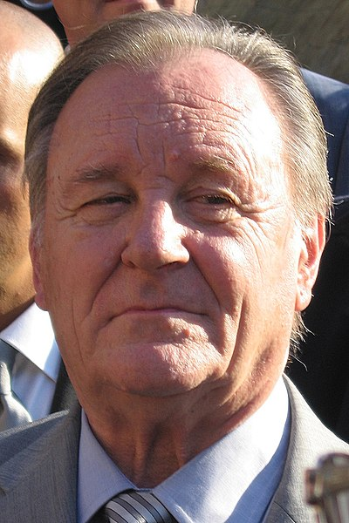
Astérix et Obélix (2/3)
lire
Amir parle de la bande dessinée, Astérix. Choisis le bon sujet.
Les auteurs ont commencé la série de bande dessinée en 1959. Ils ont créé le monde d’Astérix et Obélix en quatre heures ! Est-ce que vous avez regardé des films avec Astérix et Obélix ? Ou est-ce que vous avez préféré les bandes dessinées ?
L’auteur / Les auteurs
Il / Ils
René Goscinny
vous / les auteurs
vous / les auteurs
Albert Uderzo
Notes:
This is slide 2/3.
On revealing the first answer on this slide, pictures of René Goscinny and Albert Uderzo appear. Explain that these are the creators of the Asterix comics.
Picture sources:
https://commons.wikimedia.org/wiki/File:Albert_Uderzo.jpg
https://commons.wikimedia.org/w/index.php?search=Goscinny+et+Uderzo+&title=Special:MediaSearch&go=Go&type=image

Slide 22
Astérix et Obélix (3/3)
la bande dessinée (BD) = comic
le francophone = a French speaker
lire
Lis chaque phrases anglaise.
C’est vrai ou faux?
Nous avons trouvé une copie de la bande dessinée* franco-belge « Astérix » hier. Une bande dessinée, c’est une histoire avec beaucoup des images et peu de texte. Tous les francophones ont partagé les aventures d’Astérix et Obélix. Il y a un parc d’attraction, le Parc Astérix, à Paris. Nous avons visité le Parc l’année dernière. Les auteurs ont commencé la série de bande dessinée en 1959. Ils ont créé le monde d’Astérix et Obélix en quatre heures ! Est-ce que vous avez regardé des films avec Astérix et Obélix ? Ou est-ce que vous avez préféré les bandes dessinées ?
1. | Amir’s parents found a copy of Astérix.
2. | Astérix is a French-Belgian comic book.
3. | Comic books don’t have much text.
4. | All English speakers know about Astérix.
5. | There is an Astérix theme park.
6. | The authors finished the series in 1959.
7. | The world of Asterix took several days to create.
8. | There are films with Astérix and Obélix.
Notes:
This is slide 3/3.

Slide 23
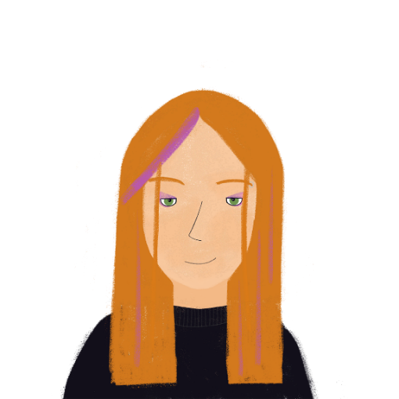
Un conte de fées*
*le conte de fees = fairy tale
parler / écrire
Tes partenaires ont visité une vieille femme dans la forêt.
Use the role play card to ask them questions about their visit in the past tense.
Make notes (in the third person) on what you hear.
Vous avez frappé à quoi ?
Nous avons frappé à la porte.
frapper à quoi Vous _______ ?
 | frapper à la porte Nous ______ .
Ils/elles ont frappé à la porte.
Notes:
Timing: 8 minutes
Aim: Oral and written production of the plural forms of –ER verbs in the perfect tense.
Procedure:
1. Print and distribute the cue cards on slides 24-25. Tell students they are going to work in pairs with another pair to co-create two fantasy stories.
2. Use this slide to model the task. Students take it in turns to ask and answer questions on behalf of their pair. Pair A begins by asking the question indicated on their role card in the perfect tense, using the vous form. At this stage, students to use intonation or est-ce que questions (inversion questions in the perfect tense will be introduced in lesson 2).
3. Pair B responds in the perfect tense using the nous form, following the prompt on their card.
4. Pair A make notes on what they hear in the ils/elles form.
5. After four turns, one member of pair A reads the full story aloud (4 sentences in the 3rd person plural). See slide 26 for the solution.
6. Pairs swap roles.
Word frequency of cognates used (1 is the most frequent word in French): interview [3186]
Source: Londsale, D., & Le Bras, Y. (2009). A Frequency Dictionary of French: Core vocabulary for learners London: Routledge.

Slide 24
Un conte de fées (A)
parler / écrire
Ask these questions |  | Give these answers
1. frapper à quoi ? Vous _______ ? |  | 5. écouter la femme Nous ______ .
2. parler à qui ? Vous _______ ? |  | 6. manger du fromage Nous ______ .
3. expliquer quoi ? Vous _______ ? |  | 7. quitter sa maison Nous ______ .
4. donner quoi à la femme? Vous _______ ? |  | 8. fermer la porte Nous ______ .
Notes:
Role play card for group A.

Slide 25
Un conte de fées (B)
parler / écrire
 | Give these answers | Ask these questions
 | 5. frapper à la porte Nous ______ . | 1. écouter qui ? Vous _______ ?
 | 6. parler à la femme Nous ______ . | 2. manger quoi ? Vous _______ ?
 | 7. expliquer l’histoire Nous ______ . | 3. quitter où ? Vous _______ ?
 | 8. donner le livre à la femme Nous ______ . | 4. fermer quoi ? Vous _______ ?
Notes:
Role play card for the previous slide.

Slide 26
Un conte de fées (réponses)
parler / écrire
Groupe A
Ils ont écouté la femme. Ils ont mangé du fromage. Ils ont quitté sa maison. Ils ont fermé la porte.
Groupe B
Ils ont frappé à la porte. Ils ont parlé à la femme. Ils ont expliqué l’histoire. Ils ont donné le livre à la femme.
Notes:
Role play card for the previous slide.

Slide 27
Talking about what groups of people did
yes/no questions (inversion) in the perfect tense (nous, vous, ils/elles)
SSCs [-s] and [-tion] revisited
Y8 French
Term 3.2 - Week 4 - Lesson 66
Amber Dudley / Catherine Morris / Catherine Salkeld
Artwork by: Chloé Motard
Date updated: 06/11/21
Notes:
Artwork by Chloé Motard. All additional pictures selected are available under a Creative Commons license, no attribution required.
Native speaker feedback provided by Sarah Brichory.
With thanks to Rachel Hawkes and Emma Marsden for their input on the lesson material.
Learning outcomes (lesson 2):
Consolidation of SSCs [-s] and [-tion]
Consolidation of yes/no questions (inversion) in the present tense
Introduction of yes/no questions (inversion) in the perfect tense
Word frequency (1 is the most frequent word in French):
8.3.2.4 (introduce) commencer [139], bibliothèque [2511], expliquer [252], emprunter [1268], quitter [507], cours [169], fois [49], tâche [887], déjà¹ [58], enfin [349], toujours [103]
8.3.1.5 (revisit) décrire [1176], traduire [1125], communauté [558], culture [913], expérience [679], information [317], produit [373], programme [340], tout¹, tous¹ [24]
8.2.2.2 (revisit) finir [583], nourrir [1261], chat [3138], dimanche [1235], heure [99], jeudi [1112], lundi [1091], mardi [1044], mercredi [1168], minute [375], vendredi [1086]
Source: Londsale, D., & Le Bras, Y. (2009). A Frequency Dictionary of French: Core vocabulary for learners London: Routledge.
The frequency rankings for words that occur in this PowerPoint which have been previously introduced in NCELP resources are given in the NCELP SOW and in the resources that first introduced and formally re-visited those words.
For any other words that occur incidentally in this PowerPoint, frequency rankings will be provided in the notes field wherever possible.

Slide 28
-s-
maison
Notes:
Timing: 1 minute (2 SSC slides).
Aim: To consolidate SSC [-s-]
Procedure: 1. Present the letter(s) and say the [-s-] sound first, on its own. Students repeat it with you. 2. Bring up the word ”maison” on its own, say it, students repeat it, so that they have the opportunity to focus all of their attention on the connection between the written word and its sound.
3. A possible gesture for this would be to trace the outline of a house in the air with two fingers. 4. Roll back the animations and work through 1-3 again, but this time, dropping your voice completely to listen carefully to the students saying the [-s- between vowels] sound, pronouncing ”maison” and, if using, doing the gesture.
Word frequency (1 is the most frequent word in French):
maison [325]
Source: Londsale, D., & Le Bras, Y. (2009). A Frequency Dictionary of French: Core vocabulary for learners London: Routledge.

Slide 29
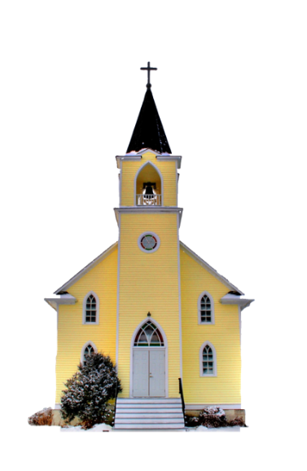
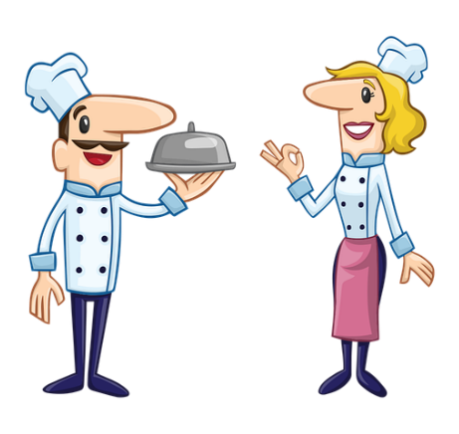
-s-
magasin
église
désolé
maison
cuisine
[sorry]
chose
[thing]
Notes:
Aim: To consolidate SSC [-s-]
Procedure:
Introduce and elicit the pronunciation of the individual SSC [-s-] and then the source word again ‘maison’ (with gesture, if using). Then present and elicit the pronunciation of the five cluster words. The cluster words have been chosen for their high-frequency, from a range of word classes, with the SSC (where possible) positioned within a variety of syllables within the words (e.g. initial, 2nd, final etc.). Additionally, we have tried to use words that build cumulatively on previously taught SSCs (see the Phonics Teaching Sequence document) and do not include new SSCs. Where new SSCs are used, they are often consonants which have a similar symbol-sound correspondence in English.
Word frequency (1 is the most frequent word in French): maison [325]; chose [125]; magasin [1736]; église [1782]; désolé [2081]; cuisine [2618]. Source: Londsale, D., & Le Bras, Y. (2009). A Frequency Dictionary of French: Core vocabulary for learners London: Routledge.

Slide 30
-tion
Attention!
Notes:
Timing: 1 minute (2 SSC slides).
Aim: To consolidate SSC [-tion]
Procedure: 1. Present the letter(s) and say the [-tion] sound first, on its own. Students repeat it with you. 2. Bring up the word ”attention” on its own, say it, students repeat it, so that they have the opportunity to focus all of their attention on the connection between the written word and its sound.
3. A possible gesture for this would be to wave one’s hand in front of oneself to indicate not to proceed. 4. Roll back the animations and work through 1-3 again, but this time, dropping your voice completely to listen carefully to the students saying the [-tion] sound, pronouncing ”attention” and, if using, doing the gesture.
Word frequency (1 is the most frequent word in French):
attention [482].
Source: Londsale, D., & Le Bras, Y. (2009). A Frequency Dictionary of French: Core vocabulary for learners London: Routledge.

Slide 31
-tion
population
situation
attention!
action
solution
international
Notes:
Aim: To consolidate SSC [-tion]
Procedure:
1. Introduce and elicit the pronunciation of the individual SSC [-tion] and then the source word again ‘attention’ (with gesture, if using). 2. Then present and elicit the pronunciation of the five cluster words.
The cluster words have been chosen for their high-frequency, from a range of word classes, with the SSC (where possible) positioned within a variety of syllables within the words (e.g. initial, 2nd, final etc.). Additionally, we have tried to use words that build cumulatively on previously taught SSCs (see the Phonics Teaching Sequence document) and do not include new SSCs. Where new SSCs are used, they are often consonants which have a similar symbol-sound correspondence in English.
Word frequency (1 is the most frequent word in French): population [509]; action [355] situation [223]; international [282]; solution [608]; attention [482]. Source: Londsale, D., & Le Bras, Y. (2009). A Frequency Dictionary of French: Core vocabulary for learners London: Routledge.

Slide 32
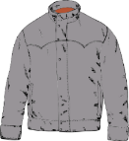
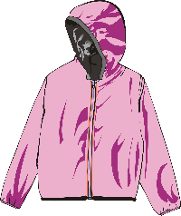
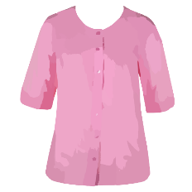
Au magasin de vêtements
Remember:
[-s-] is hard between two vowels.
[c] is hard before a/o/u.
lire / parler
Lisez les listes de mots. Attention aux SCCs en orange !
Ne dites pas l’intrus !
 | des chaussettes | un blouson | un bracelet
 | un pardessus | des lunettes de natation | une blouse
 | un tricot | une ceinture | une jupe plissée
 | un caleçon | des chaussures | une chemisette
 | des lunettes de protection | une vareuse | un chemisier
1
2
3
4
5
Notes:
Timing: 5 minutes
Aim: Pronunciation of words containing SSCs [-s-], [ss], [ç], soft [c], hard [c] and [-tion]. Raising awareness that [ss], [ç], soft [c] and the [t] in [-tion] sound identical.
Procedure:
1. Students read the sets of words, focusing on the SSCs in bold, and mentally eliminating the word containing an SSC which doesn’t match the others.
2. They take it in turns to read aloud the remaining pair of words.
3. Click to reveal the ‘odd one out’. Students say it aloud.
4. Click on the numbers to hear the full line of words said aloud by a native speaker. Students repeat.
Word frequency of cognates used (1 is the most frequent word in French):
protection [953]
Word frequency of unknown words used (1 is the most frequent word in French):
chaussette [>5000], blouson [>5000], jupe [>5000], plissé [>5000], pardessus [>5000], chaussure [3638], tricot [>5000], ceinture [4538], bracelet [>5000], blouse [>5000], caleçon [>5000], chemisette [>5000], lunette [4207], protection [953], vareuse [>5000], chemisier [>5000]
Source: Lonsdale, D., & Le Bras, Y. (2009). A Frequency Dictionary of French: Core vocabulary for learners London: Routledge.

Slide 33
Vocabulaire
parler
Dis les mots en français.
en anglais | en français | en anglais | en français
always | toujours | task, chore | la tâche
to start, to begin | commencer | to borrow, borrowing | emprunter
lesson, class | le cours | to leave, leaving (somewhere) | quitter
library | la bibliothèque | already | déjà
time | la fois | finally, at last | enfin
to explain, explaining | expliquer
Notes:
Timing: 3 minutes
Aim: Spoken recall of this week’s new vocabulary at word level.
Procedure:
1. As a class, students say the French translation of each word on the list.
2. Written forms are revealed on clicks.

Slide 34
Saying ‘time’
vocabulaire
You know two words for ‘time’ in French, le temps and la fois.
Use le temps to talk about an amount of time (seconds, minutes, hours, days, weeks, months, years, etc.):
J’ai beaucoup de temps. I have a lot of time.
Combien de temps ça prends ? How much time (how long) does it take ?
Use la fois to talk about the number of times something happens:
C’est la première fois. This is the first time.
J’ai visité le musée plusieurs fois. I (have) visited the museum several times.
Notes:
Timing: 2 minutes
Aim: To highlight a cross-linguistic vocabulary difference (one word in French, two in English); to explain when to use temps and when to use fois.
Procedure:
1. Click to animate the explanation.

Slide 35
Saying ‘time’
lire
Lis ces phrases et décide si on doit traduire « time(s) » par fois ou temps.
 |  | fois | temps
1. | We have eaten snails several times.
2. | It’s a waste of time.
3. | That was the first time we went to the moon.
4. | The dog wags his tail every time.
5. | They are spending a lot of time at work.
6. | I will find the time to do it.
7. | We are running out of time.
8. | She’s repeated herself five times now.
Notes:
Timing: 5 minutes
Aim: Written recognition of the appropriate translation (temps or fois) for ‘time’.
Procedure:
1. Students read the sentences and choose whether fois or temps is the most appropriate translation for time.
2. Click to reveal the answers.

Slide 36
Inversion questions in the past
grammaire
As you know, we can turn sentences with two verbs into questions by swapping the position of the subject pronoun and the verb in short form:
Statement: Ils vont aller à la plage.
Question: Vont-ils aller à la plage ?
Remember to add a hyphen between subject and verb in the written form!
We can use the same rule to turn statements into questions in the perfect tense. Remember, avoir is the verb in short form.
Statement: Vous avez commencé le livre.
Question: Avez-vous commencé le livre ?
____________________ ?
___________________________ ?
Notes:
Timing: 3 minutes
Aim: To introduce inversion questions in the perfect tense by comparing these with inversion questions in two-verb constructions.
Procedure:
1. Click to animate the explanation. Note that we are purposefully recommending introducing inversion questions in the perfect tense in this lesson about plural forms, given the infrequent use of the je form, and the complexities introduced by the addition of -t- with the il/elle form (this will be introduced in Year 9). It is expected that students will be able to recognise perfect tense inversion questions in the tu form from this point, however.

Slide 37
Amir parle aux politiques*
*le/la politique = a politician
*le stage = work experience
écouter
Amir fait un stage* comme journaliste. Voici ses questions aux politiques.
Écoute et décide si ses questions sont au présent ou au passé.
 | Au présent ? | Au passé ? | En anglais ?
1 |  |  | Did you find an answer to our question?
2 |  |  | Do you have any ideas?
3 |  |  | Are you suggesting a solution to the problem?
4 |  |  | Did you work with the local community?
5 |  |  | Did you visit the local schools?
6 |  |  | Are you helping the hospitals?
7 |  |  | Are you thinking about the future?
8 |  |  | Did you speak to the newspapers?
1
2
3
4
5
6
7
8
Notes:
Timing: 8 minutes
Aim: Aural recognition of questions with the plural forms of –ER verbs in the present and perfect tenses.
Procedure:
1. Students write 1-8 in their books.
2. Click on the number buttons to listen to the audio.
3. Students listen to the audio and decide whether the question is in the present or past tense, based on the presence or absence of the short form of avoir in the verb phrase. Note all the questions are in the vous form, because this present tense short form sounds identical to the past participle. This ensures that students focus on the presence or absence of the short form of avoir (and means there is no need for beeps).
4. As an extension activity, students translate the sentences into English.
5. Click to reveal answers and suggested translations. Highlight that there is no equivalent for ‘did’ in French.
Transcript:
Avez-vous trouvé une réponse à notre question ?
Avez-vous des idées ?
Proposez-vous une solution au problème ?
Avez-vous travaillé avec la communauté locale ?
Avez-vous visité les écoles locales ?
Aidez-vous les hôpitaux ?
Pensez-vous à l’avenir ?
Avez-vous parlé aux journaux ?
Word frequency of cognates used (1 is the most frequent word in French): politique [128], stage [4007], journaliste [1337], décider [165], présent [216]
Source: Londsale, D., & Le Bras, Y. (2009). A Frequency Dictionary of French: Core vocabulary for learners London: Routledge.

Slide 38
Un robot à la maison !
Des e-mails aux collègues
le député = MP
la réunion = meeting
lire
Amir envoie des e-mails. Ses questions, sont-elles au présent ou au passé ? Doit-on commencer la question avec une forme d’avoir ? Complète.
1. | avez- | vous envoyé des lettres aux députés* ? | present | past
2. |  | cherchons-nous une solution au problème ? | present | past
3. |  | travaillons-nous bien ensemble ? | present | past
4. |  | partagez-vous des ressources ? | present | past
5. | ont- | ils expliqué la situation ? | present | past
6. | avez- | vous parlé aux autres élèves ? | present | past
7. |  | écoutent-ils des élèves ? | present | past
8. | avons- | nous organisé une réunion ? | present | past
Notes:
Timing: 5 minutes
Aim: Written recognition of inversion questions with plural forms of –ER verbs in the present and perfect tenses.
Procedure:
1. Students write 1-8 and use their knowledge of inversion question structure to decide whether each question is in the present or the perfect tense.
2. Where the question is in the perfect tense, students fill in the short form of avoir.
3. Click to reveal the answers and full questions.
4. Oral translation of questions.
Word frequency of unknown words used (1 is the most frequent word in French):
e-mail [>5000], collègue [1099], député [424], réunion [971], ressource [852]
Source: Londsale, D., & Le Bras, Y. (2009). A Frequency Dictionary of French: Core vocabulary for learners London: Routledge.
Word frequency of cognates used (1 is the most frequent word in French):
ressource [852], situation [223], e-mail [>5000], présent [216], décider [165]
Source: Londsale, D., & Le Bras, Y. (2009). A Frequency Dictionary of French: Core vocabulary for learners London: Routledge.

Slide 39
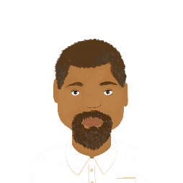
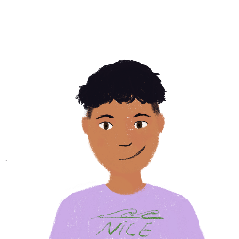
Des problems à l’école
*voir = to see
*la réunion = meeting
*la piscine = swimming pool
écrire
Amir veut trouver des solutions ! Il parle avec son professeur. On ne peut pas voir* les questions. Écris les verbes au passé composé. Ensuite, écris les questions.
Avez-vous organisé une réunion avec les autres élèves ?
Avez-vous utilisé la piscine du collège ?
Oui, nous avons organisé une réunion avec les autres élèves.
Non, nous n’avons pas utilisé la piscine*.
organiser
utiliser (ne…pas)
Ont-ils partagé des problèmes ?
Avez-vous trouvé une solution à ces problèmes ?
Oui, ils ont partagé beaucoup de problèmes !
Non, nous n’avons pas trouvé une solution à ces problèmes.
partager
trouver (ne…pas)
Notes:
Timing: 8 minutes
Aim: Written production of questions and statements with the plural forms of –ER verbs in the perfect tense.
Procedure:
1. Students read the answers to a series of questions and write the perfect tense form of the verb provided in the blue box.
2. Click to reveal the verbs in the conjugated forms.
3. Once students have filled in the blanks, ask students to write inversion questions to elicit these answers, using the same verb.
4. Click to reveal the possible questions.
Word frequency of unknown words used (1 is the most frequent word in French): réunion [971], voir [69], piscine [>5000], verbe [>5000]
Source: Londsale, D., & Le Bras, Y. (2009). A Frequency Dictionary of French: Core vocabulary for learners London: Routledge.
Word frequency of cognates used (1 is the most frequent word in French): solution [608], verbe [>5000], composer [858]
Source: Londsale, D., & Le Bras, Y. (2009). A Frequency Dictionary of French: Core vocabulary for learners London: Routledge.

Slide 40
Amir et ses professeurs
parler
Continue la conversation entre Amir et son professeur. Dis des questions et des réponses au passé composé. Voici des verbes que vous pouvez utiliser.
organiser
envoyer
utiliser
proposer
commencer
expliquer
écouter
parler
trouver
montrer
penser à
travailler
chercher
partager
visiter
Notes:
Timing: 8 minutes
Aim: Semi-structured oral production of inversion questions and statements using plural forms of –ER verbs in the perfect tense.
Procedure:
1. Begin by recapping placement rules for ne…pas in the perfect tense.
2. Students take on the role of either Amir or the teacher.
3. The student playing Amir begins by asking a question in the past tense using one of the verbs provided (or another verb). Students should use a different verb each time. At lower levels, the teacher may wish to provide some nouns to go with the suggested verbs.
4. The student playing the teacher replies with a statement using the same verb. Encourage students to use a mix of affirmative and negative sentences.
5. Continue steps 3-4 for 5 questions in total.
6. Students swap roles. Repeat steps 3-5.
Word frequency of cognates used (1 is the most frequent word in French): continuer [113], verbe [>5000], composer [858]
Source: Londsale, D., & Le Bras, Y. (2009). A Frequency Dictionary of French: Core vocabulary for learners London: Routledge.

Slide 41
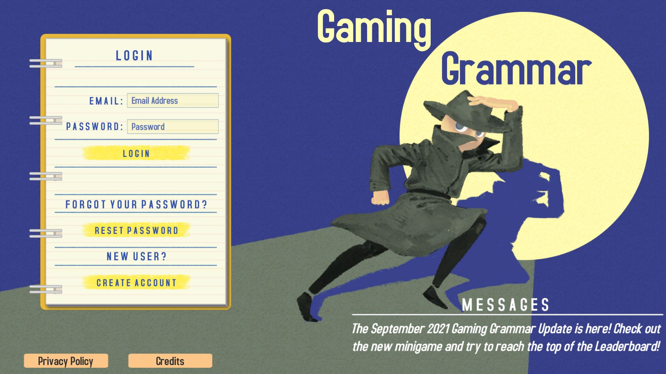
Gaming Grammar
Gaming Grammar
Relevant mini game(s):
Verbs: 1st person present & past tense (Verb agreement (past))
Verbs: 3rd person present & past tense (Verb agreement (past))
Questions: Subject-verb inversion
To have and to be: 1st person and 3rd person singular
Notes:
This slide links to Gaming Grammar login screen. The appropriate mission can then be selected from the menu page.
Students will progress through the game at their own rate; teachers should use the teacher interface to check progress. This will help to inform future lesson planning.

Slide 42
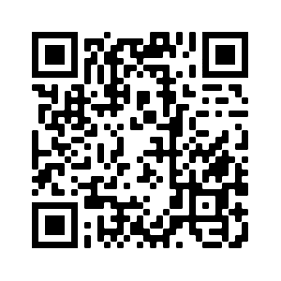
Devoirs
Vocabulary Learning Homework (Revisit Y8, Term 3.2, Week 4)
Quizlet link: Y8 Term 3.2 Week 4
Quizlet QR code:
In addition, revisit: Y8 Term 3.1 Week 5
Y8 Term 2.2 Week 2
Notes:
The answer sheet for the Y8, Term 3.2, Week 4 vocabulary learning HW is here: https://resources.ncelp.org/concern/resources/37720d59r?locale=en

