Slide 1
Expressing future intentions
aller + infinitive (future intention)
partir (je, tu, il/elle)
SSC [qu] [revisited]
Y7 French
Term 3.2 - Week 3 - Lesson 63
Joe Fincham / Stephen Owen / Kirsten Somerville
Artwork by: Chloé Motard
Date updated: 04/08/2022
Notes:
Artwork by Chloé Motard. All additional pictures selected are available under a Creative Commons license, no attribution required.
Learning outcomes (lesson 1):
Revisiting SSC [qu]
Introducing the use of aller plus the infinitive to express future intentions (je, tu, il/elle)
Introducing the partir (je, tu, il/elle) as a verb like sortir
Word frequency (1 is the most frequent word in French):
7.3.2.3 (introduce) partir [163], pars [163], part [163], (à l') avenir [471], match [1906], madame [294], monsieur [79], encore¹ [51], en retard [7/1278], tôt [513]
7.3.1.4 (revisit) dormir [1836], dors [1836], dort [1836], bureau¹ [273], équipe [814], parfois [410], sous [112], sur [16]
7.2.2.4 (revisit) allons [53], allez [53], vont [53], année [102], mois [178], vacances [1726], ville [260], Écosse [n/a], Angleterre [n/a], France [n/a], chez¹ [206], en³ [3]
Source: Londsale, D., & Le Bras, Y. (2009). A Frequency Dictionary of French: Core vocabulary for learners London: Routledge.
The frequency rankings for words that occur in this PowerPoint which have been previously introduced in NCELP resources are given in the NCELP SOW and in the resources that first introduced and formally re-visited those words.
For any other words that occur incidentally in this PowerPoint, frequency rankings will be provided in the notes field wherever possible.
The additional English meanings of the following words have been added to Quizlet since the creation of this resource: match (match, game)

Slide 2
qu
?
question
Notes:
Timing: 1 minute
Aim: To consolidate SSC [qu]
Procedure: 1. Present the letter(s) and say the [qu] sound first, on its own. Students repeat it with you. 2. Bring up the word ”question” on its own, say it, students repeat it, so that they have the opportunity to focus all of their attention on the connection between the written word and its sound.
3. A possible gesture for this would be to raise one’s eyebrows and look intently, as if querying something. 4. Roll back the animations and work through 1-3 again, but this time, dropping your voice completely to listen carefully to the students saying the [qu] sound, pronouncing ”question” and, if using, doing the gesture.
Word frequency (1 is the most frequent word in French):
question [144].
Source: Londsale, D., & Le Bras, Y. (2009). A Frequency Dictionary of French: Core vocabulary for learners London: Routledge.

Slide 3
qu
question
Notes:
With sound and no pictures to focus all attention on the sound-symbol correspondence.

Slide 4
qu
?
question
Notes:
Without sound to elicit pronunciation (without first hearing the teacher).
Teacher to elicit pronunciation by asking “Comment dit-on …"

Slide 5
qu
quatre
musique
?
question
expliquer
unique
[to explain]
manquer
[unique; only]
[to miss/be missing]
Notes:
Timing: 2 minutes
Aim: To consolidate SSC [qu]
Procedure:
1. Introduce and elicit the pronunciation of the individual SSC [qu] and then the source word again ‘question’ (with gesture, if using). 2. Then present and elicit the pronunciation of the five cluster words.
The cluster words have been chosen for their high-frequency, from a range of word classes, with the SSC (where possible) positioned within a variety of syllables within the words (e.g. initial, 2nd, final etc.). Additionally, we have tried to use words that build cumulatively on previously taught SSCs (see the Phonics Teaching Sequence document) and do not include new SSCs. Where new SSCs are used, they are often consonants which have a similar symbol-sound correspondence in English.
Word frequency (1 is the most frequent word in French): quarte [283]; musique [1139] expliquer [252]; manquer [583]; unique [402]; question [144]. Source: Londsale, D., & Le Bras, Y. (2009). A Frequency Dictionary of French: Core vocabulary for learners London: Routledge.

Slide 6
qu
quatre
musique
?
question
expliquer
unique
manquer
Notes:
With sound and no pictures to focus all attention on the sound-symbol correspondence.

Slide 7
qu
quatre
musique
?
question
expliquer
unique
manquer
Notes:
Without sound to elicit pronunciation (without first hearing the teacher).
Teacher to elicit pronunciation by asking “Comment dit-on …"

Slide 8
Dictée – ‘q’ ou ‘c’ ?
Dictée – ‘q’ ou ‘c’ ?
écrire
1
quand
6
parc
2
comprendre
7
chaque
3
cadeau
8
quatre
4
sympathique
9
combien
5
question
10
caisse
Notes:
Timing: 5 minutes
Aim: reinforce students’ awareness of the fact that [qu] has the same pronunciation as hard [c].
Procedure:
The teacher plays the recorded words (all known vocabulary items) one at a time.
Students write them, then click to check.
Transcript:
1. quand
2. comprendre
3. cadeau
4. sympathique
5. question
6. parc
7. chaque
8. quatre
9. combien
10. caisse
Word frequency (1 is the most frequent word in French):
quand [119]; comprendre [95] cadeau [2298]; sympathique [4164]; question[144]; parc [1240], chaque [151], quatre [253], combien [800], caisse [1881]
Source: Londsale, D., & Le Bras, Y. (2009). A Frequency Dictionary of French: Core vocabulary for learners London: Routledge.

Slide 9
Vocabulaire
Vocabulaire
écouter
1
to leave, leaving
partir
2
match, game
le match
3
Miss, Mrs, Ms, Madam
madame
4
Sir, Mr
monsieur
5
again
encore
6
late
en retard
7
early
tôt
8
future
l’avenir
Notes:
Timing: 3 minutes
Aim: Aural recognition of the new vocabulary items introduced this week.
Procedure:
1. Click on a number to hear a French word said aloud.
2. Students write 1-8 and the English translation.
3. Click to check.
4. At more advanced levels, transcriptions of the words can also be elicited. If doing this step, solutions appear on a second click.
Transcript: partir le match
madame monsieur encore en retard tôt l’avenir

Slide 10
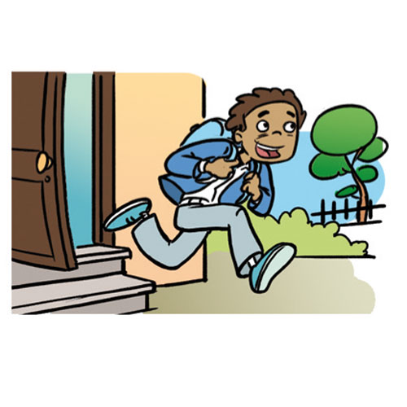
partir
[to leave| leaving]
part
[goes out | is going out]
Notes:
Timing: 3 minutes for sequence of six verbs
Aim: to introduce the verb [partir] more explicitly. Both long form (infinitive) and short form (3rd person singular) are introduced in order to familiarise students with various forms of the same verb.
Procedure
Bring up the word [partir] on its own, say it, students repeat it, and remind them of the phonics.
Try to elicit the meaning from the students. Students have had explicit teaching that the present tense in French communicates two different present tense meanings in English. This reinforces that learning. Emphasise the two meanings for the short form, reminding students that French only has one form and does not have a direct equivalent of the grammar for ‘is + ing’, the continuous form (as covered in previous weeks).
Bring up the picture, and, if using gestures, a possible gesture would be [point to the door].
Then bring up the English translations. Emphasise the two meanings for the infinitive.
Bring up the short form [part], say it, students repeat it.
Try to elicit the meaning from the students. Emphasise the two meanings for the short form.

Slide 11
partir
[to leave| leaving]
part
[leaves| is leaving]
Notes:
Cycle through the long and short form again.

Slide 12
part
[leaves| is leaving]
Elle part tôt.
[She leaves | is leaving early.]
Notes:
Introduce the short form in a sentence.

Slide 13
partir
[to leave| leaving]
Elle aime partir tôt.
[She likes to leave| leaving early.]
Notes:
Introduce the long form in a sentence.

Slide 14
part
[leaves| is leaving]
part
Elle tôt.
[She leaves| is leaving early.]
Notes:
Cycle through the short form in context again.

Slide 15
partir
[to leave| leaving]
partir
Elle aime tôt.
[She likes to leave | leaving early.]
Notes:
Cycle through the long form in context again.

Slide 16
Using the verb ‘partir’
Using the verb ‘partir’
grammaire
You have seen this pattern of –s, -s, -t, -t endings before:
sortir also follows this pattern.
This is the pattern of endings for the first, second and third person singular forms of partir:
je pars
I leave / I am leaving
tu pars
you leave / you are leaving
il part
he leaves / he is leaving
These verb forms all sound the same!
The –s on the je and tu forms is a silent final consonant (SFC)
elle part
she leaves / she is leaving
Notes:
Timing: 2 minutes
Aim: To present the first three persons singular of the verb partir is now presented. Highlight that all forms sound the same due to the SFC.

Slide 17
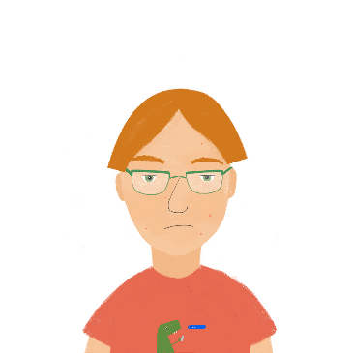
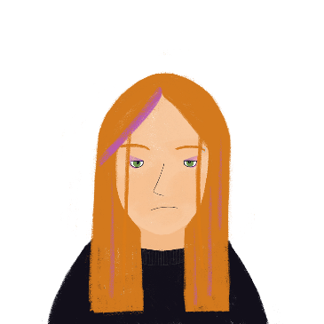
Des voyages différents
Des voyages différents
lire
Antoine et Élodie font des voyages. Léa écrit à Antoine.
Qui fait quoi ? Coche Antoine (tu) ou Élodie (elle).
 |  | Antoine (tu) | Élodie (elle)
1. | Tu pars avec tes amis.
2. | Elle part pour l’université.
3. | Tu pars tôt.
4. | Elle part en retard.
5. | Tu pars pour un mois de vacances.
6. | Tu pars pour l’Écosse.
7. | Elle part pour une année à l’étranger.
8. | Elle part en train.
?
?
?
?
?
?
?
?
Notes:
Timing: 5 minutes
Aim: Practise the verb endings for partir.
Procedure:
Students write 1-8 and choose between Antoine (tu) and Élodie (elle) for each.
Answers are revealed on clicks.
English translations can also be elicited, highlighting the different prepositions that are frequently used with this verb.

Slide 18
Reminder: aller
Reminder: aller
grammaire
aller - to go / going
je vais
I go / am going
tu vas
you go / are going
il va
he goes / is going
elle va
she goes / is going
Notes:
Timing: 1 minute
Aim: To recap the forms of aller learnt previously and which are going to feature in this week’s lessons (plural forms are practised in this new context the following week).

Slide 19
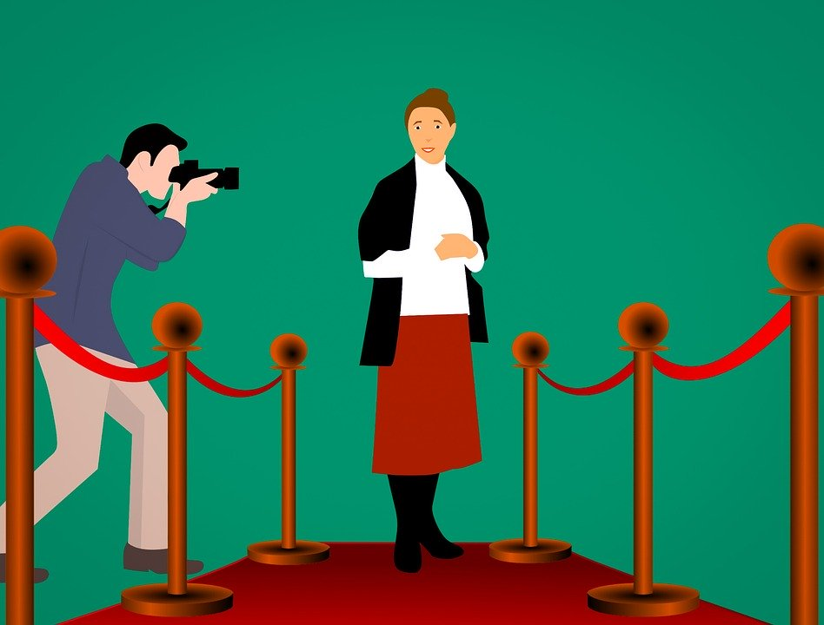
Future intention with aller
Future intention with aller
grammaire
As you know, the infinitive form of a verb is the form you see in a dictionary (e.g. manger / to eat).
In English, we use the present continuous form of the verb ‘to go’ with the infinitive to say what we are going to do in the future.
I am going to become an actress in the future.
Je vais devenir actrice à l’avenir.
In French, we do this using the short form of the verb aller with the infinitive.
Attention!
en anglais: in the future
en français: à l’avenir
Notes:
Timing: 3 minutes
Aim: To introduce the use of aller with another verb in infinitive to talk about what we are going to do in the future (first person singular form only at this stage).

Slide 20
Comme enfant ou comme adulte?
Comme enfant / adulte ?
lire
When we talk about peoples’ jobs, we don’t use an article.
This is different from English: Je vais devenir acteur. I’m going to become an actor.
Les professeurs ont des questions pour Amir! Que fait-il aujourd’hui? Que fait-il comme adulte? Je or je vais? Lis les phrases et coche. |  | aujourd’hui I am (je …) | comme adulte I am going to (je vais …)
1. | Je vais devenir acteur, Monsieur.
2. | Je vais partir en vacances, Madame.
3. | Je gagne le match de foot, Monsieur.
4. | Je viens à l’école en retard, Madame.
5. | Je vais arriver tôt à l’université, Monsieur.
6. | Je vais à la poste, Madame.
7. | Je vais travailler en Angleterre, Monsieur.
8. | Je fais les courses, Madame.
In No. 6, Amir is writing about where he is going right now. He is not talking about the future, as there is no infinitive after je vais...
Notes:
Timing: 5 minutes
Aim: Written recognition of the form of the main verb in a sentence and connecting this with meaning (future intention vs present tense).
Procedure:
1. Students write 1-8 and use their knowledge of verb forms to decide whether they refer to the present or the future.
2. Answers revealed on clicks.
3. Elicit oral translations.
Frequency rankings (1 is the most frequent word in French):
répondre [200]
Source: Londsale, D., & Le Bras, Y. (2009). A Frequency Dictionary of French: Core vocabulary for learners London: Routledge.

Slide 21
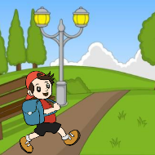
Future intention with aller [2]
Future intention with aller
grammaire
To talk about what other people are going to do in the future, we use the tu and il/elle forms of aller with the infinitive.
Tu vas arriver en retard.
You are going to arrive late.
______
Il va aller à l’école.
He is going to go to school.
______
Elle va devenir professeur.
She is going to become a teacher.
______
Notes:
Timing: 2 minutes
Aim: To further exemplify the use of aller plus infinitive to express a future intention with second and third persons singular is now exemplified. Remind students that the ‘tu’ and ‘il/elle’ forms of aller sound the same.

Slide 22
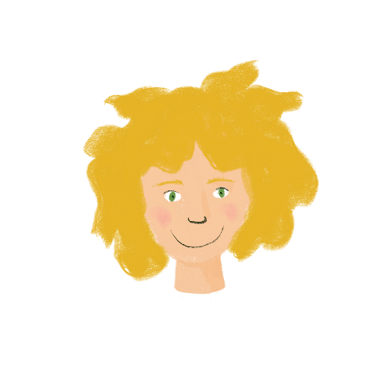
En ce moment ou le week-end?
En ce moment ou le week-end ?
écouter
Je parle de ma famille! Quand font-ils les activités?
 |  | en ce moment | le week-end
 | Tu vas aller … à Londres.
 | Il arrive … en ville en retard.
 | Tu écoutes … encore la radio.
 | Elle va … gagner le match.
 | Tu vas … changer le monde !
 | Elle habite … en Écosse.
 | Tu regardes … un film.
 | Il va habiter… en Angleterre.
1
2
3
4
5
6
7
8
Notes:
Timing: 5 minutes
Aim: Aural recognition of the form of the main verb in a sentence and connecting this with meaning (future intention vs present tense).
Procedure:
1. Click on a number to hear a sentence in either the present tense or future intention with aller.
2. Students write 1-8 and use their knowledge of verb forms to decide whether they refer to the present or the future.
3. Answers rand full transcriptions revealed on clicks.
4. Elicit oral translations.
Transcript
1. Tu vas aller à Londres.
2. Il arrive en ville en retard.
3. Tu écoutes la radio encore.
4. Elle va gagner le match.
5. Tu vas changer le monde !
6. Elle habite en Écosse.
7. Tu regardes un film tôt.
8. Il va habiter en Angleterre.

Slide 23
C’est quel verbe?
C’est quel verbe ?
écouter / écrire
Salut Léa ! Je vais aller en ville samedi.
Tu viens ? Je pense que je vais regarder le nouveau film au cinéma. Nous allons manger au café ?
Ah oui ! C’est un bon film ! Je vais faire mes devoirs, mais je pense que je vais venir. Je vais revenir tôt.
Tu vas partir quand ?
[1]
[4]
[2]
[5]
[6]
[7]
[3]
Notes:
Timing: 5 minutes
Aim: Written transcription of known verbs in infinitive form in a slightly extended context to prime for the upcoming writing task.
Procedure
1. Ask students to look at the verb preceding the gap (a form of aller in each case). What information does this give about the dialogue? Are the girls talking about what they are doing, or what they are going to do?
2. Students listen to the dialogue between Sophie and her friend Léa, which plays on clicking the bubbles. They read along and write the infinitive they hear (1-7) in each blank in the speech bubbles. 3. The answers are animated, and students should be asked in turn to translate the texts orally into English, to ensure understanding.
Note: The ‘nous’ form of aller is used here in the context of the story only; explicit practice in using the plural forms to express future intention will feature in next week’s lessons.
Transcript
Salut Léa ! Je vais aller en ville samedi.
Tu viens ? Je pense que je vais regarder le nouveau film au cinéma. Nous allons manger au café ?
Ah oui ! C’est un bon film ! Je vais faire mes devoirs, mais je pense que je vais venir. Je vais revenir tôt.
Tu vas partir quand ?

Slide 24
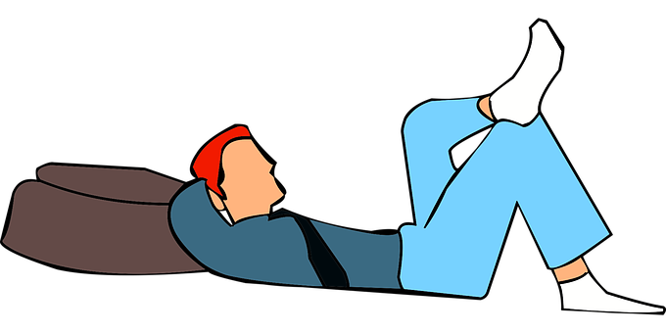
Tu vas faire quoi samedi?
Tu vas faire quoi samedi ?
écouter / écrire
Write five sentences about what you are going to do on Saturday!
Use the short form of aller with the infinitive to say what you are going to do.
You could start as follows:
Samedi, je vais aller en ville ...
Then, exchange sentences with your partner!
What are they doing on Saturday? Écris en français!
Notes:
Timing: 8 minutes
Aim: Free written production (with dictionary look up) to bring together the vocabulary and grammar covered in lesson 1.
Procedure:
Students write five sentences about what they are going to do on Saturday
If time permits, the partner should write down the sentences and translate them.

Slide 25
Asking Questions
negation: ne…pas with two-verb structures
SSC [qu] [revisited]
Y7 French
Term 3.2 - Week 3 - Lesson 64
Joe Fincham / Stephen Owen / Kirsten Somerville
Artwork by: Chloé Motard
Date updated: 04/08/2022
Notes:
Artwork by Chloé Motard. All additional pictures selected are available under a Creative Commons license, no attribution required.
Learning outcomes (lesson 2):
Revising SSC [qu]
Consolidating the use of aller plus the infinitive to express future intentions (je, tu, il/elle)
Introducing the use of aller plus the infinitive in negative sentences with future intention
Word frequency (1 is the most frequent word in French):
7.3.2.3 (introduce) partir [163], pars [163], part [163], (à l') avenir [471], match [1906], madame [294], monsieur [79], encore¹ [51], en retard [7/1278], tôt [513]
7.3.1.4 (revisit) dormir [1836], dors [1836], dort [1836], bureau¹ [273], équipe [814], parfois [410], sous [112], sur [16]
7.2.2.4 (revisit) allons [53], allez [53], vont [53], année [102], mois [178], vacances [1726], ville [260], Écosse [n/a], Angleterre [n/a], France [n/a], chez¹ [206], en³ [3]
Source: Londsale, D., & Le Bras, Y. (2009). A Frequency Dictionary of French: Core vocabulary for learners London: Routledge.
The frequency rankings for words that occur in this PowerPoint which have been previously introduced in NCELP resources are given in the NCELP SOW and in the resources that first introduced and formally re-visited those words.
For any other words that occur incidentally in this PowerPoint, frequency rankings will be provided in the notes field wherever possible.
The additional English meanings of the following words have been added to Quizlet since the creation of this resource: match (match, game)

Slide 26
Phonétique
Phonétique
parler
Lots of French words containing [qu] come from other languages!
Attention! They are still pronounced the ‘French’ way!
60
conséquence
quitter
qualité
secondes
qualification
liquide
séquence
équivalent
qualifier
tranquille
quantité
0
fréquent
équipement
DÉBUT
Notes:
Timing: 5 minutes
Aim: oral production of a unknown cognate words containing SSC [qu]
Procedure
1. Teacher explains to students that although these words have the same or similar meanings to the English words they recognise, the pronunciation is not the same.
2. Teacher clicks ‘début’.
3. Student A reads the list of words out loud to student B. Student B listens carefully to their partner’s pronunciation, and stops Student A if the [qu] sound is pronounced the English way. They only stop their partner if the [qu] is pronounced incorrectly. If another mispronunciation is noticed, the listening student should note this and correct it at only the end of the round.
4. Students count how many words Student A managed to say correctly.
5. Students swap roles. The student with the most points at the end is the winner.
6. After two rounds, the teacher plays the correct pronunciation by clicking on the audio. Students repeat.
Word frequency (1 is the most frequent word in French):
conséquence [617], qualité [606], quitter [507], qualification [4004], liquid [3520], qualifier [1283], équivalent [2476], sequence [3099], quantité [1680], tranquille [2555], fréquent [2684], équipement [1704]
Source: Londsale, D., & Le Bras, Y. (2009). A Frequency Dictionary of French: Core vocabulary for learners London: Routledge.

Slide 27
Word patterns
Word patterns
vocabulaire
Words ending in –c, -k and –cal
often change to -que in French
My grandfather likes classical music
Mon grandpère aime
la musique classique.
How would you say the following words be in French?
economic, bank, historic
Choose one and write a sentence in French.
Translate these sentences.
Le problème est logique.
It is a dramatic film.
Notes:
Timing: 5 minutes
Aim: To consolidate SSC knowledge with the introduction of a common spelling pattern.
Procedure:
Introduce word pattern.
Students translate sentences in the blue box.
Students should also discuss how to say the words in the yellow box in French.
Answers on next slide.
Word frequency:
musique [1139]; classique [1845]; logique [1107]; dramatique [2918]; économique [261]; banque [774]; historique [902]
Source: Londsale, D., & Le Bras, Y. (2009). A Frequency Dictionary of French: Core vocabulary for learners London: Routledge.
Note: Some of these words have exactly the same form in French and English - unique, technique, physique, so are orthographical cognates. But note that technique also means technical, and physique means physical, and also physics.

Slide 28
Réponses
Réponses
vocabulaire
Le problème est logique.
It is a dramatic film.
economic
bank
historic
The problem is logical.
C’est un film dramatique.
économique
la banque
historique
Note the addition of the accent.
Pronounce the words.
Notes:
Answers to the activity found on the previous slide.

Slide 29
Vocabulaire
écrire
Vocabulaire
A
B
C
D
[Miss, Mrs, Ms, Madam]
[again]
[future]
[team]
E
F
G
H
[Sir, Mr]
[town]
[match]
[he/she leaves]
I
J
L
K
[I/you leave]
[to leave]
[early]
[late]
Notes:
Timing: 5 minutes
Aim: Written recall of vocabulary in this week’s set and some words in the revisited set.
Suggested procedure
1. Students write A-K in books.
2. Click / press enter to flash an English word or picture prompt. It will disappear after 3 seconds. Note that the prompts do not appear in alphabetical order or in the list order from the previous slide, to increase the challenge.
3. Ask students to write down the French word before the word/picture has disappeared. 4. Check answers using the following slide. Elicit the French from students to check their pronunciation.

Slide 30
Vocabulaire
écrire
Vocabulaire
l’avenir (m)
l’équipe (f)
madame
encore
le match
monsieur
la ville
il/elle part
en retard
tôt
je/tu pars
partir

Slide 31
Vocabulaire
parler
Vocabulaire
le bureau
une équipe
C
A
B
parfois
← mots en français
D
F
dormir
E
sous
sur
to sleep
on
H
team
G
I
sometimes
J
office
K
under
L
mots en anglais →
Notes:
Timing: 5 minutes
Aim: Oral recall of vocabulary in this week’s revisited sets.
Procedure: 1. Students volunteer a pair of alphabet letters, one blue one orange, pronouncing the French word when it’s revealed. 2. Matching pairs are left visible, non-matching pairs are clicked again to disappear. 3. When all pairs are found, a final round of elicitation of all six French words can follow (having clicked again to cover the blue boxes).
The word ‘équipe’ also features this week’s revisited phonics SSC, a fact which should be pointed out to students.

Slide 32
Trouve l’intrus !
Trouve l’intrus !
lire
1
allez / vont / allons / ville
not a verb / not a part of aller
2
Écosse / vacances / Angleterre / France
not a place / not a proper noun
3
année / mois / chez / semaine
not a period of time / not a noun
4
parfois / chez / en / sur
does not describe location / not a preposition
5
dans / sous / sur / équipe
does not describe location / not a preposition
Notes:
Timing: 3 minutes
Aim: written recognition of vocabulary items in this week’s revisited sets. Semantic and grammatical categorisation.
Procedure: 1. The first item can be done with students to model the task. Explain that there is both a meaning-based and a grammatical justification for each odd word out. 2. Students work (either individually or in pairs) to identify the odd word out and the reason. 3. Answers and rationales appear on clicks.

Slide 33
ALLER au négatif
‘Aller’ au négatif
lire
Trouvez les paires
1. Je vais
2. Il ne va pas
3. Tu vas
4. Elle va
5. Je ne vais pas
6. Tu ne vas pas
7. Il va
8. Elle ne va pas
a. I don’t go / am not going
b. She goes / is going
c. I go / am going
d. He goes / is going
e. You go / are going
f. She doesn’t go / is not going
g. He doesn’t go / is not going
h. You don’t go / are not going
c
g
e
b
a
h
d
f
Notes:
Timing: 3 minutes
Aim: revise negation structure (ne…pas) with aller in the first three persons singular in preparation for negating future intentions with aller.

Slide 34
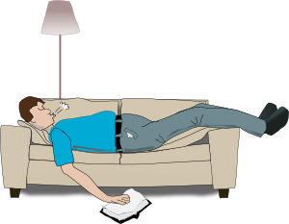
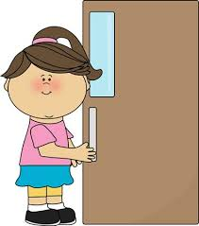
Mais je ne vais pas faire ça à l’avenir!
ne…pas with two-verb structures
grammaire
We know that we can make sentences negative by adding ne…pas around the verb:
Je vais au parc. Je ne vais pas au parc.
In sentences with two verbs, ne … pas surrounds the first verb, which is in short form.
The second verb, which is in long (infinitive) form, comes after pas.
Je n’aime pas travailler le week-end. (I don’t like working …)
______________
Tu ne vas pas devenir chanteur. (You’re not going to become …)
______________
Elle ne va pas fermer la porte. (She’s not going to close …)
______________
Notes:
Timing: 3 minutes
Aim: Introduce negation with two-verb structures.

Slide 35
Qui va faire quoi à l’avenir?
Qui va faire quoi à l’avenir ?
écouter
Amir parle à Noura de l’avenir. Qui va faire quoi dans la famille?
 |  | Oui | Non
1
Tu ne vas pas rester ici, Noura.
2
Papa, il va jouer dans une équipe.
3
Tu vas passer un mois chez mon ami.
4
Je vais passer une année en Angleterre.
5
Tu ne vas pas faire le ménage aujourd’hui.
6
Maman, elle ne va pas travailler à Londres.
7
Je vais aller au café en ville.
8
Abdel, il va passer ses vacances en Écosse.
Notes:
Timing: 5 minutes
Aim: oral recognition of aller plus infinitive in positive and negative sentences
Procedure:
Students read and decide if the sentences are positive or negative.
The answers are animated, and the sentences heard appear upon clicking the numbers.
Transcript
1. Tu ne vas pas rester ici, Noura.
2. Papa, il va jouer dans une équipe.
3. Tu vas passer un mois chez mon ami.
4. Je vais passer une année en Angleterre.
5. Tu ne vas pas faire le ménage aujourd’hui.
6. Maman, elle ne va pas travailler à Londres.
7. Je vais aller au café en ville.
8. Abdel, il va passer ses vacances en Écosse.

Slide 36
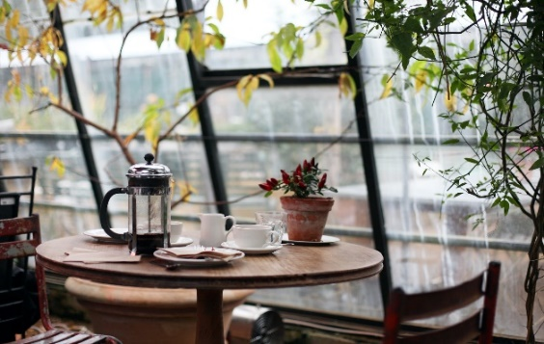
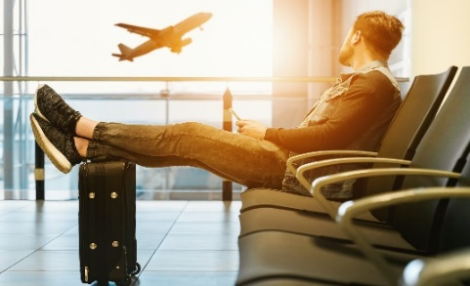
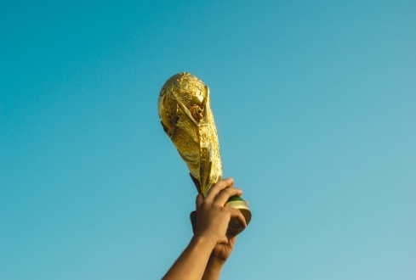
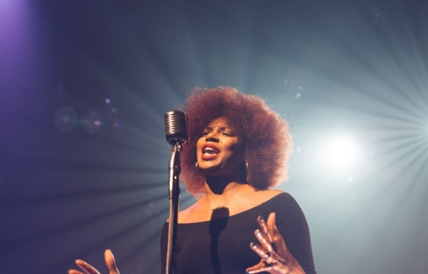
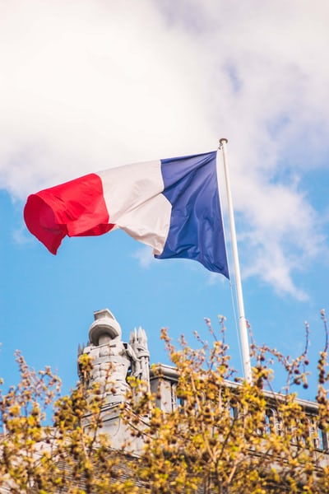
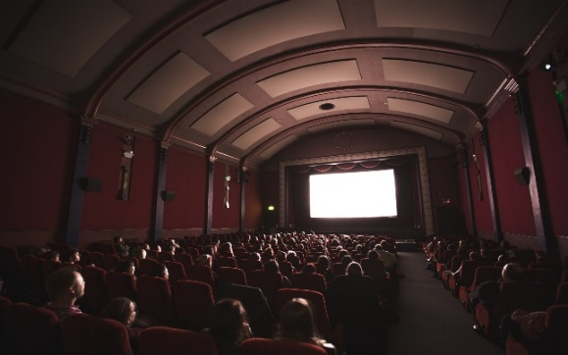
morpion
Morpion
parler
he
you
I
he
she
she
you
I
you
Notes:
Timing: 8 minutes
Aim: oral production of affirmative and negative sentences using aller with future intention. NB: a home-learning version of this activity may be found on slide 37.
Procedure:
1. The person playing as ‘noughts’ must make affirmative sentences; the person playing as ‘crosses’ must make a negative sentence using ne...pas.
2. Partners then swap roles for the next game, thereby ensuring that both have practice in making positive and negative sentences.
3. It is possible to use the displayed version to guide their game, simply drawing a 3 x 3 grid on scrap paper to play it. Alternatively, a printable student worksheet for the activity can be downloaded from the NCELP Resource Portal.
Pictures represent (from top left to bottom right):
partir en vacances
aller au café
être content
gagner le match
chanter
devenir médecin
aller en France
regarder un film
faire tes devoirs

Slide 37
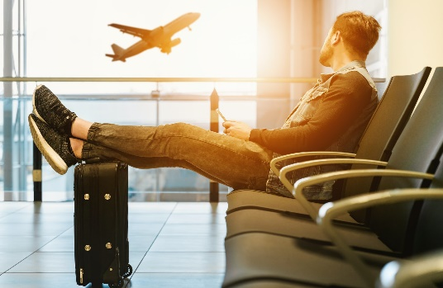
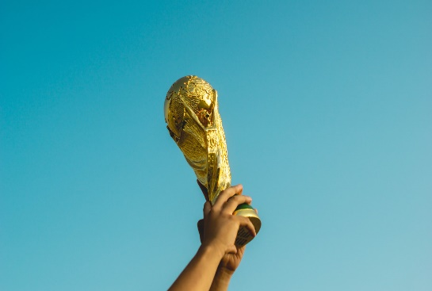
morpion
parler
Morpion
Notes:
Differentiated version of the noughts and crosses game, this time without pronouns suggested.
Students can use any pronoun of choice to create their sentences. Partners should write in the pronoun chosen upon hearing the sentence each time.

Slide 38
morpion
parler
Morpion
2
3
1
he
you
I
4
5
6
he
she
she
7
8
9
you
I
you
Notes:
Home learning version of the activity described on slide 35.
The audio for each pair of French sentences (a positive and negative version of each) is accessible upon clicking the button.
Pictures represent (from top left to bottom right):
partir en vacances
aller au café
être content
gagner le match
chanter
devenir médecin
aller en France
regarder un film
faire tes devoirs
Transcript
1. Il va partir en vacances / Il ne va pas partir en vacances.
2. Tu vas aller au café / Tu ne vas pas aller au café.
3. Je vais être content / Je ne vais pas être content.
4. Il va gagner le match / Il ne va pas gagner le match.
5. Elle va chanter / Elle ne va pas chanter.
6. Elle va devenir médecin / Elle ne va pas devenir médecin.
7. Tu vas aller en France / Tu ne vas pas aller en France.
8. Je vais regarder un film / Je ne vais pas regarder un film.
9. Tu vas faire tes devoirs / Tu ne vas pas faire tes devoirs.

Slide 39
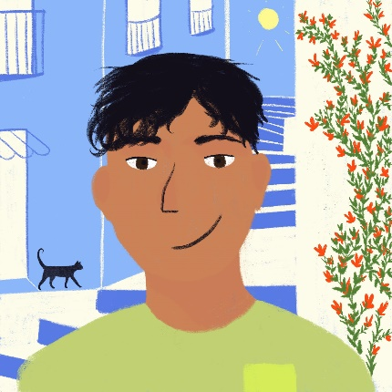
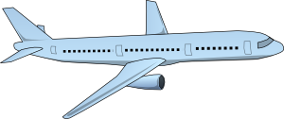
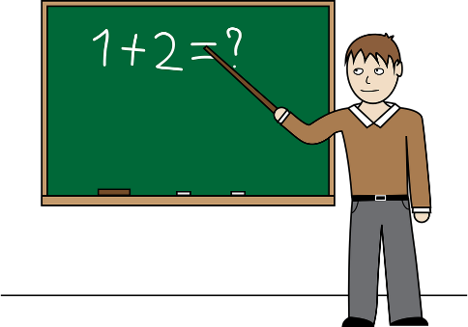
À l'avenir …
À l’avenir …
écrire
Que vais-je faire à l’avenir? Que va faire Abdel? Écris en français!
Je …
Il …
Notes:
Timing: 8 minutes
Aim: Written production of affirmative and negative sentences with aller + future intention.
Procedure:
Students use the prompts to write sentences.
Suggested answers on the following slide.

Slide 40
À l'avenir … (réponses)
À l’avenir … (réponses)
écrire
Que vais-je faire à l’avenir? Que va faire Abdel? Écris en français!
Je …
ne vais pas être médicin.
vais parler anglais.
vais étudier.
ne vais pas faire le ménage.
vais aller à l’université.
ne vais pas devenir médicin.
vais apprendre anglais.
Il …
va aller aux États-Unis.
va être professeur.
ne va pas faire la cuisine.
ne va pas regarder la télé.
va habiter aux États-Unis.
va devenir professeur.
Notes:
Suggested answers to the activity on the previous slide appear on clicks.

Slide 41
Gaming Grammar
Gaming Grammar
Relevant mini game(s):
Verbs (present): 1st person singular/plural (Verb agreement (present))
Verbs (present): 2nd person singular/plural (Verb agreement (present))
Verbs (present): 3rd person singular/plural (Verb agreement (present))
Notes:
This slide links to Gaming Grammar login screen. The appropriate mission can then be selected from the menu page.
Students will progress through the game at their own rate; teachers should use the teacher interface to check progress. This will help to inform future lesson planning.

Slide 42
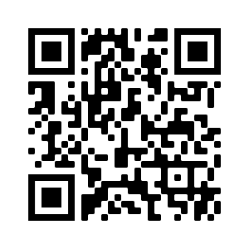
Devoirs
Vocabulary Learning Homework (Term 3.2, Week 4)
Audio file
Audio file QR code:
Student worksheet
Quizlet link
In addition, revisit: Term 3.1 Week 5
Term 2.2 Week 5

