Slide 1
NCELP Vocabulary TRG

Slide 2
Aims of the session
Develop an understanding of the research evidence relating to L2 vocabulary learning
Develop more concrete ideas for teaching vocabulary: (a) which words? (b) how to present, consolidate, develop and assess vocabulary knowledge?
Explore some of the NCELP resources and approaches for vocabulary learning
Understand the ways in which you will work with the Lead Schools to develop practice in this area
Rachel Hawkes
Notes:
Introduction to CPD: 2 minutes 1] Aims of this session

Slide 3
Research
Notes:
Hyperlink from here to the vocabulary research presentation

Slide 4
Overarching aim of teaching vocabulary
To help learners develop breadth, depth and fluency of vocabulary knowledge, with an emphasis on high-frequency words, including plenty of verbs.
It is important to:
Select vocabulary carefully, based on frequency
Regularly revisit the same vocabulary, especially before the lesson to practise in context in class
Give the meaning transparently, then force regular recall of form and meaning
Teach the verb lexicon = meaning of verbs [Verb vocabulary = infinitive or long form, (e.g. écrire, pouvoir, sauter)and the short form (écrit, peux, saute)]
Rachel Hawkes / Emma Marsden
Notes:
Draw together the key messages from the research presentations from this slide, as the segue into FREQUENCY and the VERB LEXICON.

Slide 5
Which words?
Vocabulary to be taught should be informed by frequency of occurrence in the language, and special attention should be paid to common verbs in the early stages... A consequence of not attending to frequency of occurrence in vocabulary choice is pupils realising that they cannot say or understand basic things in the language.
Anon. 2016. Modern Foreign Languages Pedagogy Review. A review of modern foreign languages teaching practice in key stage 3 and key stage 4. (Chair: Ian Bauckham). Teaching Schools Council.
Rachel Hawkes / Emma Marsden
Notes:
Section 2: Which words?
This begins to address the first ‘wish’ from the STs: a clear list of the recommended words pupils need to be able to do well at GCSE based on frequency in each language We start from the Pedagogy Review recommendation about ‘frequency’ and ‘common verbs’.
Ask ‘So how do we do this?’ Do we know the frequency of the words we are teaching? Do we have any way of knowing? What determines our vocabulary choice currently? The text book at KS3/4, the GCSE specification vocabulary list?
Do we know what informs the vocabulary choices in these resources?
Handout 1: Vocabulary lists, rationale and uses STs will need time to read this document – allow at least a full five minutes reading time.

Slide 6
GCSE frequency lists
Frequency data have been added to AQA GCSE vocabulary lists for French, German and Spanish [Sources: A Frequency Dictionary of Spanish: Core Vocabulary for Learners (Davies & Davies, 2018); A Frequency Dictionary of German (Jones & Tschirner, 2006) and A Frequency Dictionary of French (Londsale & Le Bras, 2009), published by Routledge.]
The lists are available in a variety of formats: Excel (full list), Word – A-Z, by topic, by parts of speech
Teachers may use the frequency data to:
inform the SOW design
stimulate interest amongst pupils (and teachers!)
teach multiple meanings of the same word
teach vocabulary in multiple word class clusters
teach relations between words within word families
teach cognate patterns
highlight differences between high frequency words and awarding body lists
Rachel Hawkes / Emma Marsden
Notes:
Section 2: Which words? The 3rd bullet summarises the suggestions for use section within Handout 1. STs will have just read this so this is just to emphasise the importance of the lists so that teachers understand fully what they are. For further detail and for examples, refer to Handout 1.
NB: The resources themselves will model how frequencies have been used to inform the selection of vocabulary for teaching (e.g. 10 word selections of mixed word classes within one semantic field).

Slide 7
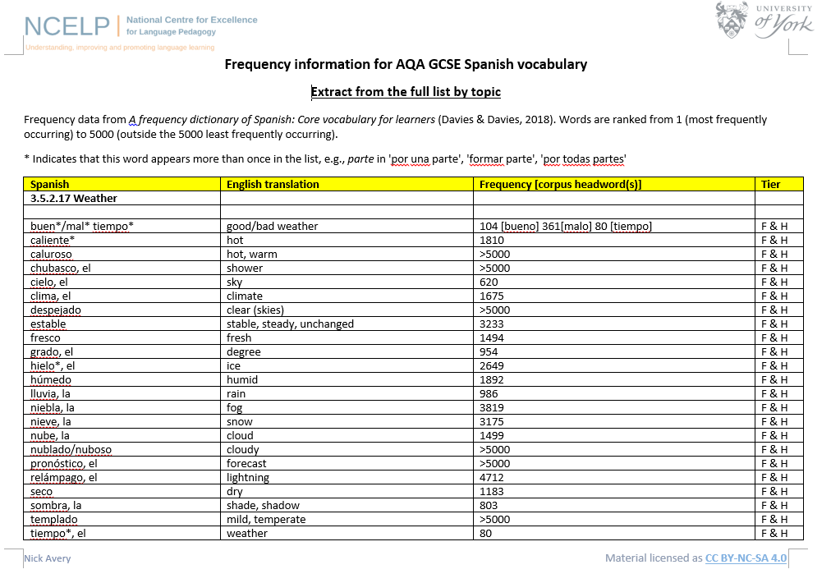
Nick Avery / Inge Alferink
Notes:
Section 2: Which words?
Handouts 2,3,4: EXTRACTS of the vocabulary lists for French, German and Spanish. This slide is a screen shot of the Spanish one. Point out that some of the inclusions in the list lie outside the top 5000 words. Given that an ambitious aim of 2000 words is commensurate with the expected vocabulary size for Common European Framework of Reference B1, it is significant that significant numbers of words on the GCSE list lie outside this frequency range. Clearly, some words will naturally lie outside the top 2000 and nevertheless be valid. However, in the theme of weather, we might rightly ask whether all of these less frequent items need necessarily to be learnt (at the expense of other, more frequent, vocabulary).
NB: It is important to say at this point that NCELP has set out to share this work with the awarding bodies, and that it is hoped that frequency will play a significant role in any future GCSE specification. However, changes to vocabulary lists are clearly not permitted within the life of a specification, so as it stands, the lists are for teacher use. It does stand to reason, however, that (with the notable exceptions of words like ‘ayuntamiento (town hall) and ‘ajedrez’ (chess) which we know that awarding bodies like to put into their papers), question writers probably do tend to use the more common words in these lists, so that we would do no harm to ensure that the most frequent words in these lists are known well by all learners. In doing this, we also ensure that learners are better prepared for communication outside the classroom, since these are the more frequently used words.

Slide 8
Which words?
In the early stages of a language course, particular attention should be paid to the planned building of pupils’ verb lexicon, focussing on the meaning of the stem or infinitive form of common verbs. A strong basic verb lexicon has been found to relate positively to pupils’ ability to effectively manipulate those verbs at later stages.
Anon. 2016. Modern Foreign Languages Pedagogy Review. A review of modern foreign languages teaching practice in key stage 3 and key stage 4. (Chair: Ian Bauckham). Teaching Schools Council.
Rachel Hawkes / Emma Marsden
Notes:
Section 2: Which words? The verb lexicon
Handout 5: Focusing on the verb lexicon: Why and how to teach a verb vocabulary.
Again, allow reading time here.

Slide 9
First encounters with high-frequency verbs
25 highest frequency verbs
15 high frequency concrete verbs
Sets of six slides per verb
Long form (infinitive) and short form (3rd person singular)
Sentences (revisiting high-frequency (phonics) vocabulary)
Audio-embedded versions
NB: these are for first encounters with these important verbs. Further practice and gradual extension to working with further pairs of forms/meanings would follow (e.g. next step - 1st and 2nd person singular)
Rachel Hawkes / Emma Marsden
Notes:
Section 2: Which words? The verb lexicon
This slide describes the essential features of the sets of verb resources, a sample of which will follow this slide. Refer STs to the handouts which list all of the verbs and the sentences that are included in the PowerPoint resources. Handouts 6, 7, 8: French 25 and 15 verbs and sentences German 25 and 15 verbs and sentences Spanish 25 and 15 verbs and sentences

Slide 10
Examples – 25 verbs
French [faire]
German [haben]
Spanish [ser]
Rachel Hawkes / Emma Marsden
Notes:
NB: Just choose one language to show an example of one of the 25 high-frequency verb presentations. At the end of the 6th verb slide, there is an ACTION BUTTON – click this to take you to slide 32 to resume the presentation.

Slide 11
faire
[to do, make | doing, making]
fait
[does, makes | is doing, is making]
Stephen Owen / Emma Marsden

Slide 12
faire
[to do, make | making, doing]
fait
[does, makes | is doing, is making]
Stephen Owen / Emma Marsden

Slide 13
fait
[does, makes | is doing, is making]
Zara fait le lit.
[Zara makes | is making the bed.]
Stephen Owen / Emma Marsden

Slide 14
faire
[to do, make | doing, making]
Zara aime faire le lit.
[Zara likes making the bed.]
Stephen Owen / Emma Marsden

Slide 15
fait
[does, makes | is doing, making]
Zara ____ le lit.
fait
[Zara makes | is making the bed.]
Stephen Owen / Emma Marsden

Slide 16
faire
[to do, make |doing, making]
Zara aime ____ le lit.
faire
[Zara likes making the bed.]
Stephen Owen / Emma Marsden

Slide 17
haben
[to have | having]
hat
[has]
Inge Alferink / Rachel Hawkes

Slide 18
haben
[to have | having]
hat
[has]
Inge Alferink / Rachel Hawkes

Slide 19
hat
[has]
Markus hat ein Fahrrad.
[Markus has a bike.]
Inge Alferink / Rachel Hawkes

Slide 20
haben
[to have | having]
Markus muss ein Fahrrad haben.
[Markus must have a bike.]
Inge Alferink / Rachel Hawkes

Slide 21
hat
[has]
Markus ____ ein Fahrrad.
hat
[Markus has a bike.]
Inge Alferink / Rachel Hawkes

Slide 22
haben
[to have | having]
haben
Markus muss ein Fahrrad _______.
[Markus must have a bike.]
Inge Alferink / Rachel Hawkes

Slide 23
ser
[to be | being]
es
[is]
Victoria Hobson / Rachel Hawkes / Emma Marsden

Slide 24
ser
[to be | being]
es
[is]
Victoria Hobson / Rachel Hawkes / Emma Marsden

Slide 25
es
[is]
Es rico.
[S/he is rich.]
Victoria Hobson / Rachel Hawkes / Emma Marsden

Slide 26
ser
[to be | being]
Quiere ser rico.
[S/he wants to be rich.]
Victoria Hobson / Rachel Hawkes / Emma Marsden

Slide 27
es
[is]
Es
___ rico.
[S/he is rich.]
Victoria Hobson / Rachel Hawkes / Emma Marsden

Slide 28
ser
[to be | being]
ser
Quiere ___ rico.
[S/he wants to be rich.]
Victoria Hobson / Rachel Hawkes / Emma Marsden

Slide 29
ST wishlist
]
Which words? [Frequency and verb lexicon]
Suggested SOW – coming soon
More teaching methods for vocabulary
Strategies for how to help students on the way to automaticity, activities so that we can vary these steps and maintain an interesting and stimulating approach
Resources we can use
Ideas/resources for revisiting vocabulary across different contexts
Time to work on planning and resources
How to assess different levels of knowledge
Teaching students revision techniques and self-testing skills for vocabulary
Rachel Hawkes
Notes:
Quick review slide as we move on from ‘Which words?’ section to ‘How to teach and learn them?’ section

Slide 30
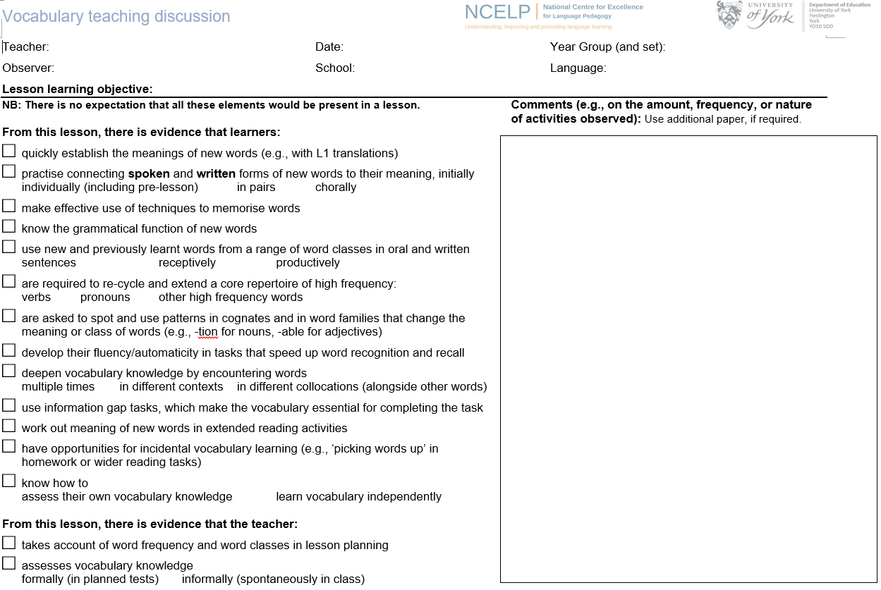
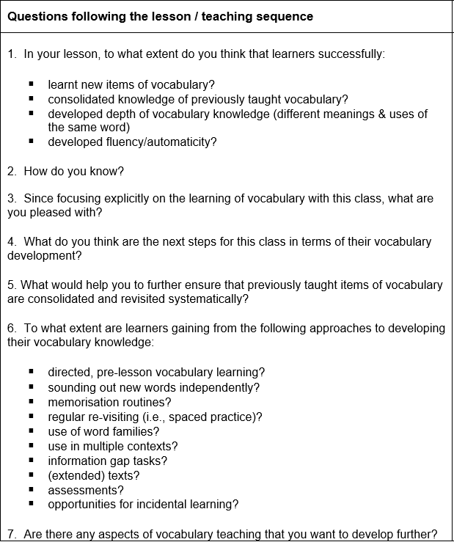
How to teach and learn vocabulary
Victoria Hobson / Rachel Hawkes / Emma Marsden
Notes:
Section 3: How to teach and learn vocabulary
Allow time to read this document
Handout 9: Vocabulary teaching discussion

Slide 31
Learners…
Introducing / establishing the vocabulary knowledge
quickly establish the meanings of new words (e.g. with L1 translations)
practise connecting spoken and written forms of new words to their meaning, initially
make effective use of techniques to memorise words
know the grammatical function of new words
Practising / Consolidating
use new and previously learnt words from a range of word classes in oral and written sentences
are required to re-cycle and extend a core repertoire of high frequency: verbs pronouns other high frequency words
are asked to spot and use patterns in cognates and in word families that change the meaning or class of words (e.g., -tion for nouns, -able for adjectives)
develop their fluency/automaticity in tasks that speed up word recognition and recall
Developing
deepen vocabulary knowledge by encountering words multiple times in different contexts in different collocations (alongside other words)
use information gap tasks, which make the vocabulary essential for completing the task
work out meaning of new words in extended reading activities
have opportunities for incidental vocabulary learning (e.g., ‘picking words up’ in homework or wider reading tasks)
Assessing
know how to assess their own vocabulary knowledge learn vocabulary independently
Teachers…
take account of word frequency and word classes in lesson planning
assess vocabulary knowledge formally (in planned tests) informally (spontaneously in class)
Victoria Hobson / Rachel Hawkes / Emma Marsden
Notes:
Section 3: How to teach and learn vocabulary
This slide takes the statements from the Vocabulary Teaching Discussion document and puts them into stages of vocabulary learning. Categories are not to be seen as fixed: you practise when you are establishing knowledge for the first time, and you consolidate as you develop.
Many activities can be repeated for different purposes, depending on how well the vocabulary is already embedded. However, this list of ways of working with words should give us ideas and broaden our thinking about the range of opportunities we give learners in and outside of the classroom.

Slide 32
How to teach and learn vocabulary
Topic-based vocabulary lists of one single word class are not optimal.
Stages of vocabulary learning
Introduction (i.e. first encounters with new words, and initial memorisation routines)
Consolidation (i.e. speed of retrieval building, controlled production, e.g. sentence-building)
Developing use (i.e. revisiting across different contexts, modalities, synthesising with previously-learnt language)
Assessment
Rachel Hawkes
Notes:
Section 4: Vocabulary teaching sequence resources
We are now going to look at a sequence of resources to show a range of opportunities to encounter, practise, consolidate, develop and assess vocabulary. There are two sequences for French, one for Spanish and one for German. NB: You need to open one of the four vocabulary teaching sequence resources at this point.
Handout 10: Sample sets of vocabulary (to accompany the resource PowerPoints) Handout 11: Teacher notes to accompany the teaching sequence PowerPoints)
Describe the thinking behind the selection of words as a mixed word class set. 1) Sets of words of one word class (e.g. nouns or verb phrases) lend themselves to minimal manipulation in the early stages. With a set of 10 nouns, when sentences are used, they will just use one set phrase (e.g. J’aime / Je n’aime pas) in which to ‘set’ the new vocabulary, so that pupils produce identical sentence structures and vary only the nouns. The ‘formula’ given doesn’t encourage pupils to keep thinking about the meaning of the whole sentence (i.e. including the verb), but just the nouns themselves.
2) There is also some evidence that says that learners can find it more difficult to remember a set of words from just one word class (a notion that they are ‘competing for the same cognitive slot’).
3) Words from different classes lend themselves more naturally to ‘meaning making ‘from the outset. They are themselves the object of learning so, without cognitive overload of bringing in other language with which to build sentences, pupils can make immediate use of the new set of vocabulary to construct sentences and express meanings.
4) All of this leads to more secure word-form-meaning mapping and the opportunities for more focused language processing and then creation increases the chances that the language will be embedded and retained over time.

Slide 33
Developing use
Information gaps
Spot the difference
Map tasks
Guess who style tasks
Dictogloss
Rachel Hawkes
Notes:
Developing use You have now shared a lot of teaching ideas and resources. Rejoin the presentation here to focus particularly on the ‘developing use’ phase.
Given the fact that the main focus within the Teaching Sequence PowerPoints is to show first encounters and consolidation, and the fact that teachers will browse those in their own language, but undoubtedly won’t see all of what has been created, it seems useful here to draw together a few examples of the Developing phase activities, in particular the Information Gap tasks, across different languages. These have also been reproduced as Handouts of the actual pupil resources themselves, as without these, it’s sometimes difficult to grasp the nature of the activity. At this point, give out the separate Resources Handouts selection.

Slide 34
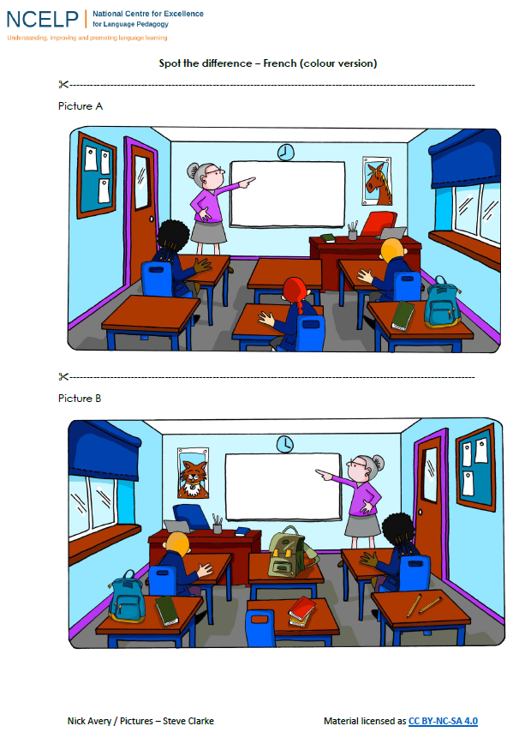
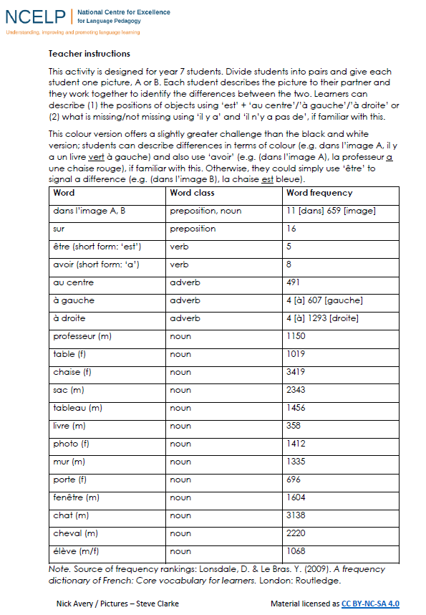
Notes:
At this point direct STs to the ‘Resources Handouts’ which are in a separate pack.

Slide 35
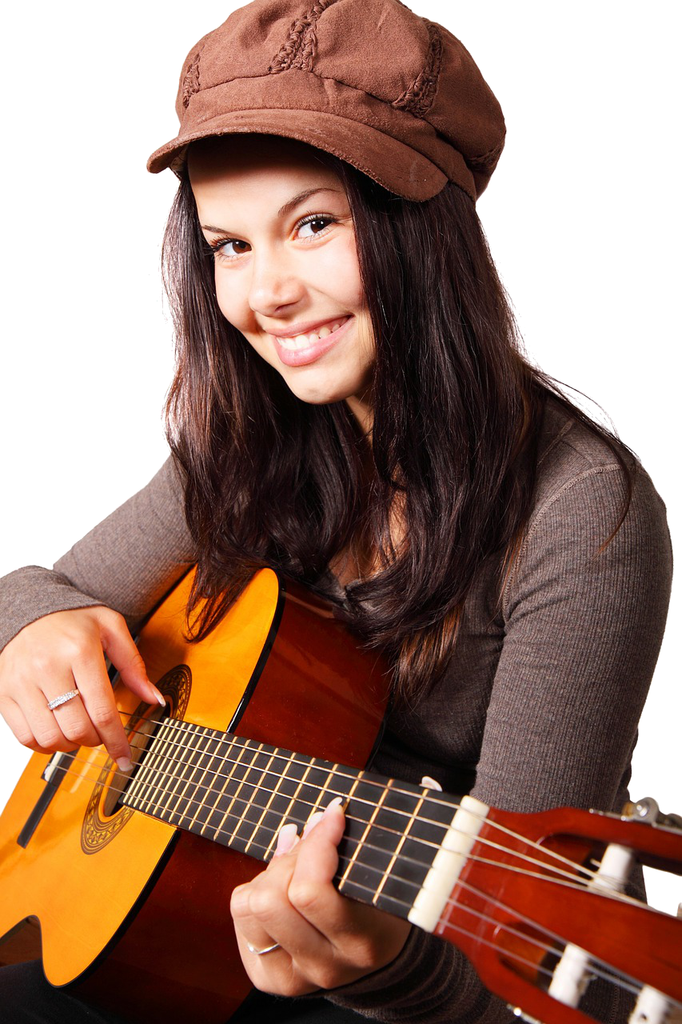
5
1
7
8
A
4
2
6
3
9
Inge Alferink / Rachel Hawkes
Notes:
Handout: with the resources handouts
This one is for the 15 concrete German verbs
A collaborative information gap exercise to practise the verbs introduced in the 15 concrete verbs PowerPoint resource/
Work in pairs.
Pupils each have a set of pictures and ask each other questions about what is in their pictures in order to find out which pictures occur in both sets.
Each picture/ person is numbered in order to reduce cognitive load and focus attention on verbs rather than nouns.
For example, Eins schläft.
NB. the numbers do not match across the sets so as not to give the solution away that way.

Slide 36
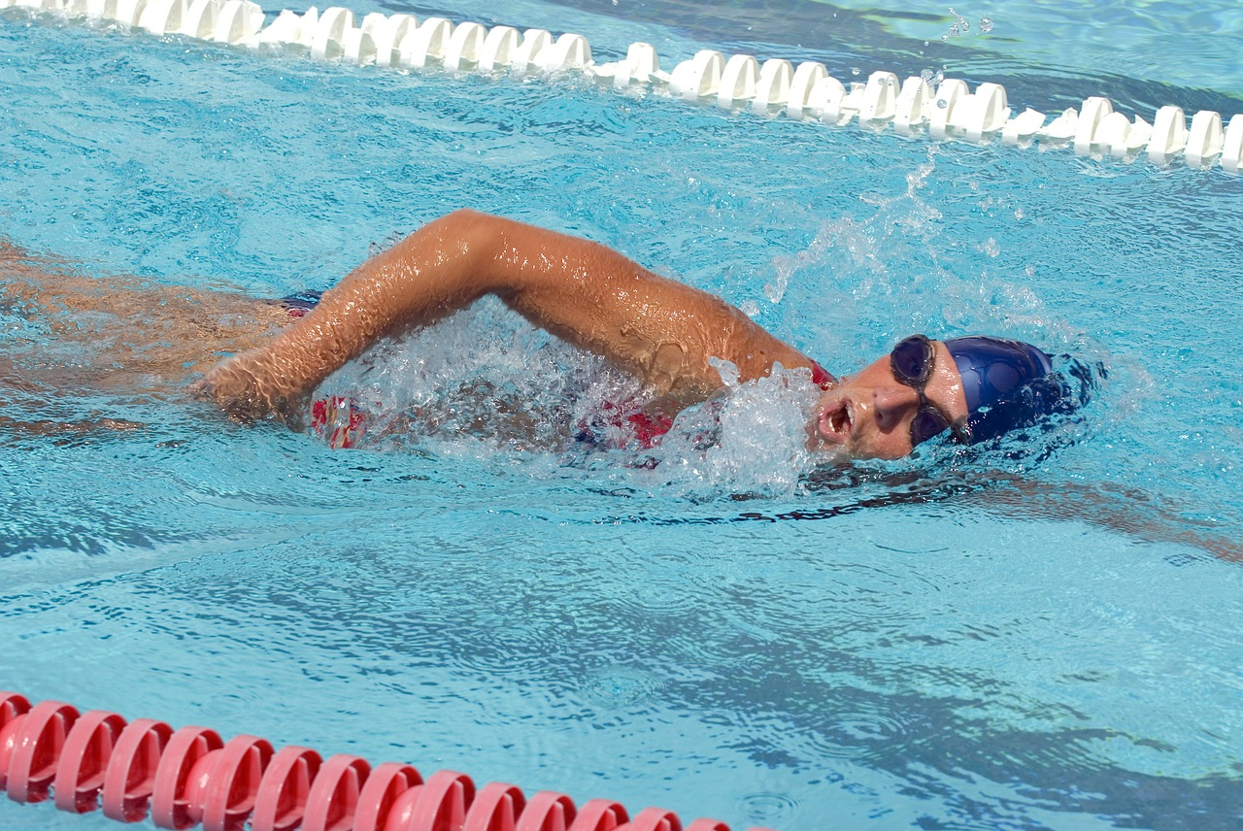
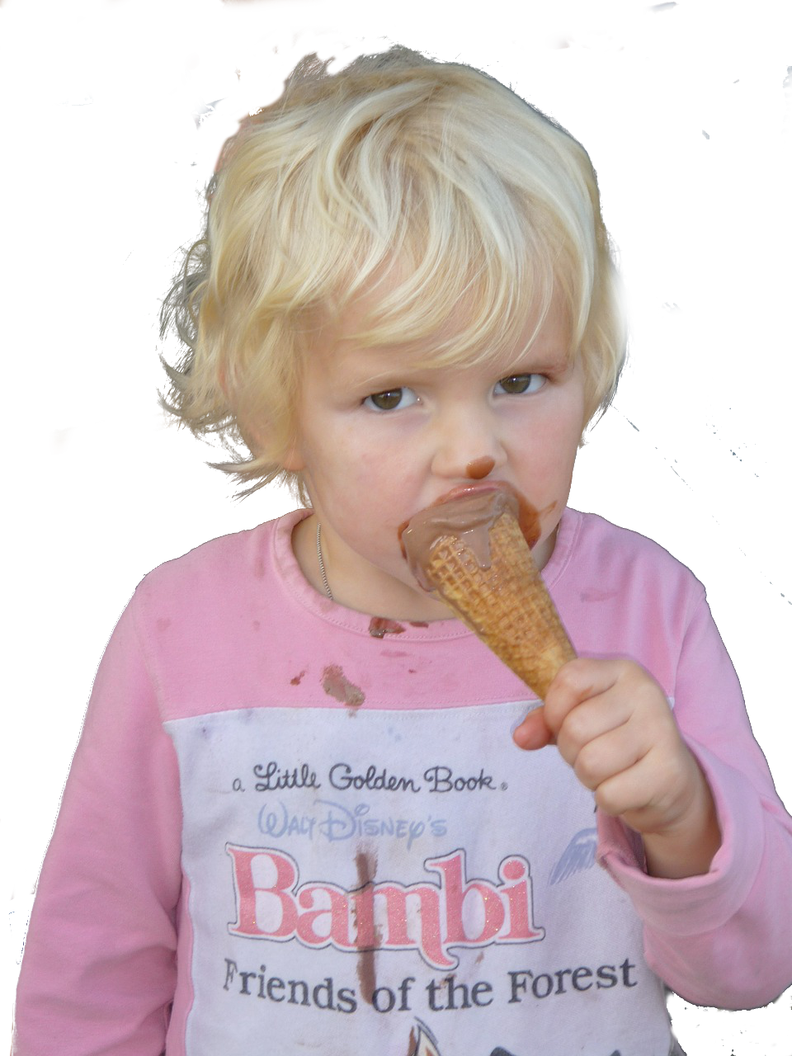
4
7
6
8
1
B
2
5
2
3
Inge Alferink / Rachel Hawkes

Slide 37
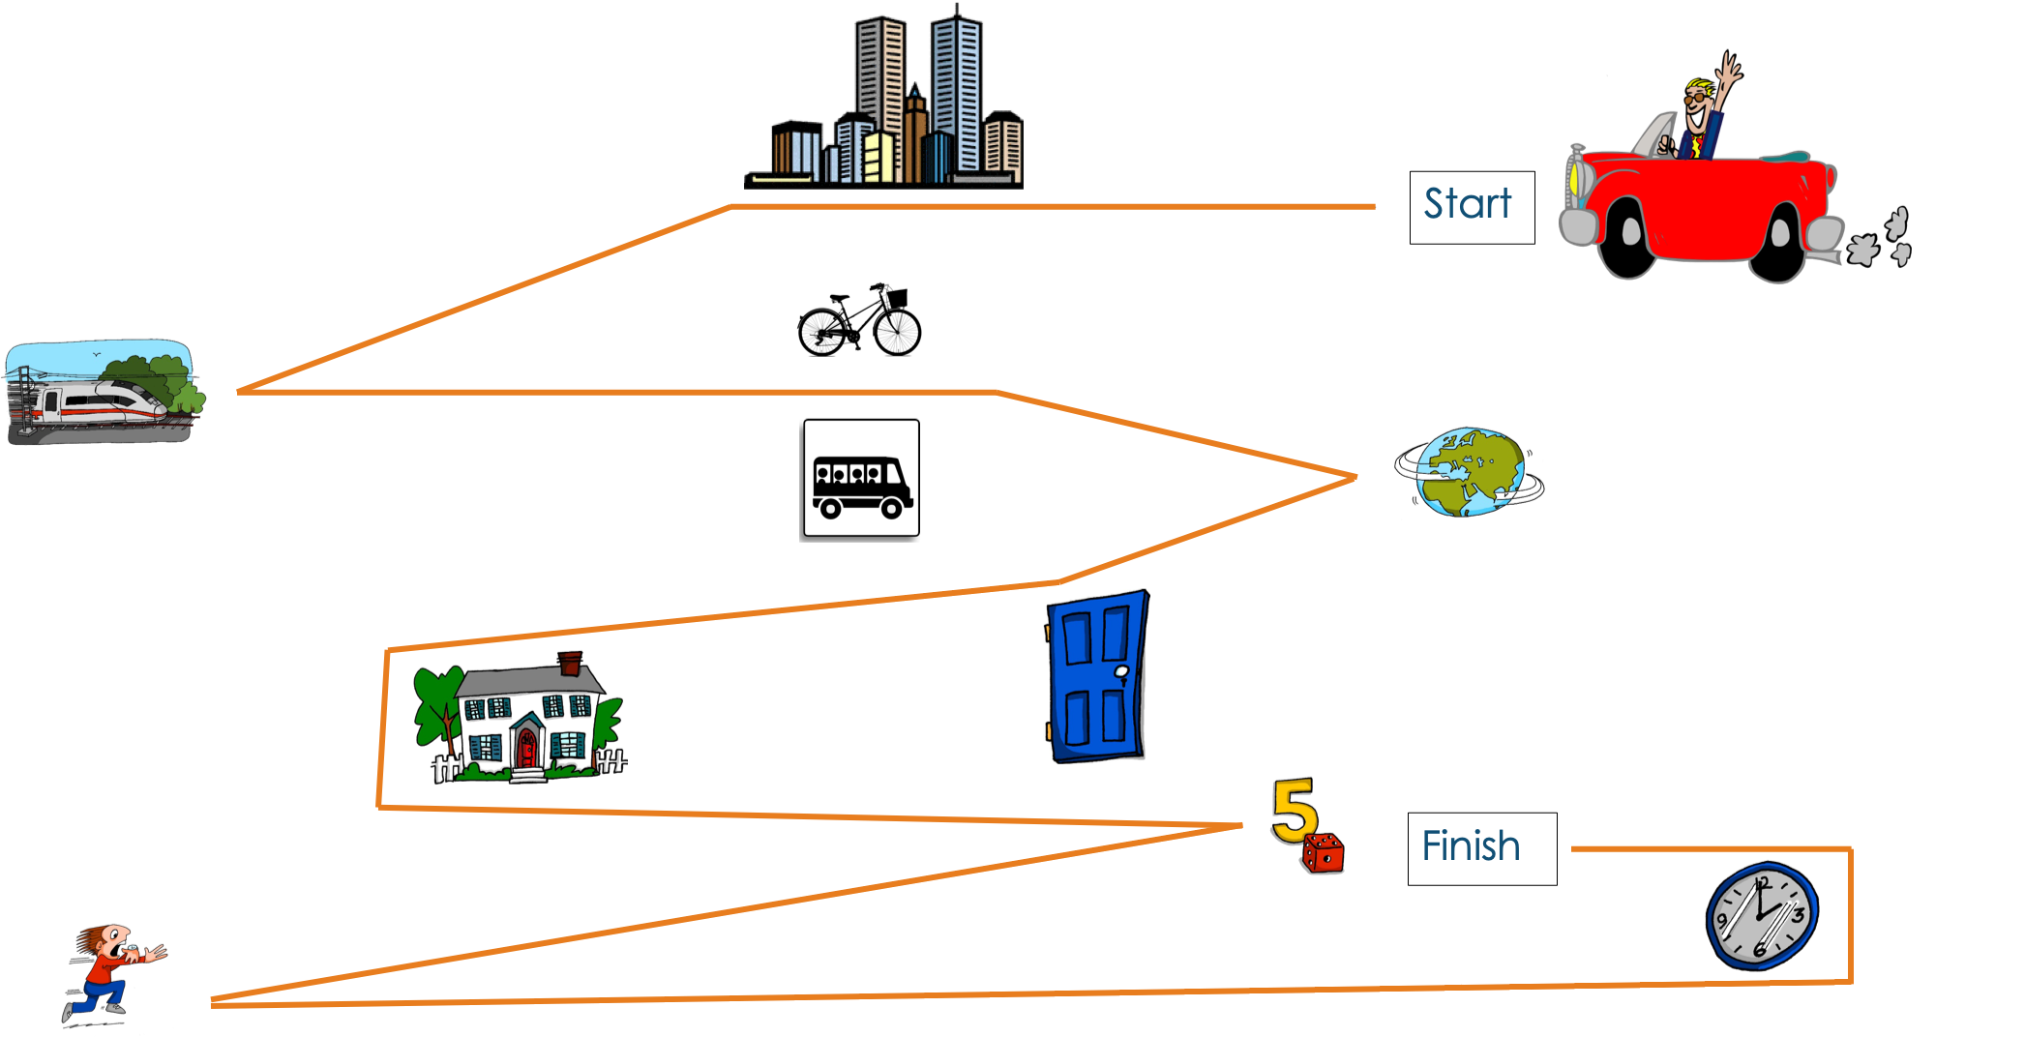
Map task
Inge Alferink
Notes:
This is available as a Handout within the Resources handouts. NB: Although this is for German, resources can and will be adapted for other languages, in time.
Map Game
Instructions
Please look at the following map. Your partner’s map does not have the route. You must guide your partner’s car from start to finish (following the line as accurately as possible). While you are communicating to complete this task, please do not LOOK AT your partner’s map. The first step (line) has been done for your partner as an example.
NB: the vocab should be ok as it’s all been introduced here or in the phonics source words.
However, pupils will need to know ‘zu’ and how to change the articles in Row 3 (dative case). zur Stadt, zum Zug, zur Welt. They could also use ‘links / auf der linken Seite’ and ‘rechts / auf der rechten Seite’ to be sure that the partner draws the lines in exactly the right place. It is a useful example of how to deepen and extend word knowledge.

Slide 38
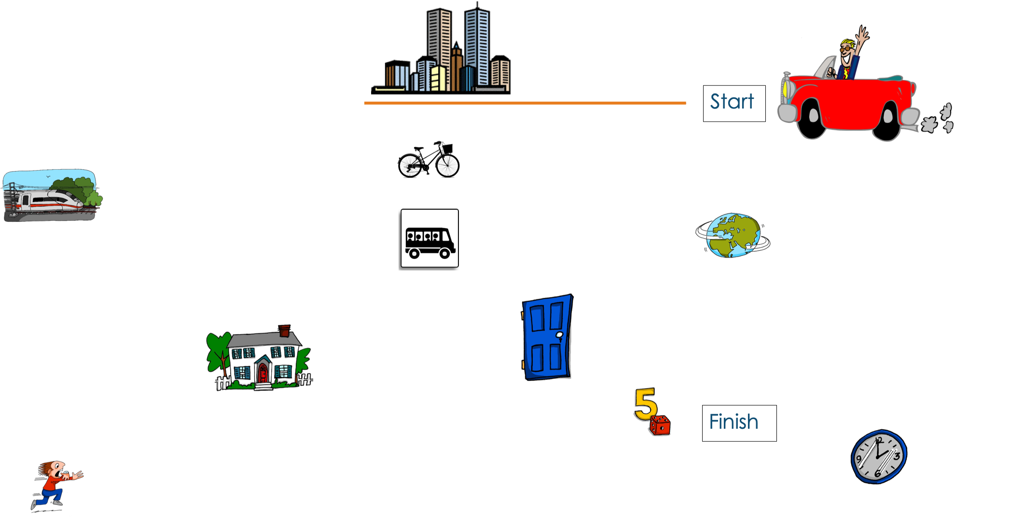
Map task
Inge Alferink

Slide 39
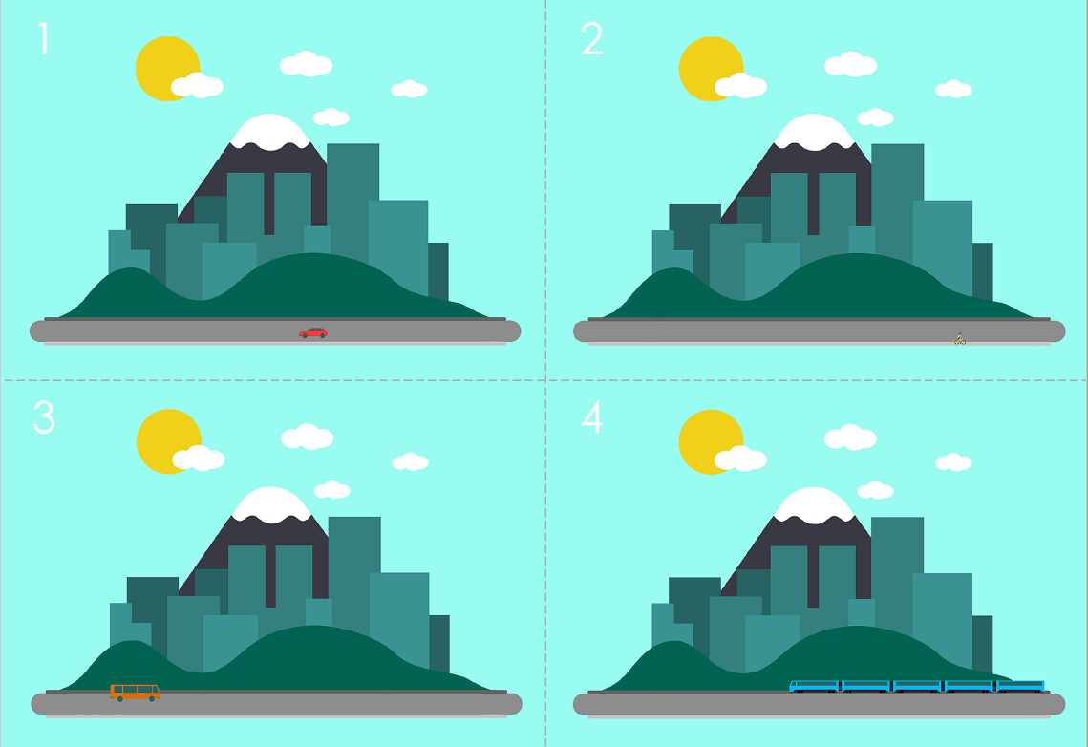
Guess where
Preparation
For each pair of pupils, you will need three sets of the pictures.
Cut them into individual cards along the dotted lines.
You can print them in colour or in black and white.
This activity takes time to prepare but the cards can be re-used time and again.
Game
Players: 2
Goal: guess which card the other person has
How to play:
This game is a variation on ‘Guess who?’.
Each player has a set of 24 cards in front of him/her.
Both players pick a card from a third set without showing the other player.
Players take turns asking each other yes/no questions about what is on the target card (e.g. Is there a car?) and turn over any cards that the answers eliminate.
The winner is the player who correctly identifies their opponent’s card first.
Word | Word class | Word frequency
geben | verb | 57
Auto (nt) | noun | 490
Zug (m) | noun | 613
Fahrrad (nt) | noun | 1596
Bus (m) | noun | 1580
Person (f) | noun | 331
Flugzeug (nt) | noun | 1395
Fluss (m) | noun | 1551
Straße (f) | noun | 355
Stadt (f) | noun | 186
Brücke (f) | noun | 2062
sonnig | adjective | <4000 [953] Sonne
sein | verb | 3
regnen | verb | 3642
Inge Alferink
Notes:
Handout also available in the resources section
This can be easily adapted for French and Spanish.

Slide 40
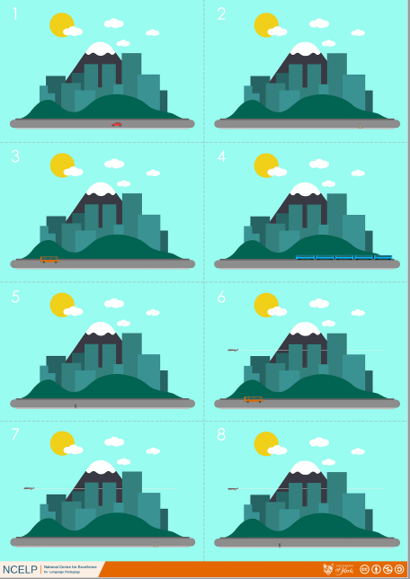
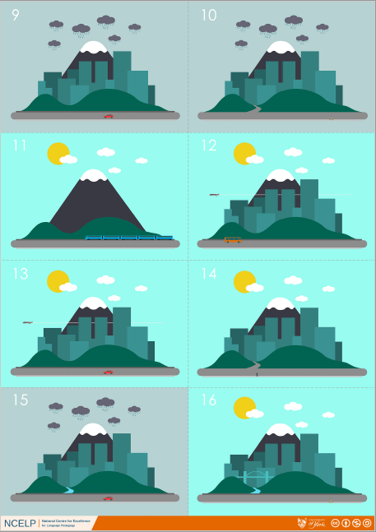
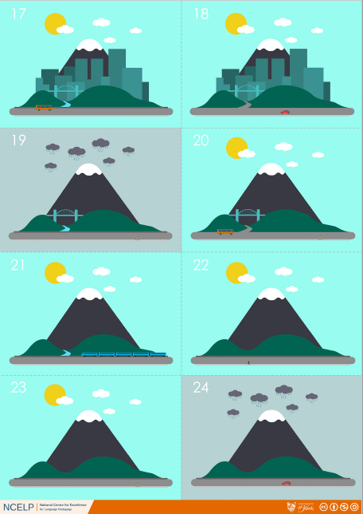
Guess where
Inge Alferink
Notes:
Screen shot of full resource – just so the game can be visualised!

Slide 41
Dictogloss
 | Word | Frequency | PoS
1 | être | 5 | verb
2 | matière (f) | 562 | noun
3 | facile | 822 | adjective
4 | anglais (m) | 784 | noun
5 | car | 176 | conjunction
6 | classe (f) | 778 | noun
7 | aimer | 242 | verb
8 | beau/belle | 393 | adjective
9 | langue (f) | 712 | noun
10 | espagnol (m) | 1666 | noun
Rachel Hawkes
Notes:
https://www.audio-lingua.eu/spip.php?article1416
When pupils have already spent some time learning and using the verb ‘etre’, and they are very familiar with ‘J’aime… parce que’ they could complete this very short dictogloss task. This is authentic audio. It contains many familiar words but also a couple of words that may be unfamiliar, which they can listen out for, and ask the teacher, about meaning or spelling. This is not a test. Pupils are able to try to note things down or remember them, and ask questions of their teacher. It is a very good way for them to try to put their phonics knowledge into practice. For example, they might ask: Comment dit-one ‘belle’ en anglais? Comment s’écrit ‘bilingue’? ‘Plutôt, c’est quoi en anglais? Qu’est-ce que c’est ‘langue’?
They then need to work in pairs to try to reconstruct the text. It is only 33 words long.
NB: Vocabulary table for the teacher and would not be displayed to pupils.
Dictogloss Pupils listen and make notes in English. They can listen several times to the passage.
Transcript: Mes deux matières préfèrés sont l’anglais et l’espagnole car je suis dans une classe bilingue. J’aime bien l’espagnole parce que c’est une belle langue et c’est plutôt facile. L’anglais j’aime bien parce que… The transcript fades out. Pupils who finish early could be encouraged to continue the passage a bit further.

Slide 42
How to teach and learn vocabulary
More ideas for developing vocabulary
Word families
Making links and spotting patterns between L1 and L2
Exploiting texts
Rachel Hawkes

Slide 43
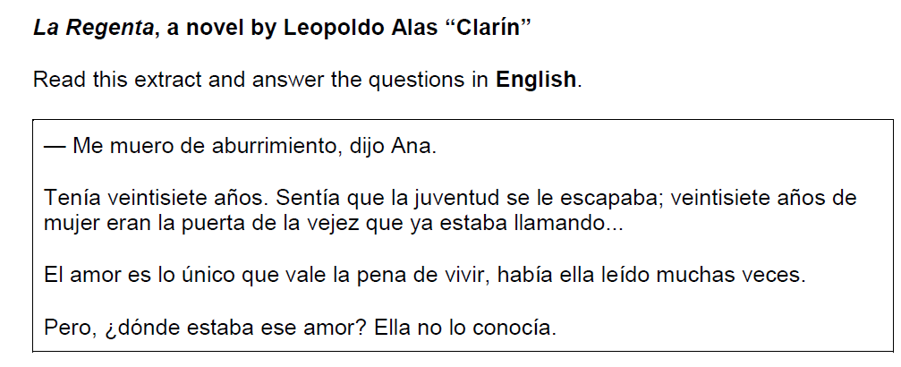
How to teach and learn vocabulary
Word families
How did Ana say she was feeling? Why was Ana depressed about being 27 years old? Give two reasons. What had Ana read about love?
Q5. AQA GCSE Higher Spanish Reading 2018
Rachel Hawkes
Notes:
Developing word knowledge through word families, teaching learners how to recognise and form cognates themselves early on in secondary supports, in my view, the sort of flexibility of thinking that is needed to succeed in the higher reading paper at GCSE. Remembering that the exams will include forms of words that learners may not have met, and are not on the prescribed vocabulary list, learners will need considerable ability to spot patterns and identify variations from words they do know, but still link them back to the meaning. A considerable challenge…
Higher Spanish Reading paper 2018 - words which may have caused issues: 1) irregular plurals that incur a spelling change with non-cognates e.g. pez --> peces 2) forms of words including prefixes - e.g. prepagada OR antitabaco and/or suffixes on infinitives - e.g. pagarlos / saltarse etc.. 3) stem-change verbs 4) spotting referent without pronouns 5) completely unknown words - e.g. 'la vejez' not on the word list – could you guess from ‘viejo’? 6) verbs used in more unfamiliar contexts - e.g. transitive use of 'subir' for 'take up' rather than intransitive 'go up' (they do meet 'subir fotos a Facebook' (upload) but this is a step away in terms of their possible 'held' translations). This last point is something we need to look at in terms of vocabulary knowledge - in Spanish there are fewer words than in English, so verbs in particular carry many different meanings - the ability of pupils to recognise these different meanings of known words is decisive in the GCSE reading paper.

Slide 44
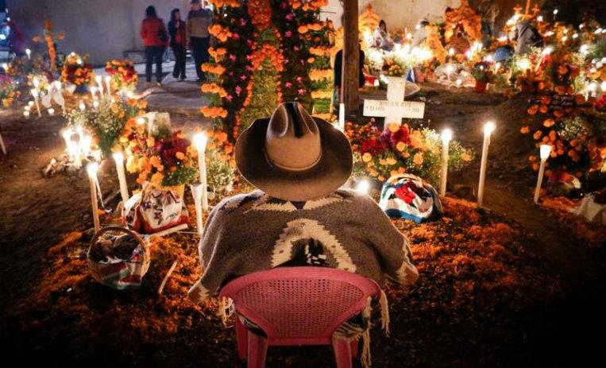
How to teach and learn vocabulary
Word families
on AQA vocabulary list
El Día de los Muertos es considerado la tradición más representativa de la cultura mexicana y es desde la cultura Azteca que se popularizó en gran parte de latinoamérica.
Word | Frequency | Part of speech | English
muere* | 212 | verb
mortal | 2673 | adjective
muerto (m) | 1103 | noun
muerto | 1103 | adjective
morir | 212 | verb
Rachel Hawkes

Slide 45
Be a language detective!
Images: https://pixabay.com/no/vectors/detective-etterforskning-mann-311684/; https://www.publicdomainpictures.net/en/view-image.php?image=155227&picture=light-bulb
Where do words come from?
Many English and French words have the same origin.
Understanding this can help us work out their meanings!
MODERN FRENCH
LATIN
OLD FRENCH
étranger
extraneus
estrangier
MODERN ENGLISH
stranger
To think about:
Why do many English and French words share the same origins?
Can you think of any other English words related to this same Latin origin?
Robert Woore
Notes:
First reflection question – What do they know about the Norman conquest and what this meant for the development of the modern English language?
Second reflection question – examples would be ‘extra’, ‘extraneous’, ‘estranged’

Slide 46
Be a language detective!
Images: https://pixabay.com/no/vectors/detective-etterforskning-mann-311684/; https://www.publicdomainpictures.net/en/view-image.php?image=155227&picture=light-bulb
MODERN FRENCH
MODERN ENGLISH
étranger
stranger
You can see this same pattern in lots of other word pairs!
ét…
st…
So… what do you think the following French words might mean?
études | 2. étudier | 3. état | 4. étendard
5. étonner | 6. établir | 7. établissement | 8. étable
Can you find any other pairs of French and English words that follow this pattern?
Robert Woore
Notes:
With the verbs we could encourage them to think about the meaning of the –er, -ir endings too. And think about the relationship between the verb and noun in the pairs {1,2} and {6, 7}.

Slide 47
Be a language detective!
Images: https://pixabay.com/no/vectors/detective-etterforskning-mann-311684/; https://www.publicdomainpictures.net/en/view-image.php?image=155227&picture=light-bulb
Where do words come from?
Many English and German words have the same origin.
Understanding this can help us work out their meanings!
OLD HIGH GERMAN
MODERN GERMAN
LATIN
pheffar
Pfeffer
piper
OLD ENGLISH
MODERN ENGLISH
piper
pepper
To think about:
Why do many English and German words share the same origins?
Can you think of any other English and German words that are related?
Robert Woore
Notes:
First reflection question – What do they know about waves of Germanic immigration to England in the first millennium AD?
Second reflection question – good examples they might know would be Bruder-brother, Mutter-mother, Vater-father etc.

Slide 48
Be a language detective!
Images: https://pixabay.com/no/vectors/detective-etterforskning-mann-311684/; https://www.publicdomainpictures.net/en/view-image.php?image=155227&picture=light-bulb
MODERN GERMAN
MODERN ENGLISH
Pfeffer
pepper
You can see this same pattern in lots of other word pairs!
pf…
p…
So… what do you think the following German words might mean?
Pfeife | 2. Pfund | 3. Pflanze | 4. Pfefferminze
5. pfefferig | 6. Krampf | 7. Pflaster | 8. Pfannkuchen
Can you find any other pairs of German and English words that follow this pattern?
Robert Woore
Notes:
They can also think about the f-p and the z-t pairings of sounds. Other possible words that could be used: Hopfen (hops) Tropfen (drop(let)) Pflaume (plum) stopfen (stuff) hüpfen (to hop) Pfennig (penny)

Slide 49
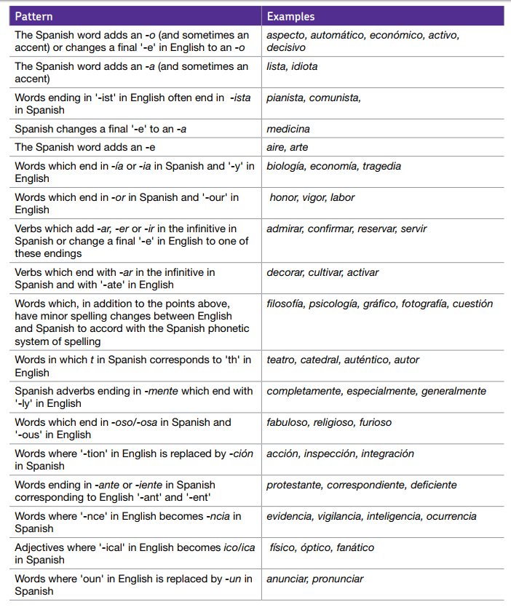
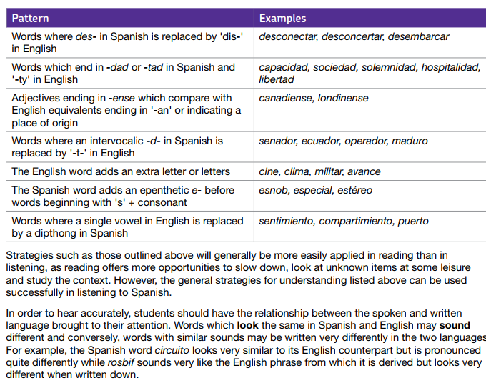
Cognates

Slide 50
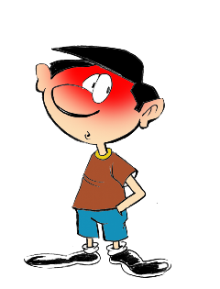
1
English → Spanish → English
-id at the end of the word often changes to -ido
The boy is timid
El chico es tímido
What would the following words be in Spanish?
solid
rapid
vivid
Can you write a sentence in English using each and translate it into Spanish?
Can you translate the following sentences?
1. El ácido es rojo.
2. The acid is a liquid.
Notice that you also add a tilde (accent) on the first vowel, i.e., tímido
Notes:
Working with cognates
NB:These are only available in Spanish at the moment.
There are 11 cognate patterns explored in this way, and a 12th task, which recaps all of the patterns met. The idea is that each pattern is given 10 minutes in tutor time (so NOT taking time out of L2 lessons!) They are written so that non-linguist tutors can deliver them. All resources will soon be available on the Resource Portal if teachers are keen to approach the pastoral teams in their schools about this.

Slide 51
1
ANSWERS
El ácido es rojo.
The acid is a liquid.
solid
rapid
vivid
The acid is red.
El ácido es un líquido.
sólido
rápido
vívido

Slide 52
12
Here is a selection of words with the cognate patterns you have seen this term:
aniversario
farmacia
contemplar
dignidad
delicioso
lívido
científico
canario
extravagancia
concentrar
catastrófico
ominoso
comedia
calamidad
vegetación
competencia
alérgico
degeneración
armonía
plácido
Work out the meaning. Extra: choose two words and write sentences in Spanish.

Slide 53
12
ANSWERS
cognate pattern | Spanish word 1 | English | Spanish word 2 | English
id → ido | lívido |  | plácido
ous → oso | delicioso |  | ominoso
tion → ción | vegetación |  | degeneración
ary → ario | aniversario |  | canario
ph → f | farmacia |  | catastrófico
ty → dad | dignidad |  | calamidad
y → ia / ía | comedia |  | armonía
ence/ance → encia / ancia | extravagancia |  | competencia
ate → ar | contemplar |  | concentrar
ic → ico | científico |  | alérgico
livid
placid
delicious
ominous
vegetation
degeneration
anniversary
canary
pharmacy
catastrophic
dignity
calamity
comedy
harmony
extravagance
competence
contemplate
concentrate
scientific
allergic

Slide 54
Exploiting texts
http://all-literature.wikidot.com/
Un hombre sin cabeza
Un hombre sin cabeza
no puede usar sombrero.
Pero éste no es
su mayor problema:
no puede pensar,
no puede leer,
no puede cantar,
no puede comer
No puede escuchar,
ni puede entender,
que para amar y besar
cabeza se debe tener.
all-literature.wikidot.com/dataentry:un-hombre-sin-cabeza
Armando José Sequera
Notes:
Original source: http://www.doslourdes.net/Un%20hombre%20sin%20cabeza.htm
Flag the ALL Literature wiki, and ALL in general!
Exploiting texts Remind STs that there are 8 rich texts from the Phonics resources (from FLEUR) that are available for French>
Tell them also that at the next residential we will be starting a strand on literature and authentic texts, when there will be a lot more available. This is just an example here, and one which fits very well with developing a verb lexicon. NB: Handout not available – permission process just getting underway, currently.
Students brainstorm in groups (big sheet of paper / big pens!) all the possible infinitives that they think could be in the poem. Tell them that they will get points for anticipating correctly, but also (a different number of) points for coming up with infinitives that no other group has. After 8 minutes to work on their list, ask the class to read the poem aloud up to the first gap. Then reveal each infinitive, one by one, telling students to mark off any that they have in common with the poem. When finished, tell them they get 3 points for every infinitive they’ve matched. Bonus points: Then ask for any additional infinitives that they had. Ask for one from each group. If no other group has it, the group gets 5 points. If other groups have it, those that do get 1 point each. Keep going until all the verbs are accounted for. There will then be a count up to identify the winning team. Pupils then decide on their own favourite version of the poem, adding/deleting verbs from the original. They practise a performance version of the poem in their groups, acting out the verbs.
There are some other things we could do here, if we played around with taking out the ‘puede’ or leaving it in. We could turn it into a minimal pairs elicited task, whereby one pupil has an adapted version, where the structure is varied, either puede + infinitive OR just 3rd person sigular. If the pupil hears ‘no puede’ s/he has to finish the sentence with the infinitive, if s/he hears ‘no’ only, s/he has to give the short verb form.

Slide 55
Someone decided that the original version was repetitive and had too many ‘no puede’s in it. She decided to change it, so that sometimes it just has ‘no’ and a short form verb. The difference in meaning is this: 1) no puede cantar – s/he cannot sing 2) no canta – s/he doesn’t sing The difference in verb form is: 1) … cantar – infinitive 2) … canta – 3rd person singular [s/he form] Work with a partner. S/he will read an adapted version of this poem to you. Every time s/he stops you need to complete the line with either the infinitive OR the 3rd person singular form of the verb. Then swap and read your version to your partner.

Slide 56
A
B
Un hombre sin cabeza
1 Un hombre sin cabeza
2 no puede usar sombrero.
3 Pero éste no es
4 su mayor problema:
5 no puede hablar,
6 no puede ver,
7 no canta,
8 no quiere,
9 No escucha,
10 ni puede creer,
11 que para amar y besar
12 cabeza se debe tener.
Un hombre sin cabeza
1 Un hombre sin cabeza
2 no puede usar sombrero.
3 Pero éste no es
4 su mayor problema:
5 no … [hablar / habla],
6 no … [ver / ve],
7 no … [cantar / canta],
8 no … [querer / quiere],
9 No …[escuchar / escucha],
10 ni …[creer / cree],
11 que para amar y besar
12 cabeza se debe tener.
Armando José Sequera
Armando José Sequera
Notes:
You wouldn’t display these to the class, obviously. It’s just for display, here.
Partner A reads but stops short and doesn’t say the words in orange (they are there so that s/he is 100% which form it should be and can give feedback) Partner B has to complete the incomplete utterances with either the long or short form of the verb, whichever is correct.

Slide 57
A
B
Un hombre sin cabeza
1 Un hombre sin cabeza
2 no puede usar sombrero.
3 Pero éste no es
4 su mayor problema:
5 no … [llamar / llama],
6 no … [saber / sabe],
7 no … [decir / dice],
8 no … [ir / va],
9 No …[querer/ quiere],
10 ni …[ser / es],
11 que para amar y besar
12 cabeza se debe tener.
Un hombre sin cabeza
1 Un hombre sin cabeza
2 no puede usar sombrero.
3 Pero éste no es
4 su mayor problema:
5 no puede llamar,
6 no sabe,
7 no puede decir
8 no puede ir,
9 No quiere,
10 ni puede ser,
11 que para amar y besar
12 cabeza se debe tener.
Armando José Sequera
Armando José Sequera
Notes:
You wouldn’t display these to the class, obviously. It’s just for display, here.
This time
Partner B reads but stops short and doesn’t say the words in orange (they are there so that s/he is 100% which form it should be and can give feedback) Partner A has to complete the incomplete utterances with either the long or short form of the verb, whichever is correct. Clearly there are many extension activities, one being to write a different poem in this style or with this theme, or both.

Slide 58
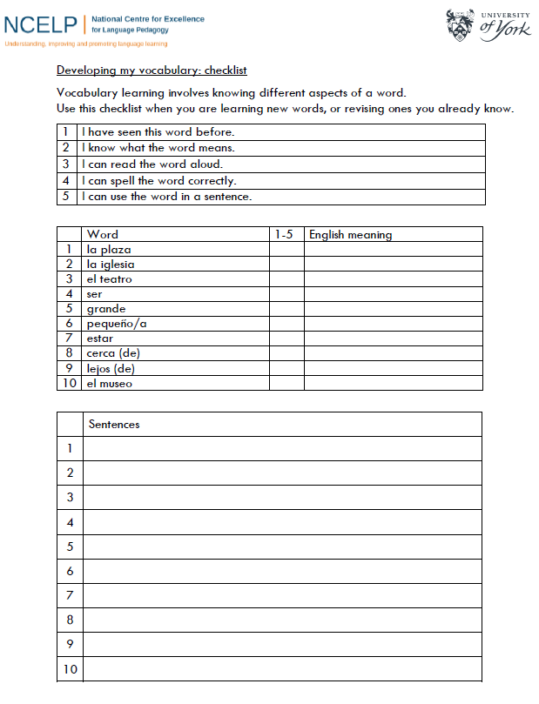
Assessment
Rachel Hawkes
Notes:
Handout 12 Pupil self-assessment checklist template
STs saw examples of the checklist and the sentence level tests in the Vocabulary teaching sequence powerpoints. Ask them what other sorts of assessments they feel they need for vocabulary. [Obviously we have some examples of the phonics assessments from the previous CPD]

Slide 59
Different rates of learning
A focus on high-frequency vocabulary, particularly verbs helps all learners, but particularly those who take longer to learn and find it more difficult to retain and retrieve.
Pre-lesson learning gives learners control over the initial learning (i.e. they can learn at their own pace and without any time pressure)
Peer presentation and consolidation methods – strategic seating can give a ‘lead’ role to more able students, initially, but changing partners to repeat then ensures that all are challenged (i.e. start with HPA/LPA pairs, then move to HPA/HPA and LPA/LPA pairs).
Self-made flashcards offer differentiation - Higher-attaining pupils can move more quickly to working from L1 to L2.
Information gap tasks can be tweaked to have differentiated levels of challenge in the pairings; tasks then repeated with equal challenge pairs.
Open-ended tasks, e.g. sentence-creation from given words, give pupils the opportunity for stretch.
Rachel Hawkes
Notes:
There will be some more detailed guidance on this, including thoughts on SEND and working with mixed attainment classes, in particular. Here we just review some of the approaches to vocabulary that we have seen which lend themselves well to working with pupils that have different rates of learning (this is ALL classes, whether set or not).
As always, the key to meeting the needs of all learners, is knowing what those needs are, i.e. knowing your learners individually. There is nothing that substitutes for this as a starting point. However, this slide is a summary of the ways in which these approaches support the best learning outcomes for all learners.

Slide 60
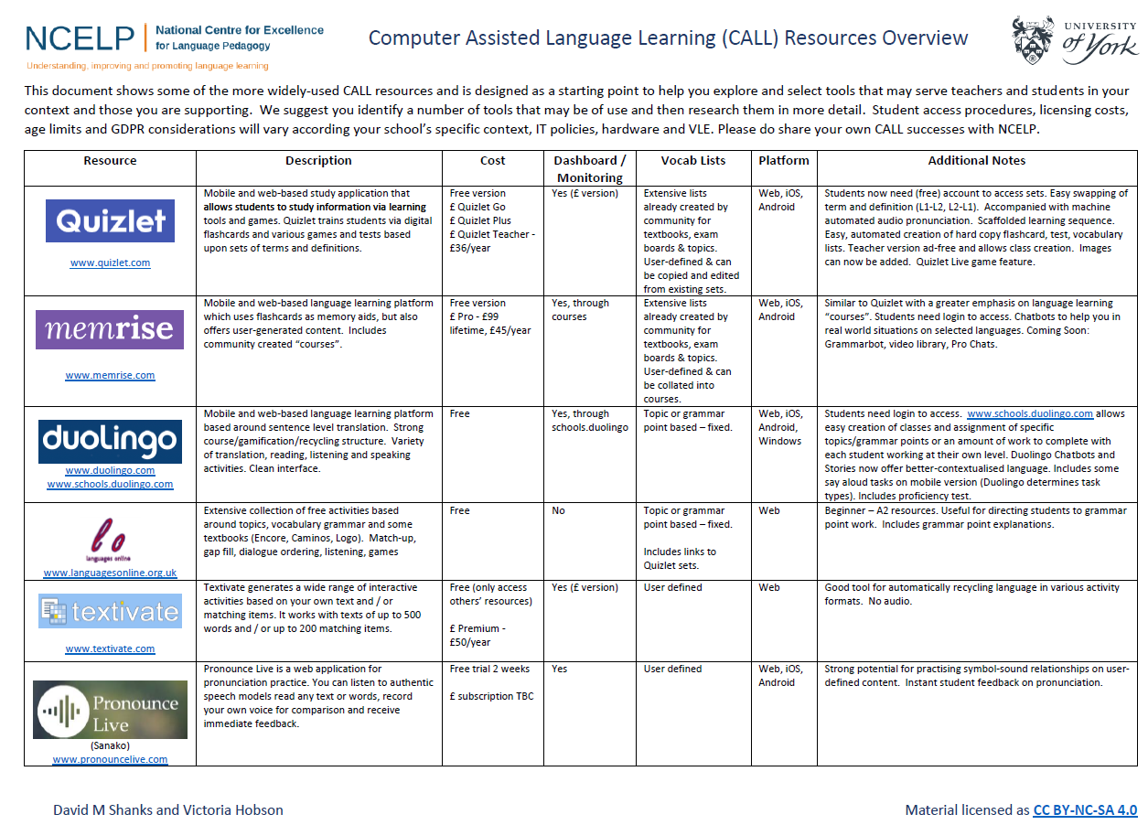
CALL
Rachel Hawkes
Notes:
Handout This is the final handout (together with another copy of the speaking homework one, just to flag this again, as there was so much in the previous CPD, it might have been a little overlooked, and is a very important area to pursue.)
It will be useful to ask STs what CALL they have available, and what they know about their partner schools.

Slide 61
Aims of the session
Develop an understanding of the research evidence relating to L2 vocabulary learning
Develop more concrete ideas for teaching vocabulary: (a) which words? (b) how to present, consolidate, develop and assess vocabulary knowledge?
Explore some of the NCELP resources and approaches for vocabulary learning
Understand the ways in which you will work with the Lead Schools to develop practice in this area
Rachel Hawkes
Notes:
Introduction to CPD: 2 minutes 1] Aims of this session

Slide 62
Conclusion and next steps
Cascade to colleagues in your departments
Plan and resource Keep in touch with each other and your lead school, sharing anything you create (or adapt from an NCELP resource). Resources will be added frequently to Resource Portal. Send resources to Enquiries@ncelp.org.uk in the first instance – we are happy to help with copyright free images / audio recordings etc..
Teach and reflect Make vocabulary teaching the focus of your next planned visit / observation. Use the observation schedule as a planning tool and focus for discussion. Share the document with us Enquiries@ncelp.org.uk .
Video parts of lessons where you focus on vocabulary If possible, video parts of your lessons. Upload to VEO and tag.
Remind yourself of your next key dates: Vocabulary TRG and Grammar CPD.
Rachel Hawkes

