Slide 1
Communicating in other languages [4]
verbs like ‘lire’ in the present (plural)
SSCs [y] and [oy]
Y8 French
Term 3.2 - Week 1 - Lesson 61
Catherine Salkeld / Catherine Morris / Stephen Owen
Artwork by: Chloé Motard
Date updated: 09/07/21
Notes:
Artwork by Chloé Motard. All additional pictures selected are available under a Creative Commons license, no attribution required.
Native teacher feedback provided by Sarah Brichory.
With thanks to Rachel Hawkes for her input on the lesson material.
Learning outcomes (lesson 1):
revisiting SSCs [y] and [oy]
introduction of verbs like ‘lire’ in the present tense (nous, vous, ils/elles)
Word frequency (1 is the most frequent word in French):
8.3.2.1 (introduce) conduire [487], dites [37], interdire [533], inscrire [1004], lieu [117], arbre [2111], autobus [4216], neige [1824], chaud [1852], froid [1307], scolaire [1993], revisit: dire [37], lire [278], écrire [382], décrire [1176], traduire [1125]
8.3.1.4 (revisit) dépendre (de) [313], entendre [159], répondre (à) [200], annonce [1887], conversation [1747], espagnol² [1666], message [792], soleil [1713], temps² [65], espagnol¹ [1666], Espagne [n/a]
8.2.2.1 (revisit) choisir [226], définir [916], remplir [751], réussir [279], blanc² [701], cahier [4001], examen [1448], lycée [2816], note [1161], alors [81]
Source: Londsale, D., & Le Bras, Y. (2009). A Frequency Dictionary of French: Core vocabulary for learners London: Routledge.
The frequency rankings for words that occur in this PowerPoint which have been previously introduced in NCELP resources are given in the NCELP SOW and in the resources that first introduced and formally re-visited those words.
For any other words that occur incidentally in this PowerPoint, frequency rankings will be provided in the notes field wherever possible.

Slide 2
y
y
Notes:
Timing: 1 minute
Aim: To consolidate SSC [y]
Procedure: 1. Present the letter(s) and say the [y] sound first, on its own. Students repeat it with you. 2. Bring up the word ”y” on its own, say it, students repeat it, so that they have the opportunity to focus all of their attention on the connection between the written word and its sound.
3. A possible gesture for this would be [to point over ‘there’]. 4. Roll back the animations and work through 1-3 again, but this time, dropping your voice completely to listen carefully to the students saying the [y] sound, pronouncing ”y” and, if using, doing the gesture.
Word frequency (1 is the most frequent word in French):
y [36]
Source: Londsale, D., & Le Bras, Y. (2009). A Frequency Dictionary of French: Core vocabulary for learners London: Routledge.

Slide 3
oy
envoyer
Notes:
Timing: 1 minute
Aim: To consolidate SSC [oy]
Procedure: 1. Present the letter(s) and say the [oy] sound first, on its own. Students repeat it with you. 2. Bring up the word ”envoyer” on its own, say it, students repeat it, so that they have the opportunity to focus all of their attention on the connection between the written word and its sound.
3. A possible gesture for this would be [sending a letter]. 4. Roll back the animations and work through 1-3 again, but this time, dropping your voice completely to listen carefully to the students saying the [oy] sound, pronouncing ”envoyer” and, if using, doing the gesture.
Word frequency (1 is the most frequent word in French):
enyoyer [526]
Source: Londsale, D., & Le Bras, Y. (2009). A Frequency Dictionary of French: Core vocabulary for learners London: Routledge.

Slide 4
Phonétique
écouter / écrire
Écoute. C’est [oy] ou [y] ?
Q | mot | [oy] | [y]
 | joyau [jewel]
 | cycliste [cyclist]
 | symbole [symbol]
 | voyelle [vowel]
 | lycée [sixth form]
 | gymnase [gym]
 | incroyable [incredible]
 | citoyen [citizen]
1
2
3
4
5
6
7
8
Notes:
Timing: 5 minutes
Aim: Aural recognition of SSCs [oy] and [y]
Procedure:
1. Click to play the audio.
2. Students tick whether they hear [oy] or [y].
3. Click to reveal the answers.
4. Click to reveal the words.
Transcript:
joyau
cycliste
symbole
voyelle
lycée
gymnase
incroyable
citoyen
Word frequency of unknown words used (1 is the most frequent word in French):
joyau [>5000], voyelle [>5000], incroyable [2231], citoyen [1081]
Word frequency of near-cognates used (1 is the most frequent word in French): symbole [1427], cycliste [>5000], mystère [2777], gymnase [>5000],
Source: Lonsdale, D., & Le Bras, Y. (2009). A Frequency Dictionary of French: Core vocabulary for learners London: Routledge.

Slide 5
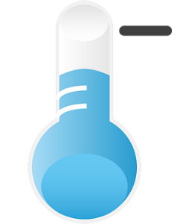
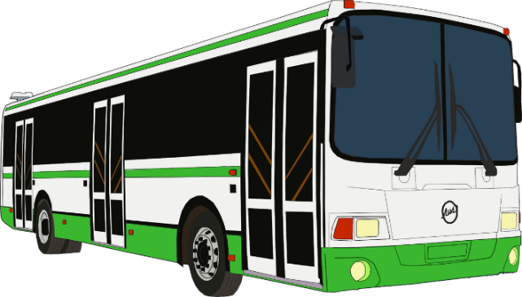
Définis les mots
écouter
J.
1
H
Écoute et écris la bonne lettre.
place
2
E
3
G
G.
you (pl/fml) say
B.
C
4
H.
5
I
A.
D
6
L’autobus (m) is often shortened to just ‘le bus’.
school (adj)
A
D.
7
F.
J
K.
8
B
9
C.
I.
F
10
K
11
E.
Notes:
Timing: 4 minutes
Aim: Aural recognition of new words in this week’s vocabulary set.
Procedure:
1. Click on a number trigger to play the audio.
2. Students write 1-10 and the letter next to the image or English word which best represents the French word they hear.
3. Click to reveal the answers.
4. Click to bring up the note on the abbreviated form ‘bus’.
Transcript:
1. interdire
2. chaud
3. le lieu
4. inscrire
5. l’autobus
6. l’arbre
7. vous dites
8. la neige
9. conduire
10. froid
11. scolaire

Slide 6
Froid / chaud
lire
Comment utiliser les mots ‘froid’ et ‘chaud’ ?
To say it is hot/warm or cold weather, we say ‘il fait’ + ‘chaud’/‘froid’:
Il fait chaud en Espagne
It’s hot/warm in Spain
Il fait froid en Angleterre
It’s cold in England
Just like:
Il fait beau
It’s nice weather
Il fait mauvais
It’s bad weather
Notes:
Timing: 1 minute
Aim: To introduce use of the verb faire with froid/chaud.
Procedure:
1. Click through information.
2. Draw parallels with faire beau/mauvais which students already know.

Slide 7
Le journal d’Océane
lire
Océane écrit dans son cahier. Traduis les phrases en anglais.
l’abattage (m) = cutting down
J’aime inscrire mes idées dans mon cahier scolaire.
En ce moment, je suis dans le bus. Nous allons conduire aux pistes de ski.
Il fait chaud dans l’autobus, mais la neige dehors est froide.
Ce lieu est beau avec tous les grands arbres.
Le gouvernement doit interdire l’abattage des arbres.
Vous ne dites pas beaucoup de choses, mais vous écoutez bien.
I like to write down my ideas in my school exercise book.
At the moment, I’m on the bus. We’re going to drive to the ski slopes.
It is warm on the bus, but the snow outside is cold.
This place is beautiful with all the big trees.
The government must ban the cutting down of trees.
You don’t say much, but you listen well.
Notes:
Timing: 8 minutes
Aim: Written recognition of new vocabulary in a longer sentence. French – English translation.
Procedure:
1. Students translate French to English.
2. Click to reveal suggested translations one by one (correct alternatives to be encouraged and praised).
Word frequency of unknown words used (1 is the most frequent word in French): abattage [>5000]
Source: Londsale, D., & Le Bras, Y. (2009). A Frequency Dictionary of French: Core vocabulary for learners London: Routledge.

Slide 8
Verbs like lire in the plural
grammaire
Verbs like lire add an -s- to the stem in the plural forms:
lire – to read, reading
je lis tu lis il/elle lit
nous lisons vous lisez ils/elles lisent
dire – to say, saying
je dis tu dis il/elle dit
nous disons vous dites ils/elles disent
traduire, conduire, interdire and dire also follow this pattern (EXCEPT: vous dites)
But ‘vous interdisez’
Unlike in the singular form, the -s- is pronounced.
Notes:
Timing: 3 minutes
Aim: To introduce the nous, vous and ils/elles forms of verbs like lire, drawing attention to the irregular form vous dites.
Procedure: 1. Cycle through the information on the slide using the animation sequence.
2. Pay particular attention to the change in pronunciation (SFC to pronounced consonant) in the plural forms.

Slide 9
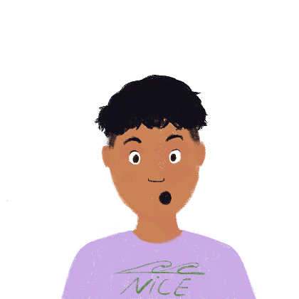
Je ne comprends pas !
lire
Océane écrit à Amir sur les difficultés avec l’italien ! Choisis le pronom correct.
Parfois, j’ai des problèmes avec la langue. Je / nous dis que c’est difficile.
Nous / ils lisons beaucoup pour apprendre – c’est plus facile.
Mon amie / mes amies disent beaucoup de choses en français aussi.
1
3
5
Je / mes amis traduisent beaucoup de choses en français.
Tu / vous lisez beaucoup à la maison en ce moment ?
Est-ce que tu / tes amis dis beaucoup de choses en italien à l’école ?
2
4
6
Notes:
Timing: 6 minutes [2 slides]
Aim: Written recognition of verbs like lire (all persons) and connecting these with meaning.
Procedure:
1. Students read the texts and identify the correct pronoun from the two alternatives in each case, paying attention to the form of the verb.
2. Click to reveal their answers.
3. Students choose True or False for the sentences on the next slide.
4. Click to reveal answers.
Word frequency of unknown words and cognates used (1 is the most frequent word in French):
difficulté [564]
Source: Londsale, D., & Le Bras, Y. (2009). A Frequency Dictionary of French: Core vocabulary for learners London: Routledge.

Slide 10
Je ne comprends pas !
lire
 | T | F
1. Océane says Italian is easy.
2. Her friends translate lots of things into French.
3. Océane and her friends read a lot.
4. Océane asks Amir if he listens to Italian at home.
5. Océane’s friends say lots of things in French.
6. Océane asks if Amir’s friends read things in Italian.
Notes:
Follow-up exercise to the activity on the previous slide.

Slide 11
Prononciation
écouter / parler
Elle lit un livre.
She is reading a book.
Notes:
Timing: 1 minute for 4 slides
Aim: To demonstrate pronunciation of the plural forms of verbs like lire.
Procedure:
1. Listen and repeat.
2. Ask students to translate the sentence.
3. Reveal English translation on click.
Transcript:
Elle lit un livre.

Slide 12
Prononciation
écouter / parler
Nous lisons un livre.
We are reading a book.
Notes:
Transcript:
Nous lisons un livre.

Slide 13
Prononciation
écouter / parler
Vous lisez un livre.
You (pl/fml) are reading a book.
Notes:
Transcript:
Vous lisez un livre.

Slide 14
Prononciation
écouter / parler
Ils lisent le livre.
They are reading the book.
Notes:
Transcript:
Ils lisent le livre.

Slide 15
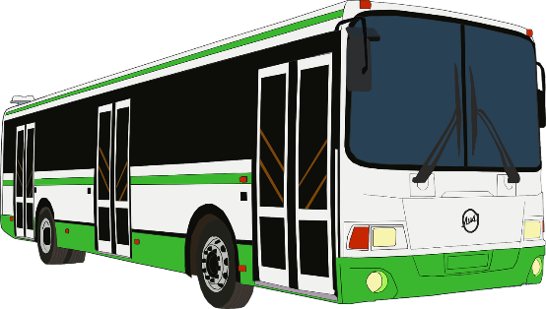
Un séjour linguistique*
*le séjour linguistique = language study holiday
*la publicité = advert
écouter
Q | nous | vous | R
1
1
Océane entend une publicité* pour un séjour linguistique scolaire.
Écoute l’annonce et choisis nous ou vous.
Écoute les réponses et fais deux listes en anglais.
1. what you (the teachers) do
2. what we (the company) do
2
2
3
3
4
4
5
5
6
6
7
7
8
8
Notes:
Timing: 8 minutes
Aim: Aural recognition of the nous and vous forms of verbs like dire and connecting them with meaning (sentence subject).
Procedure:
1. Click on the numbers on the left to play audio with the pronoun obscured.
2. Students write number 1-8 and choose nous or vous for each one.
3. Click to reveal answers.
4. Click on the numbers on the right to play the full audio.
5. Students list in English who does what. Table on the next slide.
6. Click to reveal answers.
Transcript:
Est-ce que [vous] dites souvent : « les élèves, ils ne parlent pas l’italien pendant les voyages scolaires ! » ?
Est-ce que [vous] interdisez les voyages au ski parce qu’ils ne sont pas éducatifs ?
[Nous] disons : un voyage au ski éducatif, c’est possible !
[Nous] conduisons de Nice aux Alpes italiennes chaque jour.
[Nous] ne traduisons pas les informations en français.
[Vous] lisez tout le programme en italien.
[Vous] traduisez toutes les annonces seuls !
[Nous] interdisons complètement le français. C’est idéal !
Word frequency of unknown words used (1 is the most frequent word in French):
séjour [2007], linguistique [3907], publicité [2110]
Word frequency of cognates used (1 is the most frequent word in French): ski [4571], information [317], complètement [>5000], éducatif [>5000]
Source: Londsale, D., & Le Bras, Y. (2009). A Frequency Dictionary of French: Core vocabulary for learners London: Routledge.

Slide 16
Un séjour linguistique*
*le séjour linguistique = language study holiday
*la publicité = advert
écouter
what you plural (the teachers) do | what we (the company) do
often say “the pupils don’t speak Italian on school trips” | say “an educational ski trip is possible!”
ban ski trips because they’re not educational | drive from Nice to the Italian Alps every day
read the whole schedule in Italian | don’t translate the information into French
translate everything themselves | completely ban French
Notes:
Follow-up exercise to the activity on the previous slide

Slide 17
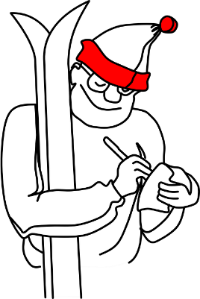
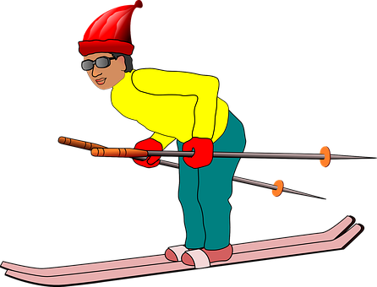
Une ou plusieurs personnes ?
écouter / lire
Qui traduit les annonces ?
Je traduis les annonces.
Ils traduisent les annonces.
Notes:
Timing: 4 minutes [8 slides]
Aim: Aural recognition of the je, tu and ils/elles forms of verbs like lire and connecting these with meaning. Raising awareness of [-s-] as an SFC in the je and tu forms. The activity trains students to dissociate the pronounced -s- from the singular form.
Procedure:
1. Click on the button to play the audio with the pronoun obscured.
2. Students listen whilst reading the two alternatives on screen.
3. They then indicate which sentence they think they heard.
4. Click to reveal the correct answer and the full audio, including the pronoun.
Transcript:
[Ils] traduisent les annonces.

Slide 18
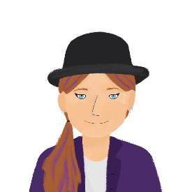
Une ou plusieurs personnes ?
écouter / lire
Qui conduit un kart ?
Tu conduis un kart.
Ils conduisent un kart.
Notes:
Transcript:
[Ils] conduisent un kart.
Word frequency of cognates used (1 is the most frequent word in French): kart [>5000]
Source: Londsale, D., & Le Bras, Y. (2009). A Frequency Dictionary of French: Core vocabulary for learners London: Routledge.

Slide 19
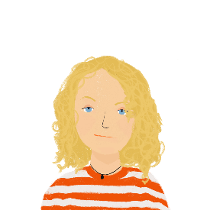
Une ou plusieurs personnes ?
écouter / lire
Qui lit les annonces ?
Je lis les annonces.
Elles lisent les annonces.
Notes:
Transcript:
[Je] lis les annonces.

Slide 20
Une ou plusieurs personnes ?
écouter / lire
Qui dit bonjour ?
Bonjour !
Bonjour !
Bonjour!
Tu dis bonjour.
Elles disent bonjour.
Notes:
Transcript:
[Elles] disent bonjour.

Slide 21
Une ou plusieurs personnes ?
écouter
Qui traduit pour mes amies ?
Je traduis pour mes amies.
Elles traduisent pour mes amies.
Notes:
Timing: 2 minutes [4 slides]
Aim: Aural recognition of the je, tu and ils/elles forms of verbs like lire and connecting these with meaning. . Raising awareness of [-s-] as an SFC in the je and tu forms. The activity trains students to dissociate the pronounced -s- from the singular forms.
Procedure:
1. Click on the button to play the audio with the pronoun obscured.
2. Students listen (this time without also reading the sentences on screen)
3. They then indicate which sentence they think they heard.
4. Click to reveal the correct answer and the full audio, including the pronoun.
5. Students write a sentence for each set of pictures (NB: the picture of Océane represents je, and the picture of Sophie tu). 6. A further click brings up the written sentences.
Transcript:
[Je] traduis pour mes amies.

Slide 22
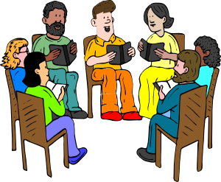
Une ou plusieurs personnes ?
écouter
Qui lit un livre ?
Je lis le livre.
Ils lisent le livre.
Notes:
Transcript:
[Ils] lisent le livre.

Slide 23
Une ou plusieurs personnes ?
écouter / lire
Qui conduit un kart ?
Tu conduis un kart.
Elles conduisent un kart.
Notes:
Transcript:
[Tu] condis un kart.
Word frequency of cognates used (1 is the most frequent word in French): kart [>5000]
Source: Londsale, D., & Le Bras, Y. (2009). A Frequency Dictionary of French: Core vocabulary for learners London: Routledge.

Slide 24
Une ou plusieurs personnes ?
écouter
Qui dit bonjour ?
Bonjour !
Bonjour !
Bonjour!
Tu dis bonjour.
Elles disent bonjour.
Notes:
Transcript:
[Tu] dis bonjour.

Slide 25
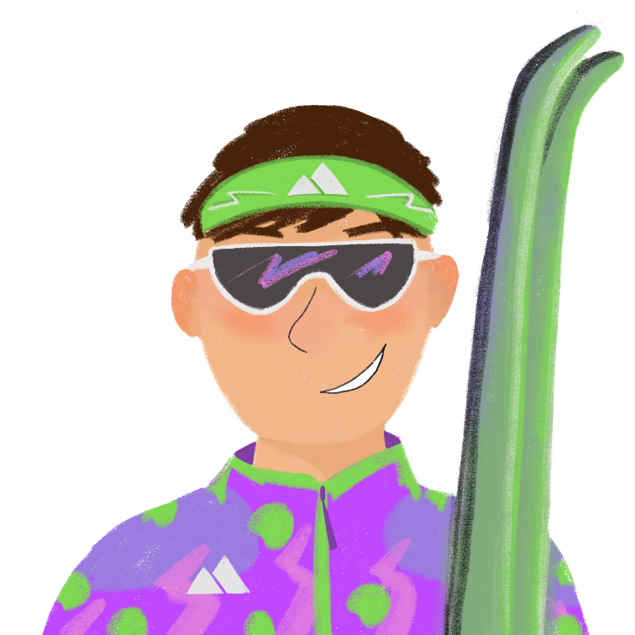
Conversations avec le moniteur de ski
*le moniteur de ski
= ski instructor
écrire
Tu peux traduire le message en français ?
1. Do you (polite) read French novels ?
2. We are translating Italian stories into French.
3. I like to answer the teacher’s questions when we read.
4. My teachers say I am going to pass all my exams.
5. You (polite) say that the red ski runs are difficult.
6. I am lucky. You (polite) answer my questions very well.
7. And you (polite) drive the bus very well too!
8. All the pupils say you (polite) are better than the other instructors.
Lisez-vous des romans français ?
Nous traduisons des histoires italiennes en français.
J’aime répondre aux questions du prof quand nous lisons.
Mes profs disent que je vais réussir tous mes examens !
Vous dites que les pistes rouges sont difficiles.
J’ai de la chance. Vous répondez très bien à mes questions.
Et vous conduisez l’autobus très bien aussi !
Tous les élèves disent que vous êtes meilleur que les
autres moniteurs.
Notes:
Timing: 8 minutes
Aim: Written translation of sentences containing verbs like lire.
Procedure:
1. Students translate the numbered sentences into French.
2. Elicit answers from students.
3. Suggested translations are revealed one sentence at a time on clicks.
Word frequency of unknown words and cognates used (1 is the most frequent word in French):
moniteur [>5000], skier [>5000]
Source: Londsale, D., & Le Bras, Y. (2009). A Frequency Dictionary of French: Core vocabulary for learners London: Routledge.

Slide 26
Communicating in other languages [4]
verbs like ‘écrire’ in the present (plural)
SSCs [y] and [oy]
Y8 French
Term 3.2 - Week 1 - Lesson 62
Catherine Salkeld / Catherine Morris / Stephen Owen
Artwork by: Chloé Motard
Date updated: 09/07/21
Notes:
Artwork by Chloé Motard. All additional pictures selected are available under a Creative Commons license, no attribution required.
Native teacher feedback provided by Sarah Brichory.
With thanks to Rachel Hawkes for her input on the lesson material.
Learning outcomes (lesson 2):
revisiting SSCs [y] and [oy]
introduction of verbs like ‘écrire’ in the present tense (nous, vous, ils/elles)
Word frequency (1 is the most frequent word in French):
8.3.2.1 (introduce) conduire [487], dites [37], interdire [533], inscrire [1004], lieu [117], arbre [2111], autobus [4216], neige [1824], chaud [1852], froid [1307], scolaire [1993], revisit: dire [37], lire [278], écrire [382], décrire [1176], traduire [1125]
8.3.1.4 (revisit) dépendre (de) [313], entendre [159], répondre (à) [200], annonce [1887], conversation [1747], espagnol² [1666], message [792], soleil [1713], temps² [65], espagnol¹ [1666], Espagne [n/a]
8.2.2.1 (revisit) choisir [226], définir [916], remplir [751], réussir [279], blanc² [701], cahier [4001], examen [1448], lycée [2816], note [1161], alors [81]
Source: Londsale, D., & Le Bras, Y. (2009). A Frequency Dictionary of French: Core vocabulary for learners London: Routledge.
The frequency rankings for words that occur in this PowerPoint which have been previously introduced in NCELP resources are given in the NCELP SOW and in the resources that first introduced and formally re-visited those words.
For any other words that occur incidentally in this PowerPoint, frequency rankings will be provided in the notes field wherever possible.

Slide 27
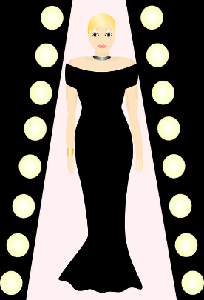
y
rythme
système
style
y
analyser
[to analyse]
physique
Notes:
Timing: 1 minute
Aim: To consolidate SSC [y]
Procedure:
1. Introduce and elicit the pronunciation of the individual SSC [y] and then the source word again ‘y’ (with gesture, if using). 2. Then present and elicit the pronunciation of the five cluster words.
The cluster words have been chosen for their high-frequency, from a range of word classes, with the SSC (where possible) positioned within a variety of syllables within the words (e.g. initial, 2nd, final etc.). Additionally, we have tried to use words that build cumulatively on previously taught SSCs (see the Phonics Teaching Sequence document) and do not include new SSCs. Where new SSCs are used, they are often consonants which have a similar symbol-sound correspondence in English.
Word frequency (1 is the most frequent word in French): système [289]; style [1999] physique [1146]; analyser [1209]; rythme [1662] Source: Londsale, D., & Le Bras, Y. (2009). A Frequency Dictionary of French: Core vocabulary for learners London: Routledge.

Slide 28
oy
nettoyer
voyage
[journey]
royal
envoyer
moyen
employé
[average]
[employee]
Notes:
Timing: 1 minute
Aim: To consolidate SSC [oy]
Procedure:
1. Introduce and elicit the pronunciation of the individual SSC [oy] and then the source word again ‘envoyer’ (with gesture, if using). 2. Then present and elicit the pronunciation of the five cluster words.
The cluster words have been chosen for their high-frequency, from a range of word classes, with the SSC (where possible) positioned within a variety of syllables within the words (e.g. initial, 2nd, final etc.). Additionally, we have tried to use words that build cumulatively on previously taught SSCs (see the Phonics Teaching Sequence document) and do not include new SSCs. Where new SSCs are used, they are often consonants which have a similar symbol-sound correspondence in English.
Word frequency (1 is the most frequent word in French): envoyer [526]; royal [2290]; nettoyer [3887]; employé [1485]; voyage [904]; moyen [186] Source: Londsale, D., & Le Bras, Y. (2009). A Frequency Dictionary of French: Core vocabulary for learners London: Routledge.

Slide 29
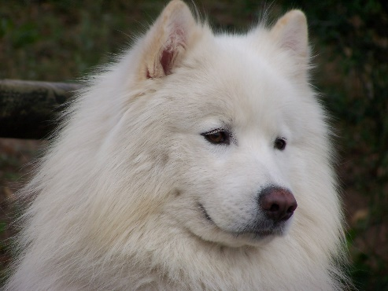
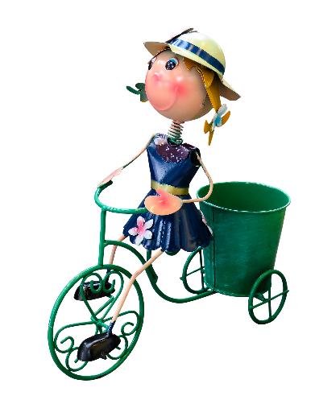
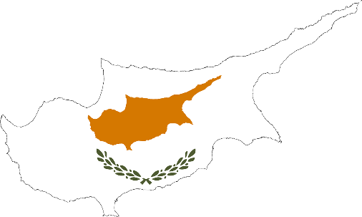
Des virelangues !
écouter / parler
Le samoyède syrien aime aboyer sur le python royal.
[The Syrian Samoyed likes to bark at the royal python.]
Sylvie la cycliste joyeuse voyage à Chypre.
[Sylvie the joyful cyclist travels to Cyprus.]
Notes:
Timing: 4 minutes (slide 1/2)
Aim: practising oral production of SSCs [oy], [y]
Procedure:
Click on play button to hear a tongue twister. Students repeat as many times a necessary.
If students feel confident, they should speed up – compete to see who can pronounce it the fastest
Transcript:
Le samoyède syrien aime aboyer au python royal.
Sylvie la cycliste joyeuse voyage en Chypre.
Word frequency of unknown words used (1 is the most frequent word in French):
samoyède [>5000], aboyer [>5000], Chypre [>5000]
Word frequency of cognates used (1 is the most frequent word in French):
syrien [4453], python [>5000], royal [2290], cycliste [>5000] , joyeux [3987]
Source: Lonsdale, D., & Le Bras, Y. (2009). A Frequency Dictionary of French: Core vocabulary for learners London: Routledge.

Slide 30
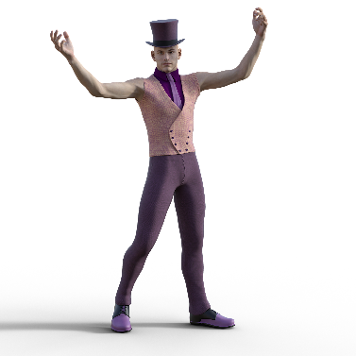
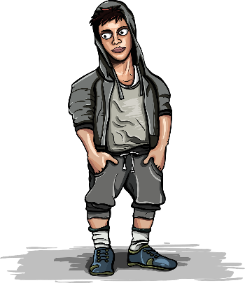
Des virelangues !
écouter / parler
Le lycéen flamboyant aime le rythme de l’hymne calypso.
[The flamboyant sixth-former likes the rhythm of the calypso carol.]
Le voyou moyen doit nettoyer les pylônes du royaume.
[The average hooligan has to clean the pylons of the kingdom.]
Notes:
Slide 2/2
Transcript:
Le lycéen flamboyant aime le rythme de l’hymne calypso.
Le voyou moyen doit nettoyer les pylônes du royaume.
Word frequency of unknown words used (1 is the most frequent word in French):
lycéen [>5000], hymne [4862], voyou [>5000], moyen [186], nettoyer [3887], royaume [2620]
Word frequency of cognates used (1 is the most frequent word in French):
flamboyant [>5000], rythme [1662], calypso [>5000], pylône [>5000]
Source: Lonsdale, D., & Le Bras, Y. (2009). A Frequency Dictionary of French: Core vocabulary for learners London: Routledge.

Slide 31
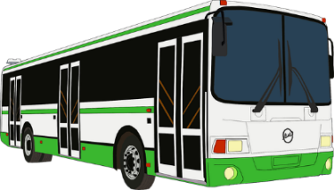
Vocabulaire
écrire
A
B
C
D
[you (pl/fml) say]
E
F
G
H
I
J
K
school (adj)
Notes:
Timing: 4 minutes [2 slides]
Aim: Written production of the new vocabulary items in this week’s set within a limited time frame.
Procedure:
1. Write A-L in books.
2. Click / press enter to flash a picture. It will disappear after 3 seconds.
3. Write down the French word before the picture has faded away. 4. Ensure that gender/definite articles are known for any words that are nouns.
5. Check answers on the next slide.
Answers:
a. vous dites
b. l’autobus (m)/le bus
c. conduire
d. le lieu
e. chaud
f. l’arbre
g. la neige
h. froid
i. scolaire
j. inscrire
k. interdire

Slide 32
Vocabulaire
écrire
vous dites
l’autobus (m)
conduire
le lieu
l’arbre (m)
chaud
la neige
froid
scolaire
inscrire
interdire
Notes:
Answers to the activity on the previous slide.

Slide 33
Vocabulaire
parler
La [?] est comment ?
La neige est froide.
Notes:
Timing: 4 minutes for 8 slides.
Aim: spoken recall of new vocabulary in longer contexts.
Procedure:
1. Students read the questions and answer in short phrases using the picture prompts.
2. Answers revealed on clicks.

Slide 34
Vocabulaire
parler
C’est quoi ?
C’est le bus scolaire / l’autobus scolaire.

Slide 35
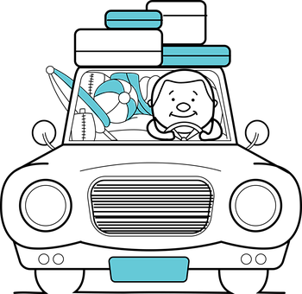
Vocabulaire
parler
Nous allons faire quoi ?
Nous allons conduire.

Slide 36
Vocabulaire
parler
Le [?] est où ?
Le lieu est en bas de la montagne.

Slide 37
Vocabulaire
parler
On doit faire quoi ?
On doit inscrire la réponse.

Slide 38
Vocabulaire
parler
Qui dit quoi ?
[pl/fml]
Vous dites qu’il fait chaud.

Slide 39
Vocabulaire
parler
Le prof veut faire quoi ?
Le prof veut interdire des portables.

Slide 40
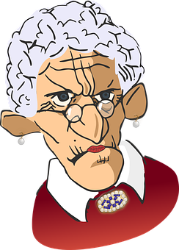
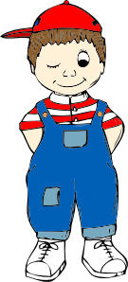
Vocabulaire
parler
L’ [?] est comment ?
L’arbre est grand et vieux.

Slide 41
Verbs like écrire in the plural
grammaire
Verbs like dire add a -v- to the stem in the plural forms:
écrire – to write
j’écris tu écris il/elle écrit
nous écrivons vous écrivez ils/elles écrivent
The -v- is pronounced.
décrire and inscrire also follow
this pattern.
Notes:
Timing: 2 minutes
Aim: To introduce the nous, vous and ils/elles forms of verbs like écrire.
Procedure: 1. Cycle through the information on the slide using the animation sequence.
2. Pay particular attention to the change in pronunciation (SFC to pronounced consonant) in the plural forms.

Slide 42
Océane écrit à ses amis
Lis le texte et remplis les blancs.
Choisis ‘nous’, ‘vous’ ou ‘ils’.
lire
Salut !
Nous dépendons de vous ! Nous écrivons un texte en italien. C’est difficile ! Je veux avoir de meilleurs notes que les garçons ! Ils écrivent très bien en italien. Nous inscrivons les mots dans un cahier, mais ils inscrivent plus de vocabulaire que nous. Ils décrivent les choses avec de nouveaux mots. Vous décrivez souvent les voyages scolaires en italien. Si vous écrivez un message et vous inscrivez des phrases utiles* en italien, c’est parfait* !
À bientôt alors !
Océane
1
2
3
4
5
6
7
8
*utile = useful
*parfait = perfect
Notes:
Timing: 8 minutes [2 slides]
Aim: Written recognition of plural forms of verbs like écrire and connecting these with meaning (sentence subject).
Procedure:
1. Students read the text and choose nous, vous or ils.
2. Click to reveal answers.
3. Move to the next slide. Students tick who does each activity in the table.
4. Click to reveal answers.
Word frequency of unknown words used (1 is the most frequent word in French): utile [1003], parfait [1600]
Source: Londsale, D., & Le Bras, Y. (2009). A Frequency Dictionary of French: Core vocabulary for learners London: Routledge.

Slide 43
Océane écrit
lire
Qui fait quoi ?
activité | Océane et ses amies | les garçons | Amir et ses amis
write a text in Italian
write very well in Italian
write words down in an exercise book
write down more vocabulary
describe things with new words
often describe school trips in Italian
write a message
write down useful phrases in Italian
Notes:
Follow-up exercise to the activity on the previous slide.

Slide 44
Prononciation
écouter / parler
Nous écrivons une histoire.
We are writing a story.
Notes:
Timing: 1 minute for 4 slides
Aim: To demonstrate pronunciation of the plural forms of verbs like écrire.
Procedure:
1. Listen and repeat.
2. Ask students to translate the sentence.
3. Reveal English translation on click.
Transcript:
Nous écrivons une histoire.

Slide 45
Prononciation
écouter / parler
Vous écrivez une lettre.
You (pl/fml) are writing a letter.
Notes:
Transcript:
Vous écrivez une lettre.

Slide 46
Prononciation
écouter / parler
Elles écrivent un message.
They are writing a message.
Notes:
Transcript:
Elles écrivent un message.

Slide 47
Qui fait quoi ?
écouter
1
2
3
4
5
6
7
8
9
1
4
7
2
5
9
3
6
8
nous
vous
elles
Notes:
Timing: 4 minutes
Aim: To practise distinguishing aurally between the plural forms of verbs like écrire.
Procedure:
1. Click on the audio buttons to play sentences with the pronouns obscured.
2. Students listen and point at the circle which they think represents the sentence subject.
3. Click to highlight the right answer and bring up full audio button.
4. Students listen again and translate the sentence orally.
Transcript:
[Nous] décrivons la situation.
[Vous] écrivez une histoire.
[Elles] décrivent le lieu.
[Nous] inscrivons les noms.
[Vous] inscrivez la date.
[Elles] écrivent à une amie.
[Nous] écrivons un article.
[Elles] inscrivent les réponses.
[Vous] décrivez le voyage.

Slide 48
Le professeur parle
écouter
Le professeur donne encore des instructions ! Que dit-il ?
Il parle des moniteurs de ski (ils), des profs (nous) ou des élèves (vous) ?
 |  | qui ? (pronom)
 | Les moniteurs de ski décrivent les pistes. | ils | nous
 | Vous inscrivez toutes les informations dans un cahier. | nous | vous
 | Les moniteurs de ski inscrivent les noms des bons élèves sur une liste. | nous | ils
 | Nous écrivons aux familles des bons élèves. | ils | nous
 | Vous écrivez de petits articles pour le magazine du collège. | nous | vous
 | S’il y a un problème, vous décrivez ça bien aux professeurs. | vous | ils
 | Nous inscrivons les problèmes pour l’hôtel. | ils | nous
 | Puis, nous décrivons les solutions à tout le groupe. | nous | vous
1
2
3
4
5
6
7
8
Notes:
Timing: 8 minutes
Aim: To practise distinguishing aurally between the plural forms of verbs like écrire.
Procedure:
1. Click on the audio buttons to play the sentences with the pronouns obscured.
2. Students listen and circle the appropriate pronoun according to the verb form heard.
3. Click to show the correct pronoun and play the full audio (including the pronoun).
4. On the second listen, students write what the subject is doing in English. If helpful, written transcripts of the full audio appear on clicks.
5. Check answers using pictorial representations of the activities which appear on a second round of clicks.
Transcript: [audio currently missing – recording in progress]
[Les moniteurs de ski] décrivent les pistes.
[Vous] inscrivez toutes les informations dans un cahier.
[Les moniteurs de ski] inscrivent les noms des bons élèves sur une liste.
[Nous] écrivons aux familles des bons élèves.
[Vous] écrivez de petits articles pour le magazine du collège.
S’il y a un problème, [vous] décrivez ça bien aux professeurs.
[Nous] inscrivons les problèmes pour l’hôtel.
Puis, [nous] décrivons les solutions à tout le groupe.
Word frequency of unknown words and cognates used (1 is the most frequent word in French):
instruction [1632], magazine [2033]
Source: Londsale, D., & Le Bras, Y. (2009). A Frequency Dictionary of French: Core vocabulary for learners London: Routledge.

Slide 49
Une interview avec une écrivaine
l’écrivaine = writer (f.)
écrire
Tu travailles pour un magazine anglais et tu interviewes une écrivaine française !
Lis les notes et écris des questions appropriées. Tu dois demander quoi ?
Find out:
1. how many stories she is writing
2. how we are going to describe the stories
3. whether she writes novels
4. where she writes down ideas
5. whether the stories describe France
6. when we are writing a story together
Notes:
Timing: 5 minutes
Aim: Written of plural forms of verbs like écrire in questions.
Procedure:
1. Ensure students understand the context. Draw attention to the word family connection between écrire and the unknown noun écrivaine.
2. Ask which verb form (nous, vous or il/elles) is required to elicit each piece of information.
3. Check students know which pieces of information require yes/no questions, and which require information questions. Recap the structure of each question type and the question words if necessary.
4. Students write questions in French. Encourage them to write three inversion questions and three intonation questions.
5. Suggested answers appear on the following slide.
Word frequency of unknown words used (1 is the most frequent word in French): écrivain [1738]
Source: Londsale, D., & Le Bras, Y. (2009). A Frequency Dictionary of French: Core vocabulary for learners London: Routledge.
Word frequency of cognates used (1 is the most frequent word in French): magazine [2033], interviewer [>5000], approprié [3591]
Source: Londsale, D., & Le Bras, Y. (2009). A Frequency Dictionary of French: Core vocabulary for learners London: Routledge.

Slide 50
Réponses
l’écrivaine = writer (f.)
écrire
1. how many stories is she writing
2. how we are going to describe the stories
3. whether she writes novels
4. where she writes down ideas
5. whether the stories describe France
6. when we are writing a story together
Vous écrivez combien d’histoires ? Combien d’histoires écrivez-vous ?
2. Nous décrivons les histoires comment ? Comment décrivons-nous les histoires ?
3. (Est-ce que) vous écrivez des romans ? Écrivez-vous des romans ?
4. Vous écrivez des idées où ? Où écrivez-vous des idées ?
5. (Est-ce que) les histoires décrivent la France ? Les histoires décrivent-elles la France ?
6. Nous écrivons ensemble une histoire quand ? Quand écrivons-nous ensemble une histoire ?
Notes:
Suggested answers to exercise on the previous slide.
NB: est-ce que questions with question words are possible alternatives to 2., 3. and 6.

Slide 51
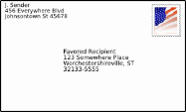
On parle ! (Exemple)
parler / écouter
Partner A:
Say ONLY the words in bold in French. Don’t say the pronoun or noun.
Your partner will say the noun in French.
A. [We] often read … [letters].
… lisons souvent …
Partner B:
Listen carefully to what your partner says.
Choose the correct picture and say
the word (noun) that completes the sentence!
… des lettres !
A
Notes:
Timing: 8 minutes [5 slides]
Aim: Oral production and aural recognition of plural forms of verbs like dire and écrire.
Procedure:
1. Use this slide to model the activity.
2. Print and distribute the role cards on slide 45.
3. Partner A reads the words in bold from a sentence on this slide. The pronoun is omitted from what is said, in order to focus Partner B’s attention on the verb ending. The noun is omitted so that Partner B can identify this by association with the person as depicted on his/her card (next slide).
4. Partner B determines what the missing noun at the end of the sentence is, by looking at the pictures on his/her card (next slide). Partner A affirms/corrects as necessary.

Slide 52
Partenaire A
Partenaire B
Say ONLY the words in bold in French.
Don’t say the pronoun or noun.
Your partner will say the noun in French.
A. [We] often write … [messages].
B. [She] is saying ... [hello].
C. [You (singular)] sometimes
translate ... [into English].
D. [They(f.pl.)] are describing ... [the weather].
E. [You (plural)] now read ... [books].
F. [I] am writing ... [letters].
Say ONLY the words in bold in French.
Don’t say the pronoun or noun.
Your partner will say the noun in French.
A. [You (plural)] now translate … [books].
B. [He] writes well... [in Spanish].
C. [You (singular)] are describing... [the sun].
D. [We] are reading ... [messages].
E. [I] am writing ... [in my exercise book].
F. [They (m.pl.] are saying ... [goodbye].
Notes:
Partner A 1&2 cards – do not display during the activity.

Slide 53
Partenaire B
parler / écouter
Listen carefully to what partner A says. Choose the correct picture and say the word (noun) that completes the sentence!
A
C
E
@
[vous]
[tu]
[tu]
@
[nous]
[vous]
[ils]
B
Bonjour !
D
F
[elle]
[il]
[je]
Au revoir !
[ils]
[elles]
[the weather]
[elles]
Notes:
Display this slide when partner A is speaking.

Slide 54
Partenaire A
parler / écouter
Listen carefully to what partner B says. Choose the correct picture and say the word (noun) that completes the sentence!
A
C
E
[tu]
[tu]
[je]
[vous]
[vous]
[elles]
B
D
F
@
Au revoir !
[ils]
[nous]
[ils]
Bonjour !
[il]
[ils]
[elle]
Notes:
Display this slide when partner B is speaking.

Slide 55
On parle ! (réponses)
parler / écouter
Partner A:
Nous écrivons souvent des messages.
Elle dit bonjour.
Tu traduis parfois en anglais.
Elles décrivent le temps.
Vous lisez maintenent des livres.
J’écris des lettres.
Partenaire B:
Vous traduisez maintenant des livres.
Il écrit bien en espagnol.
Tu décris le soleil.
Nous lisons des messages.
J’écris dans mon cahier.
Ils disent au revoir.
Notes:
Answers

Slide 56
Gaming Grammar
Gaming Grammar
Relevant mini game(s):
Verbs (present): 1st person singular/plural (Verb agreement (present))
Verbs (present): 2nd person singular/plural (Verb agreement (present))
Verbs (present): 3rd person singular/plural (Verb agreement (present))
Questions: subject-verb inversion (Question formation)
Notes:
This slide links to Gaming Grammar login screen. The appropriate mission can then be selected from the menu page.
Students will progress through the game at their own rate; teachers should use the teacher interface to check progress. This will help to inform future lesson planning.

Slide 57
Devoirs
Vocabulary Learning Homework (Y8, Term 3.2, Week 2)
Quizlet link: Y8 Term 3.2 Week 2 (Y7 Mashup 5)
Quizlet QR code:
Notes:
Use this slide to set the homework.

