Slide 1
Describing others
Adjective agreement – R2 (accusative)
SSC [R]
Y8 German
Term 1 - Week 6 - Lesson 11
Author name(s): Inge Alferink / Rachel Hawkes
Artwork: Steve Clarke
Date updated: 21/07/21
Notes:
Learning outcomes (lesson 1):
Introduction of SSC [r]
Introduction of adjective agreement with singular indefinite articles in R2 (accusative case).
Word frequency (1 is the most frequent word in German):
8.1.1.6 (introduce) verbringen [1391] Auge [222] Gesicht [346] Haar [748] Mund [856] Nase [1264] Schüler [557] Zeit [96] ähnlich [437] breit [847] dünn [1739] neu [84] rund [298] als [22]
8.1.1.2 (revisit) gegessen [323] gelegen [118] gesprochen [161] geschrieben [184] gesungen [1063] getroffen [259] getrunken [634] treffen [259] Frankreich [813] Sommer [771] Spanien [1745] bisher [441] welcher, welche, welches [122]
7.3.1.4 (revisit) Bruder [687] Eltern [351] Geschwister [3090] Kind [106] Schauspieler [2202] Schwester [776] mein1 [53] dein1 [225] ihr1[26] sein [36] über1 [48]

Slide 2
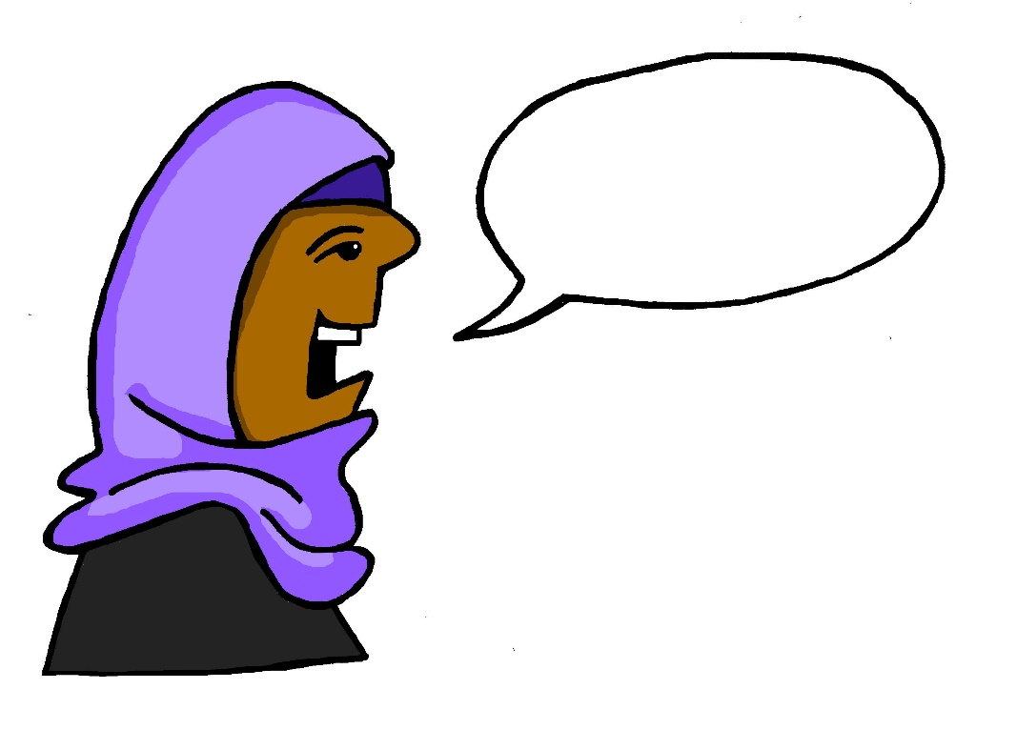
r
reden
Notes:
Timing: 1 minute
Aim: To introduce/consolidate SSC [r]
Procedure: 1. Present the letter(s) and say the [r] sound first, on its own. Students repeat it with you. 2. Bring up the word ”reden” on its own, say it, students repeat it, so that they have the opportunity to focus all of their attention on the connection between the written word and its sound.
3. A possible gesture for this would be to mime talking between your right hand and your left hand.
4. Roll back the animations and work through 1-3 again, but this time, dropping your voice completely to listen carefully to the students saying the [r] sound, pronouncing ”reden” and, if using, doing the gesture. Word frequency (1 is the most frequent word in German): reden [356]
Source: Jones, R.L. & Tschirner, E. (2006). A frequency dictionary of German: core vocabulary for learners. Routledge

Slide 3
r
Uhr
Notes:
Timing: 1 minute
Aim: To introduce/consolidate SSC [r]
Procedure: 1. Present the letter(s) and say the [r] sound first, on its own. Students repeat it with you. 2. Bring up the word ”Uhr” on its own, say it, students repeat it, so that they have the opportunity to focus all of their attention on the connection between the written word and its sound.
3. A possible gesture for this would be to look at your left wrist and tap your imaginary watch twice, to emphasise the two distinct sounds you hear – Uh-r.
4. Roll back the animations and work through 1-3 again, but this time, dropping your voice completely to listen carefully to the students saying the [r] sound, pronouncing ”Uhr” and, if using, doing the gesture. Word frequency (1 is the most frequent word in German): Uhr [349] Source: Jones, R.L. & Tschirner, E. (2006). A frequency dictionary of German: core vocabulary for learners. Routledge

Slide 4
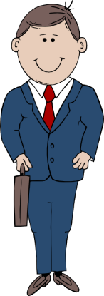
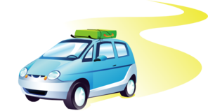
r
Regel
rot
reden
warum?
Beruf
Reise
Notes:
Timing: 2 minutes
Aim: To introduce/consolidate SSC [r]
Procedure:
Introduce and elicit the pronunciation of the individual SSC [r] and then the source word again ‘reden’ (with gesture, if using).
Then present and elicit the pronunciation of the five cluster words.
The cluster words have been chosen for their high-frequency, from a range of word classes, with the SSC (where possible) positioned within a variety of syllables within the words (e.g. initial, 2nd, final etc.). Additionally, we have tried to use words that build cumulatively on previously taught SSCs (see the Phonics Teaching Sequence document) and do not include new SSCs. Where new SSCs are used, they are often consonants which have a similar symbol-sound correspondence in English.
Word frequency (1 is the most frequent word in German): reden [356]; Regel [484] rot[381]; warum? [246]; Reise [786]; Beruf [477 Source: Jones, R.L. & Tschirner, E. (2006). A frequency dictionary of German: core vocabulary for learners. Routledge

Slide 5
r
Regel
rot
reden
warum?
Beruf
Reise
Notes:
With sound and no pictures to focus all attention on the sound-symbol correspondence.

Slide 6
r
Regel
rot
reden
warum?
Beruf
Reise
Notes:
Without sound to elicit pronunciation (without first hearing the teacher).
Teacher to elicit pronunciation by asking “Wie sagt man…”

Slide 7
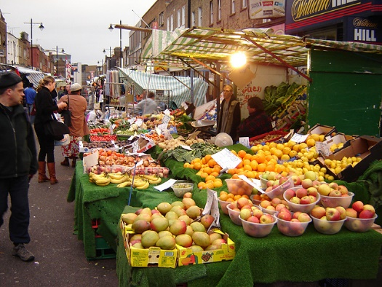
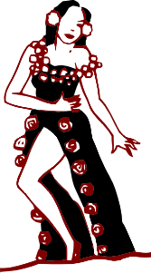
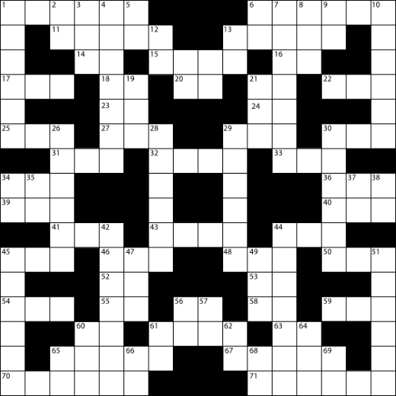
r
Markt
Morgen
Uhr
By Tarquin Binary - Own work, CC BY-SA 2.5
Kultur
Wort
dort
W O R T
Notes:
Timing: 2 minutes
Aim: To introduce/consolidate SSC [r]
Procedure:
Introduce and elicit the pronunciation of the individual SSC [r] and then the source word again ‘uhr’ (with gesture, if using).
Then present and elicit the pronunciation of the five cluster words.
The cluster words have been chosen for their high-frequency, from a range of word classes, with the SSC (where possible) positioned within a variety of syllables within the words (e.g. initial, 2nd, final etc.). Additionally, we have tried to use words that build cumulatively on previously taught SSCs (see the Phonics Teaching Sequence document) and do not include new SSCs. Where new SSCs are used, they are often consonants which have a similar symbol-sound correspondence in English.
Word frequency (1 is the most frequent word in German): Uhr [349]; Markt [508] Morgen [311]; Kultur [593]; dort [104]; Wort [243]. Source: Jones, R.L. & Tschirner, E. (2006). A frequency dictionary of German: core vocabulary for learners. Routledge

Slide 8
r
Markt
Morgen
Uhr
Kultur
Wort
dort
Notes:
With sound and no pictures to focus all attention on the sound-symbol correspondence.

Slide 9
r
Markt
Morgen
Uhr
Kultur
Wort
dort
Notes:
Without sound to elicit pronunciation (without first hearing the teacher).
Teacher to elicit pronunciation by asking “Wie sagt man…”

Slide 10
Phonetik
hören / schreiben
Wie oft hörst du [r]?
1
Ihre Schwester trägt einen roten Rock.
////
2
Sein großer Bruder reist nach Rom.
//// /
3
Deine Eltern fahren immer über die Brücke.
////
4
Das traurige Kind erlebt die Kultur.
////
5
Wir verbringen eine schöne Zeit in Frankfurt.
////
Notes:
Timing: 4 minutes Aim: Listening for and noticing the SSC [r] in a sentence context. Procedure: 1. Click on a number to hear the sentence. Click on the number again to repeat if necessary.
2. Write down how many Rs you hear in each sentence.
3. Click to see the sentence and check the answer.
4. Check understanding of sentences.
Transcript: 1. Ihre Schwester trägt einen roten Rock.
2. Sein großer Bruder reist nach Rom.
3. Deine Eltern fahren immer über die Brücke.
4. Das traurige Kind erlebt die Kultur.
5. Wir verbringen eine schöne Zeit in Frankfurt.

Slide 11
Phonetik
lesen / sprechen
reden
Tier
30
schreiben
lernen
oder
Wort
Eltern
Lehrerin
Schwester
reisen
Morgen
Farbe
Sekunden
Problem
fahren
Frage
Markt
Bruder
Frau
rund
leider
Kultur
Straße
rot
groß
0
aber
Herr
LOS!
Grund
Notes:
Timing: 1 minute Aim: To automatize pronunciation of the SSC [r] by saying words containing the SSC in a speeded fashion. All the words are known. Procedure: 1. Say a many of these words out loud in 30 seconds
2. Click on Los! to start the timer.

Slide 12
verbringen
[to spend (time)| spending (time)]
verbringt
[spends (time)| is spending time]
Notes:
Timing: 3 minutes for sequence of six verbs
Aim:
Procedure
Bring up the word [verbringen] on its own, say it, students repeat it, and remind them of the phonics. Draw attention to [r] and [v]
Try to elicit the meaning from the students. Students have had explicit teaching that the present tense in German communicates two different present tense meanings in English. This reinforces that learning. Emphasise the two meanings for the short form, reminding students that German only has one form and does not have a direct equivalent of the grammar for ‘is + ing’, the continuous form (as covered in previous weeks).
Bring up the English translations. Emphasise the two meanings for the infinitive.
Bring up the short form [verbringt], say it, students repeat it. Draw attention to [r] and [v].
Try to elicit the meaning from the students. Emphasise the two meanings for the short form.

Slide 13
verbringen
[to spend (time) | spending (time)]
verbringt
[spends (time) | is spending (time)]
Notes:
Cycle through the long and short form again.

Slide 14
verbringt
[spends (time)| is spending (time)]
Sie verbringt ein Jahr in Berlin.
[She spends | is spending a year in Berlin.]
Notes:
Introduce the short form in a sentence.

Slide 15
verbringen
[to spend (time) | spending (time)]
Er will Zeit in Rom verbringen.
[He wants to spend time in Rome.]
Notes:
Introduce the long form in a sentence.

Slide 16
verbringt
[spends (time) | is spending (time)]
Sie _________ ein Jahr in Berlin.
verbringt
[She spends | is spending a year in Berlin.]
Notes:
Cycle through the short form in context again.

Slide 17
verbringen
[to spend (time) | spending (time)]
verbringen
Er will zeit in Rom ___________.
[He wants to spend time in Rome.]
Notes:
Cycle through the long form in context again.

Slide 18
Vokabeln
mouth
Auge
Gesicht
A
similar
C
3
B
1
2
Haar
pupil
round
new
5
Schüler
as
face
E
nose
6
thin
D
F
wide
4
pupil
hair
Mund
Nase
similar
mouth
eye
face
hair
nose
als
Nase
rund
Mund
breit
neu
Auge
Gesicht
Haar
dünn
7
Schüler
8
ähnlich
G
eye
I
ähnlich
breit
dünn
wide
H
new
9
10
12
round
L
neu
11
thin
rund
als
as
J
K
Notes:
Timing: 5 minutes
Aim: This memory game checks students’ understanding of the meaning of this week’s vocabulary.
Procedure:
First, the words are practised receptively. Students volunteer a letter and number (in German), and try to find a matching pair.
Click on the letter and number chosen to reveal a German and English word.
Read both words out loud, and checks understanding by asking ‘Ist das ein Paar?’ This could be done in teams to add an element of competition.
If it isn’t a match, click on the words again to hide them
Once all the cards are revealed, a scaffolded production exercise can be attempted. On a click, English words appear one by one in the centre.
Students look at the German cards and try to recall the equivalent.
Students say their answer out loud.
Answer revealed on a click.
Click to reveal another English word.
NB: For more of a challenge, or at the beginning of lesson 2, steps 4-7 could be carried out as a writing exercise with the cards from the first activity hidden for more of a challenge. Mini whiteboards held up by students can be used to check spelling.
Word frequency (1 is the most frequent word in German): verbringen [1391] Auge [222] Gesicht [346] Haar [748] Mund [856] Nase [1264] Schüler [557] Zeit [96] ähnlich [437] breit [847] dünn [1739] neu [84] rund [298] als [22]
Source: Jones, R.L. & Tschirner, E. (2006). A frequency dictionary of German: core vocabulary for learners. Routledge
Answers
1H Auge / eye
2D Gesicht / face
3E Haar / hair
4A Mund / mouth
5F Nase / nose
6C Schüler / pupil
7B ähnlich / similar
8G breit / wide
9L dünn /thin
10I neu / new
11K rund / round
12J als / as

Slide 19
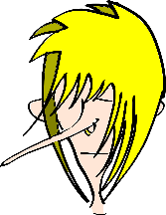
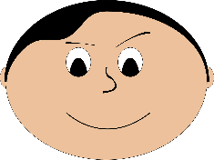
Adjektiven – indefinite articles
Grammatik
Remember, R1 adjectives after the indefinite article ‘ein’ (and‘kein’) have these endings:
Only the masculine ending is different in R2!
R2 (accusative) singular endings for indefinite articles also have the same final letter as their matching definite articles.
R1
Ein kleiner Mund ist schön.
Das ist eine lange Nase.
Ein rundes Gesicht ist langweilig.
! We often use the plural without an article. Notice how the ending changes
Meine Oma hat ein rundes Gesicht.
Seine Schwester hat einen kleinen Mund.
Ihr Bruder hat eine lange Nase.
R2
Adjectives for R2 have these endings:
den Mund
die Nase
das Gesicht
R2 plural
Ich habe keine grünen Augen.
Ich habe grüne Augen.
Notes:
Timing: 5 minutes Aim: Explaning the use of indefinite articles and adjectives in R2 (accusative) Procedure: 1. Use the animated sequence to work through the explanation and examples.
www.pixabay.com / www.publicdomainpictures.net

Slide 20
Grammatik
lesen
Andrea findet Adjektivendungen schwierig! Kannst du helfen? Ist es einen, eine oder ein?
 | Sie hat | einen | eine | ein
1. | einen schönen Mund
2. | eine hässliche Tasche
3. | ein rundes Gesicht
4. | eine kleine Nase
5. | einen freundlichen Hund
6. | einen großen Hut
7. | ein neues Handy
8. | ein rotes Fahrrad
____
____
____
____
____
____
____
____
Notes:
Timing: 5 minutes Aim: To practice noticing the adjective endings and their relationship to the indefinite article and the noun. Procedure: 1. For each item say which article fits.
2. Click to check answers.

Slide 21
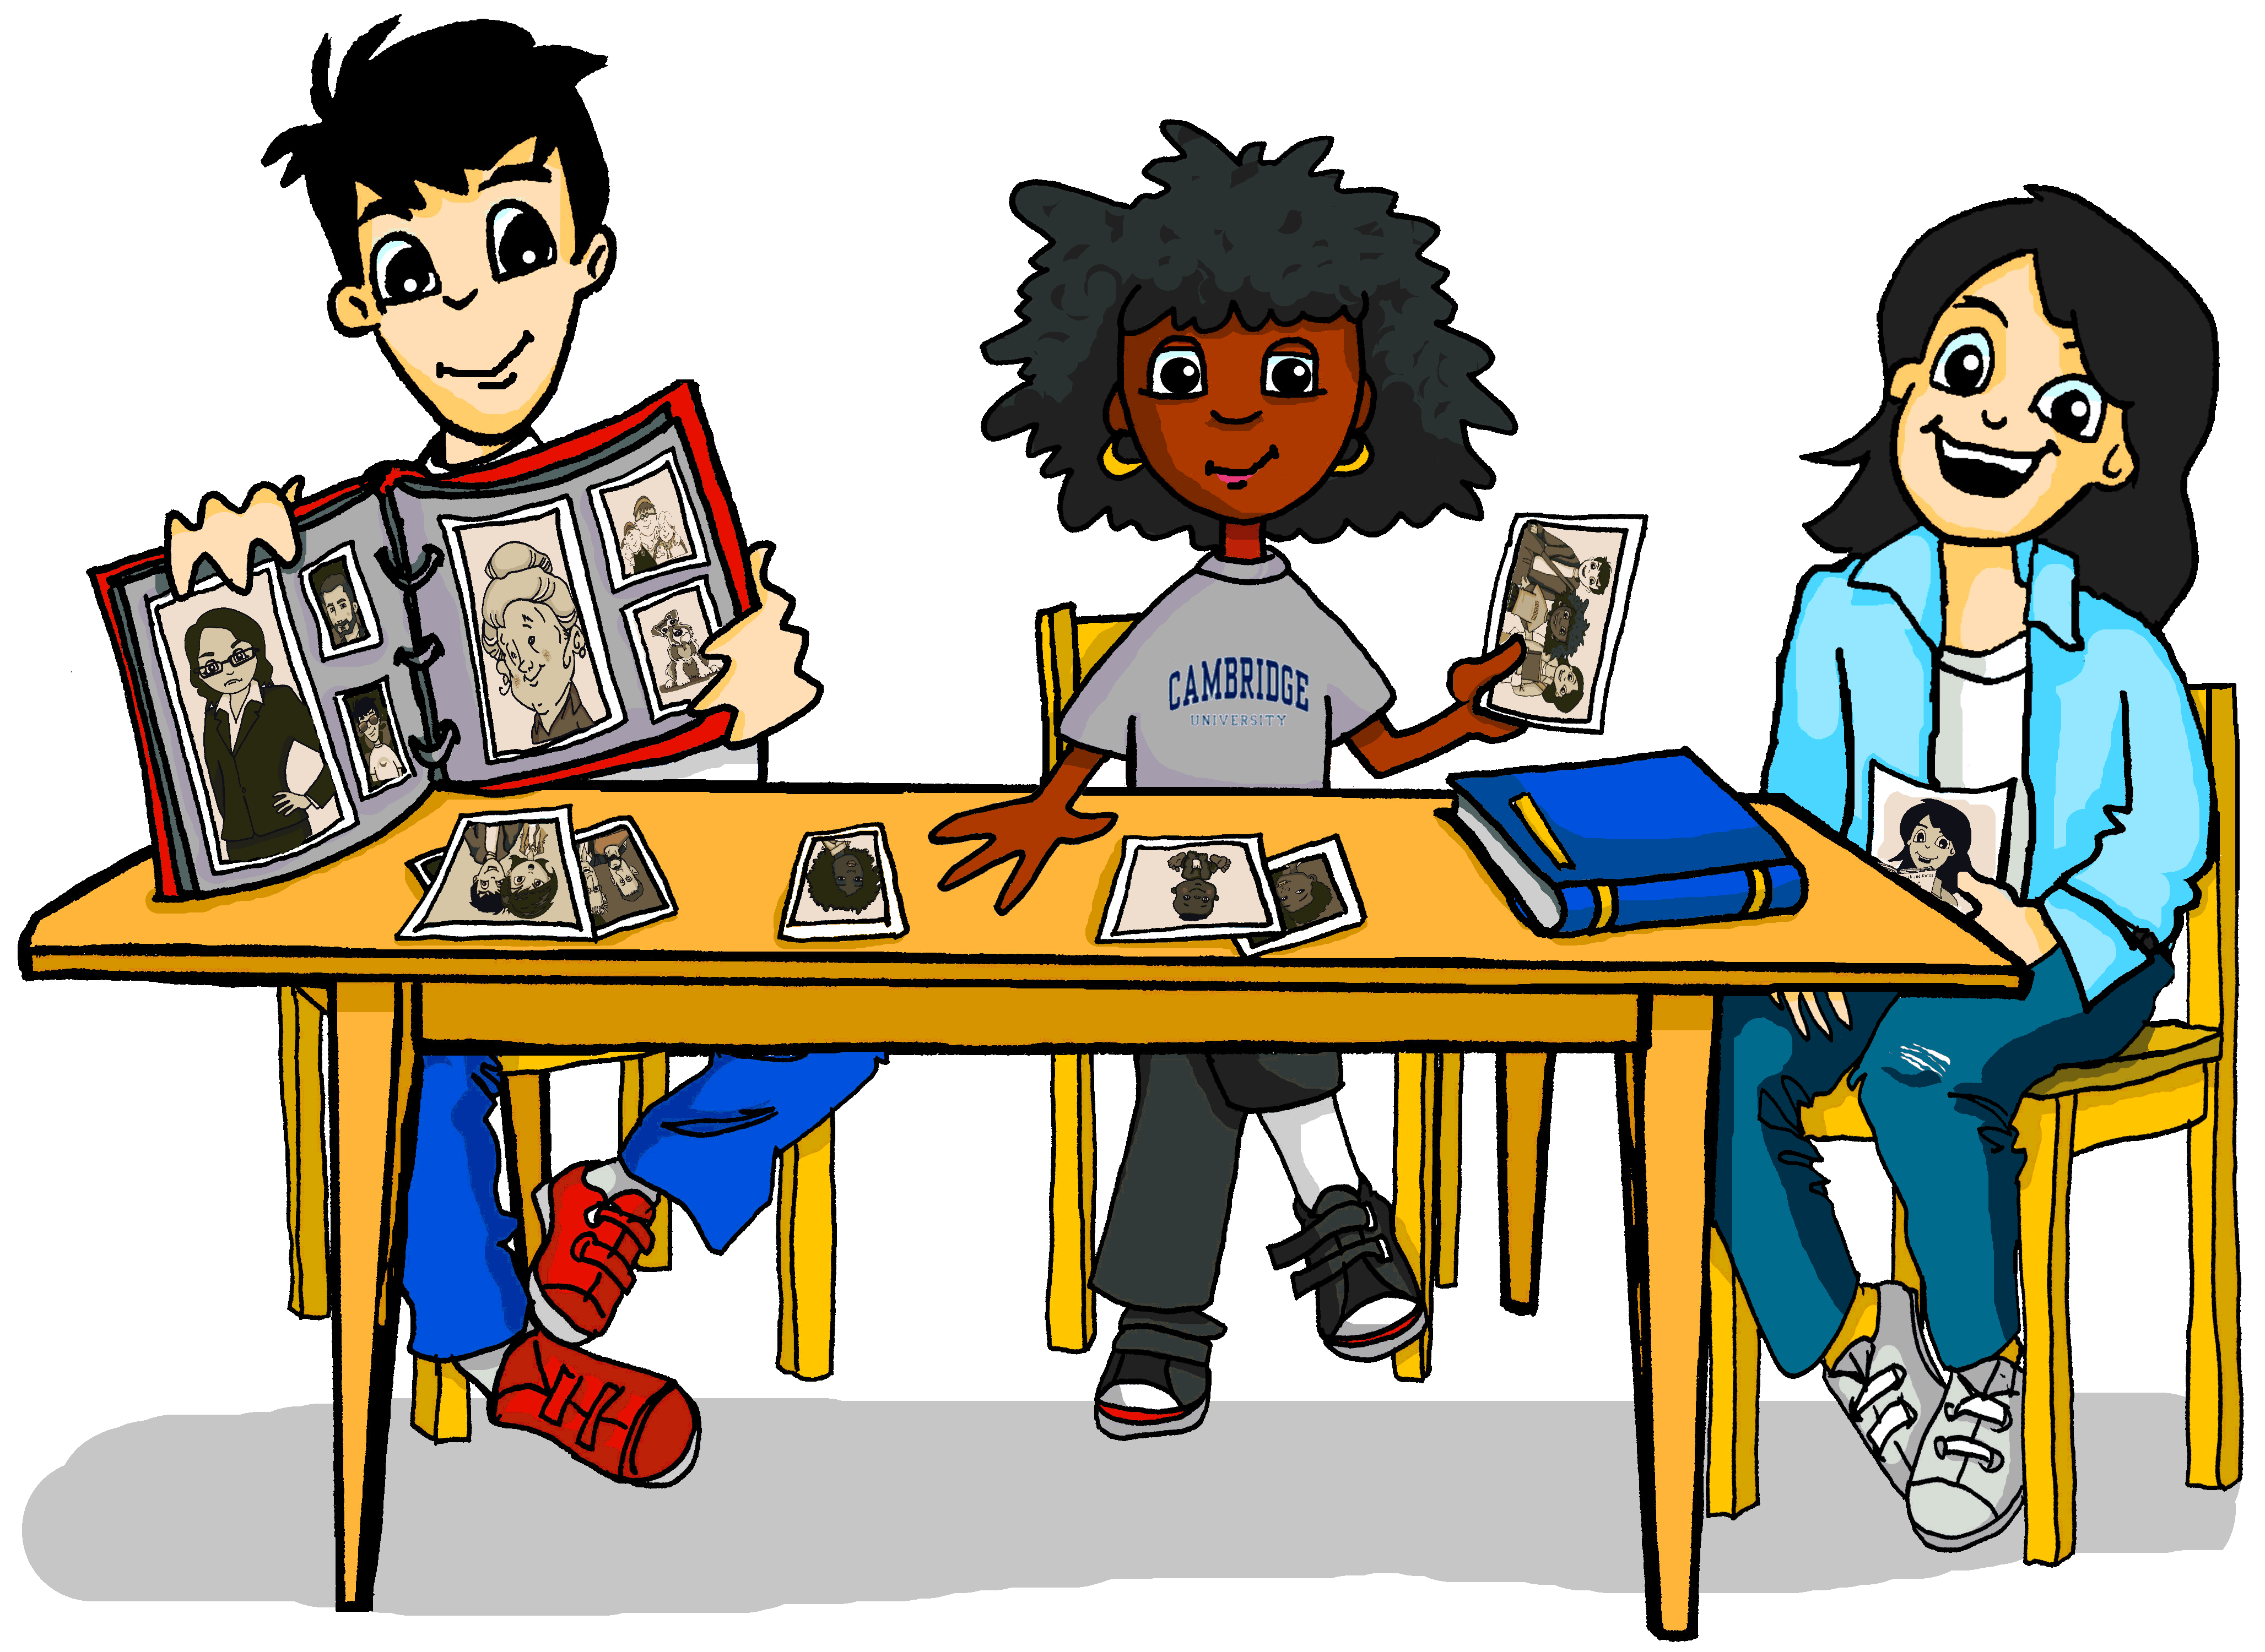
Grammatik
hören
Spelling difference: -el → -ler – dunkel → dunkle(r,s)
Mia redet über ihre Familie.
 | Meine Mutter hat schwarze
 | Sie hat eine dunkle
 | Sie hat eine kleine
 | Sie hat ein freundliches
 | Wir haben einen ähnlichen Mund
 | Meine Oma hat eine lange
 | Sie hat einen dünnen
 | Sie hat auch braune
1
2
3
4
5
6
7
8
Notes:
Timing: 5 minutes Aim: Referential listening activity to practise noticing articles and word endings. Procedure: 1. Click to reveal the first pair of pictures. Bringing up the sets of pictures one at a time avoid sensory overload and helps focus on each pair of options in turn. 2. Click on a number to play the sentence.
3. For each item select the picture that could complete the picture.
4. Click to reveal and check answers.
Transcript: 1. Meine Mutter hat schwarze [Haare / Jacke]
2. Sie hat eine dunkle [Augen / Hose]
3. Sie hat eine kleine [Nase / Mund]
4. Sie hat ein freundliches [Gesicht / Hund]
5. Wir haben einen ähnlichen [Mund / Nase]
6. Meine Oma hat ein lange [Nase / Haare]
7. Sie hat einen dünnen [Mund / Gesicht]
8. Sie hat auch braune [Augen / Hut] Word frequency (1 is the most frequent word in German): Source: Jones, R.L. & Tschirner, E. (2006). A frequency dictionary of German: core vocabulary for learners. Routledge

Slide 22
Wer bin ich?
sprechen
Person 1
Small mouth
Small face
Small nose
Small eyes
Small hat
Small child
Person 2
Small nose
Small eyes
Small face
Big hat
Small child
Small mouth
Person 3
Big face
Big hat
Big child
Big eyes
Big mouth
Big nose
Person 4
Small hat
Small face
Small eyes
Small nose
Big child
Small hat
Person 5
Big eyes
Small hat
Big face
Big mouth
Big nose
Big child
Person 6
Small child
Big mouth
Big nose
Big face
Big eyes
Big hat
Notes:
Timing: 5 minutes Aim: Practising using adjective and perfect tense in speech. Procedure: 1. Person A picks a card for person B. Person B then asks questions to find out who they are (e.g. Habe ich einen kleinen Mund?)
2. When person B has enough information they guess which card it is.
3. The activity repeats with roles swapped.

Slide 23
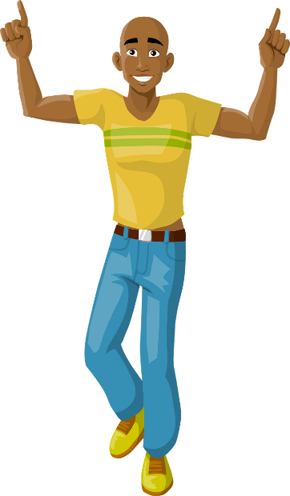
Ein Profil
schreiben
Schreib Profil 1, 2, oder 3.
Benutze alle Verben.
sein
tragen
haben
Beschreib: - die Kleidung - das Gesicht - die Haare - den Körper - den Charakter - die Laune*
Profil 1
1.
2.
3.
4.
5.
Profil 2
1.
2.
3.
4.
5.
Profil 3
1.
2.
3.
4.
5.
* die Laune - mood
Notes:
Timing: 5 minutes Aim: To practise writing using the new grammar. Procedure: 1. Pick one of the pictures and write a 5 sentence profile.
2. Use the verbs on the left at least once.

Slide 24
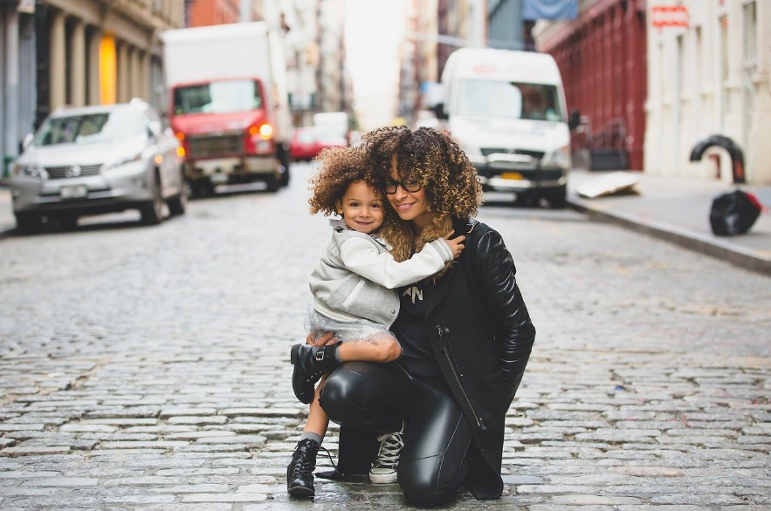
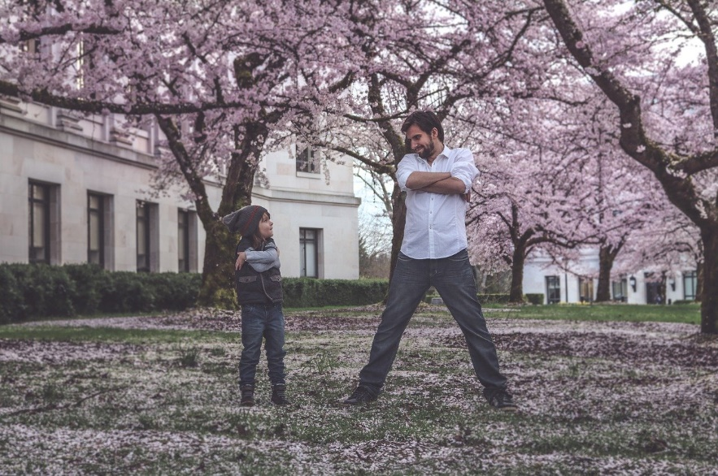
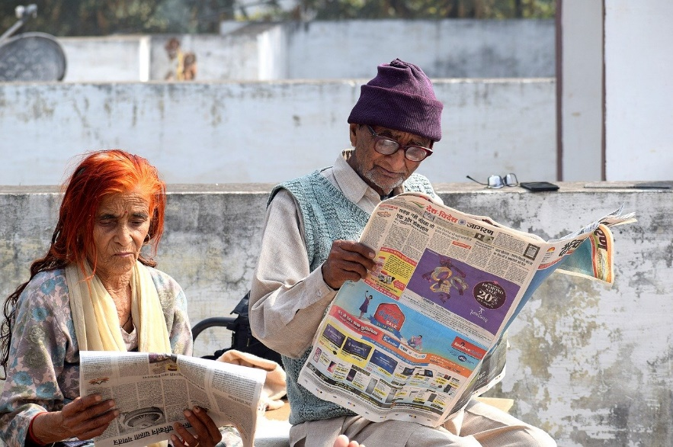
Ein Foto beschreiben
schreiben
Beschreib Foto 1, 2, oder 3.
1
2
3
Notes:
Timing: 5 minutes This could be an alternative, more challenging writing than the previous slide. Or it could be an extension task, or a homework task. Aim: To practise writing using the new grammar. Procedure: 1. Pick one of the pictures and write a 5 sentence description.

Slide 25
Describing others
Adjective agreement
SSC [r]
Y7 German
Term 1 - Week 6- Lesson 12
Author name(s): Inge Alferink / Rachel Hawkes
Artwork: Steve Clarke
Date updated: 21/07/21
Notes:
Learning outcomes (lesson 1):
Introduction of SSC [r]
Consolidation of adjective agreement with singular indefinite and definite articles in R1 (nominative) and R2 (accusative) cases.
Word frequency (1 is the most frequent word in German):
8.1.1.6 (introduce) verbringen [1391] Auge [222] Gesicht [346] Haar [748] Mund [856] Nase [1264] Schüler [557] Zeit [96] ähnlich [437] breit [847] dünn [1739] neu [84] rund [298] als [22]
8.1.1.2 (revisit) gegessen [323] gelegen [118] gesprochen [161] geschrieben [184] gesungen [1063] getroffen [259] getrunken [634] treffen [259] Frankreich [813] Sommer [771] Spanien [1745] bisher [441] welcher, welche, welches [122]
7.3.1.4 (revisit) Bruder [687] Eltern [351] Geschwister [3090] Kind [106] Schauspieler [2202] Schwester [776] mein1 [53] dein1 [225] ihr1[26] sein [36] über1 [48]

Slide 26
Phonetik: Was passt nicht in die Reihe?
hören
Welches Wort ist nicht wie die anderen Wörter?
1
Bruder / Schwester / Spiele
2
Schauspieler / Schule / Stunde
3
Partner / Sänger / Karte
4
Jede / nächster / diese
5
Welche / jeder / dieser
Notes:
Timing: 3 minutes Aim: To notice –e vs –er in a contrasting context. Procedure: 1. Click on a number to play a three-word sequence.
2. For each sequence say which one is the odd one out.
3. Click to check answers.
Transcript: 1. Bruder / Schwester / Spiele
2. Schauspieler / Schule / Stunde
3. Partner / Sänger / Karte
4. Jede / nächster / diese
5. Welche / jeder / dieser
Word frequency (1 is the most frequent word in German): Source: Jones, R.L. & Tschirner, E. (2006). A frequency dictionary of German: core vocabulary for learners. Routledge

Slide 27
English → German → English
Note that you don’t say ‘a’ with jobs.
To refer to a woman, add –in to the end of a noun.
She is a teacher.
Sie ist Lehrerin.
What would the following words be in German?
female friend / girlfriend
female pupil
female journalist female tourist Choose one and write a sentence in German.
Translate these sentences.
1. Die Ärztin ist nett.
2. Mia is my partner.
The letters ‘a’, ‘o’ and ‘u’ in the male form sometimes change to ‘ä’, ‘ö’ and ‘ü’
Notes:
Timing: 6 minutes Aim: To develop word knowledge, making links between the masculine and feminine forms of jobs / roles. Procedure: 1. Click through the animations to present the pattern.
2. Complete the short tasks.
3. Answers (with audio) are on the next slide.
Note: Students have already learnt Lehrer / Lehrerin, Freund/Freundin and Arzt/Schüler in Y7. They need to be told that Partner, Journalist and Tourist are cognates.
Word frequency of other words with this pattern (words in bold are included in the task): Freund [273] Kollege [440] Kunde [519] Präsident [546] Schüler [556] Lehrer [695] Patient [620] Arzt [622] Mitarbeiter [639] Autor [723] Künstler [789] Spieler [822] Chef [975] Sprecher [999] Trainer [1003] Student [1017] König [1087] Politiker [1140] Partner [1172] Forscher [1246] Nachbar [1283] Vertreter [1303] Tourist [1318] Experte [1437] Journalist [1480] Polizist [1433] Gegner [1532] Leser [1533] Bauer [1548] Bürgermeister [1600] Schauspieler [1704] Amerikaner [1741] Beamte [1806] Kanzler [1983] Manager [2174] Sportler [2565] Musiker [2577] Gastgeber [3008] Sänger [3029] Engländer [3903]
Source: Jones, R.L. & Tschirner, E. (2019). A frequency dictionary of German: core vocabulary for learners. Routledge
Note: This would combine well with the introduction of the plural rule for these feminine nouns, i.e. +-innen.

Slide 28
ANTWORTEN
1
Die Ärztin ist nett.
Mia is my partner.
female friend
female pupil
female journalist
female tourist
The doctor is nice.
Mia ist meine Partnerin.
die Freundin
die Schülerin
die Journalistin
die Touristin
2
3
4
5
6
What do you notice about the gender of these nouns?
der Schüler → die Schülerin
Don’t forget to pronounce the words.

Slide 29
Karaoke SSC
sprechen
Sag das deutsche Wort für jede Nummer.
6
Lehrerin
3
Schülerin
2
Partnerin
1
Sängerin
10
Kaiserin
4
Kanzlerin
5
Touristin
9
Sportlerin
8
Musikerin
7
Bankerin
Notes:
Timing: 5 minutes
Aim: Aural consolidation of SSC [r] with some known and some unfamiliar vocabulary. Several words pick up on the pronunciation difference between masculine role nouns and their feminine equivalents, which involves the SSC [r] within words. Pronunciation is very different from English, formed at the back of the throat without using the lips at all.
Procedure:
Click to highlight a word.
Say the word out loud, focusing on the SSC.
Click on the number button next to the word to check pronunciation.
Repeat as needed.
Transcript and word frequency (1 is the most frequent word in German):
1. Sängerin
2. Partnerin
3. Schülerin
4. Kanzlerin
5. Touristin
6. Lehrerin
7. Bankerin
8. Musikerin
9. Sportlerin
10. Kaiserin Word frequency (1 is the most frequent word in German): Source: Jones, R.L. & Tschirner, E. (2006). A frequency dictionary of German: core vocabulary for learners. Routledge

Slide 30
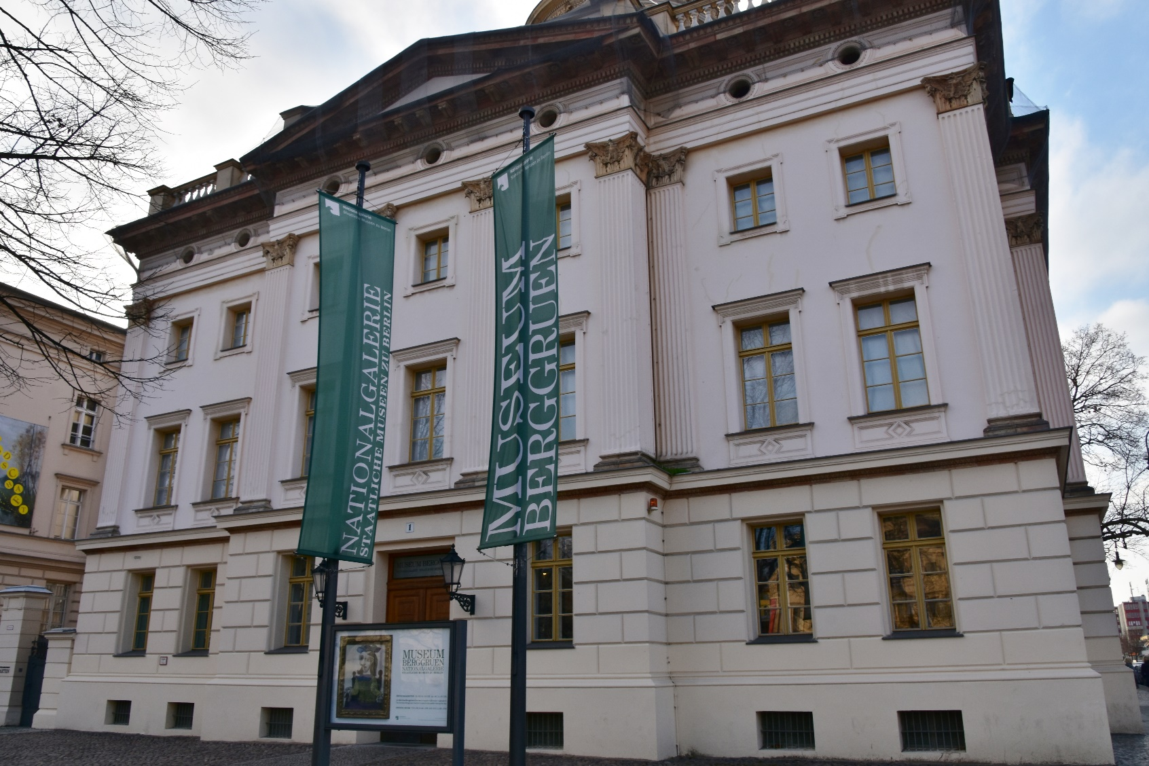
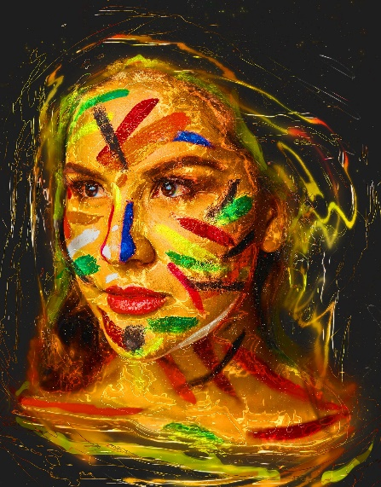
ein Museumsbesuch
lesen
Andrea hat in Berlin das Museum Berggruen besucht. Sie muss ein Kunstwerk* beschreiben.
*Kunstwerk = work of art
Notes:
Timing: 5 minutes (two slides) Aim: To apply new grammatical and vocabulary knowledge to the understanding of a short text. Procedure: 1. Use this slide to set the context. Ensure that the two sentences are understood, and draw attention to the compound noun title.
2. Number 1-8. Write the phrases that are missing.
3. Check answers.

Slide 31
ein Kunstwerk beschreiben
lesen
Leider hat Andrea ihre Notizen verloren*. Kannst du helfen? Schreib das richtig.
ein rotes
Es gibt eine Frau. Sie hat ein blaues Auge und ein rotes Auge. Sie hat auch einen grünen Mund und ihre Nase ist breit. Sie trägt einen vielfarbigen Hut. Ihr trauriges Gesicht ist grün und gelb und ihre langen Haare haben auch zwei Farben. Sie ist wirklich speziell!
breit
1._______
ein blaues
2.______
3._______
ihre langen
4._____
grün und gelb
5. ____________
6. ___________
ihr trauriges
7. ___________
8._______
einen vielfarbigen
einen grünen
verloren = lost
Notes:
Procedure cont’d:
2. Number 1-8. Write the phrases that are missing.
3. Check answers. Note: 1 and 2 are interchangeable.

Slide 32
Wer bin ich?
sprechen
1
2
3
4
Hat diese Person…?
Trägt diese Person…?
Ist er / sie Nummer [5]?
5
6
7
8
9
10
11
12
eine Brille – a pair of glasses
Notes:
Timing: 4 minutes per round Aim: To practise adjectives in the spoken modality. Procedure: 1. This is a version of Guess Who to be played in pairs.
2. Both players pick a person from the board.
3. Take turns asking each other questions until one of you arrives at the answer.
4. The game can be repeated.

Slide 33
Wolfgang redet mit Mia über die Ferien
hören und lesen
Mutti hat Recht*!
Letztes Jahr hast du viel im Sommerurlaub gemacht.
Du hast den tollen Wasserpark besucht! Du hast auch am Strand gespielt und im Café leckere Kekse gegessen. Und letzte Woche haben deine guten Freunde dich besucht. Wir haben zusammen einen neuen Film gesehen! Du hast auch im Theater ein schönes Lied gesungen! Und das große Schwimmbad macht immer Spaß.
Das ist bisher kein schlechter Urlaub!
Hör zu. Schreib 1 – 8. Schreib die Wörter.
1
5
Ist das R1 oder R2?
1.___________________
2
6
3
7
2.__________
4
8
3. __________
4._______
__
5._______
6._______
Ja, richtig! Vielleicht können wir nächstes Jahr Frankreich, Spanien, oder ein anderes Land besuchen!
__________
7. __________
8. ___________
__________
*Recht haben = to be right
Notes:
Timing: 8 minutes
Aim: To practise understanding of new language in the oral modality, segmentation and transcription. To then reflect on explicit knowledge of the new grammar in the written modality.
In terms of the storyline, Mia‘s mother‘s answer has reassured the twins, and they are now realising that they have not had such a bad time at home this summer!
Procedure
1. Click on the numbers to play the recording.
2. Write down the missing words. Note that there is always more than one missing word: (article) + adjective + noun. Students need to be able to segment stream of audio into these separate words in order to write them down accurately.
3. Click on the mouse to reveal and check answers.
4. Read the full text and decide for each gap whether the noun is R1 or R2 (Note that this stage can be omitted by removing the prompt.
5. Optional - Listen to the full recoding (click on the speech bubble). 6. Optional - Students can be asked to translate the text orally, if time.
Transcript
(Wolfgang)
Mutti hat Recht*!
Letztes Jahr hast du viel im Sommerurlaub gemacht.
Du hast den tollen Wasserpark besucht! Du hast auch am Strand gespielt und im Café leckere Kekse gegessen. Aber letzte Woche haben deine guten Freunden dich getroffen. Ihr habt zusammen einen neuen Film gesehen! Du hast auch im Theater ein schönes Lied gesungen! Und das große Schwimmbad macht immer Spaß.
Das ist bisher kein schlechter Urlaub!
(Mia)
Ja, richtig! Vielleicht können wir nächstes Jahr Frankreich, Spanien, oder ein anderes Land besuchen!

Slide 34
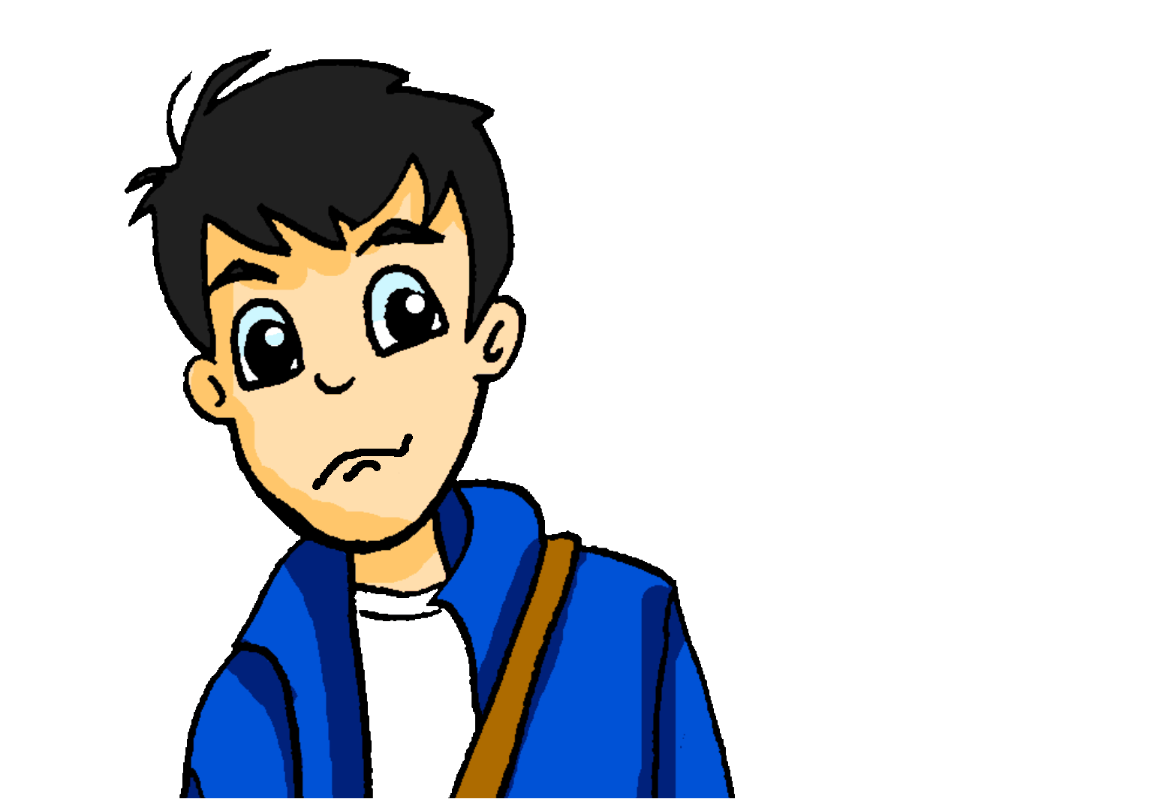
eine Postkarte aus Berlin
???
schreiben
Wolfgang versteht Andreas Postkarte nicht. Kannst du sie auf Deutsch schreiben?
Dear Mum and Dad,
How are you? I am having a lot of fun with Wolfgang and Mia. Mia’s friends are very nice. As a person Katja is great. She has violet hair and always wears interesting clothing!
I also like Heidi a lot. She is Wolfgang’s girlfriend and is always friendly. Mia and Wolfgang also showed me family photos.
The kids and their mum have very similar hair and eyes! See you soon, Andrea
Violett will need an ending to match plural Haare.
Note: Ich habe grüne Augen.
violet – violett me - mir
Notes:
Timing: 12 minutes Aim: To bring together previous and new vocabulary and grammar in writing. Procedure: 1. Translate the text.
2. Correct the text, using the next slide. Note: Students learnt ‘mir’ as a lexical item within one or two particular contexts in Y7. Later in Y7 they will be taught indirect object pronouns.

Slide 35
eine Postkarte aus Berlin
???
schreiben
Wolfgang versteht Andreas Postkarte nicht. Kannst du sie auf Deutsch schreiben?
Liebe Vati und Mutti,
Wie geht’s? Ich habe viel Spaß mit Wolfgang und Mia. Mias Freunde sind sehr nett. Als Person ist Katja ganz toll. Sie hat violette Haare und trägt immer interessante Kleidung!
Ich mag Heidi auch sehr. Sie ist Wolfgangs Freundin und ist immer freundlich.
Mia und Wolfgang haben mir auch Familienfotos gezeigt. Die Kinder und ihre Mutter haben ganz ähnliche Haare und Augen! Bis bald, Andrea
violet – violet me - mir

Slide 36
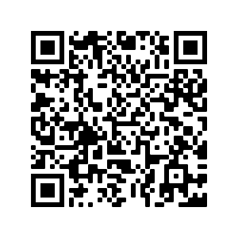
Hausaufgaben
Vocabulary Learning Homework (Y8, Term 1.1, Week 7)
Audio file
Audio file QR code:
Student worksheet
Quizlet link
In addition, revisit: Year 8 Term 1.1 Week 3
Year 7 Term 3.1 Week 6
Notes:
Answer sheet: https://resources.ncelp.org/concern/resources/5t34sk14h?locale=en

