Slide 1
Describing more things and people
Pre-nominal position of certain common adjectives
Irregular feminine forms of adjectives
SSC [ç] and soft ‘c’ [revisited]
Y7 French
Term 3.1 - Week 6 - Lesson 59
Jane Wood / Stephen Owen / Natalie Finlayson
Artwork by: Chloé Motard
Date updated: 16/08/21
Notes:
Artwork by Chloé Motard. All additional pictures selected are available under a Creative Commons license, no attribution required.
Learning outcomes (lesson 1):
Revisiting SSC [ç] and soft [c]
Introduction of prenominal position of certain common adjectives
Introduction of certain common irregular adjectival forms
Word frequency (1 is the most frequent word in French):
7.3.1.6 (introduce) belle [393], bonne [94], haut [264], nouveau [52], nouvelle [52], vieille [671], vieux [671], bâtiment [1952], église [1782], jardin [2284], pont [1889]
7.3.1.3 (revisit) langue¹ [712], maths [3438], matière¹ [562], musique [1139], nom¹ [171], science [1114], quel [146], quelle [146], que² [9], combien [800], pourquoi [193], parce que [n/a]
7.2.2.3 (revisit) tuer [591], affaires [170], fils [735], guerre [266], mère [645], père [569], vie [132], naturel [760], naturelle [760], heureux [764], heureuse [764], absolument [1009], contre [121]
Source: Londsale, D., & Le Bras, Y. (2009). A Frequency Dictionary of French: Core vocabulary for learners London: Routledge.
The frequency rankings for words that occur in this PowerPoint which have been previously introduced in NCELP resources are given in the NCELP SOW and in the resources that first introduced and formally re-visited those words.
For any other words that occur incidentally in this PowerPoint, frequency rankings will be provided in the notes field wherever possible.

Slide 2
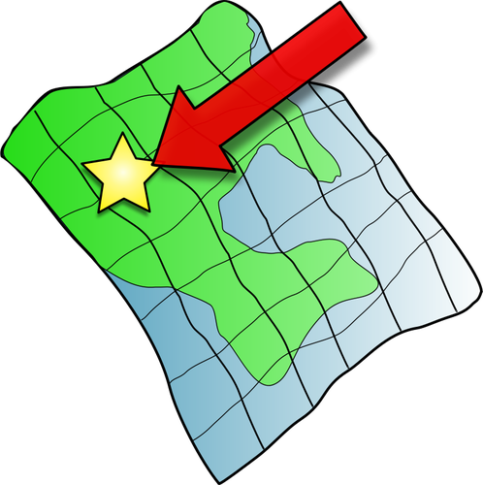
ç/c
ici
Notes:
Timing: 1 minute
Aim: To consolidate SSC [ç/c]
Procedure: 1. Present the letter(s) and say the [ç/c] sound first, on its own. Students repeat it with you. 2. Bring up the word ”ici” on its own, say it, students repeat it, so that they have the opportunity to focus all of their attention on the connection between the written word and its sound.
3. A possible gesture for this would be to point to the spot on which one is standing / indicate the room in which the lesson is taking place with a sweeping motion of one’s index finger. 4. Roll back the animations and work through 1-3 again, but this time, dropping your voice completely to listen carefully to the students saying the [ç/c] sound, pronouncing ”ici” and, if using, doing the gesture.
Word frequency (1 is the most frequent word in French):
ici [167]. Source: Londsale, D., & Le Bras, Y. (2009). A Frequency Dictionary of French: Core vocabulary for learners London: Routledge.

Slide 3
ç/c
ici
Notes:
With sound and no pictures to focus all attention on the sound-symbol correspondence.

Slide 4
ç/c
ici
Notes:
Without sound to elicit pronunciation (without first hearing the teacher).
Teacher to elicit pronunciation by asking “Comment dit-on …"

Slide 5
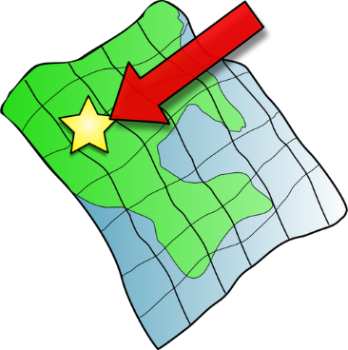
ç/c
français
garçon
ici
cinéma
cinq
décider
[to decide]
Notes:
Timing: 2 minutes
Aim: To consolidate SSC [ç/c]
Procedure:
1. Introduce and elicit the pronunciation of the individual SSC [ç/c] and then the source word again ‘ici’ (with gesture, if using). 2. Then present and elicit the pronunciation of the five cluster words.
The cluster words have been chosen for their high-frequency, from a range of word classes, with the SSC (where possible) positioned within a variety of syllables within the words (e.g. initial, 2nd, final etc.). Additionally, we have tried to use words that build cumulatively on previously taught SSCs (see the Phonics Teaching Sequence document) and do not include new SSCs. Where new SSCs are used, they are often consonants which have a similar symbol-sound correspondence in English.
Word frequency (1 is the most frequent word in French): français [251]; garçon [1599]; cinéma [1623]; décider [165]; cinq [288]; ici [167]. Source: Londsale, D., & Le Bras, Y. (2009). A Frequency Dictionary of French: Core vocabulary for learners London: Routledge.

Slide 6
ç/c
français
garçon
ici
cinéma
cinq
décider
Notes:
With sound and no pictures to focus all attention on the sound-symbol correspondence.

Slide 7
ç/c
français
garçon
ici
cinéma
cinq
décider
Notes:
Without sound to elicit pronunciation (without first hearing the teacher).
Teacher to elicit pronunciation by asking “Comment dit-on …"

Slide 8
Hard and soft [c]
Hard and soft [c]
phonétique
Remember!
In French, the letter c is naturally soft (sounds like s) before e or i:
le cinéma c’est
However, the letter c is hard (sounds like k) before a, o or u:
calme content cuisine
We sometimes soften the c before a, o or u with a cedilla (ç):
le français le garçon le reçu (receipt)
Notes:
Timing: 2 minutes
Aim: To revise spelling rules governing the pronunciation of the letter ‘c’ before vowels and use of a cedilla..
Procedure:
1. Bring up the rules governing each category on clicks.
2. Teacher reads the words in each category out loud. Students repeat.

Slide 9
C ou Ç ?
Hard [c] or [ç] ?
écouter
Do you hear a hard or a soft sound?
 |  | hard [c] | ç
 | cas (case)
 | contre (against)
 | reçu (receipt)
 | commerçant (shopkeeper)
 | aucun (none)
 | façon (way)
1
_
2
_
3
_
4
_
_
5
_
6
_
Notes:
Timing: 3 minutes
Aim: Oral recognition of hard [c] and [ç]
Procedure:
1. Ask students to look at the vowel following each gap. What do they notice? Explain that as only the letters a, o and u follow the missing SSC, the missing letter can only be either hard [c] or [ç].
2. Click numbers to play audio.
3. Students tick whether they think they hear hard or soft ‘c’
4. Answers revealed on clicks
Transcript
1) cas
2) contre
3) reçu
4) commerçant
5) aucun
6) façon
Word frequency (1 is the most frequent word in French):
cas [137], contre [121], reçu [4226], commerçant [4167] aucun [63], façon [248]
Source: Londsale, D., & Le Bras, Y. (2009). A Frequency Dictionary of French: Core vocabulary for learners London: Routledge.

Slide 10
C ou Ç ?
Soft [c] or [ç] ?
écrire
These words all contain a soft sound. How is it written?
 |  | soft [c] | ç
 | cependant (however)
 | principe (principle)
 | soupçon (suspicion)
 | cesser (to stop, stopping)
 | façade (facade)
 | société (society)
1
_
2
_
3
_
4
_
5
_
6
_
Notes:
Timing: 3 minutes
Aim: Written production of hard [c] and [ç]
Procedure:
1. Remind students of spelling rules for the soft sound ([c] in front of e or i, [ç] in front of a, o and u).
2. Students read the words and decide which letter is missing based on the vowel which follows the gap.
3. Answers revealed on clicks.
4. Click to hear the words. Students repeat. This reinforces that the pronunciation is the same.
Transcript
1) cependant
2) principe
3) soupçon
4) cesser
5) façade
6) société
Word frequency (1 is the most frequent word in French):
cependant [352], principe [447], cesser [462], soupçon [3921], façade [4029], société [295]
Source: Londsale, D., & Le Bras, Y. (2009). A Frequency Dictionary of French: Core vocabulary for learners London: Routledge.

Slide 11
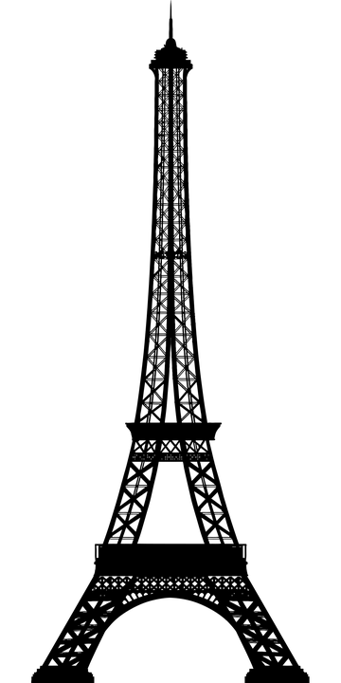
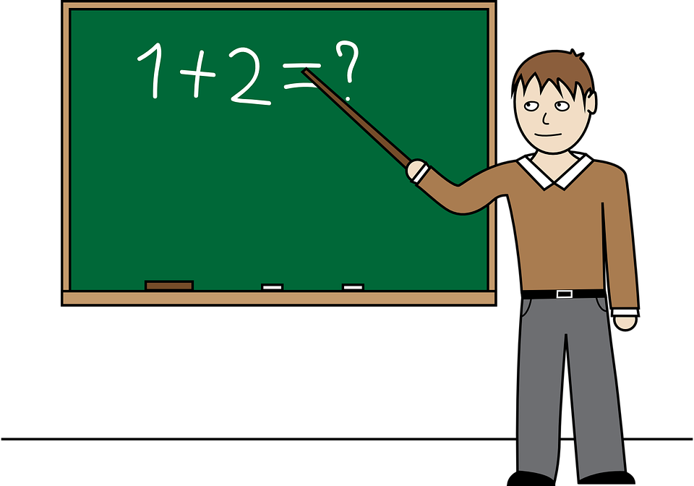
C ou Ç ?
Hard [c], soft [c] or [ç] ?
écouter / écrire
Do you hear a hard or a soft sound? If you hear a soft sound, how is it written?
 |  | hard [c] | soft [c] | ç
 | cent (hundred)
 | construire (to construct)
 | culture (culture)
 | civil (civilian)
 | leçon (lesson)
 | candidat (candidate)
1
_
2
_
3
_
4
_
5
_
6
_
Notes:
Timing: 3 minutes
Aim: Oral recognition and written production of hard [c], soft c and [ç] sounds.
Procedure:
1. Click numbers to play audio.
2. Students decide whether they hear a hard or soft sound. When they hear a soft sound, they decide whether to tick soft [c] or [ç] based on the vowel which follows the gap.
3. Answers revealed on clicks
Transcript
1) cent
2) construire
3) culture
4) civil
5) leçon
6) candidat
Word frequency (1 is the most frequent word in French):
cent [704] construire [794] culture [913] civil [929] leçon [1300] candidat [1328]
Source: Londsale, D., & Le Bras, Y. (2009). A Frequency Dictionary of French: Core vocabulary for learners London: Routledge.

Slide 12
Vocabulaire
Vocabulaire
lire
10) bon 11) bonne 12) le jardin
8) belle 9) nouveau
6) haut 7) vieille
5) une église
3) le pont 4) nouvelle
1) le bâtiment 2) vieux
Notes:
Timing: 5 minutes for 4 slides
Aim: Written recognition of new vocabulary items
Procedure:
1. Students prepare for the task by writing 1-12 in their books.
2. Starting with the words at the bottom of the screen, students are challenged to write the English for the vocabulary items introduced this week before the blocks cover the French words. If students don’t immediately know the English, they should write down the French word, as the meaning may come to them later during the activity. NB: although bon is a known word which does not feature in this week’s set, it is included here for revision purposes as its feminine form bonne is introduced this week.
3. Check answers on the slide that follows and move on to the oral version of this task on slide 14.

Slide 13
Vocabulaire - réponses
Vocabulaire - réponses
lire
1) the building
2) old (m)
3) the bridge
4) new (f)
5) a church
6) high/tall
7) old (f)
8) beautiful (f)
9) new (m)
10) good (m)
11) good (f)
12) the garden
Notes:
Answers for the activity on the previous slide.

Slide 14
Vocabulaire
Vocabulaire
lire
10) bon 11) bonne 12) le jardin
8) belle 9) nouveau
6) haut 7) vieille
5) une église
3) le pont 4) nouvelle
1) le bâtiment 2) vieux
Notes:
As per instructions on slide 13, but with time available reduced. Students produce words orally.

Slide 15
Vocabulaire
Vocabulaire
lire
10) bon 11) bonne 12) le jardin
8) belle 9) nouveau
6) haut 7) vieille
5) une église
3) le pont 4) nouvelle
1) le bâtiment 2) vieux
Notes:
As previous but with time reduced further still, encouraging automisation.

Slide 16
Irregular adjective forms
grammaire
Irregular feminine adjectives
One of the adjectives in this week’s set, haut, has a regular feminine form (add –e):
le bâtiment est haut la montagne est haute
[the building is tall] [the mountain is high]
______
Use haut(e) to describe tall objects and grand(e) to describe tall people.
The other new adjectives have an irregular feminine form:
le jardin est beau la voiture est belle
[the garden is beautiful] [the car is beautiful]
_____
le pont est nouveau l’ idée est nouvelle
[the bridge is new] [the idea is new]
__________
le bâtiment est vieux l’ église est vieille
[the building is old] [the church is old]
______
le livre est bon la réponse est bonne
[the book is good] [the answer is good]
_______
Notes:
Timing: 3 minutes
Aim: To introduce the concept of irregular feminine adjective forms. The adjectives are presented after être at this stage, so that students focus on the form.
Word frequency of cognates and near-cognates used (1 is the most frequent word in French): montagne [1732]
Source: Londsale, D., & Le Bras, Y. (2009). A Frequency Dictionary of French: Core vocabulary for learners London: Routledge.

Slide 17
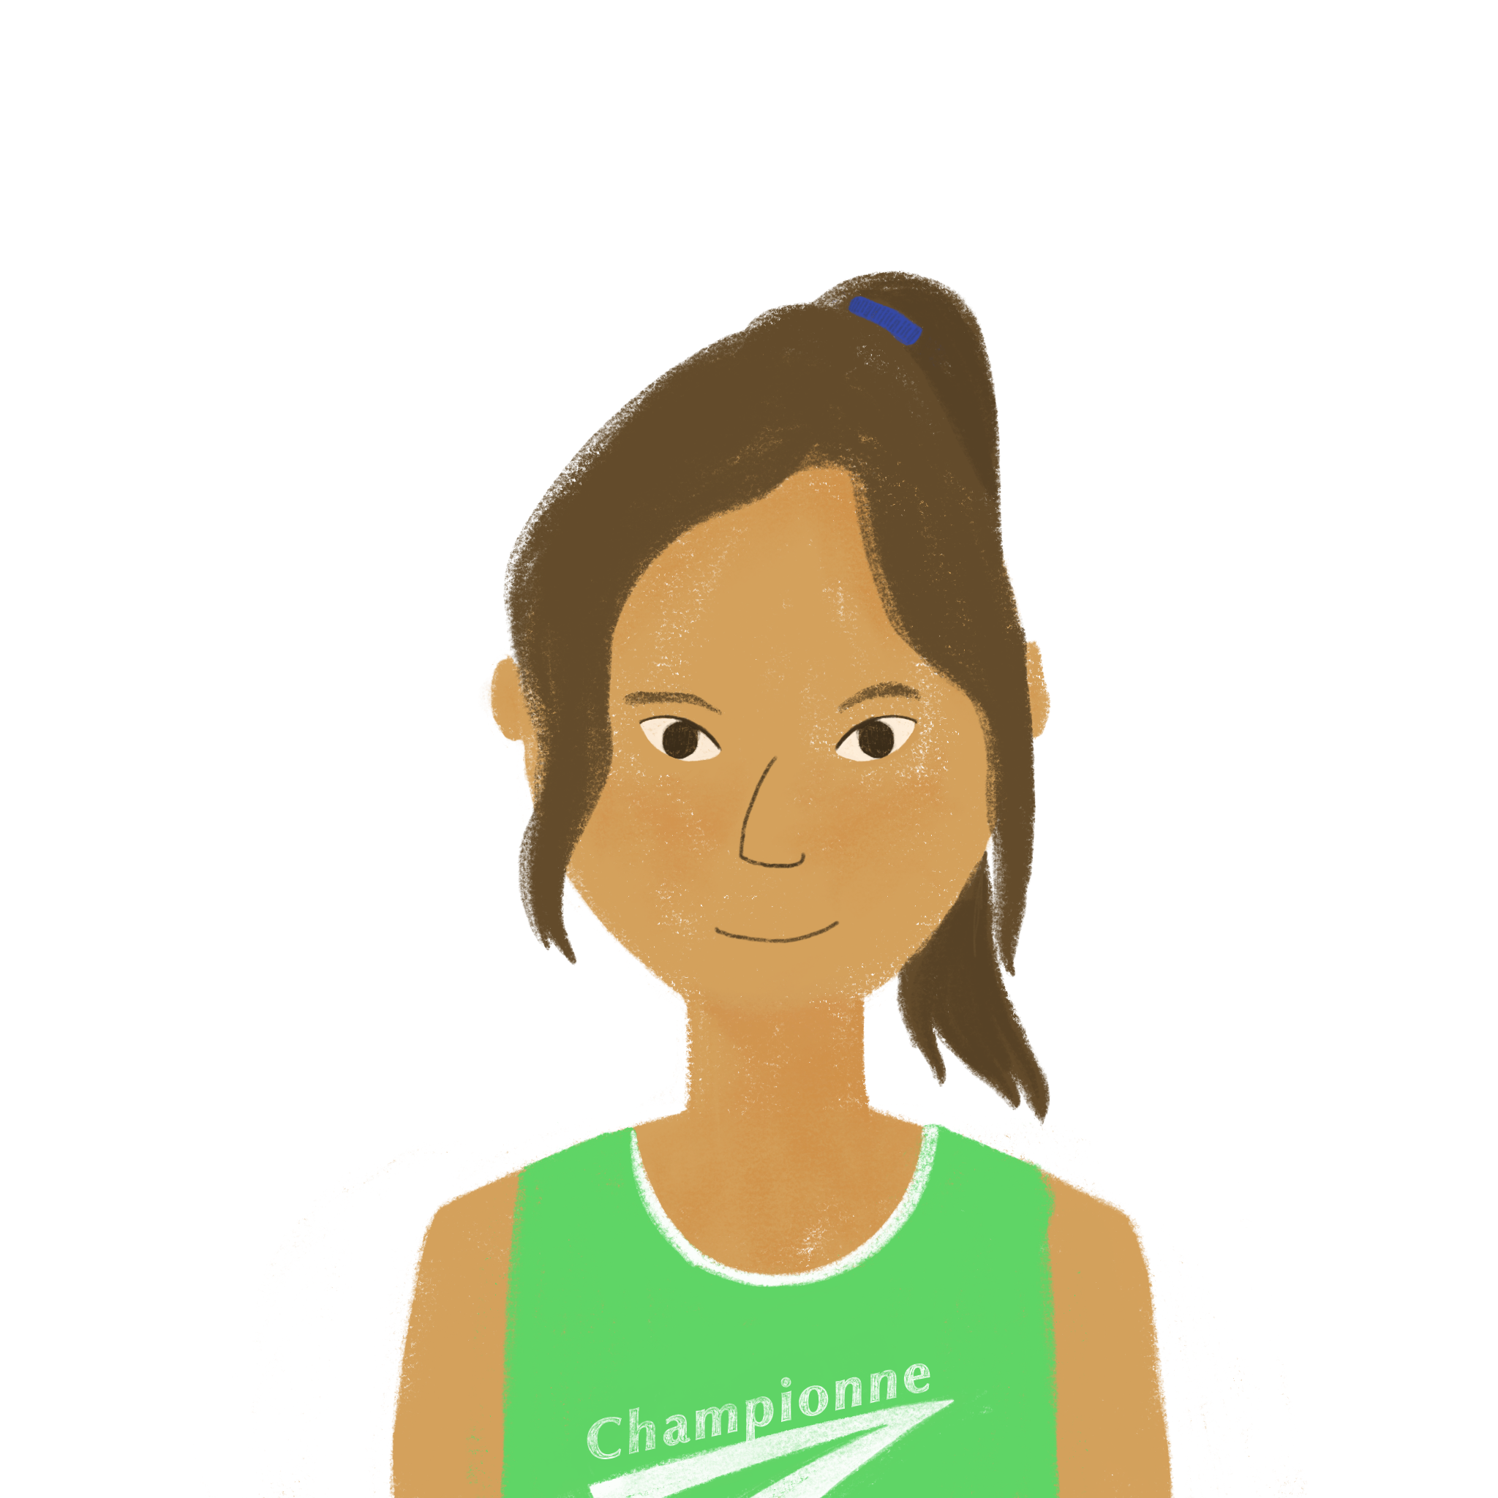
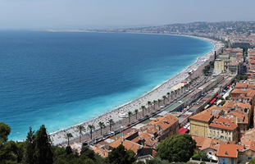
Comment est Nice?
Comment est Nice ?
lire
Océane est nouvelle à Nice. Elle adore la ville ! Que dit-elle ?
1. | Les plages ici sont belles ! | plages | jardins
2. | J’aime les rues. Les noms sont bons. | noms | voitures
3. | Les églises dans la ville sont vieilles. | églises | cafés
4. | Les ponts sont vieux aussi. | rues | ponts
5. | Les bâtiments sont hautes ! | maisons | bâtiments
6. | Et les écoles sont bonnes ! | écoles | magasins
7. | Mes nouvelles amies sont sympas. | amies | amis
8. | C’est une belle ville ! Je suis très heureuse ici. | pays | ville
_______
_______
_______
_______
_______
_______
_______
_______
What do you notice about the position of belle in this sentence ? Where is the noun?
Notes:
Timing: 5 minutes
Aim: Written recognition of adjective forms and connecting these with meaning.
Procedure:
1. Students read the sentences and decide, based on their knowledge of masculine and feminine adjective forms, which noun completes the sentence. NB: plural forms are used so that students are not given an additional clue from the article. For now, the adjectives are used after être so that students focus on the form. Question 8 is an exception, priming for the word order explanation on the next slide. 2. Answers revealed on clicks.
3. Elicit oral translations from students.
Word frequency of cognates and near-cognates used (1 is the most frequent word in French): adorer [2322]
Source: Londsale, D., & Le Bras, Y. (2009). A Frequency Dictionary of French: Core vocabulary for learners London: Routledge.
Transcript
1) Il n’y a pas de belle [plage].
2) Et il n’y a pas de vieux [pont].
3) Il n’y a pas de bonne [école].
4) Il n’y a pas de beau [bâtiment]!
5) Il n’y a pas de nouvelle [université].
6) Et il n’y a pas de nouveau [magasin].
7) Il n’y a pas de haute [église].
8) Et il n’y a pas de haut [bâtiment].
Imagine attribution: Spike / CC BY-SA (https://creativecommons.org/licenses/by-sa/4.0)

Slide 18
Adjectives after the noun
Adjectives after the noun
grammaire
In French, most adjectives used together with a noun come AFTER it.
This is different from English word order.
Remember that the feminine form of a regular adjective adds -e
un livre intéressant
an interesting book
an expensive bike
un vélo cher
une femme intelligente
an intelligent woman
une voiture bleue
a blue car
Adjectives already ending in –e do not add another –e for the feminine!
a funny man
un homme drôle
une maison moderne
a modern house
une amie sympathique
a nice friend
Notes:
Timing: 2 minutes
Aim: To revise previously-learned rules about adjectival position and agreement.

Slide 19
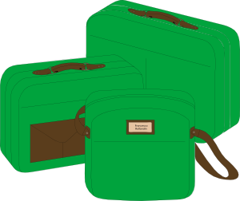
Adjectives before noun
grammaire
Adjectives before the noun
Some adjectives go BEFORE the noun. This is the same as English word order.
These are adjectives that refer to BEAUTY, AGE, GOOD/BAD or SIZE (BAGS)
B
un beau jardin a beautiful garden
une belle langue a beautiful language
A
un jeune homme a young man
une vieille femme an old woman
G
une bonne idée a good idea
une mauvaise question a bad question
S
une grande maison a big house
une petite voiture a small car
Notes:
Timing: 3 minutes
Aim: To introduce the fact that some adjectives are used pre-nominally (grand, petit, beau, bon and mauvais have all been introduced in previous vocabulary sets; two of this week’s new words also feature here: belle and vieille).

Slide 20
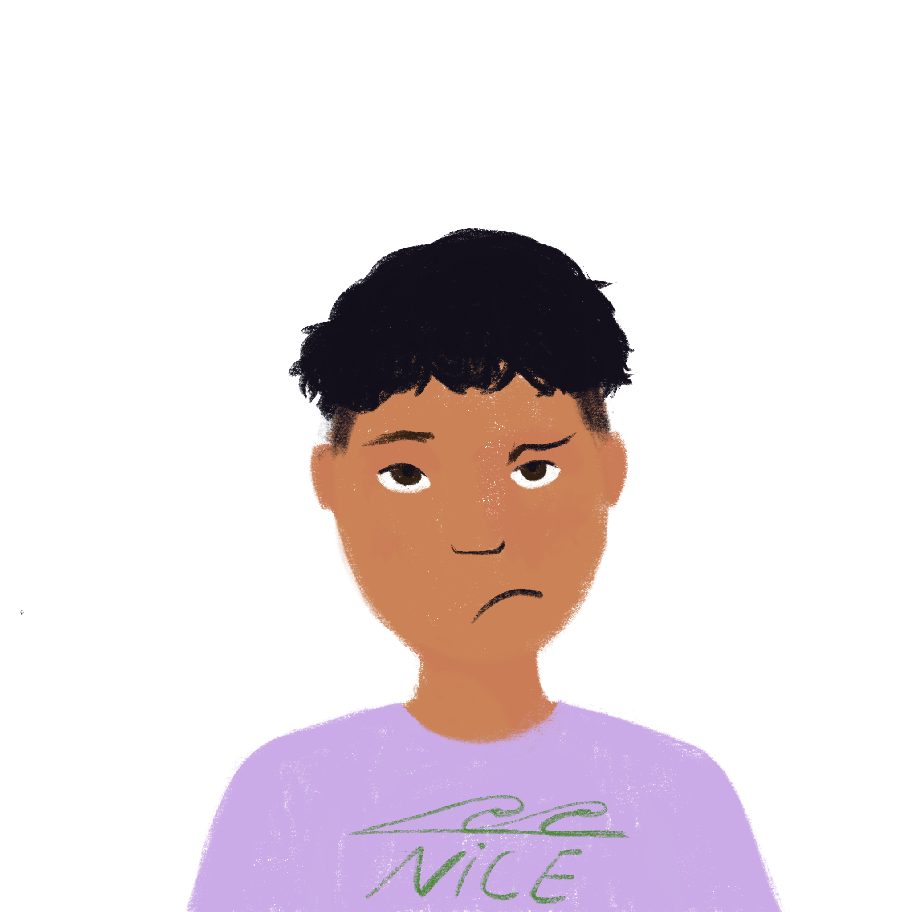
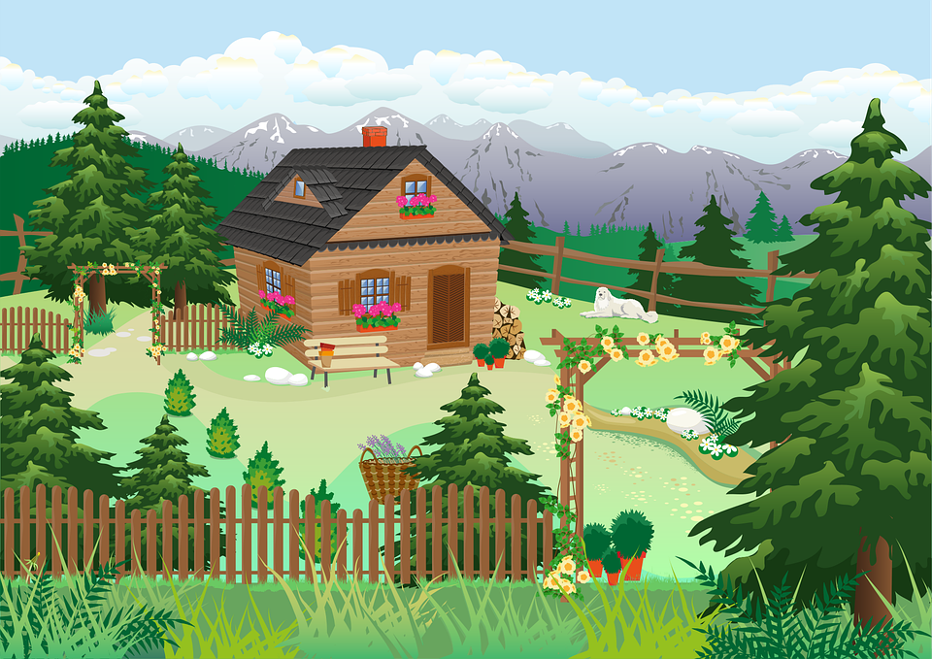
Comment est Nice?
Comment est le village ?
écouter
Amir est en vacances dans un petit village à la montagne. Il n’est pas très content - ce n'est pas comme à Nice ! Il parle avec Océane au téléphone. Que dit-il ?
 | plage | bâtiment
 | maison | pont
 | magasin | école
 | bâtiment | poste
 | université | parc
 | poste | magasin
 | bâtiment | église
 | église | bâtiment
1
Il n’y a pas d’attractions ici !
2
3
4
5
6
7
8
Notes:
Timing: 5 minutes
Aim: Aural recognition adjective forms and connecting these with meaning.
Procedure:
1. Click on a number to head the audio with the noun obscured.
2. Based on their knowledge of masculine and feminine adjective forms, students decide which noun follows the adjective heard. NB: as all adjectives in this week’s set are pre-nominal, negative sentences with il n’y a pas de are used throughout so that students are not given an additional clue from the article.
3. Answers revealed on clicks.
4. Full audio, with nouns included, may be found on the next slide.
Word frequency of cognates and near-cognates used (1 is the most frequent word in French): village [1295], montagne [1732], téléphone [1366], attraction [>5000]
Source: Londsale, D., & Le Bras, Y. (2009). A Frequency Dictionary of French: Core vocabulary for learners London: Routledge.
Transcript
1) Il n’y a pas de belle [plage].
2) Et il n’y a pas de vieux [pont].
3) Il n’y a pas de bonne [école].
4) Il n’y a pas de beau [bâtiment]!
5) Il n’y a pas de nouvelle [université].
6) Et il n’y a pas de nouveau [magasin].
7) Il n’y a pas de haute [église].
8) Et il n’y a pas de haut [bâtiment].

Slide 21
Comment est Nice?
Réponses
Comment est le village ?
écouter
Amir est en vacances dans un petit village à la montagne. Il n’est pas très content - ce n'est pas comme à Nice ! Il parle avec Océane au téléphone. Que dit-il ?
 | plage | bâtiment
 | maison | pont
 | magasin | école
 | bâtiment | poste
 | université | parc
 | poste | magasin
 | bâtiment | église
 | église | bâtiment
1
Il n’y a pas d’attractions ici !
2
3
4
5
6
7
8
Notes:
Answers to the activity on the previous slide. Full audio with noun included plays on number clicks.
Transcript
1) Il n’y a pas de belle plage.
2) Et il n’y a pas de vieux pont.
3) Il n’y a pas de bonne école.
4) Il n’y a pas de beau bâtiment!
5) Il n’y a pas de nouvelle université.
6) Et il n’y a pas de nouveau magasin.
7) Il n’y a pas de haute église.
8) Et il n’y a pas de haut bâtiment.

Slide 22
Comment est Paris? (1/6)
Comment est Paris ? (1/6)
écrire
Écris la réponse correcte:
tall
Salut Amir !
À Paris, il y a
un haut monument :
la Tour Eiffel.
____
The adjectives in this activity all come before the noun they describe!
Notes:
Timing: 5 minutes for 6 slides
Aim: Written production of masculine and feminine forms of the pre-nominal adjectives in this week’s vocabulary set.
Procedure:
Students fill the gap in the text with the correct form of the English adjective in bold.
Answer revealed on click.
Elicit oral translation of the full sentence, ensuring correct pronunciation of the buildings described.

Slide 23
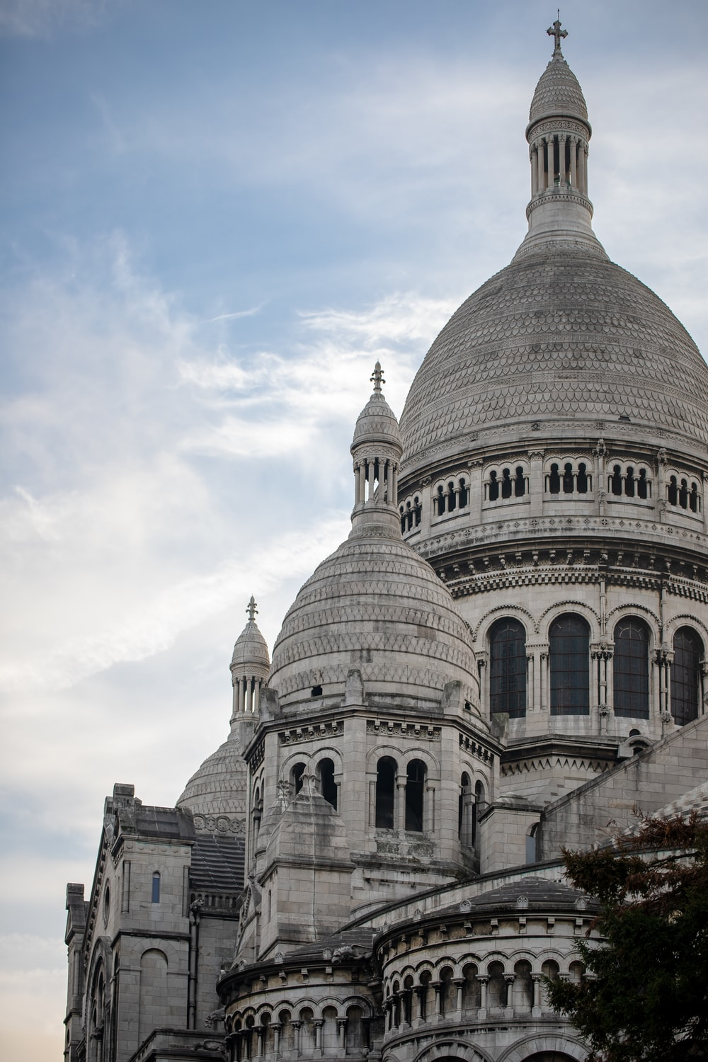
Comment est Paris? (2/6)
Comment est Paris ? (2/6)
Cœur is the French word for ‘heart’. What do you think the name of this church means?
écrire
Écris la réponse correcte:
beautiful
Il y a
une belle église :
le Sacré-Cœur.
____
Many of the adjectives in this activity have an irregular feminine form.

Slide 24
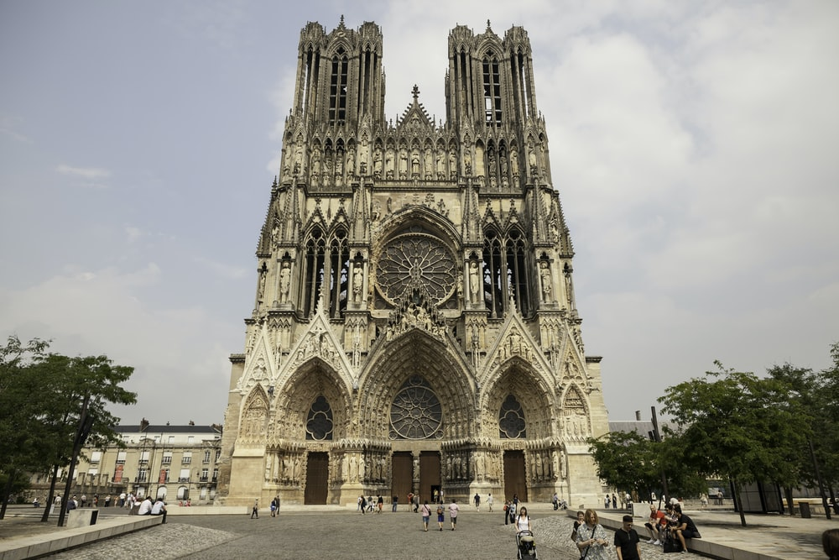
Comment est Paris? (3/6)
Comment est Paris ? (3/6)
écrire
Écris la réponse correcte:
old
Il y a
une vieille
cathédrale :
Notre-Dame.
____

Slide 25
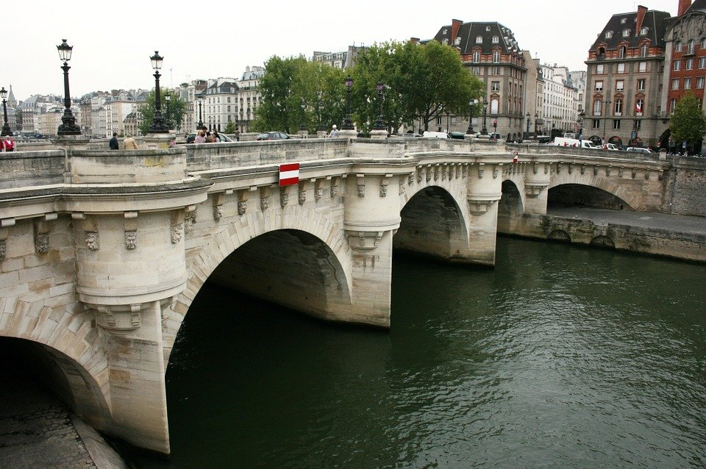
Comment est Paris? (4/6)
Comment est Paris ? (4/6)
écrire
Écris la réponse correcte:
beautiful
old
Il y a un beau pont :
le Pont Neuf.
C’est un vieux pont !
____
____

Slide 26
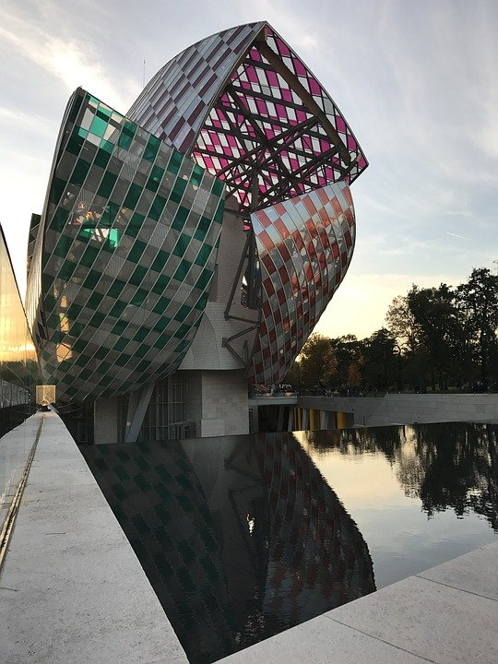
Comment est Paris? (5/6)
Comment est Paris ? (5/6)
écrire
Écris la réponse correcte:
new
Il y a un
nouveau bâtiment :
la Fondation
Luis Vuitton.
Une nouvelle idée !
________
_______

Slide 27
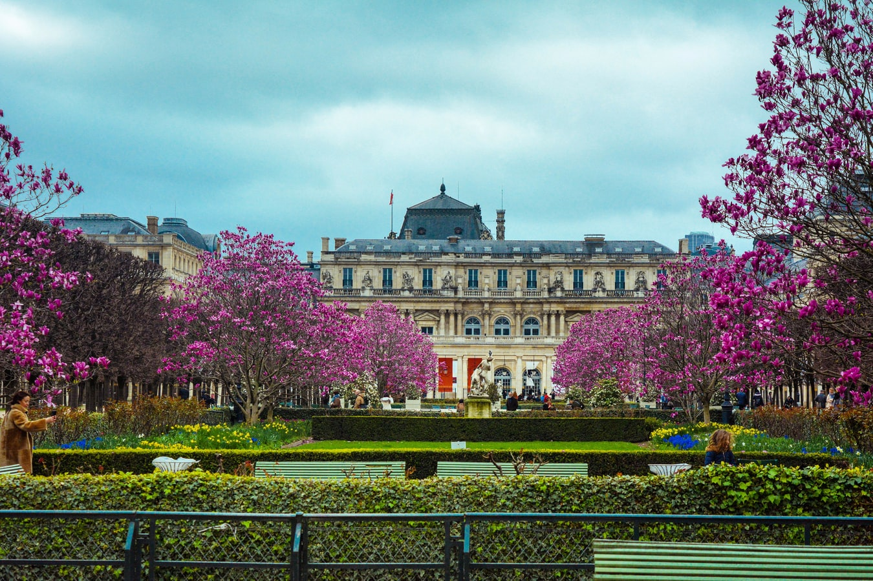
Comment est Paris? (6/6)
Comment est Paris ? (6/6)
écrire
Écris la réponse correcte:
beautiful
Et il y a un beau
jardin : le Jardin du
Luxembourg.
Bises,
Léa
____

Slide 28
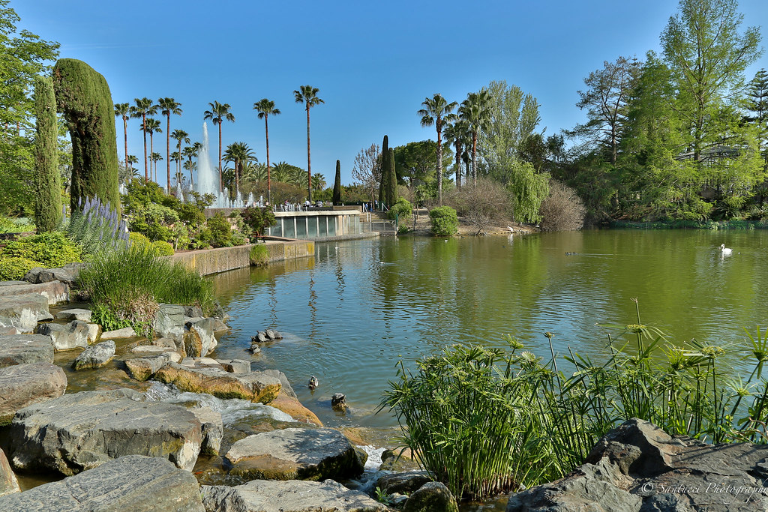
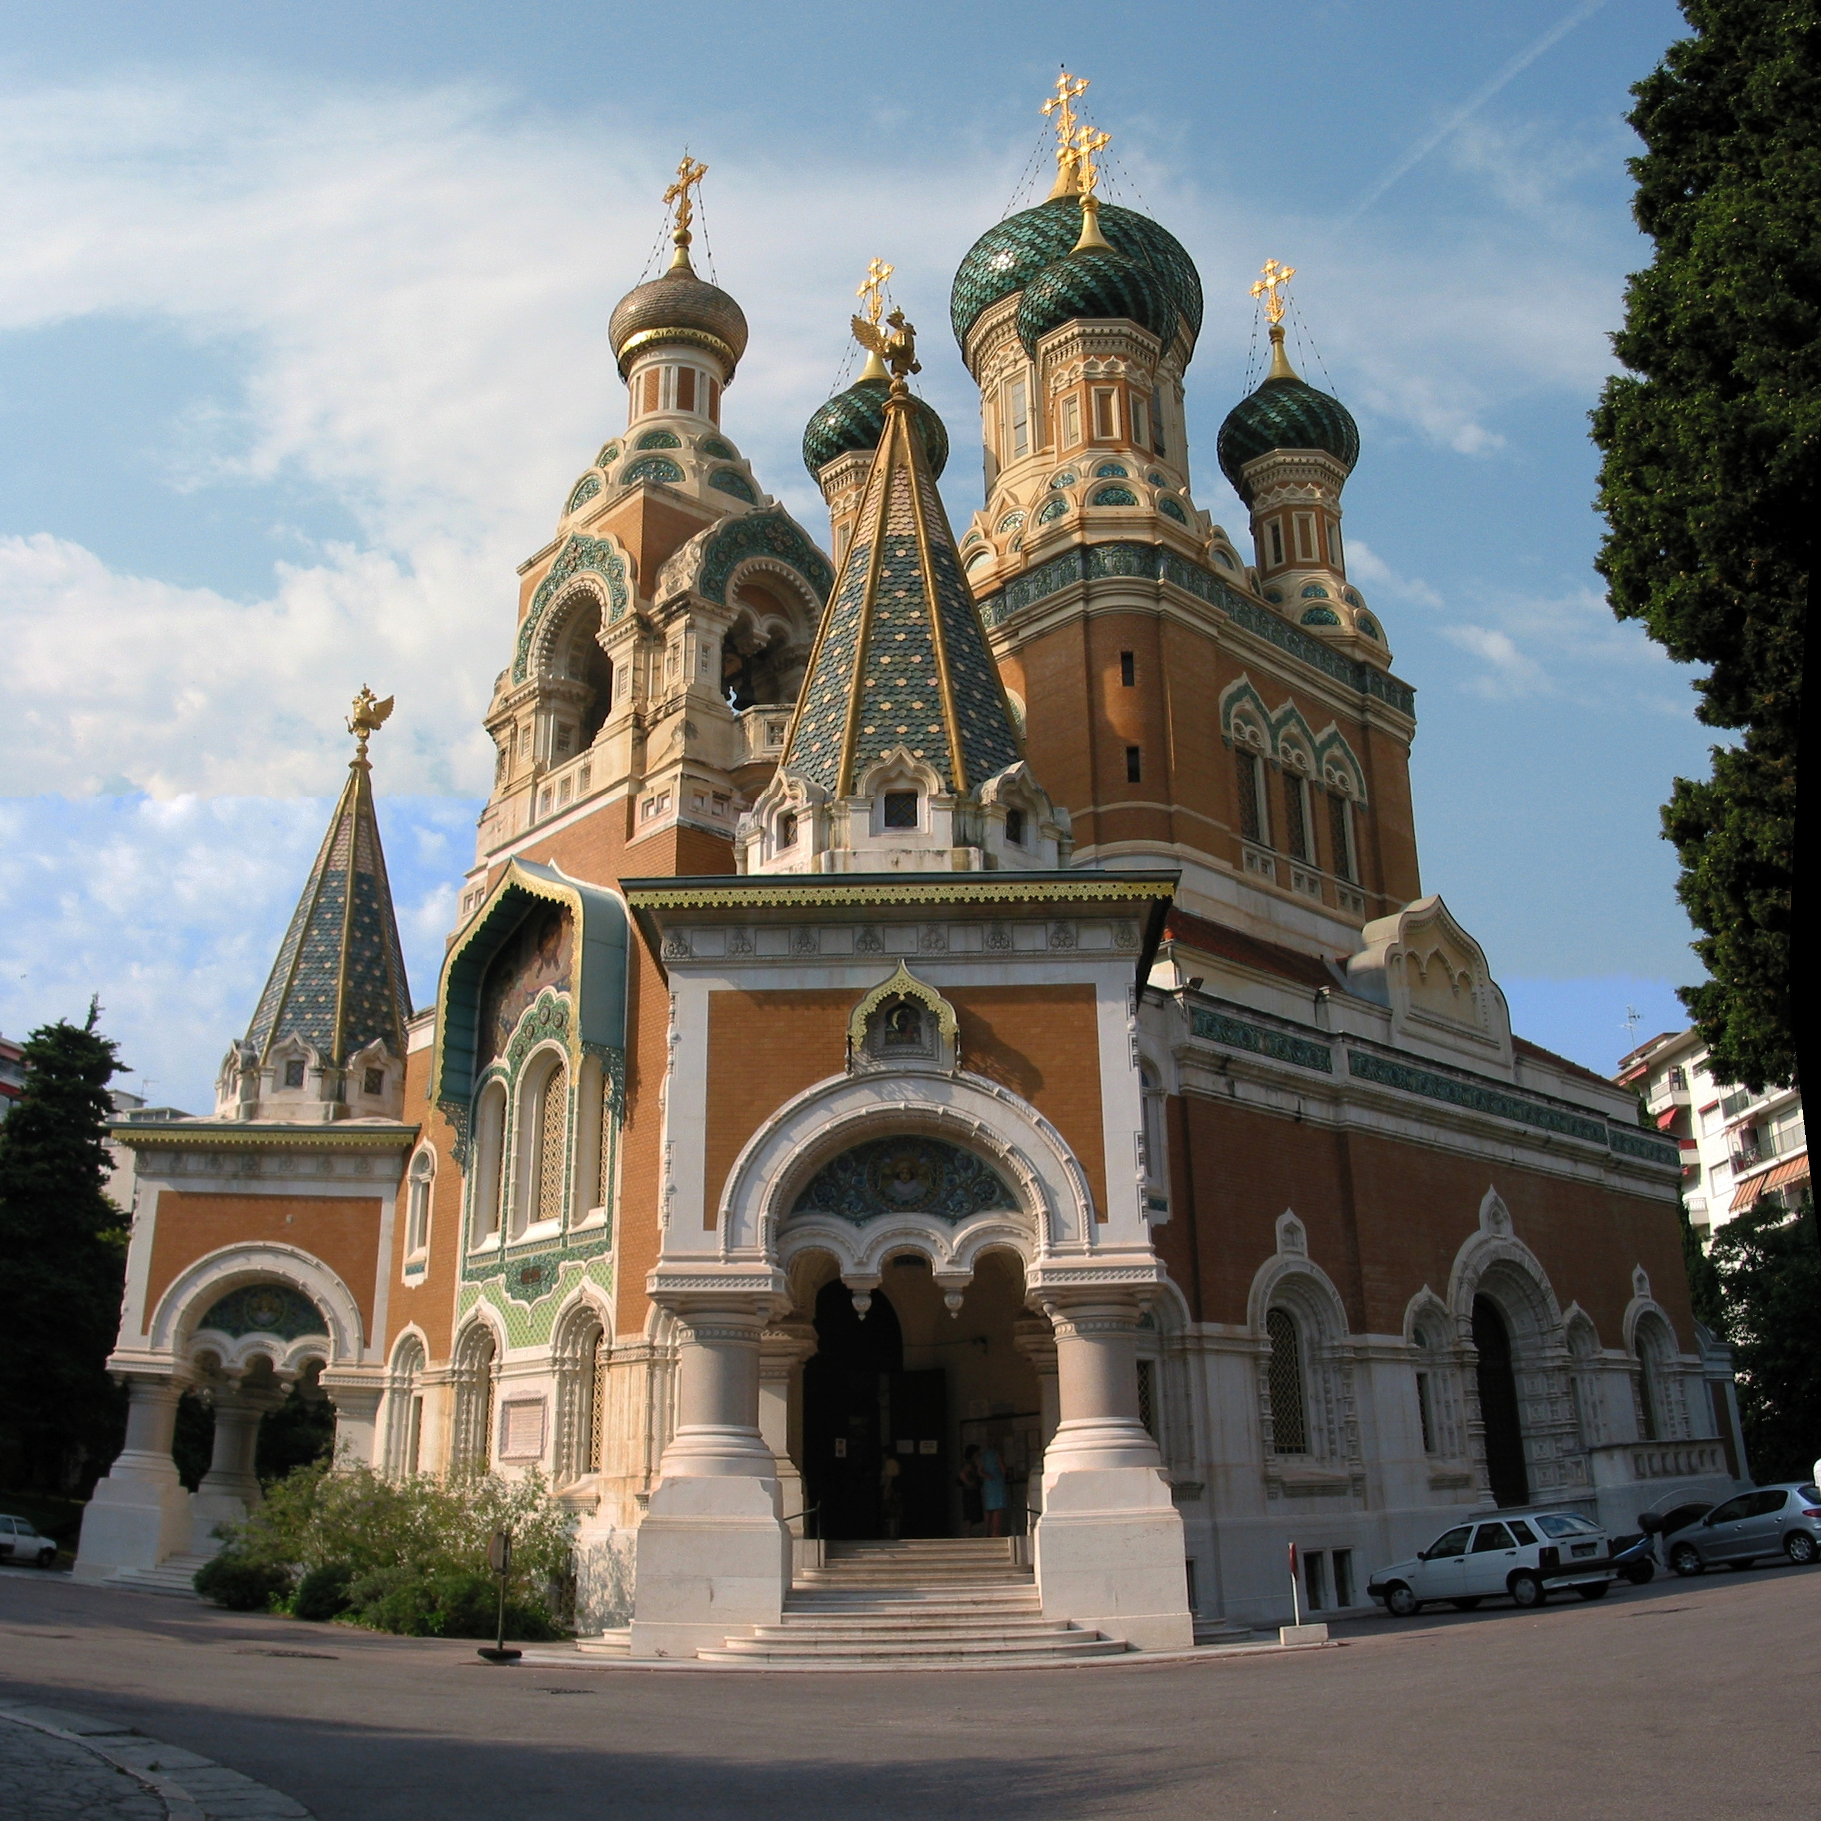
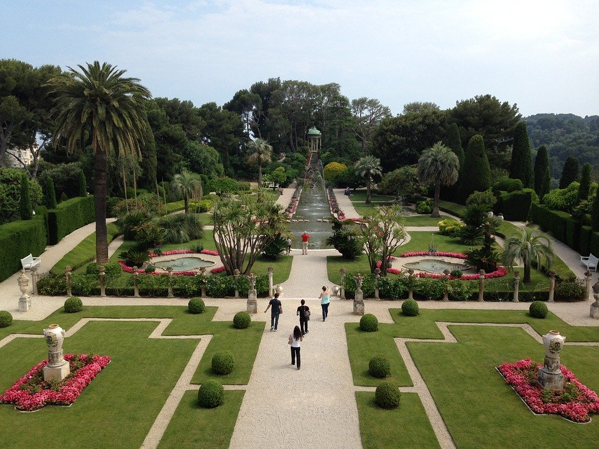
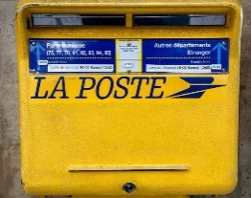
Nice et Paris
Nice et Paris
parler
Partner A
À Nice, il y a un beau…
parc
église
Partner B
À Paris, Il y a une vieille ...
jardin
poste
Notes:
Timing: 8 minutes for 5 slides Aim: Oral production and aural recognition of masculine and feminine forms of adjectives.
Procedure:
1. Download and print the student worksheet for this activity, which can be found on the portal alongside this resource.
2. Use this slide to model the task with students. Partner A says the sentence beginning, Partner B finishes the sentence. Make it clear that students will not see their partner’s sentences, so they need to listen carefully.
3. Students work in pairs, one reading the start of each sentence on their sheet, the other selecting the appropriate noun from their sheet to complete it, based upon the gender of the adjective they hear. Students should not look at each other’s sheets, but base their selection on what they hear.
4. After four sentences, students swap roles. Partner A describes Nice, Partner B describes Paris.

Slide 29
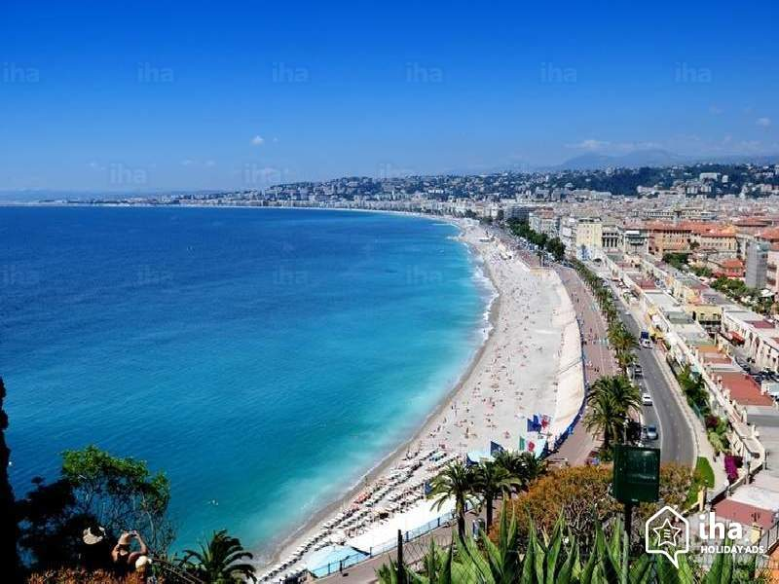
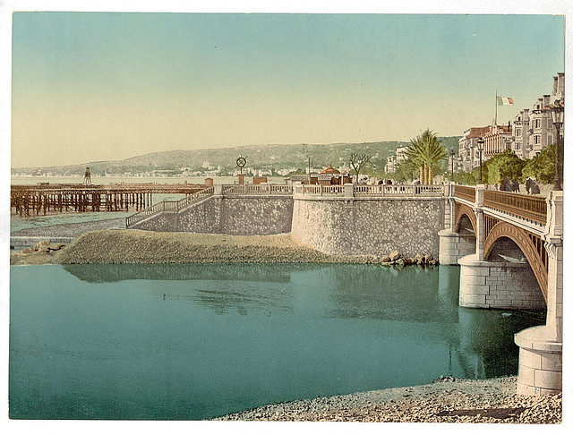
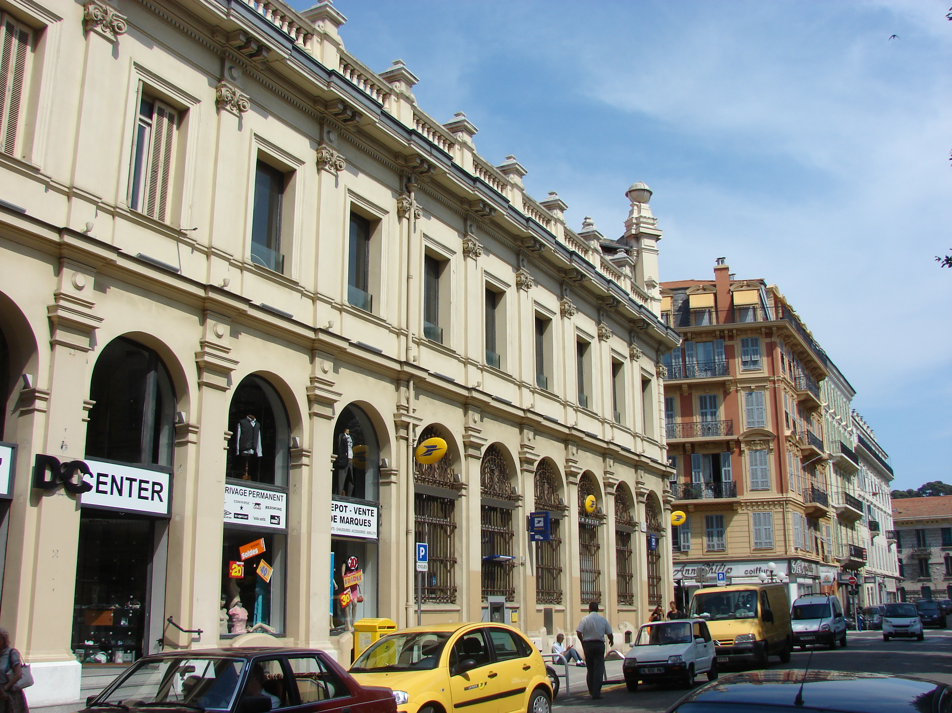
Nice [Réponses]
Nice (réponses)
parler
1
À Nice, il y a une belle...
parc
plage
2
Il y a un vieux...
pont
poste
Notes:
DO NOT DISPLAY. These slides should not be displayed during the exercise, but are animated to reveal the correct answers.
Home learning – the audio for each complete French sentence is accessible upon clicking the button.
Transcript
1. À Nice, il y a une belle plage.
2. Il y a un vieux pont.

Slide 30
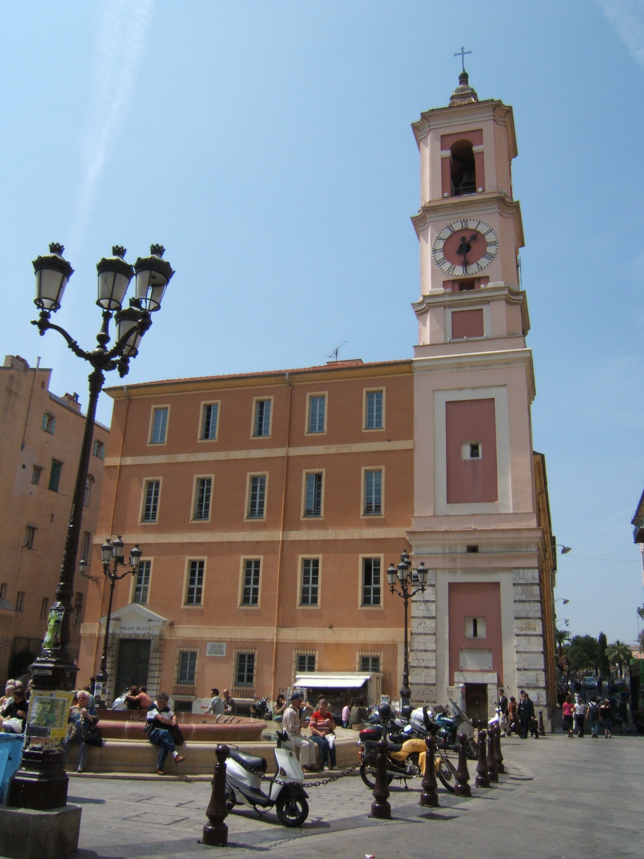
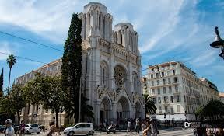
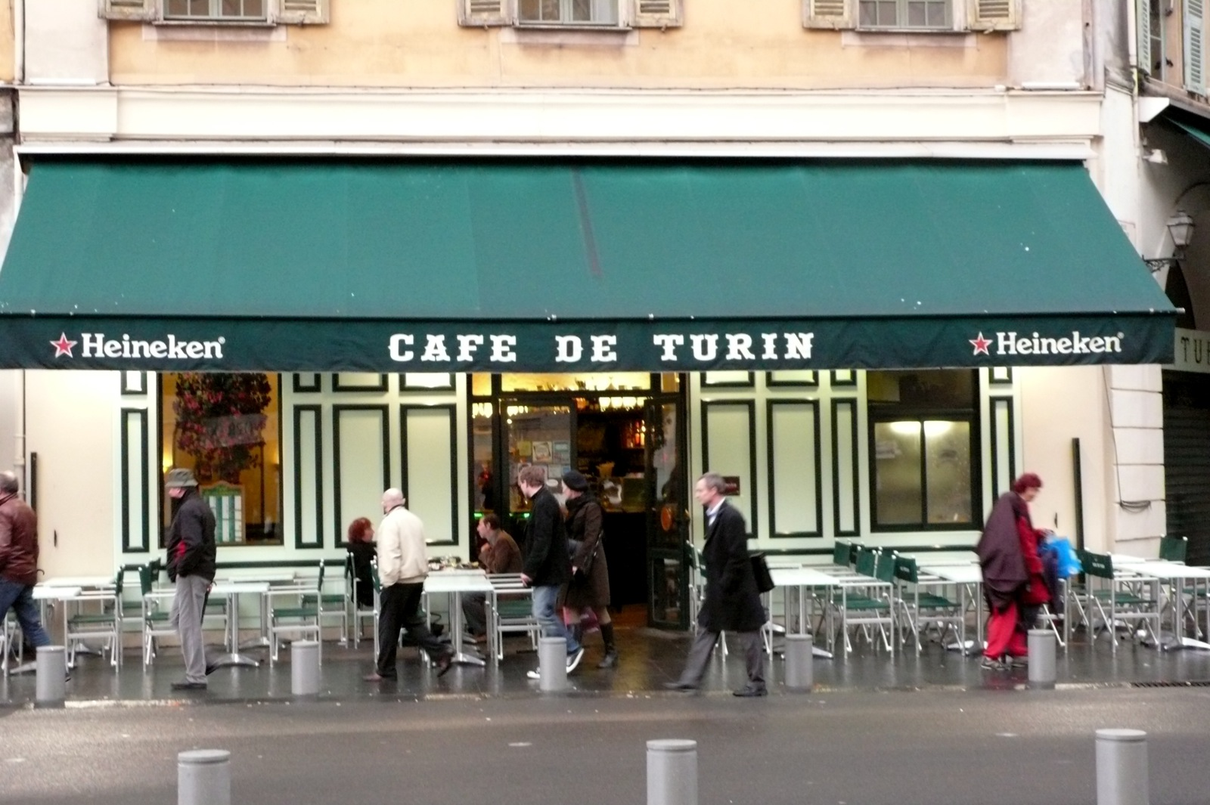
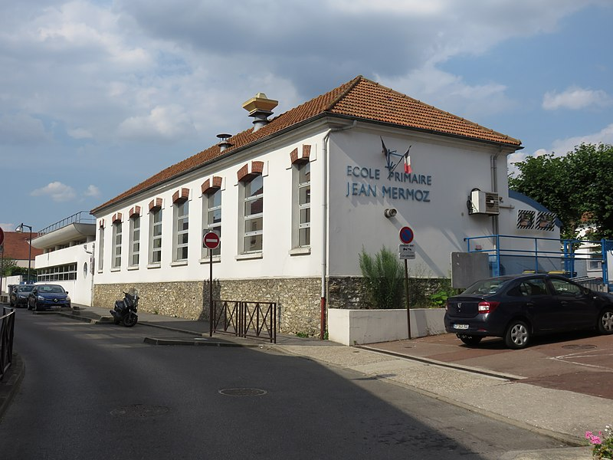
Nice [cont’d]
parler
Nice (cont’d)
3
Il y a une vieille...
église
bâtiment
4
Il y a aussi un bon...
café
école
Notes:
Transcript
3. Il y a une vieille église.
4. Il y a aussi un bon café.

Slide 31
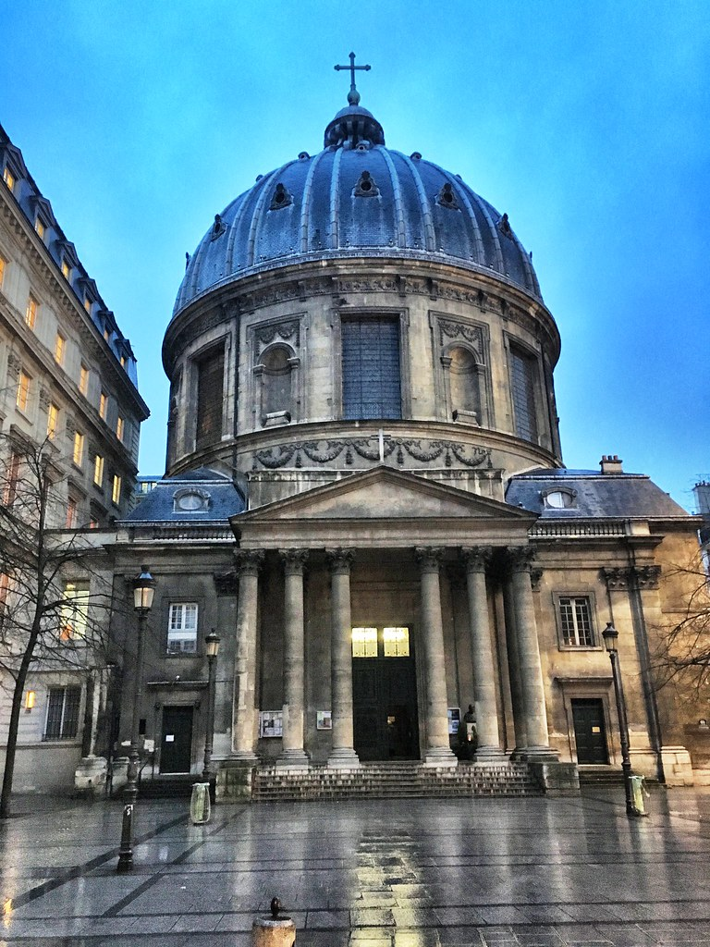
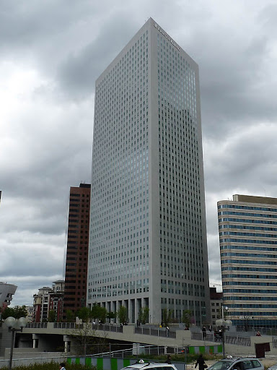
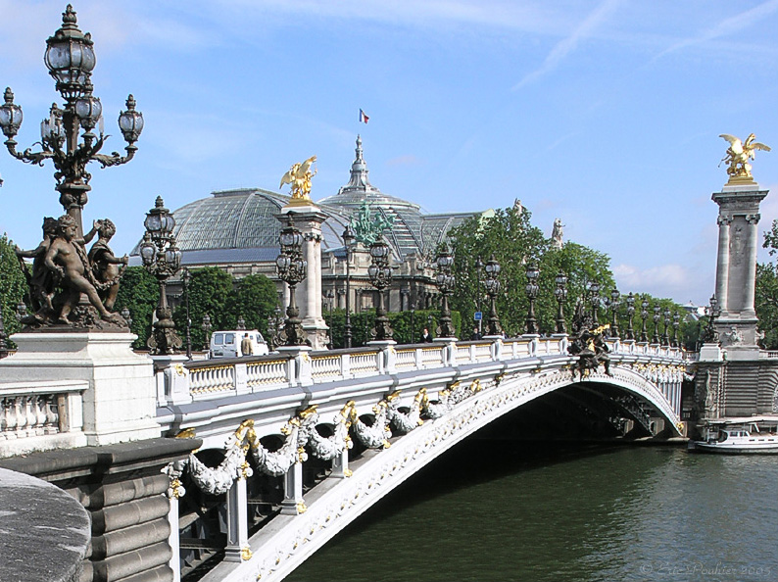
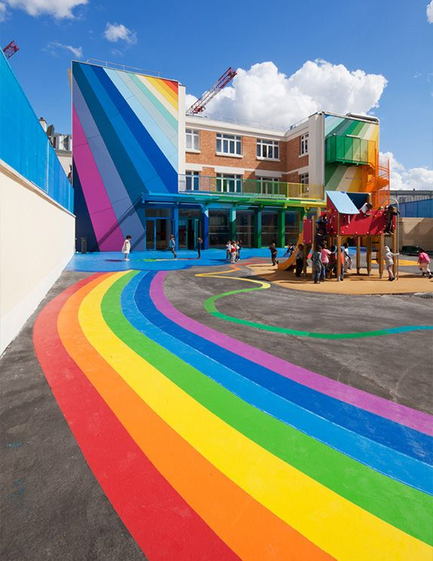
Paris [Réponses]
Paris (réponses)
parler
5
À Paris, il y a un haut...
église
bâtiment
6
Il y a une nouvelle...
pont
école
Notes:
Transcript
5. À Paris, il y a un haut bâtiment.
6. Il y a une nouvelle école.

Slide 32
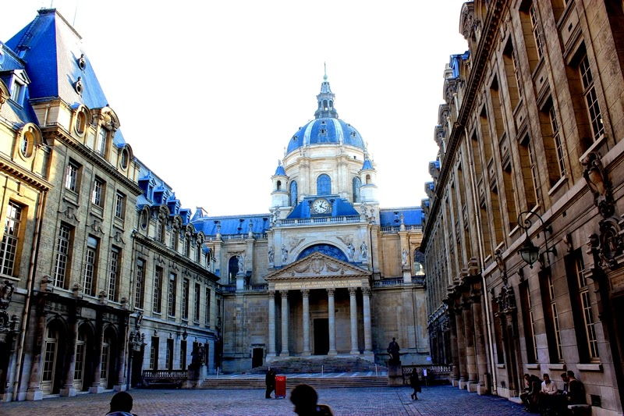
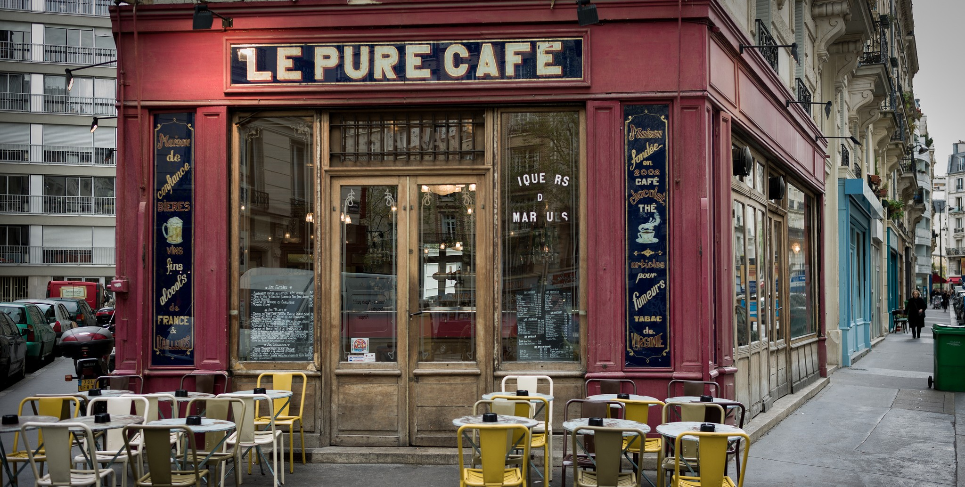
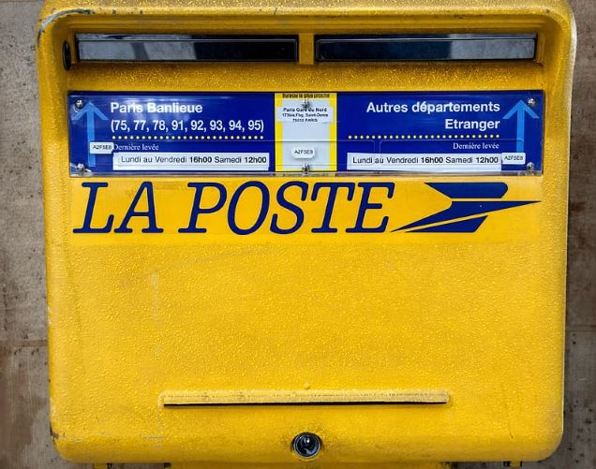
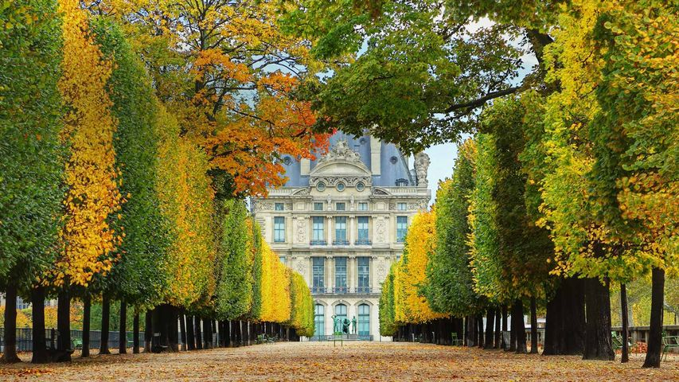
Paris [cont’d]
parler
Paris (cont’d)
7
Il y a une vieille...
université
café
8
Il y a aussi un beau...
poste
jardin
Notes:
Transcript
7. Il y a une vieille université.
8. Il y a aussi un beau jardin.

Slide 33
Describing more things and people
Pre-nominal position of certain common adjectives
Irregular feminine forms of adjectives
SSC [ç] and soft ‘c’ [revisited]
Y7 French
Term 3.1 - Week 6 - Lesson 60
Jane Wood / Stephen Owen / Natalie Finlayson
Artwork by: Chloé Motard
Date updated: 09/07/21
Notes:
Artwork by Chloé Motard. All additional pictures selected are available under a Creative Commons license, no attribution required.
Learning outcomes (lesson 1):
Consolidation of SSC [ç] and soft [c]
Consolidation of prenominal position of certain common adjectives
Consolidation of certain common irregular adjectival forms
Word frequency (1 is the most frequent word in French):
7.3.1.6 (introduce) belle [393], bonne [94], haut [264], nouveau [52], nouvelle [52], vieille [671], vieux [671], bâtiment [1952], église [1782], jardin [2284], pont [1889]
7.3.1.3 (revisit) langue¹ [712], maths [3438], matière¹ [562], musique [1139], nom¹ [171], science [1114], quel [146], quelle [146], que² [9], combien [800], pourquoi [193], parce que [n/a]
7.2.2.3 (revisit) tuer [591], affaires [170], fils [735], guerre [266], mère [645], père [569], vie [132], naturel [760], naturelle [760], heureux [764], heureuse [764], absolument [1009], contre [121]
Source: Londsale, D., & Le Bras, Y. (2009). A Frequency Dictionary of French: Core vocabulary for learners London: Routledge.
The frequency rankings for words that occur in this PowerPoint which have been previously introduced in NCELP resources are given in the NCELP SOW and in the resources that first introduced and formally re-visited those words.
For any other words that occur incidentally in this PowerPoint, frequency rankings will be provided in the notes field wherever possible.

Slide 34
Virelangue: c ou ç ?
Virelangue: c ou ç ?
écouter
Bonjour madame la saucissière, combien vendez-vous ces six saucisses-là ? Je les vends six sous, six sous ci , six sous ça, six sous ces six saucisses-là
Good day madam sausage-seller, For how much are you selling those six sausages?
I’m selling them for six sous (pennies) six sous for this one, six sous for that one, six sous for those sausages there.
Notes:
Timing: 5 minutes
Aim: Oral recognition and written production of hard [c], soft c and [ç] sounds.
Procedure:
1. Remind students of spelling rules: the cedilla is only needed to soften ‘c’ before letters ‘a’, ‘o’ and ‘u’, the letter ‘c’ being naturally soft before ‘e’ and ‘i’.
2. The teacher plays the tongue-twister (there are faster and slower options); students write in the missing letter – [c] or [ç] – in each gap.
3. The gaps are animated to disappear and reveal the answers.
Transcript
Bonjour madame la saucissière, combien vendez-vous ces six saucisses-là ? Je les vends six sous, six sous ci, six sous ça, six sous ces six saucisses-là.

Slide 35
Vocabulaire
Vocabulaire
écrire
10) good (m) 11) good (f) 12) the garden
8) beautiful (f) 9) new (m)
6) high/tall 7) old (f)
5) a church
3) the bridge 4) new (f)
1) the building 2) old (m)
Notes:
Timing: 8 minutes for 2 slides
Aim: Written and oral production of new vocabulary items
Procedure:
1. Students prepare for the task by writing 1-12 in their books.
2. Starting with the words at the bottom of the screen, students are challenged to write the French for the vocabulary items introduced this week before the blocks cover the English words. If students don’t immediately know the French, they should write down the English word, as the meaning may come to them later during the activity. NB: although bon is a known word which does not feature in this week’s set, it is included here for revision purposes as its feminine form bonne is introduced this week.
3. Check answers on the slide that follows and move on to the oral version of this task on slide 36.

Slide 36
Vocabulaire
Vocabulaire
parler
10) good (m) 11) good (f) 12) the garden
8) beautiful (f) 9) new (m)
6) high/tall 7) old (f)
5) a church
3) the bridge 4) new (f)
1) the building 2) old (m)
Notes:
As per instructions on slide 35, but with time available reduced. Students produce words orally.

Slide 37
Vocabulaire - réponses
Vocabulaire - réponses
parler / écrire
1) le bâtiment
2) vieux
3) le pont
4) nouvelle
5) une église
6) haut
7) vieille
8) belle
9) nouveau
10) bon
11) bonne
12) le jardin
Notes:
Answers for the activity on the previous slide.

Slide 38
Vocabulaire
Vocabulaire
lire / écrire
3) matière
_
_
1) pourquoi
_
2) maths
_
4) science
5) quel(le)
_
_
7) que
_
6) musique
_
8) langue
p a r c e q u e
__
__
__
__
__
__
__
__
Notes:
Timing: 3 minutes
Aim: Written recognition and production of some of the words in this week’s revisited set.
Procedure:
Students fill the gap in the words on screen.
The missing letters (in numerical order) spell another word from the vocabulary set.
Answers revealed on clicks.

Slide 39
Vocabulaire
lire / écrire
?
1. Activités économiques et financières.
2. How many?
3. Elle n’est pas triste. Elle est _______ .
4. Je suis opposé à l’idée. (synonym)
5. Enfant mâle.
6. Conflit entre des personnes.
7. Femme qui a un(e) enfant.
8. Homme qui a un(e) enfant.
9. Ce n’est pas artificiel. C’est ______ (m).
10. Prendre la vie d'une personne.
 |  | L | E | S |  | A | F | F | A | I | R | E
 |  |  | C | O | M | B | I | E | N
H | E | U | R | E | U | S | E
 |  |  |  |  | C | O | N | T | R | E
 | L | E |  | F | I | L | S
 |  | L | A |  | G | U | E | R | R | E
 |  |  | L | A |  | M | È | R | E
L | E |  | P | È | R | E
 |  |  |  |  |  | N | A | T | U | R | E | L
 |  |  |  |  |  | T | U | E | R
S
Notes:
Timing: 8 minutes
Aim: Written recognition and production of the remaining words in this week’s revisited set. NB: The activity can be adapted to suit the needs of the class by adding or deleting white boxes to cover letters in the words. Procedure: 1. Students read the questions and try to complete the crossword. Tell students that if they spell the solutions correctly, another word in the set will appear vertically underneath the arrow. 2. Teacher elicits answers by asking the French question. Student(s) volunteer(s) the answer (e.g. les affaires).
3. Teacher repeats the answer, and draws attention to any pronunciation points. 4. Teacher asks ‘Comment ça s'écrit?’ 5. Students in chorus (slowly and steadily) respond to spell out the answer: L-E-S-A-F-F-A-I-R-E-S-. As students spell the word, teacher reveals each letter on a click.

Slide 40
Vocabulary introduction
Adjectives – masculine
grammaire
Adjectives - masculine
Où va l’adjectif ?
bon
bleu
BAGS
moderne
nouveau
vert
vieux
calme
haut
beau
before
after
Notes:
Timing: 5 minutes for 2 slides.
Aim: Consolidation of the adjective placement rules learned last lesson, first with the masculine form of the adjectives, then with the feminine form.
Procedure:
Students can volunteer answers in any order.
Words are triggered.
Click the word and it flies to before/after.

Slide 41
Vocabulary introduction
Adjectives – feminine
grammaire
Adjectives - feminine
Où va l’adjectif ?
moderne
vieille
BAGS
bonne
verte
bleue
belle
calme
haute
nouvelle
before
after

Slide 42
Où est l’adjectif ? [1/10]
Où est l’adjectif ? [1/10]
lire
C’est la position A ou B pour l’adjectif?
une
A
B
vieille
église
[vieille]
Notes:
Timing: 6 minutes for 10 slides.
Aim: Written recognition of adjectives and associated placement rules.
Procedure:
Students identify position in which the adjective would appear in the phrase.
Teacher elicits answer by asking ‘A ou B’ ?
Answer revealed on click

Slide 43
Où est l’adjectif ? [2/10]
Où est l’adjectif ? [2/10]
lire
C’est la position A ou B pour l’adjectif?
ordinateur
modern
un
A
B
[modern]

Slide 44
Où est l’adjectif ? [3/10]
Où est l’adjectif ? [3/10]
lire
C’est la position A ou B pour l’adjectif?
un
A
vélo
B
beau
[beau]

Slide 45
Où est l’adjectif ? [4/10]
Où est l’adjectif ? [4/10]
lire
C’est la position A ou B pour l’adjectif?
une
A
voiture
B
nouvelle
[nouvelle]

Slide 46
Où est l’adjectif ? [5/10]
Où est l’adjectif ? [5/10]
lire
C’est la position A ou B pour l’adjectif?
un
A
hôtel
cher
B
[cher]

Slide 47
Où est l’adjectif ? [6/10]
Où est l’adjectif ? [6/10]
lire
C’est la position A ou B pour l’adjectif?
un
A
magasin
B
nouveau
[nouveau]

Slide 48
Où est l’adjectif ? [7/10]
Où est l’adjectif ? [7/10]
lire
C’est la position A ou B pour l’adjectif?
un
A
café
B
vieux
[vieux]

Slide 49
Où est l’adjectif ? [8/10]
Où est l’adjectif ? [8/10]
lire
C’est la position A ou B pour l’adjectif?
un
A
bâtiment
B
haut
[haut]

Slide 50
Où est l’adjectif ? [9/10]
Où est l’adjectif ? [9/10]
lire
C’est la position A ou B pour l’adjectif?
une
A
matière
facile
B
[facile]

Slide 51
Où est l’adjectif ? [10/10]
Où est l’adjectif ? [10/10]
lire
C’est la position A ou B pour l’adjectif?
une
belle
A
langue
B
[belle]

Slide 52
Dans un café à Nice
Dans un café à Nice
écouter
Écoute la conversation. C’est quel adjectif?
Circle your choice in the box.
 | petite / moderne |  | vieux / cher
 | nouveau / intéressant |  | vieille / intéressante
 | vieux / intéressant |  | belle / facile
 | petit / moderne |  | bon / intéressant
 | vieille / bleue |  | petit / moderne
1
6
2
7
3
8
4
9
5
10
Notes:
Timing: 5 minutes for 3 slides.
Aim: Aural recognition of word order patterns and connecting these with meaning.
Procedure:
1. Students write 1-10.
2. Click on a number to hear a sentence with the adjective obscured (wither before or after the noun).
3. Using their knowledge of adjective placement rules, students decide which adjective completes the sentence.
4. Answers appear on clicks. The full audio, with adjectives included, appears on the next slide.
5. Students listen to the full audio and take notes. They summarise the dialogue in English. A transcription and suggested translation can be found on slide 54.
Transcript
1) Où est la [petite] église ?
2) C’est derrière le [nouveau] pont.
3) Ce bâtiment-là, c’est un bâtiment [intéressant] ?
4) Non, c’est un [petit] magasin.
5) Tu as une voiture [bleue] ?
6) Ben, non, j’ai un [vieux] vélo.
7) Le français, c’est une [vieille] langue.
8) Oui, et c’est une [belle] langue aussi !
9) Ça, c’est un [bon] livre?
10) Oui, et c’est un livre [moderne].

Slide 53
Réponses
écouter
Dans un café à Nice
Réponses
 | petite / moderne |  | vieux / cher
 | nouveau / intéressant |  | vieille / intéressante
 | vieux / intéressant |  | belle / facile
 | petit / moderne |  | bon / intéressant
 | vieille / bleue |  | petit / moderne
1
6
2
7
3
8
4
9
5
10
Notes:
Answers to the listening activity on slide 52. The full audio, with adjectives included, plays on number clicks.
Transcript
1) Où est la petite église ?
2) C’est derrière le nouveau pont.
3) Ce bâtiment-là, c’est un bâtiment intéressant ?
4) Non, c’est un petit magasin.
5) Tu as une voiture bleu ?
6) Ben, non, j’ai un vieux vélo.
7) Le français, c’est une vieille langue.
8) Oui, et c’est une belle langue aussi !
9) Ça, c’est un bon livre?
10) Oui, et c’est un livre moderne.

Slide 54
Quel adjectif ?
Attention!
Which adjectives have a different position in English?
écouter
Quel adjectif ?
1
Où est la petite église ? Where is the little church?
- C’est derrière le nouveau pont. It’s behind the new bridge.
C’est un bâtiment intéressant ? Is it an interesting an building?
- Non, c’est un petit magasin. No, it’s a little shop.
Tu as une voiture bleue ? Do you have a blue car?
- Ben, non, j’ai un vieux vélo. Er … no, I have an old bike.
C’est un bon livre ? Is it a good book?
- Oui, et c’est un livre moderne. Yes, it’s a modern book.
Le français, c’est une vieille langue. French is an old language.
- Oui, et c’est une belle langue aussi ! Yes, and it’s a beautiful language too!
2
3
4
5
Notes:
Transcription and suggested translation of the text used in the activity on the previous slides. Suggested translations for each section appear on clicks.
Draw attention to the use of ben. Explain that this is a common filler word in French.

Slide 55
Parlez en français!
Parlez en français !
écouter / parler
Écoute ton/ta partenaire. Coche la description correcte ou écris la description en anglais.
Use the correct form of the adjective in French (masculine/feminine) in the correct position (before/after the noun).
e.g. C’est une matière facile.
[easy subject]
Notes:
Timing: 10 minutes for 6 slides
Aim: Oral and written production of sentences containing pre- and post-nominal adjectives in masculine and feminine forms.
Procedure:
1. Print and distribute the role cards and answer grids, available as a separate document on the NCELP Resource Portal. NB: The more challenging version removes the noun and adjective prompts from the answer grid.
2. Use this slide to model the speaking task.
3. Explain that students will take turns to describe what is in each box on their role card. The listening students ticks (or sketches/describes in words, if using the more challenging version) what they imagine the box to contain on their response sheet.
4. Peer-correction by comparing answer sheets.
5. Students use the notes they have taken to write full sentences about what appears on their partners’ cards. Suggested answers are displayed on the following slides.
N.B. in this task it has been impossible to make the grammar, in terms of the position of the adjective, task-essential (i.e. students can put the adjective before or after the noun and meanings will still be successfully conveyed). Teachers should circulate and listen in, offering feedback to prompt students to correct their adjectival placement as necessary.
Word frequency of cognates used in task instructions (1 is the most frequent word in French): description [2779], correct [2617]
Source: Londsale, D., & Le Bras, Y. (2009). A Frequency Dictionary of French: Core vocabulary for learners London: Routledge.

Slide 56
Parlez en français!
Parlez en français ! (A)
parler
A
1
2
3
Hahaha
[new building]
[intelligent girl]
[funny teacher]
5
[good question]
4
6
[beautiful idea]
[interesting subject]
Notes:
DO NOT DISPLAY. There is a student worksheet for this activity, which can be downloaded from the NCELP Resource Portal and printed out.
Home learning – the audio for each complete French sentence is accessible upon clicking the button.
Transcript
1. C’est un nouveau bâtiment.
2. C’est une fille intelligente.
3. C’est un professeur drôle.
4. C’est une belle idée.
5. C’est une matière intéressante.
6. C’est une bonne question.

Slide 57
Parlez en français!
Parlez en français ! (B)
parler
B
1
2
3
[beautiful building]
[new girl]
[interesting teacher]
[funny question]
4
5
6
Hahaha
[intelligent idea]
[good subject]
Notes:
DO NOT DISPLAY. There is a student worksheet for this activity, which can be downloaded from the NCELP Resource Portal and printed out.
Students have to describe what is in each box – their partner has to specify what they say, on one of the response sheets which follows. This is Partner B’s card. Two answer grids – an easier and a more difficult one – follow on the next two sides.
Home learning – the audio for each complete French sentence is accessible upon clicking the button.
Transcript
1. C’est un beau bâtiment.
2. C’est une nouvelle fille.
3. C’est un professeur intéressant.
4. C’est une idée intelligente.
5. C’est une bonne matière.
6. C’est une question drôle.

Slide 58
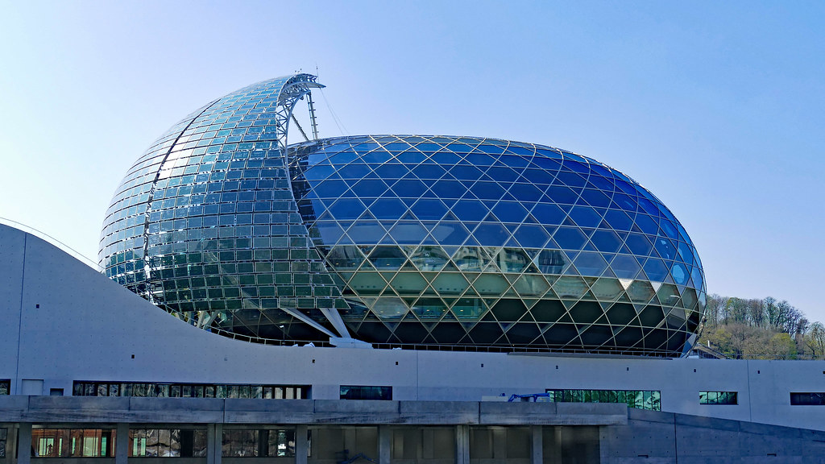
Utilise les cartes. Écris les 6 phrases.
Partenaire A
écrire
Remember!
- position
- agreement
1
C’est un nouveau bâtiment.
2
C’est une fille intelligente.
3
C’est un professeur drôle.
4
C’est une belle idée.
5
C’est une matière intéressante.
La Seine Musicale, Paris.
6
C’est une bonne question.
Notes:
Writing exercise with animated answers – Partner A.

Slide 59
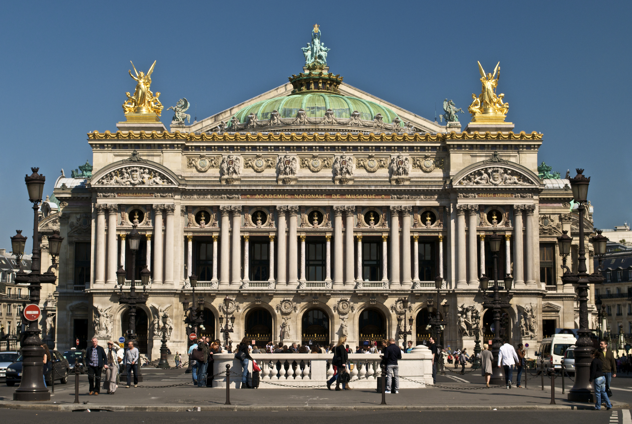
Utilise les cartes. Écris les 6 phrases.
Partenaire B
écrire
Remember!
- position
- agreement
1
C’est un beau bâtiment.
2
C’est une nouvelle fille.
3
C’est un professeur intéressant.
4
C’est une idée intelligente.
5
C’est une bonne matière.
C’est une question drôle.
Palais Garnier, Paris.
6
Notes:
Writing exercise with animated answers – Partner B.

Slide 60
Écris en français !
écrire
Écris en français !
Write some sentences contrasting your town/village with your ideal town/village. You could start as follows:
Dans mon village (idéal) / ma ville (idéale), il y a ...
Use the vocabulary from this sequence, and the dictionary to look up other places to mention.
Make longer sentences using these conjunctions (linking words):
et and comme like
mais but aussi also
ou or
Notes:
OPTIONAL EXTRA (could be set for homework)
Timing: 10 minutes
Aim: Free written production exercises bringing together all new vocabulary and grammar structures covered this week.
Procedure:
Students are now challenged to write some sentences of their own, contrasting their town/village with their ideal town/village (note that the conditional tense is not introduced at this stage), following the model of the sentences in this resource sequence.
Word frequency of cognates used in task instructions (1 is the most frequent word in French): idéal [1429]
Source: Londsale, D., & Le Bras, Y. (2009). A Frequency Dictionary of French: Core vocabulary for learners London: Routledge.

Slide 61
Gaming Grammar
Gaming Grammar
Relevant mini game(s):
Verbs (present): 1st person singular/plural (Verb agreement (present))
Verbs (present): 2nd person singular/plural (Verb agreement (present))
Verbs (present): 3rd person singular/plural (Verb agreement (present))
Notes:
This slide links to Gaming Grammar login screen. The appropriate mission can then be selected from the menu page.
Students will progress through the game at their own rate; teachers should use the teacher interface to check progress. This will help to inform future lesson planning.

Slide 62
Devoirs
Click below to revise all vocabulary learned in Year 7 so far!
Year 7 Term 1, 2 and 3.1 Vocabulary Revision Mashup

