Slide 1
Vocabulary
Y7 French
Term 3.1 - Week 1
Stephen Owen / Kirsten Somerville / Natalie Finlayson
Date updated: 17/04/20
Notes:
Frequency rankings of vocabulary introduced this week (1 is the most common word in French):
3.1.1 - apprendre [327], apprends [327], apprend [327] comprendre [95], comprends [43], comprend [43] prendre [43], prends [43], prend [43], erreur [612], facile [822]
Source: Londsale, D., & Le Bras, Y. (2009). A Frequency Dictionary of French: Core vocabulary for learners London: Routledge.

Slide 2
vocabulaire: verbes
prendre
[to take | taking]
prend
[takes | is taking]
Notes:
Introducing the verb prendre more explicitly. Prendre is one of the 25 most frequently used verbs in French. All 25 most frequent verbs will be introduced early on using the same format. Both long form (infinitive) and short form (3rd person singular) are introduced in order to familiarise students with the various forms of the same verb.
1. Bring up the word prendre on its own, say it, students repeat it (remind them of the phonics).
2. Try to elicit the meaning from the students.
3. Bring up the picture, and establish the meaning of the word in English, clearly, i.e., ‘to take’. 4. Bring up the short form prend, say it, students repeat it. Try to elicit the meaning from the students.

Slide 3
vocabulaire: verbes
prendre
[to take | taking]
prend
[takes | is taking]
Notes:
Cycle through the long and short form again.

Slide 4
vocabulaire: verbes
prend
[takes | is taking]
Chantal prend le train.
[Chantal takes | is taking the train.]
Notes:
Introduce the short form in a sentence.

Slide 5
vocabulaire: verbes
prendre
[to take | taking]
Chantal aime prendre le train.
[Chantal likes taking the train.]
Notes:
Introduce the long form in a sentence.

Slide 6
vocabulaire: verbes
prend
[takes | is taking]
Chantal ______ le train.
prend
[Chantal takes | is taking the train.]
Notes:
Cycle through the short form in context again.

Slide 7
vocabulaire: verbes
vocabulaire: verbes
prendre
[to take | taking]
Chantal aime ________ le train.
.
prendre
[Chantal likes taking the train.]
Notes:
Cycle through the long form in context again.

Slide 8
vocabulaire: verbes
apprendre
[to learn | learning]
apprend
[learns | is learning]
Notes:
Repeat as for the verb prendre.

Slide 9
vocabulaire: verbes
apprendre
[to learn | learning]
apprend
[learns | is learning]
Notes:
Repeat as for the verb prendre.

Slide 10
vocabulaire: verbes
apprend
[learns | is learning]
Elle apprend l'anglais.
[She learns | is learning English.]
Notes:
Repeat as for the verb prendre.

Slide 11
vocabulaire: verbes
apprendre
[to learn | learning]
Elle aime apprendre l'anglais.
[She likes learning English.]
Notes:
Repeat as for the verb prendre.

Slide 12
vocabulaire: verbes
apprend
[learns | is learning]
Elle ________ l'anglais.
apprend
[She learns | is learning English.]
Notes:
Repeat as for the verb prendre.

Slide 13
vocabulaire: verbes
apprendre
[to learn | learning]
Elle aime __________ l'anglais.
apprendre
[She likes learning English.]
Notes:
Repeat as for the verb prendre.

Slide 14
vocabulaire: verbes
comprendre
[to understand | understanding]
comprend
http://clipart-library.com/
[understands | is understanding]
Notes:
Repeat as for the verb prendre.

Slide 15
vocabulaire: verbes
comprendre
[to understand | understanding]
comprend
[understands | is understanding]
Notes:
Repeat as for the verb prendre.

Slide 16
vocabulaire: verbes
comprend
[understands | is understanding]
Fabien comprend la question.
[Fabien understands | is understanding the question.]
Notes:
Repeat as for the verb prendre.

Slide 17
vocabulaire: verbes
comprendre
[to understand | understanding]
Comprendre la question est important.
[Understanding the question is important.]
Notes:
Repeat as for the verb prendre.

Slide 18
vocabulaire: verbes
comprend
[understands | is understanding]
Fabien __________ la question.
comprend
[Fabien understands | is understanding the question.]
Notes:
Repeat as for the verb prendre.

Slide 19
vocabulaire: verbes
comprendre
[to understand | understanding]
Comprendre
____________ la question est important.
[Understanding the question is important.]
Notes:
Repeat as for the verb prendre.

Slide 20
The verb ‘prendre’ – to take
grammaire
We have seen how to form the third person singular of prendre:
The first and second person singular forms just add -s:
je prends
I take / I am taking
tu prends
you take / you are taking
il prend
he takes / he is taking
These verb forms all sound the same!
The –s on the je and tu forms is a silent final consonant (SFC)
elle prend
she takes / she is taking
Notes:
The first three persons singular of the verb prendre are now presented.
Point out to students that all three of these verb forms sound the same in French.

Slide 21
The verb ‘apprendre’ – to learn
grammaire
Before the vowel (a), je becomes j’
(like in ‘j’aime’)
The pattern is the same for apprendre (to learn):
j’apprends
I learn / I am learning
tu apprends
you learn / you are learning
il apprend
These verb forms all sound the same!
The –s on the je and tu forms is a silent final consonant (SFC)
he learns / he is learning
elle apprend
she learns / she is learning
Notes:
The first three persons singular of the verb apprendre are now presented.
Point out the contraction of je to j’ before the ‘a’ of apprends. Students have seen this previously, for example with j’ai , j’aime and j’étudie.
Point out to students that all three of these verb forms sound the same in French.

Slide 22
The verb ‘comprendre’ – to understand
grammaire
... and also for comprendre (to understand):
je comprends
I understand / I am understanding
tu comprends
you understand / you are understanding
il comprend
he understands / he is understanding
These verb forms all sound the same!
The –s on the je and tu forms is a silent final consonant (SFC)
elle comprend
she understands / she is understanding
Notes:
The first three persons singular of the verb comprendre are now presented.
Point out to students that all three of these verb forms sound the same in French.

Slide 23
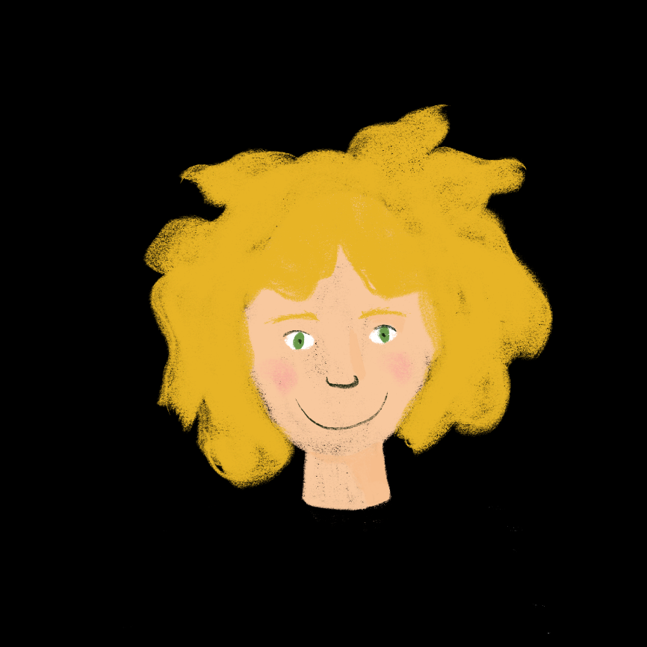
Vocabulaire
lire / écrire
Complète la conversation de Léa et Amir :
apprendre
comprendre
prendre
erreurs
lire
apprends
comprends
prends
facile
apprend
comprend
prend
Tu __________ quoi au collège, Amir ?
Pourquoi ? Ça __________ des heures …
L’anglais. Je trouve ça __________.
Pour __________ la musique anglaise !
Je fais souvent des __________ en anglais !
C’est vrai… J’aime __________ des vacances en Angleterre et écouter la radio anglaise.
Je __________ ça… c’est normal !
J’ai un cousin qui __________ l’anglais à l’université. Il __________ le rap rapide en anglais, c’est cool !
__________ l’anglais est difficile. Tu fais quoi ?
Je __________ le temps de faire les devoirs.
Notes:
This slide practises the vocabulary introduced this week, requiring students to pay attention to meaning and form in context. It also incorporates two items of revisited vocabulary, and two examples of intonation questions, which will be returned to when introducing subject-verb inversion.
Students write the missing words in order. To extend the activity, the conversation can be translated into English (a suggested translation follows on the next slide).
NB: Students may need some guidance when translating ‘Je prends le temps de faire les devoirs’. This use of ‘de’ + infinitive has not been encountered before, but the meaning may be arrived at by starting with ‘the time of doing the homework’ and working towards a more natural English expression of this idea.
Frequency rankings of vocabulary introduced this week (1 is the most common word in French):
3.1.1 - apprendre [327], apprends [327], apprend [327] comprendre [95], comprends [43], comprend [43] prendre [43], prends [43], prend [43], erreur [612], facile [822]
Frequency rankings of vocabulary revisited this week (1 is the most common word in French):
2.2.3 - pourquoi [193], frapper [745], ressembler [1398], cœur [568], temps [65], si [34], noir [572], blanc [708]
2.1.2 - êtes [5], sommes [5], sont [5], frère [1043], parent [546], sœur [1558], jeune [152], ouvert [897], sage [2643], strict [1859]
Frequency rankings of non-SOW (near-)cognates (1 is the most common word in French):
compléter [2034], conversation [1747], heure [99], musique [1139], rap [>5000], cool [>5000], normal [833]
Source: Londsale, D., & Le Bras, Y. (2009). A Frequency Dictionary of French: Core vocabulary for learners London: Routledge.

Slide 24
Vocabulaire
lire / écrire
Voici la conversation en anglais :
What are you learning at school, Amir?
Why? It takes hours…
English. I find it easy.
To understand English music!
I often make mistakes in English!
That’s true… I like taking holidays in England and listening to English radio.
I understand that… It’s normal!
I have a cousin who is learning English at university. He understands fast rap in English, it’s cool!
Learning English is difficult. What do you do?
I take time to do the homework.
Notes:
Suggested translation. Attention can be drawn to the choice between present simple and continuous translations in English – how did students choose between them?
Both versions are possible with similar meanings in some cases (eg. ‘I like taking / to take holidays in England’), different meanings in others (eg. ‘what are you learning [now] / do you learn [in general] at school?’), whilst in other cases the continuous would sound unnatural (eg. ‘I am understanding that’).

