Slide 1
Principles of Teaching Grammar
Dr Rowena Kasprowicz
& Professor Emma Marsden

Slide 2
MFL Pedagogy Review
General principles
Grammar is a key part of communication
Grammatical knowledge is cumulative
Certain bits of grammar are problematic and need to be taught directly
Key recommendations
Provide an explicit but succinct description of the grammatical feature to be taught
Provide practice of the grammar point in ‘input language’
(reading / listening)
Provide practice in productive use of the features being taught
Practice productive use in free writing and speech in a range of contexts
Utilise standard grammatical terminology
Build on knowledge developed at key stage 2
Meaningful practice (Tomorrow morning)
(Bauckham, 2016)
Notes:
Time spent: 2 min
Actual time: 14:03

Slide 3
Session Outline
A bit of background…
What do we mean by grammar teaching?
Should we teach grammar?
Principles underpinning the key recommendations…
Explaining the grammatical rule
Practising in ‘input language’
Using standard terminology & Building on KS2 learning
Notes:
Time spent: 2 min
Actual time: 14:04

Slide 4
What Do We Mean By Grammar Teaching?
“any instructional technique that draws learners’ attention to some specific grammatical form in such a way that it helps them either to understand it metalinguistically and/or process it in comprehension and/or production so that they can internalise it”
(Ellis, 2006, p. 84)
Explaining a grammatical rule
Practice recognising a grammatical feature in reading / listening
Practice using a grammatical feature in
writing / speaking
Discovering new grammatical rules incidentally
Feedback on errors
Notes:
Time spent: 3 min
Actual time: 14:07

Slide 5
What Do We Mean By Grammer Teaching?
(Implicit)
(Explicit)
Focus on MEANING
Provide extensive input
Grammar features acquired naturally
No explicit instruction or feedback
Focus on FORM
Incidental
Exposure through communicative activities
‘Notice’ grammar features that cause difficulty
Focus on FORMS
Intentional
Pre-planned
Grammar taught in isolation
Mechanical drills
(Long & Robinson, 1998)
Notes:
Time spent: 3 min
Actual time: 14:10

Slide 6
Should We Teach Grammar?
Instruction can speed up the rate of learning (e.g. White, Spada, Lightbown, & Ranta, 1991)
and…
Instruction can influence the route of learning (e.g. Avery & Marsden, under review; N. Ellis, 2006; McManus & Marsden, 2017, 2018; Murakami & Alexopoulou, 2016; Tolentino & Tokowicz, 2014)
but …
dependent upon the grammar feature and learner characteristics
(L1-L2, individual differences) and more evident for some contexts, tasks
and tests than others
Notes:
Time spent: 2 min
Actual time: 14:12

Slide 7
Should We Teach Grammar?
The accuracy with which a particular grammar feature is acquired is influenced by…
salience
complexity
communicative usefulness
frequency
context in which it is used
(DeKeyser, 2005)
Notes:
Time spent: 2 min
Actual time: 14:14

Slide 8
Should We Teach Grammar?
Instruction can be beneficial (e.g. Norris & Ortega, 2000, 2001; Spada & Tomita, 2010)
Substantial learning gains following (any) instruction
Learning gains tend to be durable
More explicit types of instruction > More implicit types of instruction
For simple and complex grammatical forms
On more controlled (e.g. gap-fill) & free tasks (e.g. conversational)
Notes:
Time spent: 3 min
Actual time: 14:17

Slide 9
Should We Teach Grammar?
We learn things we pay attention to (e.g. Schmidt, 1990, 2001)
Learners need to notice (consciously register) a grammar feature for it to be learned
Instruction: Focus learners’ attention on particular parts of the language (Sharwood-Smith, 1993)
“consciousness-raising” activities (Sharwood-Smith, 1993)
(Implicit) learning from exposure takes a long time
Notes:
Time spent: 3 min
Actual time: 14:20

Slide 10
The Key Recommendations
Provide an explicit but succinct description of the grammatical feature to be taught
Provide practice of the grammar point in ‘input language’ (comprehension)
Provide practice in productive use of the features being taught
Practice productive use in free writing and speech in a range of contexts
Utilise standard grammatical terminology
Build on knowledge developed at key stage 2
Notes:
Time spent: 1 min
Actual time: 14:21

Slide 11
Explicit, Succinct Description of the Grammatical Feature
Example: French 1st person present vs. Past tense (Marsden, 2006)
Present Past
Explain the grammatical rule
Je fais J ’ ai fait
Je dis J ’ ai dit
Focus on one pair of meanings
The problem is that learners of French often write and say
je faire or je fait not j ’ ai.
Perhaps they find this difficult because je and j ’ ai sound a bit similar!
Also, words like 'le weekend dernier' already tell us it is in the past, so we don't notice j ’ ai.
Explain the problem(s) the learner might encounter
Notes:
Time spent: 2 min
Actual time: 14:23

Slide 12
Explicit, Succinct Description of the Grammatical Feature
Knowledge about a language feature
Knowledge about how to use a language feature
Fast and accurate use of the language feature
Extensive, repeated, meaningful practice
(DeKeyser, 2015)
Notes:
Time spent: 3 min
Actual time: 14:26

Slide 13
Explicit, Succinct Description of the Grammatical Feature
Providing an explanation can help learners to…
…‘break down’ and organise the language they hear / read (Terrell, 1991)
… notice particular language features (Schmidt, 1990)
… pick up language features more quickly (e.g. Henry, et al., 2009)
Deductive approaches > Inductive approaches (Erlam, 2003; Robinson, 1996)
Notes:
Time spent: 3 min
Actual time: 14:29

Slide 14
Explicit, Succinct Description of the Grammatical Feature
May not be essential to learning, if practice fosters inductive learning
(i.e. practice pushes learners to attend to the grammatical feature and work out the rules) (DeKeyser & Prieto-Botana, 2015)
Explanation + practice vs. Practice only → equivalent learning outcomes (e.g. Benati, 2004; Farley, 2004; Marsden, 2006; VanPatten & Oikennon, 1996)
BUT
Facilitative effect of providing explanation before practice
Explanation + practice vs. Practice only
Speed up the learning process
(e.g. Henry, et al., 2009; Henry, et al., 2017; VanPatten & Borst, 2012)
Particularly beneficial for more complex grammatical forms
(e.g. Fernández, 2008)
Notes:
Time spent: 4 min
Actual time: 14:33

Slide 15
Explicit, Succinct Description of the Grammatical Feature
Is information about the L1 and L1-L2 differences also useful?
Awareness of L1-L2 differences relates to L2 performance (Ammar, Lightbown, & Spada, 2010)
Providing information about grammatical meanings that are mapped differently in L1 / L2 can be beneficial (e.g. McManus & Marsden, 2017; McManus & Marsden, 2018; McManus & Marsden, 2019)
Notes:
Time spent: 3 min
Actual time: 14:36

Slide 16
Explicit, Succinct Description of the Grammatical Feature
L1&L2 information and practice → improvement in reading and listening
‘Remapping’ concepts and reinforcing correct L2 form-meaning mappings
(McManus & Marsden, 2017; 2018)
Two forms in French could map onto one form in English
One form in French could map onto two forms in English
Il jouait au foot…
Il a joué au foot…
(Trying ‘used to…’ could help to disambiguate)
He played football...
…quand j’ai appelé.
…quand nous étions petits.
He was playing football, when I called.
Il jouait au foot…
He played football, when we were little.
Notes:
Time spent: 4 min
Actual time: 14:40

Slide 17
The Key Recommendations
✓
Provide an explicit but succinct description of the grammatical feature to be taught
Provide practice of the grammar point in ‘input language’ (comprehension)
Provide practice in productive use of the features being taught
Practice productive use in free writing and speech in a range of contexts
Utilise standard grammatical terminology
Build on knowledge developed at key stage 2
Notes:
Time spent: 1 min
Actual time: 14:41

Slide 18
Practice of the Grammar Point In ’Input Language’
In pairs / small groups, discuss the example activities taken from standard Key Stage 3 textbooks.
Discuss these questions:
Which grammar feature(s) are the activities practising?
What are the activities asking the students to do?
What are the activities asking the students to pay attention to?
Notes:
Time spent: 7 min (5 mins discussion + 2 mins feeding back)
Actual time: 14:48

Slide 19
Practice of the Grammar Point In ’Input Language’
Common elements in ‘typical’ grammar activities:
Introduce whole paradigm /
multiple grammatical features
Written / aural texts providing lots of examples
Focus on content words; possible for learners to complete activities without paying attention to the key grammatical feature(s)
Scaffolded production practice; possible for learners to copy patterns without paying attention to the function/meaning of the grammatical feature(s)
Something missing?
Reading / Listening practice requiring attention to the grammatical feature
Notes:
Time spent: 2 min
Actual time: 14:56

Slide 20
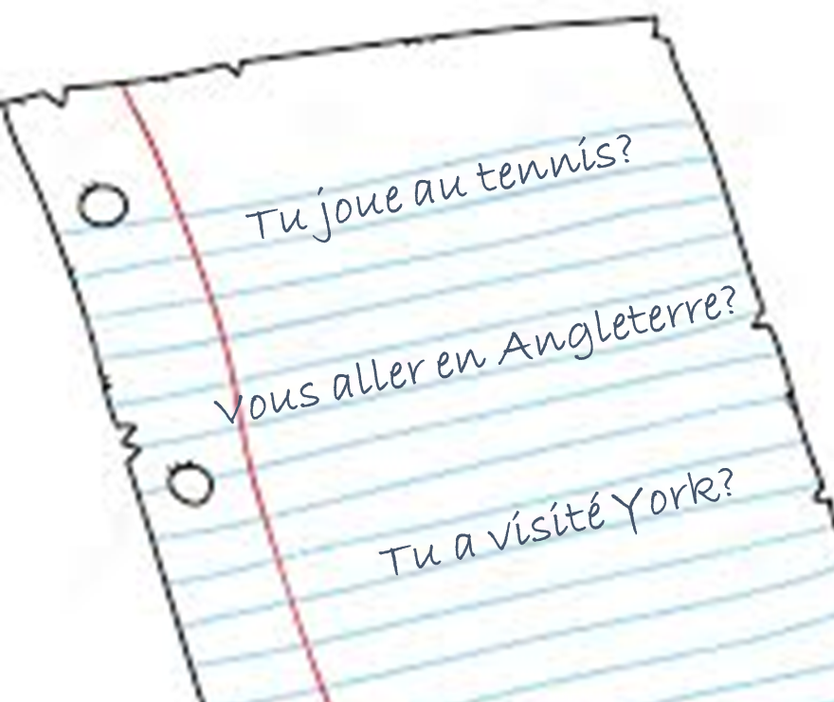
Practice of the Grammar Point In ’Input Language’
Why is it important to give learners practice paying attention to grammar in ‘input language’?
→ Some grammar features are particularly hard to notice and learn
→ Some grammar features are often overlooked / ignored by learners
→ Lack of accuracy in learners’ use of particular grammatical features
Le garcon m’appelle
Le weekend dernier je manger
Notes:
Time spent: 2 min
Actual time: 14:58

Slide 21
Practice of the Grammar Point In ’Input Language’
Do these mistakes matter?
Natural, developmental errors
Chunks are very useful
Too much emphasis on accuracy = demotivating!
Need fluency, complexity, risk-taking
BUT
Useful to breakdown and analyse chunks
Gradually become more accurate in using grammar
No
Yes
Notes:
Time spent: 2 min
Actual time: 15:00

Slide 22
Practice of the Grammar Point In ’Input Language’
Why are certain bits of grammar problematic?
Low frequency?
Poor knowledge of rules?
BUT these do not fully explain the errors…
→ ‘Noticing and extracting’ some features of the input seems to be difficult
Je fais du ski.
J’ai fait du ski.
Notes:
Time spent: 1 min
Actual time: 15:01

Slide 23
Why Are Certain Grammar Features Problematic?
One reason:
Another part of the sentence might express a similar meaning
And learners are familiar with or expect that part
Le weekend dernier j’ai mangé
It happened in the past!
Ignored!
Notes:
Time spent: 1 min
Actual time: 15:02

Slide 24
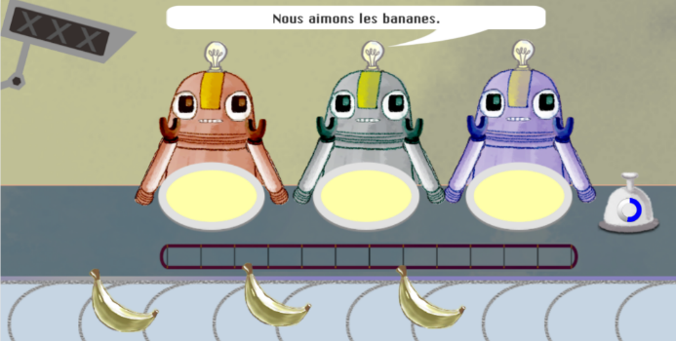
Feed ONE robot or ALL of the robots?
Practising present
tense 1st person singular/plural verb endings in French
High accuracy when pronoun is present
Drop in accuracy when pronoun is removed
Increase in accuracy when attention is on the verb ending
Notes:
Time spent: 2 min
Actual time: 15:04

Slide 25
Why Are Certain Grammar Features Problematic?
Low communicative salience (VanPatten, 2004)
Meaning expressed by another, more salient element of the sentence
More salient cue ‘overshadows’ less salient, cue (N. Ellis 2006)
Prior knowledge of more salient cues (e.g. temporal adverbs) can ‘block’ learning of other cues (e.g. verb inflections) (N. Ellis 2006)
Low perceptual salience e.g. inflections (N. Ellis, 2006)
Hard to hear / easy to overlook
Often short and not stressed / emphasised
Fluent speakers perceive such elements with
top-down support of existing language knowledge
Importance of building knowledge of verbs to facilitate learning of inflections
Notes:
Time spent: 2 min
Actual time: 15:06
N. Ellis (2006, p. 171) and p. 180
Learners often encouraged to rely on temporal adverbs (effective strategy to aid understanding and communication), knowledge of temporal adverbs from L1 and their meaning / function conveying temporality. But reliance on such cues can mean that the less salient cues e.g. verb inflections are overlooked and can be ‘blocked’ from being learned.
Marsden & David, 2008 – size of verb lexicon correlated positively with inflectional diversity (UK learners Year 9 vs. A-level)

Slide 26
Why Are Certain Grammar Features Problematic?
One reason:
English ‘habits’ entrenched
Der Mann verfolgt den Hund.
Subject (almost) always comes first in English
Ignored!
Notes:
Time spent: 1 min
Actual time: 15:07

Slide 27
Why Are Certain Grammar Features Problematic?
Some ‘cues’ are more reliable in some languages than others (MacWhinney, 2002)
Different meaning
Then man chased the dog. Der Mann verfolgt den Hund.
The dog chased the man. Den Hund verfolgt der Mann.
Same
meaning
Learners apply the reliable ‘cues’ from their L1, when interpreting the L2
e.g. L1 English learners rely on word order and overlook case marking in L2 German
(even though case marking is more reliable in German)
(e.g. Jackson, 2007; Kasprowicz & Marsden, 2017; MacWhinney, 2002)
Notes:
Time spent: 3 min
Actual time: 15:10

Slide 28
Why Are Certain Grammar Features Problematic?
Understanding a new language through the ‘lens’ of our previous language experience (N. Ellis, 2006)
Existing (L1) form-meaning associations compete for attention with new associations
Similarities / differences between L1 and L2 → ‘Positive’ / ‘negative’ transfer
Notes:
Time spent: 3 min
Actual time: 15:10

Slide 29
Why Are Certain Grammar Features Problematic?
One reason:
Common sense, expectations
The children
works in a bank.
The man
Children don’t work in banks!
Ignored!
Notes:
Time spent: 1 min
Actual time: 15:11

Slide 30
Practice of the Grammar Point In ’Input Language’
Reading & Listening
What can we do? Focused practice in ‘input language’ to…
…draw learners’ attention to problematic grammatical features
…and make those grammatical features matter
…by temporarily removing the cues that learners rely on.
Notes:
Time spent: 1 min
Actual time: 15:12

Slide 31
Practice of the Grammar Point In ’Input Language’
Form-meaning mapping 50+ experimental studies (in classrooms, as well as laboratories) since early 1990s, e.g.
French verb inflections with 11 to 14 year olds (Marsden, 2006)
German case marking with 9 to 11 year olds (Kasprowicz & Marsden, 2017)
Evidence suggests benefits for:
Improving analysis of language
‘Training the ear’ to notice small phonemic differences (e.g. je / j’ai)
Improving comprehension and production
A range of ages, proficiencies, languages, grammar features
Notes:
Time spent: 2 min
Actual time: 15:13

Slide 32
Practice of the Grammar Point In ’Input Language’
Example: English present tense subject-verb agreement (3rd person singular vs plural)
Separated subject noun phrase and verb
and
removed real world expectations
→ Use verb inflection and connect to meaning to identify the subject of the sentence
The following sentences have become jumbled.
Underline who you think does the activities:
1. The cat / parents
2. The child / men
3. The baby / parents
4. The child / adults
walks the dog
work in a bank
cry all night
listen to the news
Notes:
Time spent: 2 min
Actual time: 15:15

Slide 33
Practice of the Grammar Point In ’Input Language’
Example: French 1st person present versus past tense with avoir (je vs. j’ai)
Listen to these people talking about what they normally do at the weekend and what they did last weekend. You will hear each sentence twice.
Removed temporal adverb
and
kept main verb constant
(no phonemic difference between present tense and past participle, e.g. fais vs. fait)
→ Use presence/absence of auxiliary and connect to meaning to identify the tense
You will hear the whole sentence but the only clue is whether you hear “je” (something happens regularly) or “j’ai” (past).
1. Normalement Le weekend dernier
2. Normalement Le weekend dernier
3. Normalement Le weekend dernier
4. Normalement Le weekend dernier
5. Normalement Le weekend dernier
(Marsden, 2006)
Notes:
Time spent: 3 min
Actual time: 15:18

Slide 34
Practice of the Grammar Point In ’Input Language’
Example: German definite article case marking for masculine nouns (der vs. den)
1. Der Affe begrüβt den Panda.
Removed word order cue
and
removed real world expectations
→ Use case marking and connect to meaning to identify subject and object
A
B
2. Den Löwen erschreckt der Hamster.
A
B
(Kasprowicz & Marsden, 2017)
Notes:
Time spent: 2 min
Actual time: 15:20

Slide 35
Practice of the Grammar Point In ’Input Language’
Avoid working with whole paradigms at one time, particularly in the first stages of language learning
Attention is a limited resource; learners can only pay attention to so much at any one time (Lee & VanPatten, 1995; VanPatten, 2002; Wong, 2004)
Focus on accurate and reliable knowledge of one form juxtaposed with another (e.g. je joue vs. nous jouons)
Provide plenty of practice for each pair of grammatical forms/meaning
Gradually build up wider system
Notes:
Time spent: 2 min
Actual time: 15:22

Slide 36
The Key Recommendations
✓
Provide an explicit but succinct description of the grammatical feature to be taught
Provide practice of the grammar point in ‘input language’ (comprehension)
Provide practice in productive use of the features being taught
Practice productive use in free writing and speech in a range of contexts
Utilise standard grammatical terminology
Build on knowledge developed at key stage 2
✓
Meaningful practice (tomorrow morning)
Notes:
Time spent: 1 min
Actual time: 15:23

Slide 37
Utilise Standard Grammatical Terminology
Utilise Standard Grammatical Terminology
Build on Knowledge Developed at key Stage 2
KS2 English curriculum:
“Grammar should be taught explicitly: pupils should be taught the terminology and concepts set out in English Appendix 2, and be able to apply them correctly to examples of real language, such as their own writing or books that they have read.”
Notes:
Time spent: 1 min
Actual time: 15:24

Slide 38
Utilise Standard Grammatical Terminology
Build on Knowledge Developed at key Stage 2
KS2 languages curriculum:
“understand basic grammar relevant to the language being studied, including (where relevant): feminine, masculine and neuter forms and the conjugation of high-frequency verbs; key features and patterns of the language; how to apply these, for instance to build sentences; and how these differ from or are similar to English”
Notes:
Time spent: 1 min
Actual time: 15:25

Slide 39
Utilise Standard Grammatical Terminology
Build on Knowledge Developed at key Stage 2
Issues around transition, but:
Extensive learning about L1 English grammar (SPaG test in Year 6 SATs) at KS1 and KS2
(At least some) foreign language grammar teaching is happening at KS2
And…
Sense of progression key to motivation and engagement
(Graham et al, 2016)
Younger learners can benefit from instruction in grammar
(Kasprowicz & Marsden, 2017; Lichtman, 2016; Marsden & Chen, 2011)
Drawing comparisons between English and another language is useful
(McManus & Marsden, 2017)
Younger learners are able to engage in ‘analysis of language’, if taught how to (Bouffard & Sarkar, 2008)
Notes:
Time spent: 2 min
Actual time: 15:27

Slide 40
Summary
Lots of evidence that teaching grammar is helpful
Many factors that can make grammar difficult to learn (hard to perceive, differences with L1, meaning duplicated elsewhere)
Useful to keep these in mind when planning what to teach, when, and how
Drawing learners attention to these potential causes of difficulty can be useful
Make sure there are opportunities for practice where the learner has to pay attention to the grammar and its meaning
Notes:
Time spent: 2 min
Actual time: 15:29

Slide 41
References
Ammar, A., Lightbown, P., & Spada, N. (2010). Awareness of L1/L2 differences: Does it matter? Language Awareness 19(2), 129-146.
Avery & Marsden (under review) A meta-analysis of sensitivity to grammatical information during self-paced reading in a second language.
Bauckham, I. (2016). Modern foreign languages pedagogy review: A review of modern foreign languages teaching practice in key stage 3 and key stage 4. Teaching Schools Council
Benati, A. (2004). The roles of explicit information and structured input. In B. VanPatten (Ed.), Processing instruction: Theory, research, and commentary. Mahwah, NJ: Lawrence Erlbaum Associates.
DeKeyser, R. (2015). Skill acquisition theory. In B. VanPatten & J. Williams (Eds.), Theories in second language acquisition: An introduction (pp. 94–112). London, UK: Routledge.
DeKeyser, R., & Prieto Botana, G. (2015). The effectiveness of processing instruction in L2 grammar acquisition: A narrative review. Applied Linguistics, 36, 290–305.
Dulay, H., & Burt, M. (1974). Natural sequences in child second language acquisition. Language Learning, 24(1), 37-53.
Ellis, N. (2006). Selective attention, and transfer phenomena in L2 acquisition: Contingency, cue competition, salience, interference, overshadowing, blocking, and perceptual learning. Applied Linguistics, 27(2), 164-194.
Erlam, 2003). The effects of deductive and inductive instruction on the acquisition of direct object pronouns in French as a second language. The Modern Language Journal, 87(2), 242-260.
Farley, A. P. (2004). Processing instruction and Spanish ser and estar: Forms with semantic-aspectual values. In B. VanPatten (Ed.), Processing instruction: Theory, research, and commentary. Mahwah, NJ: Lawrence Erlbaum Associates.
Fernández, C. (2008). Re-examining the role of explicit information in Processing Instruction. Studies in Second Language Acquisition, 30, 277–305.
Graham, S., Courtney, L., Tonkyn, A., & Marinis, T. (2016). Motivational trajectories for early language learning across primary-secondary school transition. British Educational Research journal, 42(4), 682-702.

Slide 42
References
Harley, B. (1992). Patterns of second language development in French immersion. French Language Studies, 2, 159-183.
Henry, N., Culman, H., & VanPatten, B. (2009). More on the effects of explicit information in instructed SLA. Studies in Second Language Acquisition, 31, 559–575.
Henry, et al., 2017; The role of prosody and explicit instruction in processing instruction. The Modern Language Journal, 101(2), 1-21.
Keck, C. & K, Y-J. (2015). Pedagogical grammar. Amsterdam: John Benjamins Publishing Company.
Horst, M., White, J., & Bell, P. (2010). First and second language knowledge in the language classroom. International Journal of Bilingualism, 14, 331–349.
Krashen, S. (1982). Principles and practice in second language acquisition. Pergamon Press Inc.
Long, M., & Robinson, P. (1998). Focus on form: Theory, research, and practice. In, C. Doughty, & J. Williams (eds), Focus on form in classroom second language acquisition (pp. 15-41). Cambridge: Cambridge University Press.
Marsden, E. (2006). Exploring input processing in the classroom: An experimental comparison of processing instruction and enriched input. Language Learning, 56, 507–566.
Marsden, E., & Chen, H.-Y. (2011). The roles of structured input activities in processing instruction and the kinds of knowledge they promote. Language Learning, 61, 1058–1098.
Marsden, E., & David, A. (2008). Vocabulary use during conversation: A cross-sectional study of development from year 9 to year 13 among learners of Spanish and French. Language Learning Journal, 36, 181–198
McManus, K. & Marsden, E. (2017). L1 explicit instruction can improve L2 online and offline comprehension. Studies in Second Language Acquisition, 39, 459-492.
McManus, K. & Marsden, E. (2018). Online and offline effects of L1 practice in L2 grammar learning: A partial replication. Studies in Second Language Acquisition, 40, 459-475.

Slide 43
References
McManus, K. & Marsden, E. (2019). Signatures of automaticity during practice: Explicit instruction about L1 processing routines can improve L2 grammatical processing. Applied Psycholinguistics.
Murakami, A., & Alexopoulou, T. (2016). L1 influence on the acquisition order of English grammatical morphemes. Studies in Second Language Acquisition, 28, 365-401.
Norris, J., & Ortega, L. (2001). Does type of instruction make a difference? Substantive findings from a meta-analytic review. Language Learning, 51(S1), 157-213.
Robinson, P. (1996). Learning simple and complex second language rules under implicit, incidental, rule search, and instructed conditions. Studies in Second Language Acquisition, 18, 27-67.
Schmidt, R. (1990). The role of consciousness in second language learning. Applied Linguistics, 11(2), 129-158.
Spada, N., & Tomita, Y. (2010) Interactions between type of instruction and type of language feature: A meta-analysis. Language Learning, 60(2), 263-308.
Terrell, T. (1991). The role of grammar instruction in a communicative approach. The Modern Language Journal, 75(1), 52-63.
Tolentino, L., & Tokowicz, N. (2014). Cross-language similarity modulates effectiveness of second language grammar instruction. Language Learning, 64, 279–309.
VanPatten, B. (2002). Processing instruction: An update. Language Learning, 52(4), 755-803.
VanPatten, B., & Borst, S. (2012). The role of explicit information and grammatical sensitivity in processing instruction: Nominative-accusative case marking and word order in German L2. Foreign Language Annals, 45, 495–510.
VanPatten, B., & Oikkenon, S. (1996). Explanation versus structured input in processing instruction. Studies in Second Language Acquisition, 18, 495–510.
White, L., Spada, N., Lightbown, P., & Ranta, L. (1991). Input enhancement and L2 question formation. Applied Linguistics, 12(4), 416-432.

