Slide 1
Ofsted framework & NCELP
https://resources.ncelp.org/
Rachel Hawkes / Emma Marsden
Date updated: 7/7/20
Notes:
I removed ‘new’ from the title. The framework itself doesn’t now seem ‘new’. Though, of course, there won’t have been many inspections using it, of course! Despite the uncertainty surrounding the next academic year, it still seems useful to consider the Ofsted framework and NCELP side by side, or use the Ofsted framework as another lens through which we can consider NCELP principles. So...
Ofsted framework and NCELP
The Ofsted framework emphasises the centrality of curriculum to its quality of education judgements. Three inter-related dimensions – intent, implementation and impact - are implicated, as follows: “Leaders and teachers design, structure and sequence a curriculum, which is then implemented through classroom teaching. The end result of a good, well-taught curriculum is that pupils know more and are able to do more.” (p.3, Ofsted, 2019a).
There is a document on the portal – if you search ’new Ofsted framework and NCELP’ which lays out in a much more detailed way some of the ideas in this part of this morning’s session. I’d also encourage you to read that together with the pedagogy rationales (if you search ‘rationale’) you’ll find all these, too.

Slide 2
FAQ in schools this year
What is the essential knowledge in your subject?
Why are you teaching it in this order?
Is teaching clear and do learners understand?
Do they remember more, know more and can they do more? (And how do you know?)
Notes:
I’ve structured this presentation around four key questions that I WAS seeing and hearing a lot in the schools in my trust and others that I go into, back when I went into schools.

Slide 3
Q1. Essential language knowledge
most useful subject content
learning is carefully planned
end points are identified
Notes:
The first question speaks to Ofsted new framework’s questions about curriculum design: Is the subject content that’s been chosen the most useful and has the learning being carefully planned and mapped out in such a way that the end points are clearly identified.

Slide 4
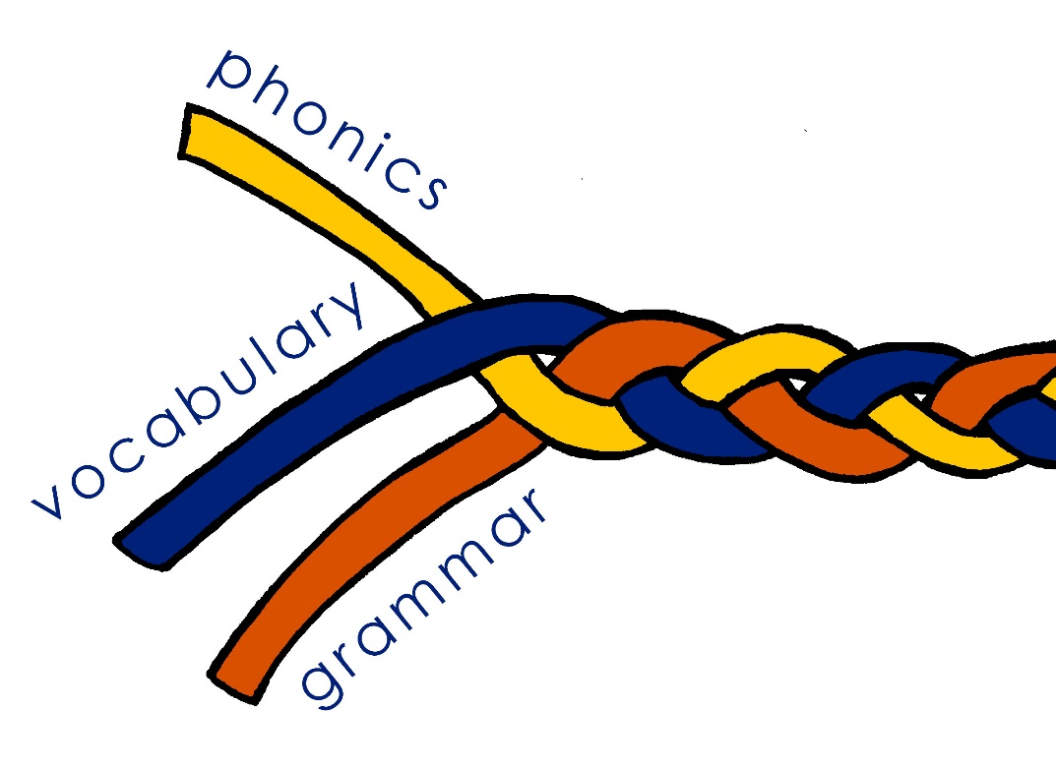
Essential language knowledge (for beginner language learners)
Pupils need to gain systematic knowledge of the vocabulary, grammar, and sound and spelling systems (phonics) of their new language, and how these are used by speakers of the language. They need to reinforce this knowledge with extensive planned practice and use it in order to build the skills needed for communication. (MFL Pedagogy Review, p.3)
Notes:
This slide draws together what Emma has already talked about. Here I just recap it as the answer to the question, when as subject leaders we are asked that question:
So, what is the subject content that we teach in languages? What is the essential knowledge? We teach three core strands of essential knowledge: phonics, which is the set of sound-symbol correspondences that represent the relationship between how the language sounds and how it is written; we teach vocabulary, a chosen set of words in the language, and we teach grammar – a set of features that are the essential building blocks needed to put language together to make meaningful sentences.
Emma may have said this, so I don’t need to repeat it!
The metaphor of the braid indicates that the knowledge is stronger because of the interconnections between the strands. The fact that they are closely intertwined suggests that each strand is important and affects the other. The loose ends recognise that the language learning process is always unfinished, and the knowledge is vulnerable to decay, just as the braid is prone to unravelling. Over time, as proficiency develops, you can add more strands, such as pragmatic competence, and discourse cohesion.
Like a hair plait, language is organic, growing and changing all the time. It can also be restyled. It can also be cut, but the roots are still there, for example in the case of someone who learns a language in infancy, returns to learn it much later, acquiring it more quickly than other learners, even though the language has not been heard in the interim.
Braid image:
By Chris 73 / Wikimedia Commons, CC BY-SA 3.0, https://commons.wikimedia.org/w/index.php?curid=10484

Slide 5
Q2. Order of teaching
need for curriculum sequencing
logical progression
learning is carefully planned
Notes:
Question 2 requires curriculum designers to address the need for appropriate sequencing. The content must be organised to show logical progression and to evidence that learning is carefully planned.

Slide 6
Order of teaching
frequency (phonics, vocabulary and grammar)
age-appropriateness / context-appropriateness
learner choice
awarding body vocabulary list
Notes:
So question 2: why are we teaching the knowledge, the phonics, vocabulary and grammar, in this order? The most important answer to this is frequency. Most frequent is the most likely to be the most useful. This applies equally to phonics, vocabulary and largely, though not in quite such a transparent way, the grammar. For example, SER / ESTAR are [5] and [22] in frequency rankings – clearly they need to be taught to make basic sentences that people say/write all the time. This involves grammar – not just verb endings, different use of pronouns, but also the cross-linguistic difficulty inherent in the fact that there are two verbs to be. The fact that we teach and practise all this early on is a direct result of ‘frequency’.
There are other considerations too, of course, such as the age of the learners, the context of the classroom, the importance of including open-ended activities with an element of learner choice, and also the awarding body’s vocabulary list. But frequency is by far the most significant in curriculum sequencing.

Slide 7
Q3. Clear teaching and understanding
sufficient explicit teaching
clear presentation of information
understanding is regularly checked
expert knowledge of teachers
Notes:
Question 3 is about implementation and asks if there is sufficient explicit teaching, clear presentation of information, whether learners’ understanding is checked regularly enough, and also wants to check that teachers have sufficient expert knowledge to do these things.

Slide 8
Clear teaching and understanding
Planning language use (teacher and students)
L1-L2 translations provided in vocabulary presentation (where images/gestures insufficient)
Paring presentation down, maximising practice
Processing pairs to make grammar memorable and meaningful
Providing frequent feedback (initially item-by-item)
Notes:
So, question 3, how do we give detailed and specific evidence that the teaching is clear and learners understand?
These are a few examples we can give from the NCELP curriculum. First, the target language used in class by teacher and students is carefully planned to build on previously taught language to ensure that learners understand and can use it themselves.
Second, where the words taught cannot be unambiguously presented with images or gestures, English-Target language translations are provided, to avoid any confusion.
When new information is presented, it is pared down to succinct wording, and supported with clear examples. Plentiful practice is given much more time than presentation. When grammar is introduced, contrasting pairs of features, for example 1st and 3rd person singular verb endings, are used first in listening and reading comprehension tasks to compel learners to focus on the difference in form and meaning between the two feature. This makes the grammar more salient and memorable. Feedback in the initial listening and reading activities is given item-by-item to support understanding.

Slide 9
Q4. Remember, know, can do more
developing cumulatively sufficient knowledge
concepts are embedded in long-term memory
knowledge applied fluently
assessment
Notes:
Question 4 targets outcomes, and not just whether learners show evidence of sufficient knowledge, but whether they retain this knowledge, if it is in their long-term memory, and can be sufficiently easily retrieved as to be applied fluently to new questions. The ‘And how do you know?’ question speaks to assessment.

Slide 10
Remember, know, can do more
Identified end points
10 new words per week, on average (36 teaching weeks)
→ average 360 words per year
→ maximum1800 words end of Y11 (2000 is equivalent to expectations for B1)
Systematic revisiting within a week, about a month, about a term, about a year
Assessment is ongoing and fit for purpose
Notes:
So, question 4, do learners remember more, know more and can they do more? Here it helps to have identified end points and specific interim steps that define clearly what students should know at any given point in the curriculum.
The NCELP Y7 scheme of work is based on 36 teaching weeks, with an average of 10 words taught per week (360 per year), assuming two lessons (of 45 - 60 minutes) per week. We allow 10% either way (more or less) on this total for any given year. Over the whole of KS3, we allow 5% either way (above or below) on the total number of words. Most words are among the 2,000 most frequent words in the language.
Vocabulary knowledge is systematically taught and revisited at least three times per year. In addition the knowledge is tested again at the end of the year.
This countable knowledge can be tested most appropriately through achievement tests in the three core strands: phonics, vocabulary and grammar.

Slide 11
NCELP Pedagogy
Ofsted - Personal development
NCELP pedagogy
the curriculum extends beyond the academic, technical or vocational. It provides for learners’ broader development, enabling them to develop and discover their interests and talents
the curriculum and the provider’s wider work support learners to develop their character – including their resilience, confidence and independence…
the provider prepares learners for life in modern Britain by:
equipping them to be responsible, respectful, active citizens who contribute positively to society
developing their understanding of fundamental British values
developing their understanding and appreciation of diversity
celebrating what we have in common and promoting respect for the different protected characteristics as defined in law
Understanding and expressing meaning is supported by a robust foundation of language knowledge
Opportunities to personalise vocabulary
Rich text resources, combining cognitive and affective dimensions
Additional opportunities to engage beyond the classroom contribute to:
character development (resilience, confidence and independence)
global citizenship
understanding and appreciation of diversity
openness towards and acceptance of others and otherness
Notes:
It’s also important to know how your languages curriculum extends beyond the classroom, and contributes to personal development. I would also argue strongly that language learning contributes to cultural capital. Often, in order to teach the new language, we help students learn more about English – both in terms of vocabulary (cognates that represent higher levels of vocabulary use than everyday vocabulary), and grammar (e.g. awareness of their own choice of tenses in English for example).

Slide 12
General considerations
Evidence of progress = evidence that students know more, remember more and can do more
Curriculum coverage does not in itself demonstrate that students know or remember more
Notes:
A few general considerations to summarise. The evidence that students are making progress is that they know more (i.e., more vocabulary, more grammar), can remember more of it over the longer term and con do more with it. Just because the phonics, vocabulary and grammar are listed on the SOW and taught doesn’t in itself mean that they are known. The evidence for knowledge lies in what students can demonstrate that they know.

Slide 13
Additional Ofsted notes on curriculum design
KS4 Curriculum
At the heart of an effective key stage 4 curriculum is a strong academic core: the EBacc.
… the large majority of pupils should be expected to study the EBacc.
It is therefore the government’s national ambition that 75% of Year 10 pupils in state-funded mainstream schools should be starting to study EBacc GCSE courses nationally by 2022 (taking their examinations in 2024), rising to 90% by 2025 (taking their examinations in 2027).
This is an ambition, and not a target for any individual school. Inspectors will not make a judgement about the quality of education based solely or primarily on its progress towards the EBacc ambition.
Nevertheless, it is an important factor in understanding a school’s level of ambition for its pupils. It is, therefore, important that inspectors understand what schools are doing to prepare for this to be achieved, and they should take those preparations into consideration when evaluating the intent of the school’s curriculum. (p.43, Ofsted, 2019b)

Slide 14
FAQ in schools this year
What is the essential knowledge in your subject?
Why are you teaching it in this order?
Is teaching clear and do learners understand?
Do they remember more, know more and can they do more? (And how do you know?)
Notes:
To conclude then, these are the four questions we have addressed in this presentation, and hopefully I’ve given some food for thought as to how NCELP principles help us to answer those questions.

Slide 15
References
The new Ofsted framework and NCELP
Ofsted, (2019a). Inspecting the curriculum, May 2019, 190024, www.gov.uk/government/organisations/ofsted. Ofsted, (2019b). School Inspection Handbook, September 2019, 190024, www.gov.uk/government/organisations/ofsted.
Notes:
There are more detailed examples of alignment between the new framework criteria and the NCELP curriculum on this link. Alternatively just use the search bar on the home page of the resource portal.

