Slide 1
Opening session: Curriculum Development, Schemes of Work, and OFSTED
Emma Marsden & Rachel Hawkes
Date updated: 17/7/2020

Slide 2
Outline
Background and aims of NCELP
Research-informed curriculum development and pedagogy
Bringing it together: the Schemes of Work
Other NCELP activities
Ofsted and NCELP alignment (Rachel Hawkes)
Emma Marsden & Rachel Hawkes

Slide 3
Background
Emma Marsden & Rachel Hawkes

Slide 4
NCELP aims to…
Connect classroom practice and research
Develop pedagogy and resources
Improve intrinsic motivation and increase GCSE uptake
Notes:
NCELP’s overarching purposes are:
1 to link research and practice more closely than has previously been the case.
2 to draw on research to change aspects of classroom pedagogy
3 with a view to improving intrinsic motivation and increasing the numbers of students studying a language at KS4.

Slide 5
1 Connecting research and practice
Substantial interest from teachers and researchers
But…
Lack of time
Limited or no funding to attend conferences
Plus…
Problems with accessibility of research (physical, contextual, and conceptual remoteness)
Kasprowicz & Marsden, 2017
Notes:
Let’s take the core purposes one by one. Why has it been and continues to be a challenge to link language learning research and practice?
Some of our teachers have said ‘why has no one told us this before?’ ‘why did I not know this?’ It is not for a lack of interest on the part of teachers or researchers. The difficulties are lack of time and money and the difficulty of gaining access to high-quality research journals.
Once no longer in full-time study, access to these journals is expensive and not supported by school CPD budgets. There are also sometimes issues in a) relating the terminology of research to the pedagogy of the classroom and b) in discerning the applicability of findings from studies in which the contexts differ wildly from our own (e.g. university learners of English in China vs secondary-age learners of FL in the UK).
So, NCELP aims help improve this situation.

Slide 6
2 Developing languages pedagogy
Generalisable - from teacher to teacher, classroom to classroom
Knowledge-based pedagogy (phonics, vocabulary, grammar)
Practice-rich
Focusing on high-frequency language
Topics de-emphasised
Notes:
NCELP aims to articulate a pedagogy that are sound and work for as many teachers and pupils as possible for as much of the time as possible, with the aim of making language teaching less reliant on personal charisma and craft knowledge of individual teachers.
It stresses the importance of establishing a body of phonics, vocabulary and grammar knowledge and sets out to define what that could look like.
It emphasises practice that doesn’t lose the connection with the meaning and the function of language (not abstract mechanical practice)
As a result of these characteristics, it becomes necessary to move away from the shaping of the curriculum around discrete topics, and this is particularly clear in the early stages.

Slide 7
3 Pedagogy itself improving motivation
Enhancing achievement and ‘perceived ease’ of learning
Increasing the likelihood of success
Teaching students explicitly to ‘sound out’ words
Taylor & Marsden (2014) OASIS summary
Graham (2004) OASIS summary
Erler & Macaro (2012) OASIS summary
Notes:
NCELP is set on developing pedagogy to improve intrinsic motivation.
Research has suggested that:
feeling good about achievement and perceiving the subject is learnable predicts whether a student chooses to do the subject
learners are more motivated by learning when they feel they can succeed and ‘know’ something or be able to do something
learners are more motivated when they feel they can read out loud
Today, we hope you will see how the NCELP pedagogy aims to give learners a really solid knowledge base, and gradually build up their capacity to use it, faster and more easily.

Slide 8
NCELP beginnings
Teaching Schools Council Report, Nov 2016
DfE Invitation to Tender for Centre for Excellence, June 2018
Awarded, September 2018
Centre began, December 2018
Currently funded until December 2021
Notes:
So, how did NCELP come about?
In November 2016, the Teaching Schools Council published the Report of the MFL Pedagogy Review.
On the back of the report, the DfE published an invitation to tender for the Centre for Excellence, which was awarded in September and which officially started work on 3 December 2018
That report made several recommendations.
NCELP was funded to help deliver the key recommendations relating to pedagogy

Slide 9
Languages Pedagogy Review: 15 recommendations (13 for schools)
vast majority should take GCSE (75% in Y10 by 2022, 90% by 2025; now in Ofsted framework)
phonics, vocabulary, grammar taught systematically, with extensive practice
stimulating content without compromising vocab and grammar
materials selected for how well they support a planned teaching of phonics, vocab and grammar
focus on detail through translation, extend vocabulary through short texts and literature, interact with native speakers
know and build on KS2 grammar
https://resources.ncelp.org/
Notes:
Today we can’t cover all of these. But you can now find resources on all of them on the ncelp resources portal.
There are professional development power points and there are documents explaining the research that underpins some of our decisions.

Slide 10
Languages Pedagogy Review, Recommendations (cont’d)
know and build on the KS2 languages teaching in feeder schools
plan own and students’ TL use carefully, to reinforce taught language
use errors to inform teaching, without discouragement
integrated teaching of L, S, R, W (they share common knowledge)
2-3 hrs teaching time, in lessons of 40-60 minutes (GCSE = 10% curriculum time)
meet needs of all learners across the ability range
assessment should focus specifically on Phonics, Vocabulary, Grammar taught (achievement tests), with some tasks to compose own sentences and give own oral presentations
https://resources.ncelp.org/
Notes:
Today we can’t cover all of these. But you can now find resources on all of them on the ncelp resources portal.
There are professional development power points and there are documents explaining the research that underpins some of our decisions.

Slide 11
Research informing practice
Emma Marsden & Rachel Hawkes

Slide 12
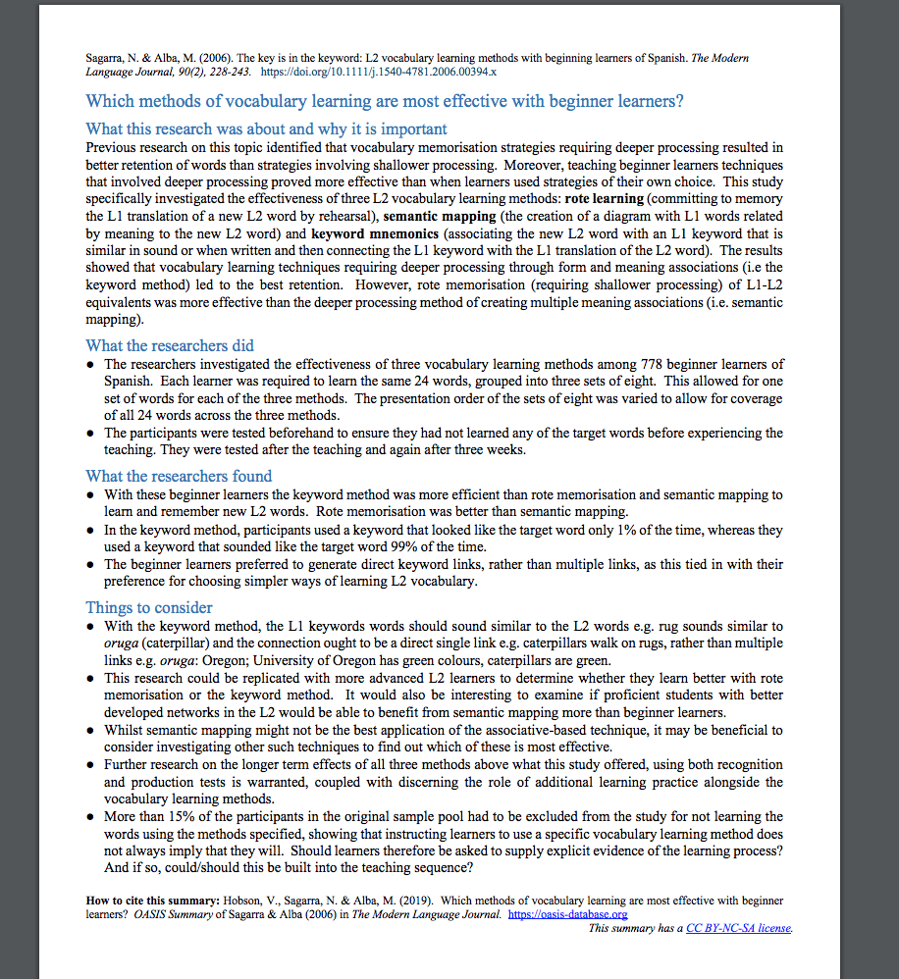
https://oasis-database.org Open Accessible Summaries in Language Studies
One page, non-technical, openly accessible summaries of high quality peer-reviewed, international research
among many others
Notes:
So, given what we have said about how difficult it is to access research – how have we been doing it?
To help communicate some examples of research to the teachers in the NCELP network we have been using summaries of research that are held on OASIS.
OASIS is a searchable database of one A4-page summaries of research studies. I have heard it said that you can read a couple in the time it takes to drink a big mug of tea!
Hundreds of findings from research studies are now available to all. They used to just be shared among academics in universities.

Slide 13
Want monthly alerts of new OASIS summaries?
Go to oasis-database.org
Scroll down to:
Sign up takes 20 seconds!
Notes:
https://mailchi.mp/481ba176f2d1/oasis-alerts

Slide 14
PHONICS
selection and order of Sound – Symbol - Correspondences (SSCs)
high-frequency ‘source’ words
staged roll out
practice activities
systematic revisiting
much more time for French – new SSCs in year 8
Erler, L. and Macaro, E. (2012) ‘Decoding Ability in French as a Foreign Language and Language Learning Motivation’. The Modern Language Journal, 95(4): 496-518.
Porter, A.M. (2014) An early start to French literacy: Learning the spoken and written word simultaneously in English primary schools. PhD thesis, University of Southampton.
Woore, R. (2007) ‘“Weisse Maus in Meinem Haus”: Using Poems and Learner Strategies to Help Learners Decode the Sounds of the L2’. Language Learning Journal, vol. 35, no. 2, pp. 175-188.
Woore, R. (2009) ‘Beginners’ progress in decoding L2 French: some longitudinal evidence from English Modern Foreign Languages classrooms’. Language Learning Journal, vol. 37, no. 1, pp. 3-18.
Woore, R. (2010) ‘Thinking aloud about L2 decoding: an exploration into the strategies used by beginner learners when pronouncing unfamiliar French words’. Language Learning Journal, vol. 38, no. 1, pp. 3-17.
Woore, R. (2011) Investigating and developing beginner learners’ decoding proficiency in second language French: an evaluation of two programmes of instruction. Unpublished PhD thesis, University of Oxford.
Woore, R. (2014) ‘Beginner learners’ progress in decoding L2 French: transfer effects in typologically similar L1-L2 writing systems’. Writing Systems Research, volume 4(2): 167-189.
Woore, R (2018) ‘Learners’ pronunciations of familiar and unfamiliar French words: what can they tell us about phonological decoding in an L2?’ The Language Learning Journal, 46(4):456-69.
Woore, R., Graham, S., Porter, A., Courtney, L. and Savory, C. (2018) Foreign Language Education: Unlocking Reading (FLEUR) - A study into the teaching of reading to beginner learners of French in secondary school. https://ora.ox.ac.uk/objects/uuid:4b0cb239-72f0-49e4-8f32-3672625884f0
Notes:
We will be hearing more about this later, so this is a brief summary:
The research informed our decisions about which phonics to teach and in which order
We chose words from a list of high frequency words
They are taught a little bit every lesson in a staged roll out
They are actively practised in activities
They are revisited
And more time is needed for French phonics! In fact we are still teaching new French phonics in year 8
Here are some of the research findings - you’ll see Robert’s name quite a lot there.

Slide 15
VOCABULARY
words that are very high-frequency → most useful!
a wide vocabulary of verbs (meanings)
mixed word class vocabulary sets: 10 per week
developing robust vocabulary knowledge
developing depth of knowledge
Davies, M, & Davies, K.H. (2018). A Frequency Dictionary of Spanish: Core Vocabulary for Learners. Routledge. Häcker, M. (2008). Eleven pets and 20 ways to express one's opinion: the vocabulary learners of German acquire at English secondary schools, The Language Learning Journal, 36:2, 215-226. Jones, R.L. & Tschirner, E. (2006). A frequency dictionary of German: core vocabulary for learners. Routledge. Lonsdale, D. & Le Bras, Y. (2009) A Frequency dictionary for French. Routledge. Marsden, E., & David, A. (2008). Vocabulary use during conversation: a cross-sectional study of development from year 9 to year 13 among learners of Spanish and French. Language Learning Journal, 36(2), 181-198.
Milton, J. (2006). Language Lite? Learning French Vocabulary in School. Journal of French Language Studies, 16,187-205. Milton, J. (2009). Measuring second language vocabulary acquisition. Multilingual Matters Milton, J. (2013). Measuring the contribution of vocabulary knowledge to proficiency in the four skills. Eurosla Monographs Series 2, 57-78. http://www.eurosla.org/monographs/EM02/Milton.pdf
Schmitt, N. (2008). Review Article. Instructed second language vocabulary learning. Language Teaching Research, 12(3), 329–363. https://doi.org/10.1177/1362168808089921 Swan, M. (2008). Talking Sense about Learning Strategies, RELC, Vol 39(2), 262-273.
Notes:
Decisions had to be made about vocabulary teaching
Which vocabulary is carefully selected from the highest frequency words according to a well constructed corpus of millions of words – the words that appear most are the most useful for communication across different situations
We know from research that you need to have a bank of verbs before you can create the sentences you want to create – the meaning of verbs is like the anchor in a sentence. We know that learning mixed sets of words allows you to create a number of sentences very quickly – but if you just know a set of nouns for sports or animals or types of television programmes, it is harder to be creative with what you can understand and say. Also we know that very closely semantically related words (sets of fruits or animals) can be confusing and more difficult to learn than more mixed sets. Research can also tell us what kinds of activities are most efficient for establishing robust knowledge that lasts and can be recalled fast and when under some pressure
And it can tell us about the kinds of activities that can help promote depth of vocabulary knowledge – knowing when to use a word, what its opposites are, which words often occur with it

Slide 16
GRAMMAR
very short, simple explanation up front of one feature
force students to attach meaning to feature in reading & listening
practise contrasting pairs of grammar features
controlled production activities that make feature ‘essential’
DeKeyser, R. (2005). What makes second-language grammar learning difficult? A review of issues. Language Learning, 55, 1-25. https://doi.org/10.1111/j.0023-8333.2005.00294.x
DeKeyser, R. (2015). Skill acquisition theory. In B. VanPatten & J. Williams (Eds.), Theories in second language acquisition: An introduction (pp. 94–112). London, UK: Routledge.
DeKeyser, R., & Prieto Botana, G. (2015). The effectiveness of processing instruction in L2 grammar acquisition: A narrative review. Applied Linguistics, 36, 290–305. Ellis, N. (2006). Selective attention, and transfer phenomena in L2 acquisition: Contingency, cue competition, salience, interference, overshadowing, blocking, and perceptual learning. Applied Linguistics, 27(2), 164-194. Lichtman, K. (2016). Age and learning environment: Are children implicit second language learners? Journal of Child Language, 43, 707-730. https://doi.org/10.1017/S0305000915000598 Marsden, E. (2006). Exploring input processing in the classroom: An experimental comparison of processing instruction and enriched input. Language Learning, 56, 507–566. Norris, J. & Ortega, L. (2001). Does type of instruction make a difference? Substantive findings from a meta-analytic review. Language Learning, 51, 157-213. https://doi.org/10.1111/j.1467-1770.2001.tb00017.x VanPatten, B. (2002). Processing instruction: An update. Language Learning, 52(4), 755-803.
Notes:
Research can inform our thinking about:
how to present grammar in very short simple explanations focusing on just one feature
How to create activities that force students to notice and attach meaning to features when they are listening and reading how to focus on contrasting pairs of features
And how to provide ample structured spoken and written practice of a particular grammar feature, that make using it and understanding it really essential to get the activity done.

Slide 17
Bringing these strands together: The NCELP Schemes of Work
Emma Marsden & Rachel Hawkes
Notes:
So, to show how these strands of knowledge are brought together, I will talk a little about the NCELP schemes of work

Slide 18
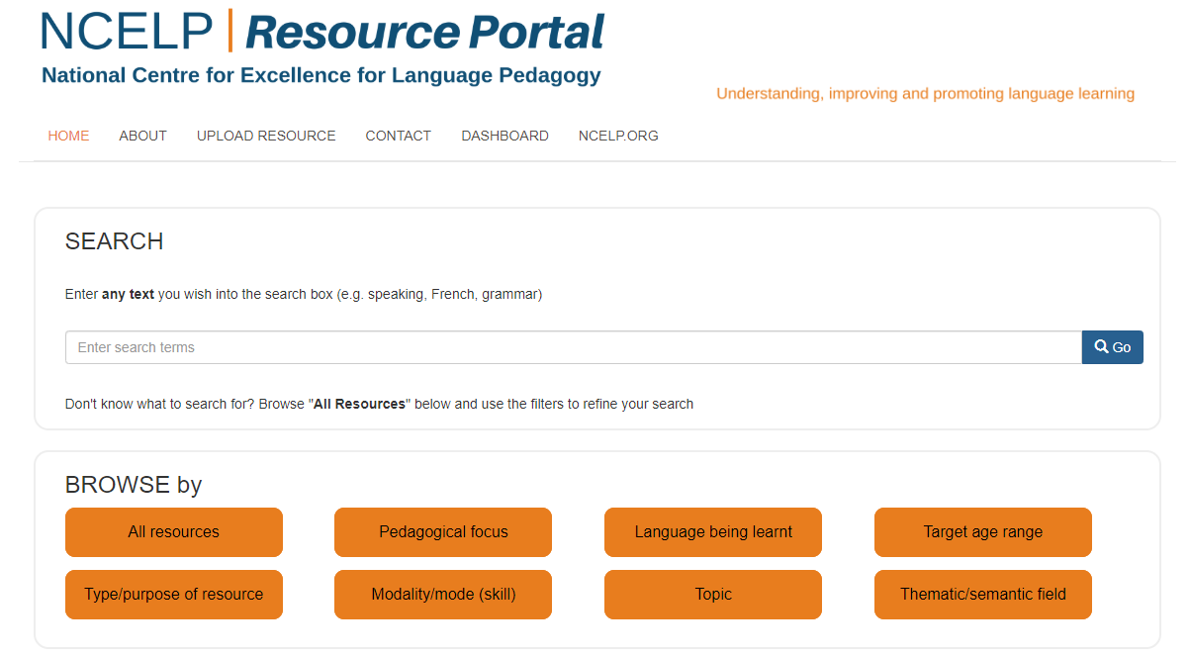
View of the Resource Portal home page
Notes:
Before I do, you can find them here. This is the resource portal – it is fully searchable and has all of the CPD and resources.
There are now 767 resources on here, more are added each week. The work of thousands of hours of resource developers time.
This is all freely accessible to any teacher, any school, not just those involved in the project.
On it you will find the schemes of work.

Slide 19
NCELP Schemes of Work
Integration of grammar, vocabulary, and phonics
Grammar-driven
Topic-based at the start of learning is difficult / impossible (?) IF we want:
high frequency vocabulary
grammar that is: principled, sequenced, re-visited, usable across different topics.
Year 7 (terms 1 & 2) available now; Term 3 & Year 8 on 17th July!
Notes:
The key, unique feature of the NCELP SOW is that it very carefully integrates the grammar, vocabulary and phonics
They are grammar-driven
rather than topic-based - Topic-based at the start of learning is difficult / impossible? IF we want high frequency vocabulary and grammar that is: principled, sequenced, and re-visited. Topic-based words are often not high frequency; topics associate one grammar feature with one topic, and then that grammar can be dropped; topics emphasise formulaic, rote–learning of phrases
If you go to the resources portal, and search for Schemes of Work, you can download the Schemes for year 7 terms 1 and 2
Term 3 and year 8 is about to go live- on 17th July!

Slide 20
Screen shot of a SOW
phonics practice every lesson
‘Context’: purpose of the language e.g., “Describing a thing or person”
Systematic revisiting of vocabulary every 3 weeks and 9 weeks
Grammar sequencing is language specific
Extremely high frequency (irregular!) verbs at start
Then highly regular and frequent verbs
Weeks set aside for work on ‘rich texts’

Slide 21
Tabs in the NCELP SOW
‘Resources’ tab contains links to powerpoints for lessons, quizlet vocab practice, and more…
Notes:
If you look at the bottom of the SOW you can see a number of useful tabs.
For example, one is ’Resources’ which links directly to the ppts for each lesson.

Slide 22
So, what can learners do?
Search ‘tests’ on the portal
’Assessment weeks’: in terms 2 and 3 of each year
Tests of knowledge of phonics, vocabulary & grammar
Applying the knowledge, e.g.,
Describe a picture (creating own language; less formulaic learning)
Translate ‘new’ sentences
Answer comprehension questions
Notes:
We have been asked – so if you teach learners like this, what can they do? What should we ‘test’ to see whether they have learnt?
The NCELP SOW have tests in terms 2 and 3, across the years.
In term 2 we focus on tests of knowledge of P, V and G
In term 3, the tests assess that knowledge again, but also whether students can apply that knowledge.
Can they string a sentence together or say anything meaningful? So these tests ask them to describe a picture, translate unseen sentences, or answer comprehension questions.

Slide 23
Other activities to date
BBC Bitesize:
https://www.bbc.co.uk/teach/teacher-support
see two NCELP Specialist Teachers
GCSE Review Panel
Oak online academy
Ofsted …
Emma Marsden & Rachel Hawkes
Notes:
We offered advice to BBC Bitesize on their KS3 materials and the BBC team have interviewed and filmed Jenny Hopper and Joe Fincham, two NCELP Specialist Teachers, talking about teaching phonics and making grammar practice meaningful.
Four members of the NCELP team are on the GCSE review panel. We have been providing advice about how tests in year 11 can best stimulate and assess the kinds of knowledge that I have talked about and you will hear more about today
Recently, members of NCELP have become involved in helping the Oak online academy design curriculum and then film lessons using the NCELP resources
And finally we have had some involvement in working on an Ofsted review group, and that is a perfect point to hand over to Rachel
Please do use the Q & A function for any questions you would like to ask – Rachel and I hope to answer as many as possible at the end of Rachel’s presentation.

