Slide 1
Vocabulary
Y7 Spanish
Term 3.1 - Week 4
Author names: St James’ Hub Teachers /
Victoria Hobson/ Nick Avery / RachelHawkes
Date updated: 16/05/20
Notes:
Source of frequency rankings: Davies, M. & Davies, K. (2018). A frequency dictionary of Spanish: Core vocabulary for learners (2nd ed.). London: Routledge

Slide 2
Vocabulario
escuchar / escribir
Escucha y completa las frases. Escribe las palabras en español.
Quiere estar moreno.
Estar feliz es importante.
No quiero estar aburrido.
Estar loco no es bueno.
El cielo parece estar oscuro.
El río está claro.
1
2
3
4
5
6
Notes:
Vocabulary revisited here is from term 2.2, week 5 (as per SoW revisiting cycle): feliz [908]; moreno [3304]; claro [1923]; oscuro [802]; aburrido [3917]; loco [846].
Students listen to identify the missing word and write it in Spanish. The words are revealed in numerical order by clicking on anywhere on the slide.
As part of the feedback, elicit the meaning in English from the students.
TRANSCRIPT
Quiere estar moreno.
Estar feliz es importante.
No quiero estar aburrido.
Estar loco no es bueno.
El cielo parece estar oscuro.
El río está claro.
Extension:
Teachers may want to ask students to translate the whole sentences. (If so answers appear in the next slide.) Note that ‘cielo’ hasn’t been previously taught as a vocabulary item, but has featured in earlier lesson material with a gloss.

Slide 3
Vocabulario
Escribe las frases en inglés.
Quiere estar moreno.
Estar feliz es importante.
No quiere estar aburrido.
Estar loco no es bueno.
El cielo parece estar oscuro.
El río debe estar claro.
He wants to be tanned.
Being/feeling happy is important.
He doesn’t want to be bored.
Being/acting crazy is not good.
The sky seems to be dark.
The river must/has to be clear.
Notes:
Vocabulary revisited here is from term 2.2, week 5 (as per SoW revisiting cycle): feliz [908]; moreno [3304]; claro [1923]; oscuro [802]; aburrido [3917]; loco [846].
Answers are revealed on a mouse click. Note that in items 1 and 3, the answer has to be ‘he’ (rather than s/he) because the adjective is the masculine form.
This slide could then be used as a recap of students’ prior learning about the infinitive form.
On a mouse click, ‘estar’ is highlighted. Teachers could ask students if they can remember the name for this part of the verb. Ask students what they can remember about its function. They may say things like:
The infinitive form of a verb is the form you see in a dictionary.
In English, this is often written ‘to + verb’.
In Spanish, the infinitive of the verb often ends in –ar (they may name some they can readily remember).
You can also begin a sentence with the infinitive.
The infinitive often describes the general meaning of the verb.
If students do not manage to remember this information, it is all recapped in the grammar explanation to come.
Point out that this infinitive ends in –ar, then ask students is they can remember any other infinitives that end in –ar. There is no need at this point to open up a discussion about regular and irregular verbs. The infinitive ‘estar’ is being used here as a platform to open a discussion about the function of the infinitive only, not conjugated forms.

Slide 4
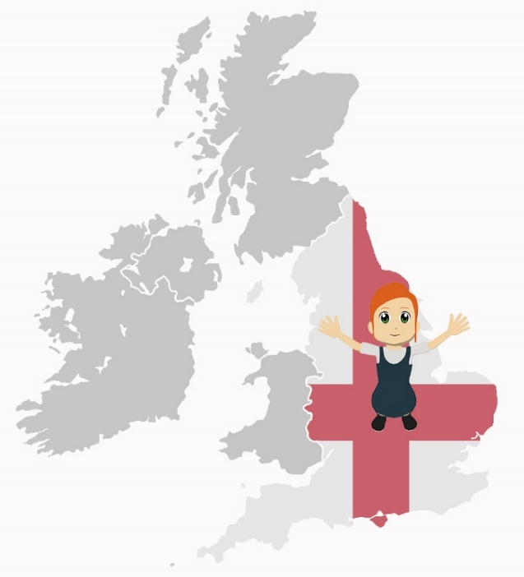
Vocabulario
vivir
comer
beber
leer
Notes:
Teachers can use this slide to practise the verbs from this week’s vocabulary set.
Use the custom animation to introduce the Spanish and elicit the meanings in English from the students. Clarify meanings in English so that students have a correct understanding of the picture.
Play a game of ‘What’s missing?’ Students give the Spanish each time. This can be done in pairs or as a whole class. The custom animation moves from one verb missing, to two then three in a variety of combinations then all four.
The additional items of vocabulary from this week’s vocabulary set will be practised in lesson two.

Slide 5
vocabulario
Spanish adverbs may come at the start of the sentence.
Nunca come carne.
S/he never eats meat.
Sólo come carne.
S/he only eats meat.
 | Word | English meaning
1 | beber | to drink, drinking
2 | comer | to eat, eating
3 | leer | to read, reading
4 | vivir | to live, living
5 | nunca | never
6 | el ejercicio | exercise
7 | la fruta | fruit
8 | la carne | meat
9 | rico | rich, tasty
10 | el agua (f) | water
11 | el hombre | man
12 | a veces | sometimes
60
‘Agua’ is a feminine noun, but the article is ‘el’.
This is because ‘agua’ starts with a stressed ‘a’ sound. (Saying ‘a’ twice in a row would be hard!)
0
INICIO
Notes:
Vocabulary practice slide Pupils either work by themselves or in pairs, reading out the words and studying their English meaning (1 minute). Then the English meanings are removed and they try to recall them, looking at the Spanish (1 minute). Then the Spanish meanings are removed and they to recall them, looking at the English (1 minute) Further rounds of learning can be facilitated by one pupil turning away from the board, and his/her partner asking him/her the meanings. This activity can work from L2 → L1 or L1 → L2.
Students will need to know that agua is a feminine noun but requires 'el‘.
beber [1085]; comer [347]; leer [209]; vivir [142]; hombre [97]; ejercicio [1162]; fruta [1925]; carne [860]; rico¹ [398]; agua [204]; nunca [158]; a veces [vez-59]

Slide 6
Limpia la pizarra
1. to drink / drinking
2. to eat / eating
3. to read / reading
4. to live / living
5. man
6. exercise
7. fruit
8. meat
9. tasty
10. water
11. never
12. sometimes
Rachel Hawkes
Notes:
Students have learnt ‘limpiar’ in week 2.2.3. In the title of this activity they will encounter the word in a new context, thus aiding consolidation. Clarify the meaning of ‘pizarra’, if needed.
Students need to translate the words on the board.
Teacher clicks on word when translated correctly and it will disappear.
Turn this into a game – one side of the class plays against the other to see who can get the fastest time. The teacher chooses students to answer. Students need to say the number of the word they are translating.
Vocabulary and frequency rankings: beber [1085]; comer [347]; leer [209]; vivir [142]; hombre [97]; ejercicio [1162]; fruta [1925]; carne [860]; rico [398]; agua [204]; nunca [158]; a veces [vez-59]

