Slide 1
Phonics
Year 7 French
Term 1.1 - Week 4
Stephen Owen / Rachel Hawkes
Date updated: 05/01/20
Notes:
Phonics learning aims for Term 1.1, Week 4:
‘u’; ‘ou’.
All pictures selected are available under a Creative Commons license; no attribution required.

Slide 2
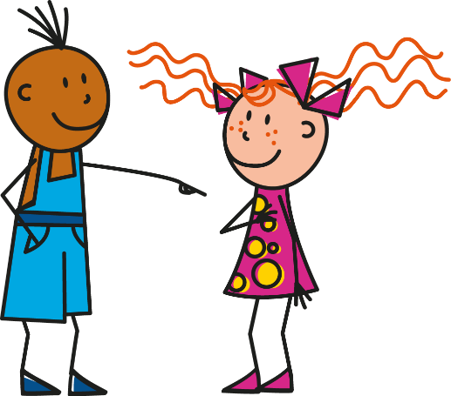
u
Salut !
vue
amusant
tu
utiliser
[to use]
sur
[on]
Stephen Owen & Rachel Hawkes
Notes:
Introduce and elicit the pronunciation of the individual SSC ‘U’ and then the source word again (with gesture, if using). Then present and elicit the pronunciation of the five cluster words. The cluster words have been chosen for their high-frequency, from a range of word classes, with the SSC (where possible) positioned within a variety of syllables within the words(e.g. initial, 2nd, final etc..) and additionally, we have tried to use words that build cumulatively on previously taught SSCs (see the Phonics Teaching Sequence document) and do not include new SSCs. Where new SSCs are used, they are often consonants which have a similar symbol-sound correspondence in English. Word frequency rankings (1 is the most common word in French): tu [112]; salut ! [2205] vue [191]; sur [16]; amusant [4695]; utiliser [345]. Source: Londsale, D., & Le Bras, Y. (2009). A Frequency Dictionary of French: Core vocabulary for learners London: Routledge.

Slide 3
u
Salut !
vue
amusant
tu
utiliser
sur
Stephen Owen & Rachel Hawkes
Notes:
Introduce and elicit the pronunciation of the individual SSC ‘U’ and then the source word again (with gesture, if using). Then present and elicit the pronunciation of the five cluster words. The cluster words have been chosen for their high-frequency, from a range of word classes, with the SSC (where possible) positioned within a variety of syllables within the words(e.g. initial, 2nd, final etc..) and additionally, we have tried to use words that build cumulatively on previously taught SSCs (see the Phonics Teaching Sequence document) and do not include new SSCs. Where new SSCs are used, they are often consonants which have a similar symbol-sound correspondence in English. Word frequency rankings (1 is the most common word in French): tu [112]; salut ! [2205] vue [191]; sur [16]; amusant [4695]; utiliser [345]. Source: Londsale, D., & Le Bras, Y. (2009). A Frequency Dictionary of French: Core vocabulary for learners London: Routledge.

Slide 4
u
Salut !
vue
amusant
tu
utiliser
sur
Stephen Owen & Rachel Hawkes
Notes:
Introduce and elicit the pronunciation of the individual SSC ‘U’ and then the source word again (with gesture, if using). Then present and elicit the pronunciation of the five cluster words. The cluster words have been chosen for their high-frequency, from a range of word classes, with the SSC (where possible) positioned within a variety of syllables within the words(e.g. initial, 2nd, final etc..) and additionally, we have tried to use words that build cumulatively on previously taught SSCs (see the Phonics Teaching Sequence document) and do not include new SSCs. Where new SSCs are used, they are often consonants which have a similar symbol-sound correspondence in English. Word frequency rankings (1 is the most common word in French): tu [112]; salut ! [2205] vue [191]; sur [16]; amusant [4695]; utiliser [345]. Source: Londsale, D., & Le Bras, Y. (2009). A Frequency Dictionary of French: Core vocabulary for learners London: Routledge.

Slide 5
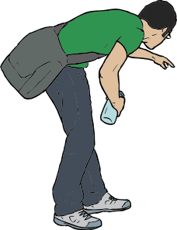
ou
trouver
jouer
Bonjour !
nous
douze
toujours
[always; still]
Stephen Owen & Rachel Hawkes
Notes:
Introduce and elicit the pronunciation of the individual SSC ‘OU’ and then the source word again (with gesture, if using). Then present and elicit the pronunciation of the five cluster words. The cluster words have been chosen for their high-frequency, from a range of word classes, with the SSC (where possible) positioned within a variety of syllables within the words(e.g. initial, 2nd, final etc..) and additionally, we have tried to use words that build cumulatively on previously taught SSCs (see the Phonics Teaching Sequence document) and do not include new SSCs. Where new SSCs are used, they are often consonants which have a similar symbol-sound correspondence in English.
Word frequency rankings (1 is the most common word in French): nous [31]; trouver [83] jouer [219]; bonjour [1972]; toujours [103]; douze [1664]. Source: Londsale, D., & Le Bras, Y. (2009). A Frequency Dictionary of French: Core vocabulary for learners London: Routledge.

Slide 6
ou
trouver
jouer
Bonjour !
nous
douze
toujours
Stephen Owen & Rachel Hawkes
Notes:
Introduce and elicit the pronunciation of the individual SSC ‘OU’ and then the source word again (with gesture, if using). Then present and elicit the pronunciation of the five cluster words. The cluster words have been chosen for their high-frequency, from a range of word classes, with the SSC (where possible) positioned within a variety of syllables within the words(e.g. initial, 2nd, final etc..) and additionally, we have tried to use words that build cumulatively on previously taught SSCs (see the Phonics Teaching Sequence document) and do not include new SSCs. Where new SSCs are used, they are often consonants which have a similar symbol-sound correspondence in English.
Word frequency rankings (1 is the most common word in French): nous [31]; trouver [83] jouer [219]; bonjour [1972]; toujours [103]; douze [1664]. Source: Londsale, D., & Le Bras, Y. (2009). A Frequency Dictionary of French: Core vocabulary for learners London: Routledge.

Slide 7
ou
trouver
jouer
Bonjour !
nous
douze
toujours
Stephen Owen & Rachel Hawkes
Notes:
Introduce and elicit the pronunciation of the individual SSC ‘OU’ and then the source word again (with gesture, if using). Then present and elicit the pronunciation of the five cluster words. The cluster words have been chosen for their high-frequency, from a range of word classes, with the SSC (where possible) positioned within a variety of syllables within the words(e.g. initial, 2nd, final etc..) and additionally, we have tried to use words that build cumulatively on previously taught SSCs (see the Phonics Teaching Sequence document) and do not include new SSCs. Where new SSCs are used, they are often consonants which have a similar symbol-sound correspondence in English.
Word frequency rankings (1 is the most common word in French): nous [31]; trouver [83] jouer [219]; bonjour [1972]; toujours [103]; douze [1664]. Source: Londsale, D., & Le Bras, Y. (2009). A Frequency Dictionary of French: Core vocabulary for learners London: Routledge.

