Slide 1
French SSC teaching sequence
U / OU [2]
Notes:
All pictures selected are available under a Creative Common license, no attribution required. This is the second 10-minute phonics sequence for the sounds ‘u’ and ‘ou’, which are introduced as a pair to strengthen learners’ ability to differentiate between them.

Slide 2
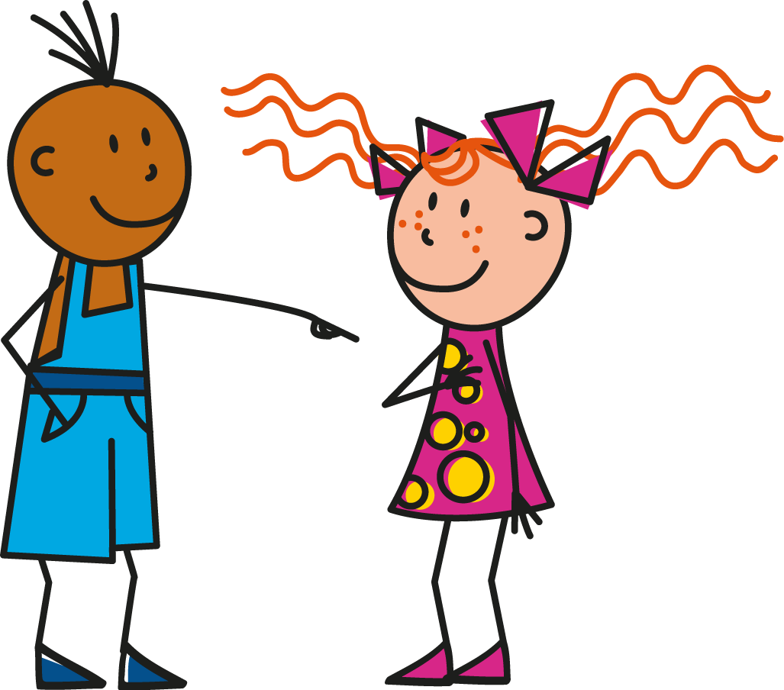
u
tu
Stephen Owen / Rachel Hawkes
Notes:
Introduce and elicit the pronunciation of the individual SSC ‘U’ and then present and practise the pronunciation of the source word ‘tu’. A possible gesture for this source word would be to point to someone else as though addressing him/her ‘you’.

Slide 3
ou
nous
Stephen Owen / Rachel Hawkes
Notes:
Introduce and elicit the pronunciation of the individual SSC ‘OU’ and then present and practise the pronunciation of the source word ‘nous’.
A possible gesture for this source word would be to have both hands draw semi-circles out away from the body. Hands start by the sides of the body, circle swiftly outwards and join up again in front, indicating the inclusion of the self in a larger group.

Slide 4
u
Salut !
vue
amusant
tu
utiliser
[to use]
sur
[on]
Stephen Owen / Rachel Hawkes
Notes:
Introduce and elicit the pronunciation of the individual SSC ‘U’ and then the source word again (with gesture, if using). Then present and elicit the pronunciation of the five cluster words. The cluster words have been chosen for their high-frequency, from a range of word classes, with the SSC (where possible) positioned within a variety of syllables within the words(e.g. initial, 2nd, final etc..) and additionally, we have tried to use words that build cumulatively on previously taught SSCs (see the Phonics Teaching Sequence document) and do not include new SSCs. Where new SSCs are used, they are often consonants which have a similar symbol-sound correspondence in English. Word frequency rankings (1 is the most common word in French): tu [112]; salut ! [2205] vue [191]; sur [16]; amusant [4695]; utiliser [345]. Source: Londsale, D., & Le Bras, Y. (2009). A Frequency Dictionary of French: Core vocabulary for learners London: Routledge.

Slide 5
u
Salut !
vue
amusant
tu
utiliser
sur
Stephen Owen / Rachel Hawkes
Notes:
Introduce and elicit the pronunciation of the individual SSC ‘U’ and then the source word again (with gesture, if using). Then present and elicit the pronunciation of the five cluster words. The cluster words have been chosen for their high-frequency, from a range of word classes, with the SSC (where possible) positioned within a variety of syllables within the words(e.g. initial, 2nd, final etc..) and additionally, we have tried to use words that build cumulatively on previously taught SSCs (see the Phonics Teaching Sequence document) and do not include new SSCs. Where new SSCs are used, they are often consonants which have a similar symbol-sound correspondence in English. Word frequency rankings (1 is the most common word in French): tu [112]; salut ! [2205] vue [191]; sur [16]; amusant [4695]; utiliser [345]. Source: Londsale, D., & Le Bras, Y. (2009). A Frequency Dictionary of French: Core vocabulary for learners London: Routledge.

Slide 6
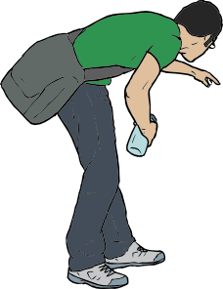
ou
trouver
jouer
Bonjour !
nous
douze
toujours
[always; still]
Stephen Owen / Rachel Hawkes
Notes:
Introduce and elicit the pronunciation of the individual SSC ‘OU’ and then the source word again (with gesture, if using). Then present and elicit the pronunciation of the five cluster words. The cluster words have been chosen for their high-frequency, from a range of word classes, with the SSC (where possible) positioned within a variety of syllables within the words(e.g. initial, 2nd, final etc..) and additionally, we have tried to use words that build cumulatively on previously taught SSCs (see the Phonics Teaching Sequence document) and do not include new SSCs. Where new SSCs are used, they are often consonants which have a similar symbol-sound correspondence in English.
Word frequency rankings (1 is the most common word in French): nous [31]; trouver [83] jouer [219]; bonjour [1972]; toujours [103]; douze [1664]. Source: Londsale, D., & Le Bras, Y. (2009). A Frequency Dictionary of French: Core vocabulary for learners London: Routledge.

Slide 7
ou
trouver
jouer
Bonjour !
nous
douze
toujours
Stephen Owen / Rachel Hawkes
Notes:
Introduce and elicit the pronunciation of the individual SSC ‘OU’ and then the source word again (with gesture, if using). Then present and elicit the pronunciation of the five cluster words. The cluster words have been chosen for their high-frequency, from a range of word classes, with the SSC (where possible) positioned within a variety of syllables within the words(e.g. initial, 2nd, final etc..) and additionally, we have tried to use words that build cumulatively on previously taught SSCs (see the Phonics Teaching Sequence document) and do not include new SSCs. Where new SSCs are used, they are often consonants which have a similar symbol-sound correspondence in English.
Word frequency rankings (1 is the most common word in French): nous [31]; trouver [83] jouer [219]; bonjour [1972]; toujours [103]; douze [1664]. Source: Londsale, D., & Le Bras, Y. (2009). A Frequency Dictionary of French: Core vocabulary for learners London: Routledge.

Slide 8
Écoute. Écris ‘u’ ou ‘ou’.
écouter
1
Les jeux sont très am__sants.
2
Vous avez une belle v__e sur la mer.
3
On se retr__ve à quelle heure?
4
Dans ma chambre, j’ai un petit b__reau.
5
Je j__e souvent au r__gby.
Stephen Owen / Rachel Hawkes
Notes:
Answers: 1. u/ 2. u / 3. ou / 4. u / 5. ou / u (NB: I have left the ‘ou’ in souvent to help pupils ‘anchor’ what they hear before and after it. Pupils can write 1-5 and note ‘u’ or ‘ou’ More able pupils can be encouraged to write the whole word. The first two questions use cluster words, the other three use words pupils may not yet have met.
Transcript: 1 Les jeux son très amusants. 2 Vous avez une belle vue sur la mer. 3 On se retrouve à quelle heure? 4 Dans ma chambre, j;ai un petit bureau. 5 Je joue souvent au rugby.

Slide 9
Trouve l’intrus.
1
jouer
salut !
douze
2
utiliser
refuser
trouver
3
toujours
sur
groupe
4
bonjour !
bureau
vue
5
nous
vue
vous
Notes:
Partner A reads three words aloud. Partner B (facing away from the board and without seeing the words) identifies the odd one out. Do numbers 1-3, then students swap roles. Additional high-frequency words included here:
groupe [187]; bureau [273] vous [50]; refuser [271] Source: Londsale, D., & Le Bras, Y. (2009). A Frequency Dictionary of French: Core vocabulary for learners London: Routledge.

