Slide 1
French SSC teaching sequence
U / OU [1]
Notes:
All pictures selected are available under a Creative Common license, no attribution required. This is the second 10-minute phonics sequence for the sounds ‘u’ and ‘ou’, which are introduced as a pair to strengthen learners’ ability to differentiate between them.

Slide 2
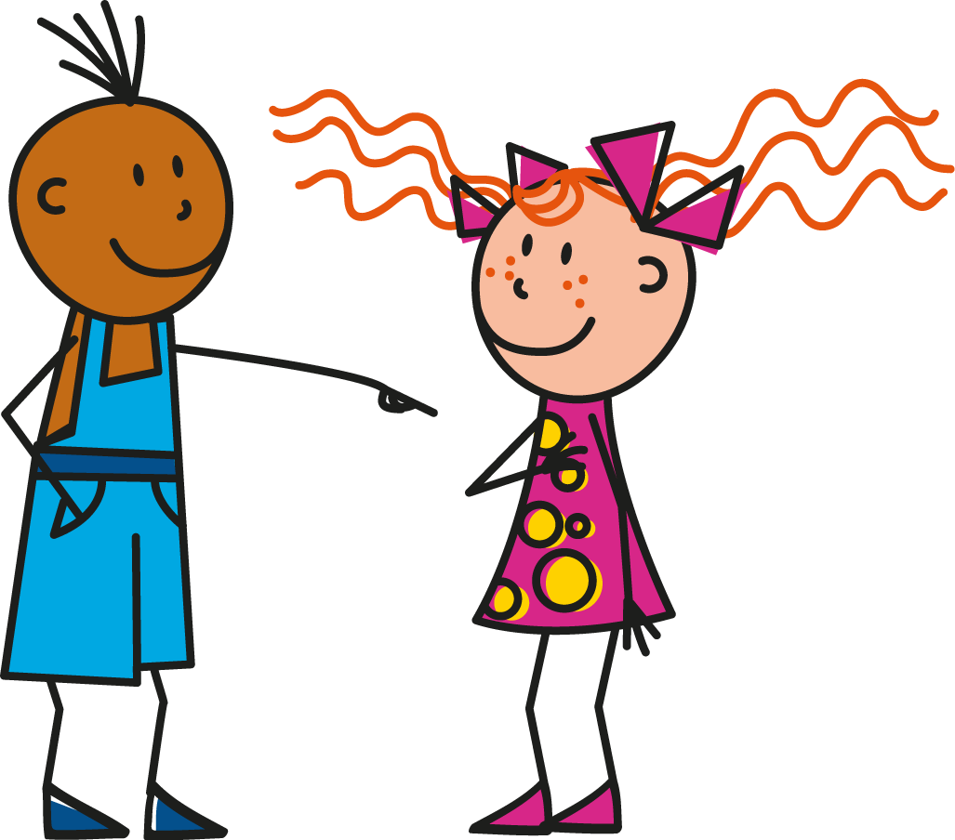
u
tu
Stephen Owen / Rachel Hawkes
Notes:
Recap the pronunciation of the individual SSC ‘U’ and then the pronunciation of the source word ‘tu’. A possible gesture for this source word would be to point to someone else as though addressing him/her ‘you’.
Word frequency rankings (1 is the most common word in French): tu [112]; salut ! [2205] vue [191]; sur [16]; amusant [4695]; utiliser [345]. Source: Londsale, D., & Le Bras, Y. (2009). A Frequency Dictionary of French: Core vocabulary for learners London: Routledge.

Slide 3
ou
nous
Stephen Owen / Rachel Hawkes
Notes:
Recap the pronunciation of the individual SSC ‘OU’ and then the pronunciation of the source word ‘nous’.
A possible gesture for this source word would be to have both hands draw semi-circles out away from the body. Hands start by the sides of the body, circle swiftly outwards and join up again in front, indicating the inclusion of the self in a larger group.
Word frequency rankings (1 is the most common word in French): nous [31]; trouver [83] jouer [219]; bonjour [1972]; toujours [103]; douze [1664]. Source: Londsale, D., & Le Bras, Y. (2009). A Frequency Dictionary of French: Core vocabulary for learners London: Routledge.

Slide 4
u
Salut !
vue
tu
amusant
sur
utiliser
[on]
[to use]
Stephen Owen / Rachel Hawkes
Notes:
Recap individual SSC ‘U’ and then the source word again (with gesture, if using). Then recap the five cluster words.

Slide 5
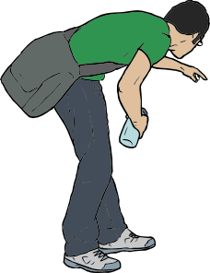
ou
trouver
jouer
nous
Bonjour !
toujours
douze
[always; still]
Stephen Owen / Rachel Hawkes
Notes:
Recap individual SSC ‘OU’ and then the source word again (with gesture, if using). Then recap the five cluster words.

Slide 6
u
Salut !
vue
tu
amusant
sur
utiliser
[on]
[to use]
Stephen Owen / Rachel Hawkes
Notes:
A further practice slide, this time without the pictures, so that pupils’ attention is focused even more carefully on the sound-writing relationship.

Slide 7
ou
trouver
jouer
nous
Bonjour !
toujours
douze
[always; still]
Stephen Owen / Rachel Hawkes
Notes:
A further practice slide, this time without the pictures, so that pupils’ attention is focused even more carefully on the sound-writing relationship.

Slide 8
Écoute. Écris ‘u’ ou ‘ou’.
écouter
1
Les jeux sont très am__sants.
2
Vous avez une belle v__e sur la mer.
3
On se retr__ve à quelle heure?
4
Dans ma chambre, j’ai un petit b__reau.
5
Je j__e souvent au r__gby.
Stephen Owen / Rachel Hawkes
Notes:
THIS SLIDE HAS AUDIO Answers: 1. u/ 2. u / 3. ou / 4. u / 5. ou / u (NB: I have left the ‘ou’ in souvent to help pupils ‘anchor’ what they hear before and after it. Pupils can write 1-5 and note ‘u’ or ‘ou’ More able pupils can be encouraged to write the whole word. The first two questions use cluster words, the other three use words pupils may not yet have met.
Transcript: 1 Les jeux son très amusants. 2 Vous avez une belle vue sur la mer. 3 On se retrouve à quelle heure? 4 Dans ma chambre, j;ai un petit bureau. 5 Je joue souvent au rugby.

Slide 9
Trouve l’intrus.
1
jouer
salut !
douze
2
utiliser
refuser
trouver
3
toujours
sur
groupe
4
bonjour !
bureau
vue
5
nous
vue
vous
Notes:
Partner A reads three words aloud. Partner B (facing away from the board and without seeing the words) identifies the odd one out. Do numbers 1-3, then students swap roles. Additional high-frequency words included here:
groupe [187]; bureau [273] vous [50]; refuser [271] Source: Londsale, D., & Le Bras, Y. (2009). A Frequency Dictionary of French: Core vocabulary for learners London: Routledge.

