Slide 1
German cultural collection
Y7 Term 1
Artwork: Steve Clarke
Date updated: 01/03/21
Notes:
Artwork by Steve Clarke. All additional pictures selected are available under a Creative Commons license, no attribution required.

Slide 2
Y7 T1.1 Week 4
Kultur
Slide 28: Speaking
Slide includes German first names

Slide 3
Vokabeln
Ort, Form oder Tier?
sprechen
Bist du ein Ort?
Ich bin kein Ort.
Mia keeps her card and it’s her turn.
Ich bin ein Tier.
Bist du ein Tier?
Wolfgang has to give up his card and it’s still Mia’s turn.
Bist du eine Form?
Ich bin keine Form.
Nein! Ach….!
Wolfgang keeps his card and it’s his turn.
Mia said ‘Nein’ so forfeits her card!
Bist du eine Form?
Notes:
Optional additional task: speaking game activity
Timing: 10 minutes (5 minutes’ creation + 5 minutes playing the game) Aim: to practise the forms of ‘ein’ and ‘kein’ learned so far, in the speaking modality.
Procedure: Yes/No game (i.e. you are not allowed to say Ja/Nein or you forfeit your card). The aim of the game is to win all of your partner’s cards (or be the one to have the most cards when the time runs out).
Create own set of mini flashcards (1 x piece A4 paper folded into 12 rectangles) drawing any animals, places, shapes. Set time limit for the creation – count down 5-4-3-2-1 for the drawing of each item.. Join own set with another person's. Mix them up and deal them equally.
Note: It’s important to draw students’ attention (again) to the gender of the nouns DER ORT, DIE FORM, DAS TIER, as the focus of this task is to correctly produce either ‘ein/eine’ or ‘kein/keine’ depending on the meaning, but also differentiating for gender. Place, shape or animal are the choices. You ask this of your partner, who either answers affirmatively (without Yes) or negatively (without No). If you guess correctly with your question, you win your partner’s card. If not, s/he keeps the card and play passes. If you say Nein by mistake (instead of ‘Ich bin keine Form’) you also lose your card.
Ask 'Bist du eine Form?'
Answer: Ich bin eine Form (have to give up your card)
Ich bin keine Form (get to keep your card).
Word frequency (1 is the most frequent word in German): ist [3] Heft [3598] Tafel [3660] Tisch [494] ich bin [8/3] Ding [337] Form [300] Mensch [104] blau [1016] gelb [1819] groß1 [74] klein [114] rot [381] ein, eine [5] kein, keine [50] Source: Jones, R.L. & Tschirner, E. (2006). A frequency dictionary of German: core vocabulary for learners. Routledge

Slide 4
Y7 T1.1 Week 5
Kultur
Slide 48: Speaking
Slides includes German first names

Slide 5
Vokabeln
sprechen
PERSON A
Person | Ding
Hannah
Julius
Noah
Sarah
Notes:
This is Person A’s card.

Slide 6
Y7 T1.1 Week 6
Kultur
Slide 47: Listening, speaking
Slide includes a German tongue twister

Slide 7
Phonetik
hören / sprechen
Eine kleine Meise geigt allein eine leise Weise, eine zweite schweigt leider.
Notes:
OPTIONAL TASK
Timing: 5 minutes Aim: To provide SSC practice in the form of a tonguetwister (Zungenbrecher).
The target SSC is ei, but some of the others are covered too: W in Weise, Z in zweite, a in allein. Most of the other sounds that have not been covered so far are similar to English with the exception of sch, which should be pointed out and modelled more carefully.
Procedure: 1. Teacher reads out the whole sentence slowly and then takes the students through it word by word.
2. Teacher models word; students respond with word.
3. Discuss the meaning of the sentence.
4. Students practise saying the sentence individually.
5. They could then do a competition to see who can say it the fastest without tripping up.
Transcript:
As displayed on slide. Word frequency (1 is the most frequent word in German): geigen [>5000] schweigen [863] die Meise [>5000] die Weise [413] leise [1160] leider [642] Source: Jones, R.L. & Tschirner, E. (2006). A frequency dictionary of German: core vocabulary for learners. Routledge

Slide 8
Y7 T1.2 Week 1
Kultur
Slide 31: Speaking
Slide 33: Grammar
Slide 54: Writing
Slides 65-66: Speaking
Slides include Berlin as a place name

Slide 9
Grammatik
sprechen
in Berlin
wohnen
Notes:
Timing: 1 minute Aim: To practise sentence-building with the vocabulary learnt this week. This is also an opportunity to volunteer the German vocabulary independently without support.
Procedure: 1. Students are asked to pair up two or three things, forming infinitive phrases and signposting how the items they have learnt for homework will be blended to form sentences in this lesson.
2. The German appears underneath item by item on your clicks.

Slide 10
Dictionary verb vs he/she form
Grammatik
Only the infinitive form of a verb appears in the dictionary.
e.g. wohnen (to live / living), lernen (to learn / learning)
To say what he/she does or is doing, use er (he), sie (she)
and change the ending from -en to -t:
There is only one present tense in German!
wohnen – Er wohnt in Berlin.
(He lives in Berlin / He is living in Berlin.)
lernen – Sie lernt Gitarre.
(She learns guitar / She is learning guitar.)
How many are there in English?
Notes:
Timing: 2 minutes Aim: To explain how the dictionary form of the verb (infinitive) relates to the third person singular form Procedure: 1. Click to animate the explanation.
2. Check students’ understanding at each stage.

Slide 11
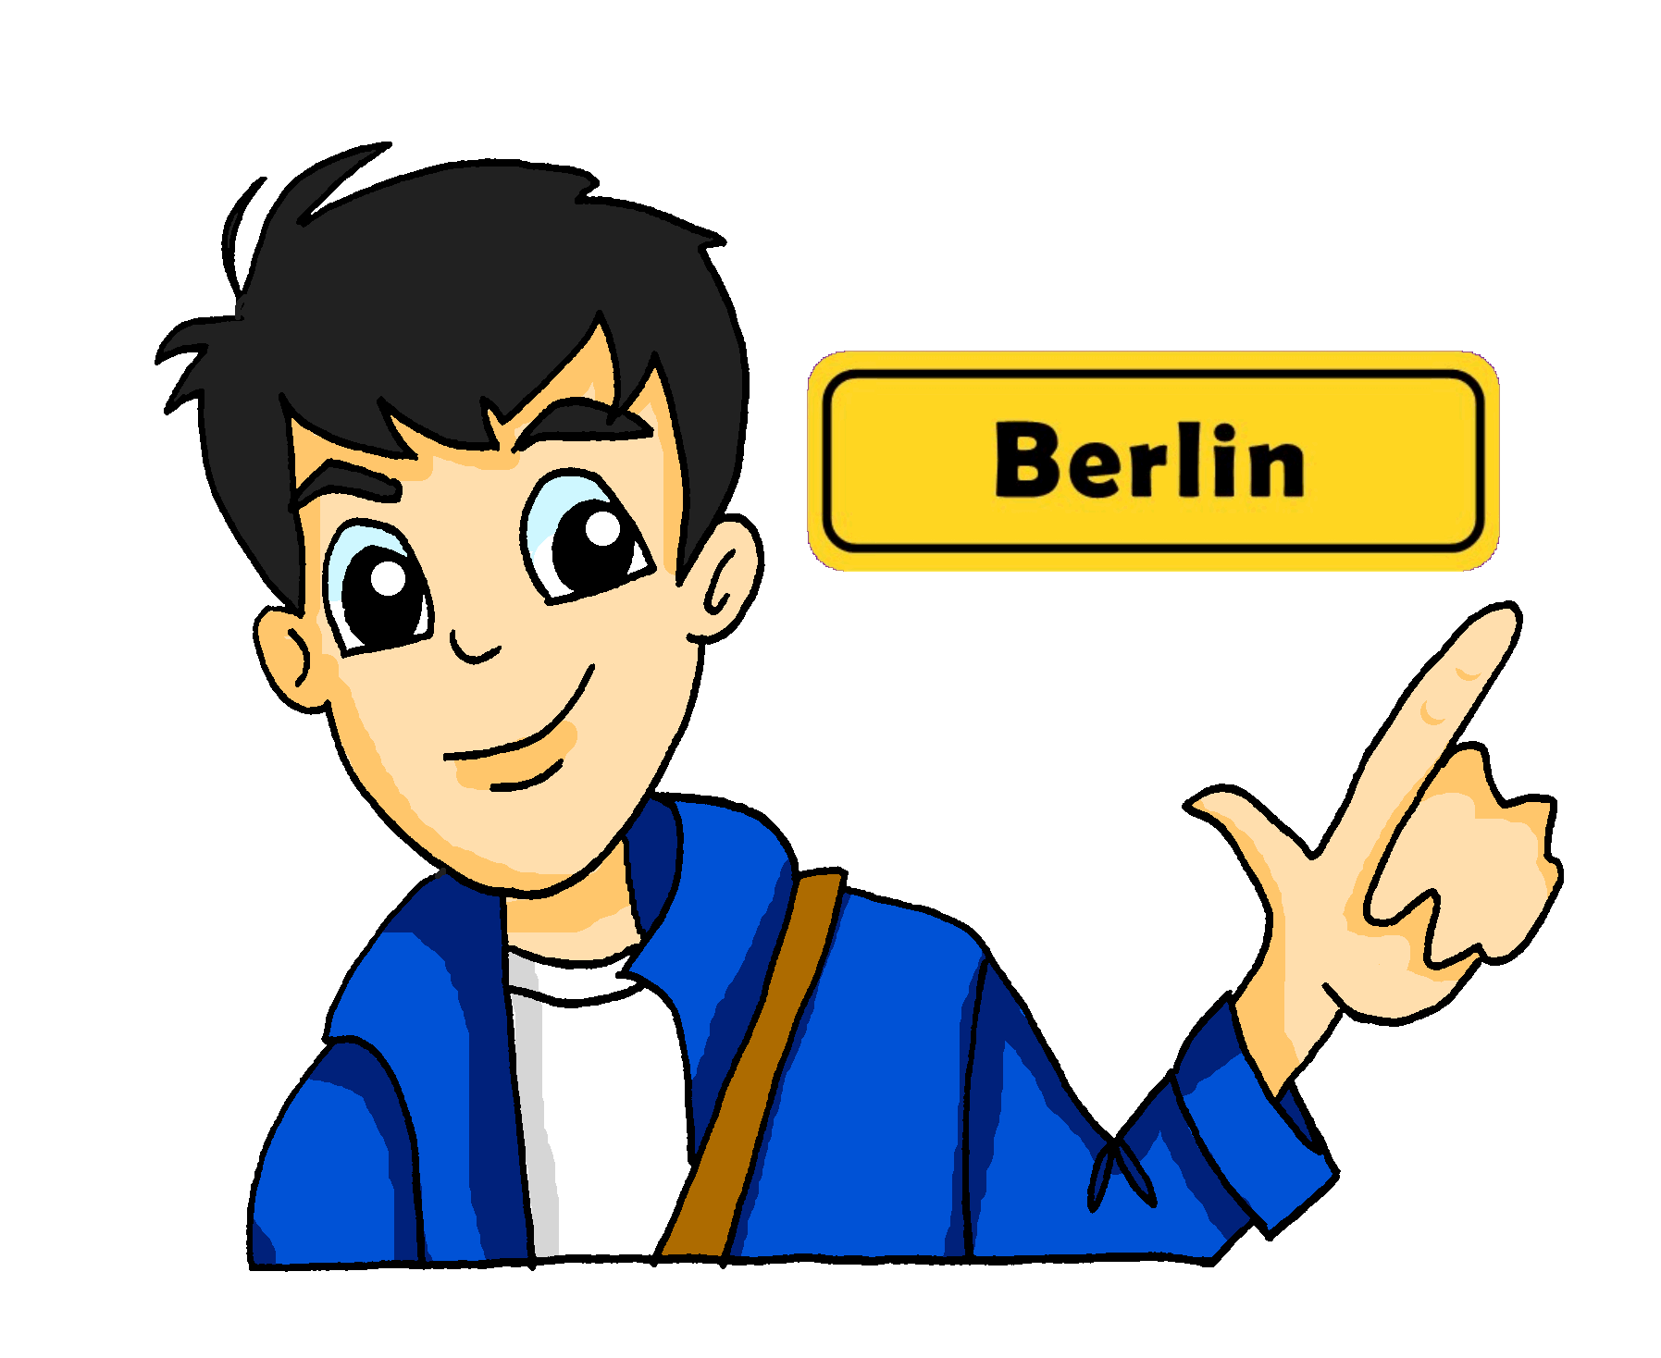
Schreiben: Wolfgangs Montag
schreiben
Schreib ein Verb!
3
wohnt
Er _______ in Berlin .
Notes:
Timing: 1 minute Aim: To provide production practice with the verb forms learned Procedure: 1. Students must now focus on reproducing verbs in the he/she/it form. This activity can be done on mini whiteboards or in exercise books.
2. Answers appear on your click.

Slide 12
Grammatik
Sprechen: Was macht Wolfgang/Mia?
sprechen
Gitarre
auf Deutsch
im Unterricht
im Klassenzimmer
in der Schule
mit Freunden
eine Aufgabe
in Berlin
Text
Er/Sie
lernt
spielt
schreibt
wohnt
redet
macht
Notes:
Timing: 4 minutes Aim: To practice making sentences using the third person singular Procedure: 1. One pupil asks a question and the other responds with the correct pronoun and a combination that makes sense!

Slide 13
Grammatik
Sprechen: Was macht Wolfgang/Mia?
sprechen
Schreiben: Was macht Wolfgang/Mia?
Gitarre
Deutsch
Unterricht
Klassenzimmer
Schule
Freunden
Aufgabe
Berlin
lernen
spielen
schreiben
wohnen
reden
machen
Notes:
Timing: 5 minutes Aim: To practise writing sentences using the third person singular Procedure: 1. Students must change the infinitive into the he/she form of the verb and combine it with an item of vocabulary, making the necessary additions to make it make complete sense.
2. Students could use mini-whiteboards to enable teachers to check accuracy and students to edit quickly if necessary.
3. Teacher can cue each ‘round’ of single sentence production by asking ‘Was macht Mia?’ or ‘Was macht Wolfgang?’ to check knowledge or ‘er’ and ‘sie’.

Slide 14
Y7 T1.2 Week 2
Kultur
Slide 20: Speaking
Slide 23: Listening
Slide 24: Listening
Slides include Leipzig as a place name; tongue twisters

Slide 15
Wer macht was zu Hause?
sprechen
Tennis
gut
Ich Er / Sie
machen arbeiten reden sitzen
singen spielen wohnen putzen kochen schreiben lernen sagen haben sein
oft
Deutsch
nichts
im Garten
den Boden
Remember: you have to change the verb ending to say ‘who’ does the action.
das Zimmer
in Leipzig
‘Ja!’
Curry
ein Haustier
ein Lied
Notes:
Timing: 5 minutes Aim: To practise sentence formation using the first and third person singular forms of the verb
Note: Most verb forms can go with more than one option.
Procedure: 1. Partner A: Creates an English sentence that can be made from a combination of the options given (using grammatical knowledge of verb endings, and lexical knowledge of vocabulary provided). S/he tries to use each verb and each item in the circle once. S/he crosses them off on his/her sheet to keep track. When s/he runs out of possible combinations, partners swap roles. 2. Partner B: Translates the sentence into German (developing speed of retrieval and word production / pronunciation). Differentiation: If vocabulary is already well known, Partner B can challenge him/herself to produce the sentences without reference to the sheet.
3. Plenary: Teachers can use this slide to create sentences in English for students to translate into German on mini whiteboards. (Alternatively, students can volunteer English sentences for the class to write in German)
4. Additional, more challenging plenary on the following slide.

Slide 16
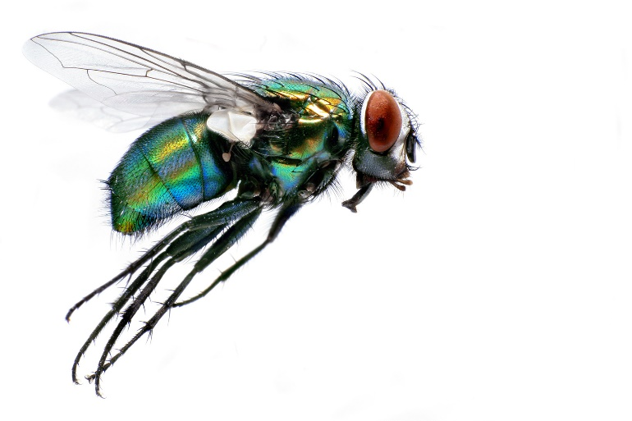
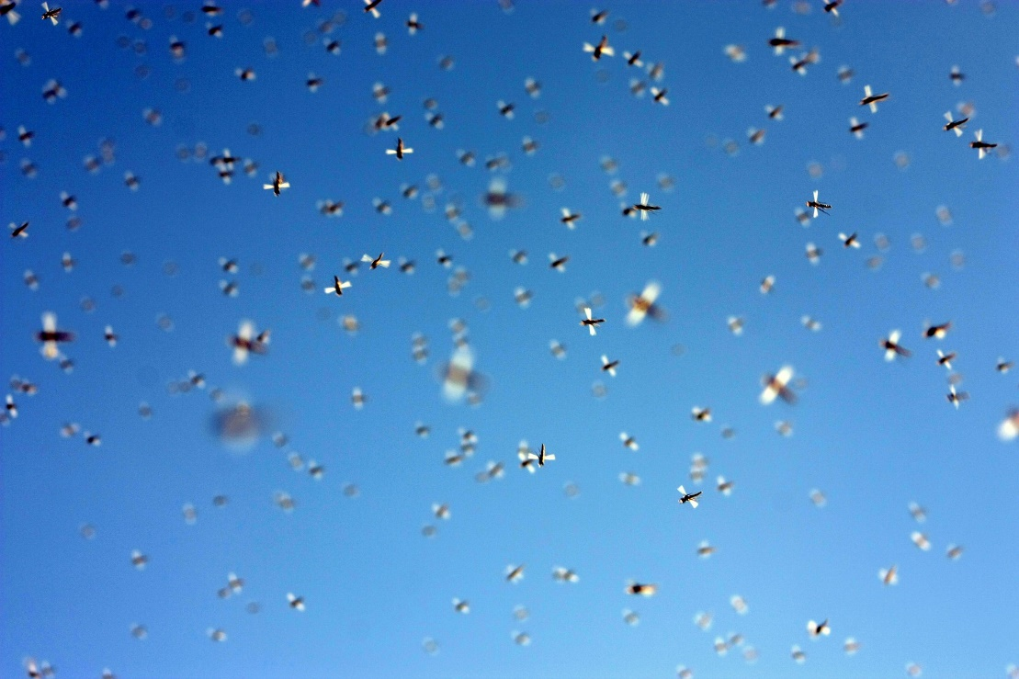
Zungenbrecher
hören
[Zunge = tongue, Brecher = breaker/crusher]
Wenn Fliegen hinter Fliegen fliegen, fliegen Fliegen Fliegen nach.
Notes:
Timing: 2 minutes Aim: To develop productive/mechanical fluency, focusing almost exclusively on this single SSC [ie]. Procedure: 1. There are two recordings of this tongue twister – one slower, one faster.
2. Click on the top button to play the slower version; the bottom button plays the faster one.
3. Draw out with students the difference between the noun ‘flies’ and the verb ‘fly’ – i.e., the capital letter.
Transcript: Wenn Fliegen hinter Fliegen fliegen, fliegen Fliegen Fliegen nach.
Translation: When flies behind flies fly, fly flies after flies.
https://creativecommons.org/licenses/by-nd/2.0/legalcode
Word frequency (1 is the most frequent word in German): fliegen [930]; die Fliege [>5000]; hinter [288]; nach [38]; wenn [43]
Source: Jones, R.L. & Tschirner, E. (2006). A frequency dictionary of German: core vocabulary for learners. Routledge

Slide 17
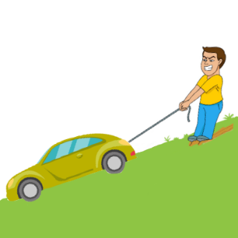
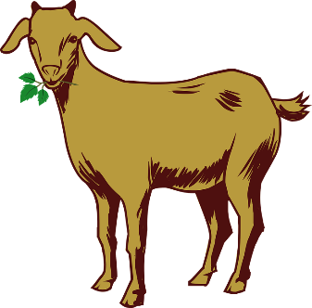
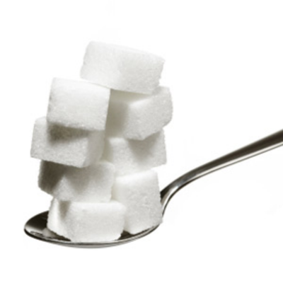
Zungenbrecher
hören
Am zehnten
um zehn Uhr zehn
ziehen zehn Ziegen
zehn Zentner Zucker
zum Zoo.
10
100
Notes:
Timing: 2 minutes Aim: To focus on the following SSCs: Z – IE – long E – short E Procedure: 1. There are two recordings of this tongue twister – one slower, one faster.
2. Click on the top button to play the slower version; the bottom button plays the faster one.
Transcript: Am zehnten um zehn Uhr zehn ziehen zehn Ziegen zehn Zentner Zucker zum Zoo. Translation: On the 10th at ten past ten pull ten goats ten hundredweight of sugar to the zoo. Word frequency (1 is the most frequent word in German): an [19]; zehn [314]; um [47]; Uhr [349]; ziehen [266]; Ziege [>4037]; Zentner [>4037]; Zucker [3823]; zu [6]; Zoo [>4037]
Source: Jones, R.L. & Tschirner, E. (2006). A frequency dictionary of German: core vocabulary for learners. Routledge
Images www.pixabay.com Except: Zoo sign
Modified by Antti Palsola (Apalsola) [Public domain]

Slide 18
Y7 T1.2 Week 3
Kultur
Slide 2: Reading, speaking
Slide includes German first names

Slide 19
Phonetik
lesen / sprechen
Wie sagt man das?
 | long o | short o |  | long i | short i
Moritz |  |  | Mia
Leonie |  |  | Felix
Jonas |  |  | Emil
Leon |  |  | Finn
Oskar |  |  | Luisa
Sofia |  |  | Elias
Anton |  |  | Lina
Notes:
Timing: 5 minutes Aim: This is a phonics recap of long and short /o/ and /i/. These German names consist of these sounds together with previously studied SSCs and transferable consonants, with the exception of /j/ in Jonas and /s/ in Sofia.
Note: Students may be interested to know that these are taken from the list of most popular German baby names 2016: https://www.expatica.com/de/living/family/german-baby-names-popular-german-boys-and-girls-names-1067023
Procedure: 1. Teacher reads the names and students identify if they are long or short vowels.
2. If the class have German names, they should at this point identify any long or short vowels they contain.

Slide 20
Y7 T1.2 Week 4
Kultur
Slides 46-47: Reading, translating
Slides 49-50: Translating, writing
Slides mention Mark Forster, German musician

Slide 21
Mias Tagebuch
lesen
Mia schreibt ein Tagebuch. Finde 28 Verben im Text!
Meine Traumwoche 21. November 2019
Ich bleibe jeden Tag zu Hause und gehe nicht in die Schule. Wolfgang hat Unterricht und lernt Englisch aber ich sitze im Garten und rede mit Freunden. Die Sonne scheint jeden Tag und ich trinke Limonade und kaufe im Supermarkt Bonbons. Ich besuche manchmal Nina, meine beste Freundin. Ich gehe mit Nina einkaufen oder schwimmen.
Meine Traumwoche 21. November 2019
Ich bleibe jeden Tag zu Hause und gehe nicht in die Schule. Wolfgang hat Unterricht und lernt Englisch aber ich sitze im Garten und rede mit Freunden. Die Sonne scheint jeden Tag und ich trinke Limonade und kaufe im Supermarkt Bonbons. Ich besuche manchmal Nina, meine beste Freundin. Ich gehe mit Nina einkaufen oder schwimmen.
Wolfgang macht Hausaufgaben, kocht und putzt den Boden. Ich schreibe ein Buch, spiele am Computer oder zeichne. Ich singe oft ein Lied und höre jeden Tag
Mark Forster. Mark Forster ist mein
Lieblingssänger. Ich liebe Mark Forster!
Ich putze nicht aber ich arbeite freiwillig im Garten.
Ich spiele mit Opa Fußball und zeige Oma Fotos.
Und … ja, das ist meine Traumwoche ☺
Wolfgang macht Hausaufgaben, kocht und putzt den Boden. Ich schreibe ein Buch, spiele am Computer oder zeichne. Ich singe oft ein Lied und höre jeden Tag Mark Forster. Mark Forster ist mein
Lieblingssänger. Ich liebe Mark Forster!
Ich putze nicht aber ich arbeite freiwillig im Garten. Ich spiele mit Opa Fußball und zeige Oma Fotos.
Und … ja, das ist meine Traumwoche ☺
Notes:
Timing: 5 minutes Aim: To practise recognising the verbs in a text (reading)
Procedure: 1. Students identify all examples of verbs. They can do this by circling/underlining on a printed copy, or by writing a list in their workbooks.
2. Remind students that the verbs could occur in the short form (ending in –e, -st or –t) or the long form (-en), and that haben and sein are also verbs. All verbs included are regular in the present tense, with the exception of haben and sein which students have learned.
3. All the verbs are highlighted in one go upon clicking the mouse.
Notes:
1) The majority of these verbs have been encountered before, but seven unfamiliar high-frequency verbs are included in preparation for the dictionary work on the next slide:
bleiben [112]; scheinen [276]; besuchen [703]; einkaufen [1789]; schwimmen [1832]; zeichnen [1808]; lieben [816].
Source: Jones, R.L. & Tschirner, E. (2006). A frequency dictionary of German: core vocabulary for learners. Routledge
2)In terms of other unfamiliar items:
a/ Students have not met Tagebuch, but they know ‘Tag’ and ‘Buch’. This is a good opportunity to introduce students to the concept of compounds. Teacher to explain that as students know the gender of Buch, they also know the gender of any word ending in Buch, as the gender of compound nouns agrees with the final stem. Same with Traumwoche. Teachers to ensure that Tagebuch and Traumwoche are understood by students before starting the task.
b/ Sonne, Limonade, Bonbons, beste and Fotos are all new words, but can be inferred from the English translations.
c/ Teacher to point out the convention for writing dates – with a full stop after the number.
d/ Mark Forster – a German singer/songwriter and TV personality.

Slide 22
Wörterbucharbeit
übersetzen
Wie ist Mias Traumwoche? Schreib Sätze auf Englisch.
Meine Traumwoche 21. November 2019
Ich bleibe jeden Tag zu Hause und gehe nicht in die Schule. Wolfgang hat Unterricht und lernt Englisch aber ich sitze im Garten und rede mit Freunden. Die Sonne scheint jeden Tag und ich trinke Limonade und kaufe im Supermarkt Bonbons. Ich besuche manchmal Nina, meine beste Freundin. Ich gehe mit Nina einkaufen oder spazieren.
Wolfgang macht Hausaufgaben, kocht und putzt den Boden. Ich schreibe ein Buch, spiele am Computer oder zeichne. Ich singe oft ein Lied und höre jeden Tag Mark Forster. Mark Forster ist mein
Lieblingssänger. Ich liebe Mark Forster!
Ich putze nicht aber ich arbeite freiwillig im Garten. Ich spiele mit Opa Fußball und zeige Oma Fotos.
Und … ja, das ist meine Traumwoche ☺
Notes:
Timing: 10 minutes Aim: To provide practice in the use of dictionaries to look up unfamiliar verbs
Procedure: 1. Tell students that they have already learnt the meanings of 20 of the 28 verbs in this text, but that some new verbs have been included, which they might need to look up.
2. As a reminder, elicit the process that they would need to go to to find the meaning of ‘bleibe’ in the dictionary, i.e. remove the ending –e, add –en, to form the infinitive –bleiben, then look up its meaning in the dictionary.
3. Also remind students of the word order rules discussed in the ‘building blocks’ section of the previous lesson – where does the adverb go?
4. Students can attempt this translation individually at first, and then compare translations with a partner.

Slide 23
Übersetzung
übersetzen
Eine Antwort:
Wolfgang macht Hausaufgaben, kocht und putzt den Boden. Ich schreibe ein Buch, spiele am Computer oder zeichne. Ich singe oft ein Lied und höre jeden Tag Mark Forster. Mark Forster ist mein Lieblingssänger. Ich liebe Mark Forster! Ich putze nicht aber ich
arbeite freiwillig im Garten. Ich spiele mit Opa
Fußball und zeige Oma Fotos.
Und … ja, das ist meine Traumwoche ☺
Wolfgang does his homework, cooks and cleans the floor. I write a book, play on the computer or draw.
I often sing a song and I listen to Mark Forster every day. Mark Forster is my favourite singer.
I love Mark Forster!
I don’t clean, but I work voluntarily in the garden.
I play football with Opa and show Oma photos.
And … yes, that’s my dream week ☺
Notes:
Timing: 5 minutes Aim: To provide suggested English sentences for the second half of the translation exercise on the previous slide
Note: This is answer slide 2 of 2.
Procedure: 1. The suggested English sentences appear one by one on clicks.
2. Teacher can present these suggested translations after eliciting suggestions from students.
3. Teacher may wish to collect ideas from the class and come up with a class translation on the board instead.
4. Teacher to stress that there could be several solutions, and to encourage and praise structurally sound alternative suggestions.

Slide 24
Wolfgangs Tagebuch
schreiben
Now imagine you are telling the story from Wolfgang’s perspective. What changes?
Mias Traumwoche 21. November 2019
Ich bleibe jeden Tag zu Hause und gehe nicht in die Schule. Wolfgang hat Unterricht und lernt Englisch aber ich sitze im Garten und rede mit Freunden. Die Sonne scheint jeden Tag und ich trinke Limonade und kaufe im Supermarkt Bonbons. Ich besuche manchmal Nina, meine beste Freundin. Ich gehe mit Nina einkaufen or schwimmen.
Wolfgang macht Hausaufgaben, kocht und putzt den Boden. Ich schreibe ein Buch, spiele am Computer oder zeichne. Ich singe oft ein Lied und höre jeden Tag Mark Forster. Mark Forster ist mein
Lieblingssänger. Ich liebe Mark Forster!
Ich putze nicht aber ich arbeite freiwillig im Garten. Ich spiele mit Opa Fußball und zeige Oma Fotos.
Und … ja, das ist meine Traumwoche ☺
Ich mache
koche
putze
Mia schreibt
spielt
Mia bleibt
geht
zeichnet.
Sie singt
hört
Ich habe
lerne
Mias
Unfair!
Mia sitzt
redet
Sie liebt
Mia trinkt
Mia putzt
sie arbeitet
kauft
Sie besucht
Sie spielt
zeigt
Mias
Mia geht
Mias
☹
Notes:
Timing: 10 minutes Aim: To practise changing verbs and pronouns from 1st to 3rd person, and vice versa
Note: This is intended as an additional task, time permitting / extension / homework
Procedure: 1. Students write a list of the verb changes which are necessary when talking in the third person.
2. Teacher to acknowledge that Mia/sie are often interchangeable.
3. Answers are revealed one by one upon clicking the mouse.

Slide 25
Y7 T1.2 Week 6
Kultur
Slides 34-35: Speaking
Slides 37-60: Reading, writing, speaking
Slides 62-72: Listening, reading, writing, speaking, grammar
Slides include Christmas songs ‘Schmückt den Saal mit grünen Zweigen!’ and ‘O Tannenbaum’; Christmas-themed vocabulary work

Slide 26
Schmückt den Saal mit grünen Zweigen! Fa-la-la-la-la-la-la-la-la!
sprechen
Tretet an zum bunten Reigen!
Fa-la-la-la-la-la-la-la-la!
Auf und nieder, immer wieder!
Fa-la-la-la-la-la-la-la-la!
Singt die alten Weihnachtslieder!
Fa-la-la-la-la-la-la-la-la!
Notes:
Timing: 5 minutes Aim: Practising phonics [ü] in a real text.
Note: lesson two includes a more detailed Christmas song covering the same SSCs. Depending on available time and how the students are getting on with these particular SSCs this activity could be left out.
Procedure: 1. Speak the first two lines out loud, drawing attention to the [ü] introduced earlier in the lesson.
2. Students repeat out loud. Note: In case students are curious about the meaning of the words to this song, the English translations are below:
Schmückt den Saal mit grünen Zweigen! (Decorate the room with green boughs/branches) Fa-la-la-la-la-la-la-la-la!
Tretet an zum bunten Reigen! (Step up to the varied melodies - i.e. an invitation to dance)
Fa-la-la-la-la-la-la-la-la!
Auf und nieder, immer wieder! (Up and down, over and over again)
Fa-la-la-la-la-la-la-la-la!
Singt die alten Weihnachtslieder! (Sing the old Christmas carols)
Fa-la-la-la-la-la-la-la-la!

Slide 27
Schmückt den Saal mit grünen Zweigen! Fa-la-la-la-la-la-la-la-la!
sprechen
Tretet an zum bunten Reigen!
Fa-la-la-la-la-la-la-la-la!
Auf und nieder, immer wieder!
Fa-la-la-la-la-la-la-la-la!
Singt die alten Weihnachtslieder!
Fa-la-la-la-la-la-la-la-la!
Notes:
Timing: 3 minutes Aim: Practising phonics [ü] in a real text.
Note: lesson two includes a more detailed Christmas song covering the same SSCs. Depending on available time and how the students are getting on with these particular SSCs this activity could be left out.
Procedure: 1. Highlight the 'ei’ / 'ie’ SSCs in the text lines by line.
2. Students repeat out loud. 3. Now sing the song together (Melody is Deck the Halls):
Schmückt den Saal mit grünen Zweigen! Fa-la-la-la-la-la-la-la-la!
Tretet an zum bunten Reigen!
Fa-la-la-la-la-la-la-la-la!
Auf und nieder, immer wieder!
Fa-la-la-la-la-la-la-la-la!
Singt die alten Weihnachtslieder!
Fa-la-la-la-la-la-la-la-la!

Slide 28
Vokabeln
lesen / schreiben
?
A. Nur montags
B. Blau, gelb, rot
C. Übersetze ‘never’
D. oder
E. Am Sonntag, Montag, Dienstag, etc.
F. Übersetze ‘hardly’
G. Übersetze ‘to wish’
H. Schreiben, sprechen, lesen, und …
I. Nicht selten
J. Wo?
K. Ehm?
E | I | N | M | A | L |  | D | I | E |  | W | O | C | H | E
 |  |  | D | I | E |  | F | A | R | B | E | N
 |  |  |  |  |  |  |  |  |  | N | I | E
 |  |  |  |  |  |  | D | A | S |  | H | A | U | S | T | I | E | R
 |  |  |  |  |  |  | J | E | D | E | N |  | T | A | G
 |  |  |  |  |  |  |  |  |  | K | A | U | M
 |  |  |  |  |  |  | W | Ü | N | S | C | H | E | N
 |  |  |  |  |  |  |  |  |  |  | H | Ö | R | E | N
 |  |  |  |  |  |  |  |  | O | F | T
 |  |  |  |  |  |  |  |  |  | D | E | R |  | O | R | T
W | I | E |  | S | A | G | T | - | M | A | N | ?
Notes:
Timing: 10 minutes Aim: To share the theme for the lesson (‘Weihnachten’), whilst revising previously-met vocabulary
Note: A more complex version of this task, in which only the first letter of each word is given, can be found on the next slide.
Procedure: 1. Teacher asks question / gives clue in German as per A – L on slide. 2. Student(s) volunteer(s) the answer (e.g. einmal die Woche).
3. Teacher asks ‘wie schreibt man das?’ 4. Students in chorus (slowly and steadily) respond to spell out the answer: E-I-N-M-A-L D-I-E W-O-C-H-E) Note: If students are practising for the Spelling Bee, then they will have learnt the term ‘Abstand’ for indicating a space between words. They could be prompted to use that, here.
5. As students spell the word, teacher reveals each letter on a click.This will enable the teacher to pick up on any of the trickier letters, and do some remedial practice in the moment.

Slide 29
Vokabeln
lesen / schreiben
?
A. Nur montags
B. Blau, gelb, rot
C. Übersetze ‘never’
D. oder
E. Am Sonntag, Montag, Dienstag, etc.
F. Übersetze ‘hardly’
G. Übersetze ‘to wish’
H. Schreiben, sprechen, lesen, und …
I. Nicht selten
J. Wo?
K. Ehm?
E | I | N | M | A | L |  | D | I | E |  | W | O | C | H | E
 |  |  | D | I | E |  | F | A | R | B | E | N
 |  |  |  |  |  |  |  |  |  | N | I | E
 |  |  |  |  |  |  | D | A | S |  | H | A | U | S | T | I | E | R
 |  |  |  |  |  |  | J | E | D | E | N |  | T | A | G
 |  |  |  |  |  |  |  |  |  | K | A | U | M
 |  |  |  |  |  |  | W | Ü | N | S | C | H | E | N
 |  |  |  |  |  |  |  |  |  |  | H | Ö | R | E | N
 |  |  |  |  |  |  |  |  | O | F | T
 |  |  |  |  |  |  |  |  |  | D | E | R |  | O | R | T
W | I | E |  | S | A | G | T | - | M | A | N | ?
Notes:
Timing: 10 minutes Aim: To share the theme for the lesson (‘Weihnachten’), whilst revising previously-met vocabulary
Note: This version of this task only gives the first letter of each word. A less complex version, in which more letters of each word are given, can be found on the previous slide.
Procedure: 1. Teacher asks question / gives clue in German as per A – L on slide. 2. Student(s) volunteer(s) the answer (e.g. einmal die Woche).
3. Teacher asks ‘wie schreibt man das?’ 4. Students in chorus (slowly and steadily) respond to spell out the answer: E-I-N-M-A-L D-I-E W-O-C-H-E). Note: If students are practising for the Spelling Bee, then they will have learnt the term ‘Abstand’ for indicating a space between words. They could be prompted to use that here.
5. As students spell the word, the teacher reveals each letter on a click. This will enable the teacher to pick up on any of the trickier letters, and do some remedial practice in the moment.

Slide 30
der Engel
lesen / sprechen
der Engel
Notes:
Timing: 5 minutes (all vocabulary slides in this sequence) Aim: To present new vocabulary (Christmas-themed)
Note: These are thematic words chosen to illustrate SSCs and plurals. They are not part of the vocabulary set for the week, but are introduced to fit with seasonal themes.
Procedure: 1. Since students have not had the opportunity to pre-learn these words, word and picture appear together from the outset.
2. Present single word + picture and ask students to read aloud using their knowledge of phonics.
3. Practise reading aloud and applying SSC knowledge - Key SSC recapped here are: short E, IE, EI, W, CH, Z.
4. Advance through all vocabulary slides in the same way.
Note: Christmas vocabulary not to be memorised; it is introduced to apply plural rules / SSC knowledge with different lexis.
Word frequency (1 is the most frequent word in German):
der Weihnachtsmann [2722 ,131] der Baum [996], der Stiefel [>4000], der Nikolaus [>4000], der Bonbon [>4000], der Schmuck [>4000], der Stern [1451], Engel [3963]
Source: Jones, R.L. & Tschirner, E. (2006). A frequency dictionary of German: core vocabulary for learners. Routledge

Slide 31
der Stern
lesen / sprechen
der Stern
Notes:
As for previous slide

Slide 32
der Stiefel
lesen / sprechen
der Stiefel
Notes:
As for previous slide
Note: The reason for including a boot as a Christmassy item might need a little cultural aside explaining that children leave a boot or shoe outside their bedroom door on the evening of 5th December for St Nikolaus. When they wake up in the morning of 6th December, they hopefully find them full of delicious goodies if they’ve been good. St Nikolaus is not the same tradition as Father Christmas (der Weihnachtsmann). Read more, here:
https://www.thelocal.de/20131206/15915

Slide 33
der Baum
lesen / sprechen
der Baum
Notes:
As for previous slide

Slide 34
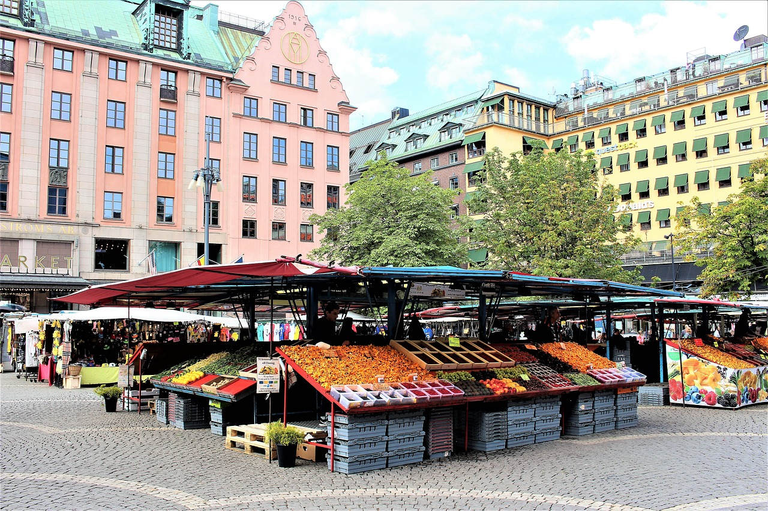
der Marktplatz
lesen / sprechen
der Marktplatz
Notes:
As for previous slide

Slide 35
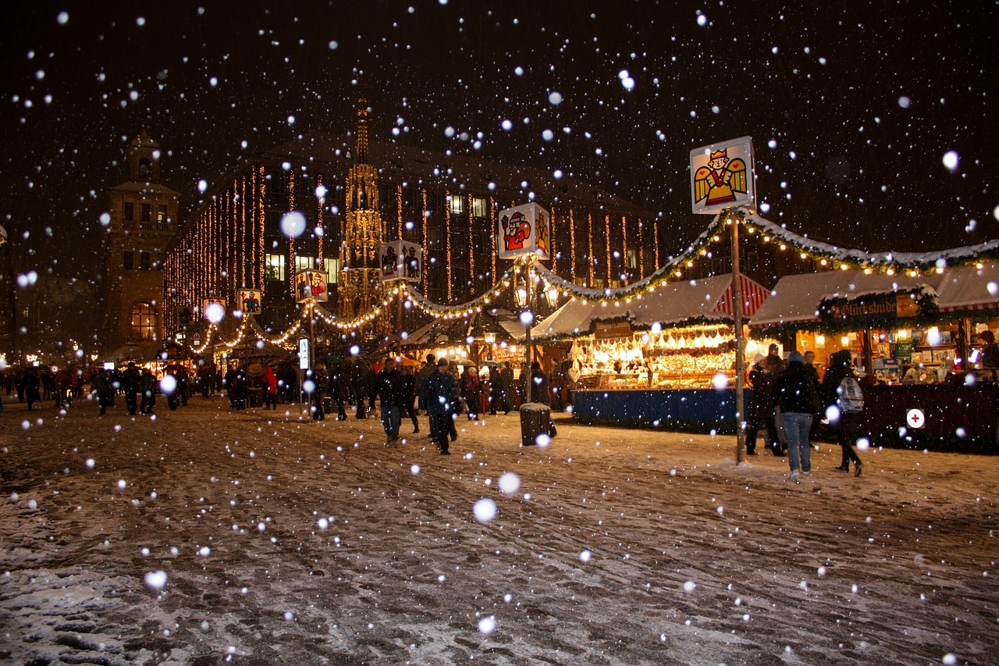
der Weihnachtsmarkt
lesen / sprechen
der Weihnachtsmarkt
Notes:
As for previous slide

Slide 36
der Weihnachtsmann
lesen / sprechen
der Weihnachtsmann
Notes:
As for previous slide

Slide 37
Vokabeln
lesen
der Stern
star
der Stiefel
boot
der Baum
tree
der Marktplatz
market square
der Weihnachtsmarkt
Christmas market
der Engel
angel
der Weihnachtsmann
Father Christmas
Notes:
Timing: 2 minutes Aim: To recap quickly on the Christmas-themed vocabulary
Procedure: 1. Students see how many words they can translate into English in one minute
2. Click to bring up the English, one word at a time.
Note: Christmas vocabulary not to be memorised; it is introduced to apply plural rules / SSC knowledge with different lexis.
Word frequency (1 is the most frequent word in German):
der Weihnachtsmann [2722 ,131] der Baum [996], der Stiefel [>4000], der Nikolaus [>4000], der Bonbon [>4000], der Schmuck [>4000], der Stern [1451], Engel [3963]
Source: Jones, R.L. & Tschirner, E. (2006). A frequency dictionary of German: core vocabulary for learners. Routledge

Slide 38
Pluralformen
schreiben
Ich sehe fünf…
Notes:
Timing: 10 minutes Aim: Writing activity to practise predicting what the plurals might be using the rules that have been introduced.
Procedure: 1. Students write down in German what they think the plural might be for the noun featured on each slide in the sequence.
2. Go through the all the questions (one per slide) first; the answers apear on a second suite of slides.
Notes:
1) sehen was a cluster word for long ‘e’ in lesson 1.1.2. Elicit the meaning from students, prompting with a gesture if necessary. 2) fünf was introduced as a phonics source word. Its meaning should be clear, here, particularly given the visual cue.
3) as these items are not part of the official vocab, students might need to be reminded of the singular form, i.e. der Engel.

Slide 39
Pluralformen
schreiben
Es gibt viele…
Notes:
As for the previous slide
Es gibt is on the vocab list for this week. viele was also learnt as part of ‘Wie viele’ (how many). Star = der Stern

Slide 40
Pluralformen
schreiben
Es gibt viele…
Notes:
As for the previous slide
Singular = der Baum

Slide 41
Pluralformen
schreiben
Es gibt ein Paar …
Notes:
As for the previous slide
Singular = der Stiefel Ensure that students remember ‘ein Paar’ from Lesson 1.1.2.

Slide 42
Pluralformen
schreiben
Ich sehe zwei…
Notes:
As for the previous slide
Singular = der Marktplatz Note: Zwei hasn’t been formally introduced but it is likely that they will not be confused about its meaning, given the visual cue.

Slide 43
Pluralformen
schreiben
Es gibt zwei…
Notes:
As for the previous slide
Singular noun = der Weihnachtsmarkt.

Slide 44
Pluralformen
schreiben
Ich sehe viele…
Notes:
As for the previous slide
Singular noun = der Weihnachtsmann

Slide 45
Pluralformen
Antworten
Ich sehe fünf…
Engel
Notes:
Timing: 10 minutes Aim: To present the answers to the writing activity
Procedure: 1. Elicit the answer from students.
2. Click to bring up the correct answer.
3. Advance through all slides in the sequence in the same way.

Slide 46
Pluralformen
Antworten
Es gibt viele…
Sterne
Notes:
As for previous slide

Slide 47
Pluralformen
Antworten
Es gibt viele…
Bäume
Notes:
As for previous slide
Students will be taught SSC äu in the 2nd week of Term 2. They will therefore need some support with the pronunciation at this stage.

Slide 48
Pluralformen
Antworten
Es gibt ein Paar…
Stiefel
Notes:
As for previous slide

Slide 49
Pluralformen
Antworten
Ich sehe zwei…
Marktplätze
Notes:
As for previous slide

Slide 50
Pluralformen
Antworten
Es gibt zwei…
Weihnachtsmärkte
Notes:
As for previous slide

Slide 51
Pluralformen
Antworten
Ich sehe viele…
Weihnachtsmänner
Notes:
As for previous slide
These examples provide some evidence that most words stick to a limited number of plural patterns. 90% masculine words form their plurals following Rule 1, for example. However, Weihnachtsmann is an exception, because it not only adds an umlaut to the vowel, it adds not just an -e but an -er.

Slide 52
O Tannenbaum
Hör die Musik an.
Ist die Musik…
a. Popmusik
b. traditionell
c. klassisch
Was ist das Thema?
a. Liebe
b. Natur
c. Europa
Notes:
Timing: 3 minutes Aim: To introduce a seasonal text
Procedure: 1. Setting the scene. Just play one verse of an instrumental version. Link to instrumental versions: https://www.youtube.com/watch?v=KurqAmMi-bc (various instruments) https://www.youtube.com/watch?v=nxvJ1SIRdiI (piano only)
2. Alternatively, click on left hand tree, then right hand tree.
Link to versions with lyrics:
https://www.youtube.com/watch?v=OVSoZn66iC4 – a capella version, lyrics are fairly clear, there is only one verse https://www.youtube.com/watch?v=RJauT4IM1Y8 (choral version; pretty, but as there are a lot of voices, the individual sounds are not as clear– 3 verses, only play verse 1) https://www.youtube.com/watch?v=lS4wTuvR7Ik (single voice; quite clear sound – 3 verses, only play verse 1)

Slide 53
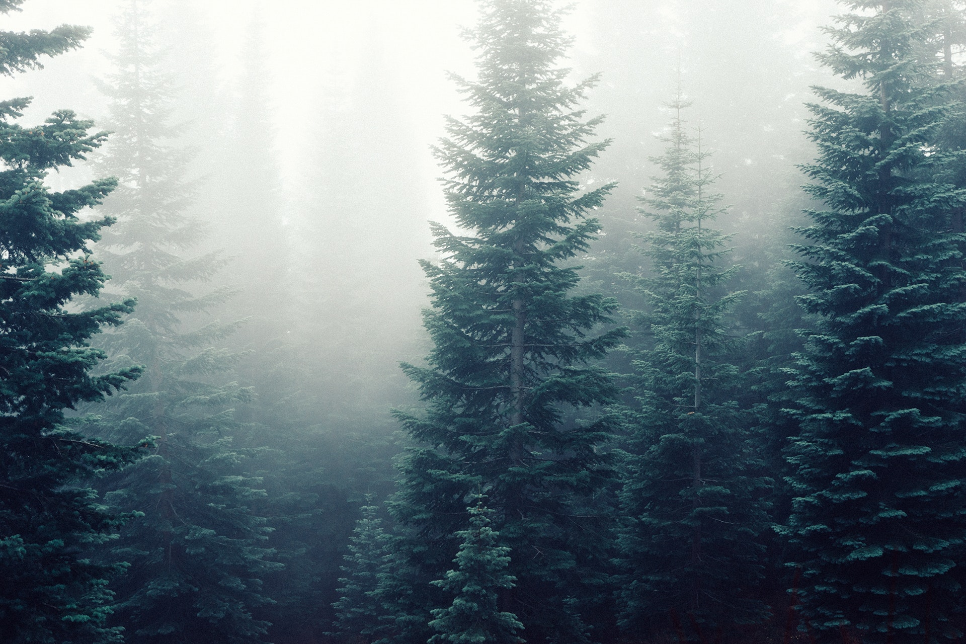
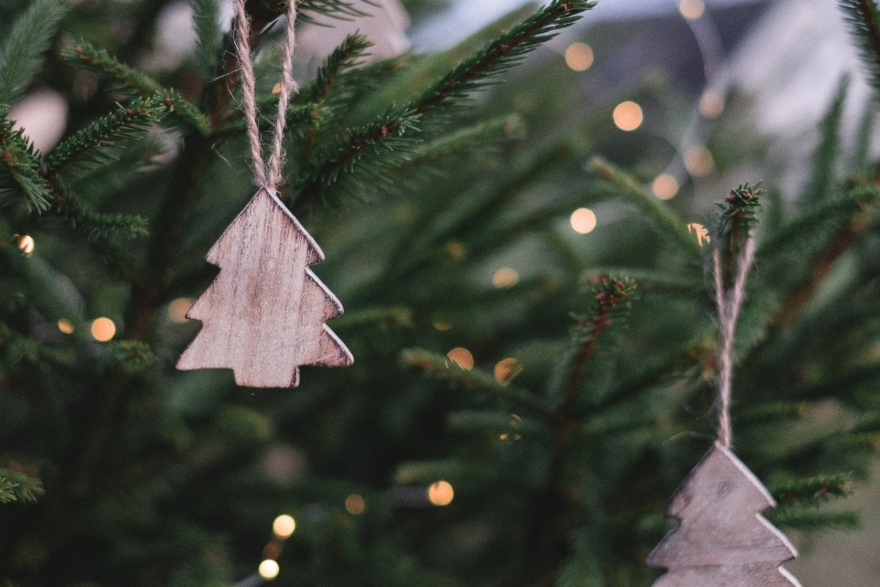
O Tannenbaum
Der Baum
O, Tannenbaum
Inge Alferink / Rachel Hawkes
Notes:
Timing: 2 minutes Aim: Further setting the scene.
Procedure: 1. The pictures emphasise the natural properties of the tree and not the decorative (Christmassy) aspect. The top right picture might prime ‘snowing’ (wenn es schneit).
2. Introduce the noun ‘der Baum’ [996] and invite the students to guess what type of tree a Tannenbaum might be.
Note: Students have not yet learnt the SSC ‘au’, but they have encountered some words with ‘au’ already (for example, das Haus). We return to this later in the lesson.

Slide 54
Geistesblitz - Vokabeln
schreiben
Titel: O, Tannenbaum
60 Sekunden.
5 Wörter (Deutsch oder Englisch)
Notes:
Timing: 3 minutes Aim: Helping students to use their real-world knowledge and previous vocabulary knowledge in a new context.
Procedure: 1. Give the instructions in German: Der Title von diesem Lied /Song ist: O, Tannenbaum. In 60 Sekunden schreib 5 Wörter (Deutsch oder Englisch) für das Lied.
2. Hear some examples.
Some ideas, with their word frequency: der Baum [996]; das Blatt [1330]; der Stamm [3500]; der Zweig/Ast [>4000]; die Wurzel [3047]; wachsen [482]; grün [556]; braun [2178]; die Erde [781]; die Sonne [953]; der Regen [1690]; der Sommer [704]; der Winter [1288]; der Schnee [2203]

Slide 55
‘U’ oder ‘Ü’?
hören
O Tannenbaum, o Tannenbaum,
wie gr_n sind deine Blätter!
D_ gr_nst nicht n_r z_r Sommerzeit,
Nein auch im Winter, wenn es schneit.
O Tannenbaum, o Tannenbaum,
wie gr_n sind deine Blätter!
Notes:
Timing: 3 minutes Aim: Phonics practice contrasting ‘u’ and ‘ü’.
Procedure: 1. Click on the fir tree in the top right hand corner to play the song. Students write ‘u’ or ‘ü’ for each missing vowel.
2. Play the song a second time. The text could also be read aloud if the recording seems too fast.
3. Alternatively, here is a link to a commercial version: https://www.youtube.com/watch?v=lS4wTuvR7Ik
(single voice, but quite clear sound – 3 verses, only play verse 1).
4. The answers are provided on the next slide.
Note: We include the source words and pictures as a refresher.
Instructions in German:
Hör zu
Schreib ‘u’ oder ‘ü’

Slide 56
Antworten – u vs ü
Antworten
O Tannenbaum, o Tannenbaum,
wie gr_n sind deine Blätter!
D_ gr_nst nicht n_r z_r Sommerzeit,
Nein auch im Winter, wenn es schneit.
O Tannenbaum, o Tannenbaum,
wie gr_n sind deine Blätter!
grün
Du
grünst
nur
zur
grün
Notes:
Timing: 2 minutes Aim: To provide the answers to the activity on the previous slide
Procedure: 1. Ask students which SSC is missing each time.c, licking to reveal the answers one by one.

Slide 57
‘IE’ oder ‘EI’
hören
O Tannenbaum, o Tannenbaum,
w__ grün sind d__ne Blätter!
Du grünst nicht nur zur Sommerz__t,
N__n auch im Winter, wenn es schn__t.
O Tannenbaum, o Tannenbaum,
w__ grün sind d__ne Blätter!
Notes:
Timing: 3 minutes Aim: Phonics practice contrasting ‘ie’ and ‘ei’.
Procedure: 1. Click on the fir tree in the top right hand corner to play the song. Students write ‘ie’ or ei’ for each missing vowel.
2. Play the song a second time. The text could also be read aloud if the recording seems too fast.
3. Alternatively, here is a link to a commercial version: https://www.youtube.com/watch?v=lS4wTuvR7Ik
(single voice, but quite clear sound – 3 verses, only play verse 1).
4. The answers are provided on the next slide.
Note: Revisiting SSCs. In the NCELP SOW these SSCs have been introduced during Term 1.1, Weeks 3 (ei) and 7 (ie). We are using these as a minimal pair because of the spelling similarities. We include the source words and pictures as a refresher.
Instructions:
Hör zu
Schreib ie oder ei

Slide 58
Antworten – ie vs ei
Antworten
O Tannenbaum, o Tannenbaum,
w__ grün sind d__ne Blätter!
Du grünst nicht nur zur Sommersz__t,
N__n auch im Winter, wenn es schn__t.
O Tannenbaum, o Tannenbaum,
w__ grün sind d__ne Blätter!
wie
deine
Sommerzeit
Nein
schneit
wie
deine
Notes:
Timing: 2 minutes Aim: To provide the answers to the activity on the previous slide
Procedure: 1. Ask students which SSC is missing each time.c, licking to reveal the answers one by one.

Slide 59
‘AU’ und ‘SCH
sprechen
AU
blau
das Haus
kaum
O Tannenbaum, o Tannenbaum,
wie grün sind deine Blätter!
Du grünst nicht nur zur Sommerzeit,
Nein auch im Winter, wenn es schneit.
O Tannenbaum, o Tannenbaum,
wie grün sind deine Blätter!
O Tannenbaum, o Tannenbaum,
wie grün sind deine Blätter!
Du grünst nicht nur zur Sommerzeit,
Nein auch im Winter, wenn es schneit.
O Tannenbaum, o Tannenbaum,
wie grün sind deine Blätter!
SCH
der Tisch
die Flasche
falsch
schreiben
in der Schule
Notes:
Timing: 2 minutes Aim: To practise two new sounds – [au] and [sch] – before attempting to sing the song
Note: There are two more sounds that have not been introduced formally (i.e. in a dedicated phonics session), but that pupils will have encountered already in other words: ‘au’ and ‘sch’. The boxes on the right hand side give the sounds in words they have already been introduced to previously in the SOW.
Procedure: 1. Practise these new sounds separately (saying ‘au’ and ‘sch’) and relate them to the sounds in familiar words, before saying them in the new words.

Slide 60
Sprich es aus oder sing mit!
sprechen
O Tannenbaum, o Tannenbaum,
wie grün sind deine Blätter!
Du grünst nicht nur zur Sommerzeit,
Nein auch im Winter, wenn es schneit.
O Tannenbaum, o Tannenbaum,
wie grün sind deine Blätter!
Notes:
Timing: 5 minutes Aim: To practise saying the text/singing the song
Procedure: 1. Ask your students to practise saying the text. 2. Click on the tree symbol to play the music and ask them to keep in time with the song to help word formation. 3. Alternatively, students could sing the song.
Note: Click tree on left for a slower instrumental version, tree on right for a quicker version.

Slide 61
Verbing nouns
Grammatik
Du grünst nicht nur zur Sommerzeit
https://www.gocomics.com/calvinandhobbes/1993/01/25
Notes:
Timing: 2 minutes Aim: To raise awareness of the relationship between certain verbs and adjectives
Procedure: 1. Ask students what type of word they think ‘grünst’ is. Clues: verb ending; personal pronoun ‘Du’
2. Can they deduce the meaning of ‘grünen’ from the adjective ‘grün’?

Slide 62
Übersetzen
lesen
O Tannenbaum, o Tannenbaum, | O fir tree, o fir tree
wie grün sind deine Blätter | how green are your leaves!
Du grünst nicht nur zur Sommerzeit, | You are not just green in summer(time),
Nein auch im Winter, wenn es schneit. | No, also in the winter, when it snows.
O Tannenbaum, o Tannenbaum, | O fir tree, o fir tree
wie grün sind deine Blätter. | How green are your leaves!
Notes:
Timing: 5 minutes Aim: To practise translation into English
Procedure: 1. Ask students to translate the verse using:
the words they already know
contextual expectations (Baum / Blätter / Grün )
cognates (Sommer & Winter)
generalisations (grünst)
2. Elicit translations from students line by line.
3. Click to bring up suggested translation, line by line.

Slide 63
Y7 T1.2 Week 7
Kultur
Slide 12: Reading
Slide 54: Speaking
Slide 55: Dictionary activity
Slides include practice of Christmas-themed vocabulary; Christmas song ‘Wir wünschen dir frohe Weihnacht’; 'Christmas list' theme

Slide 64
Singular oder Plural? Schreib 1-10 und ‘ist’ oder ‘sind’.
lesen
ist | sind
ist
1. Der Marktplatz _____ groß.
ist
2. Der Arzt _____ klein.
sind
3. Die Weihnachtsmärkte _____ schön.
ist
4. Der Kopf _____ groß.
sind
5. Die Züge _____ kurz.
sind
6. Die Bäume _____ grün.
sind
7. Die Sterne _____ gelb.
ist
8. Der Schnee _____ kalt
9. Die Stiefel _____ braun.
ist/sind
10. Der Engel _____ weiß.
ist/sind
Notes:
Reading text to decide ist or sind depending on the form of the masculine plurals. Language includes nouns recycled from previous week, i.e. the Christmas words + other masculine nouns. Articles are obscured to force students to pay attention to the form.
NB: Stiefel and Engel could be both. Teacher can emphasise that the article is a crucial piece of information here.
NB: lesen is on the list of words to repeat for this week, so this could be an opportunity to elicit the meaning from students.
Students could be asked to write 1-10 and prepare to write full sentences here, first writing in ist or sind, and then the correct article. Number one is worked through as a modelled example. Thereafter, questions 2-10 are provided on a single click for students to work through.
Then the answers are revealed one by one, verb form first and then article. Teachers to elicit both from students.
Der Marktplatz ist groß.
Der Arzt ist klein
Die Weihnachtsmärkte sind schön
Der Kopf is groß.
Die Züge sind kurz.
Die Bäume sind grún.
Die Sterne sind gelb.
Der Schnee ist kalt.
Die Stiefel sind braun.
Der Engel ist weiß

Slide 65
Sag es!
sprechen
Wir wünschen dir frohe Weihnacht,
wir wünschen dir frohe Weihnacht,
wir wünschen dir frohe Weihnacht
und ein glücklich’ Neujahr!
Notes:
Phonics practice
Read out loud line by line. Neu is a new sound and needs to be modelled.
Alternatively or additionally, sing to the tune of ‘We wish you a merry Christmas’.

Slide 66
Ich wünsche mir…
… einen Fußball
1. ______________
2. ______________
3. ______________
4. ______________
5. ______________
6. ______________
… ein Haustier
… eine Kerze
Notes:
3] Dictionary work with Weihnachtsliste - Ich wünsche mir + Row 2 nouns indefinite article (revisiting previous grammar with new lexis)
Explain ‘Ich wünsche mir’ (I wish (for myself)). At this point we will not explain the case of mir, but treat it as a chunk.
Go through the examples on the slide to remind the students of the accusative form with indefinite articles. Ask them which indefinite article goes with which gender.
Ask student to look up in the dictionary 6 things in they wish to put on their Weihnachtslist.
Students write the items on their list with the correct indefinite article in the correct form.

