Slide 1
Practice assessment
Year 8 German
Term 3 applying your knowledge test
Date updated: 02/06/21

Slide 2
Section A: Listening
There are two marks for each item
PART A
You will hear Mia talk about her and Wolfgang’s holidays. Here are some activities she mentions (plus some that she does not mention!). You have 10 seconds to read the activities.
You will hear the story twice, with a 20 second gap in between. Write one activity into each space in the grid below. You must decide who does the activity, and when.
meet friends climb a mountain go swimming go shopping go cycling go on a boat trip travel to Switzerland do sport go to the cinema
^{when?} _{who?} | last year | this year | next year
Mia | 1. meet friends 2. go shopping | 1. go on a boat trip | 1. go hiking 2. ___________________
Wolfgang and Mia | 1. stay at home | 1. ___________________
go cycling
travel to Switzerland
Notes:
[NOTE: TEMPORARY AUDIO FILE - TO BE REPLACED]
Transcript
Hallo! Ich heiße Mia. Diesen Sommer fahre ich mit meinem Bruder Wolfgang in den Urlaub. Wir fahren in die Schweiz, nach Zürich. Ich habe Lust, eine Bootsfahrt auf dem See zu machen. Letztes Jahr sind wir zu Hause in Berlin geblieben. Das habe ich langweilig gefunden! Ich habe meine Freundinnen in der Stadt getroffen und bin einkaufen gegangen, aber nicht viel mehr! Wolfgang ist mit Mehmet geschwommen. Das war gesund für ihn! Nächstes Jahr will ich nach Österreich reisen. Ich werde in den Bergen wandern und Rad fahren. Wolfgang wird viel Sport machen. Das wird spannend sein!

Slide 3
Section A: Listening
There are two marks for each item
PART B
Now listen for a third time. Answer the questions in English.
 |  | Write as many details as you can (2 marks per question)
a) | How did Mia find her holiday last year?
b) | What does Mia say about Wolfgang’s swimming last year?
boring; did not do very much
with Mehmet; healthy for him
Notes:
Transcript
Hallo! Ich heiße Mia. Diesen Sommer fahre ich mit meinem Bruder Wolfgang in den Urlaub. Wir fahren in die Schweiz, nach Zürich. Ich habe Lust, eine Bootsfahrt auf dem See zu machen. Letztes Jahr mussten wir in Berlin zu Hause bleiben. Das habe ich langweilig gefunden! Ich habe meine Freundinnen in der Stadt getroffen und bin einkaufen gegangen, aber nicht viel mehr! Wolfgang ist mit Mehmet geschwommen. Das war gesund für ihn! Nächstes Jahr will ich nach Österreich reisen. Ich werde in den Bergen wandern und Rad fahren. Wolfgang wird viel Sport machen. Das wird spannend sein!

Slide 4
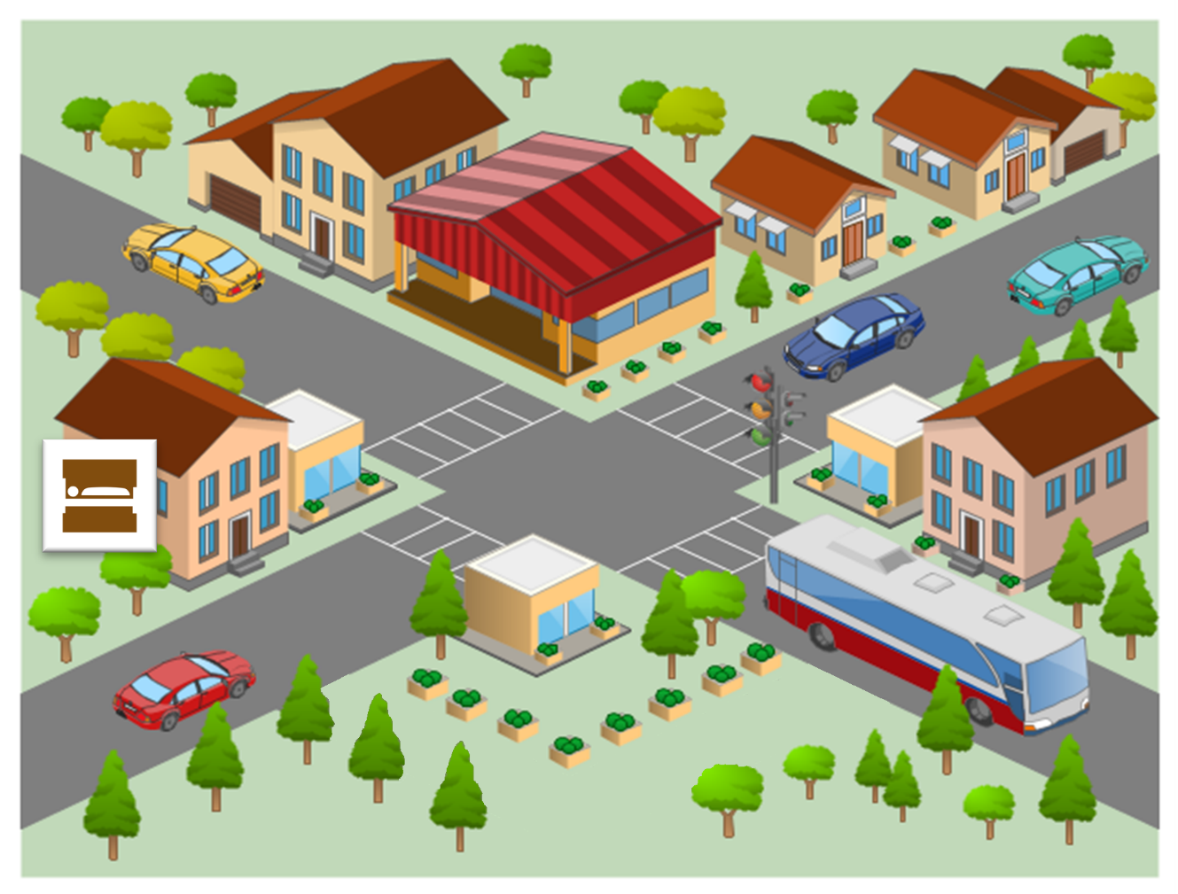
Section B: Reading Comprehension
There is half a mark for each item
PART A The map isn’t very clear!
Read the text and write the English for the words in bold in the right places on the map.
cinema
school
2.
shop
1.
museum
Neben dem Museum, auf der rechten Seite, gibt es ein kleines Geschäft. Auf der anderen Straßenseite, neben dem Kino, gibt es eine Schule.

Slide 5
Section B: Reading Comprehension
There is half a mark for each item
Now read further details about the town and answer the questions that follow.
Früher hatte die Stadt wenige Autos, aber es waren immer viele Leute im Park. Jetzt gibt es dort ein neues Schwimmbad und ein interessantes Museum. Letzte Woche bin ich ins Kino gegangen. Am Wochenende werde ich mit meinem Bruder Rad fahren.
PART B
Put a tick next to the things that describe the town, and what it had, in the past.
PART C
Number these events in the order they happen. Write numbers in the boxes on the right (1= happens first,
2 = happens second).
noisy
few cars
lots of people in the park
interesting museum
2
The author going cycling
The author going to the cinema
1

Slide 6
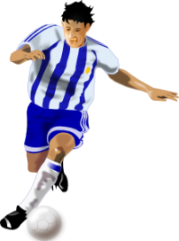
Section C: Writing
There is one mark for each item
PART A Look at the picture and complete the missing words in the text. The number of gaps tells you how many letters are missing.
Am Wochenende
Am Samstag wird Wolfgang mit seinem Freund _ _ _ _ _ _ _ spielen. Toll! Mia bleibt zu Hause. Sie wird einen Brief an ihrer Freundin in Amerika _ _ _ _ _ _ _ _ _.
Fußball
schreiben

Slide 7
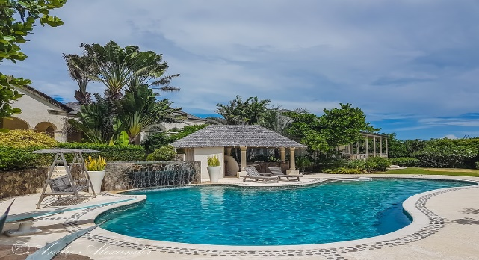
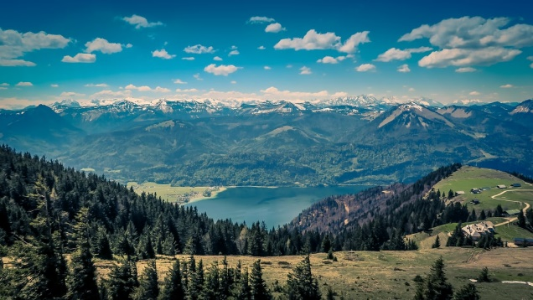
Section C: Writing
1 mark awarded for the use of a word where its meaning is fully and accurately communicated; 0.5 mark awarded where the meaning of a word is communicated but it is not used accurately (e.g., the tense or person is inaccurate).
PART B What happened last year? What will happen next year?
Write between one and three sentences in German for each picture.
Use all of the German words under the pictures.
Write your sentences in the blank box on the right. Try to show that you know what the words mean by writing full, interesting, and varied sentences that make sense.
Last year
das Flugzeug / auf Urlaub / schwimmen / Spaß
Next year
Österreich / die Berge / wandern / spannend
Notes:
Photos:
https://unsplash.com/@vincydre
https://unsplash.com/@pueblovista

Slide 8
Section D: Speaking
For each idea in parts A and B there are
2 marks for meaning and 1 mark for accuracy for each, giving 3 points for each idea in total.
Look at the photo and answer the questions below in German.
For some questions, you will need to use your imagination to make up a possible answer.
Just try to keep going and say something that you know how to say! You have 2 minutes to prepare all of your answers before you speak.
PART A
What can you see in this photo?
Try to say at least 2 different things.
Here are some ideas about what you could say.
You can say different things if you wish!
•Say what you can see in the photo
•Say what the man is going to do this afternoon
PART B
Ask the woman on the left one question
Notes:
Photo:
https://unsplash.com/@brookecagle

Slide 9
Section E: Reading Aloud and Comprehension
For each ideational unit in Part A there is 1 mark for comprehensibility and 1 mark for automaticity (fluency), giving 2 points for each idea in total.
PART A
Read the following text aloud.
You won’t know some of the words – don’t worry! Just do your best to read them aloud as you think they should sound in German. You will get points for understandable and fluent pronunciation.
PART B
Now say, in English, any 2 facts mentioned in the text.
Sarah Köhler ist eine deutsche Schwimmerin.
Sie kommt aus Hanau.
Seit zwei Jahren trainiert sie am Bundesstützpunkt in Magdeburg.
Award 1/2 point for each fact correctly identified in the text, up to a maximum of 1 point for facts from a single sentence.

