Slide 1
Saying what others do
-ER verbs (il/elle, ils/elles)
SSC [a] revisited
Y7 French
Term 1.2 - Week 6 - Lesson 25
Victoria Hobson / Emma Marsden / Rachel Hawkes
Artwork by: Chloé Motard
Date updated: 28/07/2021
Notes:
Artwork by Chloé Motard. All additional pictures selected are available under a Creative Commons license, no attribution required.
Learning outcomes (lesson 1):
Consolidation of SSC [a]
Introduction of (third person plural forms of –ER verbs]
Consolidation of [third person singular and first person plural forms of –ER verbs]
Word frequency (1 is the most frequent word in French):
7.1.2.6 (introduce) chanter [1820], étudier [960], jouer [219], ils [13], elles [38], élève [1068], fruit [896], histoire¹ [263], radio [1526], ensemble [124]
7.1.2.3 (revisit) aimer [242], cocher [>5000], passer¹ [90], porter¹ [105], rester [100], trouver [83], école [477], moment [148], semaine [245], solution [608], uniforme [1801], chaque [151], à1 [4], avec [23]
7.1.1.5 (revisit) il² [13], elle² [38], ami [467], amie [467], chanteur [3251], chanteuse [3251], femme [154], homme [136], professeur [1150], professeure [1150], drôle [2166], intéressant [1244], faux [555], sympa(thique) [4164], vrai [292]
Source: Londsale, D., & Le Bras, Y. (2009). A Frequency Dictionary of French: Core vocabulary for learners London: Routledge.
The frequency rankings for words that occur in this PowerPoint which have been previously introduced in NCELP resources are given in the NCELP SOW and in the resources that first introduced and formally re-visited those words.
For any other words that occur incidentally in this PowerPoint, frequency rankings will be provided in the notes field wherever possible.

Slide 2
a
animal
Notes:
Timing: 1 minute
Aim: To consolidate SSC [a]
Procedure: 1. Present the letter(s) and say the [a] sound first, on its own. Students repeat it with you. 2. Bring up the word ”animal” on its own, say it, students repeat it, so that they have the opportunity to focus all of their attention on the connection between the written word and its sound.
3. A possible gesture for this would be to mimic an animal’s motion, perhaps holding ones arms and hands close to the chest as ‘paws’. 4. Roll back the animations and work through 1-3 again, but this time, dropping your voice completely to listen carefully to the students saying the [a] sound, pronouncing ”animal” and, if using, doing the gesture.
Word frequency (1 is the most frequent word in French):
animal [1002]
Source: Londsale, D., & Le Bras, Y. (2009). A Frequency Dictionary of French: Core vocabulary for learners London: Routledge.

Slide 3
a
animal
Notes:
With sound and no pictures to focus all attention on the sound-symbol correspondence.

Slide 4
a
animal
Notes:
Without sound to elicit pronunciation (without first hearing the teacher).
Teacher to elicit pronunciation by asking “Comment dit-on …"

Slide 5
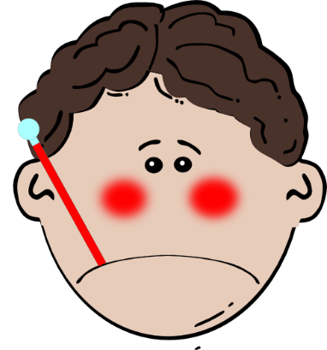
a
ça va ?
table
animal
malade
sac
mal
[badly]
Notes:
Timing: 2 minutes
Aim: To consolidate SSC [a]
Procedure:
1. Introduce and elicit the pronunciation of the individual SSC [a] and then the source word again ‘animal’ (with gesture, if using). 2. Then present and elicit the pronunciation of the five cluster words.
The cluster words have been chosen for their high-frequency, from a range of word classes, with the SSC (where possible) positioned within a variety of syllables within the words (e.g. initial, 2nd, final etc.). Additionally, we have tried to use words that build cumulatively on previously taught SSCs (see the Phonics Teaching Sequence document) and do not include new SSCs. Where new SSCs are used, they are often consonants which have a similar symbol-sound correspondence in English.
Word frequency (1 is the most frequent word in French): animal [1002]; ça va? [54 (cela), 53 (aller)]; malade [1066] mal [277]; table [1019]; sac [2343] Source: Londsale, D., & Le Bras, Y. (2009). A Frequency Dictionary of French: Core vocabulary for learners London: Routledge.

Slide 6
a
ça va ?
table
animal
malade
sac
mal
Notes:
With sound and no pictures to focus all attention on the sound-symbol correspondence.

Slide 7
a
ça va ?
table
animal
malade
sac
mal
Notes:
Without sound to elicit pronunciation (without first hearing the teacher).
Teacher to elicit pronunciation by asking “Comment dit-on …"

Slide 8
Phonétique
Phonétique
écouter / lire
How many [a] ?
La rame freine rapidement.
1
The carriage brakes quickly.
L’étoile attire son attention.
2
The star attracts his attention.
Il n’est jamais là.
3
He’s never there.
Le chat va de Paris en Andorre.
4
The cat is going from Paris to Andorra.
Notes:
Timing: 4 minutes
Aim: Oral recognition of the target SSC [a] at sentence level.
Procedure:
1. Click the number trigger to play the audio.
2. Students listen and tally the number of times they hear the SSC [a].
3. Click to bring up: a) the sentence in French b) its translation into English c) the number of tallies for each [a] within the sentence.
Transcript:
La rame freine rapidement.
L’étoile attire son attention.
Il n’est jamais là.
Le chat va de Paris en Andorre.

Slide 9
chanter
[to sing | singing]
chante
[sings | is singing]
Notes:
Timing: 3 minutes for sequence of six verbs
Aim:
To introduce the verb [chanter] more explicitly. [chanter] is one of the NCELP 15 prototypical verbs in French. Prototypical verbs are common verbs that illustrate the typical characteristics of a class of verb – the French prototypical verbs contain examples of regular/weak verbs, but also common examples of changes to the stem. All 15 prototypical verbs will be introduced early on using the same format. Both long form (infinitive) and short form (3rd person singular) are introduced in order to familiarise students with various forms of the same verb.
Procedure
Bring up the word [chanter] on its own, say it, students repeat it, and remind them of the phonics.
Try to elicit the meaning from the students. Students have had explicit teaching that the present tense in French communicates two different present tense meanings in English. This reinforces that learning. Emphasise the two meanings for the short form, reminding students that French only has one form and does not have a direct equivalent of the grammar for ‘is + ing’, the continuous form (as covered in previous weeks).
Bring up the picture using gestures if desired.
Then bring up the English translations. Emphasise the two meanings for the infinitive.
Bring up the short form [chante], say it, students repeat it.
Try to elicit the meaning from the students. Emphasise the two meanings for the short form.

Slide 10
chanter
[to sing | singing]
chante
[sings | is singing]
Notes:
Cycle through the long and short form again.

Slide 11
chante
[sings | is singing]
Elle chante à la radio.
[She sings | is singing on the radio.]
Notes:
Introduce the short form in a sentence.

Slide 12
chanter
[to sing | singing]
Elle aime chanter à la radio.
[She likes singing on the radio.]
Notes:
Introduce the long form in a sentence.

Slide 13
chante
[sings | is singing]
Elle chante à la radio.
[She sings | is singing on the radio.]
Notes:
Cycle through the short form in context again.

Slide 14
chanter
[to sing | singing]
Elle aime chanter à la radio.
[She likes singing on the radio.]
Notes:
Cycle through the long form in context again.

Slide 15
étudier
[to study | studying]
étudie
[studies | is studying]
Notes:
Timing: 3 minutes for sequence of six verbs
Aim:
To introduce the verb [étudier] more explicitly. [étudier] is one of the NCELP 15 prototypical verbs in French. Prototypical verbs are common verbs that illustrate the typical characteristics of a class of verb – the French prototypical verbs contain examples of regular/weak verbs, but also common examples of changes to the stem. All 15 prototypical verbs will be introduced early on using the same format. Both long form (infinitive) and short form (3rd person singular) are introduced in order to familiarise students with various forms of the same verb.
Procedure
Bring up the word [étudier] on its own, say it, students repeat it, and remind them of the phonics.
Try to elicit the meaning from the students. Students have had explicit teaching that the present tense in French communicates two different present tense meanings in English. This reinforces that learning. Emphasise the two meanings for the short form, reminding students that French only has one form and does not have a direct equivalent of the grammar for ‘is + ing’, the continuous form (as covered in previous weeks).
Bring up the picture using gestures if desired.
Then bring up the English translations. Emphasise the two meanings for the infinitive.
Bring up the short form [étudie], say it, students repeat it.
Try to elicit the meaning from the students. Emphasise the two meanings for the short form.

Slide 16
étudier
[to study | studying]
étudie
[studies | is studying]
Notes:
Cycle through the long and short form again.

Slide 17
étudie
[studies | is studying]
Il étudie le français.
[He studies | is studying French.]
Notes:
Introduce the short form in a sentence.

Slide 18
étudier
[to study | studying]
Il aime étudier le français.
[He likes studying French.]
Notes:
Introduce the long form in a sentence.

Slide 19
étudie
[studies | is studying]
Il étudie le français.
[He studies | is studying French.]
Notes:
Cycle through the short form in context again.

Slide 20
étudier
[to study | studying]
Elle aime étudier le français.
[He likes studying French.]
Notes:
Cycle through the long form in context again.

Slide 21
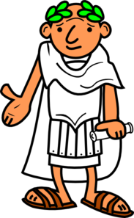
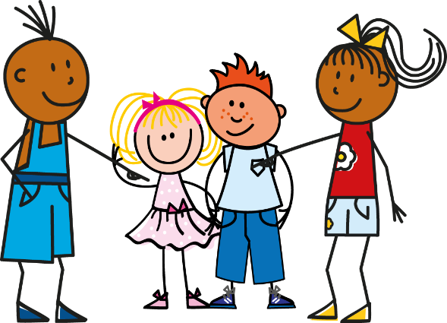
Vocabulaire
Vocabulaire
chanter
?
[to sing, singing]
?
l’histoire
?
jouer
la radio
étudier
?
?
?
un élève
[to study, studying]
[to play, playing]
[student]
ils
?
elles
?
le fruit
?
[they
masc. plu.]
ensemble
?
[they
fem. plu.]
[together]
Notes:
Timing: 5 minutes
Aim: to practise the words from this week’s new vocabulary set.
Procedure 1. Students either work by themselves or in pairs, reading out the words and recapping their English meaning (1 minute). 2. The teacher then removes the English words/pictures (one by one) and students try to recall the English orally (chorally), looking at the French (1 minute). 3. Then the French meanings are removed (one by one) and they to recall them orally (again, chorally), looking at the English/image (1 minute). Draw students’ attention to the SFC of ils and elles and reinforce pronunciation of the words if necessary. 4. Further rounds of learning can be facilitated by one student turning away from the board, and his/her partner asking him/her the meanings (‘X, c’est quoi en français ?’). This activity can work from L2 → L1 or L1 → L2.

Slide 22
Regular –ER verbs
To say ‘s/he’ + verb in French, the verb is in the short form, often ending in -e.
Il joue.
He plays.
NB! These endings are all silent – they all sound the same!
Elle joue.
She plays.
NB! These endings are all silent – so all these words sound the same!
To say ‘they’ + verb, the verb ends with -ent.
For either a group of boys or a mixed group.
Ils jouent.
They play.
For a group of girls only.
Elles jouent.
They play.
Stephen Owen
Notes:
Timing: 2 minutes
Aim: to introduce third person plural of –er verbs
Procedure:
1. Click to bring up the explanation
2. Model the sound of ‘joue’ and ‘jouent’.
3. Say ‘il joue’ and ‘ils jouent’, then ask the students if they can tell whether you are talking about one person or more than one. The answer is ‘no’!

Slide 23
Reading exercise
Qui parle ?
lire
You are reading about a band. Some members (they) and the singer (he) talk about themselves. Some words are missing. |  | ils (they) | il (he)
1 | ….joue de la guitare.
2 | ….chantent.
3 | ….écoutent la radio.
4 | ….parle anglais.
5 | ….mange un fruit.
6 | ….étudient l’histoire et l’anglais.
7 | …..regardent les films.
8 | ….aime les voyages.
Notes:
Timing: 5 minutes
Aim: to practise understanding third person singular and third person plural endings of –er verbs when reading.
Procedure:
1. Students read the sentence in French and, using the verb ending, tick whether ‘he’ is the subject of the verb or if it is ‘they’.
2. Click to bring up the answers.
3. Teachers could elicit translations into English of the sentences in desired before moving on.
Word frequency of cognate used (1 is the most frequent word in French): guitare [>5000]
Source: Londsale, D., & Le Bras, Y. (2009). A Frequency Dictionary of French: Core vocabulary for learners London: Routledge.

Slide 24
Regular –ER verbs
To say ‘s/he’ + verb in French, the verb is in the short form, often ending in -e.
Il joue.
He plays.
Elle joue.
She plays.
NB! These endings all sound the same!
To say ‘they’ + verb, the verb ends with -ent.
For either a group of boys or a mixed group.
Ils jouent.
They play.
For a group of girls only.
Elles jouent.
They play.
Stephen Owen
Notes:
Timing: 1 minute
Aim: to reinforce that 3rd person singular and plural both sound the same, and likewise for the subject pronoun, ahead of the listening activity to follow.
Procedure:
1. Click to reinforce the teaching point that these endings all sound the same.

Slide 25
Grammaire
parler
écoutent
mangent
elles
ils
étudient
chantent
jouent
Notes:
Timing: 2 minutes
Aim: to reinforce the specific pronunciation of third person plural, along with the subject pronouns ils and elles.
Procedure:
Click to bring up the verb form, model its pronunciation and elicit the pronunciation from students.
Elicit choral responses from students of the third person plural from by clicking to disappear the five verbs at random.
Repeat but this time have students practise with ‘ils’ + verb
Repeatt to practise with ‘elles’ + verb
NB – liaison between the ‘s’ on the end of ’ils/elles’ and the initial vowel of the next word is not addressed here. Therefore students are not asked to produces ils + étudient / écoutent and elles + étudient / écoutent in this round of practice.

Slide 26
écouter / écrire
C’est qui ?
écouter / écrire
il ou ils ?
elle ou elles ?
Écoute, regarde et écris en français.
Exemple
ils regardent
Notes:
Timing: 5 minutes for the next six slides
Aim: This is an example of a bimodal task which connects the spoken form with the written form simultaneously, as in this case listening alone does not indicate singular or plural. It is useful to practise bimodal tasks in this case because students practise the idea that you can only tell which verb ending to use in writing when you know whether the person is singular or plural – so, here the students get a visual cue (the picture) and this tells them what the written verb ending would be (the oral verb ending doesn’t help!). This teaches students about ‘ambiguity’ in language, and how sentences fit together. In this case, to know ‘who did the verb’ for 3rd person verbs (il and ils), you usually need other prompts to know whether singular or plural is being referred to.
Procedure:
1. Use this slide to model the task instructions.
2. Click to bring up the image and again for the audio. Students will hear a verb (e.g., ils regardent). At the same time a circle will appear around the picture to indicate whether it is 3rd person singular or 3rd person plural.
3. Once they have heard the audio and seen whether it is singular or plural, students write the correct form.
4. Click to reveal the correct written form.
Transcript:
ils regardent
Note: Teachers need to mouse click on the ‘Exemple’ box, which triggers the audio to play the word ‘exemple’
If this step is missed, the first verb may not play in full.

Slide 27
écouter / écrire
C’est qui ?
écouter / écrire
ils chantent
Notes:
Transcript:
ils chantent

Slide 28
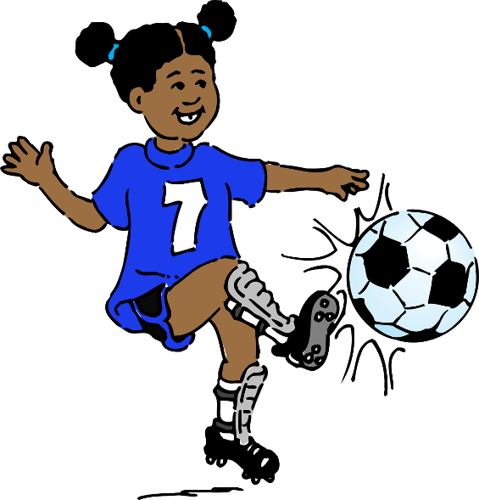
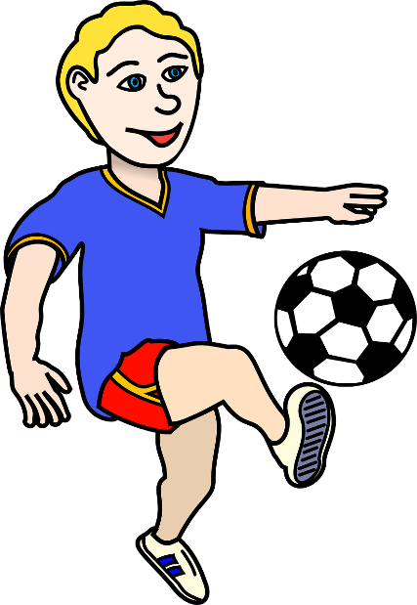
écouter / écrire
C’est qui ?
écouter / écrire
il joue
Notes:
Transcript:
il joue

Slide 29
écouter / écrire
C’est qui ?
écouter / écrire
il trouve
Notes:
Transcript:
il trouve

Slide 30
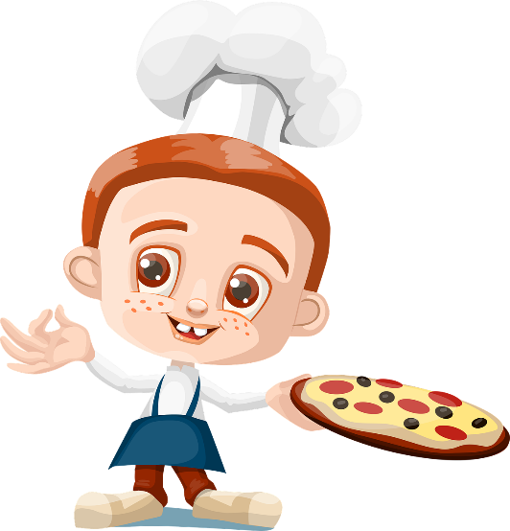
écouter / écrire
C’est qui ?
écouter / écrire
ils préparent
Notes:
Transcript:
ils préparent

Slide 31
écouter / écrire
C’est qui ?
écouter / écrire
elle mange
Notes:
Transcript:
elle mange

Slide 32
écouter / écrire
C’est qui ?
écouter / écrire
elle écoute

Slide 33
Partenaire A
parler / écrire
lire
Translate these sentences. Then say them to your partner. Your partner must understand what you say, so take care.
He studies _____________________ 5) They (f) eat ____________________
They (m) play __________________ 6) He wears _______________________
They (m) sing __________________ 7) She gives _______________________
She listens ______________________ 8) They (f) walk ____________________
Notes:
Timing: 12 minutes (to model, conduct and give feedback on the activity: slides 48-56)
Aim: to practise receptive and productive knowledge of third person singular and plural of –er verbs in present tense.
Procedure:
Each student receives a set of 8 sentences plus a picture response sheet for use when listening.
Students take around four minutes to write the French for their set of 8 verbs. At this point, teachers should circulate to check for written accuracy.
Once each pair have written their sentences, they then take it in turns to say their sentences to their partner.
The listener ticks the correct image on their response sheet, writing the verb form underneath the picture.
Partners should compare immediately after each item, rather than waiting until the end of the whole activity (students would have to find a way of keeping their forthcoming answers covered up, with an ex. book, sheet of paper etc.), This would make the feedback immediate to help strengthen the link between pronunciation, verb form and meaning.

Slide 34
Partenaire B
parler / écrire
lire
Translate these sentences. Then say them to your partner. Your partner must understand what you say, so take care.
They (f) sing __________________ 5) She studies _____________________
He listens _____________________ 6) She wears ______________________
They (m) eat _________________ 7) They (m) give ___________________
4) They (f) play __________________ 8) He walks ________________________
Notes:
Partner B’s verb set.

Slide 35
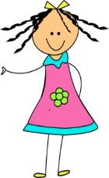
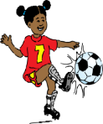
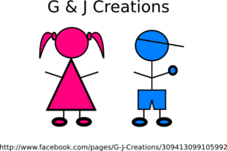
Partenaire B
écouter / écrire
lire
Listen to your partner, tick the correct picture, write the French then compare:
1) 5)
2) 6)
3) 7)
4) 8)
Notes:
Partner B’s response sheet

Slide 36
Partenaire A
écouter / écrire
Listen to your partner, tick the correct picture, write the French then compare:
1) 5)
2) 6)
3) 7)
4) 8)
Notes:
Partner A’s response sheet

Slide 37
Exemple :
écouter / écrire
Partenaire A
Partenaire B
eg)
1)
She listens
______________
__Elle écoute__
elle écoute
Notes:
Teachers could use this slide to model the instructions to the class.

Slide 38
Exemple :
parler / écrire
Partenaire A
Partenaire B
They (m) sing
_______________
1)
eg)
ils chantent
ils chantent
Notes:
Again, this could be used to model the instruction, this time with 3rd person plural. This is a valuable step to illustrate how the listener will need to think really carefully about singular and plural.

Slide 39
Réponses B :
écouter / écrire
Listen to your partner, tick the correct picture, write the French then compare:
1) 5)
2) 6)
3) 7)
4) 8)
Notes:
Partner B Answers
Teachers could elicit the spoken form from the students, then the animated circle appears to show the correct answer.
He studies / il étudie
They (m) play / ils jouent
They (m) sing / ils chantent
She listens / elle écoute
They (f) eat / elles mangent
He wears / il porte
She gives / elle donne
They (f) walk / elles marchent

Slide 40
Réponses A :
écouter / écrire
Listen to your partner, tick the correct picture, write the French then compare:
1) 5)
2) 6)
3) 7)
4) 8)
Notes:
Partner A Answers
They (f) sing / elles chantent
He listens / il écoute
They (m) eat / ils mangent
They (f) play / elles jouent
She studies / elle étudie
She wears / elle porte
They (m) give / ils donnent
He walks / il marche

Slide 41
Réponses :
parler / écrire
Partenaire A
Partenaire B
He studies _____________________
They (m) play __________________
They (m) sing __________________
She listens _____________________
They (f) eat _____________________
He wears ______________________
She gives ______________________
They (f) walk ___________________
They (f) sing ___________________
He listens _____________________
They (m) eat __________________
They (f) play___________________
She studies ____________________
She wears _____________________
They (m) give __________________
He walks ______________________
il étudie
ils jouent
ils chantent
elle écoute
elles mangent
il porte
elle donne
elles marchent
elles chantent
il écoute
ils mangent
elles jouent
elle étudie
elle porte
ils donnent
il marche
Notes:
Written answers.

Slide 42
Saying what others do
-ER verbs (il/elle, ils/elles)
SSC [a] revisited
Y7 French
Term 1.2 - Week 6 - Lesson 26
Victoria Hobson / Emma Marsden
Artwork by: Chloé Motard
Date updated: 09/07/2021
Notes:
Learning outcomes (lesson 2):
Consolidation of [third person singular and third person plural forms of –ER verbs]
Word frequency (1 is the most frequent word in French):
7.1.2.6 (introduce) chanter [1820], étudier [960], jouer [219], ils [13], elles [38], élève [1068], fruit [896], histoire¹ [263], radio [1526], ensemble [124]
7.1.2.3 (revisit) aimer [242], cocher [>5000], passer¹ [90], porter¹ [105], rester [100], trouver [83], école [477], moment [148], semaine [245], solution [608], uniforme [1801], chaque [151], à1 [4], avec [23]
7.1.1.5 (revisit) il² [13], elle² [38], ami [467], amie [467], chanteur [3251], chanteuse [3251], femme [154], homme [136], professeur [1150], professeure [1150], drôle [2166], intéressant [1244], faux [555], sympa(thique) [4164], vrai [292]
Source: Londsale, D., & Le Bras, Y. (2009). A Frequency Dictionary of French: Core vocabulary for learners London: Routledge.

Slide 43
Phonétique
écouter / écrire / parler
1
Tu as un animal.
2
Elle a un cadeau.
3
Il a un animal malade.
4
Tu as un ami sympa.
5
L’acteur a une classe calme.
6
Elle a un ami amusant.
Notes:
Timing: 5 minutes
Aim: to further practise applying knowledge of the target SSC [a] at sentence level.
Procedure:
There are several ways to use this slide:
Transcription
Click the number trigger to play the audio.
Students transcribe what is heard.
Click to reveal the French sentence in full.
Read aloud sentences
Click to bring up the French.
Students read out the sentence either as choral class work or pairs reading to each other.
Click the number trigger to play the audio to reinforce correct pronunciation.
Bi-modal input
The teacher reads out the sentence, pausing at the end of one of the words, just before one begins.
Students read the sentence as they are listening and say aloud the next word after the teacher’s pause.
The teacher can then choose to play the recording in full.
This helps students to link the sound to the written form, and helps them “segment” the input into words. When listening gets faster, students need to be really good at this – chopping up the input into words from one continuous stream.
Teachers may wish to elicit translations in English before moving on.
Transcript:
1. Tu as un animal.
2. Elle a un cadeau.
3. Il a un animal malade.
4. Tu as un ami sympa.
5. L’acteur a une classe calme.
6. Elle a un ami amusant.

Slide 44
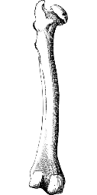
Dis les mots !
parler
fémur
parler
60
fameux
lémur
lame
frémir
drame
[blade]
[to tremble]
trémater
rame
[to overtake]
gamin
gémir
dame
démon
[kid]
0
[to moan]
DÉBUT
[lady]
Notes:
Optional further SSC practice
Timing: 1 minute
Aim: to practise spoken production of a variety of SSCs
Procedure:
1. Students say the words alternately out loud with a partner, building up speed, over 1 minute’s intensive practice.
2. Students need to call out words with alternate SSCs each time so that the key sound varies, e.g. lame – fémur – fameux – lémur.
3. The teacher can circulate during this activity to listen into students’ SSC knowledge.
Word frequency (1 is the most frequent word in French): fameux [2060]; femur [>5000]; lémur [>5000]; lame [>5000]; frémir [>5000]; drame [2275]; trémater [>5000]; rame [>5000]; gémir [>5000]; gamin [3439]; démon [4547]; dame [1983]
Source: Londsale, D., & Le Bras, Y. (2009). A Frequency Dictionary of French: Core vocabulary for learners London: Routledge.

Slide 45
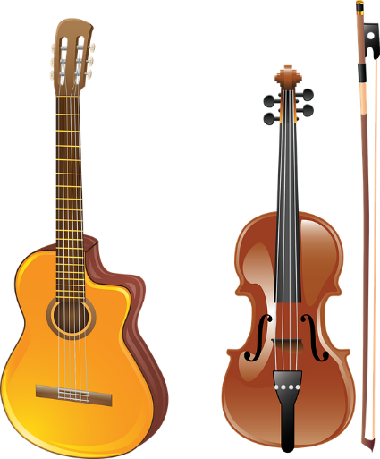
jouer
[to play | playing]
joue
[plays | is playing]
Notes:
Timing: 3 minutes for sequence of six verbs
Aim:
To introduce the verb [jouer] more explicitly. [jouer] is one of the NCELP 15 prototypical verbs in French. Prototypical verbs are common verbs that illustrate the typical characteristics of a class of verb – the French prototypical verbs contain examples of regular/weak verbs, but also common examples of changes to the stem. All 15 prototypical verbs will be introduced early on using the same format. Both long form (infinitive) and short form (3rd person singular) are introduced in order to familiarise students with various forms of the same verb.
Procedure
Bring up the word [jouer] on its own, say it, students repeat it, and remind them of the phonics.
Try to elicit the meaning from the students. Students have had explicit teaching that the present tense in French communicates two different present tense meanings in English. This reinforces that learning. Emphasise the two meanings for the short form, reminding students that French only has one form and does not have a direct equivalent of the grammar for ‘is + ing’, the continuous form (as covered in previous weeks).
Bring up the picture using gestures if desired.
Then bring up the English translations. Emphasise the two meanings for the infinitive.
Bring up the short form [joue], say it, students repeat it.
Try to elicit the meaning from the students. Emphasise the two meanings for the short form.

Slide 46
jouer
[to play | playing]
joue
[plays | is playing]
Notes:
Cycle through the long and short form again.

Slide 47
joue
[speaks | is speaking]
Louise joue au tennis.
[Louise plays | is playing tennis.]
Notes:
Introduce the short form in a sentence.

Slide 48
jouer
[to play | playing]
Louise aime jouer au tennis.
[Louise likes playing tennis.]
Notes:
Introduce the long form in a sentence.

Slide 49
joue
[plays | is playing]
Louise joue au tennis.
[Louise plays | is playing tennis.]
Notes:
Cycle through the short form in context again.

Slide 50
jouer
[to play | playing]
Louise aime jouer au tennis.
[Louise likes playing tennis.]
Notes:
Cycle through the long form in context again.

Slide 51
écouter / écrire
C’est qui ?
lire / écrire
Read the sentence, choose the correct first verb and complete the sentence with a correct part. Then write the English for each sentence.
1 | Les filles | aime | le français | et | parle français.
 |  | aiment
2 | Les hommes | étudient | l’anglais | et | étudie aussi l’anglais.
 |  | étudie
3 | La femme | parlent | français | et | trouvent l’histoire intéressante aussi.
 |  | parle
4 | Le médecin | travaillent | en France | et | parlent espagnol.
 |  | travaille
The girls like French and find history interesting as well.
The girls like French and speak Spanish.
trouvent l’histoire intéressante aussi.
parlent espagnol.
The men study English and speak Spanish.
The men study English and find history interesting as well.
parlent espagnol.
trouvent l’histoire intéressante aussi.
The woman speaks French and also studies English.
étudie l’anglais aussi.
The doctor works in France and speaks French.
parle français.
Notes:
Timing: 8 minutes
Aim: to focus on verb form by having to choose between 3rd person singular or plural, depending on the subject of the verb but by using full nouns, rather than the subject pronoun (il/ils elle/elles) as in the previous lesson when reading.
Procedure:
1. Students read the first part of the sentence.
2. They then have to choose the correct accompanying verb to form the second part of the sentence successfully.
3. Click to bring up the answers, followed by the translation into English.
Note: The context for all four sentences is similar which reduces the reliance on vocabulary to work out the answers; students will have to look carefully at verb form.
There are two possible versions for the plural forms, but not for the singular. This adds a level of complexity to the task, in that students will not only have to focus on verb form but meaning as well. Teachers could let the students realise this for themselves, or you could tell them up front.
Some regular –er verbs from previous weeks are revisted here (parler/aimer/trouver/travailler).

Slide 52
Exemple :
écouter / écrire
parler
Listen to the
sentence. Use the start of the sentence to work out how to complete the end of the sentence.
Tick the correct one
Write the correct ending
Write the correct subject pronoun
Write the correct verb
E.G.
 | Le garçon | aim_____ | le sport; |  |  | au foot.
 | Les garçons
e
il
joue
E.G.
 | La fille | rest_____ | à la maison; |  |  | la télé.
 | Les filles
ent
elles
regardent
Notes:
Timing: 8 minutes (for this and the next two slides)
Aim: to focus on verb form by having to choose between 3rd person singular or plural, depending on the subject of the verb by using full nouns when listening.
Procedure:
1. Use this slide to model the requirements of the task. Really emphasise the importance of listening carefully to the subject of the verb – is it singular or plural? Elicit from students what will be heard when the subject is singular and what is heard when it is plural – the subtle difference between ’le’ and ‘les’ (or ‘la’ and ‘les’) really makes a difference to meaning. This is key to students succeeding in the task
2. Click the E.G. trigger to play the audio.
3. Students tick the subject of the verb then use this to help write the correct verb ending (3rd person singular or third person plural).
4. Students continue to transcribe the verb from the second part of the sentence, focusing on the achieving the correct subject pronoun and verb form.
5. On completion of the task, teachers could take the opportunity to do some further sentence level comprehension by asking students to give the meanings in English of the complete sentences.
Transcript:
E.G
Le garçon aime le sport; il joue au foot.
E.G
Les filles restent à la maison; elles regardent la télé.
Note: The two part nature of the task sets up differentiation. All students should be able to complete the first part of the sentence at least – hearing the difference between ‘le’ and ‘les’; and the difference between ‘la’ and ‘les’ and then writing the verb ending accordingly: ‘e’ or ‘ent’.
The second part offers a greater level of challenge. Teachers could consider asking students to mark their work in two sets, to allow students to feel successful and give the teacher an indication of how students did with the two aspects of the task.

Slide 53
Grammaire
écouter / écrire
Tick the correct one
Write the ending
Write the pronoun
Write the correct verb
 | Le garçon | aim_____ | la télé; |  |  | des films.
 | Les garçons
 | La fille | aim_____ | la musique; |  |  | avec la radio.
 | Les filles
 | Les médecins | travaill____ | en Angleterre; |  |  | anglais.
 | Le médecin
 | Le chanteur | aim_____ | la musique; |  |  | la radio.
 | Les chanteurs
e
il
regarde
1
ent
2
elles
chantent
ent
ils
parlent
3
4
e
il
écoute
Notes:
Transcript
1) Le garçon aime la télé; il regarde des films.
2) Les filles aiment la musique; elles chantent avec la radio.
3) Les médecins travaillent en Angleterre; ils parlent anglais.
4) Le chanteur aime la musique; il écoute la radio.

Slide 54
Grammaire
écouter / écrire
Tick the correct one
Write the ending
Write the pronoun
Write the correct verb
 | Le professeur | travaill____ | dans la salle de classe; |  |  | les devoirs.
 | Les professeurs
 | Les chiens | march____ | dehors; |  |  | dans le parc.
 | Le chien
 | Les mères | prépar___ | le déjeuner; |  |  | du fruit.
 | La mère
 | Le garçon | écout____ | le professeur; |  |  | un uniforme.
 | Les garçons
ent
ils
préparent
5
e
il
joue
6
ent
elles
mangent
7
e
il
porte
8
Notes:
NOTE: This section is without audio. Teachers read out the sentence here. This facilitates the ‘idea for extension’
Transcript
5) Les professeurs travaillent dans la salle de classe; ils préparent les devoirs.
6) Le chien marche dehors; il joue dans le parc.
7) Les mères préparent le déjeuner; elles mangent du fruit.
8) Le garçon écoute le professeur; il porte un uniforme.
Idea for extension: rather than saying the whole sentence in full , stop after the first verb and do not reveal the second part of the sentence. Then, ask the students to PREDICT what will come next. Students will use the first part of the sentence and the final words to work it out. They could give answers orally or they could write down what they think will come next.
THEN, continue the sentence and the students read their own work to check whether they predicted correctly. Click to reveal the French so that they can check how they spelled the verb (-ent or –e).
Word frequency (1 is the most frequent word in French): parc [1240]
Source: Londsale, D., & Le Bras, Y. (2009). A Frequency Dictionary of French: Core vocabulary for learners London: Routledge.

Slide 55
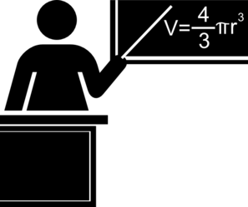
Qui fait quoi ?
parler / écouter / écrire
Parternaire A
Listen to your partner. Who does what?
Write the English under the correct image.
Translate these sentences into French:
The boy studies history.
The doctors listen to the radio.
The boys study at home.
The mums prepare lunch.
The doctor listens to the girl.
The mum prepares the fruit.
Notes:
Timing: 10 minutes (for the speaking task plus feedback)
Aim: to practise spoken production at sentence level of regular –er verbs in third person singular and plural.
Procedure:
1. Partners translate their respective set of 6 sentences into French.
2. They take it in turns to say these French sentences to their partner.
3. The listening partner must write down in English what their partner has told them, next to the correct image (singular/plural).
E.g
Partner B says: ‘Le chien joue dehors.’
Partner A finds the picture of one dog (singular) and writes in English next to the picture ‘plays outside’.
4. At the end of the activity, partners translate the sentences by writing the French underneath each picture in a full sentence, say them in French back to their partner and then compare written versions in French to see if they are correct
E.g. Partner A then writes the French for the full sentence underneath the picture: ‘Le chien joue dehors,’ says it back to their partner in French to practise pronunciation and checks his/her written French version against the original written French version that his/her partner wrote at the start to check if the verb endings match.

Slide 56
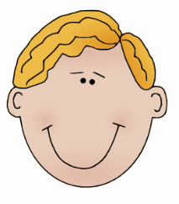
Qui fait quoi ?
parler / écouter / écrire
Parternaire B
Listen to your partner. Who does what?
Write the English under the correct image.
Translate these sentences into French:
The dog plays outside.
The teachers speak English.
The girls eat at school.
The dogs play in the sand.
The girl eats lunch.
The teacher speaks French.
Notes:
Partner B’s prompt sheet
Worked example here:
Partner A says: ‘Le garçon étudie l’histoire.’
Partner B finds the picture of one boy (singular) and writes in English next to the picture ‘studies History’.
Partners then swap roles completing this step for all 6 pictures.
At the end of the activity:
Partner B then writes the French for the full sentence underneath the picture: ‘Le garçon étudie l’histoire,’ says it back to their partner in French to practise pronunciation and checks his/her written French version against the original written French version that his/her partner wrote at the start to check if the verb endings match.

Slide 57
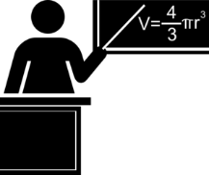
Activity sheet
Partenaire A
Partenaire B
plays outside
play in the sand
studies history
study at home
Le chien joue dehors.
Les chiens jouent dans le sable.
Le garçon étudie l’histoire.
Les garçons étudient à la masion.
eat at school
eat at home
prepares the fruit
prepare lunch
Les filles mangent à l’école.
La fille mange à la maison.
Les mères préparent le déjeuner.
La mère prépare le fruit.
speaks French
speak English
listen to the radio
listens to the girl
Le professeur parle français.
Les professeurs parlent anglais.
Les médecins écoutent la radio.
Le médecin écoute la fille.
Notes:
Answer slide
Final slide with French and English of all 12 sentences for checking.
This is what students’ sheets will look like on completion of the activity.

Slide 58
Vous faites quoi ?
parler / écrire
Now write two sentences about what your friend does - use ‘he’ or ‘she’ and write two sentences about what you think your teachers do – use ‘they’ (it doesn’t have to be true!).
E.G.
L’amie
Les professeurs
Elle écoute le chanteur.
Ils préparent le déjeuner.
Elle étudie l’histoire.
Ils chantent avec la radio.
Say your sentences to your partner who will translate them into English.
Notes:
Timing: 5 minutes
Aim: to practise creative written production at sentence level of regular –er verbs in third person singular and plural.
Procedure:
Students write (then say) two sentences describing what one friend does (it doesn't have to be true!) 'use she or he';
They then write (then say) two sentences that you think all your teachers do - use 'they'.
Note: this exercise offers an opportunity to try to get students to write and say something creative, producing their own language to express their own meanings (rather than translations as previously practised in this sequence).

Slide 59
Gaming Grammar
Gaming Grammar
Relevant mini game(s):
Verbs (present): 1st person singular/plural (Verb agreement (present))
Verbs (present): 2nd person singular/plural (Verb agreement (present))
Verbs (present): 3rd person singular/plural (Verb agreement (present))
Notes:
This slide links to Gaming Grammar login screen. The appropriate mission can then be selected from the menu page.
Students will progress through the game at their own rate; teachers should use the teacher interface to check progress. This will help to inform future lesson planning.

Slide 60
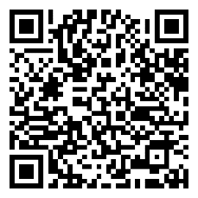
Devoirs
Vocabulary Learning Homework (Term 1.2, Week 7)
Audio file
Audio file QR code:
Student worksheet
Quizlet link
In addition, revisit: Term 1.2 Week 4
Term 1.1 Week 6

