Slide 1
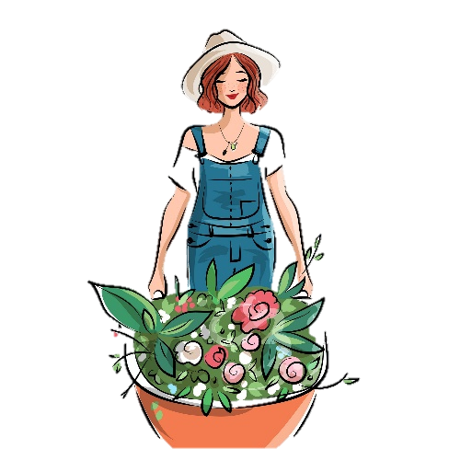
Saying ‘me’ and ‘you’
Remember, when ‘me’ or ‘you (sing.)’ is the ‘receiver’ of the verb, we use me or te, and they go before the verb.
Elle me trouve dans le jardin.
Il te voit au collège.
She finds me in the garden.
He sees you at school.
We can also use me and te when ‘me’ or ‘you (sing.) is indirectly receiving the action of the verb.
Elle me donne un cadeau.
Il te dit ‘bonjour’.
She gives a present to me.
He says ‘hello’ to you.
Notes:
Timing: 4 minutes
Aim: Revision of preverbal position of direct object pronouns me and te and introduction of preverbal position of indirect object pronouns me and te.
Procedure:
Click to reveal explanations and examples.
Ensure understanding.

Slide 2
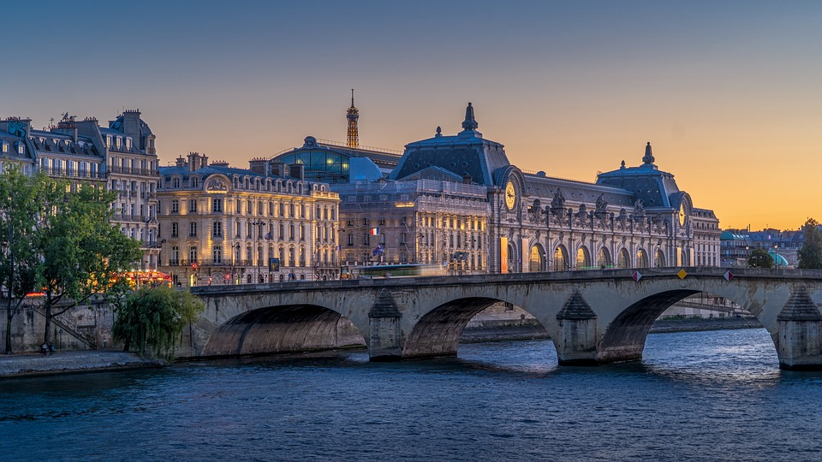
Au musée
Amir accompagne Jean au musée. Écoute. Remplis les réponses.
Who is doing it | What are they doing | To whom
I / you |  | (to) me / (to) you
I / you |  | (to) me / (to) you
I / you |  | (to) me / (to) you
I / you |  | (to) me / (to) you
I / you |  | (to) me / (to) you
I / you |  | (to) me / (to) you
I / you |  | (to) me / (to) you
I / you |  | (to) me / (to) you
1
explain
2
tell
3
help
4
show
5
give
6
ask
7
find
8
teach
Notes:
Timing: 8 minutes
Aim: Aural recognition and comprehension of preverbal position of direct and indirect pronouns me and te.
Procedure:
Click numbered buttons to hear audio for each sentence.
Students to write down who does the action, what the action is, and who they do it to.
Students may be encouraged to listen for each piece of information individually with the sentence played three times.
Elicit answers.
Click to reveal answers one by one (first verb, then object for each sentence).
Transcript:
Tu m’expliques cette chose ?
Je te raconte l’histoire.
Je t’aide avec la porte.
Je te montre la salle officielle.
Tu me donnes un exemple.
Tu me poses beaucoup de questions.
Je te trouve intéressant.
Je t’apprends de nouvelles choses.
(background image: Musée d’Orsay in Paris)

Slide 3
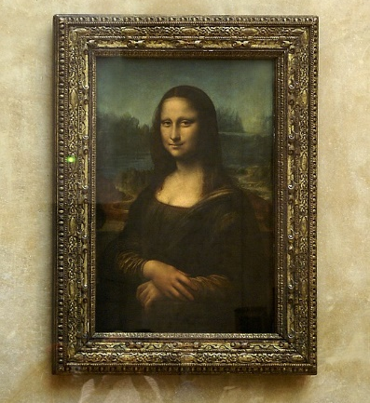
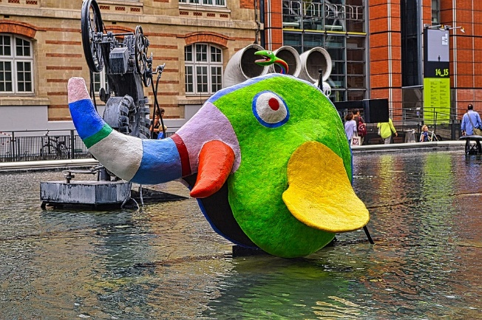
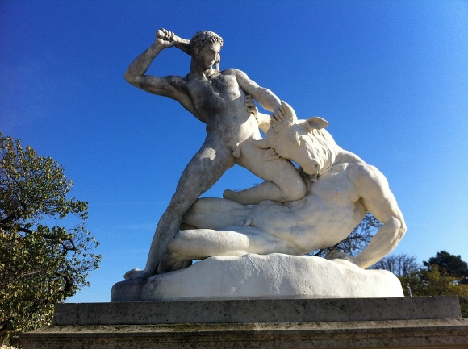
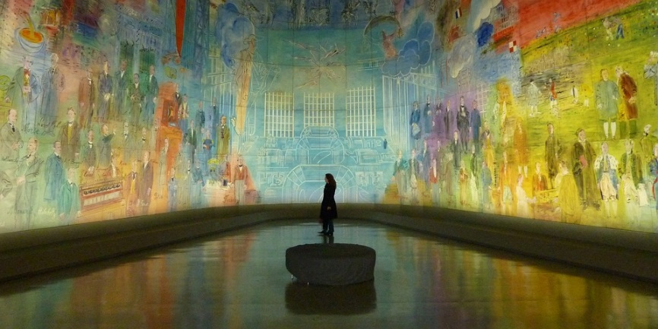
Au musée
Organise les mots en phrases.
Cet objet ne m’intéresse pas.
Le professeur m'apprend beaucoup.
1. objet intéresse m' pas ne cet
5. le apprend m’ professeur beaucoup
This object does not interest me.
The teacher teaches me a lot.
L’image me montre le passé.
2. passé l’ me image montre le
6. me nouvelles présente de musée idées le
Le musée me présente de nouvelles idées.
The picture shows me the past.
The museum introduces new ideas to me.
7. m’ apprendre art à invite l’
3. sculpture réfléchir à la encourage m’
L’art m’invite à apprendre.
La sculpture m’encourage à réfléchir.
The sculpture encourages me to think.
The art invites me to learn.
4. à donne cette tête la peinture* me mal
8. me l’ la donne de visite inspiration
Cette peinture* me donne mal à la tête.
La visite me donne de l’inspiration.
This painting gives me a headache.
The tour gives me inspiration.
*la peinture = painting
Notes:
Timing: 10 minutes
(Higher on this slide. Foundation version on next slide)
Aim: Written recognition of preverbal position of direct and indirect pronouns me and te.
Procedure:
Students to unjumble sentences making sure to put the pronoun in the right place.
Extension: translate sentences into English.
Click to reveal answers
Click to reveal translation
Word frequency of cognates:
intéresser [>2000], art [>2000]
Word frequency of unknown words:
peinture [>2000]
Source: Lonsdale, D., & Le Bras, Y. (2009). A Frequency Dictionary of French: Core vocabulary for learners London: Routledge.

Slide 4
Au musée
Organise les mots en phrases.
1. Cet objet [intéresse m' pas ne]
Cet objet ne m’intéresse pas.
5. Le professeur [apprend m’ beaucoup]
Le professeur m'apprend beaucoup.
This object does not interest me.
The teacher teaches me a lot.
2. L’image [passé me montre le]
L’image me montre le passé.
Le musée me présente de nouvelles idées.
6. Le musée [me nouvelles présente de idées]
The picture shows me the past.
The museum introduces new ideas to me.
7. L’art [m’ apprendre invite à]
La sculpture m’encourage à réfléchir.
L’art m’invite à apprendre.
3. La sculpture [réfléchir à encourage m’]
The sculpture encourages me to think.
The art invites me to learn.
4. Cette peinture* [donne mal à la tête me]
8. La visite [me l’ donne de inspiration]
Cette peinture* me donne mal à la tête.
La visite me donne de l’inspiration.
This painting gives me a headache.
The tour gives me inspiration.
*la peinture = painting
Notes:
Timing: 10 minutes
(Foundation version on this slide)
Aim: Written recognition of preverbal position of direct and indirect pronouns me and te.
Procedure:
Students to unjumble ends of sentences making sure to put the pronoun in the right place.
Extension: translate sentences into English.
Click to reveal answers
Click to reveal translation
Word frequency of cognates:
intéresser [>2000], art [>2000]
Word frequency of unknown words:
peinture [>2000]
Source: Lonsdale, D., & Le Bras, Y. (2009). A Frequency Dictionary of French: Core vocabulary for learners London: Routledge.

