Slide 1
Sequencing and Delivering a Content-Rich Curriculum
Professor Emma Marsden,
University of York 19th October 2021
Keynote talk at Modern Foreign Languages Conference. Inside Government Annual Conference.
Notes:
WORK IN PROGRESS. The analyses in this talk have not been peer-reviewed by other researchers. Analyses should therefore be considered as preliminary.
To cite this talk:
Marsden, E. (2021). Sequencing and delivering a content-rich curriculum. Keynote talk. Modern Foreign Languages Conference. Inside Government Annual Conference. 19 October, 2021.

Slide 2
Session outline
What teachers who work with NCELP materials say about them
Defining the “language content”
The content of current and proposed GCSE Subject Content

Slide 3
https://ncelp.org/getting-into-ncelp/
Notes:
I am presenting in this talk work that is now freely available in over 1,000 resources, across French, German, and Spanish, for years 7, 8 and in differing amounts, year 9. It is the result of the efforts of a large team of people over about 2.5 years.
I can only give a snap shot – if you want to dig further – please do take the time to check out some of these resources.
We have a ‘Getting into NCELP’ webpage, giving you different entry points depending on where you are in terms of your familiarity with our work.

Slide 4
Overview
What teachers who are using NCELP resources say…

Slide 5
Overview
“My team and I are really impressed with the amount of research and careful planning that has gone into the development of the schemes of work and resources. It is reassuring to know that vocabulary and grammar are mapped so carefully to ensure retrieval and retention throughout KS3 and that students will gain confidence in grammar that is at the same time ambitious and manageable. Our students have already responded very positively to these lessons and we are pleased to see that students who were previously disenchanted with languages are suddenly thriving. We look forward to rolling these schemes of work out with other year groups and have high hopes for the future. Many thanks!”
Head of Languages, Neatherd High School
“NCELP SOW and resources are the best I’ve used. It took me a full year of teaching with them to fully appreciate the thinking behind them.”
Head of Spanish, St Mary’s.
“I would just like to say how much we are enjoying using the NCELP resources with our Year 7 French and German classes this year. We have been really impressed with their progress so far and the activities are very enjoyable to teach”
Second in MFL, The Bishop’s Stortford High School

Slide 6
“I just set and marked a piece of free writing to my year 7 French class…and I saw this is why we do it…and this is why it works…I told them they could look up a word in the dictionary if they absolutely, desperately wanted to say something – I think she’s looked up about 3?
I’ve never taught them how to give opinions explicitly, yet they can still do it!
Yes, it’s not got fancy subjunctive phrases or si clauses (like some Year 7 sentence builders you see). But can this girl use the French she’s learned since September? – absolutely she can! Can she say what she wanted to (with the vocab that people are worried is ‘limited’)? Absolutely she could! She didn’t have any pre-learnt phrases in front of her whilst writing this – she did it all herself!!”
MFL Teacher and NCELP Specialist Teacher, Cardinal Hume Catholic School
“We have been thrilled to have free access to such a well planned and structured scheme of work. The resources are so well organised and easily adaptable for our classes. It has made a big difference to our workload.”
Head of Languages, Reddish Vale High School

Slide 7
Overview
What might be behind these positive comments?
Part 2: Defining the language content…
What are the core components of language in the early stages?
How much content?
Which words/grammar/phonics?
When? Revisiting it … often
How? In varied, meaningful, and engaging contexts
Notes:
Pedagogy and curriculum can overlap with each other. A well planned and sequenced curriculum influences what we can also consider to be pedagogical decisions – such as when and how often to cover language, when to teach, when to demand recall for understanding, when to demand recall for use, when to demand recall for use in an unfamiliar context, when to use in different modalities etc
What are the core components in the early stages?
How much content?
Which words, grammar, sounds/spellings?
When? Revisiting it often
How? In varied, meaningful, and engaging contexts

Slide 8
Defining the language content: Part 1
What are the components of ‘communicative competence’?

Slide 9
What do we want to teach?
What does it mean to be competent in a language?
Bachman (1990)
Canale & Swain (1980)
Organisational Competence
Grammatical Competence
Textual Competence
Pragmatic Competence
Illocutionary Competence
Sociolinguistic Competence
Morphology
Syntax
Vocab
Phonology/
Graphology
Cohesion
Rhetoric
Functions of language
Register/
Genre / Dialect
Notes:
For some time, researchers have been trying to define what it means to be communicatively competent in a language – a debate that was happening in the 1980s, if not earlier.
This visual, by Bachman, is one such foundational conceptualisation of what it takes to be communicatively competent.
You can see here on the left all the elements that relate to knowledge- what language do I need to know to make language stick together and mean something.
On the right, are components that relate to what you do with that knowledge and how you use it for functions … to express your needs, to get others to do things, to make sure that you don’t offend people. Neither of these clusters can be ignored, one can’t happen without the other. For example, you can’t do anything on the right without at least some knowledge on the left.
NCELP has used this very widely accepted conceptualisation of what language competence is to inform the content of the curriculum and the pedagogy for learners in their earliest stages.

Slide 10
Defining the language content: Part 2
How much can we expect students to learn … ?
in about 450 hours…

Slide 11
Putting classroom FL learning in context…
In your home language:
Have 17,520 hours exposure by age 4 (Roffwarg et al., 1966)
Hear 2,000 -15,000 words a DAY (Weisleder & Fernald, 2013)
Have 3,000 - 5,000 spoken words before you learn to read
Foreign language in England:
450 hours in KS3 + KS4 combined (ages 11-16)
Notes:
Given this very limited time, we need to be extremely efficient – every decision about which words to teach, which sounds to practice and which grammar to focus on, and when and how to practise it.

Slide 12
In 450 hours, how much can be learnt?
If we want to teach:
productive knowledge, not just receptive (Nation; Laufer; Meara; Webb)
polysemy (multiple meanings)
grammatical irregularities (suis, estuve) as lexical items (Clashen; Gor; Marslen-Wilson; Verríssimo)
some multi-word units (s’il vous plaît) (Crossley; Myles, Mitchell & Hooper; Siyanova-Chanturia)
some low frequency words e.g., culturally relevant
sounds of the language + spelling (phonics)
grammar
systematic revisiting (plenty of practice)
use in meaningful contexts: interaction, culture
Notes:
As we know, there is a lot to do in 450 hours.

Slide 13
What can inform our decisions about how many words to teach?
Need spaced repetition (e.g., Webb 2007)
Can learn about 10 words/week (e.g, Schmitt 2004)
Need 10+ encounters (e.g., Webb 2007)
Students can get a ‘pass’ in current GCSE with receptive knowledge of 852 words = 4 words a lesson (Milton, 2006) or perhaps 564 words (David, 2008)
A recommendation to learn a list of 1,500 (Milton, 2015)
And we can be informed by what the GCSEs have tested to date …
Notes:
One objective way of defining the size of the language content that can be learnt is by thinking about the words themselves – without words we can do nothing of course. Words and grammar work in tandem, and the words are of course closely linked with and to some extent determine the sounds and spellings we must learn.
So, I will focus on the number of words now – but there are of course other considerations about other components of communicative competence –as the earlier slide showed - but i will talk more about some of those later in the ‘what’ and ‘how’ sections.

Slide 14
How many words are on the current words lists?
AQA Spanish: 1,566 unique words
AQA French: 1,300 unique words
AQA German: 1,632 unique words
How many words does it take to create the current exams?
Tier of GCSE | Word families* used to create ONE exam (L+R) | Word families used to create THREE exams (L+R) x 3
Foundation | 609 | 1,173
Higher | 753 | 1,542
*Median of range across awarding organisations & languages
Notes:
On the current AQA’ word lists there are between 1,300 and 1630 words. Exams are created with about 600 words, higher tier exams with about 750,
and for three years about 1,100 and 1,500 different word families are used
--------------------------
‘Entry’ on the AO’s word lists includes multi-word units and words repeated in different parts of the list.
From these entries, we removed duplicate words and proper nouns (e.g., country names, celebrations) to count number of unique words.
Thus, “unique words” reflects the removal of duplicates (the use of same word in different contexts) and the absence of proper nouns.
Spanish has 24% more entries than French, a 17% difference in unique words
--------------------------
The numbers in the table are the median of the range, when the ends of the range are across awarding organisations and languages

Slide 15
How much to learn in the time available: NCELP’s estimation
Average of 10 words per week
-> 360 words per year * 5 years
= 1,700 words, for highest achievers
NCELP SOW = an illustrative road-map
those using the SOW adapt the pace to fit their context

Slide 16
Defining the language content: Part 3
Which words, grammar, sounds/spellings?
in 450 hours…
Notes:
I will start by focusing on defining the lexical content of a curriculum - about the creation and use of word lists when designing a curriculum

Slide 17
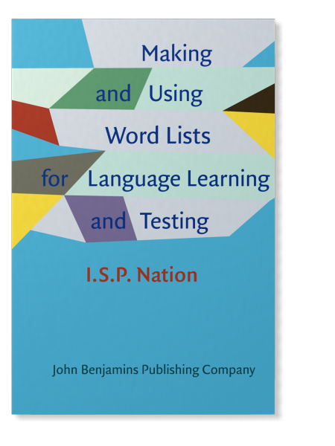
Why use a word list to define the content?
“Word lists lie at the heart of good vocabulary course design, the development of graded materials for extensive listening and extensive reading, research on vocabulary load, and vocabulary test development” (Nation, 2016).
Notes:
There has been a vast amount of research into the creation and use of word lists. A lot of this has come from the world of English as a foreign language, but there is much that is relevant for teaching any language.
Word lists are used ensure all students on the same course have an equal chance to be prepared to perform listening, reading and any production tasks which closely predict the language that is expected to be used by the learner – such as written or spoken translation tasks, or gap fills.
In free written and spoken production tasks, students can of course use any words that full the requirements of a task / successfully communicate the intended message.

Slide 18
Are word lists used for other language programmes?
Word lists for proficiency tests:
Japanese Language Proficiency Test until 2010 (Japan Educational Exchanges and Services, 2009)
~A2: 1,500 words / ~B1: 3,750 words
German-Zertifikat Proficiency Test (Goethe-Institut, 2016a, 2016b, 2016c)
A2: 1,300 words / B1: 2,400 words
Word lists for curricula:
France, Ministry of National Education (éduscol, 2020) lists 1,500 most frequent words in French for French primary school children (6-11 years)
China, Ministry of Education (2017) lists 1,500 words for English for 16 years olds (after 9 yrs of English)
Hungarian National Core Curriculum for English (Krizsán, 2003): 1,200 active vocabulary for 13-14 year olds
Guidelines about number of words:
Japanese Ministry of Education (MEXT, 2008, 2009, 2016, 2017, 2018) English: Junior high school students: 1,200 words; High school students: 1,800 words
Notes:
It is worth knowing that many other contexts use word lists. I have a small sample here
Word lists have been created for young adolescent learners in a range of different contexts.
The detail is not important. languages highlighted in red, and the numbers of words in green – for learners that are similar in age and/or level to our FL learners in England.
For students after about the same amount of exposure as those in our contexts, word lists seem to be between 1,200 and 1,800 words, even contexts in which global English is being learned.

Slide 19
What is it like working without a fixed word list, for post-beginners / low intermediates?
…It can be problematic, for test designers, textbook writers, teachers, and students
Notes:
To ask ourselves about whether a word list is useful, it might be useful to examine what it is like working without a fixed word list. The current GCSE subject content states that the AOs don’t have to provide a word list - and that they have to test words that are not on it - so the word lists currently provided are not 'the content', they are a guide to the ‘minimum’ core content. So, although they are heavily used by publishers to create textbooks and by teachers to create vocab lists and materials, we are currently working essentially without a fixed word list.
We examined the lexical content of the GCSE - how many and which kinds of words are being used to create the GCSEs, and the extent to which the current word lists are being used.

Slide 20
Which words appear in every exam?
Average number of words used
in every exam:
For Foundation: 174
For Higher: 219
Of which:
91% are in the most frequent 2,000
We analysed the lexical content of the receptive (listening and reading) components of GCSE exam papers in 2018, 2019, 2020, and the sample year. | French |  |  |  | Spanish
 | Foundation |  | Higher |  | Foundation |  | Higher
 | AQA | Edexcel | AQA | Edexcel | AQA | Edexcel | AQA | Edexcel
No. (%) of word families used in every exam paper across the four papers | 185 | 180 | 234 | 213 | 155 | 175 | 224 | 205
of which are in the 2000 most frequent words* | 164 (89%) | 151 (84%) | 211 (90%) | 184 (86%) | 148 (95%) | 163 (93%) | 213 (95%) | 193 (94%)
of which appear on the AO wordlist | 143 (77%) | 160 (89%) | 178 (76%) | 191 (90%) | 122 (79%) | 151 (86%) | 173 (77%) | 179 (87%)
*word family = jouer, joue, jouons, jouent etc
Notes:
PRELIMINARY ANALYSES.Without a fixed word list – and with the rule that words off the list must be tested, we examined how much consistency was in the words that appeared every year. To see which words are used every year.
Here is what we found. To summarise this very busy slide: on average just 174 word families have been used in every exam paper so far for Foundation and 219 for Higher.
The vast majority of these words, over 90%, are within the top 2000 most frequent words.
-----------------------
About 1 in 5 are not on the AOs lists. Perhaps because it has been assumed that they have been covered in KS2 or 3
------
Average for Foundation and Higher are aggregated across Fr & Sp, AQA & Edexcel
The % in the top 2000 and not on the AO’s lists are aggregated across F & H, Fr & Sp, AQA & Edexcel
About 1 in 5 is 17%

Slide 21
How much of the Awarding Organisations’ lists has never been used in an exam?
On average*,
49% of the words on the published word lists have never yet been used over a total of four years of L&R exams
* Across F & H, Fr & Sp, AQA & Edexcel
We analysed the lexical content of the receptive (listening and reading) components of GCSE exam papers in 2018, 2019, 2020, and the sample paper against the wordlists provided by the AOs. | French |  |  |  | Spanish
 | Foundation |  | Higher |  | Foundation |  | Higher
 | AQA | Edexcel | AQA | Edexcel | AQA | Edexcel | AQA | Edexcel
No. of different word families that appear on the AO wordlists | 1060 | 1803 | 1322 | 2071 | 1348 | 1859 | 1568 | 2090
No. (%) of word families that were never used in any exam papers | 418 (39%) | 1021 (57%) | 537 (41%) | 1108 (54%) | 648 (48%) | 1066 (57%) | 663 (42%) | 1133 (54%)
Notes:
Without a defined word list in a curriculum that has high stakes test at the end of it, we see that there can be a misfit between what is being taught and what is being tested.
Of course, due to the lost lessons due to the pandemic, for this coming year 11 cohort, the AOs are going to only include words that are on their lists.
The proposal for the changes to the GCSE subject content would make this normal practice.
----------------
This analysis has isolated the words given in multi-word units listed in the AOs lists – so this is ‘unique’ word families – not MWUs.

Slide 22
How many words are only ever used once?
On average*,
39% of the words on the published word lists have been used once,
across four years of L&R exams
* Across F & H, Fr & Sp, AQA & Edexcel
receptive components of GCSE exam papers in 2018, 2019, 2020, and the sample year. | French |  |  |  | Spanish
 | Foundation |  | Higher |  | Foundation |  | Higher
 | AQA | Edexcel | AQA | Edexcel | AQA | Edexcel | AQA | Edexcel
No. of word families that appear only once over the total of four papers (% of subtype, out of the word families that have been used only once) | 804 | 657 | 1029 | 958 | 811 | 692 | 1037 | 980
of which are not cognates or proper nouns | 524 (65%) | 370 (56%) | 702 (68%) | 609 (64%) | 656 (81%) | 529 (76%) | 894 (86%) | 793 (81%)
of which are in the top 2000 most frequent words | 332 (41%) | 246 (37%) | 388 (38%) | 376 (39%) | 348 (43%) | 319 (46%) | 430 (41%) | 416 (42%)
of which appear on the AO wordlist | 231 (29%) | 318 (48%) | 299 (29%) | 412 (43%) | 295 (36%) | 362 (52%) | 370 (36%) | 397 (41%)
Notes:
This analysis shows how many words have only been used once over the four years.
Again, there is a lot of detail, so here is a headline finding.
between 47% and 71% of those words are NOT on the AOs lists.
between 54% and 63% of are not high frequency words
between 56% - 86% are words that cannot easily be guessed – they are NOT exact cognates and they are not proper nouns
In sum: The chances of understanding these words is quite low.
This is another consequence of having a word list that is only an optional guide.

Slide 23
Defining the content: So, if we use a list, which words should be on it?
How can we objectively decide which words to include?
LOTS of work done to define the lexical content of curricula for teaching English as a foreign language
e.g., General Service List (West, 1953), CELEX lists (Baayen, Piepenbrock, & van Rijn, 1995), BNC2000 (Nation, 2006), COCA lists (Davies & Gardner, 2010), BNC/COCA2000 (Nation, 2012), New General Service List (Browne, 2014), New General Service List (Brezina & Gablasova, 2015), The Nuclear Family Word list (Cobb & Laufer, 2021)
Notes:
So, if we agree that a word list would be useful, and we know roughly the amount of words that might be learnable, then how can we decide which words to include in a word list?
Much work has gone on to define the lexical content of English as a FL curricula.
One of the main factors used to decide which words should be included has been the frequency of words in the language at large. So what does this mean?

Slide 24
Which words? Selecting generally useful words
based on their frequency
How useful are the most frequent 2,000 words?
◆ General conversation  More formal speech – e.g. lectures  Written language
Work by Paul Nation, cited by Milton, J. (2009) Measuring second language vocabulary acquisition (p. 58). Multilingual Matters.
Notes:
How useful are the most frequent 2000 words?
This visual demonstrates the importance of high frequency words. The findings about frequency of words come from 100 million of words of English.
The top grey line shows that very high frequency vocabulary gives you access to more than 90% of the words in a general conversation
The middle line shows that the most frequent 2000 words gives you access to about 85% of the words for more formal speech – the media, educational contexts,
The bottom line shows that you get access to about 70% of the words of formal written language.
If you know somewhere around 1,500 of the most frequent words you can probably understand between 70% and 92% of things you read and hear.
But after knowing about the 1,500 most frequent words, we need to know A LOT more words to be able to be sure that we will understand significantly more amounts of what we hear and read – after this point, we need to be lucky – know that word – or be very good at lexical inferencing – working out the word from context
--------------

Slide 25
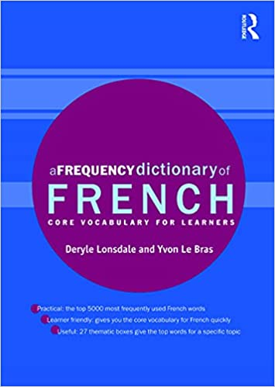
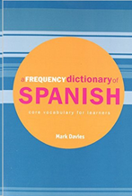
Which words? Identifying useful words: using frequency from huge corpora of language
Information about how frequent words are comes from large corpora of language
20 million words or more
based on both spoken and written language
taken from a wide range of different contexts
Examples of resources about word frequency:
are published by Routledge:
Davies & Davies (2018), Lonsdale & Le Bras (2009) and Tschirner & Möhring (2019).
Notes:
Thankfully researchers have gathered together material from a wide range of contexts to create databases of words, corpora – in Fr Spanish and German
These word lists are very useful
but of course, there are limitations to be borne in mind.

Slide 26
But … would the most frequent words be useful for the current A Level? Yes
 | average number of words* used in papers AQAª Edexcel^{b} | average % of words in an A level paper that are in the 2,000 most frequent AQAª Edexcel^{b}
French | 948 841 | 72% 73%
German | 1000 915 | 66% 61%
Spanish | 915 787 | 71% 75%
ª 2018, 2019, 2020, 2 sample papers
^{b} 2018, 2019, 2020, 1 sample paper
Notes:
Preliminary analyses

Slide 27
But … is it ok to use information about frequency from a corpus of general language use?
Why can’t we use corpora of French, German, or Spanish that only reflect the needs and interests of teenage learners?
There aren’t any!
And what would that teenage language be like anyway?!
And would such language be useful for them in the longer term?
And anyway … no matter which large corpus you use, the most frequent words remain similar
Most frequent 2,000 in other general corpora have 82-83% overlap with Routledge lists.
Any frequency list from a general corpus will contain words which are not relevant to a particular group of students.
No matter which corpus we use, we need to hand pick some of the words to include.
*Other corpora consulted: French Web 2017 (frTenTen17), French corpus of 88, 000 SMS (88milSMS), frWaC, Corpus d'Etude pour le Français Contemporain (CEFC), German Web 2013 (deTenTen13), deWaC, Datenbank für Gesprochenes Deutsch, Spanish Web 2018 (esTenTen18), esWaC, Corpus Oral de Referencia de la Lengua Española Contemporánea (CORLEC)

Slide 28
Which words? Selecting useful, low frequency words
Some words are especially relevant to a specific group of learners
But they are lower frequency because they are only common in:
a certain topic area
a certain setting (e.g., school, restaurant)
either written or spoken language
language use which doesn’t lend itself to putting in a corpus (e.g., days of the week on timetables, abbreviations in text messages)

Slide 29
Which words? Low frequency words: word classes
But for more open sets of related words, it can be tempting to get drawn in to particular topics, food or hobbies, that might not be necessary for all learners in a class.
Instead of listing so many specific words, “circumlocution skills” are part of communicative competence:
You can express the meaning of ‘niece’ or ‘sitcom’ with words which are more generally useful
Closed lexical sets consisting of comparatively small numbers of words that easily fit under a headword
(Nation & Crabbe, 1991).
Examples of classes
Days of the week
Months of the year
Compass points
Numbers
Titles
Salutations
Basic colours
Immediate family members

Slide 30
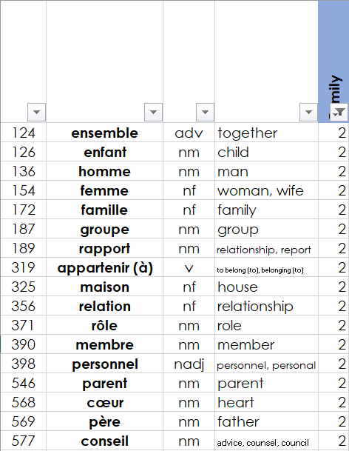
Which words? But … can high frequency words be used to talk about themes? Yes.
Family
1231 French words, 1248 Spanish words and 1318 German words had strong connections with one or more relevant themes.
Notes:
One concern that has been expressed about using high frequency words is that they are devoid of interest – that they don’t have any richness to them.
At NCELP we have checked whether the most frequent 2000 words have any connection to themes.
We asked raters to decide whether each word related to a range of themes, such as family, friends, faith, economy, cinema, or NONE – they couldn’t be linked to a theme.
Here is a snap shot of the rating grid that we used.
We found that over 1200 words i.e. around 60-65% of the words in the top 2000 could be envisaged as part one or more of the cultural themes that we considered to be relevant to GCSE-level learners.
Here is an example of words in the most frequent 2000 that are associated with the theme of family.
So, while many of the very highest frequency words are function words – e.g., conjunctions and prepositions – the most frequent 100-200 words or so - the vast majority of words in the top 2000 are rich content words.

Slide 31
How to select the PHONICS content?
Sound-Symbol Correspondences
To select the SSCs, NCELP identified:
most reliable, dependable SSCs
high-frequency ‘source’ words
staged roll out, with the most low-hanging fruit first!
practice activities and systematic revisiting
much more time for French
Erler, L. and Macaro, E. (2012) ‘Decoding Ability in French as a Foreign Language and Language Learning Motivation’. The Modern Language Journal, 95(4): 496-518.
Porter, A.M. (2014) An early start to French literacy: Learning the spoken and written word simultaneously in English primary schools. PhD thesis, University of Southampton.
Woore, R. (2007) ‘“Weisse Maus in Meinem Haus”: Using Poems and Learner Strategies to Help Learners Decode the Sounds of the L2’. Language Learning Journal, vol. 35, no. 2, pp. 175-188.
Woore, R. (2009) ‘Beginners’ progress in decoding L2 French: some longitudinal evidence from English Modern Foreign Languages classrooms’. Language Learning Journal, vol. 37, no. 1, pp. 3-18.
Woore, R. (2010) ‘Thinking aloud about L2 decoding: an exploration into the strategies used by beginner learners when pronouncing unfamiliar French words’. Language Learning Journal, vol. 38, no. 1, pp. 3-17.
Woore, R. (2011) Investigating and developing beginner learners’ decoding proficiency in second language French: an evaluation of two programmes of instruction. Unpublished PhD thesis, University of Oxford.
Woore, R. (2014) ‘Beginner learners’ progress in decoding L2 French: transfer effects in typologically similar L1-L2 writing systems’. Writing Systems Research, volume 4(2): 167-189.
Woore, R (2018) ‘Learners’ pronunciations of familiar and unfamiliar French words: what can they tell us about phonological decoding in an L2?’ The Language Learning Journal, 46(4):456-69.
Woore, R., Graham, S., Porter, A., Courtney, L. and Savory, C. (2018) Foreign Language Education: Unlocking Reading (FLEUR) - A study into the teaching of reading to beginner learners of French in secondary school. https://ora.ox.ac.uk/objects/uuid:4b0cb239-72f0-49e4-8f32-3672625884f0
Notes:
So far I have only focused on defining the lexical content.
To select the content for sound-symbol correspondences, for phonics practice, we drew out some key principles and reached decisions about content, drawing on both research and practitioner experience to inform the selection and suggested order of teaching of each phoneme-grapheme correspondence; the choice of ‘source words’ .
And research told us that it was likely that phonics is fragile and prone to decay if practice is not sustained particularly in French

Slide 32
Identifying sound-symbol correspondences
silent final consonant
a
i/y
eu
e
au/eau/closed o/ô
ou
u
silent final e
é (-er, -ez)
en/an/em/am
on/om
ain/in/aim/im
è/ê/ai
oi/oy
ch
ç (and soft 'c')
qu
j
-tion
-ien
s-liaison
t-liaison
n-liaison
x-liaison
h
um/un
-gn-
r
open eu/œu
open o
-s-
th
-ill-/-ille
-aill-/ail
long [a], including [ah], [aa] and short [a]
long [e] including [eh], [ee] and short [e]
[ei/ai]
[z]
[w]
[ie]
long [o], including [oh], and short [o]
long [i], including [ih] and short [i]
hard and soft [ch]
long [u], including [uh] and short [u]
long [ü/y], including [üh] and short [ü/y]
long [ä], including [äh] and short [ä]
long [ö], including [öh] and short[ö]
[äu]
[sch]
[sp-]
[st-]
[s-, -s-]
[ß] [ss] [-s]
[er]
unstressed [-er]
[v]
[au]
consonantal [r]
vocalic [r]
[eu]
[th]
unvoiced [-b], [-d], [-g]
[-ig]
[j]
[-tion] [qu]
[a]
[o]
[e]
[i]
[u]
[ll] [ch] [ca]
[co]
[cu]
[cu] + vowel
[ce]
[ci]
[z]
[que]
[qui]
[ga]
[go]
[gu]
[ge]
[gi] [gue] [gui]
[j]
[ñ]
[v]
[rr]
silent h
Notes:
This is clearly not for you to read but a quick eyeball shows that the phonics content extracted from the principles described earlier seems to be feasible: that is, the code that students need to ‘crack’ to be able to read unknown words out loud and to write down unknown words is not insurmountable in 5 years – this news, in itself, could be a motivator.
I haven’t talked about the selection of other aspects of content – such as grammar – but I will touch upon that a bit later in other sections

Slide 33
Defining the language content: Parts 4 & 5
When and How? practise in varied, meaningful, and engaging contexts

Slide 34
When we are “gardening in a gale” (of English) (Hawkins, 1996), how do you ensure there is enough revisiting of language?
Average of 10 words per week -> 360 words per year * 5 years
= 1,700 words, for highest achievers
But … how to space out this content?
One size won’t fit all: Variation across schools (1 - 3 hours of lessons per week)
Need to keep adding words
So, need to revisit the same language less and less frequently, so you can introduce new language
an ‘expanding practice schedule’ (Nakata, 2015)
Notes:
As we have said, with about 450 hours, @10 words per week, 36 weeks per year (minus one term in the final year as 16 year olds leave school in May to revise for and do their exams)
This allows a learner to learn about 1700 words over five years
But how to space this out – to spread it enough in the Scheme of Work but in a way that allows revisiting and also the introduction of new vocabulary

Slide 35
An expanding practice schedule
week 1: learnt for pre-lesson homework
Week 2: taught & practised in lesson
wk
2
Week 5: relearnt before lesson and included in receptive and productive practice that week
wk
5
Week 9/10: relearnt before lesson and included in receptive and productive practice that week
wk
10
Week 20: tested
Week 33: tested
Each of following years: practised and tested
Notes:
Here is an example of an expanding practice schedule
On the left, you can see the grammar covered, in the centre the vocabulary
So imagine this practice schedule for this set of words starts in week 1, when set of vocabulary is learnt for homework before a lesson…

Slide 36
Revisiting vocabulary in different grammatical and semantic contexts
Talking about people’s lives
Asking about future intentions
Talking about the environment
Notes:
The vocabulary is not revisited in the same contexts e.g., aller is seen in a wide range of topics (not just holidays), laver is seen texts that are not just about a personal routine or helping at home.
Here you can see the same vocabulary is practised in three different sets of activities: people’s lives, future intentions, and talking about the environment
And the vocabulary appears with a wide range of grammar too. So, items of vocabulary are not stuck in the same grammatical structures or sentence frames. The words are carefully moved across different grammar features.
So, here you can see the same set of vocabulary is used with er verbs in the 3rd person, with a verb + infinitive structure, and then in a revision lesson which covers a wide range of grammar features.

Slide 37
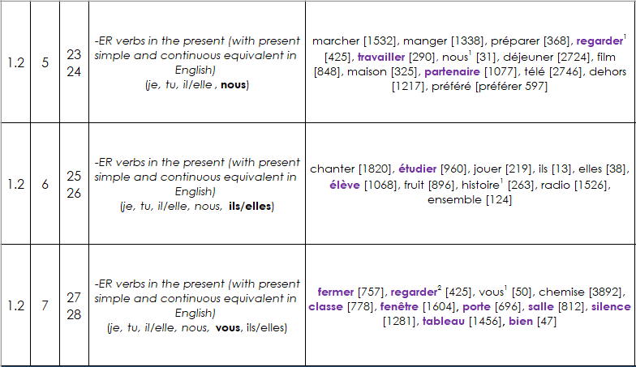
2. Design
Planning systematic vocabulary and grammatical growth
The complexity of language grows gradually
grammatical and lexical growth – the size of the word families that we can expect students to know gradually gets larger
lesson | word families grow in size | number of words grows
Notes:
As more words are learned, so too is more grammar. Lexical and grammatical growth happens in tandem, one with the other, the one bootstrapping the other.
I show an example here.
Prior to this lesson sequence, some –er verbs have already been introduced – marcher, manger, preparer – but only in the singular forms.
Then, in weeks 23/4, another two verbs, regarder and travailler are added to their repertoire, and in the same lesson the breadth of the verb paradigm is expanded – they can now talk about ‘what we do’ – they can manipulate these verbs in the ‘nous’ form.
In the next pair of lessons, another er verb is added, and the old ones are recycled- this time all these verbs are used to practice a new form – the 3rd person plural
And in the next lesson a new verb, fermer is added, a new meaning of regarder is given (not just watch but also look), and a new part of the verb paradigm is looped in – the ‘vous’ form.
And later on – not shown here - they will learn the past tense, and so these verbs are used again, in the past tense too.
So, leaners see the vocabulary not only in different semantic contexts – as shown on the last slide - they also see it in different grammatical contexts

Slide 38
Notes:
Please check out a 15 minute audio-recorded presentation that presents the NCELP Schemes of Work

Slide 39
But won’t this lead to a dull diet?
What about
the country/ people / culture?
social communication and interaction?
inferencing skills for when unknown language appears?
Notes:
One question that was persistently raised in the consultation on the new GCSE Subject Content was a misapprehension that defining the linguistic content in clear ways – by listing vocabulary, the details of grammar, and the sounds-symbol correspondences - would mean that language learning was no longer about engendering an interest in the countries and people associated with the language. That clearly defining linguistic content somehow meant that the rationale suddenly became only an academic one. Defining the language content seemed to be interpreted by some as neglecting other rationales such as raising awareness about language (in a way that could be applied to other languages later in the pupils’ lives) or imbuing a sense of curiosity in culture, places, and people.
Here are some texts I will whizz through to illustrate, I hope, that these views resulted from a false dichotomy, a conflation of completely different issues.
I hope to illustrate in a whistle stop tour of some of the 966 classroom resources that NCELP have created, that interesting texts and ideas can be communicated with high frequency words and basic grammar structures, in a curriculum where the vocab and grammar adheres to a schedule to ensure that particular vocab and grammar are revisited at specific times.

Slide 40
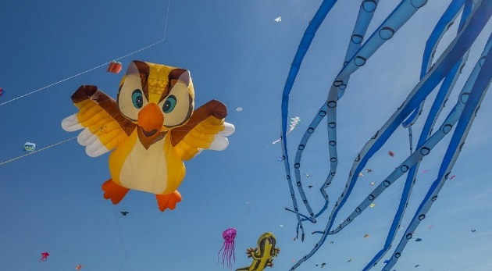
Le festival de Dieppe
lire
*le plus grand =
the biggest
*le cerf-volant = kite
*le son = sound
Comment dit-on les mots orange en anglais ?
What noun does this word look like?
What adjective does this word look like?
Le festival de Dieppe est le plus grand* festival de cerfs-volants* au monde.
On trouve le festival sur la plage.
Les visiteurs viennent de beaucoup de pays pour regarder des cerfs-volants traditionnels, de l'art et des acrobates. Un aspect important du festival est qu’on peut visiter sans acheter de billet. Il est gratuit !
Il y a beaucoup d'activités pour les enfants et le festival encourage l'imagination. Cet événement culturel célèbre les relations internationales. Pendant le dernier week-end du festival, on regarde les cerfs-volants illuminés pendant un show son* et lumière. Je pense à visiter le festival. Tu veut voyager au festival avec ma famille ?
What noun does this word look like?
visitors
What does this sentence tell you about the festival?
acrobats
traditional
The start of this word looks like the English
free
What adjective does this look like?
This word has the same stem as the previous one you worked out. What might it mean?
event
illuminated
light
What words that you already know could you use instead of the words in orange?
Now answer the question at the end.
Notes:
Here is a text about a kite-festival in Dieppe with lots of language awareness activities to help learners understand cognates
Then drawing on their current lexicons – which we know what they are precisely as they have been tracked so carefully - to replace these cognates with words they know
Then giving their reaction to the content of the text by answering a question about whether they would like to go to the festival
----------
Timing: 5 minutes
Aim: Developing inferencing skills by using surrounding context to work out meaning of unknown words; word substitution with known words.
Procedure:
1. Students try to work out the meaning of the highlighted words based on context (text and images) and similarity to English words.
2. If students need some help, click to bring up a clue
3. Click gain to reveal the translations.
4. Click to bring up the extension. Students think of known words that could replace the orange words to make a sensible sentence.
Some suggested answers:
visiteurs -> gens, enfants, personnes … any relevant noun to describe people
traditionnels -> grands, nouveaux… any relevant adjective to describe kites
acrobates -> artistes, chanteurs … any relevant noun to describe performers
événement -> lieu, festival … (note that any relevant masculine noun works here but ‘cet’ would need to change to agree)
illuminés -> verts, bons … any relevant adjective to describe kites
lumière -> musique, film … any relevant noun to describe a show

Slide 41
Hanoucca
*la bougie = candle
**deuxième = second
lire
Lis le texte. Use the words you know to understand the general meaning of the words in bold.
Pour la communauté juive, la fête importante de décembre est Hanoucca. C’est une fête de lumières et on utilise des bougies* pour célébrer. La fête est de huit jours, et on allume une bougie le premier jour, deux bougies la deuxième** jour … Les bougies sont un symbole de la bonté de Dieu. Dans une vieille histoire juive, une petite bouteille d’huile a nourri une lampe pendant huit jours, beaucoup plus de temps que normalement. On mange des beignets comme un symbole de l’huile. Les enfants jouent avec des toupies qui contiennent une phrase religieuse. Hanoucca est plus familial et spirituel que religieux.
bonté : part of body / personality / room / song
huile : a type of wood / plant / liquid / shoe
beignet : a type of drink / chair / cup / food
toupie : a type of toy / book / hat / sweet
goodness
oil
doughnut
spinning top
Notes:
Here is a text about Hanoucca . This activity includes some practice at inferencing the meaning of words by using the words that we know they have already met several times and have been tested on
At this stage of learning, lexical inferencing becomes (more) possible and likely to happen successfully, because we can be more confident that they have a critical mass of vocabulary to start doing this, than if we had used a curriculum where we weren’t very sure about which vocabulary had been covered several times already.
Timing: 5 minutes Aim: to practise lexical inferencing; the written comprehension of known words to arrive at a general understanding of one unknown word in a sentence context. In addition, to revise previously learnt vocabulary in new contexts. Procedure: 1. Ensure that students understand the task (as this is the first time they are doing this type of activity). Students need to know that they are aiming to understand the general meaning, rather than specific meaning (though they may in some cases also arrive at this).
2. Students read each text and decide which of the four options is most likely, depending on their understanding of the surrounding words.
3. Click to reveal answers.
4. Proceed to the next slide for the comprehension part of the activity.
Word frequency of unknown words used (1 is the most frequent word in French):
lumière [1059], allumer [3169], bougie [>5000], deuxième [427], bonté [>5000], huile [2340], beignet [>5000], toupie [>5000]
Word frequency of cognates used (1 is the most frequent word in French): Hanoucca [>5000], bouteille [2979], lampe [4699], normal [833], familial [1622], spirituel [3047]
Source: Lonsdale, D., & Le Bras, Y. (2009). A Frequency Dictionary of French: Core vocabulary for learners London: Routledge.

Slide 42
La Manche
Remplis les blancs avec les formes des verbes correctes.
lire / écrire
La Manche* sépare la France et l’Angleterre. On peut traverser la Manche en bateau ou en train sous l’eau. Quand nous visitons l’Angleterre, nous aimons prendre le train – c’est plus rapide. Ils préfèrent prendre le bateau pour regarder la vue. Comment traversez-vous la Manche ?
Le tunnel sous la Manche constitue le plus long tunnel sous-marin* du monde – on trouve 38 de ses 50 kilomètres sous la mer*.
On utilise le tunnel pour voyager entre l'Angleterre et la France. C'est idéal pour les vacances et les affaires.
[1]
[2]
[3]
[4]
[5]
[6]
[7]
[8]
*la Manche = the English Channel
*sous-marin = underwater
*la mer = sea
séparer (to separate)
visiter
aimer
préférer
traverser
constituer (to form)
trouver
utiliser
Notes:
Here is a text about the channel and how to cross it
This is a standard gap fill including manipulation of verbs
Followed by …
-----------------------
Timing: 4 minutes
Aim: Written production of –ER verbs in all forms; raising cultural awareness (geography).
Procedure:
1. Students read the text about the English Channel and fill the gaps with the appropriate form of the given verbs. For an added challenge at higher levels, remove the numbers from the verbs in the box and mix up the order so that students must also read for semantic meaning and assign the words to the correct gaps.
2. Click to reveal answers.
3. Click to proceed to comprehension questions on next slide.
Word frequency of unknown words used (1 is the most frequent word in French): constituer [495], marin [2101], mer [921]
Source: Londsale, D., & Le Bras, Y. (2009). A Frequency Dictionary of French: Core vocabulary for learners London: Routledge.
Word frequency of cognates (1 is the most frequent word in French): séparer [946], tunnel [3386], long [202], kilomètre [1435]
Source: Londsale, D., & Le Bras, Y. (2009). A Frequency Dictionary of French: Core vocabulary for learners London: Routledge.

Slide 43
La historia de Perú
leer / escuchar
Durante varios siglos los Reyes de España apoyaron múltiples viajes a lugares diferentes de América. En estos viajes los españoles principalmente buscaron oro. No necesitaron mucho esfuerzo porque encontraron imperios grandes pero no muy fuertes, como el imperio inca.
El último rey del imperio inca, Atahualpa, peleó contra su propio hermano en una batalla de cuatro años para ser el rey. Francisco Pizarro, un conquistador español, llegó a Perú poco después de esta batalla.
Entonces Atahualpa envió a un grupo de personas en una misión para estudiar a los españoles. Los incas mostraron miedo de los caballos, ¡unos animales totalmente nuevos para los indígenas!
Cuando los españoles llegaron a la costa Atahualpa no los atacó inmediatamente, quizás un gran error. Francisco Pizarro y sus hombres aprovecharon la situación, bajaron la montaña y buscaron un camino al pueblo de Cajamarca.
1
2
3
4
5
6
7
Notes:
Through a series of phonics, vocabulary, and grammar activities, practising sounds that have been covered already, new and old vocabulary and revising the 3rd person singular and plural in the preterite, the students are lead to then be able to access this text, a history of Peru.
The vocabulary has been actively practised in previous activities and previous lessons.
Timing: 8 minutes
Aim: to help students to connect the spoken and written forms of the language more securely; to consolidate vocabulary and grammar knowledge by eliciting suggested changes to the text.
Procedure:
Click on the audio button to play the text. Read and listen.
Note: There is a full version of the audio top right with a player. Alternatively, the audio is in 7 sections with a pause just after the words 1-6 below, to facilitate easy stop/start.
To support segmentation, stop the audio and ask students to say: a) the next word b) the previous word
In addition, to develop understanding, vocabulary and grammar knowledge, pause at key points and ask students to suggest an alternative word that could replace the next word. This is a chance to draw on previously taught grammar and vocabulary knowledge. All of set gaps are after ‘ser’ or ‘estar’, so students will need to think about words that they can use that would be possible with the verb.
... los españoles principalmente buscaron... (e.g., dinero, comida, suerte...) .
... porque encontraron... (e.g., ayuda, apoyo, una sociedad débil...).
... Entonces Atahualpa... (e.g. habló con los españoles, miró a los españoles, pensó en un plan).
... Los incas... (e.g., miraron/evitaron/pelearon contra/atacaron a los españoles...).
... Cuando los españoles llegaron a ... (e.g., la zona, al pueblo, al lugar...).
... Francisco Pizarro y sus hombres... (e.g., atacaron, visitaron al rey, caminaron a un pueblo...)
Transcript
En los siglos XV y XVI los reyes de España apoyaron varios viajes a lugares diferentes de América. En estos viajes los españoles principalmente buscaron oro. No necesitaron mucho esfuerzo porque encontraron imperios grandes pero no muy fuertes, como el imperio inca.
El último rey del imperio inca, Atahualpa, peleó contra su propio hermano en una batalla de cuatro años para ser el rey. Francisco Pizarro, un conquistador español, llegó a Perú poco después de esta batalla.
Entonces Atahualpa envió a un grupo de personas en una misión para estudiar a los españoles. Los incas mostraron miedo a los caballos, ¡unos animales totalmente nuevos para los indígenas!
Cuando los españoles llegaron a la costa Atahualpa no los atacó inmediatamente, quizás un gran error. Francisco Pizarro y sus hombres aprovecharon la situación, bajaron la montaña y buscaron un camino al pueblo de Cajamarca.
Note:
1. Students can be encouraged to provide an oral translation of the text or of some phrases in the text.

Slide 44
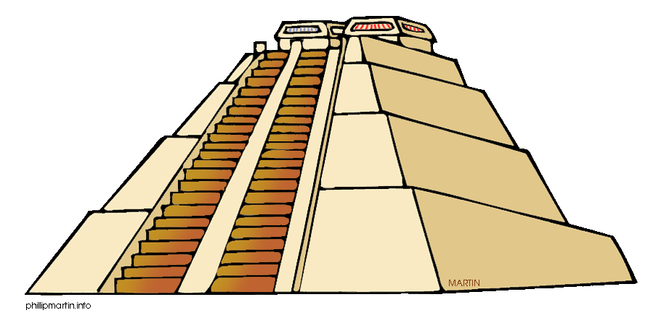
Lee unas frases de la primera parte de la historia. ¿Son verdaderas o falsas?
leer
*conquistador = conqueror
1. Los Reyes de España ayudaron a los conquistadores* en sus viajes.
2. En América los españoles encontraron imperios débiles.
3. Atahualpa y su hermano empezaron una batalla para ser el rey.
4. Francisco Pizarro y sus hombres llegaron a Perú antes de una batalla entre los incas.
5. Los caballos mostraron miedo de los incas.
6. Los incas atacaron a los españoles cuando llegaron a la costa.
7. Los españoles caminaron hasta Cajamarca después de bajar las montañas.
Notes:
The following lesson, they are asked to try to recall the history they had read about , and answer true or false.
Timing: 5 minutes
Aim: to recall the first part of the text from lesson 1 before moving on to the second part of the text; to see the use of the –aron ending in context.
Procedure:
1. Students read each phrase and decide if it’s true or false depending on the information they can remember from lesson 1.
2. Teachers show the answers one by one.
Notes:
Number 4 is false because they arrived after the battle: ‘Es falsa. Francisco Pizarro y sus hombres llegaron a Perú después de una batalla entre los incas’.
Number 5 is false because the incas feared the horses (they had never seen horses before), not the other way around: ‘Es falsa. Los incas mostraron miedo de los caballos’.
Number 6 is false because the incas did not attack the Spanish on the coast when they arrived: ‘Es falsa. Los incas no atacaron a los españoles inmediatamente cuando llegaron a la costa’.

Slide 45
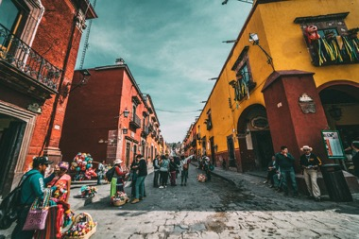
Lee este artículo y escribe el título correcto. Debes elegir ‘su’ o ‘sus’.
¿Por qué hacer un viaje a México? Aquí te damos cinco razones.
leer
gente
1. Su / sus________________
Si vienes a México es seguro que puedes hacer amigos. Los mexicanos son muy simpáticos y reciben a los visitantes* con los brazos abiertos.
2. Su / sus ________________
Los paisajes de México son geniales. Puedes visitar sus playas hermosas, sus montañas altas, sus lagos* grandes o sus bosques* llenos de vida.
3. Su / sus ________________
En sus calles vas a encontrar todo tipo de edificios: iglesias antiguas, plazas llenas de gente, mercados, teatros, tiendas con productos locales...
4. Su / sus ________________
México es conocido por sus platos deliciosos. Los mexicanos comen bien y preparan muchas cosas tradicionales: tacos, tamales, mole...
5. Su / sus ________________
Si te interesa la cultura, México es un lugar ideal. Las tradiciones son muy importantes para los mexicanos y sus celebraciones son muy especiales.
Opciones
gente
costumbres
museos
ciudades
música
comida
bebidas
naturaleza
naturaleza
ciudades
comida
*el/la visitante - visitor
costumbres
*el bosque - forest
*el lago - lake
Notes:
Here is an activity that is in a series based introducing the culture and people of Mexico,
but it is also a grammar activity that is based on VanPatten & Cadierno’s processing instruction – forcing attention on the function of the su versus sus possessive pronouns to mean ‘it / its’. This is combined with a task that focuses on the general meaning of the text in order to put the correct subtitle over the text.
So, this activity is an example of all three things: a focus on grammar, a focus on the general meaning of a text, whilst embedded in material about the culture and people.

Slide 46
Una tradición mexicana: el Día de Muertos
leer / escuchar
Lee y escucha el texto sobre el Día de Muertos:
1
5
‘Pan de muerto’ es un tipo de pan tradicional en este día.
México tiene muchas tradiciones, pero su tradición del Día de Muertos es especialmente conocida. Es una costumbre única y muy importante para su comunidad porque es una forma de pensar en los muertos. Para los mexicanos, los muertos vienen a la tierra este día.
Nadia es mexicana y celebra el Día de Muertos con su familia. Por la mañana se levanta temprano para ayudar a su abuela: preparan pan* de muerto y un poco de fruta para el altar. Su altar tiene varios* niveles. Los niveles del altar son las diferentes partes del mundo: el primer nivel es la tierra y el segundo nivel es el cielo*. Nadia pone allí fotos de su abuelo y se sienta al lado de su abuela. Se queda unas horas en casa con su familia y se acuerda de su abuelo muerto.
Por la tarde se pone ropa divertida, se pinta de blanco y negro y va a la calle con su hermano. En su barrio hay un festival con música fuerte y luces de colores. ¡Es muy divertido!
2
6
3
7
4
*el pan = bread; *el cielo = sky, heaven; *varios = various
Notes:
Following this was a task focusing on the Day of the Dead in Mexico. This was a bimodal reading and listening task – where learners are asked to follow the text whilst they listen; every so often the audio stops and they have to say the next word or the previous one, or replace the next word with something else
This was informed by evidence that bimodal input helps learners to segment the input into words and helps their comprehension.
-------------
Timing: 8 minutes
Aims:
to reinforce understanding of the difference between ‘se’ and ‘su’.
to help students to connect the spoken and written forms of the language more securely.
to consolidate vocabulary and grammar knowledge by eliciting suggested changes to the text.
Procedure:
Students read the text and write ‘se’ or ‘su’ for each space.
Click on the audio button to play the text. Read and listen.
Note: There is a full version of the audio top right with a player. Alternatively, the audio is in 6 sections with a pause just after the words 1-5 below, to facilitate easy stop/start.
To support segmentation, stop the audio and ask students to say: a) the next word b) the previous word
In addition, to develop understanding, vocabulary and grammar knowledge, pause at key points and ask students to suggest an alternative word that could replace the next word. This is a chance to draw on previously taught grammar and vocabulary knowledge.
Es una costumbre única y muy importante para su... (students volunteer other possible nouns – e.g., gente, historia, país).
y celebra el Día de Muertos con su…..(students volunteer other possible nouns – e.g., padre, madre, primo etc.).
de su abuelo y se... (students volunteer verbs in third person singular that fit after ‘se’ – e.g., se acuerda de..., se queda, se prepara (para), etc)
en casa con su familia y se ... (students volunteer other possible verbs that fit after ‘se’ – e.g., se saca (fotos), se mira en el espejo, se presenta a otra gente).
Por la tarde se…… (students are prompted other possible verbs that fit after ‘se’)
va a la calle con su…. (students volunteer other possible nouns)
Notes:
1. The word for ‘bread’ (‘pan’) will be introduced in the next week’s vocabulary set.
Transcript
México tiene muchas tradiciones, pero su tradición del Día de Muertos es especialmente conocida. Es una costumbre única y muy importante para su comunidad porque es una forma de pensar en los muertos. Para los mexicanos, los muertos vienen a la tierra este día.
Nadia es mexicana y celebra el Día de Muertos con su familia. Por la mañana se levanta temprano para ayudar a su abuela: preparan pan* de muerto y un poco de fruta para el altar. Sualtar tiene varios niveles. Los niveles del altar son las diferentes partes del mundo: el primer nivel es la tierra y el segundo nivel es el cielo. Nadia pone allí fotos de su abuelo y se sienta al lado de su abuela. Se queda unas horas en casa con su familia y se acuerda de su abuelo muerto.
Por la tarde se pone ropa divertida, sepinta de blanco y negro y va a la calle con su hermano. En su barrio hay un festival con música fuerte y luces de colores. ¡Es muy divertido!
Frequency of unknown words and cognates:
pan [1342]; cielo [620]; varios [386]
Photos:
Photo of the child by Christian Newman, from Unsplash.
Photo of ‘Pan de muertos’ by Alejandro Ávila Cortez, from Pixabay.

Slide 47
NCELP resources for 13-14 year olds, after 200 hours of instruction, on: secularism in France, the Berlin Wall and divided Germany, the ‘polite you’… For more, search for: ‘The culture collection’ (This collection currently brings together years 7 & 8 material only; for year 9, look in the year 9 SOW and resources)
https://resources.ncelp.org/

Slide 48
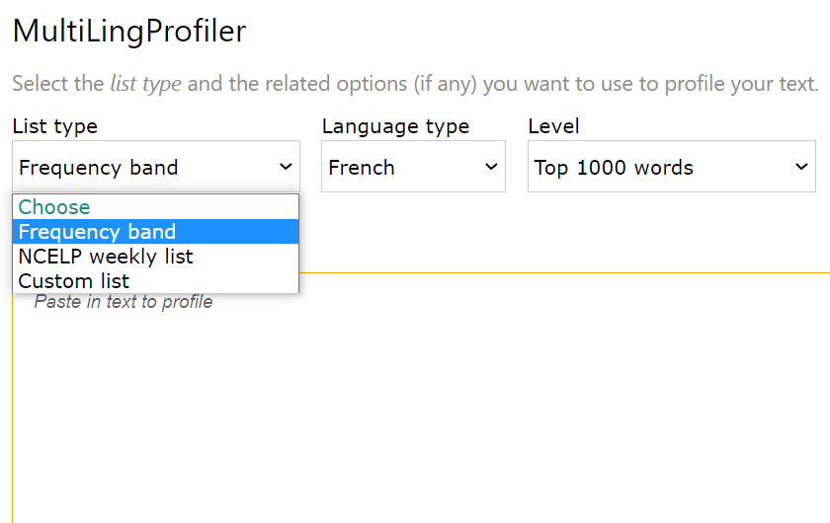
You can make your own texts – and check whether you have used the words that students have already met in the SOW
http://www.multilingprofiler.net/
Notes:
Enter your text and choose whether you want to create a text that uses just the words up to a certain point in the NCELP SOW
Or that uses just the words from the most frequent 2000
You can see whether any words flash up in orange - if they do – that means that they are no on the word list that you are using
You can then replace them with other words that they are more likely to know. It is usually easy to alter your texts: Replacing words, changing the grammar a bit.
OR … You might want to keep those words in your text – you might want to see if the students can use their inferencing skills or you might want to gloss them.
Teachers have been using this tool. For example, one teacher told us that they have created humorous fairy tales with the high frequency words.
We hope to be working with the Awarding Organisations – if the new GCSE is approved – and we would put their word list here too.

Slide 49
https://www.gaminggrammar.com/
Notes:
One more example of a resource from NCELP that is relevant to the ‘how’ – the practice of vocabulary and grammar in different and varied contexts - is Gaming Grammar
Dr. Kasprowicz and our software developer Andy Wood have been developing our online digital game
There is now a school leader board – if you want to opt in to that. The teacher can see how their own students are doing
And dozens of mini games that pupils can play to practise grammar in listening and reading activities
They are given plenty of feedback just when they need it – this is the well-researched input-based grammar learning known as Processing Instruction (VanPatten & Cadierno, 1993; and work by Marsden, McManus, Kasprowicz).

Slide 50
Overview
3: Defining content for the GCSE
Notes:
As you will know, in March this year the DfE launched a consultation on a new GCSE subject content. I’m going to talk now about those proposals, as it is clearly relevant to the issue of identifying ‘how much’ content and ‘what content’. The consultation has now closed and the DfE is considering the responses.
As a panel member, I cannot talk about the details of the discussions but I can explain some of the changes and some of the rationale behind them.

Slide 51
Purposes of learning a FL - no changes
2015 (& similar in earlier versions) | 2021 (all details to be confirmed)
develop ability and ambition to communicate in speech and writing step beyond familiar cultural boundaries develop new ways of seeing the world provide strong foundation for further study

Slide 52
Contexts of language use – would be less specificity
2015 | 2021 (to be confirmed)
specified themes and all topics within them tested: Identity and culture, local, national, international and global areas of interest, current and future study and employment | become familiar with aspects of contexts where the language is spoken because most of the vocabulary is informed by its frequency, it will enable access to a wide range of themes and contexts (e.g., cultural, geographical, political, historical or vocational aspects)
Notes:
in 2015 specific topics were compulsory and these had to be tested
Now, just compulsory that some themes will be identified.

Slide 53
Lexicon - would be much more specificity
2015 | 2021 (to be confirmed)
general: “students will enrich their vocabulary to increase their independent use and understanding …” awarding bodies can list words if they wish words & phrases driven by topics, not frequency currently about 62% of words over 4 exams is high frequency words NOT on list MUST be tested | tests will contain words from a list * 1,200 items Foundation; 1,700 items Higher 90%? (or other e.g., 85%?) words from the most frequent 2,000 10%? (or other, e.g., 15%?) selected freely 30? multi-word units & 20? places/cultural references? any off list (unfamiliar) words to test lexical inferencing and sound-symbol knowledge?? 2%?? of a text could be glossed
*equal credit given for language used that is beyond the defined content but that fulfils the test requirements
Notes:
Rather than 62% in a corpus of language, 75%-95% would be more expected,
and nearer the higher end for beginners and for a curriculum that emphasises informal speech
High frequency defined as ranked <2,000 in a list of frequency rankings according to the Routledge frequency lists.

Slide 54
How would the grammar content change?
Notes:
So that was the lexicon – what about the grammar in the new subject content?

Slide 55
Greater detail
2015 | 2021
“Interrogative forms” | Interrogatives Interrogatives expressed through: intonation with SV word order, including when followed by a wh-word (i.e., question words including ‘how’); est-ce que followed by SV word order; VS word order; wh-word followed by VS word order

Slide 56
The range of grammar expected would be less, especially for Foundation Tier students
Grammar removed completely e.g., subjunctive, pluperfect
Moved from Foundation to Higher e.g., inflectional future, depuis + present
Parts of system (e.g., singular persons) taught at Foundation, and the rest (e.g., plural persons) at Higher
Some features given tolerance for error in production at Foundation (e.g., spelling changes in present tense stems), but are credit bearing at Higher

Slide 57
Moved from ‘grammar’ to ‘vocabulary’
2015 (grammar) -> 2021 (vocabulary)
numbers
quantity
dates
times
list of conjunctions
list of prepositions
adverbs of time and place
pronouns

Slide 58
How would the content about sounds of the language change?
2015 | 2021 (to be confirmed)
use accurate pronunciation and intonation such as to be understood by a native speaker no reference to phonics (sound-writing relations) | Use clear and comprehensible speech in oral exam Apply sound-spelling principles listed in an appendix Read aloud Transcribe.

Slide 59
How would the skills/proficiencies tested change?
2015 Discrete testing of “the 4 skills” | 2021 Discrete and Multi-skills (tbc)
Speaking: describe a picture role play prepped conversation on well-rehearsed topics Reading comprehension Listening comprehension Written production (incl. translation) | Speaking: describe picture/s, then unprepared interaction role play incl. answering unprepared questions Reading comprehension Listening comprehension Speaking AND reading Read aloud & show comprehension in unprepared spoken interaction Listening AND writing Transcribe language Written production (incl. translation)

Slide 60
Summary of proposed changes to Subject Content
proposed GCSE Content
ultimate aims of learning a FL remain the same
vocabulary to be clearly identified, informed by frequency
grammar more clearly specified, and amount reduced
sound-spelling relations defined -> read aloud & transcribing language
the specific language itself drives the content, and themes and functions emerge

Slide 61
Summary of the talk
Testimonials from those who use NCELP materials
Almost ¼ million downloads of resources
Defining the language content:
Feasible amount, of most useful words, grammar, sounds/spellings
Planned revisiting, in varied, meaningful, and engaging contexts
Rationales for some of the proposed changes to the GCSE exams
Notes:
I hope I have convinced you of the value of defining the content clearly and I have illustrated how NCELP have provided one – of several no doubt - road maps to inform decisions and enrich educators’ toolkits
I hope I have persuaded you to go and check out our resources - and that it is not necessary to hold a polarised, dichotomous view that defining the content means a dry and dull diet.
We are not talking about “either / or”

Slide 62
5. Selected references
Chung, T. M., and Nation, I. S. P. (2004). Identifying Technical Vocabulary. System. 32 (2), 251−263.
Bauer, L. & Nation, P. (1993). Word Families. International Journal of Lexicography, 6(4), 253-279. doi: https://doi.org/10.1093/ijl/6.4.253
Davies, M., & Davies, K. (2018). A frequency dictionary of Spanish: Core vocabulary for learners (2nd ed.). London: Routledge
Jones, R., & Tschirner, L. (2006). A frequency dictionary of German: Core vocabulary for learners. Oxford: Routledge
Lonsdale, D. & Le Bras. Y. (2009). A frequency dictionary of French: Core vocabulary for learners. Oxford: Routledge
Kremer, G., Baroni, M. A set of semantic norms for German and Italian. Behav Res 43, 97–109 (2011). https://doi.org/10.3758/s13428-010-0028-x
Nation, I. S. P. (2016). Learning Vocabulary in Another Language. Cambridge: Cambridge University Press.
Nation, P., & Crabbe, D. (1991). A survival language learning syllabus for foreign travel. System,
19(3), 191–201. doi: 10.1016/0346-251X(91)90044-P

