Slide 1
Supporting Foreign Language Teaching in schools
NCELP (National Centre for Excellence for Language Pedagogy)
Rachel Hawkes Artwork: Steve Clarke
Notes:
Hello. My name is Rachel Hawkes. I’m a languages teacher and leader working for the Cam Academy Trust, but currently seconded from my school to work as co-director at NCELP (the National Centre for Excellence for Language Pedagogy), and secondary languages lead for Oak Academy.

Slide 2
Overview
Implementing the recommendations of the MFL Pedagogy Review
The importance of meaningful practice
Wider dissemination and expanding support to schools
CPD and the NCELP resource portal
Notes:
This is what I’m going to talk to you about this morning. It’s quite a lot to cover in a short space of time, so let’s get started with a very few words on the connection between the Pedagogy Review and NCELP. How did NCELP come about?
In November 2016, the Teaching Schools Council published the Report of the MFL Pedagogy Review.
On the back of the report, the DfE published an invitation to tender for the Centre for Excellence, which was awarded in September and which officially started work on 3 December 2018
That report made several recommendations. It is a very short document.
NCELP was funded to help deliver the key recommendations relating to pedagogy, to put meat on the bones of the report, as it were.

Slide 3
Developing languages pedagogy
Case study: Phonics in the Cam Academy Trust
Teaching more sound-symbol correspondences (SSC)
Sequencing and stretching out the teaching
Sustaining the practice throughout KS3
Focusing on minimal pairs
Differentiating the approach for different languages
Generalisable - from teacher to teacher, classroom to classroom
Knowledge-based pedagogy (phonics, vocabulary, grammar)
Practice-rich
Focusing on high-frequency language
Topics de-emphasised
Gracias @ Paula Vázquez-Valero
Notes:
NCELP aims to articulate a pedagogy that is sound and works for as many teachers and pupils as possible for as much of the time as possible, with the aim of making language teaching less reliant on personal charisma and craft knowledge of individual teachers. There is no requirement for charismatic teachers to leave their charisma at home, though!
It’s been important for me to step outside my own school context to understand this one. In my school, we’ve been fortunate for the past twenty years to be growing and developing as a languages department. Success breeds success. 39% A*-C in 1994 to 88-90% 10 years later, with 90+ cohort taking GCSE was a good platform for recruitment. Excellent teachers, just like highly able, intrinsically motivated students, are not a useful starting point for generalisations. Whatever our personal school contexts, I think it is important to accept that, for whatever reason, languages teacher supply and teacher expertise, and teacher confidence, taken as a whole at national level, is very variable.
So, NCELP’s work is based on designing a curriculum that establishes a body of phonics, vocabulary and grammar knowledge and the Schemes of work define what that could look like. It’s important to say that the SOW are one example. It’s important to separate the example from the principles. Teachers are often innovators, when they have time to be. Some of us cannot take something on board without making it our own, and this is a positive impulse, when accompanied by a powerful desire to be a lifelong learning teacher and an open mind.
I’ll give some personal testimony here, as it’s relevant. The pedagogy review was published and said, “It’s important to teach explicitly the relationship between the sounds of the new language and its writing.” I thought and said to our department, “This is exactly what we have been doing all these years with our phonics teaching in our primary and secondary SOW. Tick.” Phonics in our schools was a teacher idea, not a research idea. My colleague, Leigh McClelland and I were talking about short-cutting students to independence with pronouncing German and she came up with the German Jollyphonics resource that is still on my website now. In my school context, I fully expected that we would continue exactly as we were. By 2016 when the PR came out, wehad done so many phonics presentations that we had stopped offering this as a theme for CPD as it didn’t feel new. I genuinely felt that every school must be doing it or at least have heard about it and actively decided not to. This was not, and is not the case. On Twitter last week there was a flurry of activity showing the demand for phonics CPD and confirming that it hasn’t / hadn’t been part of people’s initial teacher training.
This was also confirmed by teachers in the NCELP lead and hub schools in 2019. And they are now reporting it as transformational in their schools. But the more important thing here is that I quickly found that other people’s work, empirical studies, research had some things to teach us in our school about phonics, and we needed to be open to hearing about that. Summarising crudely, the changes we’ve felt compelled to make are: 1. Teaching more sound-symbol correspondences than we had previously identified – this is the benefit of linguists sitting down to scope them out rather than a 30-minute conversation at the end of a busy teaching day, which was how we did ours initially 2. Teaching them in a more spread-out, drip-feed way, starting with the ‘biggest win’ SSC – i.e. the most frequent and the most difficult (in French, silent final consonant, for example) 3. Sustaining the focus on phonics throughout KS3, – research suggests that the knowledge is fragile and prone to decay without practice. 4. Focusing in on minimal pairs – I’d never heard of these – which are pairs of words that differ by only one phoneme. In English, ship vs sheep for example. 5. Acknowledging in our planning and resources that all languages are not the same in this regard – so taking longer to teach the sounds of French, whilst Spanish focuses additionally on stress patterns. German too can gain much from a focus on syllable stress, particularly with cognates. I had never been so keenly aware, nor practised in the classroom, the different patterns in cognate pronunciation – 2-3 syllable cognates for example, global → global, official → offiziell.
So, our phonics teaching in our schools (primary and secondary) has gained from all these changes to practice – and in school we are still feeling the freedom to innovate - my colleague Paula Vázquez is currently creating resources for our new, KS2 Spanish NCELP-informed scheme of work. She has just started trialling the resources. This is a read aloud and reading comprehension task from her lesson this week. She is so excited by the responses of pupils to the lessons.
All this to say that it’s tempting to read the pedagogy review as HoD and say – ‘we do all that’. It’s a very short document – a lot is implied. NCELP’s role is to put flesh on its bones so that we don’t miss the possibilities for transforming practice.
And so NCELP emphasises practice that doesn’t lose the connection with the meaning and the function of language (not abstract mechanical practice) - I will say more about practice in a minute. It also foregrounds the teaching of high-frequency vocabulary, as per the recommendation in the PR.
And as a consequence of doing these things, it becomes necessary to move away from the shaping of the curriculum around discrete topics, and this is particularly clear in the early stages. The more language that is known, the more readily it can coalesce around a specific theme, only then to re-form differently around another theme.

Slide 4
Overview
Implementing the recommendations of the MFL Pedagogy Review
The importance of meaningful practice
Wider dissemination and expanding support to schools
CPD and the NCELP resource portal

Slide 5
Meaningful practice
What is practice?
‘the learning journey from the first encounter with new language to its mastery for independent use’(Marsden & Hawkes, 2020, p.1).
What makes practice meaningful?
when it is not mechanical, i.e. when learners need to think about meaning as well as form (Paulson, 1970).
Notes:
What is practice/ Practice is the learning journey from the first encounter with new language to its mastery for independent use. So from the first time you meet a word, to being able to use it confidently when you speak and write, and also to understand it when you read it or hear it.
What makes practice meaningful?
Practice is meaningful when it is not mechanical, i.e. when learners need to attend to meaning as well as form (Paulston, 1970).
This is quite a different meaning of meaningful from the everyday use of the word, so worth dwelling on. The ‘meaningful’ aspect of this practice is the fact that the student cannot complete the task without fully understanding (connecting form with meaning) what s/he is saying or writing, or listening or reading. All modes and modalities are implicated in meaningful practice. And meaningful practice in listening and reading is under-represented in published material, generally.
And the fact that it is not mechanical doesn’t meant it won’t be structured. It will be very carefully and deliberately structured, especially in the early stages, to allow students to focus on getting one or two form-meanings connections right
Structured receptive practice is often under-represented in classrooms and textbooks. More usual are comprehension tasks that focus on understanding key words or ‘overall messages’ that can be deduced from a number of cues.
The aim is to bring together language that has been learnt over time for the purposes of meaningful communication. This happens most successfully after a lot of meaningful, structured practice.
Additional notes:
Without it, sounds and letters can be seen or heard, yet quickly forgotten, so practice is the route to retention. Without it, perception and production can lack understanding, so practice is about meaningful processing of knowledge. Without it, production (in speaking and writing) remains stubbornly slow and difficult, so practice develops automatization and confidence. In other words, practice is a wide array of activities that are “engaged in systematically, deliberately, with the goal of developing knowledge of and skills in the second language” (DeKeyser, 2007, p.8).

Slide 6
How much practice is needed?
How much practice is needed?
the more the better
1st language - 17,000 hours of exposure by age of four
2nd language in classroom - 450 hours approx. over five years
in time-poor classroom context, every moment of practice counts
(Roffwarg et al., 1966, cited in Collins & Muñoz, 2016)
Notes:
How much practice is needed?
In short, the more, the better. In their home language, children are exposed to more than 17,000 hours of exposure by the age of four (Roffwarg et al., 1966, cited in Collins & Muñoz, 2016). However, in the secondary foreign language classroom in England, learners typically have around 450 hours of learning over five years. At this rate, it would take 189 years for learners to have the equivalent hours of input as infants in the initial stages of learning their home language! Clearly, in time-poor classroom contexts, it is crucial to make every moment of practice count. It is important to identify what learners should practise and how best they should do it.
At the early stage, and in the time-poor classroom, learning is usually most successful when manipulation of language is required to fill a genuine information gap. Meaningful practice “is better at driving the brain processes that result in successful recall” (Anderson, 2005, p. 198). So, it is often preferable for learners to need to (struggle to) retrieve the key language from memory than to have it clearly in view (e.g., in prompt word lists or full speaking / writing frames).

Slide 7
Overview
Implementing the recommendations of the MFL Pedagogy Review
The importance of meaningful practice
Wider dissemination and expanding support to schools
CPD and the NCELP resource portal

Slide 8
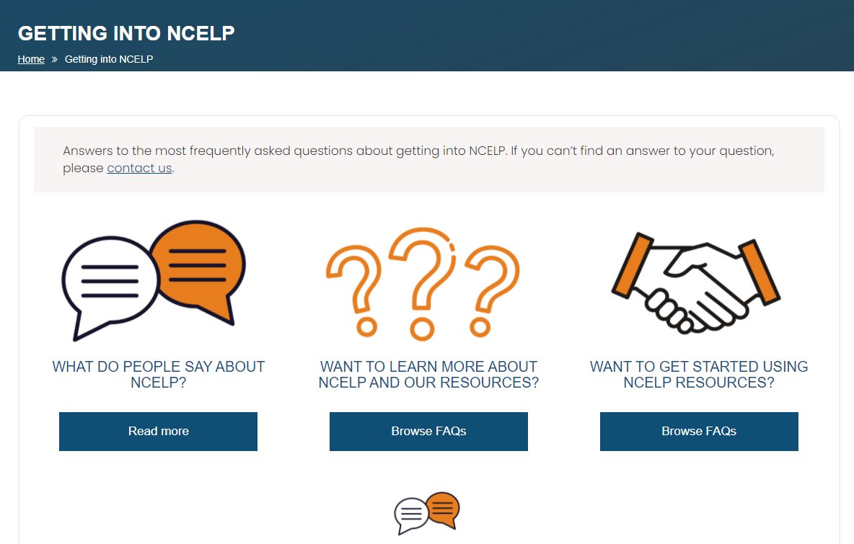
Wider support to schools
660 teachers outside the network on our regular mailing list
Some schools using and/or adapting the NCELP SOW and resources
5601 attendees at external NCELP presentations
New Getting into NCELP area of the website
Notes:
NCELP is a pilot project, set up to work intensively with 45 schools nationally, in the first phase. We have used the website, the resource portal, our mailing list and around 40 external presentations to date, to reach out to schools more widely.
So far, this has meant that…

Slide 9
Wider support to schools [2]
NCELP alignment with wider policy (ECF, Ofsted) and pedagogy (Rosenshine)
Support for the GCSE Subject Content consultation
Notes:
Two further areas of support that are very recent additions to the website are a collection called NCELP alignment with wider policy, which brings together previous work on Ofsted framework with more recent work on the Early Career Framework and the Rosenshine principles. And at the same time we have put up a screencast and analysis documents as support to engage with the GCSE Subject Content consultation. There is a 60-minute screencast comparing the 2015 and the draft 2021 Subject Content that I would commend to you. I would strongly encourage people to get involved.

Slide 10
Overview
Implementing the recommendations of the MFL Pedagogy Review
The importance of meaningful practice
Wider dissemination and expanding support to schools
CPD and the NCELP resource portal

Slide 11
The NCELP resource portal
https://ncelp.org/
Notes:
Finally, as our biggest scope for wider engagement this year is via the portal, we have also recently created (in the past two weeks) further collections of resources to enable more teachers to access material more quickly and easily. This work has been in response to feedback from teachers particularly those outside the current network of schools. So these are the phonics collection, the exemplar activities and the cultural collections.

Slide 12
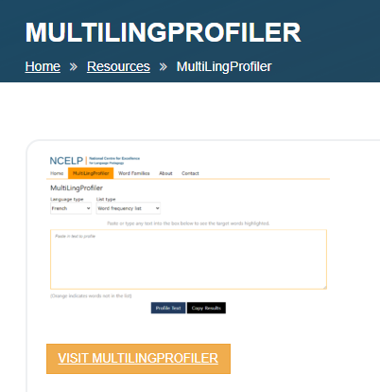
The NCELP resource portal
https://ncelp.org/
Notes:
Two final links from the NCELP homepage – one to the multilingprofiler, and one to Oasis, which has 645 (and counting) one page A4 summaries of research studies that have been published in refereed journals.

Slide 13
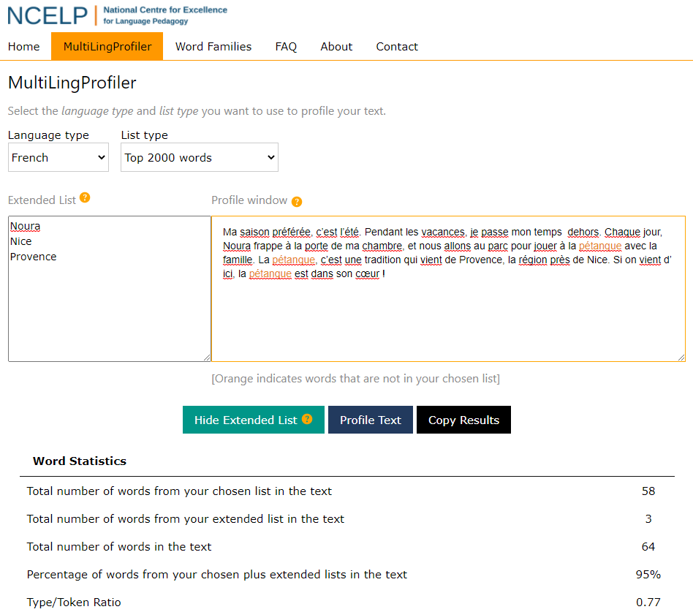
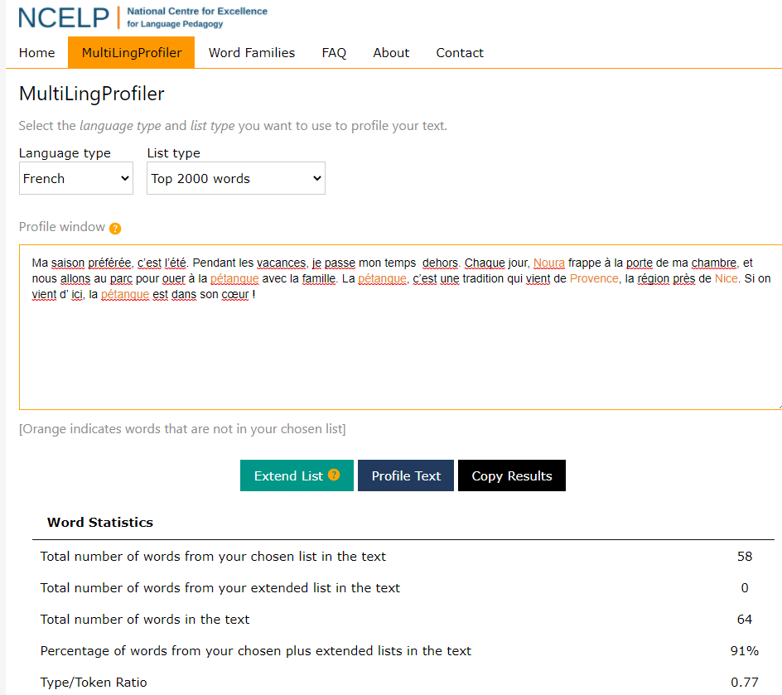
Ma saison préférée, c’est l’été. Pendant les vacances, je passe mon temps dehors. Chaque jour, Noura frappe à la porte de ma chambre, et nous allons au parc pour jouer à la pétanque avec la famille. La pétanque, c’est une tradition qui vient de Provence, la région près de Nice. Si on vient d’ ici, la pétanque est dans son cœur !
Anthony, L., Finlayson, N., Marsden, E., Avery, N. & Hawkes, R. (2020). MultiLingProfiler Version 1. [Computer Software]. Available at https://www.multilingprofiler.net/
Notes:
We don’t have time for more, but just a snapshot of the profiler. It’s open-access online tool. You copy/paste a test in, select language and list and it shows you how many and which words are in the most frequent list of 2000 words, for example. You can then edit / tweak your text, as desired, within the box and re-profile in seconds. I used to do this counting by hand…! Hard to explain to others what this was like, akin to remembering the days before mobile phones, I think, though!
Further notes and thoughts:
I thought it would be useful to show a full text here. There’s likely to be quite a lot of discussion in the next few weeks about word frequency! I think the one thing I’d like us to hold on to in this discussion is what high-frequency words means. It means the words that are ‘most often used’ – not a particular type of word, like a conjunction or the words for ‘the’, though these are most certainly high-frequency words. It has been suggested somewhere that HF words are function words and the non HF words are content words. Clearly this is nonsense. HF just means that these words are the most used, so they will include nouns, verbs, adjectives, prepositions, conjunctions –! the full range of parts of speech is represented in any list of the 2000 most frequently used words in a language.
And I will say one more thing here as it’s relevant to language and culture.
Specifying the nature (90% most frequently used words) and the amount (1200 F and 1700 H) has the following implications:
First, it removes the mystery and guesswork about which words will be in the assessment tasks and therefore which words to teach.
With the current GCSE a factor in students’ grades is their ability to guess meanings of words that they haven’t been taught. And which students are most likely to succeed in that? Number 1 – native speakers, number 2 – very literate students with a broad, sophisticated vocabulary in English, together with a wide general knowledge of the world, both of which as we know are facilitated by more affluent homes with books, newspapers, discussion at mealtimes etc… The privileging of these two cohorts of students has been an (almost certainly) unintentional consequence of the requirement to include unknown language in the current GCSE examinations. An intentional consequence of the proposed content is a levelling of the social playing field with regard to content. Knowing a specific bunch of words extremely well seems to me something that all teachers, students and awarding bodies will be able to get on board with.
It also joins up KS2, 3 and 4 because the list is comprehensive and makes no assumptions about prior knowledge. The implications for planning learning from KS2 onwards are significant, the prospects for achieving a more coherent sequence of learning from Y3 – Y11 are startling and exciting, I think.
And let’s not overlook the motivational factor or knowing that your learning efforts will be rewarded. I include teachers as well as students in this. Greater clarity and precision over content obviously makes planning easier – it’s easy to overlook the real implications of this for us as teachers, though! It means you will know when you have finished teaching the course! When has this ever been possible before? To this point, we have only been able to say that we have taught all the topics from the specification, but we have never ever been able to say to students that we have taught them the whole course, as we have never known which unknown language was going to surprise them and us in the exams. Imagine opening an exam paper in 2025 and seeing that every word in the transcript, every word in the reading texts had been taught and learnt by students, thanks to a combination of the Vocabulary List and the specified grammar. The level of unknown language in the current exams has seen me say to Higher tier students in revision sessions – Look, you might only understand around 40% of the vocabulary in this text. Honestly, that is what is expected. It doesn’t mean I’ve prepared you badly or you haven’t learnt well. It just means that they’re not testing for known material, here. It’s difficult to overstate the (monumental!) step change that this represents for our subject, but I hope I’m giving some sort of idea about that, here!
Next, it ensures that the most useful words (i.e., the words that are most in use in countries and contexts where the language is spoken) are to the fore. On the assessment side this prescribes nothing, yet rules nothing out in terms of either theme or genre. What are the implications of i) not specifying topics whilst ii) specifying the vocabulary? This is about a freeing as you can get, surely. It doesn’t say there will be literary texts, it doesn’t say there won’t be, because there could be, and there is nothing to fear about this, because the words in them will either be taught and known or glossed (up to 2%). It doesn’t mean there won’t be a text about a period in history or the geography of a region where the language is spoken because there may be, and this will be great too, because the words in the text will have been taught and will by known by students or will be glossed. I was not surprised when the recent NALA survey of teachers about the current GCSE said that “73.1% said that they did not think that GCSE topics were necessary for effective language learning” (Nala, 2020) Nala survey: The Languages Curriculum and disadvantaged students. On the teaching side, it also gives this freedom, but more than that, it gives us the certainty that we are teaching words that are those that are most often used by speakers of the language. Transparency about this is fairly powerful for motivation, too. ☺
Finally, it gives individual words back their value. In assessment, this means that awarding bodies are once again allowed (and indeed, required) to reward secure, individual word knowledge. All those who advocate for the importance of vocabulary should be leaping in the air for joy! For teachers, we can be glad, too, as this allows us to focus on teaching independent manipulation of words to build sentences, and it disprefers too-heavy a reliance on chunks.
As I think these examples show, words selected and taught on the basis of frequency lend themselves to themes that go beyond familiar KS3 curriculum topics, though they can also cohere around these topics, too. Any topics, really. Such taught words can combine and recombine in texts on many aspects of life in other countries. Carefully calibrating their readability, using the MultiLingProfiler (Anthony et al., 2020), also ensures that there is a systematic way of being fair to students, for exams to be set learners can access them.
I truly hope that teachers, text book writers, exam question setters, awarding bodies all embrace and use the profiler. As someone who has written a few textbooks, I cannot tell you how much I would have loved to have had this tool back then. And all the textbooks I will write from now on will use it. Why wouldn’t they? It is a complete no-brainer.
Going back to this example, I pasted this text into the MultilingProfiler, an online tool freely available to all to use to profile the words in a text against a list of the most frequent 2000 words in French, German or Spanish. When you do that you find that they are all in the top 2000, with the exception of the proper nouns, Noura, Nice and Provence and the three instances of the word pétanque. Including all the proper nouns, the % words in the top 2000 is already 91%. If you exclude the place and people names, this goes up to 95% and the only word missing is pétanque, which can be glossed. This 64-word text would not be out of place in a GCSE French reading exam, and plenty of question types could be set to assess its comprehension.

Slide 14
Overview
Implementing the recommendations of the MFL Pedagogy Review
The importance of meaningful practice
Wider dissemination and expanding support to schools
CPD and the NCELP resource portal
Notes:
Thank you for listening and I hope there was something new and interesting in there for all.

Slide 15
References
Anthony, L., Finlayson, N., Marsden, E., Avery, N. & Hawkes, R. (2020). MultiLingProfiler Version 1. [Computer Software]. Available at https://www.multilingprofiler.net/
Department for Education. (2013). National Curriculum. Languages programmes of study: KS3. Retrieved: https://assets.publishing.service.gov.uk/government/uploads/system/uploads/attachment_data/file/239083/SECONDARY_national_curriculum_-_Languages.pdf
Erler, L. & Macaro, E. (2012). Decoding Ability in French as a Foreign Language and Language Learning Motivation. The Modern Language Journal, 95(4), 496-518.
DeKeyser, R. (2007). Practice in a second language: Perspectives from applied linguistics and cognitive psychology. New York: Cambridge University Press.
Marsden, E. & Hawkes, R. (2020). Meaningful practice: Definitions, rationales and principles. National Centre for Excellence in Language Pedagogy.
Paulston, C. (1970). Structural pattern drills: A classification. Retrieved from: https://files.eric.ed.gov/fulltext/ED044701.pdf Roffwarg, H. P., Muzio, J. N., & Dement, W. C. (1966). Ontogenetic development of the human sleep dream cycle. Science, 152, 604–618.

