Slide 1
How it is and how it used to be
Revisit comparatives and plurals
Songtext: Früher – Wise Guys
[-e] vs [-er]
Y8 German
Term 2.2- Week 1 - Lesson 39
Author name(s): Rachel Hawkes
Artwork: Steve Clarke
Date updated: 10/10/2020
Notes:
Artwork by Steve Clarke. All additional pictures selected are available under a Creative Commons license, no attribution required.
Native teacher feedback provided by Stephanie Cross.
Learning outcomes (lesson 1):
Consolidation of SSC [-e] unstressed/final [-er]
Consolidation of comparatives Consolidation of plural rules
Word frequency (1 is the most frequent word in German):
8.2.2.1 (introduce) alles [36] alle [36] Rock [3551] Kleid [1780] alt [138] arm [1475] einfach [131] eng [59] genau [167] hell [1411] jung [199] kurz [176] reich [1568] 8.1.2.2 (revisit) fehlen [420] gefallen [601] gehören [460] meinen [213] tun [123] Leid [1300] Meinung [787] fit [4080] weh [2798] dass [22] schwer [257] 8.2.1.2 (revisit) holen [547] Arbeit [208] Bank [543] Seite [197] Sport [945] Uhr [348] wirklich [189] also [71] so [28] gestern [821] um1 [44] von [9]
Source: Jones, R.L & Tschirner, E. (2019). A frequency dictionary of German: Core vocabulary for learners. London: Routledge.
The frequency rankings for words that occur in this PowerPoint which have been previously introduced in NCELP resources are given in the NCELP SOW and in the resources that first introduced and formally re-visited those words.
For any other words that occur incidentally in this PowerPoint, frequency rankings will be provided in the notes field wherever possible.

Slide 2
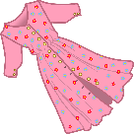
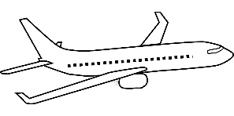
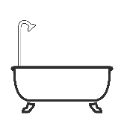
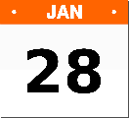
Pluralformen – [-e] oder [-er]?
About 75% neuter nouns add [-e] for their plural and 25% add [-er].
hören / schreiben
As you know, German final [-e]is not silent, but very short, e.g. danke, Klasse.
German final [-er] is a bit longer. Drop your jaw to say it, e.g. Hunger, Bruder.
Hör gut zu. Ist die Pluralform mit [-e] oder [-er]? Schreib 1-10 und die Pluralform.
Adding [-e] is Plural Rule 1, [-er] is Rule 4.
 | die Schiffe |  | die Kleider
 | die Flugzeuge |  | die Telefone
 | die Gesichter |  | die Bäder
 | die Haare |  | die Schlösser
 | die Einzelkinder |  | die Male
1
6
2
7
3
8
4
9
5
10
Notes:
Timing: 5 minutes Aim: This is a phonics activity to practise differentiating aurally between final [-e] and [-er] and connecting these SSC with the plural forms of previously learnt singular nouns. It connects SSC knowledge with building grammar knowledge of plural forms. Note – the plurals of these nouns have not previously been encountered (with the exception of Haare). Procedure: 1. Listen and transcribe the full word, paying particular attention to the final phoneme.
2. Click to reveal answers.
Transcript: die Schiffe die Flugzeuge die Gesichter die Haare die Einzelkinder die Kleider die Telefone die Bäder die Schlösser die Male Word frequency (1 is the most frequent word in German): Bad [1637] Einzelkind [308/133] Flugzeug [1776] Gesicht [346] Haare [748] Kleid [1780] Mal [82] Schiff [1176] Schloss [1907] Telefon [1595] Source: Jones, R.L. & Tschirner, E. (2019). A frequency dictionary of German: core vocabulary for learners. Routledge

Slide 3
Auf Deutsch!
Alle diese Wörter sind feminin. Wie ist die Pluralform?
*False friend! Hose means trousers.
lesen / sprechen
………?
Sag die deutschen Wörter.
20
Rose
Pause
Minute
Dame
Sekunden
Maschine
Szene
Phase
Debatte
Hose*
Nase
Sekunde
0
LOS!
Notes:
Timing: 2 minutes Aim: To practise oral production of cognates and near-cognates ending in final [-e] where the –e is pronounced in German but not in English. Note: Students learnt ‘Hose’ in Y7 so it is worth eliciting its meaning again, here. Procedure: 1. Student A tries to say all 12 words in the 20 second time limit.
2. Student B listens. If student A reverts to anglicised pronunciation of the final [-e], s/he sends Student A back to the beginning to start again.
3. They swap roles.
4. Click on each word to check pronunciation. 5. Click to bring up the gender information and elicit the knowledge that all these feminine nouns form their plural by adding –n (as do more than 90% all feminine nouns).
Note: With the exception of Rose, all words fall within the most frequent 2000 words (see below). Students may need prompting to arrive at the meanings of: Dame (lady), Szene (scene, e.g. wie in einem Film). They learnt Nase in 8.1.1.6.
Transcript: Dame Pause Minute Rose Szene Chance Phase Maschine Sekunde Debatte Nase Hose Word frequency (1 is the most frequent word in German): Dame [702] Pause [1441] Minute [324] Rose [3266] Szene [1347] Chance [551] Phase [732] Maschine [1237] Sekunde [837] Debatte [1478] Nase [1264] Hose [2156] Source: Jones, R.L. & Tschirner, E. (2019). A frequency dictionary of German: core vocabulary for learners. Routledge

Slide 4
Vokabeln
lesen
Wie heißt das Antonym? Sag es!
teuer
schnell
positiv
schlecht
klein
eng
einfach
gefährlich
hässlich
interessant
langsam
groß
breit
negativ
alt
dunkel
schwer
arm
gut
billig
lang
schön
sicher
hell
jung
reich
kurz
langweilig
Notes:
Timing: 5 minutes
Aim: To practise recognition and cued productive oral recall (by opposites) of 28 adjectives: 8 new adjectives from this week’s vocabulary set, as well as previously taught adjectives, to strengthen semantic connections.
Procedure:
1. Students supply the German adjective with the opposite meaning of the German adjective that appears. The aim is to be able to give the German before the teacher counts drei – zwei – eins.
Notes:
The activity can be repeated, clicking faster through the animations to increase speed of recall.
Teachers may wish to give students 30 seconds to look at the German adjectives on the slide before showing the first German prompt.
Word frequency (1 is the most frequent word in German):
8.2.2.1 (introduce) alt [138] arm [1475] einfach [131] eng [59] hell [1411] jung [199] kurz [176] reich [1568] 8.1.2.2 (revisit) schwer [257] Previously taught: billig [1738] breit [847] dunkel [706] gefährlich [1211] groß [67] gut [76] hässlich [3542] interessant [810] klein [111] lang [97] langsam [526] langweilig [3019] schlecht [327] schnell [204] schön [187] sicher [265] teuer [950] Cognates: negativ [817] positiv [516]
Source: Jones, R.L & Tschirner, E. (2019). A frequency dictionary of German: Core vocabulary for learners. London: Routledge

Slide 5
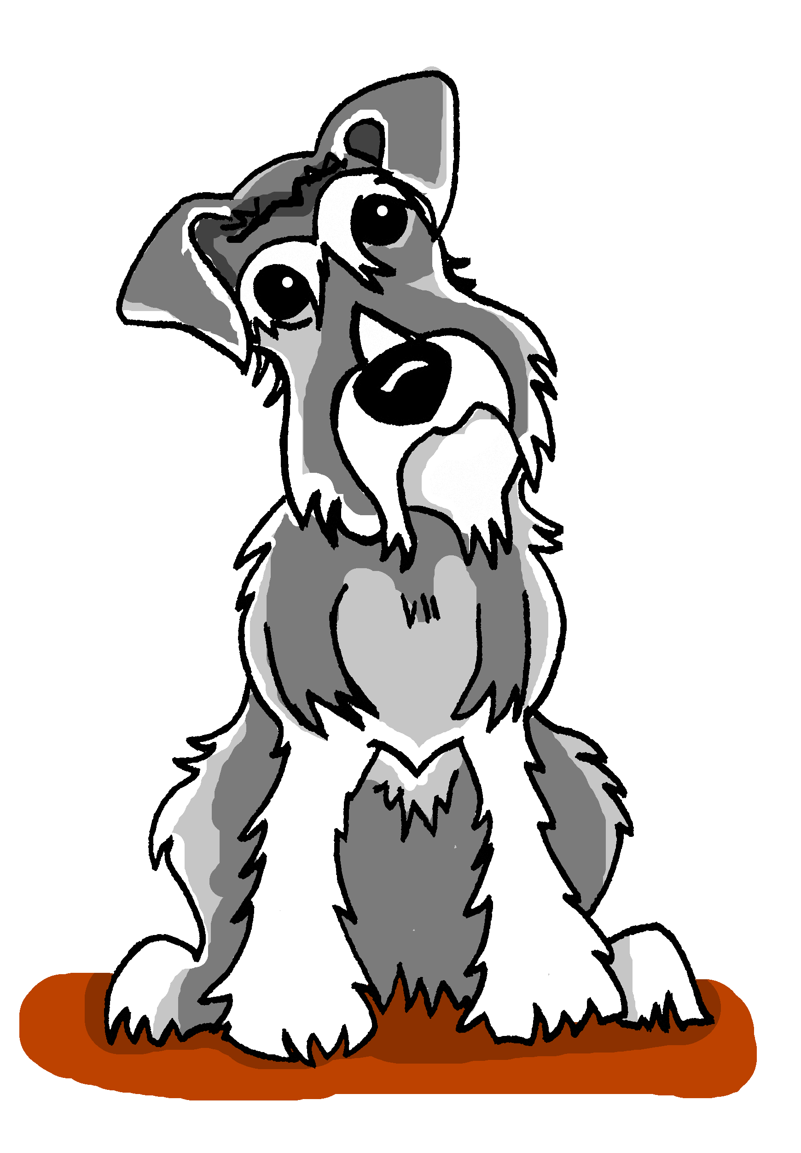
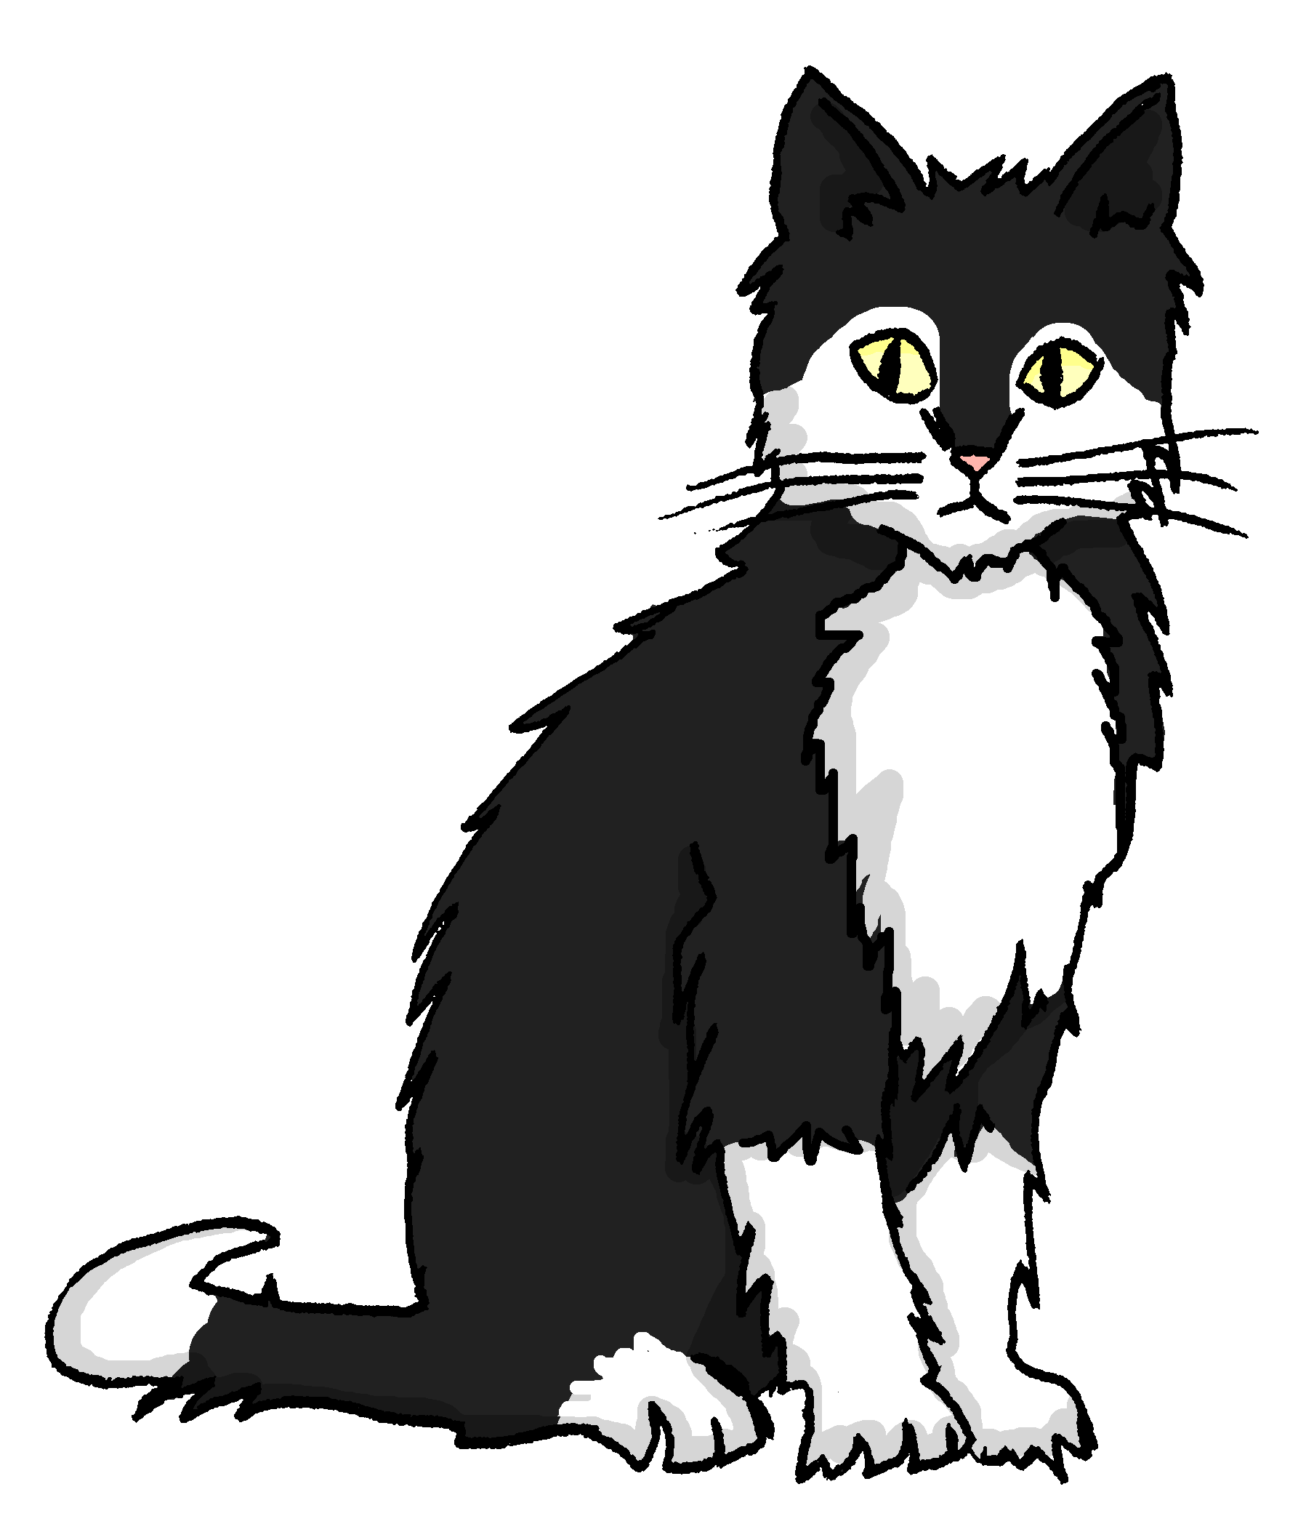
der Komparativ [1/2]
Grammatik
As you know, we compare difference like this in German:
Einstein ist größer als Mieze.
Einstein is bigger than Mieze.
You can mean the same with the opposite adjective:
Mieze ist kleiner als Einstein.
Mieze is smaller than Einstein.
Notes:
Timing: 1 minute Aim: To quickly recap the structure for comparing difference, highlighting the use of opposite adjectives to express the same meaning.
Procedure: 1. Click on the mouse to animate the explanation.
2. Ensure student understanding at each stage.

Slide 6
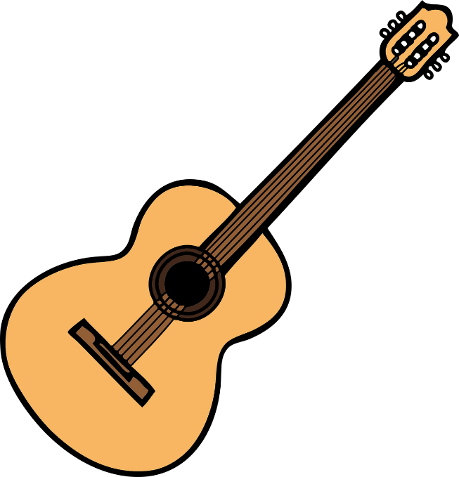
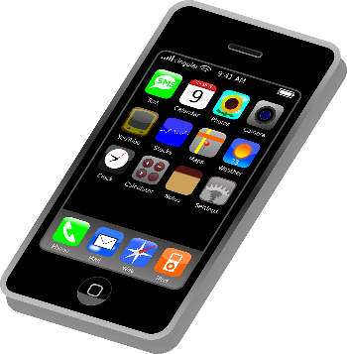
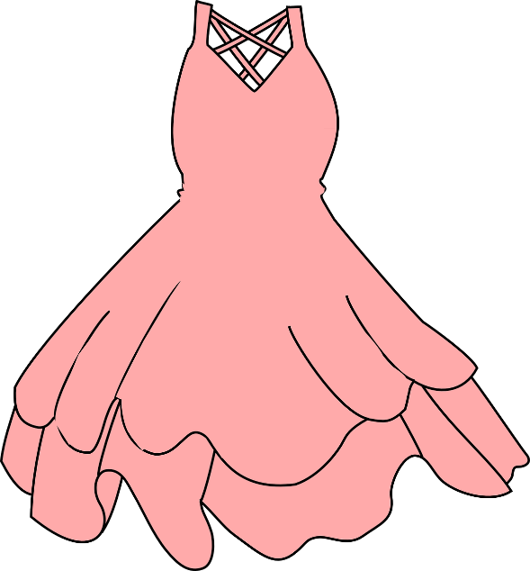
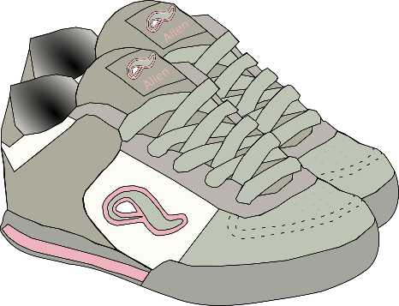
Ein Spiel
die Reihenfolge - order
hören
Was ist billiger? Was ist teurer?
Hör gut zu. Schreib A-F in der richtigen Reihenfolge*.
F
B
D
A
C
E
< billiger ------------------------------------------------------- teurer>
1
2
3
Notes:
Timing: 3 minutes
Aim: Aural comprehension of comparative sentences.
Procedure:
1. Ensure students understand that the task is to put the images in order according to the scale shown (cheapest to most expensive). Explain that they will not be able to rely on assumptions about price to complete the task!
2. Students listen to the description and decide upon the order.
3. The answer is revealed upon the next slide.
Transcript: 1. Die Sportschuhe sind billiger als die Gitarre, aber teurer als das Kleid. 2. Das Telefon ist teurer als die Sportschuhe, aber billiger als die Gitarre. 3. Der Rock ist billiger als das Kleid, aber teurer als der Ring. Word frequency (1 is the most frequent word in German): Gitarre [>5009] Objekt [1427] Ring [2258] Source: Jones, R.L. & Tschirner, E. (2019). A frequency dictionary of German: core vocabulary for learners. Routledge

Slide 7
Antworten
hören
A
C
F
B
E
D
< billiger ------------------------------------------------------- teurer>
Notes:
This is the answer slide.

Slide 8
der Komparativ [2/2]
Grammatik
Remember! Where two things are the same, we compare like this:
You already know other meanings for so (so, in that way) and wie (how).
Einstein ist so groß wie Mieze.
Einstein is as big as Mieze.
genau (exactly) is often added to so, especially in speech.
Einstein läuft (genau)so schnell wie Mieze.
Einstein runs (just) as fast as Mieze.
Notes:
Timing: 1 minute Aim: To recap the structure for comparing when things are the same.
Procedure: 1. Click on the mouse to animate the explanation.
2. Ensure student understanding at each stage.

Slide 9
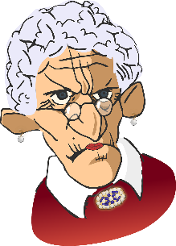
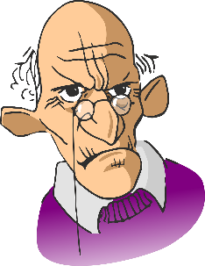
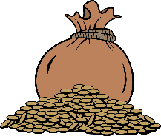
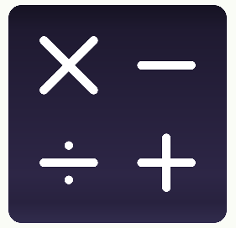
Komparativsätze [1/2]
Ist das so + Adjektiv + wie ? (the same)
Ist das [-] + Komparativ [-er] + als ? (different)
lesen
A
1
2
Sie ist [-] reicher als er.
05:00
04:00
1
2
B
Um 5 Uhr ist es so hell wie um 4 Uhr.
1
2
C
Mathe ist so einfach wie Deutsch.
Notes:
Timing: 5 minutes
Aim: A referential activity in written modality. Students notice the position and form of the elements of both comparative adjective constructions in German, whilst practising further some of this week’s new vocabulary set. Their decision as to which structure (same or different comparative) to choose depends on the form of the adjective (whether it is in the comparative form [+er] or not).
Procedure:
1. Students write down 1-6, with the numbered items for each. A1 = , A2 =.
2. Using the picture prompts, they then decide, for each statement, which word / letters will be under each numbered ‘splodge’. The boxes in the rubric show the possible options for the 1st/2nd gaps each time – either so / [-] for the 1st and wie / als for the 2nd. Draw attention to the fact that the elements of the comparative structure surround the adjective.
3. Answers: ‘splodges’ disappear one by one on clicks. Teachers can elicit the answers from students in German, asking ‘A1, was ist das?’
4. The task continues on the next slide.

Slide 10
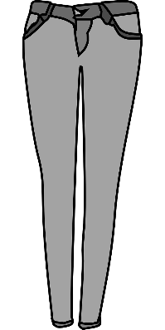
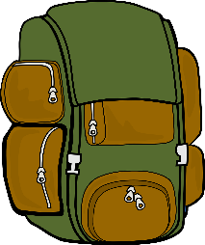
Komparativsätze [2/2]
*jener - that
lesen
1
2
D
Sie ist [-] schneller als er.
2
1
E
Die graue Hose ist [-] enger als die blaue Hose.
1
2
F
Dieser Rucksack ist so schwer wie *jener Rucksack.
Notes:
This is a continuation of the activity on the previous slide.

Slide 11
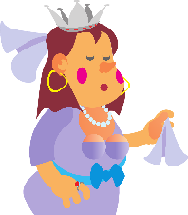
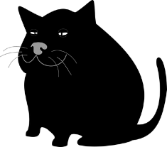
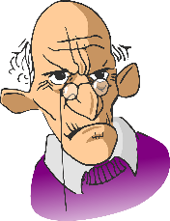
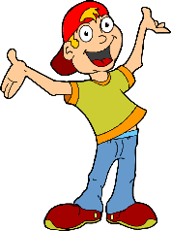
Wie sind sie?
Antworten
schreiben
Schreib Komparativsätze.
1
4
Lena – poor – Miranda
Felix – young – Milo
Lena ist ärmer als Miranda.
Felix ist so jung wie Milo.
2
5
Johann – old – Max
die Venus – bright – der Saturn
Johann ist älter als Max.
Die Venus ist heller als der Saturn.
3
6
September – short – October
Kaiserstraße – narrow – Schulstraße
September ist kürzer als Oktober.
Kaiserstraße ist so eng wie Schulstraße.
Notes:
Timing: 7 minutes
Aim: Written production of comparative sentences from English prompts.
Suggested procedure
1. Students use the words given in the box, together with a consideration of the pictures, to write an appropriate comparative sentence in German in each case.
[N.B. the pictures are meant to go with the names with which they are aligned.] The sentences should start with the name of the person on the left in each case.
2. Elicit answers orally from students (and draw attention to the umlauts). This is an opportunity for students to apply what they learnt about comparatives last week to the new week’s vocabulary set, (i.e. that single syllable adjectives with ‘a’, ‘o’ or ‘u’ usually add an umlaut in the comparative).
3. Suggested answers appear one by one upon successive clicks of the mouse. Note that numbers 3 and 5 involves world knowledge (at least one student in the class will know number 5, and will enjoy sharing with the others!)

Slide 12
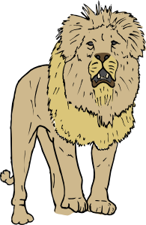
Welches Tier ist das?
sprechen
Beispiel:
A: Ist es größer als der Hund?
B: Ja, es ist größer.
A: Ist es schneller als die Kuh?
B: Ja, es ist schneller.
A: Ist es gefährlicher als die Giraffe?
B: Ja, es ist gefährlicher.
der Löwe
A: Ist es der Gepard?
B: Nein, es ist der Löwe!
Notes:
Timing: 5 minutes
Aim: Oral production of questions using comparative adjectives (re-using some of the adjectives that were revisited at the start of the lesson). The slide following this one should be displayed during the activity.
Procedure:
1. Go through the pronunciation of each animal on the following slide before pairwork begins. Students try to say the names of the animals using their SSC knowledge. Teacher demonstrates, students repeat. Ensure student understanding of der Gepard (a cheetah, rather than a leopard).
2. Student B selects an animal, without revealing which one.
3. Student A asks questions such as those shown in the examples on this slide, and using the previously-met adjectives displayed at the bottom of the following slide: schnell – gefährlich – klein – intelligent – billig – groß – ruhig – langsam – langweilig – teuer. By asking questions about whether the animal is more/less quick, dangerous, intelligent, etc., than another, Student A can try to home in on the identity of the chosen animal.
4. Student B responds to each question.
5. Students must ask three questions, before making a guess, at which point their partner reveals the correct answer.
6. Students swap roles and play again.
Word frequency (1 is the most frequent word in German): Kuh [2935] Giraffe [>5009] Gepard [>5009] Löwe [4160] Source: Jones, R.L. & Tschirner, E. (2019). A frequency dictionary of German: core vocabulary for learners. Routledge

Slide 13
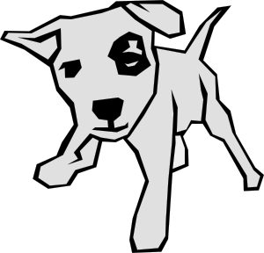
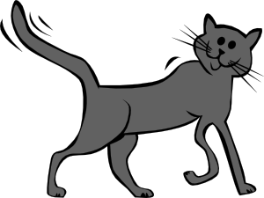
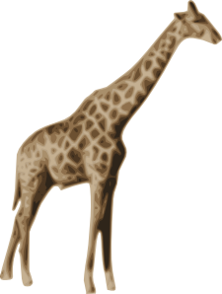
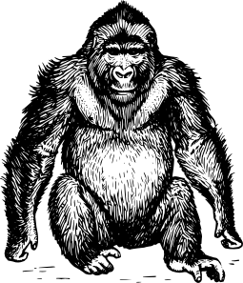
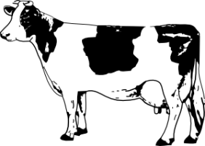
sprechen
der Löwe
der Wal
der Delfin
der Gepard
der Hund
die Katze
die Giraffe
der Elefant
der Gorilla
der Hamster
die Kuh
der Fisch
schnell – gefährlich – klein – intelligent – groß – ruhig – langsam – langweilig
Notes:
Display this slide during the activity. Word frequency of unknown words (1 is the most frequent word in German): Delfin [5009] Elefant [>5009] Fisch [1959] Gepard [>5009] Giraffe [>5009] Gorilla [>5009] Hamster [>5009]] Kuh [2935] Löwe [4160] Wal [>5009]] Source: Jones, R.L. & Tschirner, E. (2019). A frequency dictionary of German: core vocabulary for learners. Routledge

Slide 14
English → German → English
It’s a noun now, so needs a capital letter!
Making adjectives into plural nouns in German.
The rich have too much.
Die Reichen haben zu viel.
What would the following words be in German?
the first (ones)
the last (ones)
the new (ones) the poor (ones) Choose one and write a sentence in German.
Translate these sentences.
1. Die Kleinen und die Großen spielen zusammen.
2. The young need the old.
Notes:
Timing: 7 minutes Aim: To become familiar with a new word pattern in German; creating plural nouns from adjectives. This is a common word pattern that will be explored further in Lesson 2, through the authentic song text, Früher. Procedure: 1. Use the animations and present the information.
2. Students complete the tasks.
3. Use the following slide to check answers.
4. Don’t forget to ask students to pronounce the new words.
Word frequency: alt [138] arm [1475] erst- [95] groß [67] jung [199] klein [110] letzt- [152] neu [84] reich [1658]
Source: Jones, R.L. & Tschirner, E. (2019). A frequency dictionary of German: core vocabulary for learners. Routledge
Note: This is not a full explanation that includes the singular persons. Students are learning the prenominal adjective system incrementally over the course of Y8. They have already been taught prenominal adjective endings in R1 (nominative) and R2 (accusative) for singular and plural, definite and indefinite articles. Using adjectives as nouns (singular) will be explored in Y9. For example, der Kleine (for the small one – masculine) etc..

Slide 15
ANTWORTEN
This word has another meaning. What is it?
Die Kleinen und die Großen spielen zusammen.
The young need the old.
the first (ones)
the last (ones)
the new (ones)
the poor (ones)
The little ones and the big ones play together.
Die Jungen brauchen die Alten.
die Ersten
die Letzten
die Neuen
die Armen
Pronounce the words.
Notes:
This is the answer slide.

Slide 16
Früher
lesen
Dieser Text ist:
Früher Wise Guys Refrain: Früher, Früher war alles besser Früher, Früher war alles besser Früher…
A
ein Gedicht
B
ein Lied
C
ein Artikel
Notes:
Timing: 2 minutes (two slides) Aim: To introduce students to the first part of the song text, and prompt them to consider what type of text it is and the cues that tell them this. Procedure: 1. Click for text and multiple choice options.
2. Elicit response
3. Click to confirm.
4. Continue to next slide.

Slide 17
Früher
lesen
Gründe:
Früher Wise Guys Refrain: Früher, Früher war alles besser Früher, Früher war alles besser Früher…
A
die Wiederholung
das Wort ‘Refrain’
B
Refrain
C
die langen Sätze
D
das Layout
Notes:
Procedure: 1. Click for text and multiple choice options.
2. Ensure the meaning of Gründe is understood. Students have learnt Grund (reason) and encountered its plural, and learnt plural rule 1, but it may still be unfamiliar. Ensure the meaning of the four options is understood. Wiederholen was learnt in Y7 as a verb, and the pattern ‘ung’ as noun suffix has also been met. Wort is known, Refrain is a cognate. Click on the audio to hear the pronunciation (which is unusual as this is a borrowed word – sounds more like French, when pronounced). Satz and lang are both familiar, and Layout is a cognate.
3. Click to confirm the responses.
4. Continue to next slide.

Slide 18
Früher
lesen
Früher Wise Guys Refrain: Früher, Früher war alles besser Früher, Früher war alles besser Früher…
The theme of the song is:
A
the past
B
the future
C
arriving early
D
the past and the present
Notes:
Timing: 2 minutes Aim: Comprehension of the written song chorus, which contains previously taught vocabulary, and further consideration about the main theme of the song. Procedure: 1. Elicit an oral translation of the song title and chorus from students. Note: they have learnt ‘in former times’ for früher, which you might suggest sounds a bit formal for a song. In addition, repeating the three words five times to replicate the chorus wouldn’t work well. They have learnt ‘back then’ for ‘damals’ which is a synonym. Früher can also mean ‘earlier’ or ‘previously’, neither of which fit that well. Another possibility is ‘before’, which might work as a single word option, or even just ‘then’. The main idea here is for students to realise that when translating song texts, there is always more to consider than just the meaning. There is the rhythm, length of word/phrase, etc.. which are considerations not unlike those for translating a poem.
2. Click to bring up the question about theme. Tell students that more than one answer can be correct.
3. Reveal the answers and ask students to suggest why they think they might be correct.

Slide 19
Früher
sprechen
Then Wise Guys Chorus: Then Back then everything was better Then, Back then everything was better Back then…
Früher Wise Guys Refrain: Früher, Früher war alles besser Früher, Früher war alles besser Früher…
Notes:
Timing: 3 minutes Aim: Oral production of the song chorus from written English prompt. Procedure: 1. Students translate orally (chorally or in pairs or individually). 2. They repeat the chorus 2-3 times, orally. 3. Teachers may then want to play just the chorus for students to listen to. 4. Tell them they will continue their work with the song in the next lesson.

Slide 20
How it is and how it used to be
Songtext: Früher – Wise Guys
Plural rule 5: add -s
[-e] vs [-er]
Y8 German
Term 2.2- Week 1 - Lesson 40
Author name(s): Rachel Hawkes
Artwork: Steve Clarke
Date updated: 10/10/2020
Notes:
Artwork by Steve Clarke. All additional pictures selected are available under a Creative Commons license, no attribution required.
Native teacher feedback provided by Stephanie Cross.
Learning outcomes (lesson 2):
Consolidation of SSC [-e] unstressed/final [-er]
Exploitation of an authentic song text: Früher – Wise Guys Consolidation of comparatives
Word frequency (1 is the most frequent word in German):
8.2.2.1 (introduce) alles [36] alle [36] Rock [3551] Kleid [1780] alt [138] arm [1475] einfach [131] eng [59] genau [167] hell [1411] jung [199] kurz [176] reich [1568] 8.1.2.2 (revisit) fehlen [420] gefallen [601] gehören [460] meinen [213] tun [123] Leid [1300] Meinung [787] fit [4080] weh [2798] dass [22] schwer [257] 8.2.1.2 (revisit) holen [547] Arbeit [208] Bank [543] Seite [197] Sport [945] Uhr [348] wirklich [189] also [71] so [28] gestern [821] um1 [44] von [9]
Source: Jones, R.L & Tschirner, E. (2019). A frequency dictionary of German: Core vocabulary for learners. London: Routledge.
The frequency rankings for words that occur in this PowerPoint which have been previously introduced in NCELP resources are given in the NCELP SOW and in the resources that first introduced and formally re-visited those words.
For any other words that occur incidentally in this PowerPoint, frequency rankings will be provided in the notes field wherever possible.

Slide 21
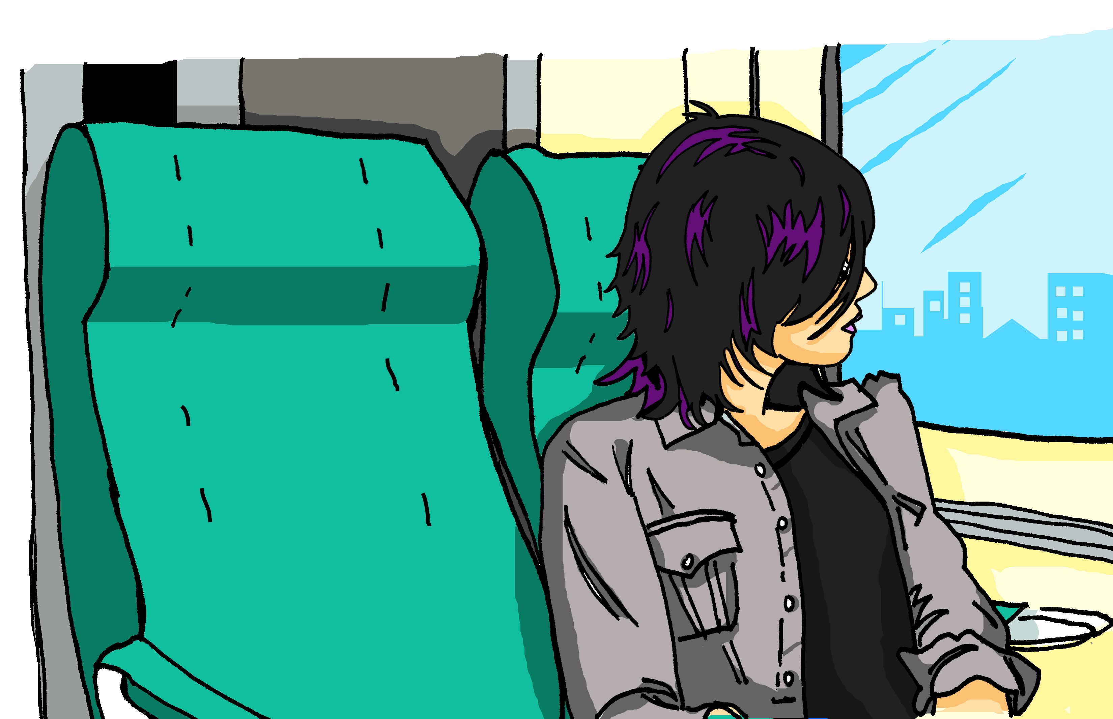
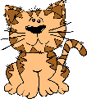
Was war es?
Hör zu. Ist die SSC [-e] oder [-er]? Schreib 1-5 und A-E.
hören / sprechen
Katja sitzt im Zug und telefoniert mit Alastair. Es ist sehr laut im Zug!
ein netter Mann
eine nette Frau
Was?! Was war das??!!!
ein einfacher Monat
eine einfache Woche
eine schwere Tasche
ein schwerer Rucksack
ein
kurzer Tag
ein jungerHund
eine kurze Liste
eine junge Katze
eine helle Sonne
ein heller Stern
ein enger Platz
eine enge Straße
1
2
3
4
5
A
B
C
D
E
F
G
H
Notes:
Timing: 6 minutes Aim: To practise aural differentiation (then oral production) of the SSC [-e] and [-er], this time as adjective endings. Procedure: 1. Click audio buttons 1-5 to hear the three-word audio sequences of adjectives.
2. Students choose between two options each time, based on the difference in adjective ending.
3. Click to reveal answers. This could be done item by item. Note: The difference is sound is very small with these two SSC. Reassure students of this. Play the audio several times, as requested, and perhaps correct item-by-item. It will get clearer for them the more examples they do.
4. Students then use the same slide to practise producing the two SSC, directing their partner to a particular letter by saying an appropriate three-adjective sequence.
Transcript: 1. nette – einfache – enger 2. netter – schwerer – junge 3. netter – schwere – kurzer 4. nette – einfacher – helle 4. netter – schwerer - junger
Answers: 1. G 2. D 3. B 4. E 5. C

Slide 22
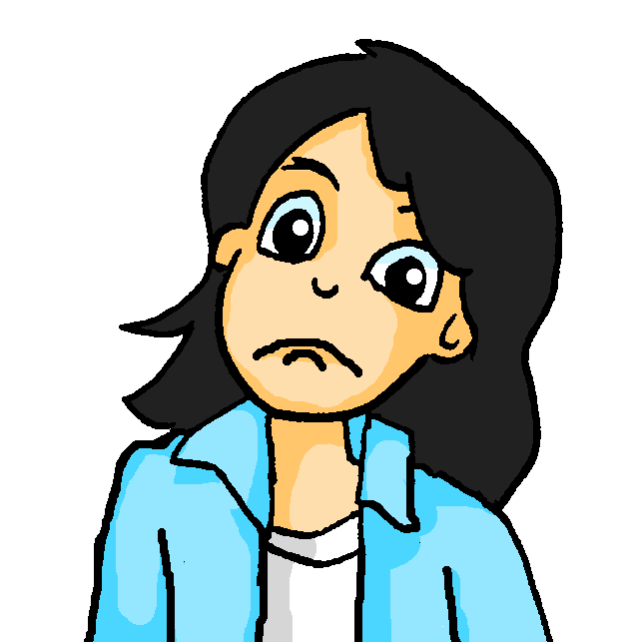
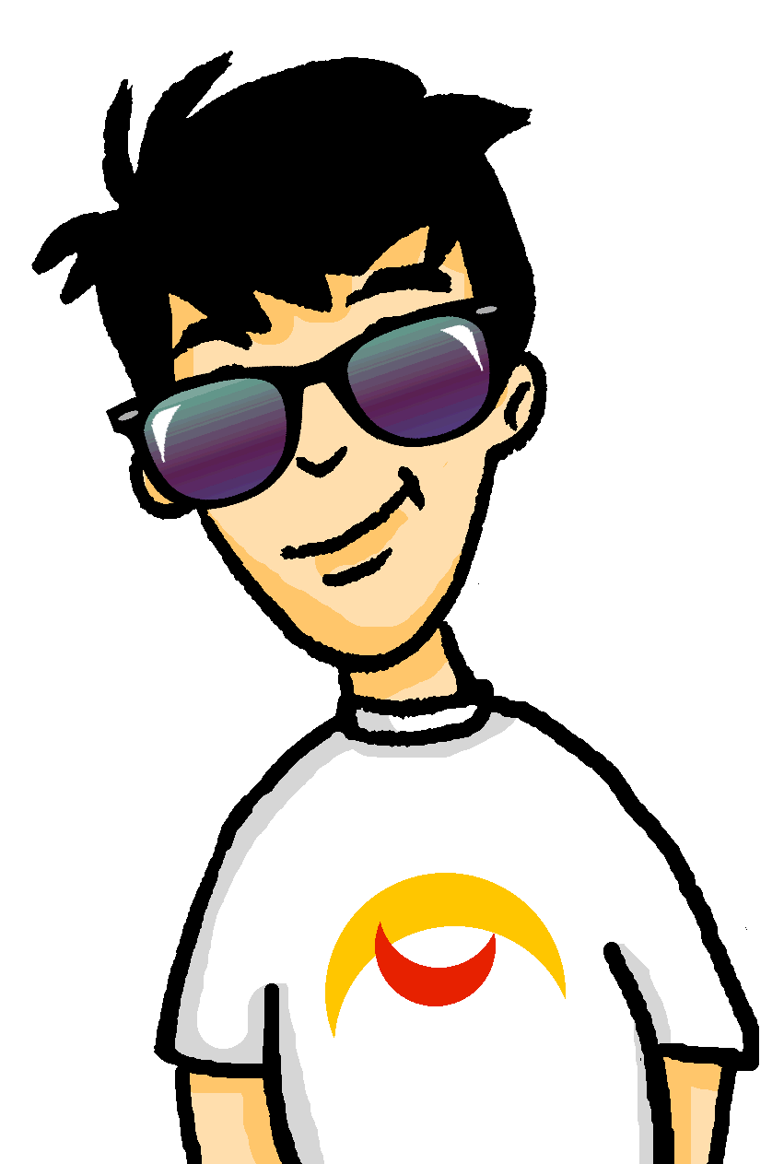
Mia und Wolfgang
Welcher Satz ist richtig?
hören / sprechen
 | Wolfgang! I’m missing my red dress. Have you seen it? | Wolfgang! I’m missing my red skirt. Have you seen it? | Wolfgang! I’m missing my blue skirt. Have you seen it?
 | Ow! I’m sorry. Your bed is too heavy. | Ow! That hurts! Your table is too heavy. | Ow! That hurts! Your bed is so heavy.
 | So, Wolfgang! I’m also missing those green jeans. | So, Wolfgang! I like these green jeans. | So, Wolfgang! These green jeans are mine.
 | I think that Mum’s work in the bank is not fun. What do you think? | I think that Mum’s work in the bank is fun. What do you think? | I think that mum has no fun when she goes to the bank. What do you think?
 | You go running every day, don’t you? That makes you fit, no? | You went running yesterday, didn’t you? That makes you tired, no? | You went running yesterday, didn’t you? That makes you fit, no?
 | Mum’s fetching her jacket from downstairs. She wants to do a bit of sport at 5 o’clock. | Mum’s fetching her jacket from upstairs. She wants to do a bit of sport at 4 o’clock. | Mum’s fetching her jacket from downstairs. She wants to do a bit of sport at 4 o’clock.
1
2
3
4
5
6
Notes:
Timing: 7 minutes Aim: To practise comprehension and production of almost all of this week’s revisited vocabulary sets in sentences. Procedure: 1. Encourage students to recall the vocabulary to predict what they will hear. In number one words that differentiate one sentence from another have been put in bold to facilitate task modelling.
2. Click the action buttons to play each sentence. Students pick which column (A, B or C) is correct. Note: Do play the items multiple times, according to student need.
3. Clicking reveals the answers. 4. Elicit the German for the other two answers each time, to practise productive recall of the vocabulary.
Transcript: 1. Wolfgang! Mir fehlt mein roter Rock. Hast du ihn gesehen?
2. Aua! Das tut mir weh! Dein Bett ist so schwer! 3. Also, Wolfgang! Diese grüne Jeans gehört mir.
4. Ich glaube, dass Muttis Arbeit in der Bank keinen Spaß macht. Was meinst du? 5. Gestern bist du laufen gegangen, nicht wahr? Das macht fit, oder?
6. Mutti holt jetzt von oben ihre Jacke. Sie will um vier Uhr ein bisschen Sport machen. Word frequency (1 is the most frequent word in German):
8.1.2.2 (revisit) fehlen [420] gefallen [601] gehören [460] meinen [213] tun [123] Leid [1300] Meinung [787] fit [4080] weh [2798] dass [22] schwer [257] 8.2.1.2 (revisit) holen [547] Arbeit [208] Bank [543] Seite [197] Sport [945] Uhr [348] wirklich [189] also [71] so [28] gestern [821] um1 [44] von [9]
Source: Jones, R.L. & Tschirner, E. (2006). A frequency dictionary of German: core vocabulary for learners. Routledge

Slide 23
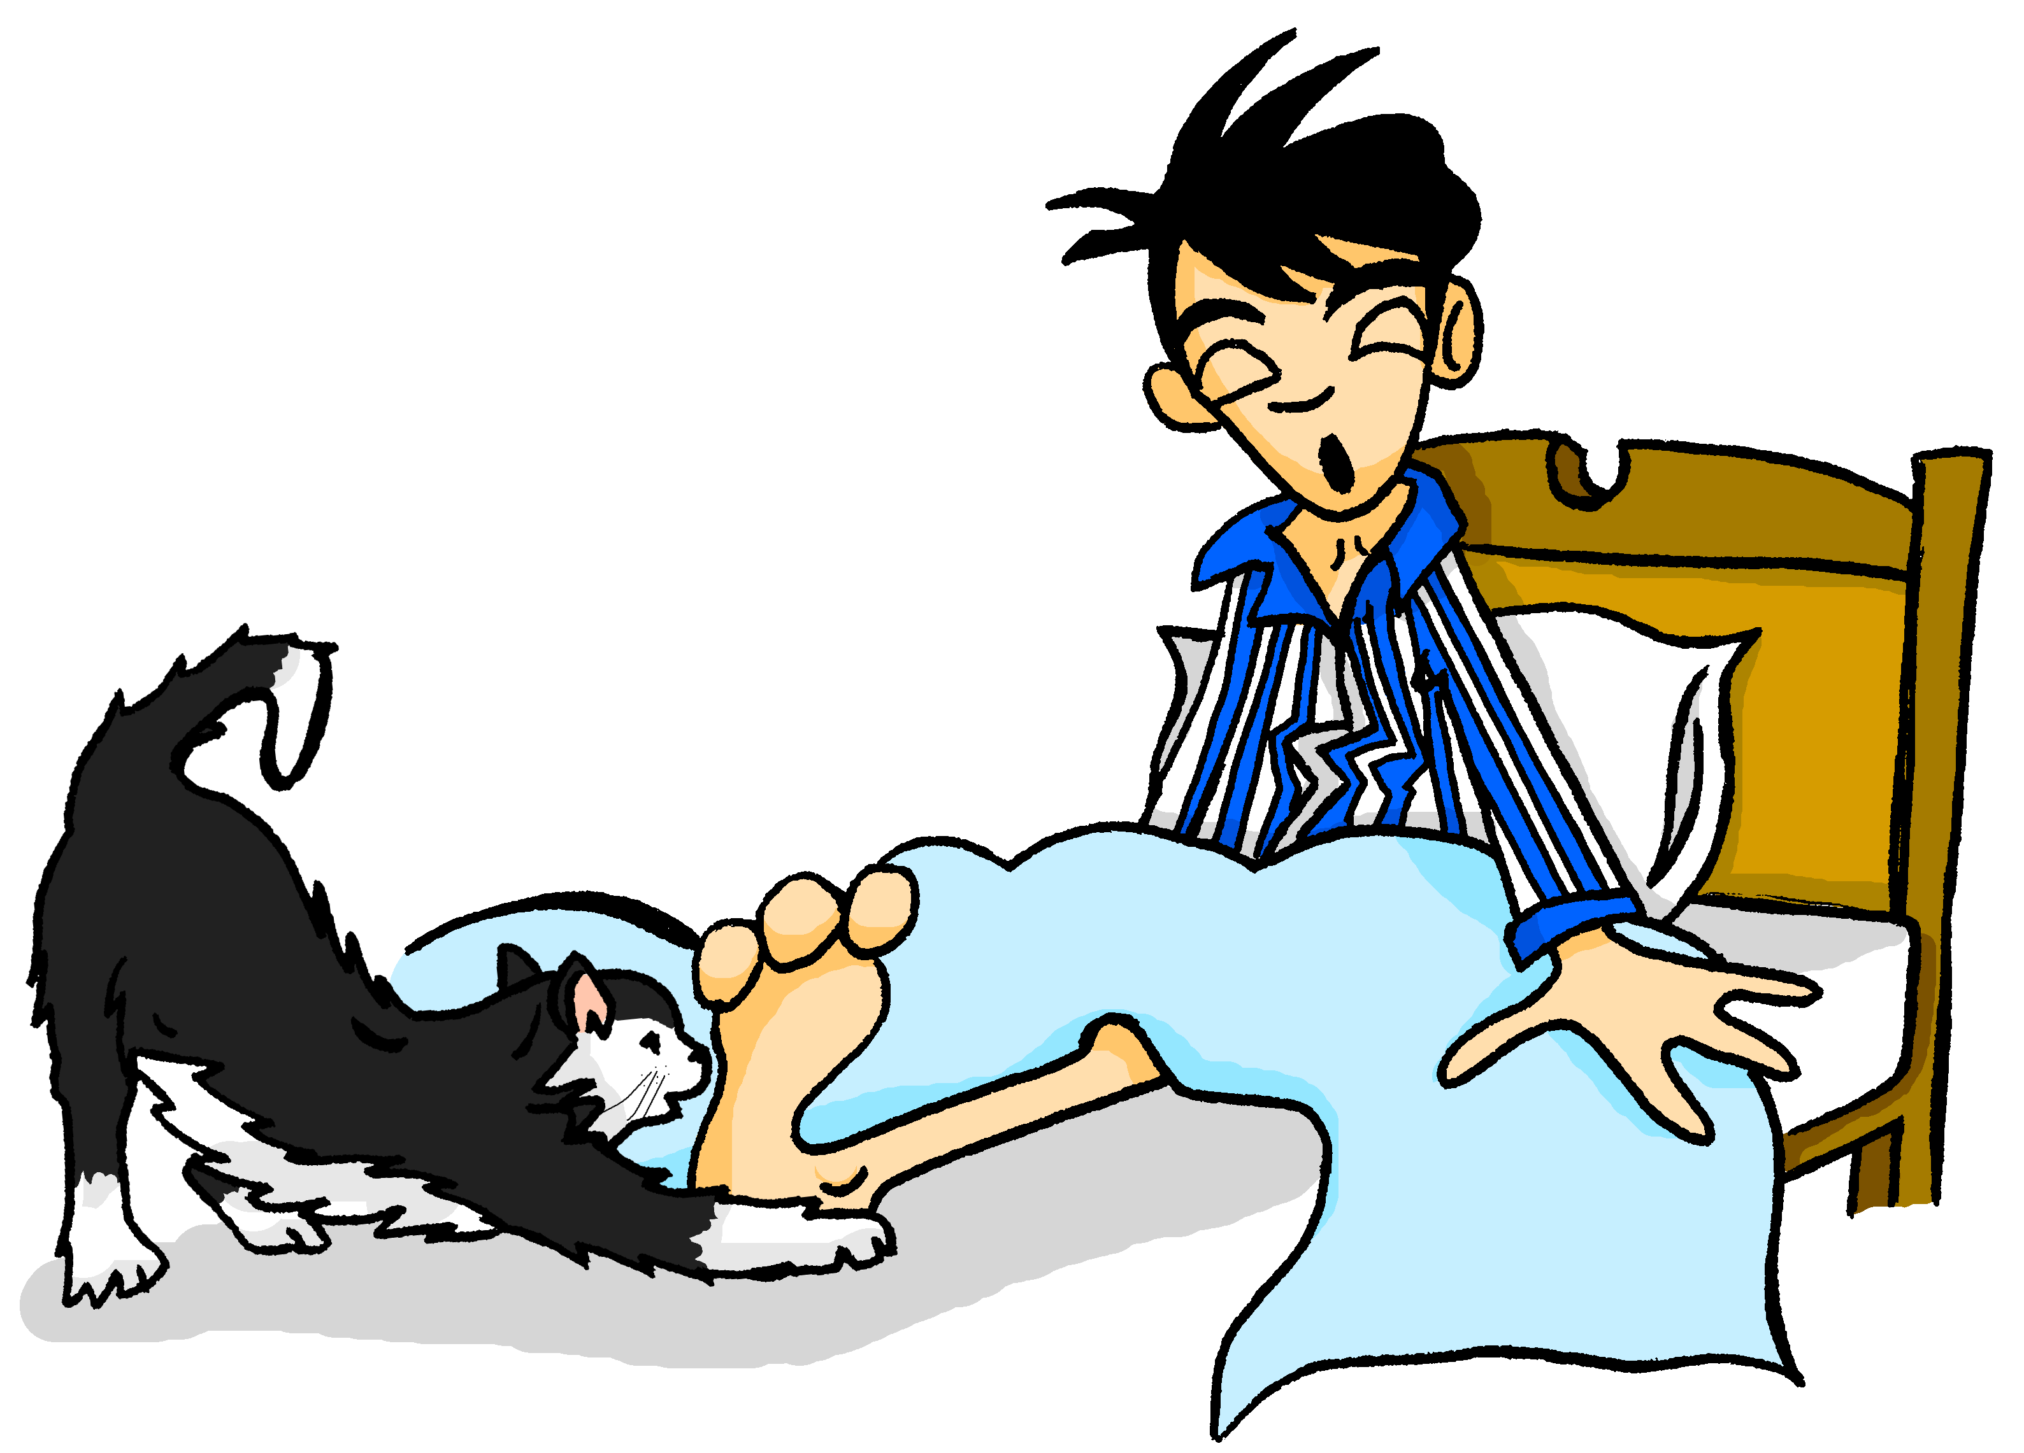
schreiben
Wolfgang ist so müde, dass er Mia ein paar SMS auf Englisch schreibt! Schreib die SMS auf Deutsch.
I’m sorry! I think your red skirt is downstairs. W
I like jogging. I think that it makes me so fit! W
Es tut mir Leid. Ich meine, dein roter Rock ist unten. W
Ich gehe gern joggen. Ich meine, dass es mich fit macht. W
Ja, ich mag die grüne Jeans nicht! W
Ich bin aber müde. Kannst du mir einen Kaffee holen? W
Yes – I don’t like the green jeans! W
I am tired. Can you fetch me a coffee?! W
Notes:
Timing: 6 minutes
Aim: This mini-Whatsapp exchange is a further opportunity for vocabulary recall, this time written production.
Procedure: 1. Translate the four messages into German without using reference resources. 2. Check the answers carefully, noting any mistakes.

Slide 24
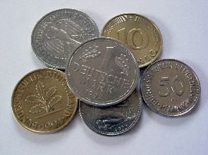
Früher
das Kissen – pillow/cushion doch – however, but zwar – admittedly, to be precise
hören / schreiben
Refrain: Früher, Früher war alles besser Früher, Früher war alles besser Früher…
1 ___
2 __
Früher war alles besser.
Die Armen waren reicher und die Reichen etwas ärmer.
Die *Kissen waren weicher, und die Sommer waren wärmer.
Die Tage waren heller und die Nächte länger,
die Röcke waren kürzer und die Tops enger.
Es gab nur drei Programme im TV,
die war‘n *zwar ganz genau so schlecht wie heute,
*doch es waren nicht so viele.
Die Kugel Eis für nur dreißig Pfennig in der Eisdiele. Früher ...
war – was waren – were
3 ___.
4 ____,
5 ____
6 ____,
There were 100 Pfennig in one Deutsche Mark, used in Germany until 2002.
7 _____
8 ________
9 ______
10 ___
Notes:
Timing: 5 minutes Aim: Transcription of 10 missing words from v1 of the song. Procedure: 1. Students write 1-10 and prepare to listen and transcribe the missing words. 2. Play the spoken version of the audio, recorded slowly but as one audio passage. The audio player is top right of the slide. 3. Students write all of the words. 4. They may request to hear the text more than once. 5. Elicit answers and click for written answers to appear one by one.
6. Play the audio for this part of the song. The audio is attached to the action button bottom right of the screen.
Word frequency of unknown words (1 is the most frequent word in German): Kissen [4898] zwar [206] doch [73] Pfennig [>5009] Source: Jones, R.L. & Tschirner, E. (2019). A frequency dictionary of German: core vocabulary for learners. Routledge

Slide 25
Pluralformen
Grammatik
Im Songtext gibt es viele Pluralformen. Schreib die Singularformen.
Plural | Singular | Rule?
die Sommer
die Tage
die Kissen
die Röcke
die Programme
die Tops
der Sommer
Rule 2: (-el,-en,-er)
der Tag
Rule 1:(+e,+/-umlaut)
das Kissen
Rule 2: (-el,-en,-er)
der Rock
Rule 1:(+e,+/-umlaut)
das Programm
Rule 1:(+e,+/-umlaut)
das Top
???
Notes:
Timing: 5 minutes Aim: to apply previous knowledge of plural rules to six of the words from the song text. The final plural form is not yet known and primes for the introduction of Plural Rule 5 on the next slide. Procedure: 1. Students aim to generate the singular forms from previous knowledge of the most common plural rules, even though they have not explicitly met the plural forms (with the exception of Tage).
2. Click to reveal singular forms and elicit the rule recognition. (Note – students may not remember the number of each rule, but it is the pattern of plural formation that we want them to remember)
3. The final word is a new plural rule - Plural Rule 5 that is explained on the next slide, and then practised.
Note: Four of these six words have been previously learnt. Top and Kissen are included from the song lyrics.
Word frequency (1 is the most frequent word in German): Kissen [4898] Programm [870] Rock [3551] Sommer [771] Tag [111] Top [>5009] Source: Jones, R.L. & Tschirner, E. (2019). A frequency dictionary of German: core vocabulary for learners. Routledge

Slide 26
More than one - Rule 5
90% masculine plurals and 75% neuter plurals work like this.
Grammatik
We have met four ways to form plurals in German:
Rule 1
Most masculine nouns add either –e at the end…
der Tag → die Tage
or an -e at the end and an umlaut on the vowel.
der Rock → die Röcke
Rule 2
Words ending in -EL or -EN or -ER are often the same in singular and plural:
das Kissen → die Kissen
der Sommer → die Sommer
Rule 3
More than 90% feminine nouns add either -n or -en at the end to form the plural:
die Frau → die Frauen
Some masculine and around 25% neuter nouns add –er at the end and an umlaut on the vowel (ä / ö / ü), where possible:
der Mann → die Männer
Rule 4
das Lied → die Lieder
Rule 5
Some (typically ‘borrowed’) nouns add –s. They may end in in –a, -i,-o,-u-or –y (or other letters).
das Top → die Tops
Remember: the word for ‘the’ is ‘die’ for all plural nouns.
Notes:
Timing: 3 minutes Aim: to revisit (with examples from this lesson) the four previously learnt plural rules and introduce plural rule 5. Procedure: 1. Click through the animations. 2. Ensure students’ understanding of the vocabulary (they may have forgotten the meaning of Kissen, for example).
Frequency rankings (1 is the most common word in German) and when introduced:
These words feature in this lesson or have been previously taught: Frau [103] Mann [131] Lied [1726] Kissen [4898] Rock [3551] Sommer [771] Tag [111] Top [>5009]
Source: Jones, R.L. & Tschirner, E. (2006). A frequency dictionary of German: core vocabulary for learners. Routledge

Slide 27
More than one – Rule 5
Sprechen
Sag die Singular- und Pluralformen.
20
die Party
das Top
der Song
das Taxi
das Handy
Sekunden
das Auto
das Kino
die Band
das Radio
der Euro
das Foto
das Hobby
0
LOS!
Notes:
Timing: 2 minutes Aim: to practise in oral production the application of Plural Rule 5 (to all the words with this pattern that students have and will meet up to the end of Y8). Procedure: 1. Students practise individually or in pairs, saying first the singular and then the plural form of each word, within the 20 seconds.
2. Remind them to change the article to ‘die’ every time.
3. After 2-3 rounds of practice, the teacher can complete the activity, with a choral round, setting the timer again and clicking to highlight the order of the words, so that all students are saying the same thing.
Note: All words have been already taught or will be taught in the singular during Y7/8 (exceptions – Radio and Taxi, which are nevertheless included as cognates). Word frequency (1 is the most frequent word in German): Auto [361] Band [1025] Euro [207] Foto [633] Handy [1693] Hobby [3608] Kino [2020] Party [2809] Radio [2576] Song [3373] Taxi [2999] Top [>5009] Source: Jones, R.L. & Tschirner, E. (2019). A frequency dictionary of German: core vocabulary for learners. Routledge

Slide 28
Früher
lesen
Welcher Satz ist richtig? Schreib 1-5 und a oder b.
Früher war alles besser.
Die Armen waren reicher und die Reichen etwas ärmer.
Die Kissen waren weicher, und die Sommer waren wärmer.
Die Tage waren heller und die Nächte länger,
die Röcke waren kürzer und die Tops enger.
Es gab nur drei Programme im TV,
die war'n zwar ganz genau so schlecht wie heute,
doch es waren nicht so viele.
Die Kugel Eis für nur dreißig Pfennig in der Eisdiele. Früher ...
weich – soft
das Fernsehprogramm – TV channel
1a. Heute ist besser als früher. | 1b. Früher war besser als heute.
2a. Das Wetter war früher besser. | 2b. Das Wetter war kälter.
3a. Die Mode war langweiliger. | 3b. Die Kleidung war nicht so konservativ.
4a. Die Fernsehprogramme* waren viel besser. | 4b. Es gibt mehr Programme heute.
5a. Das Eis war billiger. | 5b. Das Eis war leckerer.
Notes:
Timing: 5 minutes Aim: to prompt students to understand the main meaning of the written text. Procedure: 1. Students spend a few minutes reading the question options.
2. Encourage them to ask questions about individual word meanings, as necessary.
3. Elicit students’ responses, using the animations.
4. Prompt further thinking (in English) as appropriate. E.g. How old do you think the person is who’s thinking this? 30s 40s? What do we call it when we look back longingly at the past, when everything seemed better? (Nostalgia). Do you think every memory we have is likely to be true?

Slide 29
Früher
sprechen
Schreib die 10 Komparativsätze vom Songtext auf Englisch.
The rich were somewhat poorer.
The summers were warmer.
The days were brighter.
The poor were richer.
The pillows were softer.
There were not as many/fewer TV channels.
The nights were longer.
The skirts were shorter.
The tops were tighter.
The ice cream was cheaper.
Notes:
Timing: 5 minutes Aim: to prompt students to understand detail of the text. Procedure: 1. Give students a piece of A4 paper.
2. Ask them to fold it to create 10 rectangles of equal size. (You may need to model this! Fold it in half length ways and then fold it over 4 times to create 5 rectangles, which will be 10 when you unfold).
3. Ask students to find 10 comparative statements in the song and to write each one in English into a different rectangle.
4. Check their answers. 5. Then they should tear them into 10 pieces. 6. Obscure the text. 7. Play the song. Students try to order their 10 pieces as they listen. They may need several times of listening. 8. Click again to reveal the order of the text again.

Slide 30
einen Refrain schreiben
schreiben
Hier sind ein paar andere Wise Guys Songtitel:
Literally ‘Ohr’ (ear) and ‘Wurm’ (worm), it means a song you can’t get out of your head, an ‘earworm’!
Schreib einen Refrain zu einem Songtitel. Include a contrast between früher and jetzt. Use at least one comparative structure.
Ohrwurm
Dialog
Du kannst nicht alles haben
Mein neues Handy Achtung! Ich will tanzen
Im Flugzeug
Du bist die Musik
Jeden Samstag
Nein, nein, nein!
Nach Hause
Literally ‘Achtung’ means respect, but as an exclamation it translates as Look out! or even Danger!
Notes:
Timing: 6-15 minutes depending on length of lesson, plus additional HW time Aim: To prompt students to write with less support in response to a more open-ended brief. Procedure: 1. Elicit the meanings of the titles. Students will need some help with Ohrwurm and Achtung, which are words I find that students really enjoy saying and knowing.
2. Explain the task of writing a chorus (or a verse, few lines) of lyrics for one of the titles.
3. Click to bring up the ‘theme’ of comparing then and now, and the requirement to include as least one comparative structure.
Word frequency of unknown words (1 is the most frequent word in German): Ohrwurm [>5009] Ohr [1088] Wurm [>5009 ]Dialog [2459] Achtung [2954] Source: Jones, R.L. & Tschirner, E. (2019). A frequency dictionary of German: core vocabulary for learners. Routledge

Slide 31
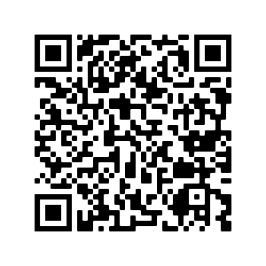
Hausaufgaben
Vocabulary Learning Homework (Y8, Term 2.2, Week 2)
Audio file
Audio file QR code:
Student worksheet
Quizlet link
In addition, revisit: Term 2.1 Week 3
Term 1.2 Week 3
Notes:
Link to Student Worksheet answers: https://resources.ncelp.org/concern/resources/3197xm772?locale=en

