Slide 1
Wir haben so viel gemacht!
Present and past tense: 1st person singular and plural
Using the preposition ‘von’ (from / of)
SSC [ch]
Y8 German
Term 1.2 - Week 2 - Lesson 17
Author name(s): Inge Alferink / Rachel Hawkes
Artwork: Steve Clarke
Date updated: 10/8/21
Notes:
Artwork by Steve Clarke. All additional pictures selected are available under a Creative Common license; no attribution required.
Learning outcomes (lesson 1):
Revisit SSC [ch]
Introduction of past (perfect) tense: 1st person plural Consolidation of past (perfect) and present tense: 1st and 2nd persons singular Preposition ‘von’ + R3 (dative) Use of the words ‘so’ and ‘also’.
Word frequency (1 is the most frequent word in German):
8.1.2.2 (introduce) holen [547] Arbeit [208] Bank [543] Seite [197] Sport [945] Uhr [348] wirklich [189] also [71] so [28] gestern [821] um1 [44] von[9] 8.1.1.6 (revisit) verbringen [1391] Auge [222] Gesicht [346] Haar [748] Mund [856] Nase [1264] Schüler [557] Zeit [96] ähnlich [437] breit [847] dünn [1739] neu [84] rund [298] als [22]
7.3.2.3 (revisit) dürfen [142] ich darf du darfst er darf sie darf[142] müssen [45] ich muss du musst er muss sie muss [45] wollen [65] ich will du willst er will sie will [65] man [34] glücklich [1189] genug [480] krank [1105] ruhig [905] traurig [1871]
Source: Jones, R.L. & Tschirner, E. (2006). A frequency dictionary of German: core vocabulary for learners. Routledge

Slide 2
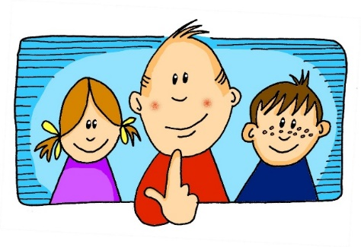
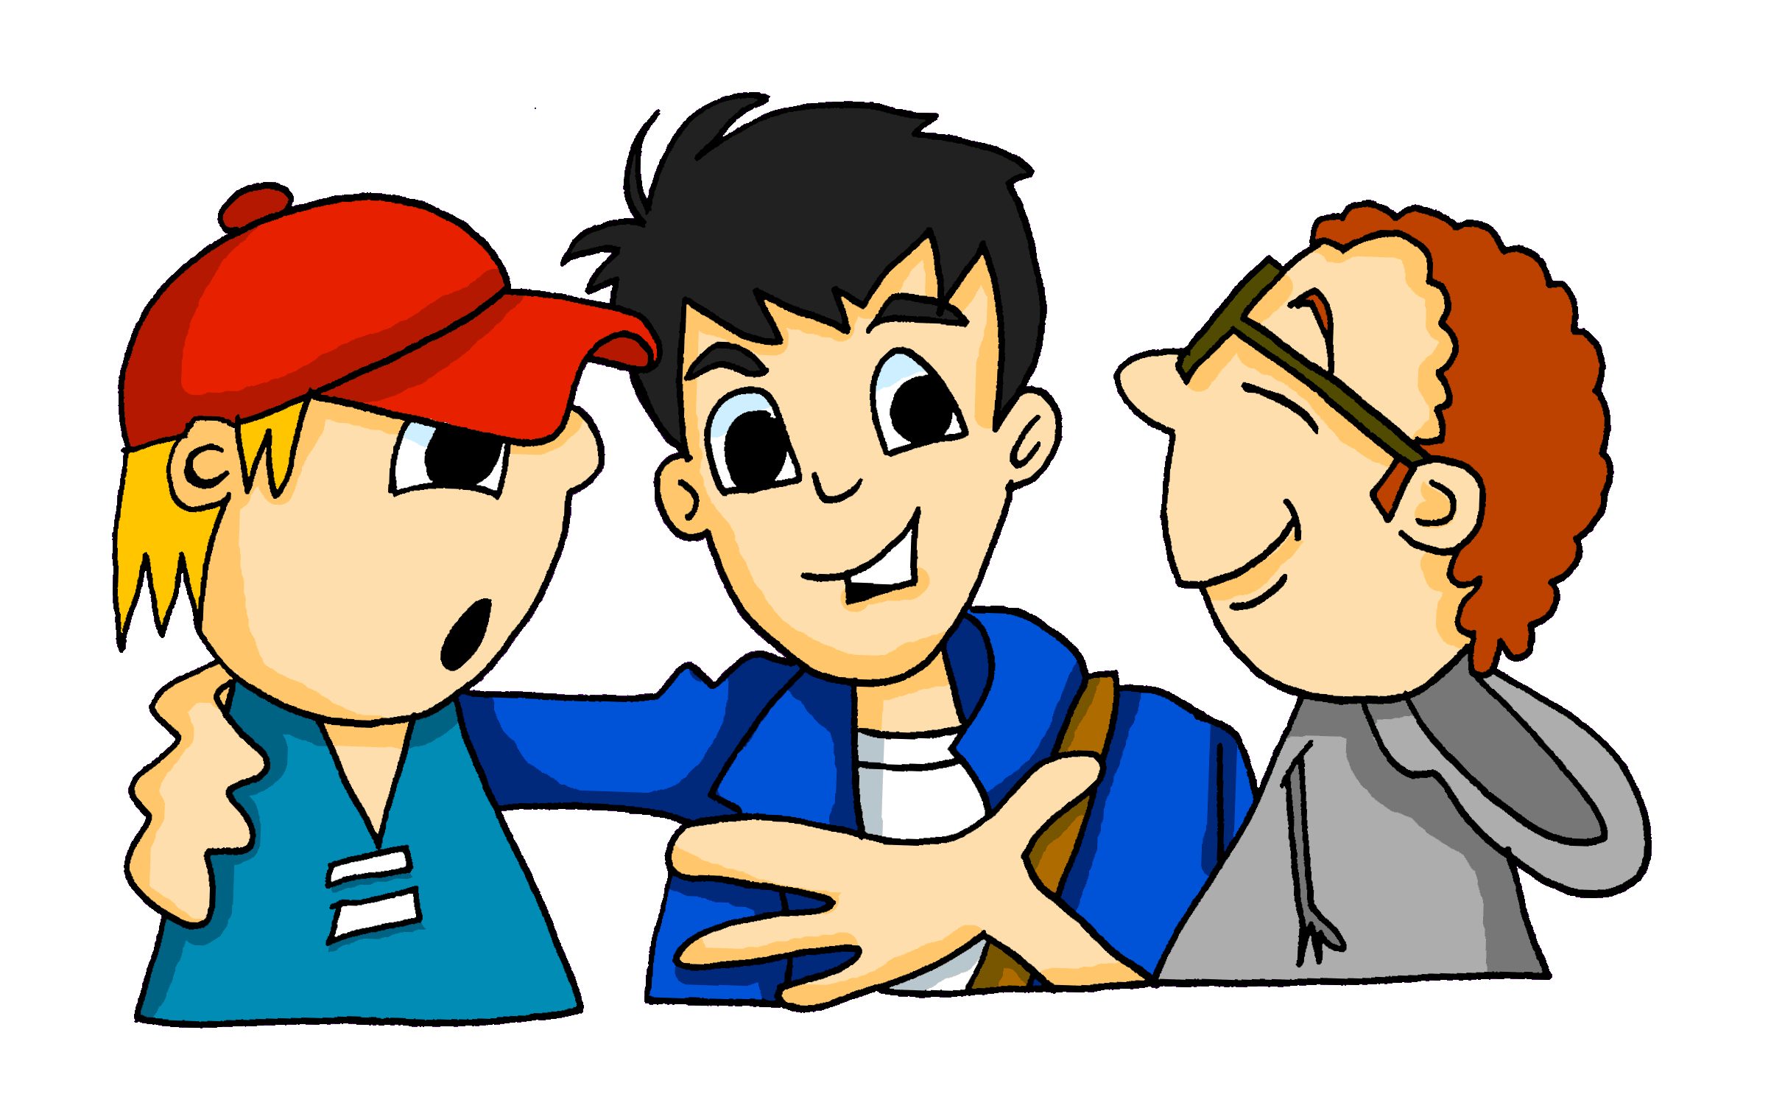
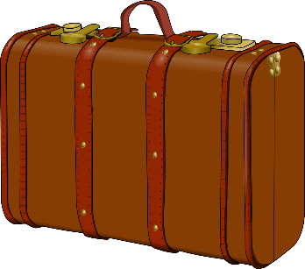
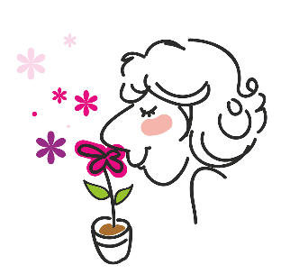
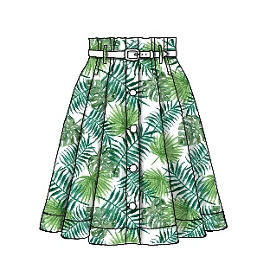
Phonetik [ch]
hören / schreiben
The German [CH] can be pronounced in two different ways:
[CH] soft
[CH] hard
Careful! [CH] and [CK] are different sounds!
Ach!
The hard-soft difference depends on the vowel that comes before it and how open your mouth is when you close the back of your throat to form the [CH].
Gespräch
Gepäck
roch
Rock
Notes:
Timing: 2 minutes Aim: To revisit the pronunciation of [ch] in different contexts and to contrast [ch] with [ck] Procedure: 1. Cycle through the explanation using the animation sequence.
2. Click on the pictures to hear each word pronounced.

Slide 3
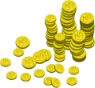
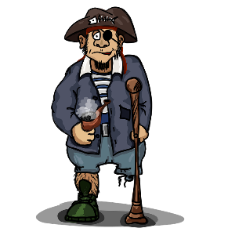
Pirates!
1
c
w
Nacht
acht
Nacht
One of the chests contains buried treasure. All the others contain poison!
Listen carefully to the secret code and follow the arrows to find the treasure.
nackt
Akt
nackt
h
z
sacken
kichern
Bach
v
Sachen
kicken
Back
k
Nacht
kichern
Bach
Akt
Nacht
i
nackt
kicken
Back-
acht
nackt
Nacht
acht
Bach
acht
Nacht
r
nackt
Akt
Back
Akt
nackt
1
Nacht
y
j
q
nackt
Notes:
This slide and the two that follow are three versions of the activity with different solutions.
The game makes use of minimal pairs of unknown words (unknown words are used so that pupils focus on the sound. Definitions are given on a later slide).
Starting on the red square, pupils listen to the words and decide whether they hear /ch/ or /ck/. They follow the arrows indicated by their choice to finish at one of the chests. There is only one correct route per slide, so pupils must correctly identify all words to find the treasure. The order or /ch/ and /ck/ changes (i.e. sometimes /ch/ is on the white square and sometimes on the blue) so the pupils must read the spellings.
Pupils can follow the slide on the projector, or the slide can be printed so they can trace the route with a pen/finger.
Teacher asks ‘Wo bist du?’ Pupils respond ‘Z, W’ etc. to practise the alphabet. Teacher clicks on the chests they say to reveal treasure (or not!)
Audio plays on clicking play. Pupils will probably need to hear the audio at least three times.
Note: Each treasure chest is triggered to reveal what is underneath. You see a hand icon appear when you mouse over it – click and the chest disappears. Each slide only has one treasure chest – the rest reveal skulls.
Transcript:
sacken, kichern, Bach, Akt, nackt
Treasure is located in chest W.

Slide 4
Pirates!
2
c
w
Nacht
Akt
Nacht
nackt
acht
nackt
One of the chests contains buried treasure. All the others contain poison!
Listen carefully to the secret code and follow the arrows to find the treasure.
h
z
sacken
kichern
Bach
v
Sachen
kicken
Back
k
Nacht
kichern
Bach
Akt
Nacht
i
nackt
kicken
Back
acht
nackt
Nacht
Akt
Bach
Akt
Nacht
r
nackt
acht
Back
acht
nackt
2
y
Nacht
q
j
nackt
Notes:
Alternative: Give pupils a copy of the transcript below on a slip of paper and ask them to read to a partner.
The game makes use of minimal pairs of unknown words (unknown words are used so that pupils focus on the sound. Definitions are given on a later slide).
Starting on the red square, pupils listen to the words and decide whether they hear /ch/ or /ck/. They follow the arrows indicated by their choice to finish at one of the chests. There is only one correct route, so pupils must correctly identify all words to find the treasure. The order or /ch/ and /ck/ changes (i.e. sometimes /ch/ is on the white square and sometimes on the blue) so the pupils must read the spellings.
Pupils can follow the slide on the projector, or the slide can be printed so they can trace the route with a pen/finger.
Teacher asks ‘Wo bist du?’ Pupils respond ‘Z, W’ etc. to practice the alphabet. Teacher clicks on the chests they say to reveal treasure (or not!)
Audio plays on clicking play. Pupils will probably need to hear the audio at least three times.
Transcript:
Sachen, kicken, Back, acht, nackt
Treasure is located in chest Y.

Slide 5
Pirates!
3
c
w
Nacht
Akt
Nacht
nackt
acht
nackt
One of the chests contains buried treasure. All the others contain poison!
Listen carefully to the secret code and follow the arrows to find the treasure.
h
z
sacken
kichern
Bach
v
Sachen
kicken
Back
k
Nacht
kichern
Bach
Akt
Nacht
i
nackt
kicken
Back
acht
nackt
Nacht
Akt
Bach
Akt
Nacht
r
nackt
acht
Back
acht
nackt
3
Nacht
y
j
q
nackt
Notes:
Alternative: Give pupils a copy of the transcript below on a slip of paper and ask them to read to a partner.
The game makes use of minimal pairs of unknown words (unknown words are used so that pupils focus on the sound. Definitions are given on a later slide).
Starting on the red square, pupils listen to the words and decide whether they hear /ch/ or /ck/. They follow the arrows indicated by their choice to finish at one of the chests. There is only one correct route, so pupils must correctly identify all words to find the treasure. The order or /ch/ and /ck/ changes (i.e. sometimes /ch/ is on the white square and sometimes on the blue) so the pupils must read the spellings.
Pupils can follow the slide on the projector, or the slide can be printed so they can trace the route with a pen/finger.
Teacher asks ‘Wo bist du?’ Pupils respond ‘Z, W’ etc. to practice the alphabet. Teacher clicks on the chests they say to reveal treasure (or not!)
Audio plays on clicking play. Pupils will probably need to hear the audio at least three times.
Transcript:
sacken, kichern, Back, Akt, Nacht
Treasure is located in chest K.

Slide 6
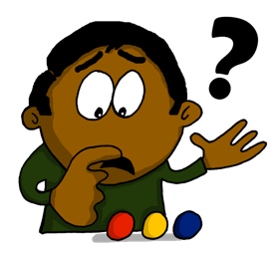
Welches Wort passt nicht in die Reihe?
lesen / sprechen
1 | wirklich | Gesicht | danach
2 | gesprochen | machen | ähnlich
3 | Fach | glücklich | Sprache
4 | noch | Frankreich | besuchen
Notes:
Phonetik Timing: 3 minutes Aim: To focus on the two different pronunciations of [ch] (soft [ch] and hard [ch].
Procedure: 1. Identify the word which has a different [ch] from the other two in the set. 2. Click to reveal the answers.
3. Check that word meanings are also known.

Slide 7
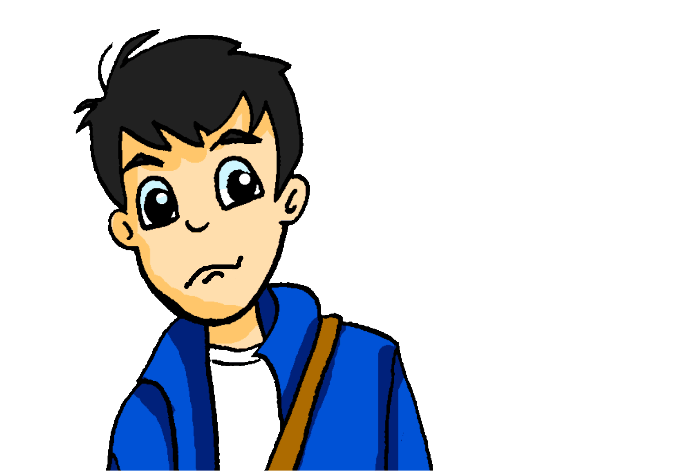
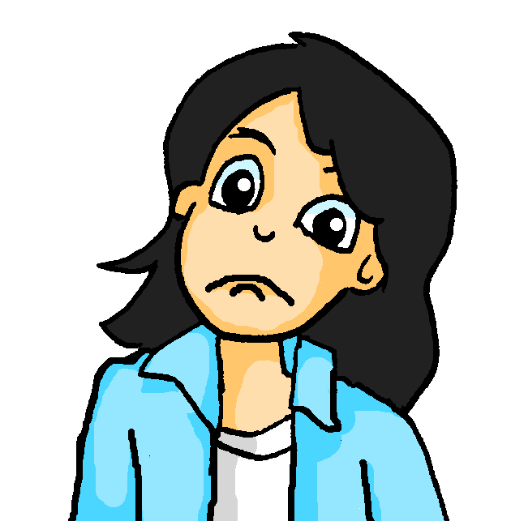
Wirklich [really] / so [so] / also [well...]
Vokabeln
$x=\frac{−b±\sqrt{b^{2}−4ac}}{2a}$
‘Also’ doesn’t mean ‘also’.
Use it to mean ‘well.......’ and to buy thinking time, before you speak.
In front of an adjective, these words add emphasis:
Deine Haare sind so toll!
Your hair is so cool!
Diese Aufgabe ist wirklich schwierig!
This task is really difficult!
Used like this, so and wirklich are synonyms.
On its own so is an adverb and means ‘like that’ or ‘in that way’:
Mia, dürfen wir das so machen?
Mia, are we allowed do it like that?
Nein, Wolfgang. So darfst du das nicht machen!
No, Wolfgang. You’re not allowed to do it in that way!
So and also can mean ‘so, therefore’. Also as a filler, means ‘well,…’
Notes:
Timing: 2 minutes Aim: To explain and exemplify the use of wirklich / so / also. Procedure: 1. Cycle through the animated sequence.
2. Click on the speech bubbles to hear the the audio.

Slide 8
Vokabeln
Passt wirklich / so oder so oder also?
lesen
Schreib 1-7 und das richtige Wort.
Oh Mia, dieser Hut ist wirklich schön!
Ja, und so musst du ihn tragen. Nein, so !!
[2]
[1]
[3]
Ach, nein! So bequem ist er auch wieder nicht.
[4]
Also ,wie findest du die blaue Hose?
[5]
So gehe ich nicht raus!
[6]
Das begreife ich nicht, Andrea. Die Hose ist wirklich super.
Mia, willst du sie kaufen?!
[7]
Notes:
Timing: 3 mins Aim: To practice wirklich / so / also in context. Procedure: 1. Click to make a speech bubble appear.
2. For each gap say what word would fit: wirklich / so OR just so OR also.
3. Click to reveal the answers.

Slide 9
Past (perfect) tense plural
Grammatik
To make the past tense in German use a form of haben with a past participle.
To make the we form, change the ending of haben.
Ich
habe
eine Tasche
gekauft.
I bought / have bought a bag.
Only haben changes!
The past participle is the same in the singular and plural.
Wir
haben
eine Tasche
gekauft.
We bought / have bought a bag.
Remember, strong verbs make the past participle differently.
Ich
habe
ein Lied
gesungen.
I sang / have sung a song.
Wir
haben
ein Lied
gesungen.
We sang / have sung a song.
Notes:
Timing: 5 minutes Aim: To explain and illustrate how the first person plural (we-form) of the past tense is made. It is contrasted here with the first person singular (I-form). Procedure: 1. Cycle through the explanation and examples using the animated sequence.

Slide 10
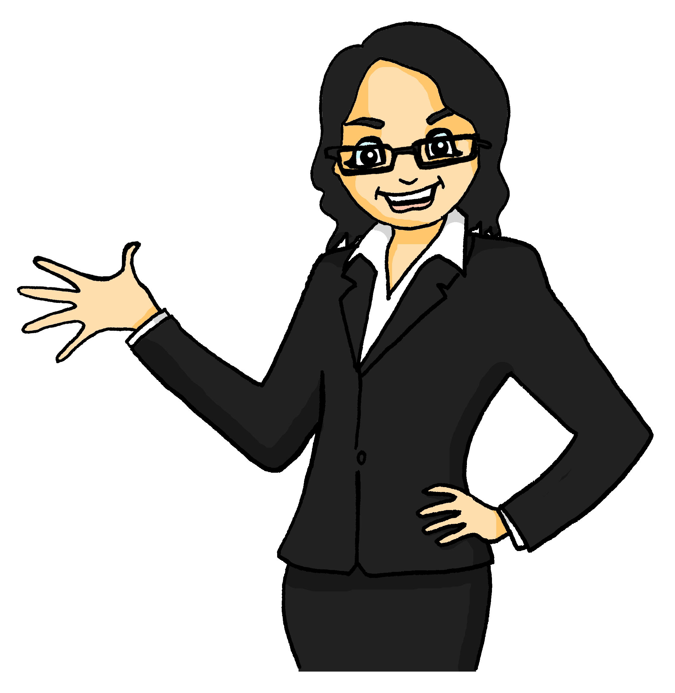
In der Stadt
lesen
Mia und Andrea sind in der Stadt und schreiben Mutti. Wer hat was geschrieben?
 |  | Ich | Wir | Jetzt / vorher
1. | Wir haben zusammen viel Spaß.
2. | Ich gehe auf die Bank, denn ich habe kein Geld!
3. | Ich habe ein neues Buch gekauft. Es hat 300 Seiten!
4. | Wir haben eine Stunde im Eiscafé verbracht.
5. | Wir haben im Sportzentum Fitnesstraining gemacht.
6. | Ich habe meine Jacke geholt, weil es so kalt ist.
7. | Wir machen heute viele Fotos.
8. | Ich habe noch viel Arbeit.
Wann? Jetzt oder vorher*?
___
jetzt
___
jetzt
___
vorher
___
vorher
___
vorher
___
vorher
___
jetzt
___
jetzt
*vorher - earlier
Notes:
Timing: 5 minutes Aim: To practise noticing the verb endings for first person singular (ich) and plural (wir). This activity then also practices present vs past tense. Procedure: 1. For each sentence say who said it Mia and Andrea (wir) or mum (ich).
3. Click to reveal the answer.
4. Then say for each sentence whether it happened now (jetzt) or in the past (gestern).
5. Click to reveal answers.
6. Who had a better day? Mia and Andrea or mum?
Transcript:
vorher [866] Word frequency (1 is the most frequent word in German): holen [547] verbracht [13 ]Arbeit [208] Bank [543] Seite [197] Sport [945] Uhr [348] wirklich [189] also [71] so [28] gestern [821] um1 [44] von[9]
Source: Jones, R.L. & Tschirner, E. (2006). A frequency dictionary of German: core vocabulary for learners. Routledge

Slide 11
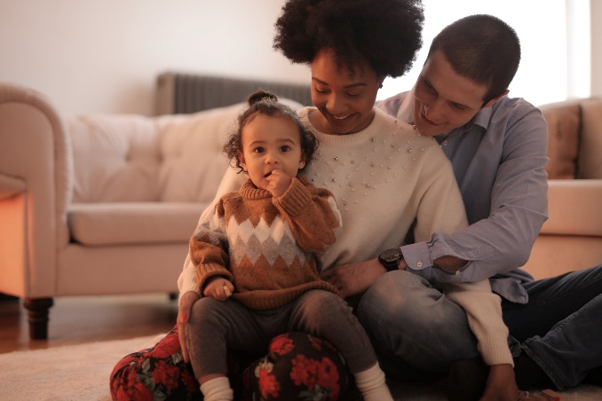
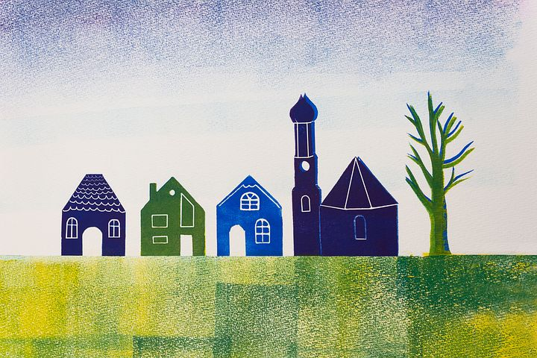
Von + R3 (dative)
Grammatik
Prepositions often have more than one meaning.
Articles after von have R3 endings:
Use von to mean from or of:
Das ist ein Foto von dem Vater, der Mutter, und dem Mädchen.
That is a picture of the father, the mother, and the girl.
Sie kommen von dem Dorf.
Remember: das Mädchen!
vom
They are coming from the village.
Remember: von + dem = vom
Notes:
Timing: 2 minutes Aim: To explain and illustrate two of the different meanings of von (of and from). Procedure: 1. Cycle through the explanation and examples using the animated sequence.
2. Elicit translation of example before bringing up the English.

Slide 12
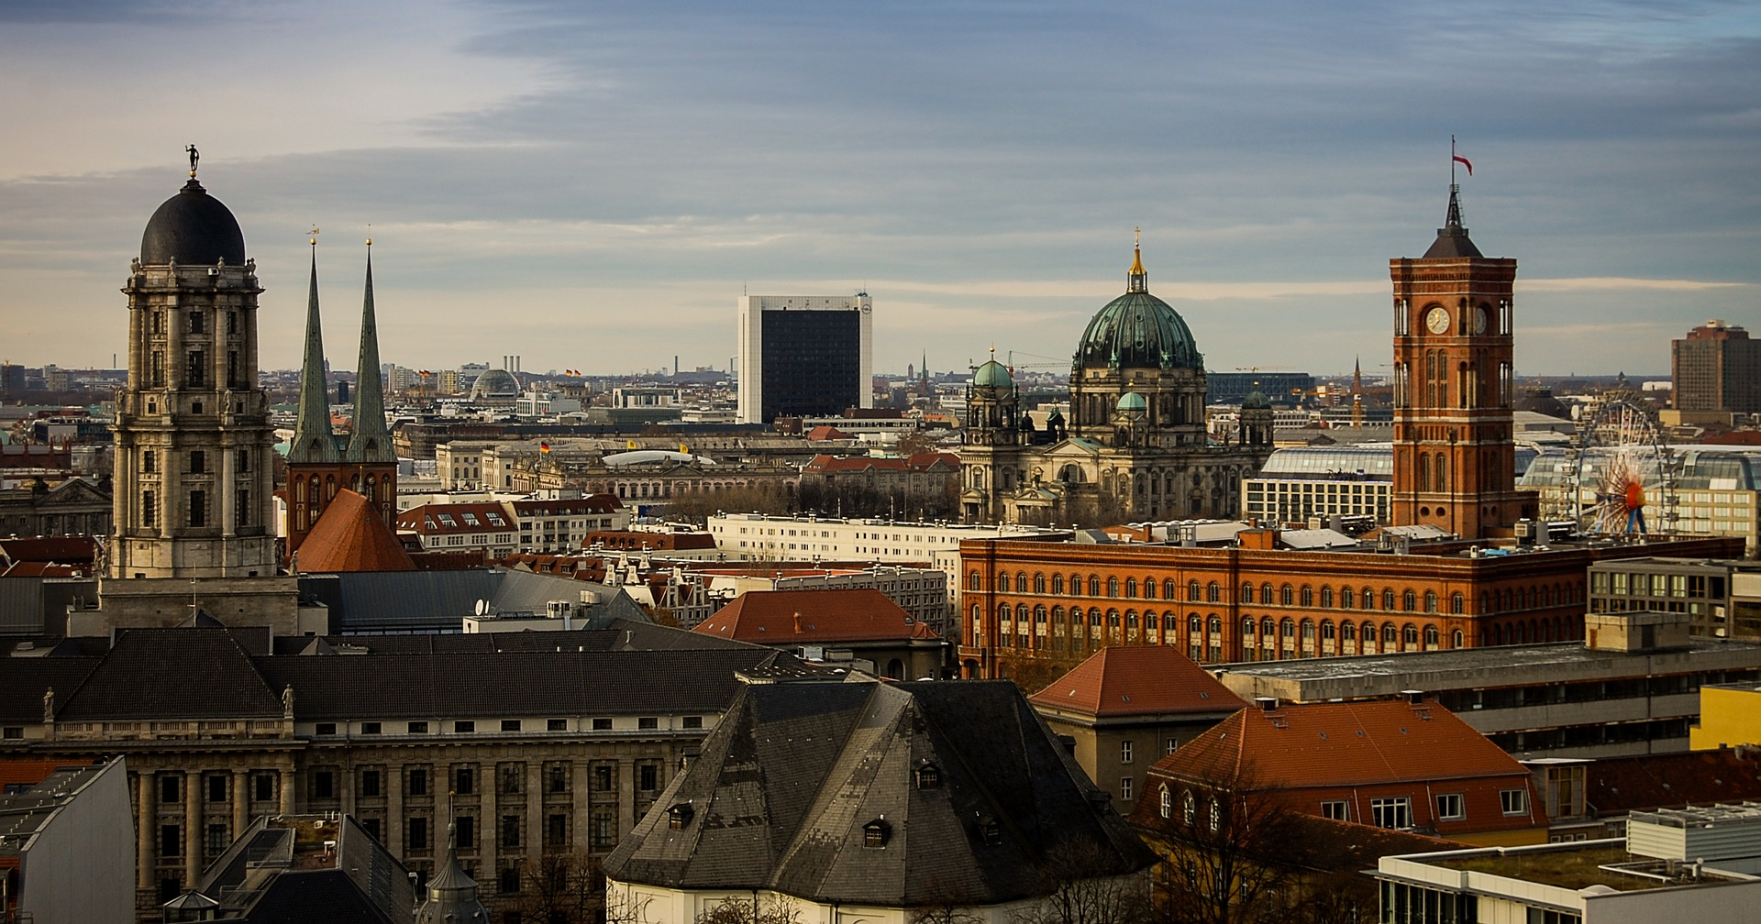
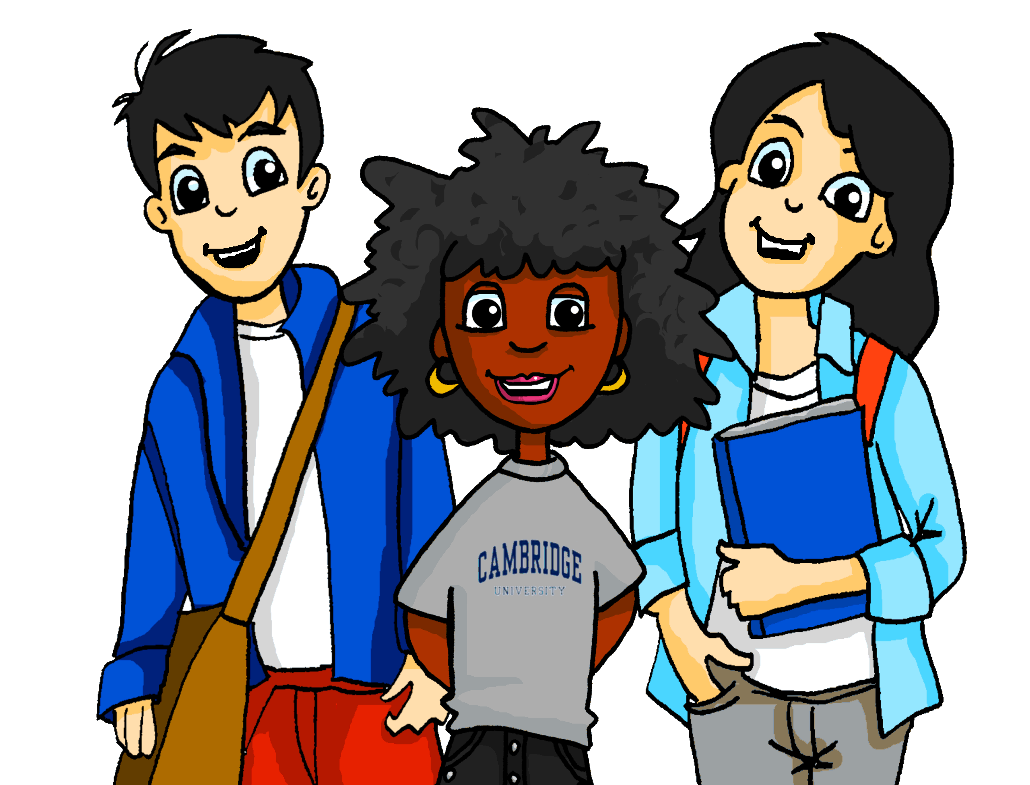
Ein letztes Mal
hören
Heute ist der letzte Tag in Berlin und die Freunde sind in der Stadt, denn Andrea will viele Fotos machen.
Notes:
Timing: 6 minutes for all slides Aim: To practise noticing the R3 definite article forms and their corresponding nouns. Procedure: 1.Click on the number to hear a sentence.
2. Tick which noun would fit in the gap.
Transcript: 1. Ich will ein Foto von der [Schule] machen. Word frequency (1 is the most frequent word in German): Source: Jones, R.L. & Tschirner, E. (2006). A frequency dictionary of German: core vocabulary for learners. Routledge

Slide 13
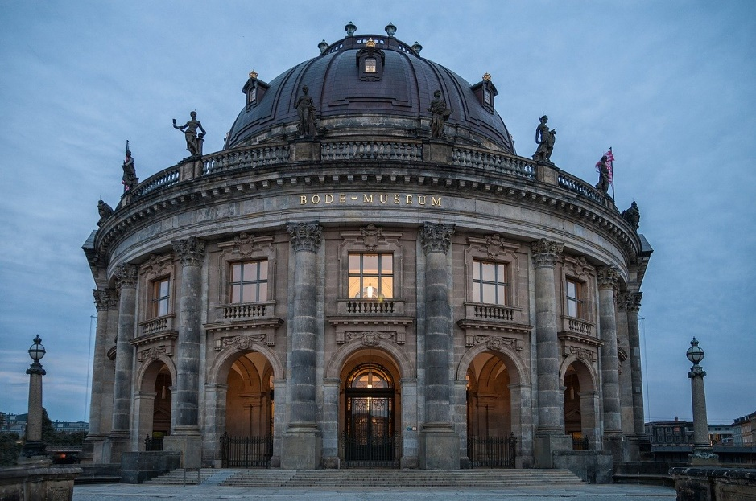
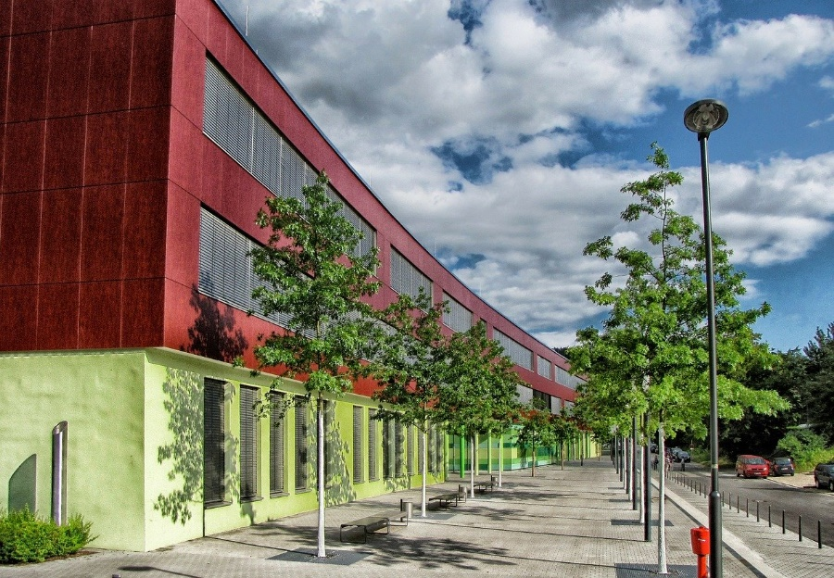
Ein letztes Mal
hören
Schreib 1-8. Hör zu. Welcher Ort ist es? Schreib den Ort.
[das Museum ]
1
[die Schule]
Notes:
Timing: 6 minutes for all slides Aim: To practise noticing the R3 definite article forms after ‘von’ and their corresponding nouns. Procedure: 1. Click on the number to hear a sentence.
2. Write the noun that would fit in the gap.
Transcript: 1. Ich will ein Foto von der [Schule] machen. Word frequency (1 is the most frequent word in German): Source: Jones, R.L. & Tschirner, E. (2006). A frequency dictionary of German: core vocabulary for learners. Routledge

Slide 14
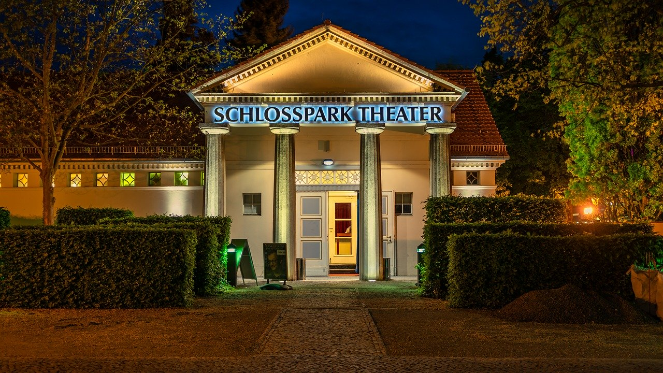
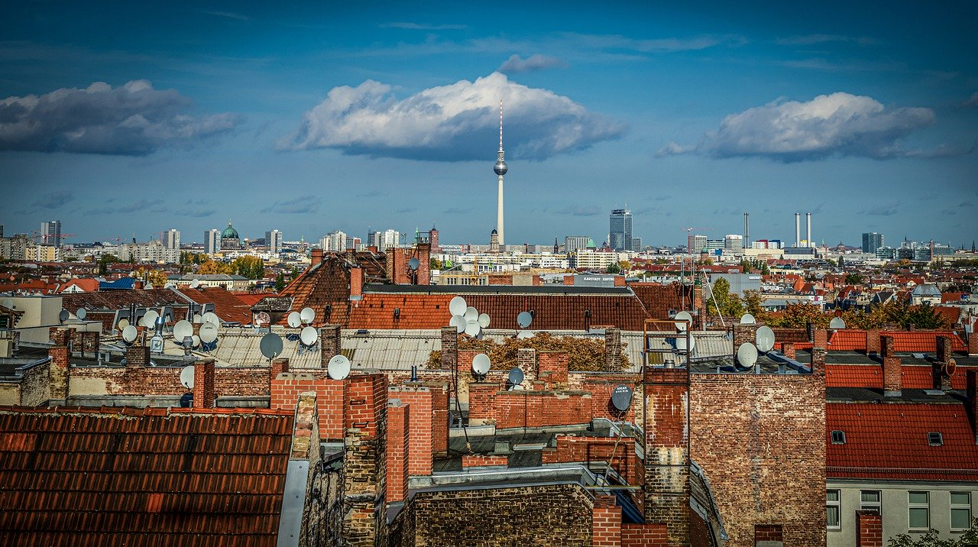
Ein letztes Mal
hören
[das Theater]
2
[die Stadt]
Notes:
2. Ich habe Lust, ein Souvenir vom [Theater] zu kaufen.

Slide 15
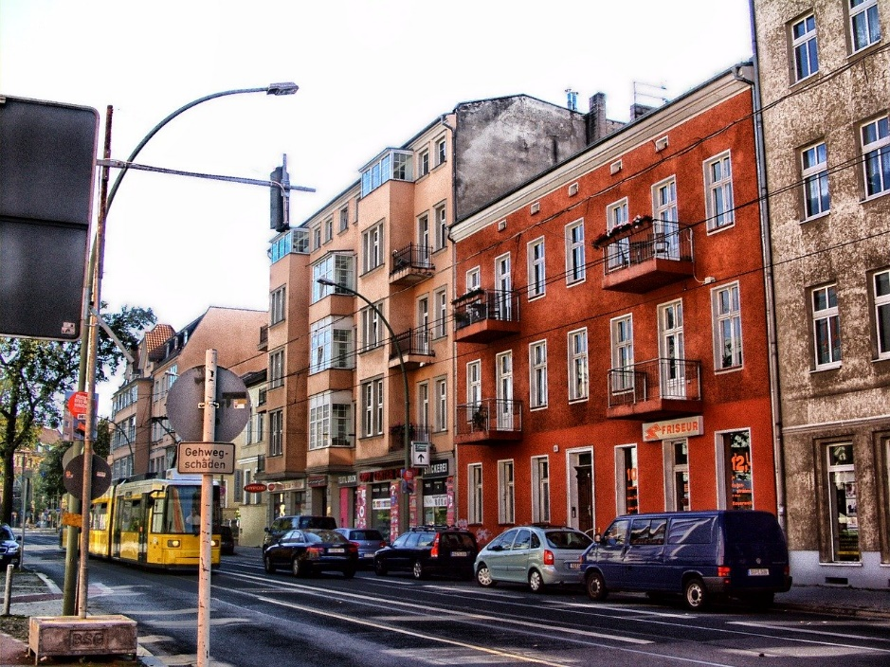
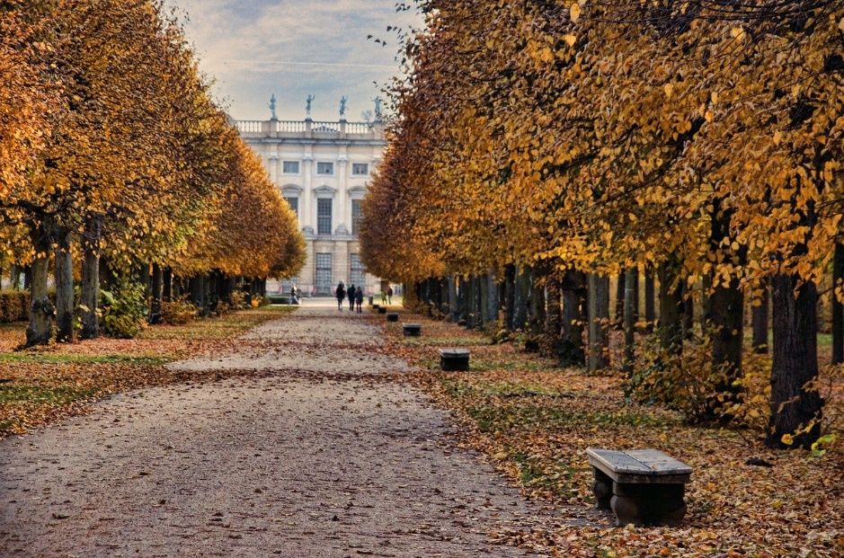
Ein letztes Mal
hören
[die Straße]
3
[der Park]
Notes:
3. Ich will ein letztes Foto von der [Straße] machen.

Slide 16
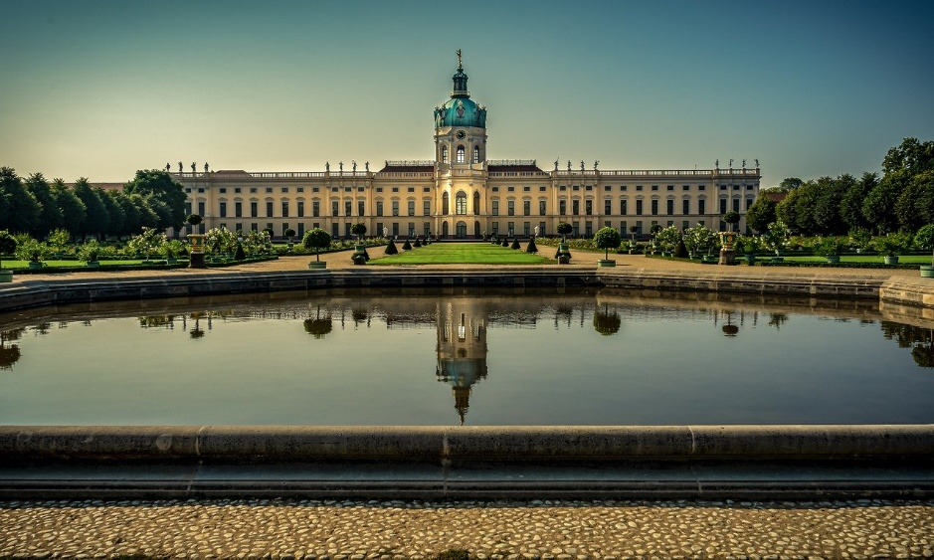
Ein letztes Mal
hören
[das Schloss]
4
[die Bibliothek]
Notes:
4. Ich will eine Postkarte vom [das Schloss ] kaufen.

Slide 17
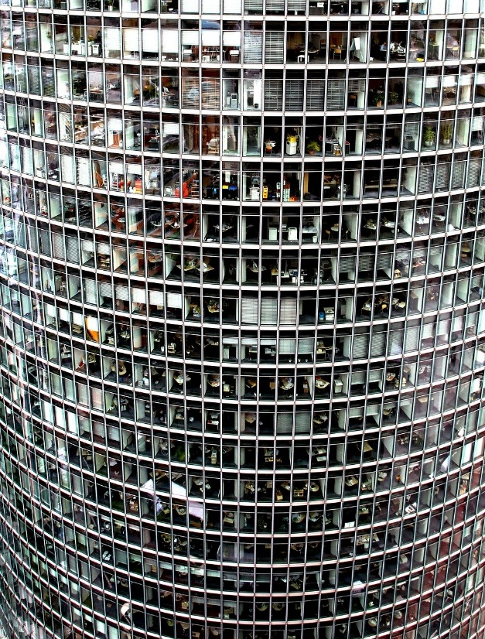
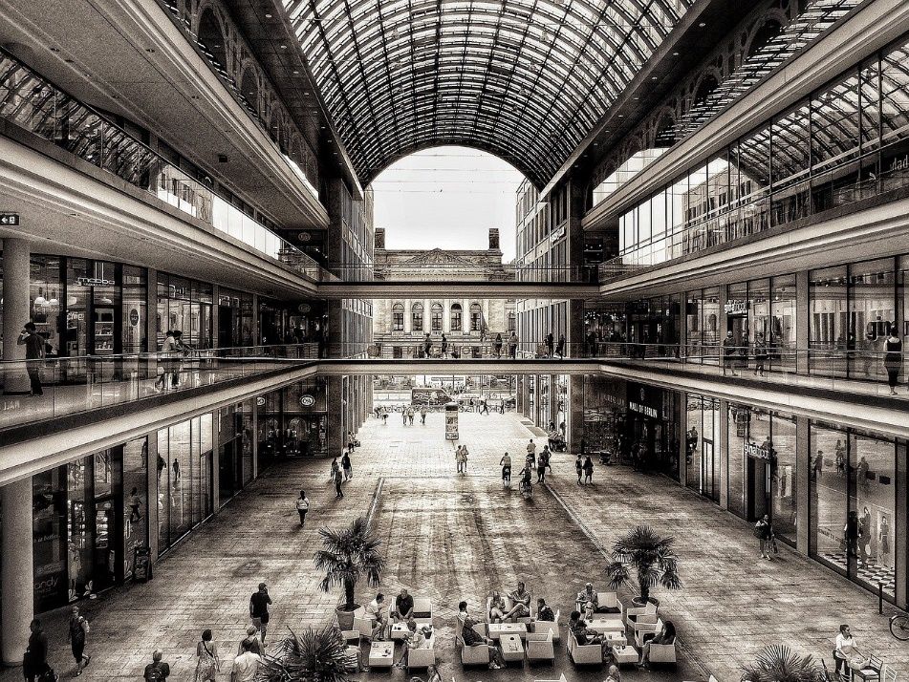
Ein letztes Mal
hören
[das Geschäft ]
5
[die Bank]
Notes:
5. Ich will Frau Meyer vom [Geschäft ] tschüss sagen.

Slide 18
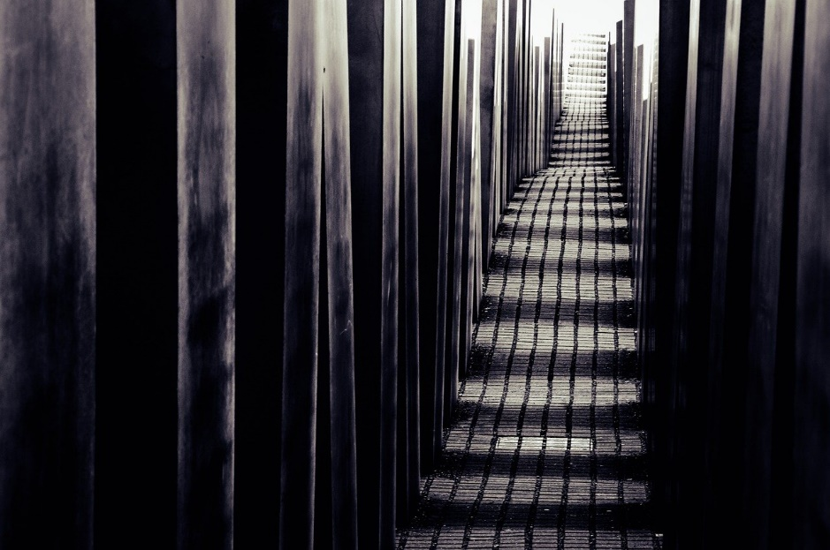
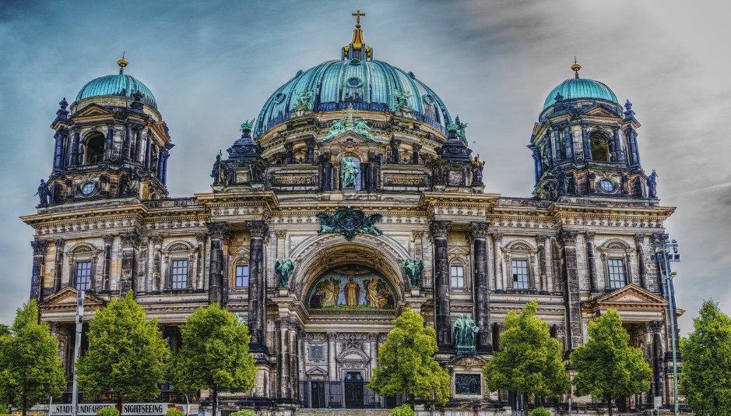
Ein letztes Mal
hören
[die Kirche]
6
[das Denkmal*]
*Denkmal = monument
Notes:
6. Ich will auch noch ein Foto von der [Kirche] machen.

Slide 19
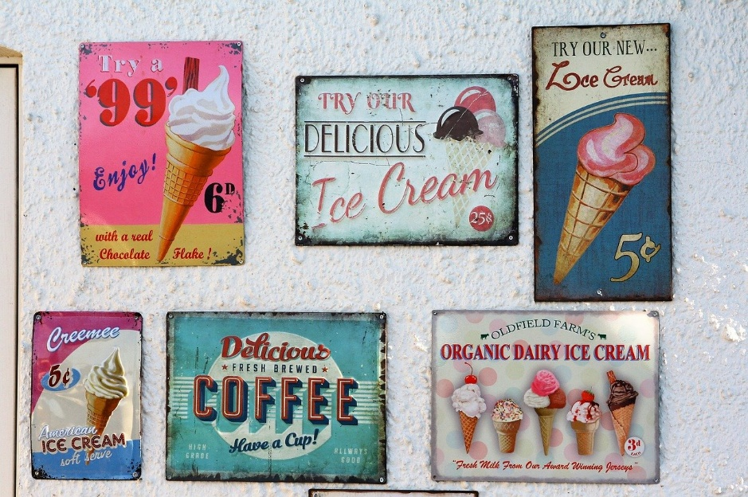
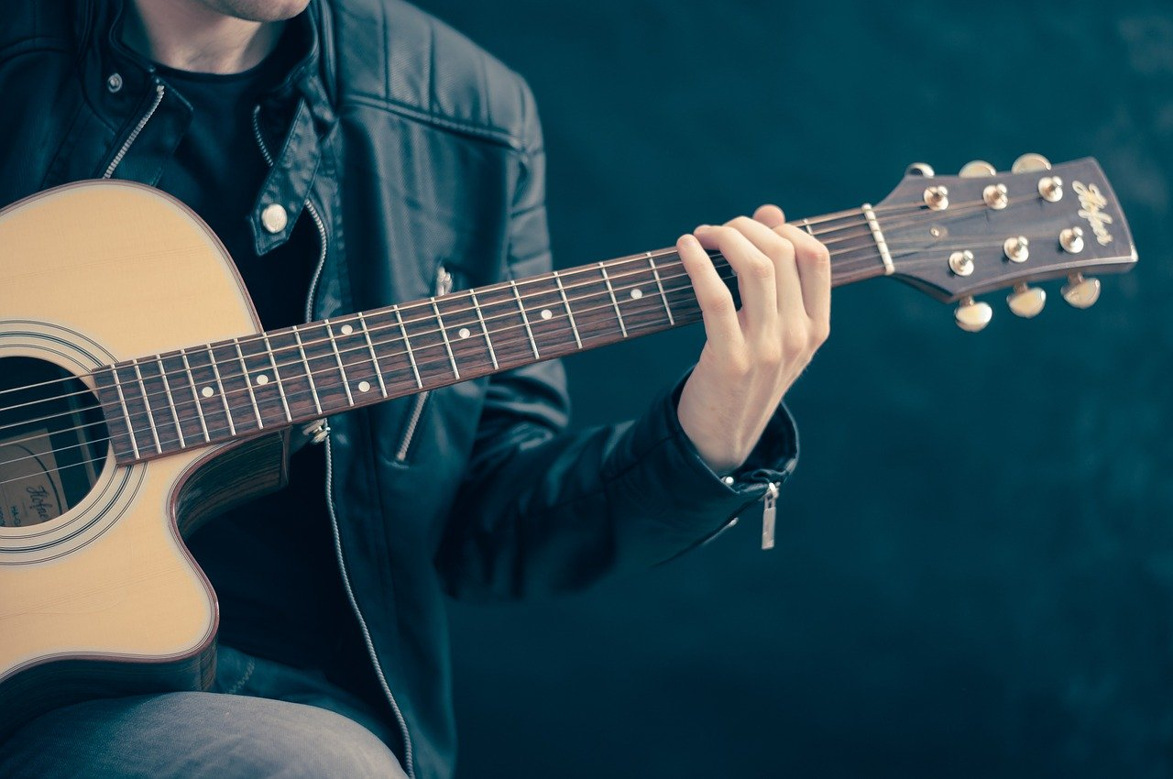
Ein letztes Mal
hören
[das Eiscafé]
7
[die Band]
Notes:
7. Ich habe Lust noch ein letztes Mal das Mädchen von der [Band] zu besuchen.

Slide 20
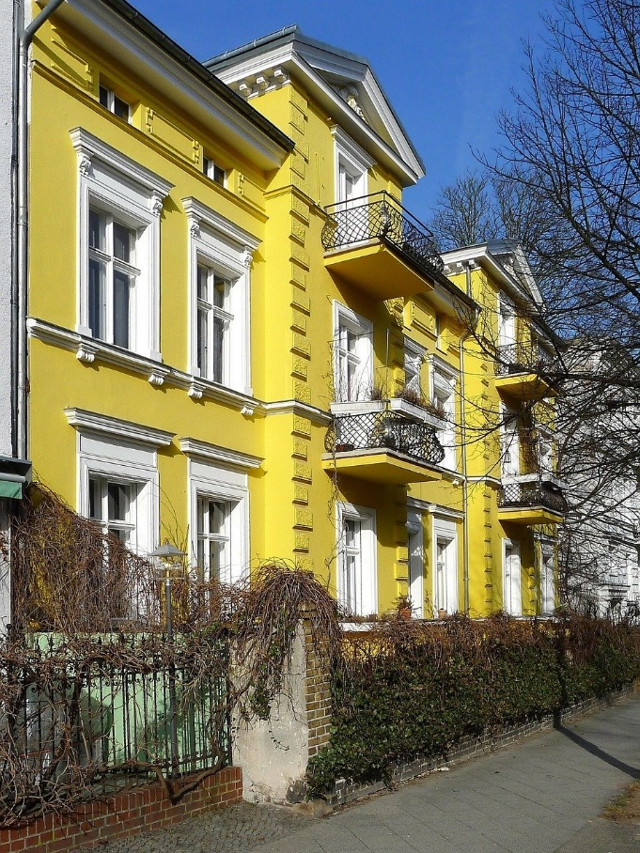
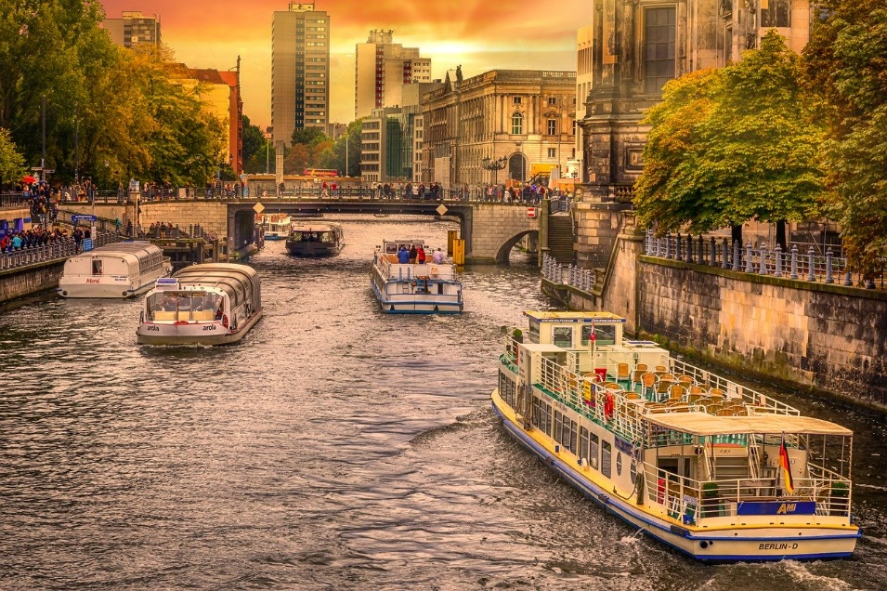
Ein letztes Mal
hören
[der Fluss]
8
[die Wohnung]
Notes:
8. Und schließlich will ich noch ein Foto vom [Fluss] machen.

Slide 21
Vokabeln
hören / schreiben
1
holen
to fetch / fetching
2
die Arbeit
work
3
wirklich
really
4
gestern
yesterday
5
um
at
6
der Sport
sport
7
die Uhr
o’clock
8
verbracht
spent (time)
9
die Bank
bank
10
die Seite
side
Notes:
Vokabeln Timing: 3 minutes
Aim: To practise understanding the vocabulary for this week in the oral modality.
Note: Students in Y8 pre-learn vocabulary on Quizlet, additionally completing several tasks. This activity provides further practice in listening and understanding the new vocabulary.
Procedure: 1. Click to hear the word in German. 2. Write down the meaning in German. 3. Write down the meaning in English. 4. Click to check answers.
Transcript: holen die Arbeit wirklich gestern um der Sport die Uhr verbracht die Bank die Seite

Slide 22
sprechen / hören / schreiben
Eine Grillparty*
Mia organisiert eine Party für Andrea. Viele Freunde kommen.
Person A fragt: ‘Was machst du morgen?’ oder ‘Was hast du gestern gemacht?’
Don’t say the ‘morgen’ or the ‘gestern’.
Person B antwortet.
Persons A – H are eight different party guests.
Wichtig! Stell die Fragen 1-8.
Beispiel:
1
Person A
1
Person B
Say ‘What are you doing’? (tomorrow).
___________________
Morgen
Gestern
[sing songs]
[do sport]
Lieder singen
Student A: Was machst du morgen?
Student B: Ich singe Lieder.
Grillparty* - BBQ party
Notes:
Timing: 10 min.
Aim: To practise producing and understanding the present (future meaning) and past (perfect) tense questions ‘What are you doing tomorrow’ and ‘What did you do yesterday?’. To practise retrieving these verbs in present and past (perfect) from memory from in oral production.
Procedure:
Person A – look at your prompt card. Ask the question ‘Was machst du morgen’ or ‘Was hast du gestern gemacht?’ Make sure not to say the tomorrow / yesterday part.
Person B – listen. Is it ‘what are you doing tomorrow?’ or ‘What did you do yesterday?’
Person A – write the activity down in German.
Important – make sure that you do the activity in order, from 1 to 8. You could say the number aloud in German beforehand to ensure that you are looking at the same item.

Slide 23
sprechen / hören / schreiben
[1] Partner A (Frag 1,2,3,4,5,6,7,8)
1
Person A
2
Person B
3
Person C
Say: ‘What are you doing? (tomorrow)
___________________
Say: ‘What did you do? (yesterday)
__________________
Say: ‘What are you doing? (tomorrow)
___________________
4
Person D
5
Person E
6
Person F
Say: ‘What did you do? (yesterday)
__________________
Say: ‘What did you do? (yesterday)
__________________
Say: ‘What are you doing? (tomorrow)
___________________
7
Person G
8
Person H
Say: ‘What did you do? (yesterday)
__________________
Say: ‘What are you doing? (tomorrow)
___________________
Notes:
A printable version of these cards is available with the resource.
Person A question cards, with space to write their partner’s answer below
Answers are on slide 12.

Slide 24
sprechen / hören / schreiben
[1] Partner B antwortet.
1
Person A
2
Person B
3
Person C
Morgen
Gestern
Morgen
Gestern
Morgen
Gestern
[sing songs]
[do sport]
[went shopping]
[experienced the culture]
[lie in the garden]
[listen to music]
4
Person D
5
Person E
6
Person F
Morgen
Gestern
Morgen
Gestern
Morgen
Gestern
[drink coffee]
[eat pizza]
[have a long shower]
[find a new shop]
[buy ice cream]
[spend time with mum]
7
Person G
8
Person H
Morgen
Gestern
Morgen
Gestern
[watch TV]
[cook food]
[play basketball]
[read a book]
Notes:
A printable version of these cards is available with the resource.
Person A question cards, with space to write their partner’s answer below
Answers are on slide 12.

Slide 25
schreiben / hören / schreiben
[2] Partner B (Frag 1,2,3,4,5,6,7,8)
1
Person A
2
Person B
3
Person C
Say: ‘What did you do? (yesterday)
__________________
Say: ‘What did you do? (yesterday)
__________________
Say: ‘What are you doing? (tomorrow)
___________________
4
Person D
5
Person E
6
Person F
Say: ‘What are you doing? (tomorrow)
___________________
Say: ‘What are you doing? (tomorrow)
___________________
Say: ‘What did you do? (yesterday)
__________________
7
Person G
8
Person H
Say: ‘What did you do? (yesterday)
__________________
Say: ‘What are you doing? (tomorrow)
___________________
Notes:
A printable version of these cards is available with the resource.
Person B question cards, with space to write their partner’s answer below
Answers are on slide 13.

Slide 26
sprechen / hören / schreiben
[2] Partner A antwortet.
1
Person A
2
Person B
3
Person C
Morgen
Gestern
Morgen
Gestern
Morgen
Gestern
[sing songs]
[do sport]
[went shopping]
[experience the culture]
[lie in the garden]
[listen to music]
4
Person D
5
Person E
6
Person F
Morgen
Gestern
Morgen
Gestern
Morgen
Gestern
[drink coffee]
[eat pizza]
[have a long shower]
[find a new shop]
[buy ice cream]
[spend time with mum]
7
Person G
8
Person H
Morgen
Gestern
Morgen
Gestern
[watch TV]
[cook food]
[play basketball]
[read a book]
Notes:
A printable version of these cards is available with the resource.
Person A question cards, with space to write their partner’s answer below
Answers are on slide 12.

Slide 27
sprechen / hören / schreiben
Partner A - Antworten
1
Person A
2
Person B
3
Person C
Say: ‘What are you doing? (tomorrow)
___________________
Say: ‘What did you do? (yesterday)
__________________
Say: ‘What are you doing? (tomorrow)
___________________
Ich singe Lieder.
Ich habe die Kultur erlebt.
Ich liege im Garten.
4
Person D
5
Person E
6
Person F
Say: ‘What did you do? (yesterday)
__________________
Say: ‘What did you do? (yesterday)
__________________
Say: ‘What are you doing? (tomorrow)
___________________
Ich habe ein neues Geschäft gefunden.
Ich habe Pizza gegessen.
Ich kaufe ein Eis.
7
Person G
8
Person H
Say: ‘What did you do? (yesterday)
__________________
Say: ‘What are you doing? (tomorrow)
___________________
Ich habe Essen gekocht.
Ich spiele Basketball.
Notes:
ANSWER SLIDE – DO NOT DISPLAY UNTIL AFTER ACTIVITY

Slide 28
schreiben / hören / schreiben
Partner B - Antworten
1
Person A
2
Person B
3
Person C
Say: ‘What did you do? (yesterday)
__________________
Say: ‘What did you do? (yesterday)
__________________
Say: ‘What are you doing? (tomorrow)
___________________
Ich habe Sport gemacht.
Ich habe die Kultur erlebt.
Ich liege im Garten.
4
Person D
5
Person E
6
Person F
Say: ‘What are you doing? (tomorrow)
___________________
Say: ‘What are you doing? (tomorrow)
___________________
Say: ‘What did you do? (yesterday)
__________________
Ich habe Zeit mit Mutti verbracht.
Ich trinke Kaffee.
Ich dusche lange.
7
Person G
8
Person H
Say: ‘What did you do? (yesterday)
__________________
Say: ‘What are you doing? (tomorrow)
___________________
Ich habe Essen gekocht.
Ich spiele Basketball.
Notes:
ANSWER SLIDE – DO NOT DISPLAY UNTIL AFTER ACTIVITY

Slide 29
Wir haben so viel gemacht
Present and past tense: 1st person singular and plural
Using um …Uhr for time
SSC [CH]
Y8 German
Term 1.2 - Week 2 - Lesson 18
Author name(s): Inge Alferink / Rachel Hawkes
Artwork: Steve Clarke
Date updated: 7/7/20
Notes:
Learning outcomes (lesson 2):
Revisit SSC [ch]
Consolidation of past (perfect) and present tense: 1st and 2nd persons singular Consolidation of past (perfect) yes/no questions Use of the words ‘Stunde’ and ‘Uhr’.
Word frequency (1 is the most frequent word in German):
7.1.2.4 (introduce) zeigen [154] zuhören [1946] sprechen [157] lesen [323] wiederholen [1044] die Antwort [707] freiwillig [1714]
7.1.2.1 (revisit) wohnen [380] schreiben [245] spielen [197] reden [356] lernen [203] machen [49] Montag [794] die Aufgabe [317] im Klassenzimmer [609/619] im Unterricht [1107] in der Schule [208] mit Freunden [13/327] er [20] sie [10]
7.1.1.2 (revisit) sagen [46] sagt [46] was?[39] der Tag [108] der Mann [131] das Paar [284] die Klasse [619] richtig [211] falsch [638] nicht [12] oder [30] ja [27] nein [120]

Slide 30
Phonetik [ch]
hören / schreiben
As you know, [CH] in German can be pronounced in two ways:
Careful! [CH] and [CK] are different sounds!
[CH] hard
[CH] soft
Ach!
Chemie and China are pronounced differently in Austria and Germany
However, [CH] is sometimes pronounced [CK] often at the start of a word:
Chor
Orchester
Wechsel
wechseln
Chemie
China
Chemie
China
Notes:
Timing: 3 minutes Aim: Explaining that sometimes [ch] is pronound [ck] Procedure: 1. Cycle through the explanation.
2. Click on the words to play the sound.
Transcript: Ach! Ich Chor
Orchester
China
Chemie
Wechsel wechseln

Slide 31
Was hörst du?
[CH] hard
[CH] soft
hören
Ach!
Soft [CH]
Both
Hard [CH]
ich
dich
wirklich
nicht
1
Ich sehe dich wirklich nicht.
Notes:
Time: 5 minutes
Aim: To practise listening out for the difference between soft and hard [ch] within full sentences.
Procedure:
Click on the number to play the sentence.
Decide for each sentence whether the sentence contains only soft [ch], only hard [ch], or both.
Click to see answer and the words in which the sounds appear.
Click again to see the sentence.
Say the sentence out loud. Click on the number again to hear the sentence again.
Transcript: Ich sehe dich wirklich nicht.

Slide 32
Was hörst du?
[CH] hard
[CH] soft
hören
Ach!
Soft [CH]
Both
Hard [CH]
Woche
verbracht
2
Letzte Woche hat die Schülerin Zeit in Hamburg verbracht.
Notes:
Transcript: Letzte Woche hat die Schülerin Zeit in Hamburg verbracht.

Slide 33
Was hörst du?
[CH] hard
[CH] soft
hören
Ach!
Only soft [CH]
Both
Only hard [CH]
Buch
Bücher
acht
3
Es gibt acht interessante Bücher und ein langweiliges Buch.
Notes:
Transcript:
Es gibt acht interessante Bücher und ein langweiliges Buch.

Slide 34
Was hörst du?
[CH] hard
[CH] soft
hören
Ach!
Soft [CH]
Both
Hard [CH]
vielleicht
nochmal
kochen
[ch] = [ck] denn die Person ist Österreicher.
4
Willst du vielleicht nochmal chinesisches Essen kochen?
Notes:
Transcript:
Willst du vielleicht nochmal chinesisches Essen kochen?

Slide 35
Was hörst du?
[CH] hard
[CH] soft
hören
Ach!
Soft [CH]
Both
Hard [CH]
Österreicher
glückliche
5
Österreicher sind immer glückliche Menschen.
Notes:
Transcript: Österreicher sind immer glückliche Menschen.

Slide 36
Vokabeln
lesen
Nase
Schüler
ruhig
Auge
genug
Haar
rund
Seite
Gesicht
Mund
dünn
ähnlich
man
breit
glücklich
als
krank
Notes:
Vokabeln Timing: 3 minutes
Aim: To practise recall of meaning of words in this week’s revisited sets in the written modality.
Procedure: 1. On click a word appears.
2. Write down the translation before the word disappears.

Slide 37
Vokabeln
lesen
nose
pupil
Nase
Schüler
quiet
eye
enough
ruhig
Auge
genug
hair
round
Haar
side
rund
face
Seite
mouth
thin
Gesicht
similar
Mund
dünn
one, you
ähnlich
man
wide
happy, fortunate
as
breit
sick, ill
glücklich
als
krank
Notes:
Antworten Timing: 30 seconds

Slide 38
Vokabeln
lesen / schreiben
1
D
E
R
M
U
N
D
A
1. Man spricht und isst damit (2).
2. Man sieht damit (2).
3. In der Mitte vom Gesicht (2).
4. Zwei Personen haben beide lange braune Haare, grüne Augen, und ein rundes Gesicht. Sie sind einander ä….
5. Man findet das (oft) auf dem Kopf.
6. Schreib auf Deutsch: wide.
7. Als Person ist sie nicht traurig; sie ist…
8. Ich habe nur drei. Das nicht nicht …
9. Nicht gesund.
10. Schreib auf Deutsch: thin.
S
2
D
A
S
A
U
G
E
E
3
D
I
E
N
A
S
E
9
I
K
4
Ä
H
N
L
I
C
H
5
H
A
A
R
H
10
A
6
B
R
E
I
T
D
N
U
7
G
L
Ü
C
K
L
I
C
H
N
I
das Gesicht
N
8
G
E
N
U
G
Notes:
Vokabeln Timing: 5 minutes
Aim: To recall the form and meaning of vocabulary in the written modality, in response to German sentence prompts.
Procedure: 1. Read the clues and fill in all the words.
2. Which word fits in the red column?
3. Click to make answers appear.

Slide 39
Uhr / Stunde
Grammatik
Remember! Use Stunde to mean hour:
Use Uhr to mean o’clock:
Wir haben eine Stunde im Café verbracht.
We spent an hour in the café.
Es ist zwei Uhr.
It is two o’clock.
It also means lesson:
Remember, the verb is always the second idea of the sentence!
Um before o’clock means ‘at’:
Um drei Uhr – at three o’clock.
Wir haben eine Musikstunde gehabt.
We had a music lesson.
In sentences, general time goes before specific time.
1. Wir haben gestern um neun Uhr gegessen.
2. Gestern haben wir um neun Uhr gegessen.
3. Gestern um neun Uhr haben wir gegessen.
Notes:
Timing: 3 minutes Aim: To explain the use of Stunde / Uhr / und and to revisit WO2. Procedure: 1. Cycle through the explanations and examples using the animated sequence.
2. Click on the numbers to hear the WO2 examples spoken. Do you notice anything about the stress?
Transcript: 1. Wir haben gestern um neun Uhr gegessen. 2. Gestern haben wir um neun Uhr gegessen.
3. Gestern um neun Uhr haben wir gegessen.

Slide 40
So viele Fragen!
lesen
Mutti hat viele Fragen für Mia. Was passt in die Lücken?
Lies den Text. Schreib 1-5 und das richtige Wort.
Gehst du um neun Uhr in die Stadt?
Wann hast du gegessen?
Was musst du machen?
Nein, Andrea und ich gehen um zehn Uhr. Die Fahrt dauert vielleicht zwei Stunden…
Um acht Uhr habe ich gegessen. Zu früh!
Ich will noch etwas für Andreas Mutti kaufen.
_3_
_5_
__1__
_4_
__2__
Notes:
Timing: 3 minutes Aim: To model the types of questions that will be used in the speaking activity later in the sequence. To practise Stunde / Uhr. Procedure: 1. Click to see a message.
2. Fill in the blank.
3. Click again to see the answer.

Slide 41
Tschüss, Andrea!
bestellen – to order, book vorher – earlier, previously
hören
Hör dir die Whatsapps von Mia und Wolfgang an. Ich oder wir? Wann? Jetzt oder vorher?
 | Ich | Wir | Wann?
1.
2.
3.
4.
Hallo, Wolfgang! Wo bist du denn? Ich warte auf dich. Wir haben schon Nudeln gegessen und jetzt trinken wir einen Milchshake. Ich habe Andrea für drei Uhr ein Taxi bestellt. Kommst du bald?
jetzt
vorher
jetzt
vorher
Mia! Ich bin immer noch in der Stadt mit Mutti! Wir haben Geld von der Bank geholt. Wir haben auch so lange im Supermarkt gewartet. Ich nehme um zwei Uhr den Bus.
 | Ich | Wir | Wann?
5.
6.
7.
8.
jetzt
vorher
vorher
jetzt
Notes:
Timing: 5 minutes Aim: To practise noticing the verb endings for first person singular (ich) and plural (wir). This activity then also practises present vs past tense. Procedure: 1. Click on the sound wave to play Mia’s message.
3. For each gap choose whether ich or wir fits.
4. Click to reveal answers.
5. Repeat with Wolfgang’s message.
6. Now listen again to decide for each action whether it is present (jetzt) or earlier (vorher).
7. Click to reveal answers.
Transcript: Message 1:
[voice mail beep] Hallo, Wolfgang! Wo bist du denn? [ich] warte auf dich. [Wir] haben schon Nudeln gegessen und jetzt trinken [wir] einen Milchshake. [Ich] habe Andrea für zwei Uhr ein Taxi bestellt. Kommst du bald?
Message 2 (Wolfgang): [voice mail beep] Mia! [Ich] bin immer noch mit Mutti in der Stadt! [Wir] haben Geld von der Bank geholt und [wir] haben so lange im Supermarkt gewartet. [Ich] nehme um zwei Uhr den Bus.

Slide 42
Wann? Beispiel
sprechen
Student A: Hast du um elf Uhr Fußball gespielt?
11:00
11:00
played football?
played football
Student B: Ja, um elf Uhr habe ich Fußball gespielt.
Remember, start your answer with the time and use word order 2.
12:00
Student B: Nein, um zwölf Uhr habe ich Fußball gespielt.
played football
Notes:
Timing: 10 minutes (for whole activity) Aim: To practise past (perfect) yes/no question forming and WO2 in answers. Procedure: 1. Student A asks a question based on the information on their card. Mix up the order of the cards!
2. Student B answers yes or no depending on the information on their card.
3. Swap roles when all cards have been used.

Slide 43
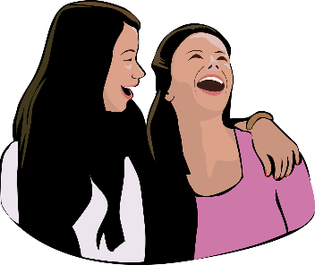
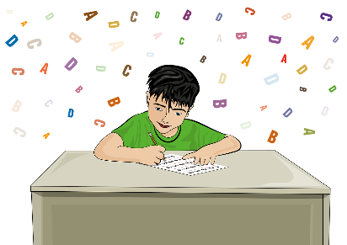
Person A [1]
sprechen
Person A stellt Fragen. Person B antwortet.
09:00
13:00
15:00
did you visit a friend?
did you write email?
did you do homework?
14:00
11:00
20:00
did you do sport?
did you read magazine?
did you eat dinner?
Notes:
DO NOT DISPLAY Person A Round 1

Slide 44
Person B [1]
sprechen
Person A stellt Fragen. Person B antwortet.
09:00
13:00
15:00
visited a friend
wrote email
did homework
14:00
11:00
20:00
did sport
read magazine
ate dinner
Notes:
DO NOT DISPLAY Person B round 1

Slide 45
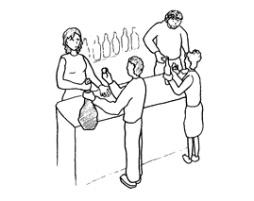
Person A [2]
sprechen
Person B stellt Fragen. Person A antwortet.
10:00
18:00
19:00
had English lesson
played guitar
showered
08:00
12:00
21:00
worked in shop
drank tea
mixed music
Notes:
DO NOT DISPLAY Person A Round 2

Slide 46
Person B [2]
sprechen
Person B stellt Fragen. Person A antwortet.
10:00
18:00
17:00
did you have English lesson?
did you play guitar?
did you shower?
08:00
14:00
21:00
did you work in shop?
did you drink tea?
did you mix music?
Notes:
DO NOT DISPLAY Person B Round 2

Slide 47
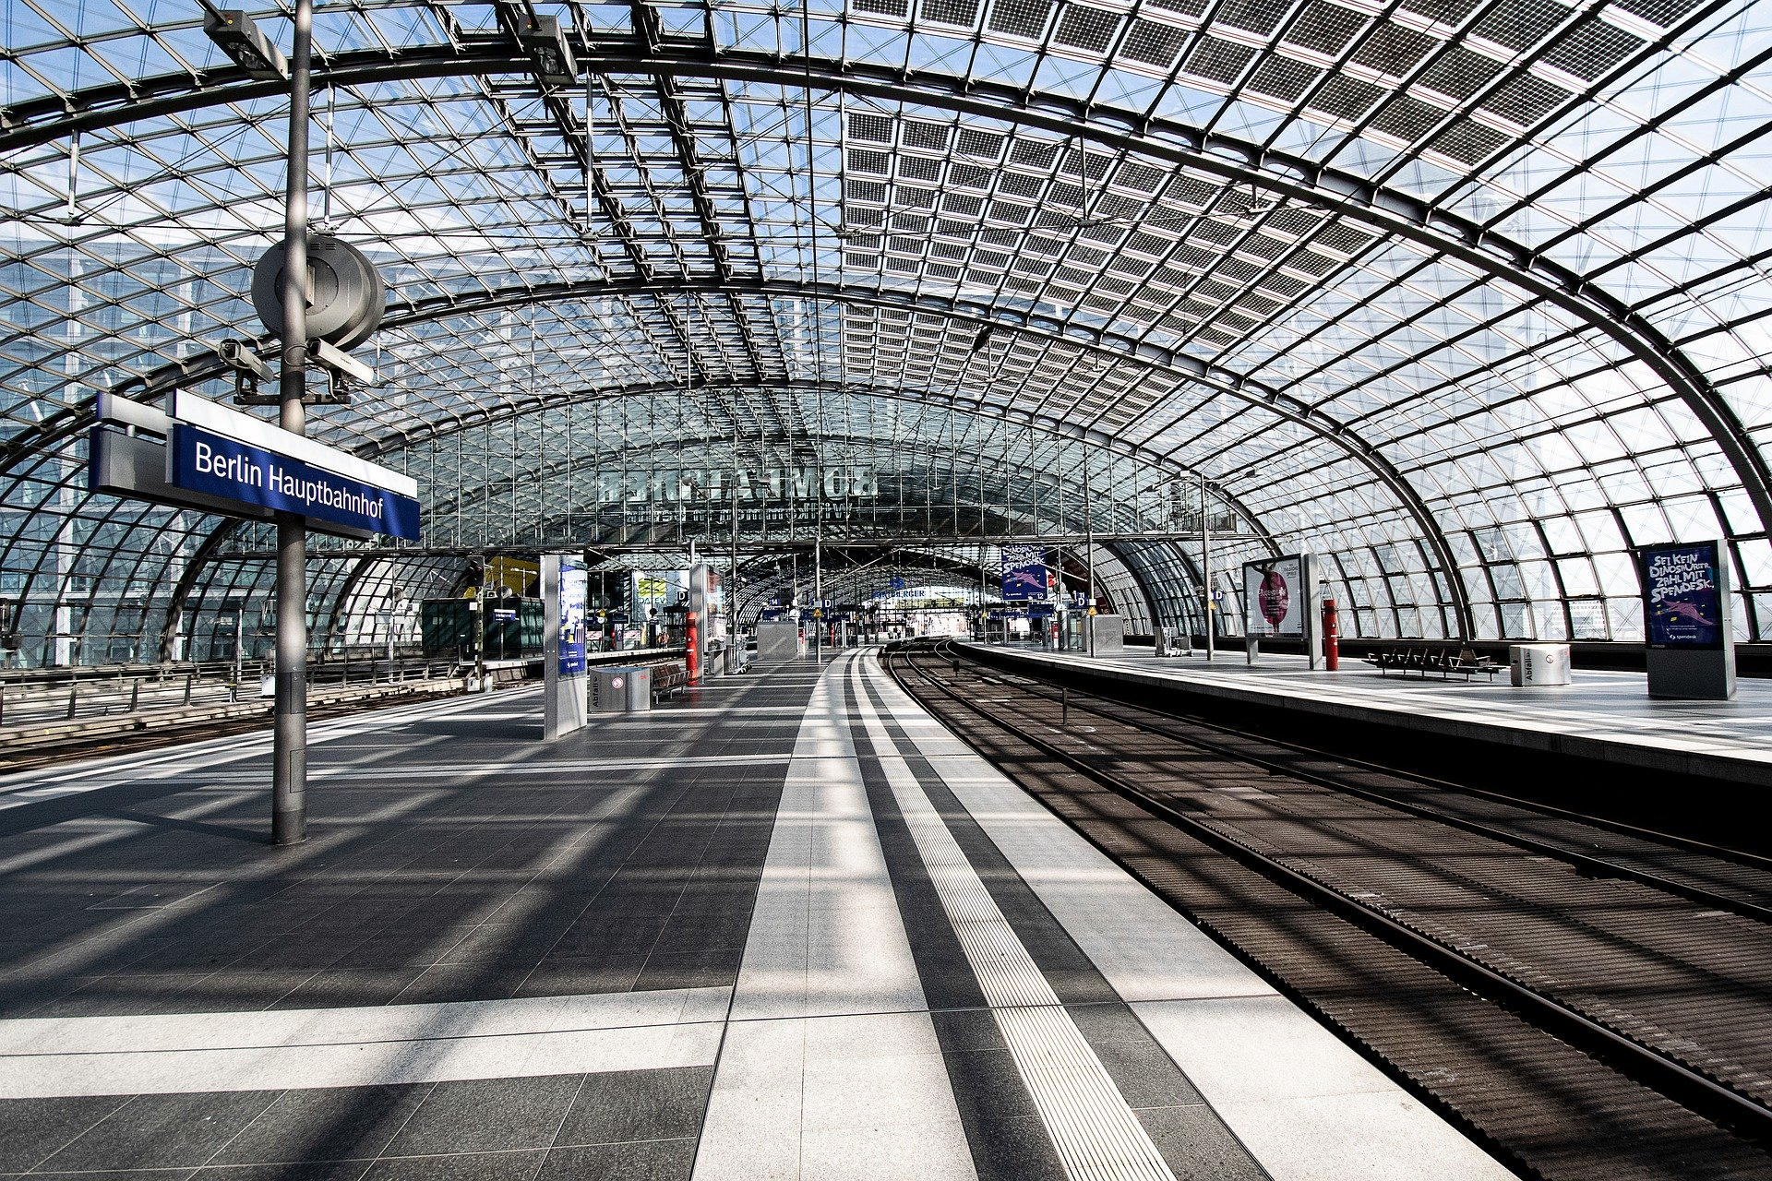
Tschüs, Berlin!
schreiben
For ‘made friends’ use ‘found friends’
Hi mum,
I’m sad, because it is my last day in Berlin. I have had a lot of fun and have made many new friends. Mia and I went to the city yesterday and I took so many pictures!
My train leaves at 9 from Berlin central station and the journey to Brussels takes nine hours. So, tomorrow I will be back at home in Cambridge.
See you (very!) soon,
Andrea
Berlin central station = Berlin Hauptbahnhof
Remember: for ‘tomorrow I will be’ use ‘tomorrow I am’
for ‘back’ use ‘wieder’ (again)
Schreib Andreas SMS auf Deutsch.
Notes:
Timing: 12-15 minutes Aim: A written practice activity to bring together the grammar and vocabulary from this and previous sequences. Procedure: 1. Translate the text into German.
2. Answers on the next slide.
Note: This is a challenging task. Groups may need to do this task with ‘in task’ support from the teacher, who can provide prompts and questions to cue learners back in to previously taught grammar features and vocabulary.

Slide 48
Tschüss, Berlin!
schreiben
Hallo Mutti,
Ich bin traurig, weil es mein letzter Tag in Berlin ist. Ich habe viel Spaß gehabt und viele neue Freunde gefunden. Mia und ich sind gestern in die Stadt gegangen und ich habe so viele Fotos gemacht!
Mein Zug fährt um neun Uhr vom Hauptbahnhof und die Reise nach Brüssel dauert neun Stunden! Also, morgen bin ich wieder in Cambridge zu Hause.
Bis (wirklich!) bald,
Andrea
Notes:
Answer

Slide 49
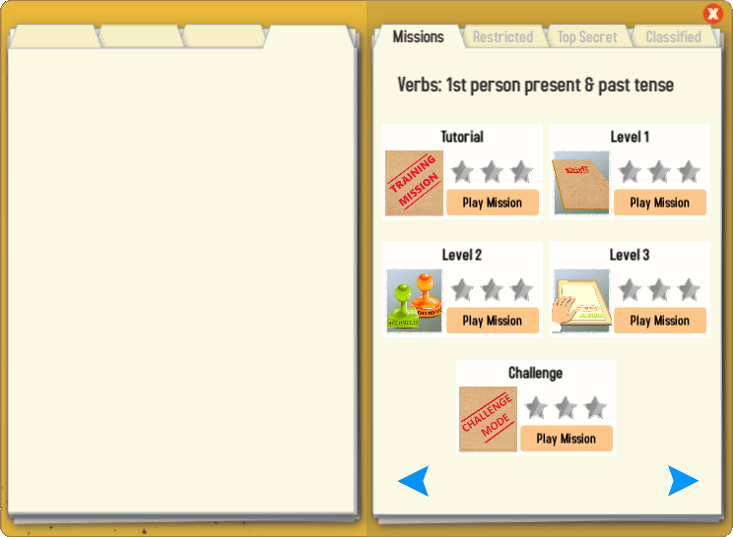
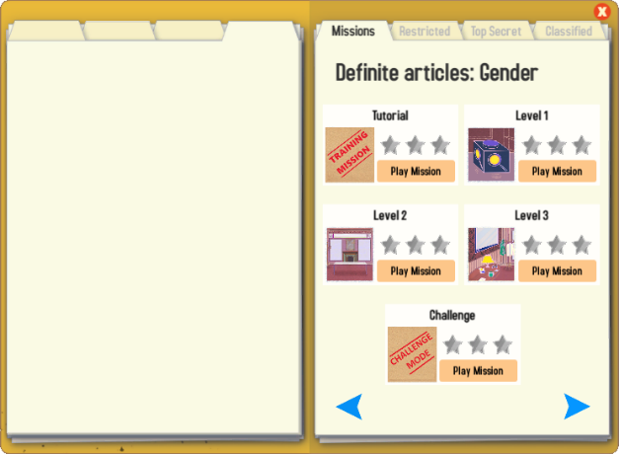
Gaming Grammar
Try the following Gaming Grammar missions to practise:

Slide 50
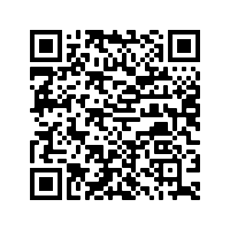
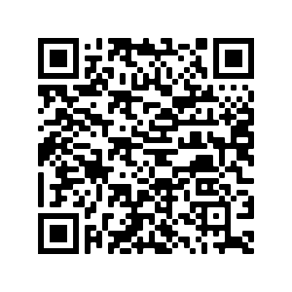
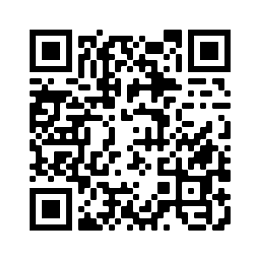
Hausaufgaben
Pre-learning for lesson: Year 8 German Term 1.2 Week 3
Revisit 1: Year 8 German Term 1.1 Week 7
Revisit 2: Year 7 German Term 3.2 Week 6

Slide 51
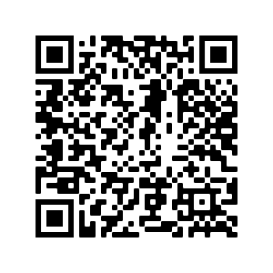
Hausaufgaben
Vocabulary Learning Homework (Y8, Term 1.2, Week 3)
Audio file
Audio file QR code:
Student worksheet
Quizlet link
In addition, revisit: Year 8 Term 1.1 Week 7
Year 7 Term 3.2 Week 6
Notes:
Answer sheet: https://resources.ncelp.org/concern/resources/hm50ts33q?locale=en

