Slide 1
den = ‘the’ after a verb
As you know, German has three words for the:
Only the masculine changes. Feminine and neuter words for ‘the’ stay the same!
masculine
feminine
neuter
die Flasche
das Fenster
der
die
das
der Tisch
After a verb the masculine word for the changes:
Niko hat den Tisch.
Niko hat den Rucksack.
Niko hat den Mann.
This change happens after most verbs but not SEIN / ist (BE / is).
Notes:
Note: This explanation expands the students’ knowledge of definite articles to the accusative (Row 2).
NB: There are of course a few verbs other than SEIN that are not followed by the accusative (Row 2): sein, werden, bleiben, scheinen, dünken, heißen.
These are not followed by objects, but typically by a ‚predicative nominal‘ (essentially like a 2nd version of the subject – e.g. Polly is a parrot. / A parrot is Polly.)
https://en.wikipedia.org/wiki/Predicate_(grammar)
At this stage, though, it is only important for students to know that SEIN is followed by nominative (Row 1), and other verbs generally by accusative (Row 2).

Slide 2
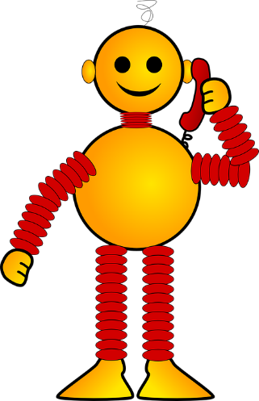
Hören
Wer hat _____?
Zorg is staying on earth. He has some possessions stored with Wolfgang and Mia. Unfortunately, he can’t remember who has what. ☹
Listen to Zorg. What is he asking about? Tick the correct person.
Wer hat die /den /das ________ ?
Wolfgang
Mia
Notes:
This listening activity and the reading activity that follows are focused on connecting articles to their nouns. The nouns are all in the accusative form and include some with the newly introduced ‘den’. The text is not given as the start of each question is the same. The students have to listen for the article.
Transcript
Wer hat die ____ [Flasche]?
Wer hat den ____ [Fußball]?
Wer hat die _____ [Tafel]?
Wer hat das _____ [Heft]?
Wer hat den ______ [Tisch]?
Wer hat das _______ [Tier]?
Wer hat das ______ [Paar]?
Wer hat die _______ [Zahl]?

Slide 3
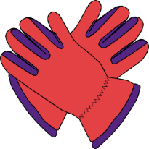
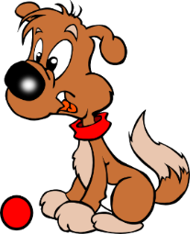
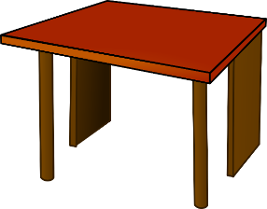
Hören
Wer hat ________ ?
Wolfgang
Mia
1
2
3
4
10
Notes:
Note: the pairs of pictures are animated to appear on the teacher’s click so that they can be brought in just before the audio is activated (by clicking the number). This prevents possible cognitive overload or distraction of seeing all the pictures all once.
Transcript
Wer hat die [Flasche]?
Wer hat den [Fußball]?
Wer hat die [Tafel]?
Wer hat das [Heft]?

Slide 4
Hören
Wer hat ________ ?
Wolfgang
Mia
5
6
7
8
10
Notes:
Transcript
5. Wer hat den [Tisch]?
6. Wer hat das [Tier]?
7. Wer hat das [Paar]?
8. Wer hat die [Zahl]?

Slide 5
Hören
Wer hat ________ ?
Wolfgang
Mia
1
2
3
4
10
Notes:
Antworten
The audio files now play the complete question. Play the audio, so students can listen to the answer before showing the correct answer.
Transcript
Wer hat die Flasche?
Wer hat den Fußball?
Wer hat die Tafel?
Wer hat das Heft?

Slide 6
Hören
Wer hat ________ ?
Wolfgang
Mia
5
6
7
8
10
Notes:
Antworten
The audio files now play the complete question. Play the audio, so students can listen to the answer before showing the correct answer.
Transcript
Wer hat den Tisch?
Wer hat das Tier?
Wer hat das Paar?
Wer hat die Zahl?

Slide 7
Lesen
Zorg made a list of his possessions and who has them, but he forgot to add the articles. Can you fill in the gaps?
Wolfgang hat ____ Flasche.
Wolfgang hat ____ Fußball.
Mia hat ____ Tafel.
Wolfgang hat ____ Heft.
Mia hat ____ Tisch.
Mia hat ____ Tier.
Wolfgang hat ____ Paar.
Mia hat ____ Zahl.
die
den
die
das
den
das
das
die
Notes:
Antworten

Slide 8
https://www.bensound.com
Notes:
Pass the parcel with cards - music stops, everyone holds up their cards (we will have 9-10 nouns in play, all the masc. ones). Teacher first asks 'Wer hat den Tisch?' Wer hat den Lehrer?'. After a few more turns, the teacher asks: 'Was hat David?' to elicit the definite article in Row 2.
Note: to start the music, click the blue ‘play’ icon. To stop it, click the red ‘no play’ icon. To start music again, click the blue ‘play’ icon again twice. Note: the final slide in the PPT has the Pass the Parcel cards.
A variation: Teacher has an extra set of the nouns in pictures. After the music stops holds a card up and ask ‘Was ist das?’ (‘Das ist der Tisch’) followed by ‘Wer hat das’? (‘David hat den Tisch’). This emphasises that masculine ‘the’ does not change after ist, but does change after other verbs.
Masculine words
der Tisch
der Tag
der Mann
der Mensch
der Ort
der Lehrer
der Fußball
der Freund der Gast
Additions
die Welt
das Wort
das Wasser
das Tier
die Sache / das Ding
die Zahl
die Farbe

Slide 9
sprechen, hören, schreiben
You are organising a garage sale for charity.
Person A has a list of all the items you’re selling and person B knows who is donating what.
Was hat Niko?
Niko has das Tier und die Flasche.
PERSON B
+
PERSON A
Niko
Notes:
You are organising a garage sale for charity. Person A has a list of all the items you’re collecting and person B knows who is donating what.
Person A: Was hat Niko? (alternative: Hat Niko x?)
Person B: Niko hat das Tier und die Flasche.
Person A: writes down Niko’s items on the response grid (…hat das Tier. … hat die Flasche.)
Which items are left over at the end?
Note: this activity combines speaking, listening, and writing. The teacher can remind students that the masculine article ‘der’ changes after a verb.

Slide 10
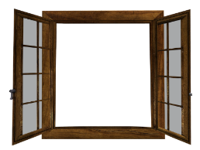
PERSON A
Person | Ding
Hannah
Julius
Noah
Sarah
Notes:
Person A: response grid

Slide 11
PERSON B
+
+
Hannah
Julius
+
+
Noah
Sarah
Notes:
Each card shows a person and the two items s/he is donating.

Slide 12
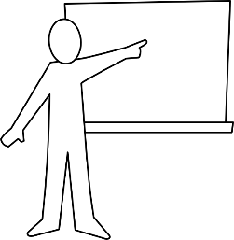
10
Inge Alferink / Rachel Hawkes
Notes:
SLIDE WITH PASS THE PARCEL CARDS
Pass the parcel with cards - music stops, everyone holds up their cards (we will have 12 nouns in play, all the masc. ones met in the SOW to date, plus 4 die/das words). Teacher first asks 'Wer hat den Tisch?' Wer hat den Mann? → Harriet hat den Mann. John hat den Mann. (there will be 2-3 students with the same noun card). After a few more turns, the teacher asks: 'Was hat David?' to elicit the definite article in Row 2.
A variation: Teacher has an extra set of the nouns in pictures. After the music stops holds a card up and ask ‘Was ist das?’ (‘Das ist der Tisch’) followed by ‘Wer hat das’? (‘David hat den Tisch’). This emphasises that the does not change after ist, but does change after other verbs.
Masculine words
der Tisch
der Tag
der Mann
der Ort (this picture is new, although students have learnt the word, so worth flagging this up)
der Lehrer
der Fußball
der Freund der Gast (this word recycled from Week 1)
Not included: (Der Mensch → difficult to distinguish from the man in a simple picture)
Additions
das Wort
die Flasche
das Tier
die Zahl

