Slide 1
Comparing what you and someone else (we) do (News and media)
Present tense -er verbs: 1st plural (-emos)
Final syllable stress
Y7 Spanish
Term 8.1 - Week 4 - Lesson 7
Victoria Hobson / Nick Avery / Rachel Hawkes Artwork: Mark Davies
Date updated: 08/10/21
Notes:
Learning outcomes (lesson 1):
Introduction of final syllable stress
Introduction of present tense –er verbs: first person plural (-emos)
Word frequency (1 is the most frequent word in Spanish):
8.1.1.4 (introduce) vender [528]; entender [229]; creer (en) [83]; esconder [1130]; poner [91]; noticia [859]; periodista [1235]; entrevista [1653]; página [598]; que [3]; sobre¹ [62]; realidad [260]; sociedad [353]
8.1.1.1 (revisit) aprovechar [885]; quedar¹ [100]; pintar [1329]; ayudar [328]; pared [778]; verano [1139]; pasado (adj.) [932]; libre [473]; máximo [935]; antes [190]; sin embargo [embargo-203]; poco (as adverb only) [76]; negro [307]
7.3.1.6 (revisit) responder (a) [464]; recibir [216]; abrir [246]; correo [1638]; electrónico [1619]; mensaje [847]; ordenador [2624]; llamada [1324]; todo¹ [472]
Source: Davies, M. & Davies, K. (2018). A frequency dictionary of Spanish: Core vocabulary for learners (2nd ed.). Routledge: London
Artwork by Mark Davies. All additional pictures selected are available under a Creative Commons license, no attribution required.

Slide 2
Fonética
hablar
Rule: If the stress is on the final syllable, and the word ends in the consonants ‘n’ or ‘s’, there will be an accent on the last vowel.
Many words in Spanish have stress on the final syllable, for example:
comer
beber
Madrid
feliz
color
español
sociedad
igual
realidad
Some words in Spanish have stress on the final syllable and have an accent to show this:
también
también
después
opción
según
después
opción
según
quizás
quizás
inglés
inglés
quizás
estación
quién
quizás
quién
autobús
estación
autobús
Notes:
Timing: 3 minutes
Aim: to introduce final syllable stress with previously learnt words
Procedure:
Teachers explain the slide, asking students to listen and repeat the items to practise putting the stress on the final syllable.
Students are given one minute in pairs to think about the meanings in English.
Elicit meaning in English of the words before moving on.

Slide 3
Fonética
leer / hablar
realidad
60
A
Z
comer
feliz
opción
Madrid
también
igual
Segundos
estación
español
color
quizás
autobús
después
según
sociedad
perdón
0
quién
inglés
beber
INICIO
Notes:
Timing: 2-4 minutes
Aim: to practise the final syllable stress with previously learnt words
Procedure:
1. Teachers start the timer. In pairs students take it in turns to say the words in alphabetical order. Partner A begins.
2. Pairs begin again, but this time partner B begins
3. This can be repeated two more times to allow students to increase their fluency.

Slide 4
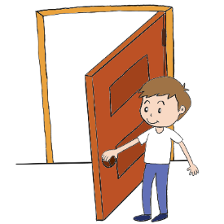
Vocabulario
hablar
Many jobs in Spanish can be masculine or feminine, depending on the person!
abrir
la noticia
pintar
el/la periodista
[journalist]
quedar
that
que
el máximo
la entrevista
maximum
[interview]
Accents matter!
qué – what
que – that
la página
black
negro, negra
Notes:
Timing: 3 minutes
Vocabulary practice slide
Procedure 1. Pupils either work by themselves or in pairs, reading out the words and recapping their English meaning (1 minute). 2. Then the teacher removes the English words or pictures (one by one) and they try to recall the English orally (chorally), looking at the Spanish (1 minute). 3. Then the Spanish meanings are removed (one by one) and they to recall them orally (again, chorally), looking at the English (1 minute) 4. Further rounds of learning can be facilitated by one pupil turning away from the board, and his/her partner asking him/her the meanings (‘Cómo se dice X en español?’). This activity can work from L2 🡪 L1 or L1 🡪 L2.
NEW Vocabulary frequency rankings (1 is the most common word in Spanish):
la noticia [859]; el periodista [1235]; la entrevista [1653]; la página [598]; que [3];
REVISITED Vocabulary frequency rankings (Y8 1.1.1)
Y8 1.1.1: máximo [935]; quedar¹ [100]; pintar [1329]; negro [307];
Y7 3.1.6: abrir [246]
Word frequency (1 is the most frequent word in Spanish): Source: Davies, M. & Davies, K. (2018). A frequency dictionary of Spanish: Core vocabulary for learners (2nd ed.). Routledge: London

Slide 5
Present tense -er verbs: 1st person plural (-emos)
gramática
Remember, some Spanish infinitives end in –er.
The verb ending changes depending on who the verb refers to.
–o
To mean ‘I’ with an –er verb, remove –er and add ___.
Later, we will see that –ir verbs work differently from this!
I reply
I learn
Respondo = _____________.
Aprendo = _____________.
To mean ‘we’ with an –er verb, remove –er and add –emos.
responder
respond
respondemos
(we answer)
Notes:
Timing: 2 minutes
Aim: to recap 1st person singular form of present tense –er/-ir verbs (-o) and introduce the 1st person plural (-emos)
Procedure:
Go through the grammar explanation with students, revealing each new sentence on a mouse click.
Notes: This will be the first time that students see –er verbs in isolation from –ir verbs. Previously they have always been practised together. Here we don’t need to explain the differences as these will be taught later. The speech bubble highlights this.
REVISITED Vocabulary frequency rankings (Y8 1.1.1)
Y7 3.1.6: responder [464]

Slide 6
vender
[to sell | selling]
vendemos
[we sell]
Notes:
Timing: 3 minutes for sequence of six slides
Aim: to introduce the verb ‘vender’ more explicitly. Vender is a prototypical verb in Spanish. Prototypical verbs are common verbs that illustrate the typical characteristics of a class of verb (in this case, -er verbs). Both the long form (infinitive) and the 1st person plural are introduced in order to familiarise students with various forms of the same verb.
Procedure
Bring up the word vender on its own, say it, students repeat it, and remind them of the phonics.
Try to elicit the meaning from the students.
Then bring up the English translations. Emphasise the two meanings for the infinitive.
Bring up the 1st person plural, say it, then students repeat it.
Try to elicit the meaning from the students. Emphasise the two meanings for the short form.

Slide 7
vender
[to sell | selling]
vendemos
[we sell]
Notes:
Cycle through the long and short form again.

Slide 8
vender
[to sell | selling]
Ana quiere vender libros.
[Ana wants to sell books.]
Notes:
Introduce the short form in a sentence.

Slide 9
vendemos
[we sell]
Vendemos libros.
[We sell books.]
Notes:
Introduce the long form in a sentence.

Slide 10
vender
[to sell | selling]
vender
Ana quiere ________ libros.
[Ana wants to sell books.]
Notes:
Cycle through the short form in context again.

Slide 11
vendemos
[we sell]
Vendemos
___________ libros.
[We sell books.]
Notes:
Cycle through the long form in context again.

Slide 12
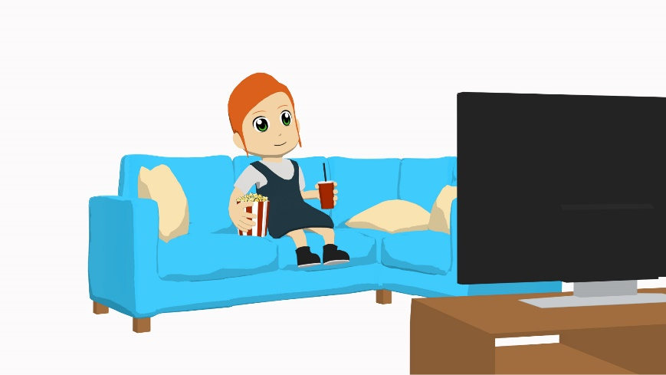
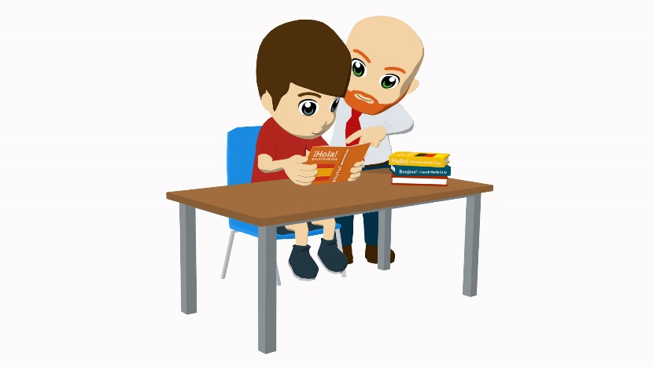
present tense -er verbs in 1st person singular and plural
gramática
esconder
[to hide]
entender
[to understand]
poner
[to put]
creer
[to believe, to think]
After ‘esconder’, say what you are hiding. For example…
Escondo unas cosas.
I hide some things.
Escondo el dinero.
I hide the money.
Notes:
Timing: 1 minute
Aim: to embed the meanings in English of these infinitives and promote student recall of the Spanish.
Procedure:
1. Introduce the four verbs on a mouse click
2. Use the sequences of custom animation to elicit the Spanish from students.
Note: the speech bubble is included to avoid suggesting that ‘esconder’ can be used as an intransitive verb (e.g. I hide). In this case, the verb would need a reflexive pronoun.
Frequency rankings: entender [229]; creer (en) [83]; esconder [1130]; poner [91]

Slide 13
present tense -er verbs in 1st person: singular and plural
gramática
escondo
[I hide]
creo
[I believe, I think]
escondemos
[we hide]
entendemos
[we understand]
creemos
[we believe, we think]
entiendo
[I understand]
ponemos
[we put]
pongo
[I put]
These four verbs all have the ‘–emos’ ending in the ‘we’ form.
This is similar to ‘hago’ (hacer) &
‘tengo’ (tener)
In the ‘I’ form, two follow the usual pattern of adding –o.
The other two add –o but also have a stem change.
Notes:
Timing: 2 minutes
Aim: to explain the first person irregularities of: entender, poner
Procedure:
Go through the grammar explanation with students, revealing each new sentence on a mouse click.
When the final callout appears, elicit meanings in English of these verbs. (They were learnt in Y7.)

Slide 14
leer
Unas personas visitan la escuela de Daniel y Lucía.
Trabajan para un periódico famoso español, El Mundo.
Lee. ¿Habla una persona (‘I’) o hablan dos personas (‘we’)?
Luego, escribe en inglés las tres frases subrayadas*.
 |  | ‘I’ | ‘We’
1. | Entiendo la realidad.
2. | Hacemos entrevistas con gente famosa.
3. | Pongo las entrevistas en una página web.
4. | No vendo los periódicos en la calle.
5. | Creemos que el trabajo es importante.
6. | İNo leo las entrevistas, no tengo tiempo!
7. | Respondo a preguntas todo el tiempo.
8. | No escondemos la verdad.
I don’t sell the newspapers in the street.
I don’t read the interviews, I don’t have time!
* underlined
We don’t hide the truth.
Notes:
Timing: 8 minutes
Aim: to practise connecting the verb ending ‘–o’ with the meaning ‘I’ and ‘–emos’ with ‘we’ for –er verbs; to raise awareness of the English auxiliary ‘do’ in negative statements.
Procedure:
1. Students read the sentences and decide if the verb refers to ‘I’ or ‘we’ by focusing on the verb ending.
2. Students then translate the underlined sections into English.
Note: The sentences to translate verbs include negatives, which are translated using the English auxiliary ‘do’. It is worth once again highlighting this difference between English and Spanish. Later in the lesson, students will work from prompts that translate sentences with the auxiliary ‘do’ back into Spanish.

Slide 15
La visita de los periodistas
escuchar
Las personas del periódico visitan la clase.
Escucha y marca la opción correcta.
¿Habla una persona (‘I’) o hablan dos personas (‘we’)?
Escucha otra vez. Escribe en inglés la actividad y cuando es.
‘I’
‘we’
 |  |  | ¿Qué? | ¿Cuándo?
EG
do interviews
on Mondays
Notes:
Timing: 1 minute
Aim: to conduct a worked example with students ahead of the grammar practice listening activity.
Procedure:
1. Play the audio example by clicking on the trigger EG.
2. Answers appear on a mouse click.
Transcript:
Ejemplo: Hago entrevistas los lunes.

Slide 16
La visita de los periodistas
escuchar
‘I’
‘we’
 |  |  | ¿Qué? | ¿Cuándo?
te
1
read other newspapers
on Tuesdays
2
don’t reply to emails
on Sundays
3
don’t sell newspapers
during the holidays
4
make calls to famous people
in the morning
5
sell magazines
in the summer
6
believe in the journalists
always
7
make calls
before eating
8
put videos on the web page
in the afternoon
Notes:
Timing: 8 minutes
Aim: To practise focusing on person agreement of present tense –er verbs in the oral modality.
Procedure:
1. Click on the number trigger to play the audio.
2. Students listen for the verb ending for number and tick the correct box.
3. Play the audio a second time.
4. Students note what the activity is in English and when it happens.
Transcript:
1) Leemos otros periódicos los martes.
2) No respondemos a los correos los domingos
3) No vendo periódicos durante las vacaciones.
4) Hago llamadas a gente famosa por la mañana.
5) Vendemos revistas en el verano.
6) Siempre creo en los periodistas.
7) Hacemos llamadas antes de comer.
8) Pongo vídeos en la pagina web por la tarde.
REVISITED Vocabulary frequency rankings
Y7 3.1.6: llamada [1324]
Y8 1.1.1: verano [1139]; antes [190]

Slide 17
Ahora, ¡eres el periodista!
escribir / hablar
I | sell | the news | in summer
We | understand | newspapers | in the holidays
I don’t | believe in | magazines | on Sundays
We don’t | hide | the truth | on Saturdays
 | put | the journalists | in the morning
 | do | reality | in the afternoon
 | read | society | every day
 | have | pages | on Thursdays
 | answer | interviews | on Fridays
No entiendo las noticias los domingos.
Leemos periódicos por la mañana.
Creo en los periodistas.
Hacemos entrevistas por la tarde.
No escondemos la verdad en las vacaciones.
No vendo revistas los sábados.
Notes:
Timing: 10-12 minutes
Aim: to create 6 sentences with –er verbs in first person singular and first person plural based on the prompts; to practise producing both affirmative and negative sentences
Procedure:
Bring up each combination of sentence parts
Ask students to the Spanish on mini-whiteboards or in their books, then volunteer the answer orally.
Students then create a number of their own sentences, using new combinations of words in the grid.
After writing the six sentences, teachers could encourage an oral simultaneous translation task, where students say a sentence and their partner translates it. Some may find this challenging to do on the spot, so this oral component could be done by some students, while other students continue to practise writing.
Sentences:
1) Leemos periódicos por la mañana.
2) Creo en los periodistas.
3) No escondemos la verdad.
4) No entiendo las noticias los domingos.
5) Hacemos entrevistas por la tarde.
6) No vendo revistas los sábados.

Slide 18
Comparing what you and someone else (we) do (News and media) [2]
Present tense -er verbs: 1st plural (-emos)
Use of present simple for unfinished actions
Y7 Spanish
Term 8.1 - Week 4 - Lesson 8
Victoria Hobson / Nick Avery / Rachel Hawkes Artwork: Mark Davies
Date updated: 08/10/21
Notes:
Learning outcomes (lesson 2):
Consolidation of final syllable stress
Consolidation of present tense –er verbs: first person plural (-emos)
Introduction of use of present simple for ongoing meaning
Word frequency (1 is the most frequent word in Spanish):
8.1.1.4 (introduce) vender [528]; entender [229]; creer (en) [83]; esconder [1130]; poner [91]; noticia [859]; periodista [1235]; entrevista [1653]; página [598]; a menudo [menudo-958]; sobre¹ [62]; realidad [260]; sociedad [353]
8.1.1.1 (revisit) aprovechar [885]; quedar¹ [100]; pintar [1329]; ayudar [328]; pared [778]; verano [1139]; pasado (adj.) [932]; libre [473]; máximo [935]; antes [190]; sin embargo [embargo-203]; poco (as adverb only) [76]; negro [307]
7.3.1.6 (revisit) responder (a) [464]; recibir [216]; abrir [246]; correo [1638]; electrónico [1619]; mensaje [847]; ordenador [2624]; llamada [1324]; todo¹ [472]
Source: Davies, M. & Davies, K. (2018). A frequency dictionary of Spanish: Core vocabulary for learners (2nd ed.). Routledge: London

Slide 19
Fonética
escuchar / escribir
Final Syllable Stress
Remember: if the stress is on the final syllable, and the word ends in ‘n’ or ‘s’, then there will be an accent on the last vowel.
Escucha y escribe la palabra en español.
 | beber
 | opción
 | color
 | realidad
 | también
 | después
 | sociedad
 | estación
 | autobús
 | feliz
1
6
2
7
3
8
4
9
5
10
Notes:
Timing: 7 minutes
Aim: to identify correctly whether the word needs an accent or not.
Procedure:
1. Play the audio.
2. Students write the word in Spanish.
3. Elicit meanings in English during the feedback.
Note: all words were previously taught within the SoW
Transcript:
beber
opción
color
realidad
también
después
sociedad
estación
autobús
feliz

Slide 20
Vocabulario
hablar
¿Cómo se dice en espanol?
city
ciudad.
NB: All –dad words in Spanish are feminine, so use ‘la’ for ‘the’ and ‘una’ for ‘a, an’.
All –dad words have final syllable stress!
activity
actividad.
-ty at the end of an English word often changes to –dad in Spanish.
Notes:
Timing: 1 minute
Aim: to explain the ‘–dad’ suffix in Spanish and its correspondence to ‘–ty’ in English.
Procedure:
Teacher elicits the Spanish for ‘city’ and ‘activity’ (both words were learnt in Y7).
Teacher reads through the follow-up explanations.
Word frequency (1 is the most frequent word in Spanish): ciudad [178]; actividad [344];
Source: Davies, M. & Davies, K. (2018). A frequency dictionary of Spanish: Core vocabulary for learners (2nd ed.). Routledge: London

Slide 21
¿Cómo se dice en español?
hablar
oportunidad
universidad
variedad
curisosidad
opportunity
university
variety
curiosity
responsabilidad
personalidad
sociedad
realidad
responsibility
personality
society
reality
Notes:
Timing: 3 minutes
Aim: to reinforce the ‘–dad’ word pattern in Spanish to ‘–ty’ in English.
Procedure:
1) Give students one minute in pairs to think about the Spanish for the eight ‘ty’ words.
2) Ask for volunteers to say the Spanish for the English words in any order.
3) Answers are revealed by clicking on the English text box.
4) Click on the Spanish text box to have the English appear again.
5) Remind students that these are all feminine nouns.
6) Draw students’ attention to spelling changes: single ‘p’ in ‘oportunidad’ and ‘a’ in ‘responsabilidad’
Word frequency (1 is the most frequent word in Spanish):
realidad [260] sociedad [353]; universidad [387]; oportunidad [564]; responsabilidad [915]; variedad [1815]; curiosidad [1830]; personalidad [1550]
Further words in most frequent 2000 words with the same pattern: necesidad [431]; cantidad [459;] posibilidad [461]; comunidad [523]; seguridad [564]; autoridad [569]; capacidad [633]; calidad [637]; unidad [848]; velocidad [1142]; actualidad [1291]; entidad [1407]; humanidad [1553]; oscuridad [1625]; identidad [1806]
Source: Davies, M. & Davies, K. (2018). A frequency dictionary of Spanish: Core vocabulary for learners (2nd ed.). Routledge: London

Slide 22
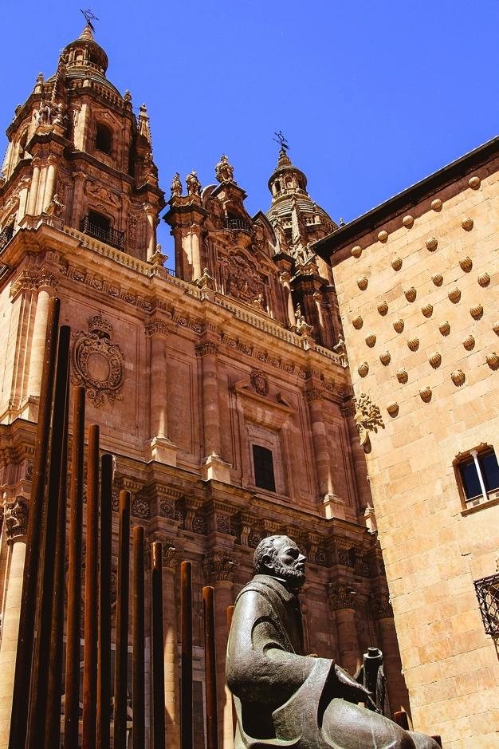
Vocabulario
escribir
La Universidad de Salamanca is the oldest university in Spain. It was founded in 1134!
Want to say ‘the opportunity to (do something)?
Use ‘la oportunidad de (hacer algo).
Escribe en español:
Salamanca has a famous university.
2) I make the most of the opportunity to use a computer.
3) In reality, receiving messages every day is normal.
4) In my free time I do not have a lot of responsibility. However, I have to/must help at home a little.
Salamanca tiene una universidad famosa.
Aprovecho la oportunidad de usar un ordenador.
En realidad, recibir mensajes todos los días es normal.
En mi tiempo libre no tengo mucha responsabilidad. Sin embargo, debo ayudar en casa un poco.
Notes:
Timing: 5 minutes
Aim: to use ‘-dad’ word in context plus other items of revisited vocabulary.
Procedure:
1. Students translate the sentences into Spanish.
2. Teachers reveal the answers on a mouse click.
Note: Be tolerant of errors around oportunidad ‘de’.
Word frequency (1 is the most frequent word in Spanish): realidad [260] universidad [387]; oportunidad [564]; responsabilidad [915]
8.1.1.1 (revisit) ayudar [328]; libre [473]; aprovechar [885]; sin embargo [embargo-203]; poco [76]
7.3.1.6 (revisit) recibir [216]; mensaje [847]; ordenador [2624]; todo¹ [472]
Source: Davies, M. & Davies, K. (2018). A frequency dictionary of Spanish: Core vocabulary for learners (2nd ed.). Routledge: London
Image of the Universidad de Salamanca free from Manuel Ramallo from Pixabay. (https://pixabay.com/es/photos/salamanca-universidad-pontificia-2307180/).

Slide 23
Routine vs ongoing/current actions
gramática
English has two present tense forms.
We make calls every Monday. We are making calls at the moment.
In Spanish, you can use the same verb for routine actions and current/ongoing actions.
Hacemos llamadas cada lunes. Hacemos llamadas en este momento.
Hacemos = We make AND
we are making
Present simple - normally; routine
Present continuous (BE + -ing) - unfinished; current
Adverbs of time tell us which English tense to choose.
We make
We are making
This is a routine action.
This is a current/unfinished action.
Notes:
Timing: 2 minutes
Aim: to explain to students ….(present continuous forms will be explicitly taught later in Y8)
Procedure:
1. Teacher to highlight the distinction in English between present simple for routine actions and present continuous for current/ongoing actions.
2. Teacher to stress that the ‘routine’ or ‘current/ongoing’ nature of the action is the way to decide which English tense to use and that it is the adverbs of time that give the pointer on this.
3. Teacher to explain that the same tense in Spanish can be used for both routine and current/ongoing actions.

Slide 24
Routine vs unfinished/current actions
gramática
Nico is babysitting for the López family.
He makes notes about the children, Lucía and Daniel.
Choose the correct adverb.
1. Daniel is playing tennis at the moment/every Sunday.
2. Lucía meets up with friends at the moment/every day.
3. Lucía is having lunch at the moment/on Fridays.
4. Daniel does his homework at the moment/on Saturdays.
5. Daniel goes for a walk at the moment/every Sunday.
Notes:
Awareness-raising [1/2]
Timing: 2 minutes
Aim: Awareness-raising exercise in English to teach students to connect temporal adverbs with the two types of present tense.
Procedure:
1. Students choose the correct adverb for the sentences.

Slide 25
Routine vs unfinished/current actions
gramática
Nico is babysitting for the López family.
He makes notes about the children, Lucía and Daniel.
Choose the correct verb in English: are these routine actions or
unfinished/ current actions?
1. Daniel washes/is washing up at the moment.
2. Lucía learns/is learning English every day.
3. Lucía plays/is playing with her friends at the moment.
4. Daniel reads/is reading a book at the moment.
5. Lucía sings/is singing on Saturdays.
Notes:
Awareness-raising [2/2]
Timing: 2 minutes
Aim: Awareness-raising exercise in English to teach pupils to connect temporal adverbs with the two types of present tense.
Procedure:
1. Students choose the correct verb in each sentence.

Slide 26
Hablan los periodistas
escuchar
The journalists give more detailed information about their jobs.
Decide if the verb refers to ‘I’ or ‘we’. Then choose the translation of the verb in English according to whether it is a routine action or a current/unfinished action.
You will know this from the adverb of time.
Remember ‘en este momento’ is used to describe current/unfinished actions and is translated into English using ‘be’ –ing.
 |  | ‘I’ | ‘We’
EG 1
respond / are responding
EG 2
make / am making
Notes:
Worked example of the listening activity on the following slide.
Timing: 2 minutes
Aim: to practise distinguishing between routine and current/unfinished actions through listening, and to pay attention to person agreement (‘I’ or ‘we’)
Procedure:
1. Click on the EG trigger to play the audio.
2. Student make a note of the verb ending for number (‘I’ or ‘we’).
3. Students listen firstly for the adverb, to indicate the best translation of the verb into English.
4. Play the audio a second time for students.
Transcript:
Respondemos llamadas todos los días
Hago una llamada en este momento.

Slide 27
Hablan los periodistas
escuchar
Los periodistas dan más información sobre el trabajo que hacen.
Escucha y marca las opciones correctas.
 |  | ‘I’ | ‘We’
te
1
do / are doing
2
sell / am selling
3
put / are putting
4
reply / are replying
5
learn / am learning
6
make / am making
7
don’t hide / aren’t hiding
don’t reply / am not replying
8
Notes:
Timing: 8 minutes
Aim: to practise distinguishing between routine and current/ongoing actions through listening plus also paying attention to verb ending for number (‘I’ or ‘we’)
Procedure:
1. Click on the number trigger to play the audio.
2. Student make a note of the verb ending for number (‘I’ or ‘we’).
3. Students listen firstly for the adverb, to indicate the best translation of the verb into English.
4. Play the audio a second time for students.
Transcript:
1. Hacemos entrevistas en este momento.
2. Vendo revistas todos los días.
3. Ponemos imágenes en la página web en este momento.
4. Respondemos los correos electrónicos en este momento.
5. Aprendo sobre la sociedad cada día.
6. Hacemos vídeos con periodistas todos los días.
7. No escondemos la verdad en este momento.
8. No respondo preguntas los viernes.
REVISITED Vocabulary frequency rankings (Y8 1.1.1)
Y8 3.1.6: correo [1638] electrónico [1619]

Slide 28
Una emergencia en las noticias
escribir
The Amazon rainforest covers a vast area in Latin America. 60% is in Portuguese-speaking Brazil, but it is also in Peruvian, Colombian, Ecuadorean, Bolivian and Venezuelan territory. Forest fires are an annual problem.
Lees en un periódico sobre los terribles incendios* en el Amazonas en Ecuador y quieres hacer algo con tus compañeros de la escuela para ayudar.
Explica la situación y tus planes para ayudar.
* fires
İIncendios* en Ecuador!
Notes:
Timing: 1 minute
Aim: to translate accurately into Spanish using 1st person plural –er verbs
Procedure:
Teachers explain the context of the writing task using this introductory slide.
Teachers explain that in this activity students will use the present simple tense for routine/timeless and unfinished actions
A callout appears with information about the Amazon and the problem of forest fires.
Note: teachers may need to explain the use of ‘para’ + infinitive here. This feature will be taught in 8.1.2.6.

Slide 29
Una emergencia en las noticias
escribir
Escribe en español el texto para la página web de la escuela:
İIncendios en Ecuador!
The situation
We understand the reality in Ecuador. We must do something because there is a problem. We believe that it is important to help.
What are we doing today?
We are making calls to people with money. We are putting information on a web page and notices* on the walls. We are selling things in front of school.
La situación
Debemos
Entendemos la realidad en Ecuador.
Creemos
hacer algo porque hay un problema.
que es importante ayudar.
¿Qué hacemos hoy?
Ponemos
Hacemos llamadas a personas con dinero.
información en una página web y anuncios en las
Vendemos cosas delante de la escuela.
paredes.
* notice
Notes:
Timing: 15 minutes
Aim: to translate accurately into Spanish using 1st person plural –er verbs showing understanding that only one tense is needed in Spanish.
Procedure:
1. Students translate the English sentences into Spanish.
2. The Spanish is revealed on a mouse click, one sentence at a time.
REVISITED Vocabulary frequency rankings (Y8 1.1.1)
Y8 1.1.1: pared [778]; ayudar [328]
Y7 3.1.6: llamada [1324]
Note: A gloss is given for ‘anuncio’ [2076], a word which hasn’t yet been taught.

Slide 30
Gaming Grammar
Gaming Grammar
Gaming Grammar mini-game verbs (present) 1st person singular/plural in the ‘Verbs agreement (present)’ menu practices aspects of this week’s lessons.
Notes:
This slide links to Gaming Grammar login screen. The appropriate mission can then be selected from the menu page.
Students will progress through the game at their own rate; teachers should use the teacher interface to check progress. This will help to inform future lesson planning.

Slide 31
Deberes
Vocabulary Learning Homework (Term 1.1, Week 5)
Quizlet link: Y8 Term 1.1 Week 5
Quizlet QR code:
In addition, revisit: Y8 Term 1.1 Week 2
Y7 Term 3.2 Week 3
Notes:
The answer sheet for the 8.1.1.5 vocabulary learning homework is here: https://resources.ncelp.org/concern/parent/7m01bm27g/file_sets/79407x77p

