Slide 1
It’s all in the planning
The Language Show November 2020
A teacher using the NCELP SOW said: ‘NCELP is what language is about.’
Rachel Hawkes Date updated: 01/11/20
Notes:
Hello. My name is Rachel Hawkes. I’m currently seconded from my school to work as co-director at NCELP, and in this presentation I'm going to talk about curriculum design. Before we get underway, I want to thank all of the NCELP team for the hard work and dedication that have gone into the NCELP project to date. In particular, with reference to curriculum planning, I want to mention Nick Avery and Natalie Finlayson, NCELP resource developers and scheme or work holders for Spanish and French respectively, and Professor Emma Marsden, director of NCELP. And very importantly, I also want to thank all of our lead and hub school teachers who are currently teaching the NCELP schemes of work in their schools, providing us with essential QA and feedback.

Slide 2
Curriculum planning principles
Teaching is carefully planned…
…to compel thinking,
thinking drives learning, and…
success in learning is motivational.
Notes:
Whether planning an individual lesson, a sequence of lessons or a whole scheme of work, there’s no doubt that excellent teaching stems from excellent planning. In this session, we focus on the planning principles for a whole languages scheme of work, whether at primary or secondary level. Examples are informed by research and practice, and taken from schemes of work that are freely available on the NCELP resource portal.
Teaching is carefully planned to compel thinking, thinking drives learning, and success in learning is motivational

Slide 3
This session
A teacher described the approach as ‘empowering.’
Principles and key features of a strong SOW
Walk through of a specific SoW document (German)
Presentation of a resource based on SoW (French)
Next steps and links to further resources
Notes:
So, this session will run as follows: we start with the principles and key features of a strong Scheme of work that apply to any new language. Then we’ll do a walk through of a specific SOW document, in this session I’m going to focus on Spanish for that. Then I’ll switch to French to show a full resource. Finally, I’ll suggest some next steps and signpost links to loads of other resources that you might be interested to explore further.

Slide 4
What does a strong SoW look like?
Logically sequenced
Detailed (down to word / SSC level)
Systematically planned for regular revisiting of PVG (phonics, vocabulary and grammar features)
Includes assessment opportunities
→ Supports teaching that equips learners to remember more, know more and do more
Notes:
Pause to reflect – 2 mins
Before I start – might be helpful to spend a moment considering what a successful scheme of work looks like for you – what do you want a scheme of work to do for you and your learners – if SoW is the vehicle that gets you and your learners to an end point – what will it include - maybe write down top 3 things you would look for in a SoW - and think about whether your current KS3 SoW do this?
In this session I hope to demonstrate that the NCELP SOW have these features.

Slide 5
NCELP SoW general principles
Clear sequencing and integration of the different strands of NCELP pedagogy: grammar, vocabulary and phonics
Grammar-driven schemes (rather than topic-based)
Sufficiently detailed to support systematic teaching
Resourcing to enable delivery of an appropriate KS3 curriculum, in line with this pedagogy, without excessive additional teacher workload
Notes:
So, following what I said on the opening slide, here are some general things that NCELP schemes of work set out to do. First, to set out clear sequencing and integration of the three strands of core language knowledge at KS3: grammar, vocabulary and phonics. They are grammar driven, rather than topic based. They need to be sufficiently detailed to support systematic teaching, and they need to be sufficiently well resourced to enable teachers to teach an appropriate Key Stage 3 curriculum, in line with the MFL pedagogy review, without an excessive additional workload falling to teachers in the creation of new resources.
As for the design features, the broad format of the scheme of work document, such as column headings, is the same across the different languages, and very similar to the Y7 sow design.
Though the schemes are grammar-driven, there is a context column, which seeks to give a broad idea of the purpose of the language in any given week, for example ‘Comparing people and places now and then’.
The scheme of work is based on a two lesson per week model. The notes column contains explanations of the language selected and ideas for teaching it.
The accompanying Y8 PPT resources are two lessons, planned as 50-60 minute lessons, where any activity that goes beyond 50 minutes is described as optional. This is a continuation of the approach followed in Y7.
There is one scheme of work for all students. However, within lessons many tasks have suggestions and scope for differentiation, either in terms of task, levels of support, or outcome.

Slide 6
NCELP SoW design features
Common format across languages
‘Context’ column giving a broad idea of the purpose of the language each week, e.g., “Comparing people and places now and then”
SOW and resources assume a two-lesson per week model, based on 36 teaching week, plus two assessment weeks
‘Notes’ column containing explanations of the language selected and/or ideas for teaching it
One SOW for all students and differentiation provided by task, level of support or outcome within lesson resources
Notes:
As for the design features, the broad format of the scheme of work document, is the same across the different languages, and very similar to the Y7 sow design.
Though the schemes are grammar-driven, there is a context column, which seeks to give a broad idea of the purpose of the language in any given week, for example ‘Comparing people and places now and then’.
The scheme of work is based on a two lesson per week model, based on 36 teaching weeks, with two weeks for assessment in terms 2 and 3.
The notes column contains explanations of the language selected and ideas for teaching it.
The accompanying Y8 PPT resources are two lessons, planned as 50-60 minute lessons, where any activity that goes beyond 50 minutes is described as optional. This is a continuation of the approach followed in Y7.
There is one scheme of work for all students. However, within lessons many tasks have suggestions and scope for differentiation, either in terms of task, levels of support, or outcome.
Let’s look at the individual strands in a bit more detail, starting with grammar.

Slide 7
This session
Principles and key features of Y8 SoW
Walk through of Y8 SoW document (language specific)
Presentation of a resource based on SoW (language specific)
Browse Y8 resources (independent task)
Feedback and discussion
Notes:
That concludes the first part of the session. For those listening to this voiceover, as I mentioned earlier, the next step is to access the language-specific scheme of work presentation for your chosen language. Then there will be time to browse the Y8 resources, and finally, to share thoughts with your TRG.

Slide 8
Tabs in the NCELP SOW
The grammar tracking tab is a week by week overview of the grammar spine, listing the new and revisited grammar features.
Notes:
If you look at the bottom of the SOW excel document you can see a number of useful tabs.

Slide 9
Grammar tracking tab
This columns denote the focus tense for that week.
This column gives the learning context.
New grammar features are in bold type.
2nd and subsequent revisits are in italics.
Extended text exploitation weeks are in orange type.
A consolidation week revises vocabulary from Y7 and grammar features from either Y7 or Y8.
Features for 1st time revisiting are in normal type.

Slide 10
Tabs in the NCELP SOW
The Y8 SOW tab is the detailed planning document for each week, with grammar, vocabulary, sounds of the language, and lesson overviews.

Slide 11
Y8 SOW
Systematic revisiting of vocabulary every 3 weeks and 9 weeks.
Sounds of the language practice in every lesson.
A focus on common word patterns every 2-3 weeks.
new | revisit | revisit
Grammar sequencing is language specific;
high frequency (irregular!) verbs,
then highly regular and frequent verbs.
Additional notes detailing the content of each lesson.
Notes:
This is what the layout of the Y8 German SoW looks like –this is from week two of the spring term.
Starts with grammar introduced – here verbs with indirect objects, and the conjunction dass –in addition it references the grammar to be revisited, some verbs of opinion and another WO3 conjunction weil.
Then we see new vocabulary introduced as well as vocabulary to be revisited – we revisit two sets of vocabulary every lesson from three and nine weeks ago - you can see that the sets differ a little in the number of words in each – the vocabulary is integrated as much as possible, but there are also stand alone vocabulary tasks, where needed.
Then the sounds of the language - in this week we are doing a 2nd revisiting of [ei] vs [ie]. And once every two to three weeks there is a focus on one specific common word pattern, either one internal to German (for example, here the nominalization of verbs) or a German-English pattern (e.g. C in English = K in German).
There is still a context – no traditional topic but a context for language use, here it is ‘Saying what we think about things’. This particular week is a typical SOW week. In addition, at regular intervals there are weeks set aside for some revision and consolidation, assessment (in term 2 and 3) and also for work on “rich” texts or authentic text exploitation, as we saw on the grammar tracking tab.

Slide 12
Grammar
Broad parity across languages in terms of key features
BUT … driven by language-specific characteristics
New grammar features are elements of a paradigm, not a full paradigm
Explanation is followed by input practice, then scaffolded production
Revisiting and repeated practice lead eventually to less-structured production activities
Notes:
As for Y7, we’re aiming for broad parity across the 3 languages in terms of the features that we cover, with differences in sequencing owing to the internal grammar of each language.
The guiding principles are also the same as for Y7; in most weeks when a new grammar feature is introduces, there will be a brief explanation, input practice in both listening and reading first, followed by scaffolded opportunities to practise the new feature in speaking and writing. A new grammar feature doesn’t mean a whole paradigm, e.g., the perfect tense, it refers to a part of a paradigm. Typically, a pair of forms is contrasted. This might be two persons of the verb, or different spelling patterns following a pair of prepositions (e.g. the accusative and dative case after the German preposition ‘auf’ or à + le combining to au, contrasted with à + la . Over time parts of paradigms build up, are revisited, both separately and eventually together, leading eventually to less-structured production activities. One of the tabs of the SOW document is called Y8 Grammar tracking. This tab sets out the grammar spine. New features are presented in bold type, normal script for first revisiting and italics for 2nd and subsequent revisits. There is also a new tab, the KS3 Grammar tab, which lists all of the paradigms and contributing features, showing which lessons they are taught, then revisited in. This tab is a reference for teachers, but a planning tool for the resource developers who are able to see at a glance how many times a feature has been practised. Y7 and Y8 grammar features are revisited in six ‘fallow’ weeks, alongside Y7 vocabulary. This allows Y7 and 8 grammar features to be extended to different lexis, which is important for strengthening the knowledge. You will see this in more detail in the language specific sessions.

Slide 13
Vocabulary (1)
New words introduced in 30 / 38 weeks
Six ‘fallow’ weeks allow for revisiting Y7 vocabulary
On average, new vocabulary sets have 10-12 new words
Overall, 300 – 360 words taught in Y8
Notes:
In contrast to Y7, new words are introduced in 30 of 38 weeks only to allow for six weeks of systematic recycling of all Y7 vocabulary, the ‘fallow’ weeks I just mentioned.
Across the 30 weeks with new vocabulary, there is an average of 10-12 new words in each vocabulary set, leading to between 300-360 new words over these 30 weeks.

Slide 14
Vocabulary (2)
Word frequency – largely words in 2000 most frequent
Continuing to build the verb lexicon
Mixed word classes, allows sentence creation from start
Word selection supports the grammar
Notes:
The essential principles guiding vocabulary choice are the same as for Y7. First and foremost is word frequency. We continue to select words that are largely within the 2000 most frequent in the language. The building of a verb lexicon also continues to be a priority.
As in Y7, our word sets contain words of different word classes. This offers greater potential for sentence creation from the start than, say, a list of 10 nouns that will just fill a slot after a verb.
At the same time, our words are selected to support the grammar, and so, in a week where we focus on adjective agreement, for example, we would choose a greater number of adjectives than we normally would.

Slide 15
Vocabulary (3)
Systematic revisiting at thee and nine week intervals
Pre-learning (and revisiting) using CALL
Y8 vocabulary learning homework now includes synonym, antonym, association and word substitution activities
Resources carefully recycle previously learnt vocabulary
NCELP approach to words with multiple meanings
Notes:
In terms of revisiting, we try to maximise encounters with vocabulary taught, as this is crucial for long-term learning.
All vocabulary sets are systematically revisited, after three weeks and again after nine weeks of teaching. This is a rolling cycle of revisiting that started in Y7 and will continue into Y11.
Words are still set as pre-learning for the week ahead, using Quizlet as one of the learning tools, as in Y7. However, Y8 vocabulary learning homeworks now include some additional tasks that integrate the three revisited vocabulary sets. Task types include synonym, antonym, association and word substitution activities. Resources are, as in Y7, carefully designed to weave in words from previous weeks.
Finally, I want to mention NCELP’s approach to words with multiple meanings (e.g., der Preis (prize, price). As a rule, words are introduced with one meaning. When a 2nd meaning is needed, the word is added to the new vocabulary set, and listed with its two meanings, which are then practised in the lesson. The progress of these polysemous words is recorded on the multiple senses tab on the sow document.

Slide 16
Sounds of the language
Builds on Y7 phonics strand
Includes range of elements most appropriate to each language
Previously-taught SSC are revisited, and in addition:
French introduces new SSC, develops liaison knowledge
Spanish focuses on word stress patterns
German combines tricker pairs and sets of SSC for further practice
Notes:
And now to phonics. In Y8 this strand is called Sounds of the language. This reflects a greater diversity of elements than in Y7 and includes sound-symbol correspondences, stress, syllables, liaison, rhythm, and pronunciation patterns, as most appropriate to each language.
There continues to be a focus on the sound-writing relationship in every lesson, with short practice activities. All three languages revisit previously taught SSC. The French Y8 SOW additionally introduces new SSC, whilst Spanish focuses on word stress patterns, and German combines trickier pairs and sets of SSC for further practice.

Slide 17
Textploitation and cultural context
Weeks to focus on rich, more challenging texts
Secure, (and growing) vocabulary of high frequency words supports the understanding of longer texts
Inclusion of authentic, semi-adapted factual and literary texts
Readability checked using the Word Profiler
Notes:
As in Y7 there are weeks set aside for work on rich, more challenging texts. Developing on from Y7, short and longer texts and spoken passages are integrated into lesson sequences more frequently, supported by students’ growing vocabulary base. It is this secure, and growing, vocabulary of high frequency words, together with grammar and phonics knowledge, that support the comprehension of longer texts, including authentic, semi-adapted factual and literary texts. Their readability is checked (using the Word Profiler) to ensure that texts are either 100% comprehensible or 90%+ with key language glossed and/or meanings carefully elicited through the activities in the lesson.

Slide 18
Assessment
Two Y8 assessment weeks, January and June
Achievement (Jan/June) and Applying your knowledge tests (June only)
Filmed assessment lessons work through two examples of each question type
More detail on assessment principles available here: Phonics, Vocabulary, Grammar
Notes:
The first Y8 assessment week is at the end of January, and the second in mid-June.
As in Y7, NCELP is designing two types of test which, between them, assess the full range of knowledge and skills students should have developed by the end of the first half of the summer term in Year 7 and 8.
The first is the ‘achievement’ test, which is designed to assess students' knowledge of a principled sample of phonics, vocabulary, and grammar (PVG) features. This ‘syllabus-based’ test is trying to find out to what extent students have actually learnt what we are trying to teach them up to the point of testing. The January test follows this model.
The second assessment type is the 'applying your knowledge' test, which brings together the PVG strands in a more holistic assessment of listening, reading, writing and speaking. This aims to assess students' ability to apply their knowledge in a fuller context through listening comprehension, oral picture description, and short translation tasks. There is one of these in the summer term of Y7 and Y8, in addition to another achievement test. Filmed assessment lessons work through two examples of each question type. These are on the Oak academy website.
If you would like more detail on the principles of assessment design, please access the following CPD screencast sessions. These contain voiceovers from NCELP specialists: i) Phonics, ii) Vocabulary, iii) Grammar
That concludes the first part of the session. For those listening to this voiceover, as I mentioned earlier, the next step would be to access the language-specific scheme of work presentation for your chosen language.

Slide 19
Tabs in the NCELP SOW
The RESOURCES Y8 is a page of individual links to each SOW resource.

Slide 20
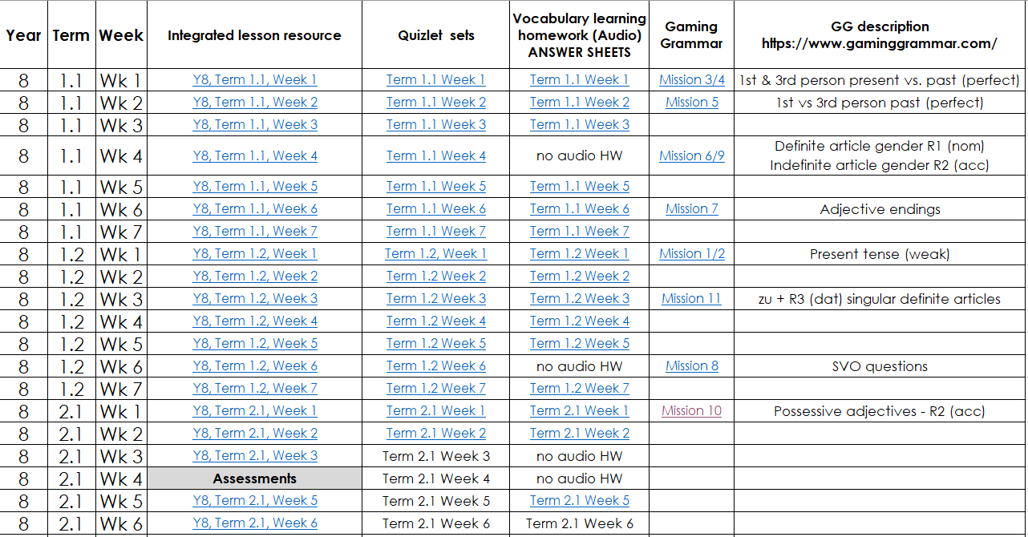
Resources Y8
Notes:
Each hyperlink takes you to the resource on the portal. You can choose the full lessons or you can download the PVG elements separately – the quizlet links for vocabulary introduced and also the vocabulary learning homework sheets - ?which Jenny will talk about more? This is the Y7 page which is complete for terms 1,2 and 3. Y8 has the same, Terms 1 and 2 are complete. Term 3 ongoing.

Slide 21
Tabs in the NCELP SOW
The NCELP Y8 vocabulary list contains all German words taught in Y8, with English meanings, parts of speech and frequency information.

Slide 22
NCELP Y8 vocabulary list
Frequency ranking of all words is provided, here.
The % words in the top 2000 is 92%.
Source of frequency information:
Jones, R.L & Tschirner, E. (2019). A frequency dictionary of German: Core vocabulary for learners. London: Routledge.

Slide 23
Tabs in the NCELP SOW
The multiple senses tab lists all the Y8 words that have more than one meaning. These meanings are taught cumulatively.

Slide 24
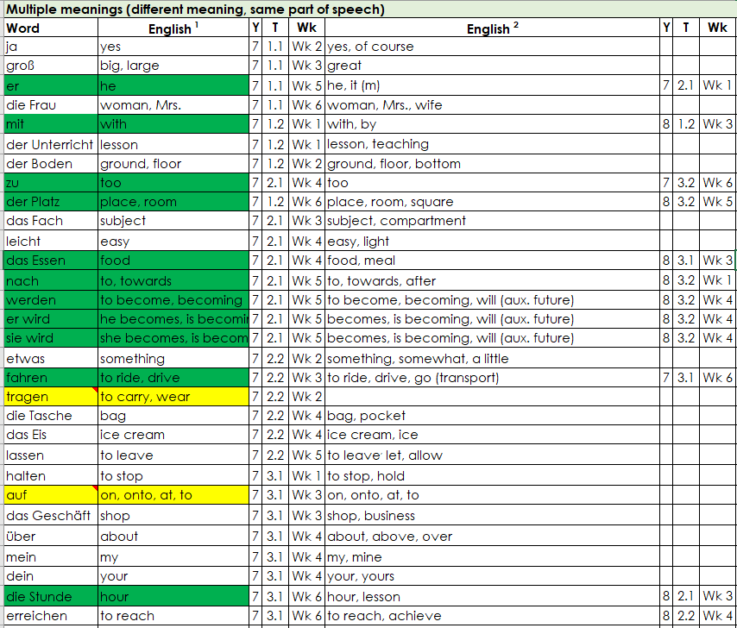
Multiple senses
Notes:
Some words in the scheme of work have multiple meanings (homonymy) or multiple senses (polysemy). To indicate how this issue is covered in the SOW, the superscript number in each column header refers to the first, second, or third time that a word is introduced, each time with a different meaning or sense. Meanings/senses are introduced in a stepwise fashion and cumulatively, so previously taught meanings/senses are included in the English translations cumulatively. For example, 'er' and 'sie' are first taught as 'he' and 'she' (Term 1.1, Week 5) and then as 'he, it' and 'she, it' (Term 2.1, Week 1).
There are three categories of polysemous words shown here: those with different meaning that are the same part of speech, e.g. das Essen (food and meal) or die Stunde (hour and lesson); those with different meanings and different parts of speech (e.g. sein (to be, verb, and his, possessive adjective) and those with the same meaning but different parts of speech.

Slide 25
This session
Principles and key features of Y8 SoW
Walk through of Y8 SoW document (German)
Presentation of a resource based on SoW (French)
Next steps and links to further resources
Notes:
That concludes the second part of the session.

Slide 26
What is it like? [1]
Present tense of common irregular -IR verbs
(je, tu, il/elle)
Adverb placement
SSC [-s-]
Y8 French
Term 1.2 - Week 6 - Lesson 25
Kirsten Somerville / Natalie Finlayson / Catherine Morris
Artwork by: Chloé Motard
Date updated: 02/09/20
Notes:
Artwork by Chloé Motard. All additional pictures selected are available under a Creative Commons license, no attribution required.
Learning outcomes (lesson 2):
Introduction of SSC [-s-]
Revision of common irregular -IR verbs (devenir, revenir, venir, sortir, partir, dormir) in the present simple and continuous
What is an adverb?
Revision of adverb placement
Word frequency (1 is the most frequent word in French):
apprendre [327], comprendre [95], devenir [162], dire [37], dis [37], dit [37], dormir [1836], dors [1836], dort [1836], partir [163], pars [163], part [163], prendre [43], prend [43], prends [43], revenir [184], sortir [309], sors [309], sort [309], venir [88], viens [88], vient [88], année [102], jour [78], mois [178], moment [148], semaine [245], anglais¹ [784], beau [393], belle [393], blanc [708], blanche [708], bleu [1216], bon [94], bonne [94], chaque [151], cher [803], chère [803], français¹ [784], grand¹ [59], grand² [59], heureux [764], heureuse [764], intelligent [2509], intéressant [1244], jaune [2585], jeune [152], naturel [760], naturelle [760], noir [572], nouveau [67], nouvelle [67], petit¹ [138], petit² [138], rouge [987], sympa(thique) [4146], vert [1060], vieille [671], vieux [671], absolument [1009], aujourd’hui [233], bien [47], dehors [1217], en retard [7/1278], encore [51], ensemble [124], ici [167], normalement [2018], parfois [410], peut-être [190], rarement [2535], souvent [287], tôt [513], très [66]
Source: Londsale, D., & Le Bras, Y. (2009). A Frequency Dictionary of French: Core vocabulary for learners London: Routledge.

Slide 27
-s-
Teachers using the NCELP SOW said: ‘Phonics make the real difference.’
‘First time in 32 years that teaching materials are creating students who pronounce much better.’
maison
Notes:
Timing: 1 minute
Aim: To introduce SSC [-s-]
Procedure: 1. Present the letter(s) and say the [-s-] sound first, on its own. Students repeat it with you. 2. Bring up the word ”maison” on its own, say it, students repeat it, so that they have the opportunity to focus all of their attention on the connection between the written word and its sound.
3. A possible gesture for this would be to trace the outline of a house in the air with two fingers. 4. Roll back the animations and work through 1-3 again, but this time, dropping your voice completely to listen carefully to the students saying the [-s- between vowels] sound, pronouncing ”maison” and, if using, doing the gesture.
Word frequency (1 is the most frequent word in French):
maison [325]
Source: Londsale, D., & Le Bras, Y. (2009). A Frequency Dictionary of French: Core vocabulary for learners London: Routledge.

Slide 28
-s-
maison
Notes:
With sound and no pictures to focus all attention on the sound-symbol correspondence.

Slide 29
-s-
maison
Notes:
Without sound to elicit pronunciation (without first hearing the teacher).
Teacher to elicit pronunciation by asking “Comment dit-on …”

Slide 30
-s-
magasin
église
désolé
maison
cuisine
[sorry]
chose
[thing]
Notes:
Timing: 2 minutes
Aim: To introduce SSC [-s-]
Procedure:
Introduce and elicit the pronunciation of the individual SSC [-s-] and then the source word again ‘maison’ (with gesture, if using). Then present and elicit the pronunciation of the five cluster words. The cluster words have been chosen for their high-frequency, from a range of word classes, with the SSC (where possible) positioned within a variety of syllables within the words (e.g. initial, 2nd, final etc.). Additionally, we have tried to use words that build cumulatively on previously taught SSCs (see the Phonics Teaching Sequence document) and do not include new SSCs. Where new SSCs are used, they are often consonants which have a similar symbol-sound correspondence in English.
Word frequency (1 is the most frequent word in French): maison [325]; chose [125]; magasin [1736]; église [1782]; désolé [2081]; cuisine [2618]. Source: Londsale, D., & Le Bras, Y. (2009). A Frequency Dictionary of French: Core vocabulary for learners London: Routledge.

Slide 31
-s-
magasin
église
désolé
maison
cuisine
chose
Notes:
With sound and no pictures to focus all attention on the sound-symbol correspondence.

Slide 32
-s-
magasin
église
désolé
maison
cuisine
chose
Notes:
Without sound to elicit pronunciation (without first hearing the teacher).
Teacher to elicit pronunciation by asking “Comment dit-on …”

Slide 33
Hard or soft [-s-]?
écouter
 |  | hard (chose) | soft (suis)
 | soupe
 | fils
 | ils ont
 | poisson
 | visage
 |  | hard (chose) | soft (suis)
 | monsieur
 | quasi
 | passer
 | personne
 | usine
1
6
2
7
3
8
4
9
5
10
What do you notice about the spelling of the words containing hard [s] compared to those containing soft [s]?
Notes:
Timing: 5 minutes
Aim: aural recognition between hard and soft [s]. Awareness of spelling rules governing the pronunciation of these SSCs.
Procedure:
1. Click on numbers to hear words. Student decide if [s] is hard or soft.
2. Click to reveal answers.
3. Students try to say the words.
4. Click again to reveal the question about spelling. Students consider in pairs. They might say things like ‘the sound occurs at the beginning’ or ‘when there is a double s’ or ‘between two vowels’. You could guide the students by explaining that there are three rules in total to spot.
4. Rules are summarized on the following slide.
Word frequency (1 is the most frequent word in French): soupe [4563], fils [735], ils ont [13/8], poisson [1616], visage [1292], monsieur [79], quasi [2778], passer [90], personne [84], usine [1482]
Source: Londsale, D., & Le Bras, Y. (2009). A Frequency Dictionary of French: Core vocabulary for learners London: Routledge.

Slide 34
Closed or open [o] ?
Hard or soft [-s-]?
Hard [s] sounds like ‘z’ as in English ‘cousin’
Soft [s] sounds like ‘s’ as in English ‘sister’
phonétique
The French s can be hard or soft.
[-s-] is hard when it:
is between two vowels, including in a liaison (oser, les amis)
[-s-] is soft when:
it is at the beginning of a word or syllable (soupe)
it is before or after a consonant (insister)
there is a double [s] (poisson)
it is at the end of a word (fils)
This is rare as word final consonants are usually SFCs
Notes:
Timing: 1 minute
Aim: to recap spelling rules governing SSC [-s-]

Slide 35
Irregular –IR verbs
grammaire
Remember, the verbs sortir, dormir and partir have the same pattern of endings:
je sors
I go out / I am going out
je dors
I sleep / I am sleeping
tu sors
you go out / you are going out
tu dors
you sleep/ you are sleeping
il sort
he goes out / he is going out
il dort
he sleeps / he is sleeping
elle sort
she goes out / she is going out
elle dort
she sleeps / she is sleeping
je pars
I leave / I am leaving
The je, tu, il and elle forms all sound the same: the –s and –t are Silent Final Consonants.
tu pars
you leave/ you are leaving
il part
he leaves / he is leaving
elle part
she leaves / she is leaving
Notes:
Timing: 3 minutes
Aim: revising the first, second- and third-person singular forms of sortir, dormir and partir

Slide 36
Irregular –IR verbs
grammaire
Venir, devenir and revenir also use these endings (with a stem change):
je viens
I come / I am coming
je deviens
I become / I am becoming
tu viens
you come / you are coming
tu deviens
you become / you are becoming
il vient
he comes/ he is coming
il devient
he becomes / he is becoming
elle vient
she comes / she is coming
elle devient
she becomes / she is becoming
je reviens
I come back / I am coming back
The only difference between these three verbs is the addition of a prefix (de- or re-).
tu reviens
you come back / you are coming back
il revient
he comes back / he is coming back
elle revient
she comes back / she is coming back
Notes:
Timing: 3 minutes
Aim: revising the first, second- and third-person singular forms of venir, devenir and revenir

Slide 37
What is an adverb?
grammaire
An adverb or adverbial phrase gives more information about when, how often, where or how something happens. They are used to describe verbs.
when?
hier
aujourd’hui
demain
bientôt
how often?
chaque semaine
rarement
normalement
chaque jour
where?
près
ici
dehors
loin
how?
absolument
bien
ensemble
peut-être
What other adverbs and adverbial phrases do you know in French?
Notes:
Timing: 3 minutes
Aim: revising adverb functions and types
Procedure:
1. Elicit answers from students before bringing up the definition.
2. Give students time to write down as many French adverbs as they can think of, using the category boxes as guides if desired.
3. Elicit examples from the class.

Slide 38
What is an adverb?
Exception!
Parfois normally comes at the beginning of a sentence:
Parfois, il mange à la cantine.
grammaire
Normally, adverbs in French come after the verb they describe.
This is sometimes different from English …
… and sometimes the same. The rules of English adverb placement are quite complicated!
Il mange souvent à la cantine. Je dors bien à la maison.
He often eats at the canteen. I sleep well at home.
Adverbs of time phrases, normally come at the beginning or the end.
In English, these normally come at the end.
Hier, j’ai visité le musée. I visited the museum yesterday.
J’ai visité le musée hier.
Aussi (also) normally comes at the end. This is different from English.
J’ai visité la Tour Eiffel aussi. I also visited the Eiffel Tower.
Notes:
Timing: 3 minutes
Aim: revising word order with adverbs.
Word frequency of cognates used (1 is the most frequent word in French): cantine [>5000], tour [523]
Source: Londsale, D., & Le Bras, Y. (2009). A Frequency Dictionary of French: Core vocabulary for learners London: Routledge.

Slide 39
Le week-end de Noura
lire
1. Le samedi / souvent, je joue avec Amir dans le parc.
2. Nous jouons dehors/le week-end quand il fait beau.
3. Rarement / Parfois, nous jouons au foot.
4. Nous jouons ensemble / aussi à la pétanque.
5. Nous faisons nos devoirs bien / aussi.
6. Je travaille bien / rarement dans ma chambre.
7. Aujourd’hui / Souvent, je fais une pause.
8. Je regarde des films et je dors aussi/ beaucoup !
Noura parle de son week-end.
Que dit-elle ?
Notes:
Timing: 4 minutes
Aim: to use knowledge of adverb placement rules to decipher meaning.
Procedure:
Students read the pairs of sentences and decide which adverb is needed using their knowledge of adverb placement rules in French.
Click to reveal a French answer.
Discuss the reasons for the answer with reference to French word order rules. Where there are alternatives, discuss how the sentence would be structured for the alternative answer to be correct.
Word frequency of cognates used (1 is the most frequent word in French): week-end [2475]
Source: Londsale, D., & Le Bras, Y. (2009). A Frequency Dictionary of French: Core vocabulary for learners London: Routledge.

Slide 40
Trouve le contraire !
lire
1. dans le passé | a) maintenant
 | b) à l’avenir
 | c) en retard
 | d) tôt
4. demain | a) souvent
 | b) ici
 | c) hier
 | d) partout
7. d’abord
2. parfois | a) peut-être
 | b) contre
 | c) bientôt
 | d) souvent
5. près | a) loin
 | b) puis
 | c) peu
 | d) rarement
a) contre
b) où
c) aujourd’hui
d) puis
3. beaucoup | a) assez
 | b) aujourd’hui
 | c) un peu
 | d) très
6. tôt | a) en retard
 | b) comment
 | c) d’abord
 | d) quand
Notes:
Timing: 5 minutes
Aim: written recognition of adverbs
Procedure:
Students tick the word they think represents the opposite of the word in bold
Answers revealed on clicks
Word frequency of cognates used (1 is the most frequent word in French): contraire [619]
Source: Londsale, D., & Le Bras, Y. (2009). A Frequency Dictionary of French: Core vocabulary for learners London: Routledge.

Slide 41
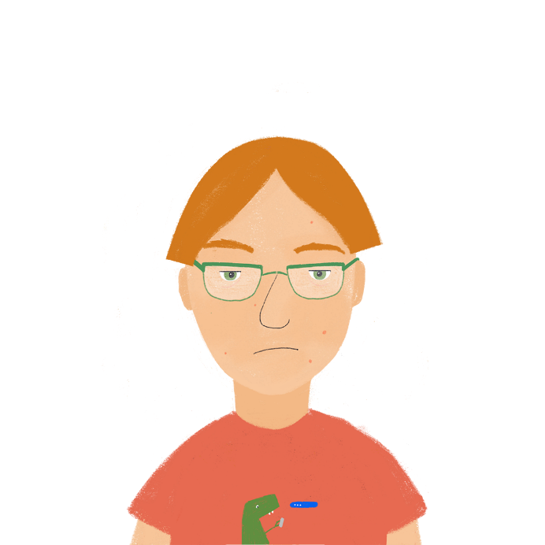
Le rêve d’Antoine
écouter
Antoine parle souvent quand il dort. Que dit-il ? Écris les phrases en anglais.
1
I’m on the island again!
_______________________________
Does it sound better to change the word order in English, or to keep it the same as the French?
2
The waves are very beautiful, too.
_______________________________
3
My favourite animal lives here.
_______________________________
4
A man is singing outside.
_______________________________
5
We often talk about France.
Zzzz…
_______________________________
6
I normally go into the mountains.
_______________________________
7
My boat is arriving early.
_______________________________
8
Maybe this is a dream …
_______________________________
9
I absolutely have to come back!
_______________________________
Notes:
Timing: 5 minutes
Aim: awareness-raising of adverb placement in French and English
Procedure:
1. Click the numbers to play the audio.
2. Students write 1-8 and try to write each sentence in English, paying attention to the adverb placement.
3. Click to reveal the answers.
4. Replay the audio and discuss which sentences sound natural with the adverb in the same position / a different position to the original French.
Transcript:
Je suis encore sur l’île !
Les vagues sont très belles aussi.
Mon animal préféré habite ici.
Un homme chante dehors.
Nous parlons souvent de la France.
Je vais normalement dans les montagnes.
Mon bateau arrive tôt.
C’est peut-être un rêve…
Je dois absolument revenir !

Slide 42
Qui fait quoi ?
Now translate the sentences into English. Where does the time phrase go?
Look at the time phrases. Do you need present simple or continuous in English?
Look at the time phrases. Do you need present simple or continuous in English?
lire
Léa compare sa vie avec Sophie.
C’est Léa (je) ou Sophie (elle) ?
 |  | simple (habitual action) | continuous (ongoing action)
1. | Je / Elle revient d’Allemagne aujourd’hui.
2. | Je / Elle dort bien normalement.
3. | Je / Elle pars parfois en retard pour le collège.
4. | Je / Elle dors rarement avec la fenêtre ouverte.
5. | Je / Elle part de la station de métro chaque jour.
6. | Je / Elle deviens amie avec Sonja en ce moment.
7. | Je / Elle sort avec des amis le week-end.
8. | Je / Elle sors en ville cette semaine.
9. | Maintenant je / elle vient au cinéma.
10. | Je / Elle viens souvent au collège à vélo.
Notes:
Timing: 8 minutes
Aim: written recognition of the first- and third-person singular forms of irregular –IR verbs, translating the French present simple
Procedure:
1. First, students write 1-10 and choose je or elle for each sentence.
2. Click to reveal the answers.
3. Then, click to reveal the hidden columns of the table.
4. Students use the time phrases to decide whether to translate each sentence using the present simple or the present continuous.
5. Click to reveal the answers.
6. If time permits, click to reveal the follow-up task instruction. Students translate sentences into English. Suggested answers can be found on the following slide.
Word frequency of cognates used (1 is the most frequent word in French): station [1399], métro [3227], week-end [2475]
Source: Londsale, D., & Le Bras, Y. (2009). A Frequency Dictionary of French: Core vocabulary for learners London: Routledge.

Slide 43
Qui fait quoi ?
lire
Léa compare sa vie avec Sophie.
C’est Léa (je) ou Sophie (elle) ?
 |  | simple (habitual action) | continuous (ongoing action)
1. | She is coming back from Germany today.
2. | She normally sleeps well.
3. | I sometimes leave late for school .
4. | I rarely sleep with the window open.
5. | She leaves the metro station every day.
6. | I am becoming friends with Sophie at the moment.
7. | She goes out with friends every weekend.
8. | I am going into town this week.
9. | She is coming to the cinema now.
10. | I often go to school by bike.
Notes:
Suggested translations for the activity on the previous slide.

Slide 44
Parle en français ! (A)
écouter / parler / écrire
Demande quand, où et comment ton / ta partenaire fait les choses.
Vous êtes similaires ? Écris des phrases en français avec je et il / elle.
 |  | ? | A | B
1. | sortir en ville | quand ? | on Saturday
2. | venir | où ? | here
3. | partir pour le collège | quand ? | early
4. | devenir malade | quand ? | sometimes
5. | dormir | comment ? | quite well
6. | revenir des vacances | quand ? | at the moment
Notes:
Timing: 8 minutes for 3 slides
Aim: aural recognition of adverbs and time phrases, oral and written production of irregular –IR verbs, adverb placement
Procedure:
1. Partner A asks Partner B a question using the prompts in the first columns of their role card (eg. ‘Quand sors-tu en ville?).
2. Partner B responds with a sentence using the prompt in the ‘B’ column of their role card (see next slide) (eg. ‘Je sors en ville chaque jour’).
3. Partner A notes the response in the ‘B’ column of their role card.
4. Continue until Partner A has noted responses for all 6 questions.
5. Partners swap roles. Repeat steps 1-4.
6. Then, each partner writes sentences in French, comparing their own responses with their partners’.
7. Answers are provided on the réponses slide.
Word frequency of cognates used (1 is the most frequent word in French): similaire [2632]
Source: Londsale, D., & Le Bras, Y. (2009). A Frequency Dictionary of French: Core vocabulary for learners London: Routledge.

Slide 45
Parle en français ! (B)
écouter / parler / écrire
Demande quand, où et comment ton / ta partenaire fait les choses.
Vous êtes similaires ? Écris des phrases en français avec je et il / elle.
 |  | ? | A | B
1. | sortir en ville | quand ? |  | every day
2. | venir | où ? |  | outside
3. | partir pour le collège | quand ? |  | late
4. | devenir malade | quand ? |  | often
5. | dormir | comment ? |  | very well
6. | revenir des vacances | quand ? |  | today

Slide 46
Parle en français !
Réponses
écouter / parler / écrire
Change verbs to –s for ‘je’ phrases.
Demande quand, où et comment ton / ta partenaire fait les choses.
Vous êtes similaires ? Écris des phrases en français avec je et il / elle.
 | Partenaire A... | Partenaire B...
1. | … sort en ville le samedi. | … sort en ville chaque jour.
2. | … vient ici. | … vient dehors.
3. | … part tôt pour le collège. | … part en retard pour le college.
4. | … devient parfois malade. | … devient souvent malade.
5. | … dort assez bien. | … dort très bien.
6. | … revient des vacances en ce moment. | … revient des vacances aujourd’hui.

Slide 47
This session
Principles and key features of Y8 SoW
Walk through of Y8 SoW document (German)
Presentation of a resource based on SoW (French)
Next steps and links to further resources
Notes:
That concludes the second part of the session.

Slide 48
Next steps ?
Use the NCELP resource portal to explore SoW collections
Pick a week and look at the integrated lesson resources in depth.
Watch the Oak Academy video for the same lesson.
Use one of the resources in your teaching (phonics?).
Notes:
So could your next steps be – having learnt a bit more about the NCELP SoW?
First I would recommend exploring the NCELP SoW collections - download the schemes of work and the over view documents so you get an idea of the breadth of material - then pick a week and look at the integrated lesson resources in depth – if you choose a lesson from year 7 you can also watch the equivalent oak video to see what it looks like in practice.
Suggestion from one of our STs: The easiest way to start using NCELP pedagogy is with the phonics resources – choose one of the phonics sequences and integrate into one of your lessons – could be with any year group to get a feel for what it is like teaching from the NCELP resources – I have been using phonics as a starter with year 10 groups with positive results.

Slide 49
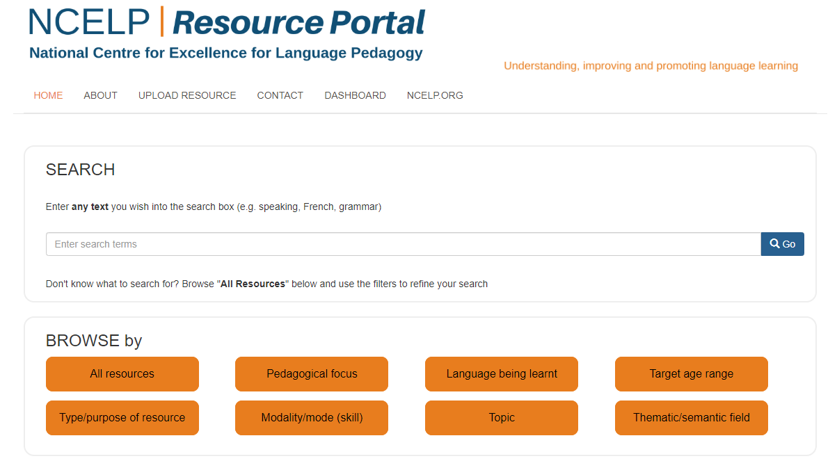
How do I find the NCELP schemes of work?
Notes:
First of all where can you find the NCELP schemes of work?
Where to find SoW – 1min
Sow is fully accessible on NCELP resource portal – search for year 7 scheme of work Spanish (French or German) and the collections will come up

Slide 50
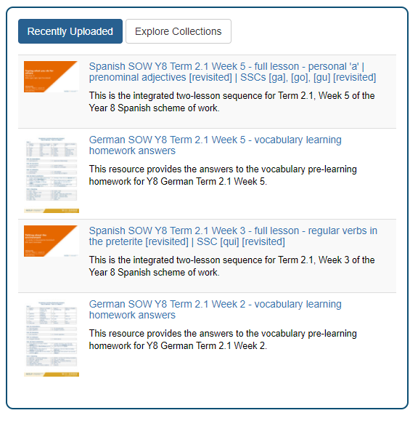
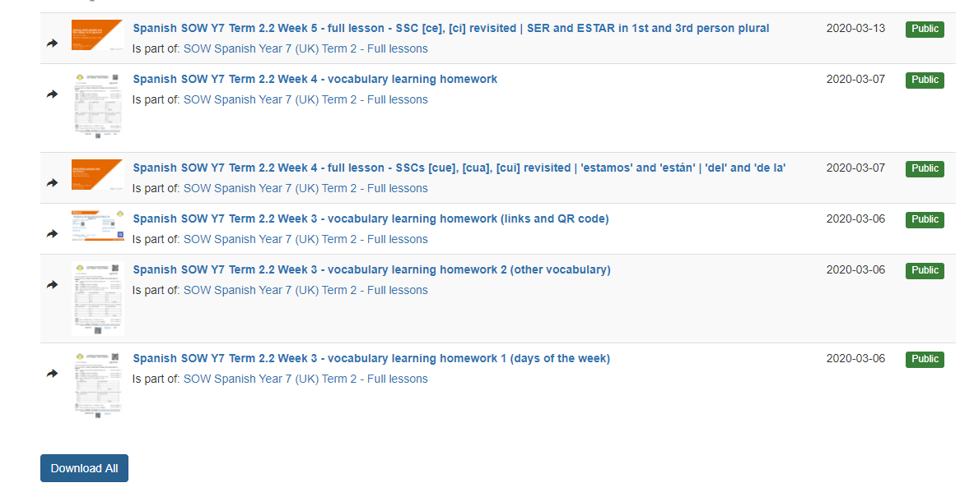
Resource collections
2. Browse All Collections to find the one you want.
1. On home page →Explore Collections.
3. Scroll down to find Download All. Click it!
Notes:
Alternatively, you can download a whole term’s resources, complete with 2-lesson sequence powerpoints for each lesson, and the vocabulary learning homework sheets, all with one click, like this.

Slide 51
Language guides
Notes:
In addition to the lesson powerpoints , there are also printable language guides to give your students – there is a page for each week with the phonics, vocabulary and grammar to be covered plus an exercise to practice the learning points .
There are Y8 versions in development, too. Term 1 out, Term 2 by end of this term. If you want to have a closer look the images on this slide are hyperlinked to the resources on the portal. Available as pdf downloads or editable PPT files.

Slide 52
Update Y7 scheme of work
Introduction to NCELP Y7 schemes of work (screencast)
Y7 schemes of work: French, German, Spanish
Filmed Y7 lessons: French, German, Spanish
Notes:
So, as I said, I’m going to focus in particular on the Y8 scheme of work today. If you are not already familiar with the Y7 scheme of work, there is a separate screencast about it, from Nick Avery, on the NCELP Resource Portal. Just search for scheme of work, or alternatively download the PowerPoint that comes with this presentation and follow the link you can see on the screen, here.
The full scheme of work for Y7, plus its accompanying PowerPoint resources, are already available on the resource portal. The process of creating Google slide versions of all of the PowerPoints is also well underway. In addition, versions of all of the Y7 lessons have been filmed and are available on the Oak Academy Website.

Slide 53
Y8 scheme of work
Y8 full year overview: French, German, Spanish
Term 1 resources: French, German, Spanish
Term 2 resources: French, German, Spanish
Schemes of work: French, German, Spanish
Notes:
For Y8, PowerPoint lessons for Terms 1 and 2 are complete (or nearly complete) for French, German and Spanish. Term 1 lessons have been filmed and are available on the Oak website. The Y8 draft full schemes of work and overview documents for the whole year are on the portal, with an updated version following teaching this term to be published to the portal, shortly. Y9 planning is also in train, with first resources to be worked on from January onwards. It might seem like this is a long-old process! It is definitely the longest amount of time I’ve ever spent writing a scheme of work. When reflecting on why this is, I think it comes down to the fact that all the previous schemes of work I’ve written have borrowed at least something from previous schemes of work. Whereas, here, the process of translating the recommendations from the MFL pedagogy review into a fully resourced three-year SOW for KS3 involved starting from scratch, as the existing SOW that we were aware of were all topic driven. So it has been quite a painstaking process, with many revisions along the way. There have been and will be more revisions, as NCELP schools and an increasing number of other schools, try it out and provide us with important feedback. And It’s important to bear in mind that this work is just one example of a scheme of work based on the pedagogy review principles.

Slide 54
This session
Principles and key features of Y8 SoW
Walk through of Y8 SoW document (German)
Presentation of a resource based on SoW (French)
Next steps and links to further resources
Notes:
This was our session plan. I hope that you’ve found this useful and that it will help you find your way around the NCELP portal, resources and SOW.

Slide 55
Next steps?
Free ‘Introduction to NCELP’ conference [20 November]
Visit the NCELP Portal and sign up to the mailing list
Sign up for my free advent webinars
Culture and cultural capital in the language classroom [5 December]
Making practice meaningful [12 December]
Look at any of the Y7 / Y8 filmed versions of NCELP lessons on the Oak Academy website
BBC Bitesize – NCELP teachers talking about grammar and phonics
https://www.justgiving.com/crowdfunding/rachel-hawkes
Notes:
BBC Bitesize
NCELP teachers talking about grammar and phonics!
https://www.bbc.co.uk/teach/teacher-support/mfl-teaching-aids/zjfckmn
New content focusing on vocab, phonics, grammar:
French: https://www.bbc.co.uk/bitesize/subjects/zgdqxnb
German: https://www.bbc.co.uk/bitesize/subjects/zcj2tfr
Spanish: https://www.bbc.co.uk/bitesize/subjects/zfckjxs
JustGiving: Weʼre raising £5,000 to provide for the essential needs of children in the Casa Hogar Amor de Dios orphanages in Arequipa, Perú. The amazing children (64 boys and girls aged 1 – 18) at the Casa Hogar Amor de Dios need help to have the basis things all children need: food, clothes, education, play, and caring adults around them.
José and Gloria Ingalls run three orphanages in Arequipa, Perú without any government funding. They now also open their doors every week to welcome and feed many elderly people in the local community, who are vulnerable and struggling. They are really wonderful people, and I want to support them in their life’s work. Money is always tight but Covid-19 has made the situation critical. As a nation, Peru is suffering both a devastating death toll and a huge economic downturn. The donations will go directly to José and Gloria, and they will use them to provide food, clothing, books and to pay their very small team of carers.

Slide 56
It’s all in the planning
The Language Show November 2020
Rachel Hawkes Date updated: 01/11/20

