Slide 1
Diesen Sommer
Present vs past (perfect): weak verbs
[ie] vs [ei]
Y8 German
Term 1.1 - Week 1 - Lesson 1
Author name(s): Inge Alferink / Rachel Hawkes
Artwork: Steve Clarke
Date updated: 07/07/21
Notes:
Artwork by Steve Clarke. All additional pictures selected are available under a Creative Common license; no attribution required.
Learning outcomes (lesson 1)
Revisit of SSCs [ie] and [ei]
Introduction of present and past tense weak verbs: 1st person singular.
Frequency rankings of vocabulary introduced and revisited this week (1 is the most common word in German):
8.1.1.1 - besuchen [820] erleben [570] kaufen [506] August [1929] Ferien [3448] Juli [1544] Kleidung [2820] Kultur [594] Spaß [1045] Tour [2640] Türkei [922] dieser, diese, dieses [24] letzter, letzte, letztes [152] schon [61] selbst, selber [101] 7.3.2.4 - ziehen [266] gewinnen [408] erhalten [283] beginnen [239] legen [296] werfen [672] mischen [2105] das Ziel [325] die Mitte [756] der Punkt [427] jeder, jede, jedes [88]
7.2.2.5 - lassen [82] nehmen [141] halten [144] dann [33] zuerst [726] spät(er) [171] danach [437] schließlich [307] deshalb [264]

Slide 2
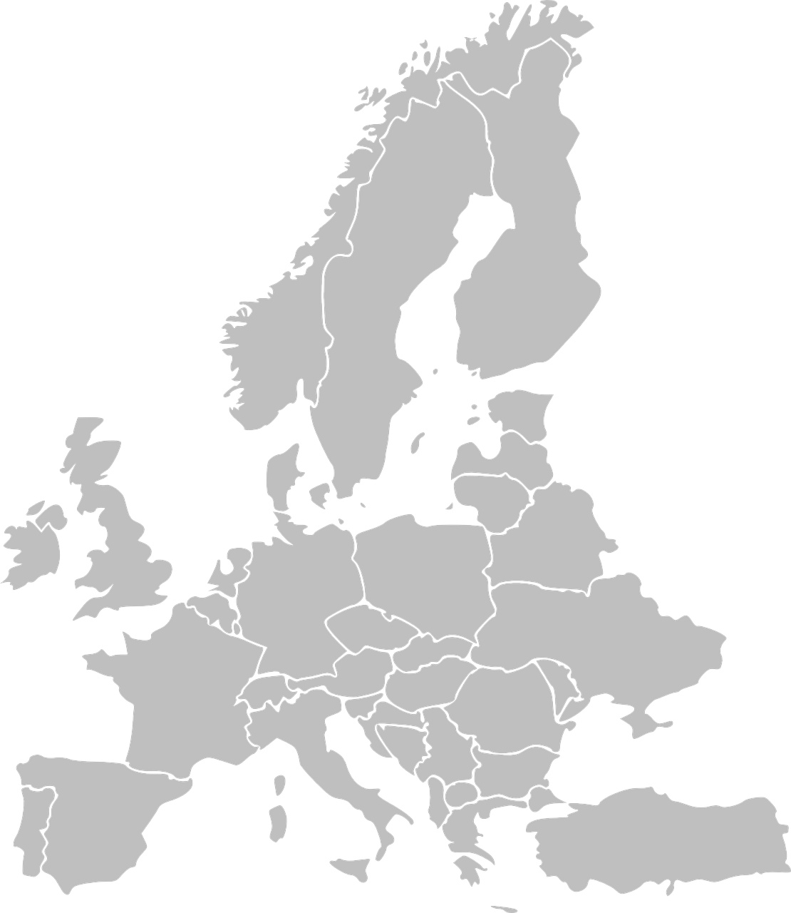
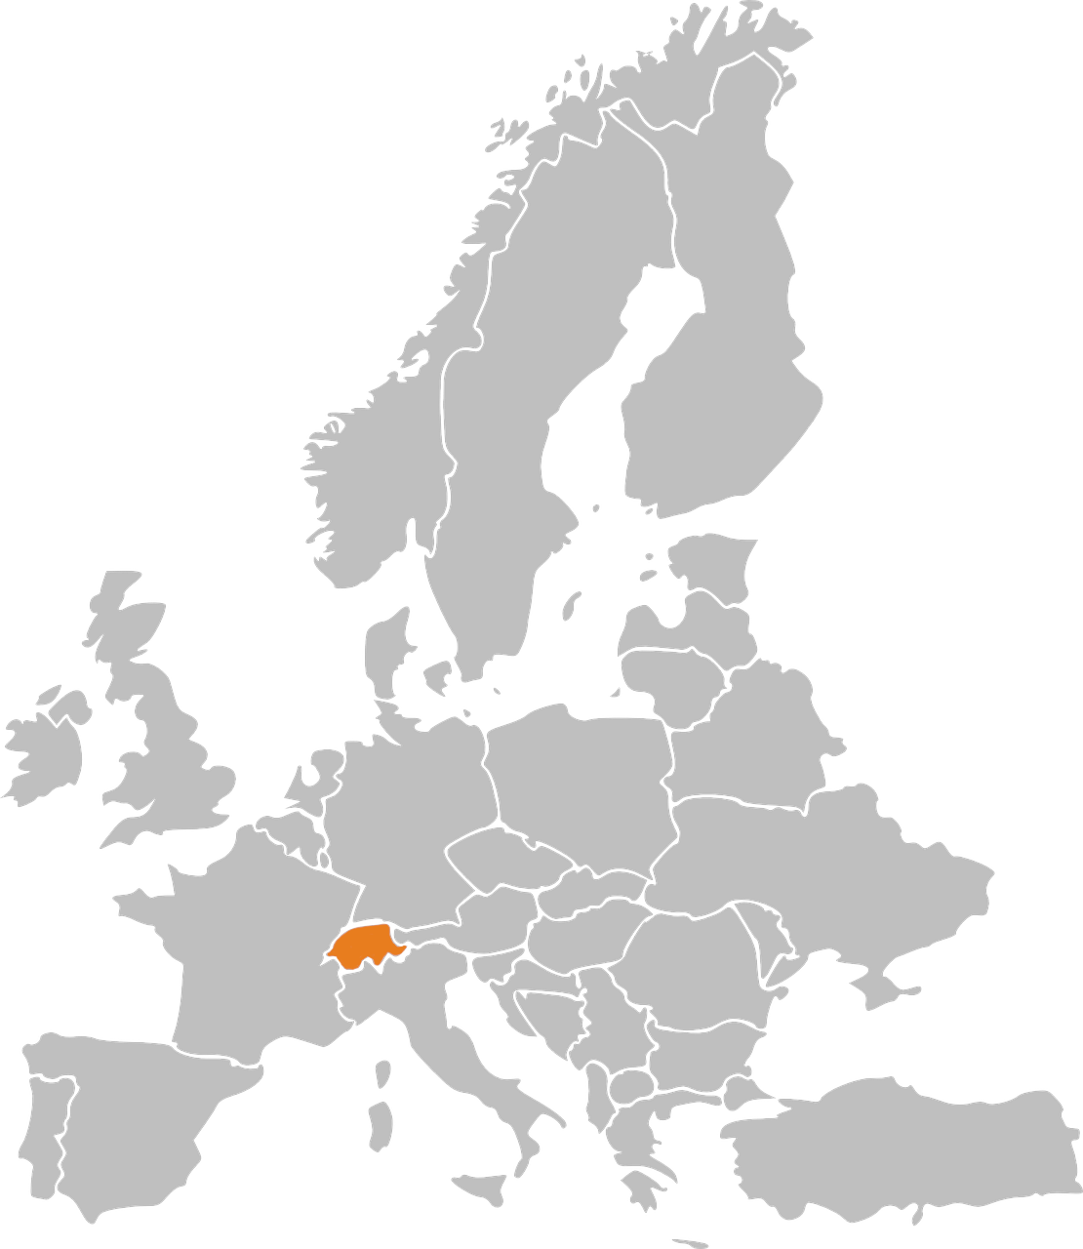
Phonetik: Stadt oder Land?
hören / schreiben
1
die Schweiz
Notes:
Timing: 3 minutes Aim: to revisit and practise the distinction between [ie] and [ei] Procedure: 1. Write 1-10.
2. Click on the number to play the sound. Note: each word is said TWICE. Transcribe either the whole word OR just the SSC [ei] / [ie].
3. Click again for spelling to appear.
4. Bist du in einer Stadt oder einem Land?
5. Click will reveal Stadt oder Land.
Transcript: die Schweiz
die Türkei
Wien
Kiel
Freiburg
Italien
Liechtenstein
Österreich
Spanien
Lienz

Slide 3
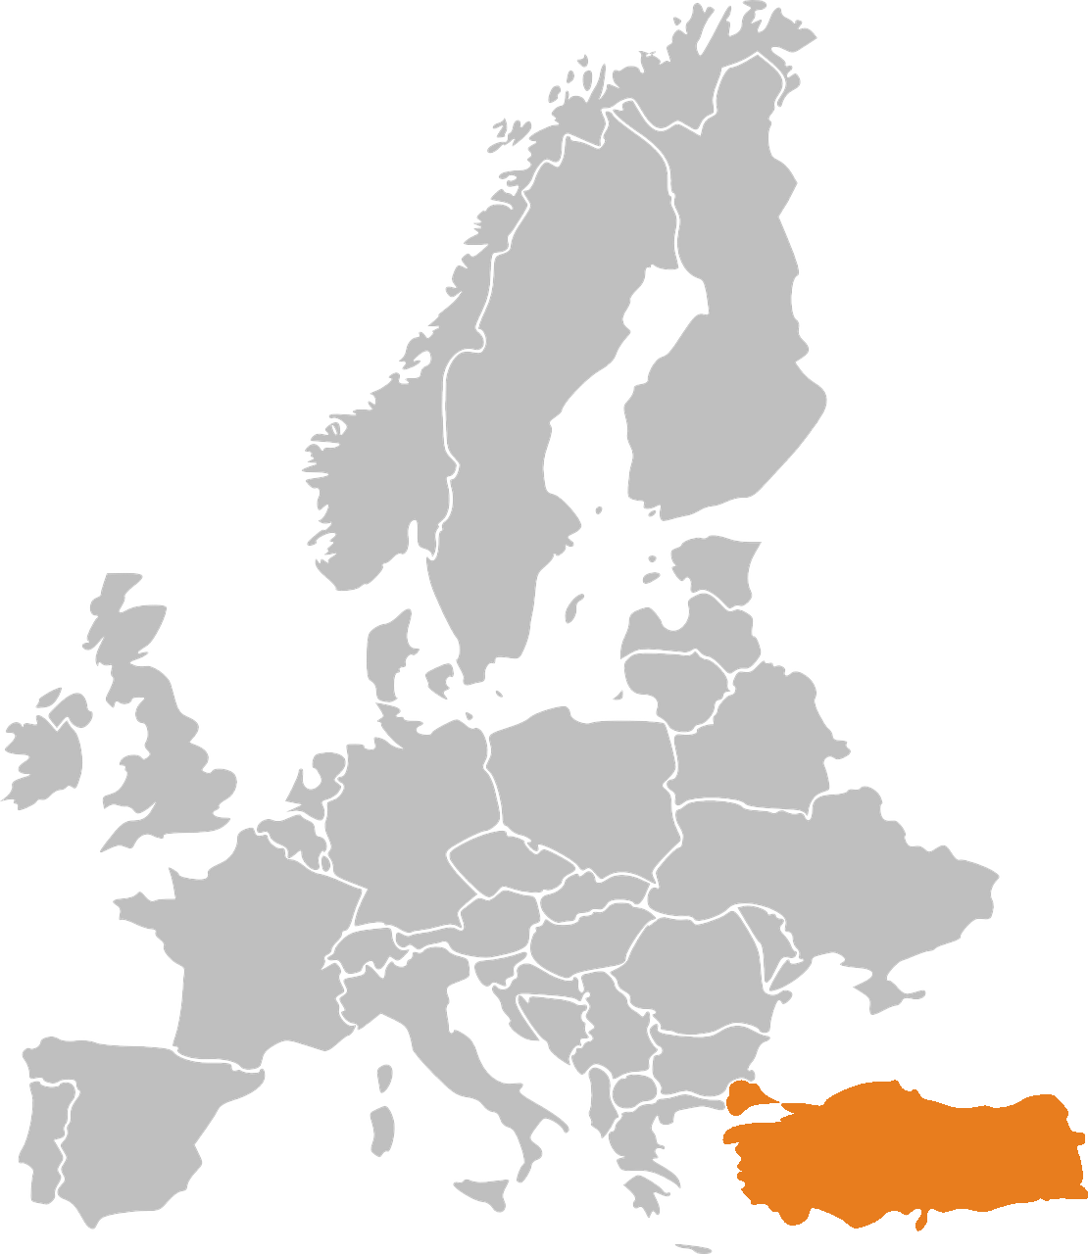
Phonetik: Stadt oder Land?
hören / schreiben
2
die Türkei

Slide 4
Phonetik: Stadt oder Land?
hören / schreiben
3
Wien

Slide 5
Phonetik: Stadt oder Land?
hören / schreiben
4
Kiel

Slide 6
Phonetik: Stadt oder Land?
hören / schreiben
5
Freiburg

Slide 7
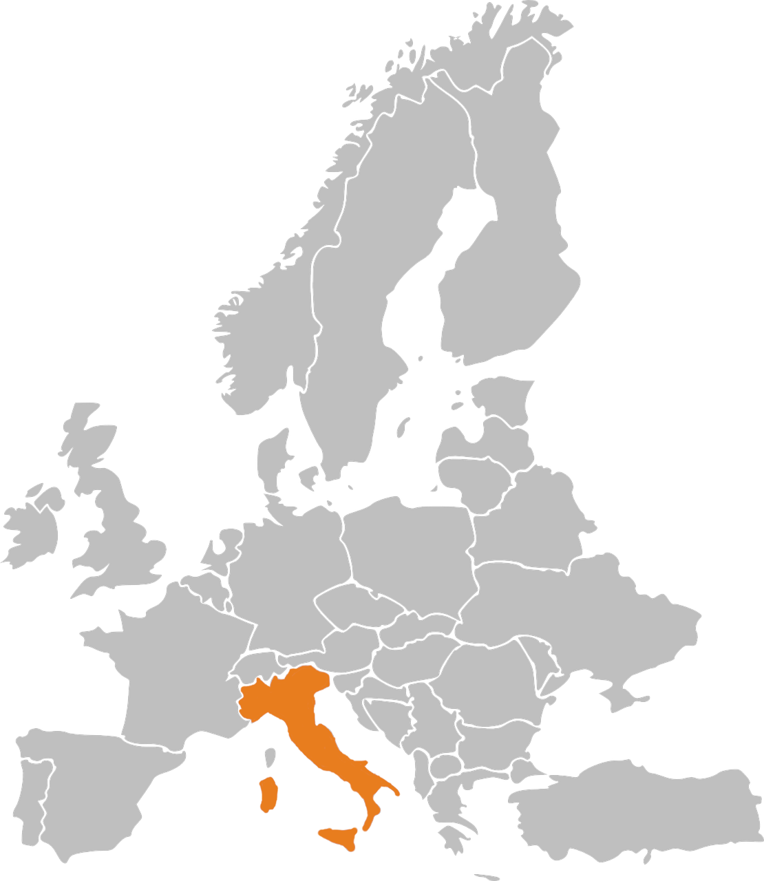
Phonetik: Stadt oder Land?
hören / schreiben
6
Italien

Slide 8
Phonetik: Stadt oder Land?
hören / schreiben
7
Liechtenstein

Slide 9
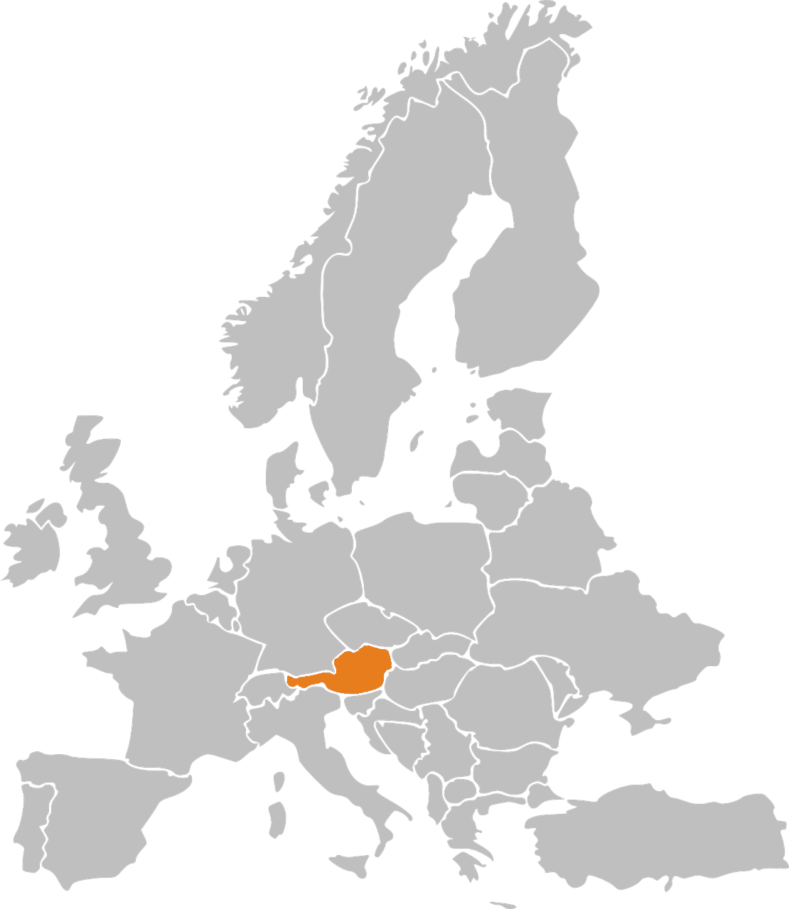
Phonetik: Stadt oder Land?
hören / schreiben
8
Österreich

Slide 10
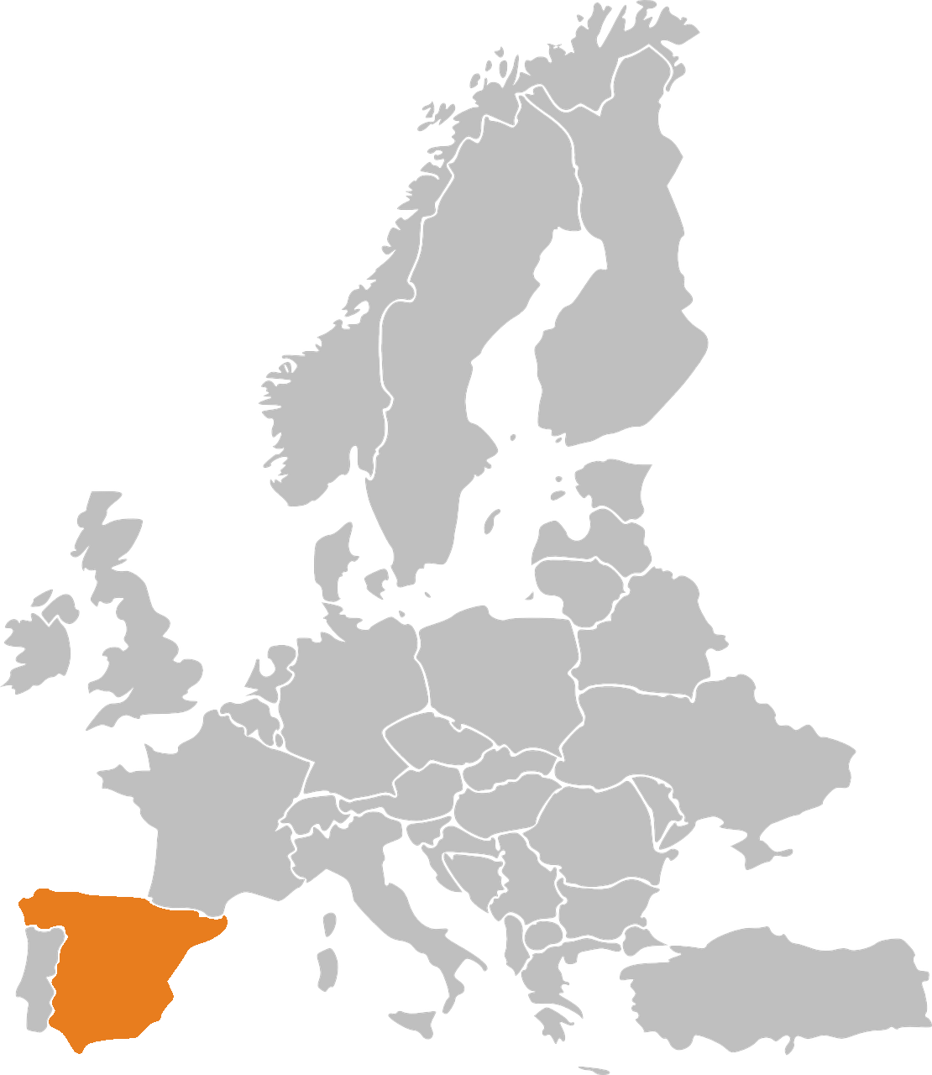
Phonetik: Stadt oder Land?
hören / schreiben
9
Spanien

Slide 11
Phonetik: Stadt oder Land?
hören / schreiben
10
Lienz
Note that when followed by –n, [ie] sometimes sounds as two syllables. Wie sagt man…? Spanien Italien Lienz

Slide 12
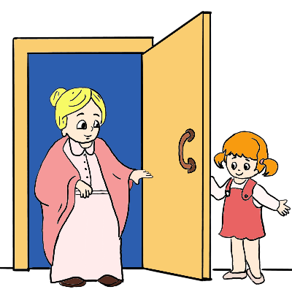
besuchen
[to visit | visiting]
besucht
[visits | is visiting]
Notes:
Timing: 3 minutes for sequence of six slides
Aim: to introduce the long and short forms of the verb ‘besuchen’, bearing in mind that students have had a substantial holiday period and will not have done pre-learning for the lesson. As the learning contrasts present and past (perfect) forms, it is important that students are thoroughly familiar with both the infinitive and short form in the present, before they are presented with the past (perfect) forms.
Procedure
Bring up the word [besuchen] on its own, say it, students repeat it, and remind them of the phonics. Draw attention to [SSC – s (like English ‘z’)]
Try to elicit the meaning from the students. Students have had explicit teaching that the present tense in German communicates two different present tense meanings in English. This reinforces that learning. Emphasise the two meanings for the short form, reminding students that German only has one form and does not have a direct equivalent of the grammar for ‘is + ing’, the continuous form (as covered in previous weeks).
Bring up the picture, and, if using gestures, a possible gesture would be [mime knocking on a door, as though you were going to visit someone’s house].
Then bring up the English translations. Emphasise the two meanings for the infinitive.
Bring up the short form [besucht], say it, students repeat it.
Try to elicit the meaning from the students. Emphasise the two meanings for the short form.

Slide 13
besuchen
[to visit |visiting]
besucht
[visits | is visiting]
Notes:
Cycle through the long and short form again.

Slide 14
besucht
[visits | is visiting]
Sie besucht die Türkei.
[She visits | is visiting Turkey.]
Notes:
Introduce the short form in a sentence.

Slide 15
besuchen
[to visit | visiting]
Sie will ihre Oma besuchen.
[She wants to visit her granny.]
Notes:
Introduce the long form in a sentence.

Slide 16
besucht
[visits | is visiting]
besucht
Sie ________ die Türkei.
[She visits | is visiting Turkey.]
Notes:
Cycle through the short form in context again.

Slide 17
besuchen
[to visit | visiting]
besuchen
Sie will ihre Oma ___________.
[She wants to visit her granny.]
Notes:
Cycle through the long form in context again.

Slide 18
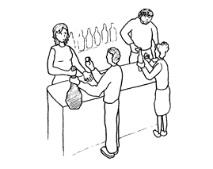
kaufen
[to buy | buying]
kauft
[buys | is buying]
Notes:
Timing: 3 minutes for sequence of six slides
Aim: to introduce the long and short forms of the verb ‘kaufen’, bearing in mind that students have had a substantial holiday period and will not have done pre-learning for the lesson. As the learning contrasts present and past (perfect) forms, it is important that students are thoroughly familiar with both the infinitive and short form in the present, before they are presented with the past (perfect) forms.
Procedure
Bring up the word [kaufen] on its own, say it, students repeat it, and remind them of the phonics. Draw attention to [SSC – au (like in ‘Haus’)]
Try to elicit the meaning from the students. Students have had explicit teaching that the present tense in German communicates two different present tense meanings in English. This reinforces that learning. Emphasise the two meanings for the short form, reminding students that German only has one form and does not have a direct equivalent of the grammar for ‘is + ing’, the continuous form (as covered in previous weeks).
Bring up the picture, and, if using gestures, a possible gesture would be [mime taking a wallet out of your pocket and handing over money].
Then bring up the English translations. Emphasise the two meanings for the infinitive.
Bring up the short form [kauft], say it, students repeat it.
Try to elicit the meaning from the students. Emphasise the two meanings for the short form.
Note: Students have had explicit teaching that the present tense in German communicates two different present tense meanings in English. This reinforces that learning. Emphasise the two meanings for the short form, reminding students that German only has one form and does not have a direct equivalent of the grammar for ‘is + ing’, the continuous form (as covered in previous weeks).

Slide 19
kaufen
[to buy | buying]
kauft
[buys | is buying]
Notes:
Cycle through the long and short form again.

Slide 20
kauft
[buys | is buying]
Er kauft Souvenirs.
[He buys | is buying souvenirs.]
Notes:
Introduce the short form in a sentence.

Slide 21
kaufen
[to buy | buying]
Sie will Kleidung kaufen.
[She wants to buy clothes.]
Notes:
Introduce the long form in a sentence.

Slide 22
kauft
[buys | is buying]
kauft
Er _____ Souvenirs.
[He buys | is buying souvenirs.]
Notes:
Cycle through the short form in context again.

Slide 23
kaufen
[to buy | buying]
kaufen
Er will Kleidung ________.
[He wants to buy clothes.]
Notes:
Cycle through the long form in context again.

Slide 24
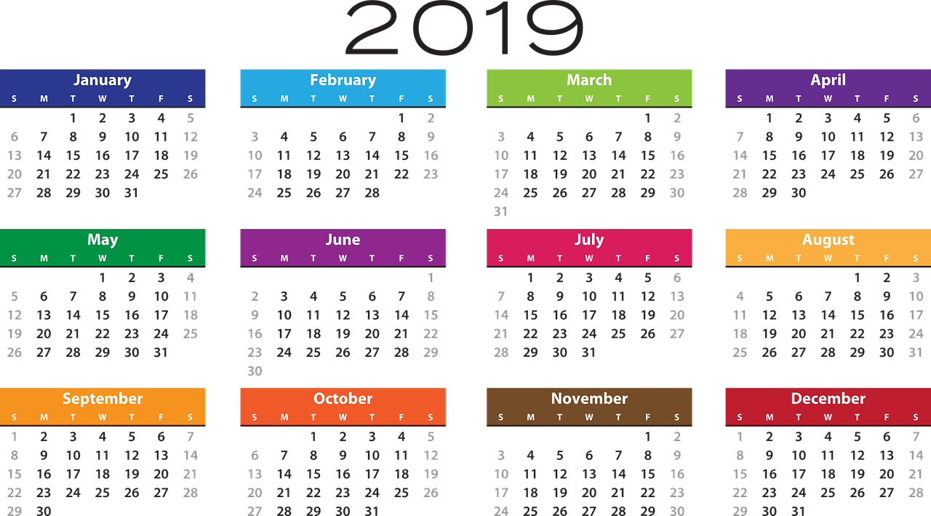
Vokabeln
lesen
August
Notes:
Timing: 3 minutes total Aim: Practise the new vocabulary for this week. Students are unlikely to have done any pre-learning, so we will return to the vocab at the end of this lesson. Procedure: 1. Read word out loud
2. Click to display illustration
3. Elicit translation Word frequency (1 is the most frequent word in German): 8.1.1.1 - besuchen [820] erleben [570] kaufen [506] August [1929] Ferien [3448] Juli [1544] Kleidung [2820] Kultur [594] Spaß [1045] Tour [2640] Türkei [922] dieser, diese, dieses [24] letzter, letzte, letztes [152] schon [61] selbst, selber [101] Source: Jones, R.L. & Tschirner, E. (2006). A frequency dictionary of German: core vocabulary for learners. Routledge

Slide 25
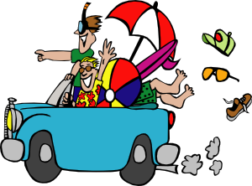
Vokabeln
lesen
Ferien (holidays) is always plural. Holiday is der Urlaub.
die Ferien

Slide 26
Vokabeln
lesen
Juli

Slide 27
Vokabeln
lesen
die Kleidung

Slide 28
Vokabeln
lesen
die Kultur

Slide 29
Vokabeln
lesen
erleben
[to experience]

Slide 30
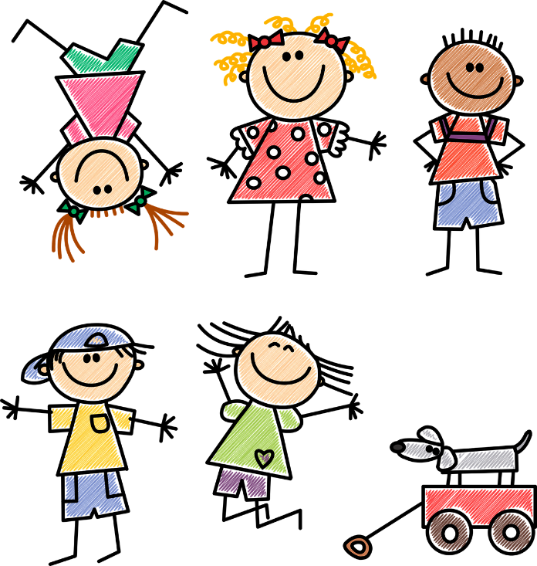
Vokabeln
lesen
der Spaß

Slide 31
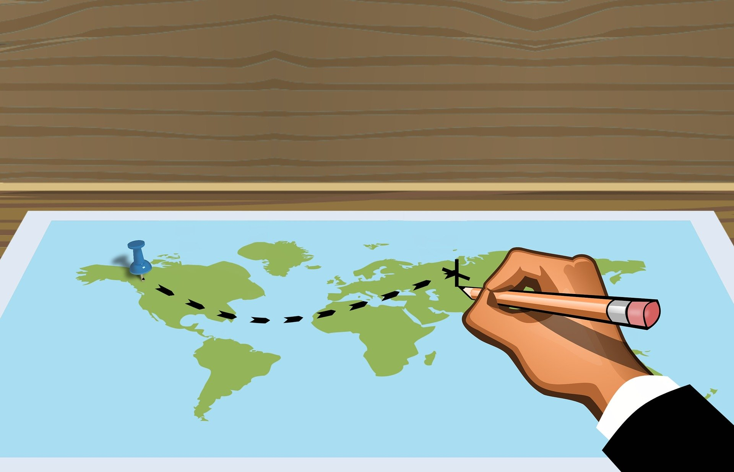
Vokabeln
lesen
die Tour

Slide 32
Vokabeln
lesen
die Türkei

Slide 33
Vokabeln
lesen
letzter, letzte, letztes
[last]

Slide 34
Vokabeln
lesen
dieser, diese, dieses
[this]

Slide 35
Vokabeln
lesen
selbst, selber
[-self]

Slide 36
Vokabeln
lesen
schon
[already]

Slide 37
Vokabeln
lesen
die
Kultur
August
Juli
die
Ferien
die Kleidung
culture
August
July
holidays
clothing
besuchen
erleben
kaufen
to visit,
visiting
to experience,
experiencing
to buy,
buying
this
tour
dieser,
diese,
dieses
selbst,
selber
werfen
beginnen
die
Tour
-self
to throw,
throwing
to begin, beginning
schon
ziehen
already
to pull, pulling
letzter,
lezte,
letztes
gewinnen
erhalten
to win,
winning
to receive, receiving
last
die
Türkei
Turkey
fun
der Spaß
Notes:
Timing: 2 minutes Aim: This slide practises the spoken form and meaning of the new vocabulary introduced this week, and some of the revisited vocabulary. Timed spoken speed recall.
Procedure:
The activity is designed like a scratch card. On clicks, the English translations appear in a random order.
Click to select a word (the word will change colour). Ask Wie heißt das auf Englisch?
Click again to trigger a 5-second ‘scratch’ animation, which slowly reveals the English equivalent. Students must race against the timer and try to say the word before it is fully revealed.
Word frequency (1 is the most frequent word in German): 8.1.1.1 - besuchen [820] erleben [570] kaufen [506] August [1929] Ferien [3448] Juli [1544] Kleidung [2820] Kultur [594] Spaß [1045] Tour [2640] Türkei [922] dieser, diese, dieses [24] letzter, letzte, letztes [152] schon [61] selbst, selber [101] 7.3.2.4 - ziehen [266] gewinnen [408] erhalten [283] beginnen [239] werfen [672] Source: Jones, R.L. & Tschirner, E. (2006). A frequency dictionary of German: core vocabulary for learners. Routledge

Slide 38
Past (perfect) tense
Note the word order! The past participle goes at the end of the sentence.
Grammatik
To talk about what you did, use the present tense of ‘haben’ and a past participle:
Present
Past (perfect)
Ich
mache
eine Tour.
Ich
habe
eine Tour
gemacht.
I’m
doing
a tour.
I
have
done
a tour.
I
do
a tour.
I
did
a tour.
Regular past participles sandwich the stem with ge- and –t.
Some verbs don’t add –ge!
besuchen → besucht
erleben → erlebt
It would be harder to pronounce them if they did!
machen
ge
t
→
mach
spielen
ge
t
→
spiel
kaufen
ge
t
→
kauf
Notes:
Timing: 3 minutes Aim: To explain how to form and use the 1st person singular (I-form) perfect tense in German. Procedure: 1. Present and carefully read each statement.
2. Wherever possible, elicit the English from students before presenting it.
Word frequency (1 is the most frequent word in German): Tour [2640] spielen [205] kaufen [506] machen [58] besuchen [820] Source: Jones, R.L. & Tschirner, E. (2006). A frequency dictionary of German: core vocabulary for learners. Routledge

Slide 39
Was sagt Mia?
lesen
Present or past? Ich oder ich habe?
 |  | Ich | Ich habe
1. | Ich habe im Juli Freunde besucht.
2. | Ich habe oft im Park Hockey gespielt.
3. | Ich habe keinen Spaß gehabt.
4. | Ich kaufe selbst viel Kleidung.
5. | Ich koche immer das Abendessen.
6. | Ich besuche das Museum.
7. | Ich habe Chinesisch gelernt.
8. | Ich habe schon eine Bootfahrt gemacht.
_______
_______
_______
_______
_______
_______
_______
_______
Notes:
Timing: 5 minutes Aim: Reading activity to practise noticing the the present form or past participle. Procedure: 1. Remind that it is the presence of a past participle at the end of the sentence that is the cue for ‘ich habe’.
2. Read the sentences.
3. Which word(s) fit in the gap?
Frequency rankings of vocabulary introduced and revisited this week (1 is the most common word in German):
8.1.1.1 - besuchen [820] erleben [570] kaufen [506] August [1929] Ferien [3448] Juli [1544] Kleidung [2820] Kultur [594] Spaß [1045] Tour [2640] Türkei [922] dieser, diese, dieses [24] letzter, letzte, letztes [152] schon [61] selbst, selber [101] 7.3.2.4 - ziehen [266] gewinnen [408] erhalten [283] beginnen [239] legen [296] werfen [672] mischen [2105] das Ziel [325] die Mitte [756] der Punkt [427] jeder, jede, jedes [88]
7.2.2.5 - lassen [82] nehmen [141] halten [144] dann [33] zuerst [726] spät(er) [171] danach [437] schließlich [307] deshalb [264]

Slide 40
Grammatik
hören
Mia telefoniert. Was sagt sie?
 | Ich | Ich habe
te
Hör dir die Sätze an. Ich oder ich habe?
1
2
3
4
5
6
7
8
Notes:
Timing: 5 minutes Aim: Practising to notice the present form or past participle. Procedure: 1. Click on number to play sound.
2. Say whether they have been done (ich habe xxx) or are being done (ich xxx).
Transcript: 1. [Ich habe] die Stadt besucht.
2. [Ich habe] immer Spaß gehabt.
3. [Ich] mache eine Radtour.
4. [Ich] spiele oft Fußball.
5. [Ich habe] manchmal gekocht.
6. [Ich habe] in der Türkei Kleidung gekauft.
7. [Ich] lerne ein bisschen Türkisch.
8. [Ich] wohne in einem Ferienhaus.

Slide 41
Und auf Englisch?
Grammatik
The perfect tense in German can be translated in two ways in English:
Ich habe Berlin besucht.
→ I have visited Berlin.
→ I visited Berlin.
The English meaning we use often depends on information about when it happened.
Specified times that are finished use simple past.
Ich habe im August Berlin besucht → I visited Berlin in August.
Unspecified, general times in the past use present perfect.
Ich habe oft Berlin besucht → I have often visited Berlin.
Other words to look out for: im Juli, letzten Monat, letztes Jahr.
Other words to look out for: schon, nie
Notes:
Timing: 3 minutes Aim: To present the two different translations of the German perfect tense. Procedure: 1. Go through the information on the slide using the animation.

Slide 42
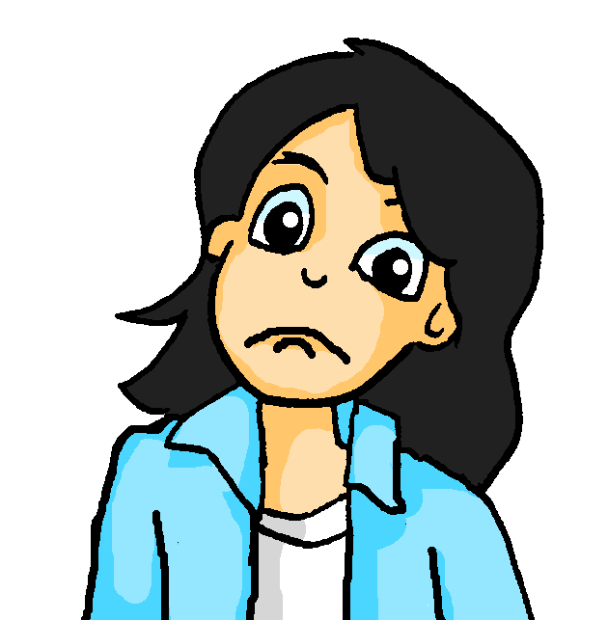
Mia findet Englisch schwierig!
lesen
Kannst du helfen? Wie heißen die Säzte auf Englisch?
1 | Letzten Monat habe ich jeden Tag die Stadt besucht.
2 | Ich habe nie in einem Hotel gewohnt.
3 | Ich habe die Kultur in der Türkei schon erlebt.
4 | Ich habe heute morgen das Essen selber gekauft.
5 | Letzte Woche habe ich viel Spaß gehabt.
6 | Ich habe immer meine Kleidung selbst gemacht.
7 | Ich habe im Juli viele Fotos gemacht.
8 | Ich habe schon eine Reise nach London gemacht.
I visited | I have visited
I have never stayed | I never stayed
I already experienced | I have already experienced
I have bought| I bought
I had | I have had
I always made| I have always made
I have taken| I took
I made| I have already made
Notes:
Timing: 5 minutes Aim: To practise translating the German perfect tense into English. Procedure: 1. Model the task using number 1. 2. Remind students to look carefully at the temporal adverbs.
3. Complete each sentence and then feed back. This knowledge is very new and the process of establishing it needs to be very supported.
Word frequency (1 is the most frequent word in German): 8.1.1.1 - besuchen [820] erleben [570] kaufen [506] August [1929] Ferien [3448] Juli [1544] Kleidung [2820] Kultur [594] Spaß [1045] Tour [2640] Türkei [922] dieser, diese, dieses [24] letzter, letzte, letztes [152] schon [61] selbst, selber [101] Source: Jones, R.L. & Tschirner, E. (2006). A frequency dictionary of German: core vocabulary for learners. Routledge

Slide 43
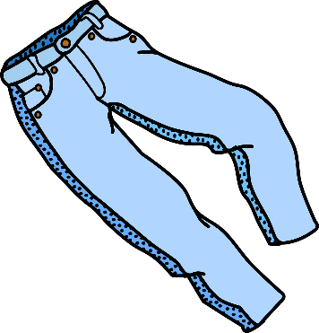
Grammatik
sprechen / hören
Start present sentences with ‘ich’
Finish the sentence with the present: → mache Fotos.
1] Person B
1] Person A
Present
1.
Finish the past sentence: → eine Hose gekauft.
Start past sentences with ‘ich habe’
2] Person A
2] Person B
Past
1.
Notes:
EXAMPLE SLIDE to model the speaking task. The following slide NOT to be displayed, but printed. NOTE: this is for the live-in classroom version, for the video lesson version see the next two slides.
Timing: 1 minute Aim: Trapping the form (ich vs ich habe) Procedure: 1. Print slide and make sure each person has their information for round 1 and 2.
2. For round 1 person A starts a sentence with Ich (present) or Ich habe (past).
3. Person B than finishes the sentence with the activity cued on their card using the correct form of the verb.
4. Person A write down the activity.
5. For round 2 person A and B swap roles.

Slide 44
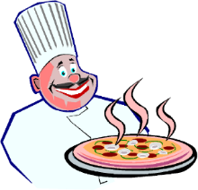
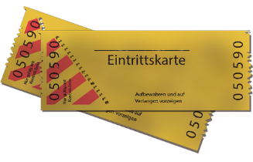
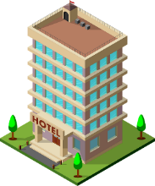
Grammatik
sprechen
1] Person B
1] Person A
Present 4. Present
Past 5. Past
Past
1.
[Volleyball]
2.
2] Person A
1.
3.
4.
5.
2.
3.
[Berlin]
2] Person B
Present 4. Present
Past 5. Past
Past
4.
[New York]
5.
[Basketball]
Notes:
DO NOT DISPLAY NOTE: this is for the live-in classroom version, for the video lesson version see the next two slides.
Timing: 7 minutes Aim: Trapping the form (ich vs ich habe) Procedure: 1. Print slide and make sure each person has their information for round 1 and 2.
2. For round 1 person A starts a sentence with Ich (present) or Ich habe (past).
3. Person B than finishes the sentence with the activity cued on their card using the correct form of the verb.
4. Person A write down the activity.
5. For round 2 person A and B swap roles.

Slide 45
Grammatik
hören / sprechen
1.
[Volleyball]
I am playing volleyball
2.
I (have) bought ice cream
3.
I (have) made pizza
4.
I am listening to a concert
5.
I (have) visited Berlin
[Berlin]
Notes:
NOTE: This is the video lesson version of this task.
Timing: 7 minutes Aim: Trapping the form (ich vs ich habe) Procedure: 1. Look at the pictures.
2. Listen to the teacher saying the sentences.
3. Write down the meaning of each sentence.
4. Cycle through the answers.
Script for video teacher
Ich spiele Volleyball.
Ich habe Eis gekauft.
Ich habe Pizza gemacht.
Ich höre ein Konzert.
Ich habe Berlin besucht.
What did I say?
I am playing volleyball
I bought ice cream / I have bought ice cream
I made pizza / I have made pizza
I am listening to a concert
I visited Berlin / I have visited Berlin
Now it’s your turn!

Slide 46
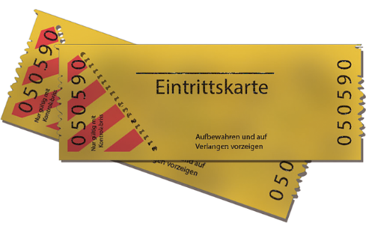
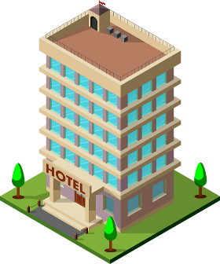
Grammatik
hören / sprechen
1.
Past
2.
Present
3.
Past
4.
Past
[Basketball]
[New York]
5.
Present
Notes:
NOTE: This is the video lesson version of this task.
Timing: 7 minutes Aim: Trapping the form (ich vs ich habe) Procedure: 1. For item use the tense and picture cues to create a sentence and speak it out loud.
2. Check the answers
Script for the video teacher:
Now it’s your turn!
You say 5 sentences to me.
…
…
…
Ok, I think you said:
Ich habe (Eintritts)karten gekauft.
Ich lerne Englisch.
Ich habe in einem Hotel gewohnt.
Ich habe Basketball gespielt.
Ich besuche New York.

Slide 47
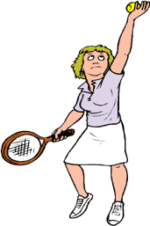
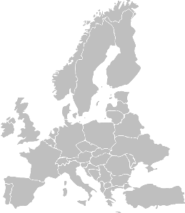
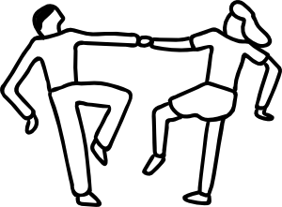
Grammatik
schreiben
Du bist im Urlaub!
You are doing a lot this year, but nothing is the same as you did last year on holiday. Write five sentences to describe your activities this year, and five to say what you did last year. Remember to use the right verb(s) for past and present. Use all the cards.
Notes:
Timing: 10 minutes Aim: To practise 1st person present tense vs perfect tense in writing. Procedure: 1. Use all the cards.
2. Write 5 sentences to describe your activities this year and 5 sentences to describe your activities last year.

Slide 48
Diesen Sommer
Present vs past weak verbs
Mixed SSC
Y8 German
Term 1.1 - Week 1 - Lesson 2
Author name(s): Inge Alferink / Rachel Hawkes
Artwork: Steve Clarke
Date updated: 07/07/21
Notes:
Learning outcomes (lesson 2):
Consolidate the present and perfect 1st person singular
Introduce new determiners
In + indefinite article (Row 3)
Frequency rankings of vocabulary introduced this week (1 is the most common word in German):
8.1.1.1 - besuchen [820] kaufen [506] selbst, selber [101] welcher, welche, welches [122] August [1929] Ferien [3448] Juli [1544] Kleidung [2820] Kultur [594] Spaß [1045] Tour [2640] Türkei [922] letzten Monat [152/316]
Frequency rankings of vocabulary revisited this week (1 is the most common word in German):
7.3.2.4 - ziehen [266] gewinnen [408] erhalten [283] beginnen [239] legen [296] werfen [672] mischen [2105] das Ziel [325] die Mitte [756] der Punkt [427] jeder, jede, jedes [88]
7.2.2.5 - lassen [82] nehmen [141] halten [144] dann [33] zuerst [726] spät(er) [171] danach [437] schließlich [307] deshalb [264]

Slide 49
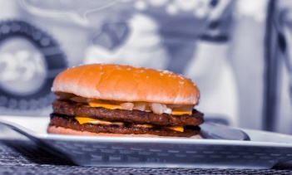
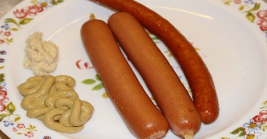
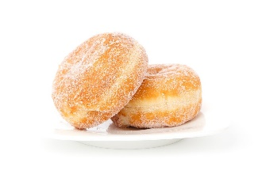
Referring to inhabitants of a place
Kultur
To refer to an inhabitant of a place in German, we usually add –er to the place name:
Notice that we do not say ‘ein Leipziger’
(the indefinite article is omitted in German!)
This is a bit like saying ‘I am a Londoner’ in English!
e.g. Er ist Leipziger.
He is a Leipziger (i.e. from Leipzig).
So someone from Hamburg would say:
US President Kennedy famously made this little error, when he said in a speech to the people in Berlin in 1963:
‘Ich bin ein Berliner.’
(I am a doughnut!)
What did he mean to say?
Ich bin Hamburger.
Ich bin ein Hamburger!
NOT:
...and somebody from Frankfurt:
Ich bin Frankfurter.
Ich bin ein Frankfurter!
NOT:
...and somebody from Berlin:
Ich bin Berliner.
Ich bin ein Berliner!
NOT:
Notes:
Timing (grammar slide)
3 minutes
Aim
This slide describes how to refer to a inhabitant of a particular town in German, as well as pointing out the comic consequences of neglecting to omit the definite article before the noun!
Suggested procedure
1. Click on the mouse to animate the explanation.
2. Check students’ understanding at all stages.

Slide 50
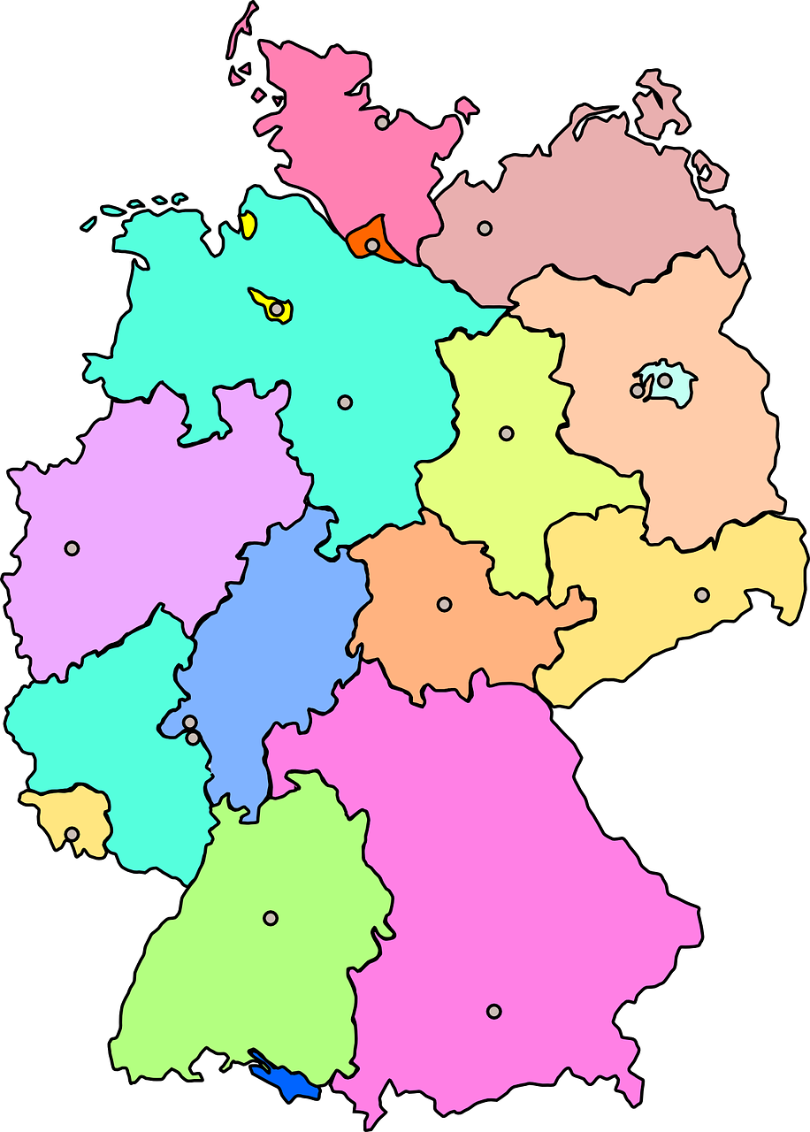
Phonetik
Kiel
lesen / sprechen
Potsdam
Bremen
Düsseldorf
Magdeburg
Mainz
Dresden
Saarbrücken
Stuttgart
Erfurt
Notes:
Timing: 5 minutes Aim: In this activity various SSCs are revisited. Students pronounce novel words (names of cities) using the SSC knowledge they have so far accumulated. This activity builds in some cultural knowledge as the cities are the capitals of some of the German provinces (Bundesländer). They then apply the pattern for naming the inhabitants of a place. The aim here is not that students learn these as words, but to understand the concept of the pattern and to put their phonics knowledge into practice. Procedure: 1. Read the names of the cities out loud.
2. Go through the cities again, but now say what an inhabitant of the city would be called (like Hamburg – Hamburger on the previous slide).
3. Click place names to hear the name of the inhabitants. Note that we have included few that deviate slightly from the pattern (in bold below), essentially dropping a syllable.
Transcript: Bremer
Düsseldorfer
Mainzer
Saarbrücker
Stuttgarter
Kieler
Potsdamer
Magdeburger
Dresdner, sometimes Dresdener
Erfurter

Slide 51
Vokabeln
hören
Hör dir die Wörter an. Hast du diese Wörter auf Deutsch gehört?
x
1
first
zuerst
2
to receive / receiving
erhalten
3
goal
das Ziel
x
4
to mix / mixing
mischen
x
5
in the end
schließlich
Notes:
Timing: 3 minutes Aim: To practise vocabulary in the spoken modality. Procedure: 1. Click on the number to play the sound.
2. Listen to the German words.
3. On a click and English word will appear. Was the word included in the German set?
Transcript: 1. Später – Danach – Schließlich – jetzt → First
2. Lassen – erhalten – halten – beginnen → To receive
3. das Ziel – die Mitte – der Punkt – der Spieler → the goal
4. Ziehen – nehmen – legen – werfen → to mix
5. deshalb – leider – aber – ziemlich → in the end

Slide 52
Letzter, letzte, letztes
Grammatik
In German, the adjective letzt- means ‘last’.
It works like nächst-, taking endings according to the gender of the thing it describes:
Remember - these are the Row 2 endings.
der Monat
letzten Monat (last month)
die Woche
letzte Woche (last week)
das Jahr
letztes Jahr (last year)
Another German adjective that works in the same way is dies- (this).
And you already know jeder, jede, jedes(every)
der Monat
diesen Monat (this month)
die Woche
diese Woche (this week)
letzt- always refers to the past, but dies- and jed-can refer to present or past
das Jahr
dieses Jahr (this year)
Notes:
Timing (grammar slide)
5 minutes
Aim
This slide explains how to form three useful past time adverbials (which are part of this week’s new vocabulary set) using the German adjective letzt, and comparing this to nächst, as met previously in 7.3.2.5 – one of the week’s whose vocabulary is being revisited this week. The Row 2 adjective agreement is again detailed, and the fact that Word Order 2 (as first met in 3.1.1 with adverbs of time) is required here is pointed out.
Suggested procedure
1. Click on the mouse to animate the explanation.
2. Check students’ understanding at all stages.

Slide 53
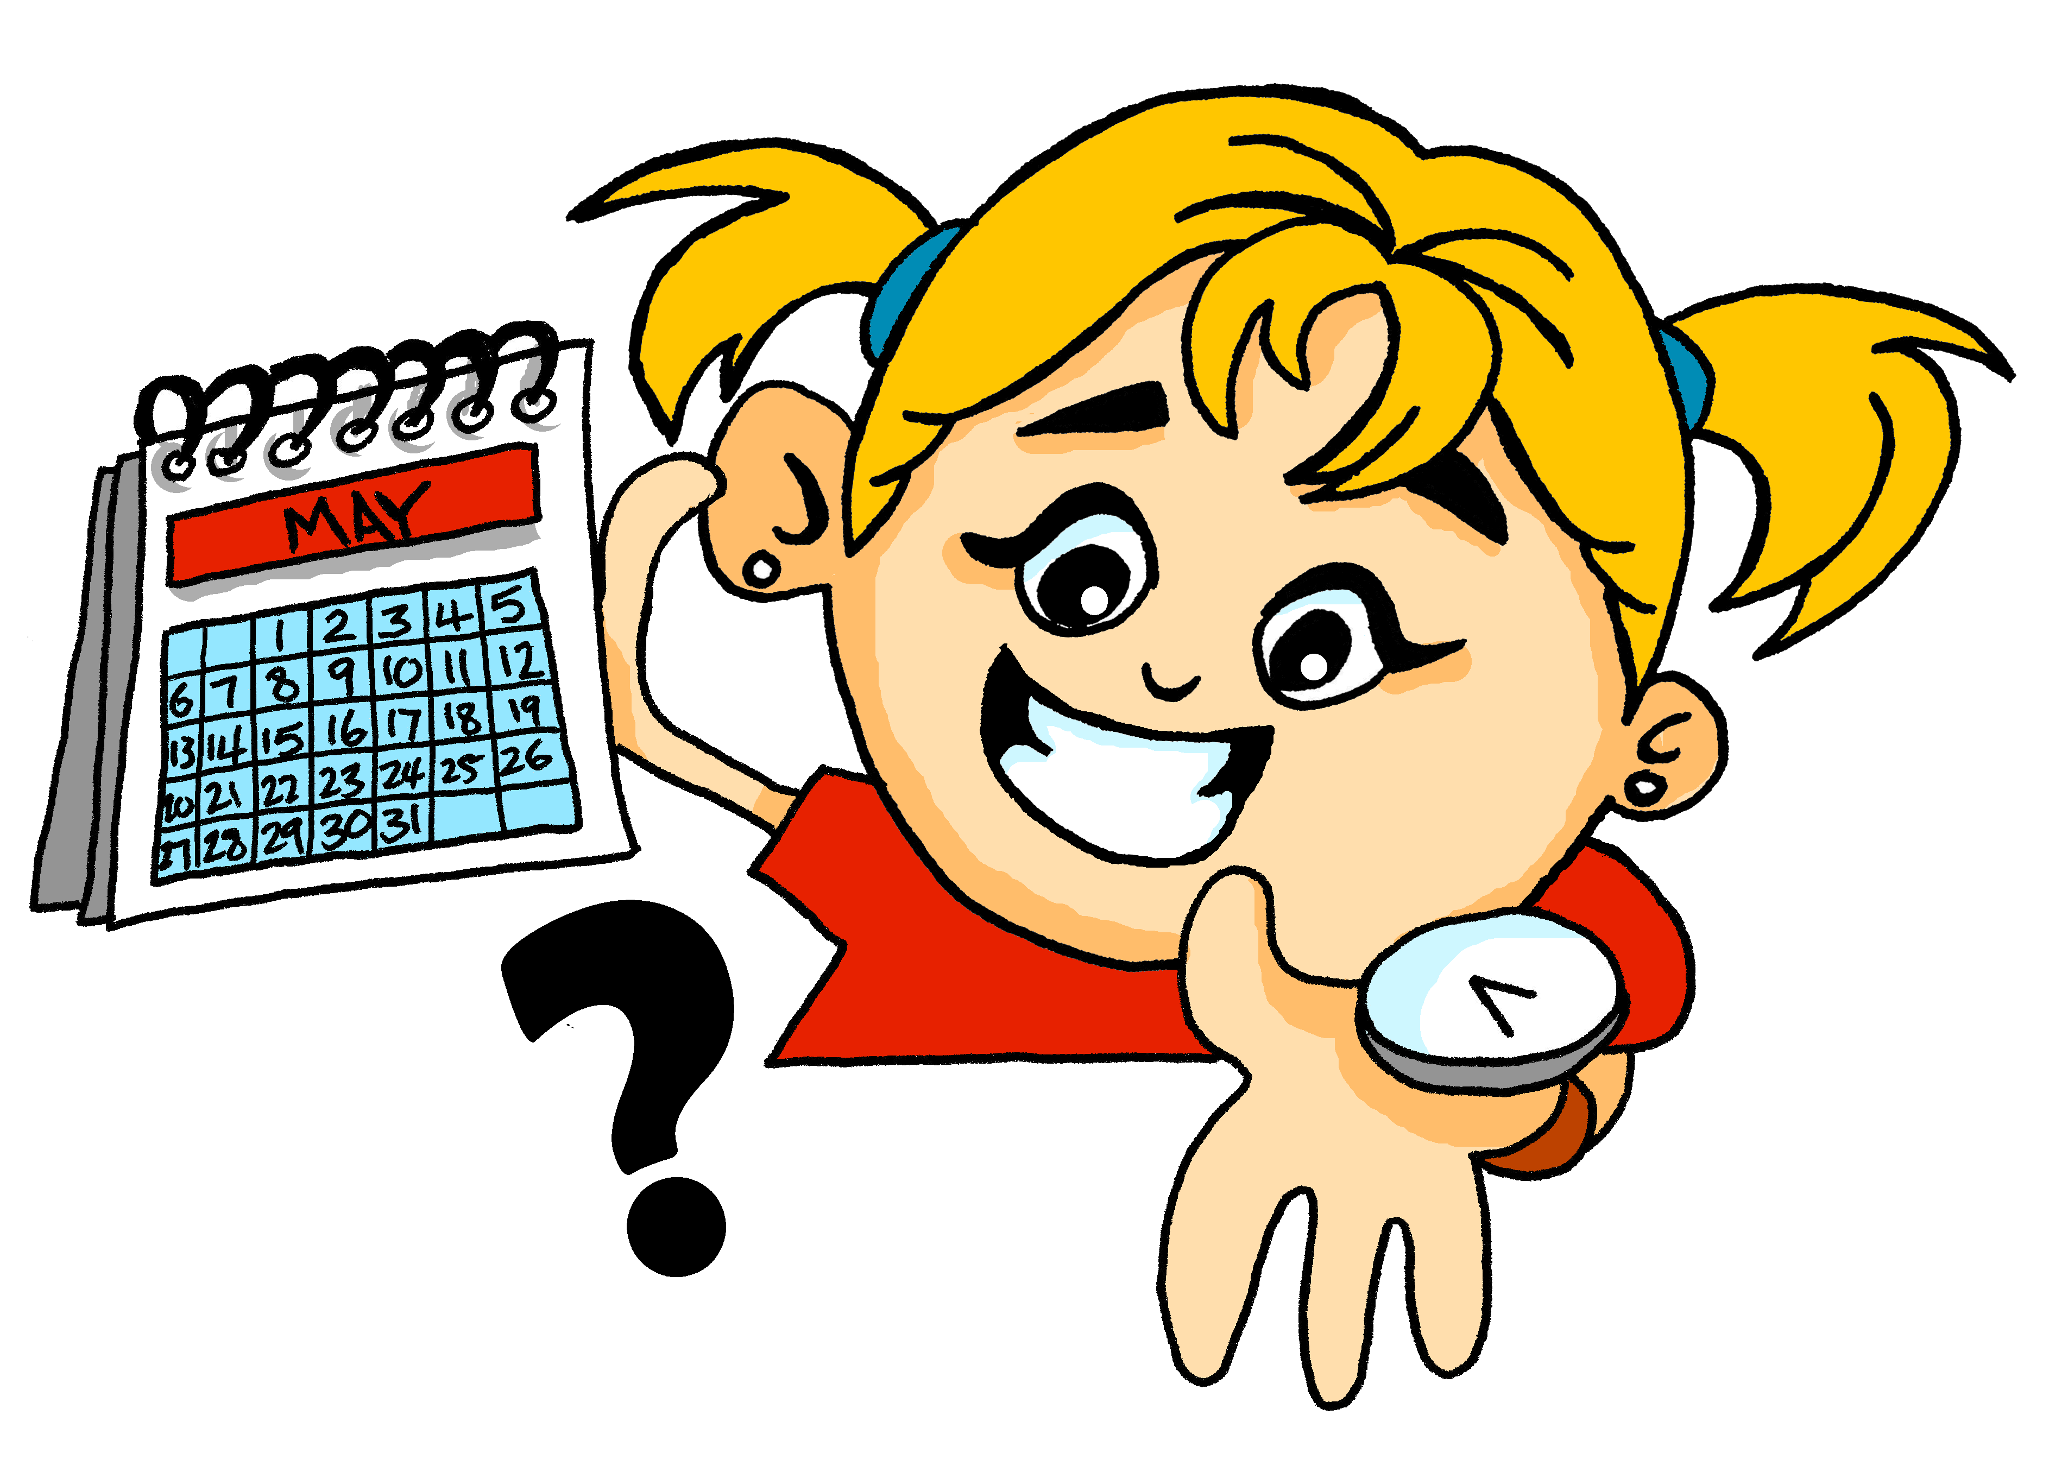
Wann ist das? Wann war* das?
lesen
Lies die Sätze. Welches Wort passt?
 |  | Monat | Woche | Jahr
1. | Diese Woche mache ich eine Bootfahrt.
2. | Letzten Monat habe ich in einem Hotel gewohnt.
3. | Jeden Monat reise ich nach Luxembourg.
4. | Dieses Jahr habe ich eine Sprache gelernt.
5. | Letzte Woche habe ich das Haus geputzt.
6. | Diesen Monat erlebe ich die Kultur in Paris.
7. | Jede Woche habe ich Farben gemischt.
8. | Jedes Jahr kaufe ich eine Jacke.
______
______
______
____
______
______
______
____
*war = was
Notes:
Timing: 5 minutes Aim: Referential reading activity to notice the endings of dies-, jed-. and letzt- as well as present vs past. Procedure: 1. Read the sentences.
2. Tick the word that could complete the sentence.
3. Click to see the answer.
4. Now say whether each sentence is happening now or happened in the past, by translating it orally into English.

Slide 54
Katjas Ferien
hören / schreiben
Hör Katja zu und schreib auf Englisch.
1
Last week I visited the museum.
2
This summer I had a lot of fun.
3
This week I am eating pizza and ice cream every day.
4
I visit my brother in Mainz every week.
5
Last month I often played tennis in the park.
6
This year I’m winning every football match.
7
I have not bought any clothes this month.
8
I listened to music every day.
Notes:
Timing: 8 minutes Aim: To practise the newly introduced determiners in combination with present and past tense. Procedure: 1. Click on the numbers to play the audio.
2. Write the English translation.
3. Click to see the answer.
Transcript: 1. Letzte Woche habe ich das Museum besucht.
2. Diesen Sommer habe ich viel Spaß gehabt.
3. Diese Woche esse ich jeden Tag Pizza und Eis.
4. Ich besuche jede Woche meinen Bruder in Mainz.
5. Letzten Monat habe ich oft im Park Tennis gespielt.
6. Dieses Jahr gewinne ich jedes Fußballspiel. 7. Ich habe diesen Monat keine Kleidung gekauft. 8. Jeden Tag habe ich Musik gehört.

Slide 55
In + indefinite article (R3)
Grammatik
Remember: row 3 is used when describing location in or on something
After in and auf the words for the sometimes changes:
Row 1:
der Park
die Stadt
das Kino
im Park
in dem Kino
Row 3:
Ich bin…
in dem Park
in der Stadt
im Kino
The same happens with the word for a:
Row 1:
ein Park
eine Stadt
ein Kino
Row 3:
Ich bin…
in einem Park
in einer Stadt
in einem Kino
Notes:
Timing: 3 minutes Aim: To briefly recap in + row 3 with definite articles and then extend the principle to include indefinite articles.
Procedure: 1. Click on the mouse to animate the explanation.
2. Check students’ understanding at all stages. Word frequency (1 is the most frequent word in German): Source: Jones, R.L. & Tschirner, E. (2006). A frequency dictionary of German: core vocabulary for learners. Routledge

Slide 56
Wo?
hören
Hör dir die Sätze an. Welches Wort passt?
jetzt | letzten Monat
1
Hotel / Stadt
2
Party / Konzert
3
Galerie / Dorf
4
Schule / Geschäft
5
Wasserpark / Band
6
Stadt / Dorf
7
Theater / Stadt
8
Konzert / Straße
Notes:
Timing: 4 minutes + 2 minutes Aim: 1] Practise in + row 3. 2] Practise present and perfect tense. Procedure: 1. Click to bring up the first sentence with the two location options. 2. Click on corresponding number to play audio.
2. Listen to the sentence and pick the word that fits. Pay attention to the ending of the indefinite article.
3. Click to see the answer. Continue steps 1-4 with items 2-8.
4. Then listen to each sentence again, to confirm whether it is happening now or was happening last month. 5. Click to see ticks.
Transcript:
1. Ich mache Fotos in einem [Hotel / Stadt] 2. Ich tanze auf einem [Party / Konzert] 3. Ich habe in einer... [Galerie / Dorf] Souvenirs gekauft. 4. Ich kaufe Kleidung in einem [Schule / Geschäft].
5. Ich habe in einem [Wasserpark / Band] viel Spaß gehabt. 6. Ich habe in einem [Stadt / Dorf] Sport gemacht. 7. Ich erlebe in einer [Theater / Stadt] die Kultur. 8. Ich habe auf einer [Konzert / Strasse] Rockmusik gehört.
Word frequency (1 is the most frequent word in German): Source: Jones, R.L. & Tschirner, E. (2006). A frequency dictionary of German: core vocabulary for learners. Routledge

Slide 57
Wer bin ich?
sprechen
Person 1
Visits Münich
Buys coat
Has holidays in Switzerland
Plays handball
Works at a festival
Often cooks
Person 2
Has holidays in Switzerland
Buys coat
Plays handball
Often cooked
Works at a festival
Visits Münich
Person 3
Often cooked
Visited Münich
Worked at a festival
Had holidays in Switzerland
Bought coat
Played handball
Person 4
Often cooks
Has holidays in Switzerland
Buys coat
Visits Münich
Worked at a festival
Plays handball
Person 5
Played handball
Buys coat
Had holidays in Switzerland
Visited München
Worked at a festival
Often cooked
Person 6
Often cooks
Visited Münich
Bought coat
Had holidays in Switzerland
Played handball
Worked at festival
Notes:
Timing: 5 minutes Aim: Practising using present and perfect tense in speech. Procedure: 1. Person A picks a card for person B. Person B then asks questions to find out who they are (e.g. Habe ich München besucht?)
2. When person B has enough information they guess which card it is.
3. The activity repeats with roles swapped.
Teacher transcript for the online recording version:
Ich habe München besucht,
Ich habe oft gekocht.
Ich kaufe eine Jacke.
Wer bin ich?
Ich bin Person 5.
NB: Tell students to be careful – they must listen very carefully to whether the activity is in the present or past, not jump to conclusions based on vocabulary clues.

Slide 58
Grammatik
schreiben
dann
später
schließlich
zuerst
danach
letzt-
dies-
jed-
Juli
Monat
Woche
August
Tag
Sommer
Notes:
Timing: 10 minutes Aim: To practise present and perfect in writing. This activity also brings in the new determiners and sequencing adverbs. Procedure: 1. Pick one of the persons from the previous activity and write down their information.
2. Based on the information write a postcard message.
3. In your message also use at least 2 words from each of the three boxes above.

Slide 59
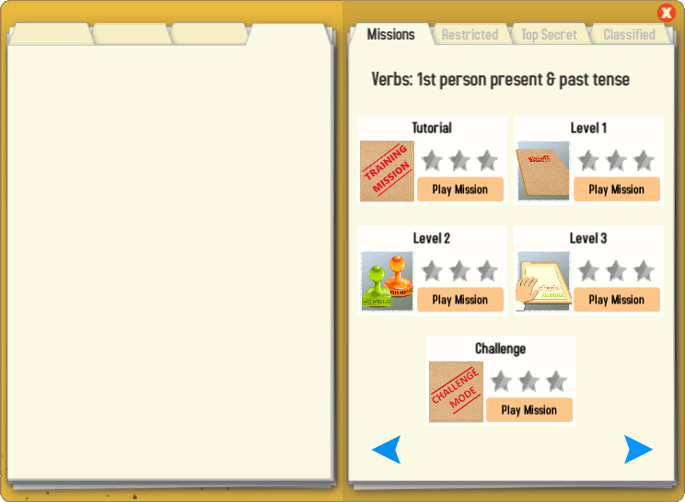
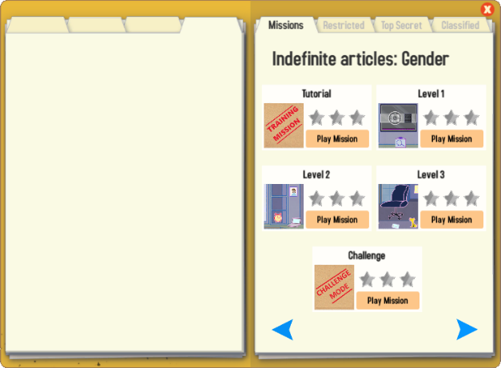
Gaming Grammar
Try the following Gaming Grammar missions to practise:
Notes:
Y8 T1.1 W1

Slide 60
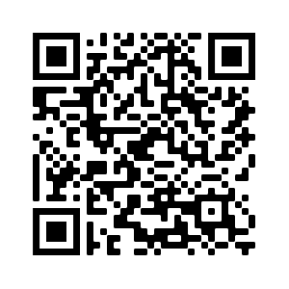
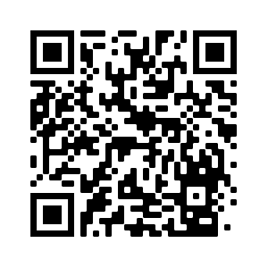
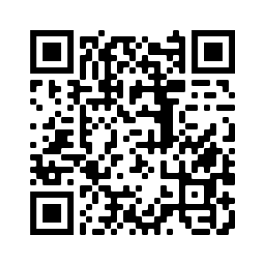
Hausaufgaben
Pre-learning for lesson: Year 8 German Term 1.1 Week 2
Revisit 1: Year 7 German Term 3.2 Week 5
Revisit 2: Year 7 German Term 3.1 Week 1
Notes:
Answer sheets for the learning HW with the link to the HW sheets are here: https://resources.ncelp.org/concern/resources/mw22v6020?locale=en

Slide 61
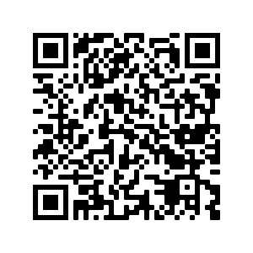
Hausaufgaben
Vocabulary Learning Homework (Y8, Term 1.1, Week 2)
Audio file
Audio file QR code:
Student worksheet
Quizlet link
In addition, revisit: Year 7 Term 3.1 Week 1
Year 7 Term 3.2 Week 5
Notes:
Answer sheets for the learning HW with the link to the HW sheets are here: https://resources.ncelp.org/concern/resources/mw22v6020?locale=en

