Slide 1
What do you do when? [2] What do others do and when? [2]
Time phrases as nouns and adverbs
SSC [revision]
Y7 German
Term 3.1 - Week 2 - Lesson 51
Author name(s): Natalie Finlayson / Rachel Hawkes
Artwork: Steve Clarke
Date updated: 20/12/21
Notes:
Artwork by Steve Clarke. All additional pictures selected are available under a Creative Commons license, no attribution required.
Learning outcomes (lesson 1):
Introduction of adverbial forms of time phrases (nachmittags, montags etc.)
Consolidation of word order 2
Revisit several SSCs
Word frequency (1 is the most frequent word in German):
7.2.2.2 (revisit) benutzen [1119] essen [323] können, kann, kannst [23] sehen [79] tragen1&2 [271] trinken [634] etwas [100] Butterbrot [>5009] Hose [2156] Hut [2763] Keks [4083] Leute [224] Obst [4980]
7.2.1.1 (revisit) denken [128] er² [15] es [12] sie² [7] Fahrrad / Rad [2138] Geschenk [2595] Gutschein [>5009] Handy [1693] Jacke [3287] hässlich [3542] toll [972] ganz [69] jetzt [72] ziemlich [605] in Ordnung [n/a]
Source: Jones, R.L & Tschirner, E. (2019). A frequency dictionary of German: Core vocabulary for learners. London: Routledge.
The frequency rankings for words that occur in this PowerPoint which have been previously introduced in NCELP resources are given in the NCELP SOW and in the resources that first introduced and formally re-visited those words.
For any other words that occur incidentally in this PowerPoint, frequency rankings will be provided in the notes field wherever possible.

Slide 2
Meine Woche und deine Woche
schreiben / sprechen / hören
Was macht dein Partner/deine Partnerin? Mach Notizen!
Mo | Di | Mi | Do | Fr | Sa | So
Notes:
Timing: 10 minutes
Aim: To practise oral production and comprehension and written production of previously taught vocabulary. In this multimodal activity, students revise vocabulary introduced in week 3.1.1. They will extend their knowledge of these words in this lesson.
Procedure: 1. Students have not yet encountered the word Notiz [>4034], used in the task rubric. Teacher to encourage students to draw on knowledge of English to infer the meaning of the instruction (take notes).
Note: Students should have already prepared sentences describing what they do each day, as this was set for homework in 3.1.1.
2. Students sketch grids as shown above, and work with a partner to find out about their week. They take it in turns to ask Was machst du am Montag, am Dienstag etc., taking notes on what they hear. If a student says something their partner doesn’t understand (a new word they have found in the dictionary), the partner should be encouraged to ask Was heißt/wie sagt man das auf Englisch? to find out the meaning, and to ask Wie schreibt man das? to find out the spelling.
3. Students will use their answers in the written exercise on the next slide.

Slide 3
Meine Woche und deine Woche
schreiben
Was machst du, und was macht dein Partner/deine Partnerin? Schreib Sätze mit und / aber.
Use a comma before ‘und’ and ‘aber’, when joining two main clauses together.
Ich spiele am Montag Tennis, und Anna spielt am Montag auch Tennis.
Am Dienstag esse ich Obst, aber Anna isst Kekse.
same
different
Notes:
Timing: 10 minutes
Aim: In this written exercise, students are invited to build longer sentences drawing basic comparisons between their weekly routine and their partner’s.
Procedure:
1. Cycle through the information on the slide using the aimation sequence.
2. Students should write sentences using a mix of WO1 and WO2. 3. If students are unsure how to recognise a ‘main clause’, it is worth explaining, with these examples on the board that, if they took the ‘und’ and ‘aber’ out and put a full stop where the comma is, there would be two full sentences that make sense on their own. Eliciting the translations of these new sentences from students will help cement this understanding.
4. Teacher may wish to elicit some oral examples from students by asking e.g. Was macht Anna am Montag?

Slide 4
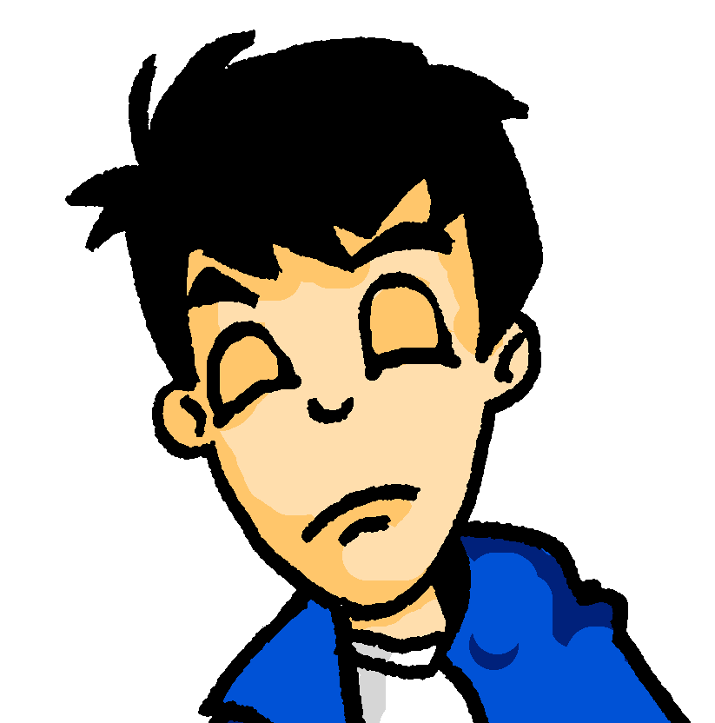
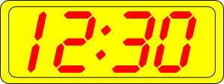
Samstagnachmittag
lesen / hören
Es ist Samstagnachmittag und Wolfgang schläft. Er träumt von …
Kirschen
Kirchen
1
Notes:
Slide 1/8
Timing: 12 minutes (all 8 slides)
Aim: In slides 4-11, students encounter a range of known SSCs contrasted in minimal pairs. By correctly identifying the word they hear, they complete the story of Wolfgang and Heidi’s very different Saturday afternoons. The activity aims to show how a single SSC can change the meaning of a full sentence! The following SSCs are revisited in this activity: [sch], [ch], short [i], short [e], [ei], [ie], [ü], [u], [äu], [v] and [w].
Note: Students are also encouraged to write short summaries of each slide in English. A range of vocabulary and key grammar points from across terms 1 and 2 are revisited.
Procedure:
1. Teacher to draw attention to compound ‘Samstagnachmittag’ and help students break it down. Students have encountered träumen [1907] as an SSC cluster word, but not as a vocabulary item. Teacher to remind students of its meaning. Students have not yet met preposition von [11]. Teacher to explain its use here to of mean of.
2. Teacher clicks on the number button to play the audio. Here, SSCs [ch] and [sch] are contrasted.
3. Students hear one of the options and circle a) or b) to complete the sentence.
4. Students write a one sentence summary in English (at more advanced levels, the teacher might wish to ask for the summary in German).
5. The answer is revealed on a click.
6. Teacher elicits example translations from one or two students. Point out to students how differently the story would unfold if they had heard the other SSC instead!
7. Teacher elicits oral pronunciation of the other word using “Wie sagt man …” to create the alternative scenario!
Transcript:
Kirschen
Word frequency (1 is the most frequent word in German):
Kirsche [4034]
Source: Jones, R.L & Tschirner, E. (2011). A frequency dictionary of German: Core vocabulary for learners. London: Routledge.

Slide 5
Samstagnachmittag
lesen / hören
Heidi schläft nicht. Am Wochenende ist sie sehr aktiv. Heidi mag Kunst. Sie malt eine(n) …
a) Stirn
b) Stern
2
Notes:
Slide 2/8
Transcript:
Stirn
Word frequency (1 is the most frequent word in German):
Stirn [1943], Stern [1446]
Source: Jones, R.L & Tschirner, E. (2011). A frequency dictionary of German: Core vocabulary for learners. London: Routledge.

Slide 6
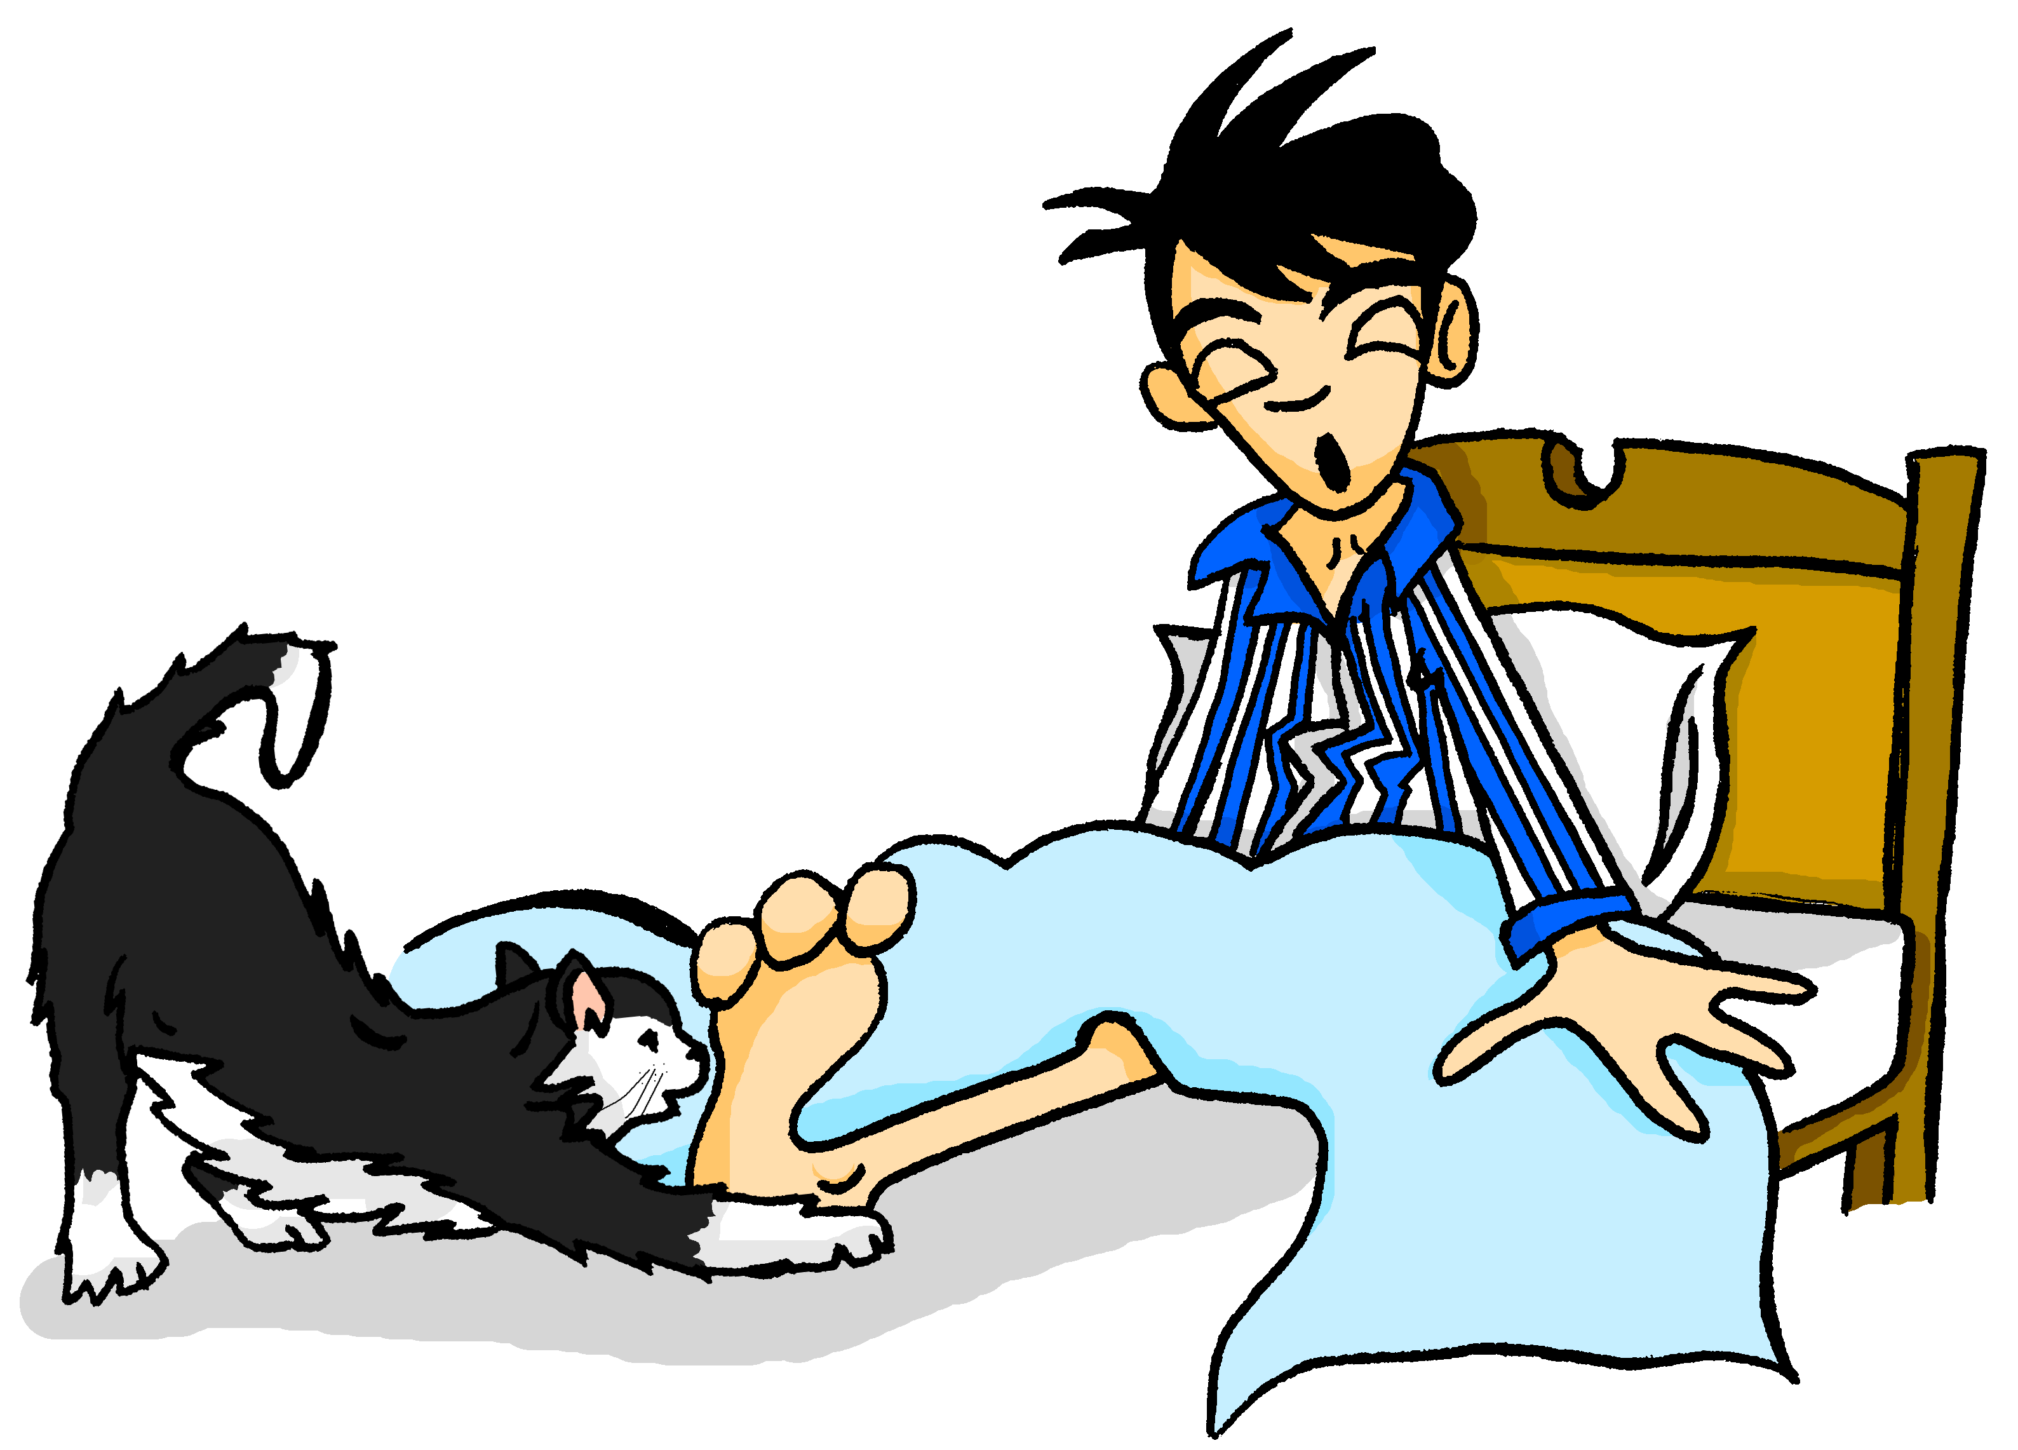
Samstagnachmittag
lesen / hören
Mieze ist auch sehr aktiv. Sie spielt mit Wolfgangs …
a) Beinen
b) Bienen
3
Notes:
Slide 3/8
Transcript:
Beinen
Word frequency (1 is the most frequent word in German):
Bein [937], Biene [>4034]
Source: Jones, R.L & Tschirner, E. (2011). A frequency dictionary of German: Core vocabulary for learners. London: Routledge.

Slide 7
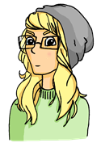
Samstagnachmittag
lesen / hören
Heidi chillt jetzt ein bisschen. Sie liest ein Buch, aber es ist langweilig.
Sie findet ________ nicht so interessant.
a) Kisten
b) Küsten
4
Notes:
Slide 4/8
Transcript:
Kisten
Word frequency (1 is the most frequent word in German):
Kiste [1943], Küste [1446]
Source: Jones, R.L & Tschirner, E. (2011). A frequency dictionary of German: Core vocabulary for learners. London: Routledge.

Slide 8
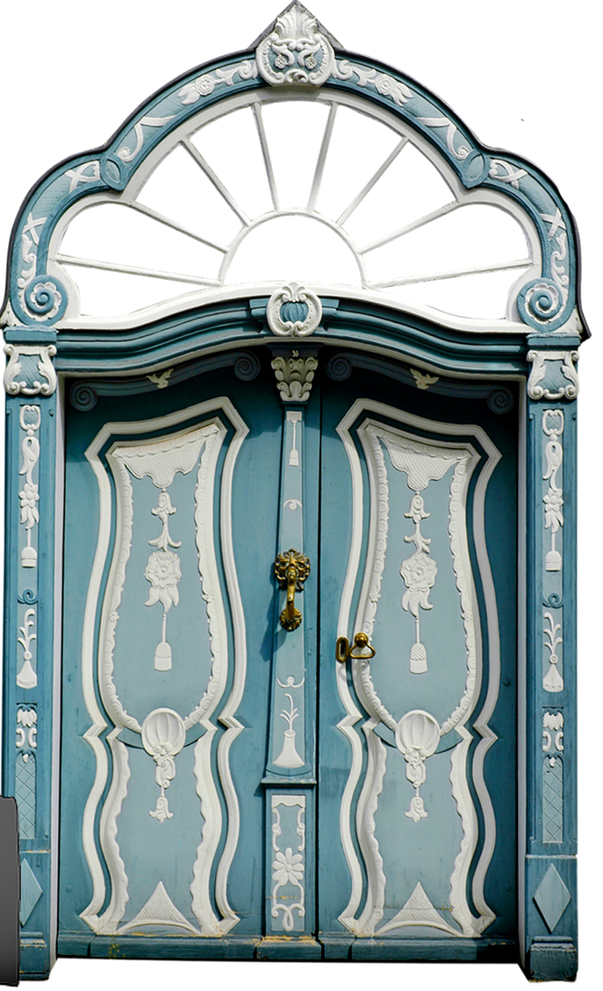
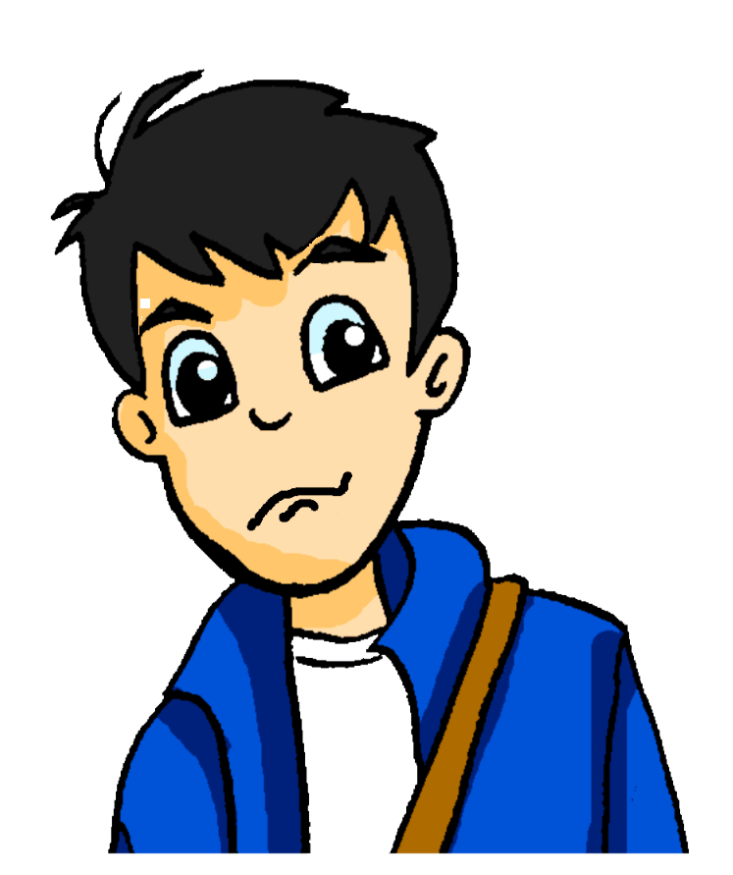
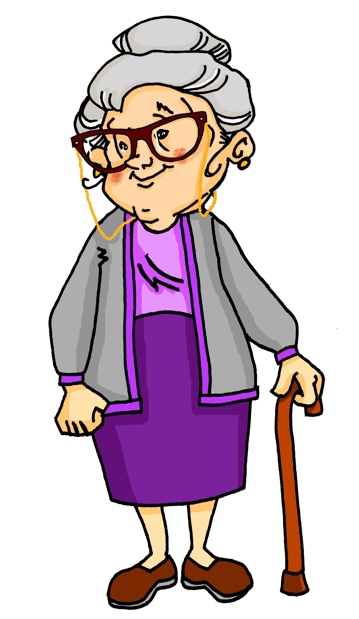
Samstagnachmittag
lesen / hören
Wolfgang hat ein bisschen Angst. Es wird spät, und er hat heute Nachmittag ein Date! Er sieht Oma im Wohnzimmer. Sie surft im Internet. Sie fragt: „Wolfgang! Wie findest du die …“
a) Tour
b) Tür
5
Notes:
Slide 5/8
Transcript:
Tür
Word frequency (1 is the most frequent word in German):
Tour [2474]
Source: Jones, R.L & Tschirner, E. (2011). A frequency dictionary of German: Core vocabulary for learners. London: Routledge.

Slide 9
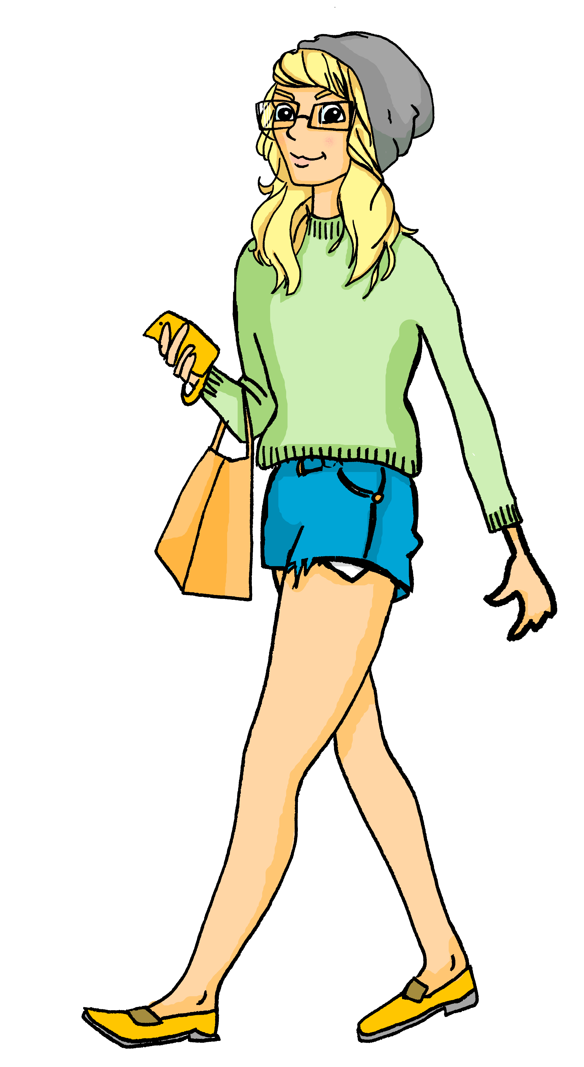
Samstagnachmittag
lesen / hören
Heidi geht ganz relaxt in den Park. Wolfgang kommt in zehn Minuten.
Sie bleibt ein Moment stehen, und sieht einen/eine …
a) Berg
b) Burg
6
Notes:
Slide 6/8
Transcript:
Burg
Word frequency (1 is the most frequent word in German):
Berg [1134], Burg [2984]
Source: Jones, R.L & Tschirner, E. (2011). A frequency dictionary of German: Core vocabulary for learners. London: Routledge.

Slide 10
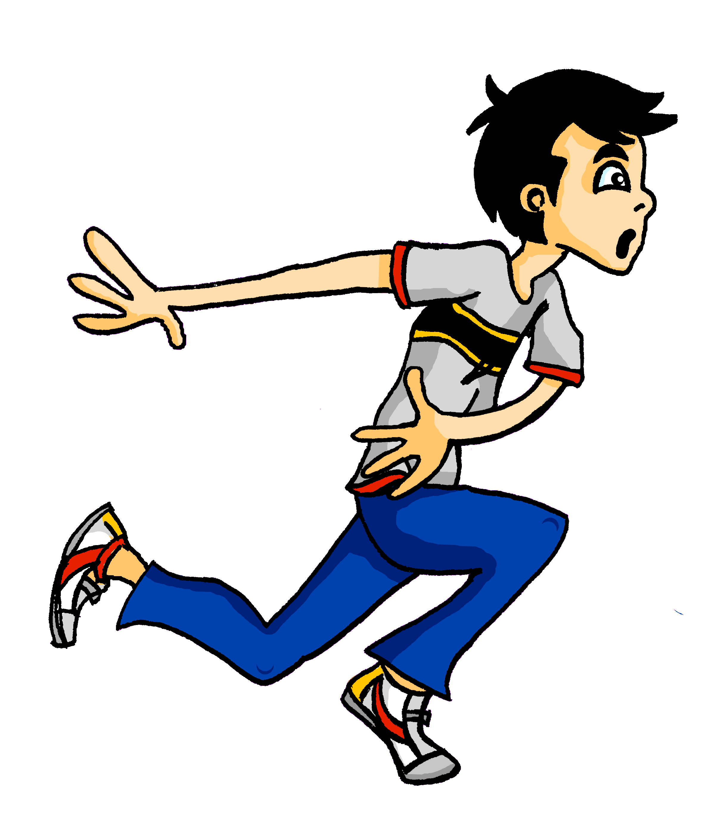
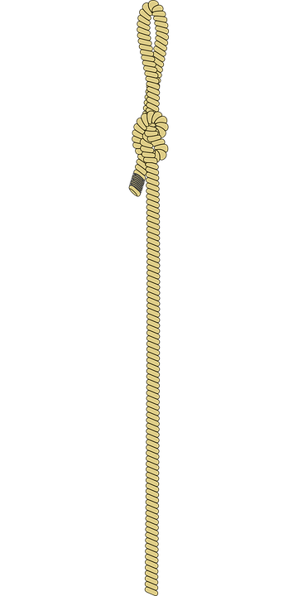
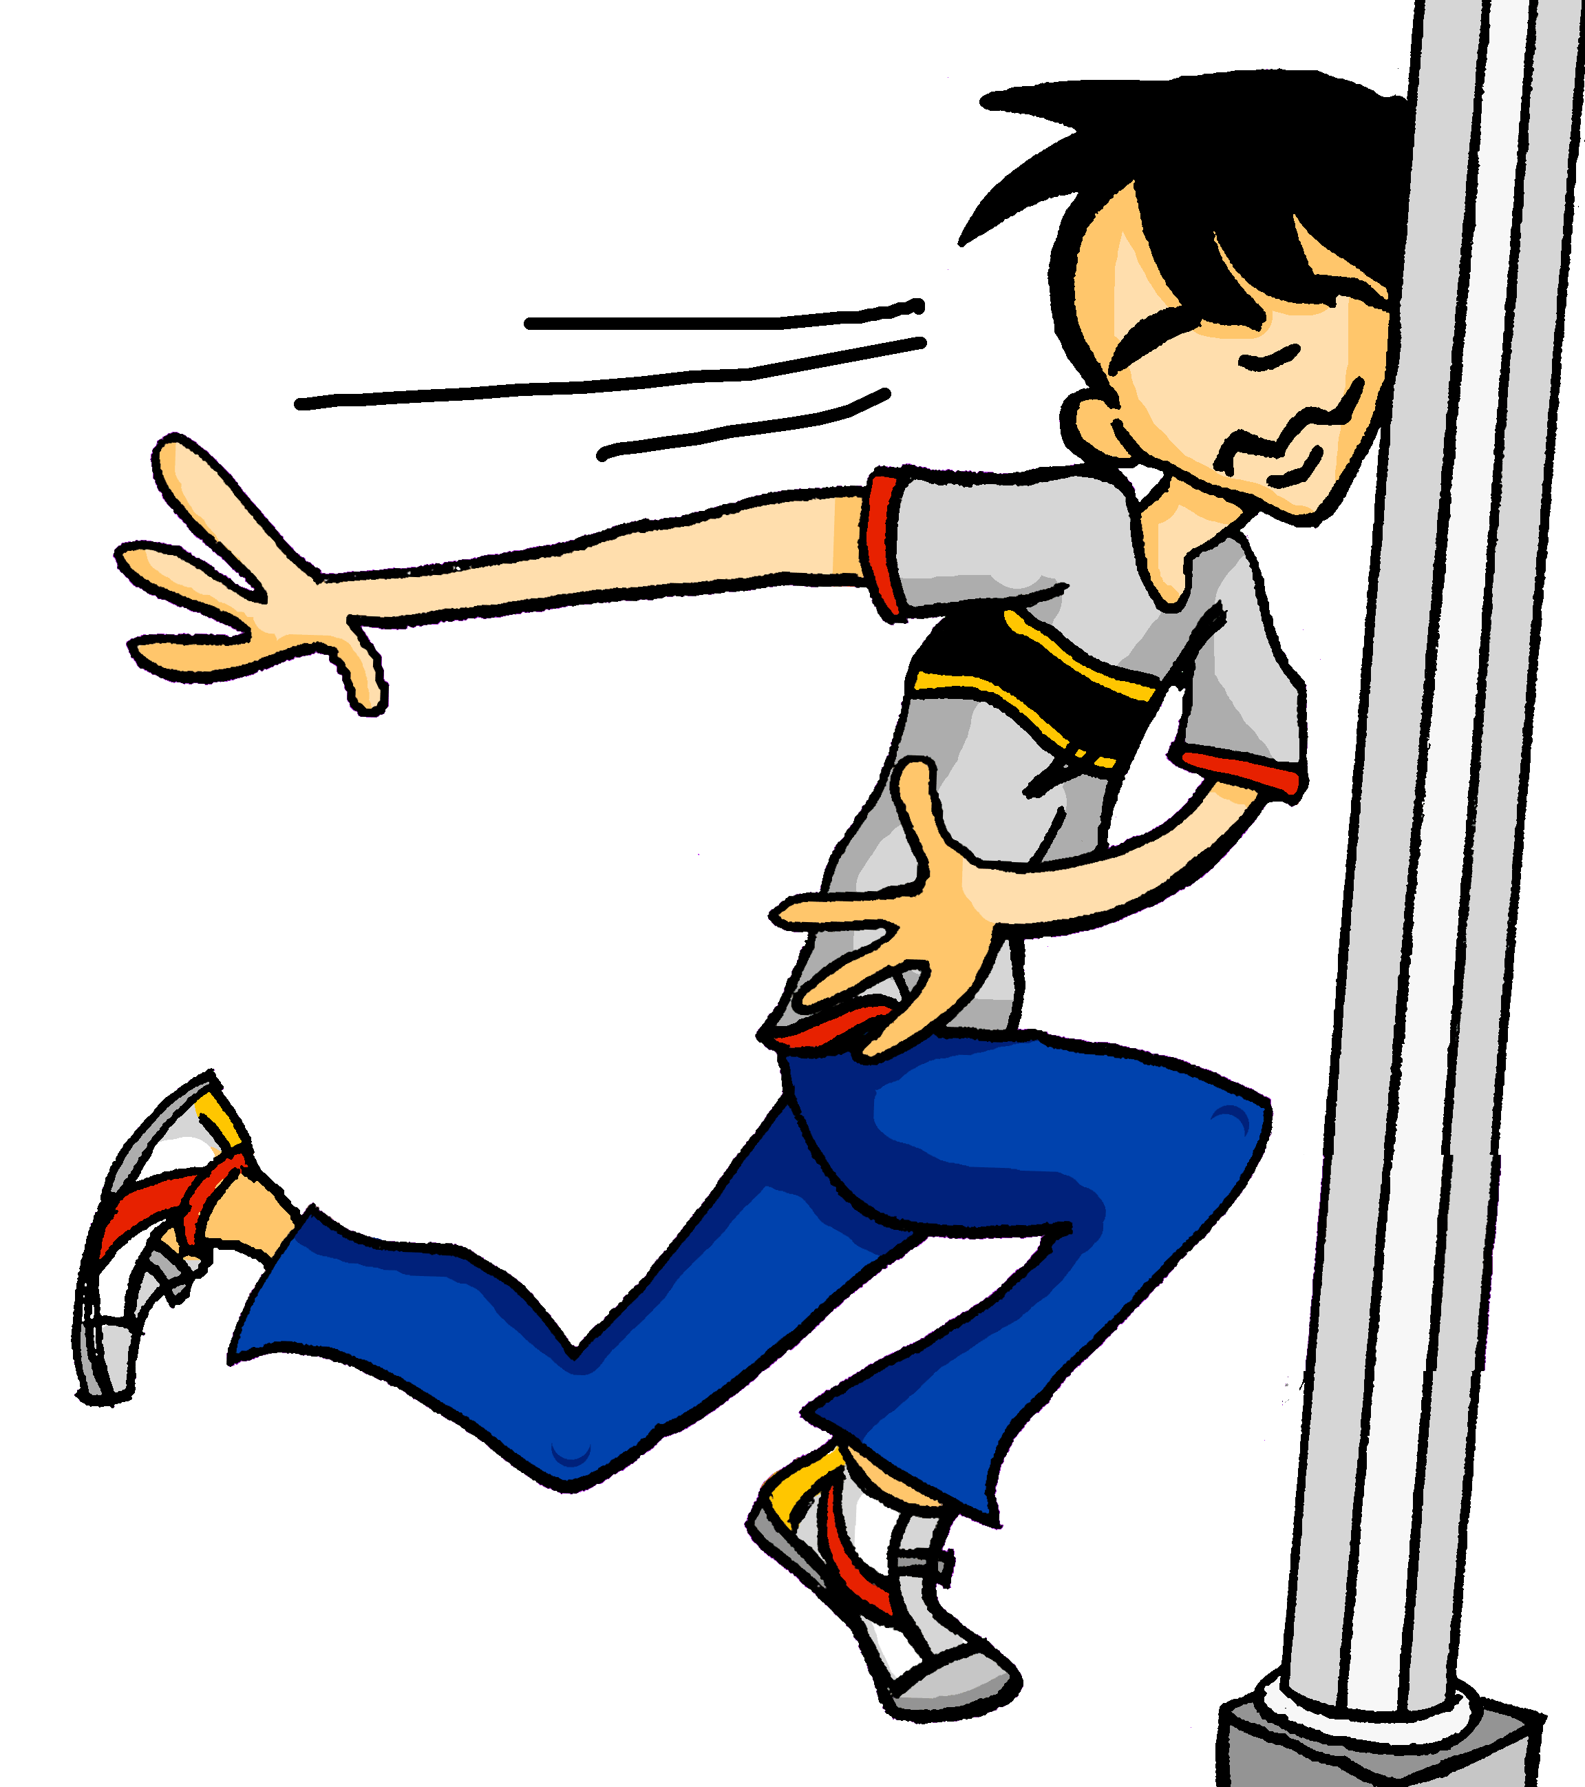
Samstagnachmittag
lesen / hören
Wolfgang ist im Stress. Er läuft in den Park. Leider sieht er nicht die …
a) Seile
b) Säule
7
Notes:
Slide 7/8
Transcript:
Säule
Word frequency (1 is the most frequent word in German):
Seil [>4034], Säule [3778]
Source: Jones, R.L & Tschirner, E. (2011). A frequency dictionary of German: Core vocabulary for learners. London: Routledge.

Slide 11
Samstagnachmittag
lesen / hören
Jetzt hat Heidi ein bisschen Angst. Wo ist Wolfgang? Sie telefoniert mit Wolfgang. Er sagt: „Jaaa … ich brauche eine …“
a) Weile
b) viele
8
Notes:
Slide 8/8
Transcript:
Weile
Word frequency (1 is the most frequent word in German):
Weile [1807]
Source: Jones, R.L & Tschirner, E. (2011). A frequency dictionary of German: Core vocabulary for learners. London: Routledge.

Slide 12
‘Am Montag’ oder ‘montags’?
Der Tag is a masculine noun, so Dienstag and Nachmittag are masculine, too!
Grammatik
As you know, days of the week and times of day (der Dienstag, der Nachmittag) are nouns.
We add ‘am’ to talk about what we are doing on a specific day, or at a specific time of day:
To talk about what we normally do on a day or time of day, we change the nouns into adverbs.
We do this by removing the capital letter and adding –s.
Use am Dienstag to talk about a one-off event. Use dienstags to talk about a regular event.
Ich spiele am Dienstag im Orchester.
am Dienstag
on Tuesday
I’m playing in the orchestra on (this) Tuesday.
am Nachmittag
in the afternoon
Ich spiele dienstags im Orchester.
dienstags
on Tuesdays
I (always) play in the orchestra on Tuesdays.
nachmittags
in the afternoons
Notes:
Timing: 3 minutes
Aim: To explain how to talk about what we are doing on specific days/at specific times, as contrasted with what we normally do on a particular day/at a particular time.
Procedure:
1. Teachers to invite students to suggest the English for ‘Am Montag’ and ‘montags’. They know ‘am Montag’ from 3.1.1 and are likely to make the link from the English ‘s’ to ‘Mondays’. 2. Cycle through the information on the slide using the animation sequence. The English sentence ‘I’m playing in the orchestra on Tuesday’ appears before its German translation, so that teachers can elicit the German from students.
3. Teacher to point out the present tense difference in English. Present continuous with nouns (one-off events), present simple with adverbs (repeated events). 4. Teacher also to elicit from students the reason why ‘dienstags’ doesn’t have a capital letter, but ‘am Dienstag’ does, to reinforce the knowledge of word classes and German use of a capital letter on all nouns.
Note: The text in the bubble provides an opportunity for teachers to revise compound noun formation, first encountered in week 1.1.1 as a phonics cluster word and in 1.1.2 as part of a vocabulary set.

Slide 13
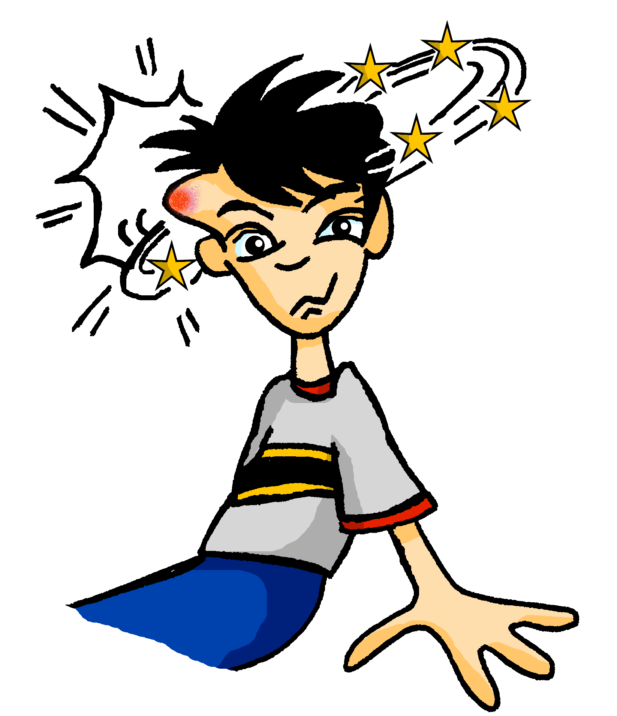
Wolfgangs Kopf!
hören
Wolfgang braucht einen Arzt! Der Arzt hat viele Fragen. Is the doctor asking questions about the week ahead, or about Wolfgang’s regular routine?
 | week ahead | regular routine
 |  | nachmittags
 | am Sonntag
 |  | abends
 |  | morgens
 | am Montag
 | am Abend
 |  | samstags
1
2
3
4
5
6
7
Notes:
Timing: 7 minutes
Aim: To connect temporal adverbials forms with meaning in the oral modality.
Procedure:
1. Remind students that they must listen carefully to the time phrase to determine whether one-off or habitual actions are being talked about. The presence of am indicates a specific day or time of day. The presence of the –s suffix indicates routine.
2. Audio plays on clicking individual number buttons. Students tick the appropriate column in each case.
3. Answers revealed on clicks.
4. Draw attention to the patterns highlighted in the answer columns.
Transcript:
Läufst du nachmittags oft in den Park?
Kannst du am Sonntag chillen?
Wann gehst du abends schlafen?
Isst du morgens Obst?
Hast du am Montag Schule?
Fährst du am Abend mit dem Fahrrad nach Hause?
Trägst du samstags manchmal einen Hut … ?

Slide 14
Wolfgangs Kopf!
lesen
Der Arzt gibt Wolfgang ein Formular. Was schreibt Wolfgang?
1. Was isst du normalerweise?
Morgens / am Morgen esse ich ein Butterbot und nachmittags / am Nachmittag esse ich Kekse.
2. Was machst du heute?
Ich habe nachmittags / am Nachmittag ein Date und ich spiele abends / am Abend Computer.
3. Fährst du später Fahrrad?
Ich fahre abends / am Abend mit dem Bus
nach Hause.
4. Trinkst du jeden Tag Wasser?
Morgens / am Morgen trinke ich Wasser, aber abends / am Abend trinke ich eine Cola.
5. Machst du jede Woche Sport?
Ich tanze montags / am Montag und spiele freitags / am Freitag mit Freunden Fußball.
6. Kannst du jetzt relaxen?
Ich bleibe sonntags / am Sonntag zu Hause.
Der Arzt denkt, die Antworten sind in Ordnung. Wolfgang kann gehen.
Er gibt Wolfgang einen Pflaster und sagt: ‘Obst essen ist wichtig!’
Notes:
Timing: 8 minutes
Aim: To practise written comprehension of the contextual clues in the questions to decide whether one-off events or routines are being asked about. Then, they must choose a time-phrase accordingly to complete the response.
Procedure:
1. Teacher to remind students that the words in the questions will tell them which form of the time phrase to use. Is the question asking about how things are at the moment, or about general routine?
2. Students have not yet met cognates and near-cognates Formular [>4034], Pflaster [>4034] and normalerweise [1898]. Teacher to clarify meaning.
3. Students state which of the two options is correct in each sentence.
4. Answers revealed on clicks.
Word frequency (1 is the most frequent word in German):
Formular [>4034], Pflaster [>4034] and normalerweise [1898].
Source: Jones, R.L & Tschirner, E. (2011). A frequency dictionary of German: Core vocabulary for learners. London: Routledge.

Slide 15
What do you do when? [2] What do others do and when? [2]
VSO questions with wann
SSC [revision]
Y7 German
Term 3.1 - Week 2 - Lesson 52
Author name(s): Natalie Finlayson / Rachel Hawkes
Artwork: Steve Clarke
Date updated: 20/12/21
Notes:
Artwork by Steve Clarke. All additional pictures selected are available under a Creative Commons license, no attribution required.
Learning outcomes (lesson 2):
Introduction of VSO questions with wann
Consolidation of word order 2
Revisit several SSCs
Word frequency (1 is the most frequent word in German):
7.2.2.2 (revisit) benutzen [1119] essen [323] können, kann, kannst [23] sehen [79] tragen1&2 [271] trinken [634] etwas [100] Butterbrot [>5009] Hose [2156] Hut [2763] Keks [4083] Leute [224] Obst [4980]
7.2.1.1 (revisit) denken [128] er² [15] es [12] sie² [7] Fahrrad / Rad [2138] Geschenk [2595] Gutschein [>5009] Handy [1693] Jacke [3287] hässlich [3542] toll [972] ganz [69] jetzt [72] ziemlich [605] in Ordnung [n/a]
Source: Jones, R.L & Tschirner, E. (2019). A frequency dictionary of German: Core vocabulary for learners. London: Routledge.
The frequency rankings for words that occur in this PowerPoint which have been previously introduced in NCELP resources are given in the NCELP SOW and in the resources that first introduced and formally re-visited those words.
For any other words that occur incidentally in this PowerPoint, frequency rankings will be provided in the notes field wherever possible.

Slide 16
Finde ein Wort …
lesen / schreiben
Heidi sitzt im Park. Sie findet den Park langweilig, und spielt ein Handyspiel. Kannst du Heidi helfen?
hässlich, schön, __________
Montag, Mittwoch, __________
die Hose, das T-shirt, __________
der Butterbrot, der Keks, __________
das Fahrrad, der Bus, __________
ziemlich, ein bisschen, __________
am Morgen, am Nachmittag, __________
wann, wo, __________
Notes:
Timing: 5 minutes
Aim: To practise written comprehension of some of the new and revisited vocabulary from this week, and written production of known vocabulary items (from these or other weeks) to complete the sets. In doing so, students strengthen semantic connections between known words, helping them to recall relevant vocabulary in a range of situations.
Procedure:
1. Students read the words in each list and decide what connects them. They then write a word that fits the connection.
2. Teacher to stress that there are several possible answers, and elicit a range of suggestions from the class.
Suggested answers:
toll, nett, lecker (opinions, likes/dislikes)
Dienstag, Donnerstag, Sonntag (days of the week)
der Hut, die Jacke (items of clothing)
das Obst, das Fleisch, das Eis (food)
der Zug, das Auto (transport)
ganz, sehr (words describing intensity/how strongly you feel about something
am Abend, jeden Tag (when you do something/times of day)
wer, was, wie (question words)

Slide 17
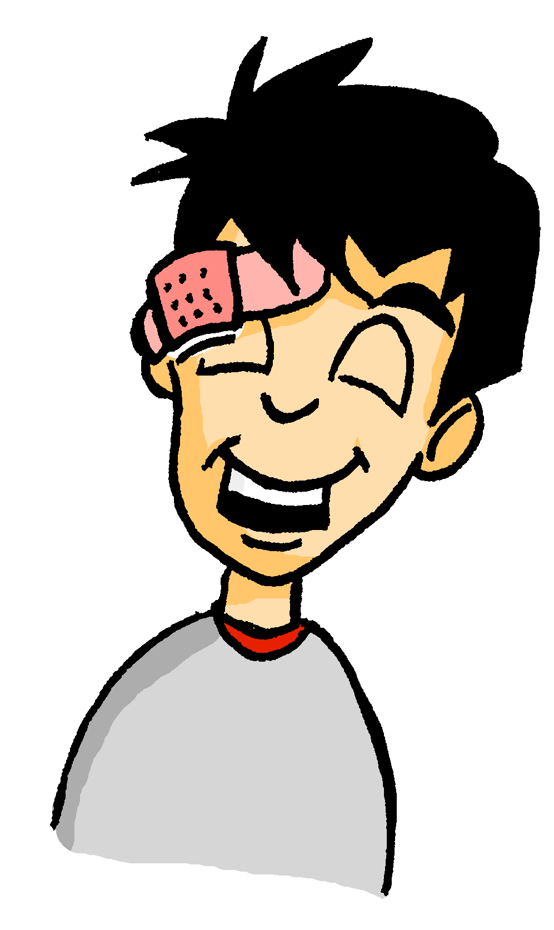
Wolfgang ist hier!
lesen
Was sagt er?
What do you think comes next in English? ‘on/in’ or ‘this’?
1) Sorry, Heidi! Ich schlafe am Samstag / samstags immer viel.
Sorry, Heidi, I always sleep a lot on Saturdays.
2) Und am Morgen / morgens denke ich nicht klar.
And I don’t think clearly in the mornings.
3) Ich habe ein Problem, aber es it okay. Am Abend / abends chille ich.
I have a problem, but it’s okay. I’m chilling out this evening.
4) Und montags / am Montag gehe ich nicht in die Schule!
And I’m not going to school on Monday!
5) Ich trage nachmittags / am Nachmittag einen Hut, denke ich. Los geht’s!
I guess I’m wearing a hat this afternoon. Let’s go!
____________ .
____________ .
____________ .
____________ .
____________ .
Notes:
Timing: 5 minutes
Aim: To revisit the difference in meaning between nominal and adverbial forms of days of the week, this time asking the students to identify the form required using the English tense to help them.
Procedure:
1. Teachers may wish to expand on the hint given in the bubble, explaining that one possible translation of the am + noun form (e.g. am Samstag, am Nachmittag) is ‘this Saturday, this afternoon’, while the adverbial forms (samstags, nachmittags) are most often equivalent to ‘on Saturdays, in the afternoons’ etc.
2. On completing the exercise, teachers should ask students to compare the English tenses with their German translations, highlighting once again that the two English present tense forms (simple and continuous) correspond to only one present tense in German.
3. Answers revealed on clicks. The English appears simultaneously in 1-3, but is delayed by another click in 4 and 5, to allow the teacher to elicit it from the students.

Slide 18
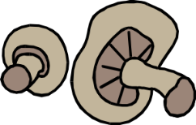
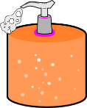
Heidis Shoppingliste
Was braucht Heide? Ordne die Dinge zu!
Zahnbürste
_
Pilze
Osterhase
_
_
s/z
s
z
Seife
_
Sonnenschutz
_
_
Salz
_
_
_
_
Säge
_
Zelt
_
Zitrone
_
Notes:
Timing: 5 minutes
Aim: To contrast and revisit two SSCs which were not revisited in lesson 1 - [s] and [z].
Procedure:
1. Students sketch the Venn-diagram in their answer books, listen to the pronunciation of these unknown words, and assign each to the appropriate part of the diagram.
2. Audio plays on clicking the images.
3. Answers are revealed (clockwise) on clicks, starting with Zahnbürste and finishing with Pilze
Word frequency (1 is the most frequent word in German):
Zahnbürste [2449/>4034], Osterhase [>4034], Sonnenschutz [953/1094], Säge [>4034], Zitrone [>4034], Zelt [2969], Salz [2437], Seife [>4034], Pilz [>4034]
Source: Jones, R.L & Tschirner, E. (2011). A frequency dictionary of German: Core vocabulary for learners. London: Routledge.

Slide 19
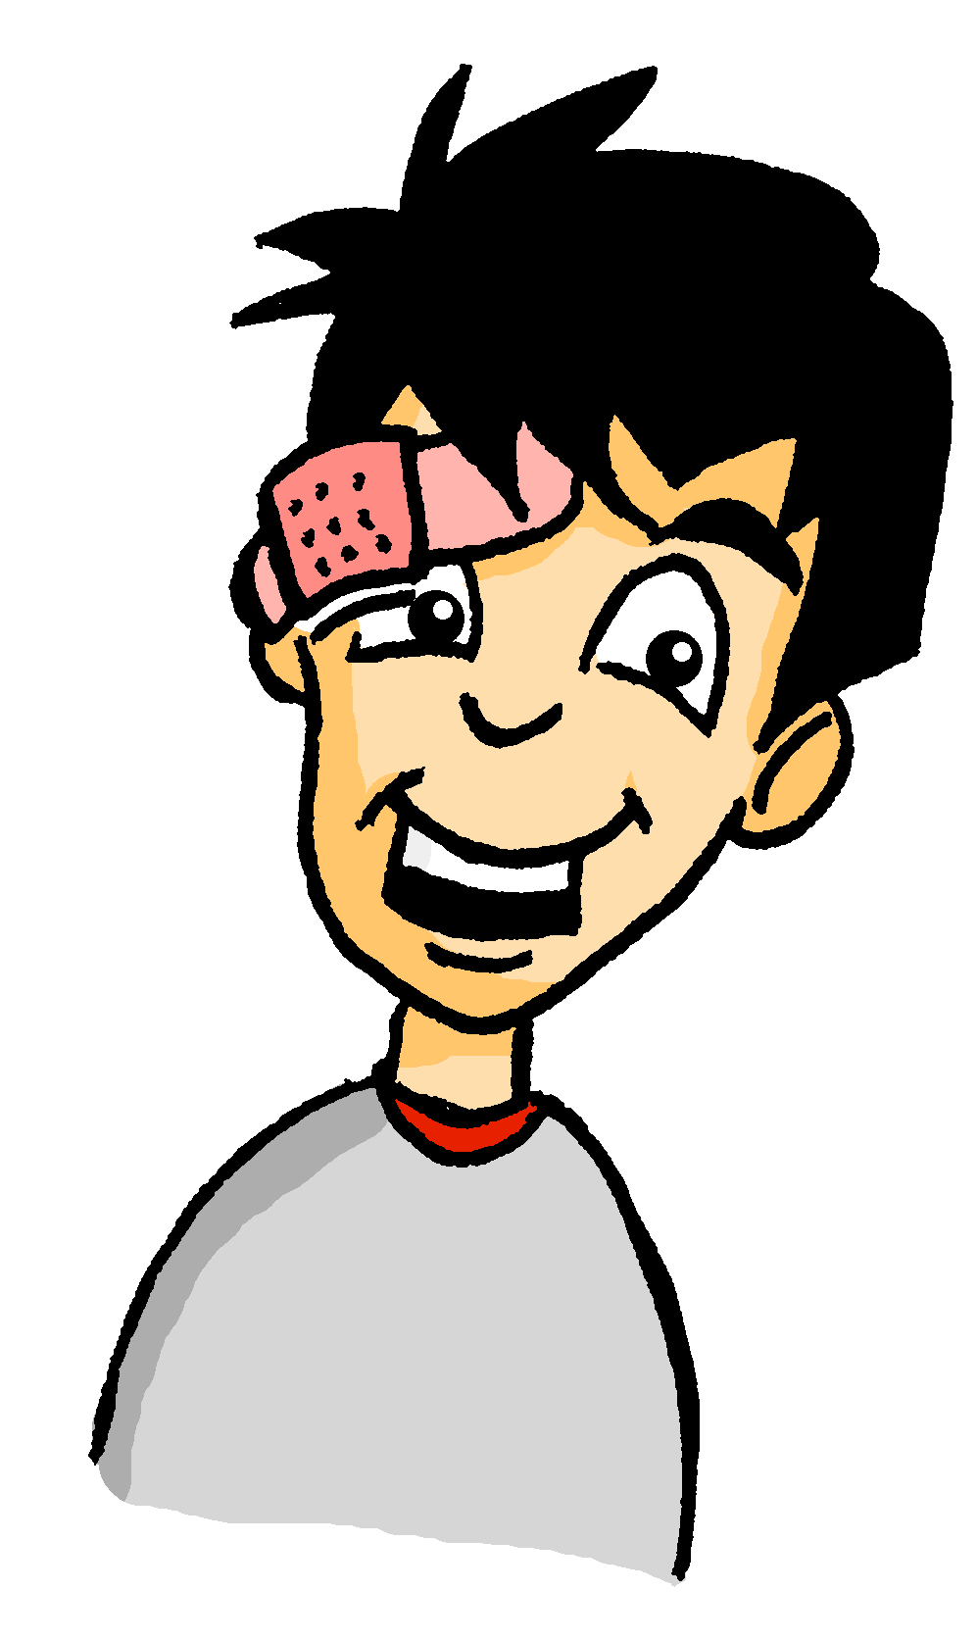
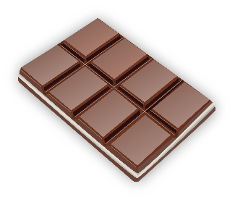
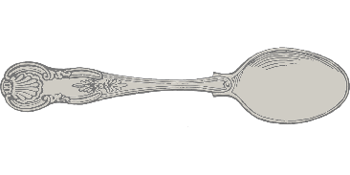
Wolfgangs Shoppingliste
Schokolade
_
_
Und was braucht Wolfgang? Ordne die Dinge zu!
Löffel
_
Brötchen
_
o/ö
o
ö
Knöpfe
_
Kopfhörer
_
_
Socken
_
Tomaten
_
Sonnenbrille
_
Olivenöl
_
_
Notes:
Timing: 5 minutes
Aim: To revisit and contrast SSCs which were not revisited in lesson 1 - long [o], short [o], long [ö] and short [ö].
Procedure:
1. Students sketch the Venn-diagram in their answer books, listen to the pronunciation of these unknown words, and assign each to the appropriate part of the diagram.
2. Audio plays on clicking the images.
3. Answers are revealed (clockwise) on clicks, starting with Schokolade and finishing with Löffel.
4. During the feedback, teacher could break down the word Kopfhörer, asking students which noun and verb they recognise in the compound.
Word frequency (1 is the most frequent word in German):
Schokolade [>4034], Socke [>4034], Knopf [>4034], Tomate [>4034], Olivenöl [>4034], Sonnenbrille [953/3423], Löffel [>4034], Kopfhörer [279/1557], Brötchen [>4034]
Source: Jones, R.L & Tschirner, E. (2011). A frequency dictionary of German: Core vocabulary for learners. London: Routledge.

Slide 20
W-Fragen und WO2
Grammatik
To ask an open question, we place a question word directly in front of the verb:
The word order in w-questions is similar to that of statements in word order 2.
Wann gehst du in die Bibliothek? Am Donnerstag gehe ich in die Bibliothek.
Question Statement
Closed
Gehst du in die Bibliothek?
Are you going to the library?
Wo
Open
Wann gehst du in die Bibliothek?
When are you going to the library?
Notes:
Timing: 3 minutes
Aim: To explain open (wh-) questions.
Procedure:
1. Cycle through the information on the slide using the animation sequence.
2. Teacher to draw attention to word order: VSO for closed questions, Question word + VSO or VO for open questions.
3. Several examples using previously taught question words are given in German. Teacher elicits the meaning in English.
This primes for the question generation task later this lesson.

Slide 21
Wie läuft’s?
hören
Wolfgang hat ein Problem! Er denkt, Mia kann helfen. Er redet mit Mia am Telefon.
Is the missing word a question word or a time phrase? Write ‘Q’ or ‘T’.
der Geldautomat cash machine
1
2
____
____
____
____
3
____
4
____
____
____
5
____
6
____
____
____
7
____
8
____
____
____
9
____
10
____
____
____
Notes:
Timing: 7 minutes
Aim: To raise student awareness of the fact that they cannot always rely on word order to tell them whether a sentence is a question or a statement.
Procedure:
1. Students encountered the verb laufen in its literal sense ‘to run’ in week 2.2.3. Teacher to highlight its idiomatic usage in the title here, drawing comparisons to the English equivalent idiom ‘how’s it going?’
2. All words in this listening have been encountered before, with the exception of cognate Shopping-Centre [>4034] and near-cognate Automat [>4034]. Students may struggle to recognise and recall the meaning of Geld in the compound Geldautomat, so teacher may wish to provide a gloss before playing the recording.
3. Students must listen to the dialogue and use intonation to decide whether a question word or a time phrase is blanked out. Teacher should remind students that the word order will be the same in each case.
4. Audio (with question word/time phrase removed) plays on clicking numbers.
5. The answers are animated on the next slide.
Transcript:
1. Hallo, Mia - [Was] machst du? Ich habe ein Problem.
2. Hallo, Wolfgang! [Samstags] chille ich. Ich kann reden!
3. Gut, danke! Also, [heute] bin ich mit Heidi im Shopping-Centre …
4. Ach, ja! Wie läuft’s? [Wie] findest du Heidi?
5. Toll! Ich finde sie ganz toll. [Am Abend] gehen wir Eis essen.
6. Na, super! Und … [wo] ist das Problem?
7. Naja … ich habe kein Geld mit! [Wo] ist hier eine Bank oder ein Geldautomat?
8. Wolfgang! [Manchmal] denkst du nicht sehr praktisch!
9. Ja, ja, ich weiß … [jetzt] brauche ich aber bitte eine Antwort!
10. Okay, okay! [Oft] gibt es im Supermarkt einen Geldautomaten.
Word frequency (1 is the most frequent word in German):
Shopping-Centre [>4034] Automat [>4034].
Source: Jones, R.L & Tschirner, E. (2011). A frequency dictionary of German: Core vocabulary for learners. London: Routledge.

Slide 22
Antworten
hören
Wolfgang hat ein Problem! Er denkt, Mia kann helfen. Er redet mit Mia am Telefon.
Is the missing word a question word or a time phrase? Write ‘Q’ or ‘T’.
der Geldautomat cash machine
1
2
Q
____
T
____
3
T
4
____
Q
____
5
T
6
____
Q
____
7
Q
8
____
T
____
9
T
10
____
T
____
Notes:
Timing: 2 minutes
Aim: To provide the answers to the activity on the previous slide.
Procedure:
1. The full audio (with question word/time phrase included this time) plays on clicking numbers.
2. Answers revealed on clicks.
Transcript:
1. Hallo, Mia - Was machst du? Ich habe ein Problem.
2. Hallo, Wolfgang! Samstags chille ich. Ich kann reden!
3. Gut, danke! Also, heute bin ich mit Heidi im Shopping-Centre …
4. Ach, ja! Wie läuft’s? Wie findest du Heidi?
5. Toll! Ich finde sie ganz toll. Am Abend gehen wir Eis essen.
6. Na, super! Und … wo ist das Problem?
7. Naja … ich habe kein Geld mit! Wo ist hier eine Bank oder ein Geldautomat?
8. Wolfgang! Manchmal denkst du nicht sehr praktisch!
9. Ja, ja, ich weiß … jetzt brauche ich aber bitte eine Antwort!
10. Okay, okay! Oft gibt es im Supermarkt einen Geldautomaten.
Word frequency (1 is the most frequent word in German):
Shopping-Centre [>4034] Automat [>4034].
Jones, R.L & Tschirner, E. (2011). A frequency dictionary of German: Core vocabulary for learners. London: Routledge.

Slide 23
Wie läuft’s?
Mia schreibt mit Heidi.
Siehst du eine Frage (?) oder einen Satz (./!) ?
lesen
1. Mia: Na Heidi, wie läuft’s? Wo bist du? Im Eiscafé?
4. Heidi: Japp.
Aber jetzt braucht Wolfgang einen Hut.
7. Mia: Mmmm … ich weiss nicht, sorry!! Wie findest du Wolfgang?
__
__
__
2. Heidi: Also … im Moment stehe ich im Supermarkt.
5. Mia: Was?? Nein ... nie trägt Wolfgang einen Hut!
8. Heidi: Ach, oft finde ich ihn ganz toll. Aber ... er ist ein bisschen unorganisiert.
__
__
__
6. Heidi: Tja … plötzlich trägt er einen.
Wo kann er hier einen Hut finden?
3. Mia: Oh! Wann gehst du Eis essen? Es wird spät …
__
__
9. Mia: Mm. Heute ist er ziemlich nervös. Er mag dich sehr, Heidi!
__
__
Notes:
Timing: 5 minutes
Aim: This accustomise students to seeing WO2 in both written statements and written questions.
Procedure:
1. To complete the task, students write 1-9 and either ? for a question, or ./! for a statement.
2. Using the vocabulary in the text messages, they must decide whether the sentence they are reading is a question or a statement. The word order will not help them here – remind students that these are not all questions. They will need to understand the meaning of the sentences to work out if they are questions or statements, as there aren’t easy word order cues to tell them.
3. Students have not yet met cognates nervös [2930] and unorganisiert [>4034] (they have previously encountered the cognate verb organisieren [1163] and may recognise the meaning, here, particularly as they are following the Wolfgang and Heidi storyline). Students have not yet been taught the personal object pronoun dich [212]. It will likely be understood in context, here. Teachers may want to draw attention to it, though it is not crucial for task completion. Teacher might also like to point out, and clarify the meaning of, conversation fillers na [267], also [40], japp [n/a], tja [2211] and ach [404].
4. Teachers could extend the task by eliciting oral translations so that students can get used to moving between the two languages, and hearing/noting the difference in word order.
5. Answers appear on clicks.
Note: In this sequence there are several instances of ‘in’ plus Row 3 (dative) e.g., im Eiscafé, im Supermarkt. This will obviously not be a barrier to understanding, as the meaning of ‘in’ is transparent. This week students are likely to ignore the changes in article that they encounter, but they can be considered useful ‘priming’ for next week’s teaching which focuses explicitly on the two prepositions ‘in’ and ‘auf’ with Row 2 (accusative) and Row 3 (dative).
Word frequency (1 is the most frequent word in German):
nervös [2930] unorganisiert [>4034] dich [212] na [267] also [40] japp [n/a] tja [2211] and ach [404]
Source: Jones, R.L & Tschirner, E. (2011). A frequency dictionary of German: Core vocabulary for learners. London: Routledge.

Slide 24
Wer macht was und wann?
sprechen
Q
1
2
Q
1
2
Q
1
2
Q
1
2
Q
1
2
du
am Nachmittag
liest
ein Buch
das Mädchen
jetzt
trinkt
Wasser
er
jeden Tag
trägt
einen Hut
sie (pl.)
jede Woche
sprechen
Deutsch
sie (sing.)
am Montag
bekommt
ein Geschenk
Wo
Q
1
2
Q
1
2
Q
1
2
Q
1
2
Q
1
2
du
freitags
hörst
Musik
ich
morgens
putze
das Auto
er
am Donnerstag
benutzt
den Computer
wir
am Dienstag
spielen
Fußball
ich
jetzt
sehe
das Problem
Q
1
2
Q
1
2
Q
1
2
Q
1
2
Mia und Katja
am Mittwoch
kochen
das Essen
Katja
jeden Tag
nehmen
den Zug
du
heute
fährst
Fahrrad
der Junge
abends
isst
Obst
1, 3, 5 – WO 1
2, 4, 6 – WO 2
Notes:
Timing: 5 minutes
Aim: To practise asking wann-questions orally, and answering in sentences using both word order 1 and 2.
Note: a more complex version of this activity, in which the prompts are given in English, can be found on the next slide.
Procedure:
Classroom version
1. Before the game begins, the teacher should recap word order rules, alerting students to the fact that the information in the squares is not presented in the required order.
2. Students work in pairs and assign themselves a colour.
3. The ‘blue’ player asks wann-questions to elicit the information on the blue squares (‘Wann bleibst du zu Hause?). The ‘green’ player rolls a dice to see whether they must answer the question using word order 1 or word order 2. (‘Ich bleibe samstags zu Hause’/Samstags bleibe ich zu Hause).
4. The ‘green’ player asks wann-questions to elicit the information on the green squares. The ‘blue’ player rolls a dice to see whether they must answer the question using word order 1 or word order 2.
Self-study version
1. Starting with the first blue square, students form an appropriate question, say it out loud, and check their word order and pronunciation by clicking to the right of the ‘Q’ button on that square.
2. They then roll a decide to determine whether they must form an answer using word order 1 or word order 2. Again, they check their answer by clicking to the right of either ‘1’ or ‘2’.
3. Students repeat as many times as they need to.

Slide 25
Wer macht was und wann?
sprechen
Q
1
2
Q
1
2
Q
1
2
Q
1
2
Q
1
2
you
in the afternoon
are reading
a book
the girl
now
is drinking
water
he
every day
wears
a hat
they
every week
speak
German
she
on Monday
is receiving
a gift
Wo
Q
1
2
Q
1
2
Q
1
2
Q
1
2
Q
1
2
you
on Fridays
listen to
music
I
in the mornings
clean
the car
he
on Thursday
is using
the computer
we
on Tuesday
are playing
football
I
now
see
the problem
Q
1
2
Q
1
2
Q
1
2
Q
1
2
Mia and Katja
on Wednesday
are cooking
the food
Katja
every day
takes
the train
you
today
are cycling
the boy
in the evenings
eats
fruit
1, 3, 5 – WO 1
2, 4, 6 – WO 2
Notes:
Timing: 5 minutes
Aim: To practise asking wann-questions orally, and answering in sentences using both word order 1 and 2.
Note: a less complex version of this activity, in which the prompts are given in German, can be found on the previous slide.
Procedure:
Classroom version
1. Before the game begins, the teacher should recap word order rules, alerting students to the fact that the information in the squares is not presented in the required order.
2. Students work in pairs and assign themselves a colour.
3. The ‘blue’ player asks wann-questions to elicit the information on the blue squares (‘Wann bleibst du zu Hause?). The ‘green’ player rolls a dice to see whether they must answer the question using word order 1 or word order 2. (‘Ich bleibe samstags zu Hause’/Samstags bleibe ich zu Hause).
4. The ‘green’ player asks wann-questions to elicit the information on the green squares. The ‘blue’ player rolls a dice to see whether they must answer the question using word order 1 or word order 2.
Self-study version
1. Starting with the first blue square, students form an appropriate question, say it out loud, and check their word order and pronunciation by clicking to the right of the ‘Q’ button on that square.
2. They then roll a decide to determine whether they must form an answer using word order 1 or word order 2. Again, they check their answer by clicking to the right of either ‘1’ or ‘2’.
3. Students repeat as many times as they need to.
In this exercise, students practise asking wann-questions orally, and answering in sentences using both word order 1 and 2.

Slide 26
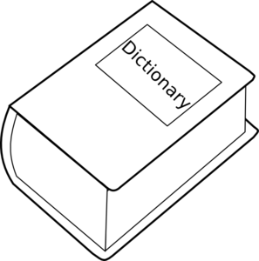
Mit wem hast du viel gemeinsam?
schreiben / sprechen
Was machst du jede Woche? Schreib 3 Sätze.
Rede mit vielen Personen.
Mit wem hast du viel gemeinsam?
Ich putze samstags mein Zimmer.
Remember!
Word order 2 after times and question words.
Wann putzt du dein Zimmer?
Ich koche nie Abendessen.
Notes:
Timing: 8 minutes
Aim: To apply the knowledge gained this week to own contexts in a free-writing and speaking activity.
Procedure:
1. Teacher gives students three minutes to write three sentences describing habitual activities they do on certain days.
2. Teacher reminds students how to turn statements into wh-questions.
3. Students must find others in the class with similar routines to theirs by asking wann- questions.
4. If students don’t do the activity at all, they should be encouraged to reply in the negative with nie/nicht/kein as appropriate.

Slide 27
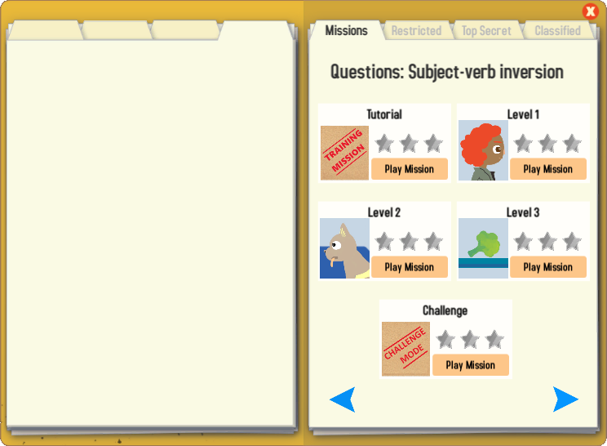
Gaming Grammar
Try the following Gaming Grammar missions to practise:

Slide 28
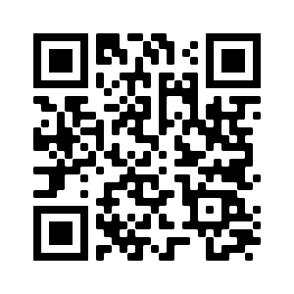
Hausaufgaben
Vocabulary Learning Homework (Term 3.1, Week 3)
Audio file
Audio file QR code:
Student worksheet
Quizlet link
In addition, revisit: Term 2.2 Week 4
Term 2.1 Week 3
Notes:
Use this slide to set the homework.

