Slide 1
Phonics: revisiting SSC [u]
Y7 Spanish
Term 2.2 - Week 2
Amanda Izquierdo / Nick Avery
Date updated: 19/04/2020
Notes:
Revisited SSCs : [u]

Slide 2
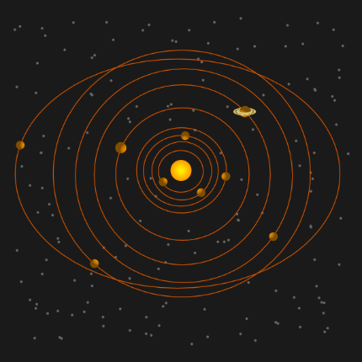
u
mundo
mucho
un
lugar
universo
[a; an]
[place]
nunca
[never]

Slide 3
u
mundo
mucho
un
lugar
universo
nunca

Slide 4
u
mundo
mucho
un
lugar
universo
nunca

Slide 5
Escucha. ¿Cuántas veces escuchas el sonido ‘u’?
escuchar / escribir
1
2
3
Escucha otra vez. Escribe las frases en español.
1
Hay un mercado.
2
Escuchar música es fantástico.
3
El mundo es grande.
4
Estudia mucho en la escuela.
5
El lugar está cerca.
6
Tiene la respuesta.
7
El pueblo antiguo está lejos.
8
El pájaro azul está en la naturaleza.
9
¿Solo hay un universo?
10
Hay un museo en la ciudad.
Notes:
Transcript: 1. Hay un mercado; 2. Escuchar música es genial; 3. El mundo es grande; 4. Estudia mucho en la escuela; 5. El lugar está cerca; 6. Tiene la respuesta; 7. El pueblo antiguo está lejos; 8. El pájaro azul está en la naturaleza; 9. ¿Sólo hay un universo?; 10. Hay un museo en la ciudad.
Students first listen out for how many times they can listen to the sound ‘u’, 1, 2 or 3 times. They then listen again and write the whole sentence. Higher-achieving groups may be able to write the whole sentence the first time they listen. Writing the sentence will help students to check their initial decision about how many times ‘u’ appears.
Note that there is some phonological variation in the SSC ‘u’ in several of these words. It can be useful to make students aware that ‘u’ can vary in sound, depending on the letters that come before or after it. (For example, it is followed by a vowel in respuesta, pueblo and antiguo and so sounds different). Students may recognise other previously taught SSCs, e.g. ‘cu’ in escuchar.
Students have already met cuánto/cuantos in lesson 2.1.4, but have not seen its feminine form or ‘vez’, yet. Ensure that the meaning of this word is clear to them when giving task instructions.

Slide 6
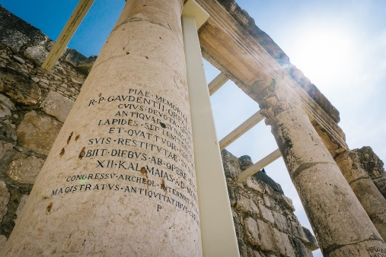
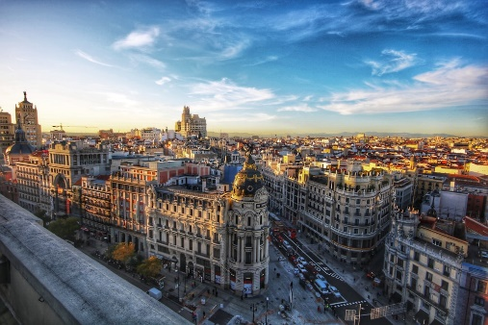
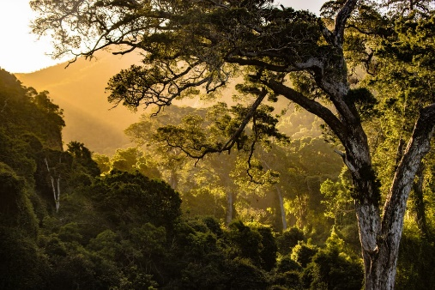
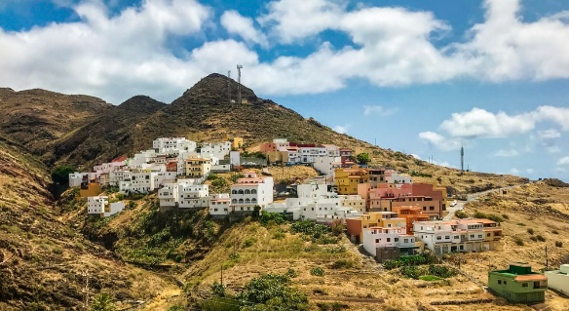
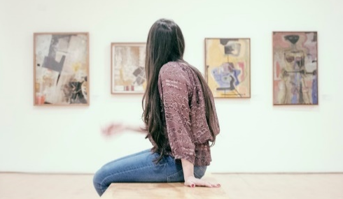
Identifica la imagen y escribe la letra correcta.
C
A
B
naturaleza
E
F
azul
F
escuchar
H
museo
D
E
I
G
escuela
D
mundo
C
pueblo
J
J
antiguo
H
I
A
ciudad
B
respuesta
G
Notes:
OPTIONAL
Having focused on the sound-spelling correspondence(s), students now focus on the meaning of the words used for practice.
They can write them in their books, and write the letter next to the word, as above.
Elicit the letter in Spanish to practise letters of the alphabet.
Alternatively, the teacher can read out each word and students will say the corresponding letter in Spanish.
A) Photo by fhlcreative on Unsplash
B) Photo by jorgefdezsalas on Unsplash
C) Free clipart from clker.
D) Photo by NeONBRAND on Unsplash
E) Photo by redcharlie on Unsplash
F) Photo by micahboswell on Unsplash
G) Free clipart from clker.
H) Free clipart from clker.
I) Photo by gilber franco on Unsplash
J) Photo by bananablackcat on Unsplash

Slide 7
¿A, e, i, o, u?
hablar / escuchar / escribir
Persona A
✄
Persona B
Mi ciudad es interesante y bonita. Hay tiendas, un mercado, un museo, una iglesia y dos bancos. También tiene naturaleza: hay un río entre árboles muy verdes. Mi _sc_ _la es m_y b_en_, p_ed_ p_rtic_par en d_p_rt_s en gr_p_ y t_mbién p_ _d_ _st_diar c_ _nc_a y _rt_. P_ _d_ camin_r a l_ _sc_el_ o ir _n b_c_clet_ p_rqu_ _stá c_rca.
M_ c_ _udad es int_resant_ y b_nit_. H_y t_ _ndas, un m_rc_d_, un m_s_ _, una igl_s_ _ y dos b_nc_s. T_mb_én t_ _n_ n_t_ral_za: hay un rí_ _ntr_ árb_l_s m_y v_rd_s. Mi escuela es muy buena, puedo participar en deportes en grupo y también puedo estudiar ciencia y arte. Puedo caminar a la escuela o ir en bicicleta porque está cerca.
- - - - - - - - - - - - - - - - - - - - - - - - - - - - - - -
Notes:
Do not display during the activity.
Pairs take it in turns to read out the text to their partner who has to listen out for the missing vowels, which are all revisited this week and last week in the SoW.
Some highly skilled students might be able to complete some of the words on their own, but most will need the input from their partner reading the full text aloud to be able to complete all the words.
More vowels can be deleted to make it more challenging, depending on the level of the group.
All the vocabulary used here has been seen in previously taught vocabulary sets or phonics practice, and words have also been included from the sets of words to be revisited during this week. Also, the form “puedo” has been purposely used to allow an opportunity for teachers to focus students on this verb, which was taught in lesson 1.

