Slide 1
Work with challenging text: Un hombre sin cabeza (Armando José Sequera)
SSCs [que], [qui] [revisited]
Y7 Spanish
Term 3.1 - Week 2 - Lesson 51
Amanda Izquierdo / Rachel Hawkes / Nick Avery Artwork: Mark Davies
Date updated: 16/08/21
Notes:
Artwork by Mark Davies. All additional pictures selected are available under a Creative Commons license, no attribution required.
Learning outcomes (lesson 1):
Consolidation of SSCs [que], [qui]
Consolidation of modal verbs poder and querer
Introduction of new vocabulary items
Understanding of a challenging text: Un hombre sin cabeza (Armando José Sequera)
Word frequency (1 is the most frequent word in Spanish):
7.3.1.2 (introduce) hombre [97]; cabeza [265]; pensar [105]; amar [700]; sin [54]
7.2.2.4 (revisit) estamos [estar-21]; están [21]; oeste [2416]; este [>5000*]; estación [1404]; coche [1190]; tren [1488]; delante [1742]; fuera [299]; detrás [2044]; debajo [1366]
7.2.1.4 (revisit) ¿cuándo? [57]; ¿cuánto? [580]; ¿cuál? [445]; hacer [26]; hago; haces; hace; deporte [1489]; deberes [2187]; actividad [344]; dibujo [1726]; noche [164]; tarde [392]; mañana [402]; de [2]; para [16]
Source: Davies, M. & Davies, K. (2018). A frequency dictionary of Spanish: Core vocabulary for learners (2nd ed.). Routledge: London
The frequency rankings for words that occur in this PowerPoint which have been previously introduced in NCELP resources are given in the NCELP SOW and in the resources that first introduced and formally re-visited those words.
For any other words that occur incidentally in this PowerPoint, frequency rankings will be provided in the notes field wherever possible.

Slide 2
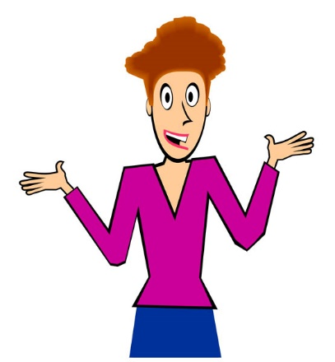
que
porque
Notes:
Introduce and elicit the pronunciation of the individual SSC ‘que’ and then present and practise the pronunciation of the source word ‘porque’.
A possible gesture for this source word would be to rotate your index fingers in a clockwise direction, akin to miming a wheel in forward motion.
Whilst abstract, this is a gesture often used in the classroom to encourage learners to justify their opinions with reasons. NB: The English meaning ‘because’ should be clearly given to ensure secure word-meaning mapping.

Slide 3
que
porque
Notes:
Repeat the sound and elicit the source word.

Slide 4
que
porque
Notes:
Repeat the sound and elicit the source word.

Slide 5
que
parque
pequeño
porque
¿qué?
querer
[because]
[to want]
quedar
[to meet up; stay; suit]
Notes:
Introduce and elicit the pronunciation of the individual SSC ‘que’ and then the source word again (with gesture, if using). Then present and elicit the pronunciation of the five cluster words.
The cluster words have been chosen for their high-frequency, from a range of word classes, with the SSC (where possible) positioned within a variety of syllables within the words (e.g. initial, 2nd, final etc.). Additionally, we have tried to use words that build cumulatively on previously taught SSCs (see the Phonics Teaching Sequence document) and do not include new SSCs. Where new SSCs are used, they are often consonants which have a similar symbol-sound correspondence in English.

Slide 6
que
parque
pequeño
porque
¿qué?
querer
quedar
Notes:
Without the images, students focus this time again closely on the SSC and the cluster words.

Slide 7
que
parque
pequeño
porque
¿qué?
querer
quedar
Notes:
Without the images or sound, students have to pronounce the words themselves.

Slide 8
Escucha las frases.
How many times can you hear ‘que’?
Escucha otra vez y escribe la frase. ¿Qué significa?
Frase | ¿Qué significa?
 | 1 | 2 | 3
El coche es barato porque es pequeño.
The car is cheap because it is small.
1
Es normal querer hacer deporte por la mañana.
It’s normal to want to do sport in the morning.
2
Es bueno quedar con amigos para hacer los deberes.
3
It’s good to meet friends to do (the) homework.
4
El parque es muy bonito aunque es pequeño.
The park is very pretty although it is small.
5
¿Qué actividades haces en el parque?
What activities do you do in the park?
Notes:
Timing: 8 minutes
Aim: to practise aural recognition and spelling of SSC ‘que’, and to understand the vocabulary in the sentence.
Procedure:
Click on the number buttons to play the recordings.
Students listen and tally how many [que] SSCs they hear in each recording and tick the appropriate column.
Answers are shown by clicking in order.
In the second part of the activity, students need to listen and transcribe the Spanish sentence, before then translating it. It may be necessary to play the recording several times.
Transcript:
El coche es barato porque es pequeño.
Es normal querer hacer deporte por la mañana.
Es bueno quedar con amigos para hacer los deberes.
El parque es muy bonito aunque es pequeño.
¿Qué actividades haces en el parque?
Notes:
Students haven’t yet met ‘para’ with the meaning ‘in order to’. However, this use of ‘para’ will appear in the poem used in this week’s lessons, so now could be a good opportunity to direct students’ attention to it.
All of the phonics source and cluster words have been used here, plus some of the vocabulary to be revisited this week has been used: T2.2 Week 4 (revisited this week)
coche [1190] T2.1 Week 4 (revisited this week) hacer [26]; deporte [1489]; deberes [2187]; actividad [344]; mañana [402]; para [16]

Slide 9
¿Qué es?
Es una cabeza
Es una ca_ _ _ _
La cabeza no solo es una parte del cuerpo.
¿Qué cosas tenemos en la cabeza?
Notes:
Timing: 3 minutes
Aim: to activate knowledge of concepts and ideas relevant to the text.
Procedure:
1. Elicit ‘cabeza’ (a previously taught phonics word) from students and the meaning of the sentence below it.
2. Ask students to consider the different senses of ‘cabeza’ (a physical body part, but also the human mind). They may wish to use words that they have not yet learned, so encourage use of ‘¿Cómo se dice ____ en inglés?
3. Possible suggestions here could include cognates/near-cognates: emociones, ideas, imaginación. The Spanish for thought (pensamiento) and feeling (sentimiento) might also come up. The key point here is to focus on the ideas and concepts.
Notes
Use of L1 could be useful in pointing out cross-linguistic similarity – in English we use literal and figurative and literal language with ‘head’: ‘he’s keeping a cool head’ (fig), ‘she shook her head’ (lit). In Spanish, cabeza is used in both senses too.
Previously taught language on this slide
sólo (2.1.3); qué (1.1.4); cosa (1.1.7); tenemos (2.2.2); en (1.1.1)
Cuerpo is a previously taught phonics cluster word.
Images from http://clipart-library.com/

Slide 10
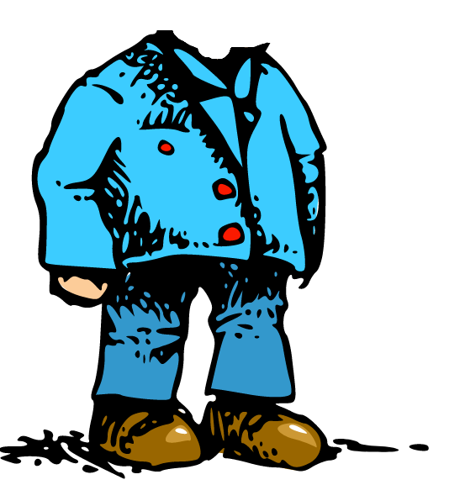
Escucha la frase. ¿Cuál es la persona?
El texto de hoy es un poema.
escuchar
¿Qué NO puede usar?
1
2
un sombrero
A
B
un hombre con cabeza
un hombre sin cabeza
Notes:
Timing: 2 minutes
Aim:
The aim of this slide is to work with the vocabulary in the poem and facilitate its introduction, clarifying the meaning of ‘sin’ as opposed to ‘con’. Also, we are practising with the previously taught question word ’quién’ (also a cluster word from the SCC ‘qui’, which is revisited this week).
Procedure:
Hover mouse over the audio symbol (top right of the slide) and then click on the ‘play’ icon to listen to the first line of the poem.
Students hear the beginning of the poem and decide whether the poem is about character A or B. Then, students answer the question ’¿Qué no puede usar?’ (B).
Previously taught vocabulary items words:
con (1.1.6); puede (2.2.2); usar (1.1.7); quién (1.1.6); no (1.2.1); cuál (2.1.4) – revisited in the scheme of work this week; persona (1.2.3)
Cabeza [1.2.1] and sin [1.1.2] are previously taught phonics words.

Slide 11
Poema: «Un hombre sin cabeza»
Un hombre sin cabeza no puede hacer unas cosas. ¿Qué otras actividades no puede hacer? En parejas, escribe otros verbos.
Un hombre sin cabeza
no puede usar sombrero.
Pero éste no es
su mayor problema:
no puede pensar,
no puede leer,
no puede cantar,
no puede comer,
no puede escuchar,
ni puede entender,
que para amar y besar
cabeza debes tener.
think
Palabras importantes:
éste = this (m.)
mayor = biggest
ni = nor
que = that
para = in order to
pensar
El autor: Armando José Sequera
Notes:
Timing: 12 minutes
Aim: to anticipate some of the language that will appear in the text. A focus here is on poder as a modal verb before an infinitive, which was taught in Year 7 Term 2.
Procedure:
1. Students brainstorm in pairs all the possible infinitives that they think could be in the poem. 2. Tell students that they will get points for anticipating correctly, but also (a different number of) points for coming up with infinitives that no other group has. 3. After 8 minutes to work on their list, ask the class to read the poem aloud up to the first gap. 4. Then reveal each infinitive by clicking, one by one, telling students to mark off any that they have in common with the poem. 5. When finished, tell students they get 3 points for every infinitive they’ve matched. 6. Bonus points: Then ask for any additional infinitives that they had. You could ask for one from each group. If no other group has it, the group gets 5 points. If other groups have it, those that do get 1 point each. Keep going until all the verbs are accounted for. There will then be a count up to identify the winning team. Original source of the poem: http://www.doslourdes.net/Un%20hombre%20sin%20cabeza.htm
Taken from: http://all-literature.wikidot.com/

Slide 12
Escucha y lee el poema completo. Identifica el verbo en cada imagen.
leer / escuchar
Puedes usar el diccionario si quieres. Escucha y comprueba.
Un hombre sin cabeza
no puede usar sombrero.
Pero éste no es
su mayor problema:
no puede pensar,
no puede leer,
no puede cantar,
no puede comer
no puede escuchar,
ni puede entender,
que para amar y besar
cabeza debes tener.
[think]
1
2
3
4
[understand]
5
6
7
8
Notes:
Timing: 4 minutes
Aim: to make sure that students understand all the verb infinitives in the poem.
Procedure:
Students now hear full poem in full and can read it at the same time. To play the poem hover the mouse over the grey speaker icon in the top right hand corner, then press ‘play’.
Ask students to write 1-8 in their books and write the Spanish verb corresponding to the each numbered image. Click each blue number to hear the correct verb so that students can check their answers.
Transcript:
Cantar
Comer
Pensar
Besar
Escuchar
Amar
Entender
Leer
Notes:
NB ‘Besar’ and ‘entender’ haven’t been previously taught (though ‘entiendo’ has), but students might be able to work out these two meanings by process of elimination.
If students already have experience in using bilingual dictionaries, they can look up any word they don’t fully understand. The NCELP dictionary skills training will come in lesson 2 of this teaching sequence.
Clipart from clker.com

Slide 13
Escucha los 8 verbos. ¿Cuál es la imagen correcta?
Escribe la letra.
escuchar
1
E
A
B
C
2
B
3
C
D
E
D
F
4
5
F
6
G
[understand]
G
H
7
H
[think]
8
A
Notes:
OPTIONAL
Aim: listening exercise to consolidating understanding of verb infinitives.
Procedure:
Click on the number trigger to play the verb and students write which image it is.
The individual answers are revealed by clicking.
Transcript
Amar
Leer
Escuchar
Entender
Cantar
Pensar
Comer
Besar
Notes:
The order of audio items and pictures is different from that on slide 9, so the activities could be done one after the other.
This time students can only hear each verb (no text is displayed), so it is more challenging than the previous slide, where the text can be seen. This additional verb recognition practice will help to prepare students for production activities that appear later in this lesson.

Slide 14
¿Cómo se dice en español? Lee el poema en parejas.
leer / hablar
Un hombre sin cabeza
no puede usar sombrero.
Pero éste no es
su mayor problema:
no puede to think,
no puede to read,
no puede to sing,
no puede to eat
no puede to listen,
ni puede to understand,
que para to love y to kiss
cabeza debes tener.
¿Cómo está la pronunciación?
rojo
amarillo
verde
Notes:
Timing: 3 minutes
Aim: to practise pronunciation of the poem and to recall the Spanish verb infinitives
Procedure:
1. In this activity students do a paired read aloud, taking it in turns to read the text. The English verbs serve as prompts for students to recall the Spanish translation while reading aloud. 2. At the end the partner who was listening rates his/her partner (verde, amarillo, rojo) like a traffic light for his/her pronunciation, and then they swap roles. 3. Teachers can elicit the name of the colours before doing this activity, as they were taught [2.1.3] and revisited [2.2.5] - answers for colours are animated to appear on clicks.

Slide 15
Otra versión del poema
hablar / escuchar
Someone decided that the original version was repetitive, with too many ‘no puede’s. She changed it so that sometimes it just has ‘no’ and a short form verb. The difference in meaning is: 1) no puede cantar – s/he cannot sing 2) no canta – s/he doesn’t sing The difference in verb form is: 1) … cantar – infinitive 2) … canta – 3rd person singular [s/he form] Your partner will read an adapted version of this poem to you. Every time s/he stops, complete the line with either the infinitive OR the 3rd person singular form of the verb. Then swap and read your version to your partner.
Notes:
Timing: 6 minutes
Aim: to practise adapting verb forms from modal verb + infinitive to 3rd person singular in the oral modality (speaking and listening)
Procedure:
This slide introduces and explains the speaking activity.
Hand out the cards (these cards are shown on slides 13 and 14, which should not be shown on the screen during the activity).

Slide 16
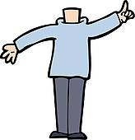
hablar / escuchar
A
B
hablar / escuchar
Un hombre sin cabeza
1 Un hombre sin cabeza
2 no puede usar sombrero.
3 Pero éste no es
4 su mayor problema:
5 no puede hablar,
6 no puede estudiar,
7 no canta,
8 no pregunta,
9 no escucha,
10 ni puede creer,
11 que para amar y besar
12 cabeza debes tener.
Un hombre sin cabeza
1 Un hombre sin cabeza
2 no puede usar sombrero.
3 Pero éste no es
4 su mayor problema:
5 no … [hablar / habla],
6 no … [estudiar / estudia],
7 no … [cantar / canta],
8 no … [preguntar / pregunta],
9 no … [escuchar / escucha],
10 ni … [creer / cree],
11 que para amar y besar
12 cabeza debes tener.
Armando José Sequera
Armando José Sequera
Notes:
Do not display in class.
Partner A reads but stops short and doesn’t say the words in orange (they are there so that s/he is 100% sure which form it should be and can give feedback) Partner B has to complete the incomplete utterances with either the long or short form of the verb, whichever is correct.
Printer-friendly speaking cards in Word format accompany this resource.

Slide 17
hablar / escuchar
A
B
hablar / escuchar
Un hombre sin cabeza
1 Un hombre sin cabeza
2 no puede usar sombrero.
3 Pero éste no es
4 su mayor problema:
5 no … [llamar / llama],
6 no … [saber / sabe],
7 no … [decir / dice],
8 no … [cambiar / cambia],
9 no … [querer/ quiere],
10 ni … [ser / es],
11 que para amar y besar
12 cabeza debes tener.
Un hombre sin cabeza
1 Un hombre sin cabeza
2 no puede usar sombrero.
3 Pero éste no es
4 su mayor problema:
5 no puede llamar,
6 no sabe,
7 no puede decir,
8 no puede cambiar,
9 no quiere,
10 ni puede ser,
11 que para amar y besar
12 cabeza debes tener.
Armando José Sequera
Armando José Sequera
Notes:
Do not display in class.
This time
Partner B reads but stops short and doesn’t say the words in orange (they are there so that s/he is 100% sure which form it should be and can give feedback) Partner A has to complete the incomplete utterances with either the long or short form of the verb, whichever is correct.
Printer-friendly speaking cards in Word format accompany this resource.

Slide 18
Escribe un poema similar. Puedes usar un diccionario.
escribir
Una persona sin respeto
no quiere decir ’gracias’.
Pero este no es su mayor problema:
no quiere _____________
no quiere _____________
no quiere _____________
no quiere _____________
no quiere _____________
ni quiere entender que cada persona
respeto debe tener.
Notes:
Either do this activity or the activity on the next slide
Timing: 6 minutes
Aim: Creative task using another common modal verb + infinitive structure
Procedure:
Students write their own poem following the structure provided, which uses another modal verb (‘querer’).
Final poems could be read out, and students try to work out what the new verbs mean.
Notes:
Querer (including quiere) was taught in Term 1.2, week 7. The SSC ‘que’ is also the phonics focus for this week.
If students already have experience in using bilingual dictionaries, they can look up any word they don’t fully understand. The NCELP dictionary skills training will come in lesson 2 of this teaching sequence.

Slide 19
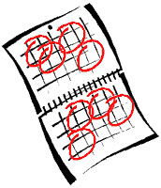
Escribe un poema similar. Puedes usar un diccionario.
escribir
Una persona sin ayuda
debe hacer cosas sola.
Pero este no es su mayor problema:
no _____________
no _____________
no _____________
no _____________
no _____________
pero puede entender que para _____________ y _____________
ayuda debes tener.
Notes:
Alternative activity to previous slide
Timing: 8 minutes
Procedure:
1.This version has been left more open in terms of the structures that students can use. They could use any of puede + infinitive, quiere + infinitive, debe + infinitive or 3rd person singular. These structures could even be varied within the poem, following the examples on slides 13 and 14.
Notes
Note the slight difference on the 3rd last line, where ‘pero’ is used and the verb is affirmative (as opposed to negative with ‘ni’). This conjunction seemed appropriate in context. (A person without help often knows and understands the consequences / what it might be like if they did have help.)
‘Ayuda’ was taught in 1.1.7
Hacer was taught in 2.1.4 (revisited this week)
If students already have experience in using bilingual dictionaries, they can look up any word they don’t fully understand. The NCELP dictionary skills training will come in lesson 2 of this teaching sequence.
Clipart from http://clipart-library.com/

Slide 20
Escribe el poema «Un hombre sin cabeza» en inglés.
Español | Inglés
Un hombre sin cabeza
no puede usar sombrero.
Pero éste no es
su mayor problema:
no puede pensar,
no puede leer,
no puede cantar,
no puede comer,
no puede escuchar,
ni puede entender,
que para amar y besar
cabeza debes tener.
A man without a head…
su = his
ni = nor
que = that
Notes:
OPTIONAL
Aim: In this activity students are challenged to provide a full translation in English. There is a gloss with those words that students will probably not know.

Slide 21
Escribe el poema «Un hombre sin cabeza» en inglés.
Español | Inglés
Un hombre sin cabeza
no puede usar sombrero.
Pero éste no es
su mayor problema:
no puede pensar,
no puede leer,
no puede cantar,
no puede comer,
no puede escuchar,
ni puede entender,
que para amar y besar
cabeza debes tener.
A man without a head…
can't wear a hat.
But this is not
his biggest problem:
he can't think
he can’t read,
he can’t sing,
he can’t eat
he can’t listen,
nor can he understand,
that to love and to kiss
you must have a head.
Notes:
This slide shows a translation of the poem.

Slide 22
Using word reference resources Research skills for the MFL student
SSCs [que], [qui] [revisited]
Y7 Spanish
Term 3.1 - Week 2 - Lesson 52
Amanda Izquierdo / Rachel Hawkes / Nick Avery Artwork: Mark Davies
Date updated: 16/08/21
Notes:
Learning outcomes (lesson 2):
Consolidation of SSCs [que], [qui]
This sequence of slides aims to raise students’ awareness of the importance of using dictionaries or translation sites to research the meaning of unknown words when translating from the target language, and to find the correct target language word for the desired meaning when translating from the English.
It also attempts to help students to deal with the common pitfalls encountered by newcomers to dictionary use, by giving practice opportunities in the basic thought and decision-making processes required.
The following version of the sequence is adapted for the Year 7 Spanish scheme of work.
Word frequency (1 is the most frequent word in Spanish):
7.3.1.2 (introduce) hombre [97]; cabeza [265]; pensar [105]; amar [700]; sin [54]
7.2.2.4 (revisit) estamos [estar-21]; están [21]; oeste [2416]; este [>5000*]; estación [1404]; coche [1190]; tren [1488]; delante [1742]; fuera [299]; detrás [2044]; debajo [1366]
7.2.1.4 (revisit) ¿cuándo? [57]; ¿cuánto? [580]; ¿cuál? [445]; hacer [26]; hago; haces; hace; deporte [1489]; deberes [2187]; actividad [344]; dibujo [1726]; noche [164]; tarde [392]; mañana [402]; de [2]; para [16]
Source: Davies, M. & Davies, K. (2018). A frequency dictionary of Spanish: Core vocabulary for learners (2nd ed.). Routledge: London
The frequency rankings for words that occur in this PowerPoint which have been previously introduced in NCELP resources are given in the NCELP SOW and in the resources that first introduced and formally re-visited those words.
For any other words that occur incidentally in this PowerPoint, frequency rankings will be provided in the notes field wherever possible.

Slide 23
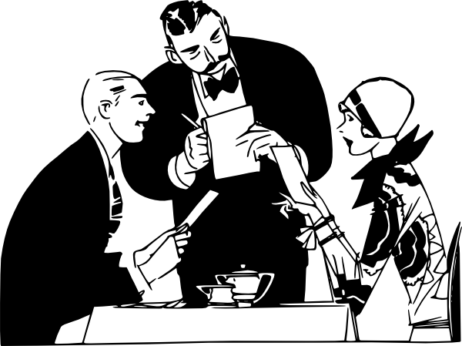
qui
quiero
Notes:
Introduce and elicit the pronunciation of the individual SSC ‘qui’ and then present and practise the pronunciation of the source word ‘quiero’.
A possible gesture for this source word would be to fold hands over your heart, and then move the right hand away from the body.

Slide 24
qui
quiero
Notes:
Repeat the sound and elicit the source word.

Slide 25
qui
quiero
Notes:
Repeat the sound and elicit the source word.

Slide 26
qui
izquierda
tranquilo
quiero
[I want…]
quince
¿quién?
equipo
Notes:
Introduce and elicit the pronunciation of the individual SSC ‘qui’ and then the source word again (with gesture, if using). Then present and elicit the pronunciation of the five cluster words.
The cluster words have been chosen for their high-frequency, from a range of word classes, with the SSC (where possible) positioned within a variety of syllables within the words (e.g. initial, 2nd, final etc.). Additionally, we have tried to use words that build cumulatively on previously taught SSCs (see the Phonics Teaching Sequence document) and do not include new SSCs. Where new SSCs are used, they are often consonants which have a similar symbol-sound correspondence in English.

Slide 27
qui
izquierda
tranquilo
quiero
quince
¿quién?
equipo
Notes:
Without the images, students focus this time again closely on the SSC and the cluster words.

Slide 28
qui
izquierda
tranquilo
quiero
quince
¿quién?
equipo
Notes:
Without the images or sound, students have to pronounce the words themselves.

Slide 29
Escucha las frases.
How many times can you hear ‘qui’?
Escucha otra vez y escribe la frase. ¿Qué significa?
Frase | ¿Qué significa?
 | 1 | 2 | 3
El equipo está en el estadio a la izquierda del aeropuerto.
The team is in the stadium to the left of the airport.
1
¿Quién quiere viajar en avión por la noche?
Who wants to travel by plane at night?
2
¿Cuándo hago quince dibujos de deberes?
When do I do fifteen drawings for homework?
3
4
Quieren estar tranquilos aquí en la estación.
They want to be calm here at the station.
5
Estamos en el este pero el oeste está a la izquierda.
We are in the east but the west is on the left.
Note. el estadio = stadium; el avión = plane
Notes:
Timing: 8 minutes
Aim: to practise recognising and spelling SSC ‘qui’.
Procedure:
Teachers click on the number buttons to play the recordings.
Students listen and tally how many [qui] SSCs they hear in each recording and tick the appropriate column.
Answers are shown by clicking in order.
In the second part of the activity, students need to listen and transcribe the Spanish sentence, before then translating it. Teachers click to show this second grid. Teachers may need to play the recording several times.
Transcript:
El equipo está en el estadio, a la izquierda del aeropuerto;
¿Quién quiere viajar en avión por la noche?
¿Cuándo hago quince dibujos de deberes?
Quieren estar tranquilos aquí en la estación;
Estamos en el este pero el oeste está a la izquierda;
Notes:
All of the phonics source and cluster words have been used, here, plus some of the vocabulary to be revisited this week has been used: T2.2 Week 4:
estamos [estar-21]; oeste [2416]; este [>5000*]; estación [1404]; tren [1488]
T2.1 Week 4:
¿cuándo? [57]; hago [26]; deberes [2187]; dibujo [1726]; noche [164]; de [2];

Slide 30
Identifica la palabra correcta.
hace
cuánto
hablar
cuánto
1 | 2 | 3
4 | 5 | 6
7 | 8 | 9
how much? | night | afternoon, evening
sport | you do, you make | of, from
s/he does, s/he makes | they are (location/state) | for, in order to
haces
están
de
la tarde
para
la noche
el deporte
Notes:
Timing: 2 minutes
Aim: to revise words from weeks 2.2.4 and 2.1.4 receptively (revisited in the scheme of work this week)
Procedure:
1. The teacher says the number (either in numerical or random order, to challenge students more). Students have to search the options around the edge of the box to decide which is the corresponding word. Pause for several seconds to allow students to search, then elicit the Spanish word from students in chorus.
Notes:
To allow for flexibility in the order of numbers, the answers have not been animated.

Slide 31
Can you just guess?
Could you guess the meanings of these Spanish words? (if you had not met them):
actividad
activity
this is a near-cognate: it is similar in both languages
oeste
west
not quite a cognate, but its sound gives you a clue!
estación
station; season
not quite a cognate, but its sound gives you a clue about one of its meanings!
debajo
under; underneath
you need to know it – you cannot really hope to guess!
mañana
morning; tomorrow
you need to know it – you cannot really hope to guess!
So guessing the meaning would clearly not be a reliable strategy for half of these words!
Notes:
Timing: 2 minutes
Aim: This slide aims to raise students’ awareness of the importance of looking up words rather than guessing their meaning, even though sometimes meanings can be worked out (e.g. for cognates and near-cognates).
Procedure:
There are different ways of approaching this. Teachers could either give the students a minute to guess the word, and then see what options students have come up with, and see what strategies were being employed, or teachers could simply go through each word one by one, saying the word and seeing if the students can come up with an answer.
Teachers click to show the meanings and then the explanation of what cognates / near-cognates are.
Notes:
Vocabulary revisiting: estación, debajo, oeste (2.2.4) and mañana (2.1.4) are revisited in the scheme of work this week

Slide 32
Which side is it?
A paper dictionary (i.e. a real book!) has two sections:
for a Spanish dictionary, these are Spanish to English and English to Spanish.
Can you say in which section of the dictionary you would look for the words below?
bread
delante
Spanish to English
English to Spanish
happy
with
tren
fuera
we
detrás
Notes:
Timing: 2 minutes
Aim: to introduce students to Spanish-English dictionary use.
Procedure:
This slide explains the fact that there are two ‘sides’ to a paper dictionary, something which often causes beginner dictionary users problems.
Students are challenged to allocate the words in the centre – a mix of English and Spanish words – to one side or the other. Though this should not be too difficult a task, it ‘trains’ the student in the correct first step to be taken upon consulting a paper dictionary (the ‘from’ and ‘to’ languages settings also being a consideration, of course, with online dictionaries and translation websites).
The answers are animated, and the words ‘fly’ to the correct side.
Notes:
Vocabulary revisiting: Term 2.2 Week 4 – delante, fuera, tren and detrás are revisited in the scheme of work this week

Slide 33
Alphabetical order
In a paper dictionary, words are listed in alphabetical order.
Put these English words into the order in which they would appear in the dictionary:
before
bold
because
ball
befriend
1
2
3
4
5
So we had to go as far as the fourth letter to sort words 3 and 4 into alphabetical order!
Notes:
Timing: 2 minutes
Aim: to give students further introductory information on dictionary use.
Procedure:
1. Students need to put the English words into alphabetical order
2. The answers are animated, and the words ‘fly’ into their correct position in the order when teacher click.
3. Teachers will need to explain how this alphabetising process works.
Notes
Alphabetical ordering is something which can also cause beginner dictionary users problems – particularly when they are required to look beyond the initial letter. This slide therefore attempts to provide some practice in this skill, essential for the second step in locating the word to be looked up in the dictionary. It is necessary to look as far as the fourth letter to sort two of the words!

Slide 34
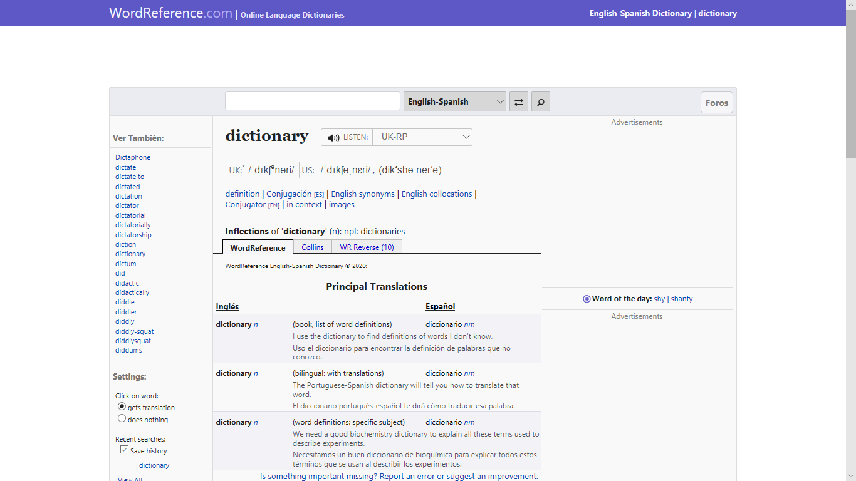
Online dictionary
These days, you don’t have to use a paper dictionary: online dictionaries are available. A good one for Spanish is WordReference
It looks like this:
You type the word you want to look up here (make sure it is in the right language!)
You swap between the
English to Spanish and Spanish to English sections here
Notes:
Timing: 2 minutes
Aim: to introduce Wordreference.com
Procedure:
Having practised two of the skills required for paper dictionary use, the students are now introduced to our choice of online dictionary for Spanish. It is recommended that they bookmark this on their own devices.
It could be worth showing this process on the site itself
Teachers click to show the callouts highlighting how to change between source language.

Slide 35
Parts of speech
Assuming we can find our word we also need to know what type of word it is, in the context in which we need to use it. Can you match the words on the left below with their type (in orange), on the right?
Sometimes, the same word can be both a noun and a verb – take the English word ‘lead’, for example (something you use to walk the dog, and something you do when others follow you!)
happy
adjective
article (determiner)
bread
with
adverb
verb
the
pronoun
we
preposition
quickly
make
conjunction
noun
but
Notes:
Timing: 4 minutes (for slides 35 and 36)
Aim: to teach students about recognising the parts of speech of words, and how this is important when using a dictionary.
Procedure:
Explain the exercise, clicking to show that some words can be different parts of speech.
Students match up the English word on the left with the part of speech on the right in their exercise books.
Answers are on the next slide, which can be displayed when the students have completed the task.

Slide 36
Answers
Did you match the words and their word types correctly?
bread
noun
happy
adjective
make
verb
quickly
adverb
the
article (determiner)
we
pronoun
with
preposition
but
conjunction
Types of word are called ‘parts of speech’.
Notes:
Procedure:
Click to show the answers.
The term ‘parts of speech’ is explained.
Teachers should take this opportunity to check understanding of what these parts of speech are.

Slide 37
Abbreviations used
Dictionaries give the type of word (part of speech) using abbreviations (often in italics and sometimes in a different colour) after the word itself.
Can you find the abbreviations used in WordReference for each part of speech?
nm or nf
noun
adj
adjective
vtr or vi
verb
adv
adverb
def art or indef art
article (determiner)
pron
pronoun
prep
preposition
conj
conjunction
Similar abbreviations are used in paper dictionaries, too.
Notes:
Timing: 5 minutes
Aim: to understand where dictionaries refer to these parts of speech and how they are abbreviated.
Procedure:
This exercise can be done with WordReference.com or with paper dictionaries.
Students are now challenged to find the abbreviations used on the recommended Spanish dictionary site for the parts of speech listed; the answers are animated. A similar exercise could be done with any paper bilingual dictionaries in use.
Teachers could ask students what ‘nm’ and ‘nf’ might refer to.

Slide 38
Un hombre sin cabeza (adapted poem)
Un hombre sin cabeza
no puede usar sombrero.
Pero éste no es
su mayor problema:
no puede pensar,
no puede leer,
no puede cantar,
no puede comer
No puede escuchar,
ni puede entender,
que para amar y besar
cabeza debes tener.
Y como tiene dos pares de ojos
mira de frente y baja la mirada
todo al mismo tiempo
y no nos enteramos.
Armando José Sequera
You are studying the poem opposite in Spanish this week. You have learnt many of the words it contains previously, but some others are new.
Can you look up the words highlighted in orange in the dictionary (or using WordReference) and list their
English meaning and part of speech?
sin prep without
mayor adj biggest
pensar vi to think
mirada nf look
Notes:
Timing: 4 minutes
Aim: to practise dictionary use.
Procedure:
Four words are thus highlighted for students to look up, practising the skills introduced earlier in this sequence.
The answers are animated and appear upon successive clicks of the mouse.
Notes:
In Week 2 of Term 3.2 of the Spanish scheme of work, students are working with the text Un hombre sin cabeza. Note that this is a slightly extended version (the final four lines were not in the version that students worked on in lesson 1).
Many of the words in this text have been previously introduced and learnt (this was one factor in the choice of this text for this point in the scheme of work).
Four words are thus highlighted for students to look up, practising the skills introduced earlier in this sequence.
The answers are animated and appear upon successive clicks of the mouse.

Slide 39
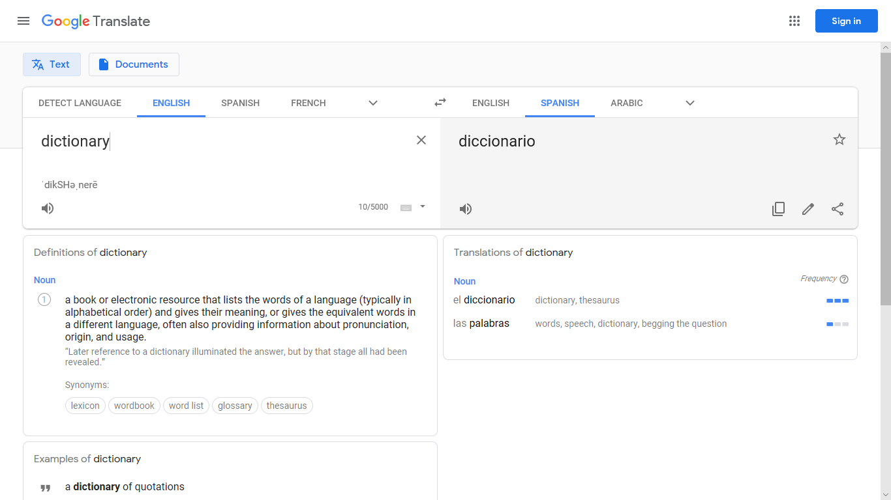
Translation websites
You can reverse the direction of translation (English to Spanish or Spanish to English), here.
Some people like to use translation websites, such as Google Translate.
It looks like this:
You select the ‘from’ and ‘to’ languages, here.
You type the word you want to look up here (make sure it is in the right language!)
Notes:
Timing: 2 minutes
Aim: to introduce translation websites (using the example of Google Translate) – a popular alternative to dictionaries for many students. These sites are extremely simple to use, but are often very basic in the amount of information offered, at least initially.
Procedure
1. Teachers click to go through the explanation and introduction to translation websites. It may be useful to show this online.
Notes:
The relative lack of exemplification of correct word usage can lead to a mis-translation of the intended concept being adopted by the student.
The next slide will invite students to consider the benefits offered by the dictionary, as compared with these sites.

Slide 40
Comparing options
Compare below the amount of information about correct Spanish usage given by the online dictionary (on the left) and the translation website (on the right).
Which is likely to be the most useful?
Notes:
Timing: 2 minutes
Aim: This slide invites students to consider the benefits offered by the dictionary, as compared with translation sites. As can be seen from the screenshots, the dictionary often provides greater detail and, in particular, exemplification of correct word usage in a variety of contexts, thus better enabling the student to select the correct word to express the meaning desired.
Procedure:
1. No animations on this slide. Use the screenshots to discuss the pros and cons use of dictionary and translation websites

Slide 41
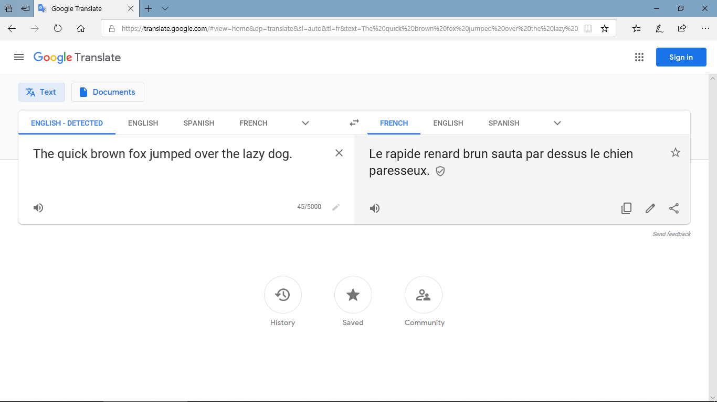
Watch what happens as you go round a few languages translating this well-known sentence. First, from the English into French:
You haven’t learnt any past tense yet, but it’s worth knowing that google translate often selects the simple past in French and German, when this is seldom / never (!) what you need.
Notes:
Timing: 2 minutes (for slides 41-44)
Aim: to show potential problems with translation sites.
Procedure:
The slides move from English-French-German-Spanish and back to English, showing how meaning can be altered. There are callouts on several slides showing certain specific problems.
The final slide in this sequence explains certain issues.

Slide 42
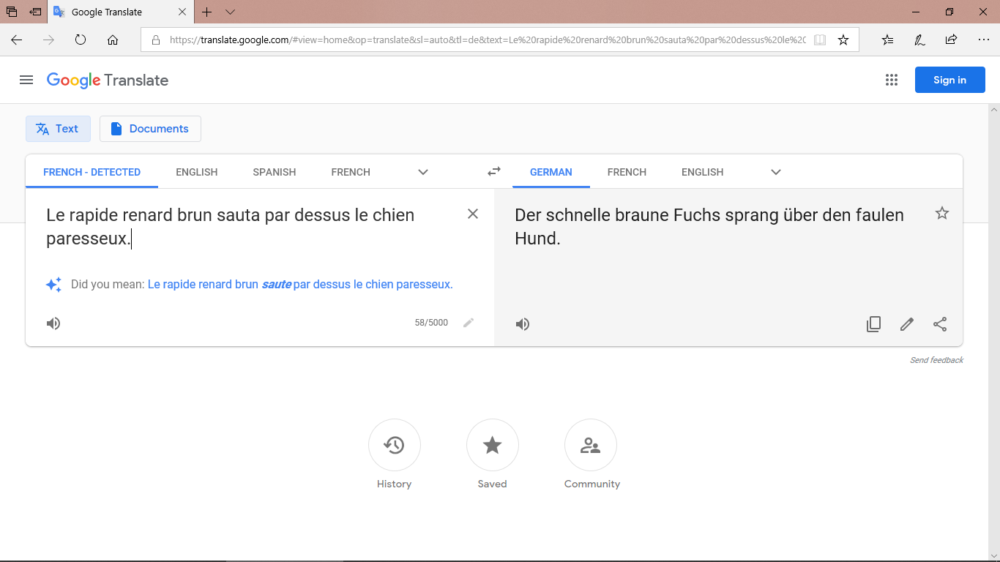
Then from the French into German:
The past simple in German, too!

Slide 43
Then the German into Spanish:

Slide 44
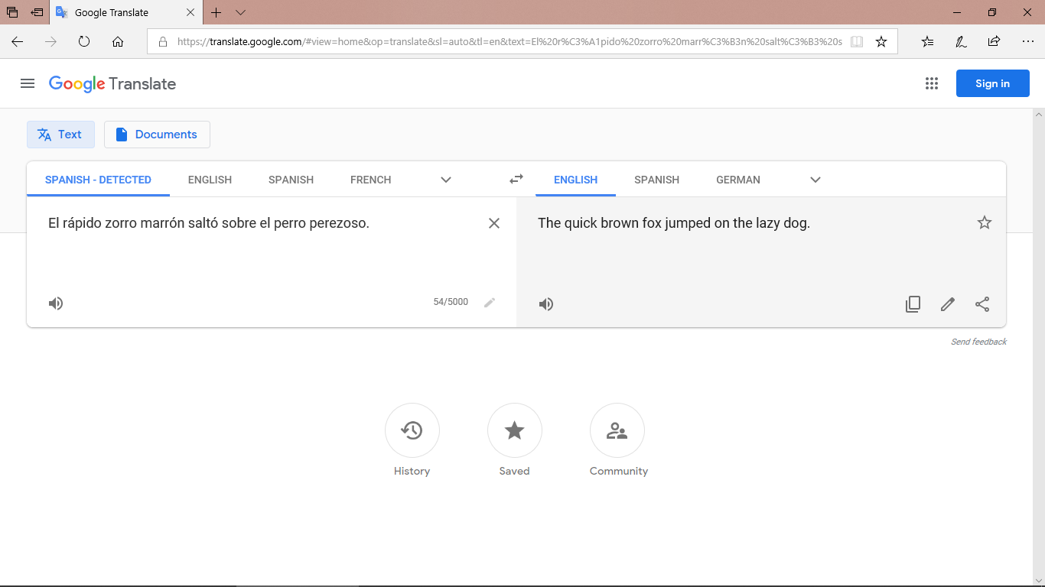
... and finally from the Spanish back into English:
So we have gone from:
‘The quick brown fox jumped over the lazy dog.’
to:
The quick brown fox jumped on the lazy dog.
Quite a difference for the dog! Sometimes these small errors make a big difference to the intended meaning (e.g., whether there was a fox-dog fight!)

Slide 45
Deberes
There is no vocabulary learning homework this week, but revisit vocabulary from term 1 and 2 in this mashup.
Notes:
Next week (3.1.3) is a revision week, so there is no vocabulary pre-learning. However, students can revise vocabulary from terms 1 and 2 in the Quizlet mashup. This will refresh students’ knowledge of vocabulary ahead of revision week.

