Slide 1
Grammar
‘Somos’ for traits
‘Estamos’ (revisited) for state / mood
Y7 Spanish
Term 2.2 - Week 5 - Lesson 47
Victoria Hobson / Nick Avery
Date updated: 29/03/20
Notes:
Source of frequency rankings: Davies, M. & Davies, K. (2018). A frequency dictionary of Spanish: Core vocabulary for learners (2nd ed.). London: Routledge

Slide 2
ser
[to be | being]
somos
[we are - permanent]
Notes:
Use this slide to introduce the first person plural of ‘ser’.

Slide 3
Describing permanent attributes versus temporary states: Using ‘somos’ and ‘estamos’
ser
estar
In Spanish there are two verbs for ‘to be’: ______ and ________.
We use ser to describe permanent attributes and estar to describe temporary states.
Compare:
Somos tranquilos.
Estamos tranquilos.
Somos locos. – We are insane.
Estamos locos. – We are acting crazy.
Somos aburridos. – We are boring.
Estamos aburridos. – We are bored.
Some adjectives have different meanings when used with ser and estar. For example:
moreno / loco / aburrido
In English, we often use a verb with ‘-ing’ to talk about a temporary state (‘right now’).
For example,
We are feeling calm.
We are acting crazy.
We are being strange.
Somos morenos. – We are dark-skinned/dark-haired.
Estamos morenos. – We are tanned/brown.
→ We are calm (in general).
We are calm (at the moment).
Notes:
Note: It is worth pointing out to students that ser loco is only used in Spain to refer to people who are clinically insane / in a mental institution. It does have a broader use than this in much of South America, but it’s important to stress to students that when they want to say someone is crazy, they will want to use ‘estar’.

Slide 4
leer
Una familia de vacaciones
In general
(permanenttrait)
On holiday
(temporary state)
La familia escribe una postal. Lee las frases. ¿Qué dice la familia?
1 | Estamos morenos como los surfistas.
2 | Somos tranquilos, descansamos en el hotel.
3 | En los museos estamos aburridos.
4 | Estamos locos por las noches, bailamos mucho en las discotecas.
5 | No usamos el ascensor* en el hotel porque somos nerviosos.
6 | Somos serios, escuchamos las instrucciones en la estación.
7 | Estamos felices en la playa y en las tiendas.
8 | No somos tontos.
*el ascensor – lift
Notes:
Four adjectives in this activity were taught in Term 1.1, week 2: nervioso [1521]; tranquilo [1073]; serio [856]; tonto [2379]. Ask students to recall the meaning of these.

Slide 5
leer
Una familia de vacaciones
In general
(permanenttrait)
On holiday
(temporary state)
Lee otra vez.
Escribe las frases subrayadas en inglés.
el ascensor – lift
1 | Estamos morenos como los surfistas.
2 | Somos tranquilos, descansamos en el hotel.
3 | En los museos estamos aburridos.
4 | Estamos locos por las noches, bailamos mucho en las discotecas.
5 | No usamos el ascensor en el hotel, somos nerviosos.
6 | Somos serios, escuchamos las instrucciones en el avión.
7 | Estamos felices en las tiendas.
8 | No somos tontos.
We are tanned / brown.
We are calm.
We are bored.
We are (acting) crazy.
We are nervous.
We are serious.
We are (feeling) happy.
We aren’t silly.
Notes:
Teachers could ask students to translate the whole sentence as a differentiation opportunity for higher ability students.

Slide 6
escuchar
Una familia de vacaciones
El padre habla por teléfono con los abuelos en Inglaterra. Describe las vacaciones. Escucha. ¿La familia describe cómo es en general o cómo está hoy? Marca la opción correcta. También escribe el adjetivo en inglés.
 | En general | Hoy
 | En general | Hoy
1
cheerful
5
bored
2
dark-skinned
6
serious
(being)
strange
(feeling)
nervous
3
7
(acting)
crazy
4
calm
8
Notes:
Alegre, raro, serio and nervioso were all taught in Term 1.1 of Year 7.
TRANSCRIPT
Somos alegres
Somos morenos
Estamos raros
Somos raros.
Estamos aburridos
Somos serios
Estamos nerviosos
Estamos locos

Slide 7
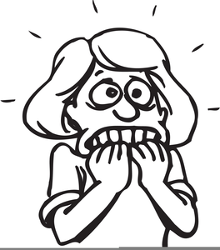
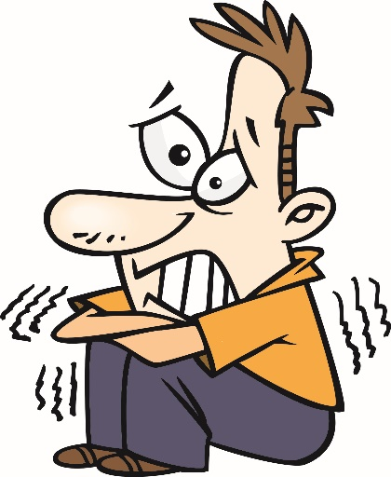
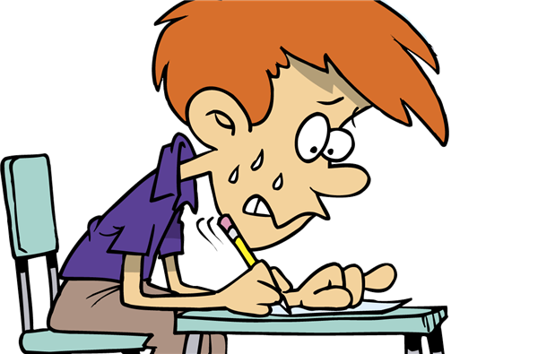
¿Somos o estamos?
escribir
24h
E.G.
E.G.
Somos
nerviosos.
Estamos
nerviosos.
We are nervous.
We are feeling nervous.
Notes:
Use this slide to model the instructions for students.
Students write two contrasting sentences, using ser and estar in first person plural. In addition, students should strive for correct adjective agreement. However, this skill will be explicitly practised in the next lesson. Teachers may feel they need to give students help with the adjectives to be used in case the picture alone does not make this clear.
Ask for translations into English of the sentences once complete so that students can evidence their understanding of the person referred to by the verb and the meaning (to reinforce that they both are translated as ‘to be’) and the meaning of the adjective, depending on whether it is used with ser or estar.

Slide 8
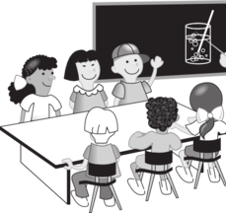
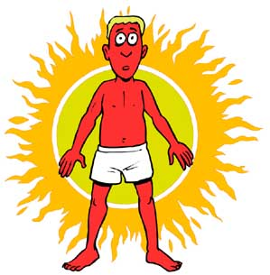
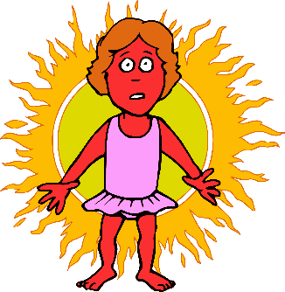
İA escribir!
escribir
zzz
zzz
2)
1)
Somos
aburridos.
Estamos
aburridos.
We are bored.
We are boring.
3)
4)
Somos
rojos.
Estamos
rojos.
We are red.
We are red (burnt).
5)
6)
Somos
locos.
We are insane/crazy.
We are acting crazy.
Estamos
locos.
7)
8)
Estamos
morenos.
We are tanned/brown.
We are dark-haired/dark-skinned.
Somos
morenos.
Notes:
Here students write two contrasting sentences, using ser and estar in first person plural. In addition, students should try for correct adjective agreement (by remembering to add ‘s’ for plural – as modelled in the input activities), however, this skill will be explicitly practised in the next lesson (which is why only the –os ending is needed here). Teachers may feel they need to give students help with the adjectives to be used in case the picture is not clear.
Teachers can ask for translations into English as part of the feedback if desired, to emphasise the difference in meaning of adjectives with ser and estar.
Another adjective is revisited here to illustrate ser vs estar: rojo (taught in Term 2.1, week 3). Note: Somos locos has been indicated by a crazy monster image. It is worth pointing out to students that ser loco is only used in Spain to refer to people who are clinically insane / in a mental institution. It has a broader use than this in much of South America, but it’s important to stress to students that when they want to say someone is crazy, they will want to use ‘estar’.
Images of sunburnt characters and Mr Men from http://clipart-library.com/ (freely available).

Slide 9
Grammar [2]
‘Somos’ for traits
‘Estamos’ (revisited) for state / mood
Y7 Spanish
Term 2.2 - Week 5 - Lesson 47
Victoria Hobson / Nick Avery
Date updated: 29/03/20
Notes:
Source of frequency rankings: Davies, M. & Davies, K. (2018). A frequency dictionary of Spanish: Core vocabulary for learners (2nd ed.). London: Routledge

Slide 10
Descripciones de los amigos
leer
Lee las descripciones. ¿Son de Paco y Paulina o Sara y María?
Escribe los adjetivos en inglés.
están morenos
son serias
están locas
Paco
Paulina
Sara
María
son aburridos
They are…
tanned
boring
nervous
(being) serious
They are…
serious
(acting) crazy
dark-haired/skinned
bored
son nerviosos
son morenas
están aburridas
están serios
Notes:
In this activity, we are reinforcing the meanings of the adjectives when used with ser and estar, this time with son and están (which have both been introduced in previous sequences). In order to determine the translation of the adjective, students will need to pay close attention to the verb i.e. temporary state or trait. Also, this is the opportunity to revisit rules on adjective agreement. (Correct adjective agreement will be necessary in the production activities at the end of this sequence.) Before students attempt the activity, elicit the rules by asking the class how they will work out the answers.
Click on the box to reveal the answer. This allows students to give the answers in any order. (Teachers will have to work out which box to click by looking at the descending order from the list in Spanish)
Paco & Paulina: (adjectives listed in the order they descend in the list)
tanned
boring
nervous
being serious
Sara & María:
serious
acting crazy
dark-haired/skinned
bored

Slide 11
¿Qué describe Ignacio?
escuchar
Marca la opción correcta y escribe el adjetivo.
Luego, escucha otra vez. Es ‘hoy’ o ‘en general’?
el cielo = sky
 |  | ¿Los dos? | Adjetivo en español | ¿Hoy (temporary state) o en general (permanent)?
El cielo | La imagen
Los ríos | Las flores
Los abuelos | Las abuelas
Los primos | Las primas
Las camisas | Los colores
Los perros | Las chicas
Las cremas | Los zapatos
Las profesoras | Los autores
1
oscuro
hoy
2
claros
hoy
3
fuertes
en general
4
hermosas
hoy
oscuros
en general
5
activos
hoy
6
claras
en general
7
8
tranquilos
en general
Notes:
TRANSCRIPT
[el cielo] está oscuro
[los ríos] están claros
[las abuelas] son fuertes
[las primas] están hermosas
[los colores] son oscuros
[los perros] están bastante activos en el parque
[las cremas] son claras
[los autores] son tranquilos
The adjectives chosen here include three from 2.1.2 (hermoso, activo, fuerte) to offer further reinforcement of the revisited vocabulary (and evidence changing patterns of adjectives ending in -o plus adjectives ending in –e). Oscuro and claro are included from this week’s set as these have not yet been practised. This serves to offer variety of language/sentences and different contexts to further illustrate the use of ser/estar.
To ensure that students also pay attention to the use of ser/estar, students can listen again and decide whether the verb refers to a temporary state (está, están) or trait (son).
During the feedback, check students’ understanding of the nouns. Some of these words will be needed in the speaking activity which follows. (Los ríos / Las casas / Los chocolates / Las profesoras / Las primas / Los perros/ Las camisas / Los abuelos). Teacher could quickly write them on the board to serve as a visual support during the speaking activity.

Slide 12
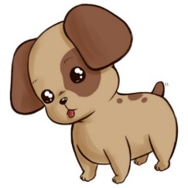
hablar / escuchar
Persona A
Say a sentence to your partner.
Escucha. Marca la opción correcta y escribe la frase en inglés.
Usa ‘Los/las……..+ ‘son’ / ‘están’.
dark-skinned | bored
acting crazy feeling nervous | calm brown
Hoy
[in general]
[today]
Hoy
En general
En general
The………………………………………..
The………………………………………..
[today]
[in general]
Hoy
Hoy
En general
En general
The………………………………………..
The………………………………………..
Notes:
Do not show during activity
These prompt cards/grid are available in Word format (for ease of printing).
This is partner A’s sheet. The pictures + adjectives are what partner A will translate into Spanish to say to their partner. The second half of the sheet (the blank grid) is for partner A to record in English the details partner B has told them.
Task instructions:
Give students a few minutes to think about their sentences. (There is a separate writing activity to follow which is why writing is not included here, although teachers could incorporate this element should it be desired or of benefit to the students). They then take it in turns to say their sentences in Spanish to their partner, who has to decide if the sentence is ‘today’ or ‘in general’ and write in English the noun and adjectives on the second half of the sheet. (This can be done anywhere - it does not matter if they are not mirrored in the same boxes). The listener will have to pay careful attention to the verb to determine the translation of the adjective. Teachers should circulate to check for accuracy of adjective agreement.
At the end of the task, students can compare sheets to see if they understood the sentences correctly – the English should match. The next slide also displays the English to facilitate feedback.

Slide 13
hablar / escuchar
Persona B
Say a sentence to your partner.
Escucha. Marca la opción correcta y escribe la frase en inglés.
Usa ‘Los/las……..+ ‘son’ / ‘están’.
quite serious | clear
tanned | active
Hoy
Hoy
[today]
[in general]
En general
En general
The………………………………………..
The………………………………………..
[today]
[in general]
Hoy
Hoy
En general
En general
The………………………………………..
The………………………………………..
Notes:
Do not show during activity

Slide 14
hablar/escuchar
Persona A
Persona B
Hoy
Hoy
Hoy
Hoy
En general
En general
En general
En general
The boys/cousins (m) are being quite serious.
The rivers are clear.
The cousins (m/f) are dark-skinned.
The girls/cousins (f) are bored.
Hoy
Hoy
Hoy
Hoy
En general
En general
En general
En general
The grandparents are tanned.
The teachers (f) are active.
The boys (f) are acting crazy and feeling nervous.
The dogs are calm and brown.
Notes:
Here are the answers for students to be able to readily check their translations.

Slide 15
Ser or estar?
Lee las frases. Es necesario usar ‘ser’ o ‘estar’ en español?
1 | The sky is dark today.
2 | We are bored in the holidays.
3 | We are happy (in general).
4 | The rivers are clear in the morning.
5 | The authors are boring.
6 | The grandparents are tanned.
7 | We are dark-skinned.
8 | The cousins (f) are active today.
9 | We are calm (in general).
10 | They are good-looking (in general).
11 | The girls are nervous (now).
12 | The dogs are crazy in the car.
estar
ser
estar
estar
ser
ser
estar
ser
ser
estar
estar
estar
Notes:
Here all the adjectives used come from this week’s vocab set. The sentences for moreno and aburrido exemplify the difference in meaning of these two adjectives when used with ser or estar. During the feedback, draw students’ attention to this. They will then be translating these sentences as a production activity next.
Previously taught vocabulary: activo guapo nervioso were taught in Term 1.1 and Term 2.1.
Note: The use of ser + loco differs regionally. In Spain, ser loco is generally avoided, as its use is limited to someone who is clinically insane. A more general craziness might be conveyed by ‘Ser un loco’, which is a level of complexity we avoid here. In South America, ser loco is more widely used. We have, however, avoided using it with ser in this exercise. For further debate, see: https://forum.wordreference.com/threads/ser-estar-loco.442135/

Slide 16
Ser or estar?
escribir
Escribe las palabras subrayadas en español.
1 | The sky is dark (today).
2 | We are bored in the holidays.
3 | We are happy (in general).
4 | The rivers are clear in the morning.
5 | The authors are boring.
6 | The grandparents are tanned.
7 | We are dark-skinned.
8 | The cousins (f) are active today.
9 | We are calm (in general).
10 | They are good-looking (in general).
11 | The girls are nervous (now).
12 | The dogs are crazy in the car.
Está oscuro.
estar
Somos morenos.
ser
Estamos aburridos.
estar
Las primas están activas hoy.
estar
Somos felices.
ser
Somos tranquilos/tranquilas.
ser
Los ríos están claros por la mañana.
estar
Son guapos.
ser
Los autores son aburridos.
ser
Las chicas están nerviosas.
estar
Los abuelos están morenos.
estar
Los perros están locos en el coche.
estar
Notes:
This final translation activity requires students to use both ser and estar in first and third person plural and consider adjective agreement, combing their learning from across the two lessons.
During the feedback, discuss with students alternate translations for the sentences with estar, such as ‘the girls are feeling nervous’ (11) or ‘the dogs are acting crazy’ (12).
All vocabulary required for the translations has been seen in previous vocab sets.

