Slide 1
Vocabulary
Y7 German
Term 1.2 - Week 4 - Lesson 21
Natalie Finlayson / Rachel Hawkes
25 November 2019

Slide 2
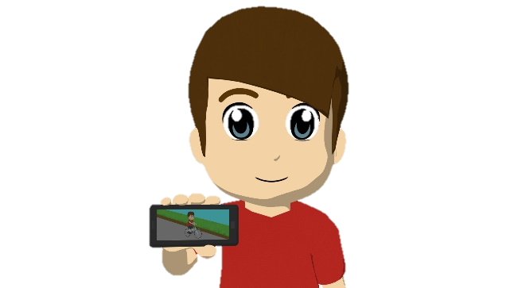
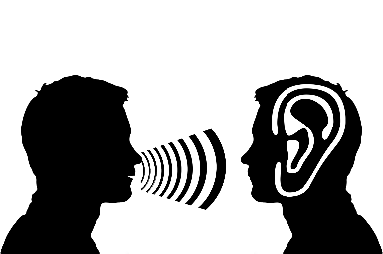
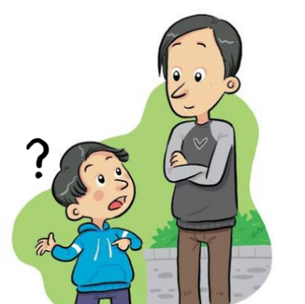
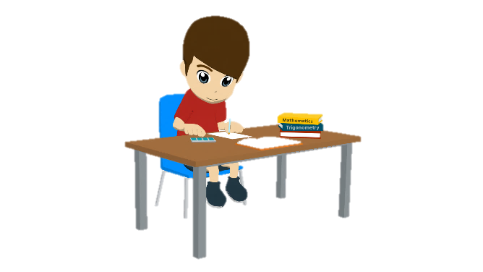
Vokabeln
lesen / schreiben
schreiben
Hallo!
Hallo!
Hallo!
antworten
sprechen
wiederholen
lesen
zeigen
zuhören
wiederholen
zeigen
…
lesen
fragen
sprechen
fragen
schreiben
antworten
zuhören
Notes:
Revision/consolidation/reminding of the vocabulary that students will have learnt in advance of the lesson, with some verbs from previous weeks mixed in. All verbs chosen can be used to give classroom instructions. Teacher should highlight that simple instructions will be given in German from now on, and so it is important that students can understand the meaning in spoken and written form.
Students read the choices and choose the one that best fits each picture. Teacher elicits answers by pointing at the picture and asking ‘Was ist das?’ to elicit a choral response.
Note: Students have not yet learnt /ö/, /s-/ or /sp-/ as an SSC and may therefore need some help/practice with these.
Answers appear on your click.

Slide 3
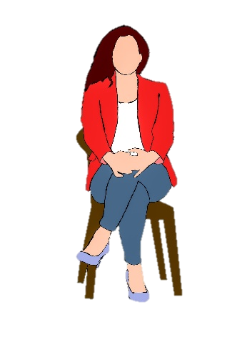
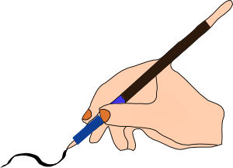
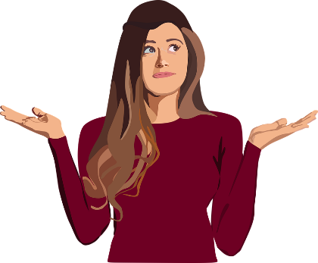
Du bist dran!
hören / sprechen
Schreiben!
Zuhören!
Sitzen!
Lesen!
Zeigen!
Sprechen!
Fragen!
Antworten!
Notes:
Optional additional practice for classroom verbs. Teacher first brings up the vocabulary items one by one, and asks students to perform a gesture/mime to represent the meaning. The slide provides example gestures.
Once gestures have been agreed, a Simon Says-type game can be played. The students stand up and the teacher hides the slide. The teacher then lists the verbs in a random order. Students must perform the action which corresponds to the word they hear. If they perform the wrong action, or take too long to decide, they are out of the game and must sit down. The last student standing is the winner.

Slide 4
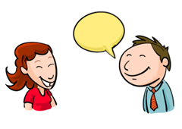
sprechen
[to speak | speaking]
spricht
[speaks | is speaking]
Notes:
Note: Students should know the meanings of the infinitives of these verbs already, as it was homework to learn them (audio and quizlet) but they are re-presented here in the infinitive and short form to deepen students’ knowledge and model the use of both forms in sentences.
Introducing the verb sprechen more explicitly. Sprechen is one of the NCELP 15 prototypical verbs in German. Prototypical verbs are common verbs that illustrate the typical characteristics of a class of verb – the German prototypical verbs contain examples of regular/weak verbs, but also common examples of each stem-change: e → i, a → äu, e → ie. All 15 prototypical verbs will be introduced early on using the same format. Both long form (infinitive) and short form (3rd person singular) are introduced in order to familiarise students with various forms of the same verb.
Note that this strong verb is being presented ‘lexically’ at the moment, as it is a very common verbs, particularly in a classroom language learning context. Learning a few prototypical strong verbs like this early on ‘primes’ for the formal introduction of present tense strong verbs in 2.2.3 (in the 2nd half of the spring term). Teachers may want to prompt learners to say what they notice about the stem of the verb in the 3rd person singular, comparing it to the infinitive.
Bring up the word sprechen on its own, say it, students repeat it, and remind them of the phonics. Draw attention to the soft /ch/ which features in this weeks’ SSC.
Try to elicit the meaning from the students.
Bring up the picture, and, if using gestures, a possible gesture would be to make one hand ‘talk’ like a puppet.
Then bring up the English translations. Emphasise the two meanings for the infinitive.
Bring up the short form spricht, say it, students repeat it.
Try to elicit the meanings from the students. Emphasise the two meanings for the short form.
Note: Students have had explicit teaching that the present tense in German communicates two different present tense meanings in English. This reinforces that learning. Emphasise the two meanings for the short form, reminding students that German only has one form and does not have a direct equivalent of the grammar for ‘is + ing’, the continuous form (as covered in previous weeks).

Slide 5
sprechen
[to speak | speaking]
spricht
[speaks | is speaking]
Notes:
Cycle through the long and short form again.

Slide 6
spricht
[speaks | is speaking]
Er spricht Deutsch.
[He speaks | is speaking German.]
Notes:
Introduce the short form in a sentence.

Slide 7
sprechen
[to speak | speaking]
Er muss Deutsch sprechen.
[He must speak German.]
Notes:
Introduce the long form in a sentence.

Slide 8
spricht
[speaks | is speaking]
spricht
Er ______ Deutsch.
[He speaks | is speaking German.]
Notes:
Cycle through the short form in context again.

Slide 9
sprechen
[to speak | speaking]
sprechen
Er muss Deutsch __________.
[He must speak German.]
Notes:
Cycle through the long form in context again.

Slide 10
lesen
[to read | reading]
liest
[reads | is reading]
Notes:
Introducing the verb lesen more explicitly. Lesen is one of the NCELP 15 prototypical verbs in German. Prototypical verbs are common verbs that illustrate the typical characteristics of a class of verb – the German prototypical verbs contain examples of regular/weak verbs, but also common examples of each stem-change: e → i, a → äu, e → ie. All 15 prototypical verbs will be introduced early on using the same format. Both long form (infinitive) and short form (3rd person singular) are introduced in order to familiarise students with various forms of the same verb.
Note that this strong verb is being presented ‘lexically’ at the moment, as it is a very common verbs, particularly in a classroom language learning context. Learning a few prototypical strong verbs like this early on ‘primes’ for the formal introduction of present tense strong verbs in 2.2.3 (in the 2nd half of the spring term). Teachers may want to prompt learners to say what they notice about the stem of the verb in the 3rd person singular, comparing it to the infinitive.
Bring up the word lesen on its own, say it, students repeat it, and remind them of the phonics. Draw attention to the long and short /e/ which was the focus SSC in 1.1.2.
Try to elicit the meaning from the students.
Bring up the picture, and, if using gestures, a possible gesture would be to put hands side by side, palms facing up, and open and close like a book.
Then bring up the English translations. Emphasise the two meanings for the infinitive.
Bring up the short form liest, say it, students repeat it.
Try to elicit the meanings from the students. Emphasise the two meanings for the short form.
Note: Students have had explicit teaching that the present tense in German communicates two different present tense meanings in English. This reinforces that learning. Emphasise the two meanings for the short form, reminding students that German only has one form and does not have a direct equivalent of the grammar for ‘is + ing’, the continuous form (as covered in previous weeks).

Slide 11
lesen
[to read | reading]
liest
[reads | is reading]
Notes:
Cycle through the long and short form again.

Slide 12
liest
[reads | is reading]
Sie liest ein Buch.
[She reads | is reading a book.]
Notes:
Introduce the short form in a sentence.

Slide 13
lesen
[to read | reading]
Sie kann ein Buch lesen.
[She can read a book.]
Notes:
Introduce the long form in a sentence.

Slide 14
liest
[reads | is reading]
liest
Sie ____ ein Buch.
[She reads | is reading a book.]
Notes:
Cycle through the short form in context again.

Slide 15
lesen
[to read | reading]
lesen
Sie kann ein Buch ______.
[She can read a book.]
Notes:
Cycle through the long form in context again.

Slide 16
Vokabeln
lesen und schreiben
?
A. Was machst du in England?
B. Nicht falsch.
C. Wo bist du?
D. Was ist das? →
E. Was machst du in der Schule?
F. Wo ist das Klassenzimmer?
G. Nicht richtig.
H. Das ist ein Tag.
I. Was machst du mit einer Gitarre?
J. Du redest …
K. Er ist keine Frau.
L. Was machst du im Unterricht?
 |  |  |  |  |  |  |  | W | O | H | N | E | N
 |  |  |  |  |  |  | R | I | C | H | T | I | G
I | M | - | K | L | A | S | S | E | N | Z | I | M | M | E | R
 |  |  |  |  |  |  |  | D | A | S | - | P | A | A | R
 |  |  |  |  |  |  | L | E | R | N | E | N
 |  |  | I | N | - | D | E | R |  | S | C | H | U | L | E
 |  |  | F | A | L | S | C | H
 |  |  |  |  |  |  | M | O | N | T | A | G
 |  |  |  | S | P | I | E | L | E | N
 | M | I | T | - | F | R | E | U | N | D | E | N
 |  | D | E | R | - | M | A | N | N
 | D | I | E | - | A | U | F | G | A | B | E
Notes:
Starter
Note: a more complex version of this task, in which only the first letter of each word is given, can be found on the next slide.
This starter task revises 12 items of vocabulary (shown in bold below) drawn from 1.1.2 and 1.1.7 (the two weeks students were set to revisit last week). A further 7 items of vocabulary (shown in italics below) feature in the clues and are therefore revised receptively.
By working out the answers to the clues and spelling out the words correctly, students create the word ‘Wiederholung’, which is the focus for this activity. So the activity does the task of ‘sharing the context learning objective’ with students. Students should have pre-learned the verb ‘wiederholen’ as part of their audio and Quizlet homework, so teacher should explain that this is the noun form.
Note: The clues relate to the words directly to their right.
To elicit answers, and integrate additional alphabet practice:
1. Teacher asks question / gives clue in German as per A – L on slide. 2. Student(s) volunteer(s) the answer (e.g. wohnen).
3. Teacher asks ‘wie schreibt man das?’ 4. Students in chorus (slowly and steadily) respond to spell out the answer: W – O – H – N – E – N. 5. As students spell the word, teacher reveals each letter on a click. This will enable the teacher to pick up on any of the trickier letters, and do some remedial practice in the moment.
T1.1 Week 2
sagen [46] sagt [46] was? [39] der Tag [108] der Mann [131] das Paar [284] die Klasse [619] richtig [211] falsch [638] nicht [12] oder [30] ja [27] nein [120] T1.2 Week 2
wohnen [380] schreiben [245] spielen [197] reden [356] lernen [203] machen [49] Montag [794] die Aufgabe [317] im Klassenzimmer [609/619] im Unterricht [1107] in der Schule [208] mit Freunden [13/327] er [20] sie [10]

Slide 17
Vokabeln
lesen und schreiben
?
A. Was machst du in England?
B. Nicht falsch.
C. Wo bist du?
D. Was ist das? →
E. Was machst du in der Schule?
F. Wo ist das Klassenzimmer?
G. Nicht richtig.
H. Das ist ein Tag.
I. Was machst du mit einer Gitarre?
J. Du redest …
K. Er ist keine Frau.
L. Was machst du im Unterricht?
 |  |  |  |  |  |  |  | W | O | H | N | E | N
 |  |  |  |  |  |  | R | I | C | H | T | I | G
I | M | - | K | L | A | S | S | E | N | Z | I | M | M | E | R
 |  |  |  |  |  |  |  | D | A | S | - | P | A | A | R
 |  |  |  |  |  |  | L | E | R | N | E | N
 |  |  | I | N | - | D | E | R |  | S | C | H | U | L | E
 |  |  | F | A | L | S | C | H
 |  |  |  |  |  |  | M | O | N | T | A | G
 |  |  |  | S | P | I | E | L | E | N
 | M | I | T | - | F | R | E | U | N | D | E | N
 |  | D | E | R | - | M | A | N | N
 | D | I | E | - | A | U | F | G | A | B | E
Notes:
Starter
Note: a less complex version of this task, in which only the first letter of each word is given, can be found on the next slide.
This starter task revises 12 items of vocabulary (shown in bold below) drawn from 1.1.2 and 1.1.7 (the two weeks students were set to revisit last week). A further 7 items of vocabulary (shown in italics below) feature in the clues and are therefore revised receptively.
By working out the answers to the clues and spelling out the words correctly, students create the word ‘Wiederholung’, which is the focus for this activity. So the activity does the task of ‘sharing the context learning objective’ with students. Students should have pre-learned the verb ‘wiederholen’ as part of their audio and Quizlet homework, so teacher should explain that this is the noun form.
Note: The clues relate to the words directly to their right.
To elicit answers, and integrate additional alphabet practice:
1. Teacher asks question / gives clue in German as per A – L on slide. 2. Student(s) volunteer(s) the answer (e.g. wohnen).
3. Teacher asks ‘wie schreibt man das?’ 4. Students in chorus (slowly and steadily) respond to spell out the answer: W – O – H – N – E – N. 5. As students spell the word, teacher reveals each letter on a click. This will enable the teacher to pick up on any of the trickier letters, and do some remedial practice in the moment.
T1.1 Week 2
sagen [46] sagt [46] was? [39] der Tag [108] der Mann [131] das Paar [284] die Klasse [619] richtig [211] falsch [638] nicht [12] oder [30] ja [27] nein [120] T1.2 Week 2
wohnen [380] schreiben [245] spielen [197] reden [356] lernen [203] machen [49] Montag [794] die Aufgabe [317] im Klassenzimmer [609/619] im Unterricht [1107] in der Schule [208] mit Freunden [13/327] er [20] sie [10]

