Slide 1
Talking about things that happened at the same time
Imperfect vs perfect
Ongoing events with 'BE + -ing’
Est-ce que questions
SSC [r]
Y9 French
Term 3.2 - Week 6 - Lesson 69
Author names: Louise Bibbey
Artwork by: Chloé Motard
Date updated: 08/08/2022
Notes:
Artwork by Chloé Motard. All additional pictures selected are available under a Creative Commons license, no attribution required.
Native speaker feedback provided by Stéphanie Schmitt.
With thanks to Rachel Hawkes for her input on the lesson material.
Learning outcomes (lesson 1):
Revision of SSC [r]
Introduction of imperfect vs perfect
Introduction of imperfect tense to describe ongoing events with BE + -ing
Revision of Est-ce que questions with and without question words
Word frequency (1 is the most frequent word in French):
9.3.2.6 (introduce): dîner [2365], voir, je vois, tu vois, il/elle voit [69], pièce [813], salon [2729], escalier [3705], cave [4870], salle à manger [812, 4, 1338], téléphone [1366], quand(2) [119], pendant que [89/9]
9.3.2.2 (revisit): défendre [389], obtenir [334], permettre (à…de) [158], promettre (à...de) [854], vendre [710], colonie [3375], indépendance [1651], kilomètre [1435], Métropole [n/a], siècle [603], africain [2289], jusqu'à [n/a], à cause de [n/a]
9.2.2.3 (revisit): participer à [670], artiste [1797], concours [1375], défi [1728], diversité [2537], émission [1074], genre [556], personnage [1449], sexe [1691], scène [794], spectacle [1687], annuel [1674], culturel [1495], non-binaire [>5000], transgenre [>5000]
Source: Lonsdale, D., & Le Bras, Y. (2009). A Frequency Dictionary of French: Core vocabulary for learners London: Routledge.
The frequency rankings for words that occur in this PowerPoint which have been previously introduced in NCELP resources are given in the NCELP SOW and in the resources that first introduced and formally re-visited those words.
For any other words that occur incidentally in this PowerPoint, frequency rankings will be provided in the notes field wherever possible.
The additional English meanings of the following words have been added to Quizlet since the creation of this resource:
escalier – stairs, staircase

Slide 2
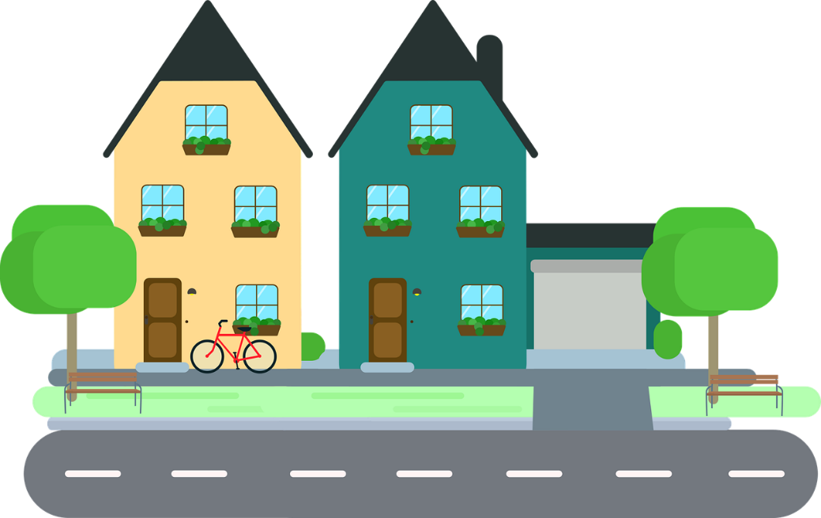
r
rue
Notes:
Timing: 1 minute
Aim: To consolidate SSC [r]
Procedure: 1. Present the letter(s) and say the [r] sound first, on its own. Students repeat it with you. 2. Bring up the word ”rue” on its own, say it, students repeat it, so that they have the opportunity to focus all of their attention on the connection between the written word and its sound.
3. A possible gesture for this would be to look left and right and mime crossing a road. 4. Roll back the animations and work through 1-3 again, but this time, dropping your voice completely to listen carefully to the students saying the [r] sound, pronouncing ”rue” and, if using, doing the gesture.
Word frequency (1 is the most frequent word in French):
rue [598]
Source: Lonsdale, D., & Le Bras, Y. (2009). A Frequency Dictionary of French: Core vocabulary for learners London: Routledge.

Slide 3
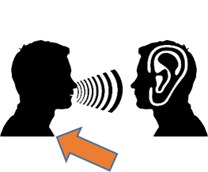
r
triste
frère
[brother]
moderne
rue
parler
[modern]
être
[to be]
Notes:
Timing: 2 minutes
Aim: To consolidate SSC [r]
Procedure:
Introduce and elicit the pronunciation of the individual SSC [r] and then the source word again ‘rue’ (with gesture, if using). Then present and elicit the pronunciation of the five cluster words. The cluster words have been chosen for their high-frequency, from a range of word classes, with the SSC (where possible) positioned within a variety of syllables within the words (e.g. initial, 2nd, final etc.). Additionally, we have tried to use words that build cumulatively on previously taught SSCs (see the Phonics Teaching Sequence document) and do not include new SSCs. Where new SSCs are used, they are often consonants which have a similar symbol-sound correspondence in English.
Word frequency (1 is the most frequent word in French): rue [598]; frère [1043], triste [1843], moderne [1239], être [5], parler [106] Source: Lonsdale, D., & Le Bras, Y. (2009). A Frequency Dictionary of French: Core vocabulary for learners London: Routledge.

Slide 4
Phonétique [r]
info
Remember that it is a raspy sound pronounced in the back of the throat, and is not like the English ‘r’!
There is no equivalent sound in English.
Follow these steps to revise pronunciation of [r]:
1. Open your mouth.
2. Close your throat as if you’re about to gargle and say ‘k’ several times.
3. Start again but don’t close your throat completely.
4. Instead of ‘k’, practise saying “ra-ra-ra”.
Notes:
Timing: 2 minutes
Aim: To build familiarity with movement in the mouth and throat when saying SSC [r].
Procedure:
1. Click to reveal step by step process of pronouncing [r].
2. Students should practise for a minute.

Slide 5
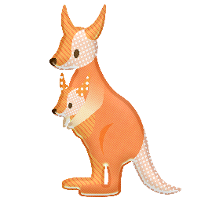
Phonétique: SSC [r]
Qui va avec chaque phrase?
lire/parler
Catherine
Arthur
Rosalie
Laurent
Beatrice
Rachid
Béatrice
1
Catherine
2
Laurent
3
…veut être
une vraie actrice.
…va travailler dur
dans l’usine*.
…roule en rond*
dans le vent.
Rosalie
4
Rachid
5
Arthur
6
…a nourri un wallaby en Australie.
…est sportif et
très rapide.
…fait un dessin
pur sur le mur*.
*usine = factory, rouler en rond = ride in circles, dessin = drawing, pur = pure, mur = wall
Notes:
Timing: 4 minutes
Aim: Consolidation of SSC [r]
Procedure:
Students read the phrases aloud in pairs and match them to each person.
Click on buttons to play the audio.
Students listen and check their answers.
Click to reveal answers.
Transcript:
Beatrice veut être une vrai actrice.
Catherine va travailler dur dans l’usine.
Laurent roule en rond dans le vent.
Rosalie a nourri un wallaby en Australie.
Rachid est sportif et très rapide.
Arthur fait un dessin pur sur le mur.
Word frequency of cognates used (1 is the most frequent word in French): wallaby [>5000], solide [1414], pur [1643]
Source: Lonsdale, D., & Le Bras, Y. (2009). A Frequency Dictionary of French: Core vocabulary for learners London: Routledge.
Word frequency (1 is the most frequent word in French): usine [1482], rouler [2599], rond [2268], dessin [2624], mur [1335]
Source: Lonsdale, D., & Le Bras, Y. (2009). A Frequency Dictionary of French: Core vocabulary for learners London: Routledge.

Slide 6
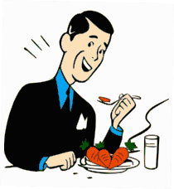
Vocabulaire
écouter
e. when
l. to see, seeing
1
la salle à manger
8
le téléphone
a. cellar
2
il / elle voit
9
voir
d. stairs/staircase
i. you see, are seeing
3
l’escalier
10
le salon
k. lounge
g. while / whilst
j. he / she sees,
is seeing
4
dîner
11
la pièce
5
je vois
h. room
b. to dine, dining
12
la cave
6
pendant que
c. dining room
m. I see,
am seeing
f. telephone
7
tu vois
13
quand
Notes:
Timing: 4 minutes
Aim: Aural recognition of new vocabulary
Procedure:
Click on the numbers to hear the French vocabulary
Students identify the English translation and write the letter of the corresponding English words.
For extra transcription practise, students write the French words they hear.
Click to reveal answers.
Transcript:
la salle à manger
il/elle voit
l’escalier
dîner
je vois
pendant que
tu vois
le téléphone
voir
le salon
la pièce
la cave
quand

Slide 7
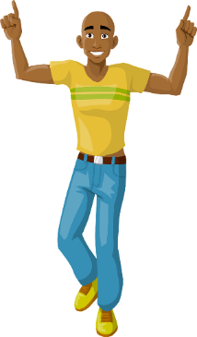
The imperfect: past continuous
grammaire
You already know the difference between the perfect and imperfect tenses:
Remember that étais in this context is translated as ‘was’, rather than ‘used to be’
Perfect:
One-off actions or events
that happened in the past.
Hier, j’ai dansé avec mon ami.
Yesterday, I danced with my friend.
Imperfect:
Things that used to happen
regularly in the past.
Quand j’étais jeune, je dansais.
When I was young, I used to dance.
The imperfect in French is also used to express the English
PAST CONTINUOUS tense.
The English PAST CONTINUOUS is made from the past tense of the verb
TO BE and the -ing form of a verb:
I was dancing
She was waiting
You were reading
Je dansais
Elle attendait
Tu lisais
Notes:
Timing: 2 minutes
Aim: Revision of the difference between the perfect and imperfect tenses, and introduction to the imperfect tense to express the English past continuous tense.
Procedure:
Click to bring up information step by step.
Check comprehension at each step.
For the three examples of the past continuous tense, elicit answers from students.
Bring up the last pop-up box to remind students of the use of étais/était as ‘was’ and ‘were’ in this context.
Word frequency of cognates (1 is the most frequent word in French): danser [2934]
Source: Lonsdale, D., & Le Bras, Y. (2009). A Frequency Dictionary of French: Core vocabulary for learners London: Routledge.

Slide 8
Le parfait ou l’imparfait?
Les phrases sont au parfait ou à l’imparfait ?
écouter
Perfect? one-off action | Imperfect? continuous action
 |  | Elle a parlé avec son amie. [She talked with her friend.]
 |  | Il écoutait de la musique. [He was listening to music.]
 |  | Tu es allé au parc. [You went to the park.]
 |  | Je faisais mes devoirs. [I was doing my homework.]
 |  | Mon frère jouait de la guitare. [My brother was playing the guitar.]
 |  | Ma mère a appelé son ami. [My mother called her friend.]
 |  | Il a donné le livre à sa sœur. [He gave the book to his sister.]
 |  | Tu lisais un livre. [You were reading a book.]
1
2
3
4
5
6
7
8
Notes:
Timing: 3 minutes
Aim: To identify whether statements are talking about completed (perfect) or ongoing events (imperfect) in the past
Procedure:
Click on the numbers on the left to hear the statements.
Students need to pay attention to the verb tense being used to decide which events are ongoing (imperfect) and which are completed (perfect).
Click to reveal the answers, followed by the transcript and translation of the sentences.
Transcript:
Elle a parlé avec son amie.
Il écoutait de la musique.
Tu es allé au parc.
Je faisais mes devoirs.
Mon frère jouait de la guitare.
Ma mère a appelé son ami.
Il a donné le livre à sa sœur.
Tu lisais un livre.

Slide 9
Simultaneous events
grammaire
To talk about an event which occurs when something else is already happening, we use the perfect and imperfect tenses together:
This involves using the conjunctions quand [when] or pendant que [while]:
While I was doing my homework…
Pendant que je faisais mes devoirs…
…my mother called her friend.
…ma mère a appelé son amie.
I was dancing on the stage…
Je dansais sur scène…
…when my friend arrived.
…quand mon amie est arrivée.
Notes:
Timing: 2 minutes
Aim: To introduce the use of the perfect tense and past continuous function of the imperfect tense to talk about two things happening at the same time, including the use of conjunctions quand and pendant que.
Procedure:
Click to bring up information step by step.
Check comprehension at each step.
Elicit translations into French from students for the final example to check comprehension (this could be done on mini white-boards)

Slide 10
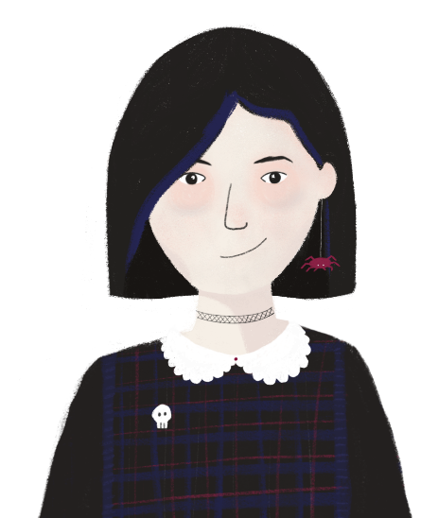
On parle de deux choses…
*évènement = event
écrire/parler
Parle avec ton partenaire de deux évènements* dans le passé.
Partenaire A: traduis les mots anglais en français pour ton partenaire.
Partenaire B: écris les mots que tu entends et construis une phrase complète avec le parfait (P) et l’imparfait (I).
Exemple:
Partenaire A: to listen (I) / music / when / to eat (P) / bread
Partenaire B: __________________________________________.
écouter (I) / musique / quand / manger (P) / pain
J’écoutais de la musique quand j’ai mangé le pain.
Partenaire A
Partenaire B
Notes:
Slide 1 of 3
Timing: 10 minutes
Aim: To practise talking about two things happening at the same time, using the perfect and imperfect tenses
Procedure:
Give the printed role cards to pairs of students (partner A and partner B)
Click to reveal the information and example, pointing out that the person providing the French words gives the verb infinitives and indicates to their partner whether they should conjugate in the perfect (P) or imperfect (I) tense.
Partner A starts by translating their words from English to French, remembering to say which tenses must be used for the verbs.
Partner B can write down the words to help create their sentence.
Partner B then says their sentence, following the example. They can decide whether to use je, il, elle or tu for their sentence.
Partners take it in turns to translate the words and construct sentences.
Go to the following slide to reveal the suggested answers.

Slide 11
On parle de deux choses…
parler
Partenaire A:
1. to do (I) / homework / when / friend / to call (P)
2. to dine (P) / father / while / to visit (I) / France
3. to sing (P) / song / while / to make (I) / meal
4. to go (I) / to the cinema / when / to fall (P)
Partenaire B:
1. to dine (I) / when / sister / to steal (P) / money
2. to go (P) / to the show / while / to visit (I) / Montreal
3. to play (I) / in the garden / when / brother / to arrive (P)
4. to send (P) / letter / while / to be (I) / in the town
Partenaire A:
1. to do (I) / homework / when / friend / to call (P)
2. to dine (P) / father / while / to visit (I) / France
3. to sing (P) / song / while / to make (I) / meal
4. to go (I) / to the cinema / when / to fall (P)
Partenaire B:
1. to dine (I) / when / sister / to steal (P) / money
2. to go (P) / to the show / while / to visit (I) / Montreal
3. to play (I) / in the garden / when / brother / to arrive (P)
4. to send (P) / letter / while / to be (I) / in the town
Partenaire A:
1. to do (I) / homework / when / friend / to call (P)
2. to dine (P) / father / while / to visit (I) / France
3. to sing (P) / song / while / to make (I) / meal
4. to go (I) / to the cinema / when / to fall (P)
Partenaire B:
1. to dine (I) / when / sister / to steal (P) / money
2. to go (P) / to the show / while / to visit (I) / Montreal
3. to play (I) / in the garden / when / brother / to arrive (P)
4. to send (P) / letter / while / to be (I) / in the town
Partenaire A:
1. to do (I) / homework / when / friend / to call (P)
2. to dine (P) / father / while / to visit (I) / France
3. to sing (P) / song / while / to make (I) / meal
4. to go (I) / to the cinema / when / to fall (P)
Partenaire B:
1. to dine (I) / when / sister / to steal (P) / money
2. to go (P) / to the show / while / to visit (I) / Montreal
3. to play (I) / in the garden / when / brother / to arrive (P)
4. to send (P) / letter / while / to be (I) / in the town
Notes:
[2/3]
Role-cards for printing

Slide 12
On parle de deux choses…
Suggested answers
parler
Partenaire A:
1. faire (I) / devoirs / quand / ami /
appeler (P)
2. dîner (P) / père / pendant que / visiter (I) / France
3. chanter (P) / chanson/ pendant que /
faire (I) / repas
4. aller (I) / au cinéma / quand / tomber (P)
Partenaire B:
1. Je faisais mes devoirs quand mon ami a appelé.
2. Elle a dîné avec son père pendant qu’elle visitait la France.
3. Il a chanté un chanson pendant qu’il faisait
un repas.
4. Tu allais au cinéma quand tu es tombé.
Partenaire B:
1. dîner (I) / quand / sœur / voler (P) / argent
2. aller / spectacle / pendant que / visiter (I)
/ Montréal
3. jouer (I) / dans le jardin / quand / frère /
arriver (P)
4. envoyer (P) / lettre / pendant que / être (I) /
en ville
Partenaire A:
1. Je dînais quand ma sœur a volé mon argent.
2. Elle est allée au spectacle pendant qu’elle visitait Montréal.
3. Je jouais dans le jardin quand mon frère
est arrivé.
4. J’ai envoyé la lettre pendant que j’étais
en ville.
Notes:
[3/3]

Slide 13
Est-ce que questions
grammaire
You already know how to ask est-ce que questions in the perfect tense:
Qu’est-ce qu’il a acheté ?
What did he buy?
Asking est-ce que questions in the imperfect tense follows the same structure:
Qu’est-ce qu’elle faisait ?
What was she doing?
We can ask about two things happening at the same time using est-ce que:
Qu’est-ce qu’elle faisait…
What was she doing…
…quand il a acheté le livre?
…when he bought the book?
Est-ce que tu as bu ton café…
Did you drink your coffee…
…pendant que tu écoutais de la musique ?
…while you were listening to music?
Notes:
Timing: 3 minutes
Aim: To introduce asking est-ce que questions (with and without question words) about two things happening at the same time in the past
Procedure:
Click through the information, eliciting answers from selected students if desired.

Slide 14
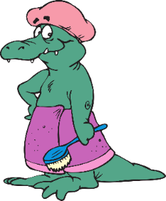
Est-ce que questions
Complète les
questions en français:
bleu: parfait / orange: imparfait
écrire
*douche = shower
Questions:
who
how
what
where
which
why
1. Qu’ est-ce qu’il a vendu pendant qu’il travaillait au magasin ?
?
to sell
to work
2. Pourquoi est-ce que tu portais un chapeau pendant que tu prenais
une douche* ?
?
to wear
to take
3. Avec qui est-ce qu’elle a parlé pendant qu’elle était en France ?
?
to speak
to be
4. Où est-ce que tu étais quand j’ai appelé la police au téléphone ?
?
to be
to call
5. Comment est-ce qu’il a volé l’argent pendant qu’il dînait au château ?
?
to steal
to dine
6. Dans quelle pièce du château a-t-il mis l’argent quand la police est arrivée ?
?
to put
to arrive
Notes:
Timing: 8 minutes
Aim: To revise the meaning of question words in context to complete sentences using imperfect and perfect tenses to talk about two things happening at the same time.
Procedure:
Students write the sentences, replacing the English infinitives with the correct form of perfect and imperfect (following colour coding: blue for perfect, orange for imperfect).
Students then use the information in the questions to determine the correct question word from the six options.
Students to translate into English if time allows.
Click to reveal answers.
Word frequency of unknown words (1 is the most frequent word in French):
douche [>5000]
Source: Lonsdale, D., & Le Bras, Y. (2009). A Frequency Dictionary of French: Core vocabulary for learners London: Routledge.

Slide 15
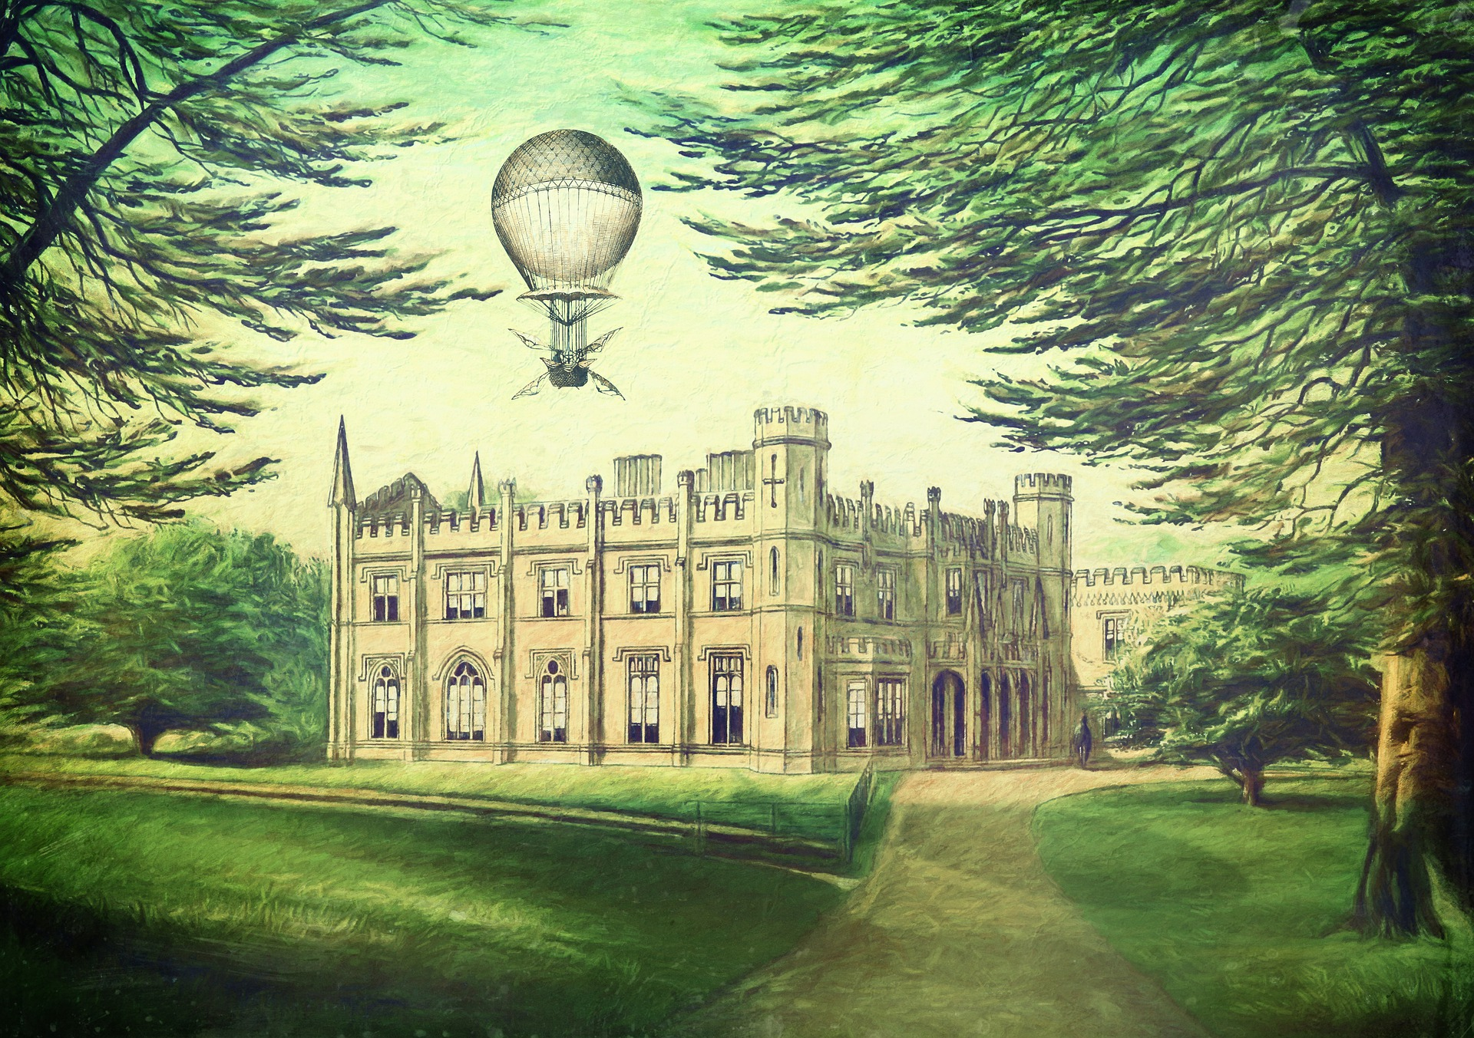
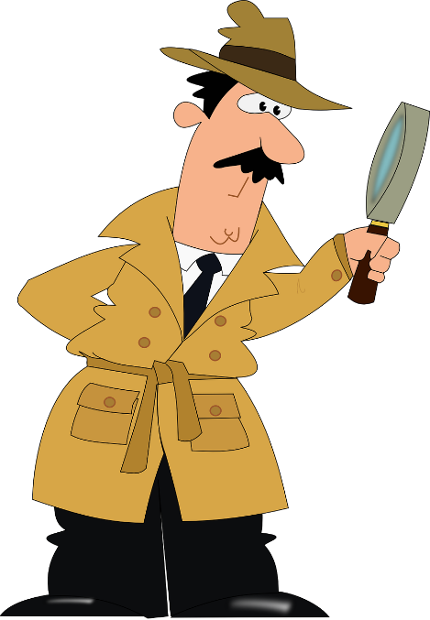
Escape game
lire
The French for ‘Escape room’ would be Salle d’évasion, but an English phrase is used instead!
Bonjour ! Je suis l’Inspecteur Jevoistout.
Je suis arrivé au Château de Monsieur et Madame Snobinard*.
Maintenant, tu vas entrer dans la maison avec moi.
Une personne a volé de l’argent, et je dois trouver cette personne.
Pour quitter la maison, j'ai besoin de toi pour poser des questions aux suspects pour trouver des clés…
snobinard = snobby person
Notes:
Slide 1 of 27
Timing: 12 minutes
Aim: Escape room game to practise understanding of asking est-ce que questions to talk about two things happening at the same time (Perfect and Imperfect)
Procedure:
Read through the instructions
Click to continue through the game
For each challenge, there are multiple choice answers.
Read the question to the whole class, followed by options 1, 2 and 3.
Ask class to put up 1, 2, or 3 fingers to indicate which answer they think is correct.
Click on the answer which gets the majority of votes.
When the answer is correct, a key appears with a letter in it. Pupils must write the letter down before moving on.
Once the final key is found, pupils must unscramble the letters to find the occupation of the person who stole the money.
Word frequency (1 is the most frequent word in French):
clé [1200], courrier [1935], portefeuille [2836], sol [1491]
Source: Lonsdale, D., & Le Bras, Y. (2009). A Frequency Dictionary of French: Core vocabulary for learners London: Routledge.
Word frequency of cognates used (1 is the most frequent word in French): inspecteur [2694], snobinard [>5000], suspect [2571]
Source: Lonsdale, D., & Le Bras, Y. (2009). A Frequency Dictionary of French: Core vocabulary for learners London: Routledge.

Slide 16
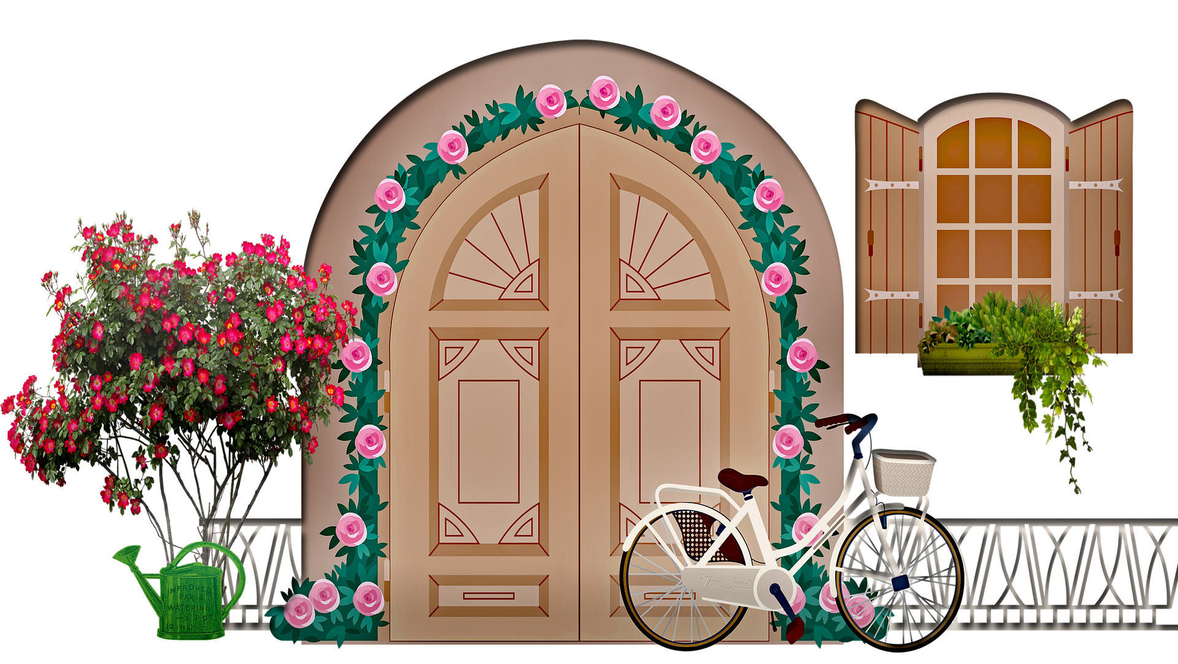
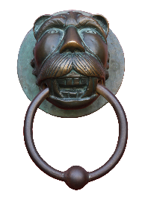
Escape game
lire
Je vois qu’il faut frapper à la porte pour entrer…
Notes:
Slide 2 of 27

Slide 17
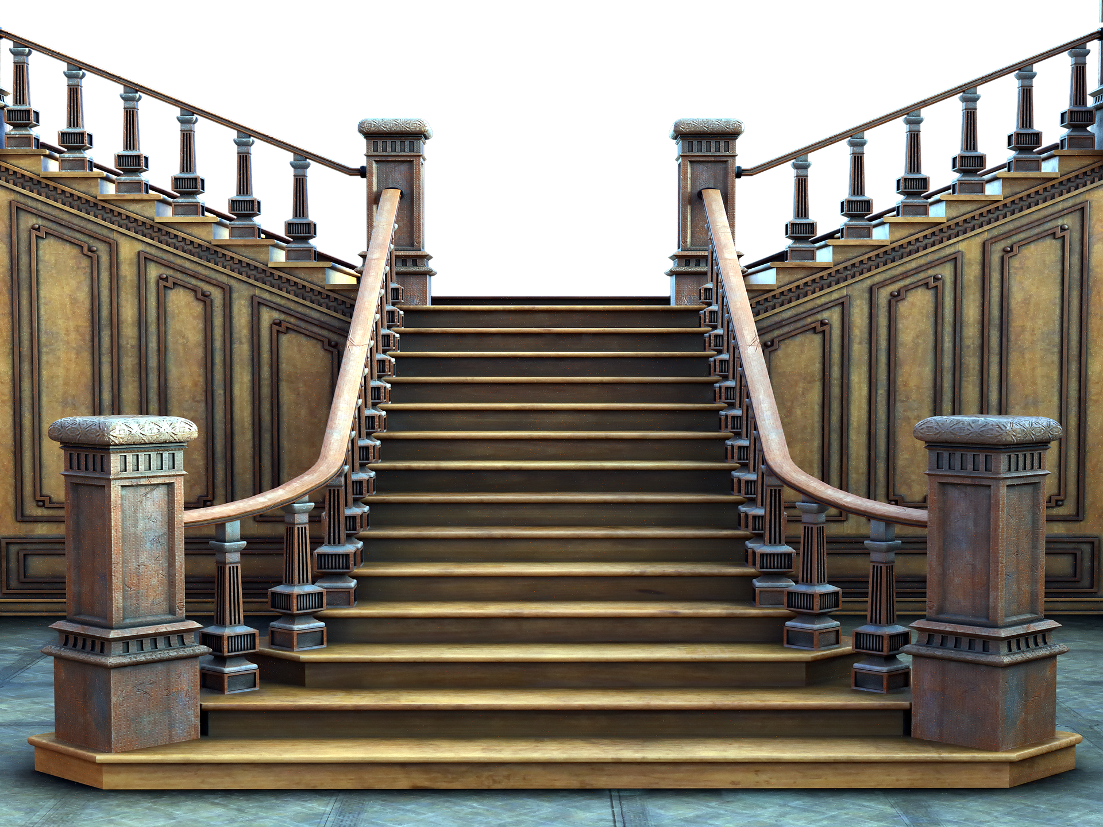
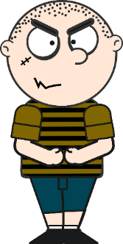
Escape game
lire
1. Oscar Snobinard, qu’est-ce que tu faisais dans l’escalier quand tu as entendu le téléphone ?
Je jouais avec mon argent ! J’aime bien l’argent.
How do you translate into French…
Oscar Snobinard, what were you doing on the stairs when you heard the telephone?
2. Oscar Snobinard, qu’est-ce que tu as fait dans l’escalier quand tu entendais le téléphone ?
3. Oscar Snobinard, qu’est-ce que tu faisais dans l’escalier quand tu entendais le téléphone ?
Notes:
Slide 3 of 27

Slide 18
Escape game
lire
Non, désolé.
Essaye encore!
Retour
Notes:
Slide 4 of 27

Slide 19
Escape game
lire
Oui, bravo!
Tu as trouvé la première clé !
Inscris la lettre, puis clique sur la clé pour continuer...
R
Notes:
Slide 5 of 27

Slide 20
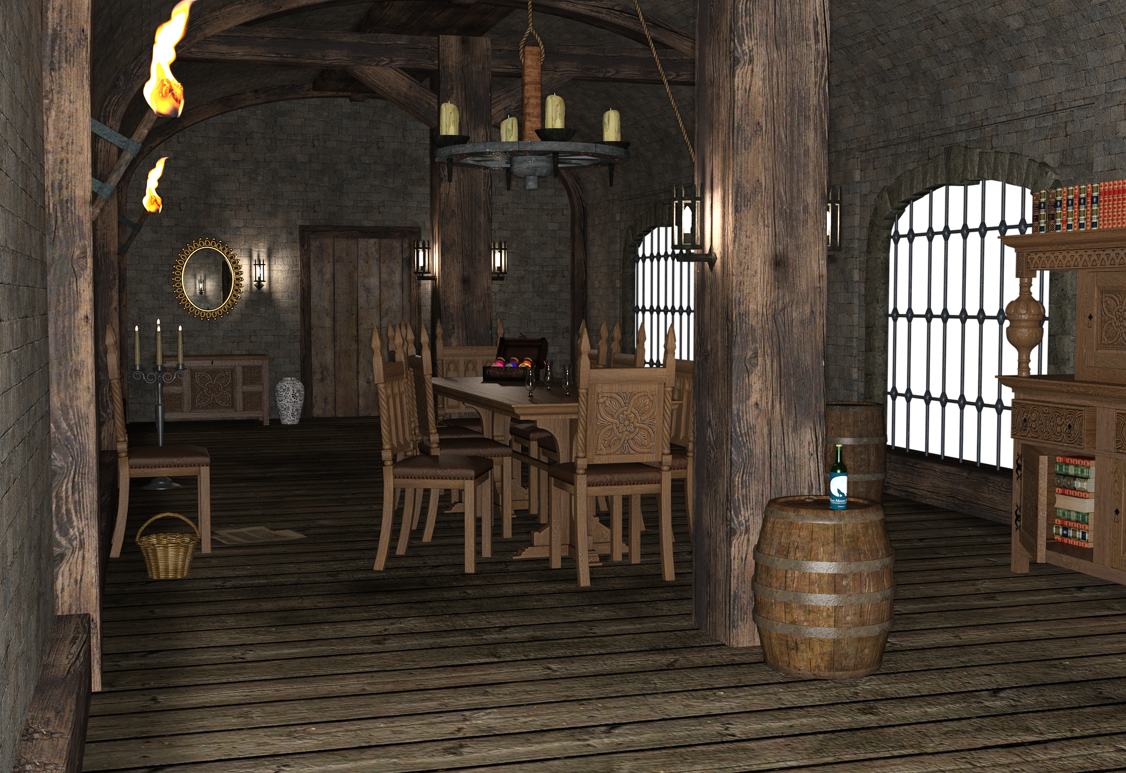
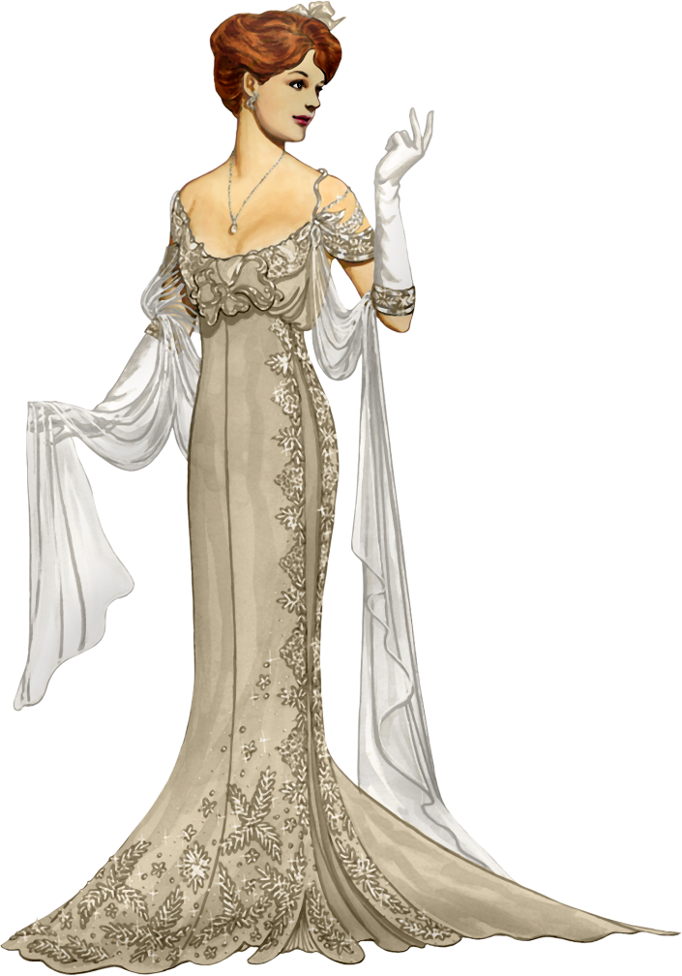
Escape game
lire
1. Madame Snobinard, est-ce que tu entendais le téléphone pendant que tu as dîné dans la salle à manger ?
How do you translate into French…
Mais non, Inspecteur !
Madame Snobinard, did you hear the telephone while you were dining in the dining room?
2. Madame Snobinard, est-ce que tu entendais le téléphone pendant que tu dînais dans la salle à manger ?
3. Madame Snobinard, est-ce que tu as entendu le téléphone pendant que tu dînais dans la salle à manger ?
Notes:
Slide 6 of 27

Slide 21
Escape game
lire
Non, désolé.
Essaye encore!
Retour
Notes:
Slide 7 of 27

Slide 22
Escape game
lire
Oui, bravo!
Tu as trouvé la deuxième clé !
Inscris la lettre, puis clique sur la clé pour continuer...
E
Notes:
Slide 8 of 27

Slide 23
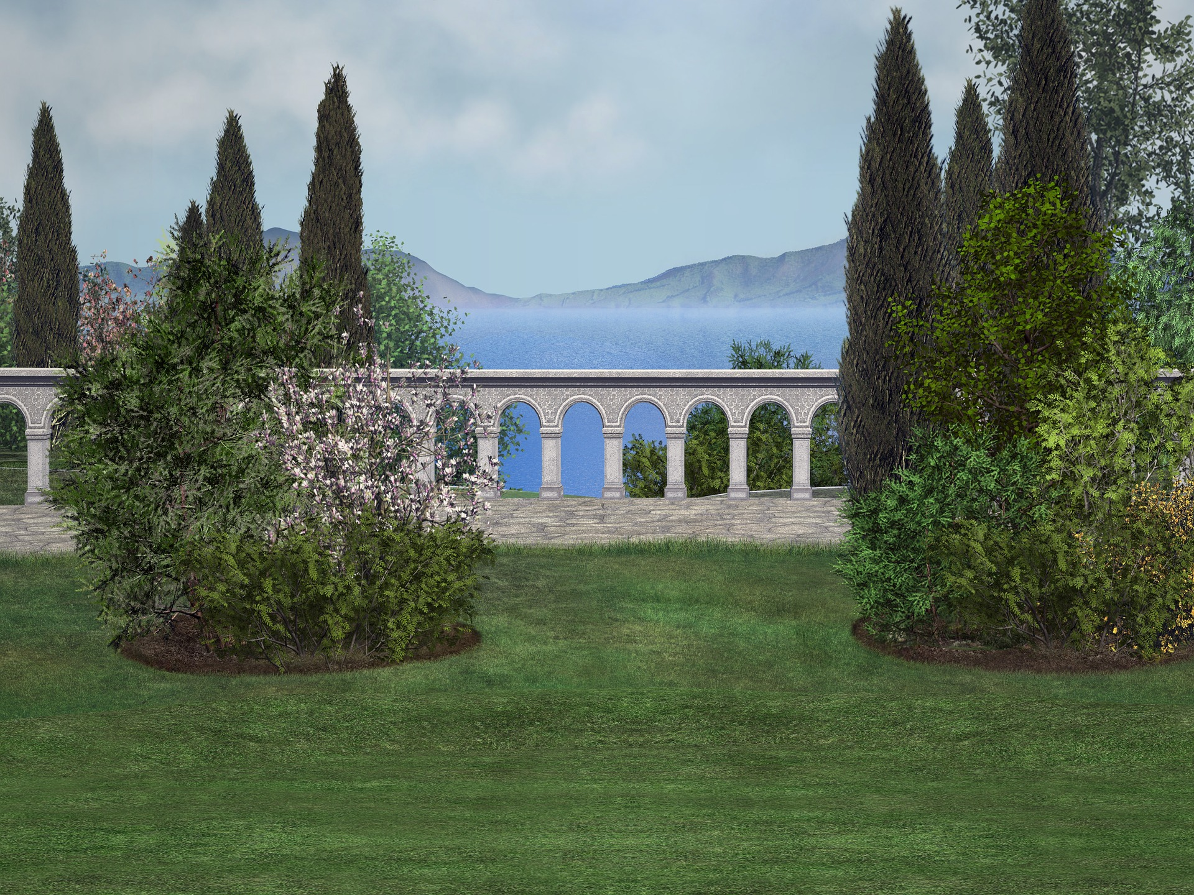
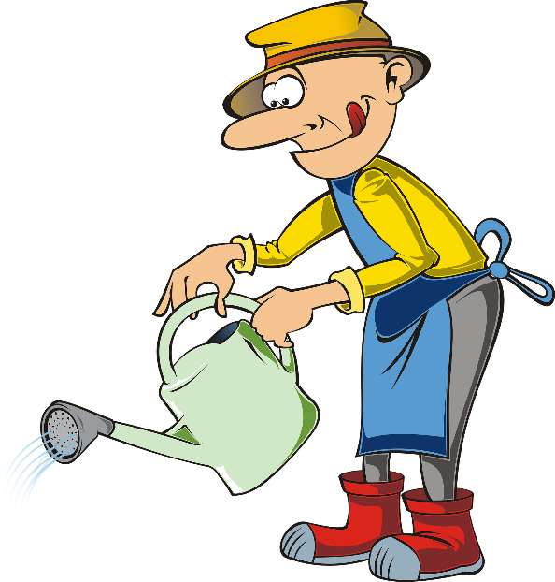
Escape game
lire
1. Monsieur Cerisier, où est-ce que tu as été pendant que Madame Snobinard a dîné ?
How do you translate into French…
Dans le jardin, Inspecteur !
Monsieur Cerisier, where were you while Madame Snobinard was dining?
2. Monsieur Cerisier, où est-ce que tu étais pendant que Madame Snobinard dînait ?
3. Monsieur Cerisier, où est-ce que tu étais pendant que Madame Snobinard a dîné ?
Notes:
Slide 9 of 27

Slide 24
Escape game
lire
Non, désolé.
Essaye encore!
Retour
Notes:
Slide 10 of 27

Slide 25
Escape game
lire
Oui, bravo!
Tu as trouvé la troisième clé !
Inscris la lettre, puis clique sur la clé pour continuer...
A
Notes:
Slide 11 of 27

Slide 26
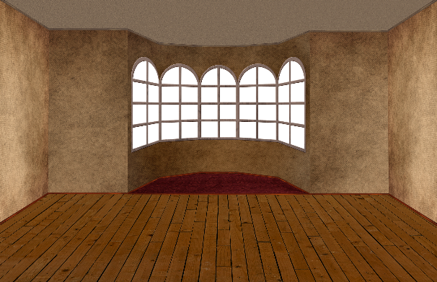
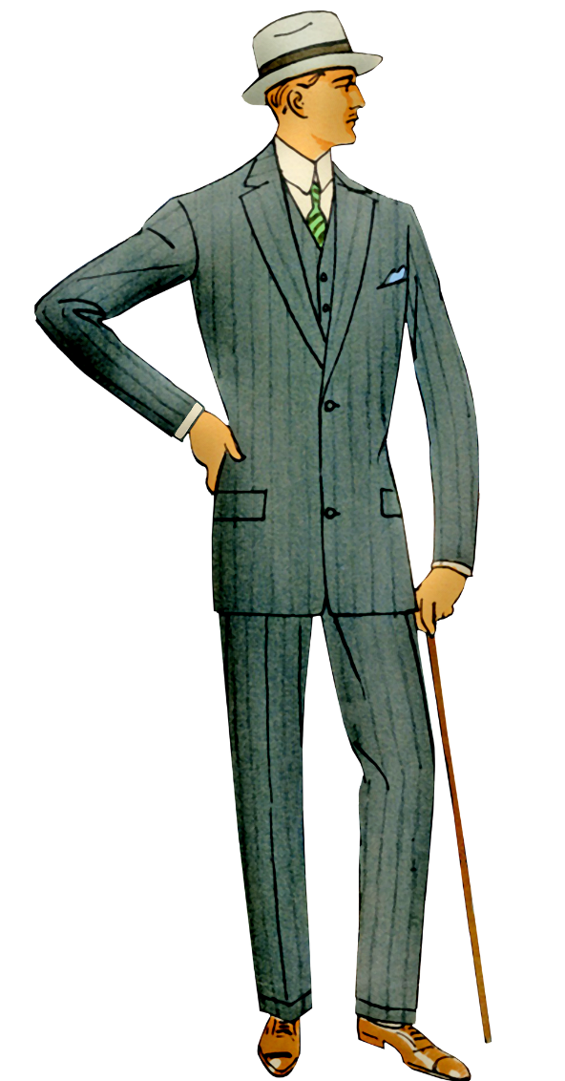
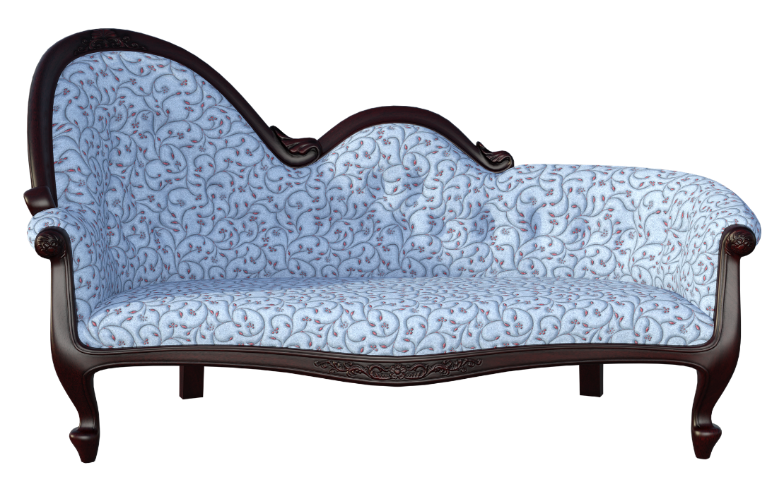
Escape game
lire
À la banque, Inspecteur !
1. Monsieur Snobinard, où est-ce que tu allais quand le chef a servi le repas ?
How do you translate into French…
Monsieur Snobinard, where were you going when the chef served the meal?
2. Monsieur Snobinard, où est-ce que tu es allé quand le chef servait le repas ?
3. Monsieur Snobinard, où est-ce que tu allais quand le chef servait le repas ?
Notes:
Slide 12 of 27

Slide 27
Escape game
lire
Non, désolé.
Essaye encore!
Retour
Notes:
Slide 13 of 27

Slide 28
Escape game
lire
Oui, bravo!
Tu as trouvé la quatrième clé !
Inscris la lettre, puis clique sur la clé pour continuer...
C
Notes:
Slide 14 of 27

Slide 29
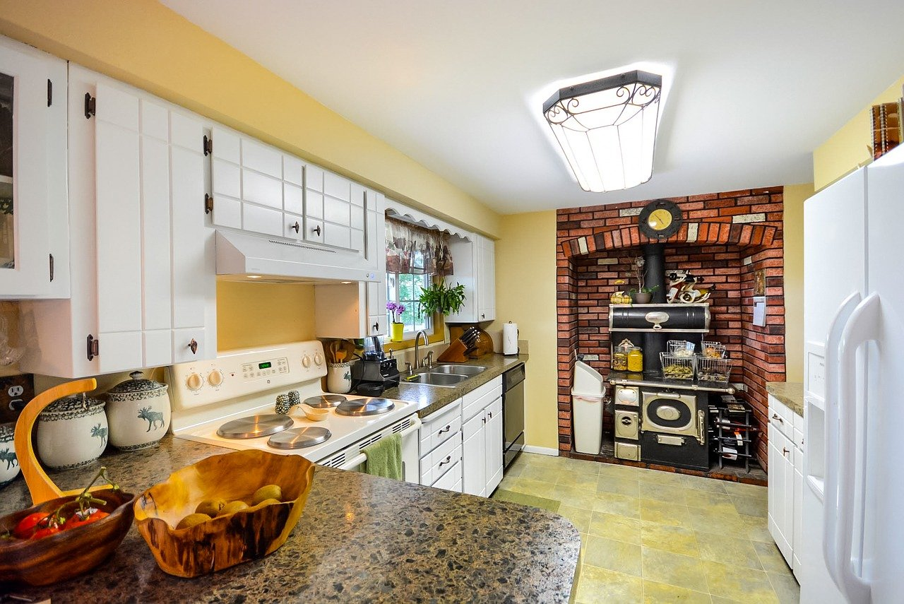
Escape game
lire
How do you translate into French…
1. Madame Croissant, est-ce que tu es sortie de la cuisine pendant que tu as fait le repas ?
Non, je suis toujours dans la cuisine, Inspecteur !
Madame Croissant, did you go out of the kitchen while you were making the meal?
2. Madame Croissant, est-ce que tu sortais de la cuisine pendant que tu faisais le repas ?
3. Madame Croissant, est-ce que tu es sortie de la cuisine pendant que tu faisais le repas ?
Notes:
Slide 15 of 27

Slide 30
Escape game
lire
Non, désolé.
Essaye encore!
Retour
Notes:
Slide 16 of 27

Slide 31
Escape game
lire
Oui, bravo!
Tu as trouvé la cinquième clé !
Inscris la lettre, puis clique sur la clé pour continuer...
I
Notes:
Slide 17 of 27

Slide 32
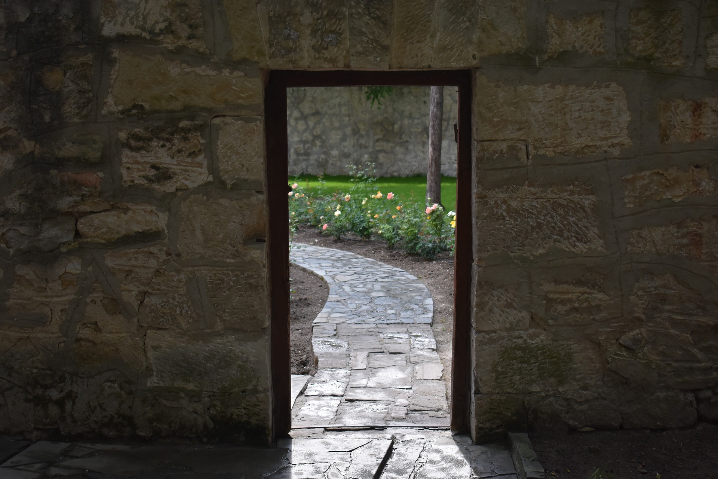
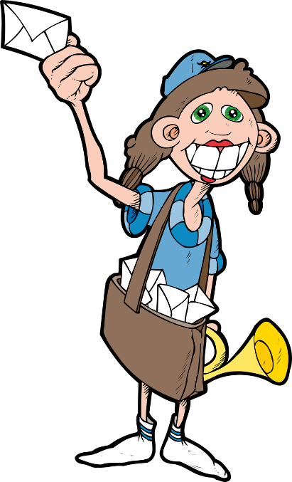
Escape game
*le courrier = post
lire
1. Madame Courrier, est-ce que tu as volé l’argent pendant que tu as donné le courrier* à Monsieur Assiette ?
How do you translate into French…
Quel argent, Inspecteur ?
Madame Courrier, did you steal the money while you were giving the post to Monsieur Assiette?
2. Madame Courrier, est-ce que tu as volé l’argent pendant que tu donnais le courrier* à Monsieur Assiette ?
3. Madame Courrier, est-ce que tu volais l’argent pendant que tu donnais le courrier* à Monsieur Assiette ?
Notes:
Slide 18 of 27

Slide 33
Escape game
lire
Non, désolé.
Essaye encore!
Retour
Notes:
Slide 19 of 27

Slide 34
Escape game
lire
Oui, bravo!
Tu as trouvé la sixième clé !
Inscris la lettre, puis clique sur la clé pour continuer...
T
Notes:
Slide 20 of 27

Slide 35
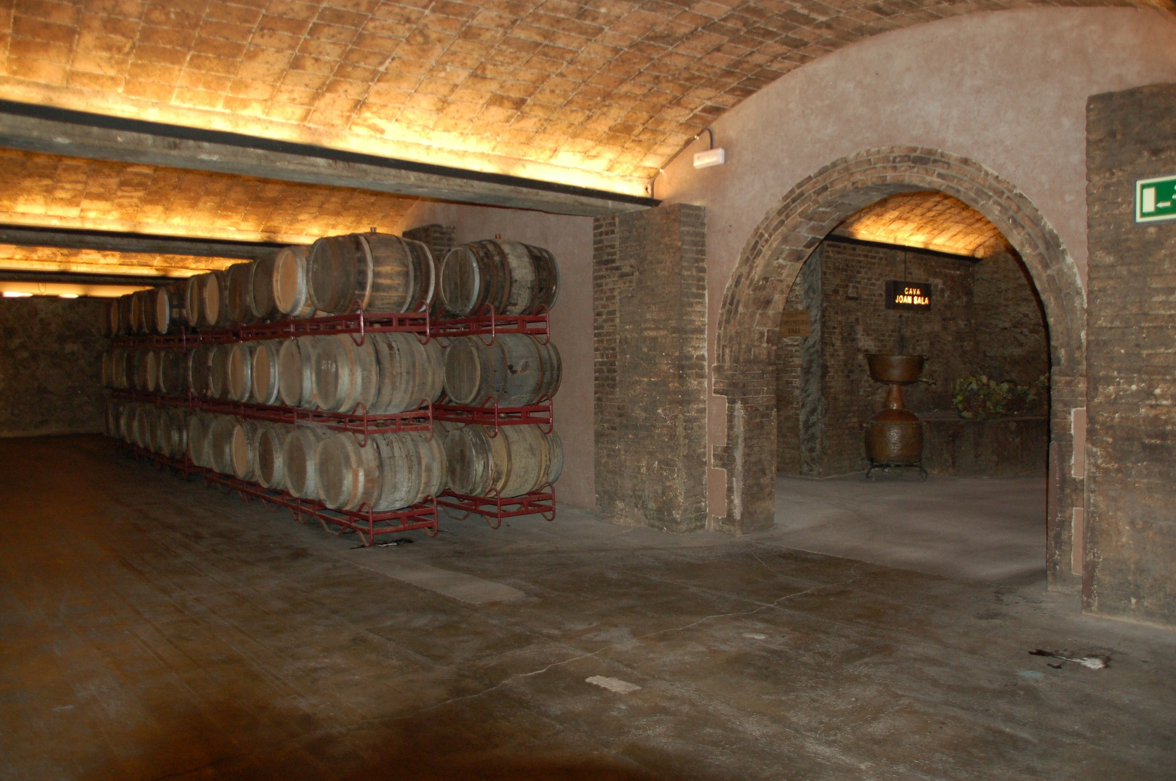
Escape game
*le portefeuille = wallet
lire
How do you translate into French…
Le portefeuille* de Monsieur Snobinard, Inspecteur !
1. Monsieur Assiette, qu’est-ce que tu as cherché dans la cave quand la personne a volé l’argent ?
Monsieur Assiette, what were you looking for in the cellar when the person stole the money?
2. Monsieur Assiette, qu’est-ce que tu cherchais dans la cave quand la personne volait l’argent ?
3. Monsieur Assiette, qu’est-ce que tu cherchais dans la cave quand la personne a volé l’argent ?
Notes:
Slide 21 of 27

Slide 36
Escape game
lire
Non, désolé.
Essaye encore!
Retour
Notes:
Slide 22 of 27

Slide 37
Escape game
lire
Oui, bravo!
Tu as trouvé la septième clé !
Inscris la lettre, puis clique sur la clé pour continuer...
C
Notes:
Slide 23 of 27

Slide 38
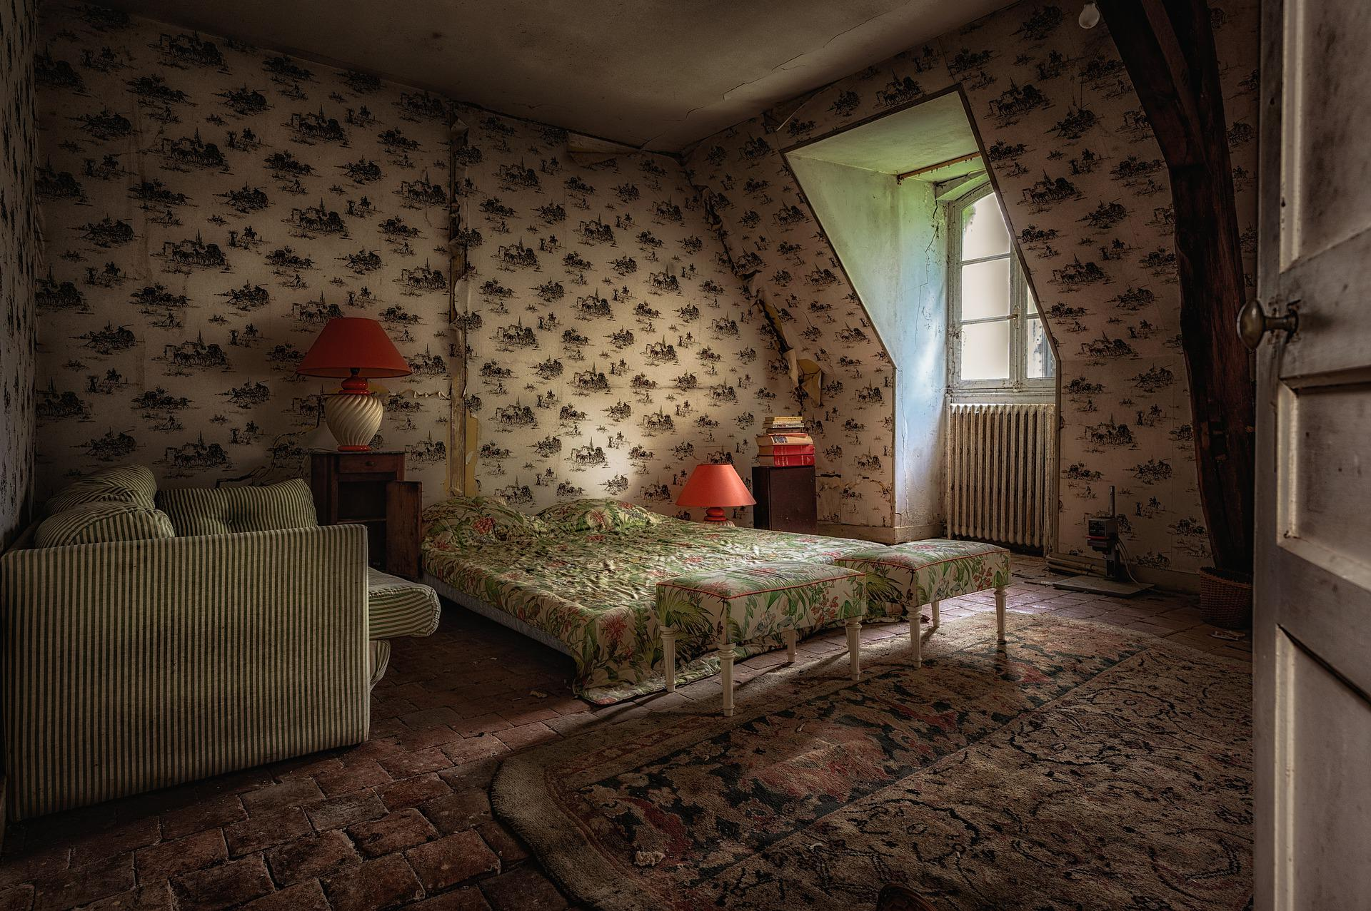
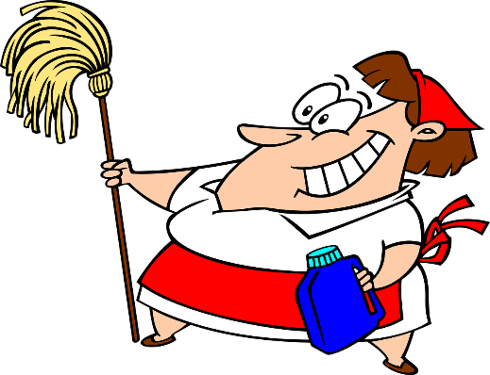
*le sol = floor
lire
Escape game
1. Madame Repassage, pourquoi est-ce que tu as lavé le sol de la chambre pendant que le chef servait le repas?
How do you translate into French…
Madame Repassage, why did you wash the bedroom floor while the chef was serving the meal?
C’est mon travail Inspecteur !
2. Madame Repassage, pourquoi est-ce que tu as lavé le sol de la chambre pendant que le chef a servi le repas?
3. Madame Repassage, pourquoi est-ce que tu lavais le sol de la chambre pendant que le chef servait le repas?
Notes:
Slide 24 of 27

Slide 39
Escape game
lire
Non, désolé.
Essaye encore!
Retour
Notes:
Slide 25 of 27

Slide 40
Escape game
lire
Oui, bravo!
Tu as trouvé la huitième clé !
Inscris la lettre, puis clique sur la clé pour continuer...
F
Notes:
Slide 26 of 27

Slide 41
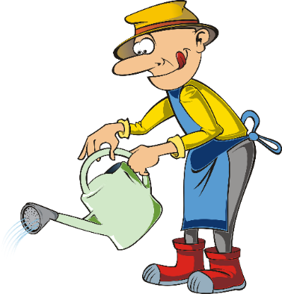
Escape game
lire
Tu as trouvé les lettres
R, E, A, C, I, T, C, F
C’était la FACTRICE, Madame Courrier,
qui a volé l’argent!
Bravo! Tu as trouvé toutes les clés!
You have escaped from the house of Monsieur and Madame Snobinard!
Your last task is to unscramble the letters to reveal a job which involves delivering things to people’s houses, then you will know who stole the money!
Notes:
Slide 27 of 27

Slide 42
Talking about things that happened at the same time
Imperfect vs perfect
Ongoing events with 'BE + -ing’
Est-ce que questions
SSC [r]
Y9 French
Term 3.2 - Week 6 - Lesson 70
Author names: Louise Bibbey
Artwork by: Chloé Motard
Date updated: 08/08/2022
Notes:
Artwork by Chloé Motard. All additional pictures selected are available under a Creative Commons license, no attribution required.
Native speaker feedback provided by Stéphanie Schmitt.
With thanks to Rachel Hawkes for her input on the lesson material.
Learning outcomes (lesson 2):
Revision of SSC [r]
Consolidation of imperfect vs perfect
Consolidation of ongoing events with BE + -ing
Word frequency (1 is the most frequent word in French):
9.3.2.6 (introduce): allais, allait, faisais, faisait, dîner [2365], voir, je vois, tu vois, il/elle voit, pièce [813], téléphone [1366], quand(2) [119], pendant que [89/9]
9.3.2.2 (revisit): défendre [389], obtenir [334], permettre (à…de) [158], promettre (à...de) [854], vendre [710], colonie [3375], indépendance [1651], kilomètre [1435], Métropole [n/a], siècle [603], africain [2289], jusqu'à [n/a], à cause de [n/a]
9.2.2.3 (revisit): participer à [670], artiste [1797], concours [1375], défi [1728], diversité [2537], émission [1074], genre [556], personnage [1449], sexe [1691], scène [794], spectacle [1687], annuel [1674], culturel [1495], non-binaire [>5000], transgenre [>5000]
Source: Lonsdale, D., & Le Bras, Y. (2009). A Frequency Dictionary of French: Core vocabulary for learners London: Routledge.
The frequency rankings for words that occur in this PowerPoint which have been previously introduced in NCELP resources are given in the NCELP SOW and in the resources that first introduced and formally re-visited those words.
For any other words that occur incidentally in this PowerPoint, frequency rankings will be provided in the notes field wherever possible.
The additional English meanings of the following words have been added to Quizlet since the creation of this resource:
escalier – stairs, staircase

Slide 43
r
rue
Notes:
Timing: 1 minute
Aim: To consolidate SSC [r]
Procedure: 1. Present the letter(s) and say the [r] sound first, on its own. Students repeat it with you. 2. Bring up the word ”rue” on its own, say it, students repeat it, so that they have the opportunity to focus all of their attention on the connection between the written word and its sound.
3. A possible gesture for this would be to look left and right and mime crossing a road. 4. Roll back the animations and work through 1-3 again, but this time, dropping your voice completely to listen carefully to the students saying the [r] sound, pronouncing ”rue” and, if using, doing the gesture.
Word frequency (1 is the most frequent word in French):
rue [598]
Source: Lonsdale, D., & Le Bras, Y. (2009). A Frequency Dictionary of French: Core vocabulary for learners London: Routledge.

Slide 44
r
triste
frère
[brother]
moderne
rue
parler
[modern]
être
[to be]
Notes:
Timing: 2 minutes
Aim: To consolidate SSC [r]
Procedure:
Introduce and elicit the pronunciation of the individual SSC [r] and then the source word again ‘rue’ (with gesture, if using). Then present and elicit the pronunciation of the five cluster words. The cluster words have been chosen for their high-frequency, from a range of word classes, with the SSC (where possible) positioned within a variety of syllables within the words (e.g. initial, 2nd, final etc.). Additionally, we have tried to use words that build cumulatively on previously taught SSCs (see the Phonics Teaching Sequence document) and do not include new SSCs. Where new SSCs are used, they are often consonants which have a similar symbol-sound correspondence in English.
Word frequency (1 is the most frequent word in French): rue [598]; frère [1043], triste [1843], moderne [1239], être [5], parler [106] Source: Lonsdale, D., & Le Bras, Y. (2009). A Frequency Dictionary of French: Core vocabulary for learners London: Routledge.

Slide 45
Des virelangues !
lire / parler
Le poivron rouge donne de la fièvre à la pauvre pieuvre qui dort dans le havre.
[The red pepper gives a fever to the poor octopus that sleeps in the harbour.]
1
2
3
Notes:
Timing: 6 minutes for 3 slides
Aim: Oral production of SSC [r].
Procedure:
1. Read the tongue twister.
2. Click to hear example pronunciation (1 = slow; 2 = medium; 3 = fast).
3. Click to reveal English translations.
4. Repeat on next slides (3 tongue twisters in total).
Transcript:
Le poivron rouge donne de la fièvre à la pauvre pieuvre qui dort dans le havre.
Word frequency (1 is the most frequent word in French): poivron [>5000], fièvre [4105], pauvre [699], pieuvre [>5000], havre [>5000]
Source: Lonsdale, D., & Le Bras, Y. (2009). A Frequency Dictionary of French: Core vocabulary for learners London: Routledge.

Slide 46
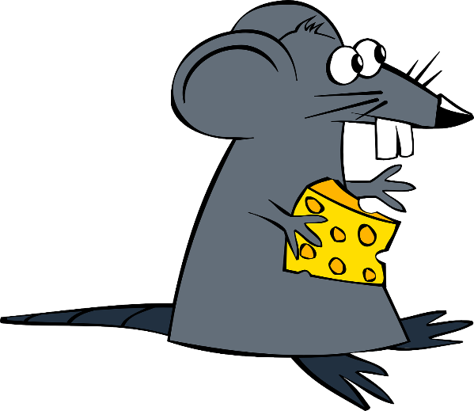
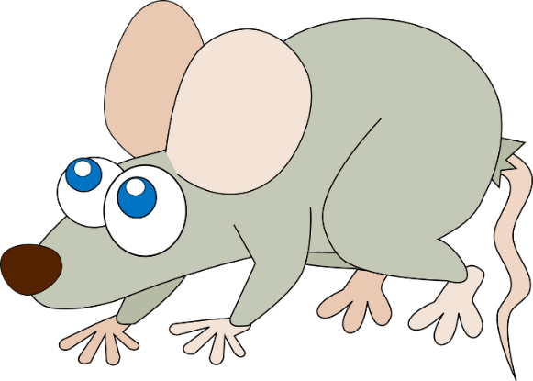
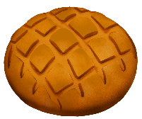
Des virelangues !
lire / parler
Trois gros rats gris dans trois gros trous ronds rongent trois gros croutons ronds.
[Three big grey rats in three big round holes gnaw on three big round croutons.]
1
2
3
Notes:
Slide 2 of 3
Transcript:
Trois gros rats gris dans trois gros trous ronds rongent trois gros croutons ronds.
Word frequency of cognates used (1 is the most frequent word in French): rat [4290], rond [2268], crouton [>5000]
Source: Lonsdale, D., & Le Bras, Y. (2009). A Frequency Dictionary of French: Core vocabulary for learners London: Routledge.
Word frequency (1 is the most frequent word in French): gris [2769], trou [2180], ronger [>5000]
Source: Lonsdale, D., & Le Bras, Y. (2009). A Frequency Dictionary of French: Core vocabulary for learners London: Routledge.

Slide 47
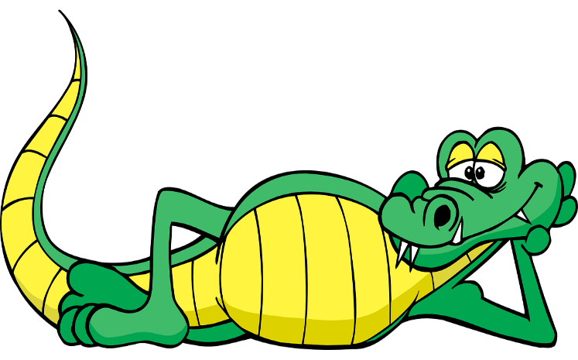
Des virelangues !
lire / parler
Le cricri de la crique crie son cri cru et critique car il craint que le crocodile ne le croque et ne le craque.
[The cricket in the creek cries its raw and critical cry because it fears that the crocodile will crunch and crack it.]
1
2
3
Notes:
Slide 3 of 3
Transcript:
Le cricri de la crique crie son cri cru et critique car il craint que le crocodile ne le croque et ne le craque.
Word frequency of cognates used (1 is the most frequent word in French): critique [909], crocodile [>5000]
Source: Lonsdale, D., & Le Bras, Y. (2009). A Frequency Dictionary of French: Core vocabulary for learners London: Routledge.
Word frequency (1 is the most frequent word in French): cri [2380], crique [>5000], crier [1950], cru [>5000], car [176], craindre [500], croquer [>5000], craquer [4893]
Source: Lonsdale, D., & Le Bras, Y. (2009). A Frequency Dictionary of French: Core vocabulary for learners London: Routledge.

Slide 48
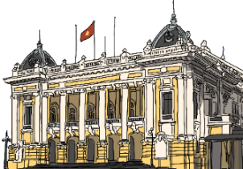
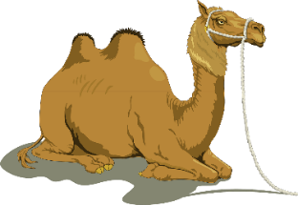
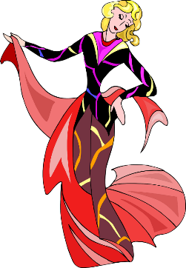
Un quiz rapide sur deux thèmes!
Est-ce que tu connais tous ces mots?
lire
défendre
obtenir
to allow someone…to
to defend
to obtain
permettre à…de
la colonie
africain
l’indépendance
le siècle
colony
African
independence
century
début
le kilomètre
kilometre
la Métropole
mainland France
fin
le défi
transgenre
challenge
transgender
non-binaire
culturel
annuel
le sexe
le personnage
le genre
la diversité
non-binary
cultural
annual
sex
character
gender
diversity
Notes:
Timing: 4 minutes
Aim: Rapid recall of revisited vocabulary
Procedure:
The teacher elicits French translations of vocabulary from students, either orally or on mini-whiteboards if time allows.
Click to reveal the answers.
Alternatively, students work in pairs to translate the terms as quickly as possible.

Slide 49
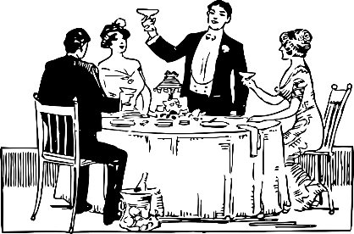
Un repas chez nous
Traduis l’anglais en français
*bouteille = bottle
écrire
dîner
l’escalier
Bonjour, est-ce que tu veux voir ma maison?
to see
Ma maison a beaucoup de pièces et un grand escalier.
il/elle voit
rooms
staircase
le téléphone
Ici, c’est le salon, et à côté tu vois la salle à manger.
the lounge
you see
the dining room
pendant que
Ici, c’est la cave, où j’ai des bouteilles* de jus de fruits.
je vois
the cellar
Je vois que tu aimes bien manger.
la pièce
I see
quand
Est-ce que tu veux dîner avec nous?
to dine
tu vois
Je faisais le repas quand j’ai entendu le téléphone.
le salon
when
the telephone
voir
Tu peux attendre ici pendant que je finis le repas.
while
la salle à manger
la cave
Ah! Voici mon amie, Émilie. Elle voit que tu as faim!
She sees
Notes:
Timing: 4 minutes
Aim: Written production of new vocabulary
Procedure:
Students write the correct French translations for the English in each sentence, numbering the answers from 1 to 13.
This can be done on mini white-boards.
Point out that forms of verbs, nouns and adjectives may have to be changed to fit the English.
Click to reveal answers.
Word frequency (1 is the most frequent word in French): bouteille [2979]
Source: Lonsdale, D., & Le Bras, Y. (2009). A Frequency Dictionary of French: Core vocabulary for learners London: Routledge.

Slide 50
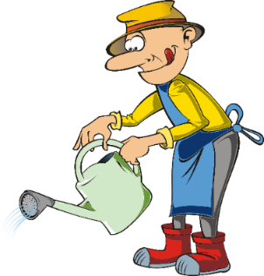
Un mystère* au château !
parler
*mystère = mystery, trésor = treasure, serveur = waiter, femme de ménage = housekeeper, jardinier = gardener
Une personne a volé le trésor* du château Snobinard!
Exemple:
L’Inspecteur: what / doing / when / person / stole / treasure?
Monsieur Assiette: serving / the family / in the dining room.
Qu’est-ce que tu faisais quand une personne a volé le trésor ?
Je servais la famille dans la salle à manger quand une personne a volé le trésor !
Il y a quatre suspects...
Monsieur Assiette, le serveur*
Madame Repassage, la femme de ménage*
Monsieur Cerisier,
le jardinier*
Madame Croissant, le chef
Notes:
Slide 1 of 4
Timing: 12 minutes
Aim: To practise asking questions about two things happening at the same time, using the perfect and imperfect tenses
Procedure:
Students work in teams of five (if possible, but smaller groups could be created, with fewer characters).
Print the role cards and put them face down on the table. Students pick a card. One person is Inspecteur Jevoistout, and the others are Monsieur Assiette, Madame Repassage, Monsieur Cerisier and Madame Croissant.
The person who is the inspector turns their back and the others decide which of them is the thief.
The inspector then asks each person Question One using the prompts on the role cards, using the imperfect or perfect tenses where appropriate.
Each person answers Question One using their prompts, giving a full sentence answer.
Once each person has answered Question One, the inspector tries to guess which suspect is the thief.
NOTE: the clue to who is the culprit is not in the actual answers given, but the inspector needs to guess who the thief if by looking at the body language and facial expressions of the culprit and the other students.
The cards are put down again and another student is the inspector, who asks each person Question 2.
The process is repeated for all five questions, giving all students the opportunity to ask and answer questions.
Word frequency of cognates used (1 is the most frequent word in French): mystère [2777]
Source: Lonsdale, D., & Le Bras, Y. (2009). A Frequency Dictionary of French: Core vocabulary for learners London: Routledge.
Word frequency (1 is the most frequent word in French): trésor [3097], serveur [4377], ménage [2326], jardinier [>5000]
Source: Lonsdale, D., & Le Bras, Y. (2009). A Frequency Dictionary of French: Core vocabulary for learners London: Routledge.

Slide 51
Un vol au château
Higher challenge version
parler
Inspecteur Jevoistout
Who / to call / while / Oscar Snobinard / playing / in the garden
What / doing / when / Madame Snobinard / to enter / kitchen
Did / to put / telephone / in the cellar / while / Monsieur Snobinard / going up / stairs
Where / being / when / Madame Snobinard / talking / with the police
Did / to steal / treasure / while / family / dining
Monsieur Cerisier, le jardinier
my mother
working in the garden
no / a tree
in the garden
no / Madame Repassage stole
Madame Repassage, la femme de ménage
my brother
cleaning the lounge
no / his hat
in the bedroom
no / Monsieur Cerisier stole
Madame Croissant, le chef
my friend
dancing in the kitchen
no / the bread
in the kitchen
no / Monsieur Assiette stole
Monsieur Assiette, le serveur
my daughter
singing in the cellar
no / a glass
in the dining room
no / Madame Croissant stole
Notes:
[2/4]
Role-cards for printing

Slide 52
Un vol au château
Scaffolded / translation version
parler
Inspecteur Jevoistout
Who did you call while Oscar Snobinard was playing in the garden? (appeler, jouer)
What were you doing when Madame Snobinard entered the kitchen? (faire, entrer)
Did you put the telephone in the cellar while Monsieur Snobinard was going up the stairs? (mettre, monter)
Where were you when Madame Snobinard was talking with the police? (être, parler)
Did you steal the treasure while the family was dining? (voler, dîner)
Monsieur Cerisier, le jardinier
I called my mother while he was playing in the garden.
I was working* in the garden when she entered the kitchen.
No! I put a tree in the cellar while he was going up the stairs.
I was in the garden when she was talking with the police.
No! Madame Repassage stole the treasure while the family was dining! *travailler
Madame Repassage, la femme de ménage
I called my brother while he was playing in the garden.
I was cleaning* the lounge when she entered the kitchen.
No! I put his hat in the cellar while he was going up the stairs.
I was in the bedroom when she was talking with the police.
No! Monsieur Cerisier stole the treasure while the family was dining! *nettoyer
Madame Croissant, le chef
I called my friend while he was playing in the garden.
I was dancing* in the kitchen when she entered the kitchen.
No! I put the bread in the cellar while he was going up the stairs.
I was in the kitchen when she was talking with the police.
No! Monsieur Assiette stole the treasure while the family was dining! *danser
Monsieur Assiette, le serveur
I called my daughter while he was playing in the garden.
I was singing* in the cellar when she entered the kitchen.
No! I put a glass in the cellar while he was going up the stairs.
I was in the dining room when she was talking with the police.
No! Madame Croissant stole the treasure while the family was dining! *chanter
Notes:
[3/4]
Role-cards for printing

Slide 53
Un vol au château
Les questions et réponses
parler
Inspecteur Jevoistout
Qui est-ce que tu as appelé pendant qu’Oscar Snobinard jouait dans le jardin ?
Qu’est-ce que tu faisais quand Madame Snobinard est entrée dans la cuisine ?
Est-ce que tu as mis le téléphone dans la cave pendant que Monsieur Snobinard montait l’escalier ?
Où est-ce que tu étais quand Madame Snobinard parlait avec la police ?
Est-ce que tu as volé le trésor pendant que la famille dînait ?
Monsieur Cerisier, le jardinier
J’ai appelé [ma mère] pendant qu’Oscar jouait dans le jardin.
Je [travaillais dans le jardin] quand elle est entrée dans la cuisine.
J’ai mis [un arbre] dans la cave pendant qu’il montait l’escalier.
J’étais dans [le jardin] quand Madame Snobinard parlait avec la police.
Non ! [Madame Repassage] a volé le trésor pendant que la famille dînait !
Madame Repassage: 1. mon frère, 2. nettoyais le salon, 3. son chapeau, 4. la chambre, 5. Monsieur Cerisier
Madame Croissant: 1. mon ami, 2. dansais dans la cuisine, 3. le pain, 4. la cuisine, 5. Monsieur Assiette
Monsieur Assiette: 1. ma fille, 2. chantais dans la cave, 3. un verre, 4. la salle à manger, 5. Monsieur Croissant
Notes:
[4/4]

Slide 54
Un mystère au théâtre ?
Lis le texte et
réponds aux questions.
lire
Médecin: Qu’est-ce que tu faisais quand tu as eu l’accident ?
Eric: Je participais à un spectacle au théâtre quand je suis tombé dans l’escalier.
Médecin : Est-ce qu’une autre personne était proche de toi quand tu es tombé ?
Eric : Oui, un autre artiste est arrivé à côté de moi pendant que je dansais.
Médecin : Est-ce qu’il a appelé l’ambulance pendant que le spectacle continuait ?
Eric : Non, il a continué à danser pendant que je tombais. Il a trouvé un téléphone pendant que l’audience dînait après le spectacle.
Médecin : Pourquoi est-ce qu’il a attendu jusqu’à la fin pour appeler l’ambulance quand tu étais en bas ?
Eric : Euh, je me demandais si peut-être ce n’était pas un vrai accident ! Est-ce que je suis tombé à cause de l’autre artiste?
5. Why does Eric think it took a long time for the other artist to call the ambulance?
4. When did the artist call the ambulance?
1. What was Eric doing when the accident happened?
3. Did the other artist call an ambulance immediately?
2. What happened while Eric was dancing?
When the audience were dining after the show.
Another artist arrived next to him.
Taking part in a show
He was wondering if it was a real accident!
No, he carried on dancing.
Notes:
Timing: 6 minutes
Aim: To read and understand the new grammar and new/revisited vocabulary in context
Procedure:
Ask students to read the text.
Click to reveal the five questions and elicit answers in English from the students.
Word frequency of cognates used (1 is the most frequent word in French): ambulance [>5000], audience [2071], danser [2934]
Source: Lonsdale, D., & Le Bras, Y. (2009). A Frequency Dictionary of French: Core vocabulary for learners London: Routledge.

Slide 55
Le parfait ou l’imparfait?
Quels verbes sont au parfait ou à l’imparfait ?
écouter
 | Verbs ongoing? | Verbs completed?
 | dîner | arriver | Est-ce qu’elle dînait dans la salle à manger quand je suis arrivé ?
 | conduire | promettre à | Il a promis à son ami deux choses pendant qu’il conduisait au spectacle.
 |  | entrer tomber | Quand elle est entrée dans la cave, elle est tombée dans l’escalier.
 | parler regarder |  | Pendant que tu parlais à ton frère, il regardait la télévision.
 | faire | acheter | J’ai acheté un nouveau téléphone pendant que je faisais les courses.
 | être | appeler | Elle était dans le salon quand sa sœur a appelé.
 | faire chanter |  | Qu’est-ce que tu faisais pendant que je chantais ?
 | être | commencer | Où est-ce que tu étais quand l’émission a commencé ?
1
2
3
4
5
6
7
8
Notes:
Lower challenge version: more difficult version with English translation is on the next slide
Timing: 6 minutes
Aim: To identify whether statements are talking about completed or ongoing events in the past
Procedure:
Click on the numbers on the left to hear the sentences, each containing two verbs.
Students need to pay attention to the verb tense being used to decide which events are ongoing and which are completed.
Students identify which verbs (in their infinitive form) are ongoing (i.e., imperfect), and which are completed (i.e., perfect).
Point out that some sentences may not include both tenses.
Click to reveal the verbs, followed by the transcript of the sentences.
Transcript:
Est-ce qu’elle dînait dans la salle à manger quand je suis arrivé ?
Il a promis à son ami deux choses pendant qu’il conduisait au spectacle.
Quand elle est entrée dans la cave, elle est tombée dans l’escalier.
Pendant que tu parlais à ton frère, il regardait la télévision.
J’ai acheté un nouveau téléphone pendant que je faisais les courses.
Elle était dans le salon quand sa sœur a appelé.
Qu’est-ce que tu faisais pendant que je chantais ?
Où est-ce que tu étais quand l’émission a commencé ?

Slide 56
Le parfait ou l’imparfait?
Quels verbes sont au parfait ou à l’imparfait ?
écouter
 | Verbs ongoing? | Verbs completed?
 | dîner | arriver | Was she dining in the dining room when I arrived?
 | conduire | promettre à | He promised his friend two things while he was driving to the show.
 |  | entrer tomber | When she entered the cellar, she fell on the stairs.
 | parler regarder |  | While you were talking to your brother, he was watching the television.
 | faire | acheter | I bought a new telephone while I was doing the shopping.
 | être | appeler | She was in the lounge when her sister called.
 | faire chanter |  | What were you doing while I was singing?
 | être | commencer | Where were you when the programme started?
1
2
3
4
5
6
7
8
Notes:
Higher challenge version: alternative to previous slide, with translation into English
Timing: 6 minutes
Aim: To identify whether statements are talking about completed or ongoing events in the past
Procedure:
Click on the numbers on the left to hear the sentences, each containing two verbs.
Students need to pay attention to the verb tense being used to decide which events are ongoing and which are completed.
Students identify which verbs (in their infinitive form) are ongoing (i.e., imperfect), and which are completed (i.e., perfect).
Point out that some sentences may not include both tenses.
As an additional challenge, students need to translate the sentences they have heard into English.
Click to reveal the verbs, followed by the English translations of the sentences.
Transcript:
Est-ce qu’elle dînait dans la salle à manger quand je suis arrivé ?
Il a promis à son ami deux choses pendant qu’il conduisait au spectacle.
Quand elle est entrée dans la cave, elle est tombée dans l’escalier.
Pendant que tu parlais à ton frère, il regardait la télévision.
J’ai acheté un nouveau téléphone pendant que je faisais les courses.
Elle était dans le salon quand sa sœur a appelé.
Qu’est-ce que tu faisais pendant que je chantais ?
Où est-ce que tu étais quand l’émission a commencé ?

Slide 57
Using the verb ‘savoir’
Voir: to see
grammaire
Je vois qu’elle dînait quand la police est arrivée au château.
In the je and tu forms voir loses the ‘r’ which is replaced by ‘s’
In the il/elle forms, the ‘r’ is replaced by ‘t’.
The ‘s’ and ‘t’ are silent final consonants (SFC).
je vois
I see, am seeing
tu vois
you see, are seeing
il/elle voit
he/she sees, is seeing
The verb voir is used in many expressions in French, such as:
These verb forms all sound the same!
The –s on the je and tu forms is a silent final consonant (SFC)
voir grand = think big [‘see big’]
rien à voir avec = nothing to do with [‘nothing to see’]
voir la vie en rose = to see life through rose-coloured glasses
Notes:
Timing: 2 minutes
Aim: To introduce the je, tu, il and elle forms of the verb voir and to give examples of the use of the verb
Procedure:
Click to reveal the information on conjugating the je, tu, il/elle forms of voir.
Highlight that all singular forms sound the same due to the SFC.
Draw attention to the sentence spoken by the man, as this is the focus of the following slide: a sentence using the present, past continuous and simple past.
Explain that the verb voir is used in many expressions in French, and may not already translate directly as ‘to see’ in English.

Slide 58
Qu’est-ce que tu vois?
Écris les phrases avec bons verbes dans la bonne forme (présent, parfait ou imparfait).
écrire
1. Je _______ que le jardinier _____ son travail pendant que le chef __________ le repas. (voir, finir, préparer)
vois
a fini
préparait
2. Il ________ que la femme de ménage __________ la télévision quand la factrice _______ le trésor. (voir, regarder, voler)
voit
regardait
a volé
3. Tu ______ que l’artiste __________ pendant qu’il _________ spectacle. (voir, tomber, participer à)
vois
est tombé
participait au
4. Elle _______ que le serveur _________ de l’argent dans toutes les pièces du château pendant que Madame Snobinard __________ la police.
(voir, trouver, appeler)
voit
a trouvé
appelait
Notes:
Timing: 8 minutes
Aim: Written recognition and comprehension of present forms of voir, and to correctly write perfect and imperfect forms, using sentence context to identify the correct location of each tense
Procedure:
Students read the sentences and decide which verbs fit in the gaps
Students write the sentences in full
Click to reveal answers.
Oral or written translation of sentences if time allows.

Slide 59
Devoirs
Vocabulary Learning Homework (Y9, Term 3.2, Week 7)
Audio Homework link
Audio Homework QR code:
Quizlet link
Quizlet QR code:
Student worksheet
In addition, revisit:
Y9, Term 3.1, Week 2
Y9, Term 3.2, Week 3
Notes:
The answer sheet for the 9.3.2.7 vocabulary learning homework is here: Resource | French SOW Y9 Term 3.2 Week 7 - vocabulary learning homework answers | ID: 4j03d195g | NCELP

