Slide 1
SOW-based vocabulary testing for NCELP Y7
Principles, design, creation
NCELP Residential 3
Natalie Finlayson / Emma Marsden
Date updated: 02/03/20

Slide 2
Outline
Vocab testing team
Principles of vocabulary testing
2.1 Breadth of knowledge testing
2.2 Depth of knowledge testing
Question types
Scoring
Summary

Slide 3
1. Vocab testing team
Test leads: Natalie Finlayson & Emma Marsden
French
Test developer
Kirsten Somerville
Proofreader
Ivan Avaca
Spanish
Test developer
Ivan Avaca
Proofreaders
Nick Avery
Pep Mateos Gonzalez
German
Test developers
Inge Alferink
Natalie Finlayson
Proofreaders
Inge Alferink
Natalie Finlayson
With huge thanks to: Giulia Bovolenta, Victoria Hobson, Stephen Owen, Helen Thomas, Catherine Morris, Ciaran Morris, Jack Peacock, Laurence Anthony

Slide 4
2. Vocab testing principles
Objectives
To test breadth and depth of knowledge of vocabulary studied in Y7 Terms 1.1.1 - 2.1.1
Considerations
Syllabus-based achievement test
Productive vs receptive knowledge
Recall vs recognition
Oral and written modalities

Slide 5
2.1 Breadth of knowledge
Objective 1: To find out how many words students know
Sample size
Target time: 12 minutes
Pilot testing indicates students can comfortably answer one question in 9 seconds
720 / 9 = 80 total test items (split equally between L, R, W & S)
SOW coverage:
French: 43%* Spanish: 35% German: 35%

Slide 6
2.1 Breadth of knowledge
Objective 1: To find out how many words students know
Item pool
To test overall knowledge of words in SOW – words distributed amongst students
Words are equally likely to be selected from randomised pools
All words in the SOW appear in the test once only
Part of speech ratios (noun : verb : other) broadly upheld within different question types
(French: 2:1:2; Spanish: 3:1:3; German: 2:1:3)

Slide 7
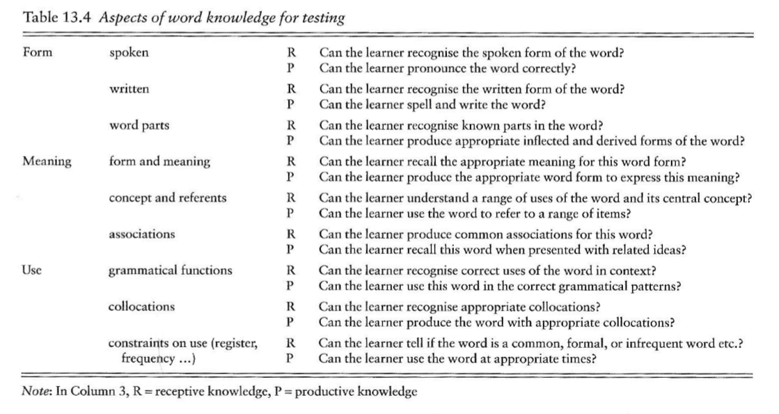
2.2 Depth of knowledge
Nation 2013, p. 538
Objective 2: To find out how well students know target words
Year 8+
tested separately
Year 8+

Slide 8
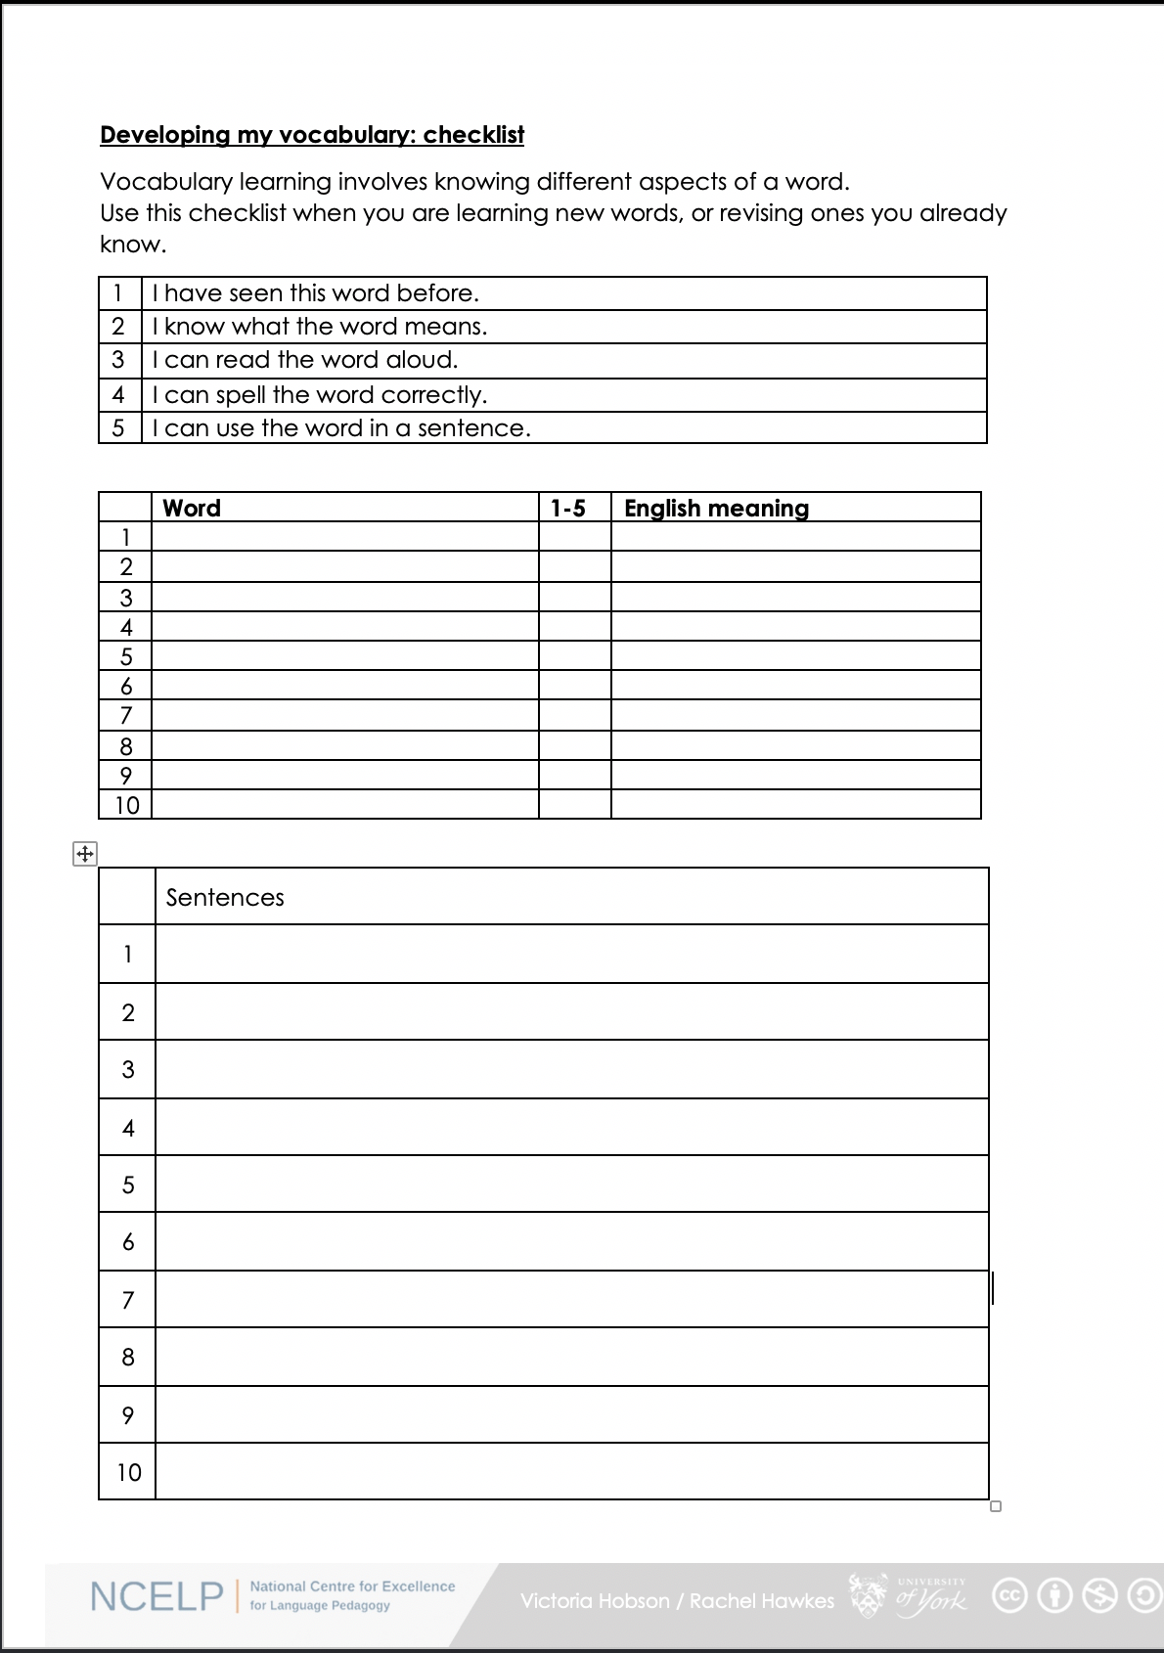
2.2 Depth of knowledge
How well do you know the words we have learned so far?
1. I have seen this word before.
2. I know what the word means.
3. I can read the word aloud.
4. I can spell the word correctly.
5. I can use the word in a sentence.
6. I know the gender of nouns.

Slide 9
2.2 Depth of knowledge
Recognition tests
multiple choice activities whereby learners select or guess the correct response from the alternatives given
such tests may strengthen any existing memory traces (McDaniel & Mason, 1985)
Recall
demands the production of responses from memory
more difficult than recognition because learners must search for the correct response within their mental representation of the newly experienced information (Cariana & Lee, 2001; Glover, 1989; McDaniel & Mason, 1985).
Definitions adapted from Jones (2004)

Slide 10
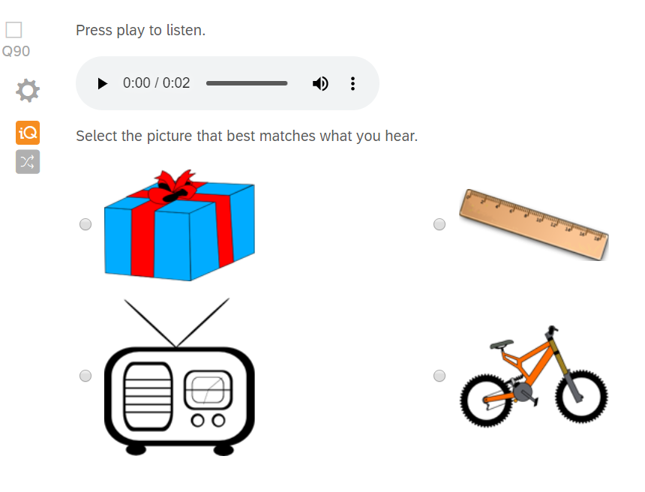
3. Question type 1
Read 2000, Chapter 3
Modality
Listening
Type of activity
Spoken meaning recognition
Knowledge tested
Meaning (definition)

Slide 11
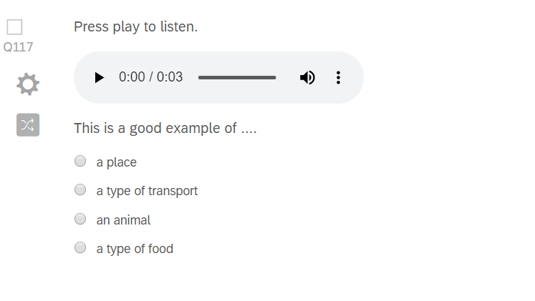
3. Question type 2
Read 2000, Chapter 3
Modality
Listening
Type of activity
Spoken meaning recognition
Knowledge tested
Meaning (definition) Meaning (association)

Slide 12
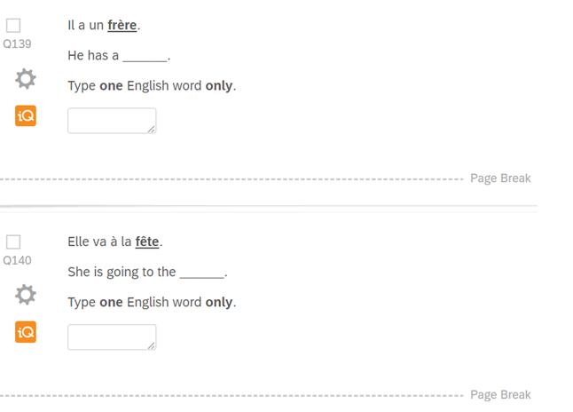
3. Question type 3
Read 2000, p. 163
Modality
Reading
Type of activity
Written meaning recall
Knowledge tested
Meaning (definition)

Slide 13
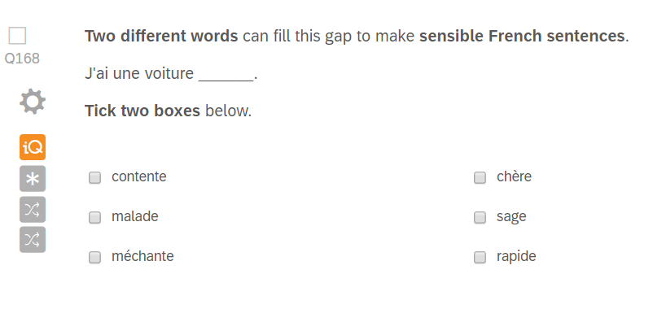
3. Question type 4
Modality
Reading
Type of activity
Written meaning recall
Knowledge tested
Meaning (definition)
Use (collocation)

Slide 14
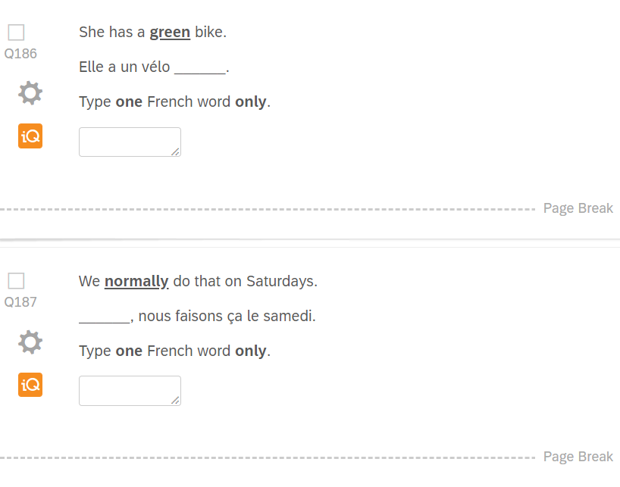
3. Question type 5
Modality
Writing
Type of activity
Written form recall
Knowledge tested
Form (written)
Meaning (definition)

Slide 15
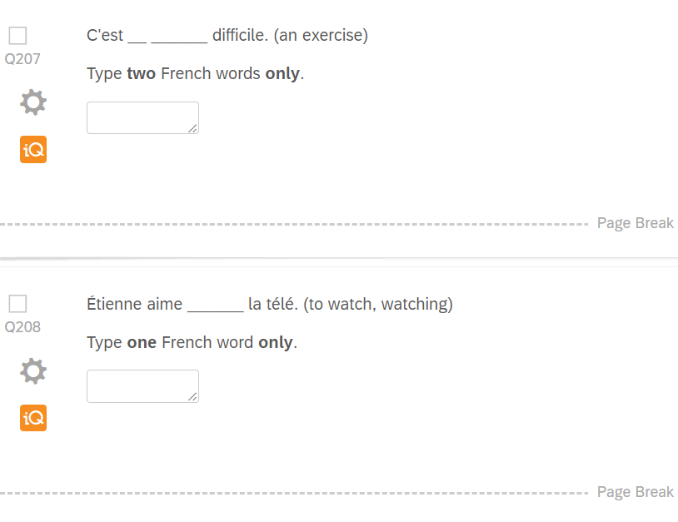
3. Question type 6
Laufer & Nation 1995
Modality
Writing
Type of activity
Written form recall
Knowledge tested
Form (written)
Meaning (definition)
Use (collocation)

Slide 16
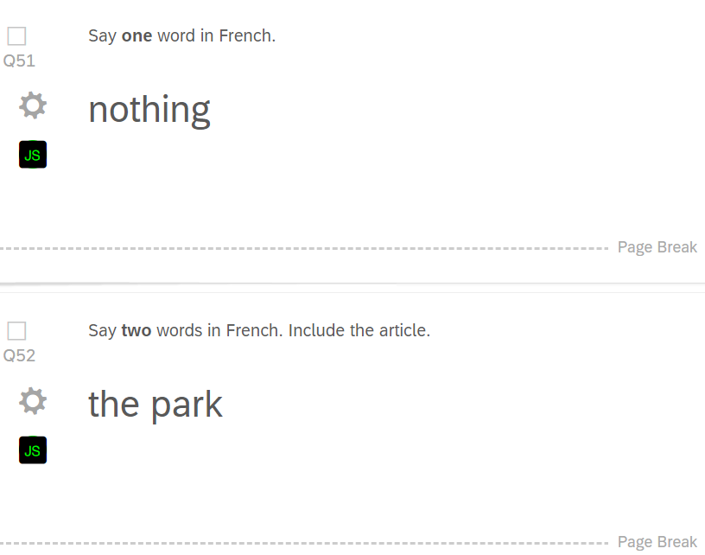
3. Question type 7
Modality
Speaking
Type of activity
Spoken form recall
Knowledge tested
Form (spoken)
Meaning (definition)

Slide 17
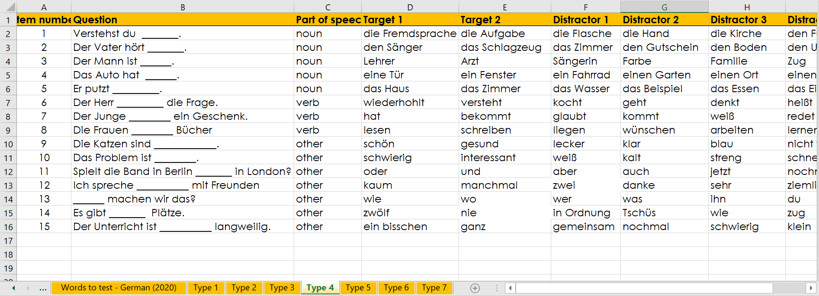
3. Question types

Slide 18
3. Question types
80 x test items
Listening
20 x spoken meaning recognition
Reading
20 x written
meaning recall
Writing
20 x written
form recall
Speaking
20 x spoken
form recall
40 x receptive
40 x productive
Bias towards recall:
encourages active vocabulary building from the beginning
minimises use of multi-choice format - average score increase of 16.7% due to guessing in a 6-choice format (Stewart & White, 2011) and up to 25% in 4-choice (Stewart 2014)

Slide 19
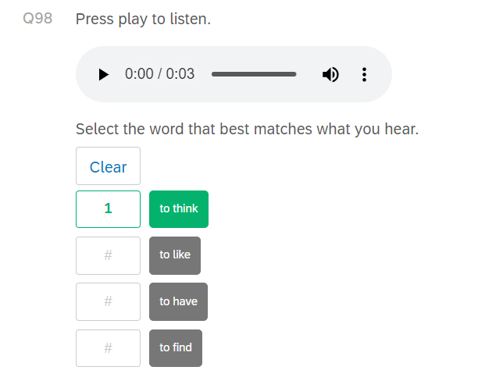
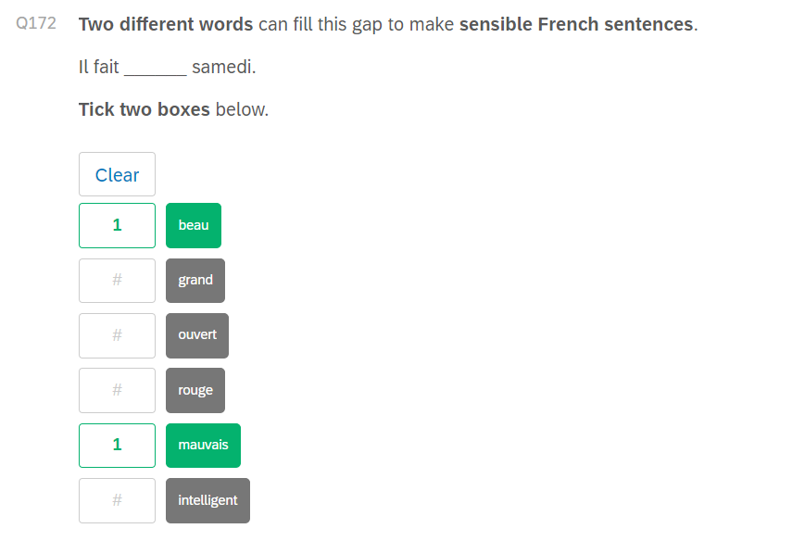
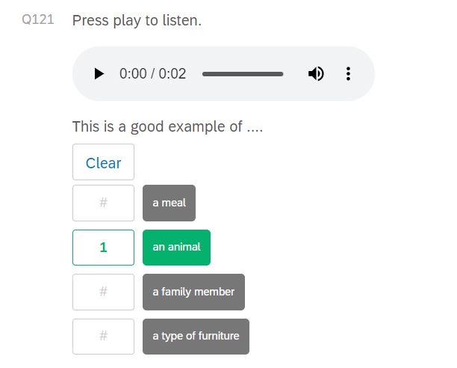
4. Scoring (binary)

Slide 20
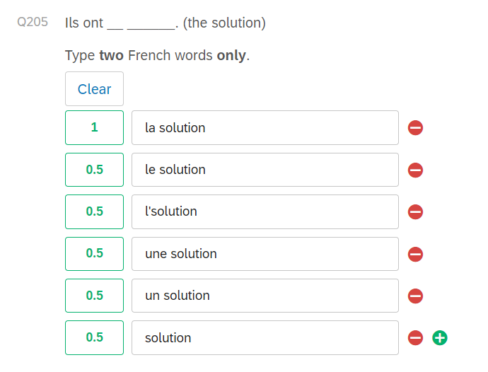
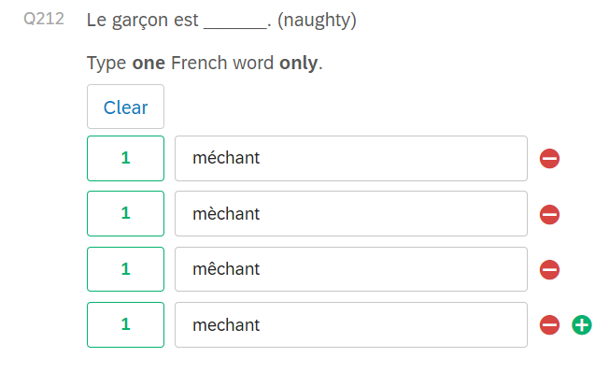
4. Scoring (tolerance)
For now, after 18 weeks of lessons, we are tolerant of accent errors and semi-tolerant of article errors
if lemma (word) is correct
For now, after 18 weeks lessons, we are semi-tolerant of article and accent errors,
if lemma (word) is correct

Slide 21
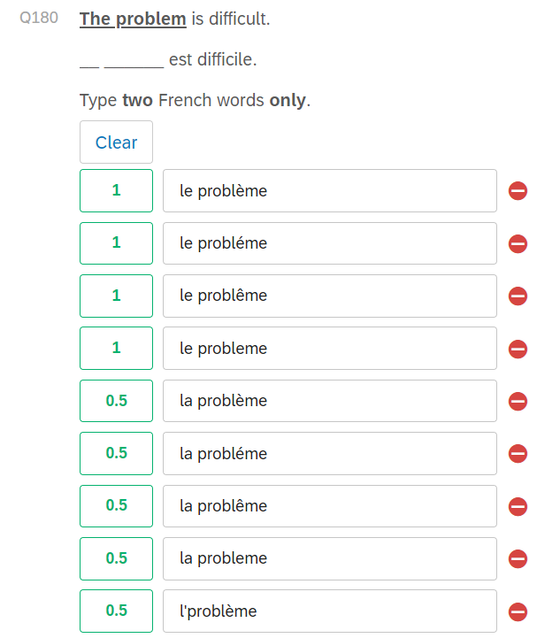
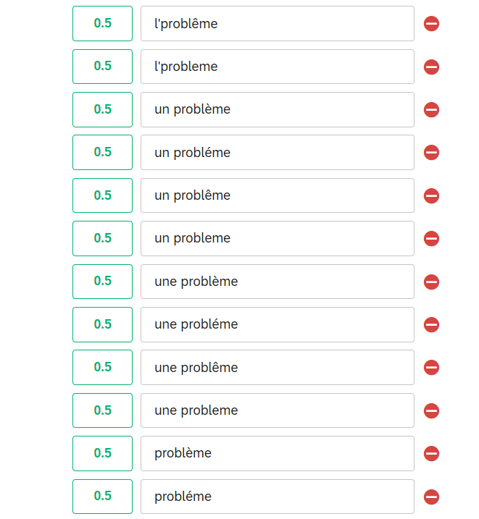
4. Scoring (tolerance)

Slide 22
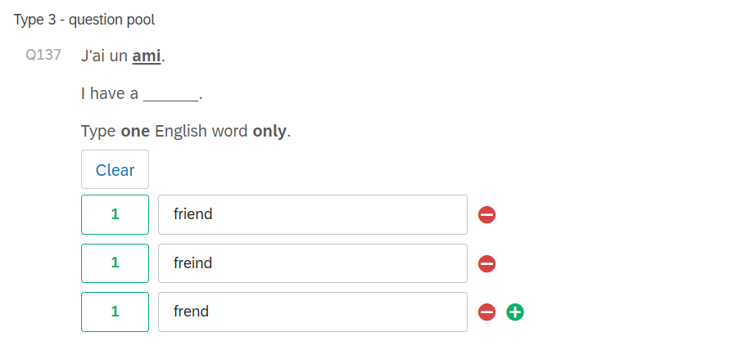
4. Scoring (tolerance)

Slide 23
5. Summary
The NCELP Y7 vocabulary test …
is a syllabus-based vocabulary test designed to measure vocabulary breadth and depth
provides a highly reliable snapshot of student achievement in a manageable timeframe
tests all words featured in the SOW tested by distributing randomly amongst students
tests recognition and recall skills across four modalities
thoroughly tests different elements of word knowledge tested, in line with aspects taught
provides automated scoring of 6/7 question types

Slide 24
References
Cariana, R. B., & Lee, D. (2001). The effects of recognition and recall study tasks with feedback in a computer-based vocabulary lesson. Educational Technology Research & Development 49 (3), pp. 23-36.
Glover, J. A. (1989). The "testing" phenomenon: Not gone but nearly forgotten. Journal of Educational Psychology, 81(3), 392-399.
Jones, L. (2004). Testing L2 vocabulary recognition and recall using pictorial and written test items. Language Learning & Technology 8 (3), pp. 122-143.
Laufer, B., & Nation, P. (1995). Vocabulary Size and Use Lexical Richness in L2 Written Production. Applied Linguistics, 16, pp. 307-322.
McDaniel, M. A., & Mason, M. E. J. (1985). Altering memory representations through retrieval. Journal of experimental psychology. Learning, Memory and Cognition 11, pp. 371-385.
Nation, I. S. P. (2013). Learning vocabulary in another language. Cambridge: Cambridge University Press
Read, J. (2000). Assessing Vocabulary. Cambridge: Cambridge University Press.
Stewart, J. (2014). Do Multiple-Choice Options Inflate Estimates of Vocabulary Size on the VST? Language Assessment Quarterly, 11(3), pp. 271–282. doi:10.1080/15434303.2014.922977
Stewart, J., & White, D. A. (2011). Estimating guessing effects on the vocabulary levels test for differing degrees of word knowledge. TESOL Quarterly, 45 (2), pp. 370–380. doi:10.5054/tq.2011.254523

Slide 25
Questions?
Thanks for listening!
Any questions?
natalie_eloise

