Slide 1
Talking about food
direct objects ‘lo’ and ‘la’[revisited]
present tense –ar verbs [revisited]
Y9 Spanish
Term 1.1 - Week 5 - Lesson 9
Amanda Izquierdo / Louise Caruso / Nick Avery
Artwork: Mark Davies
Date updated: 03.06.21
Notes:
Artwork by Mark Davies. All additional pictures selected are available under a Creative Commons license, no attribution required.
With thanks to Rachel Hawkes for her input on the lesson material and Blanca Román for native teacher feedback.
Learning outcomes (lesson 1)
Consolidation of the following features:
direct objects ‘lo’ and ‘la’
pre-verbal position of object pronouns
present tense –ar verbs in singular persons
penultimate syllable stress
Frequency rankings of vocabulary introduced this week (1 is the most common word in Spanish):
pan [1341]; huevo [1994]; leche [1397]; vino [1344]; dulce [1860]; tradicional [1222]; fresco [1494]; caliente [1810]; colocar [801]; mezclar [1567]; cortar [755]; verdura [4335]; soler [559]; probar [959]; costar [775]; preferir [714]
note: soler [559]; probar [959]; costar [775]; preferir [714] are introduced in lesson 2
Frequency rankings of vocabulary revisited this week (1 is the most common word in Spanish):
Y8 3.2.5
conducir [998]; traducir [2037]; discutir [1310]; dirigir [390]; francés [562]; ruso [1645]; rápido [870]; despacio [3383]; personaje [595]; actor [1533]; actriz [3567]; escena [1089]
Y8 3.1.5
hice [26]; hizo [26]; evitar [495]; fila [1976]; fuego [884]; daño [1319]; habitación [1069]; fondo¹ [413]; jardín [1195]; estadio [2581]; campo² [342]; mayo [909]; junio [1035]; viejo [225]; dentro [548]
Source: Davies, M. & Davies, K. (2018). A frequency dictionary of Spanish: Core vocabulary for learners (2nd ed.). Routledge: London
The frequency rankings for words that occur in this PowerPoint which have been previously introduced in NCELP resources are given in the NCELP SOW and in the resources that first introduced and formally re-visited those words. For any other words that occur incidentally in this PowerPoint, frequency rankings will be provided in the notes field wherever possible.

Slide 2
hablar
A
B
C
D
[to direct, directing]
[to drive, driving]
[to argue, arguing]
[Russian] (language)
¿Cómo se dice en español?
¡Tienes tres segundos para decir la palabra!
E
F
G
H
[to translate, translating]
[actor]
[fast]
[scene]
I
J
K
L
[character (e.g. in a film)]
[French] (language)
[actress]
[slow]
Notes:
Timing: 3 minutes
Aim: to revise in productive mode/oral modality 12 items of vocabulary from this week’s revisited set, 8.3.2.5, within a limited time frame.
Procedure:
1. Click and press enter to bring up an English prompt. It will disappear after 3 seconds. Note that the prompts do not appear in alphabetical order in order to increase the challenge.
2. Students say the Spanish word before the English prompt has faded away. 3. Ensure that definite articles are known for any words that are nouns (in order to check that students remember the gender).
ANSWERS:
A = dirigir
B = conducir
C = discutir
D = el ruso
E = el actor
F = traducir
G = rápido
H = la escena
I = el personaje
J = la actriz
K = el francés
L = despacio

Slide 3
Respuestas
hablar
dirigir
conducir
discutir
el ruso
[to direct, directing]
[to drive, driving]
[to argue, arguing]
[Russian]
el actor
traducir
rápido
la escena
[actor]
[to translate, translating]
[fast]
[scene]
el personaje
la actriz
el francés
despacio
[character (in a film)]
[actress]
[French]
[slow]
Notes:
ANSWERS TO PREVIOUS SLIDE
Note: Answers are animated to appear one by one, from left to right, proceeding row by row. This allows for further practice, if desired.
Alternatively, the animations could be removed to show all of the answers straight away.

Slide 4
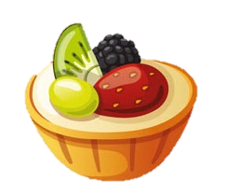
Vocabulario
hablar
[1/2]
el pan
el vino
[bread, loaf of bread]
’Dulce’ can be used as a noun (m) or adjective.
Compare:
1. Me gustan los dulces.
I like sweets/sweet things.
2. Me gusta la comida dulce.
I like sweet food.
In Spanish, ‘el pan’ can be countable and uncountable.
Uncountable → el pan = bread
Countable → el pan = a loaf of bread
[wine]
el huevo
dulce
[egg]
[sweet]
traditional
tradicional
la leche
[milk]
Notes:
[1/2]
Vocabulary practice slide
Timing: 3 minutes
Aim: to introduce new vocabulary.
Procedure 1. Pupils either work by themselves or in pairs, reading out the words and recapping their English meaning. 2. Then the teacher removes the English words or pictures (one by one) and they try to recall the English orally (chorally), looking at the Spanish. 3. Then the Spanish meanings are removed (one by one) and they to recall them orally (again, chorally), looking at the English. 4. Further rounds of learning can be facilitated by one pupil turning away from the board, and his/her partner asking him/her the meanings (‘Cómo se dice X en español?’). This activity can work from L2 → L1 or L1 → L2.

Slide 5
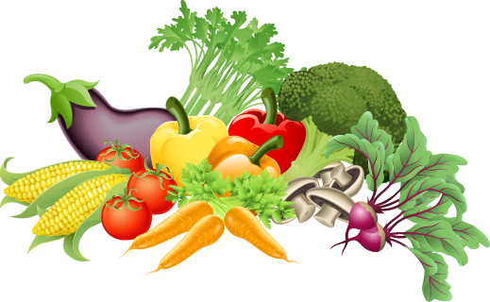
Vocabulario
hablar
to mix,
mixing
[2/2]
mezclar
fresco/a
to cut,
cutting
cortar
caliente
[hot]
to place,
placing
la verdura
colocar
[vegetable]
Notes:
[2/2]

Slide 6
Saying who or what receives the action Using the pronoun ‘lo’
gramática
Use ‘lo’ to mean ‘him’ or ‘it’ (for masculine objects):
→ Daniel collects the bread.
Daniel recoge el pan.
Daniel recoge a un amigo.
→ Daniel collects a friend.
¡Ojo! The Spanish object pronoun often goes before the verb.
→ Daniel picks him / it (m) up.
Daniel lo recoge.
Notes:
Timing: 2 minutes
Aim: to recap the direct object pronoun ‘lo’ ahead of subsequent activities.
Procedure:
Click to bring up the explanation.
After presenting the final sentence, remind students that sometimes we don’t hear the subject. For example, we might not hear a person’s name because it has already been mentioned or is made clear by the context. For example, ‘lo recoge’ means ‘S/he picks him / it (m) up’.
Note: The RAE also accepts the use of ‘le’ for direct objects when the referent is human and male.
https://www.rae.es/consultas/uso-de-los-pronombres-los-las-les-leismo-laismo-loismo
This use of ‘le’, referred to as leísmo, is common in the centre and north of Spain (Butt and Benjamin, 2004).

Slide 7
Saying who or what receives the action Using the pronoun ‘la’
gramática
If the object is feminine, use ‘la’ to mean ‘her’ or ‘it’:
Lucía busca la verdura.
→ Lucía looks for the vegetable.
Lucía busca a una amiga.
→ Lucía looks for a friend.
This can be tricky because ‘la’ also means ‘the’ when it comes before a noun.
→ Lucía looks for her / it (f).
Lucía la busca.
Notes:
Timing: 2 minutes
Aim: to recap the direct object pronoun ‘la’ ahead of subsequent activities.
Procedure:
Click to bring up the explanation.
After presenting the final sentence, remind students that sometimes we don’t hear the subject. For example, we might not hear a person’s name because it has already been mentioned or is made clear by the context. For example, ‘la busca’ means ‘S/he looks for her / it (f)’.

Slide 8
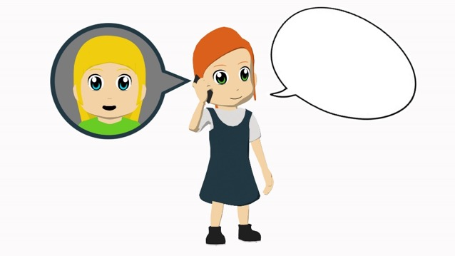
Lucía prepara una comida
¿Tienes
pan?
leer
Lee las frases sobre las actividades de Lucía.
¿Qué significa ‘lo’ y ‘la’ (probablemente) en cada frase?
 | ‘it’ | ‘him’ | ‘her’ | La frase completa (en inglés)
1. La corta.
2. La llama para pedir ingredientes.
3. Lo saluda.
4. La mezcla con los huevos.
5. Lo coloca encima de la mesa.
6. La acompaña a la cocina.
S/he cuts it.
S/he calls her to ask for ingredients.
S/he greets him.
S/he mixes it with the eggs.
S/he places it on the table.
S/he goes with her to the kitchen.
Notes:
Timing: 7 minutes
Aim: to practise understanding the possible meanings of the pronouns ‘lo’ (‘him’ or ‘it’) and ‘la’ (‘her’ or ‘it’).
Procedure:
1. Draw students’ attention to the title. ‘Comida’ is used here to mean ‘meal’.
2. Students read the sentences in Spanish and decide if the corresponding sentence in English refers to ‘it’, ‘him’ or ‘her’. They will need to pay attention to the pronoun and to the meaning of the verb (whether it is most likely to be used for a living or non-living thing) in order to do this.
3. Show the answers and give feedback.
Note: the teacher will need to make it clear to students that the ‘it’, ‘him’ and ‘her’ columns do not refer to the verb ending (as is often the case in these activities), but instead to the pronoun highlighted in bold.
Frequency of unknown words and cognates:
ingrediente [4063]

Slide 9
Lucía prepara una comida
¿Tienes
pan?
leer
Identifica las dos partes de cada frase.
c
1.
2.
3.
4.
5.
6.
Primera parte
1. Lucía ve al profesor del colegio en el mercado, entonces…
2. Pone la leche en un *bol y …
3. Su tía vive cerca de ella entonces…
4. Ahora Lucía tiene la fruta y...
5. Daniel quiere ayudar a su hermana así que…
6. Cuando el dulce está listo,…
d
Segunda parte
a) …la corta.
b) …la llama para pedir más huevos.
c) …lo saluda.
d) …la mezcla con los huevos.
e) …lo coloca encima de la mesa.
f) …la acompaña a la cocina.
b
a
f
e
*el bol = bowl
Notes:
Timing: 5 minutes
Aim: to understand the meanings of ‘lo’ and ‘la’ in context.
Procedure:
Explain the task to students. They will need to match up the two sentence halves by paying attention to the gender of the noun or person mentioned in the first part, and to the animacy of the verb.
Elicit answers from students. Ask for an oral translation of the full sentence in English to check understanding.
Each answer is revealed on a click.
Frequency of unknown words or cognates:
bol [>5000]

Slide 10
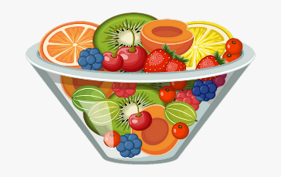
Lucía prepara una comida
hablar
Remember: when reading words aloud in Spanish, stress the penultimate syllable for any word ending in a vowel, ‘n’ or ‘s’ (unless there is a written accent).
¿Qué palabras tienen el énfasis en la penúltima sílaba? Lee las frases en parejas y marca las sílabas con énfasis.
1. Lucía ve al profesor del colegio en el mercado, entonces lo saluda.
1. Lucía ve al profesor del colegio en el mercado, entonces lo saluda.
2. Su tía vive cerca de ella entonces la llama para pedir ingredientes.
2. Su tía vive cerca de ella entonces la llama para pedir ingredientes.
3. Ahora Lucía tiene la fruta y la corta.
3. Ahora Lucía tiene la fruta y la corta.
4. Daniel quiere ayudar a su hermana así que la acompaña a la cocina.
4. Daniel quiere ayudar a su hermana así que la acompaña a la cocina.
5. Cuando el dulce está listo lo coloca encima de la mesa.
5. Cuando el dulce está listo lo coloca encima de la mesa.
Notes:
Timing: 5 minutes
Aim: to practise pronunciation of words with penultimate syllable stress.
Procedure:
Students read out each sentence in pairs and note down the words with penultimate syllable stress.
Click to show the answers for each sentence. The words with penultimate syllable stress appear in bold.

Slide 11
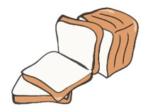
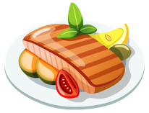
Y Daniel, ¿cómo ayuda?
Daniel también ayuda.
Escucha. ¿Es ‘A’ o ‘B’?
Escribe la acción y el lugar en inglés.
escuchar
Acción y lugar
Acción y lugar
1
buys it at the market
4
cuts it in
the kitchen
A milk (f)
B bread (m)
A fruit (f)
B cheese (m)
leaves it next to the window
2
5
mixes it in
a glass
A wine (m)
B vegetable (f)
A honey (f)
B juice (m)
places it on the table
takes it out of the bag
3
6
A food (f)
B egg (m)
A banana (m)
B apple (f)
Notes:
Timing: 8 minutes
Aim: to practise recognising the gender of the direct object pronouns ‘lo’ and ‘la’.
Procedure:
Students listen to each sentence and decide if it refers to A or B, depending on the direct object pronoun that they hear. Note that in this activity, all pronouns refer to ‘it’ (rather than ‘him’ or ‘her’).
Students write the action and place in English.
Show the answers and give feedback. Students may be interested to know how to say some of the unknown words in Spanish (and they may learn their meanings incidentally). These are:
cheese: el queso [3187]
honey: la miel [3201]
juice: el jugo [3756]; zumo [>5000] is also used in Spain
banana: el plátano [>5000]
apple: la manzana [3214]
Transcript:
Lo compra en el mercado.
Lo deja al lado de la ventana.
La coloca encima de la mesa.
Lo corta en la cocina.
La mezcla en un vaso.
La saca de la bolsa.
Note:
Some food items have not been previously taught, although this does not impede the completion of the activity as the aim is to identify ‘lo’ being masculine and ‘la’ being feminine.
An alternative use of this activity could be full or partial sentence transcription. Some students may engage in this anyway, taking notes before writing their answer in English.
Frequency of unknown words or cognates:
queso [3187]; miel [3201]; jugo [3756]; zumo [>5000] is also used in Spain; el plátano [>5000]; manzana [3214]; acción [404]

Slide 12
¡A escribir!
Ahora escribe las seis frases en español.
Debes mirar la imagen para saber si es ‘lo’ o ‘la’.
¡Atención! La frase empieza con ‘lo’ o ‘la’.
escribir
S/he mixes it with a little bit of hot water.
1
S/he prepares it with egg.
4
Lo prepara con huevo.
(f)
La mezcla con un poco de agua caliente.
[cake] (m)
S/he buys it with other fresh products at the market.
2
S/he looks for it in the kitchen.
5
La busca en la cocina.
(f)
La compra con otros productos frescos en el mercado.
(f)
S/he takes it out of the bag and places it on the table.
3
S/he leaves it in the glass.
6
Lo deja en el vaso.
Lo saca de la bolsa y lo coloca encima de la mesa.
(m)
(m)
Notes:
Timing: 7 minutes
Aims:
to produce 6 written sentences using direct object pronouns ‘lo’ and ‘la’.
to do so with accurate word order (pronoun before the verb).
to also produce vocabulary.
Procedure:
Go through instructions with students. Explain that they’ll need to write a sentence with ‘lo’ or ‘la’ based on the English and picture prompts. It will be worth reminding them of the pre-verbal position of the pronoun (see line 3 of instructions).
Students read each sentence in English and write it in Spanish.
Show the answers one by one and give feedback. Students may be interested to know how to say one further unknown word in Spanish in one of the pictures: pastel [>5000]. They may learn its meaning incidentally.

Slide 13
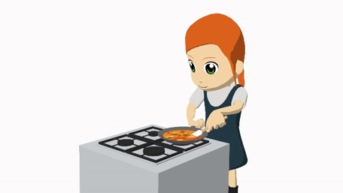
Persona A: read the sentence in Spanish. Use ‘lo’ for a singular masculine object and ‘la’ for a singular feminine object.
Lucía en la cocina
hablar / escuchar
Persona B: look at the cards. Is it ‘A’ or ‘B’? Write down the correct letter and also complete the table in English with the location.
Un ejemplo
Lo compra en el mercado.
Persona A (habla):
1. She buys it (m) at the market.
Persona B (escucha, mira la tarjeta y escribe):
A
[bread] (m)
B
[milk] (f)
 | Letra | ¿Dónde? (en inglés)
1
A
at the market
Notes:
Timing: 8 minutes
Aim:
to practise producing the direct object pronouns ‘lo’ and ‘la’.
to practise producing vocabulary.
to practise understanding the gender of the pronoun and vocabulary.
Procedure:
This is the example slide to explain the activity. Teachers click to go through the example stage by stage. It may be useful to give the pairs out their cards to help understand the task. The prompt cards for both Person A and Person B are on slide 14, and the picture cards (the answer options) are on slide 13. The answer options should be displayed on the board during the activity.
Person B listens to Person A’s question and decides which image ‘lo’ or ‘la’ is referring to. This will be the image that matches the gender of the pronoun. Person B then writes ‘A’ or ‘B’.
Students swap roles after doing all 6.
The answers to the activity are shown on slide 15.
Notes:
It may be useful to remind students that ‘agua’ is a feminine noun (see next slide, where it appears with ‘(f)’). However, it takes the masculine article ‘el’ as it would be difficult to say *la agua.
Most of the food items on slide 14 are known vocabulary items. ‘Sweet pastry’ could be translated as ‘dulce’, which was taught earlier in the lesson. To challenge higher achieving groups, students could be required to write the food itself (rather than only the letter that matches the pronoun).

Slide 14
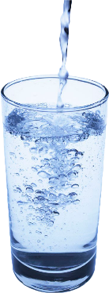
1.
A
[chocolate] (m)
B
[vegetable] (f)
4.
A
[milk] (f)
B
[plate] (m)
2.
A
[fruit] (f)
B
[egg] (m)
5.
A
[food] (f)
B
[sweet pastry] (m)
3.
A
[bread] (m)
B
[meat] (f)
6.
A
[water] (f)
B
[wine] (m)
Notes:
Person A
DISPLAY THIS SLIDE DURING THE ACTIVITY

Slide 15
Persona A
 | Letra | ¿Dónde? (en inglés)
1
2
3
4
5
6
Say these sentences in Spanish:
She buys it (f) at the market.
She takes it (m) out of the box.
She cuts it (m) on a plate.
She places it (m) on the table.
She prepares it (f) in the kitchen.
She carries it (m) in the bag.
Persona B
 | Letra | ¿Dónde? (en inglés)
1
2
3
4
5
6
Say these sentences in Spanish:
She cuts it (f) on the table.
She mixes it (f) with the bread.
She prepares it (f) outside.
She carries it to (m) the kitchen.
She places it (f) on a plate.
She leaves it (f) next to the window.
Notes:
Prompt cards & blank answer grid
DO NOT DISPLAY DURING THE ACTIVITY

Slide 16
Persona A
 | Letra | ¿Dónde? (en inglés)
1
2
3
4
5
6
Say these sentences in Spanish:
on the table
B
She buys it (f) at the market.
She takes it (m) out of the box.
She cuts it (m) on a dish.
She places it (m) on the table.
She prepares it (f) in the kitchen.
She carries it (m) in the bag.
A
in a bowl
B
outside
B
in the kitchen
A
on the dish
A
next to the window
Persona B
 | Letra | ¿Dónde? (en inglés)
1
2
3
4
5
6
Say these sentences in Spanish:
B
at the market
She cuts it (f) on the table.
She mixes it (f) in a bowl*.
She prepares it (f) outside.
She carries it to (m) the kitchen.
She places it (f) on a dish.
She leaves it (f) next to the window.
B
out of the box
*el bol
A
on the dish
B
the table
A
in the kitchen
B
in the bag
Notes:
Prompt cards & completed answer grid
DISPLAY FOR FEEDBACK

Slide 17
Talking about food [2]
direct objects ‘los’ and ‘las’
Y9 Spanish
Term 1.1 - Week 5 - Lesson 10
Amanda Izquierdo / Louise Caruso / Nick Avery
Artwork: Mark Davies
Date updated: 03.06.21
Notes:
Artwork by Mark Davies. All additional pictures selected are available under a Creative Commons license, no attribution required.
With thanks to Rachel Hawkes for her input on the lesson material and Blanca Román for native teacher feedback.
Learning outcomes (lesson 2)
Introduction of direct objects ‘los’ and ‘las’
Introduction of several new radical changing verbs
Consolidation of penultimate syllable stress
Consolidation of definite articles ‘los’ and ‘las’
Consolidation of vocabulary
Frequency rankings of vocabulary introduced this week (1 is the most common word in Spanish):
pan [1341]; huevo [1994]; leche [1397]; vino [1344]; dulce [1860]; tradicional [1222]; fresco [1494]; caliente [1810]; colocar [801]; mezclar [1567]; cortar [755]; verdura [4335]; soler [559]; probar [959]; costar [775]; preferir [714]
note: soler [559]; probar [959]; costar [775]; preferir [714] are introduced in lesson 2
Frequency rankings of vocabulary revisited this week (1 is the most common word in Spanish):
Y8 3.1.5
hice [26]; hizo [26]; evitar [495]; fila [1976]; fuego [884]; daño [1319]; habitación [1069]; fondo¹ [413]; jardín [1195]; estadio [2581]; campo² [342]; mayo [909]; junio [1035]; viejo [225]; dentro [548]
Source: Davies, M. & Davies, K. (2018). A frequency dictionary of Spanish: Core vocabulary for learners (2nd ed.). Routledge: London
Y8 3.2.5
conducir [998]; traducir [2037]; discutir [1310]; dirigir [390]; francés [562]; ruso [1645]; rápido [870]; despacio [3383]; personaje [595]; actor [1533]; actriz [3567]; escena [1089]
The frequency rankings for words that occur in this PowerPoint which have been previously introduced in NCELP resources are given in the NCELP SOW and in the resources that first introduced and formally re-visited those words. For any other words that occur incidentally in this PowerPoint, frequency rankings will be provided in the notes field wherever possible.

Slide 18
Vocabulario
hablar
el estadio
el fuego
hizo
dentro
el jardín
evitar
viejo
hice
to avoid
fire
I did, I made
stadium
old
inside
garden
s/he/it did
Notes:
Timing: 1 minute
Aim: to consolidate students’ knowledge of vocabulary from 8.3.1.5.
Procedure:
Click to reveal the English.
Students say out loud the word in Spanish from the selection.

Slide 19
leer
line
May
back, end
harm, damage
leer
June
bedroom
countryside, pitch
to avoid
la habitación
el campo
fila
bedroom
countryside, pitch
line
el fondo
el daño
harm, damage
junio
back, end
evitar
mayo
June
May
to avoid
Notes:
Timing: 1 minute
Aim: to promote recall of meanings in English of this week’s revisited vocabulary set from 8.3.1.5
Procedure:
1. Give students 30 seconds to consider the options, then remove the English meanings with a click of the mouse.
2. Students give the translation of the 8 words in English (orally). Click the mouse to then show the answers when the students have finished.

Slide 20
Vocabulario
escribir
garden
old
I did, I made
back, end
el jardín
viejo
hice
el fondo
May
stadium
line
June
el estadio
mayo
la fila
junio
Notes:
Timing: 2 minutes
Aim: to promote recall of the Spanish words with correct spellings.
Procedure:
1. Students write the word in Spanish for the eight vocabulary items.
2. Teachers click to show the answers one by one.

Slide 21
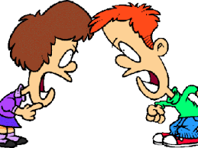
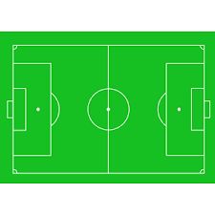
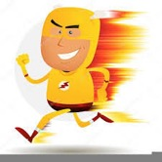
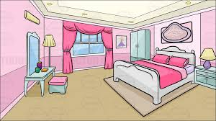
leer / hablar
Escribe la letra correcta para cada palabra en español.
Después, las palabras van a desaparecer. Debes decir una letra en español. Tu compañero debe decir la palabra en español. ¡Toma turnos!
 | Palabras | ¿Qué letra?
1 | conducir
2 | discutir
3 | despacio
4 | dentro
5 | el fuego
6 | hizo
7 | la habitación
8 | dirigir
9 | el daño
10 | el campo
11 | rápido
12 | el francés
a)
b)
c)
d)
k
[harm, damage]
c
a
[to argue]
[to direct]
i
e)
f)
g)
h)
f
[s/he/it did, made]
h
j
[French]
[countryside,
pitch]
[fire]
d
j)
k)
l)
i)
b
g
[inside]
l (L)
[bedroom]
[to drive]
[fast]
e
Notes:
Timing: 4 minutes
Aim: to revisit words from both of this week’s revisited vocabulary sets.
Procedure 1. Students either work by themselves or in pairs, matching up words with the corresponding picture (1 minute) 2. Then the teacher shows the answers one by one (1 minute).
3. After one more click, the Spanish words are covered up.
4. Students work in pairs. One says a random letter and the other says the word in Spanish as fast as possible. Students take turns (2 minutes).
Note:
To increase the level of difficulty for a higher-ability group, students could skip steps 1-3 and go straight to step 4 (production).
Images free from clipart-library.com

Slide 22
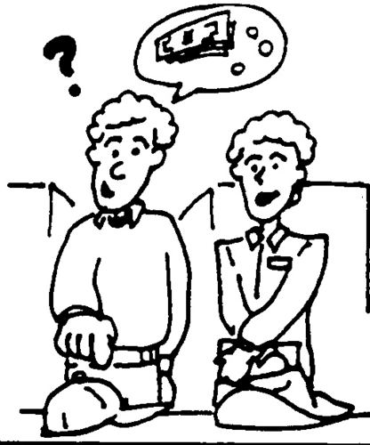
Vocabulary
hablar
[to usually do something]
soler
costar
[to cost]
The stem of ‘preferir’ changes (e->ie), like ‘querer’.
querer (to want) →
quiero (I want)
preferir (to prefer) →
prefiero (I prefer)
probar
[to prefer]
preferir
[to try, to taste]
Notes:
Vocabulary practice slide
Timing: 2 minutes
Aim: to introduce new vocabulary.
Procedure 1. Pupils either work by themselves or in pairs, reading out the words and recapping their English meaning (1 minute). 2. Then the teacher removes the English words or pictures (one by one) and they try to recall the English orally (chorally), looking at the Spanish (1 minute). 3. Then the Spanish meanings are removed (one by one) and they to recall them orally (again, chorally), looking at the English (1 minute) 4. Further rounds of learning can be facilitated by one pupil turning away from the board, and his/her partner asking him/her the meanings (‘¿Cómo se dice X en español?’). This activity can work from L2 → L1 or L1 → L2.

Slide 23
Using stem-changing verbs Verbs probar, costar and soler
gramática
As you know, the stem may change on some verbs.
You already know some verbs with this change:
One type of change is o → ue.
poder (to be able to, can) →
puedo (I am able to, I can)
‘Probar’, ‘costar’ and ‘soler’ work in the same way.
Probar →
Pruebas la leche.
You try/taste the milk.
Costar →
El pan cuesta un euro.
The bread costs one euro.
Suelo comer temprano.
I usually eat early.
‘Soler’ is a modal verb, so it is followed by an infinitive.
Soler →
Notes:
Timing: 2 minutes
Aim: to recap radical change verbs o>ue.
Procedure:
Click to bring up the explanation and examples.
Notes:
Students might wonder about the word ‘suelo’, as they have learned this word in Y7 with the meaning ‘floor’. This is correct; however, the context will always determine the meaning of the word. A sentence like ‘Suelo limpiar el suelo’ is perfectly possible!
It may be useful to add that stem changes are typically on the last vowel of the stem.
Acordar → acuerdas is another example of a verb with the o->ue change. Students saw this verb last week.

Slide 24
Saying who or what receives the action using ‘la’ & ‘las’ in object-first sentences
gramática
Remember, to mean ‘her’ or ‘it’ when referring to a singular (or uncountable) feminine object, use ____ before a verb.
la
Compro la fruta.
→ I buy the fruit.
La compro.
→ I buy it.
To mean ‘them’ for a plural feminine object, use las before a verb.
Cortas las verduras.
→ You cut (up) the vegetables.
→ You cut them (up).
Las cortas.
¡Ojo! ‘La’ and ‘las’ also mean ‘the’ before a feminine noun!
Notes:
Timing: 2 minutes
Aim: to recap the direct object pronoun ‘la’ and to introduce ‘las’.
Procedure:
Click to bring up explanation and examples.

Slide 25
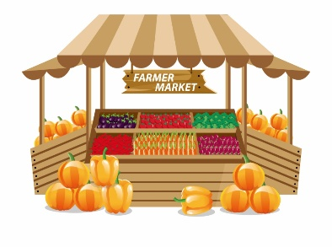
Lucía prepara algo de comer
leer
[1/2]
 |  |  | La parte subrayada
1. Compra | una verdura | en el mercado y las pone en una bolsa. | S/he______________________.
 | unas verduras
puts them in a bag
 |  |  | La parte subrayada
2. Encuentra | unas bebidas | pero cuestan demasiado entonces no las compra. | S/he________________________.
 | una bebida
doesn’t buy them
 |  |  | La parte subrayada
3. Lleva | una fruta | a casa y la coloca en la mesa. | S/he _______________________.
 | unas frutas
places it on the table
Notes:
Timing: 7 minutes
Aim: to practise understanding the meaning of the feminine direct object pronouns (‘la’ for ‘it’ and or ‘las’ for ‘them’) with reference to the preceding noun.
Procedure:
Students write 1-6 in their books. For each sentence, they will need to write the missing noun (by paying attention to the pronoun) and to translate the underlined part of the sentence.
Click to show answers item by item. The correct noun first appears, and then the English translation of the underlined text.
Notes:
1. The activity could be adapted for different levels of ability by increasing or decreasing the amount of text that students are required to translate.

Slide 26
Lucía prepara algo de comer
leer
[2/2]
 |  |  | La parte subrayada
4. Suele comprar | una carne especial | por la mañana. Luego la cocina* por la tarde. | S/he_________________________________.
 | unas carnes especiales
cooks it in the
afternoon
*cocinar = to cook
 |  |  | La parte subrayada
5. Corta | una manzana | primero y después las mezcla con el plátano*. | S/he_________________________________.
 | unas manzanas
mixes them with the
banana
*el plátano = banana
 |  |  | La parte subrayada
6. Pone | unas cosas | en la mesa pero siempre las lava primero. | S/he_______________________ ____.
 | una cosa
always washes them
first
Notes:
Slide 2/2
Frequency of unknown words:
cocinar [3074]; plátano [>5000]

Slide 27
Lee las frases y marca. ¿Qué significa ‘las’ en cada frase?
¿Qué significa la frase completa en inglés?
leer
 | ‘The’ | ‘Them’ | La frase completa (en inglés)
1. Las preparas en casa.
2. Las verduras están ricas.
3. Las pruebas con una bebida caliente.
4. Las sueles comprar en el mercado.
5. Las frutas están en la cocina.
6. Las prefieres dulces.
7. Las mezclas en el plato.
8. Las comidas son tradicionales.
You prepare them at home.
The vegetables are tasty.
You try them with a hot drink.
You usually buy them at the market.
The fruits are in the kitchen.
You prefer them (to be) sweet.
You mix them on the plate.
The foods are traditional.
Notes:
OPTIONAL
Timing: 7 minutes
Aim:
to practise differentiating between the two meanings of ‘las’ (‘the’ and ‘them’).
to understand sentences with new and revisited vocabulary.
Procedure:
1. Students read the sentences in Spanish and decide if the word ‘las’ means ‘the’ or ‘them’ in each case.
2. Click to bring up the answers.

Slide 28
Saying who or what receives the action using ‘los’ in object-first sentences
gramática
Remember, to mean ‘him’ or ‘it’ when referring to a singular or uncountable masculine object, use ____before a verb.
lo
→ I buy the wine.
Compro el vino.
Lo compro.
→ I buy it.
To mean ‘them’ referring to masculine objects in plural, use los.
→ You mix the eggs.
Mezclas los huevos.
→ You mix them.
¡Ojo! ‘Los’ also means ‘the’ before a plural masculine noun!
Los mezclas.
Notes:
Timing: 2 minutes
Aim: to recap the direct object pronoun ‘lo’ and to introduce ‘los’.
Procedure:
Click to bring up explanation and examples.

Slide 29
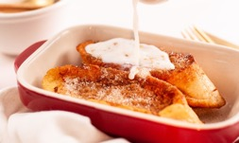
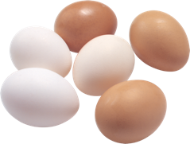
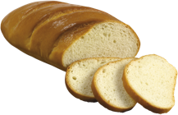
Daniel prepara un plato
escuchar
Las Torrijas son un dulce tradicional de España. Tienen pan, huevo y azúcar*.
Escucha las instrucciones para un plato tradicional.
¿Habla del pan o de los huevos?
 | pan | huevos | ¿Qué significa?
*el azúcar = sugar
1
need them
You ____________ to be fresh.
place it
2
You ______________ on the table.
cut it
3
You ______________ into small parts.
mix them
4
You ______________ first.
prepare it
5
You ______________ with the milk.
6
leave them
You ______________ on the plate.
7
try/taste them
You _______________.
8
eat it
You _________ with a coffee.
Notes:
Timing: 6 minutes
Aim:
to practise recognising the masculine direct object pronouns ‘lo’ vs ‘los’ in object-first sentences.
to understand the meaning of the verb in each sentence.
Procedure:
1. Click the number trigger to play the audio.
2. Students listen and indicate whether the phrase is referring to ‘pan’ (singular) or ’huevos (plural).
3. Click to reveal the answers one by one.
Transcript:
Los necesitas frescos.
Lo colocas en la mesa.
Lo cortas en partes pequeñas.
Los mezclas primero.
Lo preparas con la leche.
Los dejas en el plato.
Los pruebas.
Lo comes con un café.
Frequency of unknown words or cognates:
azúcar [2007]

Slide 30
Vamos a leer y escuchar un diálogo en el mercado. Antes, vamos a leer unas partes del diálogo. Marca la opción correcta:
leer
(m. pl.)
(f. pl.)
1. Los tengo grandes y pequeños.
2. ¡Las necesito para hacer torrijas!
3. ¿Los prefieres calientes o fríos?
4. ¿Los colocas en la bolsa?
5. No, los pongo en otra bolsa.
6. ¿Las tienes frescas?
Notes:
Timing: 4 minutes
Aims:
to practise recognising the gender of the pronouns ‘los’ and ‘las’ in object-first sentences.
to help students understand some fragments of the text that they will encounter in the next activity.
Procedure:
Students read each sentence and decide whether it’s referring to a plural masculine or plural feminine object.
Show the answers with further clicks and elicit oral translations in English.

Slide 31
Lucía compra en el mercado y habla con un dependiente. Lee y escucha el diálogo. Después, lee las frases en inglés. ¿Son verdaderas o falsas?
leer / escuchar
 | V | F
1. Lucía only wants big loaves of bread.
2. She prefers hot bread.
3. She wants bread for the evening.
4. She puts the loaves of bread in the bag with the bottles of milk.
5. The vegetables are fresh.
Hola, buenos días. ¿Cuánto cuestan los panes?
Los tengo grandes y pequeños. Los grandes cuestan un euro y los pequeños un euro con cincuenta céntimos.
Vale. Entonces dos pequeños y dos grandes.
¿Y los prefieres calientes o fríos?
Mmm... calientes, para desayunar. ¿Y cuánto cuestan estas botellas de leche?
1 euro la botella, pero también tenemos botellas grandes.
Pues... dos pequeñas. ¡Las necesito para hacer torrijas!
Perfecto. Los panes ya están calientes. ¿Los colocas en la bolsa con la leche?
No, los pongo en otra bolsa. Entonces, ¿cuánto cuesta todo?
A ver*... Todo cuesta nueve euros.
Bien, gracias. ¡Ah! También necesito verduras. ¿Las tienes frescas?
Sí, ¡claro*! ¿Qué tipo de verdura?
*a ver = let’s see
*claro = of course
Notes:
Timing: 7 minutes
Aim:
to see the examples of ‘los’ and ‘las’ on the previous slide in the context of a dialogue
to understand the vocabulary in the text
to correctly identify which of the five sentences are true and false, and why
Procedure:
Go through instructions with students. The word ‘dependiente’ (shop assistant) was glossed in an earlier resource, but hasn’t been taught as vocabulary, so ensure that its meaning is clear.
Students read and listen to the dialogue, trying to get the gist of the text.
Students then read the statements in English and decide whether they are true or false.
Draw students’ attention to several features of the text where there is not a word for word translation into English:
Notes:
Here are some additional uses of the text:
oral read aloud, in pairs (see next slide for extracts of the text that can be used for practice of penultimate syllable stress)
oral read aloud, with pairs of pronouns and verbs (e.g. los colocas) given as a prompt in English (‘you place them’) to prompt productive recall under some time pressure.
splitting the text into jumbled parts and asking students to reorder them
rewriting the text in a new way (e.g. with different items of food) and checking that the pronouns maintain the correct agreement. It may be necessary to provide some of the food items used in lesson 1 to support practice here.
Frequency of unknown words or cognates:
dependiente [>5000]

Slide 32
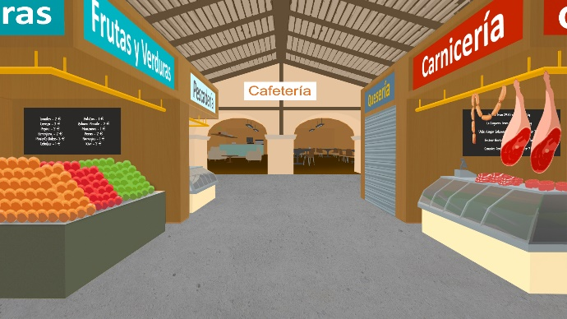
Remember: when reading words aloud in Spanish, stress the penultimate syllable for any word ending in a vowel, ‘n’ or ‘s’ (unless there is a written accent).
Lee unas frases de Lucía y del dependiente.
hablar
Los tengo grandes y pequeños, ¿cuáles prefieres?
1
Los tengo grandes y pequeños, ¿cuáles prefieres?
Los prefiero calientes, para desayunar. ¿Y cuánto cuestan las botellas de leche?
2
Los prefiero calientes, para desayunar. ¿Y cuánto cuestan las botellas de leche?
Los panes ya están calientes. ¿Los colocas en la bolsa también?
3
Los panes ya están calientes. ¿Los colocas en la bolsa también?
4
Todo cuesta seis euros con cincuenta céntimos.
Todo cuesta seis euros con cincuenta céntimos.
También necesito verduras. ¿las tienes frescas?
5
También necesito verduras. ¿las tienes frescas?
Notes:
Timing: 5 minutes
Aim: to practise penultimate syllable stress.
Procedure:
Students read each sentence and note down the words with penultimate syllable stress.
Students listen to each sentence.
Teacher shows the answers.
Note: some sentences have been changed slightly to facilitate practice with penultimate syllable stress.

Slide 33
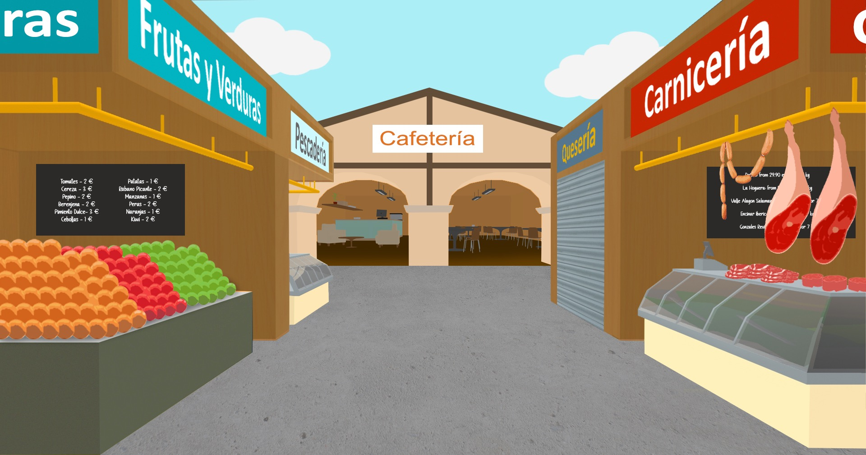
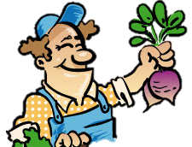
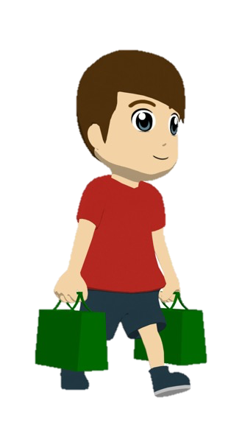
Ahora intenta completar este diálogo en español:
escribir
Hola, ¿cuánto _________ los huevos?
1
1
Hi, how much do the eggs cost?
cuestan
2
Do you prefer them big or small?
¿___ _________ grandes o pequeños?
Los
prefieres
2
Mmmm, big. I also want to buy fruit and vegetables.
3
Mmm, grandes. También quiero comprar _________ __________.
3
fruta y
verduras
Look – I have some fresh apples. You can try one if you like.
Mira – tengo unas manzanas frescas. ______________ una si quieres.
4
Puedes probar
4
Perfect, thank you! I need them for a traditional dish.
¡Perfecto, gracias! _____________ para un plato tradicional.
5
Las necesito
5
Notes:
[1/2]
Timing: 6 minutes
Aim:
to practise producing the pronouns ‘los’ and ‘las’ in a written dialogue
to also produce other aspects of the language, including new vocabulary items
Procedure:
Students read the dialogue and write the translation in Spanish.
Teacher clicks to bring up each missing part of the translation.
Notes:
See slide 33 for a version of the activity for higher-ability groups.
Frequency of unknown words or cognates:
manzana [3214]

Slide 34
Mira las respuestas. ¿Tu traducción es correcta?
escribir
Hola, ¿cuánto cuestan los huevos?
1
1
Hi, how much do the eggs cost?
¿Los prefieres grandes o pequeños?
2
2
Do you prefer them big or small?
Mmmm, big. I also want to buy fruit and vegetables.
3
Mmmm, grandes. También quiero comprar fruta y verduras.
3
4
Look - I have some fresh apples*!
Mira - tengo unas manzanas frescas.
4
Perfect, thank you! I need them for a traditional dish.
5
¡Perfecto, gracias! Las necesito para un plato tradicional.
5
*apple = la manzana
Notes:
ALTERNATIVE VERSION – HIGHER ABILITY
Activity as described on the previous slide, but this time requiring a full translation of the dialogue.
Note that the dialogue has been modified very slightly to ensure that all language produced is part of existing productive knowledge or glossed.
It is likely to take longer than the 6 minutes envisaged for the version on the previous slide, given that it requires more writing.

Slide 35
Deberes
Vocabulary Learning Homework (Y9, Term 1.1, Week 6)
Student worksheet
Quizlet link
Quizlet QR code
Notes:
Note: 9.1.1.6 will revisit words from Year 7 and Year 8 in a single set. There are no additional sets to revisit.
The Vocabulary Learning Homework answers are available here: https://resources.ncelp.org/concern/parent/bz60cx29b/file_sets/cc08hg77b

