Slide 1
Comparing jobs in the past and present
SER for traits:
present tense - soy, eres [revisited]
imperfect tense - era, eras
Y9 Spanish
Term 3.1 – Week 3 – Lesson 53
Author name(s): Nick Avery, Louise Caruso Artwork: Mark Davies
Date updated: 31/03/22
Notes:
Artwork by Mark Davies. All additional pictures selected are available under a Creative Commons license, no attribution required.
With thanks to Rachel Hawkes for her input on the lesson material and Amanda Izquierdo for native teacher feedback.
Learning outcomes (lesson 1):
Introduction of SER in the imperfect tense: ‘era’ and ‘eras’
Introduction of new vocabulary
Consolidation of SER in the present tense: ‘soy’ and ‘eres’
Consolidation of antepenultimate syllable stress
Word frequency (1 is the most frequent word in Spanish):
9.3.1.3 (introduce): era [ser-7]; eras [ser-7]; artista [817]; dueño [1239]; escritor [864]; metro [798]; transporte [1400]; conductor [2645]; enfermero [3385]; dependiente [3891]; agradable [1997]; cierto [159]; común [742]; popular [798]; moderno [861]; optimista [1025]; posible [427]; buen [bueno-103]; mal [mal-66]; gran [grande-369]; único [213]
Note: words in bold above are introduced in lesson one of this sequence.
9.2.2.3 (revisit): animar [1630]; anunciar [785]; cerrar [521]; charlar [2968]; llover [2134]; notar [696]; atención [489]; prestar atención [atención-489]; regresar [573]; boda [2473]; espectáculo [1622]; golpe [746]; llegada [1604]; olor [1070]; sabor [2108]; enseguida [2866]; mundial [572]; en este momento [momento-121]; de repente [repente-1805]
9.2.1.5 (revisit): encender [1431]; morir [212]; producir [245]; prohibir [1641]; promover [1601]; proteger [1107]; resolver [867]; sobrevivir [1908]; bosque [1444]; consumo [1424]; efecto [309]; futuro [719]; medio ambiente [ambiente – 729]; planeta [1496]; plástico [1965]; recurso [1149]; situación [285]; uso [471]; vidrio [1905]; esencial [1872]; grave [901]; terrible [1246];
Source: Davies, M. & Davies, K. (2018). A frequency dictionary of Spanish: Core vocabulary for learners (2nd ed.). Routledge: London
The frequency rankings for words that occur in this PowerPoint which have been previously introduced in NCELP resources are given in the NCELP SOW and in the resources that first introduced and formally re-visited those words.
For any other words that occur incidentally in this PowerPoint, frequency rankings will be provided in the notes field wherever possible.

Slide 2
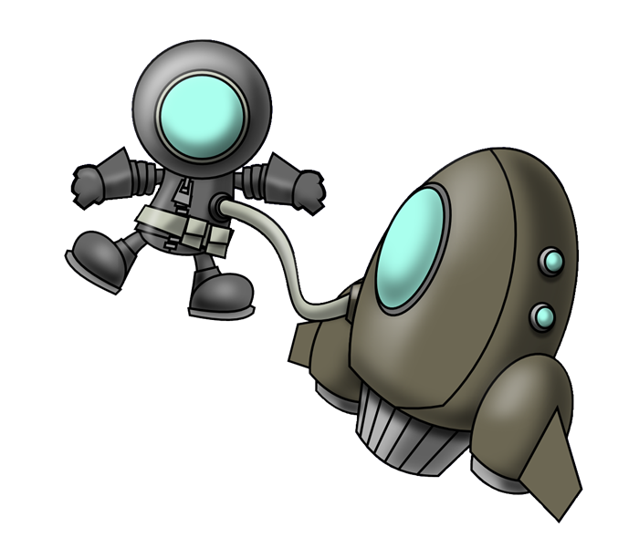
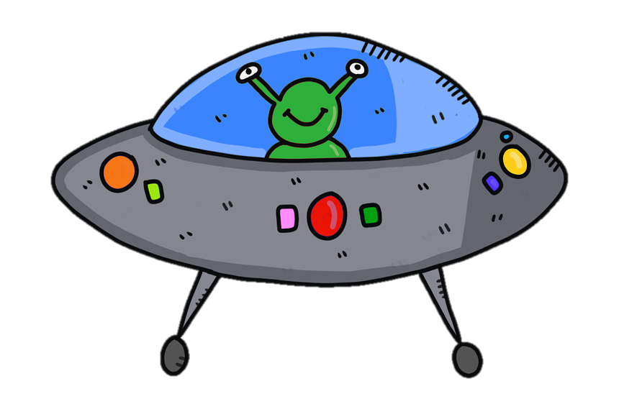
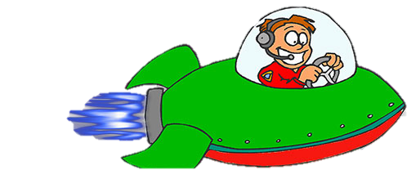
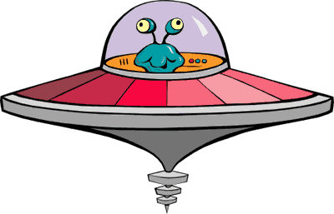
Debes escribir cada palabra en inglés. ¡Atención! Desaparecen rápido. Finalmente, debes decir las palabras de tu lista en español en el mismo orden.
el uso
resolver
leer / hablar
notar
animar
prestar atención
llover
el recurso
el vidrio
charlar
el bosque
el espectáculo
encender
Notes:
Timing: 3 minutes
Aim: to revisit 12 items of vocabulary in both receptive and productive modes of language use.
Procedure:
Students write 1-12 down the left hand side of their books.
Click on the screen once to trigger each animation.
Students write a list with each word that appears. They should translate the words on the screen into English (if it helps to give them time for reflection, they could also write the Spanish, too).
Check the answers to ensure that all students have the correct list of 12 words in English (see below).
Afterwards, students orally translate each English word on their list into Spanish, working with a partner (either taking turns or each trying to do all twelve). Partners can give each other feedback.
Note: the teacher can speed up the activity by clicking to end one word’s animation and begin the next. In this way s/he can adapt it to suit the class.
English words (in the order in which Spanish words appear on the slide):
to rain, raining
forest
to resolve, resolving
to encourage, to cheer up
glass
to chat, chatting
show (noun)
to pay attention
to note, noting
to turn on, turning on
resource
use (noun)

Slide 3
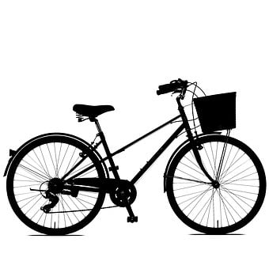
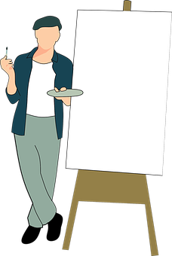
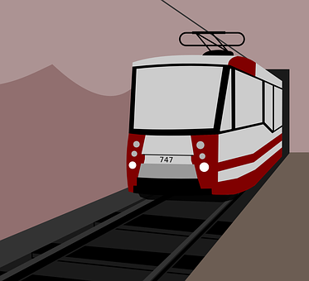
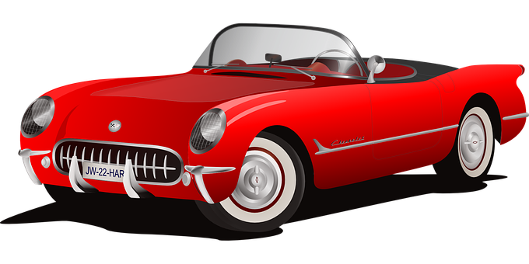
Vocabulario
leer
[artist]
[metro, underground train]
[transport]
[driver]
el conductor,
la conductora
el, la artista
el metro
el transporte
[shop assistant]
[nurse]
[owner]
[writer]
el enfermero,
la enfermera
el dueño, la dueña
el escritor,
la escritora
el, la dependiente
Notes:
Slide 1/3
Timing: 3 minutes (slides 3-5)
Aims: to introduce 8 new vocabulary items
Procedure:
Click to reveal each new Spanish word.
Encourage students to say the new word aloud, in chorus.
Click again to reveal its meaning.
Note: see slide 4 for practice in recognition of the new vocabulary and slide 5 for practice in recall.

Slide 4
¿Cuál es la palabra en español?
Vocabulario
leer
el metro
el, la dependiente
el escritor,
la escritora
el transporte
el dueño, la dueña
el conductor,
la conductora
el enfermero,
la enfermera
el, la artista
[metro,
underground train]
[transport]
[driver (m/f)]
[artist (m/f)]
[nurse (m/f)]
[shop assistant (m/f)]
[owner (m/f)]
[writer (m/f)]
Notes:
Slide 2/3
Aim: to recognise the meaning of each new vocabulary item.
Procedure:
Students look at the picture or read the word in English when it appears on the slide and say out loud the corresponding word in Spanish from the list.
Click to bring up the correct answer.
Note: this activity focuses on identification of vocabulary. The next activity requires students to recall the vocabulary themselves. Teachers might wish to use this slide as a lead in/recap ahead of the next slide.

Slide 5
¿Cómo se dice en español?
hablar
[metro,
underground train]
[artist (m/f)]
[transport]
[shop assistant (m/f)]
el/la artista
el metro
el transporte
el, la dependiente
?
?
?
?
[nurse (m/f)]
[owner (m/f)]
[writer (m/f)]
[driver (m/f)]
el enfermero,
la enfermera
el dueño, la dueña
el escritor,
la escritora
el conductor,
la conductora
?
?
?
?
Notes:
Slide 3/3
Timing: 2 minutes
Aim: to promote productive (oral) recall of the new vocabulary.
Procedure:
Elicit the Spanish for each English word and picture.
Students say the correct Spanish word.
Click on the beige box to reveal the answer.
Note: the boxes can be clicked in any order, giving students the flexibility to offer a response to a prompt of their choice.

Slide 6
Comparing traits SER in the present and imperfect
gramática
‘to be’
In Spanish, the verb ‘ser’ means _______. It is used to talk about traits.
‘soy’
To say, ‘I am’ for a trait, use ______.
Soy jugador de fútbol.
I am a football player.
This is the imperfect tense.
To say ‘I was’ or ‘I used to be’ for a trait, use ‘era’.
Antes era dependiente.
Before I was / used to be a shop assistant.
In English we say ‘a’ or ‘an’ before the job. In Spanish, ‘un’ and ‘una’ are only used if you are describing the job with an adjective (e.g. una artista famosa).
Notes:
Timing: 2 minutes
Aim: to recap the verb ‘soy’ and introduce the verb ‘era’.
Procedure:
Click to bring up each line of the explanation.
Encourage students to recall the word ‘soy’ and to offer translations of the examples.
Click to bring up the green callout. Highlight the cross-linguistic difference between Spanish and English article use. This has been covered once before in the SOW.

Slide 7
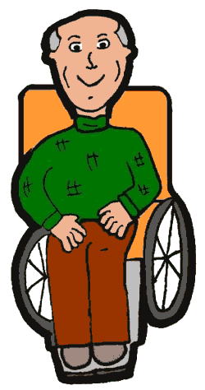
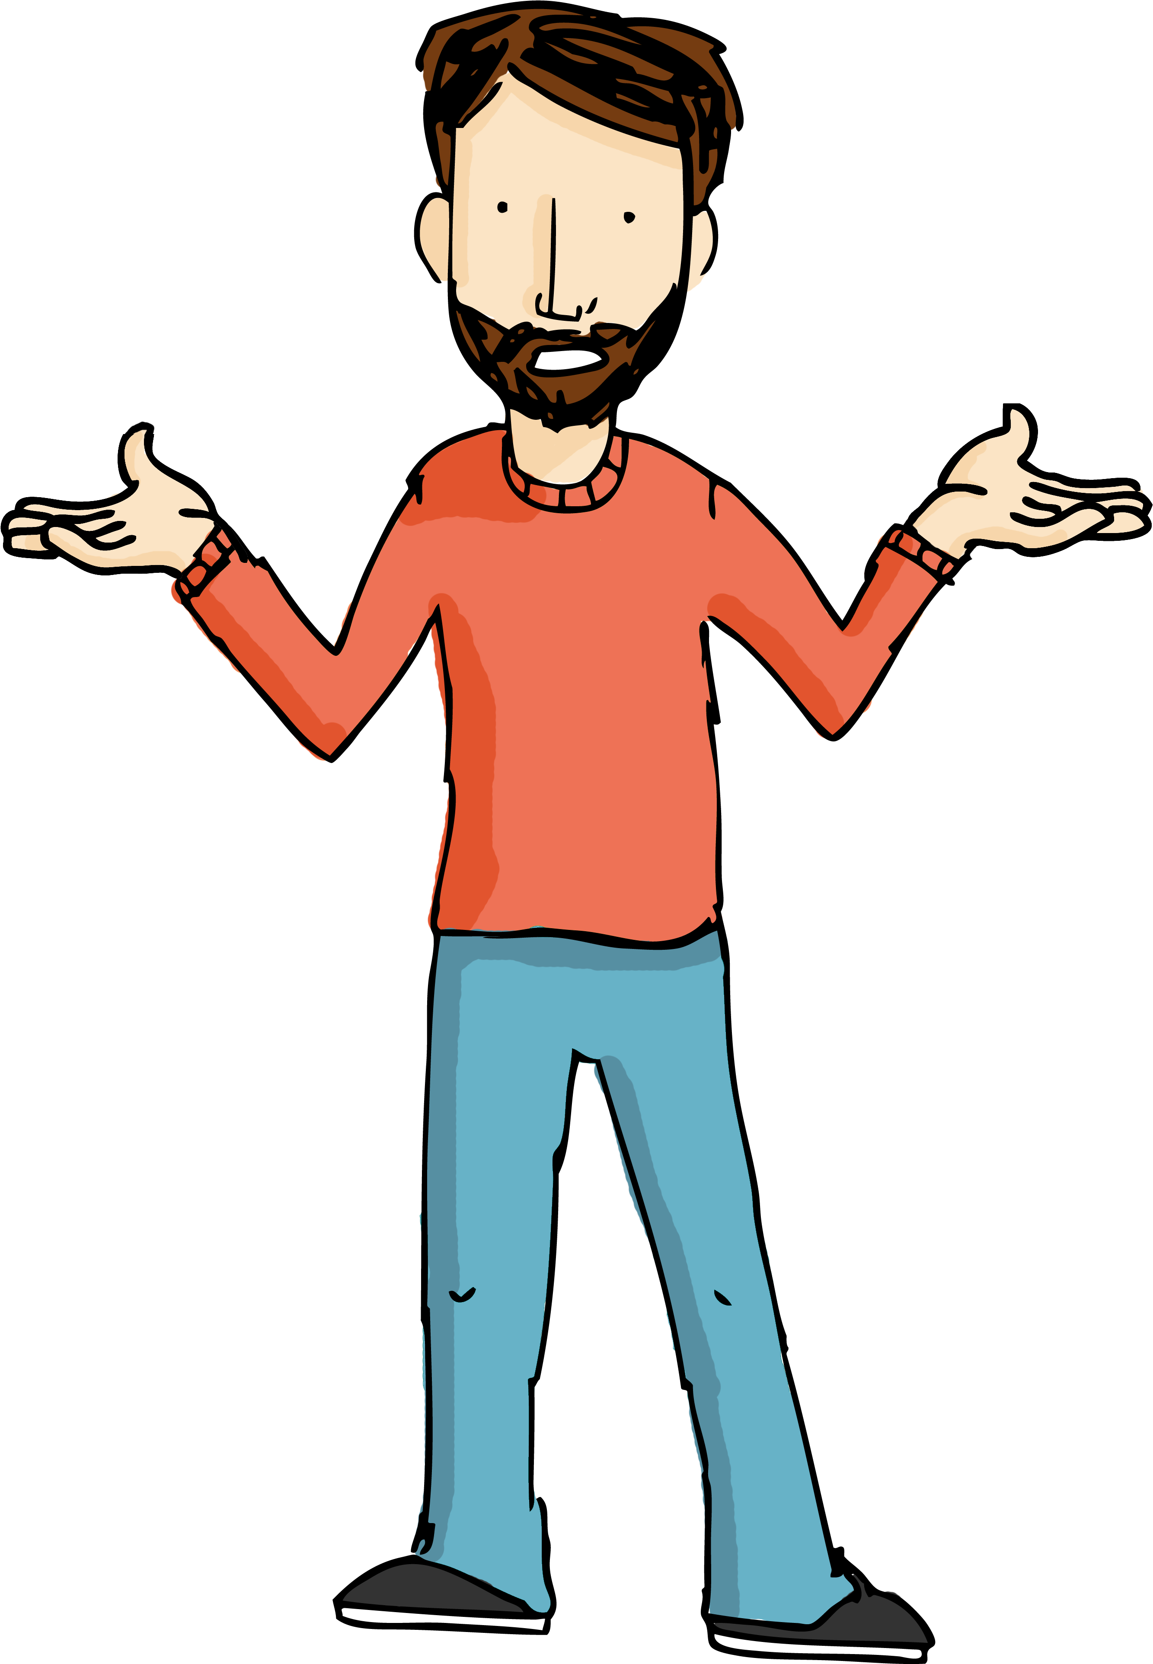
leer
Lee las frases. En cada frase una persona dice su trabajo.
Contesta las preguntas con el nombre de la persona correcta.
María
Rafa
Era conductor de metro.
Era periodista.
Asun
Soy enfermero.
Era dependiente.
Soy abogado.
Álvaro
Irene
Nerea
Era abogado.
Soy periodista.
Era enfermera.
Adrián
Carlos
Soy dependiente.
David
Who…
Soy conductora de metro.
Nerea
Alba
1) was / used to be a nurse?
4) is a shop assistant?
David
2) is a lawyer?
Álvaro
5) was / used to be a journalist?
María
3) was / used to be a metro driver?
Asun
Notes:
Timing: 6 minutes
Aims:
i) to practise comprehension of soy and era in reading.
ii) to understand a range of nouns for different job types.
Procedure:
Students write 1-5 in their books.
They read the questions and give the name of the corresponding person. Note that each job is mentioned by two different people. Students will need to pay attention to the use of ‘soy’ or ‘era’ to decide which person is the correct answer.
Click to reveal answers.
Elicit oral translations of each speech bubble.

Slide 8
Comparing traits SER in the present and imperfect
gramática
‘eres’
To say, ‘you are’ for a trait, use ______.
Eres escritor.
You are a writer (m).
Eres una jugadora famosa .
You are a famous player (f).
To ask ‘are you…?’ for a trait, you can simply change your intonation.
1
Eres periodista.
You are a journalist.
In English, we change the order of the subject and verb to ask a question.
2
¿Eres periodista?
Are you a journalist?
iAtención! Remember to add the ‘¿’ at the start of a question, too!
Notes:
Timing: 1 minute
Aim: to recap the verb ‘eres’ and the use of raised intonation to ask questions.
Procedure:
Click to bring up each line of the explanation.
Encourage students to recall the word ‘eres’ and to offer translations of the examples.
Highlight the difference in word order between English and Spanish.
Draw attention to Spanish punctuation for questions.

Slide 9
Hablamos del trabajo
leer / escuchar
Escucha unas preguntas sobre el trabajo.
Escucha y escribe la puntuación correcta.
Afirmación* → .
Pregunta → ¿?
B) Escribe la frase en inglés.
Eres una profesora simpática
1
¿ ?
Are you a nice teacher (f)?
2
Eres conductor de autobús
You are a bus driver (m).
.
¿ ?
Are you a hard-working lawyer (f)?
3
Eres una abogada trabajadora*
Eres un enfermero muy raro
You are a very strange nurse (m).
4
.
¿ ?
5
Eres periodista
Are you a journalist (m/f)?
You are a shop assistant (m/f) in a clothes shop.
Eres dependiente en una tienda de ropa
6
.
la afirmación = statement
trabajador(a) = hard-working
Notes:
Timing: 7 minutes
Aim:
i) to practise recognising question and statement intonation
ii) to practise using the correct punctuation (use of ¿ for questions)
iii) to demonstrate understanding of the sentences
Procedure:
In this activity students listen to the sentences and write the correct punctuation to complete the sentence.
Click on the number button to play the recording. If it is a statement, students need to add a full stop. If it is a question, they add the question marks.
Answers are shown by clicking.
Then, students translate the statements or questions into English. They can either write this or simply translate it orally. Again, the answers are shown by clicking.
Transcript:
¿Eres una profesora simpática?
Eres conductor de autobús.
¿Eres una abogada trabajadora?
Eres un enfermero muy raro.
¿Eres periodista?
Eres dependiente en una tienda de ropa.
Frequency of unknown words:
trabajador [>5000]; afirmación [2892]

Slide 10
Comparing traits SER in the present and imperfect
gramática
Some words in Spanish look and sound very similar, but have different meanings!
‘eres’
To say, ‘you are’ for a trait, use ______.
To say ‘you were’ or ‘you used to be’ for a trait, use ‘eras’.
Compare:
Antes eras artista.
Before you were / used to be an artist.
Ahora eres músico.
Now you are a musician.
Adverbs like ‘ahora’ (now) and ‘antes’ (before) can help us to know which verb we should use.
Notes:
Timing: 1 minute
Aim: to recap the verb ‘eres’ and introduce ‘eras’
Procedure:
Click to bring up each line of the explanation.
Encourage students to offer oral translations of the examples.
Click to bring up the green callout. Highlight how temporal adverbs can help us to know which verb form should be used.

Slide 11
Los estudiantes de un colegio tienen preguntas sobre el trabajo. Escucha. ¿La pregunta es en presente o pasado? También elige la letra de la respuesta probable* (A o B).
escuchar / leer
Are you…?
Were you…?
A
Sí. Cuidaba a los niños enfermos en un hospital.
B
Sí, pero quiero cambiar de trabajo. Trabajo muchas horas.
1
[nurse]
[nurse]
A
Sí. Llevo a los jóvenes al colegio.
B
Sí, y estaba bastante contenta.
2
[bus driver]
[bus driver]
A
Sí, pero no me gustaba el jefe.
B
Sí, y ime encanta!
3
[scientist]
[scientist]
4
A
B
Sí, trabajaba con compañeros geniales.
Sí, y me gusta. Siempre aprendo algo nuevo.
5
[shop assistant]
[shop assistant]
A
Sí, era mi propio jefe.
B
Sí, soy mi propio jefe.
*probable = likely
[business owner]
[business owner]
Notes:
Timing: 6 minutes
Aim:
i) to practise comprehension of eres and eras in listening
ii) to practise comprehension of present vs imperfect tense forms of –ar verbs in reading
iii) to understand the vocabulary in the sentences
Procedure:
Students write 1-5 in their books.
They listen and initially decide whether the question means ‘are you…?’ or ‘were you…?
Click to reveal the answer and give feedback. This should be done before moving on to step 4.
Click one more time to reveal two possible responses to the question in the audio. These appear as A and B.
Students read the two sentences and identify which response is most likely. To do this, they should
look to see if the question was asked in past or present (i.e. part 1 of the activity, which has already been checked)
look to see if the answer is in the present or imperfect. If the question was in the past, then they will need to identify the answer with a past tense ending (-aba). This has already been taught and practised in Year 9, so should be fresh in the memory.
6. Click to reveal the answer and elicit oral translations of the two responses.
7. Repeat steps 2-6 for all remaining question items.
Note: as there is not enough space on the slide, only the meaning ‘were you’ is included on the slide. ‘Eras’ can also be translated as ‘you used to be’.
Transcript:
1. ¿Eres enfermero?
2. ¿Eras conductora de autobús?
3. ¿Eras científico?
4. ¿Eres dependiente?
5. ¿Eras dueño de una empresa?
Frequency of unknown words:
probable [2154]

Slide 12
Un estudiante y su profesor hablan del trabajo. Lee y completa el texto.
leer
Profe, ¿te gusta tu trabajo? ¿Cómo es dar clases todos los días?
Bueno, a veces los días son largos y salgo del trabajo con sueño, pero me da satisfacción ayudar a los jóvenes a aprender idiomas. Además, yo aprendo cosas de mis propios (1) _____________!
estudiantes
eres
¿Y solo (2) _____________ profesor? ¿O haces otra cosa?
También (3) _______ (4) _______. La gente me pide dibujos de personas y animales. No gano mucho, pero el trabajo suele ser divertido. Ahora aprendo a hacer dibujos de paisajes.
soy
artista
iQué guay*! iYo quiero uno! ¿Y qué hacías antes?
era
Cuando (5) _______ más joven, trabajaba como
(6) _____________ de metro. Aunque la empresa me pagaba bien, pasaba muchas horas sin la luz del sol.
conductor
eras
¿No (7) _____________ muy feliz?
No. Quería hacer otra cosa, así que, un día, decidí estudiar una carrera para ser (8) _____________ de lenguas.
profesor
*Qué guay = that’s so cool!
Opciones:
soy | eres | era | eras | profesor | conductor | artista | estudiantes
Notes:
Timing: 8 minutes
Aim:
to correctly identify which gaps the words at the bottom fit into
to encourage students to make connections between temporal adverbs and the four forms of ser (soy, eres, era, eras)
Procedure:
Students write 1-8 in their books.
Ask students to look at the eight gaps at the bottom of the slide and decide which ones might fit in which gaps. To do this, they will need to look at the context around the gaps (e.g. to look at temporal adverbs or verb forms to identify whether the form of ser is present or imperfect).
Students listen and write what they hear in the five gaps.
When giving feedback, ask students about how these compared with their original answers. Did these also work in the context? Why (not)?
To check understanding of the text, the following comprehension questions could also be asked:
Why does the teacher enjoy his job? Answer: 1) he gets satisfaction from helping young people to learn languages and 2) he learns things from them
What is the teacher learning to do now?) Answer: to draw landscapes
What was the problem with working as a metro driver? Answer: he spent many hours without the sunlight – he wasn’t particularly happy
Note: in some contexts, ‘usted’ would be more appropriate for a student addressing a teacher, but the feature has not been covered yet in this scheme of work.
Frequency of unknown words/cognates:
satisfacción [2118]; guay [>5000]

Slide 13
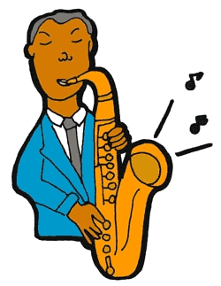
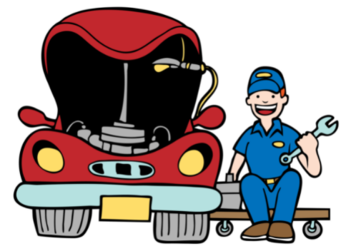
Lee las frases. ¿Qué significan?
leer / hablar
Ahora intenta pronunciar las palabras correctamente. Trabaja con un/a compañero/a.
When reading words aloud in Spanish, stress any syllable with a written accent.
Sometimes the stress will fall on the third-last syllable.
1
La científica pálida estudia los satélites en órbita.
1
2
Este médico también es músico. Sus espectáculos son magníficos*.
2
3
La fotógrafa* saca fotos de pájaros con una cámara fantástica.
3
4
El mecánico tiene un trabajo práctico y lo disfruta al máximo.
4
el/la fotógrafo/a = photographer
magnífico = magnificent
el/la mecánico/a = mechanic
Notes:
Timing: 3 minutes
Aim: to improve fluency of pronunciation in sentences that have words with antepenultimate stress position
Procedure:
1. First ask students to read the four sentences and discuss the meaning in pairs.
2. Check understanding by eliciting oral translations into English.
3. Click to reveal the instructions to the next part of the activity. Students will be reading sentences aloud and aiming to stress the words in the correct places. It may be helpful to remind them beforehand that a written accent indicates the part of the word that should be stressed (emphasised). The partner can give peer feedback on this.
4. Students to take turns to read the sentences aloud. The partner can give peer feedback on accuracy and fluency.
5. Click one more time to reveal the beige action buttons. Students can then listen to this to compare their own production with that of a native speaker.
Frequency of unknown words and cognates:
satélite [3555]; órbita [3963]; magnífico [2121]; fotógrafo [3683]; mecánico [>5000]; fantástico [2501]

Slide 14
hablar / escuchar
Hablamos del trabajo
Use your cards to
ask questions in the past and present.
choose the correct answer and say it in Spanish.
Your partner will also ask you. Take turns.
¿Eres científico/a?
Un ejemplo:
Sí, ies un trabajo genial!
Persona B (contesta):
Persona A (pregunta):
Ask your partner these questions.
Which question did you hear?
Was it ‘eres’ o ‘eras’?
Give the corresponding answer in Spanish.
Write down the answer in English.
1. Are you a scientist?
a) Are you... ? →
b) Were you...? →
Yes, it’s a great job!
Yes, it’s a great job.
Yes, but now I am a lawyer.
Notes:
Timing: 10 minutes
Aim:
to practise asking questions with ‘eres’ and ‘eras’
to practise understanding these two verb forms in listening
to consolidate a range of vocabulary
Procedure:
Person A reads aloud the question on their prompt card. This will either have to produce ‘eres’ or ‘eras’, depending on the prompt.
Student B listens and decides which of the two sentences they heard: a) or b)
Student B then says the corresponding answer in Spanish depending on which of the two sentences they heard. This part of the activity requires retrieval of language for oral production.
Student A listens and translates the sentence into English, noting it down on his/her card.

Slide 15
Persona A
Ask your partner these questions.
Which question did you hear?
Was it ‘eres’ o ‘eras’?
Give the corresponding answer in Spanish.
Write down the answer in English.
1. Are you an artist?
1a) Are you... ? →
1b) Were you...? →
Yes, I like it a lot.
No, I was a doctor.
2. Were you a journalist?
2a) Were you... ? →
2b) Are you...? →
Yes. I didn’t use to earn much.
No, I’m a lawyer.
3. Are you a metro driver?
3a) Are you... ? →
3b) Were you...? →
Yes, in a new company.
Yes, but I didn’t use to like my boss.
4. Were you a nurse?
4a) Were you... ? →
4b) Are you...? →
No, I used to be a bus driver.
Yes, I like studying the planet.
5. Are you a musician?
5a) Are you... ? →
5b) Were you...? →
Yes, I look after a lot of people.
Yes, I used to work near here.
Notes:
DO NOT DISPLAY DURING ACTIVITY
See accompanying Word doc for printable version.

Slide 16
Persona B
Ask your partner these questions.
Which question did you hear?
Was it ‘eres’ o ‘eras’?
Give the corresponding answer in Spanish.
Write down the answer in English.
1. Are you a shop assistant?
1a) Are you... ? →
1b) Were you...? →
Yes, I like painting.
No, but now I like to do drawings.
2. Were you a writer?
2a) Were you... ? →
2b) Are you...? →
Yes, I used to work for a newspaper.
Yes, but I want to change my job.
3. Are you a boss/manager?
3a) Are you... ? →
3b) Were you...? →
Yes, I work in Madrid.
No, I was a bus driver.
4. Are you a scientist?
4a) Were you... ? →
4b) Are you...? →
Yes, I used to love it.
No, it’s a difficult job.
5. Were you a doctor?
5a) Are you... ? →
5b) Were you...? →
Yes, it’s fun! I play the guitar every day.
Yes, but now I am a football player.
Notes:
DO NOT DISPLAY DURING ACTIVITY
See accompanying Word doc for printable version.

Slide 17
Persona A
Persona B
1. Are you an artist?
1. Are you a shop assistant?
Yes, I like painting.
(Sí, me gusta pintar.)
Yes, I like it a lot.
(Sí, me gusta mucho.)
2. Were you a journalist?
2. Were you a writer?
Yes, I used to work for a newspaper.
(Sí, trabajaba para un periódico.)
Yes, I didn’t use to earn much.
(Sí, no ganaba mucho.)
3. Are you a metro driver?
3. Are you a boss/manager?
Yes, I work in Madrid.
(Sí, trabajo en Madrid.)
Yes, in a new company.
(Sí, en una empresa nueva.)
4. Were you a nurse?
4. Are you a scientist?
Yes, I used to love it.
(Sí, me encantaba.)
Yes, I like studying the planet.
(Sí, me gusta estudiar el planeta.)
5. Are you a musician?
5. Were you a doctor?
Yes, it’s fun! I play the guitar every day.
(Sí, es divertido. Toco la guitarra todos los días.)
Yes, I used to work near here.
(Sí, trabajaba cerca de aquí.)
Notes:
ANSWERS – DISPLAY DURING FEEDBACK
Note: students weren’t expected to write down the Spanish shown here. It’s only included to support feedback.

Slide 18
Comparing society nowadays and in the past
SER for traits:
present tense - ‘es’
Imperfect tense - ‘era’
Y9 Spanish
Term 3.1 – Week 3 – Lesson 54
Author name(s): Nick Avery, Louise Caruso Artwork: Mark Davies
Date updated: 31/03/22
Notes:
Artwork by Mark Davies. All additional pictures selected are available under a Creative Commons license, no attribution required.
With thanks to Rachel Hawkes for her input on the lesson material and Amanda Izquierdo for native teacher feedback.
Learning outcomes (lesson 1):
Introduction of ‘era’ (now with meaning ‘s/he OR it was, used to be’).
Consolidation of ‘es’, ‘eres’, ‘eras’
Consolidation of prenominal adjectives
Word frequency (1 is the most frequent word in Spanish):
9.3.1.3 (introduce): era [ser-7]; eras [ser-7]; artista [817]; ciudadano [926]; ciudadana [926]; dueño [1239]; dueña [1239]; escritor [864]; escritora [864]; metro [798]; transporte [1400]; agradable [1997]; cierto [159]; común [742]; popular [798]; moderno [861]; normal [1000]; optimista [1025]; posible [427]; buen [bueno-103]; mal [mao-66]; gran [369]; único [213]
Note: words in bold above are introduced in lesson 2 of this sequence.
9.2.2.3 (revisit): animar [1630]; anunciar [785]; cerrar [521]; charlar [2968]; llover [2134]; notar [696]; atención [489]; prestar atención [atención-489]; regresar [573]; boda [2473]; espectáculo [1622]; golpe [746]; llegada [1604]; olor [1070]; sabor [2108]; enseguida [2866]; mundial [572]; en este momento [momento-121]; de repente [repente-1805]
9.2.1.5 (revisit): encender [1431]; morir [212]; producir [245]; prohibir [1641]; promover [1601]; proteger [1107]; resolver [867]; sobrevivir [1908]; bosque [1444]; consumo [1424]; efecto [309]; futuro [719]; medio ambiente [ambiente – 729]; planeta [1496]; plástico [1965]; recursos [1149]; situación [285]; uso [471]; vidrio [1905]; esencial [1872]; grave [901]; terrible [1246];
Source: Davies, M. & Davies, K. (2018). A frequency dictionary of Spanish: Core vocabulary for learners (2nd ed.). Routledge: London
The frequency rankings for words that occur in this PowerPoint which have been previously introduced in NCELP resources are given in the NCELP SOW and in the resources that first introduced and formally re-visited those words.
For any other words that occur incidentally in this PowerPoint, frequency rankings will be provided in the notes field wherever possible.

Slide 19
Vocabulario
hablar
3
¿Cómo se dice en español?
‘Volver’ is also possible!
Segundos
anunciar
cerrar
regresar
to announce,
announcing
to close, closing
to go back, going back
0
INICIO
Notes:
Vocabulario: whole class choral activity
Timing: 3 minutes Aim: to practise productive (oral) recall of three words within a given time. This is slide 1/7.
Procedure:
1. Say all three words before three seconds elapse.
2. Click to reveal answers.
3. Repeat if additional practice needed.

Slide 20
Vocabulario
hablar
3
¿Cómo se dice en español?
Segundos
la boda
el golpe
la llegada
wedding
hit, bang
arrival
0
INICIO
Notes:
Slide 2/7

Slide 21
Vocabulario
hablar
3
¿Cómo se dice en español?
Segundos
el olor
el sabor
enseguida
smell (noun)
taste (noun)
straightaway
0
INICIO
Notes:
Slide 3/7

Slide 22
Vocabulario
hablar
3
¿Cómo se dice en español?
Segundos
mundial
de repente
el medio ambiente
worldwide
all of a sudden
environment
0
INICIO
Notes:
Slide 4/7

Slide 23
Vocabulario
hablar
3
¿Cómo se dice en español?
Segundos
en este momento
la situación
el plástico
at the moment
situation
plastic
0
INICIO
Notes:
Slide 5/7

Slide 24
Vocabulario
hablar
3
¿Cómo se dice en español?
Segundos
producir
prohibir
promover
to produce, producing
to ban, to prohibit
to promote, promoting
0
INICIO
Notes:
Slide 6/7

Slide 25
Vocabulario
hablar
3
¿Cómo se dice en español?
Segundos
sobrevivir
el consumo
el efecto
to survive, surviving
consumption
effect
0
INICIO
Notes:
Slide 7/7

Slide 26
Vocabulario
iAtención! Many English words look the same (or similar) in Spanish, but have different pronunciation!
agradable
pleasant
popular
popular
cierto
certain, true
moderno
modern
Ejemplo:
Padre: Daniel, nunca ayudas en casa.
Daniel: iNo es cierto! Siempre lavo los platos.
normal
normal
optimista
optimistic
‘Optimista’ ends in –a. It does not matter whether the subject is masculine or feminine.
posible
possible
grave
serious
Notes:
Timing: 2 minutes
Aim: to introduce the seven remaining vocabulary items for this week
Procedure:
Click to reveal the Spanish word.
Click to reveal its English meaning.
Repeat for each vocabulary item.
A callout will appear highlighting how orthographic cognates may sometimes sound different. Use the words here to highlight this (popular, moderno, normal, posible), particularly in relation to stress position e.g. pop-u-LAR (Spanish, final syllable stress) vs POP-u-lar (English, third-last syllable). Elicit two more words here: ‘esencial’ and ‘terrible’ (as they also differ in terms of stress position and are revisited vocabulary items this week).
Note: the adjective ‘grave’ is from this week’s revisited sets and is included here for additional practice.
Animation sequences on this type of slide typically involve words appearing and disappearing. However, it was deemed that this practice would be slightly too easy, given that the words are mostly cognates.

Slide 27
Talking about what people are like SER in the present tense
gramática
era
To say ‘I was’ or ‘I used to be’ for a trait, use _______.
Era más optimista sobre el futuro del planeta.
I was / used to be more optimistic about the future of the planet.
eras
To say ‘you were’ or ‘you used to be’ for a trait, use ______.
Eras un poco raro.
You were / used to be a bit strange.
Be careful not to confuse ‘eras’ (‘you were’) with ‘eres’ (‘you are’).
To say ‘s/he or it was’ or ‘s/he or it used to be’ for a trait, use ‘era’.
Es cierto, era muy guapo.
It’s true, he was / used to be very good-looking.
Remember that ‘era’ can also mean ‘I was’ or ‘I used to be’.
Notes:
Timing: 1 minute
Aim:
to recap ‘ser’ in singular persons in the imperfect tense (era, eras).
to introduce a new meaning of ‘era’
Procedure:
1. Go through the grammar explanation with students, revealing each new sentence on a mouse click.

Slide 28
Referring to different genders Gender marking on adjectives
Remember, most Spanish adjectives need to agree with the gender of the subject that they describe. This is often marked by the last letter of the word.
masculine
Spanish adjectives ending in –o usually refer to a _____________ subject.
Ejemplo: Eres raro.
You are strange (m).
feminine
Spanish adjectives ending in –a usually refer to a _____________ subject.
Ejemplo: Eres alta.
You are tall (f).
Other Spanish adjectives do not change.
Ejemplos: Eres feliz. Eres interesante.
These could refer to a boy OR a girl!
Notes:
Timing: 1 minute
Aim: to recap adjectival gender agreement
Procedure:
1. Go through the grammar explanation with students, revealing each new sentence on a mouse click.

Slide 29
Lee cada frase y completa la tabla. El verbo, ¿qué significa? ¿El adjetivo describe una chica, un chico o puede ser chico / chica?
leer
 | ‘you are’ | ‘you were’ | ‘I was, s/he was’
1.
2.
3.
4.
5.
6.
7.
8.
1
5
Eras muy feliz.
Eras aburrida.
chico / chica
chica
2
6
Eres optimista.
Era agradable.
chico / chica
chico / chica
3
7
Era guapo.
Eres tonto.
chico
chico
4
8
Eres seria.
Eres alegre.
chica
chico / chica
Notes:
Timing: 7 minutes
Aim:
to differentiate between the meanings of three similar verbs (‘eres’, ‘era’ and ‘eras’) in reading
to consolidate gender agreement knowledge
Procedure:
Students write 1-8 in their books.
They read each sentence and write ‘you are’, ‘you were’ or ‘I was / she was’. Alternatively they copy the grid on the slide and complete it with ticks.
They also note down, for each item, whether the adjective refers to a boy (chico), girl (chica) or either (chico / chica).
Show the answers one by one. Elicit oral translations in English.

Slide 30
Describing things Prenominal adjectives
These are called prenominal adjectives.
gramática
Remember that in Spanish some adjectives can come before the noun.
same
last
first
second
third
own
mismo
último
primero
segundo
tercero
propio
Un ejemplo:
the last word
la última palabra
The adjective ‘único’ may either come before or after the noun.
This changes its meaning:
Eres una persona única.
You are a unique person.
Eres la única persona en mi vida.
You are the only person in my life.
These adjectives can be used straight after the personal ‘a’.
Describes a tu propio profesor =
you describe your own teacher
Ayudas a la misma persona =
you help the same person
Notes:
Timing: 2 minutes.
Aim: to recap prenominal adjectives and explain a new meaning of the word ‘único’.
Procedure:
Go through the grammar explanation with students, revealing each new sentence on a mouse click.
Elicit Spanish words and English meanings where appropriate.

Slide 31
Describing things Prenominal adjectives
gramática
As you know, most masculine adjectives end in –o.
However, some lose this ‘o’ before a singular masculine noun.
tercero
tercer
e.g. el tercer lugar
bueno
buen
e.g. un buen amigo
primero
primer
e.g. el primer mes del año
malo
mal
e.g. un mal olor
The adjective ‘grande’ shortens to ‘gran’ before any singular noun.
Look at how this changes this usual meaning:
Una caja grande
A big box
Una gran persona
A great, remarkable person
Notes:
Timing: 2 minutes.
Aim: to recap prenominal adjectives (as used for singular masculine nouns) and introduce the meaning of the word ‘gran’.
Procedure:
Go through the grammar explanation with students, revealing each new sentence on a mouse click.
Elicit Spanish words and English meanings where appropriate.

Slide 32
escuchar
Jorge Jesús habla con un amigo sobre la experiencia en el colegio.
Escucha. ¿Quién es? También completa la frase con un nombre y un adjetivo.
 | A | B
 | I was, s/he was | You were
 | I was, s/he was | You were
 | I was, s/he was | You were
 | I was, s/he was | You were
 | I was, s/he was | You were
 | I was, s/he was | You were
 | I was, s/he was | You were
 | I was, s/he was | You were
1
great
friend
a _________ __________.
2
only
person
the _________ __________ in class with Cuban roots.
3
student
a _________ _________.
popular
4
good
football
player
a _________ _________ _________.
5
boy
a _________ _________, especially with the girls.
nervous
first
classmate
6
the _________ ___________ to talk to new students.
a _________ ___________ sometimes.
7
bad
example
8
a _________ ___________, according to Sofía.
terrible
boyfriend
Notes:
Timing: 8 minutes
Aim:
to practise recognising and understanding ‘era’ and ‘eras’
to understand pairs of nouns and adjectives, both in prenominal and postnominal positions
Procedure:
Students write 1-8 in their books.
Click on the orange number trigger to play the audio.
The first time students listen, they focus on whether they hear ‘era’ or ‘eras’ and identify the correct meaning. They can simply write ‘A’ or ‘B’.
The teacher gives feedback on this.
The next time students listen, they listen and need to complete the sentence. They will either need to add a noun + adjective or adjective + noun.
Give feedback on step 5.
Transcript:
Eras un gran amigo.
Era la única persona en clase con raíces cubanas.
Eras un estudiante popular.
Eras un buen jugador de fútbol.
Era un chico nervioso, sobre todo con las chicas.
Eras el primer compañero en hablar con nuevos estudiantes.
Era un mal ejemplo a veces.
Eras un novio terrible, según Sofía.
Note: sobre todo will be introduced formally in 9.3.1.4.

Slide 33
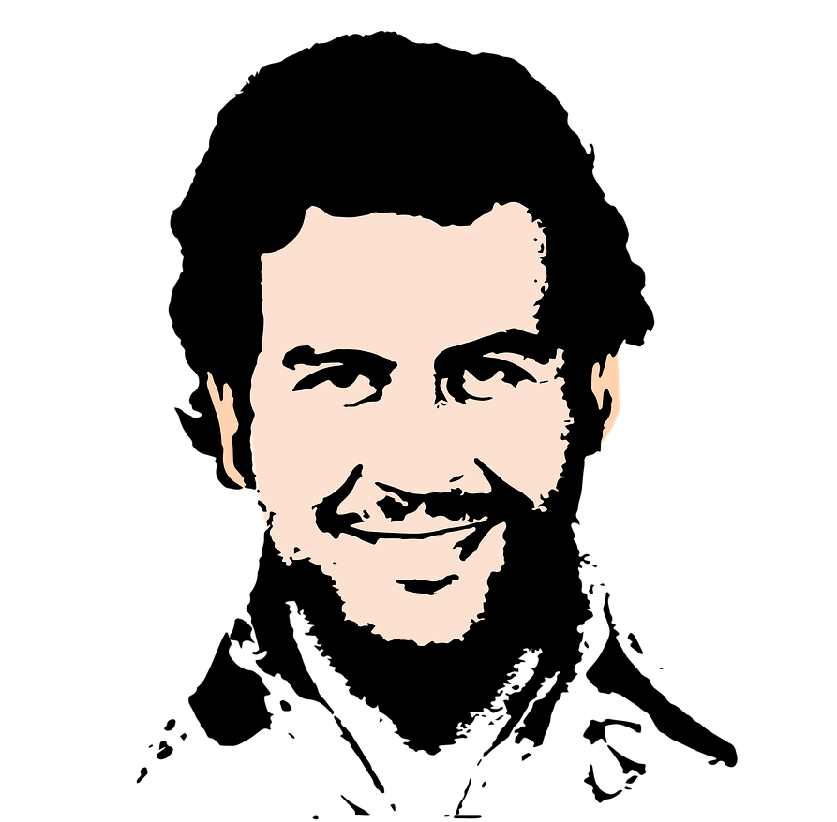
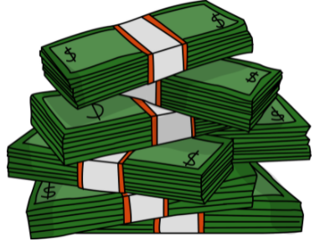
El pasado de Medellín
escuchar / escribir / leer
Escucha y completa el texto.
Medellín es una ciudad en Colombia que hace veinte años era muy peligrosa. Un grupo de criminales, el Cartel de Medellín, organizaba redes de narcotráfico* y prácticamente controlaba la ciudad. El narcotráfico era un muy _______ _________ (el Cartel ganaba hasta sesenta millones de dólares al día), así que era posible ganar mucho dinero en muy ________ _________. Sin embargo, era una ___________ _________ y el grupo usaba la violencia* muy a menudo. Mataba a policías en la calle y secuestraba* a ___________ _____________. A pesar de estas acciones, el jefe del cartel, Pablo Escobar, era una persona popular en los _________ _________. Él ayudaba a la población en lugares donde el gobierno no estaba. Por eso mucha gente de estas comunidades lo consideraba una _______ _________.
buen
negocio
poco
tiempo
actividad
ilegal
personas
importantes
barrios
pobres
gran
persona
*el narcotráfico = drug trafficking
*la violencia = violence
*secuestrar = to kidnap, kidnapping
Notes:
Timing: 10 minutes
Aims:
to learn about the past of a Spanish-speaking city
to accurately transcribe the missing words
to consolidate understanding of pre-nominal adjectives
to demonstrate understanding of key information in the text
Procedure:
Students write 1-6 down the left hand side of their books.
Explain to students that they will hear six pairs of missing words.
They listen to the text and write the missing pairs of words.
Check answers and give feedback. Elicit oral translations in English of the words in the gaps.
Ask students which pairs of words have an adjective before the noun (ANSWER: buen negocio, poco tiempo, gran persona).
Ask which pairs of words have an adjective after the noun (ANSWER: actividad illegal, personas importantes, barrios pobres).
To check comprehension of the text on this slide, the questions below could be asked. These could be written on the board by the teacher or distributed on a handout (word doc available with this resource). The answers can be checked orally in English afterwards, with reference to the Spanish text displayed on the board.
Comprehension questions:
Who was effectively in charge of Medellín twenty years ago? (The Cartel de Medellín)
How much could the Cartel de Medellín earn in a day? (Up to 60 million dollars)
What is said about violence? What examples are given? (The group used violence frequently. It killed police officers and kidnapped important people)
Why was Pablo Escobar considered to be a great person? (Because he helped the population in poor neighbourhoods where the government wasn’t present)
Notes: it is assumed that students will be able to understand ‘prácticamente’ given that the word ‘práctico’ has been taught, as well as the meaning of the affix –mente.
Based on the text length (142 words), 2% of the text is 2.6 words. In the new GCSE, a maximum of 2% of words in a text may be glossed. This is rounded up to the nearest single figure (3) here.
One additional cognate (dólar) is included as it has been used in previous phonics activities.
An additional way in which the text could be exploited would be to ask students to identify instances of ‘era’ and their meanings (e.g. ‘[it] was’ for the city, ‘[he] was’ for Escobar).
Image credits: Image retrieved from https://pixabay.com/es/illustrations/pablo-escobar-gr%c3%a1ficos-dise%c3%b1o-4439780/ (image free to use)
Sources and additional information:
Source of information regarding income: Pablo Escobar: The Life and Crimes of the Most Notorious Colombian Drug Lord By J.D. Rockefeller
Frequency of glossed words:
narcotráfico [3549]; secuestrar [>5000]; violencia [1100]
Frequency of cognates:
criminal [2884; controlar [994]; dólar [677]; ilegal [2912]

Slide 34
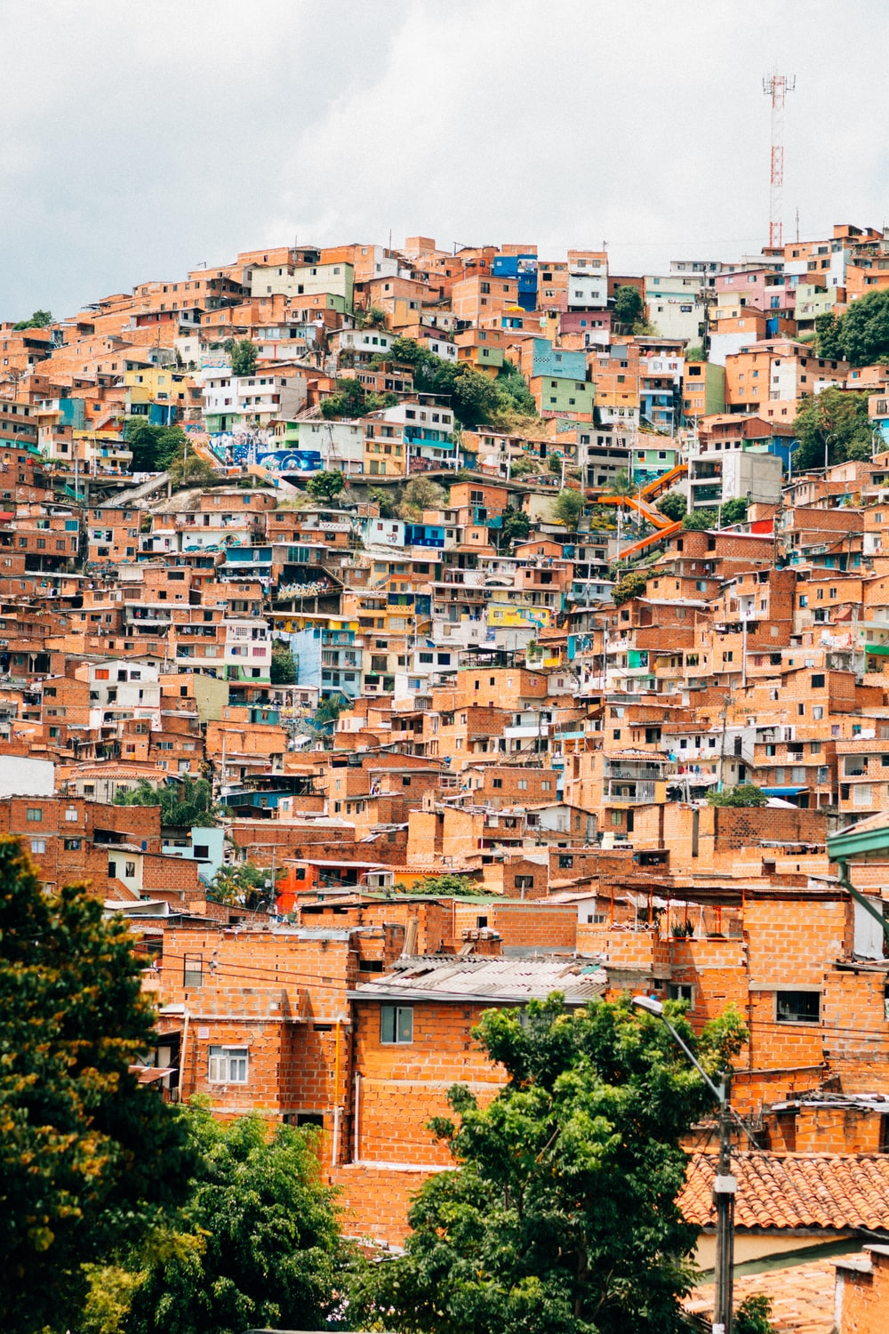
Hablamos sobre el pasado de Medellín en parejas.
leer / escuchar
Persona A: lee la frase.
Persona B: escucha y elige la opción correcta para completar la frase.
Luego, Persona A y Persona B escriben la frase en inglés.
Ejemplo:
Estudiante A
Estudiante B
1 | Es cierto, la vida en Medellín…
1 | era muy peligrosa.
It’s true, life in Medellín was / used to be very dangerous.
Notes:
Timing: 10 min
Aims:
to correctly match the sentence halves, working in pairs
to then accurately translate the sentences into English
to gain confidence in oral production
Procedure:
Students A and B are given their prompt cards.
The first time round, Student A reads the sentence starter aloud (e.g. Las montañas pueden…). Student B listens and then says the correct sentence ending (e.g. ser muy altas).
The students then work together to translate the sentence into Spanish.
Students repeat for the rest of items 1-5, then swap roles. This time, Student B will repeat the sentence starter and Student A will listen and complete it.
Note: Photo by Kobby Mendez on Unsplash (free to use)

Slide 35
Estudiante A
*el narcotráfico = drug trafficking
Estudiante A
*la cárcel = prison
a) quería mandar a Escobar a la cárcel* en Estados Unidos.
*la droga = drug
1. Medellín…
2. Trabajar en el narcotráfico*…
b) era un grupo que mandaba drogas* al extranjero.
3. Mucha gente de los barrios pobres…
c) era un país con muchos problemas.
4. El Cartel de Medellín…
d) era normal en Medellín en los años 80.
5. Poca gente…
e) viajaba mucho para proteger a su familia.
Era esencial.
Estudiante B
Estudiante B
a) pensaba que Escobar era un gran hombre.
6. Matar a policías…
b) era la única opción a veces.
7. Colombia…
c) vivía una vida tranquila.
8. El Cartel de Medellín…
d) era una organización criminal que ganaba mucho dinero.
9. Pablo Escobar…
e) era un buen lugar para el cartel.
10. El gobierno…
Notes:
DO NOT DISPLAY DURING ACTIVITY
Read aloud cards
Frequency of unknown words:
droga [1600]; cárcel [2043]; narcotráfico [3549]

Slide 36
Solución
[1/2]
1. Medellín era un buen lugar para el cartel.
Medellín was a good place for the cartel.
2. Trabajar en el narcotráfico era la única opción a veces.
Working in drug trafficking was the only option sometimes.
3. Mucha gente de los barrios pobres pensaba que Escobar era un gran hombre.
Many people from (the) poor neighbourhoods thought that Escobar was a great man.
4. El Cartel de Medellín era una organización criminal que ganaba mucho dinero.
The Medellín Cartel was a criminal organisation that used to earn a lot of money.
5. Poca gente vivía una vida tranquila.
Few / not many people used to live a calm life.

Slide 37
Solución
[2/2]
6. Matar a policías era normal en Medellín en los años 80.
Killing police officers was normal in the eighties.
7. Colombia era un país con muchos problemas.
Colombia was / used to be a country with a lot of problems.
8. El Cartel de Medellín era un grupo que mandaba drogas al extranjero.
The Medellín Cartel was a group that used to send drugs abroad.
9. Pablo Escobar viajaba mucho para proteger a su familia. Era esencial.
Pablo Escobar used to travel a lot to protect his family. It was essential.
10. El gobierno quería mandar a Escobar a la cárcel en Estados Unidos.
The government used to want to send Escobar to prison in the USA.

Slide 38
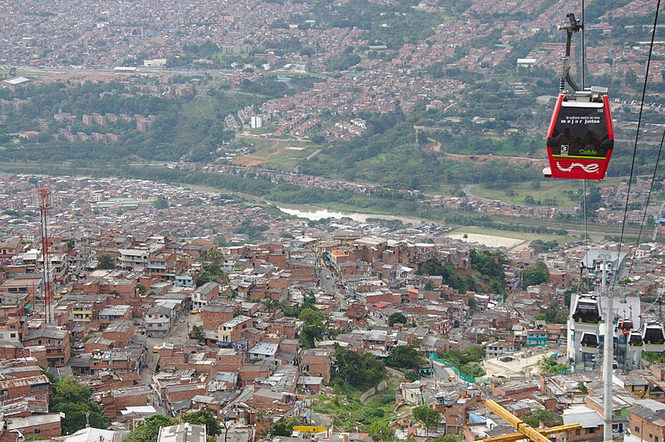
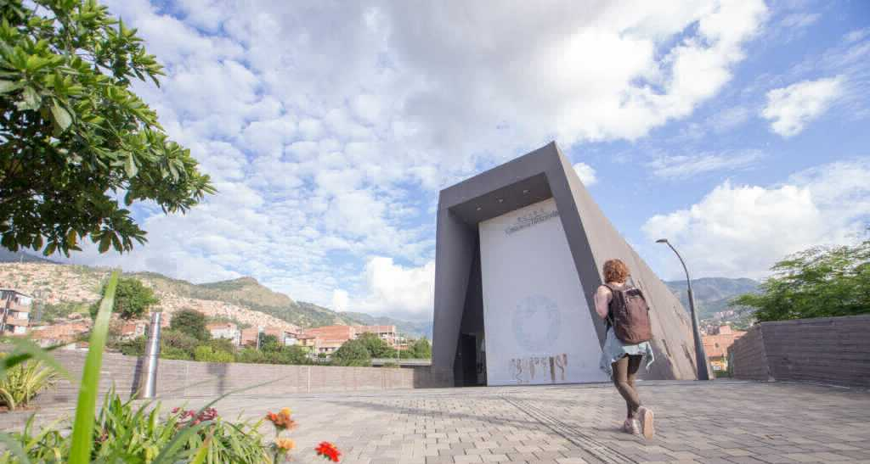
El Medellín de hoy
*la violencia = violence
leer
Escobar murió en el año 1993. Hoy en día Medellín es mucho más __________. En general la gente puede vivir tranquilamente. La zona urbana es bastante agradable, con museos, plazas y parques. Medellín es la ________ ciudad de Colombia que tiene su _________ metro y una red de “metrocables” (un tipo de transporte que conecta las partes altas de la ciudad con las partes bajas). En 2012, incluso ganó un premio a nivel ____________ por estos proyectos de transporte público.
Al _________ tiempo, la ciudad no olvida su pasado ________. En 2006 el gobierno abrió un museo, la “Casa de la Memoria”, para acordarse de la violencia y promover el diálogo. La idea: aprender del pasado para crear un futuro _______.
seguro
única
propio
El metrocable
mundial
mismo
oscuro
La Casa de la Memoria
mejor
Opciones:
propio | única | mundial | oscuro | seguro | mismo
Notes:
Timing: 8 minutes
Aims:
to learn about present day life in a Spanish-speaking city
to correctly identify the missing words in the gaps
to understand key information in the text
Procedure:
Ask students to read the text and identify which word should go in which gap.
Teachers may wish to challenge higher achieving students by not showing them the answer options initially.
Reveal each answer and give feedback. Check understanding of the text via oral translation of each sentence into English.
Notes: students may be interested to know that Escobar died in 1993 during a military attack by the Colombian armed forces. To give an indication of Escobar’s popularity, around 25,000 people attended his funeral (https://faroutmagazine.co.uk/how-pablo-escobar-became-symbol-of-resistance-popular-culture/).
Students were taught the spelling change o > u in the word ‘murió’ in Y9 T2 but it may be worth recapping this.
Frequency of unknown words:
tranquilamente [4526] (not glossed as students have learnt ‘tranquilo’ and the affix –mente); violencia [1100]; conectar [1973]
Images free to use from wikicommons and from the Museo Casa de la Memoria website.
https://commons.wikimedia.org/wiki/File:Metrocable_and_Comuna_1_in_Medell%C3%ADn_01.jpg
https://www.museocasadelamemoria.gov.co/en/elmuseo/acerca-de-nosotros/

Slide 39
Deberes
escribir
Ahora puedes escribir tu propio texto sobre una ciudad de España o Latinoamérica.
Quizás puedes intentar contestar unas preguntas:
¿Cómo era en el pasado?
¿Cómo es ahora?
¿Hay una persona famosa de allí? ¿Cómo es / era?
Describe diferentes aspectos de su historia.
Puedes usar diferentes adjetivos:
mismo
propio
mal
popular
moderno
agradable
optimista
buen
gran
único (‘only’)
normal
posible
único (‘unique’)
Notes:
OPTIONAL HOMEWORK
Aim: to produce the new and revisited features in writing about the past of another Spanish speaking country.
Procedure:
Go through all the prompts to ensure that each is understood.
Encourage students to write their own text about another Spanish-speaking city, comparing it in the past and present.

Slide 40
Deberes
Vocabulary Learning Homework (Y9, Term 3.1, Week 4)
Audio file
Audio file QR code:
Student worksheet
Quizlet link
In addition, revisit: Term 3.1 Week 1
Term 2.2 Week 1

Slide 41
hablar
optimista
o _ _ _ _ _ _
normal
n_ _ _ _ _
posible
p _ _ _ _ _ _
only (before noun), unique (after noun)
true, certain
possible
popular
normal
pleasant
modern
optimistic
moderno, moderna
ú _ _ _o, ú _ _ a
m _ _ _ _ _ o, m _ _ _ _ _ a
único, única
c_ _ _ _o, c_ _ _ _a
agradable
cierto, cierta
e _ _ _ _ _ o, e _ _ _ _ _ a
popular
p _ _ _ _ _
Notes:
OPTIONAL EXTRA VOCABULARY PRACTICE #1
Timing: 3 minutes (12 slides) Aim: to give students additional practice in productive oral recall of this lesson’s new words. Procedure: 1. Teacher elicits vocabulary orally from students, in response to the prompt (picture and word) in the centre.
2. Click for answer.

Slide 42
Vocabulario
Persona A: lee los titulares* de un periódico español: El País.
Persona B: completa las frases.
escuchar / escribir
1
Many efforts, one objective: the future of the _________.
Nadal, from ______ to _______.
5
hit
hit
planet
2
The bad quality of the _____________ causes 12.6 million deaths a year.
environment
6
War on _________.
plastic
7
3
St Petersburg celebrates its first royal ____________ in more than a century.
Being creative allowed ‘Homo sapiens’ to _____________.
wedding
survive
8
________________ it is almost impossible to distinguish flu from COVID.
4
The lost __________ of tomatoes.
At the moment
taste
*el titular = headline
Notes:
OPTIONAL EXTRA VOCABULARY PRACTICE #2
Timing: 6 minutes
Aims:
aural recognition and comprehension of revisited vocabulary in context.
accurate transcription of the vocabulary Procedure: 1. Hand out the printed speaking cards to student A only. These are available in a separate word doc.
2. Student B faces the board.
3. Student A reads the full headline on his/her cards aloud.
4. Student B writes the word s/he heard in the gap.
6. Click to reveal the translations.
7. Note that the activity includes unknown words. These are not glossed on this slide, as the English translation is provided, but they are on the next slide, where only the Spanish is given.
Transcript:
Muchos esfuerzos, un objetivo: el futuro del planeta.
La mala calidad del medio ambiente causa 12,6 millones de muertes al año.
San Petersburgo celebra su primera boda real en más de un siglo.
El sabor perdido de los tomates.
Nadal, de golpe a golpe.
Guerra al plástico.
Ser creative permitió sobrevivir al ‘homo sapiens’.
En este momento es casi imposible distinguir une gripe de la covid.
Note: before starting the activity, it may be worth checking understanding of ‘San Petersburgo’ and the term ‘Homo Sapiens’.
Source of sentences: https://elpais.com/
Picture source: Javier Micora on Flickr. Attribution 2.0 Generic (CC BY 2.0)
Retrieved from: https://www.journalism.co.uk/news/-editors13-why-el-pais-investing-at-a-time-of-crisis-/s2/a553149/
Words revisited in the sentences: planeta, medio ambiente, boda, sabor, golpe, plástico, sobrevivir, en este momento
Frequency of unknown words (glossed):
titular [2376]; objetivo [657]; distinguir [1412]; gripe [>5000]
Frequency of cognates (not glossed): causar [900]; real [444]; homo sapiens [N/A}; imposible [1418]; covid [N/A]
Source: Davies, M. & Davies, K. (2018). A frequency dictionary of Spanish: Core vocabulary for learners (2nd ed.). Routledge: London

Slide 43
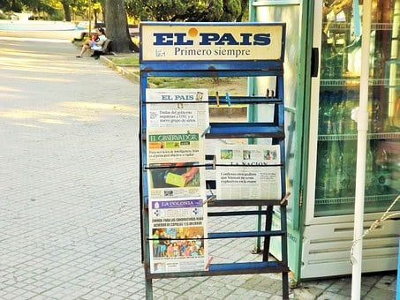
Persona A
leer
*distinguir = to distinguish, distinguishing
*el objetivo = objective
*la gripe = flu
1. Muchos esfuerzos, un objetivo: el futuro del planeta
*real = royal
2. La mala calidad del medio ambiente causa 12,6 millones de muertes al año
3. San Petersburgo celebra su primera boda real en más de un siglo
4. El sabor perdido de los tomates
5. Nadal, de golpe a golpe
6. Guerra al plástico
7. Ser creativo permitió sobrevivir al ‘Homo sapiens’
8. En este momento es casi imposible distinguir una gripe de la covid
Notes:
Person A speaking cards – DO NOT DISPLAY DURING ACTIVITY

