Slide 1
Session 5: Global nation,
global you

Slide 2
England, Half English
My mother was half English and I’m half English too
I’m a great big bundle of culture tied up in the red white and blue
I’m a fine example of your Essex man
And I’m well familiar with the Hindustan
Cos my neighbours are half English and I’m half English too
My breakfast was half English and so am I you know
I had a plate of Marmite soldiers washed down with a cappuccino
And I have a veggie curry about once a week
The next day I fry it up as bubble and squeak
Cos my appetite’s half English and I’m half English too
Billy Bragg
Notes:
Play them this verse of the song. Perhaps at this point just ask them to suggest what they think the message is. If prompting needed, you could ask – Which country is the song talking about? What are some of the characteristics of the singer’s life in the UK? Why do you think he says he is half-English?
Sorts of thoughts that may come out: mixture of cultures / multiculturalism in terms of nationality, family, people (neighbours), food and appetite. There’s a lot about food – perhaps draw this out a bit. Which foods are typically English in the song? Marmite / Bubble and Squeak Where does cappuccino originally come from? Italian word Where did curry originate? India How did the UK get curry?

Slide 3
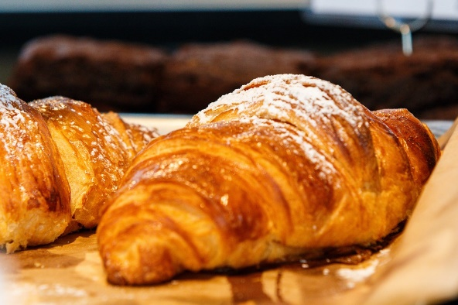
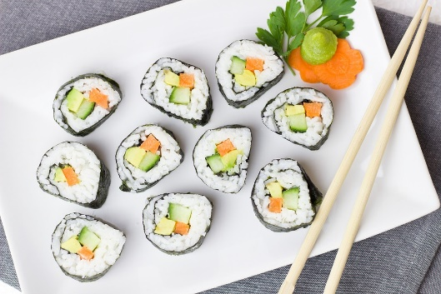
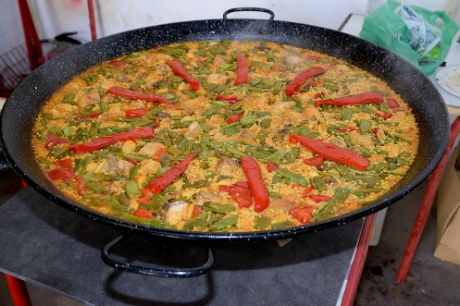
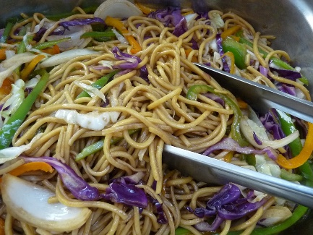
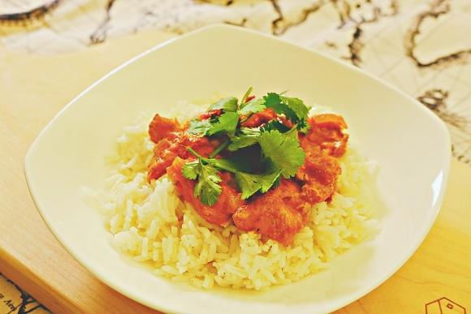
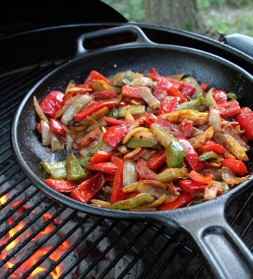
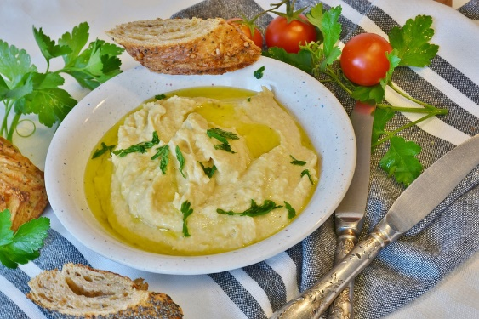
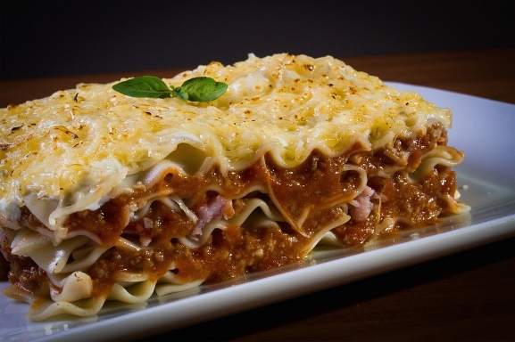
Some of our favourites…
croissant
sushi
paella
chow mein
tikka masala
hummus
fajitas
lasagne
Notes:
British food fusion – typical - foods from around the world Try to pronounce them as in the country of origin…
If needed, I’ve hyperlinked the pictures to google translate and you can click on the sound icon to hear the pronunciations. Some of the dishes have moved further away from the real pronunciation than others! And, of course, it does depend on the individual…
https://yougov.co.uk/topics/food/articles-reports/2019/03/12/italian-cuisine-worlds-most-popular All pictures from pixabay except: Tikka masala: https://en.wikipedia.org/wiki/British_cuisine#/media/File:Chicken_tikka_masala.jpg By Michael Hays - Flickr, CC BY 2.0, https://commons.wikimedia.org/w/index.php?curid=3031790

Slide 4
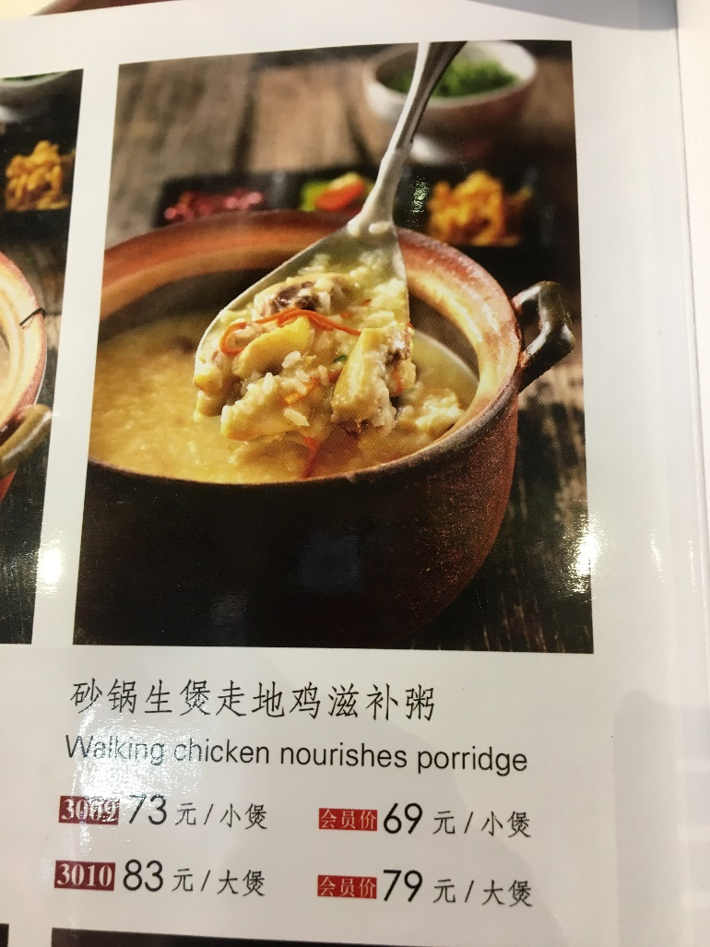
Explaining food is not that simple…!
Translation fail!
Notes:
Menu mistranslations These are some I saw in Beijing earlier this year!. There are many internet sites with lots of these (teachers need to sift carefully and choose with care) – they are not reproducible here for copyright reasons.

Slide 5
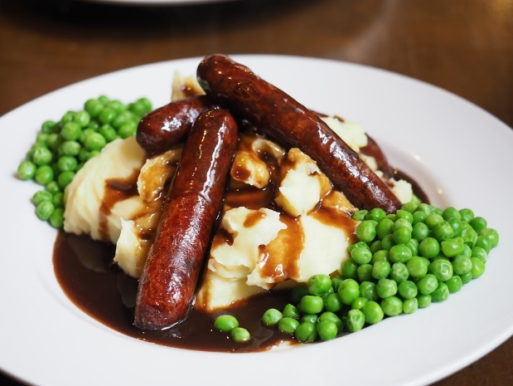
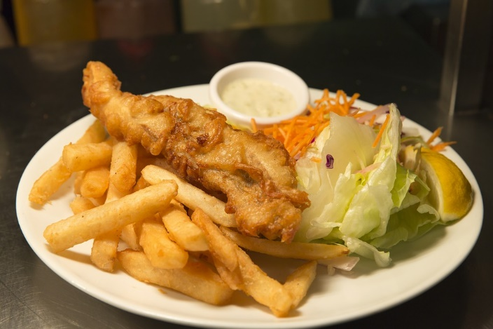
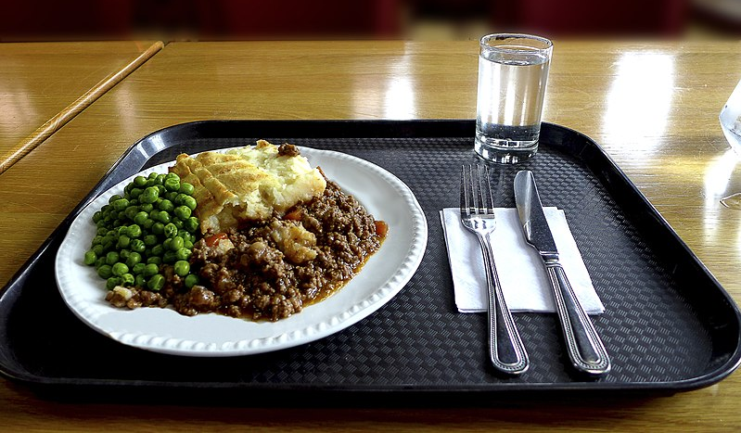
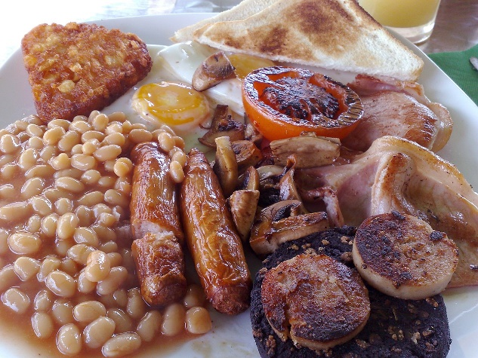
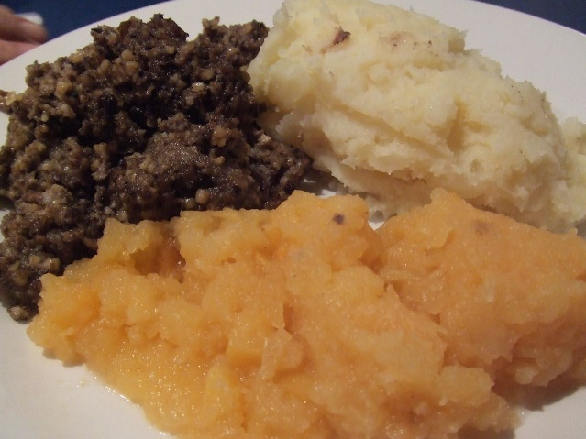
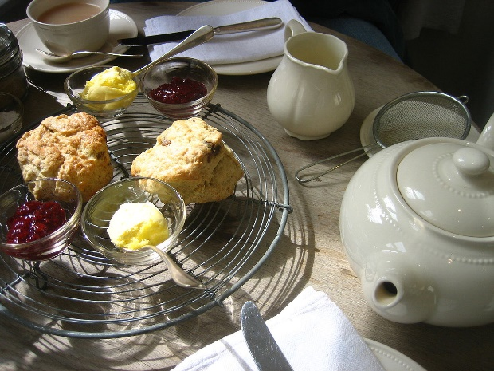
How could we describe these dishes to tourists? (in French, German, Spanish, etc…)
Notes:
Create descriptions for typical British Dishes (in TL) e.g. Cottage Pie, Ploughman’s, Yorkshire Pudding
This is a task that has been used for real as a piece of project work and local pubs have added these descriptions to versions of their menus to help tourists. [I hope to have examples to share – waiting for them to arrive in my in box!]
Bangers and mash: pixabay Shepherd’s pie: https://upload.wikimedia.org/wikipedia/commons/f/fd/Homerton_College_-_Shepherd%27s_pie.jpg Oxfordian Kissuth [CC BY-SA 3.0 (https://creativecommons.org/licenses/by-sa/3.0)]
Fish & Chips: https://en.wikipedia.org/wiki/British_cuisine#/media/File:Fish_and_chips_blackpool.jpg
By Matthias Meckel - Own work, CC BY-SA 4.0, https://commons.wikimedia.org/w/index.php?curid=74468548
Full English breakfast: https://en.wikipedia.org/wiki/British_cuisine#/media/File:Englishbreakfast.jpg By Jrv73 - Own work, Public Domain, https://commons.wikimedia.org/w/index.php?curid=4415475
Cream tea: https://en.wikipedia.org/wiki/British_cuisine#/media/File:Tea_and_scones_2.jpg
By Jeremy Keith from Brighton & Hove, United Kingdom - Tea and scones, CC BY 2.0, https://commons.wikimedia.org/w/index.php?curid=2217164
Haggis, neeps and tatties: https://en.wikipedia.org/wiki/British_cuisine#/media/File:Haggis_neeps_and_tatties.jpg By Biology Big Brother - originally posted to Flickr as Haggis, Neeps and Tatties!, CC BY 2.0, https://commons.wikimedia.org/w/index.php?curid=4517430
Christmas dinner: https://en.wikipedia.org/wiki/British_cuisine#/media/File:ChristmasDinnerScotland.jpg By Qualit-E at English Wikipedia - Transferred from en.wikipedia to Commons by Liftarn using CommonsHelper., Public Domain, https://commons.wikimedia.org/w/index.php?curid=11938349
https://en.wikipedia.org/wiki/British_cuisine

Slide 6
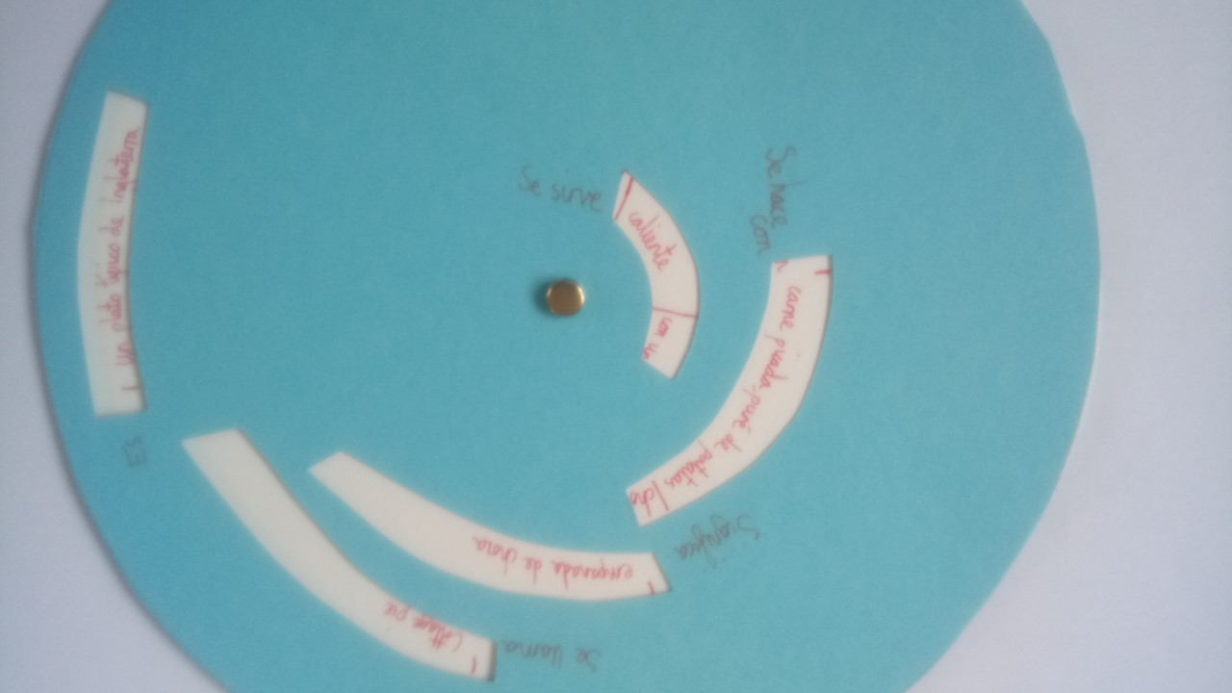
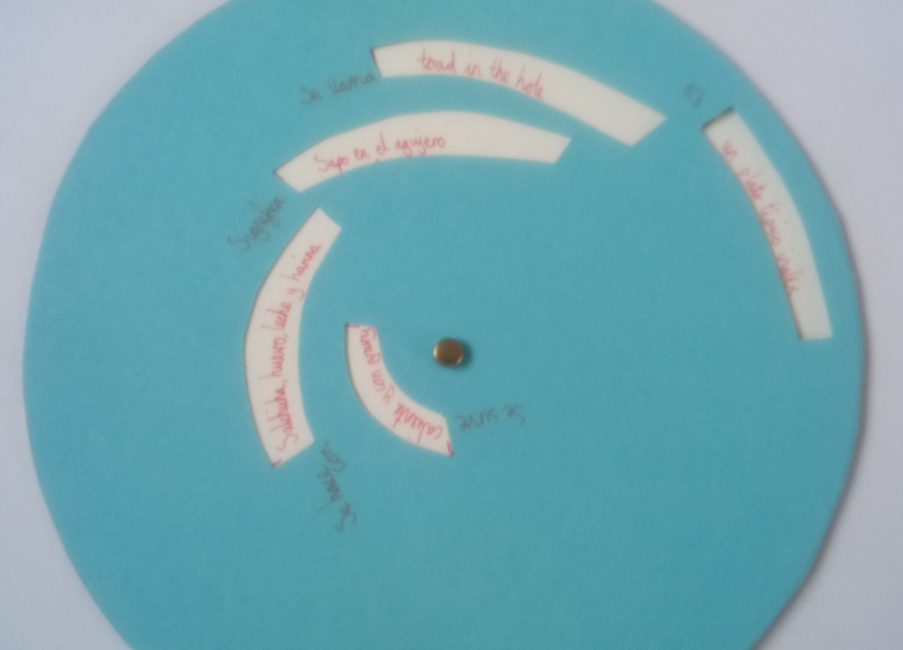
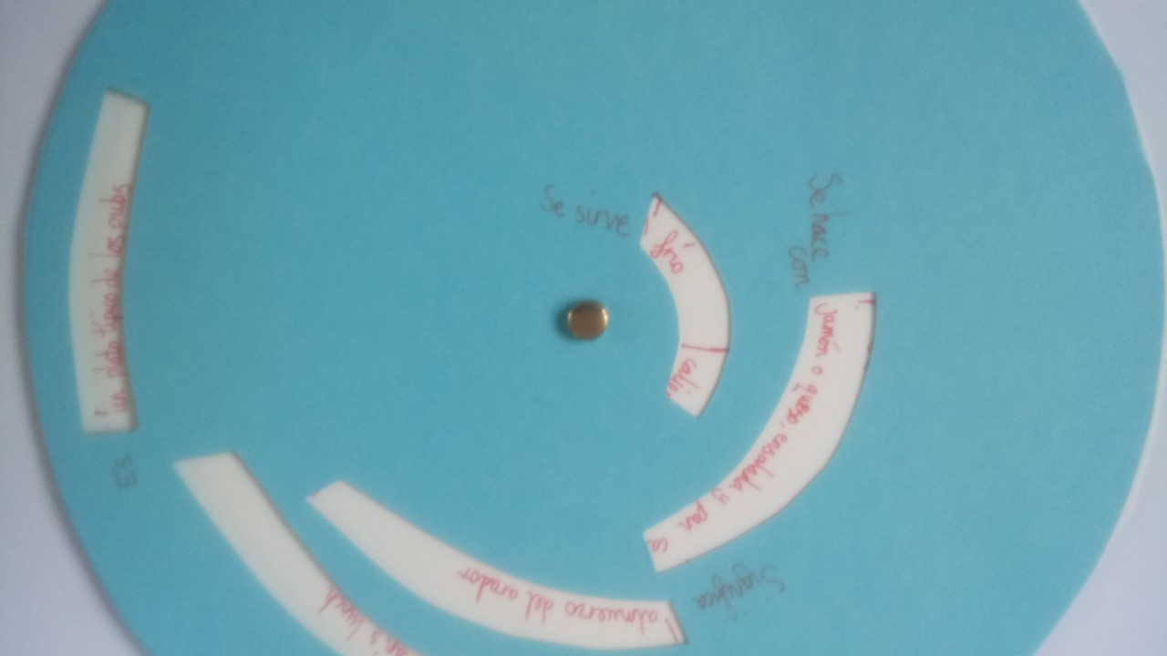
Examples of student menu wheels With thanks @Vincent Everett

Slide 7
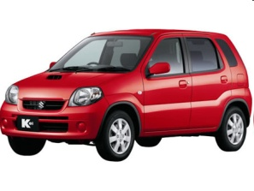
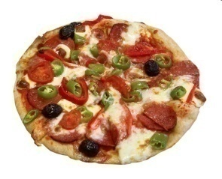
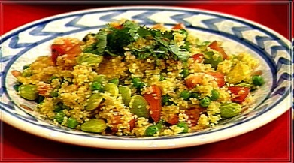
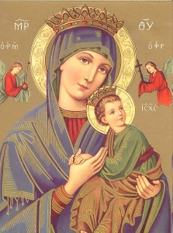
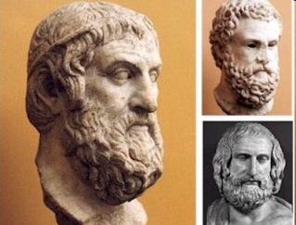
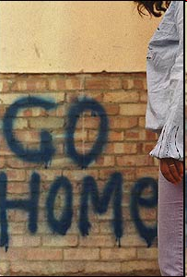
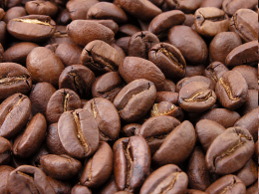
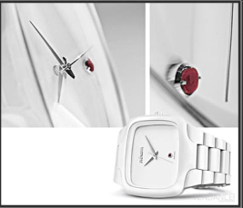
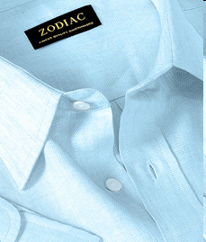
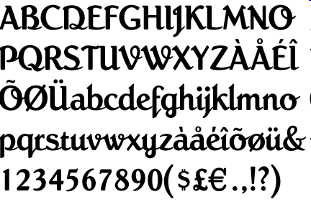
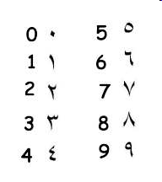
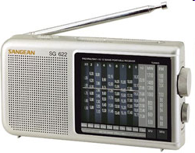
Tu Cristo es judío
Tu coche es japonés,
Tu pizza es italiana y tu couscous argelino
Tu democracia es griega
Tu café es brasileño,
Tu reloj es suízo, tu camisa es india
Y tu radio es coreana,
Tus vacaciones son turcas,tunecinas o marroquís
Tus números son árabes, tu escritura es latina
Y… tu reprochas a tu vecino el ser extranjero.
Notes:
Optional text [French version on next slide, it would also be possible to translation into German]
Read this poem out to the class clearly and slowly, clicking to bring the pictures on individually to support understanding of each line.
Worth perhaps eliciting what the Billy Bragg and this poem have in common? It would work to do an oral translation of the poem with a whole group OR to work more intensively on it, with more time.

Slide 8
Ton Christ est Juif
Ta voiture est japonaise
Ta pizza est italienne
Ton couscous est algérien
Ta démocratie est grecque
Ton café est brésilien
Ta montre est suisse, ta chemise est indienne
Ta radio est coréenne, tes vacances sont tunisiennes
Tes chiffres sont arabes, ton écriture est latine
Et tu reproches à ton voisin d'être étranger
Notes:
Optional text [French version, it would also be possible to translation into German]
Read this poem out to the class clearly and slowly, clicking to bring the pictures on individually to support understanding of each line.
Worth perhaps eliciting what the Billy Bragg and this poem have in common? It would work to do an oral translation of the poem with a whole group OR to work more intensively on it, with more time.

Slide 9
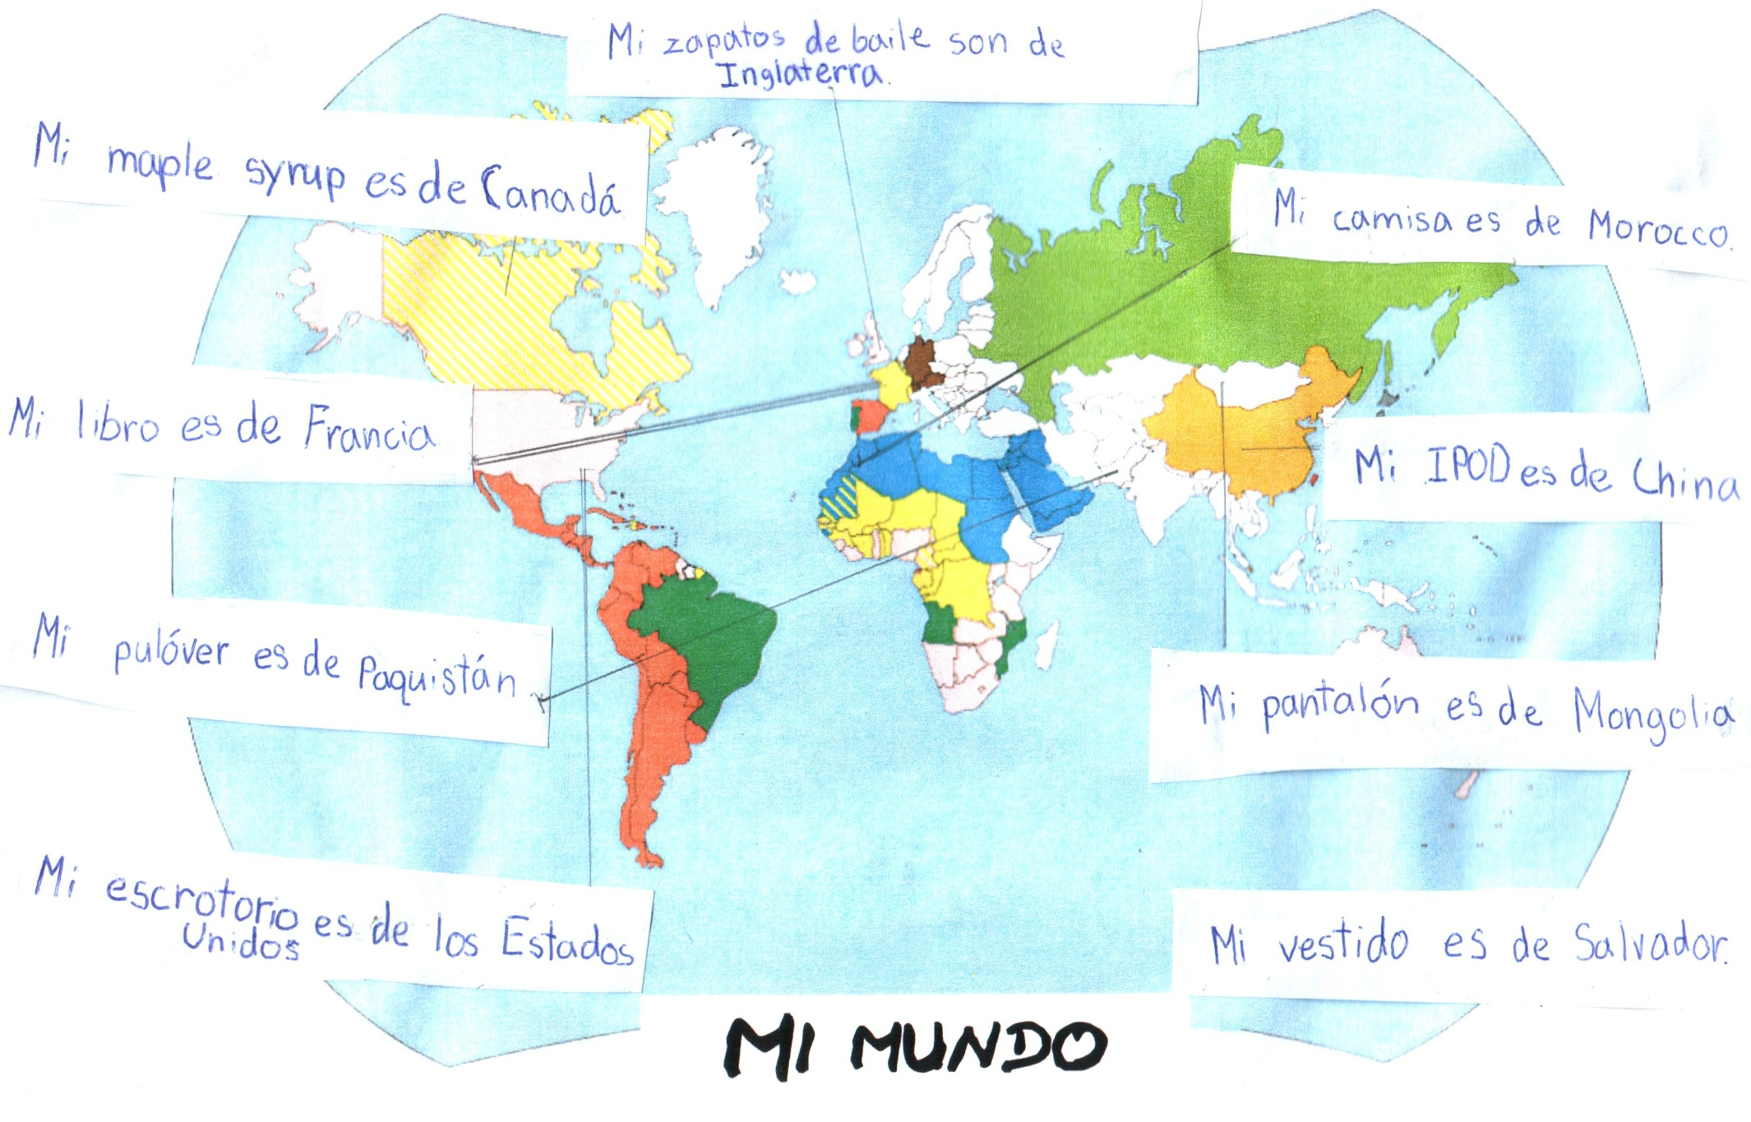
Notes:
Activity – Global you Charting the origin of your favourite possessions (do this in the target language students are studying) ‘My shoes are from Vietnam – where’s Vietnam?!’

Slide 10
Session 5: Global nation – global you | Resource | Attribution
Multiculturalism in the UK →British food fusion | Slide 2 ‘England, half English’ Billy Bragg song lyrics
Typical foods from around the world that are favourites in the UK | Slide 3 8 foods to pronounce
Menu mistranslations | Slide 4 Explaining food dishes to visitors is not that simple!
Create descriptions for typical British Dishes (in TL)⁶ e.g. Cottage Pie, Ploughman’s, Yorkshire Pudding | Slide 5 6 different dishes to choose from. | ⁶Idea and resources from Vincent Everett
Poem | Slides 6 & 7 Ton Christ est juif / Tu Cristo es judío Additional reinforcement of the idea that we are all interlinked- we exchange (often without thinking) food, drink, clothes, writing, number systems, religion and come to make those things an indispensable part of our lives – we are international beings.
Activity – Global you Charting the origin of your favourite possessions (do this in the target language) | Slide 8 ‘My shoes are from Vietnam – where’s Vietnam?!’
Notes:
Overview of content: Session 5 – Global you Unless otherwise attributed, all ideas contributed by Rachel Hawkes.

