Slide 1
Session 3: Perspectives: seeing the world differently

Slide 2
Perspectives: seeing the world differently
“A new language is a new life.”
- Persian proverb
Notes:
Why might people think this? People often say that they feel like they can be a different person when they speak another language. In what way might this be true? Does language affect how we understand the world?

Slide 3
Empathy… makes you a more successful language learner.
Perspectives: seeing the world differently
Research has shown that if you are empathetic you are more able to develop accurate pronunciation in the language(s) you learn (Guiora et al., 1972).
Empathy is the capacity to understand or feel what another person is experiencing from their perspective, that is, the capacity to place oneself in another's position.
Some people suggest that it might also work the other way around, i.e., by learning a foreign language you might become more empathetic (but there is no strong evidence for this, yet…)
Notes:
Include the research on empathy

Slide 4
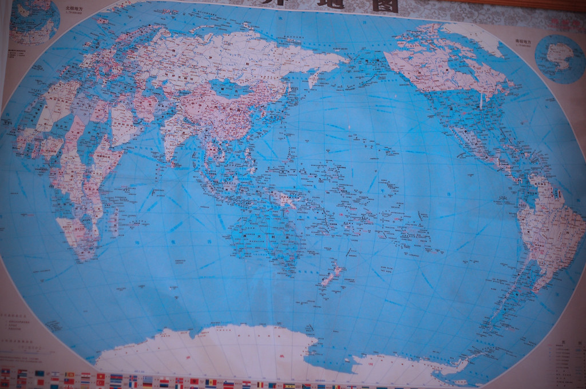
One suggestion is that learning a language gives you different perspectives…
Perspectives: seeing the world differently
This world map is from a classroom wall. Where?
China (Zhong Guo) is made up of the characters for middle (中) and country (国)
Chinese people believed their empire to be in the middle of the earth.
There is not just one world map – different countries choose different projections
We are more used to looking at one with the UK at the centre!
CC BY 2.0 https://www.flickr.com/photos/timquijano/4912508598/
Notes:
Global Perspectives –
maps with different countries in the centre https://www.flickr.com/photos/timquijano/4912508598/
“CHINA” (ZHONG GUO) IS made up of the Chinese characters for middle (中) and country (国). Dating back to around 1000 BCE, inhabitants of what is now China believed their empire to be the Middle Kingdom, as in, at the middle of all of Earth. Indeed, that sentiment prevailed to some extent right up until the past few decades, and some would argue that the Chinese government still teaches its children that China is the center of the world. At leasts, its maps suggest as much.
Note: You can hardly see Britain!

Slide 5
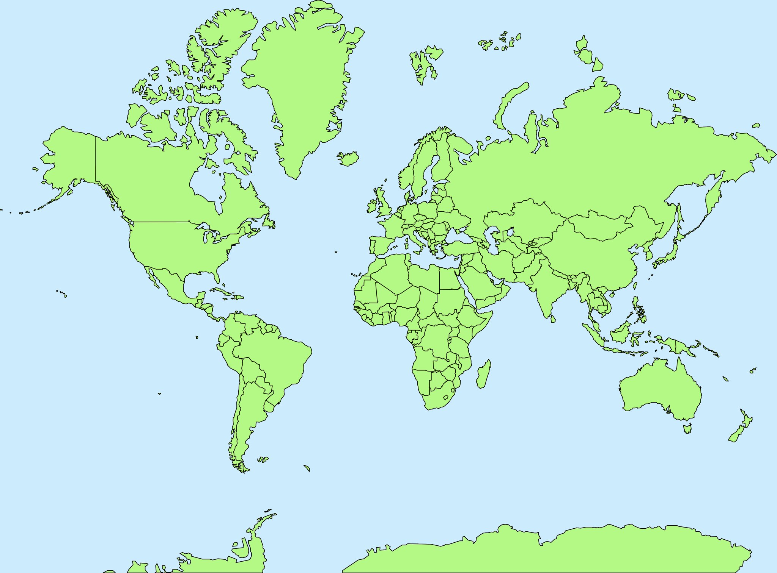
Perspectives: seeing the world differently
Mercator projection
Greenland looks as big as Africa (but Africa is 14 x bigger)
Greenland is the same size as Mexico
Alaska looks bigger than Brazil (but is 1/5 the size)
CC BY 2.0 https://www.flickr.com/photos/107442568@N08/12547327134
Notes:
Like this one! This is the version we are most used to seeing in the west – the one with Europe at the centre. There were good reasons for drawing the map like this (a long time ago – its purpose was for sea navigation) but there are some issues with the perspectives it gives us. For example, it’s hard NOT to think of Greenland as quite a big country, using this map!

Slide 6
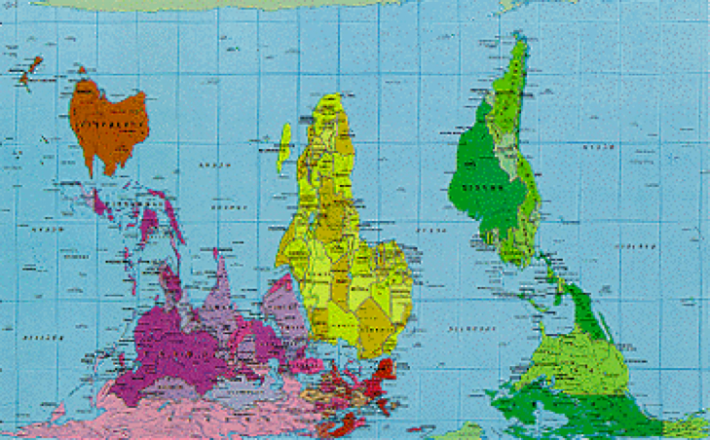
Perspectives: seeing the world differently
Peters projection
now used in a lot of schools
this version is inverted so that the South Pole is at the top
it looks weird (to us) but it’s no less valid!
CC BY 2.0 https://www.flickr.com/photos/adwentures/1481635874
Notes:
This is the Peters Projection, but upside down. There’s no reason that we should have our maps with the north pole at the top!
The Arno Peters Projection is recent, from 1973, but inspired by the Gall Projection from the 19th century.
Some say that because Arno Peters worked at a time when worldwide decolonization was coming to an end, he tried to reset the cartographic representation of the world by taking away the importance of the western world in the maps designed so far according to Mercator Projection. The result was extreme and overcompensated the significance of the southern hemisphere.
Maps based on the Peters Projection are widely used in English-speaking schools and by UNESCO.
https://www.joaoleitao.com/geography/different-world-map-projections/

Slide 7
Is it universal, cultural or personal?
Perspectives: seeing the world differently
1. Believing that snakes are bad.
2. Feeling that football is better than reading books.
3. Thinking it’s right to give a tip in restaurants.
4. Eating and drinking regularly.
5. Loving jeans.
6. Old people are wise.
Notes:
Different views of different things – e.g. snakes (how different cultures see them) Seeing own views in a different light – re-framing what we take for granted in a fresher, more objective way.
CULTURAL. Snakes in Christianity-based cultures are associated with evil. In some other cultures they represent fertility and rebirth.
Ancient Chinese thought that the snake could prolong life, and considered it to be a symbol of good luck, great harvest, and reproduction. It is one of the 12 animals in the Chinese Zodiac. https://en.wikipedia.org/wiki/Serpent_(symbolism) http://en.people.cn/90782/8136321.html 2. PERSONAL. 3. CULTURAL – In some countries, if you tip it will be considered an insult (Japan, South Korea, Iceland). In some countries, it will confuse people and could cause embarassment. This may happen in Peru, Bolivia, Spain, Kazakhstan, Mongolia and Thailand. In others, it is not expected, so not necessary – people might react positively - That's how it goes in China, Iran, Finland, Norway, Denmark, the Netherlands, Belgium, Switzerland, Croatia, Macedonia, Brazil and Paraguay. More details here: https://bigthink.com/strange-maps/in-which-countries-should-you-tip-and-how-much
4. UNIVERSAL HUMAN NEED 5. PERSONAL - http://answers.google.com/answers/threadview/id/24342.html
6. CULTURAL – Eastern cultures tend to believe this more strongly, Western cultures tend to value the cult of youthfulness. https://www.huffpost.com/entry/what-other-cultures-can-teach_n_4834228?guccounter=1&guce_referrer=aHR0cHM6Ly93d3cuZ29vZ2xlLmNvbS8&guce_referrer_sig=AQAAAGyH8i0Oe8DxI8pMiKiSfcucsAoSL6rkCuj6g5Dtr_amPdGo0O765nN1FVNlO3a-6kVoMl-dVMZxlGMi7d72XEPGMNWnq8wCgKxhTQ_qyTXQT3LREcDtfdz8ToteWBHo5V_6oDOIGIUCRzDxRNKs6d-90V24rpmcwckybSJgKvJS
More phrases: 1. Celebrating a wedding. UNIVERSAL 2. Loving spicy food. CULTURAL/PERSONAL 3. Fearing death. CULTURAL 4. Running away from attacking animals. UNIVERSAL 5. Queuing in a public toilet / Waiting your turn in general is right. CULTURAL

Slide 8
Perspectives: seeing the world differently
Festivals
Literature
Food
Religious rituals
Paintings
Facial expressions
Gestures
Music
Styles of dress
Eating habits
Understanding the natural world
Religious beliefs
Childraising beliefs
Attitudes to animals
Work ethic
Concept of fairness
Importance of time
Notion of modesty
Nature of friendship
Rules of social etiquette
Concept of beauty
Concept of personal space
Values
Concept of self
General world view
Religious beliefs
The iceberg concept of culture
Notes:
When you learn a language, you begin to learn about the culture, too.
Although there is surface and deeper culture, (and often we start by learning about the surface culture), the two are related. One is often the underlying rationale for the other.
One idea is that exposing learners to the things they can perceive, the surface culture in a very real and sensitive way, will pave the way for a better understanding of the belief systems that underpin them.
This is an encouragement to students to take every opportunity to find out about other countries’ cultures and see this as a related part of their language learning.
http://www2.pacific.edu/sis/culture/File/sec1-1-1h1.htm
http://globalcompetency.wikispaces.com/file/view/iceberg2Culture.gif/121647553/iceberg2Culture.gif

Slide 9
Perspectives: seeing the world differently
Some suggest that learning a language makes you a more effective communicator in English…
In today’s complex and globalising
world, well-trained, multilingual and
culturally sophisticated teachers are
needed to teach learners of English. ...
It is time for those involved in the ELT
profession to resist the employment of
untrained native speaker teachers.
Why?
you may have more understanding for the difficulties
you may be a more attentive listener
you may be used to puzzling out meaning when not every word is clear
you may simplify your English, avoiding slang, idioms
Andy Kirkpatrick, Professor at Hong Kong Institute of Education (in English Next, Graddol (2006, p.121)
Notes:
It is worth explaining a little bit about the background, here. 1. Countries have been so keen to learn English that English Language Teaching abroad has become a massive industry “The English language teaching sector directly earns nearly £1.3 billion for the UK in invisible exports and our other education related exports earn up to £10 billion a year more.” (Graddol, 2006). 2. Many English-native speakers, often also students on a gap year before uni or a year abroad after uni have found it very easy to get work teaching English to foreign students abroad. But over time just being a ‘native speaker of English’ is becoming viewed as not enough for successful teaching. Teachers who are ‘multilingual’ are seen as better able to teach their own language, English. Why? 1. Perhaps because those who have learnt another language understand the processes better from the perspective of those learning – they can empathise which what those learners find difficult. 2. Perhaps because they are more attentive listeners, better able to infer what learners are trying to say
3. You may be used to not understanding every word, and not letting it faze you – you have strategies to puzzle out meanings
4. Perhaps because you simplify their own speech, carefully avoiding language that they sense might confuse beginner learners (e.g. slang, idioms) – as a language learner you develop a sense for what might confuse people and you can use strategies to make the meanings clear.

Slide 10
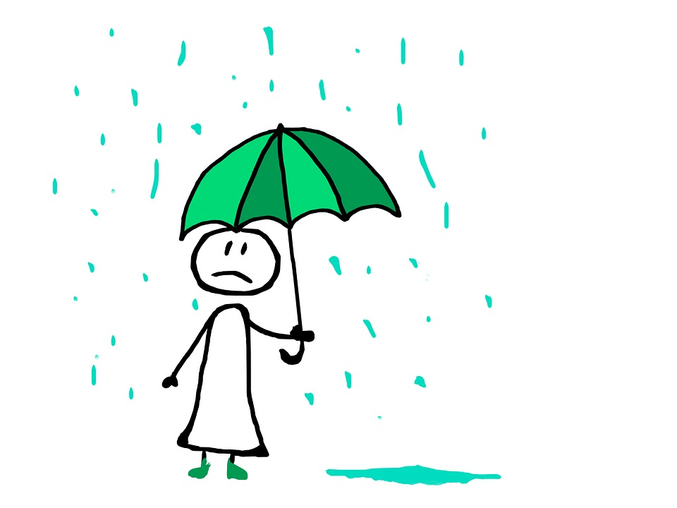
What would you say instead?
Perspectives: seeing the world differently
He’s feeling a bit under the weather today.
Oh no! It’s all gone a bit pear-shaped.
It’s a piece of cake!
That’s not my cup of tea.
I wouldn’t touch the lasagne with a barge pole!
“Those who know nothing of foreign languages know nothing of their own.” Johann Wolfgang Goethe
Notes:
Speakers of all languages use a lot of idioms, most of all in conversation. Some have exact equivalents in other languages, but others don’t, because they are culturally specific, and can cause a lot of confusion, embarrassment or anxiety in communication.
As language learners we develop a sensitivity to our own language, and can spot the sorts of language that may confuse non-native learners. When we speak ourselves, we can avoid idioms (or use them, and then explain them) which helps to ease the communication, it makes non-native learners feel more comfortable. As language learners we are the ‘social glue’ that often makes communication work between people from different countries.
What would you say to explain these in simpler language? 1. He’s feeling ill or tired. 2. It’s gone wrong. 3. It’s really easy.
4. That’s not something I like – that’s not for me. 5. Don’t eat the lasagne – it’s not good.
https://globalgraduates.com/articles/20-bizarre-english-idioms-and-how-to-explain-them https://onextrapixel.com/oh-idioms-overused-amusing-and-often-confusing/
This is why there are lots of quotes out there saying that the way to learn about your own language is to learn a foreign language! It’s another example of the different perspectives you gain when you learn another language.

Slide 11
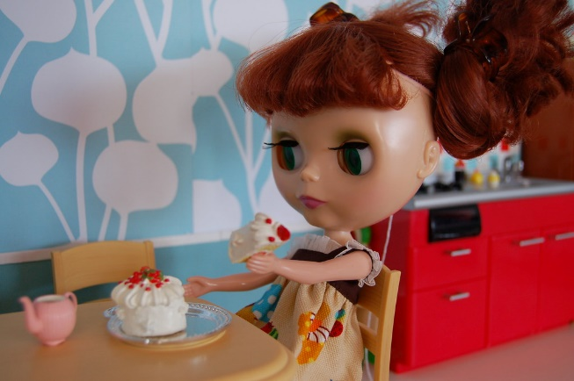
Untranslatable words
Perspectives: seeing the world differently
Kummerspeck [German] Excess weight gained from emotional overeating. Literally, grief bacon.
l’esprit de l’escalier [French] A clever reply that you think of after the moment has passed. Literally, staircase wit.
sobremesa [Spanish] The time after a meal where everyone sits, chatting at the table.
Feierabend [German] The time between finishing work and when you go to bed. Literally, celebration evening.
le depaysement [French] The feeling that comes from not being in one’s home country; being a foreigner.
la madrugada [Spanish] The time of day between midnight and early morning.
fisselig [German] Being flustered to the point of incompetence. It’s nervous clumsiness caused by another person’s nagging!
desvelado [Spanish] Being unable to sleep or how you feel the day after when you’re sleep-deprived.
friolero [Spanish] How to describe someone who is particularly sensitive to the cold.
https://creativecommons.org/licenses/by-nc-sa/2.0/
Notes:
Link to image:
https://www.flickr.com/photos/smallchick/4015366220
Language as a reflection of culture/thought Language learners often engage in translation from one language to another. At some point we notice that this is not always easy, i.e. there is no direct word-for-word translation. And then we also discover that there are some words which don’t have translations because that specific idea has only be captured in a single word in another language. i.e. we can ‘explain’ around the word, but we have no equivalent word for that idea.
Learning some of these words as we go along learning the language is such a satisfying and enjoyable experience – you really feel like you are adding to your understanding and experience of life, making it richer. [Again, personal anecdotes useful here – personally, I have never found an exact English expression for the German ‘Ich bin gespannt’ – something I often say in conversation when I’m skeptical about but also intensely interested in what will happen next in a particular situation.]
Sources: https://cogdog.github.io/nowords/ [This page links to sets of French, German, Spanish untranslatable words, and others, too]. https://baselang.com/blog/vocabulary/35-words-not-in-english/
https://www.ef.com/wwen/blog/language/13-words-with-no-english-translation/
https://www.lifehack.org/articles/lifestyle/lost-translation-30-words-with-english-equivalent.html http://mentalfloss.com/article/50698/38-wonderful-foreign-words-we-could-use-english https://www.theguardian.com/world/2018/jul/27/10-of-the-best-words-in-the-world-that-dont-translate-into-english
https://www.huffpost.com/entry/english-translation-words_n_4790396
https://www.rocketlanguages.com/blog/20-of-the-worlds-most-beautiful-untranslatable-words https://baselang.com/blog/vocabulary/35-words-not-in-english/
Other favourites: Tartle [Scots] - That panicky hesitation just before you have to introduce someone whose name you can't quite remember.
Lagom [Swedish] - Not too much, and not too little, just right. Pålegg (Norwegian) - Anything that you might consider putting into a sandwich, so ‘sandwich fodder’ Uffda (Swedish) - This Swedish exclamation is a sympathetic word to use when someone else is in pain. Pronounced “OOF-dah”, it’s like a mix between “Ouch for you” and “I’m sorry you hurt yourself!” Tshiluba (Southwest Congo) — A word famous for its untranslatability, most professional translators pinpoint it as the stature of a person “who is ready to forgive and forget any first abuse, tolerate it the second time, but never forgive nor tolerate on the third offense.”

Slide 12
Same, similar or completely different?
Perspectives: seeing the world differently
English | Spanish | French | German
You’re pulling my leg! | ¡Me tomas el pelo!
An eye for an eye and a tooth for a tooth. | Ojo por ojo y diente por diente
I am fed up to the back teeth with… | Estoy hasta las narices de…
I know this place like the back of my hand | Conozco este lugar como la palma de mi mano
Keep your feet on the ground | Pon los pies en la tierra.
Notes:
Optional comparison task of idioms using parts of the body. Are they the same, similar, or completely different? Teachers should edit the slide to include only the languages that students are studying, of course.

Slide 13
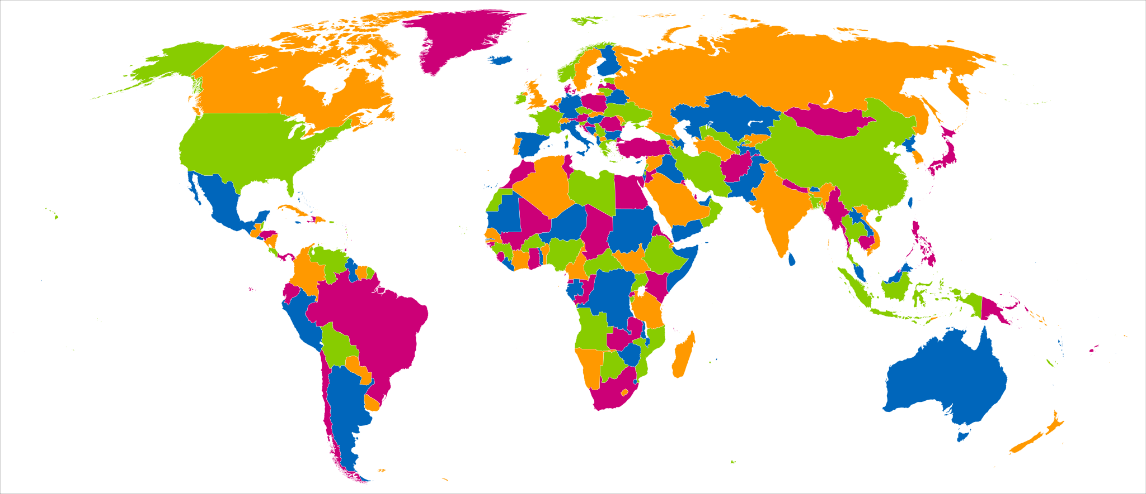
Colours of the world
Perspectives: seeing the world differently
post box
taxi
public bus
telephone box
police uniforms
Fibonacci [CC BY-SA 3.0 (https://creativecommons.org/licenses/by-sa/3.0)]
Notes:
Attribution: Fibonacci [CC BY-SA 3.0 (https://creativecommons.org/licenses/by-sa/3.0)] Link: https://upload.wikimedia.org/wikipedia/commons/4/4a/World_map_with_four_colours.svg
When we see and experience life through just one language / one culture, we even take basic things like colours and numbers for granted. When we learn another language and experience another culture, we realise that there is not ONLY ONE RIGHT WAY TO DO/SEE/SAY/EXPERIENCE THINGS. What is the first colour that comes to mind when you think of the following things: 1 – post box
2 – taxi
3 – public bus
4 – telephone box
5 – police uniforms

Slide 14
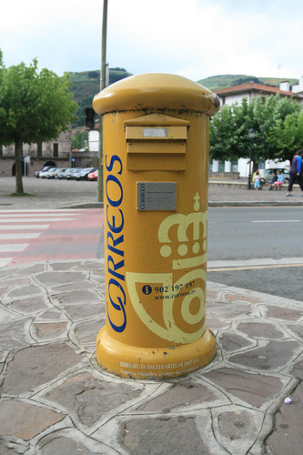
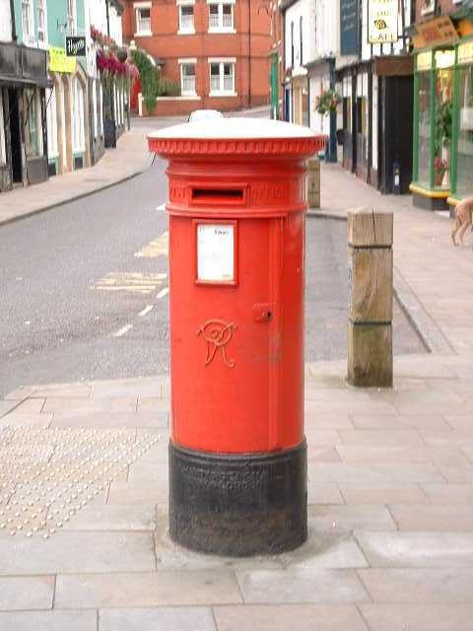
Perspectives: seeing the world differently
un buzón español
un buzón inglés
Gracias a Neil Jones

Slide 15
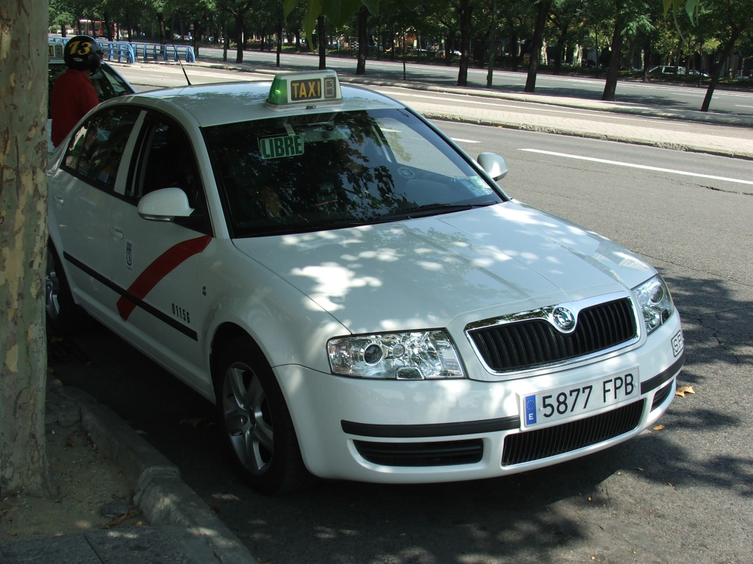
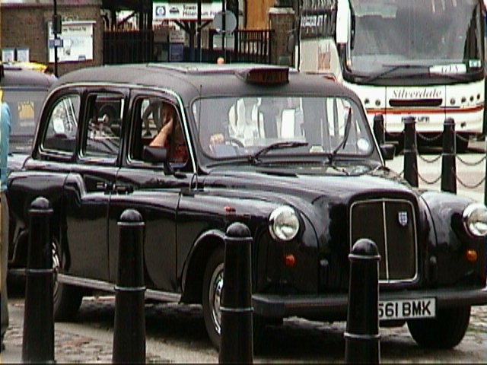
Perspectives: seeing the world differently
un taxi de Barcelona
un taxi de Londres
Gracias a Neil Jones

Slide 16
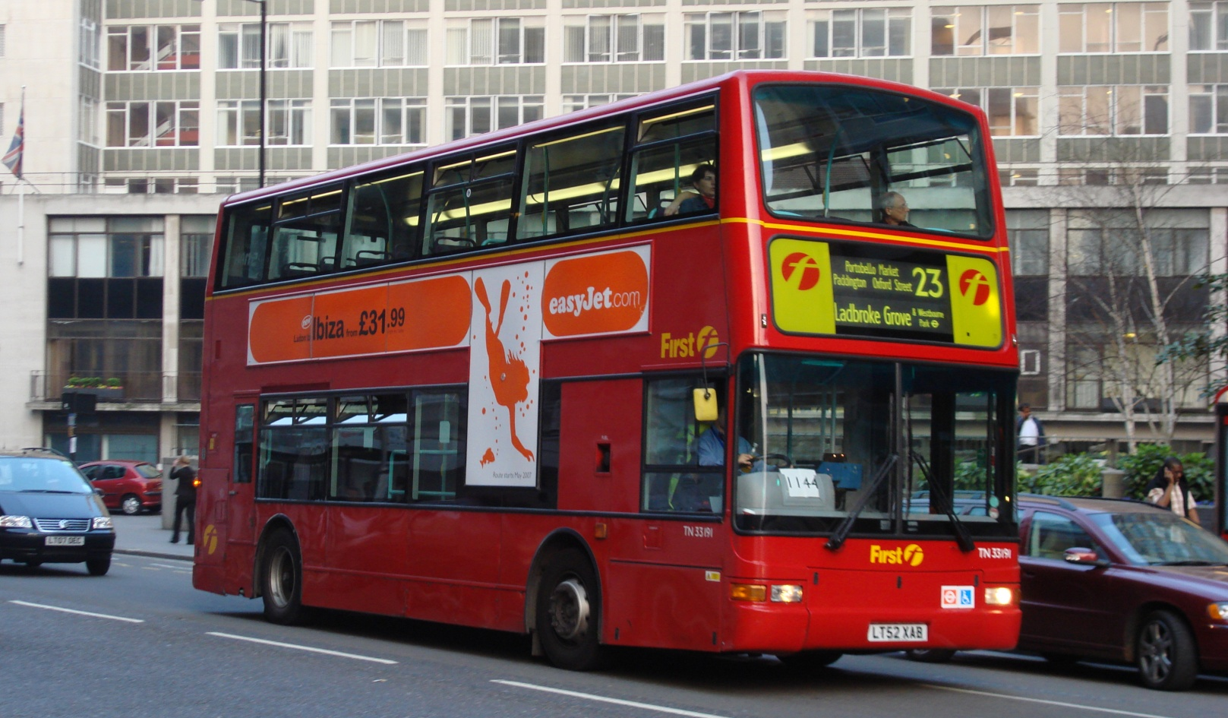
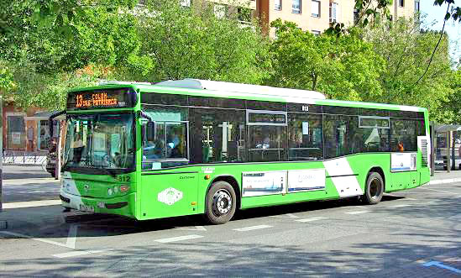
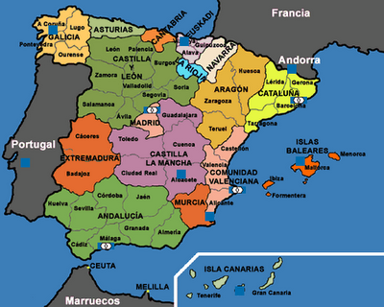
Perspectives: seeing the world differently
un autobús de Londres
un autobús de Córdoba
Gracias a Neil Jones

Slide 17
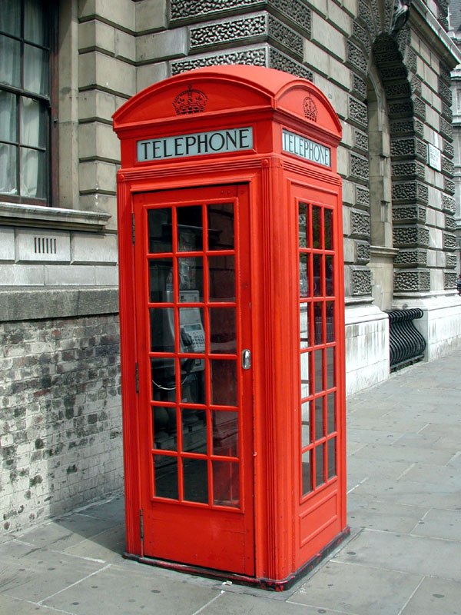
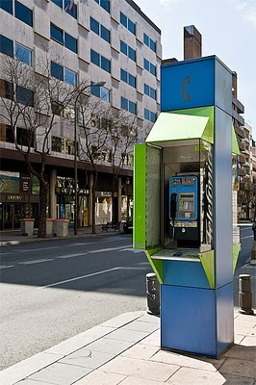
una cabina telefónica
en Inglaterra
una cabina telefónica
en España
Gracias a Neil Jones

Slide 18
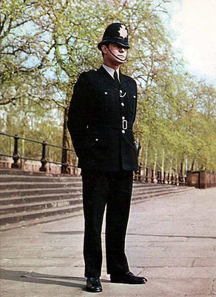
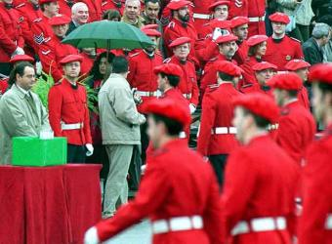
el uniforme de la
policía de Bilbao
el uniforme de la
policía inglesa
Gracias a Neil Jones

Slide 19
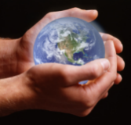
Perspectives: seeing the world differently
Lucky and unlucky numbers
1 | 2 | 3 | 4 | 5
6 | 7 | 8 | 9 | 10
11 | 12 | 13 | 14 | 15
16 | 17 | 18 | 19 | 20
Notes:
Lucky and unlucky numbers By now we are realising that we should never take anything for granted. We have lucky and unlucky associations that we attach to numbers but will those be the same the world over?
Note: The slide is animated to bring up numbers and to invite students to say what they know about them. Details as follows: 1. 13 – unlucky in Britain and many other Western countries. 2. 17 – unlucky in Italy! Who knows why?! 3. 4 – lucky in many Western countries – e.g. 4-leaf clover. Has positive associations, generally (long been associated with an archetypal family number – 2 parents, 2 children etc..)
BUT in Chinese/Japense the number 4 (sì) sounds like the word for death, so 4 (and all number with 4 in them) are considered very very unlucky. They are even avoided as floor numbers or flat/house numbers! 4. 7 – a positive number in Western culture – (possibly because of the creation connotations ‘world created in 7 days’, number of days in a week), but in Chinese it sounds like anger, and so is a number to avoid. 5. 8 and 9 are especially positive in Chinese – good fortune, happy times, prosperity. 6. 6 – bad in Western culture, associated with the devil/evil, very positive in Eastern cultures (see explanation below). 7. 14 – bad in Eastern culture because it has the number ‘4’ in it!
666 - Six hundred and sixty-six is an interesting number. It is both extremely bad luck in Western culture but very good luck in many Asian cultures and Chinese culture. As everyone knows, according to the Christian bible, 666 is the number of the beast and is synonymous with Satan. 666 might actually be the most avoided number in Western culture, followed closely by the number 13. But in cultures in Asia, the pronunciation of 666 sounds very much like the phrase, "things going smoothly," and it is considered to be very lucky. Many shopkeepers will place a sign or plaque with 666 written or carved on it in their window as a good luck charm. The same goes for the front door of a home or apartment. In Western culture, 666 has appeared millions of times, almost universally in a bad connotation.

Slide 20
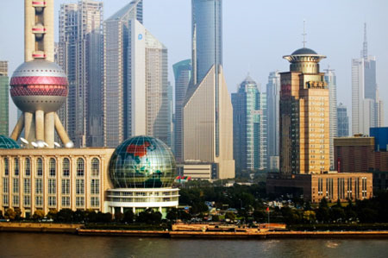
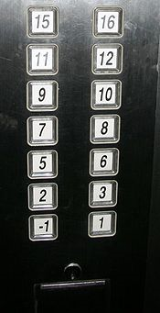
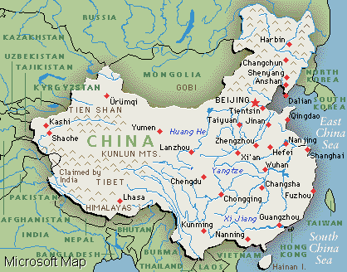
Perspectives: seeing the world differently
A lift in a block of flats in Shanghai.
Notes:
Just to exemplify that floor 4 is often simply omitted!

Slide 21
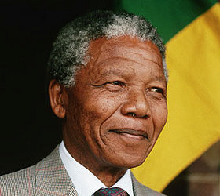
New perspectives change us…
“If you talk to a man in a language he understands, that goes to his head.
If you talk to him in his language, that goes to his heart.”
Nelson Mandela
Notes:
What difference does it make? i.e. that through learning a language we learn that:
1) There are different words for things 2) Different peoples have chosen different colours for things in their environment 3) Different cultures have different ideas about what numbers mean 4) Different classrooms teach their students using different maps of the world 5) That people use language differently and some expressions cannot be translated word-for-word
Hopefully the difference that it makes is this: 1) It makes us less likely to suffer a culture shock when we meet people from different nations (or travel to other countries) 2) It makes us better able to understand and interpret positively what we see and hear around us 3) It makes us less prone to jump to conclusions and make premature assumptions when we are in new situations with new people 4) It makes it more likely that we will make friends with people we meet from other countries, rather than hold them at a distance 5) It makes us more able to help others when they are in need of help and don’t speak our language well 6) It makes us more committed to the importance of learning even just a bit of a new language, to be able to greet people in their own language, showing empathy and respect. 7) It makes us more willing to have a go at new things, particularly if we can see that they are culturally important to the people we meet. 8) It makes us more likely to be the kind of person we would like to meet if we were alone in an unfamiliar country!

Slide 22
Learning a language improves…
Perspectives: seeing the world differently
Intercultural competence
A person’s ability to relate to and communicate with people who speak a different language and live in a different cultural context.

Slide 23
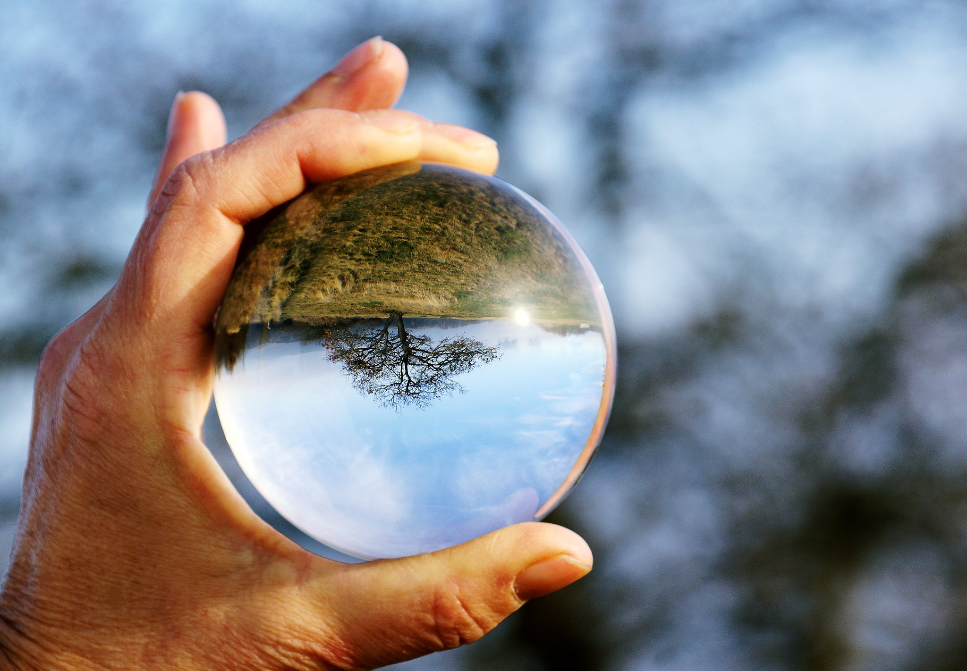
“To have another language is to possess a second soul.” Charlemagne (Holy Roman Emperor, 742 – 814 AD)
CC BY-NC-SA 4.0 Dörk_Hö
Notes:
Image link: https://www.flickr.com/photos/hoelli/8197601674 Finish with a quote about seeing the world differently. Ask students to relate the photo and the quote… Ask students to reflect on the meaning of this, if they can see the added value in learning to see the view through other people’s eyes, to gain a different point of view of the world, to accept that there isn’t just one way to do/see/experience things.
Some additional thoughts - There are a lot of sweeping statements in this blog, and we want to be way of getting carried away wholesale, but there isn’t anything I disagree with here!
https://blog.fluentcity.com/how-learning-a-language-makes-you-see-the-world-differently/

Slide 24
Session 3: Perspectives | Resource | Attribution
Start with quote - learning another language makes you see the world differently | Slide 2 “A new language is a new life.” - Persian proverb | ²Idea adapted from Ursula Lanvers
Include the research on empathy | Slide 3
Global Perspectives – maps with different countries in the centre | Slides 4-6
Different views of different things – e.g. snakes (how different cultures see them) | Slides 7-8 Is it universal, cultural or personal? Set of statements to respond to, to reflect on things we take for granted.
Language learners are more effective communicators | Slides 9-10 Task: how would students explain the idioms?
Language as a reflection of culture/thought – numbers of words for things – words that don’t have translations because the ideas only exist in that culture | Slide 11 Untranslatable words with explanations – from French, German and Spanish Practise pronunciation and ask students to choose a favourite.
Idioms – same, similar, completely different | Slide 12 Idioms with parts of the body.
Meanings of colours³ | Slides 13-18 Another example of opening eyes to multiple ways of seeing and questioning a world view where even the most basis things around us have only one ‘right’ way to be. NB: These slides are labelled in Spanish but can of course be adapted. | ³Idea and resources from Neil Jones
Meanings of numbers | Slides 19-20 See what students know about different cultural perspectives on numbers
Concluding thoughts | Slides 21-23
Notes:
Overview of content: Session 3 – Perspectives Unless otherwise attributed, all ideas contributed by Rachel Hawkes.

