Slide 1
Session 2: Language: what language?

Slide 2
Learning [language] is like… because…
Notes:
Note: Change [language] to the specific language students are currently learning.
This is a task to get learners to reveal their feelings about their language learning journey so far. They can write their similes anonymously (to be collected in a box for the teacher to look at later). It is worth telling the class that they should be honest, there are no right answers, their feelings are anonymous, but you will be interested to see the different range of ideas and responses later. Tell them also that they will come back to do this again at some point in the future, to see if their beliefs have changed in any way.

Slide 3
How many languages are there in the world?
Quiz
around 5000
around 7000
around 9000
Notes:
6 question quiz. The idea here was to generate interest, not to do an exhaustive or even evangelical quiz about languages!
Number of languages: Not easy to get an exact answer! Many reasons for this – definition of language vs dialect, the number is changing as languages die out, no one, single authoritative source. Also, there are some parts of the world (Amazon for example) where we still don’t know as we haven’t met and talked to people who live there – some parts of the world are still unexplored! I went for this one: https://www.linguisticsociety.org/content/how-many-languages-are-there-world 6909 distinct languages and this one: https://www.ethnologue.com/guides/how-many-languages = 7111 languages https://www.theintrepidguide.com/how-many-languages-are-there-in-the-world/#.XVJmp-hKiUk – 7097 languages
http://langscape.umd.edu/map.php
Lovely image of language family tree
http://sssscomic.com/comic.php?page=196

Slide 4
How many languages does the most multilingual person speak?
Quiz
15
42
58
Notes:
List of languages Ziad Fazah speaks: Albanian, German, Amharic, Arabic, Armenian, Azeri, Bengali, Burmese, Bulgarian, Cambodian, Cantonese, Mandarin, Wu, Sinhalese, Singapore Colloquial English, Korean, Danish, Dzongkha, Spanish, Finnish, French, Fijian, Greek, Hebrew, Hindi, Dutch, Hungarian, Indonesian, English, Icelandic, Italian, Japanese, Swahili, Lao, Malay, Malagasy, Mongolian, Nepali, Norwegian, Papiamento, Persian, Polish, Portuguese, Pashto, Kyrgyz, Romanian, Russian, Serbo-Croatian, Swedish, Tajik, Thai, Czech, Tibetan, Turkish, Urdu, Uzbek and Vietnamese. (Parkvall p.117 – 120)
He says that he learnt most of these before the age of 20.
Weblink:http://news.bbc.co.uk/1/hi/education/4883418.stm

Slide 5
Ziad Fazah speaks all these languages:
Albanian German Amharic Arabic Armenian Azeri Bengali Burmese Bulgarian Cambodian Cantonese Mandarin Wu Sinhalese Singapore English Korean Danish Dzongkha Spanish Finnish French Fijian Greek Hebrew Hindi Dutch Hungarian Indonesian English Icelandic Italian Japanese Swahili Lao Malay Malagasy Mongolian Nepali Norwegian Papiamento Persian Polish Portuguese Pashto Kyrgyz Romanian Russian Serbo-Croatian Swedish Tajik Thai Czech Tibetan Turkish Urdu Uzbek Vietnamese
He says that he learned most of them before he was 20.

Slide 6
Which language has the greatest number of native speakers?
Quiz
379 million
English
Spanish
Chinese
460 million
1.311 million
Notes:
Size of languages, in terms of numbers of L1 speakers of each language
https://www.ethnologue.com/statistics/size

Slide 7
What % world’s population does not speak any English at all?
Quiz
25%
75%
94%
Notes:
Note: 94% doesn’t speak English as their first language, but 20-25% speak English as a native or they are learning/have learnt it.
Also, this figure is constantly changing. Lots of different numbers flying around here, too. https://www.babbel.com/en/magazine/how-many-people-speak-english-and-where-is-it-spoken/ - this says 20% world’s population speaks English, including natives and 2nd language learners. https://en.wikipedia.org/wiki/English-speaking_world

Slide 8
Which of these languages has ‘died’ this century?
Quiz
2016, United States
Whichita
Latin
Cornish
8th century
26 December 1777, Cornwall
Notes:
Note: Explain that languages ‘die’ when the last living ‘native’ speaker of that language dies. Cornish, for example, still exists – there is a website with Cornish news and people are still learning Cornish, but there is no longer anyone who grew up speaking Cornish in his/her family. Linguists estimate that a languages dies every two weeks and that in the next 100 years we will lose about 3000 languages – approximately half of those that exist, currently.
https://en.wikipedia.org/wiki/List_of_languages_by_time_of_extinction
https://www.quora.com/Why-did-Latin-die-out-How-and-why-have-other-languages-died-out-What-are-the-processes Latin morphed into other languages, so is dead in the strict sense that it has no native speakers.

Slide 9
Living languages grow!
Old English had approximately 50,000-60,000 words
It then borrowed from Celtic, Latin, Old Norse, French, Latin (again), Greek
Writers created some new words (e.g. Shakespeare alone invented 1700 new English words
First official dictionary of English by Samuel Johnson in 1755
American English diversified the language further (Noah Webster’s 1828 dictionary)
More borrowing from many languages: Spanish, French (again), German (again), etc….
Now 273,000 headwords in the Oxford English dictionary
Notes:
So languages ‘die’ but they also therefore ‘live’. What does it mean for a language to be ‘alive’? Not just that it has living native speakers, but also that it is growing and changing, on a daily basis.
Currently there are 273,000 headwords in the Oxford dictionary. https://en.wikipedia.org/wiki/List_of_dictionaries_by_number_of_words
http://www.whitesmoke.com/evolution-of-english-vocabulary
Words Shakespeare invented:
http://www.shakespeare-online.com/biography/wordsinvented.html
It is estimated that the most frequently used 2000 words—in all or most of their multiple senses—cover approximately seventy-five to eighty percent of a general text in English and other European languages; such a limited vocabulary also allows one to express more complicated concepts.

Slide 10
Which of these words was or were officially added to English this year?
Quiz
chipmunky, adj.
misgender, vb.
latin@, n. & adj.
“Resembling or characteristic of a chipmunk, typically with reference to a person having prominent cheeks or a perky, mischievous character.”
To assign the wrong grammatical gender to (a word).
A person of Latin American origin or descent.
Notes:
https://public.oed.com/updates/new-words-list-march-2019/#new_words
Some of my favourites!
bigsie, adj.: “Having an exaggerated sense of one’s own importance; arrogant, pretentious, conceited.”
chipmunky, adj.: “Resembling or characteristic of a chipmunk, typically with reference to a person having prominent cheeks or a perky, mischievous character.”
chuddies, n.: “Short trousers, shorts. Now usually: underwear; underpants.” dorgi, n.: “A dog cross-bred from a dachshund and a corgi; such dogs considered collectively as a breed.”
favourite, v.: “transitive. To store a link to (a web page) in a web browser so as to enable quick access in future; to bookmark. Also intransitive. Cf. favourite n…” misgender, v.: “transitive. To assign the wrong grammatical gender to (a word). rare.”
Latin@, n. and adj.: “A person of Latin American origin or descent. Cf. Latinx n.”
peoplekind, n.: “The human race; humankind.” sewist, n.: “A person who sews, esp. as a hobby. Cf. sewer n.3”
sit-ski, v.: “intransitive. To ski on a sit-ski.”
sproglet, n.: “A baby or small child. Cf. sprog n. 2.”
translingual, adj.: “Occurring in or involving more than one language. Also (of a person): able to switch effortlessly from one language to another when speaking or…”

Slide 11
Which of these is/are true?
Quiz
French has just recognised feminine forms for some professions – e.g. a female teacher will now be ‘professeure’
The word ‘táper’ meaning plastic food container has just officially entered the Spanish dictionary
‘Planking’ and ‘MeToo-Debatte’ are two of German’s new words
Notes:
https://vozlibre.com/sin-categoria/62-palabras-nuevas-diccionario-rae-8893/ - 62 new Spanish words
Fair play. m. Juego limpio. English word.
Táper. m. Recipiente de plástico con cierre hermético, que se usa para guardar o llevar alimentos. (adapted from ‘tupperware’
Compostar. tr. Transformar residuos orgánicos en compost. Cliquear. intr. En informática, clicar.
Buenismo. m. Actitud de quien ante los conflictos rebaja su gravedad, cede con benevolencia o actúa con excesiva tolerancia.
Buenista. adj. 1. Que actúa con buenismo. 2. Perteneciente o relativo al buenismo.
Audiolibro. m. Grabación sonora del texto de un libro.
Aporofobia. f. cult. Fobia a las personas pobres o desfavorecidas.
https://en.wikipedia.org/wiki/Gender_neutrality_in_Spanish#cite_note-sophia-4
https://www.bbc.co.uk/news/world-europe-47414140 Professeur → Professeure Auteur → Auteure/autoresse/autrice – already exist Some French jobs already have feminine forms such as infirmière (nurse) but the vast majority of job titles are masculine.
The feminine definitive article is commonly used to distinguish between sexes, for example la juge (judge) or la ministre (minister).
Any changes may simply be a matter of making formal a job title that already exists.
Some will just have an extra "e" as a suffix and maybe an accent, such as préfète (prefect), députée (MP) avocate (lawyer) and procureure (prosecutor).
The terms cheffe (female chef), écrivaine (writer) and ingénieure (engineer) have been used in Canada for 40 years. A doctor is called une médecin or une docteure.
https://www.u-schaecher.de/51-neue-woerter-in-unserem-wortschatz-2019/

Slide 12
Which of these languages does NOT have separate words for ‘he’ and she’?
Quiz
French
Finnish
Chinese
‘hän’ = both ‘he’ and ‘she’
‘tā’ = both ‘he’ and ‘she’ in spoken Mandarin BUT there are different characters: 他 = ‘he’ and 她 = ‘she’.

Slide 13
How many words do you need to know to say you ‘know a language’?
Quiz
2000 words cover 75-80% words in a general text. This number of words allows you to say quite a lot!
2000
20,000
200, 000
This would be like knowing most of the words in a dictionary! A very well-educated person at the age of 50-60 might recognise possibly 50,000 words!
Notes:
https://www.quora.com/How-many-words-were-part-of-human-vocabulary-1000-years-ago It is estimated that the most frequently used 2000 words—in all or most of their multiple senses—cover approximately seventy-five to eighty percent of a general text in English and other European languages; such a limited vocabulary also allows one to express more complicated concepts.

Slide 14
How many countries are there in the world?
Quiz
352
195
876
Notes:
https://www.worldometers.info/geography/how-many-countries-are-there-in-the-world/

Slide 15
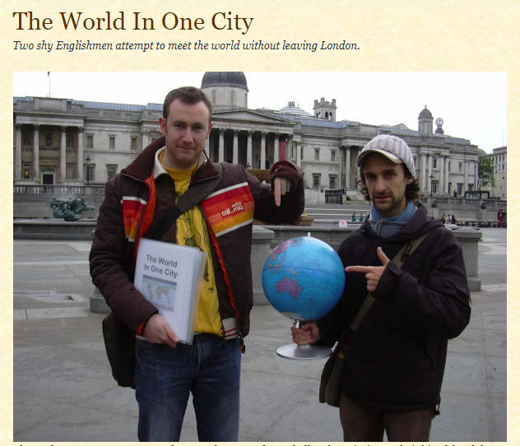
Hello!
This is a project that Owen Powell and Alex Horne started on October 24th, 2006 (United Nations Day), and finished on October 24th, 2007. Our aim was to prove that London is the most cosmopolitan city in the world, by endeavouring to meet and chat to a citizen from every country in the world who currently lives and works in London.
We managed to meet people from 189 countries. According to the UN, there are 192 countries in the world, so we've proved that at the very least, London contains over 98.4% of the nations of the world!
We are still looking for people from three countries:
Marshall Islands; Palau; Tuvalu.
Notes:
The world in one city project
http://worldinonecity.blogspot.com/
https://www.theguardian.com/uk/interactive/2012/jun/22/london-foreign-nationals-map-interactive Interesting as an idea – also proof that you don’t need to travel outside the UK to meet people from all over the world.

Slide 16
Shout out to Londoners
Around 15% overall UK population was born outside the UK
More than 40% Londoners were born outside the UK
Apart from English and Welsh, Polish is the most spoken language in the UK (more than 1 million speakers)
More than 300 languages are spoken in London

Slide 17
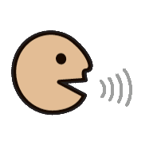
Shout out to Londoners
Albanian | Arabic | Bengali | Bulgarian | Chinese | Croatian | Czech
English | Estonian | Farsi | French | German | Greek | Gujarati
Hindi | Hungarian | Italian | Japanese | Latvian | Lithuanian | Polish
Portuguese | Punjabi | Romanian | Russian | Serbian | Slovak | Slovenian
Somali | Spanish | Swahili | Tamil | Turkish | Urdu | Vietnamese
Notes:
Shouting ‘hello’ in different languages (i.e. some of the ones most spoken in London) These are the languages UK authorities advise public relations to work with, if they want to reach the population of the UK: Albanian/Kosovan, Arabic, Bengali, Bulgarian, Chinese, Cornish, Croatian, Czech, English, Estonian, Farsi /Persian, French, German, Greek, Gujerati, Hindi, Hungarian, Irish, Italian, Japanese, Latvian, Lithuanian, Polish, Portuguese, Punjabi, Romanian, Russian, Scots, Scottish Gaelic, Serbian, Slovak, Slovenian, Somali, Spanish, Swahili, Tamil, Turkish, Urdu, Vietnamese and Welsh.
The UK population was 14.4% foreign-born and 9.5% non-British citizens in 2017.
39% (only) of the foreign-born population came from EU countries.
Foreign-born people constituted 41% of Inner London’s population in 2017.
Poland is the most common country of birth and the most common citizenship among migrants in the UK.
Rienzo, Cinzia and Carlos Vargas-Silva. “Migrants in the UK: An Overview,” Migration Observatory briefing, COMPAS, University of Oxford, August 2018
https://migrationobservatory.ox.ac.uk/resources/briefings/migrants-in-the-uk-an-overview/
Language in England and Wales: 2011
https://www.ons.gov.uk/peoplepopulationandcommunity/culturalidentity/language/articles/languageinenglandandwales/2013-03-04
Those who reported English (or Welsh in Wales) as their main language
accounted for 92.3% of the population, except in London where proportion was much
lower. Those who reported another main language accounted for 7.7% of the
population, with Polish topping the list of "other" main languages.

Slide 18
Shout out to Londoners
Source:
https://www.omniglot.com/index.htm
Albanian | Arabic | Bengali | Bulgarian | Chinese | Croatian | Czech
English | Estonian | Farsi | French | German | Greek | Gujarati
Hindi | Hungarian | Italian | Japanese | Latvian | Lithuanian | Polish
Portuguese | Punjabi | Romanian | Russian | Serbian | Slovak | Sloveniaan
Somali | Spanish | Swahili | Tamil | Turkish | Urdu | Vietnamese
Mir dita!
Merhaba!
Namaskar
Zdraveite
你好 Nǐ hǎo!
Dobar dan
Ahoj
Hello
Tere
Salam
Bonjour
Hallo
Γειά σου Yasou
નમસ્તે! Namaste
Namaste
Jo napot
Buon
giorno!
こんにちは！ Kon’nichiwa
Sveiki
Sveiki
Cześć
Olá
ਸਤ ਸ੍ਰੀ ਅਕਾਲ
Sata srī akāla
Bună ziua
Zdravstvuyte
Zdravo
Ahoj
Zdravo
Sideed tahay?
Hola
Hujambo
வணக்கம்
Vaṇakkam
Merhaba
السلام علیکم Assalamo aleikum
xin chào
Notes:
Click on any speech bubble to hear the audio. Note: There are many different ways to greet people in most languages – if this is not the word you know in this language for ‘hello’ that’s probably why!

Slide 19
Shout out to Londoners
Zdravo
Bonjour
Mir dita
Dobar dan
Γειά σου Yasou
Hallo
Namaskar
Zdravo
Buon
giorno!
வணக்கம்
Vaṇakkam
Hello
Namaste
Tere
Jo napot
Zdravstvuyte
Bună ziua
Cześć
Hujambo
こんにちは！ Kon’nichiwa
Hola
નમસ્તે! Namaste
Zdraveite
ਸਤ ਸ੍ਰੀ ਅਕਾਲ
Sata srī akāla
Olá
你好 Nǐ hǎo!
xin chào
Ahoj
Salam
السلام علیکم Assalamo aleikum
Sadeed tahay
Sveiki
Merhaba
Ahoj
Sveiki
Merhaba
Notes:
Optional additional slide to look at patterns between the languages.
Albanian
Arabic
Bengali
Bulgarian
Chinese
Croatian
Czech
English
Estonian
Farsi
French
German
Greek
Gujarati
Hindi
Hungarian
Italian
Japanese
Latvian
Lithuanian
Polish
Portuguese
Punjabi
Romanian
Russian
Serbian
Slovak
Sloveniaan
Somali
Spanish
Swahili
Tamil
Turkish
Urdu
Vietnamese

Slide 20
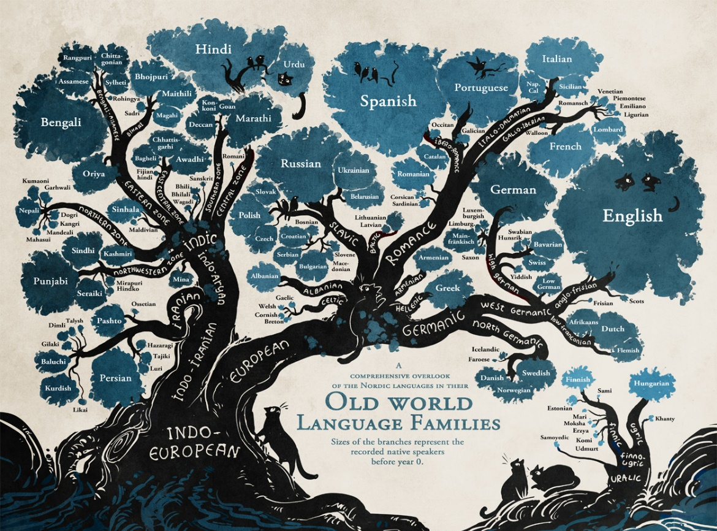
CC BY 4.0 https://www.flickr.com/photos/austinaronoff/17466175495
Notes:
Language families There are many similarities between languages because they share common roots. Let’s look at a the word for ‘bread’ in several different languages.

Slide 21
pain
Brot
pa
pane
t’anta
brood
pan
mkate
bread
Spanish | English | German
Catalan | French | Dutch
Quechua | Italian | Swahili
Notes:
Encountering a number of unknown words from different languages – hear and pronounce them All these are words for bread in different languages.
In case not known, mkate = swahili and t’anta = quechua

Slide 22
Languages where you are Answer one or more of these questions
What are the main languages spoken where you live?
How many languages are spoken in your school?
Which languages are spoken in your class?
How many languages can you say ‘Hello’ in?
Notes:
Local census (area, school, class) This was last done nationally in 2011.

Slide 23
Session 2: Identity Language – what language? | Resource | Attribution
Simile task² | Learning [name of language studied] is like… because… This is a task to get learners to reveal their feelings about their language learning journey so far. They can write their similes anonymously. | ²Idea adapted from Ursula Lanvers
Quiz – facts about languages | Slides 3-8 Languages in the world Most multi-lingual person Most widely spoken (as first) languages % not speaking English Languages that have died
Living languages grow and change | Slides 9 -13 growth of English new words in English new words in French, German, Spanish how many words do you need to know to ‘know a language’?
The world in one city: Languages in London | Slides 14-15 Number of countries in the world Project about meeting people from all over the world in London (blog)
Shout out to Londoners Shouting ‘hello’ in different languages (i.e. some of the ones most spoken in London) | Slides 16-19 Multicultural and multilingual London Main languages spoken by Londoners – can we say ‘hello’ in these languages? Spot some similarities between some of these languages
Links between languages | Slide 20 Language families Words for ‘bread’ in 9 different languages
Languages where you are | Census task! Languages (first, second, third?) in your local area OR group of schools OR just your school
Notes:
Overview of content: Session 2 – Language, what language? Unless otherwise attributed, all ideas contributed by Rachel Hawkes.

